Slide 1
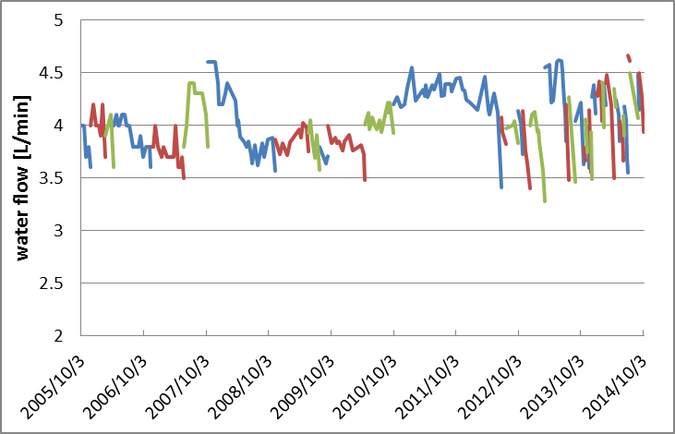
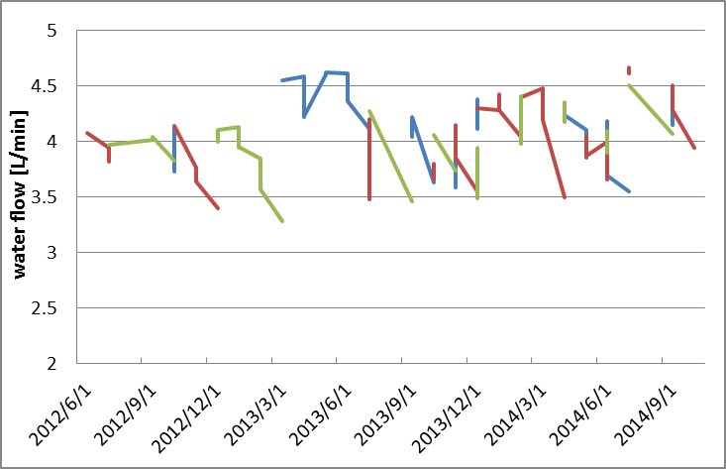
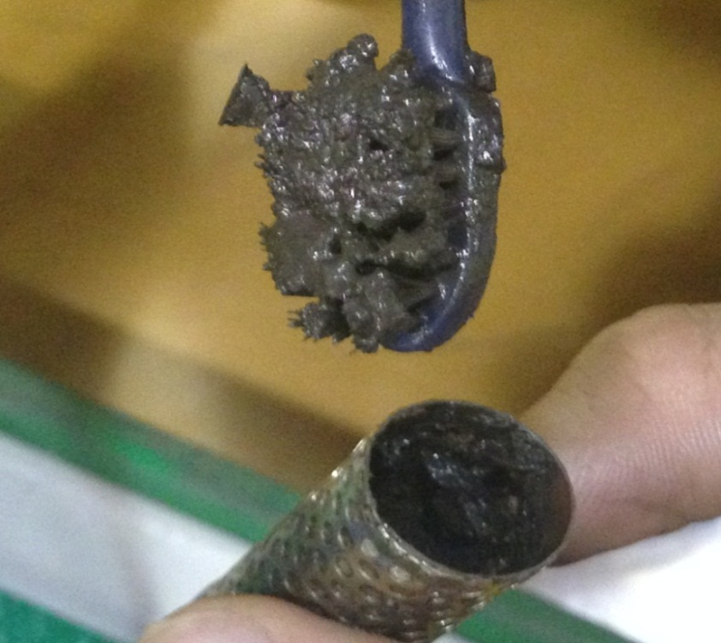
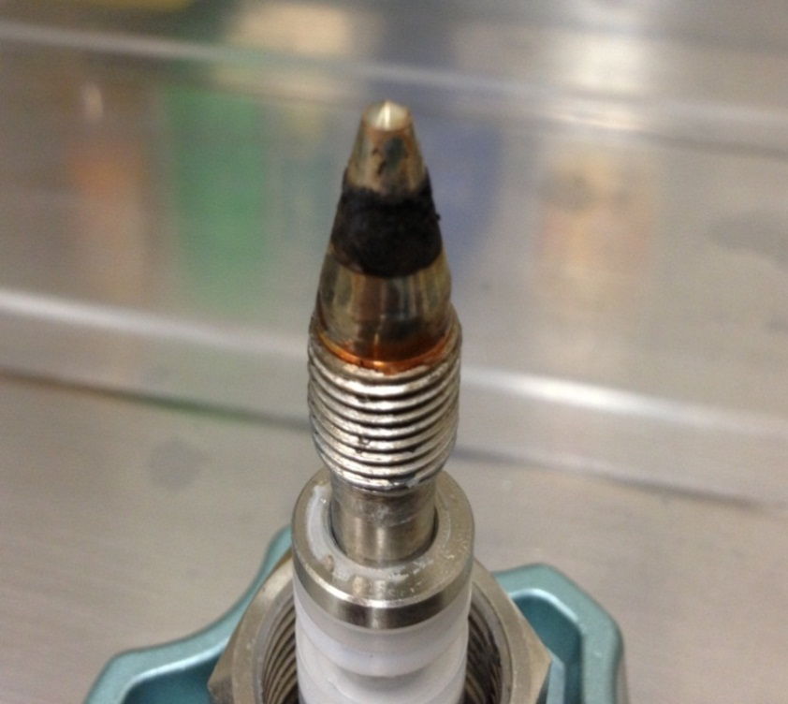
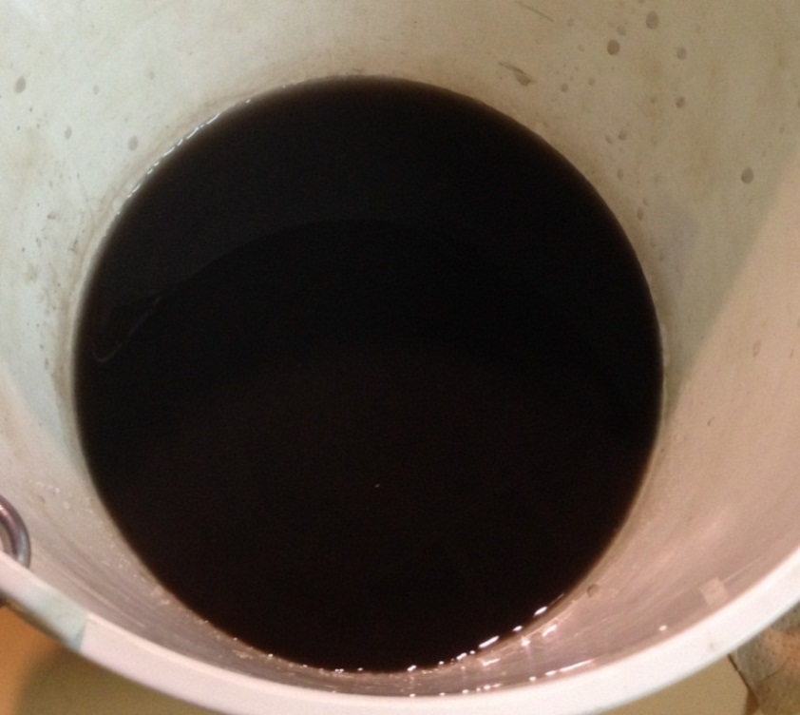
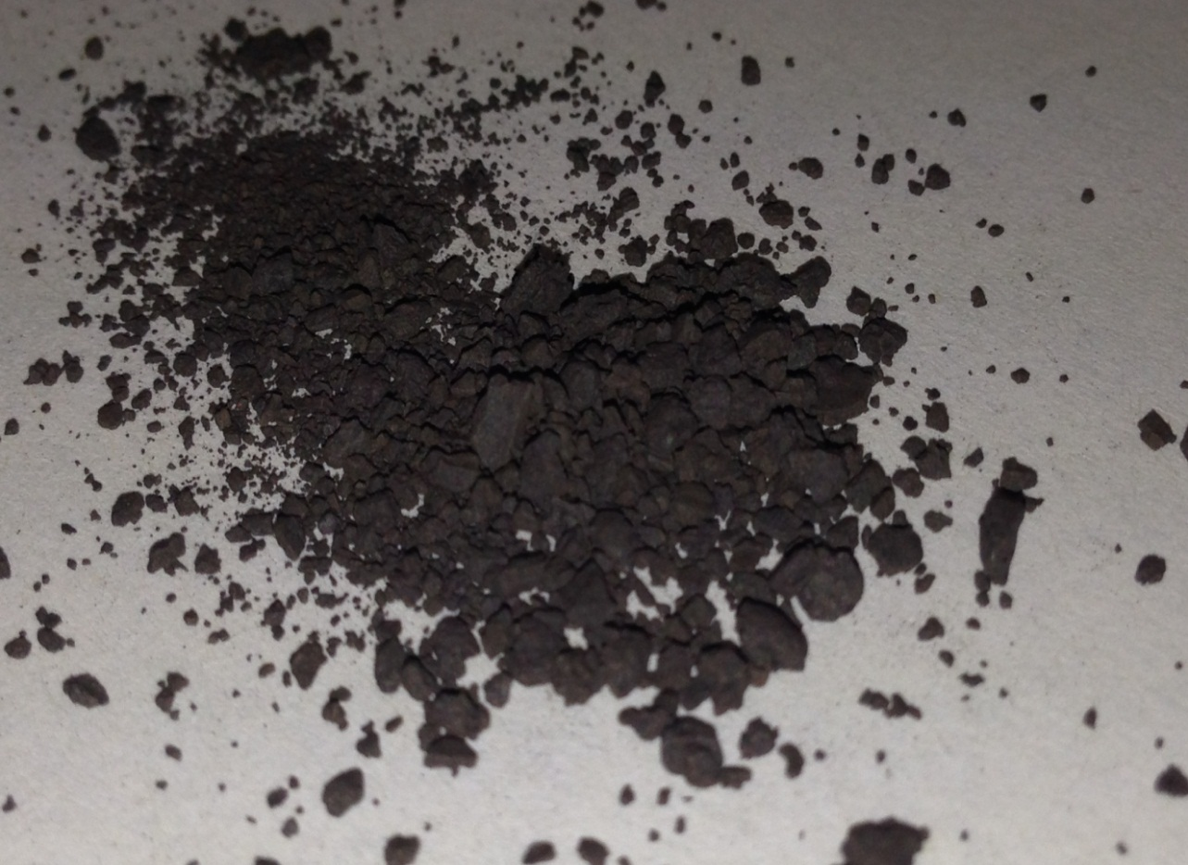
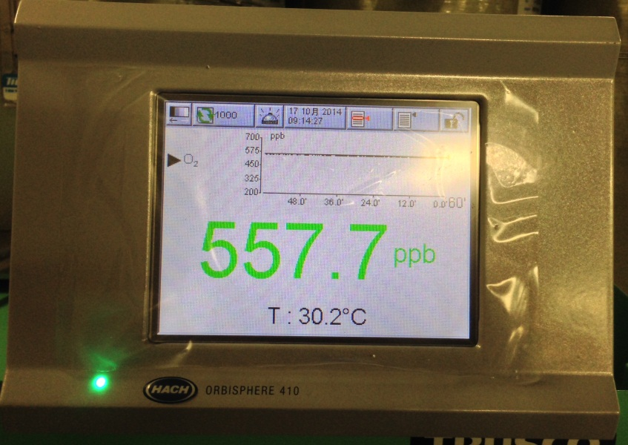
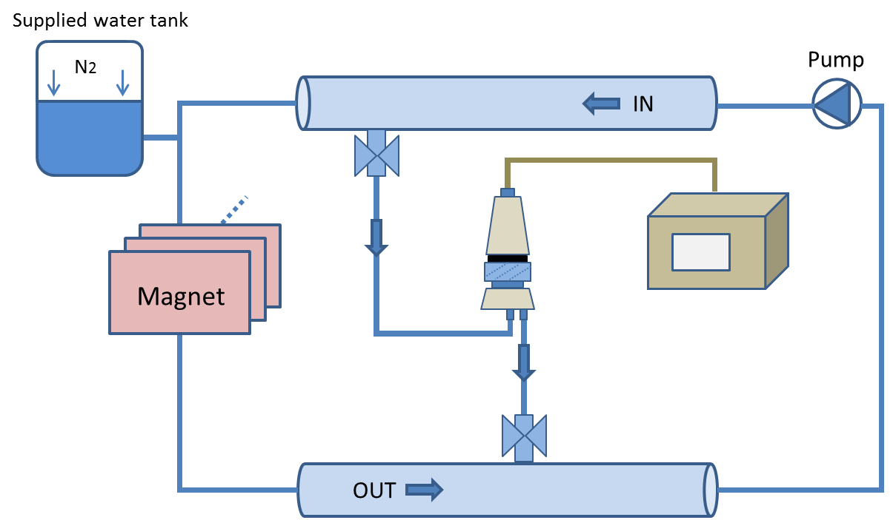
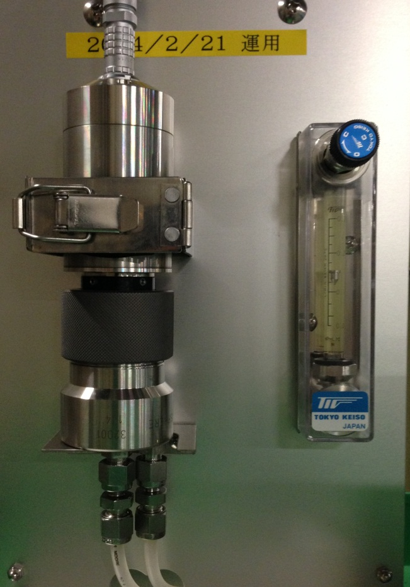
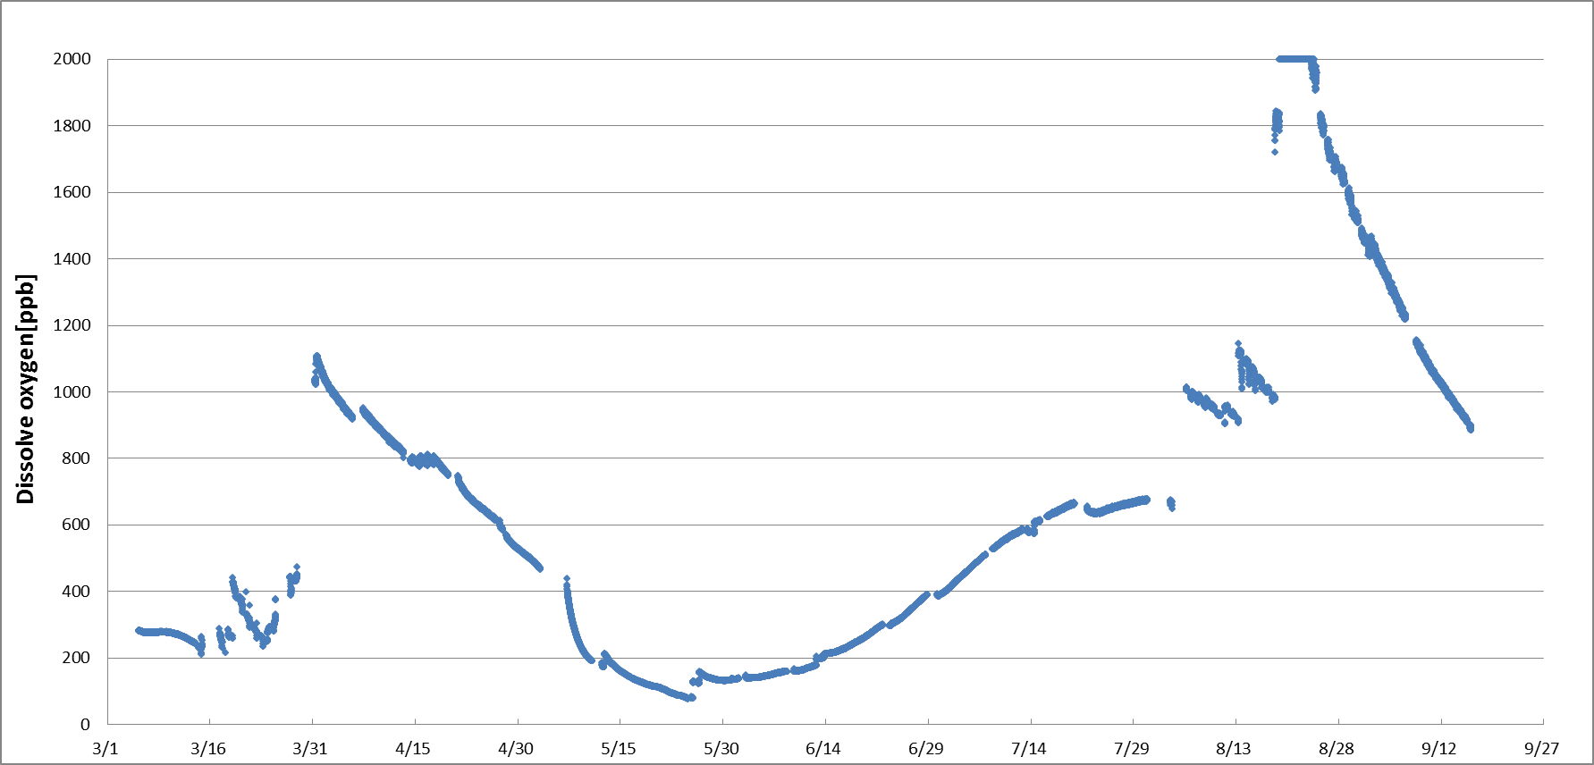
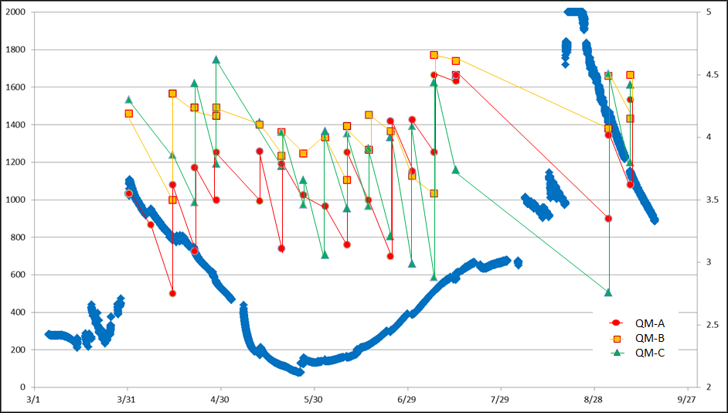
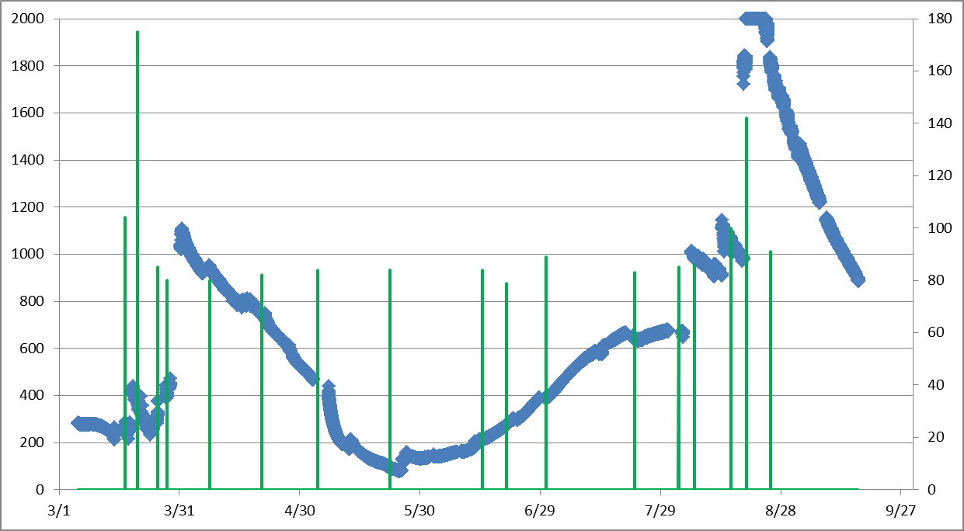
Cooling Water Management: dissolved oxygen and clogging corpuscle
Intoroduction
The flow rate of cooling water for magnets is current problem in Heavy Ion Medical Accelerator in Chiba (HIMAC).
Diminishing flow rate is large
The flow rate of cooling water for magnets is diminishing remarkably since 2012. Therefore, we frequently adjust the flow rate by valve control. Fig. 1 shows typical trend of the cooling water flow. The cooling water flow is adjusted to the timing from which the color is changing to blue→red→green.
It is assumed that the cause of diminishing flow rate is a clogged copper oxide. Therefore, cooling water flow can be recovered by cleaning clogging copper oxide.
Water flow rate [L/min]
2 year
Water flow rate [L/min]
Countermeasures in order to recover from diminishing flow rate.
3 month
2. NEEDLE VALVE CLEANING
1. STRAINER CLEANING
3. COIL FLASHING
date
Fig1. HL_QM2 water flow rate
date
Those measures are effective to recover cooling water flow. But…
Those countermeasures do not solve problem essentially. We should consider to reduce the copper oxide!!
clogging
Current problem
Diminishing flow rate by copper oxide
Measurement system
Copper combines with dissolved oxygen(DO) in cooling water , and generates copper oxide.
Generated copper oxide makes oxide films in piping.
The oxide films was peeled off by cooling water flow.
Diminishing of the flow rate is caused by clogging in the strainer that is peeled off oxide films (Fig. 2).
It is assumed that dissolved oxygen (DO) in cooling water increases at the timing above countermeasures(refer to Intoroduction 1 thou 3). We must understand the correlation between diminishing flow rate and amount of DO of low conductivity water in magnet-cooling system.
We have installed DO sensor and monitor in magnet- cooling system. (Fig. 3 )
Fig. 2 Deposited copper oxide
2Cu + O2 = 2CuO
DO monitor
CF
Copper oxide deposited about 0.3g per magnet in one year. And there are 37 magnets in 273.
DO sensor needs 1.5~2.0mL/min water flow.
Copper oxide deposited 37 magnets in one year = 0.3g × 37magnets = 11.1g
Copper oxide deposited per magnet = 11.1g ÷ 273magnets = 0.041g
One magnet issues copper = 0.041g × 4/5 = 0.032g
Actually, It is assumed that the amount of copper more than 0.0328g because strainer can not catch all copper oxide in piping. One magnet issues copper in one year was only about 4.3e-5% to used hollow conductor of one magnet.
Fig. 3 DO measurement system
Optical type
Hach Ultra K1100
0-2ppm range
DO sensor
Measurement result
Periodic machine maintenance.
Dissolve oxygen[ppb]
water flow[L/min]
Dissolve oxygen[ppb]
Supplied water[L]
Fig. 6 DO vs Water flow of magnet
Fig. 7 DO vs Supplied water
Fig. 4 Measurement result to DO
→Correlation was not found although the water flow rate of several magnets and DO were compared.(Fig6)
→DO was fluctuating after the water is supplied.(Fig. 7). But we can not measure the DO in supplied water.
HIMAC was shut down in March and August due to periodic machine maintenance. DO is increasing during this period, because the cooling water was drains and refills at the Periodic machine maintenance. As shown in Fig. 4 . DO is fluctuating from 100 to 1100ppb.
38hours
Conclusion
We find that coil flashing is cause to increase DO. But there seems no correlation between diminishing flow rate and DO value.
We will improve the measurement system to measure DO that contained supplied water .
In order to understand the correlation between diminishing flow rate and DO, we need to measure the DO at the closer position of magnets.
Coil flashing
DO increases after performing coil flashing.
It took about 38 hours to return DO before coil flashing .(Fig5)
Fig. 5

