Slide 1
A Common Operation Metrics for
3rd Generation Light Sources
M.Pont, ALBA-CELLS
WAO’2014
26-31/10/2014

Slide 2
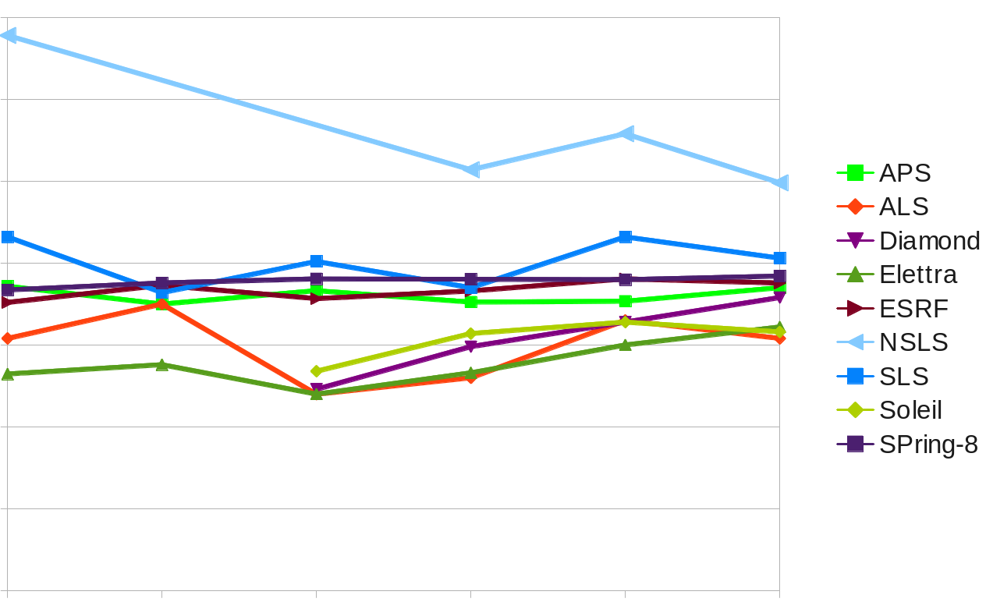
Comparison of Light Sources
A. Luedeke, ‘Do you believe in Operation Statistics?, ARW11, Cape Town
Beam Availability
110%
100%
90%
80%
2005
2006
2007
2008
2009
2010
Year

Slide 3
Survey on Failure Analysis at Light Sources
Previous experience
A. Luedeke, Phys. Rev. ST Accel. Beams 12, 024701 (2009)
How do you exactly define “beam downtime”?
How do you exactly define “beam availability”?
Result of the survey:
No two facilities were calculating “beam availability” in the same way!
Some examples:
Downtime: often defined in common sense rules
Short up-time: some did count every up-time, some dismiss up-times up to 1 hour
Compensation time: some subtract it from downtime, some not
“Beam availability”: shows reliability of one facility over time; BUT
comparison of numbers from different facilities is meaningless!!!

Slide 4
Starting point: “Beam availability”
Talk of Andreas Lüdeke: Find your "Happy User Index“
Every type of machine has it’s own figure of merit.
Common metrics to compare facilities (Beam availability, MTBF, MTTR)
Specific metrics to optimize your facility (quantify user demands)
Open Discussion:
Do we have a common way to calculate beam availability?
There were 12 representatives from different light sources present.
Conclusion: No, we don’t!

Slide 5
Starting point: “Beam availability”
Examples:
When does a downtime start?
< 99% of nominal beam current (e.g. SPEAR3)
< 50% of nominal beam current (e.g. ELETTRA, Diamond)
no beam (e.g. ALBA)
When does a downtime end?
Nominal beam current is restored (e.g. Australian Synchrotron)
Beam is given to the users (e.g. ALBA, SLS)
Penalty time added after beam is back (e.g. ELETTRA: +15min, PETRA III: +1h)

Slide 6
Starting point: “Beam availability”
Conclusion:
We need a world wide common standard on accelerator reliability!
We’ve started the initiative for:
A Common Operation Metrics for 3rd Generation Light Sources

Slide 7
How to define this Standard?
Redefine “downtime” and “beam availability”?
No, that would not work:
Risk of ambiguity (old and new definitions)
Risk of resistance (Availability numbers can be part of contracts)
Too simple to be meaningful (Downtime has many modes)
Instead start with a list of common failure modes

Slide 8
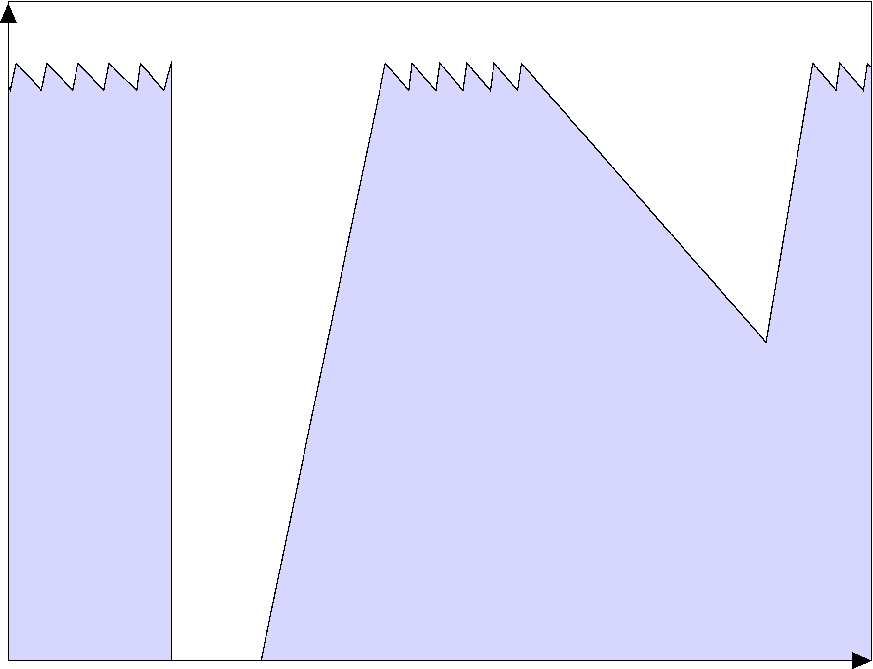
Primary Failure Modes
Beam-
current
“Low-beam-current”
“No-beam”
I(nom)
I(min)
99.5% I(min)
20% I(nom)
No-beam
Low-beam-current
Time

Slide 9
Secondary Failure Modes
Define a set of secondary failure modes
Low lifetime
Beam blow-up
Distorted Orbit
Distorted Bunch Timing
Bunch Impurity
Beam Feedback Outages
Short Uptime
Beam unrelated Outages (Network,…)
…
Number and total duration of failure modes answers:
Is our orbit feedback system as reliable as those of other facilities?
How reliable is our top-up mode compared to other light sources?
Is our beam size fluctuation normal?
…

Slide 10
User Time
Scheduled User Experiment Time (users scheduled > 1 month ago)
Scheduled User Reserve Time (user re-scheduled ≥ 1 month ago)
Spontaneous User Compensation Time (user re-scheduled < 1 month ago)
The sum of all the above is the User Time
Example: Vacuum leak, 5 days lost
Management decision:
5 days shutdown for repair,
next service week shortened by 5 days,
these 5 days given to users
Accounting:
“No beam” event of 5 days
5 days “Spontaneous User Compensation Time”
This adds 5 days to the “User Time”

Slide 11
Failure Mode Statistics: what to publish?
Publish for each failure mode:
Failure count
Total duration
Publish user schedule statistics:
𝑇_{𝑆𝑐ℎ𝑒𝑑𝑢𝑙𝑒𝑑}
𝑇_{𝑅𝑒𝑠𝑒𝑟𝑣𝑒}
𝑇_{𝐶𝑜𝑚𝑝𝑒𝑛𝑠𝑎𝑡𝑖𝑜𝑛}
𝑇_{𝑈𝑠𝑒𝑟}= 𝑇_{𝑆𝑐ℎ𝑒𝑑𝑢𝑙𝑒𝑑} + 𝑇_{𝑅𝑒𝑠𝑒𝑟𝑣𝑒} + 𝑇_{𝐶𝑜𝑚𝑝𝑒𝑛𝑠𝑎𝑡𝑖𝑜n}

Slide 12
Failure Mode Statistics: how to use it?
Simple beam availability:
$$A_{(simple)}=\frac{T_{User}−\sum{T(no­˗beam)}}{T_{User}}$$
Compensated beam availability:
$$A_{(compensated)}=\frac{T_{User}−\sum{T\left(no­˗beam\right)}}{T_{User}−\left(T_{Compensation}+T_{Reserve}\right)}$$
Mean Time Between Distortions:
$$MTBD=\frac{T_{User}}{Count\left(no­˗beam\right)+Count\left(low­˗beam­˗current\right)+Count\left(orbit­˗fb­˗fail\right)}$$

Slide 13
Example
In the operations calendar for 2014:
T_{scheduled}: 4800 h T_{reserve}: 72 h T_{compensation}: 0 h
At the end of the year
T_{outages}: 80 h + 3 full days due to a main PS failure T_{outages}: 152 h
T_{reserve} is fully used
In addition Management decides to extend the last run for 1d, that is T_{compensation}: 24 h

Slide 14
Example
To compare to other facilities
Internal use: Did all users get their beamtime?

Slide 15
Summary
We propose a simple, distinct and standardized operation metrics:
Primary failure modes: clearly defined, easy to measure
Secondary failure modes: work-in-progress
Defined accounting for user schedule statistics
Only such a standard allows a meaningful comparison
of the reliability of 3rd generation light sources!

Slide 16
Acknowledgements
Many thanks for input to this talk go to:
Michael Bieler, Petra III at DESY
Jean-François Lamarre, SOLEIL
Andreas Lüdeke, SLS at PSI

Slide 17
Contacts
Mailing List of this initiative:
Michael Bieler for PETRA 3 at DESY,
Ruy Hanazaki do Amaral Farias for Sirius at LNLS,
Laurent Hardy for the ESRF,
Stefano Krecic for Elettra,
Jean-François Lamarre for SOLEIL,
Andreas Lüdeke for the SLS at PSI,
Roland Müller for BESSY2 at HZB
Montse Pont for ALBA at CELLS

Slide 18
Contacts
Visit us at http://sites.google.com/site/comi3gls

