Slide 1
“New and Improved”: The JLab (state-of-the-art) HCO System
At least until the next guy talks…
Dr. Ken Baggett
Engineering Support Liaison to Operations

Slide 2
Outline
Why change?
Overview of JLAB’s new Hot Checkout (HCO) processS
Process Execution
Users
Signoff processes
Operations Utilization
Summary

Slide 3
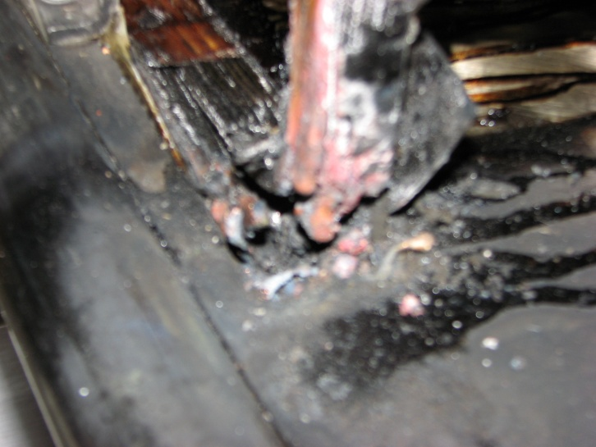
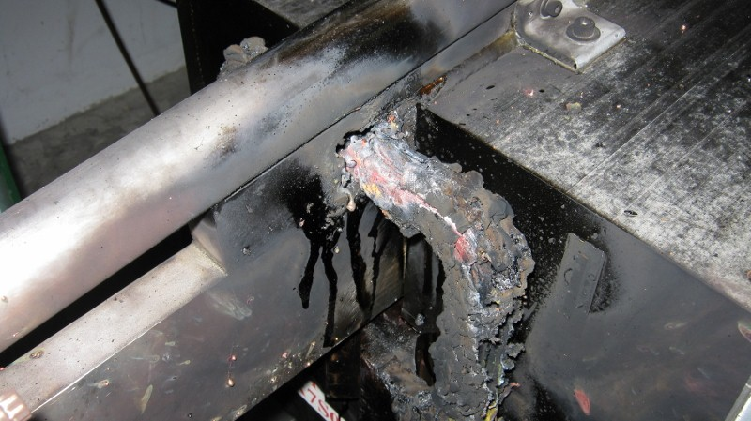
Why Change?
On 10/14/12 two Septa magnets (YR) in the Northeast Spreader region caught on fire and sustained heavy damage.

Slide 4
YR Fire - What went wrong? (cont.)
What happened?
LCW valves for the dipoles were closed.
A jumper in the box supply prevented the thermal switches from tripping the box supply on an over temperature fault.
Root causes identified to be:
Lack of adequate Work Control practices
No systematic method of checking system readiness
Contributing Causes:
Poor communication between System Owners and Operability
Poor attendance at coordination meetings
Inadequate tools for communicating/determining status

Slide 5
How the new HCO system addresses findings
No systematic method of checking system readiness
Inadequate documentation of system status/condition before turn-on.
Tools for System Owners/RECO inefficient or inadequate for information management.
No LCW valve lineup data/indicators (tags) at magnets.
LCW flow/cooling effectiveness not verified on the magnets.
Power supply not fully inspected prior to installation.
Very light attendance at RECO meetings by System Owners.
Inadequate documentation of system status/condition before turn-on.
Undocumented jumper installed in power supply.
Failure to pass along known problems with power supply identified on Sept 2011
HCO Status Software
HCO Group Checklists
HCO Process
ABIL

Slide 6
New HCO Approach
Identify the users
Involve everyone
Engage both technicians and management.
Involve them in the system design
Get specific
HCO software captures checkout of each component.
Ensure work plans are developed for component HCO
Be efficient
HCO software is web-based
It efficiently handles documentation.
Displays multiple, dynamic reports.
Change the culture
Ensure management actively and visibly supports the process
Accelerator Readiness Reviews (ARR) helped by ensuring we completed the steps we committed to during the reviews.

Slide 7
Users
Technicians – Work to checkout components based on HCO requirements.
Group Leaders & Experts – System Experts, Group Leaders, Engineering Liaison work together to determine system readiness.
Management – Program Deputy (PD), Engineering Liaison, and Operability managers monitor/drive HCO progress based on beam destinations.
Operations – Verifies component status based on beam destinations prior to establishing beam for the PD’s accelerator program.

Slide 8
Determining Component Readiness Status
New process utilizes a three stage sign-off process
Components are initially “Not Ready”.
Technicians upgrade them to “Checked” once work is completed
Group leaders upgrade them to “Ready” once work is reviewed.
Staff can add comments without having to change status.
Anyone can downgrade a component to “Not Ready”.
Once all groups have signed off on a component, the component name will be turned GREEN on the interface.

Slide 9
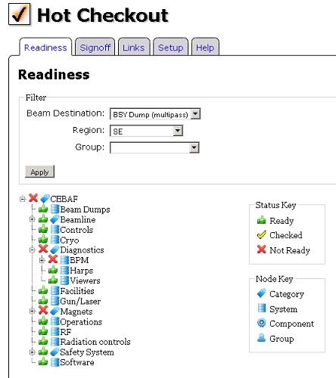
Readiness Status
Readiness: status of all accelerator components needed for operations.
Built from a “superset” of the accelerator’s element database (CED)
Accelerator status:
Can be filtered and displayed based on beam destination

Slide 10
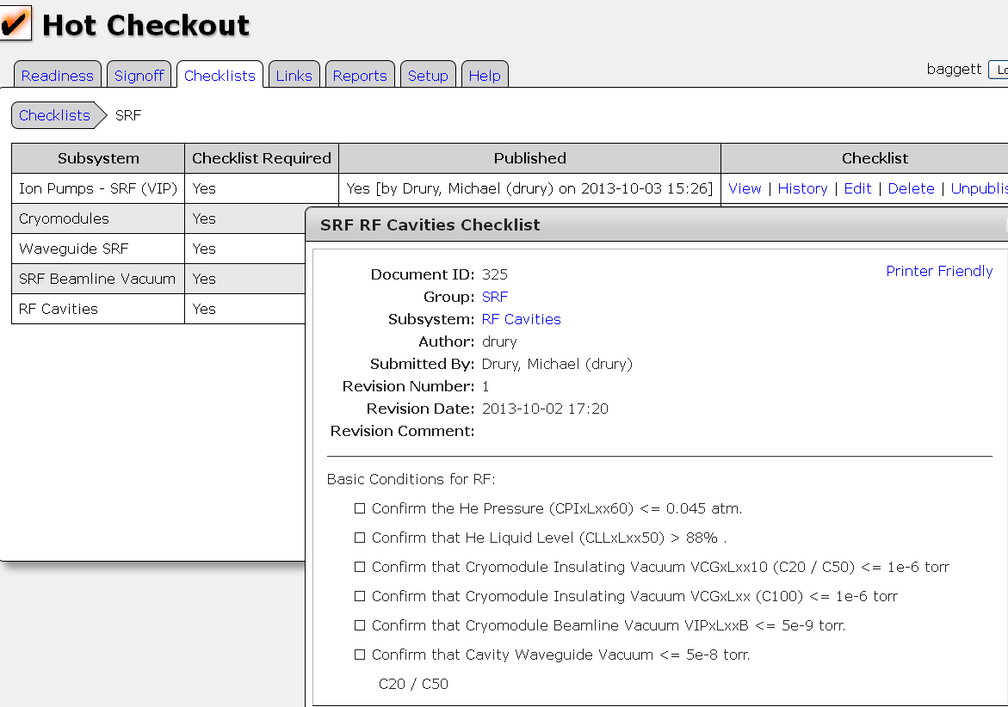
HCO Checklists
Checklists are used (and required) for each group performing work that could cause damage to personnel or the machine during beam operations.
HCO Checklists are:
Maintained by work groups.
Stored in the HCO database
Documented using a configuration management process in software.
Checklists improve outcomes with no increase in skill
(A. Gawande, Checklist Manifesto)

Slide 11
“Bulk” Sign-off
Signoff of components:
Currently: 8,104 elements, 18,679 signoffs
One at a time” approach won’t work.
Solution?
Regional signoff option
Group leader or technician can verify that all components in the region have been Checked/Ready.
Allows groups to signoff higher level equipment that supports specific components (i.e., a single bulk power supply that supports ARC 1 dipoles).

Slide 12
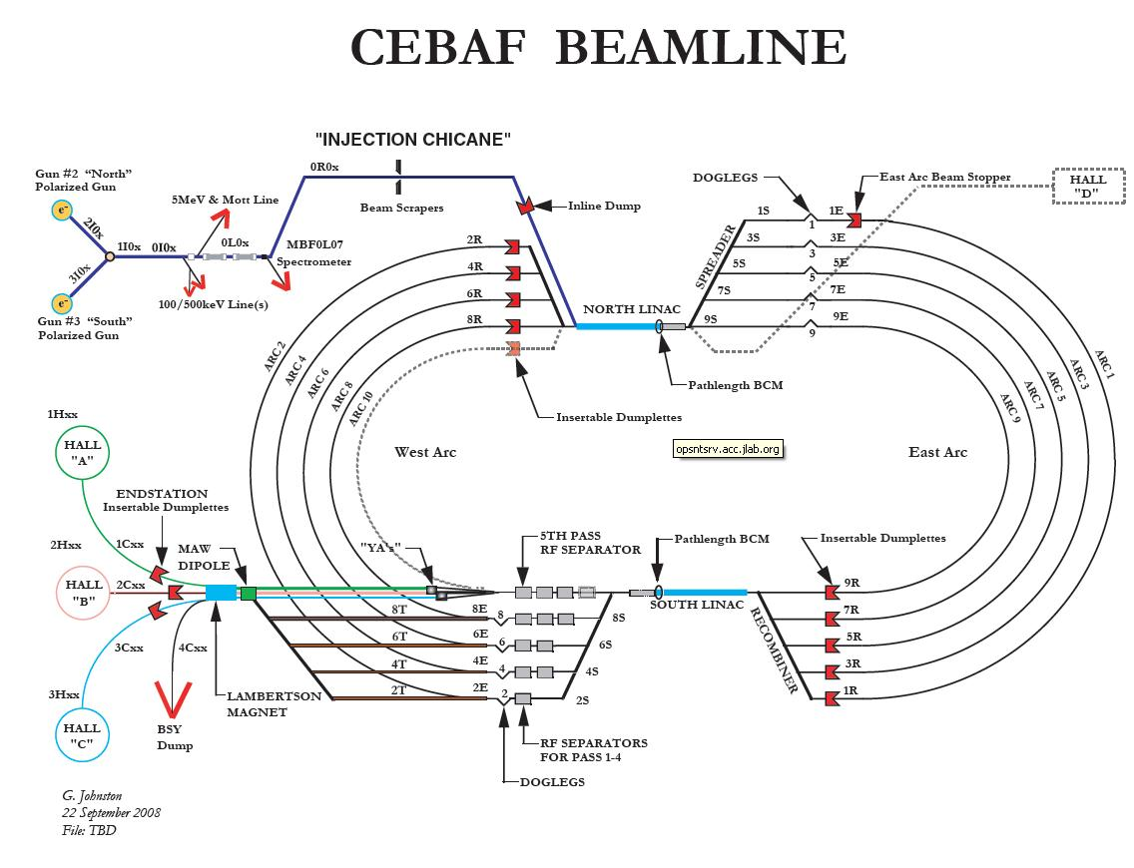
North East Spreader

Slide 13
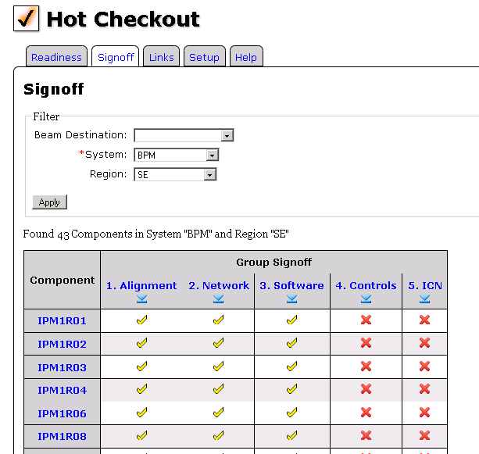
Group Signoff
The software interface:
Is web-browser accessible.
Shows all associated groups in work order.
Provides for simple bulk signoff of components.
Facilitates making, tracking, and reviewing comments.

Slide 14
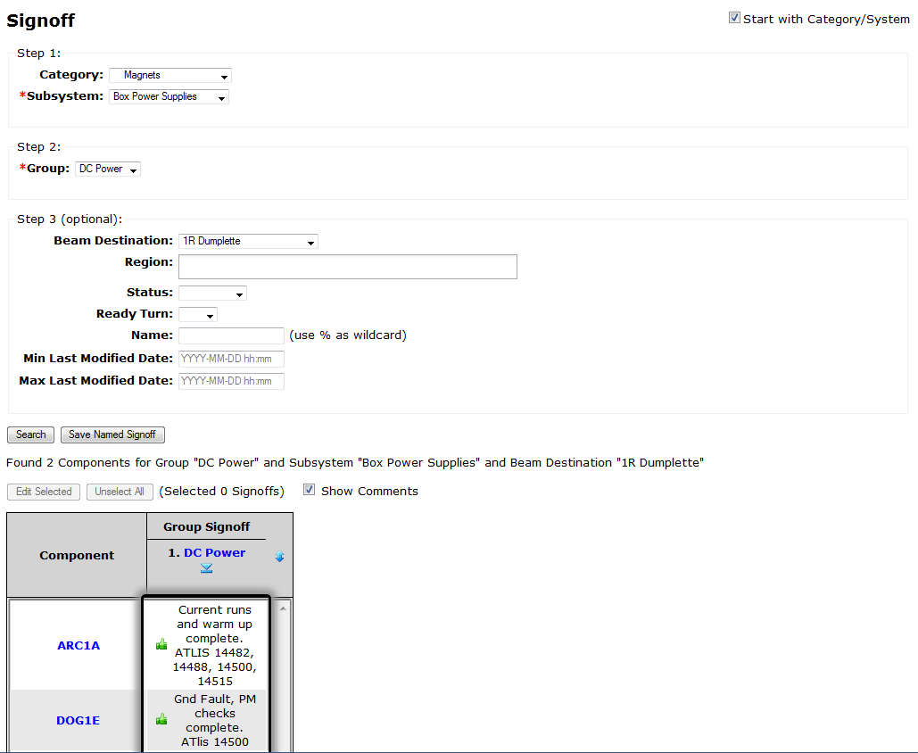
Signoff - Filtering

Slide 15
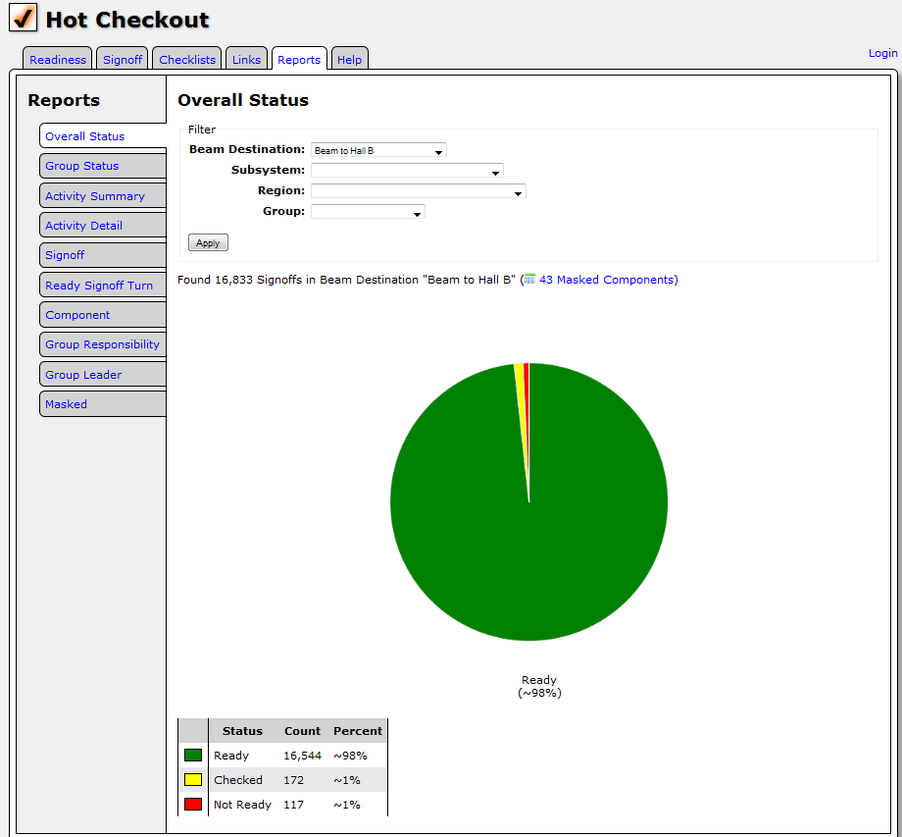
Overall Status

Slide 16
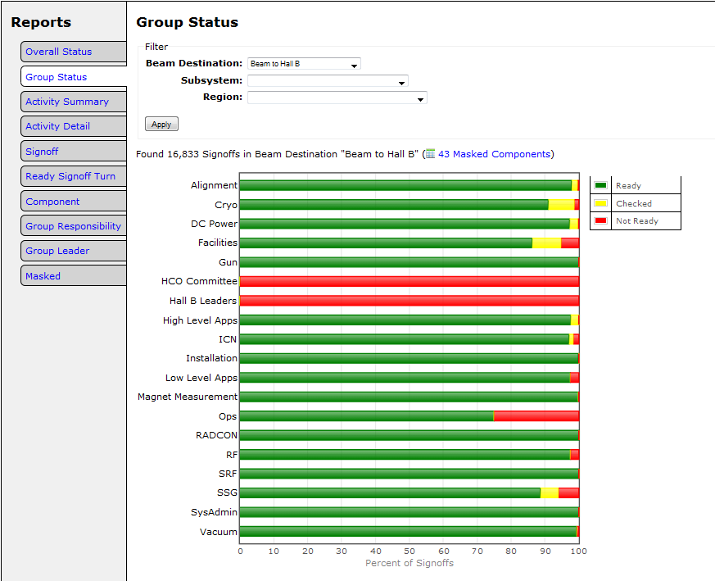
Group-by-Group Progress

Slide 17
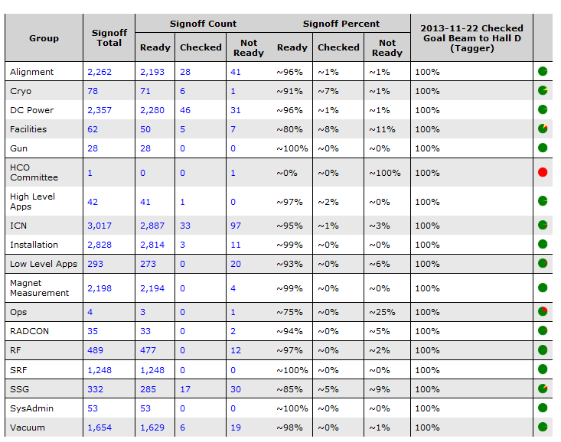
Group-by-Group Status Breakdown

Slide 18
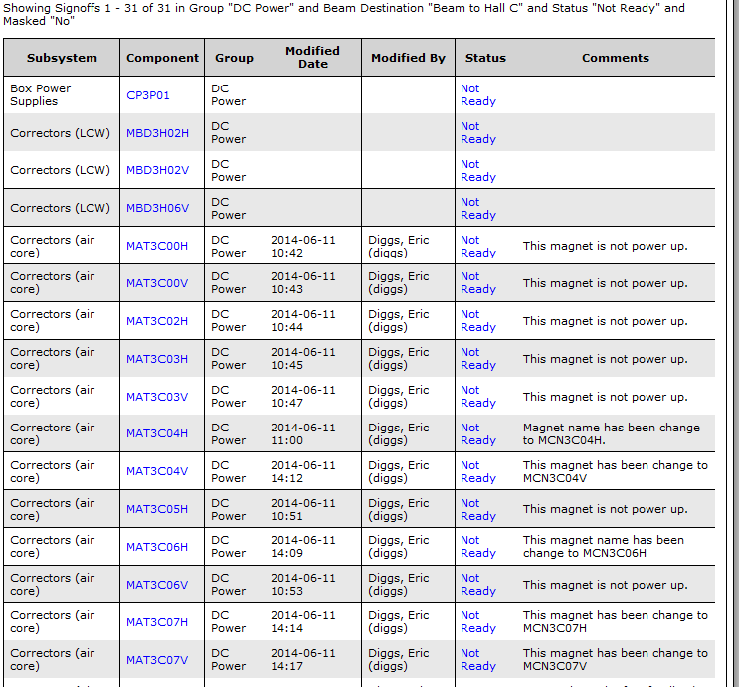
Drill Down

Slide 19
HCO Process Execution
HCO Program
HCO team leaders serve as Program Deputy (PD)
Beam destination set based on program goals
HCO software filters and displays components that require HCO.
Group leaders and geographic integrators continually verify that the lists of components are accurate.
Coordination and Sign-off
Integrated activities coordinated daily 0800 meetings:
Communicate system status, tunnel access.
Detail work priorities
Resolve any group and/or schedule conflicts.

Slide 20
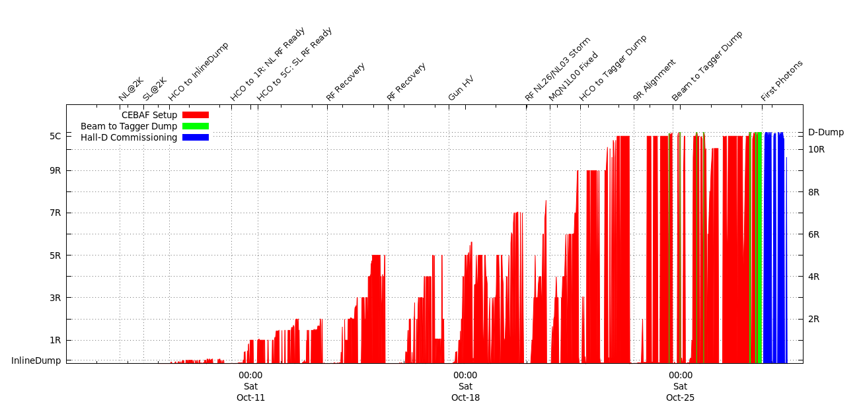
Accelerator Startup

Slide 21
Summary & Conclusions
New HCO system ties together people, process, resources, and environment.
Process developed with system owners involvement.
HCO components require groups to have a written checklist
Technicians “Check” components.
Group leaders responsible for saying components are “Ready”
HCO software provides web-based status of accelerator readiness

Slide 22
Thank You!
Questions?

