Slide 1
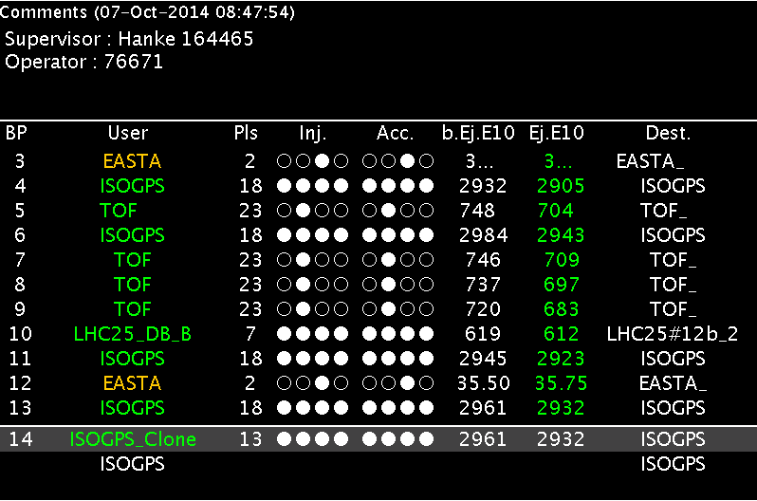
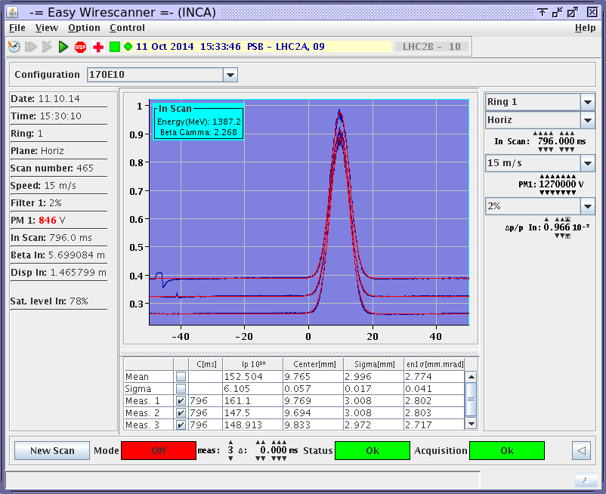
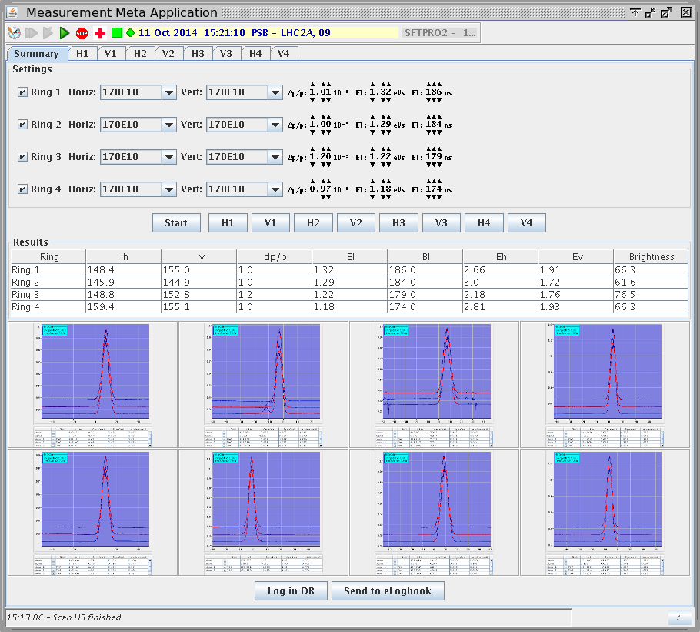
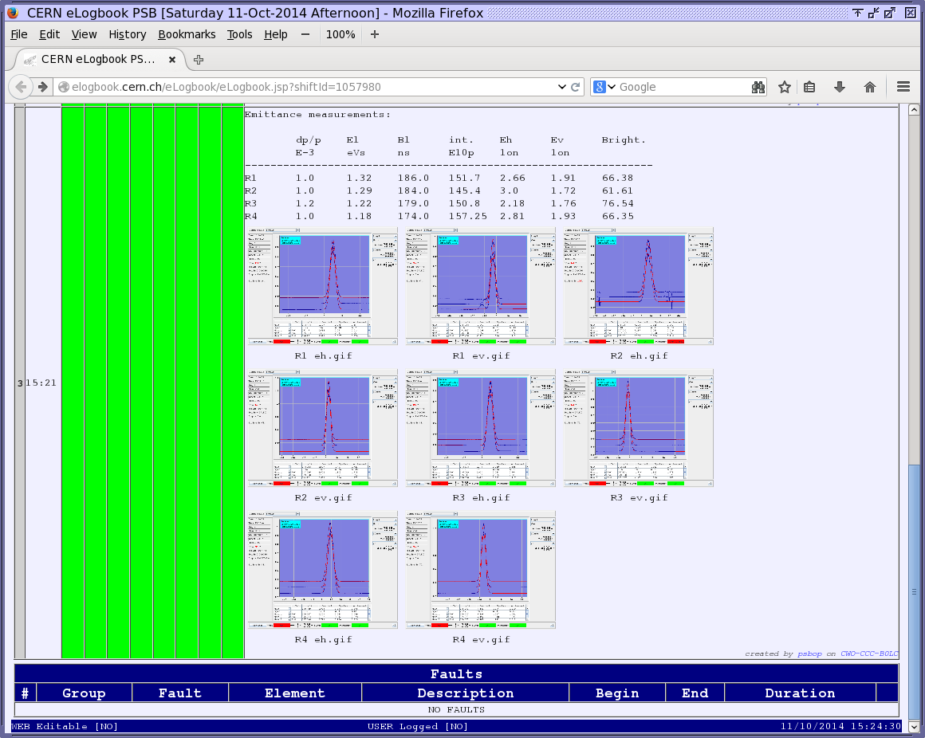
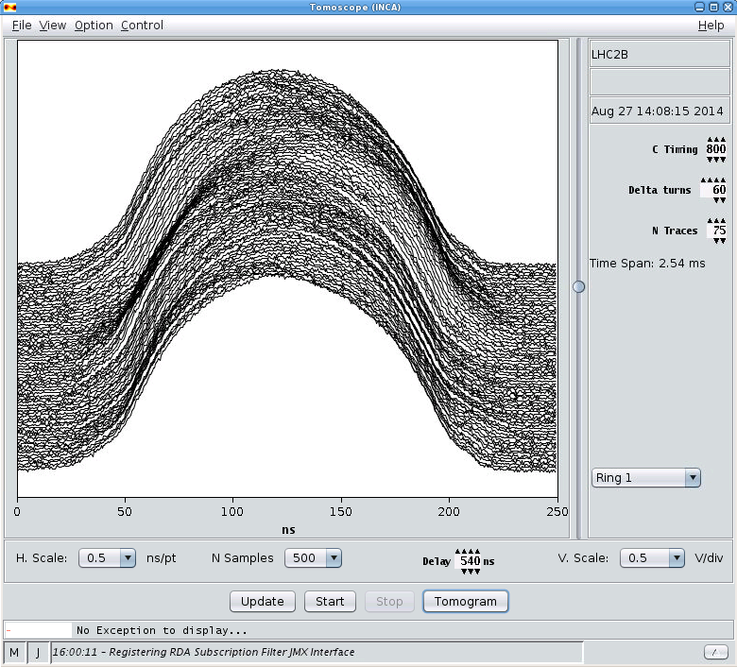
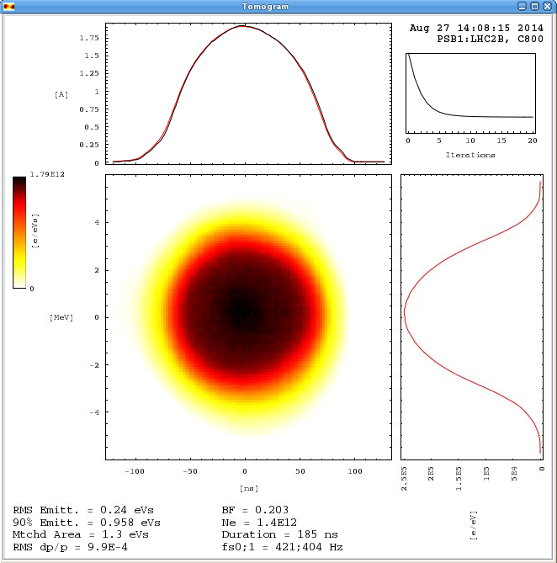
Automatic emittance measurement in the CERN 1.4 GeV Booster
J.F. Comblin, OP Group, CERN
ABSTRACT
To deliver high brightness beams to the LHC, the injectors are running at their stability limit and have to be constantly tuned to avoid beam degradation. A quality monitoring has been put in place and requires repeated measurements of intensity, transverse and longitudinal emittances.
For the Booster, which has 4 rings, this represents a supplementary work load of 1 hour every shift. To minimize the impact for the other facilities and users, an application has been developed to ease this task: the measurements are done automatically, while the operator keeps the responsibility of logging the final quality results.
INTRODUCTION
The CERN Booster is a synchrotron with four superposed rings that accelerates protons from 50 MeV to 1.4 GeV. It is a pulsed machine that delivers several types of beams to different experiments and the downstream machines every 1.2 seconds. As part of the LHC injectors, it determines the transverse emittances of the beam and therefore the final LHC beam brightness.
The quality monitoring requires the following steps:
Longitudinal measurements, with the Tomoscope application, to obtain dispersion, bunch length and emittance.
Transverse emittance measurements, with wire scanners.
Logging of results in database and logbook, with screenshots.
Steps 2+3 are repeated for the 4 rings and the 2 planes. With a super cycle of 40+ cycles and only 1 dedicated to measurements, the whole process takes more than 1 hour, during which the operator is not available for the other operations.
CERN’s accelerator complex
Booster cycles
THE application
In the quality monitoring process, the part that takes most of the time is the use of the wire scanners. For a specific LHC beam, the main difficulty is to find the best settings: wire speed, photomultiplier gain and filter. The first step of automation was to save predefined settings in a file that could be easily and quickly loaded. The next step was to write an application that loads these configuration files and starts the wire scanners one at a time.
The application consists of 8 instances of the wire scanner application and a panel with settings, results and screenshots. It can be launched in the background of other tasks or operations. Once finished the operator can check the results and restart a single measurement if necessary. Finally all results and screenshots can be sent directly from the application to the logging database and the logbook.
8 x wire scanner application
logbook
Meta application
CONCLUSIONS
The goal of this work was to automatize the repetitive operator actions, to reduce the duration of the beam quality measurements and minimize errors due to related inattention. The proposed application does not replace the original wire scanner application and still requires operator knowledge of the equipment. The responsibility of the operator is to log coherent measurements of emittance and brightness together with some longitudinal parameters, which is now considerably faster and easier.
Even if the LHC run has not yet started, tests were done during the setting-up of the LHC beams. The results are very encouraging: the work load decreases down to 20 minutes in the worst conditions. Most of this time is now spent for the longitudinal measurements. Booster operators can now apprehend the next LHC run with confidence!
FUTURE PLAN
Once the success of this new application will be confirmed during the start of the LHC run, the application will be extended with longitudinal measurements: 4 instances of the Tomoscope will be integrated. A 100% automatic application covering longitudinal and transverse measurements of all rings and planes, of course still without removing the need for the critical eye and experience of the operators.
Tomoscope application

