Slide 1
Automation at the CERN Super Proton Synchrotron Automation without losing skills
WAO 2014
James RIDEWOOD - CERN

Slide 2
Overview
Introduction to the SPS (Super Proton Synchrotron)
Evolution of the SPS
Automation in the SPS
Maintaining skills and motivation
Operator feedback
The future
Conclusions

Slide 3
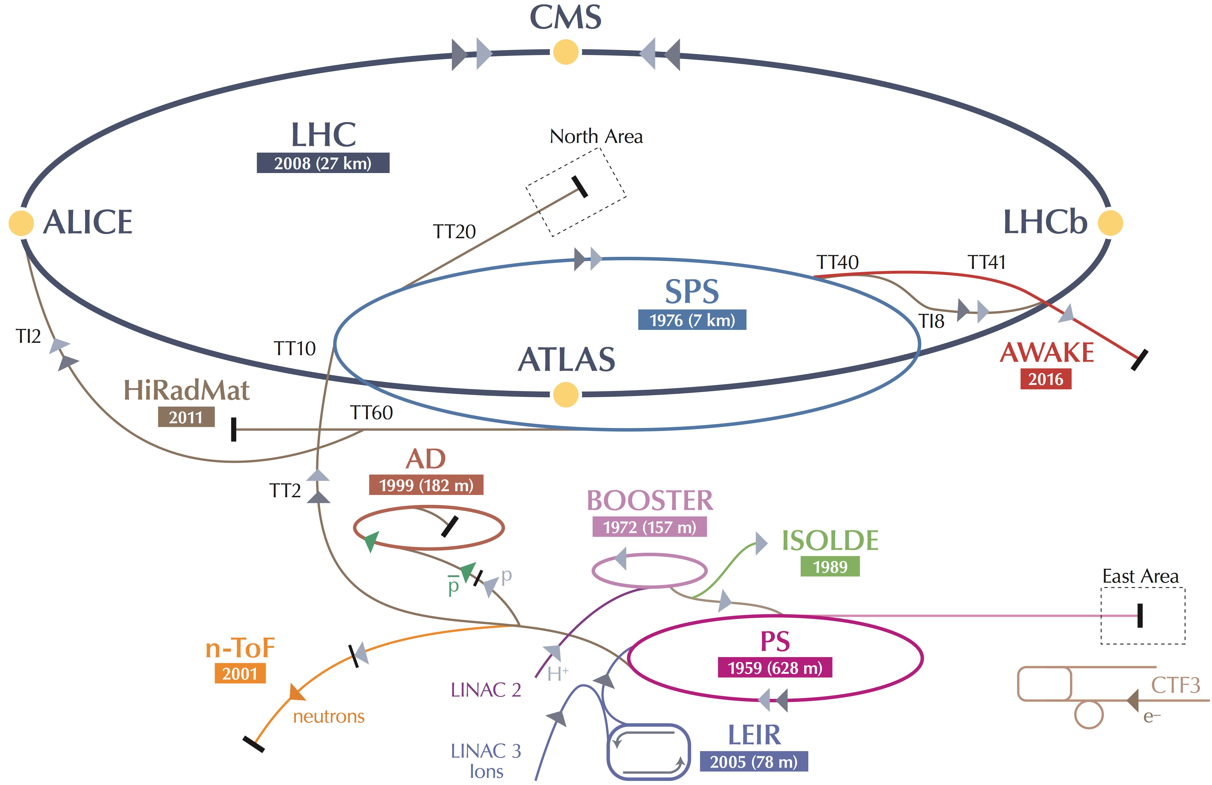
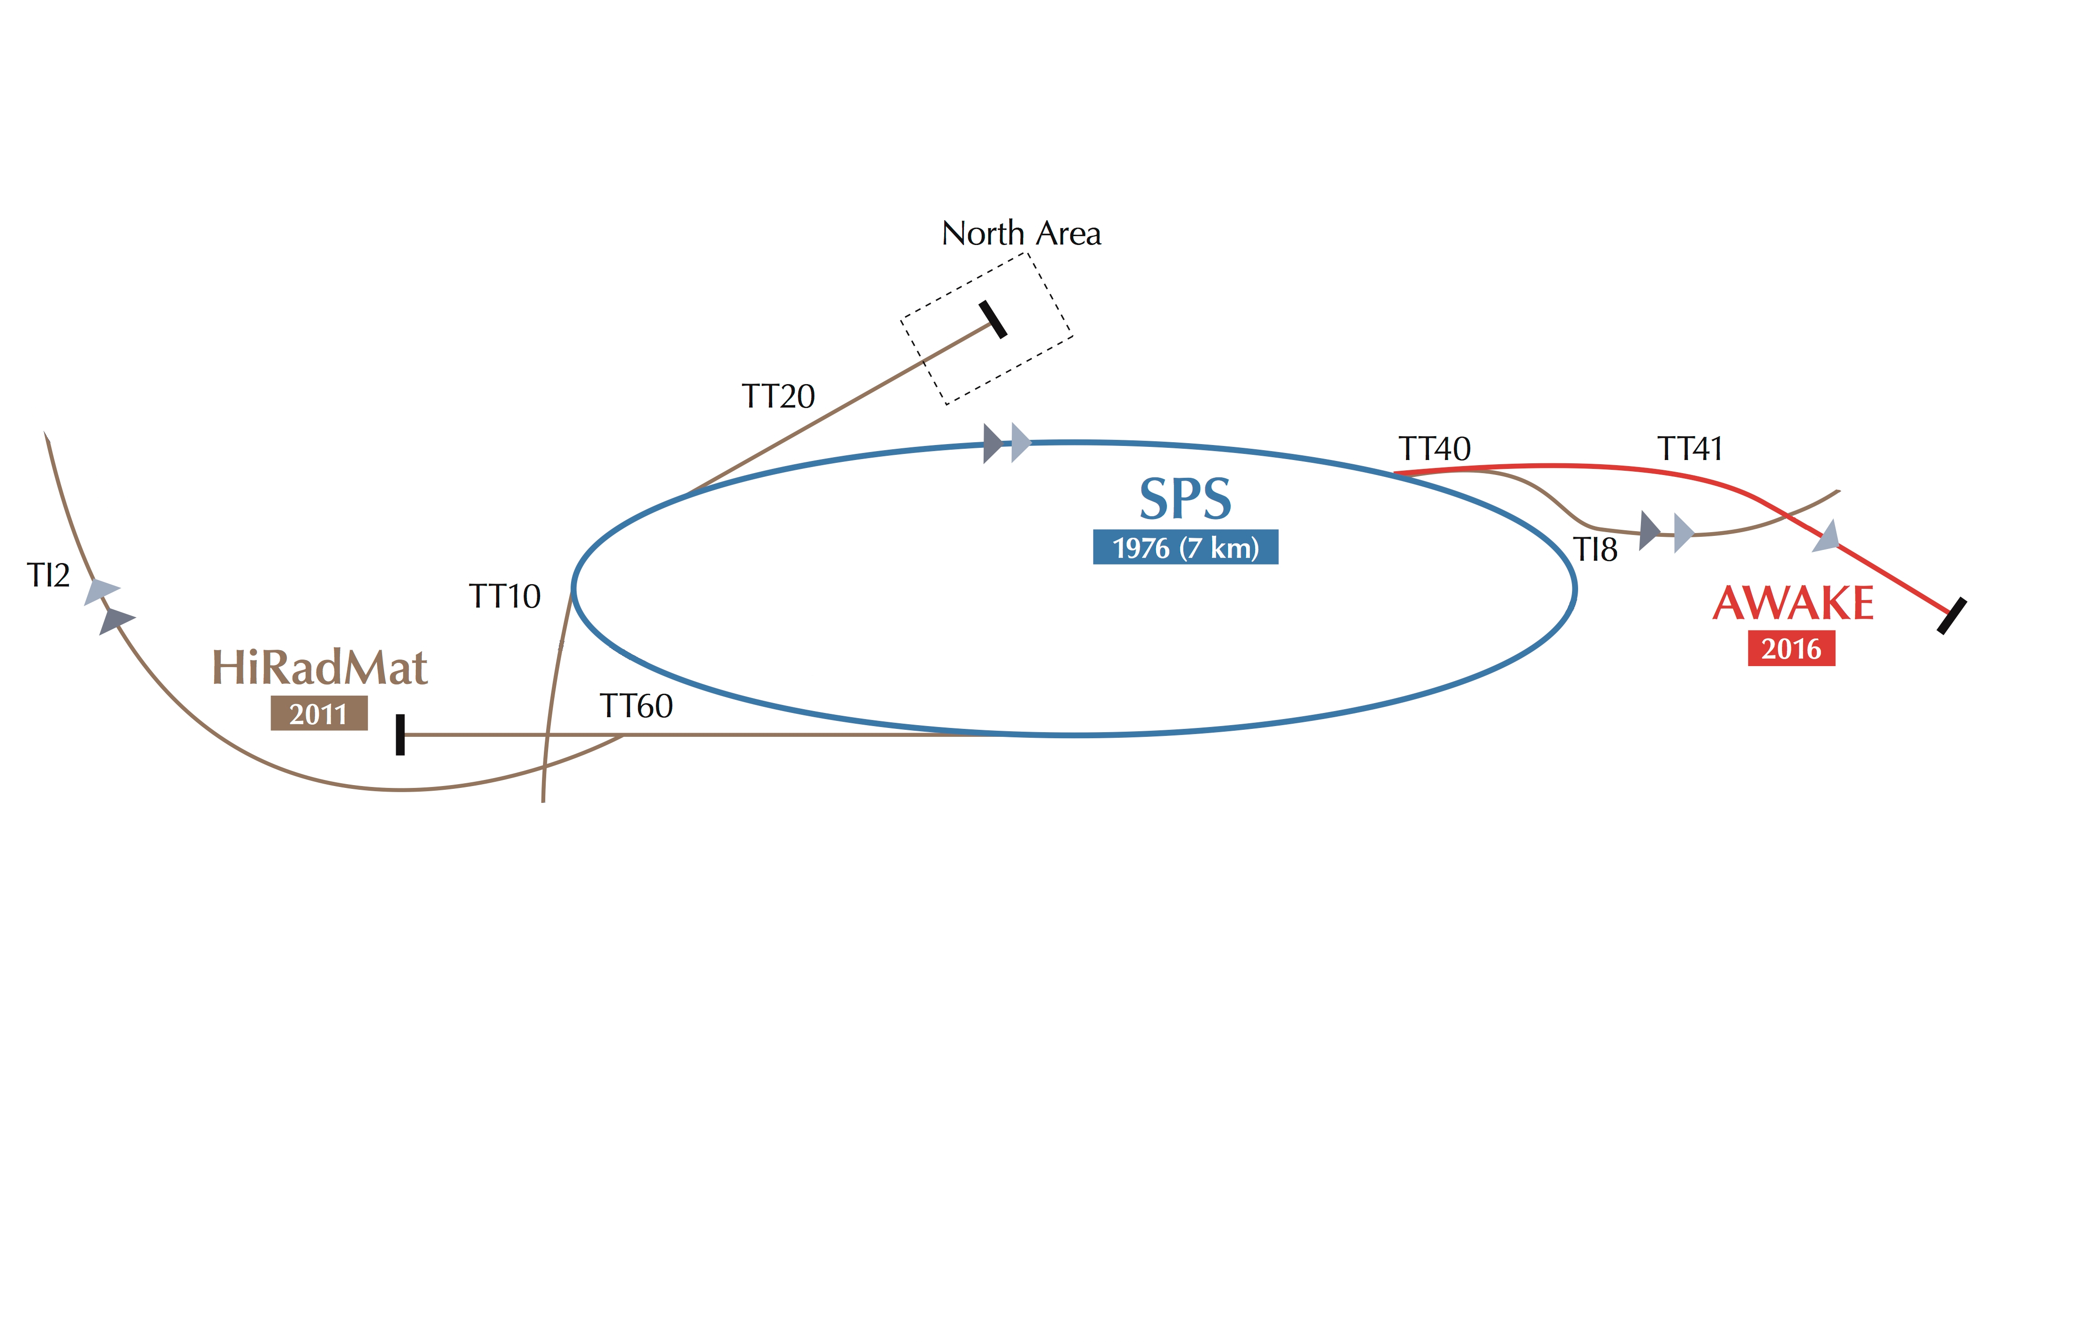
Super Proton Synchrotron
450GeV
LHC 450GeV via TI2
…and TI8 transfer lines
North experimental area - 400GeV
HiRadMat - High-Radiation to Materials 440GeV
AWAKE - Advanced Wakefield Experiment – 400GeV – 2016
Ex CNGS – CERN Neutrinos to Gran Sasso – 2006-2012

Slide 4
Evolution of the SPS
The LHC requires good quality beam quickly
Reducing time from dump to reinjection is critical for physics
SPS (and the entire injector complex) needs to be ready as soon as LHC requires beam
…..whilst still satisfying our other users
Sometimes a juggling act

Slide 5
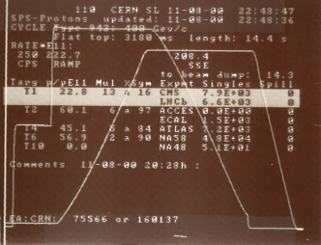
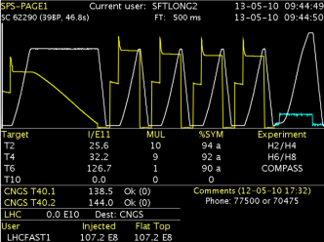
Evolution of the SPS
When I arrived at CERN the SPS was a very different machine
Machine user configuration was rarely changed – usually one single cycle
With multiple cycles, multiple users and the advent of the LHC era these changes can be several times per shift!
Several clients expecting beam simultaneously
We had to automate to keep our heads above water!
2000
2010
Notes:
Not only do we have more cycles and users but the configuration changes frequently too

Slide 6
Automation tools in the SPS
Beam trajectory steering application
Auto tune and chromaticity measurement and correction
Task sequencer

Slide 7
Beam trajectory steering application
Automated injection oscillation corrections
Automated steering on targets
Closed orbit corrections
Transfer line trajectory corrections
Benefits:
Reliable
Fast
….but its use is not trivial
Notes:
Trivial, foolproof

Slide 8
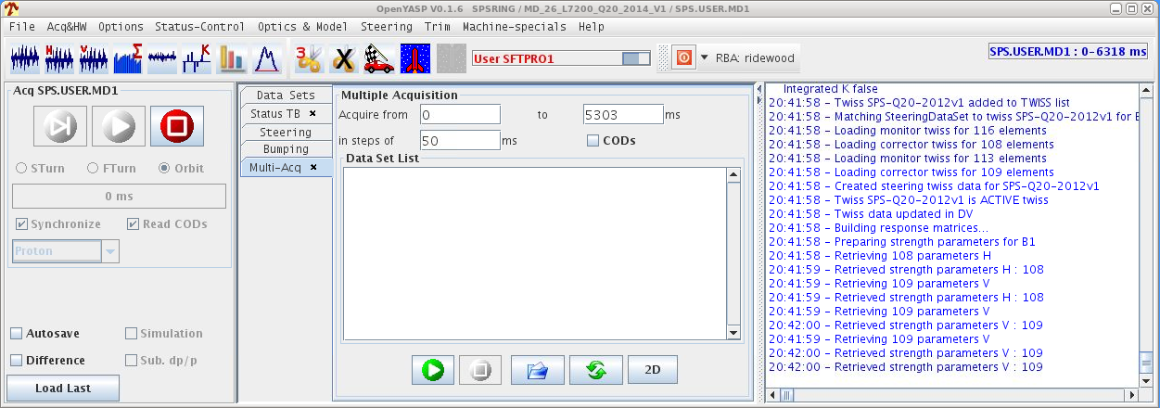
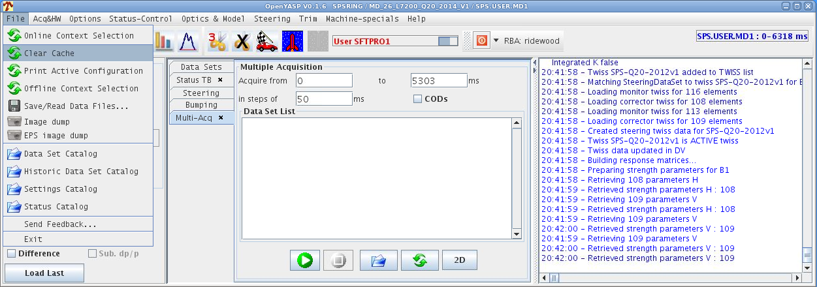
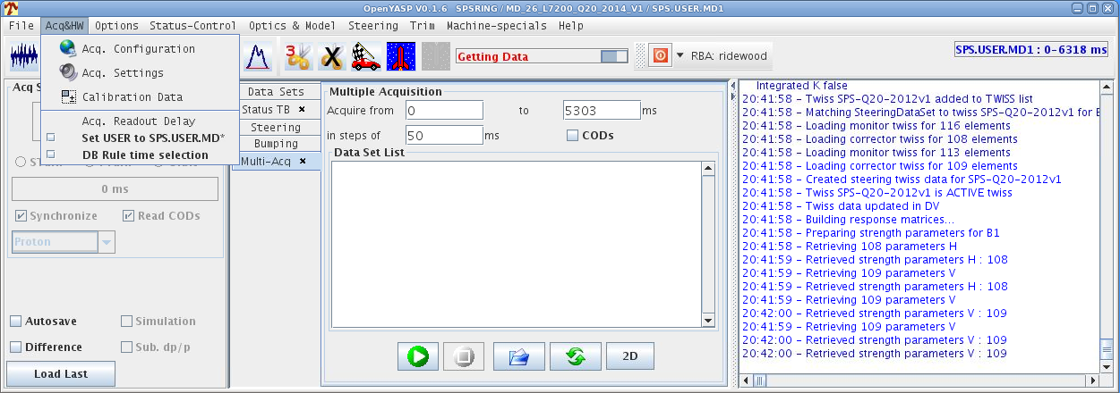
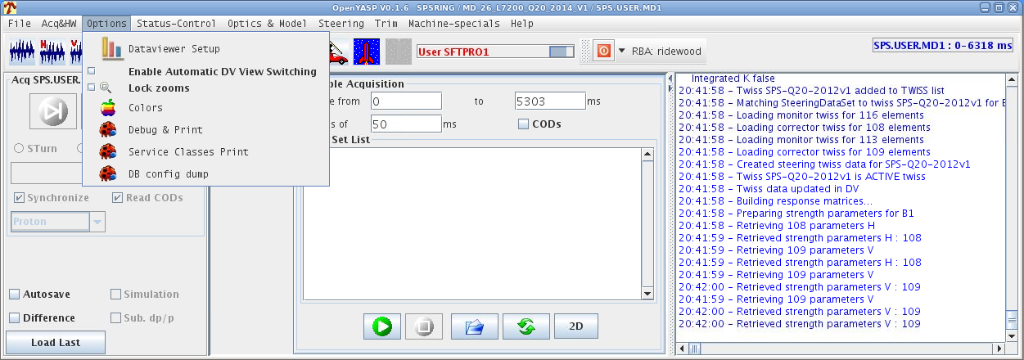
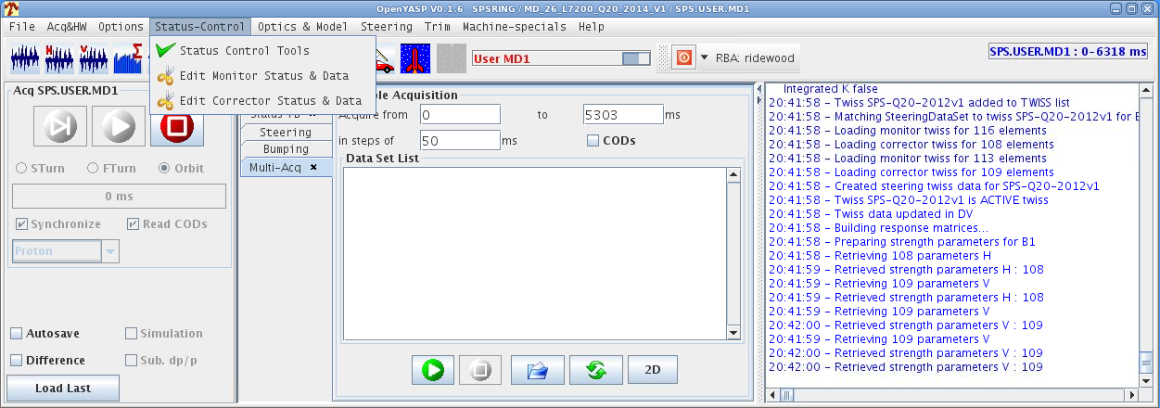
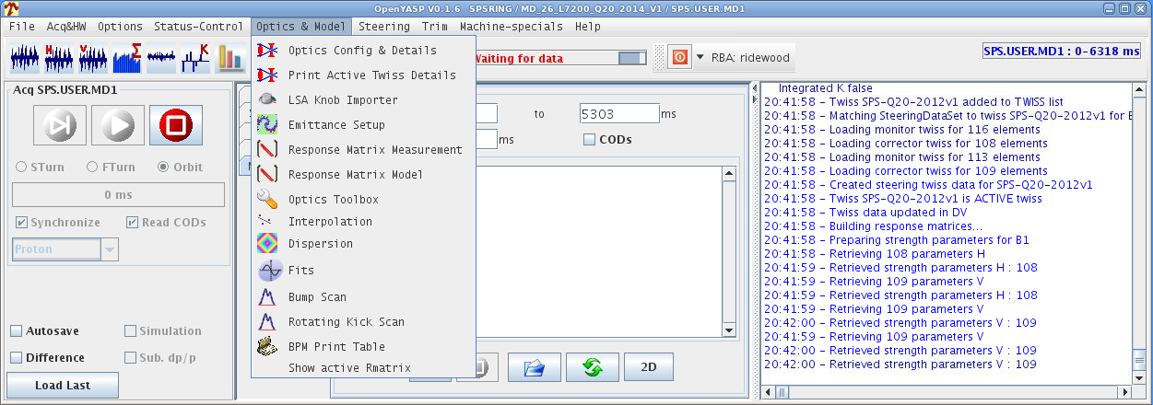
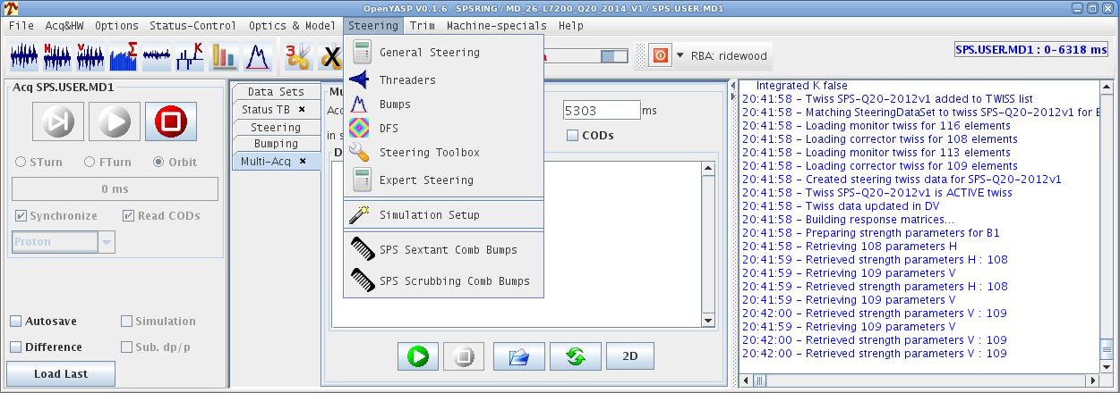
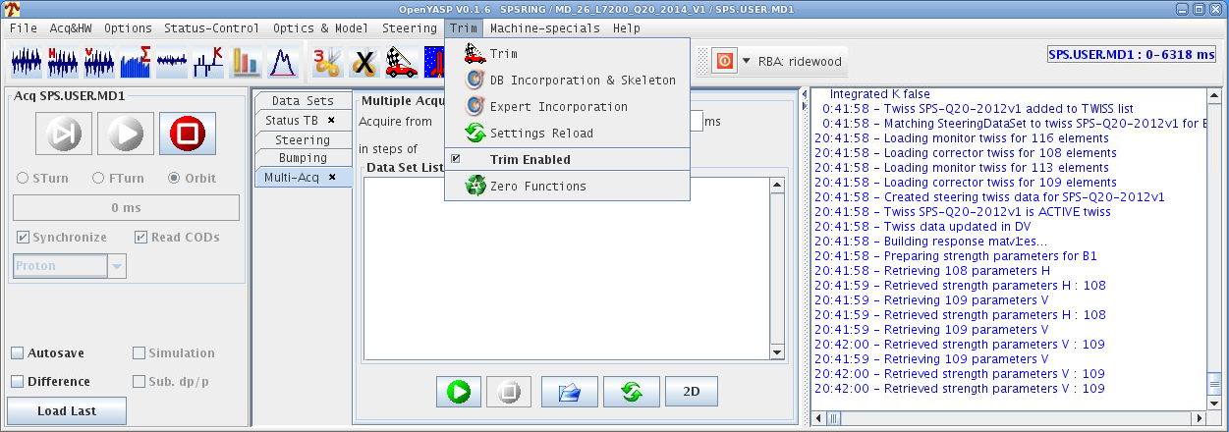
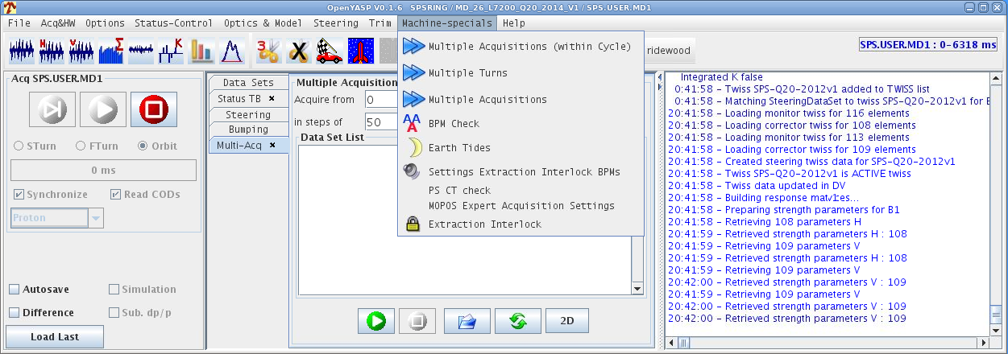
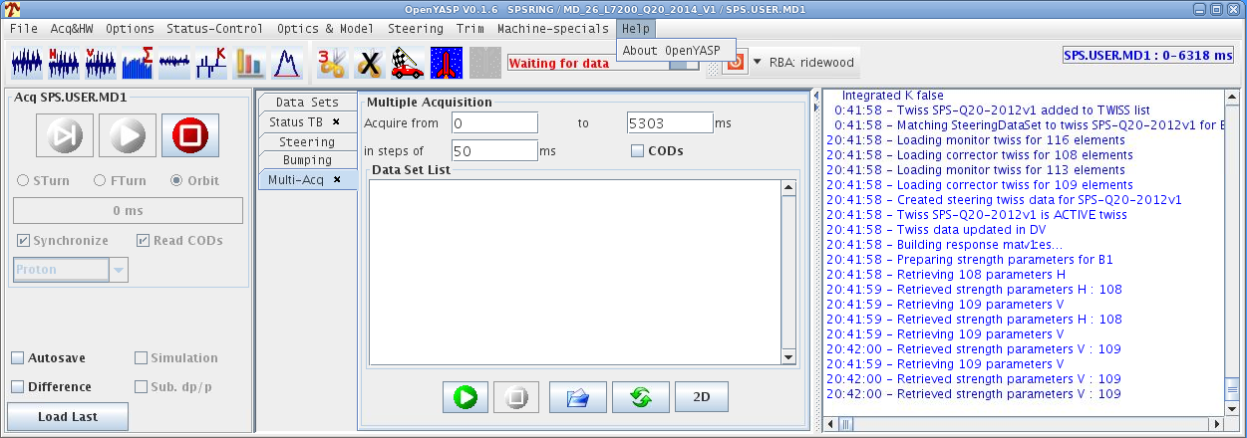
Beam trajectory steering application
Our automation tools are not always simple
Require a certain understanding to get best results
Notes:
This perhaps demonstrates that a minimum of understanding is still essential.
These aren’t set and forget tools

Slide 9
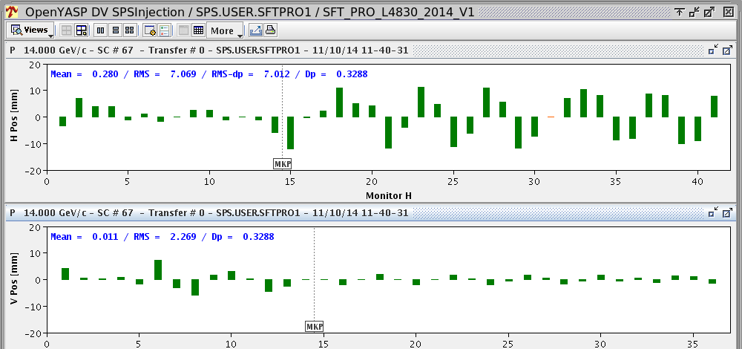
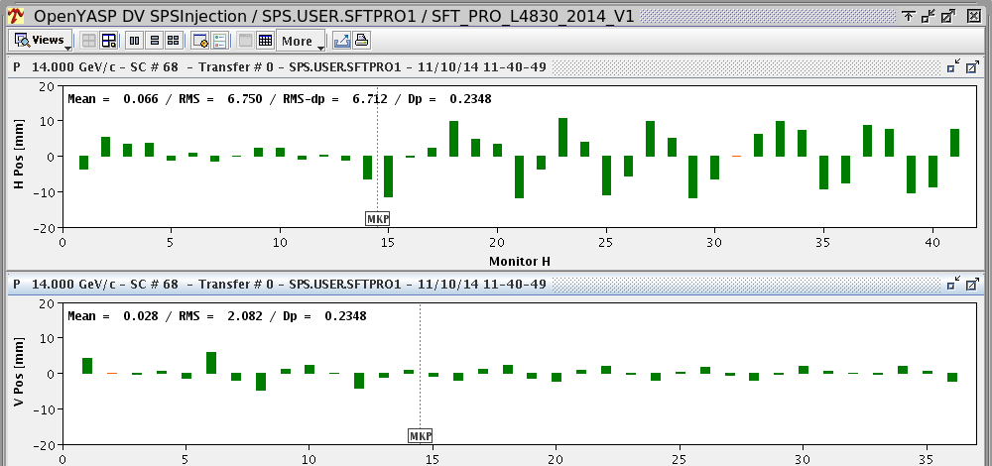
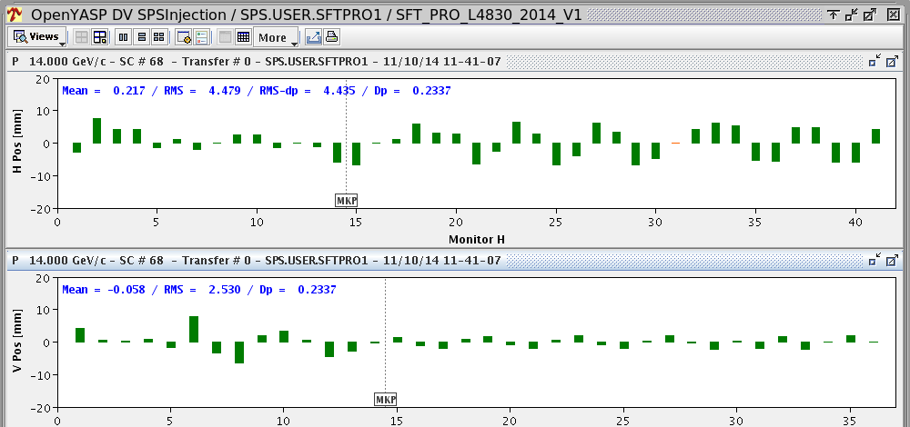
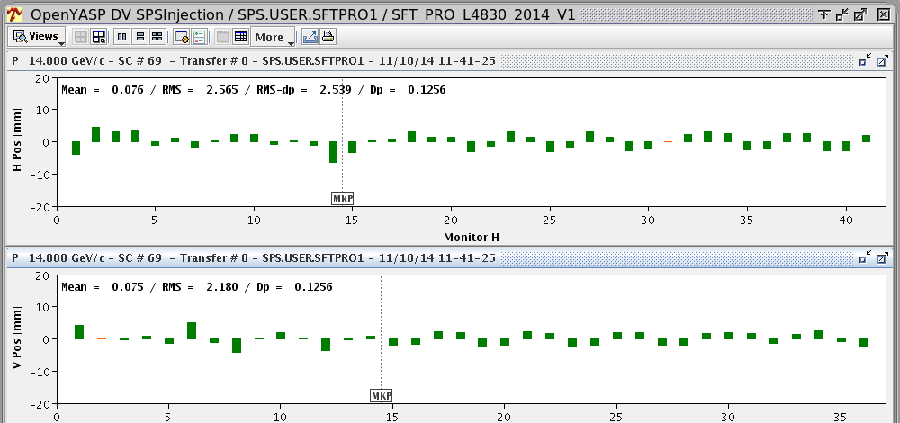
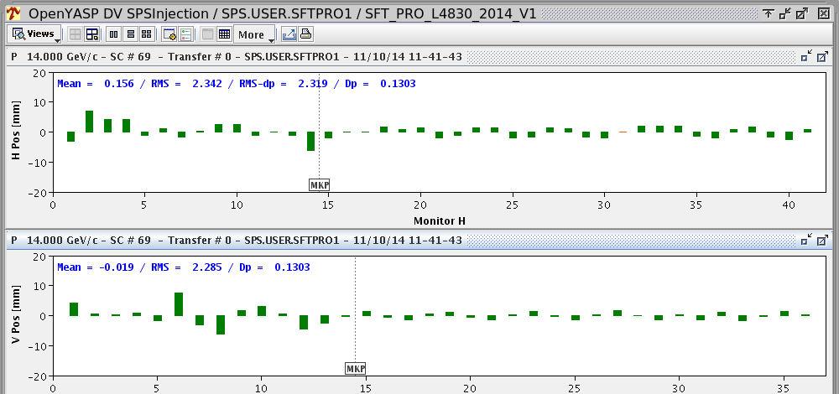
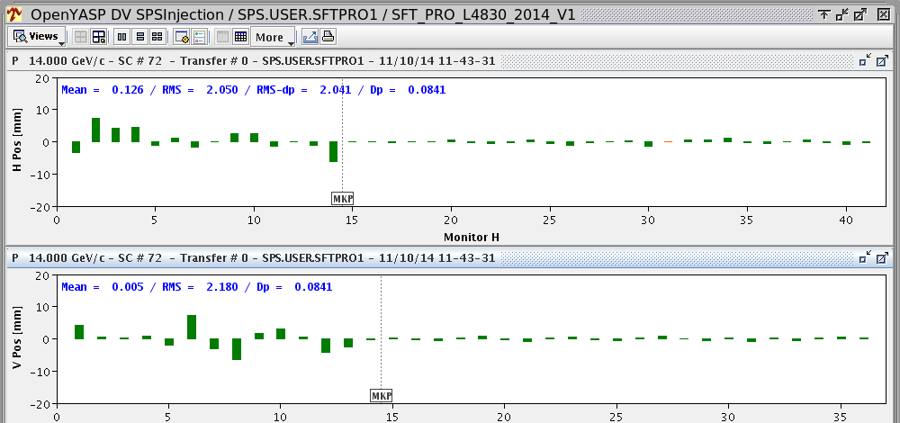
Beam trajectory steering application
Horizontal plane
Vertical plane
Injection line trajectory
Difference of first turn wrt closed orbit for sextants 1 and 2
Corrections converge cycle by cycle to minimise injection oscillations
*

Slide 10
Beam trajectory steering application
Injection oscillation corrections:
2000 ~20-30 mins
2014 ~3-4 mins
Horizontal plane
Vertical plane
Corrections converge cycle by cycle to minimise injection oscillations
Notes:
Another advantage is the possibility of parallel operations so we can be optimising steering on targets for the north area fixed target program whilst correcting injection oscillations for the cycle destined for the LHC

Slide 11
Beam trajectory steering application
Parallel optimisation is also possible.
e.g. re-steer all 3 north area targets whilst correcting injection oscillations on the cycle destined for the LHC
Horizontal plane
Vertical plane
Corrections converge cycle by cycle to minimise injection oscillations
Notes:
Another advantage is the possibility of parallel operations so we can be optimising steering on targets for the north area fixed target program whilst correcting injection oscillations for the cycle destined for the LHC

Slide 12
Auto tune and chromaticity measurement and correction
Measurement of tune throughout cycle
Previously only point by point - laborious
Non destructive. Excitation not always necessary
Benefits
Fast …gets us quickly up and running
…but again not foolproof! Need to understand what’s behind to be able to take advantage of its labour saving potential
…and invariably needs fine tuning the old fashioned way after

Slide 13
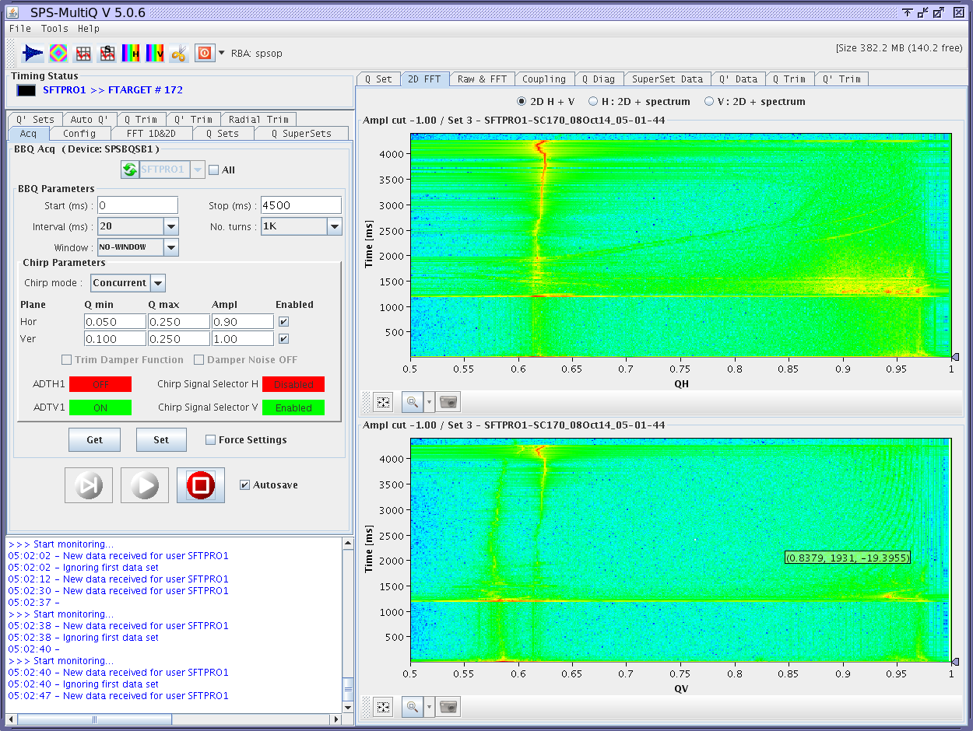
Horizontal tune
Cycle time
0.62
Tune value
(Decimal part)
Vertical tune
0.58

Slide 14
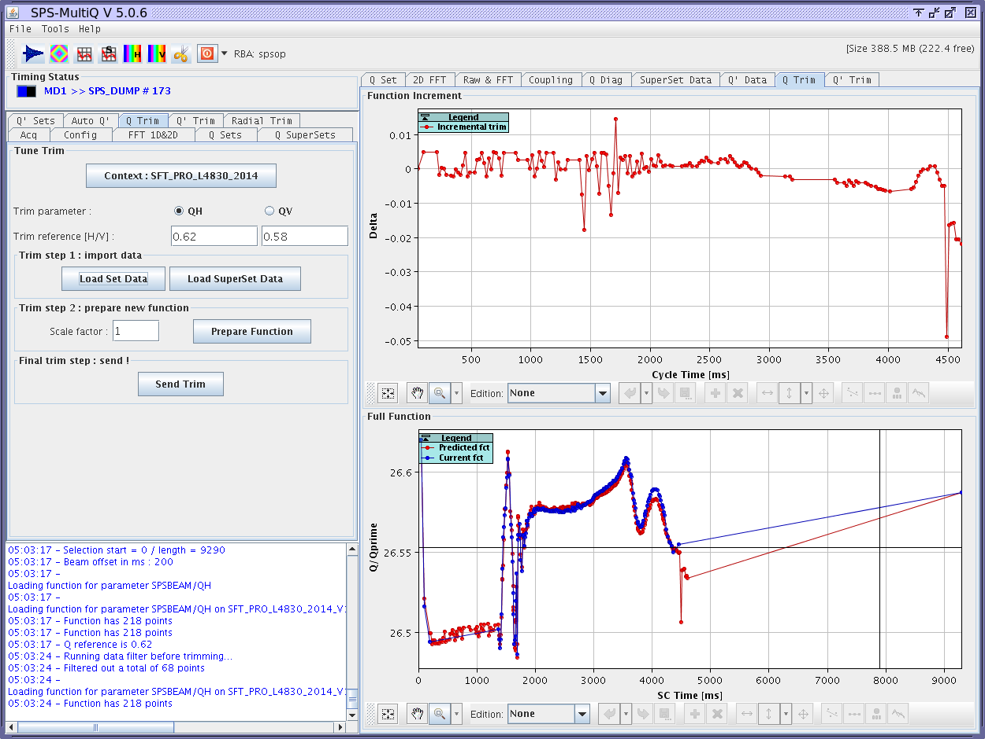
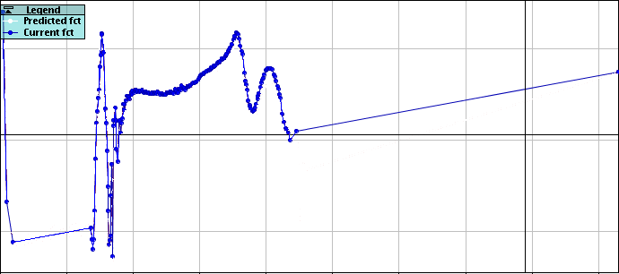
Difference between measured tune and theoretical tune
current tune function
Proposed correction often requires manual adjustment by an experienced hand before sending to hardware
Proposed correction

Slide 15
Difference between measured tune and theoretical tune
Tune measurement and correction throughout cycle at 10ms intervals:
2000 ~1-2 hours
2014 ~10 mins
current tune function
Proposed correction often requires manual adjustment by an experienced hand before sending to hardware
Proposed correction

Slide 16
Task sequencer
Good for repetitive tasks such as:
Preparation of zones for personnel access
Change of machine configuration e.g. cycling to coast beam
Switch to economy settings in temporarily unused areas
With more sequences currently under development
Benefits:
Same sequence every time – can avoid unnecessary written, manual procedures
Same results regardless of operator – no variations
Avoids the necessity that everyone is informed of and remembers changes!

Slide 17
Task sequencer
A sequencer has existed in one form or another for many years in the SPS
New sequencer inherited from LHC with greater functionality and flexibility
The sequencer is still in its infancy in the SPS but is gaining ground rapidly
Increased use of the sequencer is encouraged by management

Slide 18
Task sequencer
Functionalities:
Controls middleware – set and get values to and from equipment
Function database – Can revert to a function saved in history
Power converter controls – Change of state: ON, OFF, ECONOMY
Timing events – enable, disable, adjust delays
Software interlocks – mask, unmask, unlatch

Slide 19
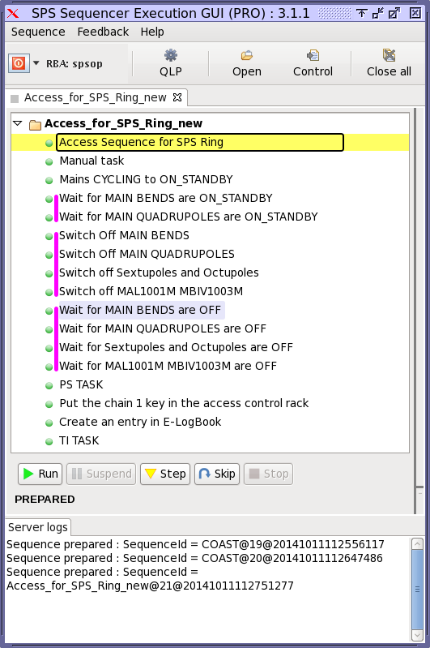
Typical access sequence

Slide 20
A well designed sequence will execute all tasks as foreseen…but the sequencer gives us the option to:
Run: Execute all tasks sequentially
Suspend: Pause a running sequence
Step: Execute a single task
Skip: skip a task
Stop: Stop a running sequence
In addition, sequence details remain visible and (in rare cases) editable if the need arises

Slide 21
Losing skills?
The operator’s skill set has evolved along with the machine
Today’s operators perhaps would not be as immediately adept in performing the tasks that were day-to-day jobs 10-15 years ago
…but the focus has moved and the management of priorities now plays a large part in a multi-cycling machine
Evaluating and changing machine user configuration to optimise beam availability to users
Operations has not become “easier” despite the advent of automation
Notes:
The requirements from operators has moved with the evolution of the machine

Slide 22
Maintaining skills and motivation
Each operator is given a specialisation
This is Diego, a young operator responsible for managing, maintaining and implementing new sequences
He and fellow operators on the front line identify areas where automation could be of interest
Operations conceive, create and edit sequences
Good way for newer operators to understand the underlying processes

Slide 23
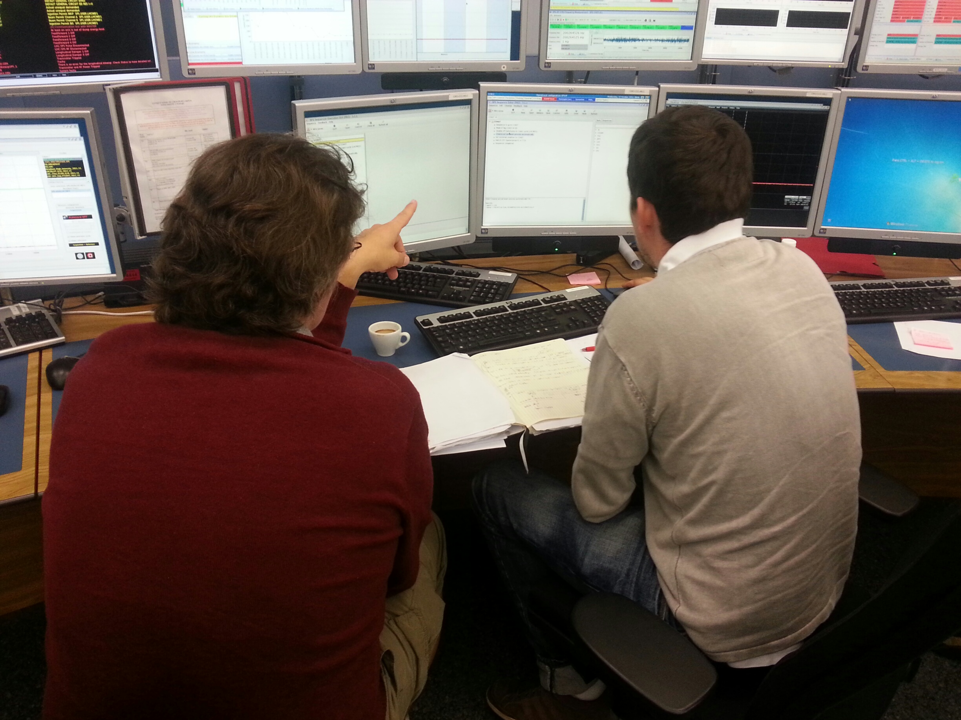
Maintaining skills and motivation
To maintain skill levels operators are actively involved with:
Machine re-commissioning
Set-up of new beams
Machine development sessions
All are examples of when automation may not be ideally suited or easily applied
Notes:
Machine re-commissioning –
Since the LHC now more or less imposes shutdowns machines are stopped for greater periods with more work executed in the tunnel
Setting up of new beams –
new multi turn extraction schemes from the PS
Ion beams Argon – Lead in the past, Xenon in the future
Coasting beams
Doublet beams for scrubbing
etc

Slide 24
Operator feedback
Operators have pride in the good functioning of their machine and are motivated to improve efficiency and performance
Automation is often seen as an effective means to do so
Automation can mean less time is spent on “mundane” tasks
Meaning greater availability for more rewarding and stimulating work
Operators do not currently feel threatened by automation
…as long as operations are involved in how it’s implemented

Slide 25
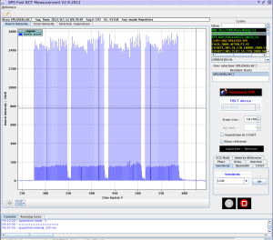
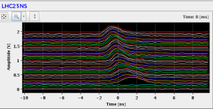
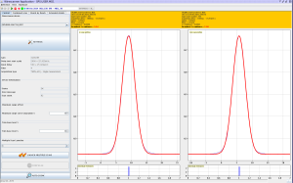
The future?
A large amount of our time is spent for measurement and fine tuning of LHC beams
Bunch intensity and structure
Longitudinal parameters
Transverse emittance
Critical for LHC luminosity!

Slide 26
Conclusions
Some level of automation is essential for modern accelerator operations
Automation tools are not necessarily straightforward and often require a well-trained operator to get best results
Operator’s skillset has evolved in line with the machine
Despite the assistance of automation operation is not easier today than it was 10-15 years ago
Operators should continue to be implicated in it’s implementation

Slide 27
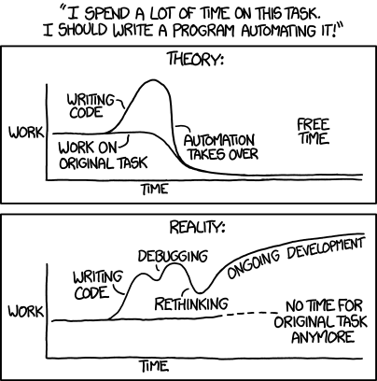
Thank you for your attention
http://xkcd.com/1319/

