Slide 1
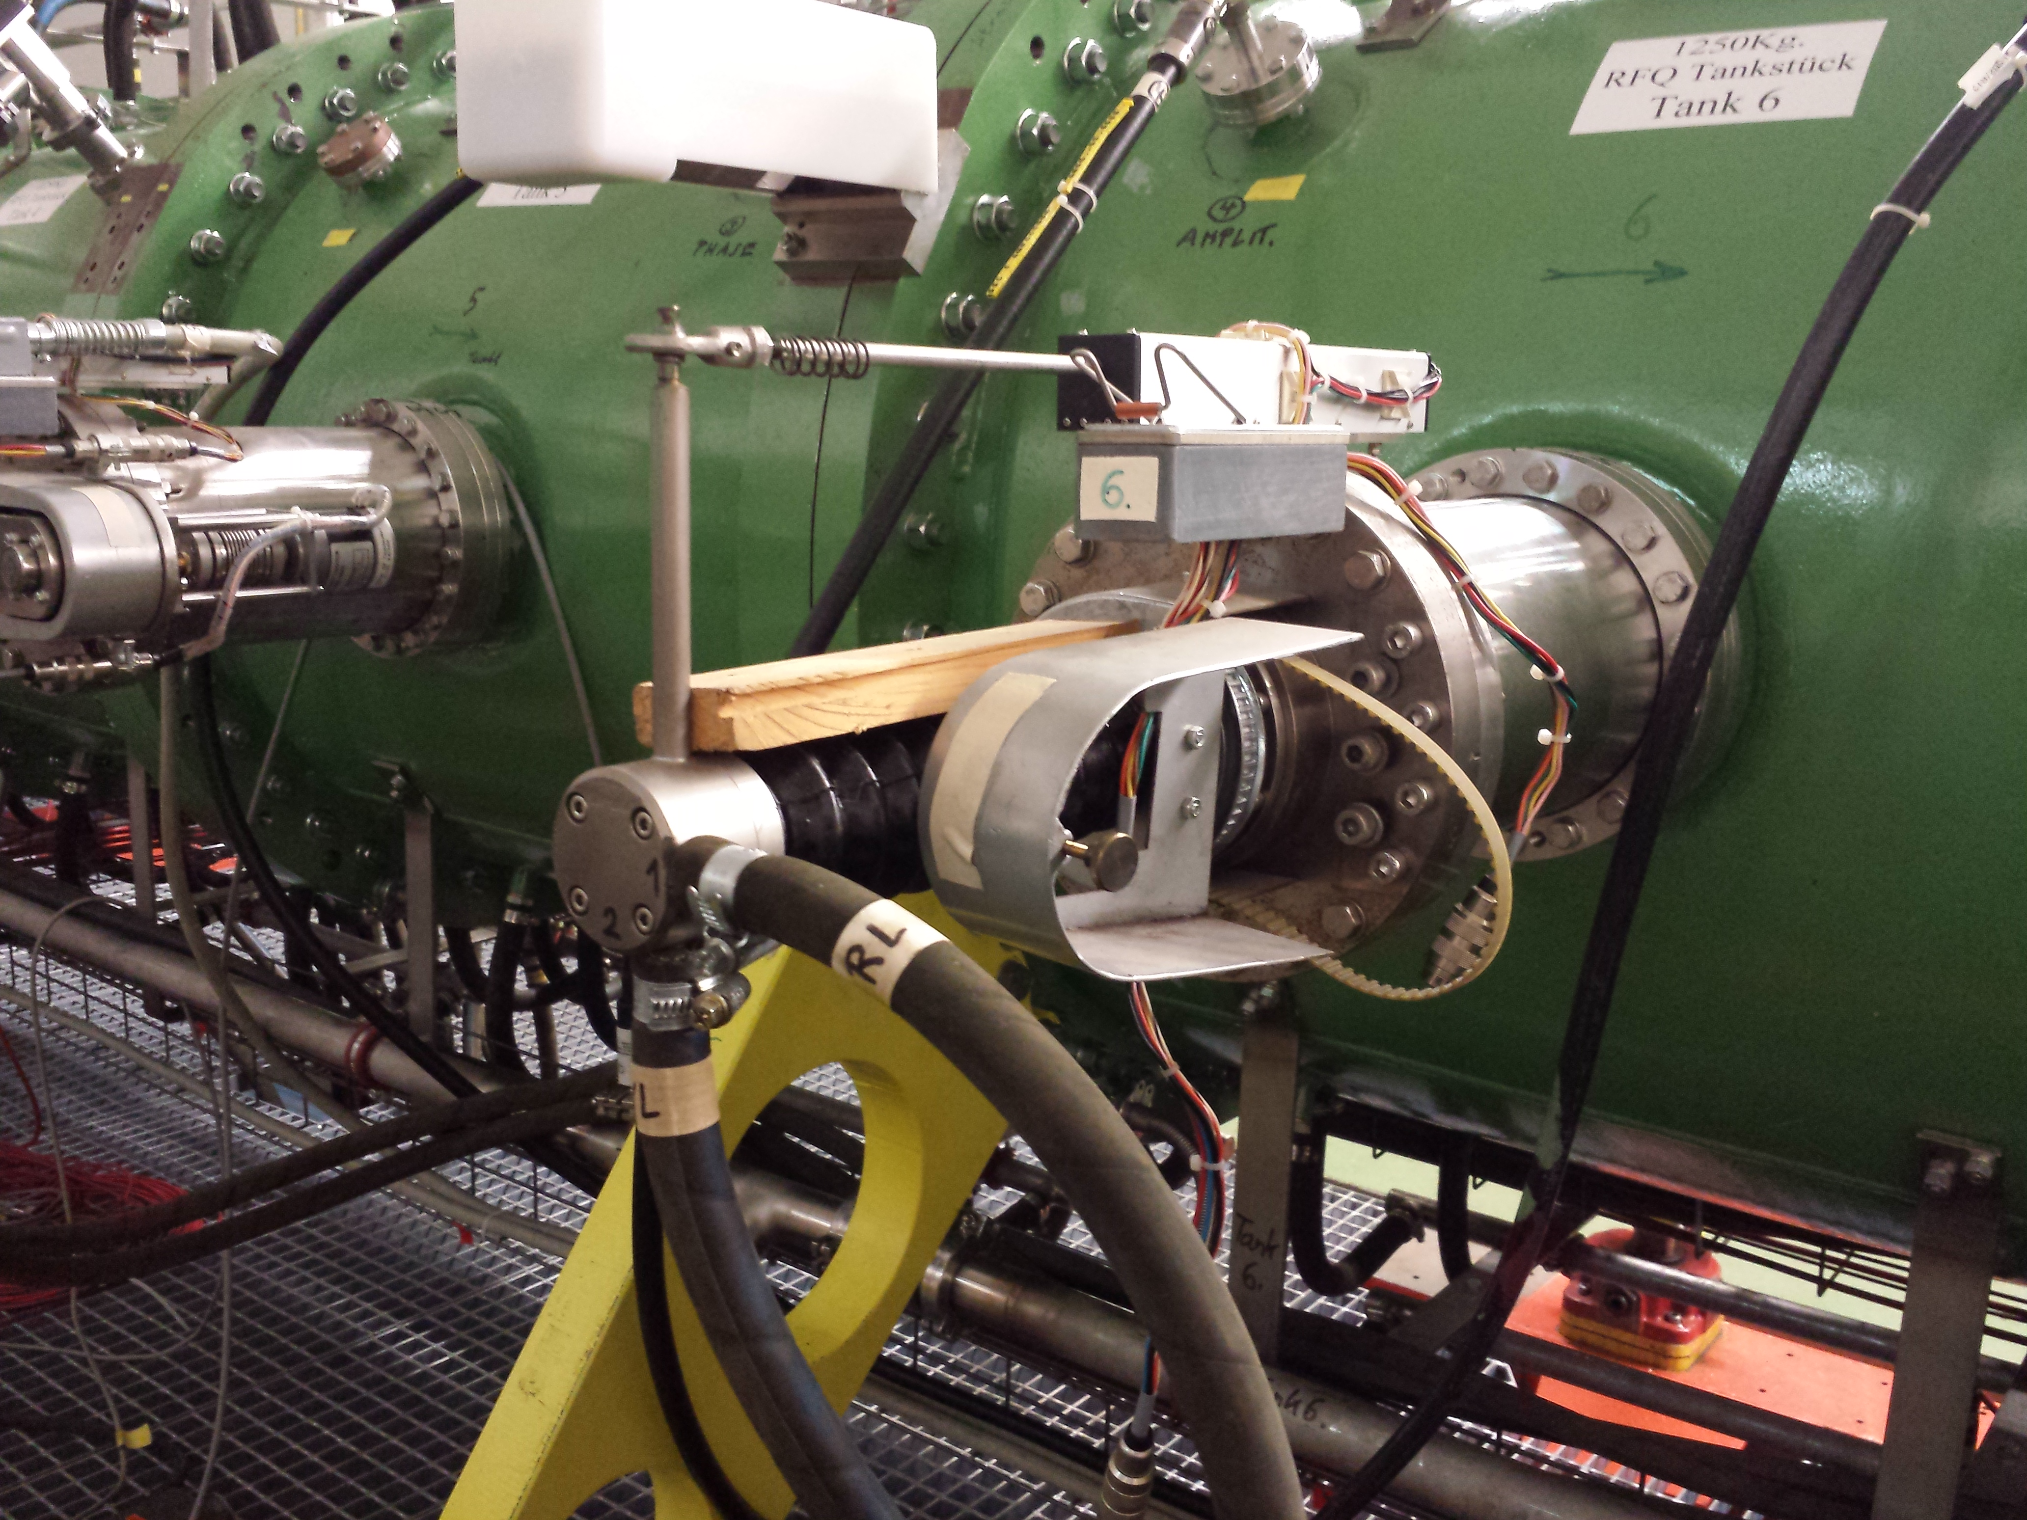
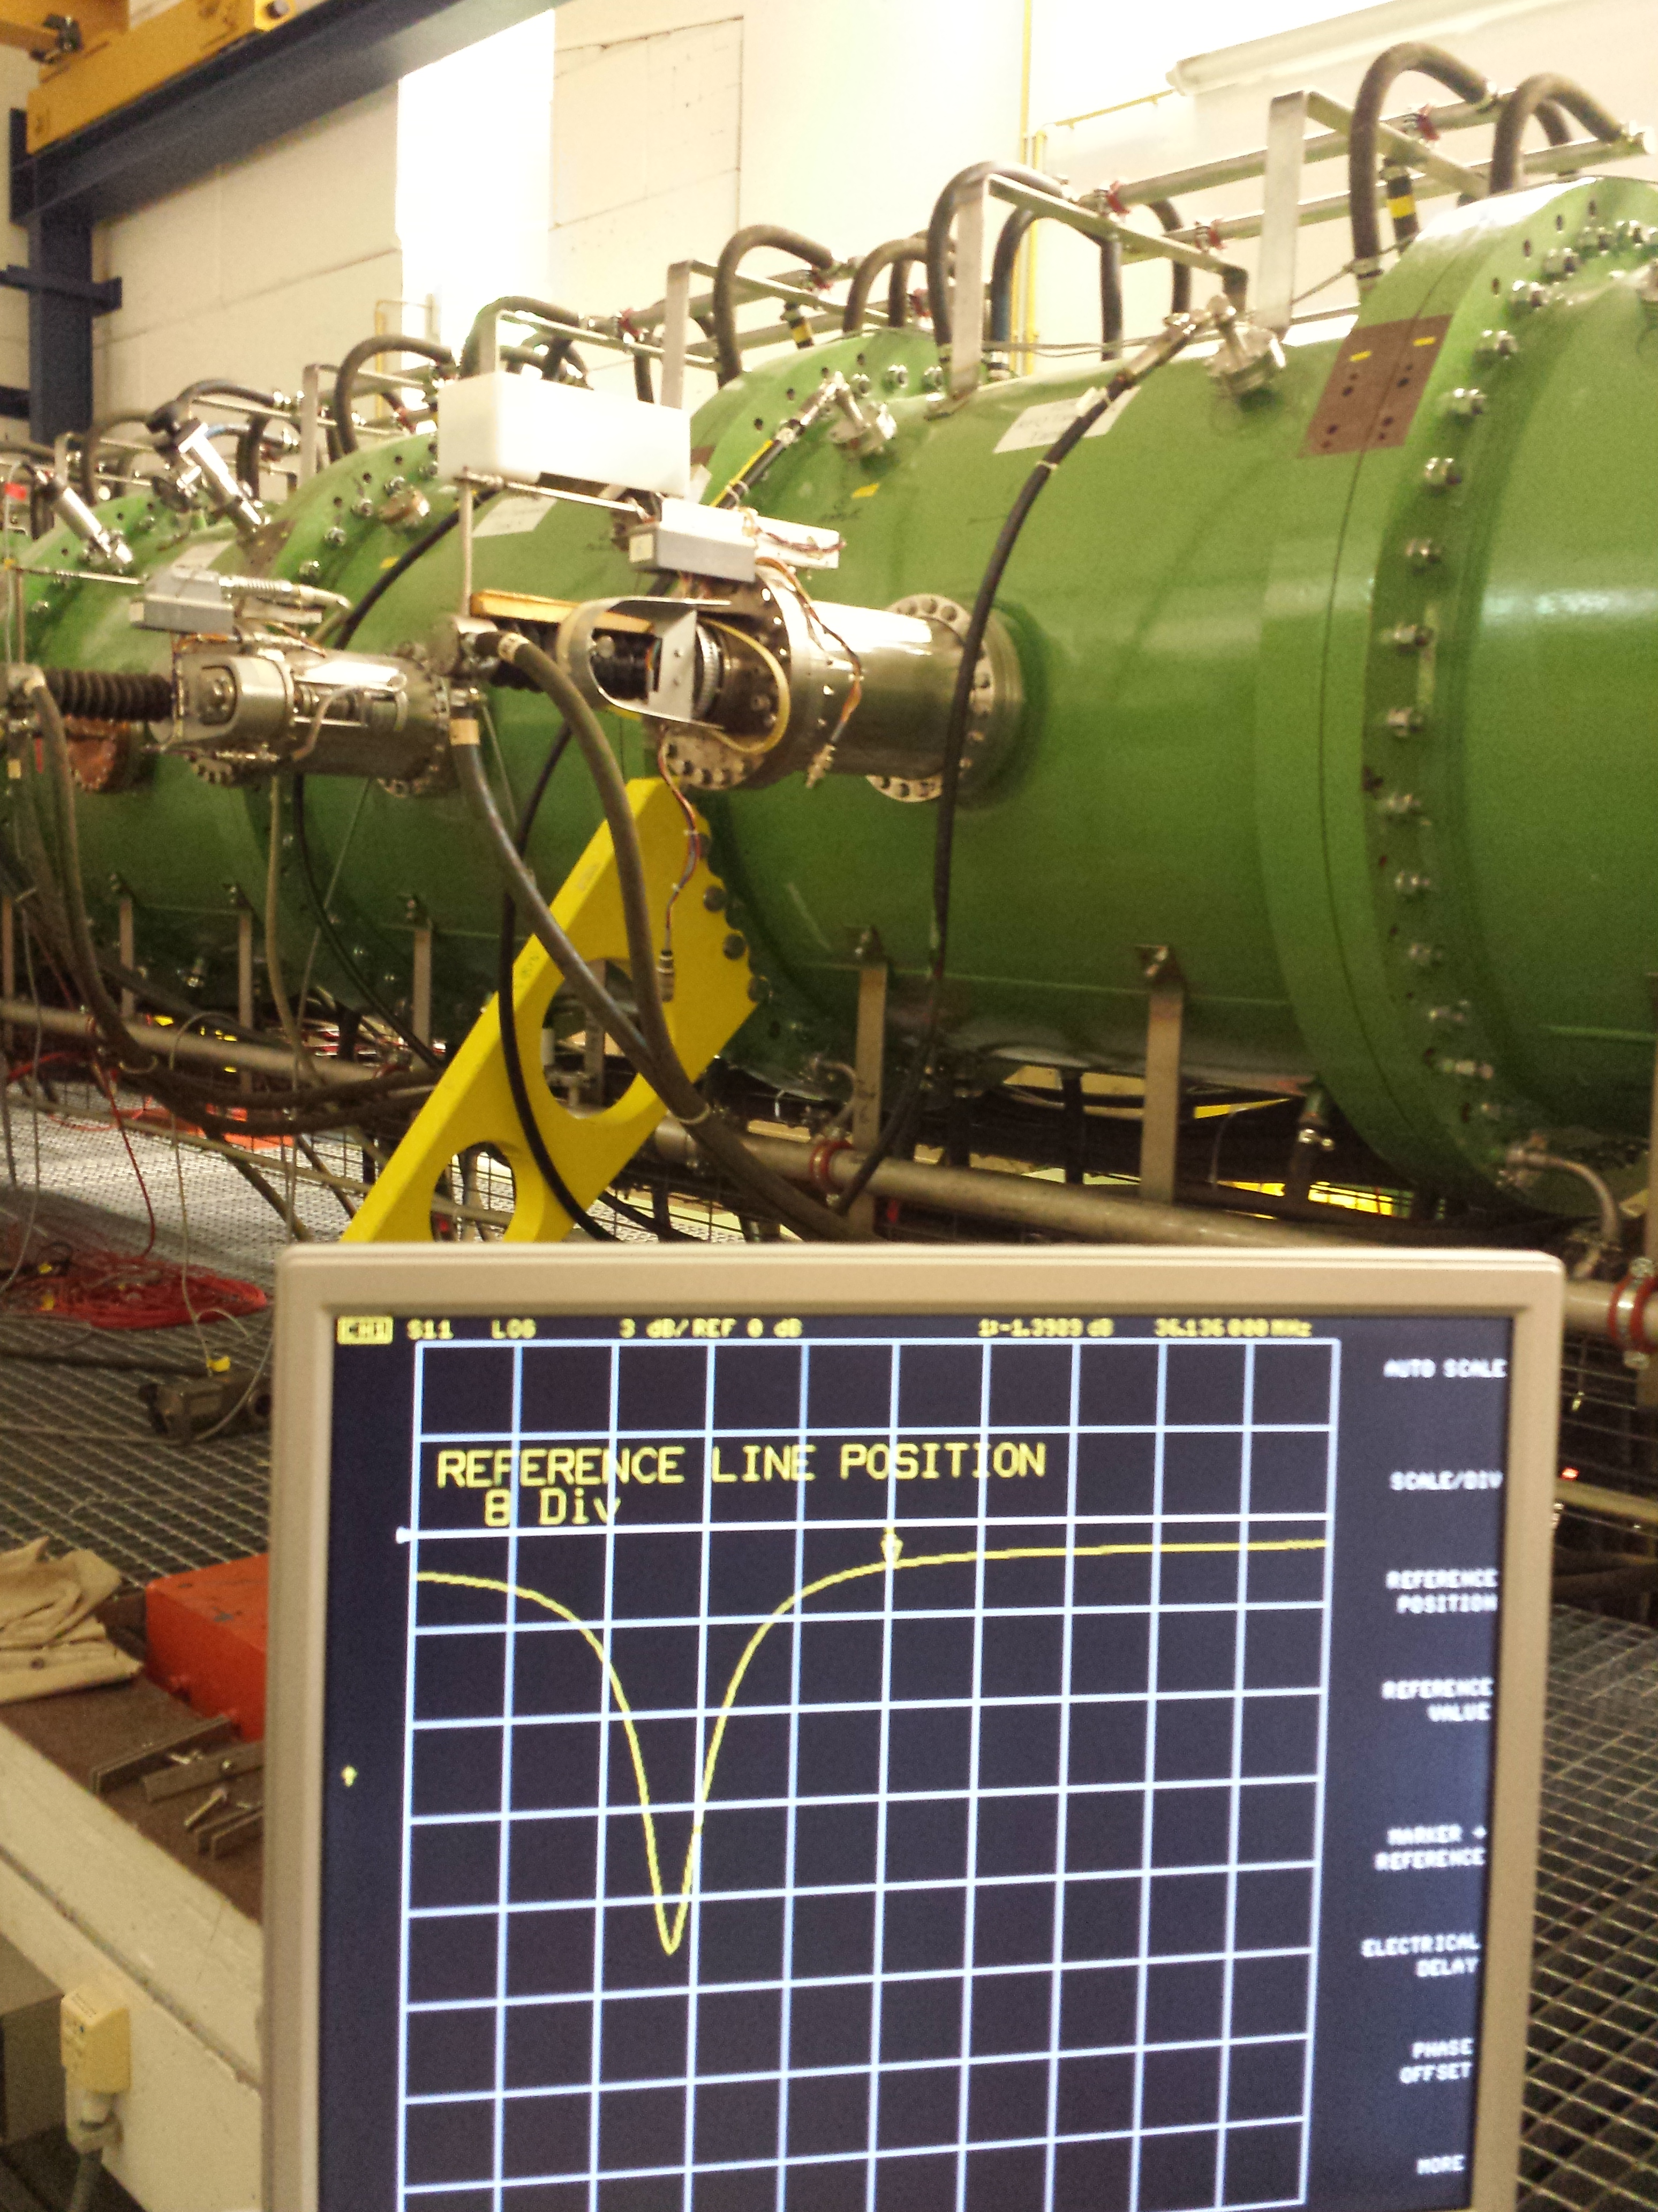
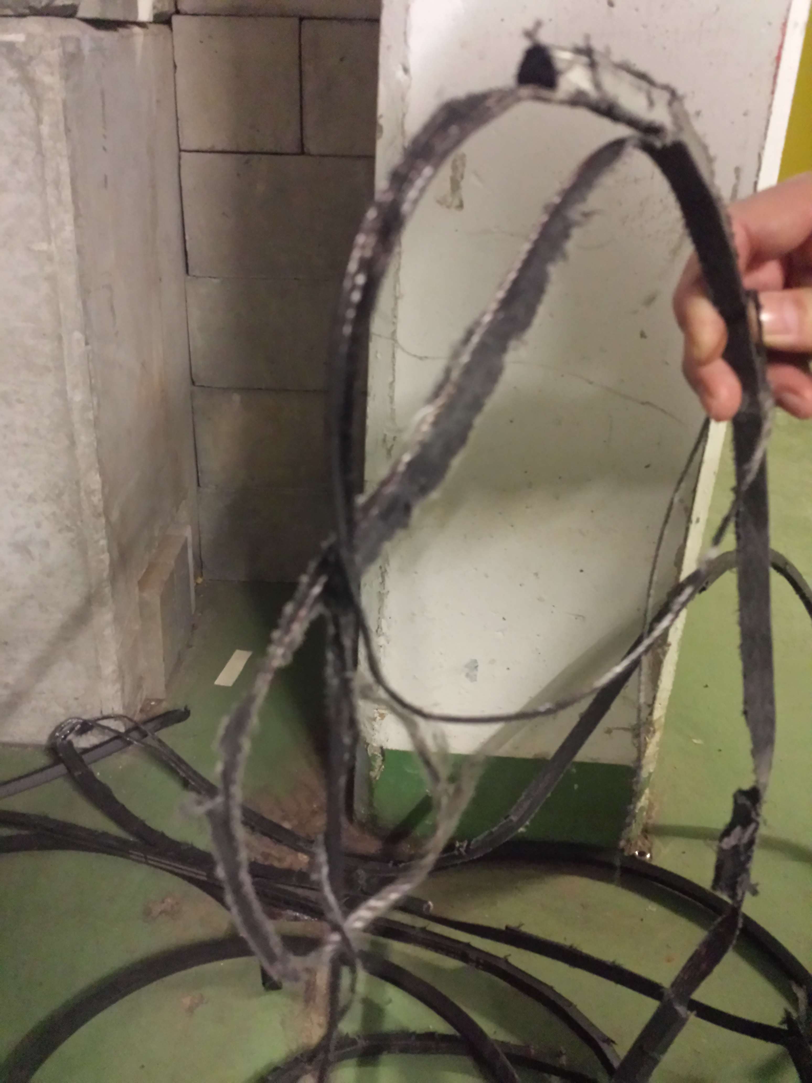
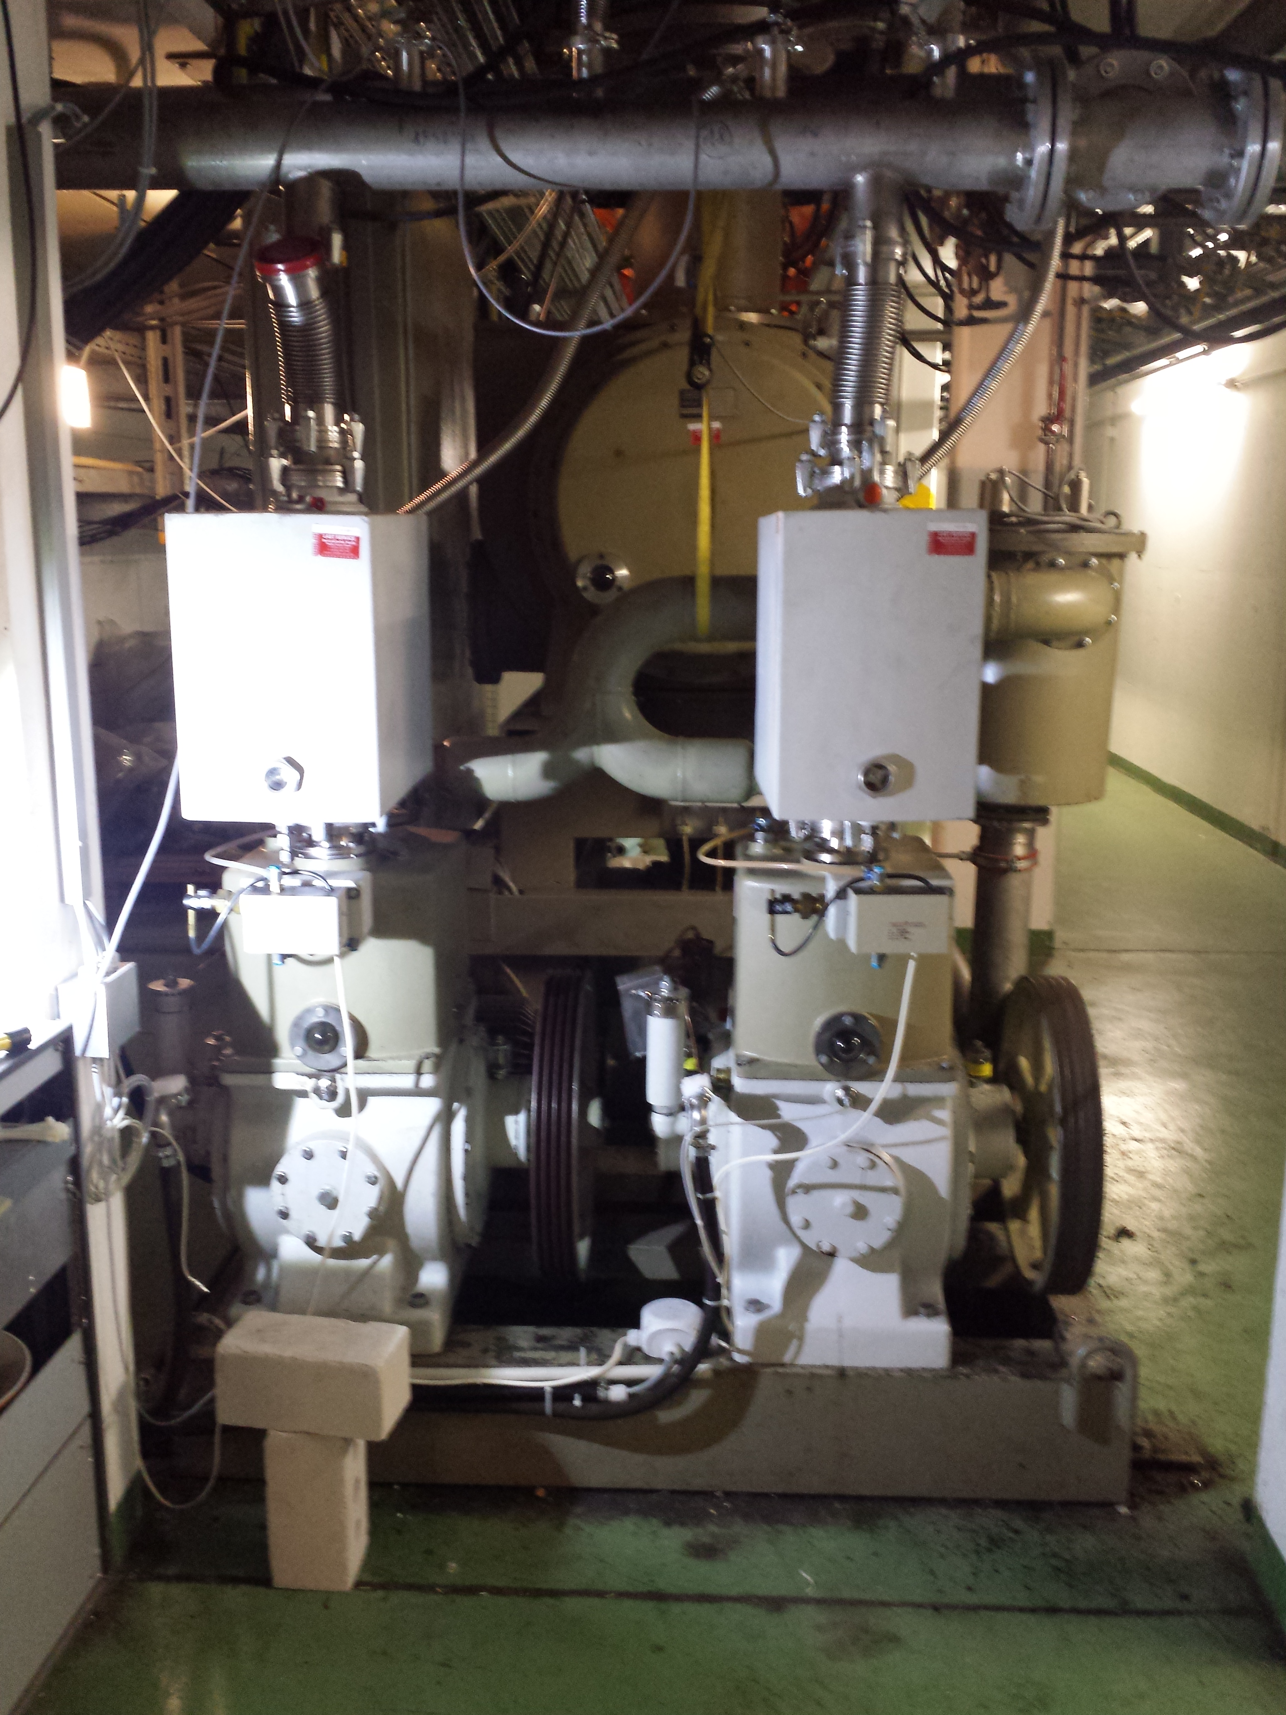
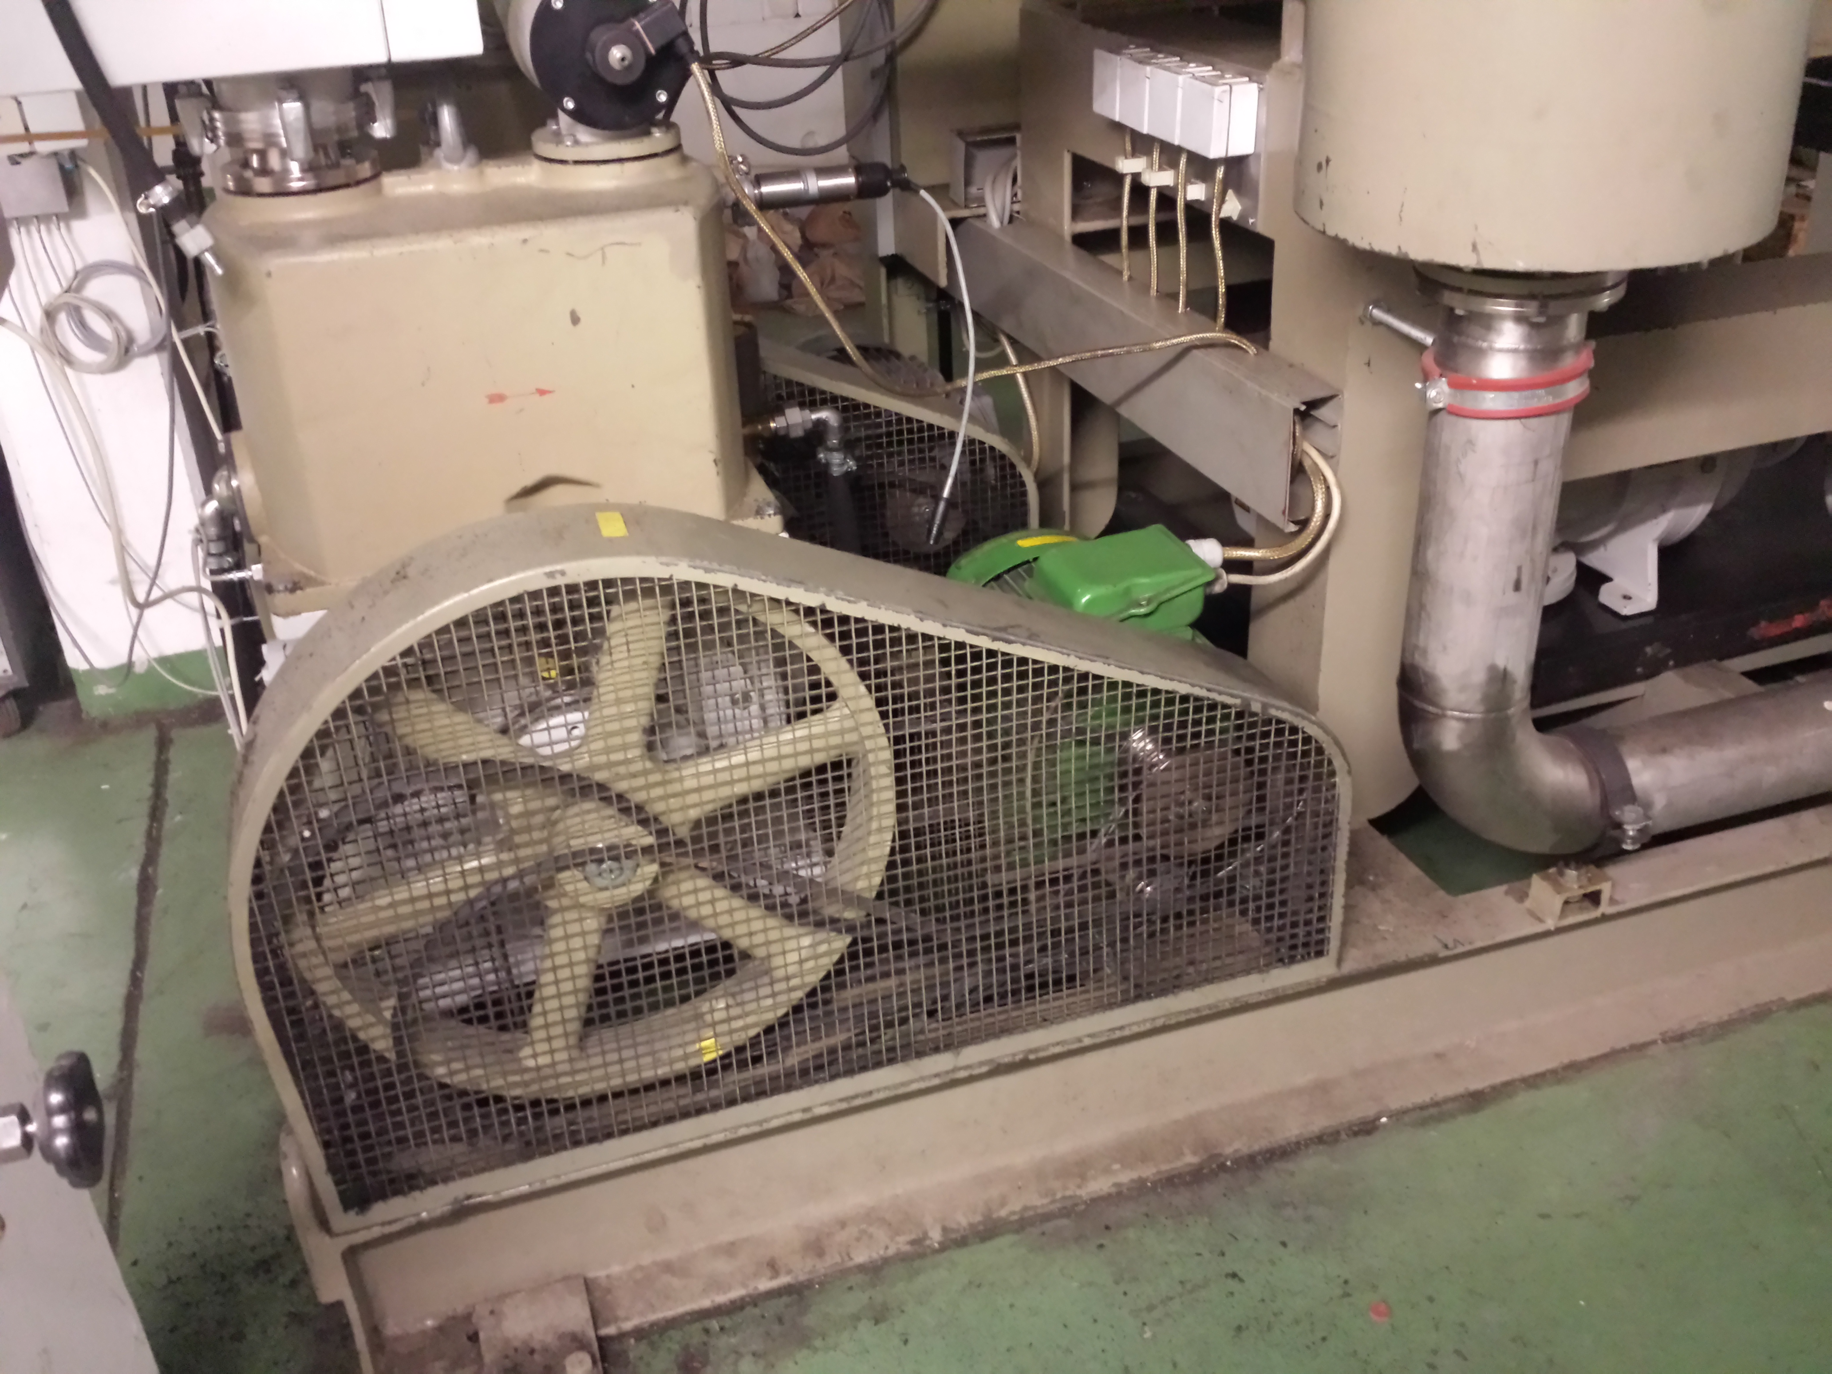
Unilac – 28.01.2020
HSI-RFQ:
  Conditioning ongoing.
  Try improved plunger setting now
Gas stripper roots pump:
  All V-belts of the rotary vane pumps broken, at least one rotary vane pump broken
  Repair foreseen for Tuesday+Wednesday (today +tomorrow), incl. replacement of the broken pump by a spare pump.

