Slide 1
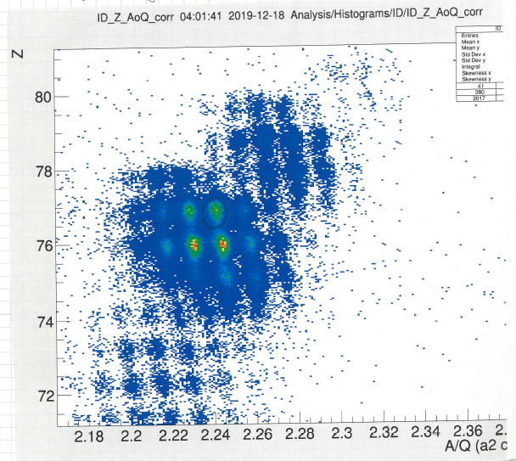
Status FRS
Summary engineering run
primary beam to HFS, FRS-HTC, FRS-ESR
Ar fragment to HFS and FRS-HTC,
U projectile fragment to HFS
in-flight PID
Tagging of U fragment with DESPEC and FRS-IC analysis ongoing
visualization of optic + refitting + beam steering
Training/learning: every day useful, still an issue
Not demonstrated: unambigous PID fission fragment
U projectile fragments

Slide 2
Shutdown work 1
Ta+S1:
Target ladder #2: is repaired
alignment TA-area is ongoing
cabling work for TOF upgrade ongoing
S2:
crane rail mounted
removed leaking detector pockets (MW21+22)
new degrader plates – still to do
Experiment installation S2 in air – is ongoing

Slide 3
Shutdown work 2
S3 Alignment tpc31 - done
S4
patch-panel, trigger cable
sc41+42
S6
vacuum pocket
installation CGs
Scraper
S8
gate valve - ongoing
magnet cooling water interlock - ongoing

