Slide 1
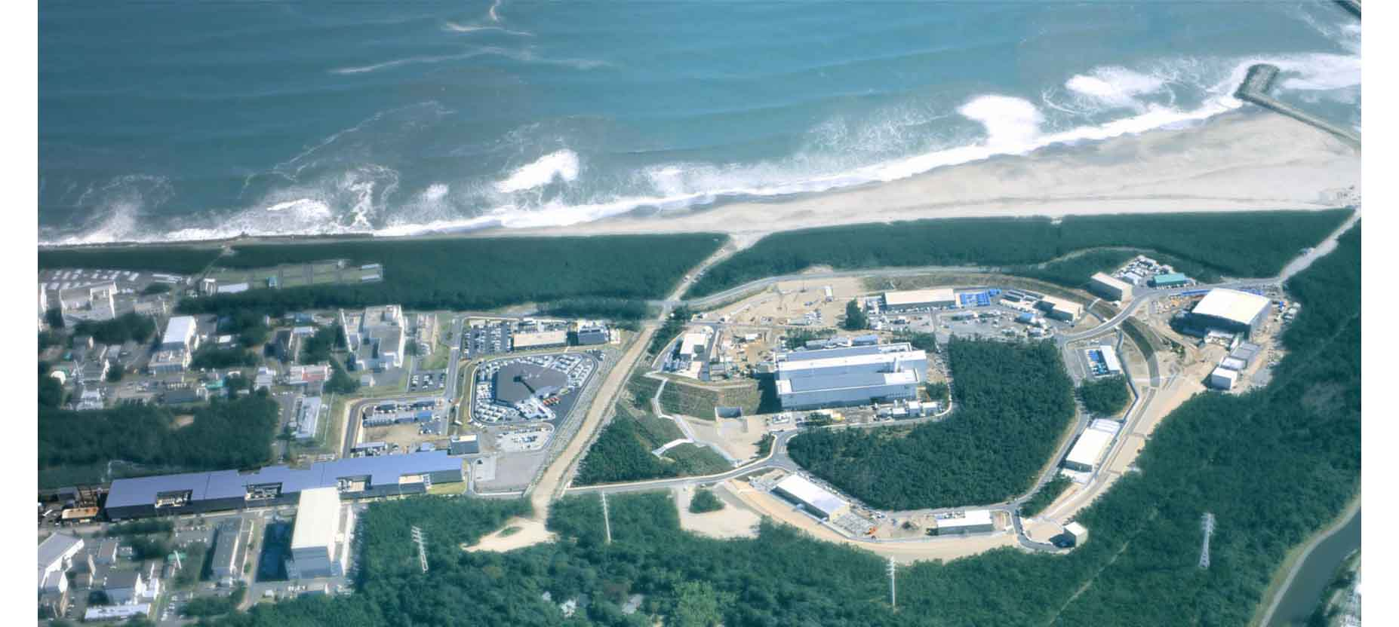
2023.7.3
EMMI workshop
Strangeness Nuclear Physics
--Personal View for Future Directions--
H. Tamura
Tohoku University / Japan Atomic Energy Agency

Slide 2
Contents
1. Introduction – neutron stars and BB interactions
2. Present status – S=-2 systems at J-PARC
3. Future plan 1 --- ΛNN interaction
4. Future plan 2 --- In-medium baryon modification
5. Summary

Slide 3
  Introduction
  --Neutron stars and the hyperon puzzle

Slide 4

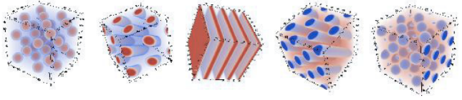

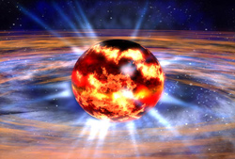
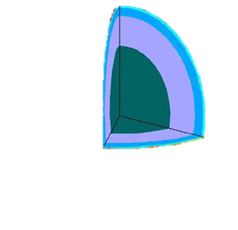
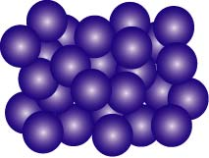

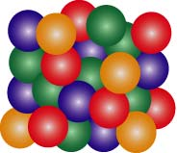
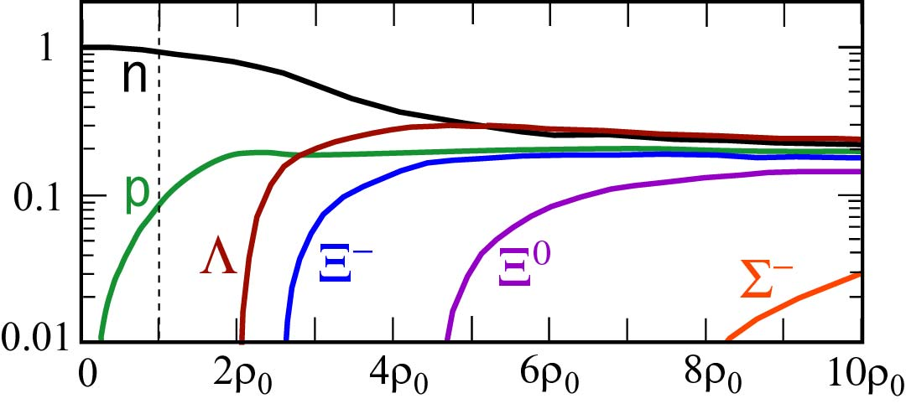

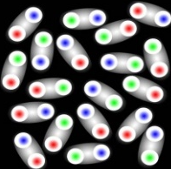
4/25
Mistery of matter in neutron stars
Outer crust
Neutron-rich
nuclei
Inner crust
Pasta nuclei
Outer core
Neutron Matter
n
C. Ishizuka et al., J.Phys.G 35 (2008) 085201
EOSY: U_{Λ}= -30 MeV, U_{Σ} = +30 MeV, U_{Ξ} = -15 MeV
assumptions based on experimental suggestions
Inner core
Hyperon Matter
(Strange Hadronic Matter)
d
p
n
baryon fraction
Λ
Ξ
?
?
Inner core
Deconfined
Quark Matter
??
ρ （density）
Hyperons (Λ, Ξ⁻) should appear at ρ ~ 2-3 ρ₀
Sensitive to YN, YY interactions

Slide 5
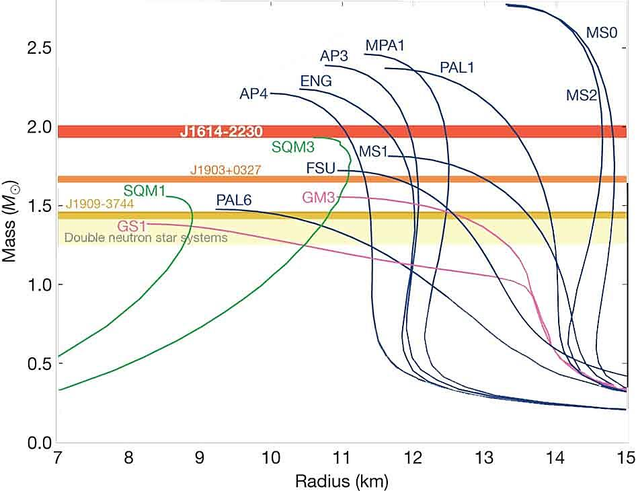
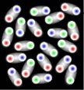
5/25
Inconsistency with observation – “hyperon puzzle”
EOS’s with hyperons are too soft to support massive NS’s of >1.5 M_{sun}.
2.0 M_{sun} neutron stars are observed.
Present nuclear physics has almost no predictive power for > ρ₀
1.97±0.04 M_{sun}
J1614-2230 (2010)
Ignore hyperons
How to solve the puzzle?
2.01±0.04 M_{sun}
J0348-0432 (2013)
Repulsive three-body force in NNN
=> Also in YNN, YYN, YYY ?
M
2.14±0.10 M_{sun}
J0740-6620 (2020)
but no clear experimental evidence
+Hyperons
NS mass
Phase transition to quark matter?
(hybrid star)
Quark matter
Λ
??
n
n
?
p
NS radius (km)
Ξ
YN, YY interactions in (dense) nuclear medium should be clarified.

Slide 6
6/25
BB interactions and NS: experimental status and plans
・ΛN int. in nuclei <= B_{Λ} / level data of ~40 Λ hypernuclei via (π,K⁺), (e,e’K⁺) / γ spectroscopy
・ΣN int. in nuclei <= Σ⁻ atomic data, ⁴_{Σ}He but no other Σ hypernuclei.
・ΞN, ΛΛ int. in nuclei <= Ξ, ΛΛ hypernuclei w/emulsion(J-PARC E07) / (K⁻,K⁺) spectroscopy (E70,E75)
Ξ⁻ atomic X rays (E03,E96)
BB int. in matter: much different from those in free space
strong density dependence
・ΛN, ΣN int. in free space <= Σp scattering (E40), Λp scattering (CLAS, E86)
・ΛN-ΣN, ΛΛ-ΞN int. <= light(A=3) /n-rich Λ hypernuclei, light ΛΛ/Ξ hypernuclei / Ξ atoms
・ΛNN int. (ρ dependence of ΛN) <= precise B_{Λ} / level data of light-to-heavy Λ hypernuclei
・ΛN, ΣN, ΞN, ΛΛ,... int. in free space (s wave) <= Femtoscopy w/ high statistics (ALICE)
Structure of baryons in matter: could be different from those in free space
・ Baryon modification <= Λ’s magnetic moment (E63), beta decay rate in nuclei

Slide 7
Present status
--- S=-2 systems at J-PARC

Slide 8
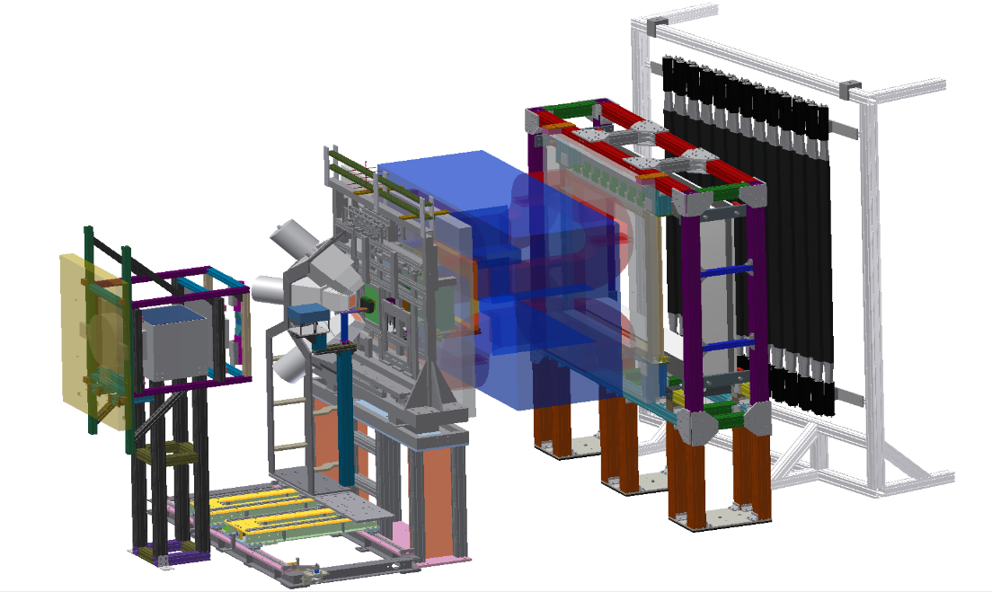
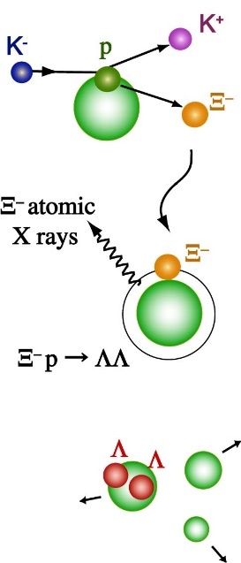

Emulsion experiment for double strange nuclei (J-PARC E07)
8/25
(Nakazawa, Imai, Tamura et al.)
K⁻ p → Ξ⁻ K⁺
Produce ~10² double strange (ΛΛ and Ξ) hypernuclei
+ study Ξ atomic X-rays
via emulsion-counter hybrid method
Target
K⁺
K⁻
SSD
1.8GeV/c
Ξ⁻
X-ray
TOF wall
Ge detector
Emulsion Sheets
Emulsion
Ξ−atomic X-rays
K⁺
ΛΛ hypernucleus
Ge array
Ξ⁻
Λ
Λ
K⁻
twin Λ hypernuclei
Beam exposure finished in 2017.
1st-stage emulsion analysis has been finished.
Magnetic spectrometer
# of S=-2 nuclei: 33 events in J-PARC E07 + 14 events in previous KEK experiments

Slide 9
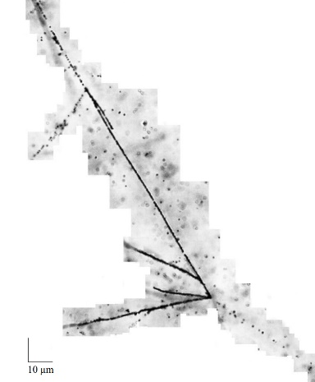
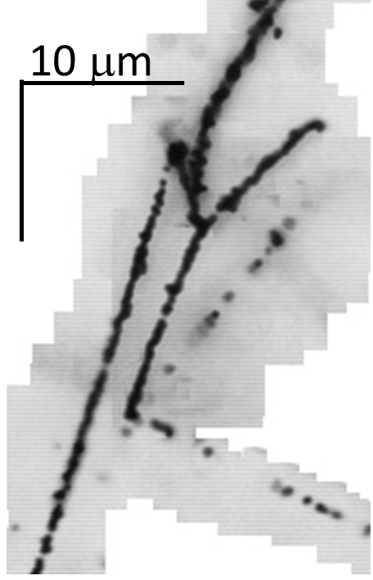
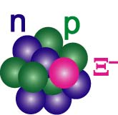
9/25
Doubly strange hypernuclei in emulsion
# of S=-2 nuclei: 33 events in J-PARC E07 + 14 events in previous KEK experiments
S. H. Hayakawa,
PRL 126 (2021) 062501
M. Yoshimoto et al.,
PTEP 2021, 073D02
IBUKI event
IRRAWADDY event
Ξ⁻
⁴He
Ξ⁻ + ¹⁴N →¹⁵_{Ξ}C
⁵_{Λ}He
K⁻ p → Ξ⁻ K⁺
⁵_{Λ}He
Ξ⁻
⁵_{Λ}He
¹⁰_{Λ}Be
20μm
¹⁵_{Ξ}C -> ⁵_{Λ}He + ⁵_{Λ}He + ⁴He + n
¹⁵_{Ξ}C -> ¹⁰_{Λ}Be + ⁵_{Λ}He
= 1.27 ± 0.21 MeV
= 6.27 ± 0.27 MeV

Slide 10
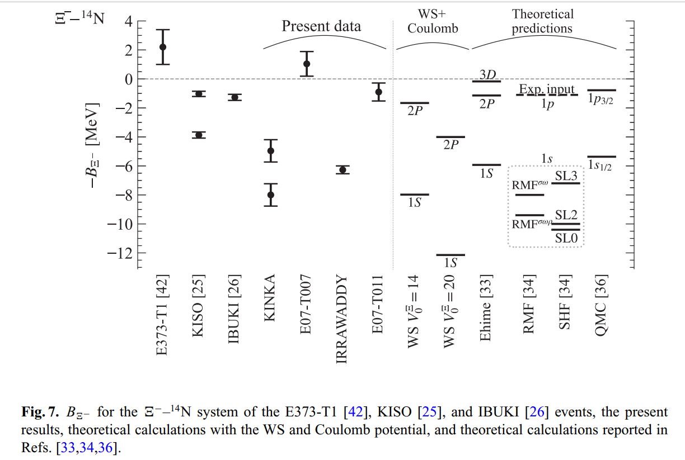
10/25
Observation of p- and s-state Ξ hypernucleus (?)
M. Yoshimoto et al., Prog. Theor. Exp. Phys. 2021, 073D02
¹⁵_{Ξ}C
Coulomb
p_{Ξ}
p_{Ξ}
or
Ξ⁻
s_{Ξ}
or
s_{Ξ}
Ξ⁻
Nuclear force
Mystery on ΞN→ΛΛ strength
Nijmegen SC models: Ξ absorption mainly from 3D orbit. 4%-0.3% from 2P orbit (T. Koike)
HAL QCD: ~ 1/10 of NSC -> 2P absorption comparable to 3D, but 1S absorption still negligible
m(Ξ⁻) - m(Ξ⁰) = 6.9 MeV => p(Ξ⁰) state via Ξ⁻−Ξ⁰mixing? (Gal-Friedman, PLB 837 (2023) 137669)

Slide 11
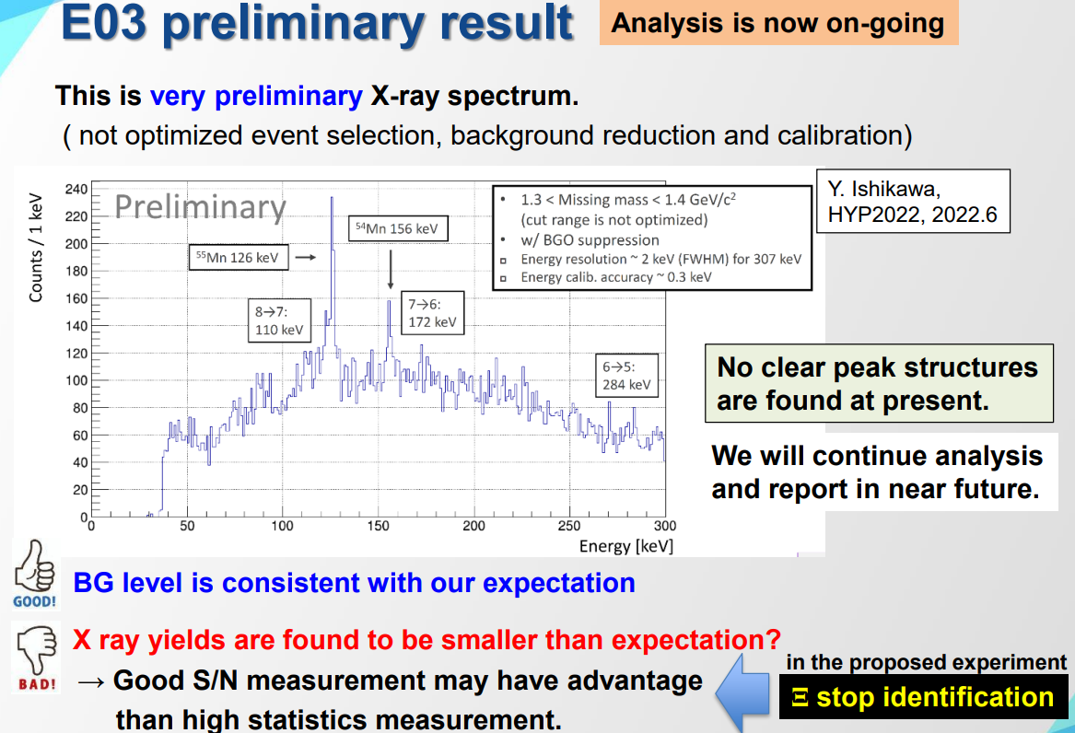
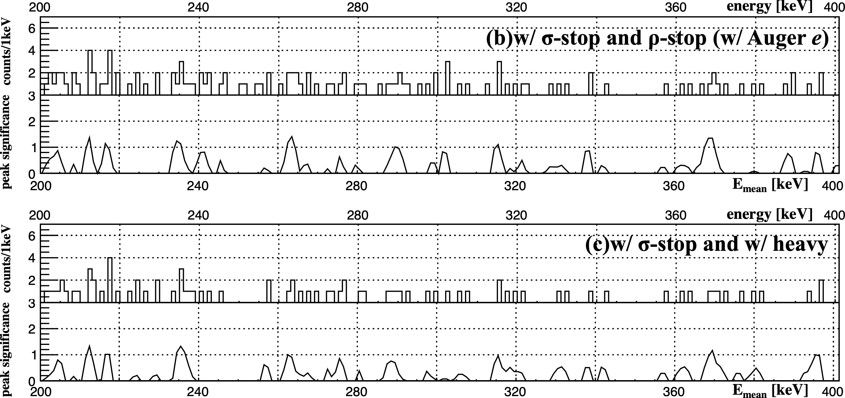
More S=-2 studies (under analysis)
11/25
Ξ⁻ atomic X-rays (E07, E03)
E07 “Reaction-Xray-Emulsion” triple-coinc. hybrid method
E03: Ξ⁻ stopped in Fe (dense) target
M. Fujita et al, PTEP 2022 (2022) 123D01
Br (8→7)
206 keV
Ag (9→8)
255 keV
Br (7→6)
316 keV
Ag (8→7)
370 keV
Ξ absorption events selected via emulsion image analysis
Background reduced by 1/170.
H dibaryon search via H->ΛΛ (E42)
X-rays not observed yet at present
X-ray yields: much lower than calculation.
¹²C(K⁻,K⁺) H + X, H→ΛΛ, ΞN with fast TPC.
Data successfully taken in 2021, under analysis

Slide 12
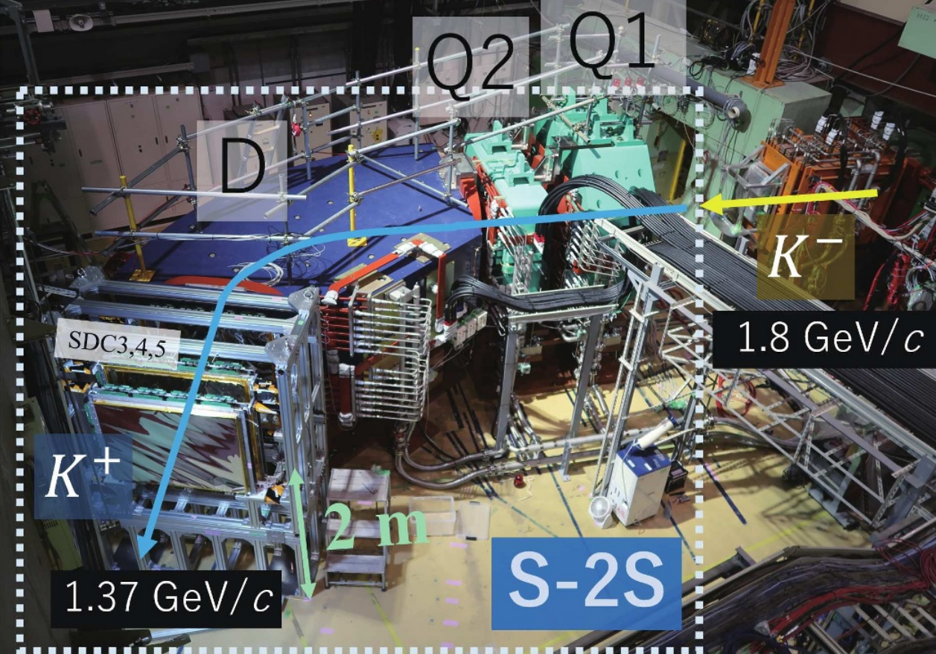
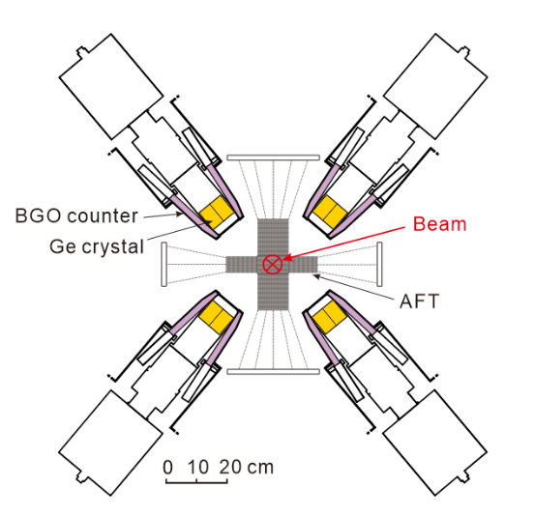
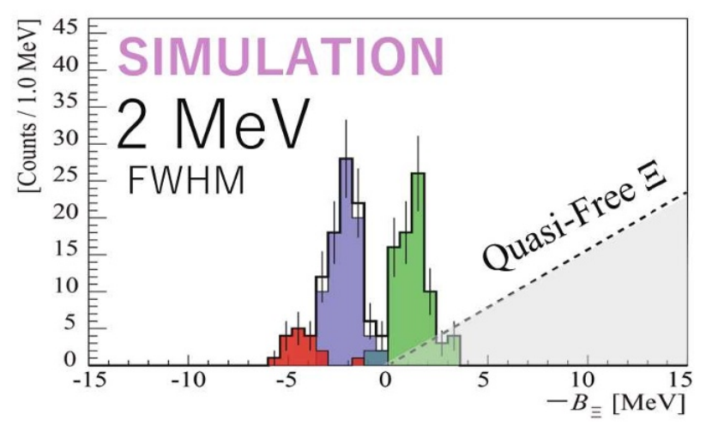
12/25
New experiments have started
E70: ¹²C(K-,K+)¹²_{Ξ}Be
E75: ⁷Li(K-,K+)⁷_{Ξ}H
J-PARC E96:
¹²C Ξ atomic X-rays
Active Fiber Target
-> potential
Energy loss correction
4F
Stopped Ξ selection
abs
3D
T. Gogami et al.,
EPJ Web of Conf. 271, 11002 (2022)
Commisioning run
last week
energy shift
2P
yield ratio
-> ΞN→ΛΛ width
abs

Slide 13
3. Future Plan 1
---ΛNN three-body force

Slide 14
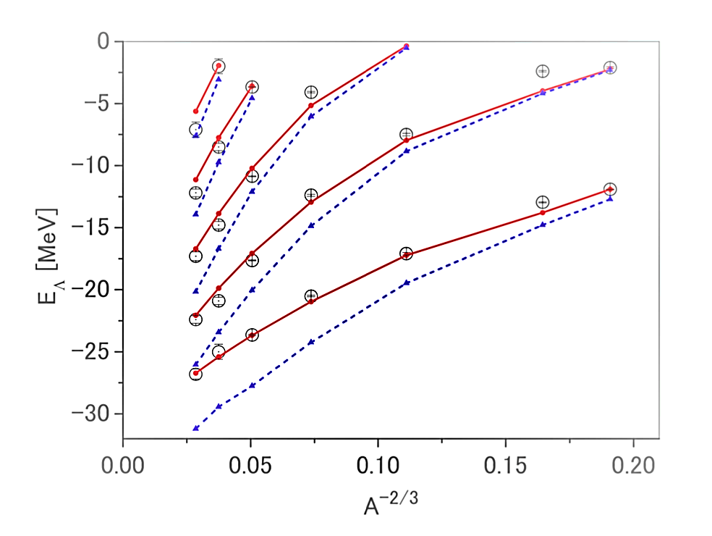
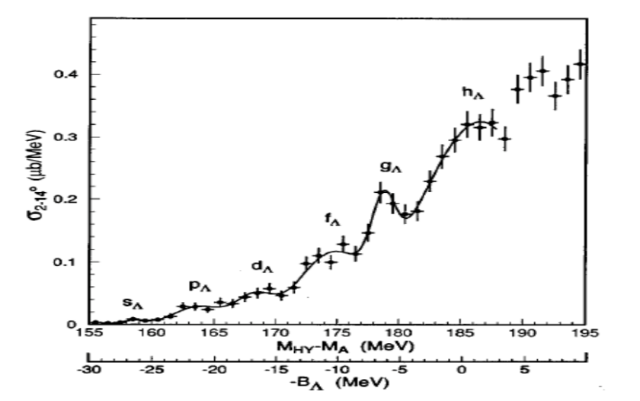
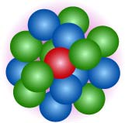
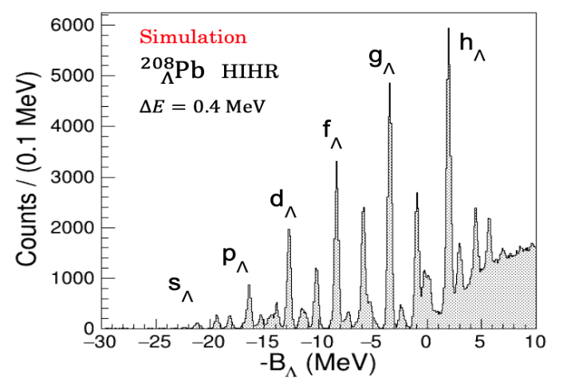
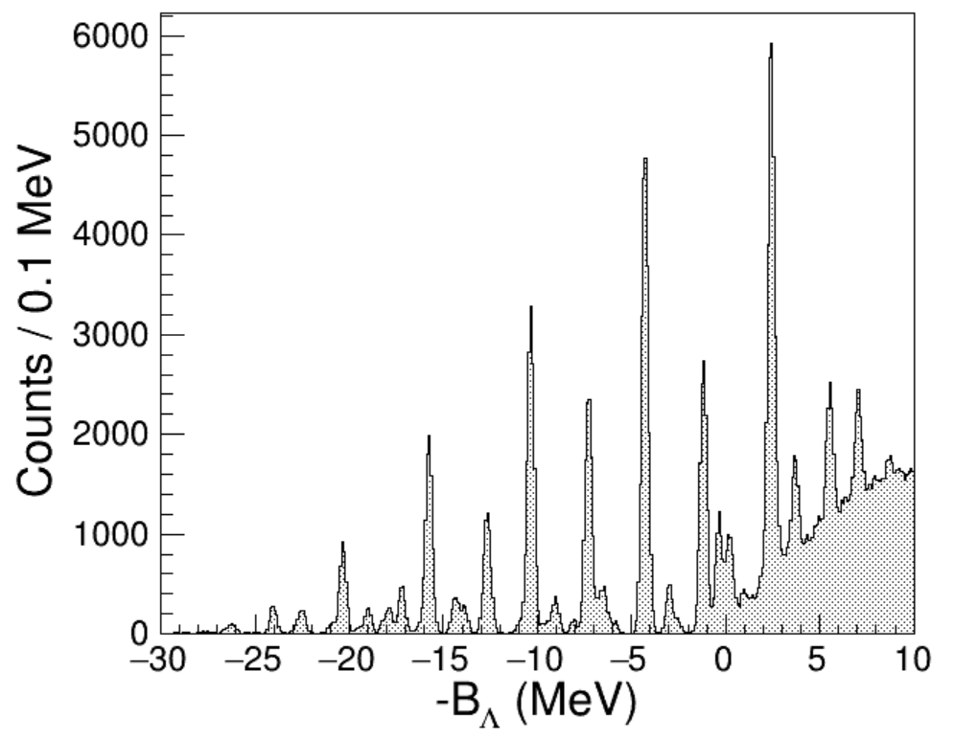
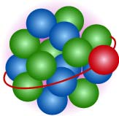
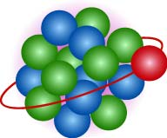
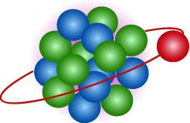
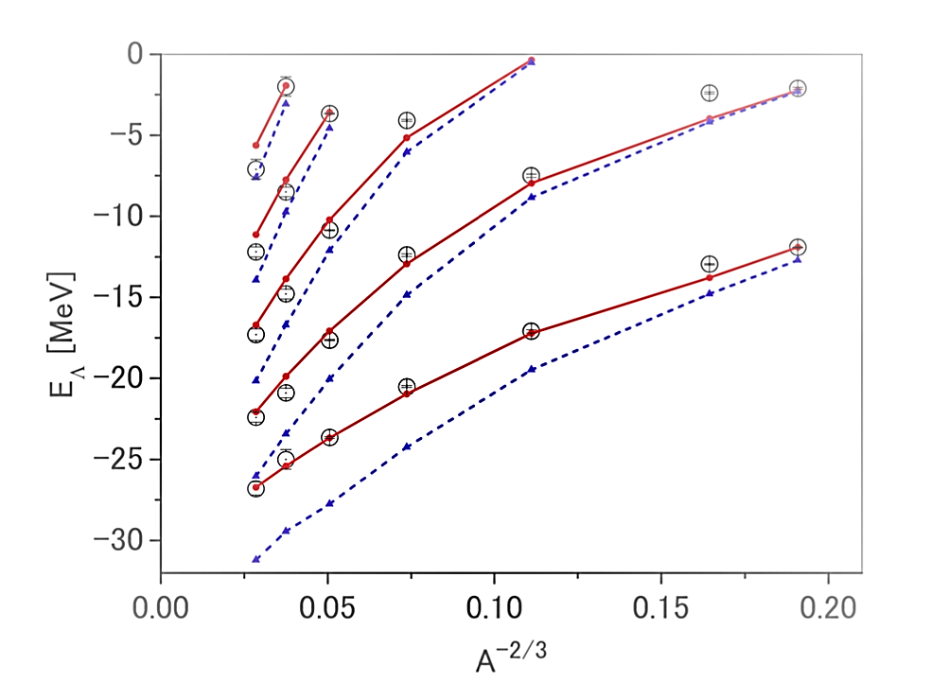
14/25
How can we extract YNN 3-body force effect ?
High-quality ΛN scattering data at JLab(CLAS) + J-PARC(E96,Miwa) -> SU(3)f chiral EFT force
Single particle energies of Λ in hypernuclei
=> sensitive to ΛN density dep. (= ΛNN 3BF)
Λ is distinguishable from nucleons. No Pauli from nucleons.
We know the local density where the Λ is located.
Different mass numbers, orbitals -> probe different densities
ΛNN int.
with the same strength as repulsive NNN
force reproducing AA collision data,
and supporting 2 solar mass NSs.
Pb
M.M. Nagels et al. PRC99, 044003 (2019)
w/o ΛNN int.
²⁰⁸_{Λ}Pb
w/ ΛNN int.
ΔE ~ 2.2 MeV
Nijmegen ESC16
s_{Λ}
p_{Λ}
g_{Λ}
d_{Λ}
f_{Λ}

Slide 15
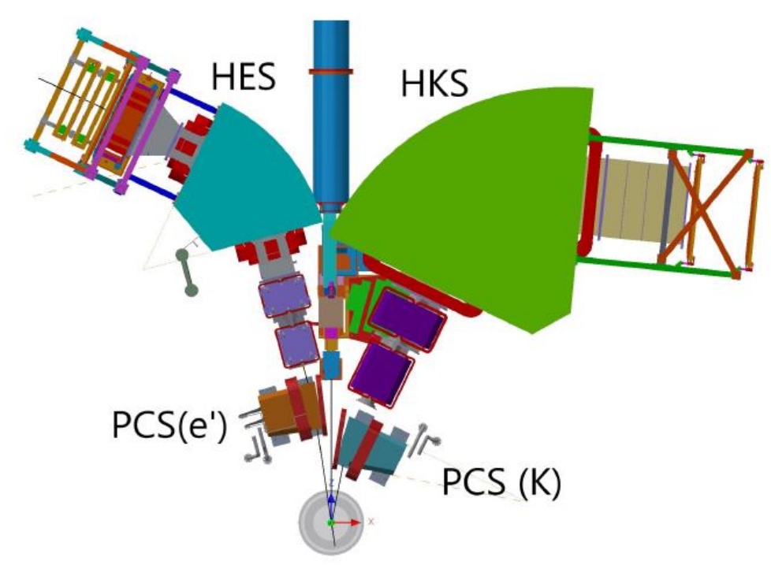
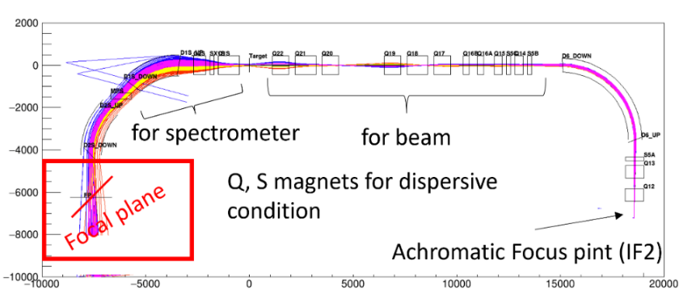
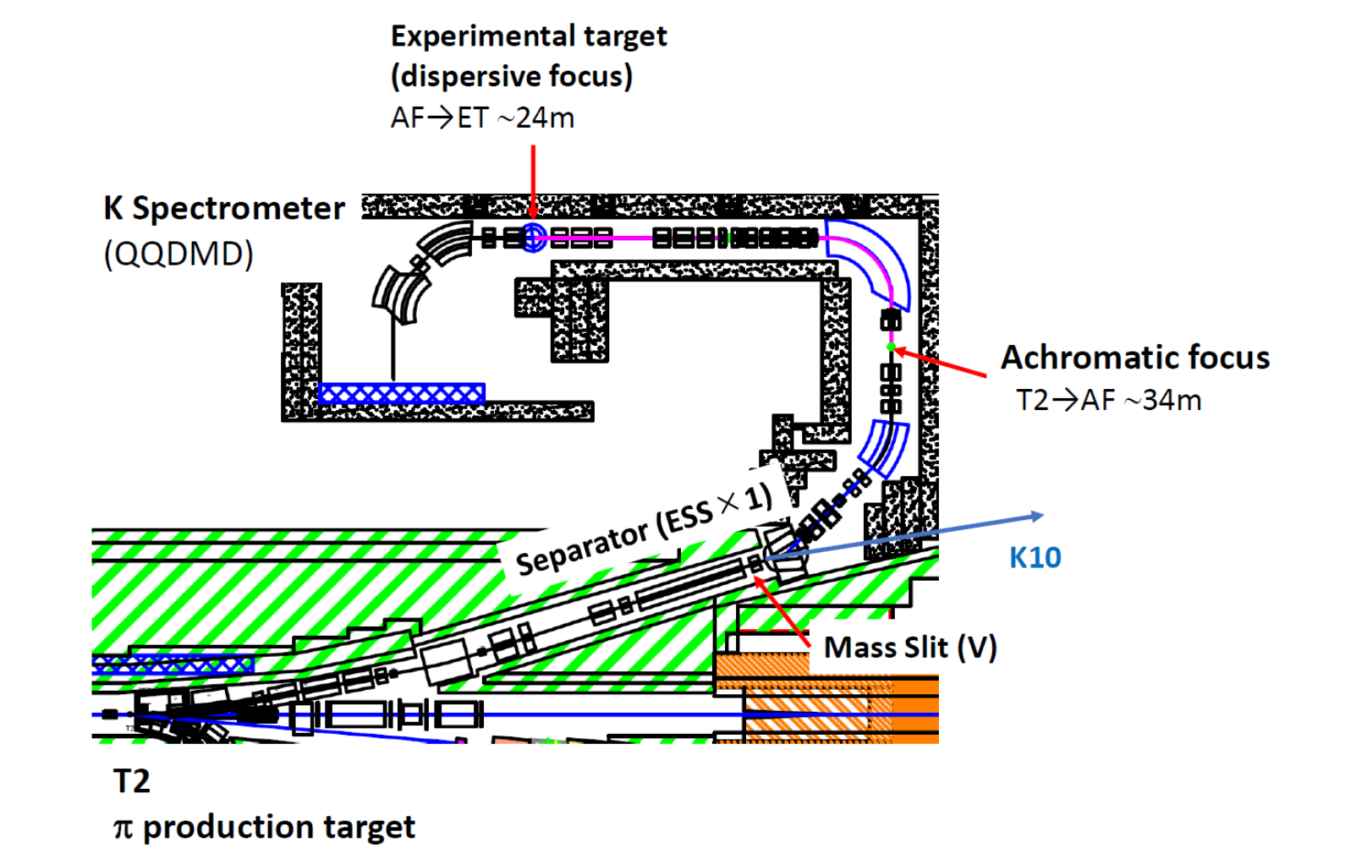
15/25
𝑒⁻
Experimental Plans
JLab @Hall C
𝐾⁺
E12-15-008: ^{40,48}Ca(𝑒,𝑒’𝐾⁺) ^{40,48}_{Λ}K
E12-18-013: ²⁰⁸Pb (𝑒,𝑒’𝐾⁺) ²⁰⁸_{Λ}Tl
T=1 ΛNN force => Λnn force in NS
J-PARC @HIHR line
at the extended Hadron Facility
HIHR
P84: (π⁺,𝐾⁺) ...¹²_{Λ}C, ²⁸_{Λ}Si, ⁴⁰_{Λ}Ca,
⁵¹_{Λ}V, ⁸⁹_{Λ}Y, ¹³⁹_{Λ}La, ²⁰⁸_{Λ}Pb
Pion intensity > 2x10⁸/spill
limited by proton intensity
ΔM < 400 keV (FWHM)
ΔM ~ 0.3 MeV FWHM
Δp/p = 1/10000
Together with ΛΝ scattering exp. (E86 @K1.1),
those B_{Λ} values give info. on ΛΝΝ strength.

Slide 16
16/25
Possibilities on neutron star core
repulsive
J-PARC determines
this strength
Described in hadron level
strong
ΛNN
strength
Hyperons do not appear
or
Hyperons partly appear
weak
T
Cannot be explained in hadron level
170 MeV
Quark matter appears (hybrid star)
crossover
0
?
crossover between hadron phase and quark phase?
∼2ρ₀ Quark matter begins to appear? -> repulsive
?
FAIR-CBM J-PARC HI project
-> direct production of high density quark matter?
ρ₀
a few x ρ₀
ρ

Slide 17
Future plan 2
---Modification of baryons in nuclei

Slide 18
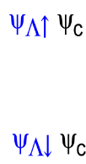
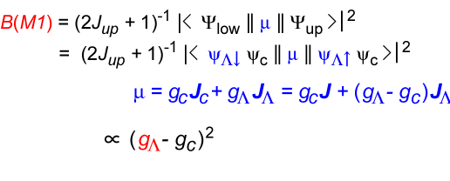
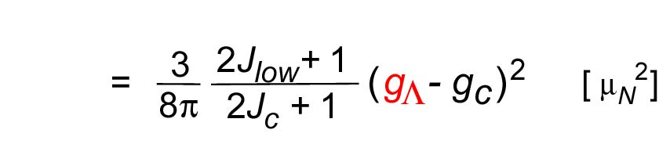
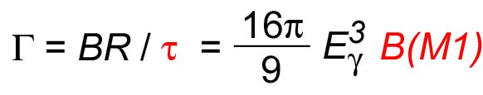

18/25
Λ’s magnetic moment in a nucleus
Measurement of μ_{Λ} in a hypernucleus is very difficult => possible via HI in future
Λ-spin-flip M1 transition: B(M1) -> g_{Λ}
g_{c}
in s-orbit
: assuming “weak coupling”
between a Λ and the core.
R.H. Dalitz and A. Gal, Annals of Phys. 116 (1978) 167.
Doppler Shift Attenuation Method: eg) B(E2): Tanida et al.
PRL 86 (2001) 1982
⁷_{Λ}Li
~100%
Modification of g_{Λ} in nuclear medium?
A few~10% (?) change expected from ΛΝ−ΣΝ mixing / K, 2π exchange current
Possible effect of Λ’s structure change --- theoretically not studied
ΛΝ−ΣΝ mixing: C.B. Dover, H. Feshbacj, A. Gal, PRC 51 (1995) 541.
+2--5 % for ⁴_{Λ}He, small for T=0 hypernuclei
K, 2π exchange current: K. Saito, M. Oka, T. Suzuki, NPA 625 (1997) 95.
-7% for ⁷_{Λ}Li
“Quark exchange current” in QCM T. Takeuchi, K. Shimizu, K. Yazaki, NPA 481 (1988) 693
Structure change of a Λ in nuclear matter?

Slide 19
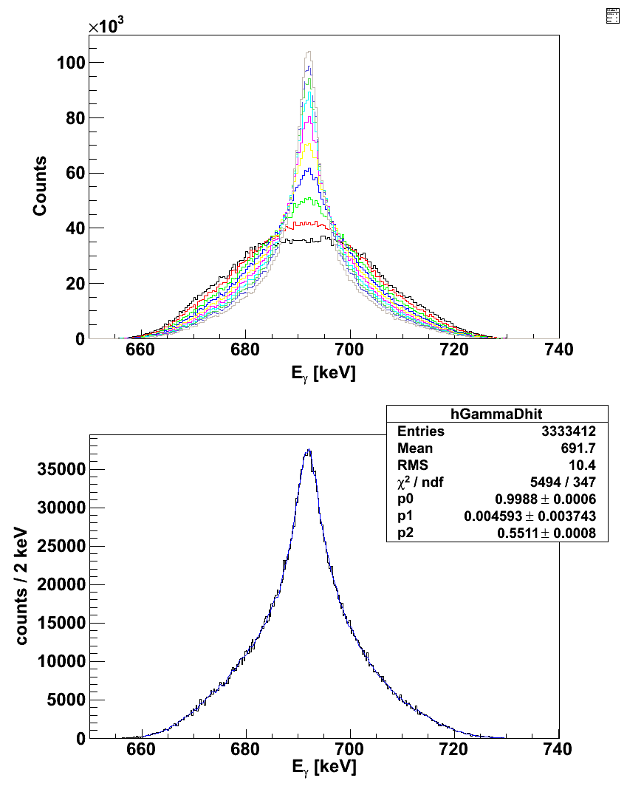
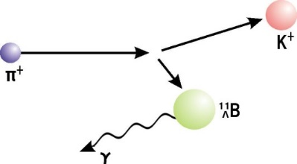
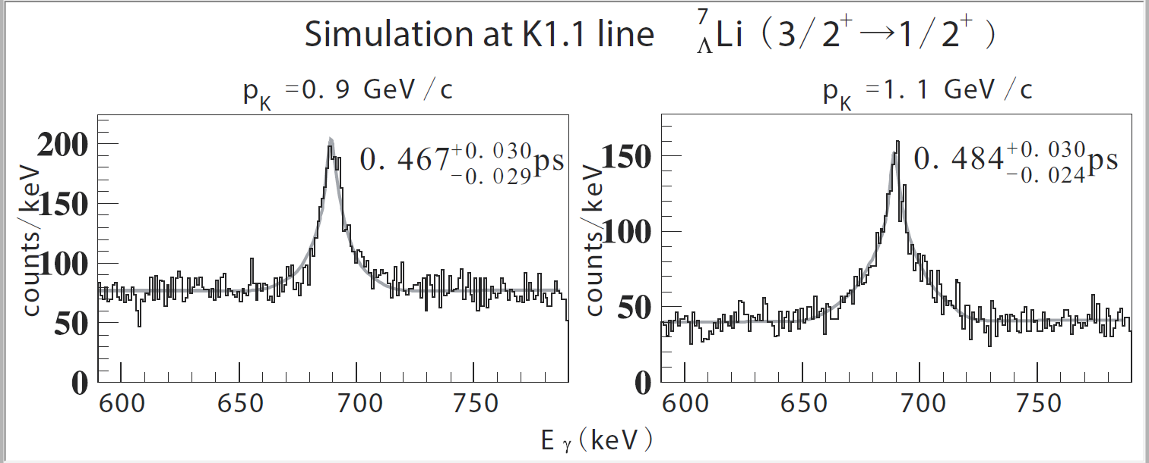
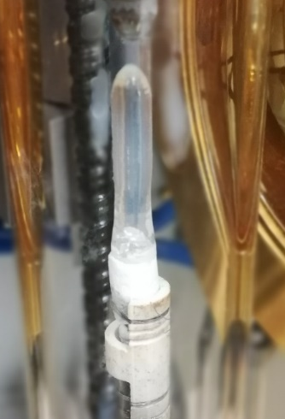
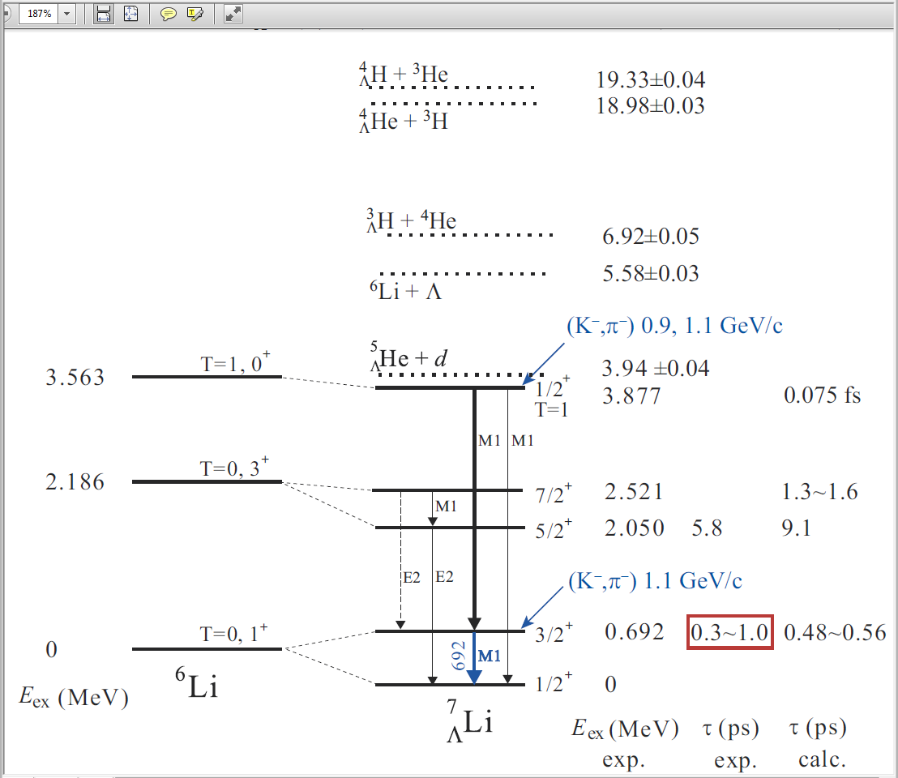
19/25
Experiment at J-PARC (E63)
p_{K}= 1.1 GeV/c
τ=1.0 ps
⁷_{Λ}Li : the best-studied hypernucleus
τ=0.5 ps
Doppler Shift Attenuation Method
π⁻
τ =0.1 ps
τ ~ 0.5 ps, t_{stop} ~ 2 ps
Slows down
in material
K⁻
Hypernucleus
in excited state
in Li₂O (2.01 g/cm^{3,} single crystal)
p_{K}= 1.1 GeV/c
H. Tamura et al., Nucl.Phys. A881 (2012) 310
Stat. error
Δτ/τ = 6%
Δ|g_{Λ}-g_{c}|
For 35 days for 50kW
Assuming 176k K⁻/spill for 1.1 GeV/c
=>
~ 3%
|g_{Λ}-g_{c}|
3⁺
7/2⁺
5/2⁺
3/2⁺
1⁺
1/2⁺
⁶Li
⁷_{Λ}Li

Slide 20
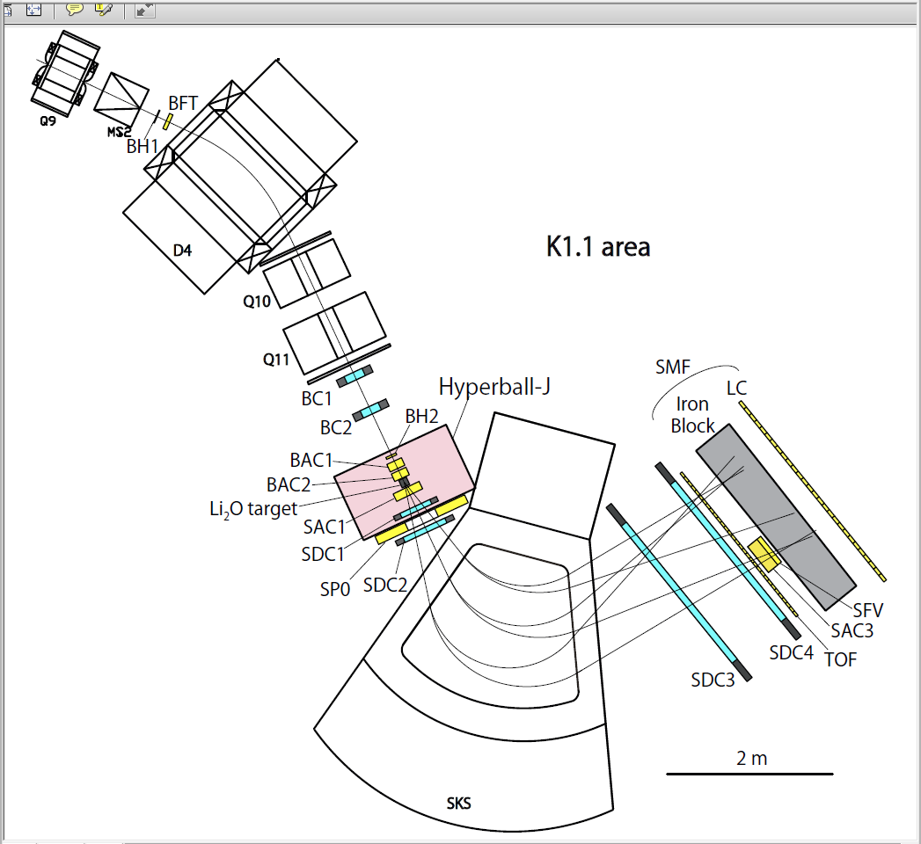
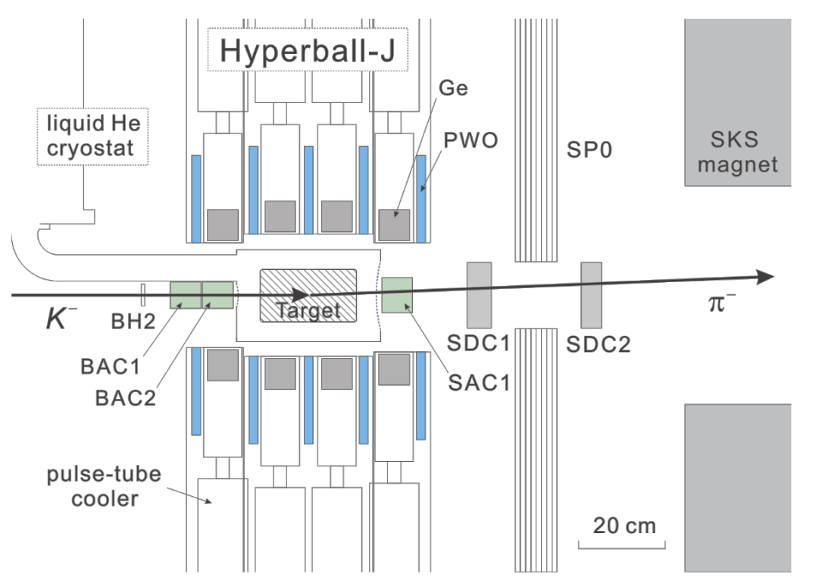
K1.1
20/25
E63 setup
K1.1 Beam spectrometer
Δp/p = 0.042% (FWHM) @1.1 GeV/c
+ multiple scat. effect
K⁻
π⁻
Ge array “Hyperball-J”
All the detectors are ready.
K1.1 beamline is not constructed yet.

Slide 21
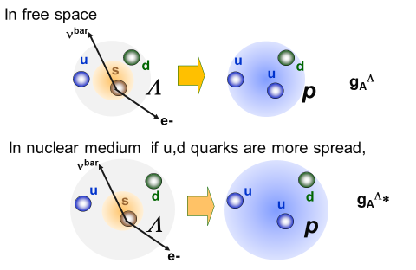
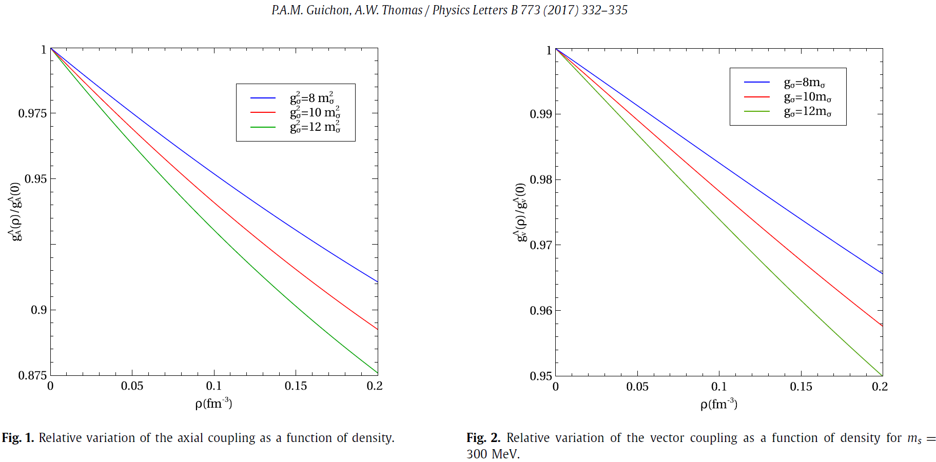
confinement potential
=> B : Pressure from outside
21/25
Λ’s beta decay rate in a nucleus
Modification of g_{A}^{Λ} due to baryon “swelling” in medium
Λ −> p e⁻ ν^{bar}
Sensitive to overlap of u and s quark w.f.
Bag model picture
s
u
R
m
but s quark is not spread, then
R’
m
Less overlap between s and u quarks
Reduction of beta decay rate
in medium
m*
QMC model: u,d quarks couple to σ, ρ, ω fields in a nucleus but s quark does not.
δ g_{A} (ρ₀) ~ -10%
δ g_{V} (ρ₀) ~ -4%
→ δ Γ_{β} < -20%

Slide 22
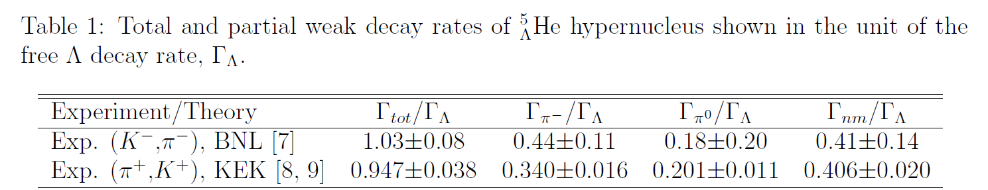
22/25
What to measure?
Measure branching ratio BR_{β} and lifetime τ of a hypernucleus
Γ_{β} = BR_{β}/τ ∝ (g_{V}^{Λ})² |∫1|² + (g_{A}^{Λ})² |∫σ|²
Free Λ: BR_{β} = 8x10⁻⁴
g_{V}^{Λ} = 1, g_{A}^{Λ} /g_{V}^{Λ} = −0.718 ± 0.015
Light hypernuclei -> Little quenching of g_{A} from meson exchange and nuclear effects.
Precise calculation possible
⁵_{Λ}He :
⁵_{Λ}He(0⁺)→ ⁴He p e⁻ ν^{bar} : Fermi + GT
⁶Li (π⁺, K⁺) ⁵_{Λ}He + p,
Statistically, ΔBR_{β} ~4% and Δτ ~ 2% => ΔΓ_{β} ~ 4.5% => Δg_{A}^{Λ} (⁵_{Λ}He) ~3.7%
Final state p is not bound -> Effect may be reduced.
Γ_{β} ∝ (g_{V}^{Λ})² + 3 (g_{A}^{Λ})² ~ 1 + 1.5
Experimentally feasible.
⁴_{Λ}H :
⁴He (K⁻, π⁰) ⁴_{Λ}H -> Large yield, but π⁰ spectrometer very expensive
ΔBR_{β} ~2-3% and Δτ ~ 2% => ΔΓ_{β} ~ 3% => Δg_{V}^{Λ} (⁴_{Λ}H) ~1.5%
Final state p is bound in ⁴He, but
⁴_{Λ}H(0⁺)→ ⁴He e⁻ ν^{bar} : Fermi transition
Γ_{Fermi} ∝ (g_{V}^{Λ})² -> Effect is small
22
KEK E462

Slide 23
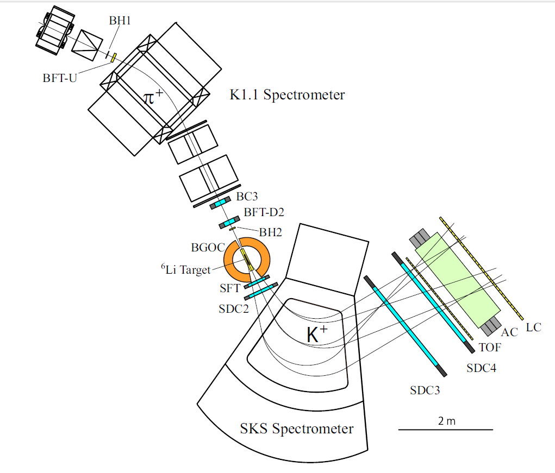
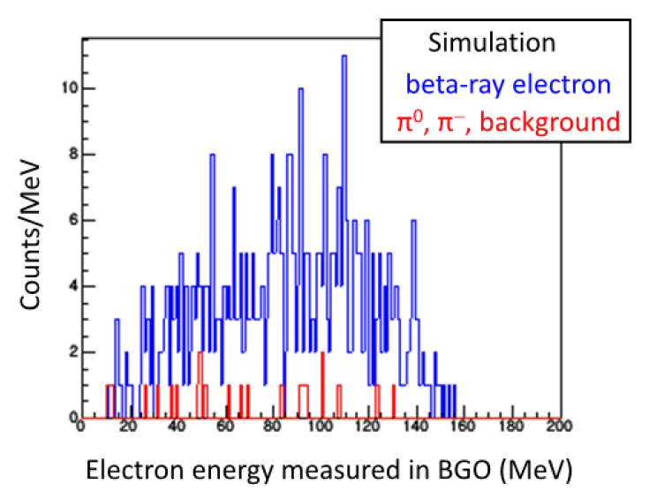
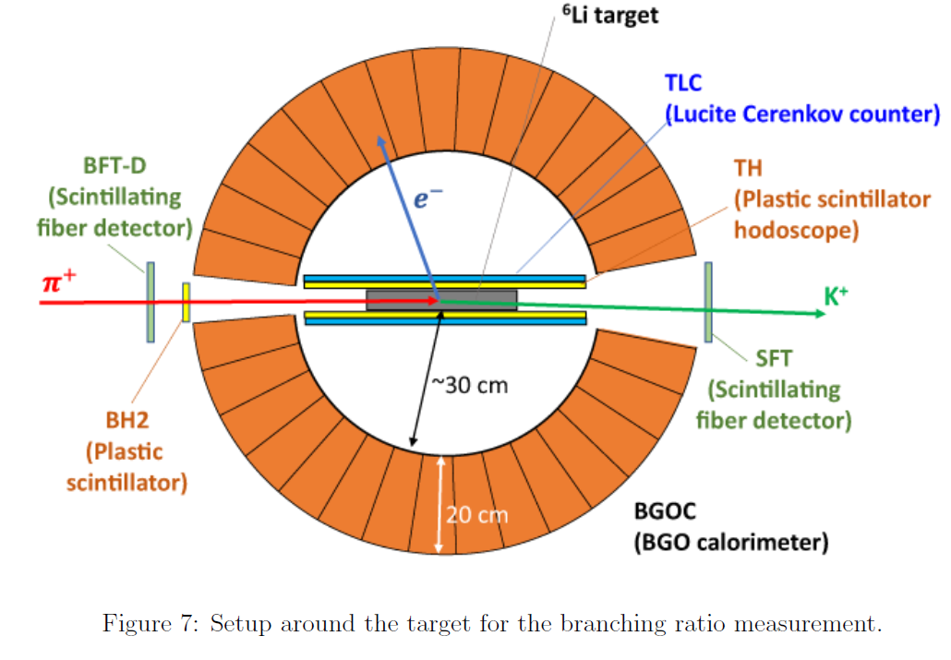
Setup for ⁵_{Λ}He at K1.1 beam line
23/25
One of the future experiments at the Extended Hadron Facility
⁶Li(π⁺,K⁺) ⁶_{Λ}Li, ⁶_{Λ}Li -> ⁵_{Λ}He + p
Background/ Signal
≈ BR(π⁰ bg)/ 0.68 BR_{β}
= 0.35x10⁻⁴ / ( 0.68 x 8.3x10⁻⁴)
= 0.06
Systematic error in BR_{β} will be < 2%
Detailed studies for background are on-going.
Theoretical calculations for the beta decay rate are necessary.
Setup around the target for BR measurement

Slide 24
24/25
Yield and statistical error for BR
1400 hours’ (2 months’) beam time is assumed
⁵_{Λ}He via (π⁺, K⁺)
⁴_{Λ}H via (K⁻, π⁰)
⁶Li (π⁺, K⁺) ⁵_{Λ}He+p | PS E462 | Proposed exp.
# of pi+ beam | 2.5x10¹² | 43x10¹² (30M/spillx1400h)
Target thickness | 3.7g/cm² | 14g/cm² (30 cm)
SKS efficiency | ↓
⁵_{Λ}He counts | 45653 | 2.0x10⁶
BR(beta) x Pauli |  | 8x10⁻⁴ x 0.6
Eff (e-) |  | 0.7
Beta-ray counts |  | 673
⁴He (K⁻, π⁰) ⁴_{Λ}H | Proposed exp. ⁴_{Λ}H: 90μb
# of K- beam | 2.9x10¹¹ (200k/spillx1400h)
Target thickness | 4 g/cm² (30 cm)
Eff(π⁰) | 0.05?
⁴_{Λ}H counts | 3.0x10⁶
BR(beta) x Pauli | 8x10⁻⁴ x ~ 0.76
Eff (e-) | 0.7
Beta-ray counts | 1277
¹³_{Λ}C
¹³C target
20g/cm²
¹³_{Λ}C counts
1.3x10⁶
0.3
222
6.7%
√N_{e}/N_{e} = 3.9%
√N_{e}/N_{e} = 2.8%

Slide 25

25/25
Summary
Solving the hyperon puzzle is one of the most important but challenging tasks in nuclear physics. Study of YN (and YNN) interactions is a key to this problem.
2. At J-PARC, Ξ hypernuclear events observed in emulsion indicated a significant
depth of attractive Ξ-nucleus potential. New experiments for (K⁻,K⁺) spectroscopy
of Ξ hypernuclei and Ξ-atomic X-ray spectroscopy have started.
3. To investigate ΛNN interaction, precise hypernuclear spectroscopy is planned at
JLab and then at J-PARC extended Hadron Facility.
4. Baryon modification in nuclear medium will be investigated in future via magnetic
moments and beta-decay rates of Λ hypernuclei.

