Slide 1
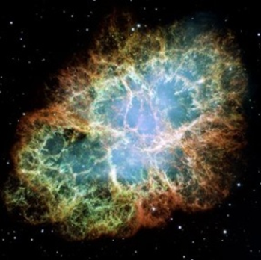
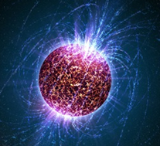
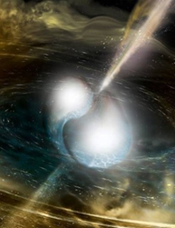
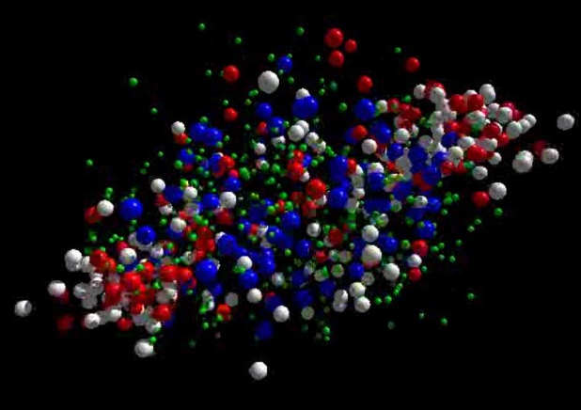




neutron
matter
Cosmic matter in the laboratory -
Experiments at FAIR and NICA
Outline:
Peter Senger
Exploring dense baryonic matter in the laboratory
- the high-density nuclear matter equation-of-state
- the QCD phase diagram at large μ_{B}
- hyperons in neutron stars ?
➢ Experiments: CBM at FAIR and BM@N at NICA
Workshop on the QCD Phase Structure at High Baryon Density Region
College of Physical Science and Technology, Center China Normal University
Wuhan, November 12 – 14, 2019

Slide 2
Neutron star mergers and heavy-ion collisions
density
temperature
M. Hanauske et al.,
J. Phys.: Conf. Ser.
878 012031
n-star merger
EOS
Au +Au
1.5A GeV

Slide 3
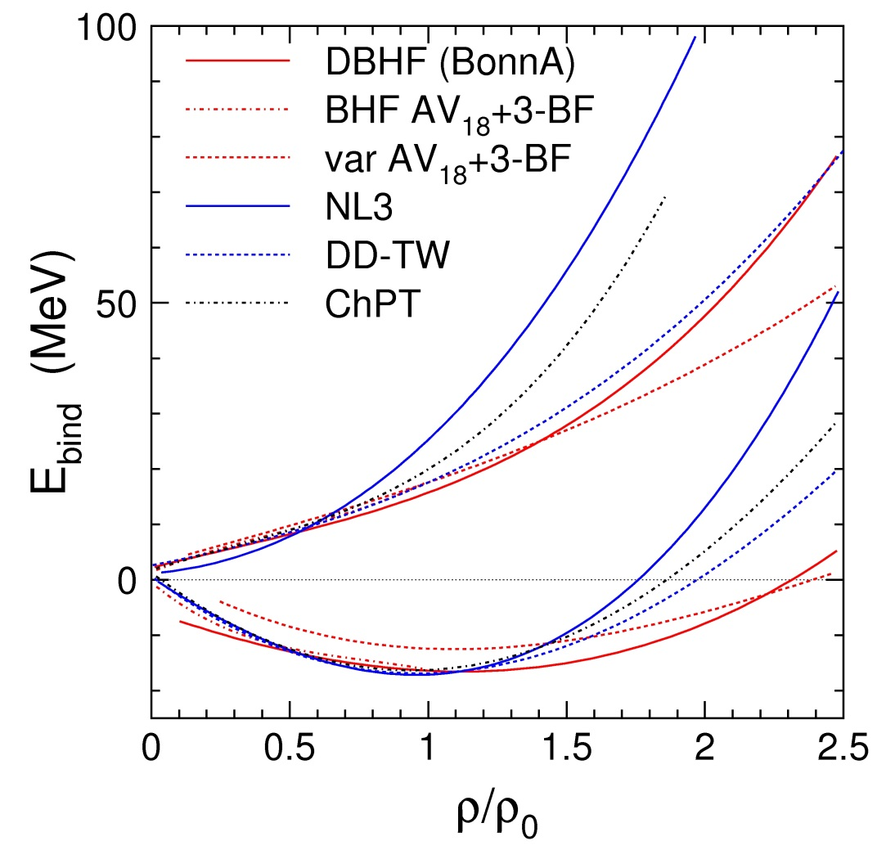
The nuclear matter equation-of-state
The nuclear matter equation of state (EOS) describes the relation between density, pressure, temperature, energy, and isospin asymmetry
P = δE/δV⏐_{T=const}
V = A/ρ
δV/ δρ = - A/ρ²
P = ρ² δ(E/A)/δρ⏐_{T=const}
Ch. Fuchs and H.H. Wolter, EPJA 30 (2006) 5
Neutron matter
E/A
E_{A}(ρ,δ) = E_{A}(ρ,0)+E_{sym}(ρ)·δ²
with δ= (ρ_{n}–ρ_{p})/ρ
E_{sym}
Symmetric matter

Slide 4
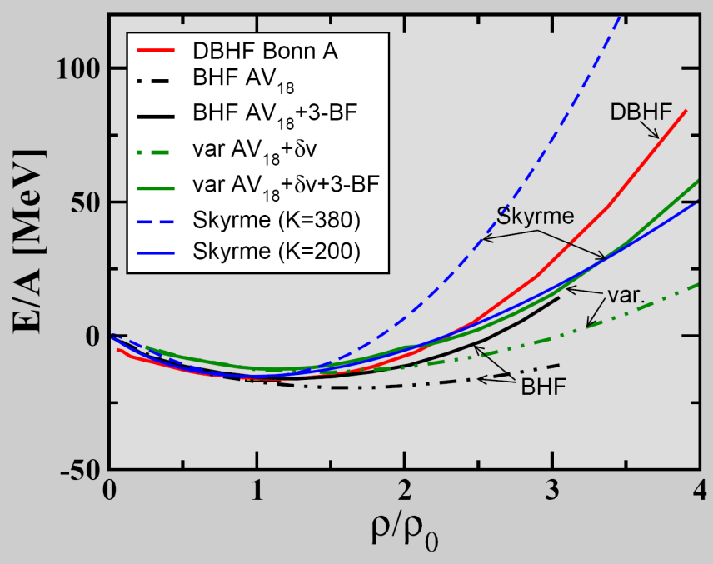
The EOS of (symmetric) nuclear matter
E_{A}(ρ,δ) = E_{A}(ρ,0) + E_{sym}(ρ)·δ² + O(δ⁴)
C. Fuchs, Prog. Part. Nucl. Phys. 56 (2006) 1
T=0: E/A = 1/ρ ∫ U (ρ)dρ
Effective NN-potential:
U(ρ)=αρ+βρ^{γ}
E/A(ρ_{o}) = -16 MeV
slope δ(E/A)(ρ_{o})/δρ = 0
curvature K_{nm} = 9ρ² δ²(E/A)/δρ²
(nuclear incompressibility)
Measurements at GSI SIS18:
elliptic flow of light fragments
subthreshold kaon production
K_{nm} = 200 MeV: "soft" EOS
K_{nm} = 220 ± 40 MeV: "soft" EOS
A. Le Fevre et al., Nucl. Phys. A945 (2016) 112
C. Sturm et al., (KaoS Collaboration) Phys. Rev. Lett. 86 (2001) 39
Ch. Fuchs et al., Phys. Rev. Lett. 86 (2001) 1974
K_{nm} = 380 MeV: "stiff" EOS

Slide 5
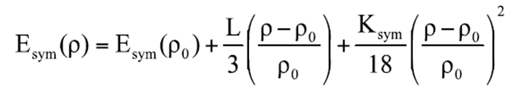
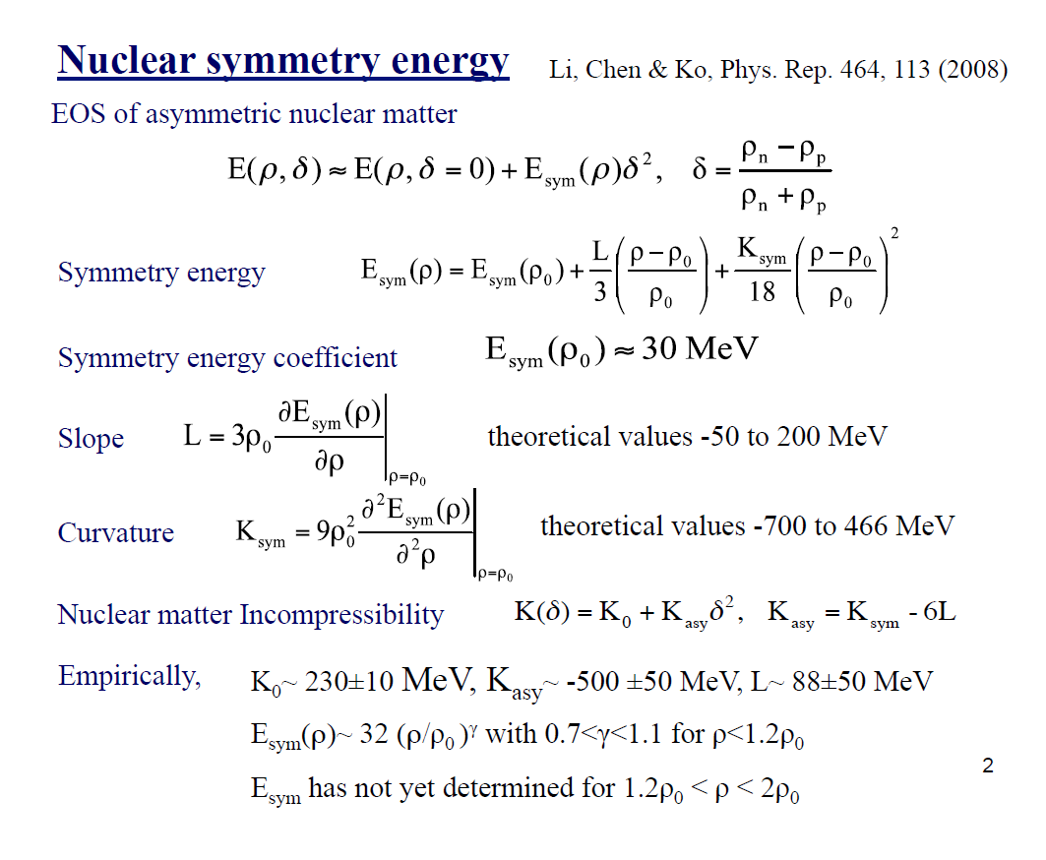
The nuclear symmetry energy
E_{A}(ρ,δ) = E_{A}(ρ,0)+E_{sym}(ρ)·δ²
Ch. Fuchs and H.H. Wolter, EPJA30 (2006) 5
Empirical value E_{sym}(ρ₀) ≈ 30 MeV
slope
theoretical value L(ρ₀) ≈ 60 MeV
E_{sym} (MeV)
B.A. Li and X. Han, Phys. Lett. B 727 (2013) 276
curvature
elliptic flow n/ch
Au+Au 400A MeV
theoretical value K_{sym} = -700 to 470 MeV
P. Russotto et al., Phys. Rev. C 94, 034608 (2016)

Slide 6
Mass-density relation of neutron stars
for different EOS
PSR J0740+6620
M = 2.17±0.11 M_{sun}
H. Cromartie et al.,
arXiv:1904.06759 (2019)
J. M. Lattimer and M. Prakash, From Nuclei to Stars, ed. S. Lee, p.275, WorldScientific. (2011) arXiv:1012.3208v1

Slide 7
The high-density nuclear matter
equation-of-state
Symmetry energy E_{sym} ?
Neutron matter
4 – 7 ρ₀
E/A
Symmetric matter EOS ?
E_{sym}
Symmetric matter
3.0 3.5 4.0 4.5 5.0

Slide 8


Baryon densities in central Au+Au collisions
I.C. Arsene et al., Phys. Rev. C 75, 24902 (2007)
5 A GeV
10 A GeV
8 ρ₀
5 ρ₀
∼ 2 ρ₀
∼ 5 ρ₀
8
courtesy Toru Kojo (CCNU)

Slide 9
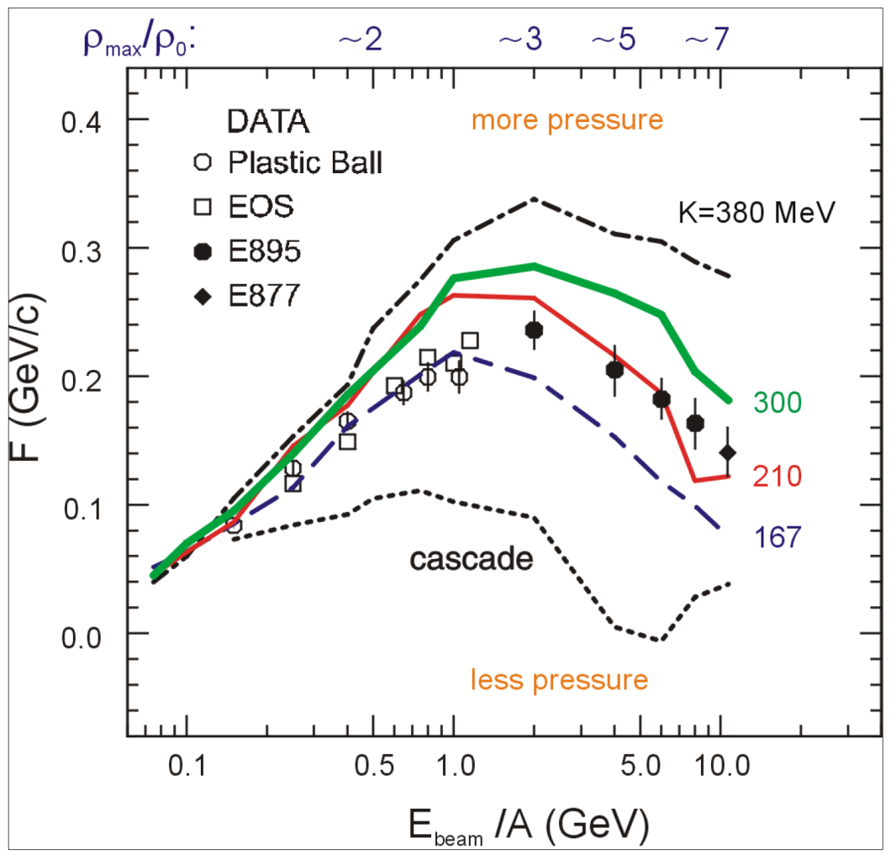
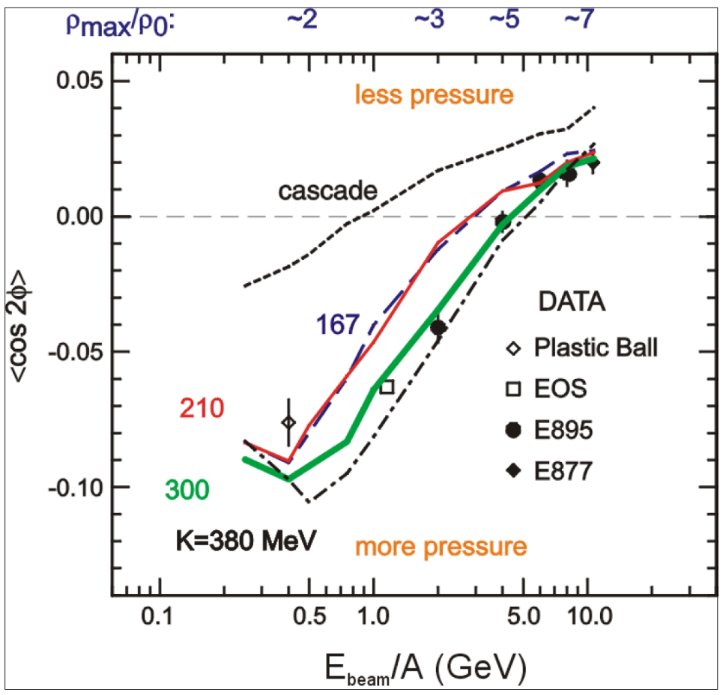
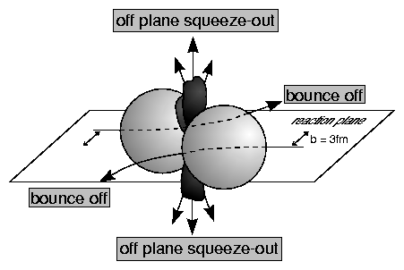
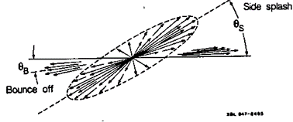
First attempts to study the high-density EOS
EOS of symmetric matter extracted from collective proton flow
→ driven by the pressure gradient in the early fireball
P. Danielewicz, R. Lacey, W.G. Lynch, Science 298 (2002) 1592
Transverse in-plane flow:
F = d(p_{x}/A)/d(y/y_{cm})
dN/dφ ∝
(1+2v₁cosφ+2v₂cos2φ)

Slide 10
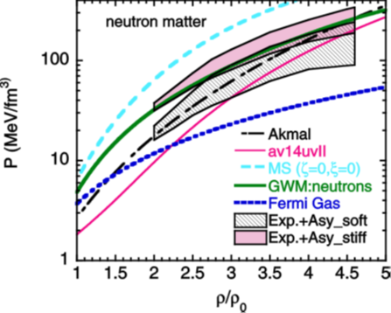
First attempts to study the high-density EOS
Au+Au collisions measured at AGS for beam energies from 2 to 11A GeV:
„The heavy-ion constraint“
hard EoS
soft EoS
K⁺ prod.
fragment flow
P. Danielewicz, R. Lacey, W.G. Lynch, Science 298 (2002) 1592

Slide 11
Future attempts to study the high-density EOS
Systematic studies of collective flow of baryons
Threshold production of multi-strange hyperons
Idea:
Ξ and Ω yield at subthreshold energies ∼ multi-step collisions ∼ density → EOS
Hyperon production via multiple collisions
Strangeness production:
pp → K⁺Λ⁰p (E_{thr} = 1.6 GeV)
pp → K⁺K⁻pp (E_{thr} = 2.5 GeV)
pp → K⁺nΣ⁺
pp → K⁺pΛ⁰
pn → K⁺pΣ⁻
Σ⁺Λ⁰→ Ξ⁰ p
Σ⁻ Ξ⁰ → Ω⁻ n
pp → Ξ⁻ K⁺K⁺p (E_{thr} = 3.7 GeV)
pp → Ω⁻ K⁺K⁺K⁰p (E_{thr} = 7.0 GeV)
pp → Λ⁰Λ⁰ pp (E_{thr} = 7.1 GeV)
pp → Ξ⁺ Ξ⁻ pp (E_{thr} = 9.0 GeV)
pp → Ω⁺ Ω⁻ pp (E_{thr} = 12.7 GeV
pp → K⁺pΛ⁰
pp → K⁺pΛ⁰
pn → nK⁺Σ⁰
Λ⁰Λ⁰→ Ξ⁻ p
Σ⁰ Ξ⁻ → Ω⁻ n
pp → K⁺nΣ⁺
pn → K⁺pΣ⁻
pp → K⁺pΛ⁰
Σ⁺Σ⁻ → Ξ⁻ p
Λ⁰ Ξ⁻ → Ω⁻ n

Slide 12
Future attempts to study the high-density EOS
Systematic studies of collective flow of baryons
Threshold production of multi-strange hyperons
Idea:
Ξ and Ω yield at subthreshold energies ∼ multi-step collisions ∼ density → EOS
Hyperon production via multiple collisions
Isospin-dependent strangeness-exchange cross sections in UrQMD
pp → K⁺nΣ⁺
pp → K⁺pΛ⁰
pn → K⁺pΣ⁻
Σ⁺Λ⁰→ Ξ⁰ p
Σ⁻ Ξ⁰ → Ω⁻ n
pp → K⁺pΛ⁰
pp → K⁺pΛ⁰
pn → nK⁺Σ⁰
Λ⁰Λ⁰→ Ξ⁻ p
Σ⁰ Ξ⁻ → Ω⁻ n
pp → K⁺nΣ⁺
pn → K⁺pΣ⁻
pp → K⁺pΛ⁰
Σ⁺Σ⁻ → Ξ⁻ p
Λ⁰ Ξ⁻ → Ω⁻ n
G. Graef, J. Steinheimer, F. Li, M. Bleicher,
Phys. Rev. C 90, 064909 (2014)

Slide 13
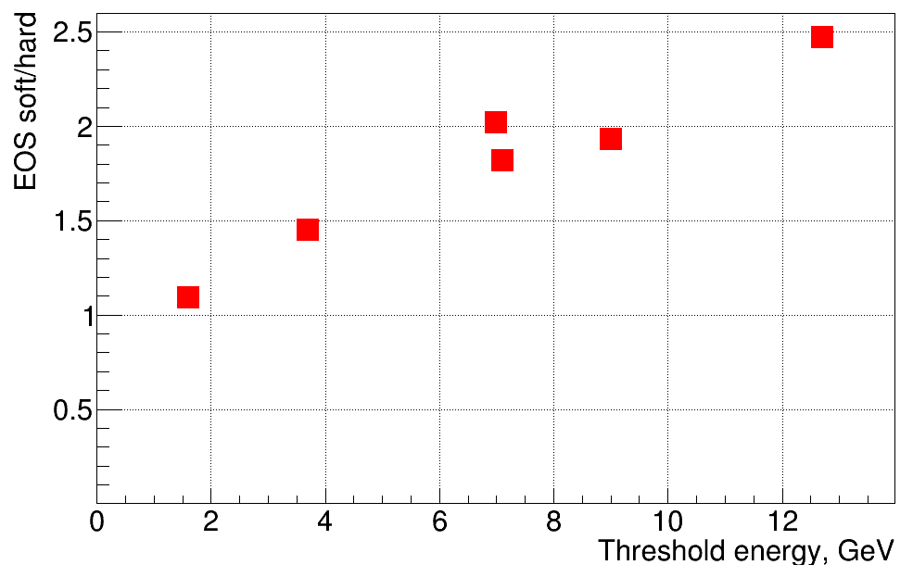
Multi-strange hyperons: promising observables for the EOS of symmetric matter
6 M central Au+Au collisions at 4A GeV
soft EOS (K=240 MeV) / hard EOS (K=350) MeV
Ω⁻
Ω⁺
Ξ⁺
Λ
Ξ⁻
preliminary !
Λ
PHQMD calculations , J. Aichelin, E. Bratkovskaya, V. Kireyeu et al., priv. comm.

Slide 14
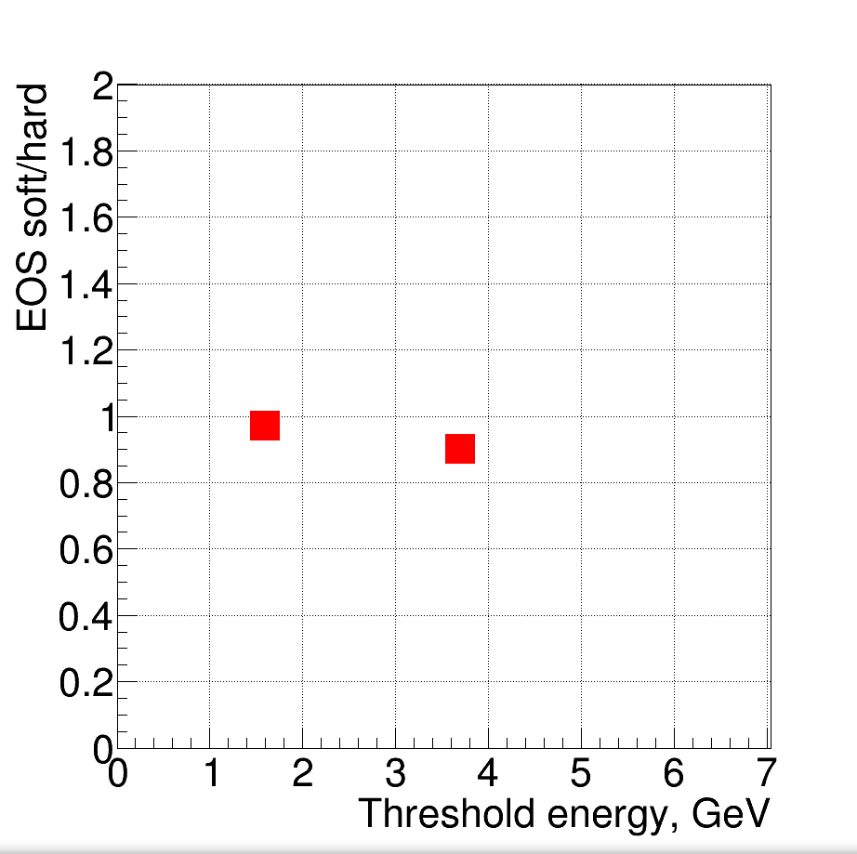
Multi-strange hyperons: promising observables for the EOS of symmetric matter
6 M central C+C collisions at 4A GeV
soft EOS (K=240 MeV) / hard EOS (K=350) MeV
Ξ⁻
Λ
preliminary !
PHQMD calculations , J. Aichelin, E. Bratkovskaya, V. Kireyeu et al., priv. comm.

Slide 15
The symmetry energy E_{sym} at high density
Elliptic flow neutrons/protons (upgrade option for CBM)
Particles with opposite isospin ?
Flow of Σ⁺ and Σ⁻ ?
π⁻/π⁺
I₃ | particle | production | E_{thr} GeV | decay
+1 | Σ⁺(uus) | pp → Σ⁺K⁺n pp → Σ⁺K⁰p pn → Σ⁺K⁰n | 1.8 | Σ⁺ → pπ⁰ Σ⁺→ nπ⁺
-1 | Σ⁻(dds) | pn → Σ⁻K⁺p nn → Σ⁻K⁺n | 1.8 | Σ⁻ → nπ⁻
Au+Au 400A MeV
n/p flow
n/p flow
Missing mass method
π⁻/π⁺
π⁻/π⁺
W.-M. Guo et al., Phys. Lett. B738 (2014) 397

Slide 16
Exploring the QCD phase diagram
NUPECC Long Range Plan 2017

Slide 17
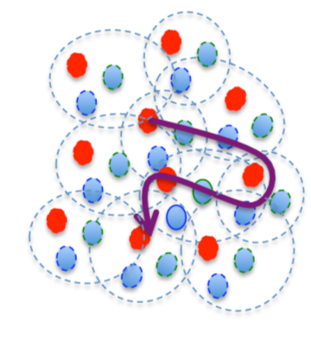
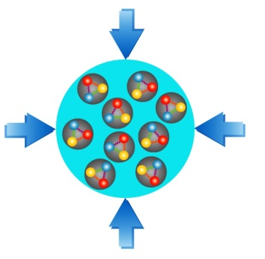
Exploring the QCD phase diagram
At high baryon density:
➢ N of baryons >> N of antibaryons , densities like in neutron star cores
L-QCD not (yet) applicable, models predict phase transitions and exotic phases
Experiments:
BES at RHIC, NA61 at CERN SPS, CBM at FAIR, MPD/BM@N at NICA, CEE at HIAF

Slide 18
EOS with phase transition
T. Fischer, N. Bastian, M. Wu, S. Typel, T. Klähn, D. Blaschke,
Nature Astronomy (2018), DOI: 10.1038/s41550-018-0583-0, arXiv:1712.08788v2
Quark deconfinement as supernova explosion engine for massive blue-supergiant stars

Slide 19
Quark-hadron phase transitions in general-relativistic neutron-star mergers ?
E. Most et al., (… M Hanauske, L. Rezzola), Phys. Rev. Lett. 122, 061101 (2019)
Transition from hadronic matter to quark matter
at ρ > 4 ρ₀ and T > 50 MeV ?

Slide 20
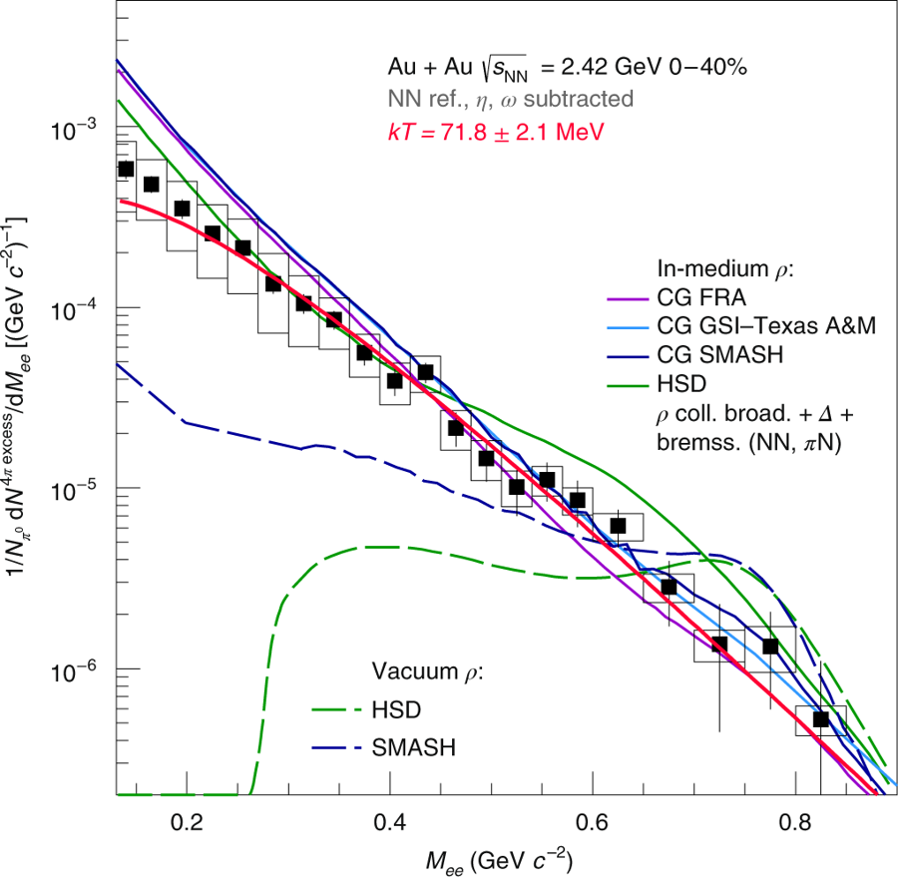
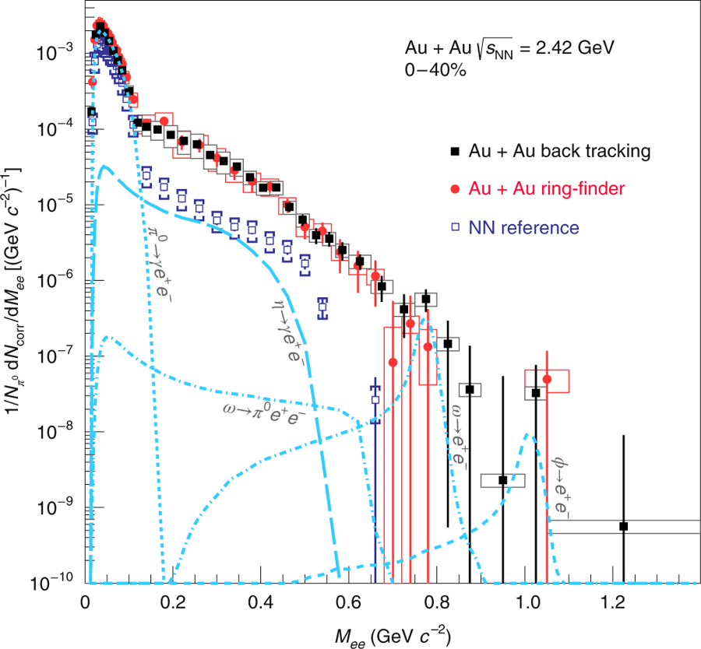
Thermal radiation from dense QCD matter
Au+Au collisions at 1.25 A GeV: ρ ≤ 2.5 ρ₀, T ≈ 72 MeV
Di-electron excess yield
after subtraction of vector mesons
Di-electron yield
J. Adamczewski-Musch et al., The HADES Collaboration, Nature Physics 2019,
https://doi.org/10.1038/s41567-019-0583-8

Slide 21
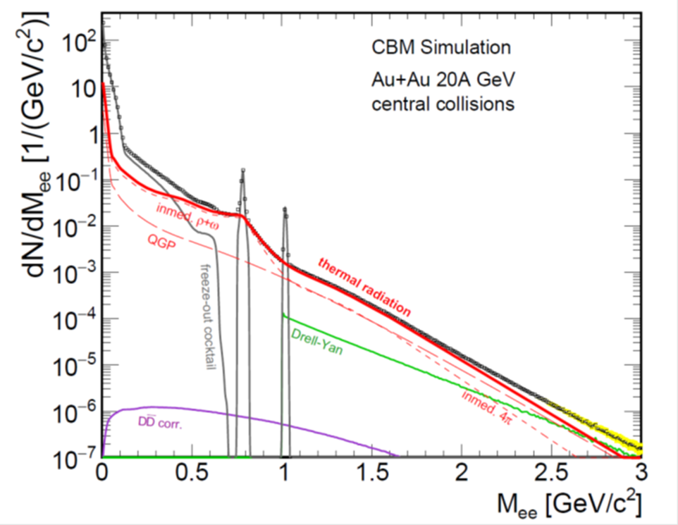
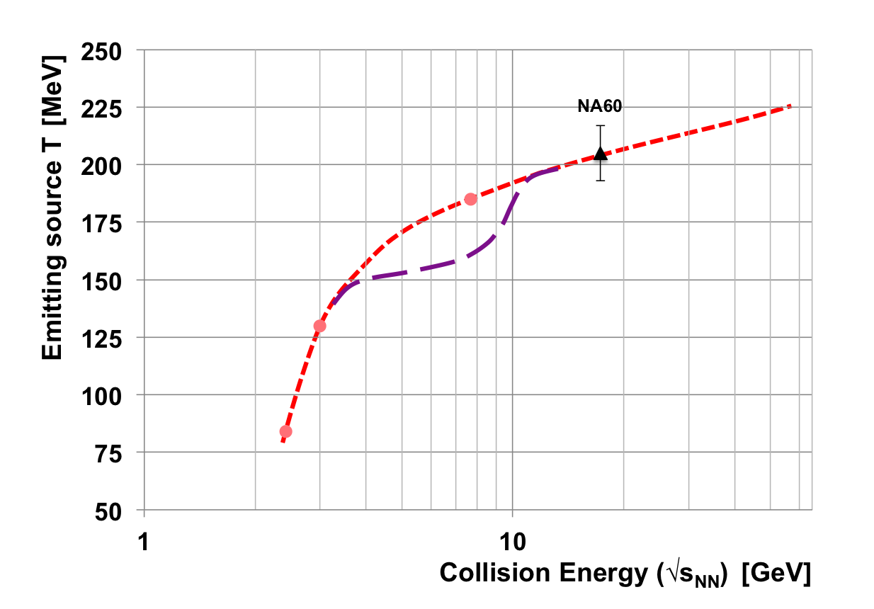
Experimental indication for a phase transition at large μ_{B}?
Invariant mass (M_{inv} > 1 GeV/c² ) of lepton pairs as function of beam energy → thermal radiation from fireball → caloric curve → phase coexistence (1st order transition)
Invariant mass distribution of lepton pairs
Slope of dilepton invariant mass spectrum
1 GeV/c² < M_{inv} < 2.5 GeV/c²
HADES
T. Ablyasimov et al., (CBM Collaboration)
Eur. Phys. J. A 53 (2017) 60

Slide 22
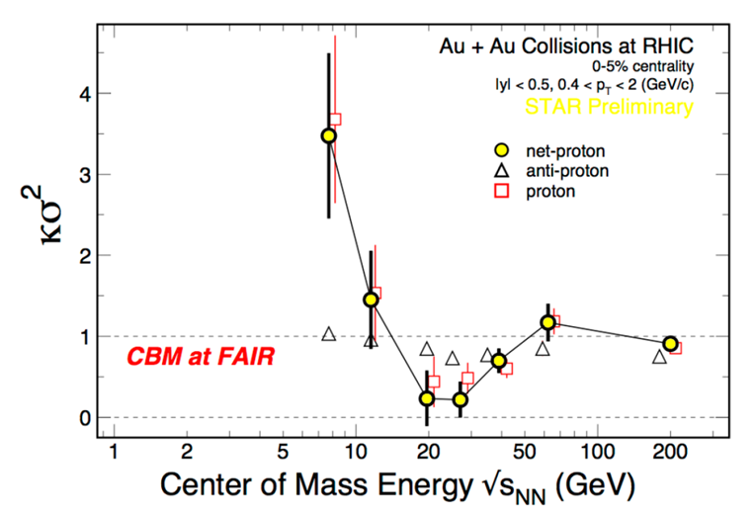
Searching for the critical endpoint of the
1st order phase transition at SIS100 energies ?
Event-by-event fluctuations of conserved quantities (B,S,Q)
“critical opalescence”
4th moment of net-proton multiplicity distribution
Data:
STAR at RHIC
beam energy scan

Slide 23
Experimental indication for a phase transition at large μ_{B}?
Invariant mass (M_{inv} > 1 GeV/c² ) of lepton pairs as function of beam energy → thermal radiation from fireball → caloric curve → phase coexistence (1st order transition)
Invariant mass distribution of lepton pairs
Slope of dilepton invariant mass spectrum
1 GeV/c² < M_{inv} < 2.5 GeV/c²
CP ?
★
HADES
T. Ablyasimov et al., (CBM Collaboration)
Eur. Phys. J. A 53 (2017) 60

Slide 24
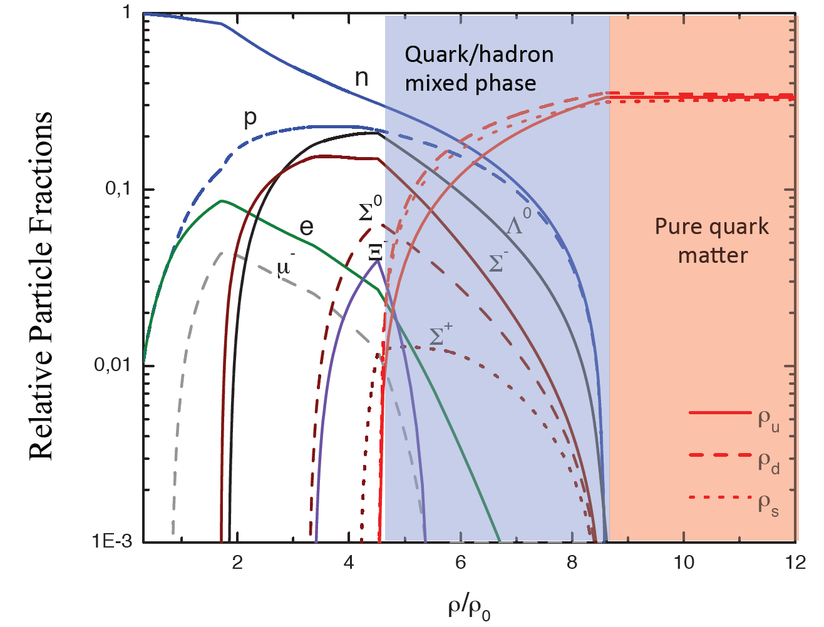
Hyperons in massive neutron stars?
M. Orsaria, H. Rodrigues, F. Weber, G.A. Contrera, arXiv:1308.1657
Phys. Rev. C 89, 015806, 2014 (SU(3)-NJL model calculations)

Slide 25
Hyperons in massive neutron stars?
J. Rikovska-Stone, P.A.M. Guichon, H.H. Matevosyan, A.W. Thomas
Nucl. Phys. A792 (2007) 341 (QMC model calculations)
3 ρ₀

Slide 26
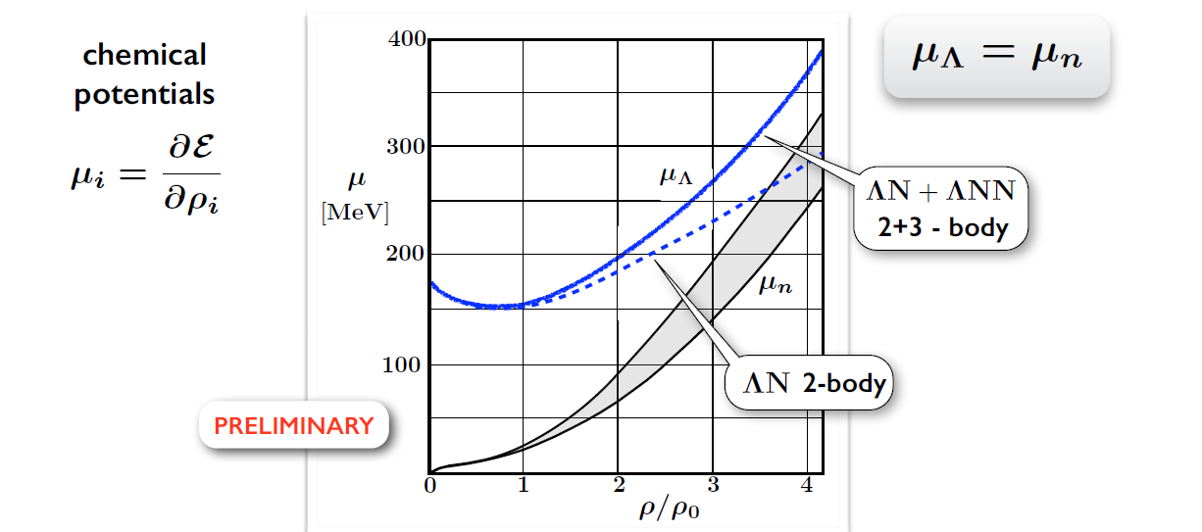
Hyperons in massive neutron stars?
W. Weise, JPS Conf. Proc. 011002 (2019), arXiv:1905.03955v1,
(Lambda single particle potential in neutron star matter from Chiral SU(3) EFT interactions)

Slide 27

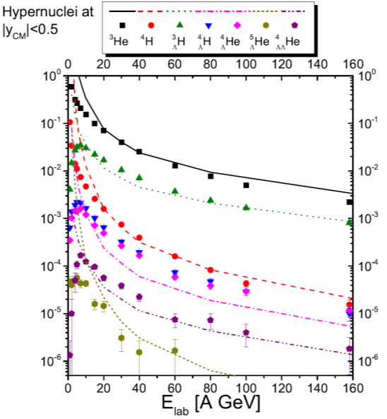
Production of light hypernuclei in
heavy-ion collisions
Study of ΛN, ΛNN, and ΛΛN interactions
SIS100
A. Andronic et al., Phys. Lett. B697 (2011) 203
SIS100
J. Steinheimer et al., Phys. Lett. B 714 (2012) 85

Slide 28
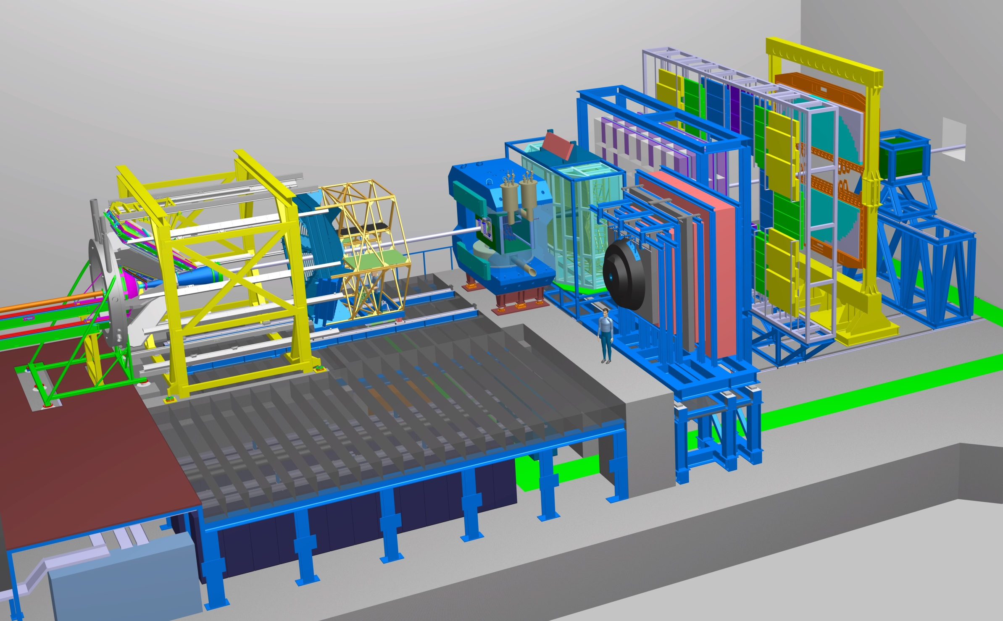
The Compressed Baryonic Matter Experiment
Ring
Imaging
Cherenkov
Transition
Radiation
Detector
SC Dipol
Magnet
Silicon
Tracking
System
Time of Flight
Detector
HADES
p+p, p+A
A+A (low mult.)
Micro
Vertex
Detector
Muon
Detector
Projectile
Spectator
Detector
DAQ/FLES HPC cluster

Slide 29
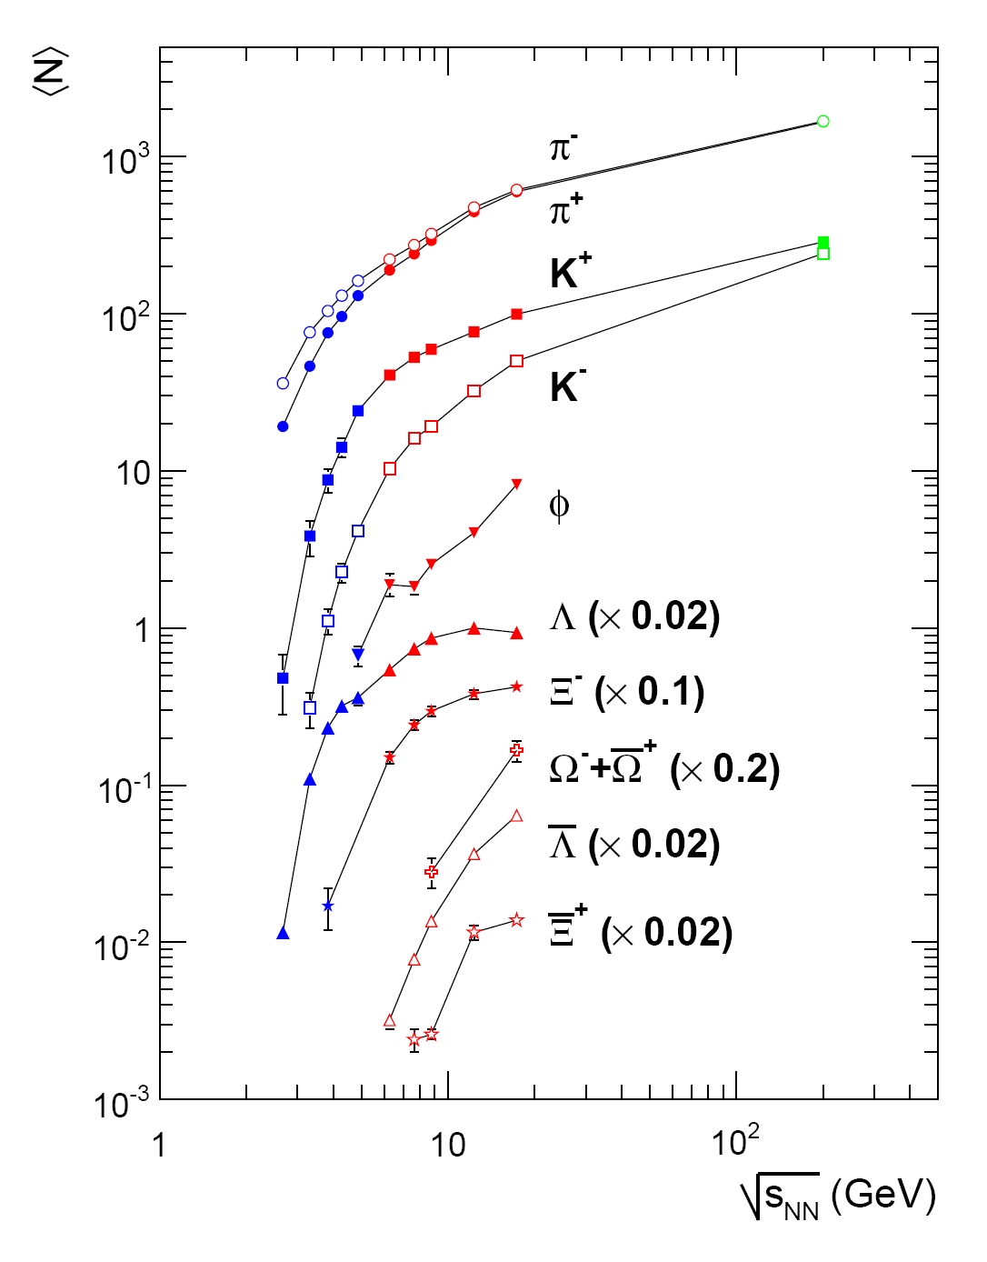
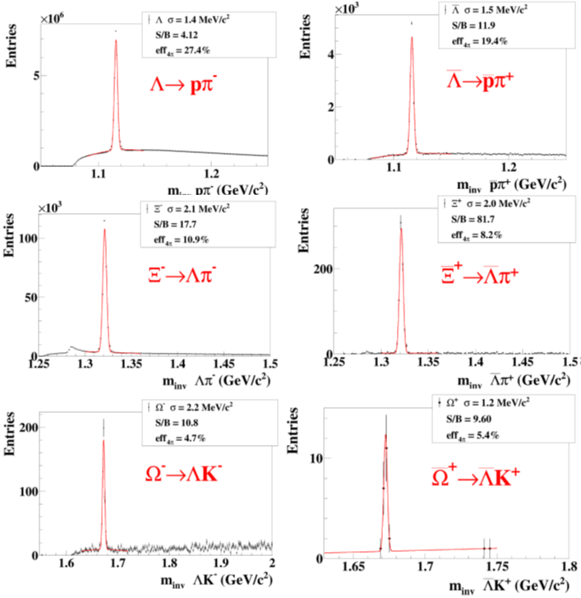
Multi-strange hyperons:
data situation and CBM performance
Simulations using the UrQMD event generator
for central Au+Au collisions 10A GeV based
on realistic detector responses
FAIR

Slide 30
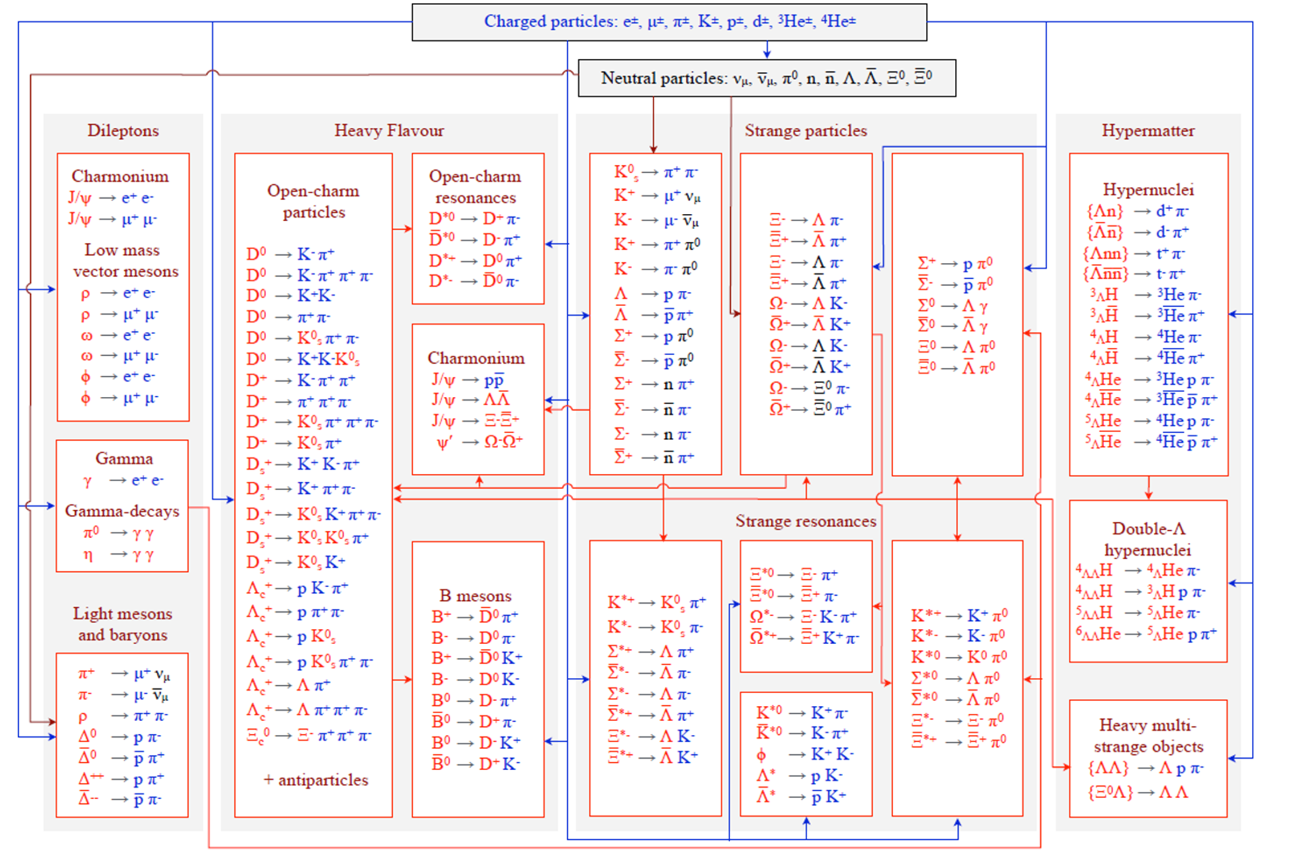
Online particle identification in CBM:
The KF Particle Finder

Slide 31
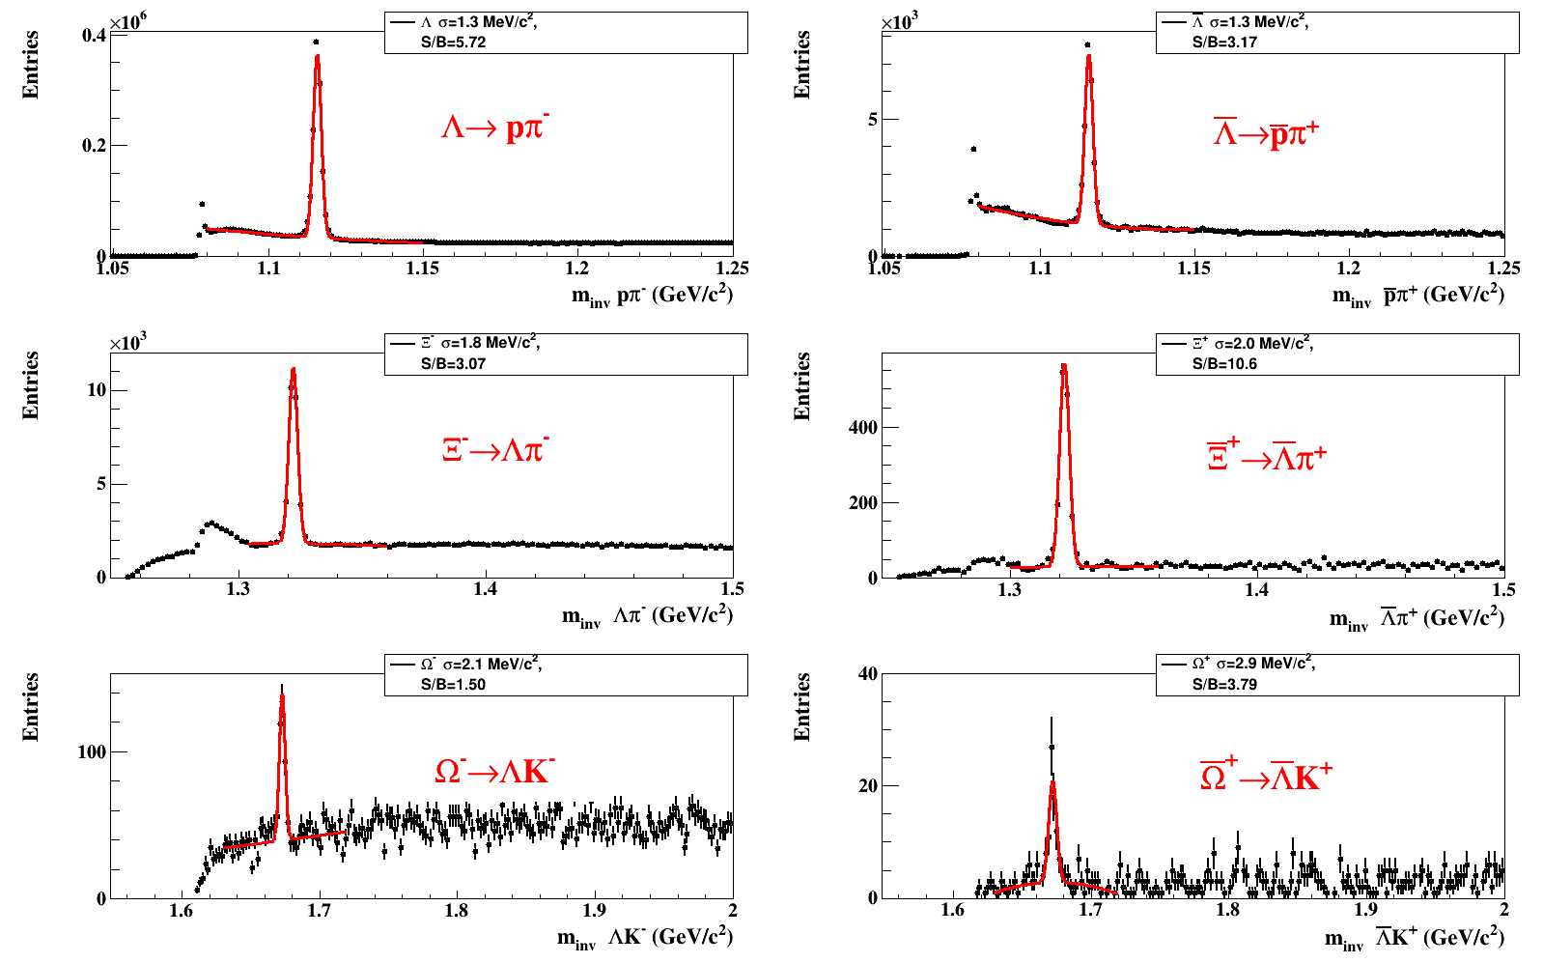
Real data analyzed with CBM KF Particle Finder
STAR 4.4 M mbias AuAu collisions, √s_{NN}=7.7 GeV

Slide 32
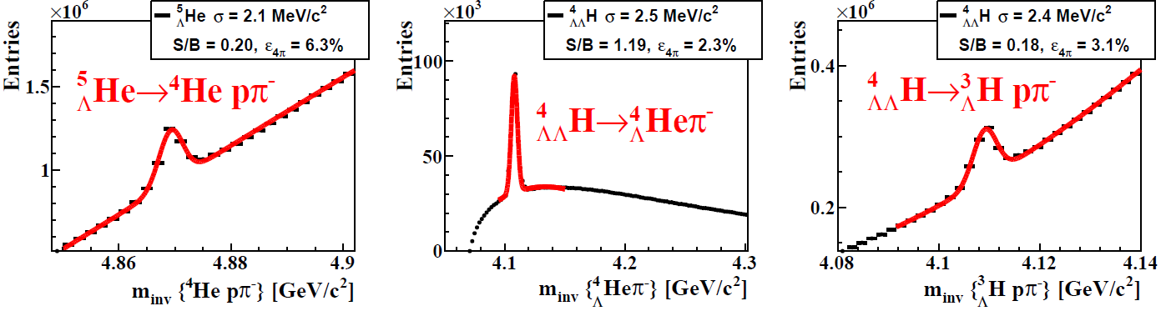
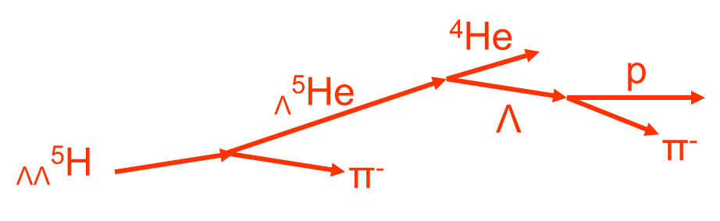
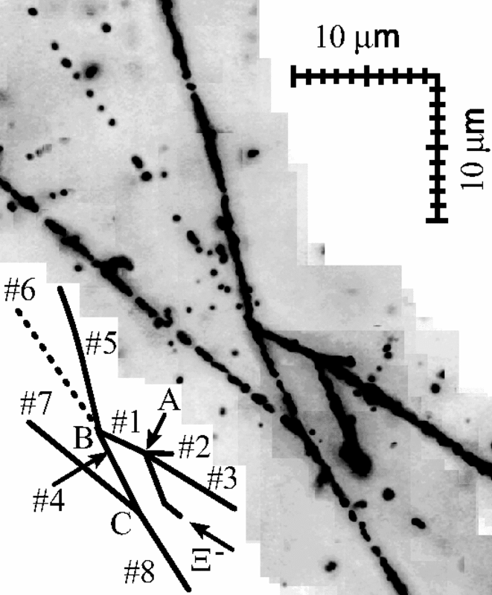
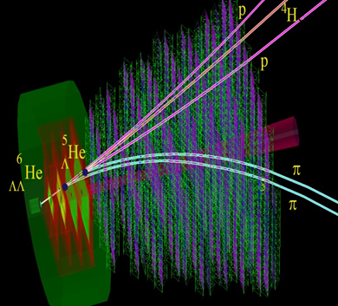
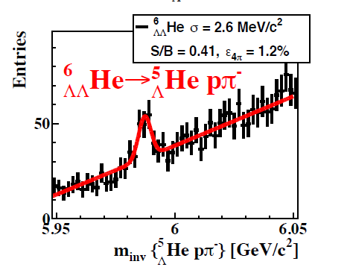
Hypernuclei reconstruction in CBM
5 M min. bias Au+Au collisions 10A GeV/c
_{ΛΛ}⁶He yield 60/week
(reaction rate 1 MHz, BR 10%, efficiency 1%)
Example:
_{ΛΛ}⁶He
p
p
π
⁶_{ΛΛ}He
⁵_{Λ}He
t
Nagara event

Slide 33
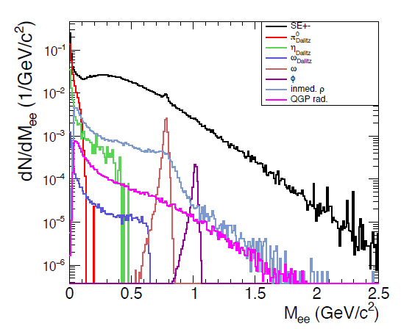
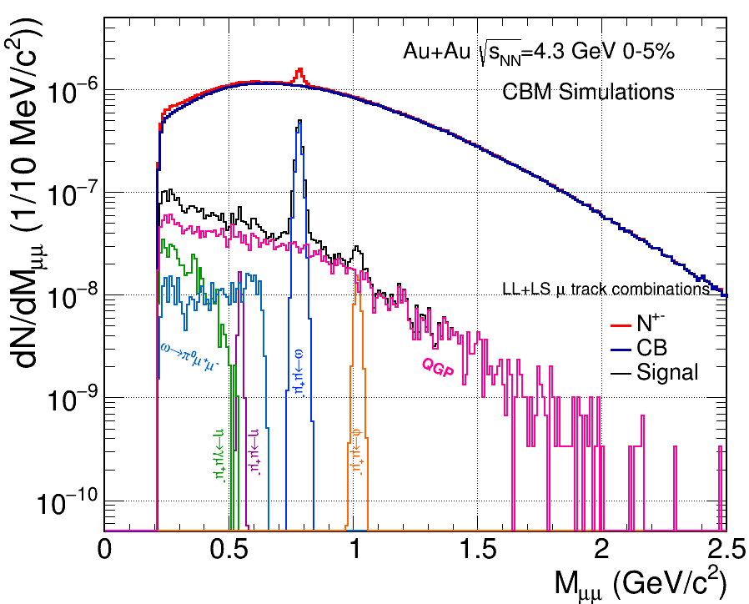
Dilepton invariant mass spectra
central Au+Au collisions at a beam energy of 8A GeV
Simulations: CBM experiment
Electron-positron pairs
Muon pairs
QGP +
inmed. 4π

Slide 34
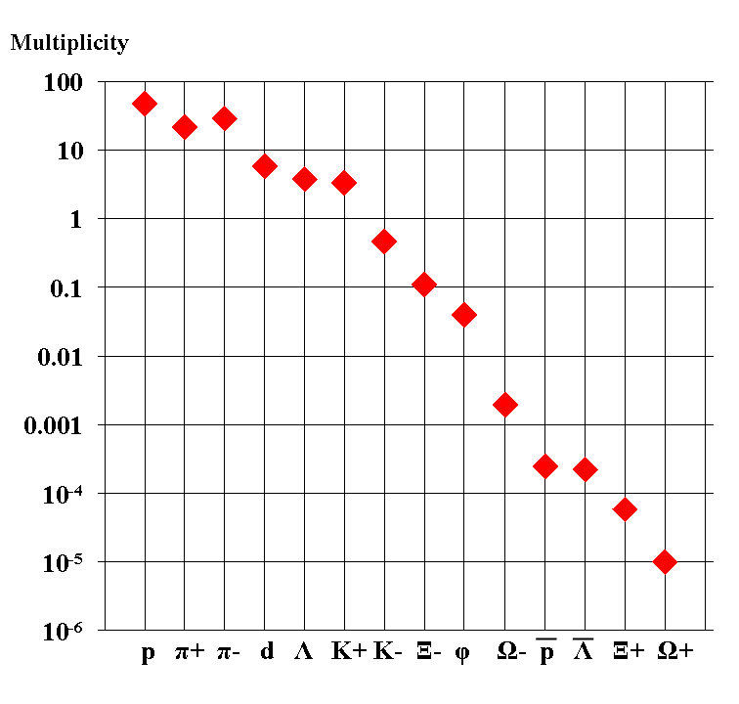
Experimental challenges
Particle yields in central Au+Au 4 A GeV
Statistical model, A. Andronic, priv. com.
AGS
extremely high
interaction rates
required !
e⁺e⁻
μ⁺μ⁻

Slide 35
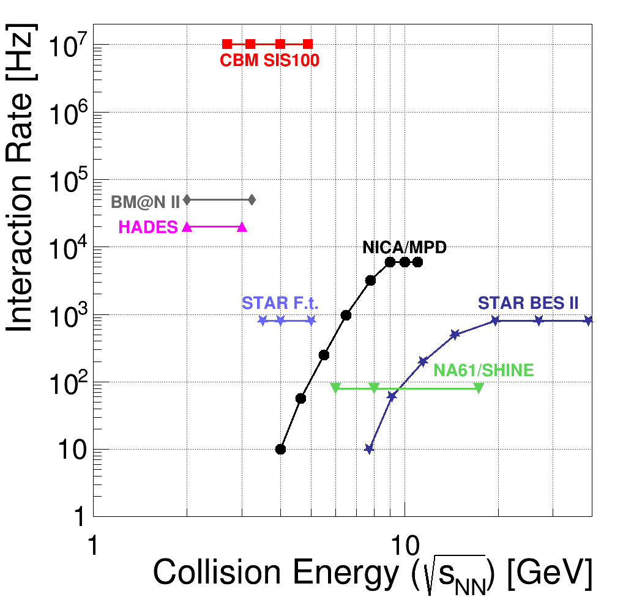
Experiments exploring dense QCD matter
high net-baryon densities
Complementary approaches towards the study of dense baryonic matter, but joint technical developments:
CBM photon detector
used in HADES
CBM TOF detector and reconstruction software used in STAR
Foreward calorimeters for CBM and NA61/SHINE
Silicon detector and software developments for NICA
T. Ablyasimov et al., (CBM Collaboration) Eur. Phys. J. A 53 (2017) 60

Slide 36
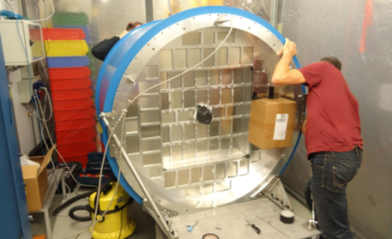
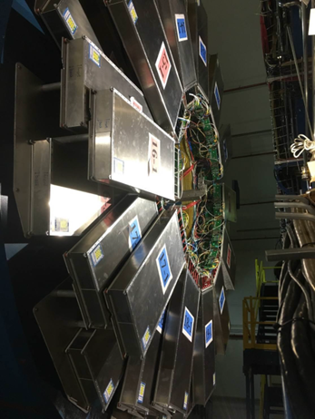
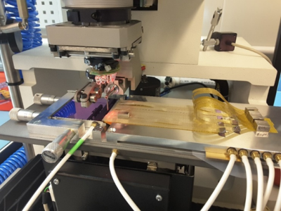
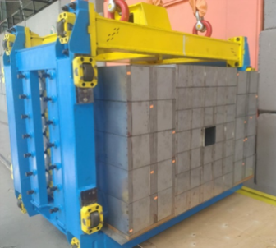
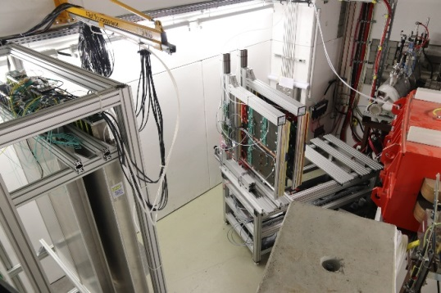
CBM „phase 0“ experiments on dense QCD matter
1. CBM RICH photon detector: 430 out of 1100
multi-anode photo-multipliers (MAPMT) installed
in HADES experiment and used for physics runs
2. CBM TOF detector: 10% of the CBM TOF
modules including read-out chain installed and
used at STAR/RHIC (BES II 2019/2020)
3. Four Silicon Tracking Stations and a
Projectile Spectator Detector will be installed
in the BM@N experiment at the Nuclotron in
JINR/Dubna (start 2022 with Au-beams
up to 4.5A GeV )
4. miniCBM experiment installed at GSI/SIS18
and commissioned with beam for a full system
test with high-rate nucleus-nucleus collisions
from 2018 - 2021
36

Slide 37
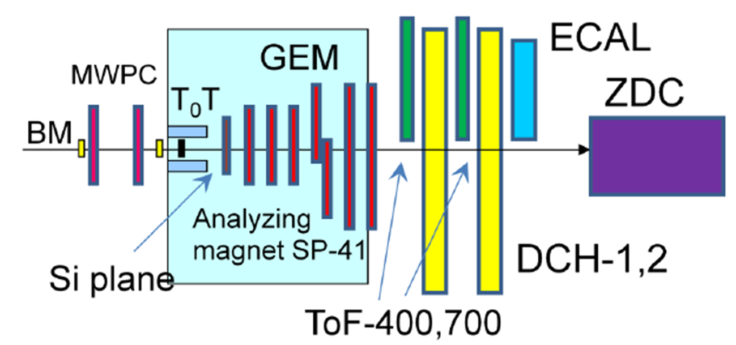
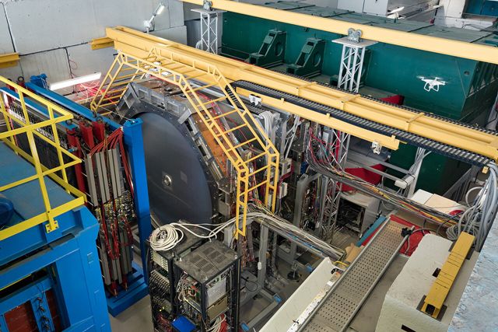
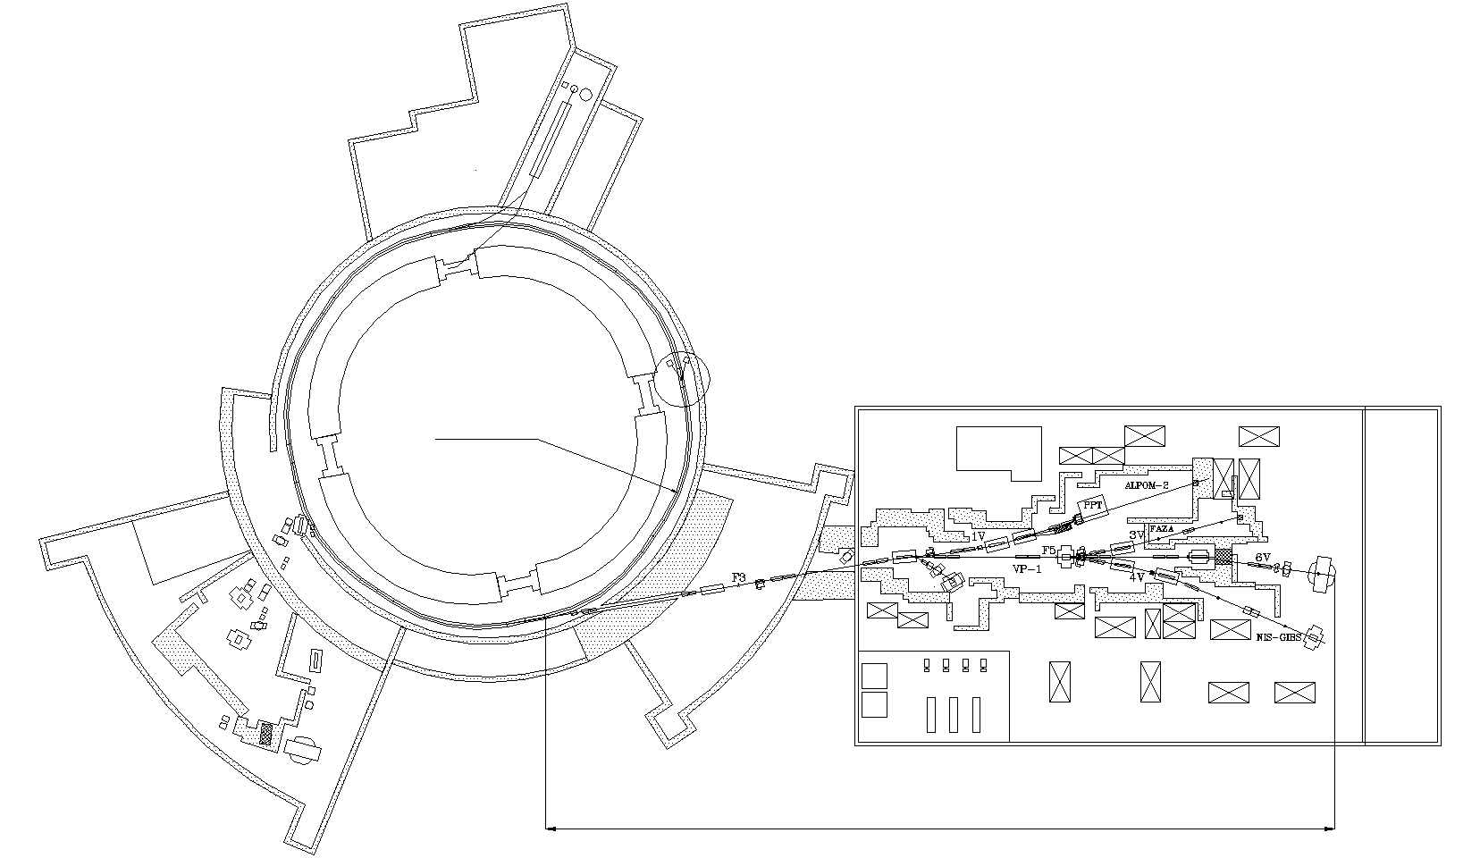
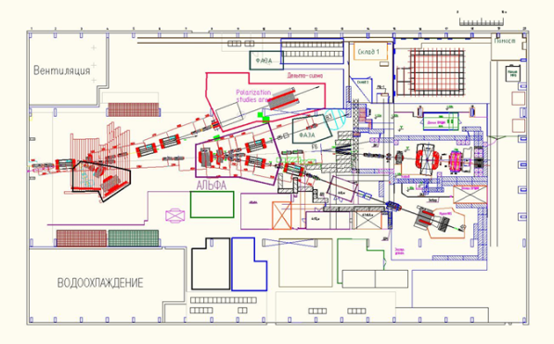
The Baryonic Matter at Nuclotron
(BM@N) experiment
Nuclotron
~160 m

Slide 38
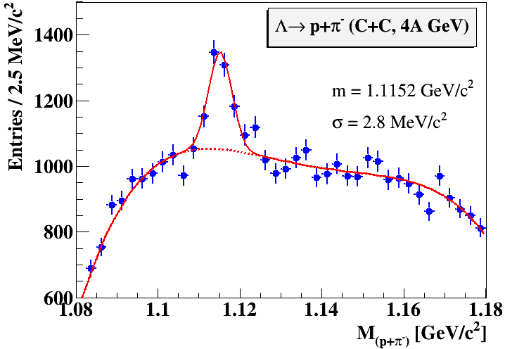
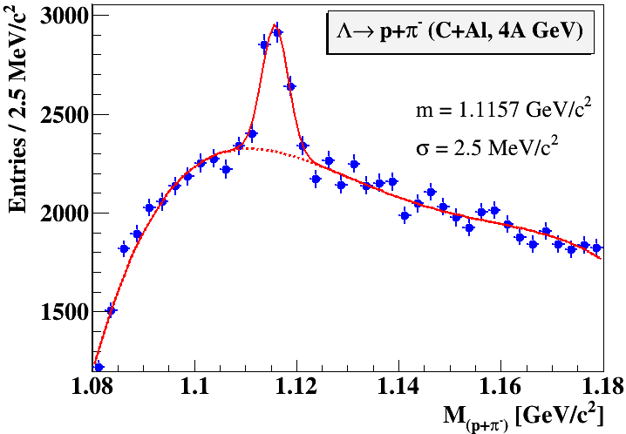





Lambda production in
C + C, Al, Cu collisions at 4A GeV
Available beams:
C, Ar, Kr, … up to 6A GeV
Current situation:
Air gaps in beamline to Expt.
No beam pipe in Expt.
Energy dependence of Λ hyperon yields in minimum bias C+C interactions.
Energy dependence of Λ hyperon yields in minimum bias C+C interactions.
Next plans→ add results for 3.5 and 4.5A GeV Carbon-nucleus interactions
Next plans→ add results for 3.5 and 4.5A GeV Carbon-nucleus interactions
Acknowledgements. This work was supported by the Russian Foundation for Basic Research (RFBR): grant No. 18-02-40036 mega.
Acknowledgements. This work was supported by the Russian Foundation for Basic Research (RFBR): grant No. 18-02-40036 mega.

Slide 39



BM@N upgrade for Au+Au collisions up to 4.5A GeV
The hybrid tracking system:
4 stations double-sided micro-strip silicon sensors
7 stations Gas-Electron-Multiplier (GEM) chambers

Slide 40







Slide 41



BM@N upgrade for Au+Au collisions
central Au+Au collisions at 4A GeV (QGSM generator)
track reconstruction efficiency
momentum resolution
low GEM granularity

Slide 42



Physics performance simulations
of the hybrid tracking system
Lambda reconstruction in 1000 central Au+Au 4A GeV
Produced Λ
Reconstructed Λ
ε(Λ) ≈ 10% without PID for p and π

Slide 43




Radiation environment
FLUKA
max. rate 5 kHz/cm² (innermost sensors)
strip size 50 μm ⋅ 6 cm = 3⋅10⁻² cm²
read-out time 1 μs → occupancy 1.5⋅10⁻⁴
2⋅10⁶ Au ions/s with 4.5A GeV on 1% int. Au target
Expected run time: 5 years, 4 months/year
→ Ionizing dose 100 Gy (mild damage)
→ Neutron equivalent dose 10¹¹ n_{eq}/cm²
(well below type inversion)

Slide 44


Work package
Joint development of instrumentation for NICA and FAIR/CBM
Grant 4.6 M€ over 4 years for manpower (starting 2020)
Task | Partners
Integration, installation, and test of Silicon Trackers for NICA and CBM | JINR Dubna, FAIR/GSI, Univ. Tübingen
Developments for the data acquisition chain, for data preprocessing and computing procedures | JINR Dubna, FAIR/GSI, WUT Warsaw
Development of common software packages for simulation and data analysis, participation in physics performance studies | JINR Dubna, FAIR/GSI, MEPhI, Wigner Inst. Budapest
Development and construction of beam monitors, target chamber, beam pipe for NICA and CBM | JINR Dubna, FAIR/GSI
Development and construction of Zero Degree Calorimeters for NICA and CBM | INR Moscow, NRI-CAS Prague

Slide 45
Work package
Joint development of detector technologies
Task | Partners
Develop a beyond state of the art CMOS pixel sensors (MAPS) for high-rate Silicon trackers | JINR Dubna, FAIR/GSI, Univ. Frankfurt, KINR Kiev, IPHC Strasbourg,
Grant 1.0 M€ over 4 years for manpower (starting 2020)

Slide 46


Slide 47


Slide 48


Slide 49


The CBM Collaboration: 58 institutions, > 460 members
China:
CCNU Wuhan
Tsinghua Univ.
USTC Hefei
CTGU Yichang
Chongqing Univ.
IMP Lanzhou
Czech Republic:
CAS, Rez
Techn. Univ. Prague
France:
IPHC Strasbourg
Hungary:
KFKI Budapest
Eötvös Univ.
Germany:
Darmstadt TU
FAIR
Frankfurt Univ. IKF
Frankfurt Univ. FIAS Frankfurt Univ. ICS
GSI Darmstadt
Giessen Univ.
Heidelberg Univ. P.I.
Heidelberg Univ. ZITI
HZ Dresden-Rossendorf
KIT Karlsruhe
Münster Univ.
München TU
Tübingen Univ.
Wuppertal Univ.
ZIB Berlin
Russia:
IHEP Protvino
INR Troitzk
ITEP Moscow
Kurchatov Inst., Moscow
VBLHEP, JINR Dubna
LIT, JINR Dubna
MEPHI Moscow
PNPI Gatchina
SINP MSU, Moscow
Ukraine:
T. Shevchenko Univ. Kiev
Kiev Inst. Nucl. Research
India:
Aligarh Muslim Univ.
Bose Inst. Kolkata
Panjab Univ.
Rajasthan Univ.
Univ. of Jammu
Univ. of Kashmir
Univ. of Calcutta
B.H. Univ. Varanasi
VECC Kolkata
IOP Bhubaneswar
IIT Kharagpur
IIT Indore
Gauhati Univ.
Japan:
KEK Tsukuba
Korea:
Pusan Nat. Univ.
Poland:
AGH Krakow
Jag. Univ. Krakow
Warsaw Univ.
Warsaw Univ. Tech.
Romania:
NIPNE Bucharest
Univ. Bucharest
CBM Scientists
49
49
30th CBM Collaboration meeting Sept. 2017, CCNU, Wuhan, China

Slide 50




Summary
The goal of the CBM experiment at FAIR is to explore fundamental properties of QCD matter by measuring multi-differential observables (hadrons and leptons) with unprecedented precision. First beams of Au ions up to 11A GeV are expected in 2025.
The BMN experiment at NICA offers the opportunity to prototype the CBM silicon tracking system, and to start the investigation of dense nuclear matter produced in Au+Au collisions at beam energies of up to 4.5A GeV in 2023.

Slide 51
Backup

Slide 52
EOS from the elliptic flow of fragments
in Au+Au collisions at SIS18 energies (ρ < 3ρ₀)
A. Le Fevre , Y Leifels, W. Reisdorf, J. Aichelin, Ch. Hartnack, Nucl. Phys. A945 (2016) 112
HM
SM

Slide 53


Kaon production at GSI/SIS 18
Experiment: C. Sturm et al., (KaoS Collaboration) Phys. Rev. Lett. 86 (2001) 39
Theory: QMD Ch. Fuchs et al., Phys. Rev. Lett. 86 (2001) 1974
IQMD Ch. Hartnack, J. Aichelin, J. Phys. G 28 (2002) 1649
Au/C ratio: cancellation of systematic errors both in experiment and theory

