Slide 1
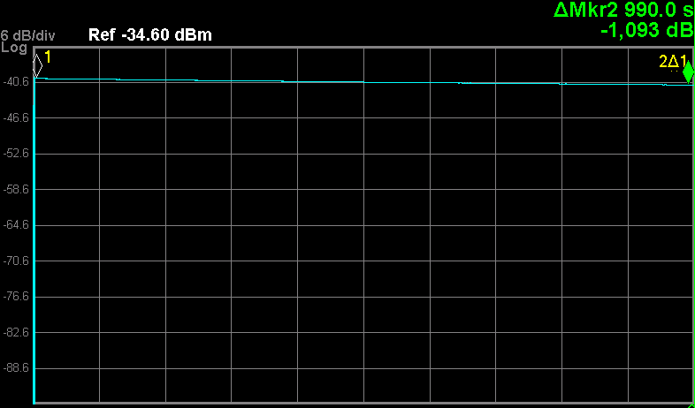
and HITRAP
CRYRING@ESR
CRYRING@ESR
ECooler
leak in isolation vacuum
next test fill after the fix in Jan.
Major vacuum incident on Nov-23 vented 7 out of 8 sections
Post mortem report (link), later found that the cryopump at the E Gun is broken (due to the vent or the bake out) – to be fixed in Jan.
UHV + Ring operation reestablished by Dec-10. Ready for ESR beam
Ring Operation/Test
stored D⁺ @ 5 MeV/u for 1000 s (with only little losses) – life time beyond 6000 s
injection kicker tested successfully with beam
extraction kicker tested, beam disappears, extraction section BI not available
HITRAP
EBIT run for B³⁺ laser spectroscopy conducted by TUDA colleagues ended
started removing the faulty MPS (multi passage spectrometer/ beam switch)
1000 s
December-17, 2019
Frank Herfurth

Slide 2
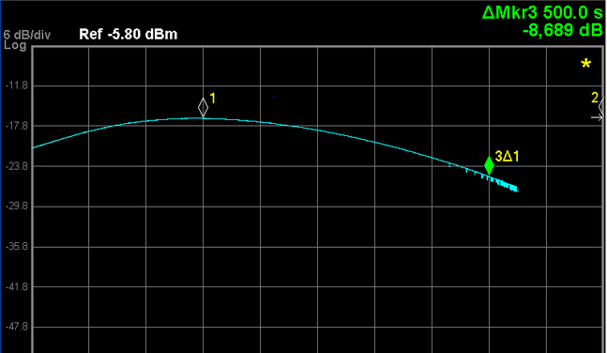
and HITRAP
CRYRING@ESR
CRYRING@ESR
Summary of engineering run and Status for Experiments
stored Ar¹⁸⁺ @ 13 MeV/u – life time about 600 s
required 14 shift with ESR beam (Machine Meeting in June)
got less than 2 shifts
did not measure life time for heavier, highly charged ions
we have almost no control on the beam setup quality (tuning/optimization)
To set one new value for the coupled ESR – CRYRING pattern requires at least 1 min, but usually 3 to 6 min.
this yields less than 10 different values per hour
Experiments at CRYRING@ESR will be extremely challenging
1000 s
PAC Experiments in 2020 expect:
¹³⁶Xe⁵⁰⁺, ²³⁸U⁸⁸⁺ and ²³⁸U⁹¹⁺ @ about 10 MeV/u, 10⁷ (/ minute)
cooled!
Januar-07, 2020
Frank Herfurth

