Slide 1

CBM Iron yoke and support design
11 2019, BINP, M.Kholopov, A.Bragin, S. Pivovarov.

Slide 2
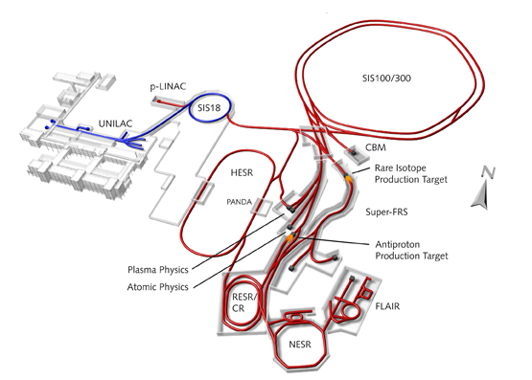
FAIR

Slide 3
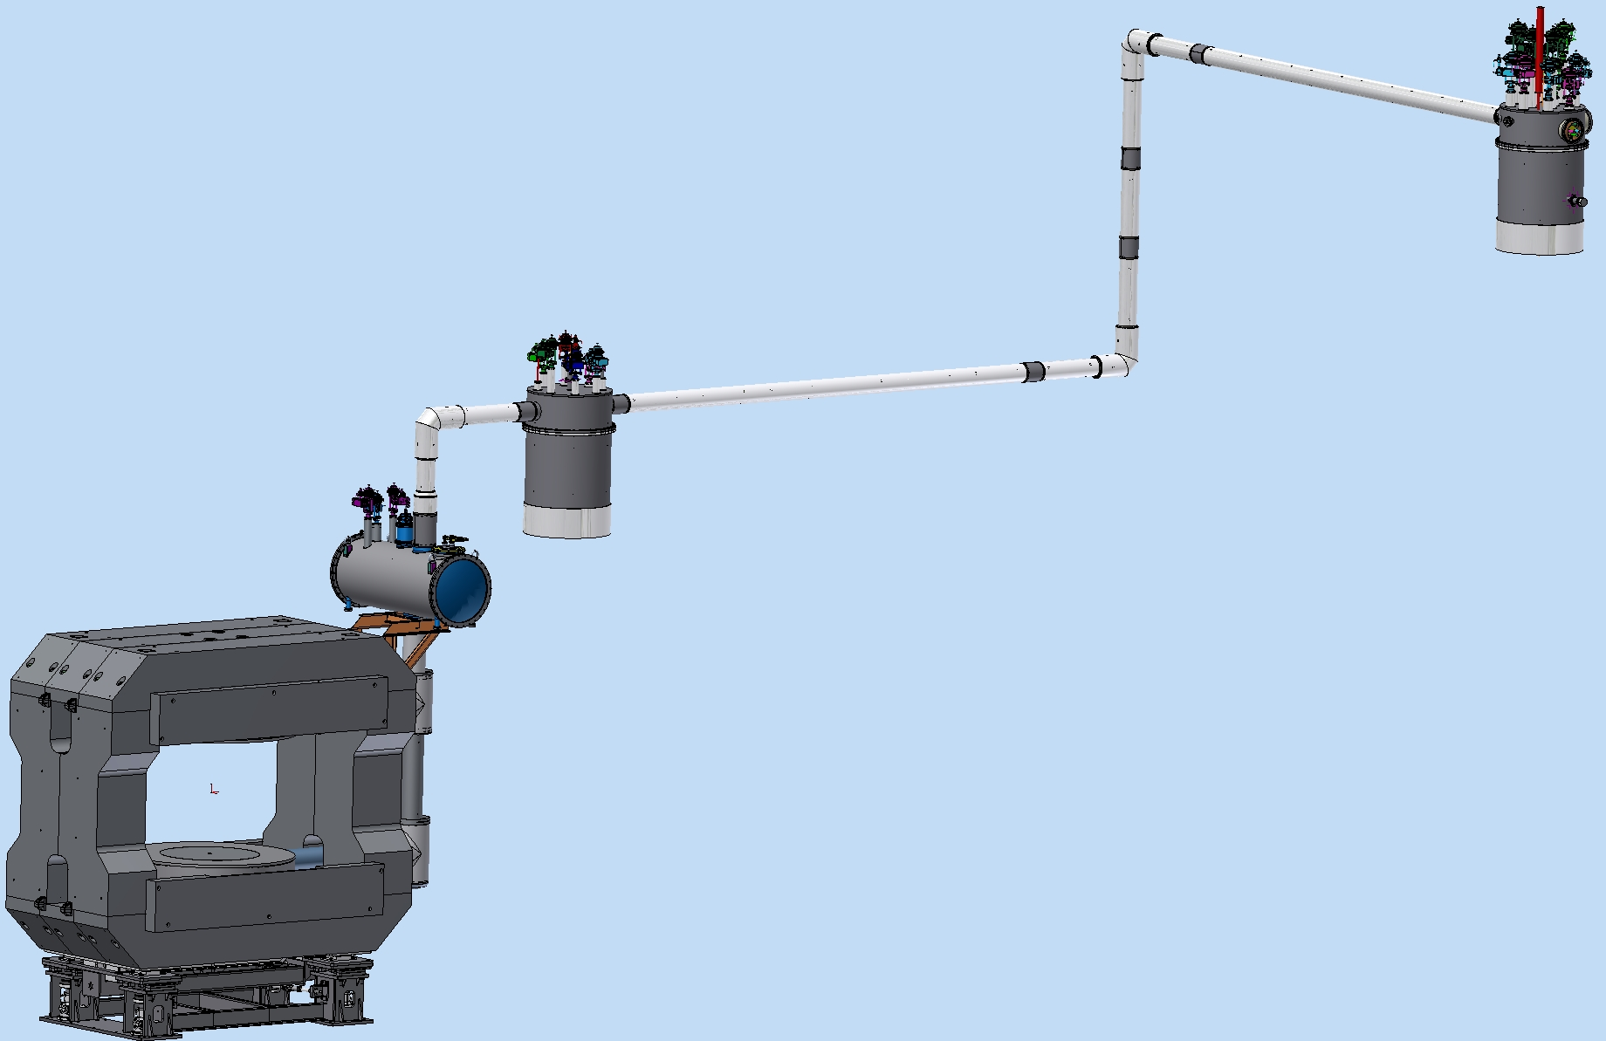
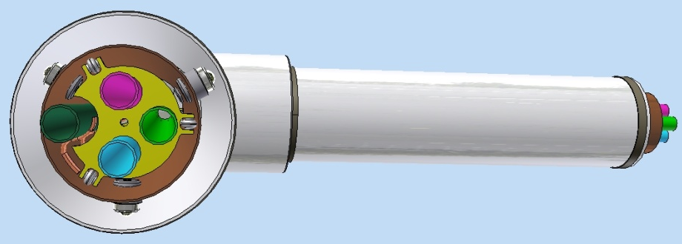
3D Model of CBM Magnet and cryosystem
Feed Box (m=1160kg, D=1100mm, H=2370mm)
Cryostat,
TL, magnets (m=7850kg)
Branch Box (m=1560kg, D=1100mm, H=2680mm)
Iron Yoke (m=145412kg)
He transfer
Line (30kg*m)
Coil (m=1479kg)
Support (m= 4480 kg)

Slide 4
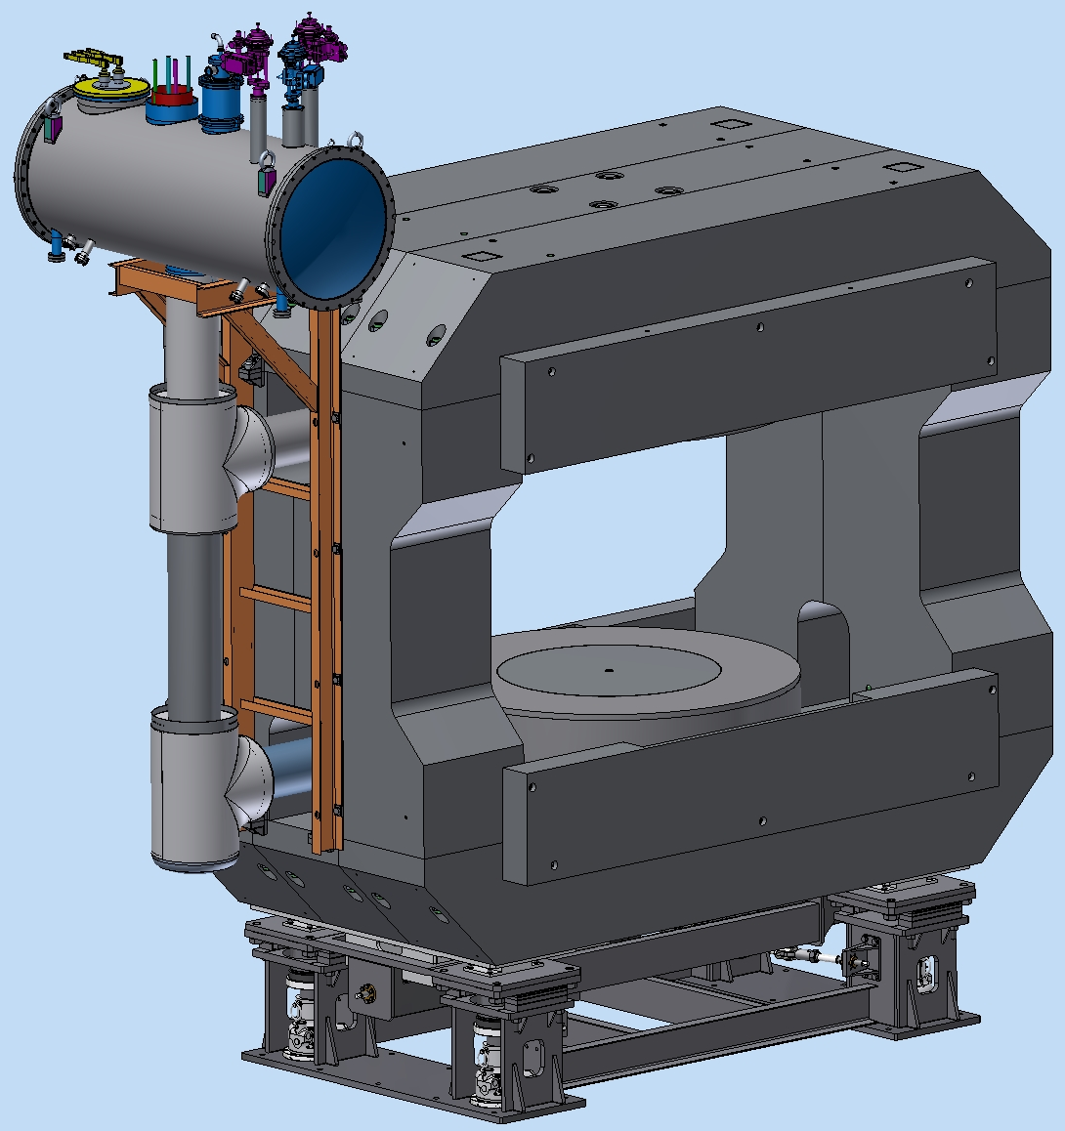
3D Model of CBM Magnet (new design)
2
Support m= 4480 kg
Iron Yoke m=145412kg
Coils m=3100kg
Cryostat m=940kg
Cryostats TL m=710kg
The support’s load – 154 tons
4
3
5
1

Slide 5
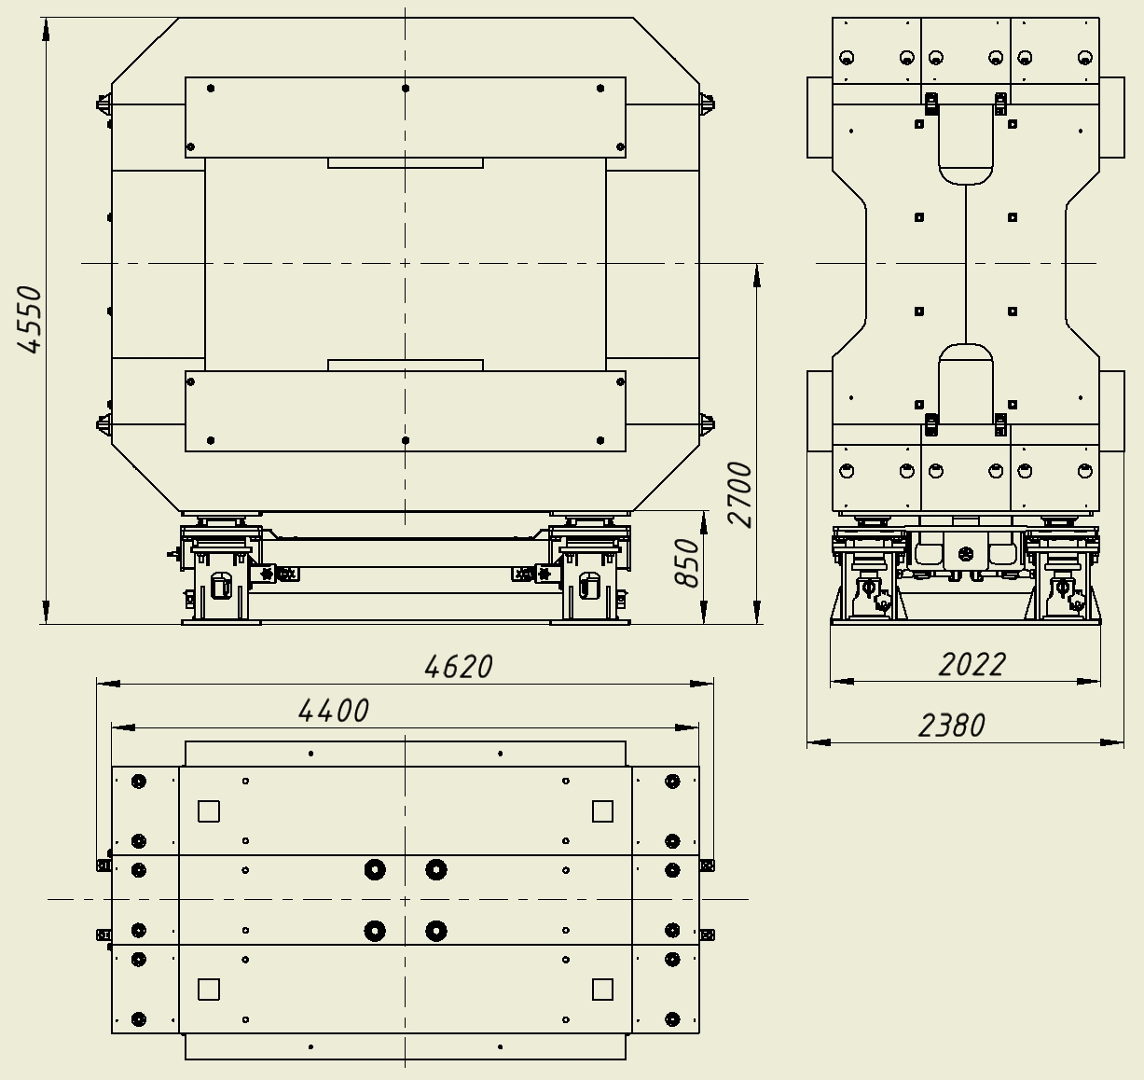
Iron Yoke and supports drawing
Weight and size
m= 150000 kg
L=4620mm
W=2380mm
H=4550mm

Slide 6
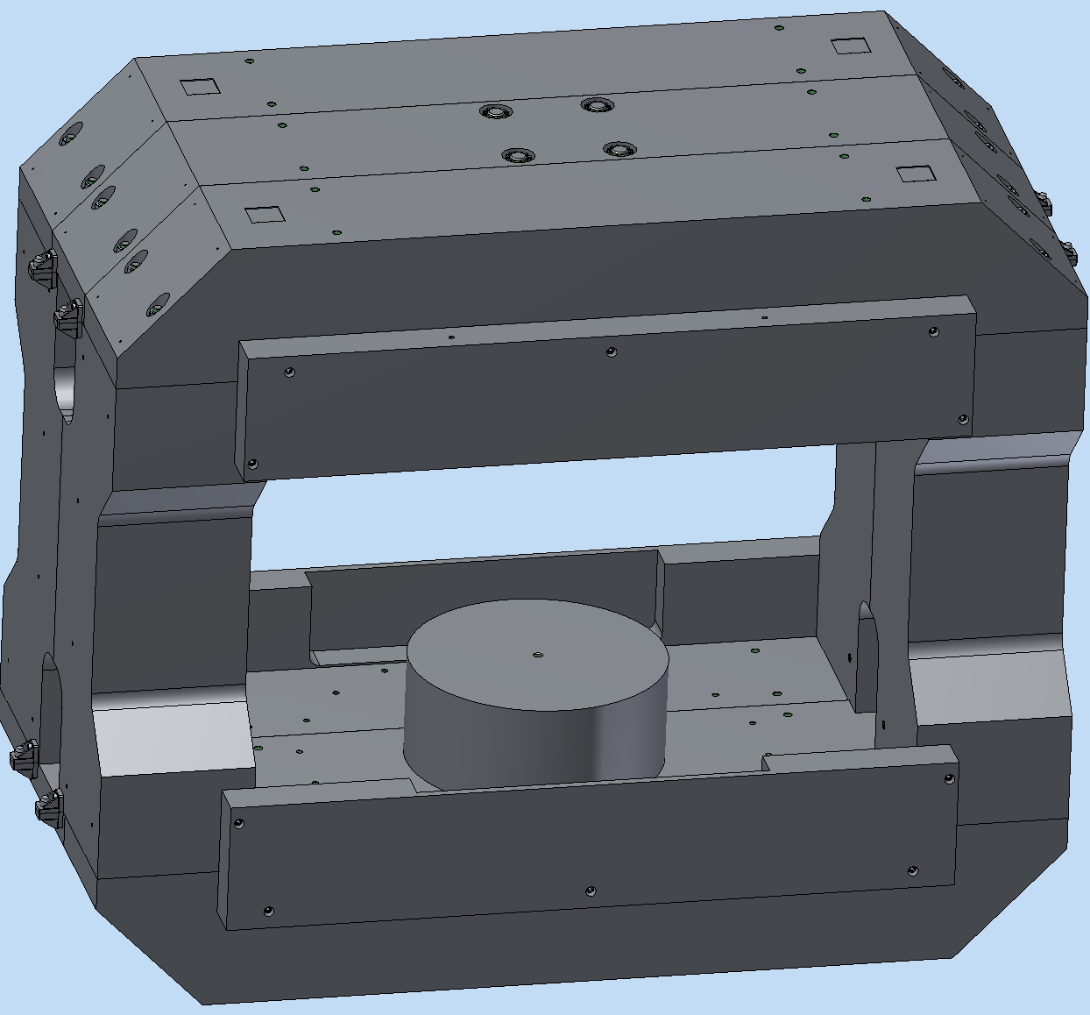
Iron Yoke 3D Model
Geodetic platform
Top beam
13551 kg
Central beam
13594 kg
Geodetic holes
Rack
10335 kg
Pole
3967 kg
Mounting bracket
Screen
2214 kg

Slide 7
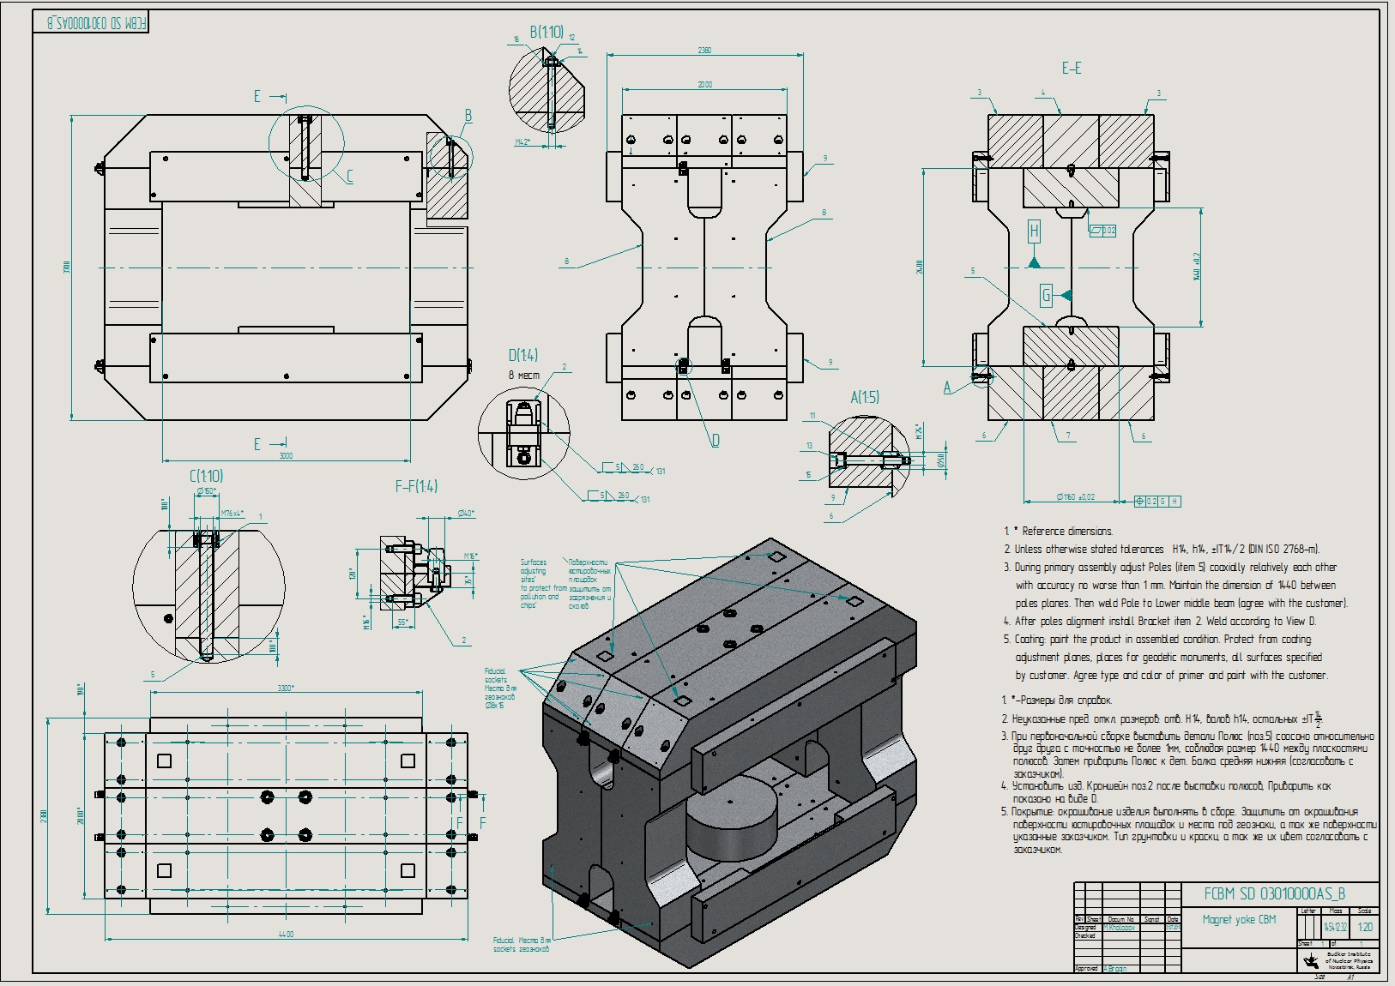
Iron Yoke and supports drawing
Weight and size
-m= 145412 kg
-L=4440mm
-W=2380mm
-H=3700mm

Slide 8
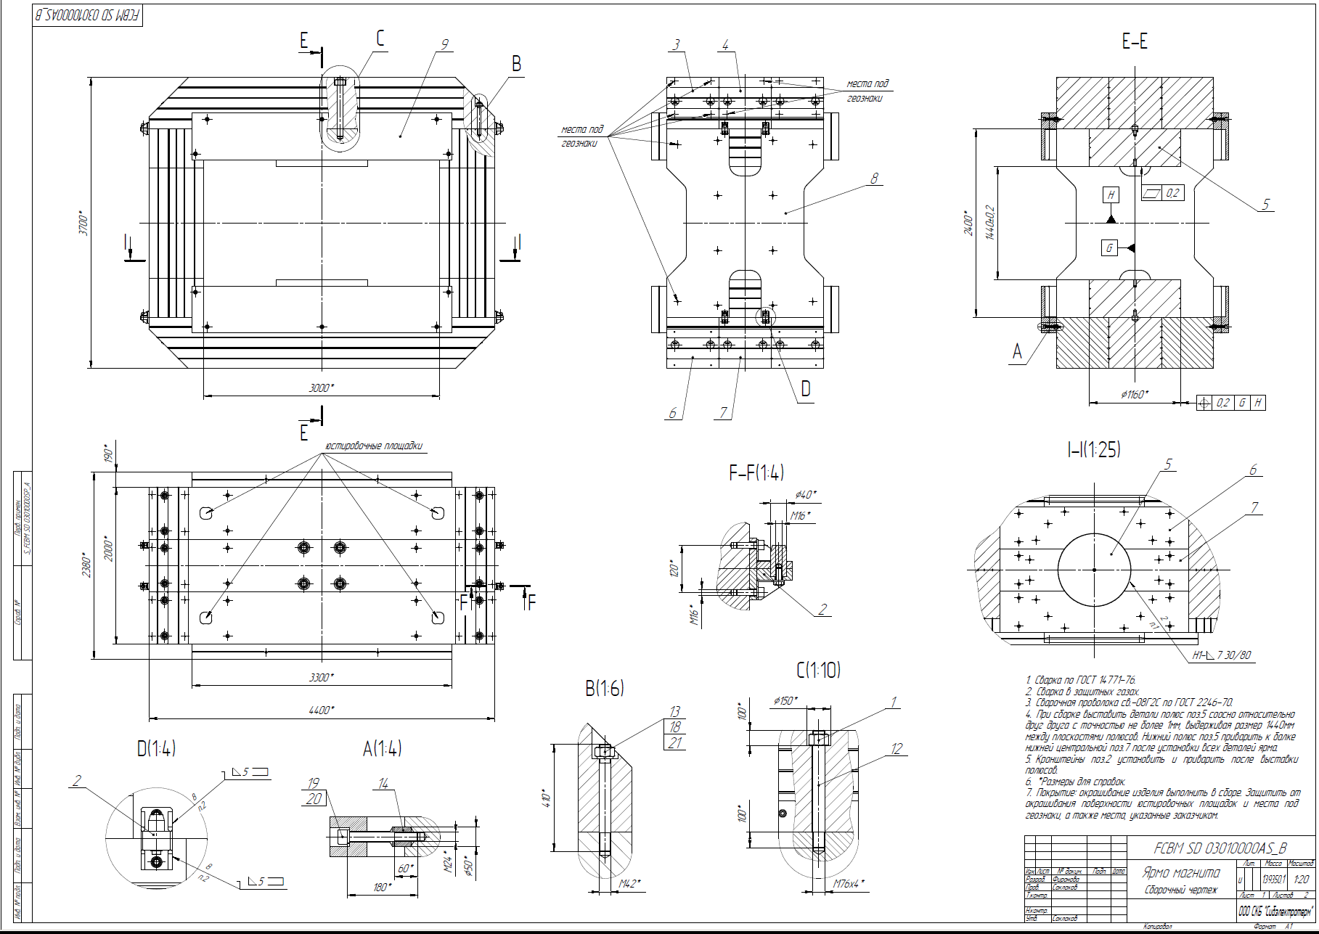
Iron Yoke production drawing
Drawings are processed in technologists and prepared for translation.

Slide 9
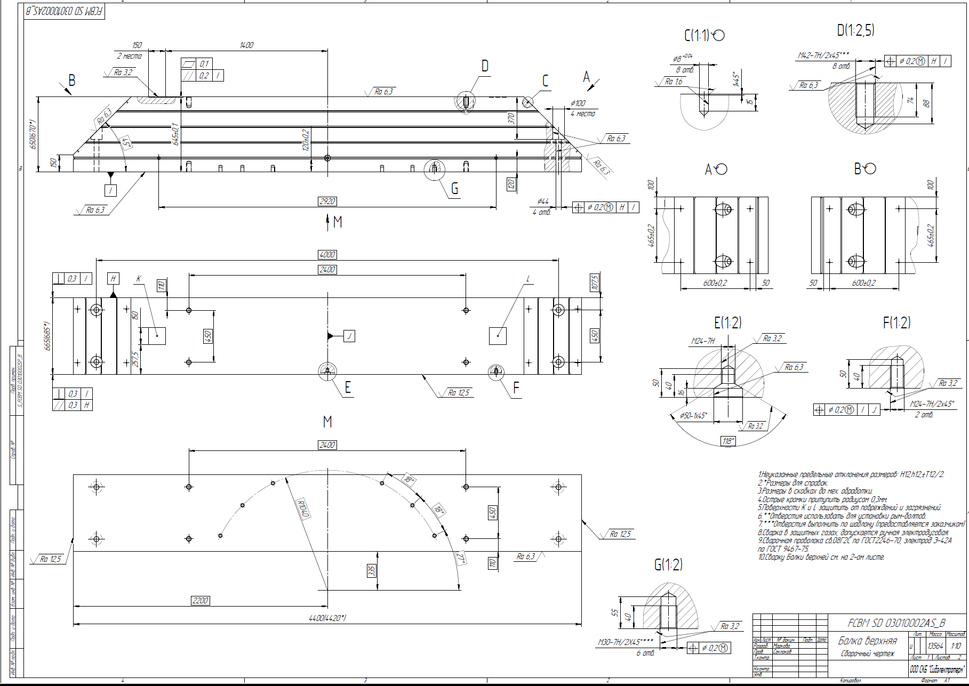
Iron Yoke production drawing
Top beam
An example of the implementation of the yoke of sheet material.

Slide 10
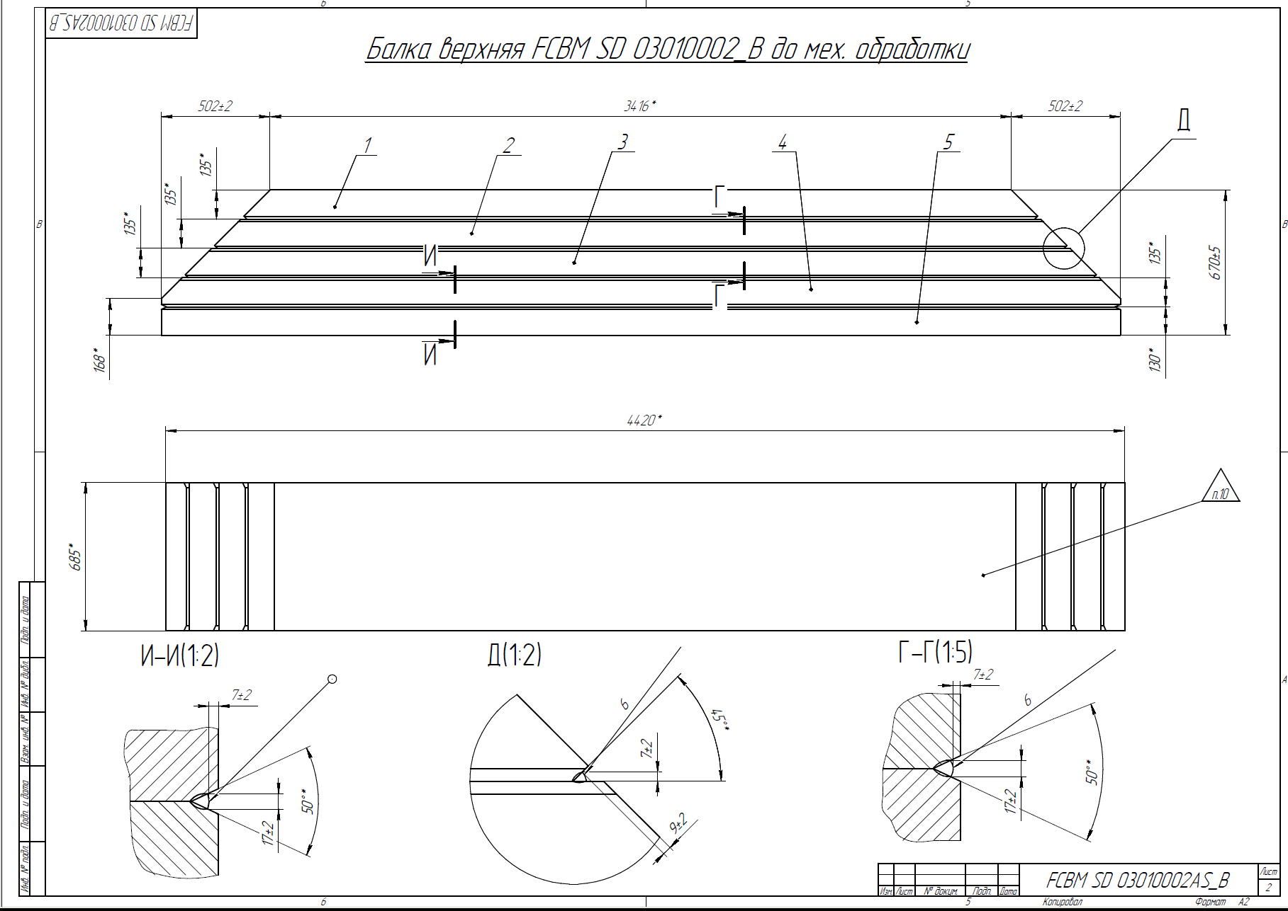
Iron Yoke production drawing
Detail - Top Beam to the machining, allowance for processing 10 mm.
An example of the implementation of the yoke of sheet material.

Slide 11
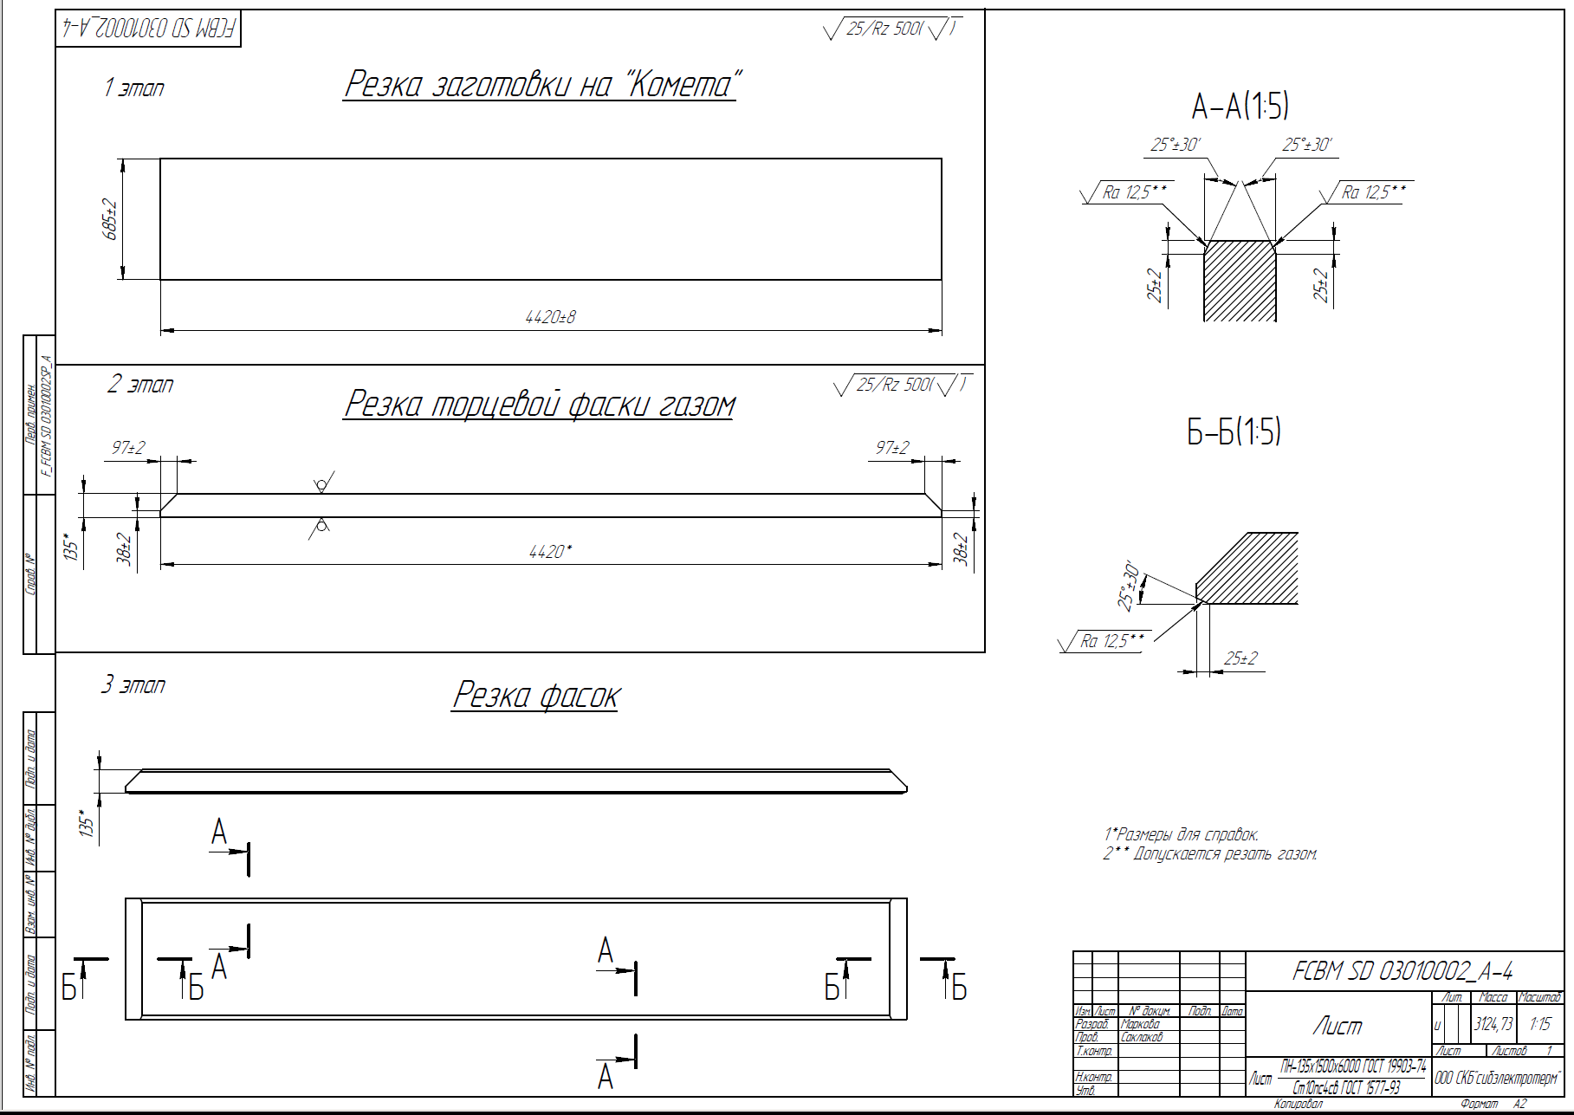
Iron Yoke production drawing
First step
Cutting the blanks from a sheet
Second step
End chamfer cutting
Third step
Cutting chamfers for welding
Sheet
An example of the implementation of the yoke of sheet material.

Slide 12
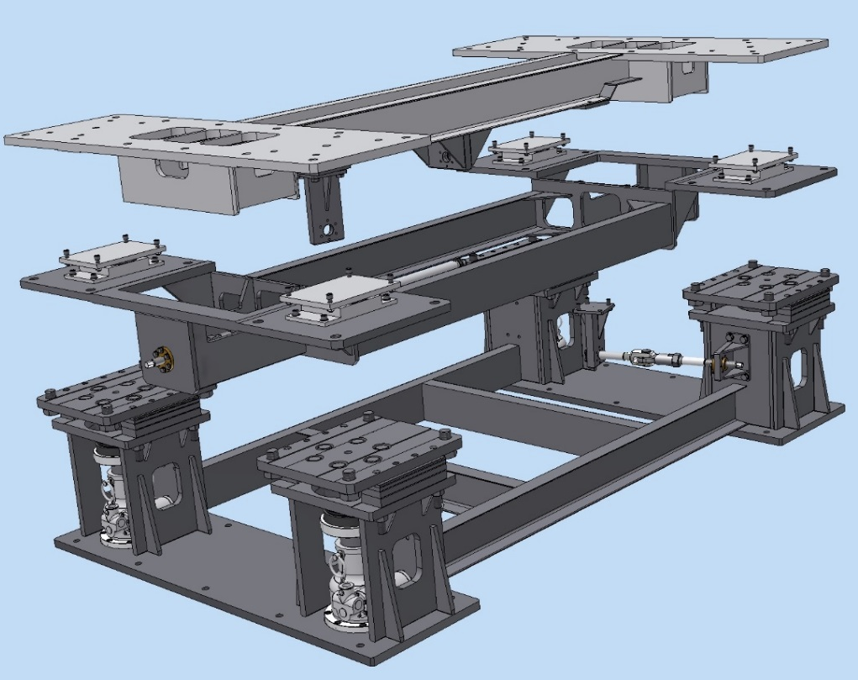
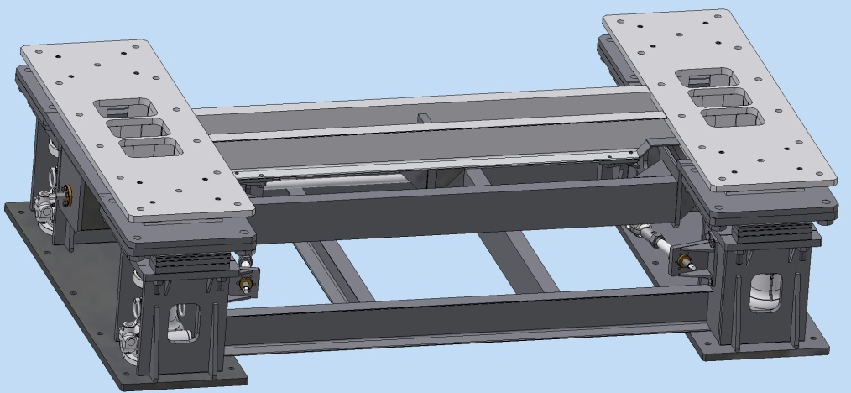
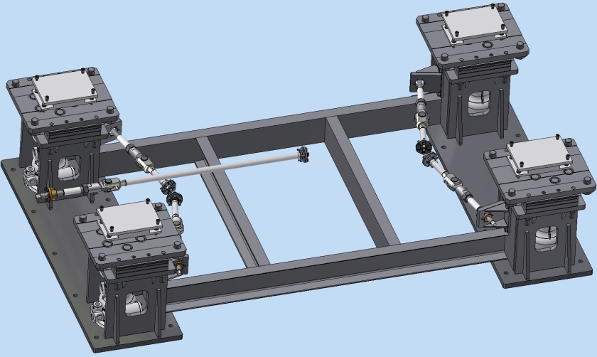
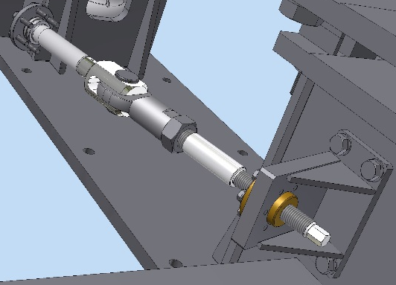
CBM Magnet support
Iron yoke
Fixation plate
Top frame
Magnet supports alignment tools
- Position accuracy: ± 0.5 mm (meeting in December 2018)
- Orientation accuracy (roll): ± 0.5 mrad
-Also, this design allows rotation around vertical axis ± 0.5 ⁰
-The gimbals has a fixation and alignment tool
Intermediate frame
Screw jack Rack
Sliding support
Weight and size
Gimbal longitudinal
m= 4480 kg
2022x3470x850mm
move in 3D ±40mm
Rotation top frame ±4⁰
Loading capacity 200000 kg
strength class of fasteners - 8.8
Swivel bearing
Cross gimbal

Slide 13
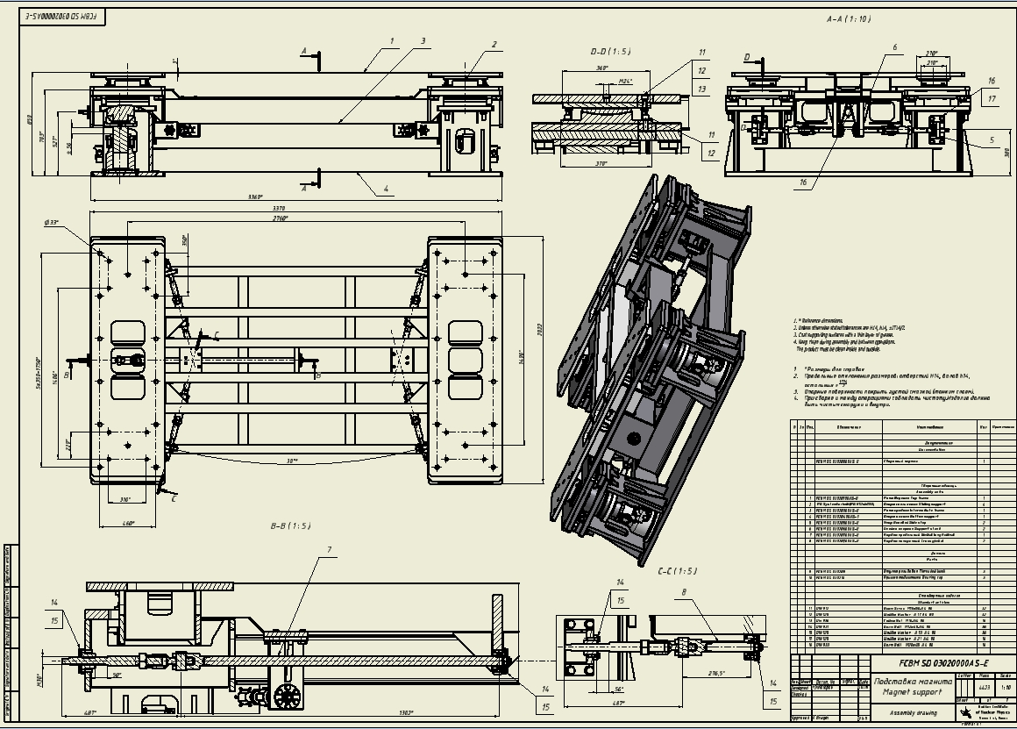
Magnet supports drawing

Slide 14
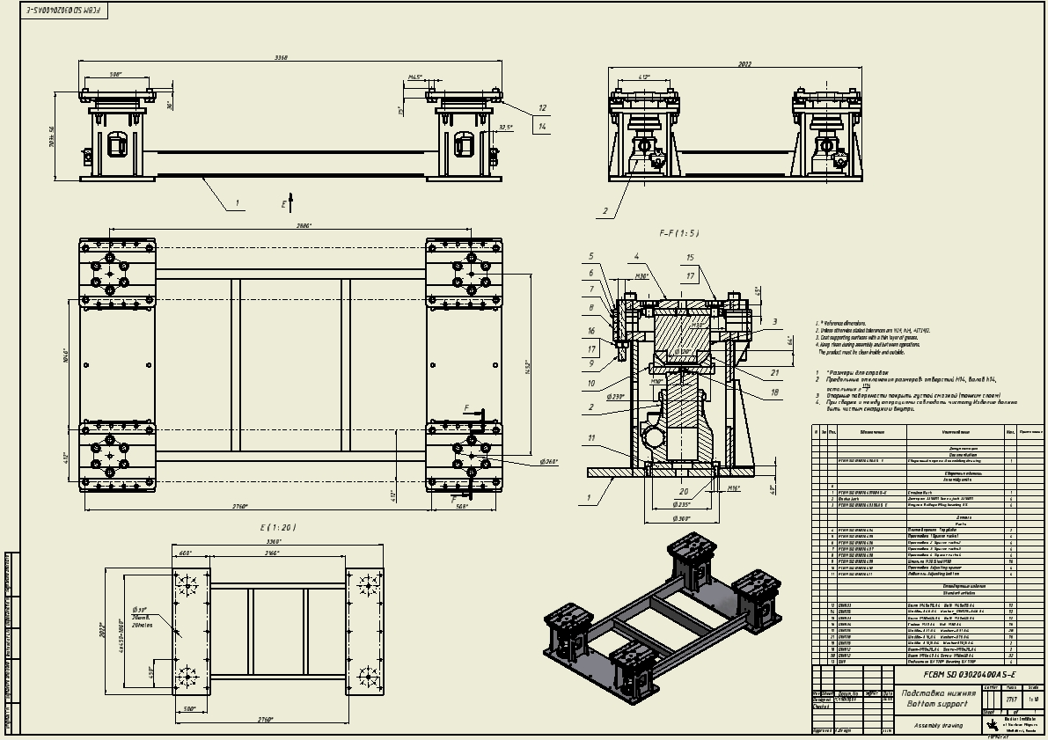
Bottom supports drawing

Slide 15
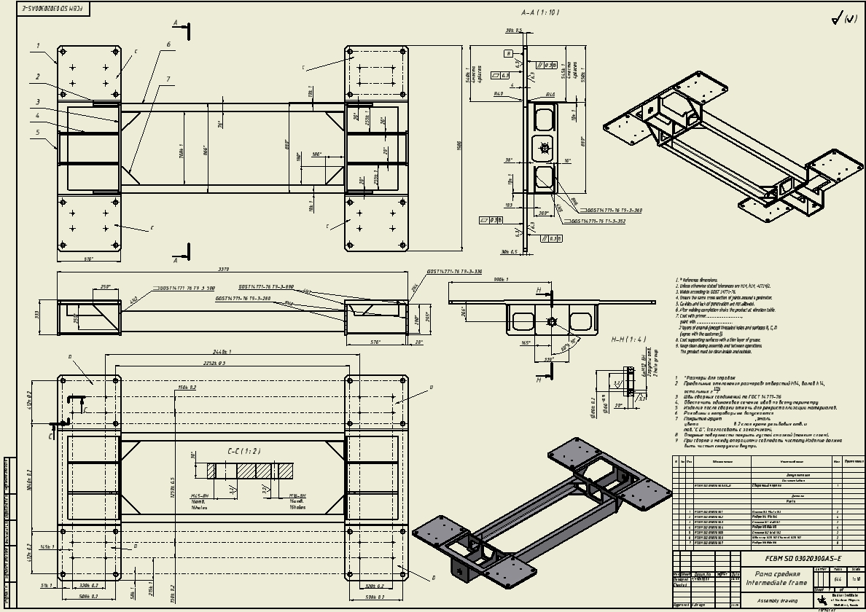
Intermediate frame drawing

Slide 16
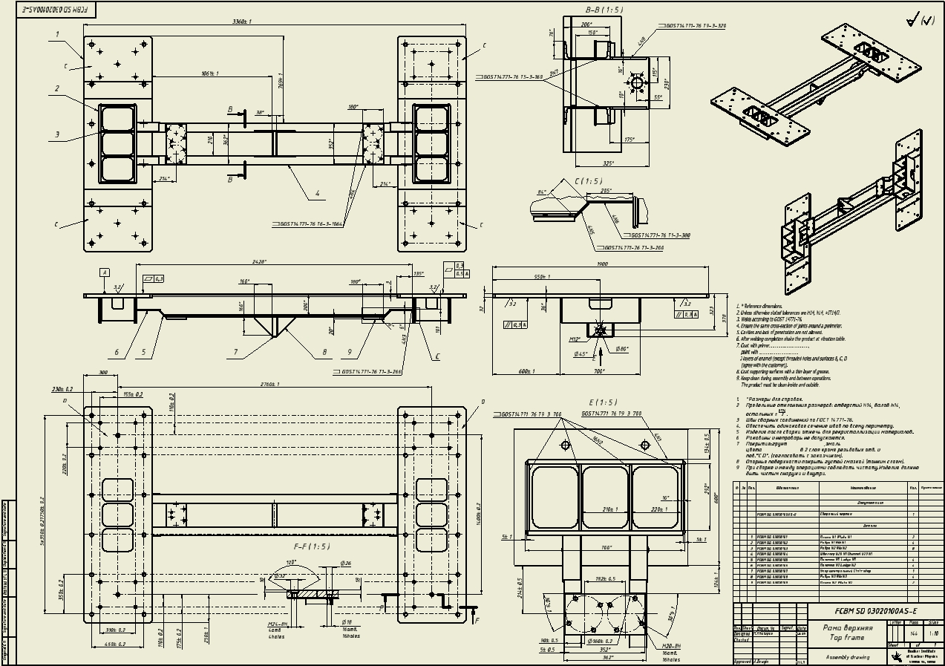
Top frame drawing

Slide 17
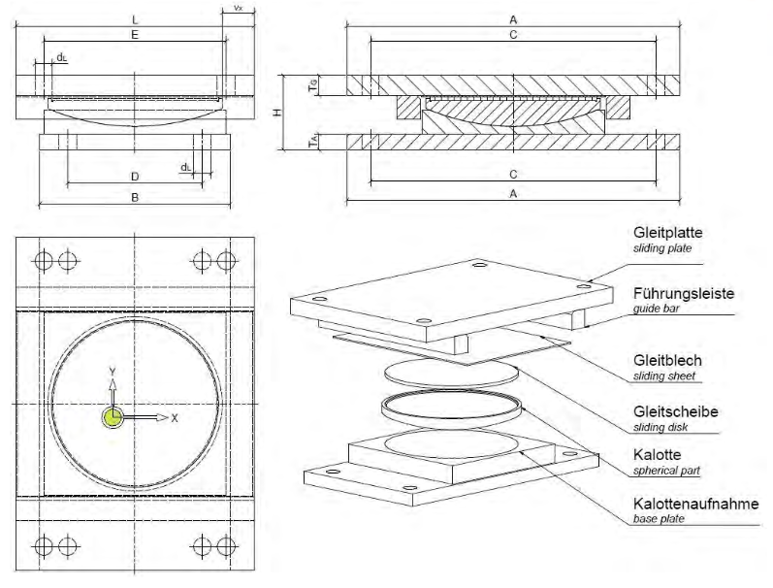
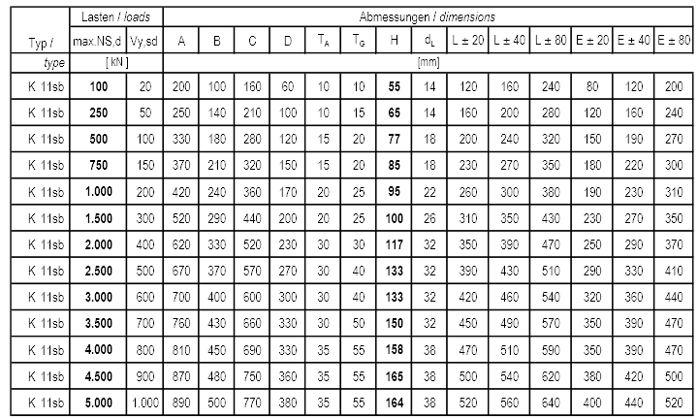
PTFE plate can be replaced with radiation resistant material. For example bronze with lubrication.
PTFE bearings are maintenance-free, this also applies to lubricated PTFE bearings;
Very Low Friction Constant
For the sake of simplicity, the following friction constants may be assumed under optimum installation conditions:
PTFE bearing, not lubricated about max. μ = 0.1
PTFE bearing, lubricated about max. μ = 0.04
The PTFE slidingplates are absolutely corrosion resistant, re-sistant against chemicals and aging. The steel parts of the bearings are by standard sandblasted and provided with a zinc phosphate coating. Upon request, all usual corrosion protection processes are of-fered, including hot galvanizing. Versions made of special steel alloys or stainless steel on request

Slide 18
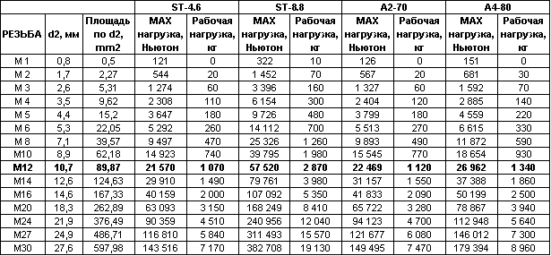
Fastener strength tablet
class of fasteners
Thread
MAX load,
N
Work load,
kg
MAX load,
N
Work load,
kg
MAX load,
N
Work load,
kg
MAX load,
N
Work load,
kg

Slide 19
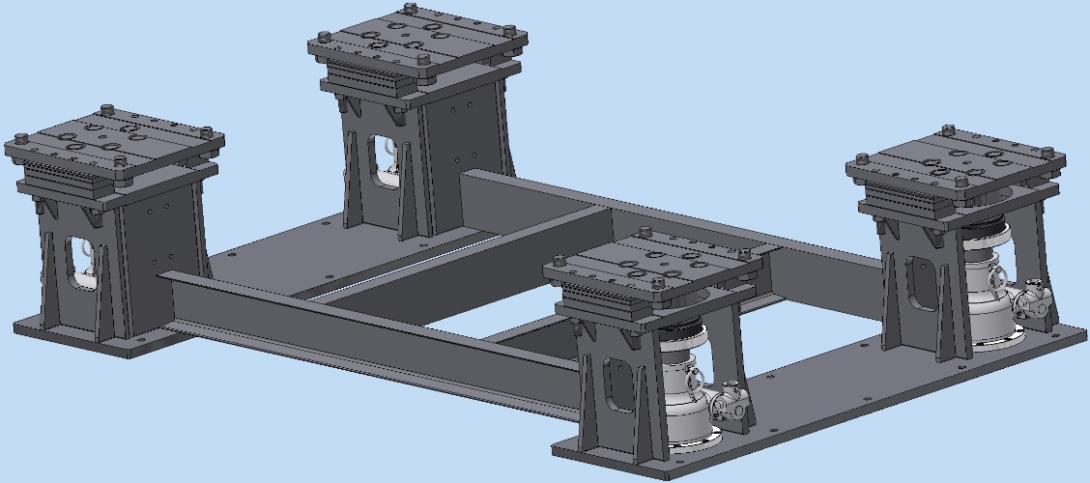
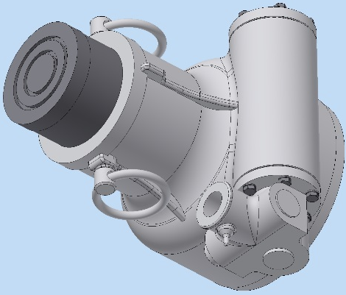
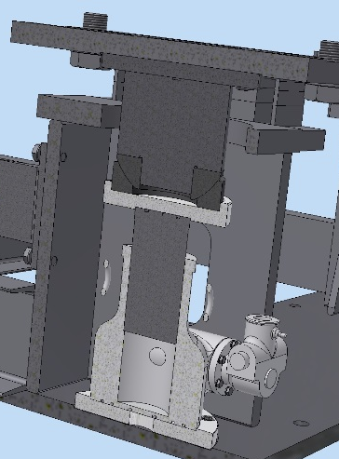
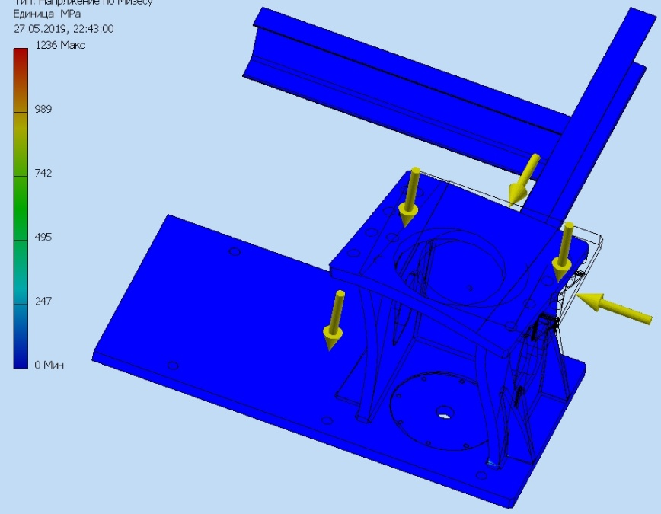
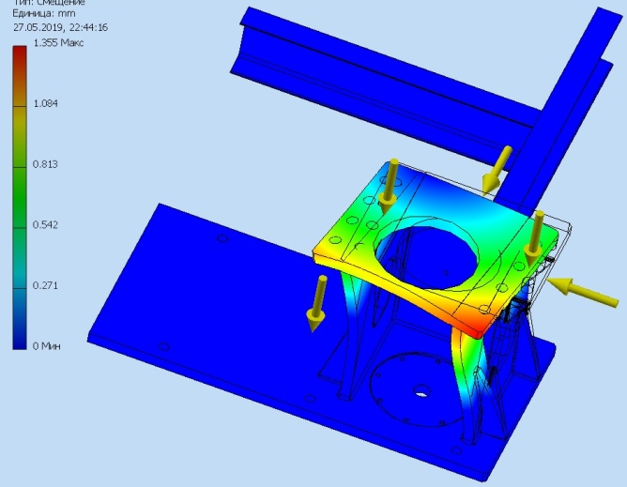
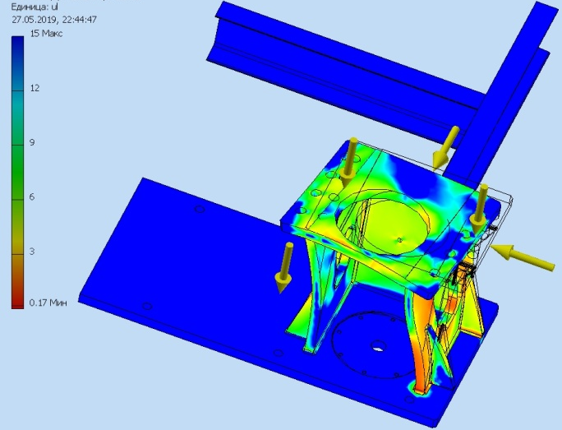
Screw jack Rack : design and calculation
2767 kg
Bottom support
1515 kg
Screw jack
Osaka Jack Co JJ10011
loading capacity 1000kN
Spherical bearings
(GX120FDIN ISO12240-2) loading capacity 1430kN
Stress
375 kN
Deformation
Margin
G
200 kN (seismic load - 12%m)
The bottom support is designed for a load of 200 tons and additionally added seismic hazar (20 tons)

Slide 20
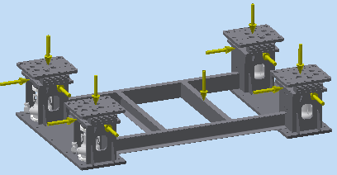
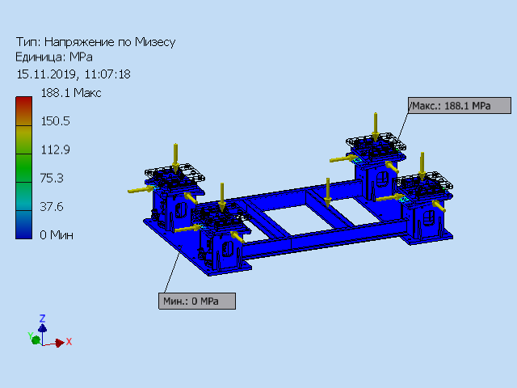
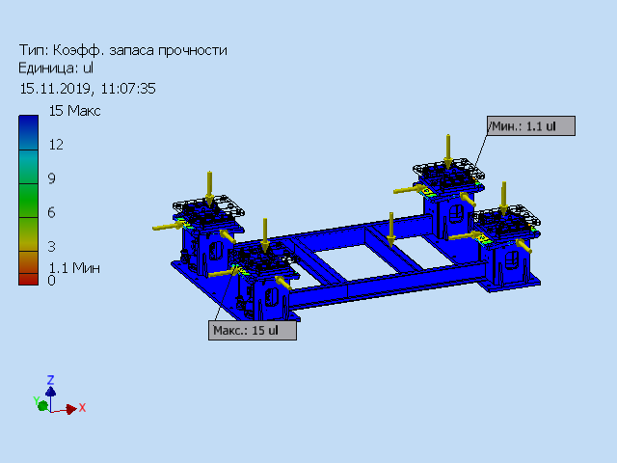
Screw jack Rack : design and calculation
750 kN
G
Stress
200 kN (seismic load - 12%m)
Margin
The bottom support is designed for a load of 200 tons and additionally added seismic hazar (20 tons)

Slide 21
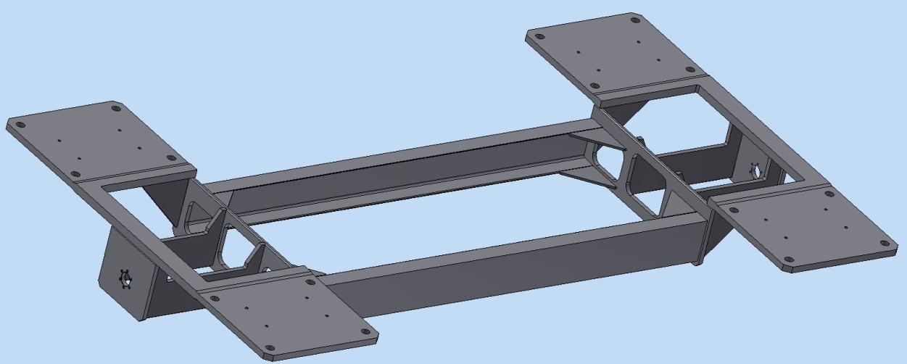
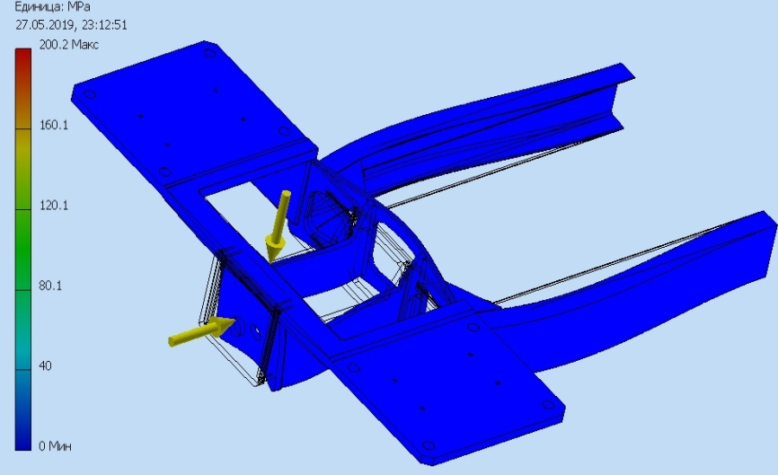
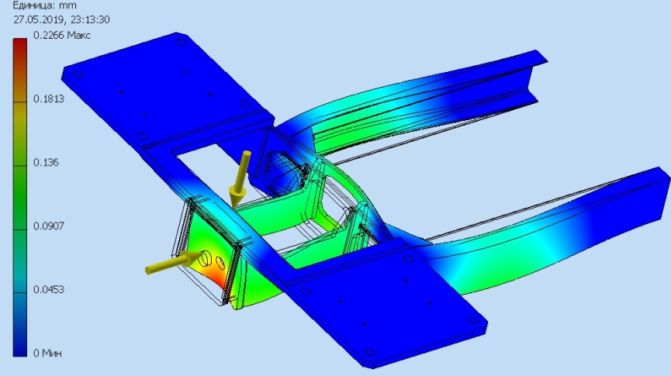
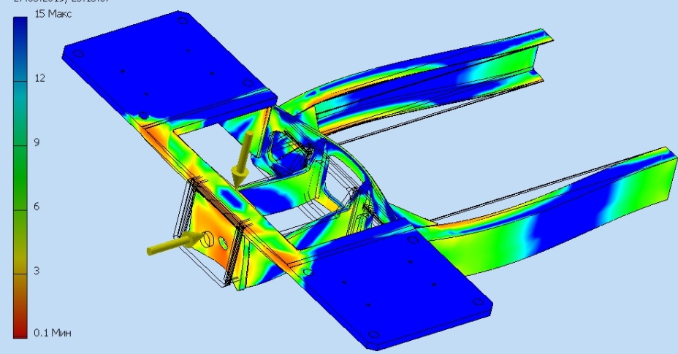
Intermediate frame : design and calculation
644 kg
Stress
G
opening limits the movement of the Top frame
200 kN (seismic load - 12%m)
Deformation
Margin
The intermediate frame is designed for seismic load which acts from the gimbal longitudinal (20 tons)

Slide 22
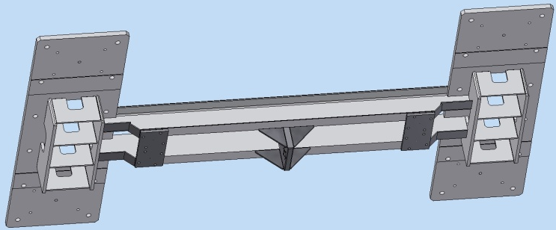
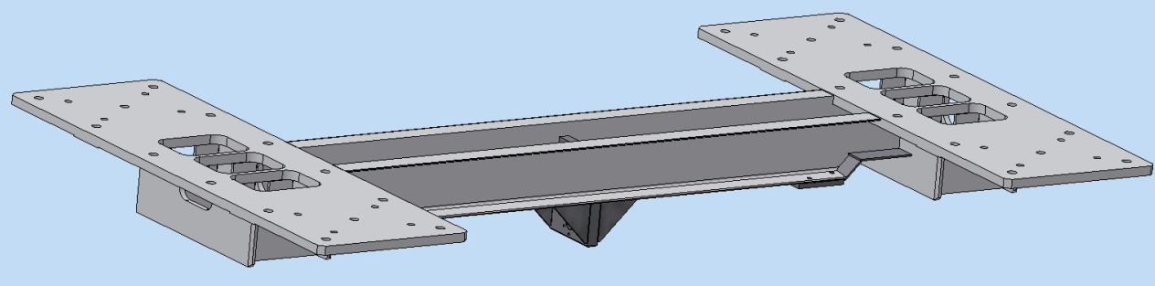
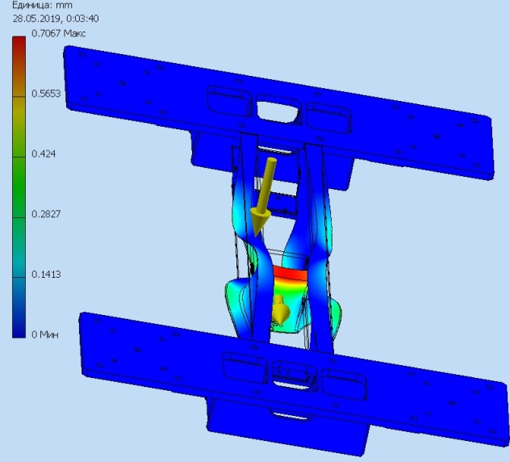
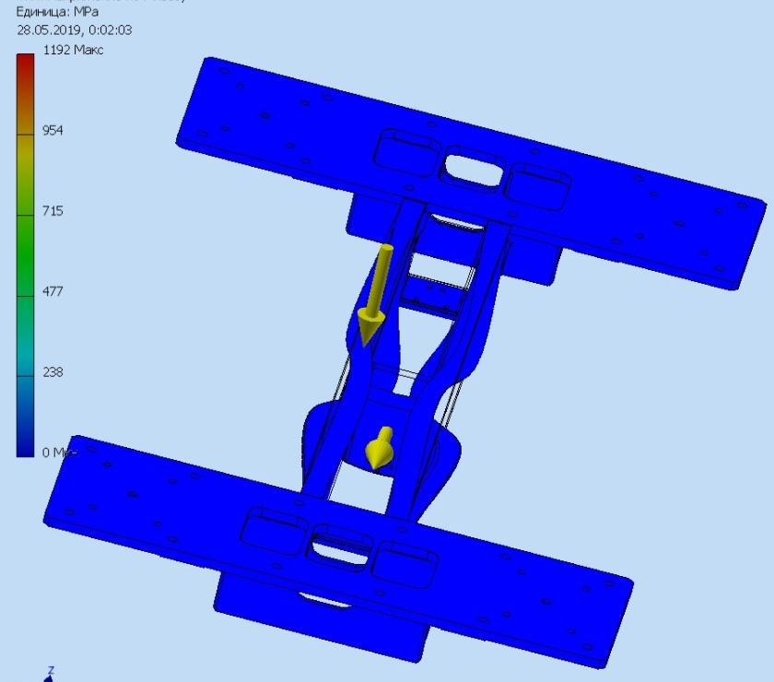
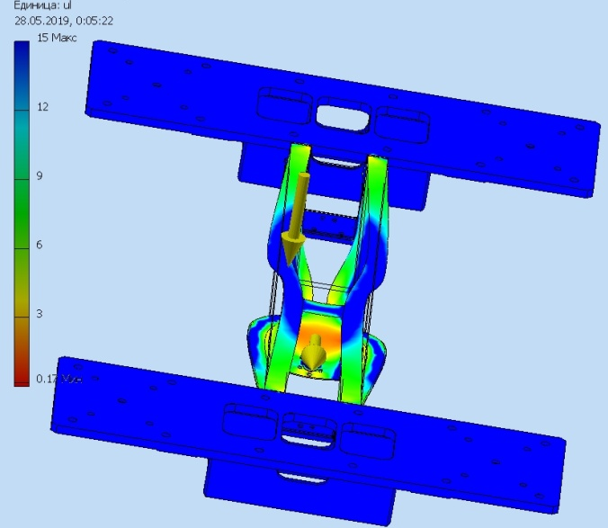
Top frame : design and calculation
744 kg
Deformation
Box limiting the movement of the Top frame in the opening of the Intermediate frame
Stress
Margin
G
The top frame is designed for seismic load which acts from the gimbal longitudinal (20 tons)
200 kN (seismic load - 12%m)

Slide 23
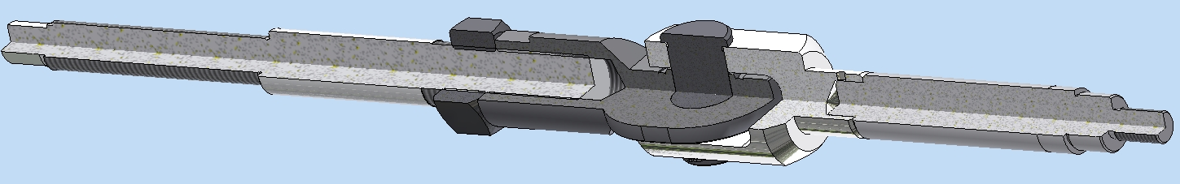
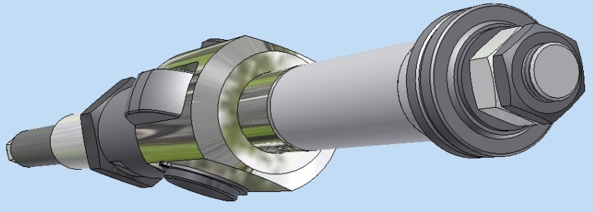
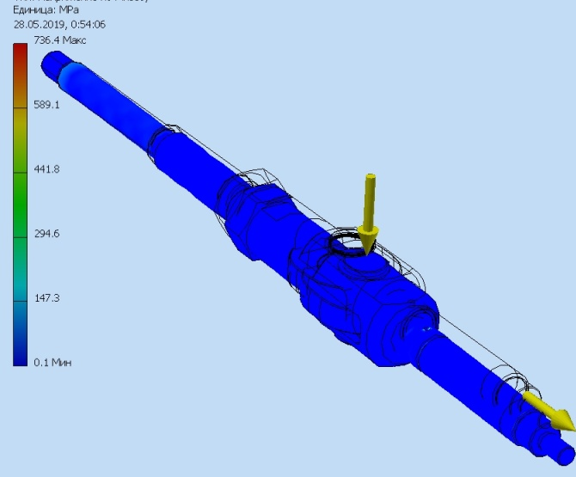
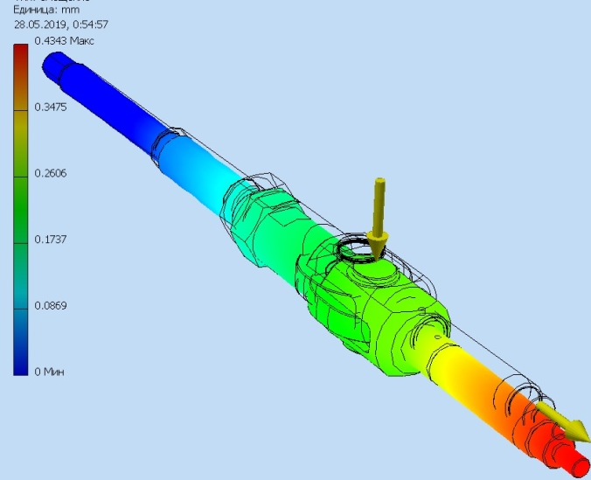
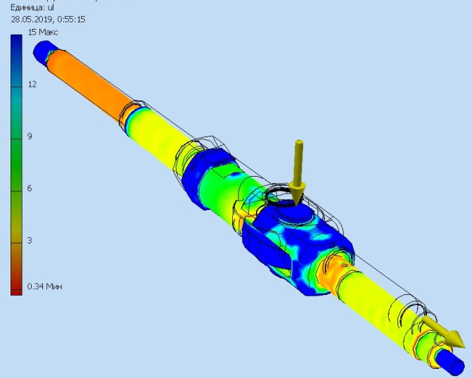
Gimbals : design and calculation
traction axle
locknut
Swivel bearing
support plug
swivel head
Stress
Deformation
Margin
G
workload : 50kN
design load: 200kN
200 kN (seismic load - 12%m)

Slide 24
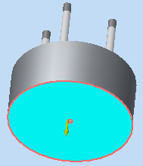
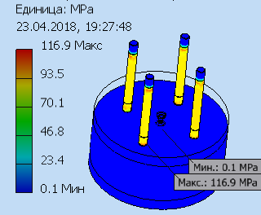
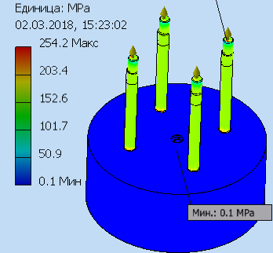
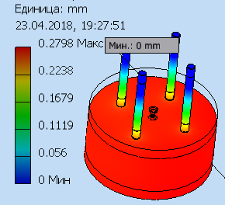
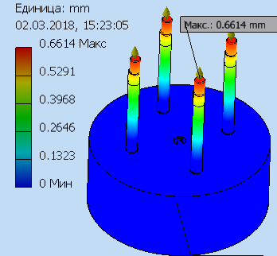


Calculation of studs for Pole CBM magnet
Stress
Stress
1500000N
3000000N
Deformation
Deformation
Margin
Margin

Slide 25




Calculation of Pole & crossbar CBM magnet
3000000N
Имя | Low carbon steel
General | Mass density | 7.86 г/см^3
 | Yield strength | 207 MПа
 | Ultimate tensile strength | 345 MПа
stress | young modulus | 220 ГПа
 | poisson ratio | 0.275 бр
 | Shear modulus of elasticity | 86.2745 ГПа
Stress
Margin
Deformation

Slide 26
Thank you for your attention!

