Slide 1

CBM Iron yoke and support design
11 2019, BINP, M.Kholopov, A.Bragin, S. Pivovarov.

Slide 2
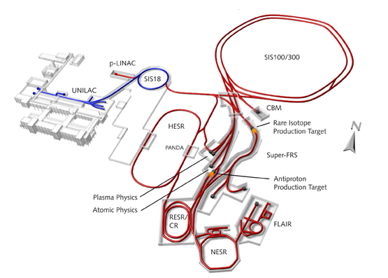
FAIR

Slide 3
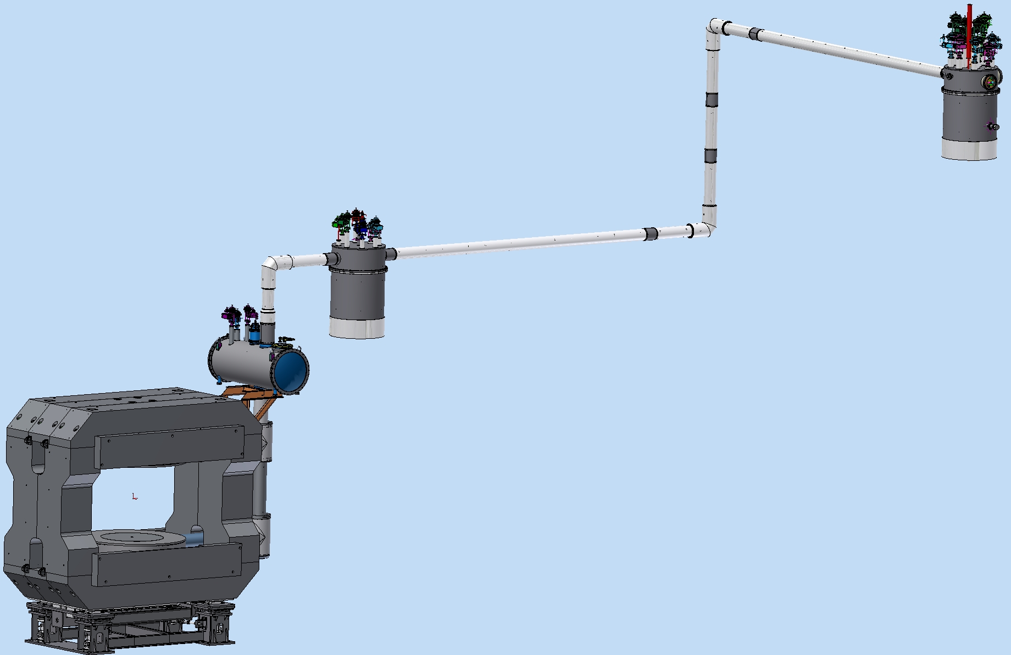
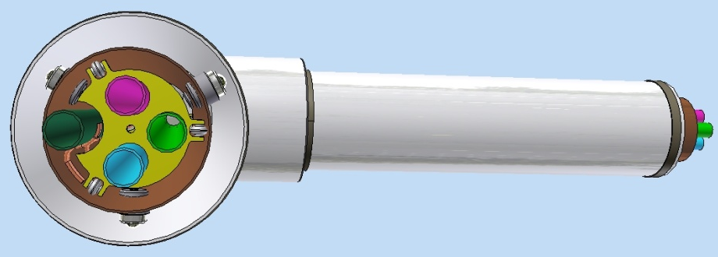
3D Model of CBM Magnet and cryosystem
Feed Box (m=1160kg, D=1100mm, H=2370mm)
Cryostat,
TL, magnets (m=7850kg)
Branch Box (m=1560kg, D=1100mm, H=2680mm)
Iron Yoke (m=145412kg)
He transfer
Line (30kg*m)
Coil (m=1479kg)
Support (m= 4480 kg)

Slide 4
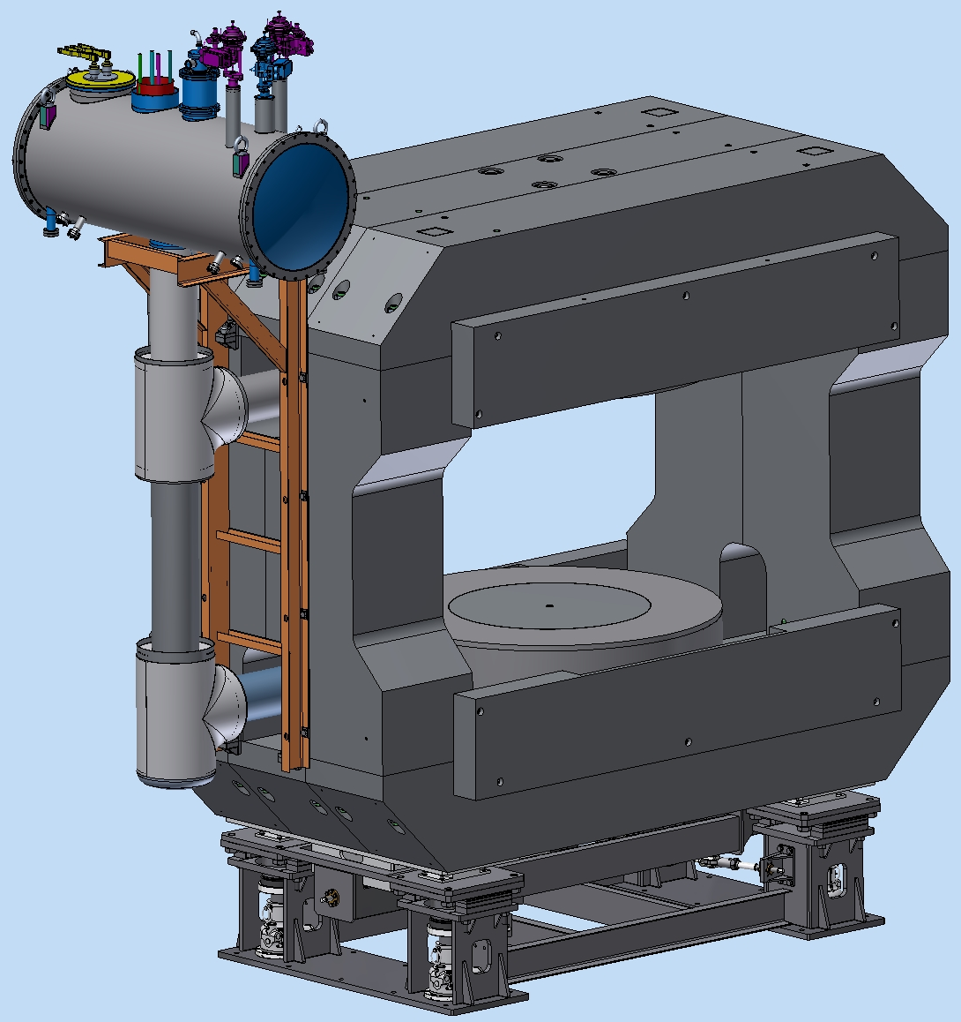
3D Model of CBM Magnet (new design)
2
Support m= 4480 kg
Iron Yoke m=145412kg
Coils m=3100kg
Cryostat m=940kg
Cryostats TL m=710kg
The support’s load – 154 tons
4
3
5
1

Slide 5
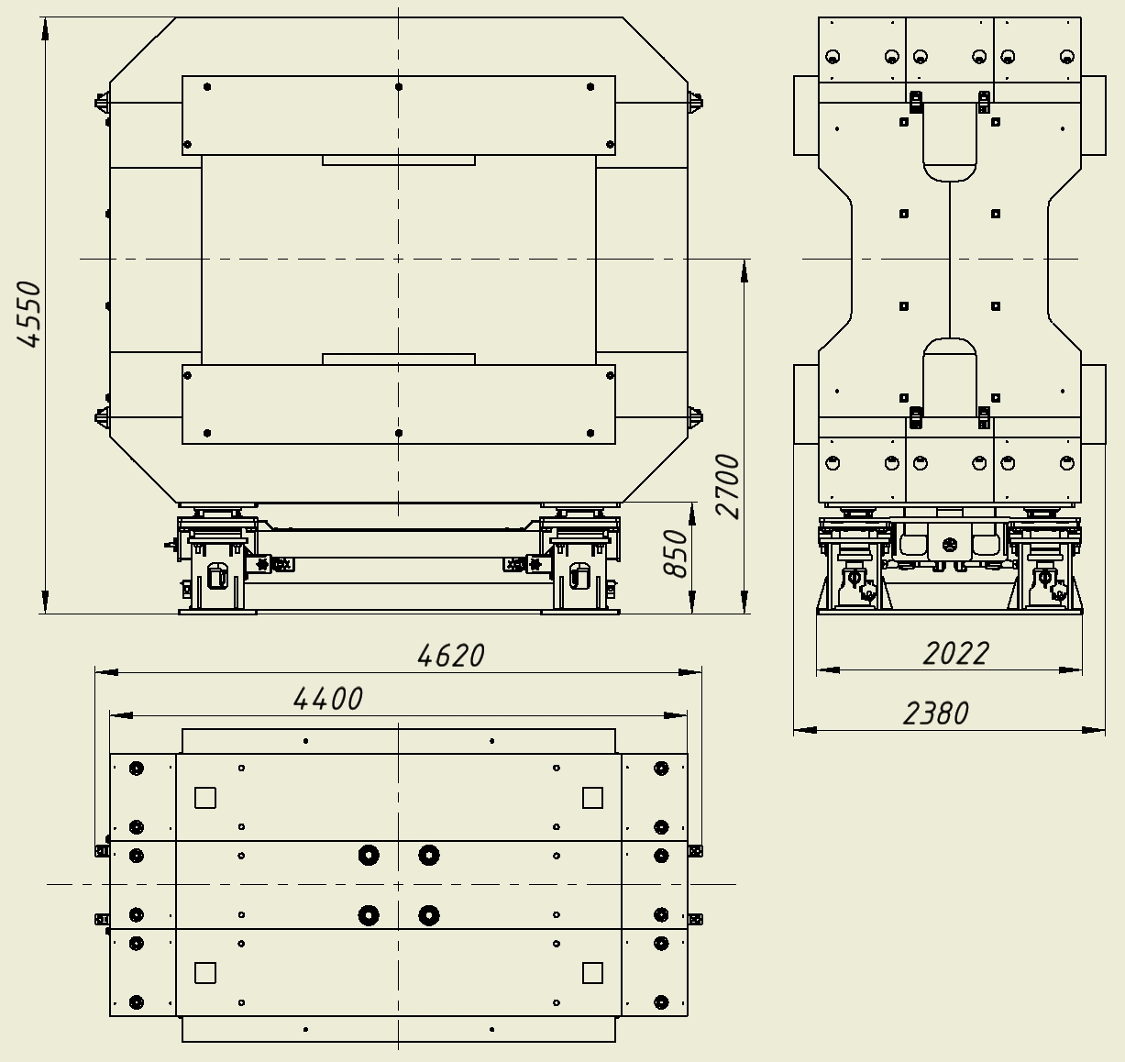
Iron Yoke and supports drawing
Weight and size
m= 150000 kg
L=4620mm
W=2380mm
H=4550mm

Slide 6
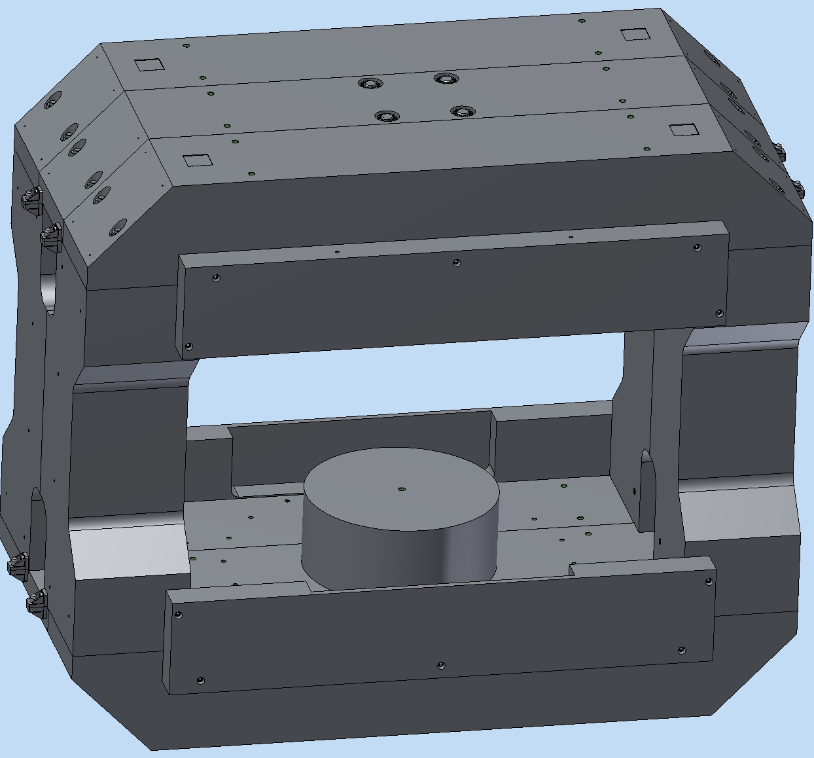
Iron Yoke 3D Model
Geodetic platform
Top beam
13551 kg
Central beam
13594 kg
Geodetic holes
Rack
10335 kg
Pole
3967 kg
Mounting bracket
Screen
2214 kg

Slide 7
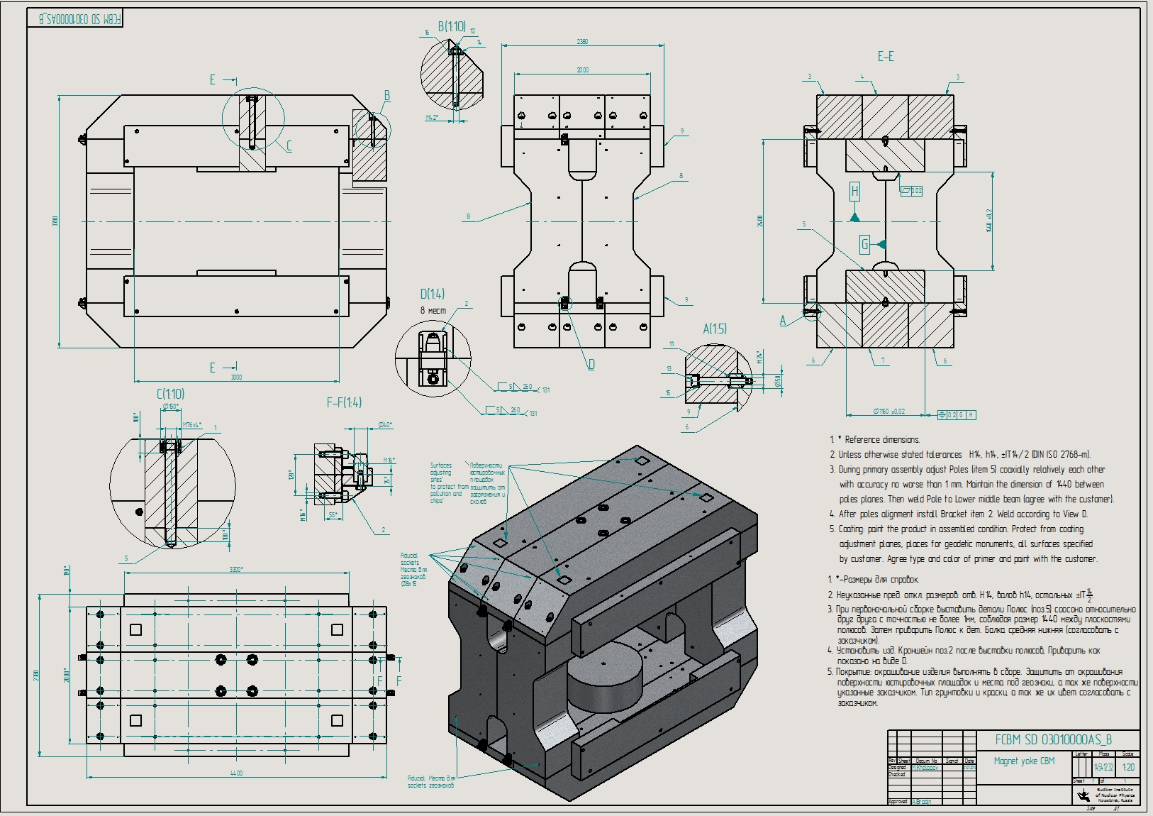
Iron Yoke and supports drawing
Weight and size
-m= 145412 kg
-L=4440mm
-W=2380mm
-H=3700mm

Slide 8
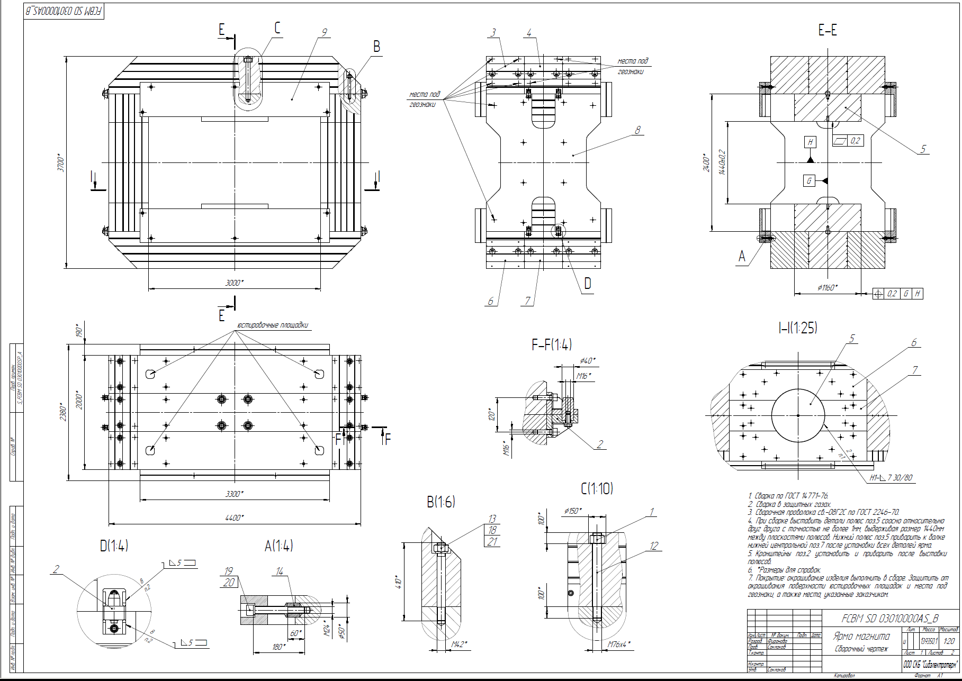
Iron Yoke production drawing
Drawings are processed in technologists and prepared for translation.

Slide 9
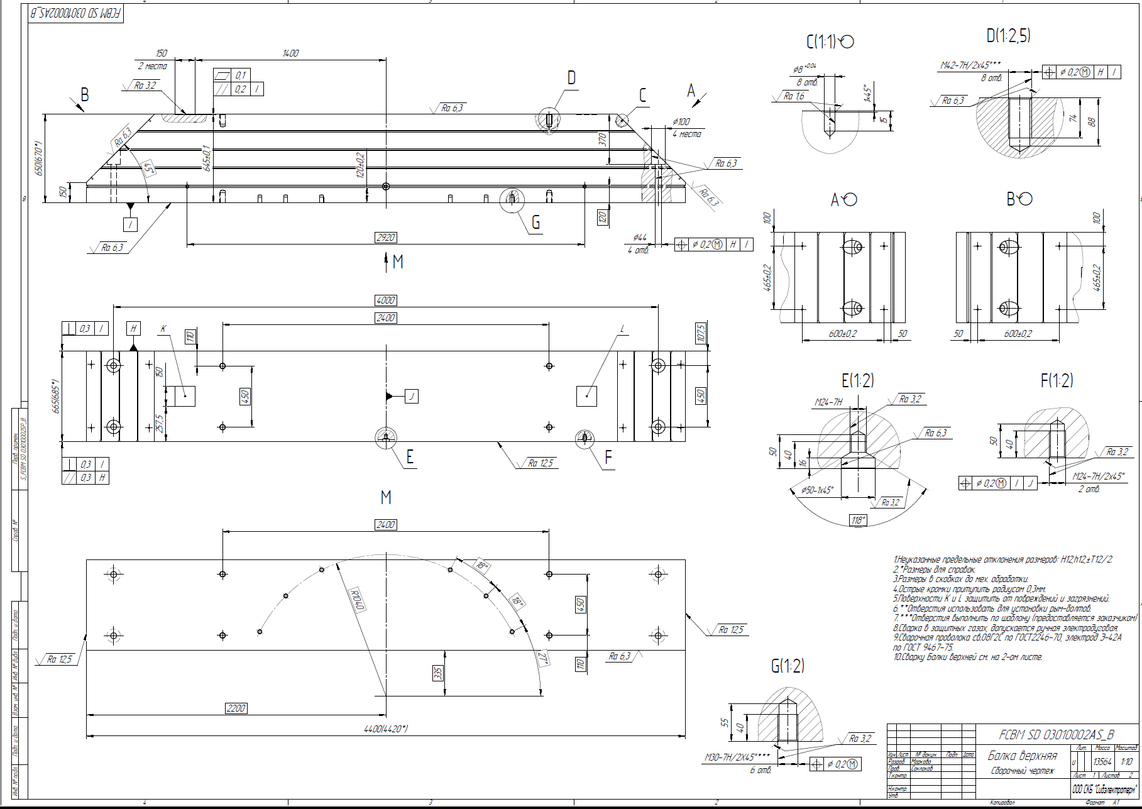
Iron Yoke production drawing
Top beam
An example of the implementation of the yoke of sheet material.

Slide 10
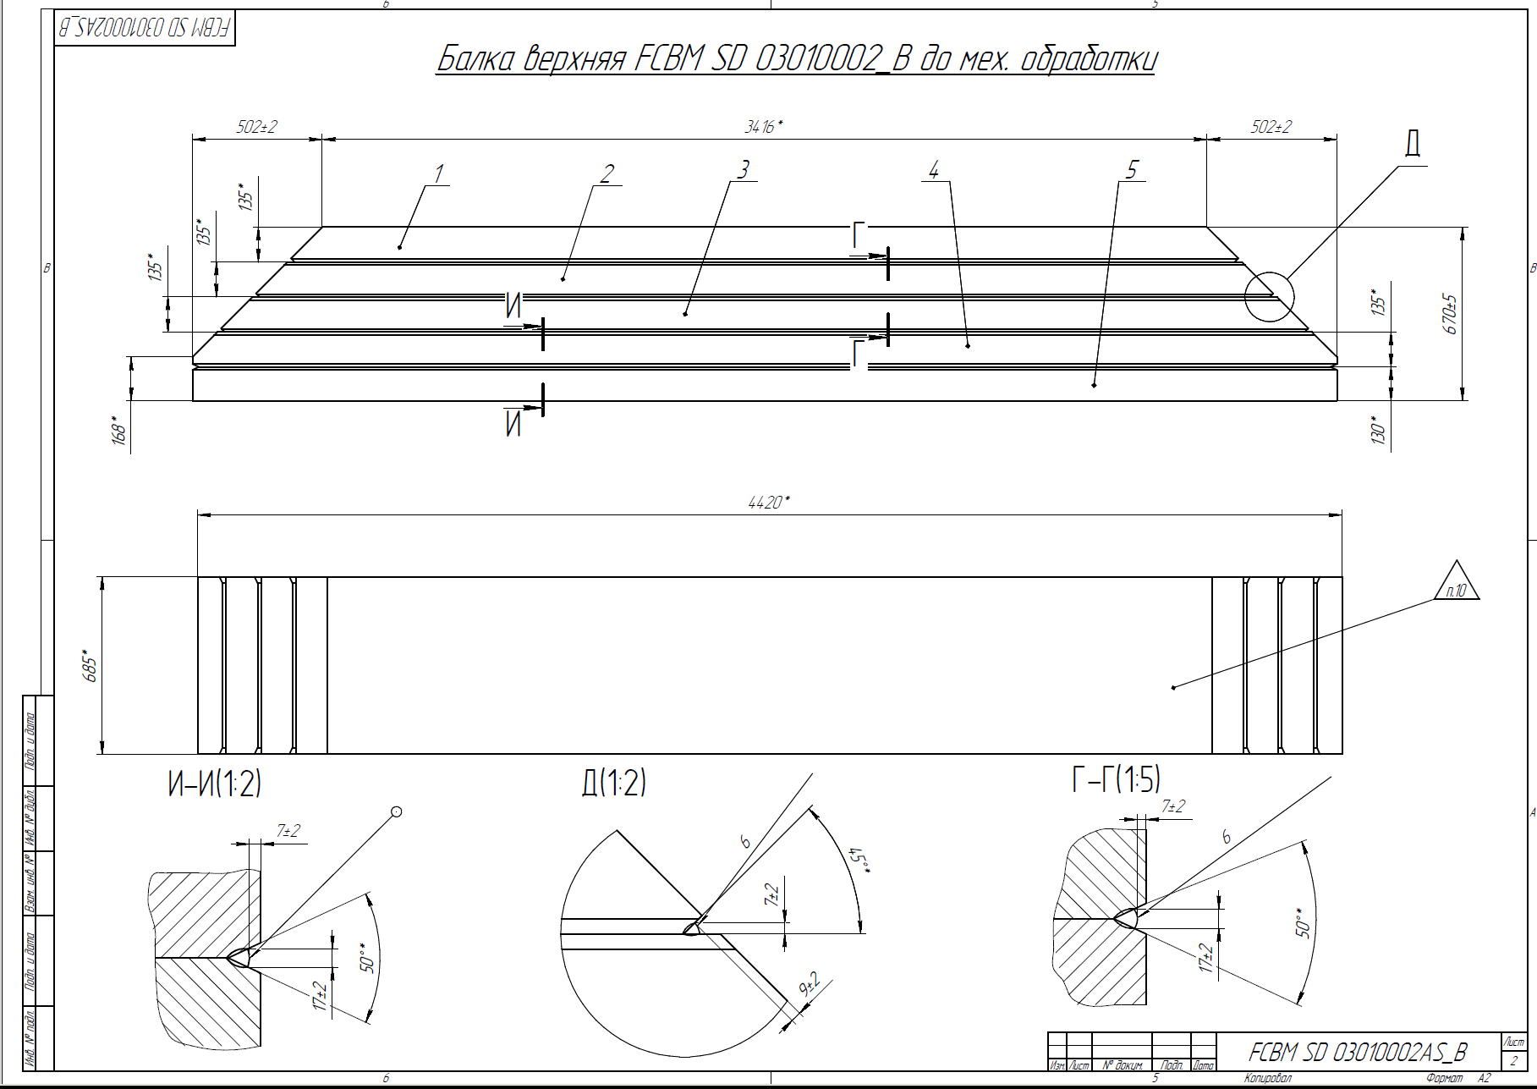
Iron Yoke production drawing
Detail - Top Beam to the machining, allowance for processing 10 mm.
An example of the implementation of the yoke of sheet material.

Slide 11
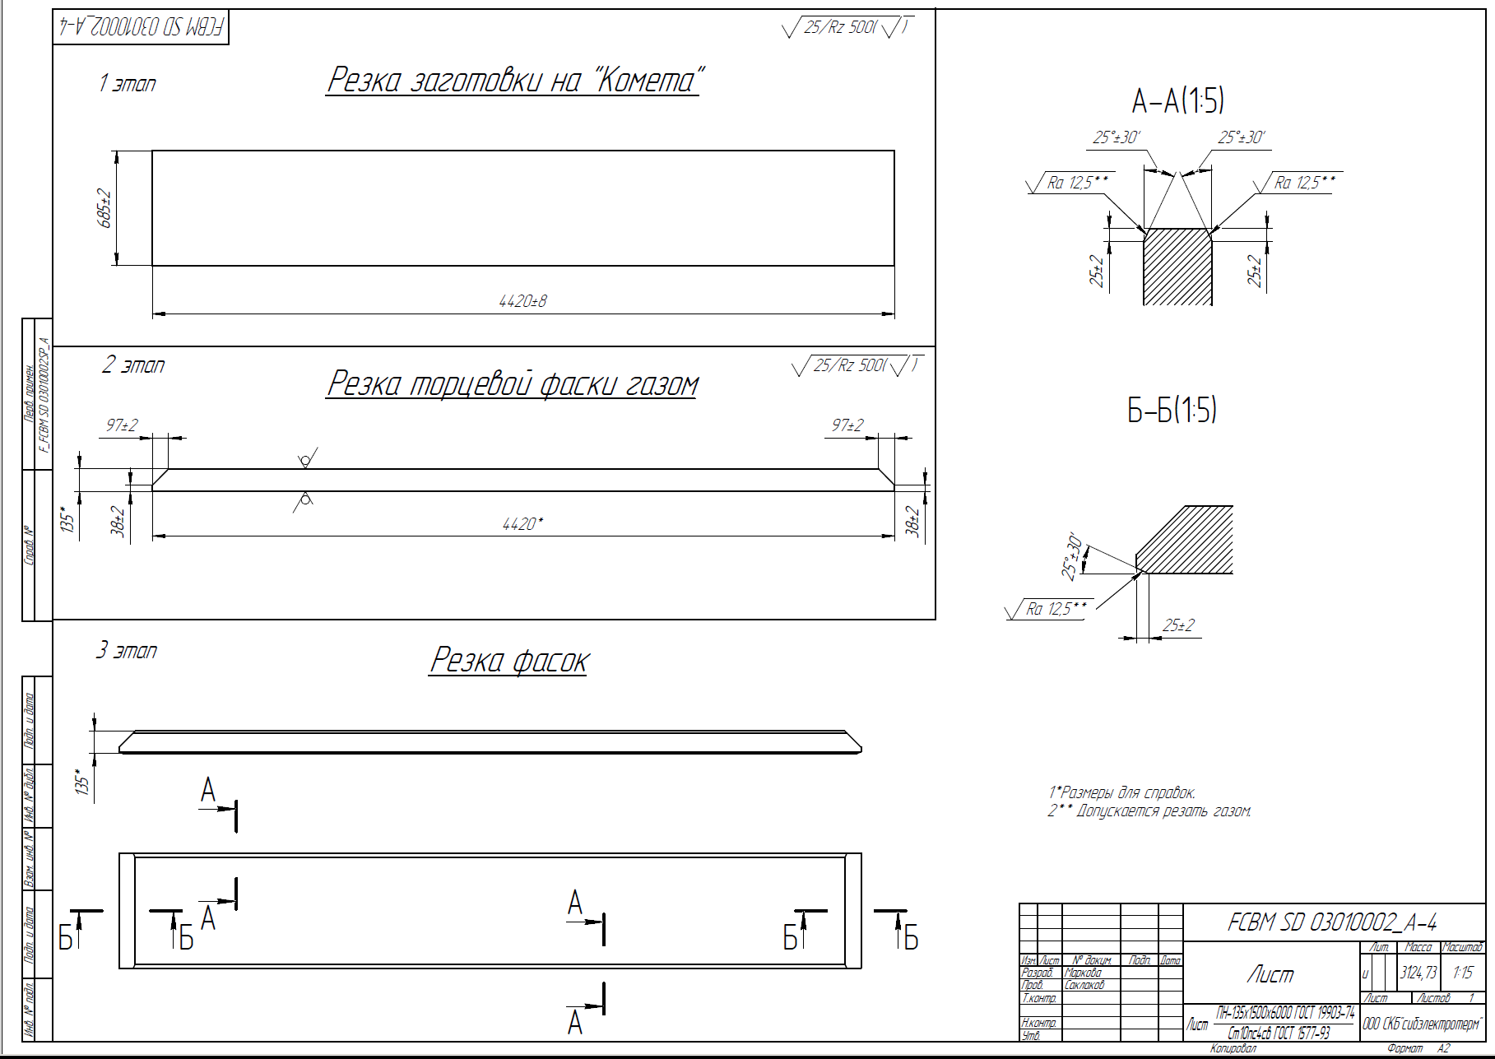
Iron Yoke production drawing
First step
Cutting the blanks from a sheet
Second step
End chamfer cutting
Third step
Cutting chamfers for welding
Sheet
An example of the implementation of the yoke of sheet material.

Slide 12
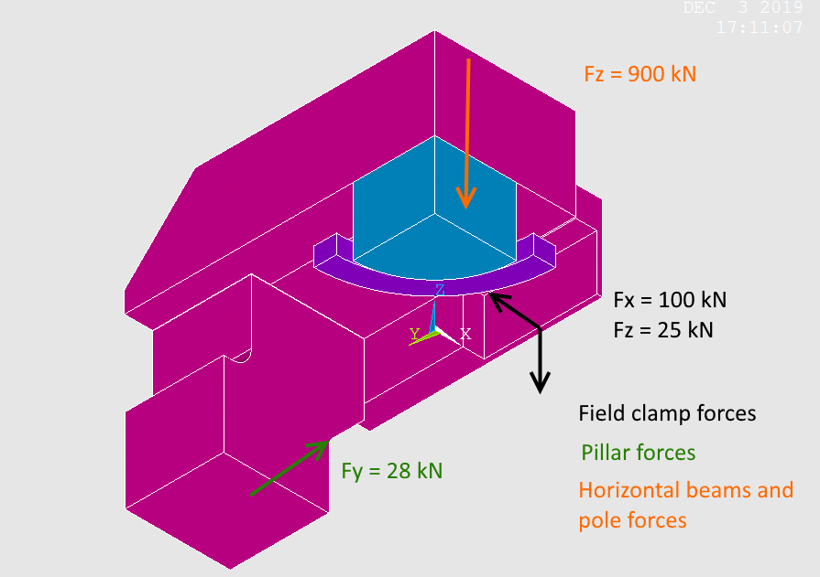
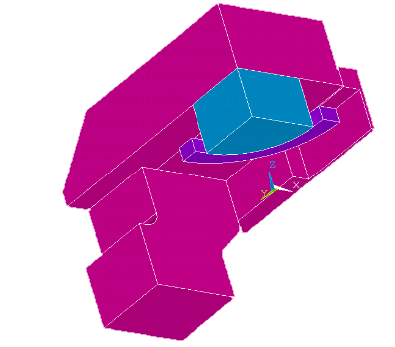
Influence of the laminations on the magnetic field
The Fz = 900 kN – is the force attracting the horizontal beams down: to opposite coil and to the pillars! This force is distributed in the whole volume of the iron block.
Model for the ANSYS magnetic field calculations

Slide 13
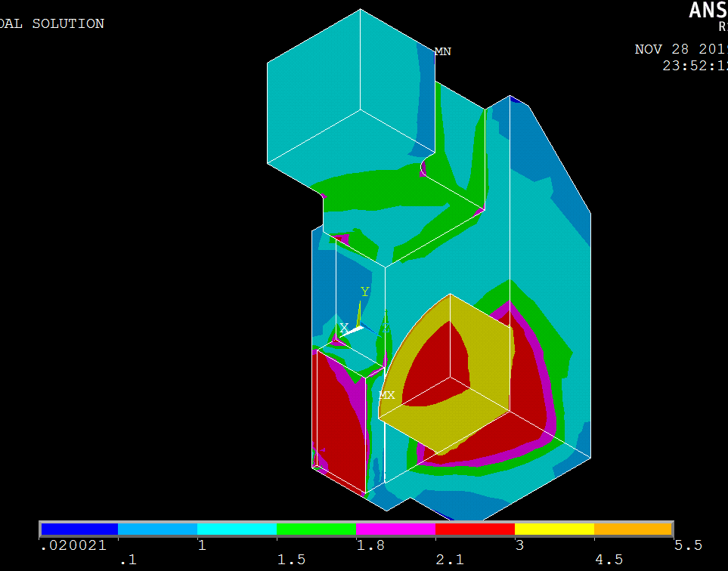
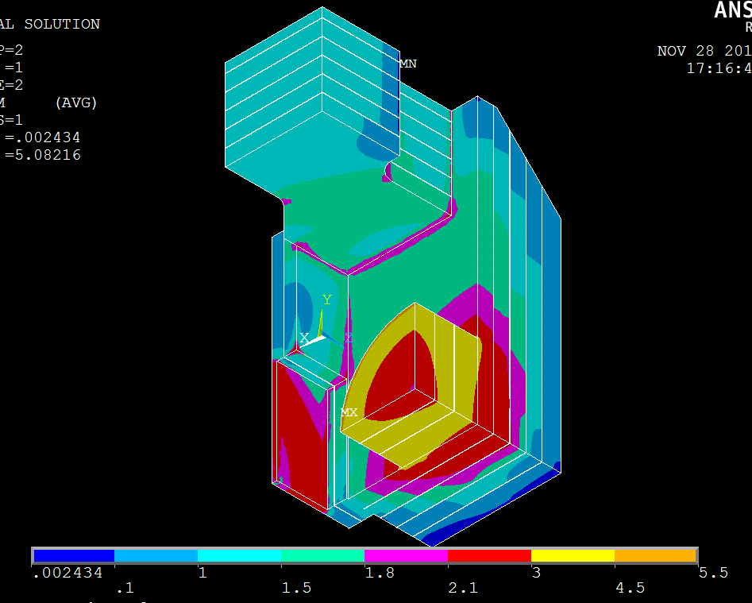
Comparison of the iron block with 3 mm gap of horizontal lamination
Without lamination horizontal laminations with 3 mm gaps

Slide 14
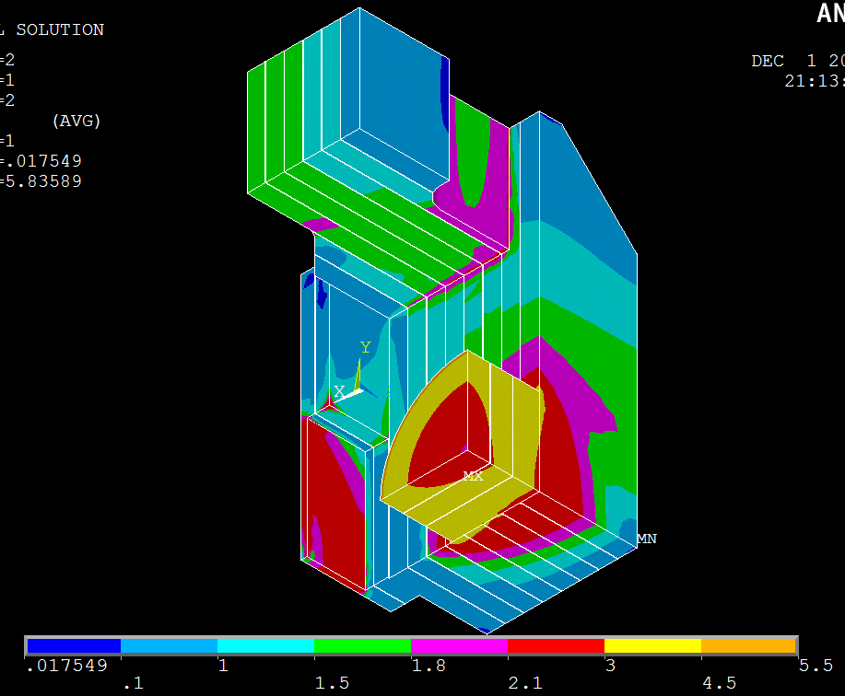
Comparison of the iron block with 3 mm gap of vertical lamination
Without lamination vertical laminations with 3 mm gaps

Slide 15
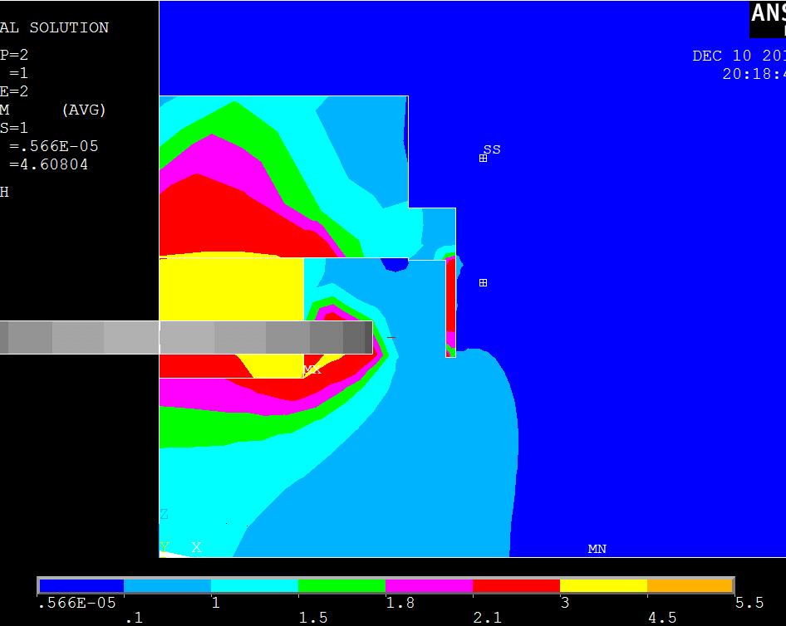
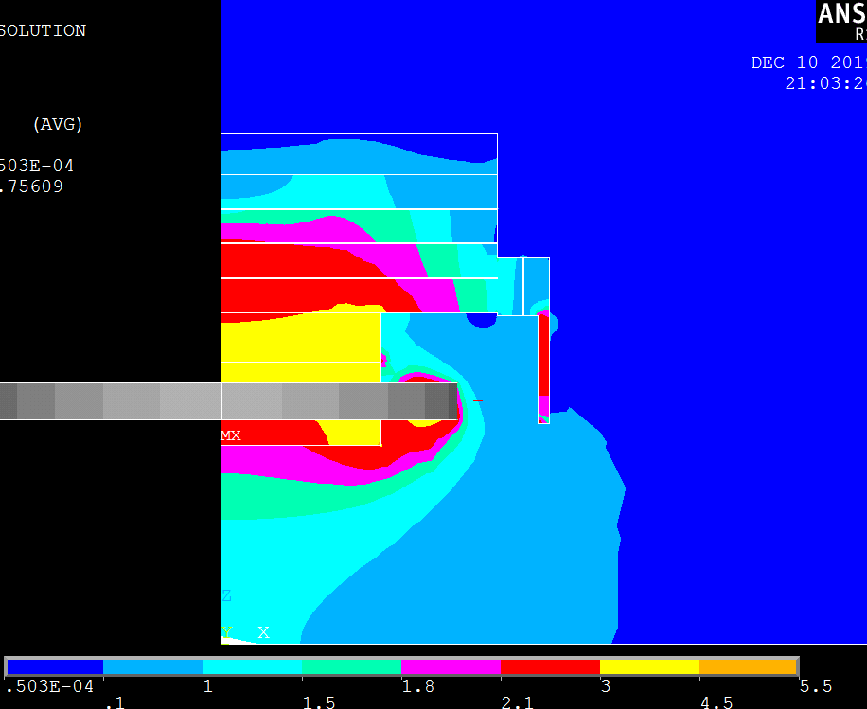
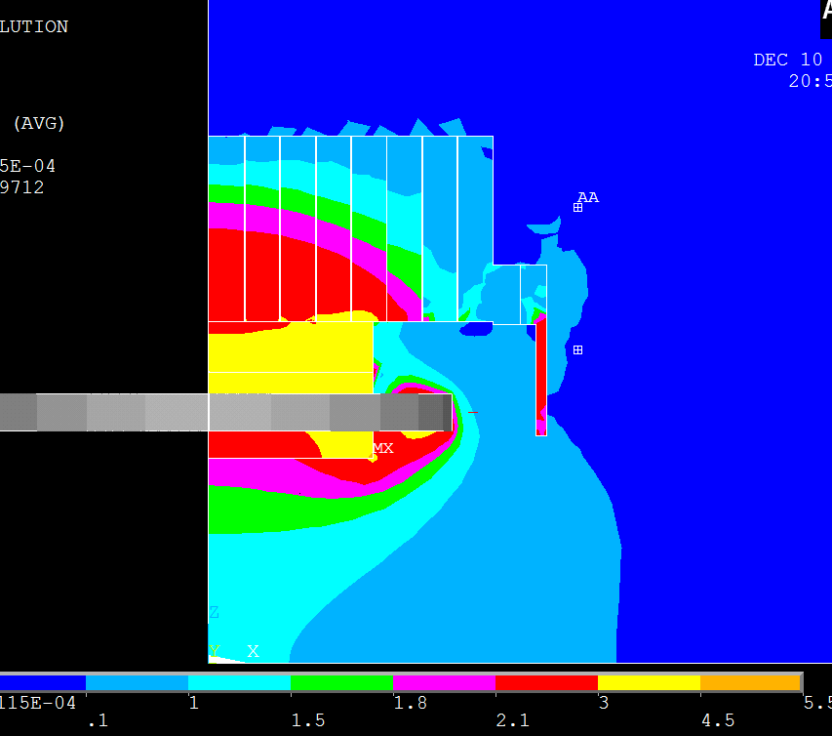
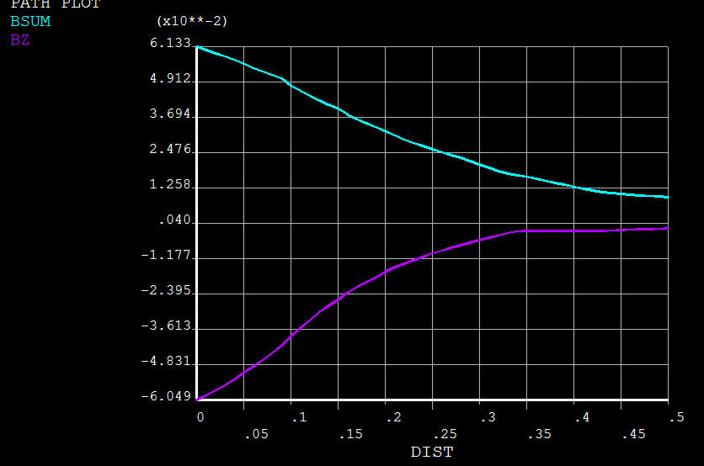
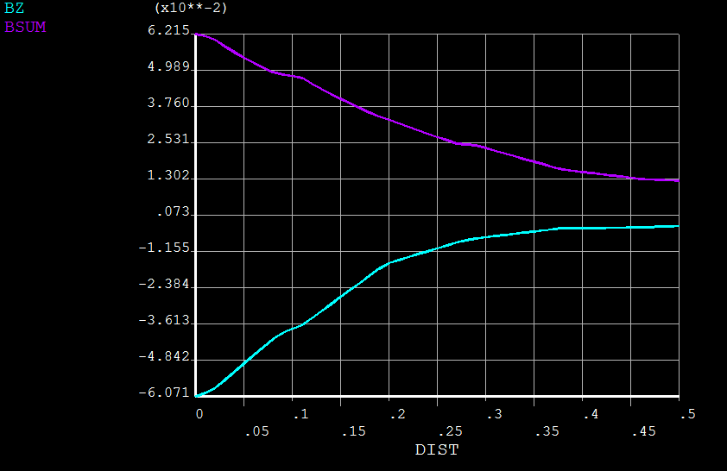
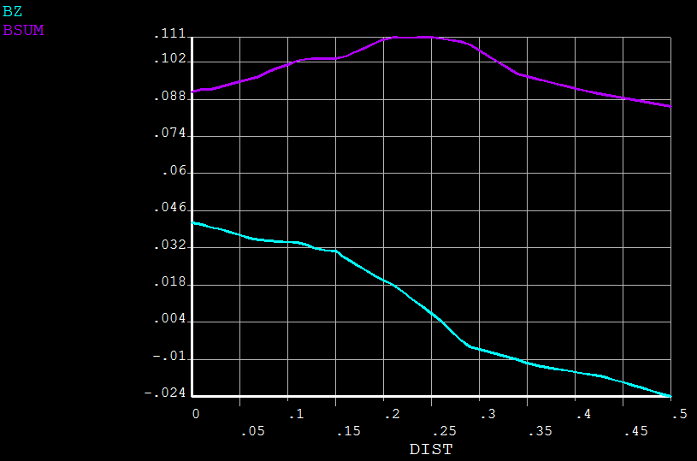
Influence on the stray fields
Non-laminated
Horizontally laminated
vertically laminated
Stray field is 8 times higher!

Slide 16
Influence of the laminations on the main parameters of the magnet
Parameter | Base model | Horizontal lamination | Vertical lamination
Integ.B*ds, T*m | 1.012 | 0.9995 | 0.9998
Bcenter, T | 1.099 | 1.086 | 1.086
Stored energy, MJ | 4.90 | 4.87 | 4.86
Conclusion:
The iron yoke works mostly as return yoke. The real lamination will give not much influence on the main parameters of the magnet. The manufacturer promises to obtain the gap < 0.3 mm.
Stray field is much better in the horizontally laminated plates.
The iron sheets will be pressed by 100 t press before welding.
What kind of paint and color is needed for the iron yoke?

Slide 17
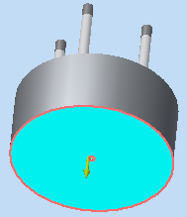
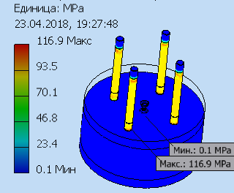
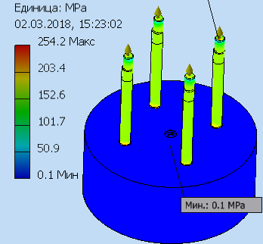
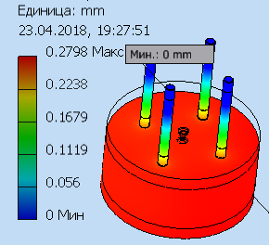
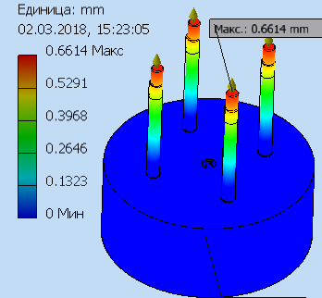
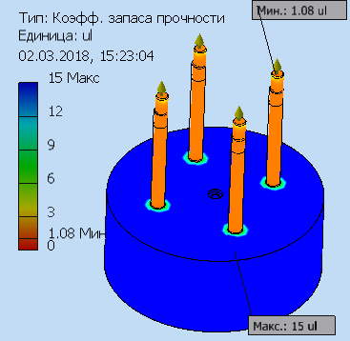
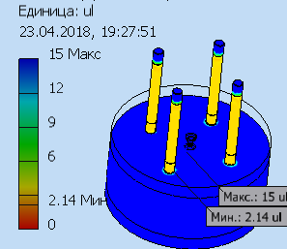
Calculation of studs for Pole CBM magnet
Stress
Stress
1500000N
3000000N
Deformation
Deformation
Margin
Margin

Slide 18
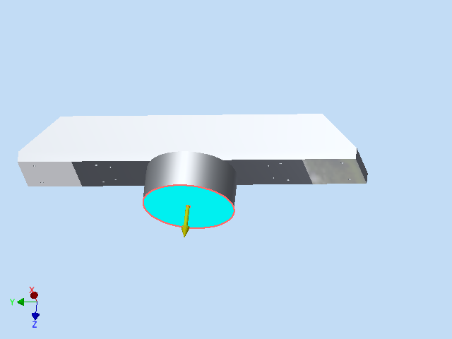
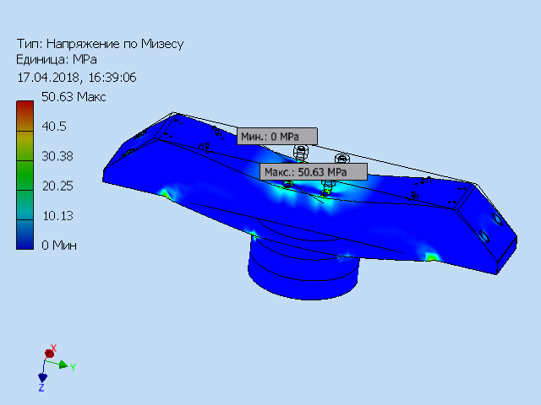
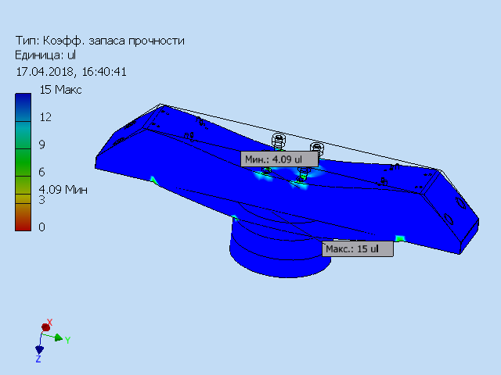
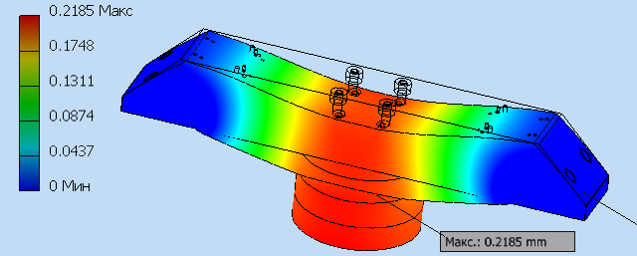
Calculation of Pole & crossbar CBM magnet
3000000N
Имя | Low carbon steel
General | Mass density | 7.86 г/см^3
 | Yield strength | 207 MПа
 | Ultimate tensile strength | 345 MПа
stress | young modulus | 220 ГПа
 | poisson ratio | 0.275 бр
 | Shear modulus of elasticity | 86.2745 ГПа
Stress
Margin
Deformation

Slide 19
Thank you for your attention!

