Slide 1

Installation of the PANDA solenoid magnet in BINP
Test of the PANDA solenoid magnet in BINP

Slide 2
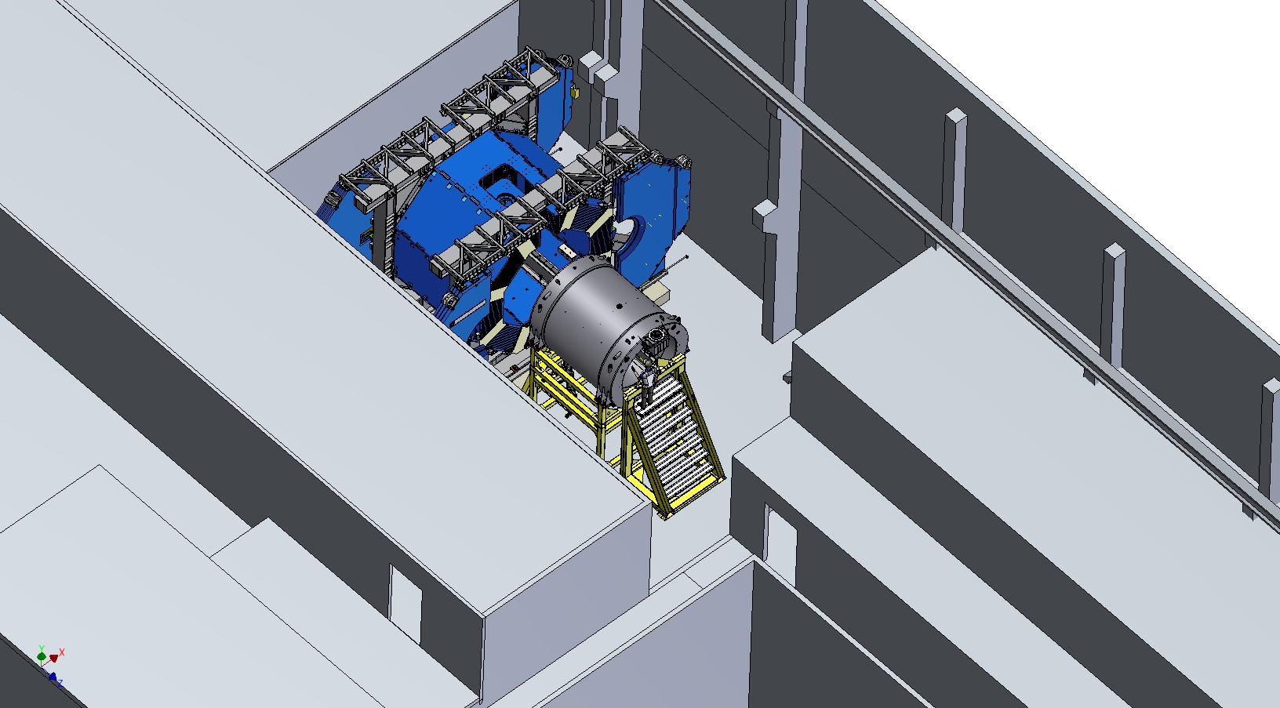
Installation of the PANDA solenoid magnet in BINP
Position of the PANDA solenoid in 13th building of BINP. Now we are considering the possibility of assembling and testing the magnet in the 13th building of BINP

Slide 3
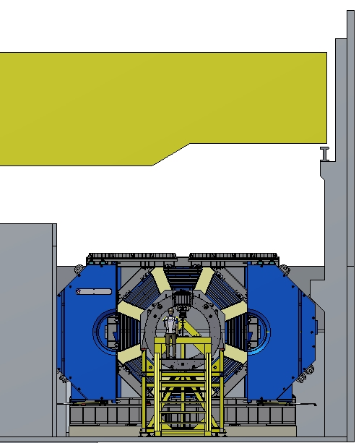
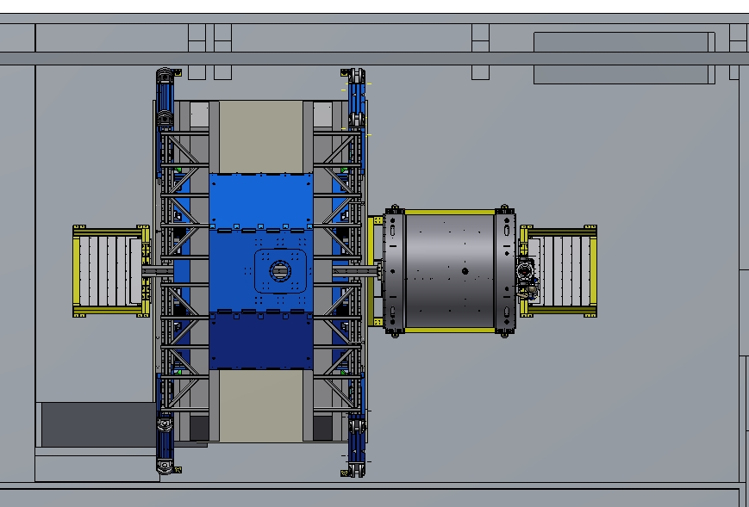
Installation of the PANDA solenoid magnet in BINP
Position of the PANDA solenoid in 13th building of BINP. There is enough space for assembling and testing the magnet.

Slide 4
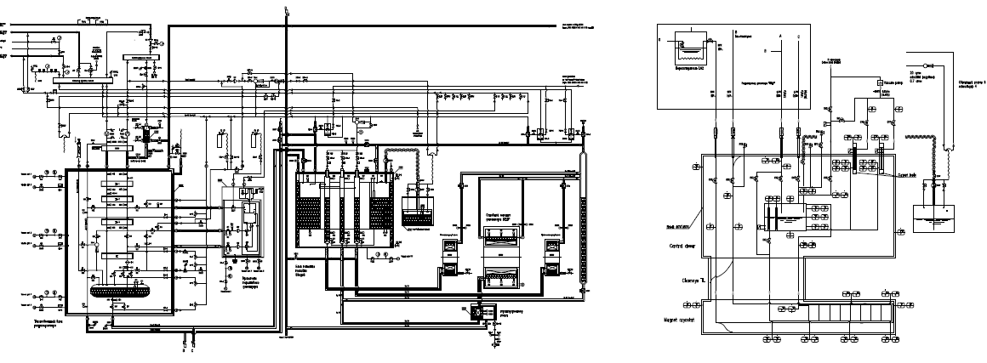
Test of the PANDA solenoid magnet in BINP
Flow schemes.
Flow scheme of the KEDR Solenoid.
Flow schemes of the PANDA Solenoid test.

Slide 5
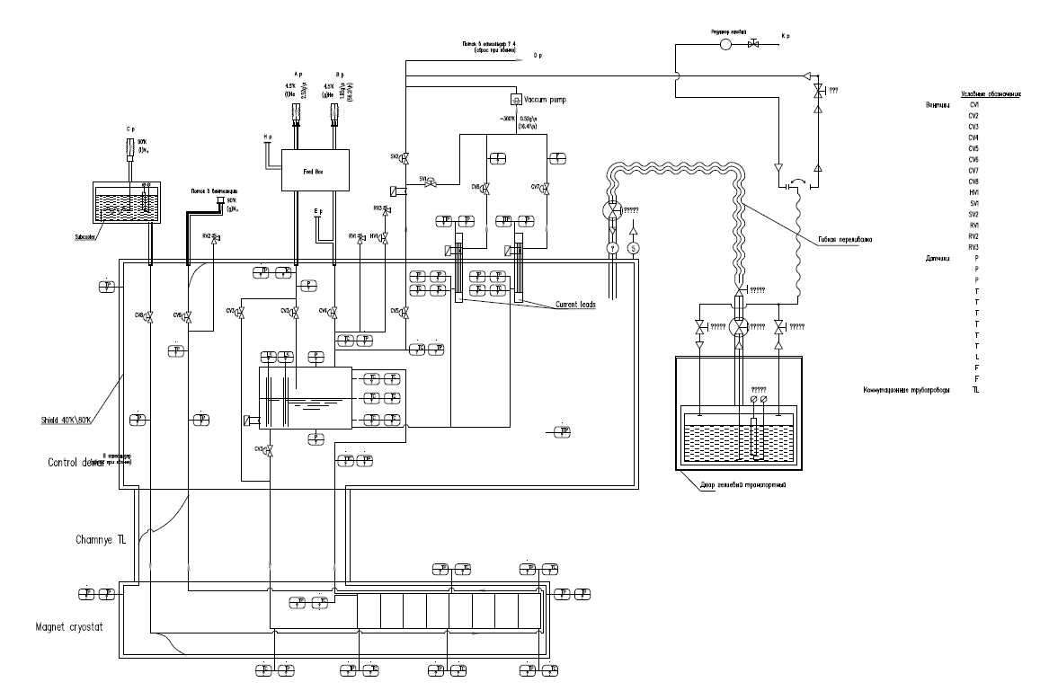
Flow scheme of the PANDA Solenoid test.

Slide 6
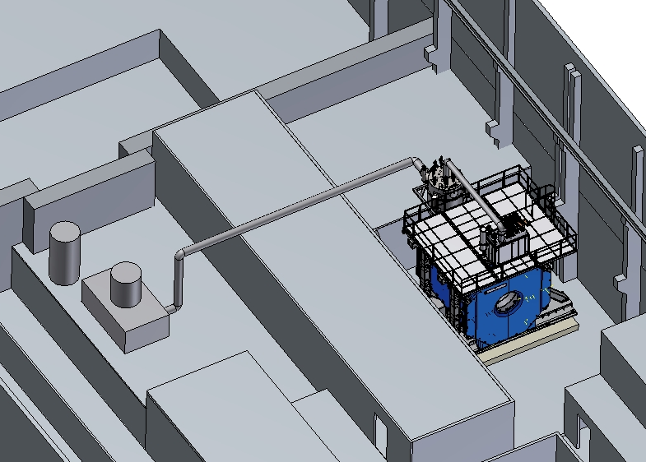
PANDA Solenoid test.
Feedbox
Transferline ~20m
Transferline ~7m
Refrigerator of the
KEDR detector
Control Dewar box of PANDA Magnet

Slide 7
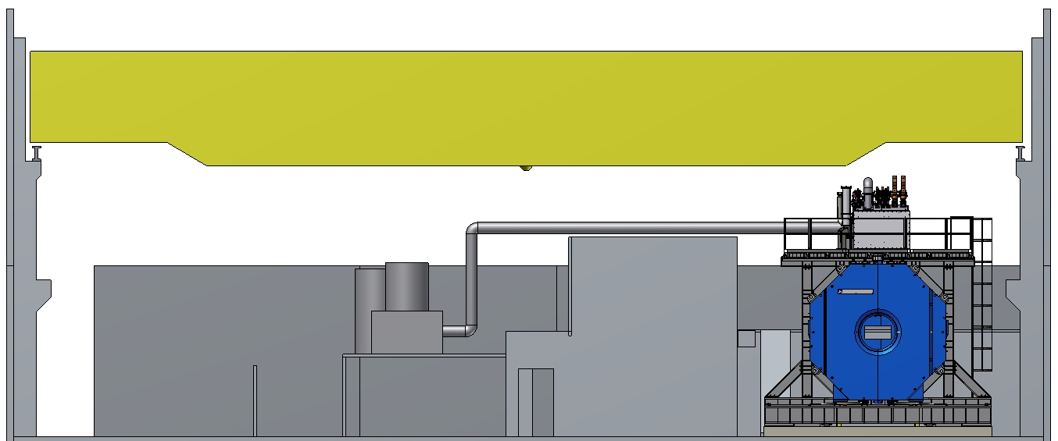
PANDA Solenoid test.

Slide 8
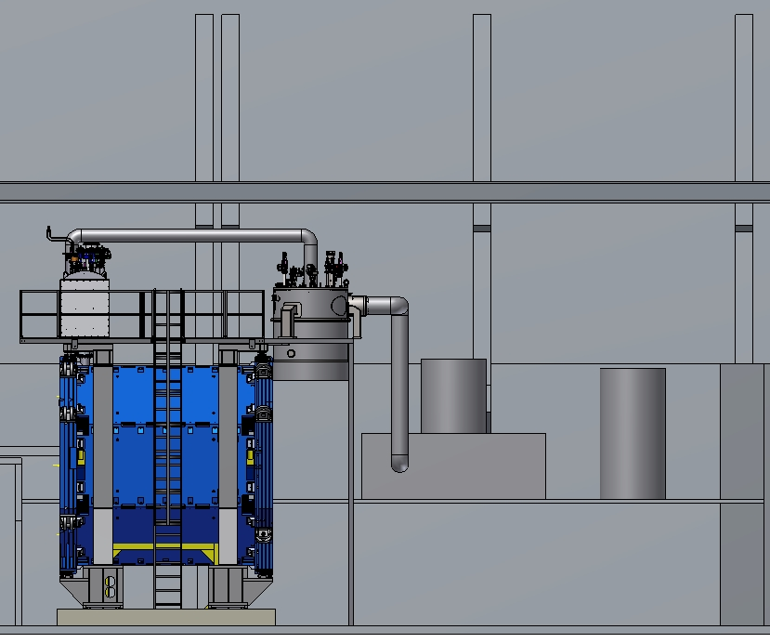
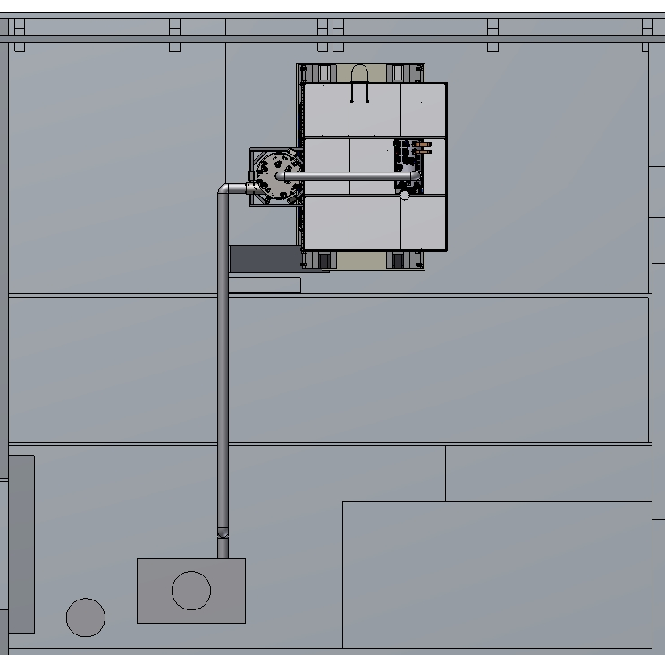
PANDA Solenoid test.

Slide 9
Thank you for your attention!

