Slide 1
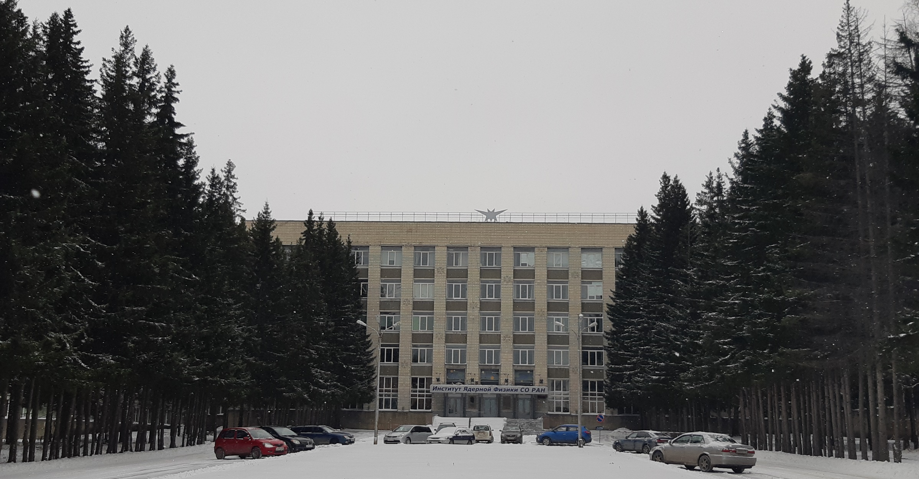
Status of the PANDA Solenoid Magnet Production in BINP
E.Pyata,S.Pivovarov, M.Kholopov, M.Azimbaev BINP, Novosibirsk

Slide 2
Development of the PANDA solenoid magnet
Name of item | Status of work
Yoke and frame | Design is ready, production
Cryostat of solenoid | Design is ready, technological development, purchasing raw material, preparation drawings of tooling, workshops. Call for tender
Cold mass | Design is ready, technological development, purchasing raw material, preparation drawings of tooling, workshops. Call for tender
Conductor purchasing | Development work, preparation Call for tender
Control Dewar box | Preliminary design December 2019
PANDA solenoid power cabling | Design is ready, production
Power supply and energy extraction system | Detail design is ready, production Power supply devices 1,1 kA will be an industrial production not BINP / A.Erokhin
Magnet safety system | in process
FAT | Preparation place for PANDA solenoid installation, procedures installation, development a flow scheme of connection KEDR-PANDA solenoid cryogenics
Table 2. Status of work of the PANDA solenoid production.

Slide 3
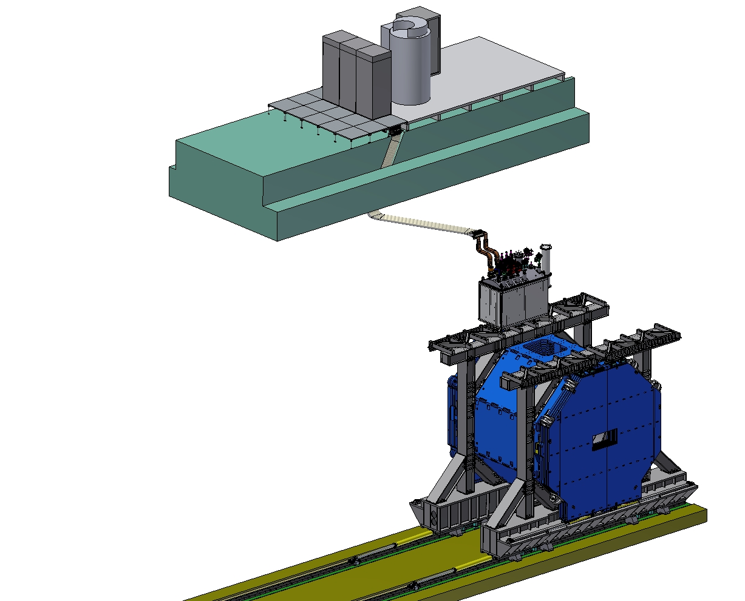
PANDA solenoid magnet, BINP responsibility
Power supply and energy extraction system
Control Dewar box
Cable channel
Solenoid and yoke
Frame of Yoke
Figure 1. Arrangement of the components of the PANDA solenoid.

Slide 4
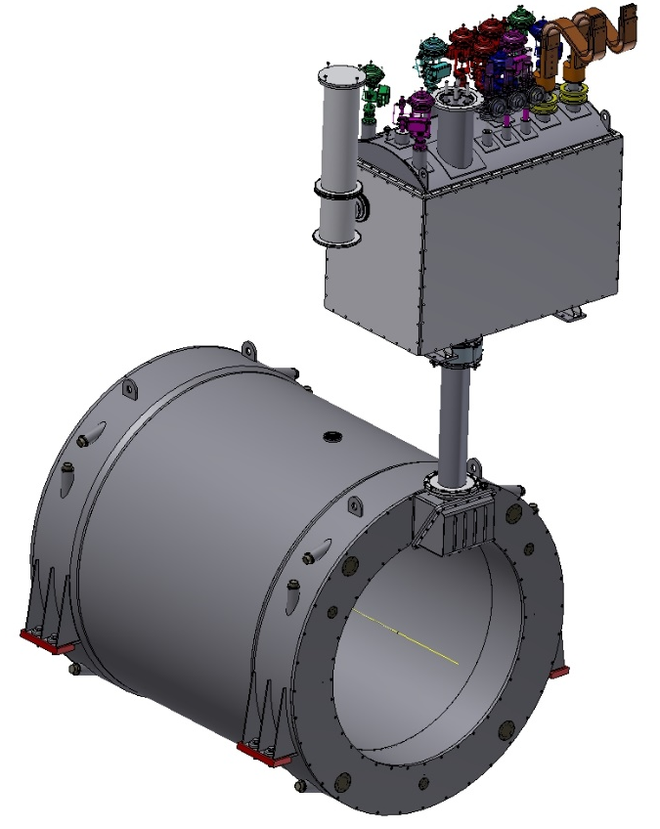
3D model of the Magnet and Control Dewar.
Control Dewar box
Cryostat and Coil

Slide 5
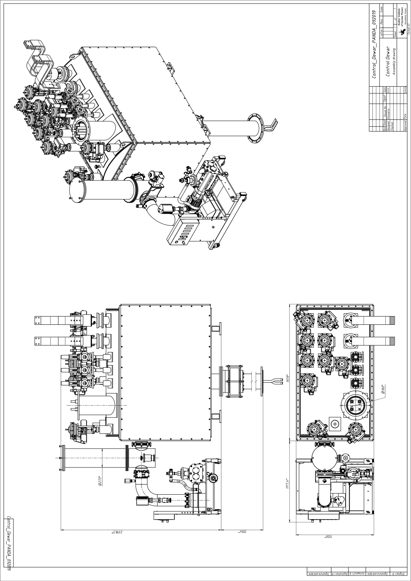
Control Dewar
Flexible contact
2318.5mm
The surface of the common platform.
Figure 4. Dimensions and weight of the control Dewar.
Weight control Dewar about 3160 kg. with vacuum post 3350 kg.

Slide 6
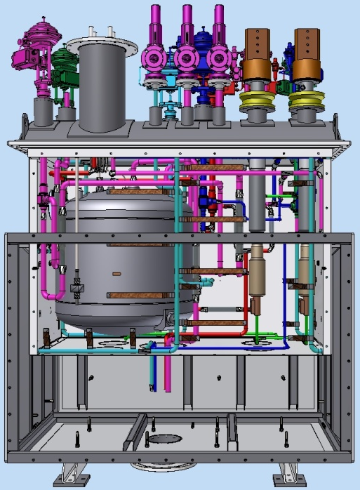
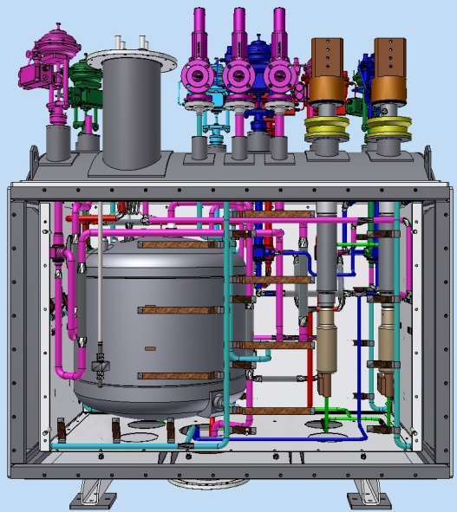
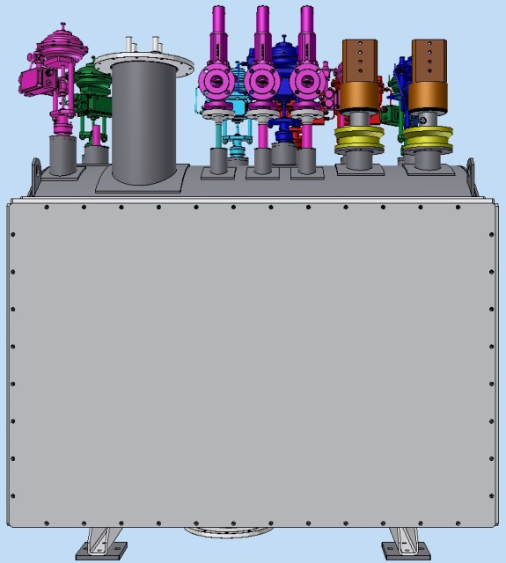
Control Dewar
3. Installation pipelines on the lid and thermal shields to the vacuum shell

Slide 7
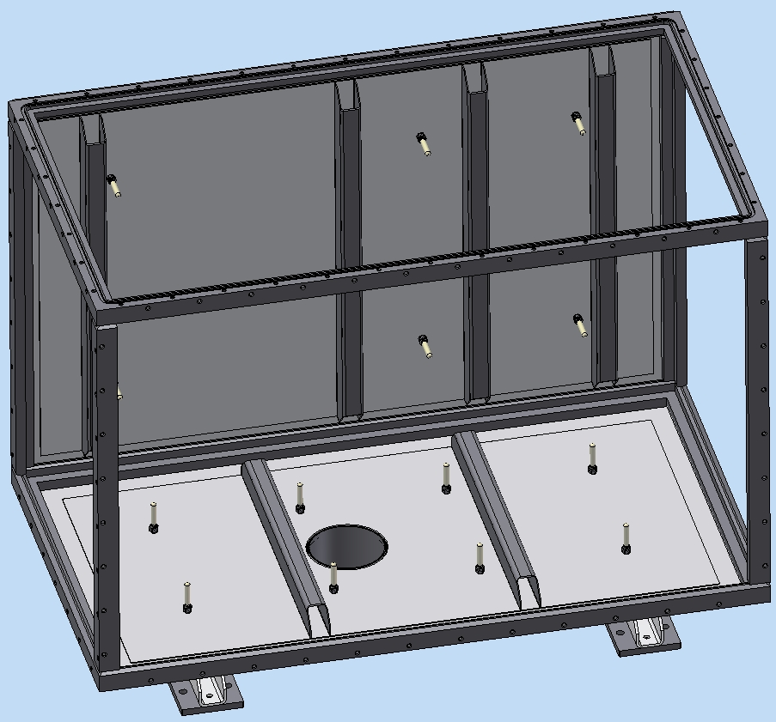
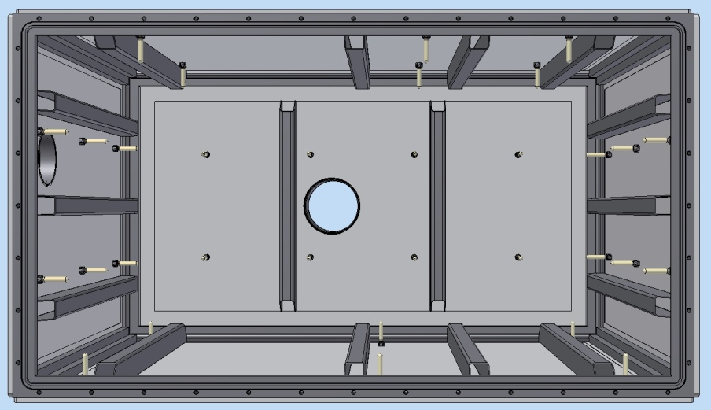
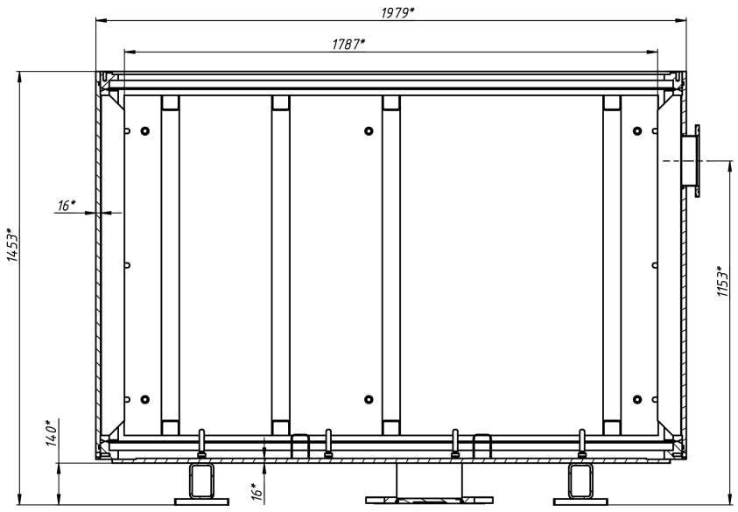
Design of the Vacuum shell
Vacuum shell Assembly, top view.
The Frame
Removable wall
G10 supports
The material of the frame and walls of the Vacuum shell is low alloy steel. m=1670 kg.

Slide 8
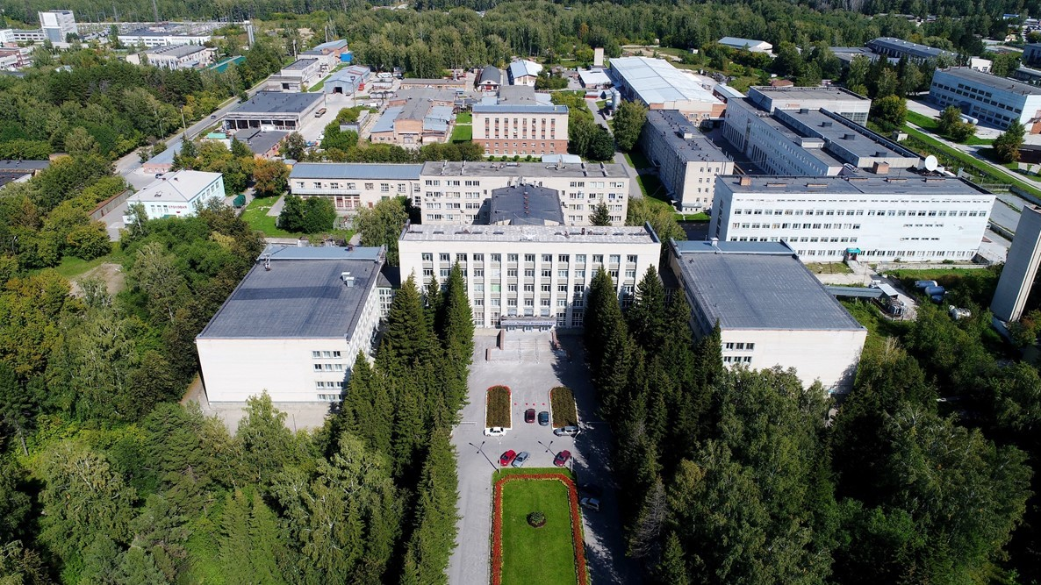
Thank you for your attention

