Slide 1
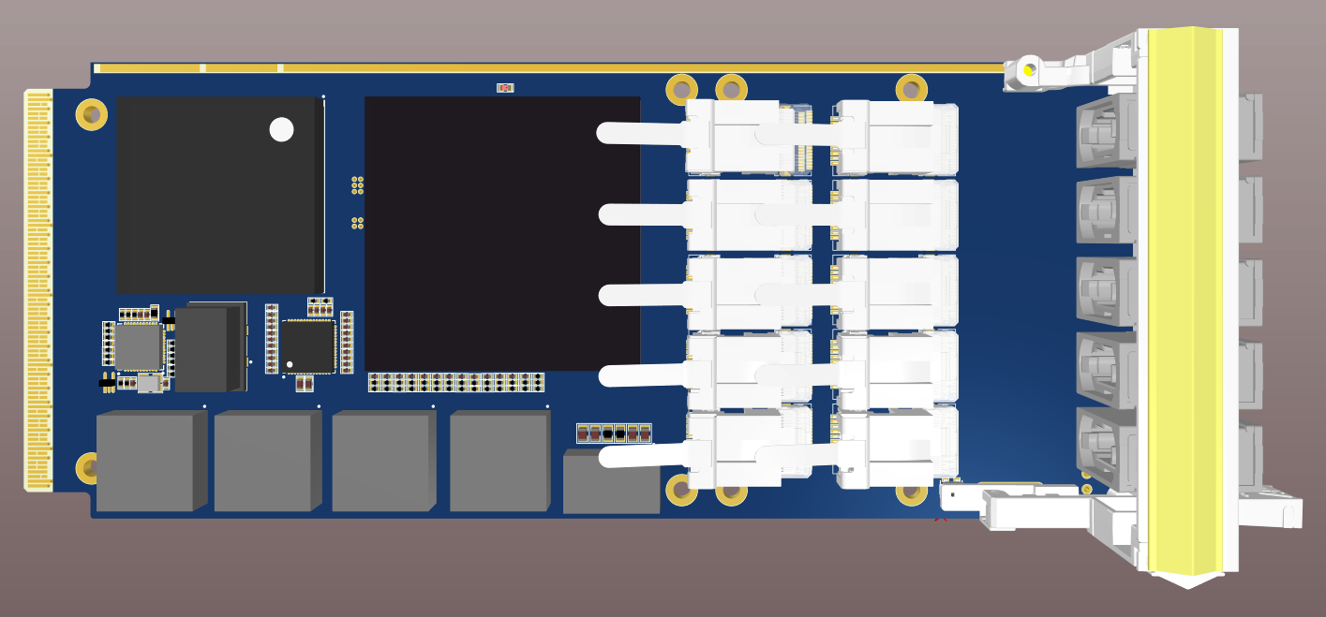
PANDA DC
A data Concentrator for
the PANDA experiment
Pawel Marciniewski, PANDA FEE Meeting, GSI 28.05.19

Slide 2
PANDA DC
A data Concentrator for
the PANDA experiment
FireFly
TX
FireFly
RX
12
FPGA
XCKU15P-FFVA1760
PLL
LMK04610
FireFly
TX
FireFly
RX
12
8 LVDS
FireFly
TX
FireFly
RX
12
60 optical links!
MEMORY
HMC-Gen2
FireFly
TX
FireFly
RX
12
16
16
AMC Backplane
FireFly
TX
FireFly
RX
12
+1.8V 2.2A
+2.5V 2.4A
+3.3V 3.5A
LTM4644
+0.85V 30A
2*LTM4620
4-phase
+0.90V 12A
LTM4620
2-phase
+1.20V 20A
LTM4620
2-phase
MMC
ATMega328P
Pawel Marciniewski, PANDA FEE Meeting, GSI 28.05.19

Slide 3
PANDA DC
Hybrid Memory Cube
Pawel Marciniewski, PANDA FEE Meeting, GSI 28.05.19

Slide 4
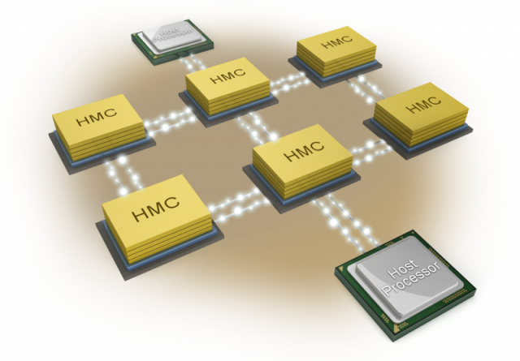
PANDA DC
Hybrid Memory Cube
Pawel Marciniewski, PANDA FEE Meeting, GSI 28.05.19

Slide 5
PANDA DC
A data Concentrator for
the PANDA experiment
FireFly
TX
FireFly
RX
12
FPGA
XCKU15P-FFVA1760
PLL
LMK04610
FireFly
TX
FireFly
RX
12
8 LVDS
FireFly
TX
FireFly
RX
12
60 optical links!
MEMORY
HMC-Gen2
FireFly
TX
FireFly
RX
12
16
16
AMC Backplane
FireFly
TX
FireFly
RX
12
+1.8V 2.2A
+2.5V 2.4A
+3.3V 3.5A
LTM4644
+0.85V 30A
2*LTM4620
4-phase
+0.90V 12A
LTM4620
2-phase
+1.20V 20A
LTM4620
2-phase
MMC
ATMega328P
Pawel Marciniewski, PANDA FEE Meeting, GSI 28.05.19

Slide 6
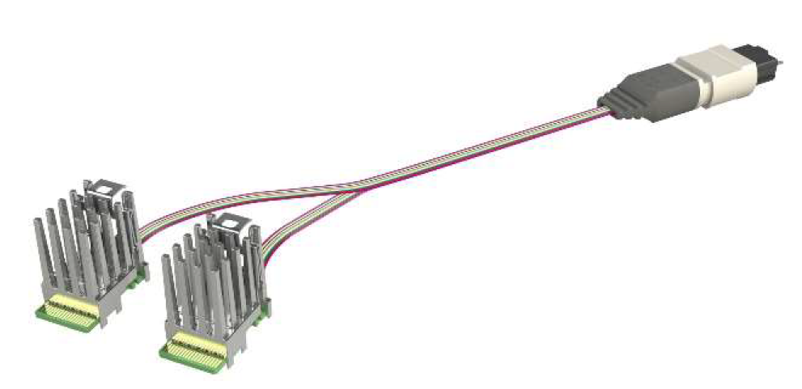
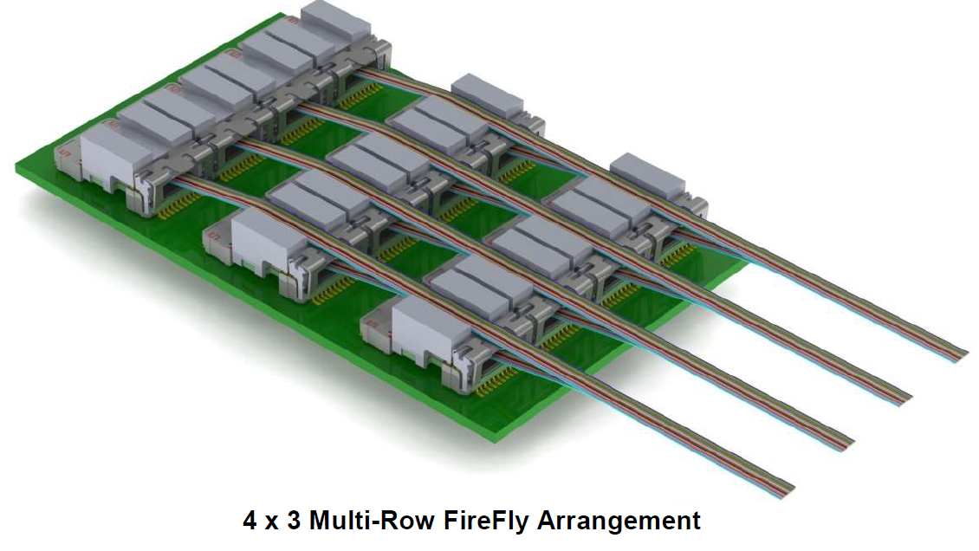
PANDA DC
Samtec FireFly optical modules
Pawel Marciniewski, PANDA FEE Meeting, GSI 28.05.19

Slide 7
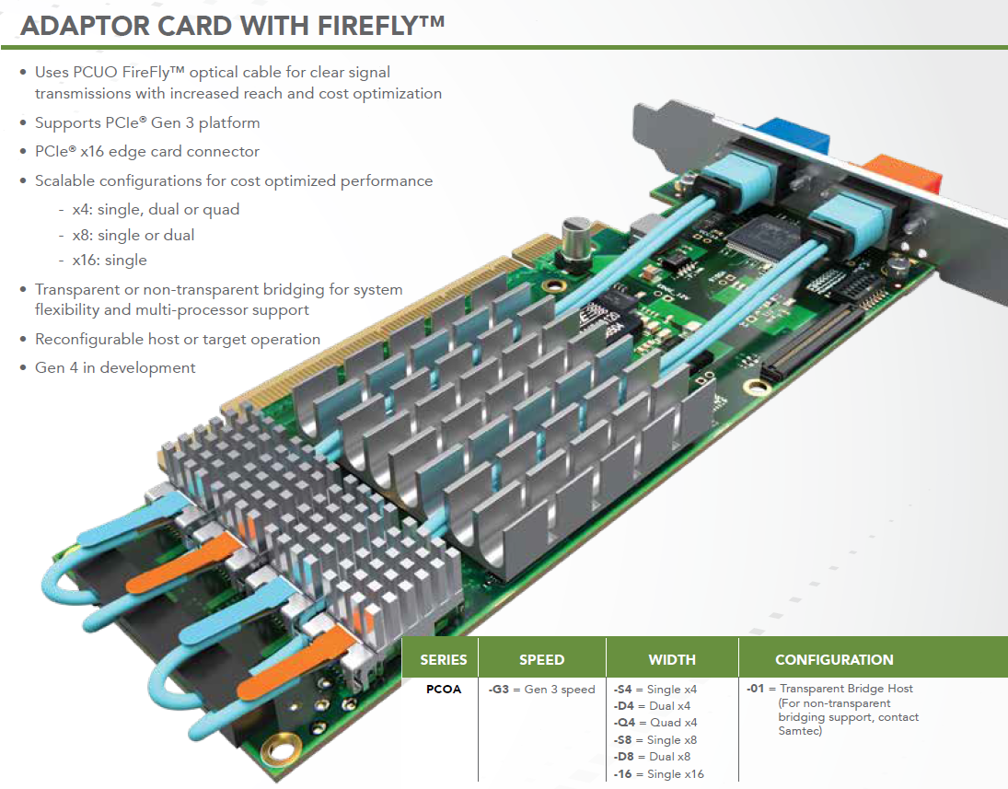
PANDA DC
Samtec FireFly optical modules
Pawel Marciniewski, PANDA FEE Meeting, GSI 28.05.19

Slide 8
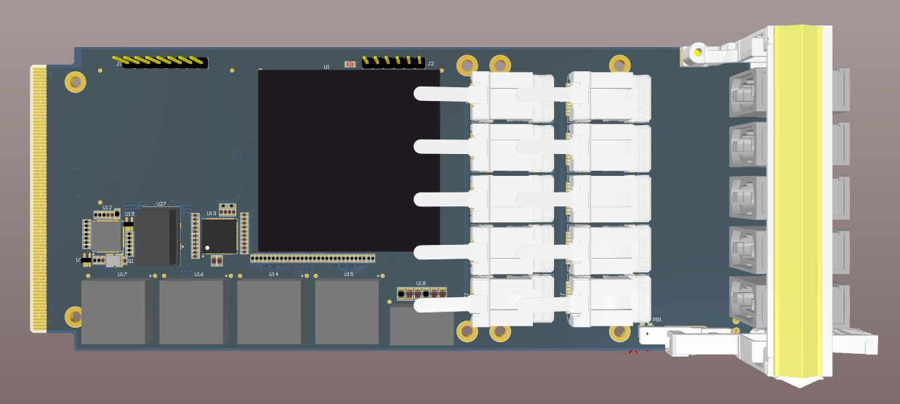
PANDA DC
Pawel Marciniewski, PANDA FEE Meeting, GSI 28.05.19
Pawel Marciniewski, PANDA FEE Meeting, GSI 28.05.18

Slide 9
PANDA DC
Pawel Marciniewski, PANDA FEE Meeting, GSI 28.05.19

Slide 10
PANDA DC
Pawel Marciniewski, PANDA FEE Meeting, GSI 28.05.19

Slide 11
PANDA DC
Pawel Marciniewski, PANDA FEE Meeting, GSI 28.05.19

Slide 12
PANDA DC
Pawel Marciniewski, PANDA FEE Meeting, GSI 28.05.19

Slide 13
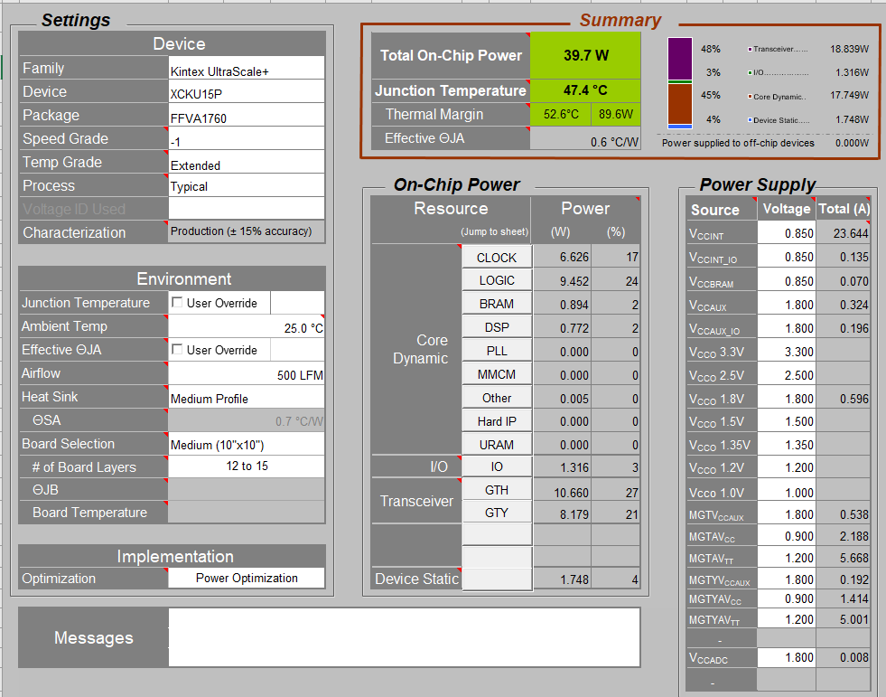
PANDA DC
P_{TOT} = 39.7W
Pawel Marciniewski, PANDA FEE Meeting, GSI 28.05.19

Slide 14
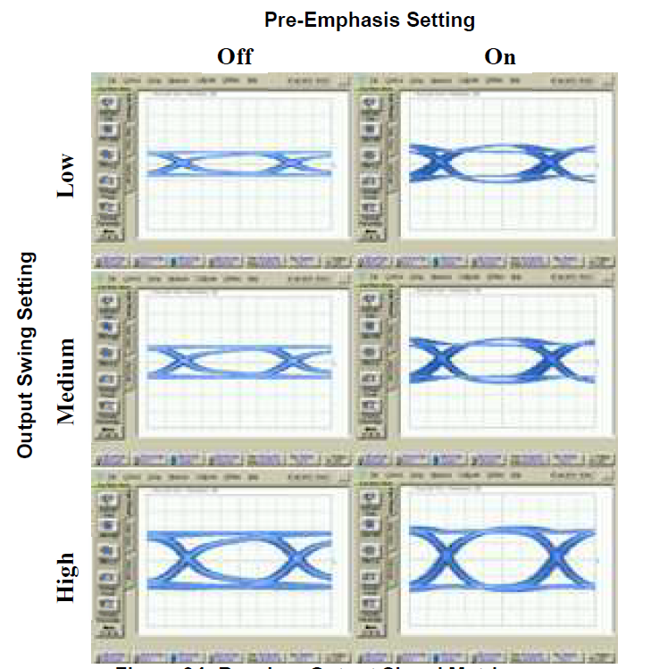
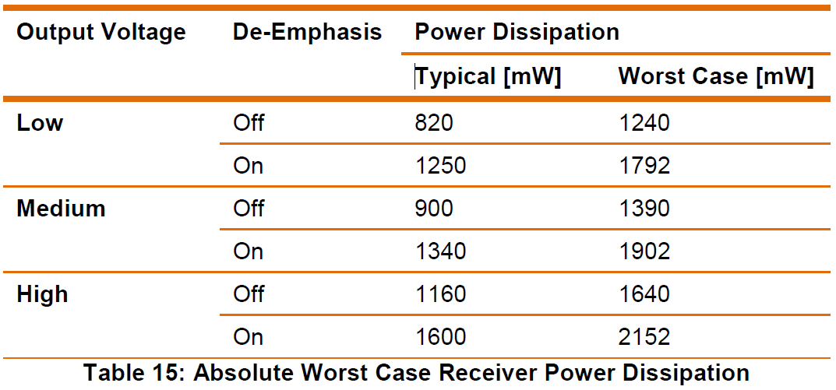
PANDA DC
P_{TOT} = 13.4W
Pawel Marciniewski, PANDA FEE Meeting, GSI 28.05.19

Slide 15
PANDA DC
Module Power (54W)
FireFly
TX
FireFly
RX
12
FPGA
XCKU15P-FFVA1760
PLL
LMK04610
FireFly
TX
FireFly
RX
12
8 LVDS
FireFly
TX
FireFly
RX
12
MEMORY
HMC-Gen2
FireFly
TX
FireFly
RX
12
16
16
AMC Backplane
FireFly
TX
FireFly
RX
12
+1.8V 2.2A
+2.5V 2.4A
+3.3V 3.5A
LTM4644
+0.85V 30A
2*LTM4620
4-phase
+0.90V 12A
LTM4620
2-phase
+1.20V 20A
LTM4620
2-phase
MMC
ATMega328P
Pawel Marciniewski, PANDA FEE Meeting, GSI 28.05.19

Slide 16
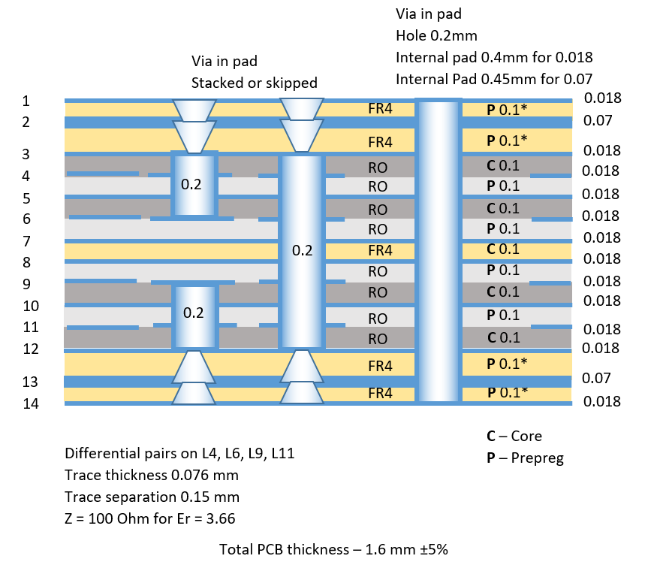
PANDA DC
PCB Stack
75μ
100μ
18μ
RO4350B
100μ
ε_{r} = 3.66
150μ
Total PCB thickness 1.6 mm
Pawel Marciniewski, PANDA FEE Meeting, GSI 28.05.19

Slide 17
PANDA DC
Work progress
The design containing HMC ready
The re-design without HMC is done
The PCB technology is under consultancy with the manufacturer.
The FPGAs are purchased (10 pcs)
The FireFly modules are in preparation (non-standard pig-tail lengths)
Remaining are:
overall scrutiny
Pawel Marciniewski, PANDA FEE Meeting, GSI 28.05.19

Slide 18
PANDA DC
Thank You !
Pawel Marciniewski, PANDA FEE Meeting, GSI 28.05.19

