Slide 1
STT BEAmdata analysis and inputs to simulation
06.11.19 I Gabriela pérez andrade
Panda collaboration meeting
Tracking session

Slide 2
Outline
Calibration/tracking
Global calibration
Investigation of straws efficiency
Inputs to simulation
1

Slide 3
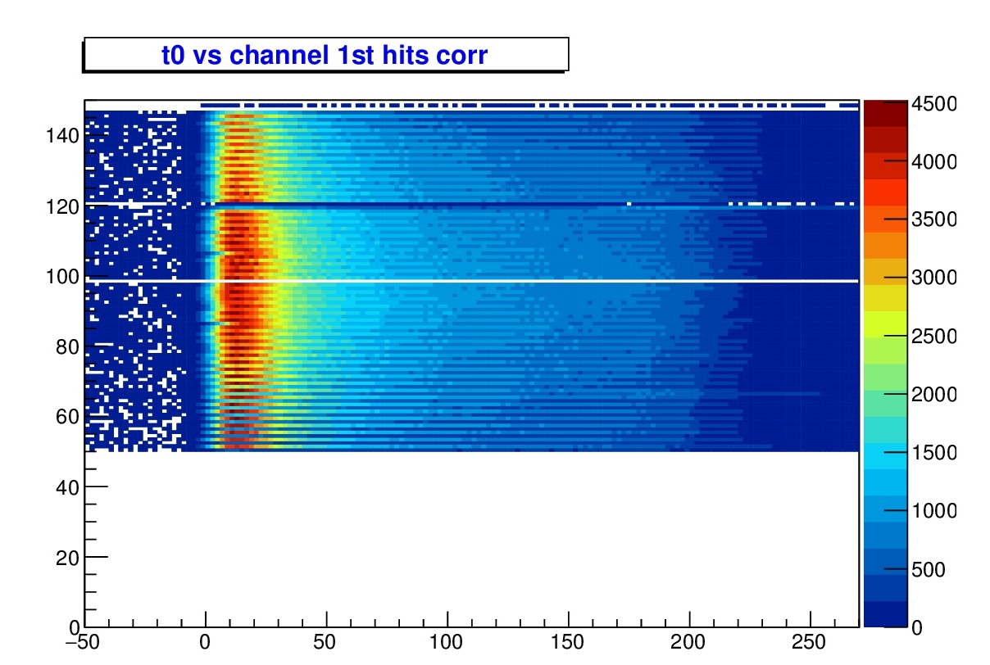
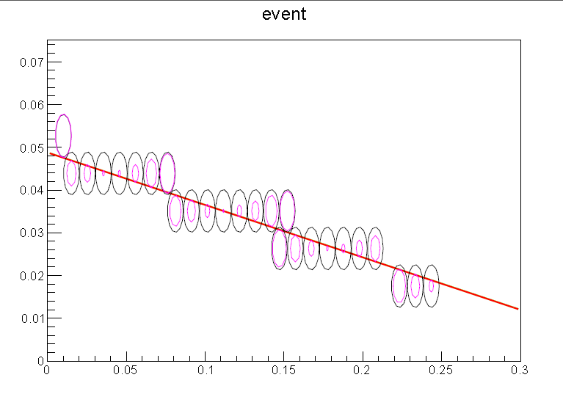
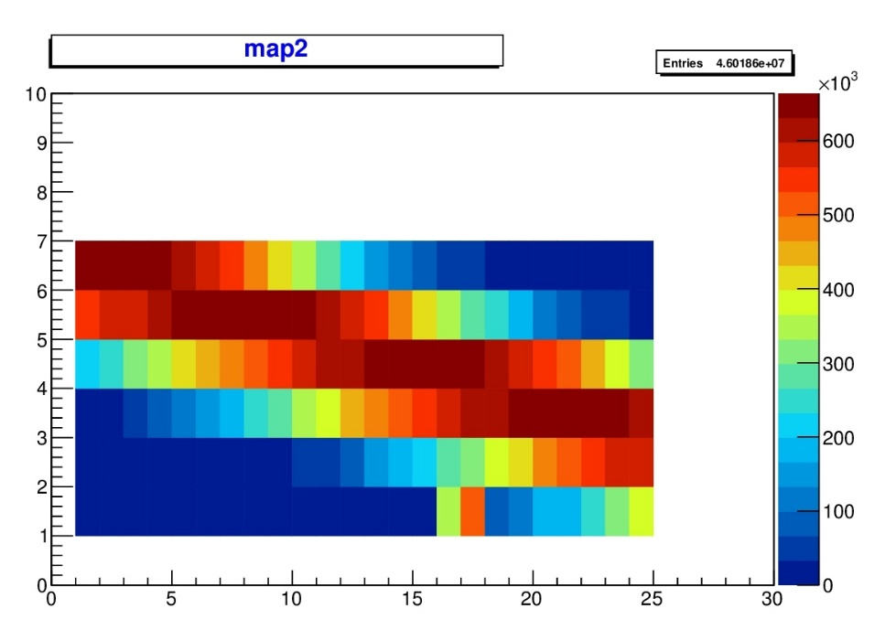
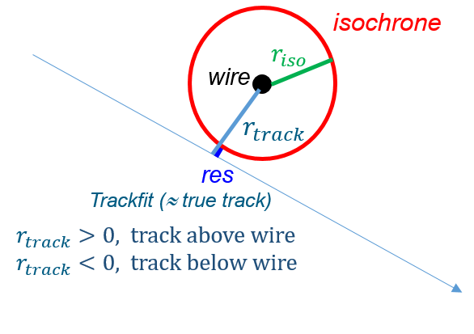
CALIBRATION AND TRACKING
Straw channel no.
Isochrone parametrization
Track Pre-fit from wire positions of straws with hits
$r_{iso}$ calculation for each hit
Residual definition: $r_{res}= r_{track} − r_{iso}$
Use of χ2- MINUIT function to reduce distance from isochrones
to fitted track.
Single outliers rejection:
Condition in $r_{track}$, (e.g. > 900 µm).
All channels drift time (ns)
$r(t)=\sum_{i=0}^{4}{P_{i}×t^{i}}$
Radial distance (mm)
Drift time (ns)
Beam
2

Slide 4
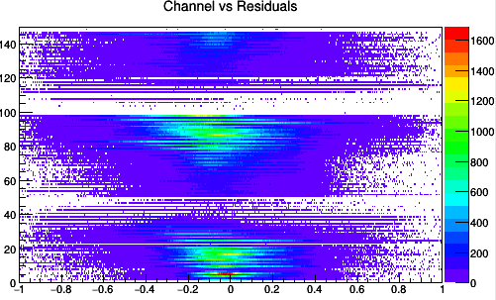
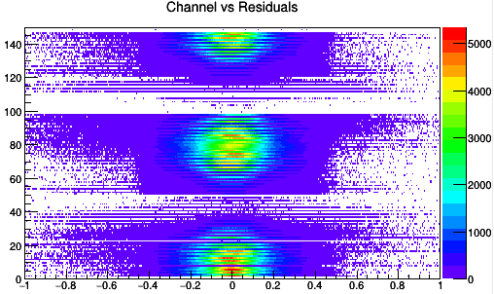
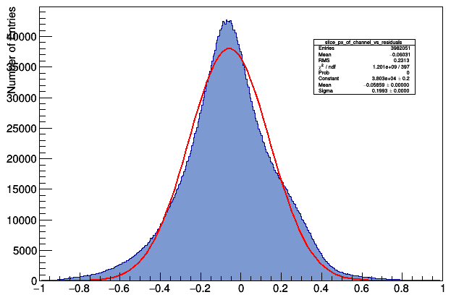
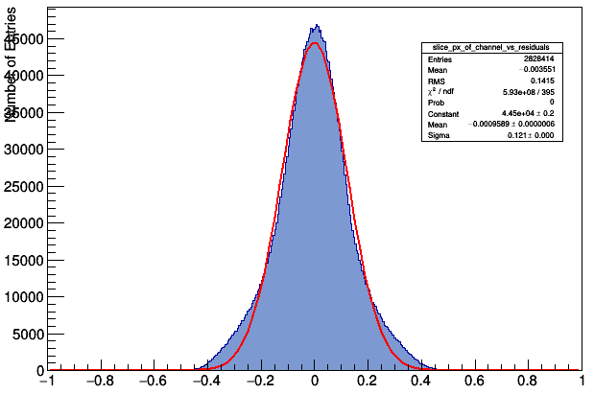
TRACKING RESOLUTION
Expected residual distribution around $r_{res}=0$.
Shifted $r_{res}$ mean indicates systematic error caused by wire misplacement i.e. channel dependent.
Correction through $r_{iso}$ :
$r_{ new}$ = $r_{iso}$ + $r_{ mean up/down}$, where $r_{ mean up/down}$ refers to tracks above and below the wire respectively
Re-fit with $r_{ new}$ (iterative procedure).
Hit resolution given by fit to residuals distribution (σ).
Channel number
Channel number
Residuals [µm]
Residuals [µm]
σ = 121 µm
µ = -1 µm
= 191 µm
µ = -60 µm
Protons 2.5 Gev/c initial
3
Protons 2.5 Gev/c iteration 10

Slide 5
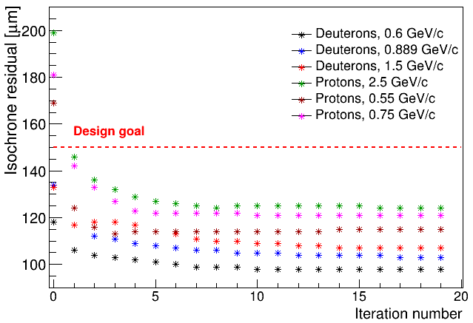
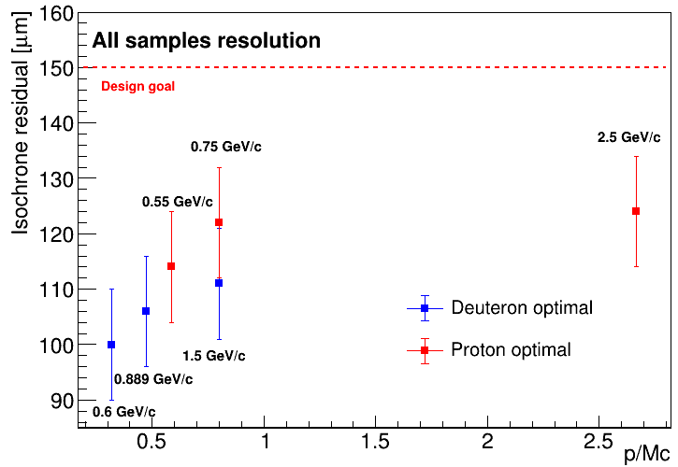
TRACKING RESOLUTION
At ~ 6 iterations, the resolution value stabilizes.
After value stabilizes, the resolution value difference is of ~2 µm between iterations
Final resolution in general is < 130 µm
Hit resolution better than design goal (i.e. 150 µm) after a few iterations.
Systematic error correction further improves hit resolution.
4

Slide 6
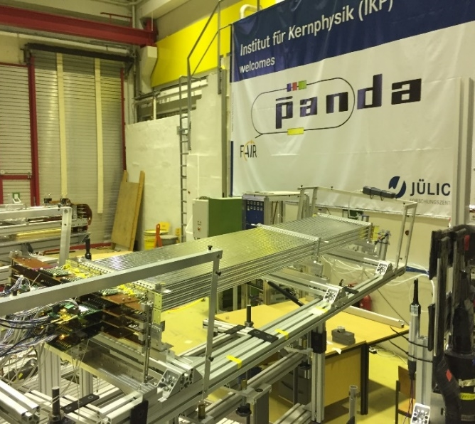
rEMARKS
Calibration and tracking (iterations) are performed for each dataset :
Results are slightly biased.
Isochrone parametrization and systematic error correction should be performed only once.
Information such as particle momenta will not be available in the experiment i.e. method should be dE/dx independet.
An approach for a global calibration has been tested in 3 proton and 3 deuteron beam datasets at different beam momenta.
5

Slide 7
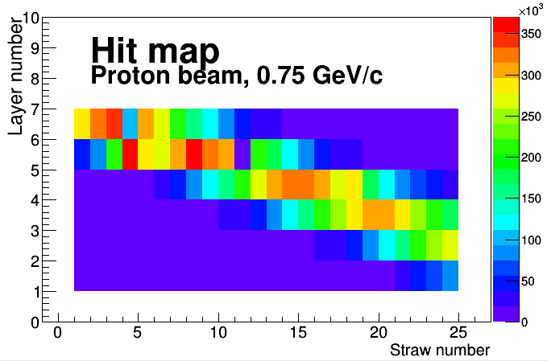
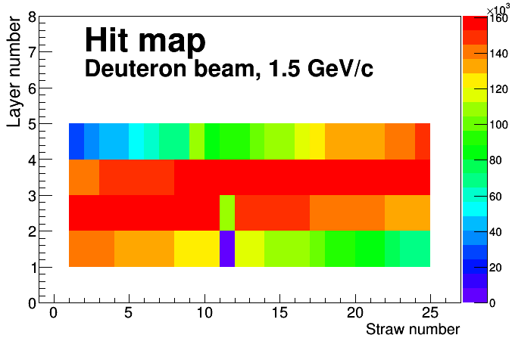
Global calibration
A global dataset is chosen based on uniform illumination.
Parameters from calibration and giving optimal hit resolution are obtained, i.e.
Isochrone parametrization
$r_{ mean up/down}$ correction
Output parameters from calibration and tracking are used as input for other datasets of same particle specie.
Compare hit resolution and residual shift correction.
6

Slide 8
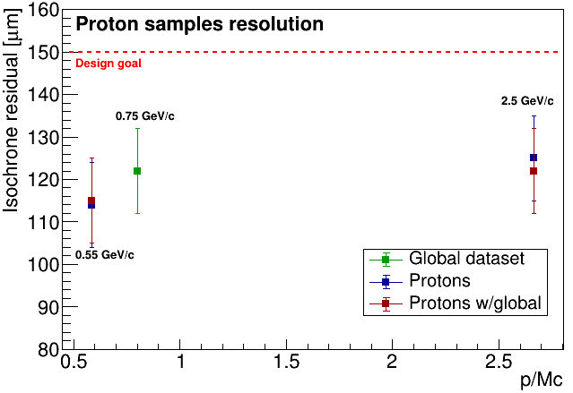
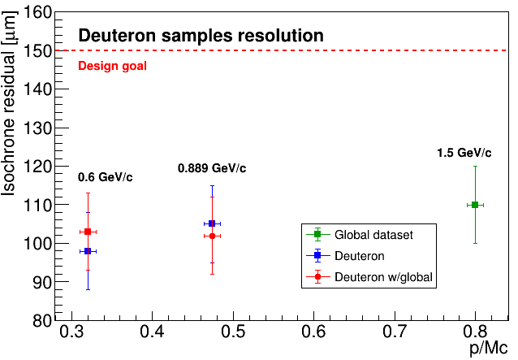
Preliminary results
Global calibration, hit resolution
Global calibration/tracking parameters result on a difference of < 5 µm with own calibration/tracking parameters.
7

Slide 9
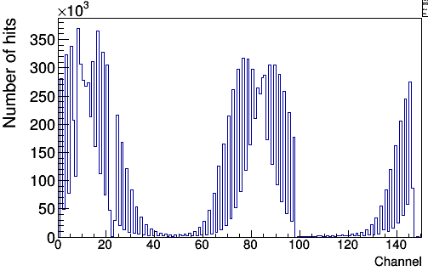
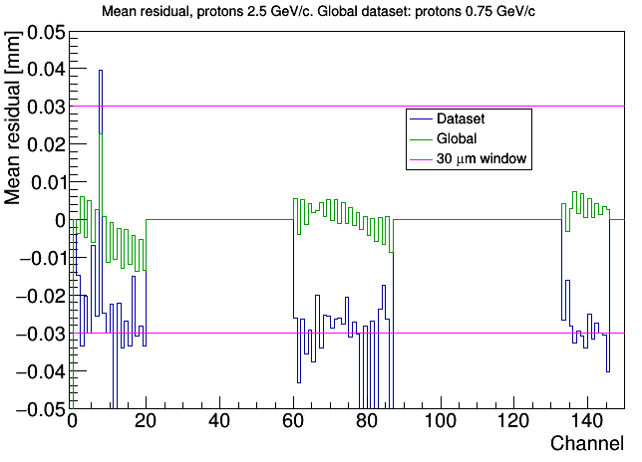
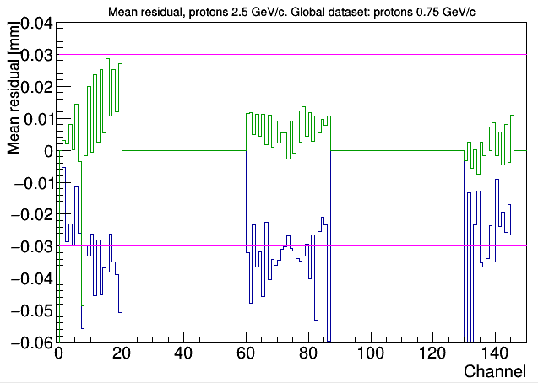
Channel RESIDUAL comparison
Mean residual, tracks above the wire
Proton beam 2.5 GeV/c
Mean residual, tracks below the wire
Mean residual stay mostly within a window of 30 µm for tracks above the wire.
Difference in mean residuals can be attributed to hit-map differences.
8

Slide 10
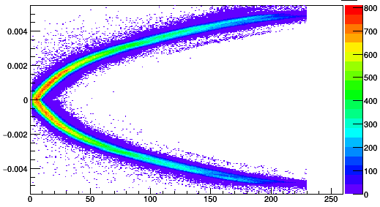
Investigation of Straws efficiency (un-biased)
Global isochrone parametrization.
Perform tracking using specific straw areas.
Test tracking performance in blocked straws:
Obtain hit resolution
Retrieve straw radii.
Obtain wire misplacement information from $r_{track}$
$r_{track}$ [m]
Time [ns]
9

Slide 11
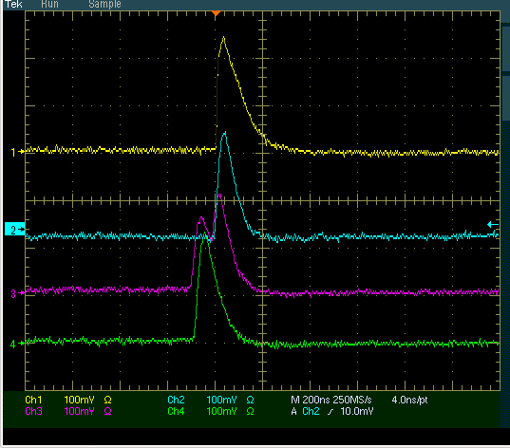
Inputs to Simulation (hit digitization)
Information extracted from experimental data can be used to benefit some simulation features for tracking:
Driftime-Isochrone:
Isochrone uncertainity.
Hit resolution.
Time over Threshold (ToT) characterization to:
Obtain information about hit multiplicity.
Use as criterion for hit filtering (δ-electrons).
Use as PID observable.
ToT [ns]
Drift time [ns]
10
Straw signals

Slide 12
Summary and outlook
Calibration and tracking iterations introduce a slight bias in hit resolution and systematic error correction.
Hit resolution using global calibration and tracking parameters show a difference of < 5 µm from own calibration/tracking (preliminary tests). Residual shift stay mostly within a window of 30 µm (preliminary tests).
Straw properties (e.g. radius, wire misplacement) can be investigated if tracking is performed using a reduced amount of straws.
Available data could provide with useful information for simulation parameters.
11

Slide 13
THANK YOU!

Slide 14
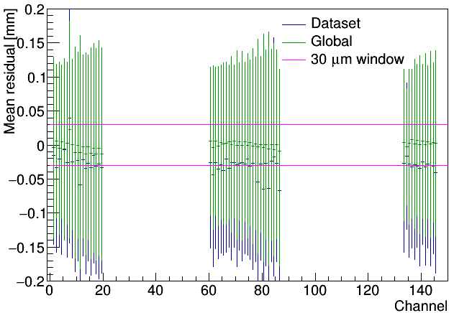
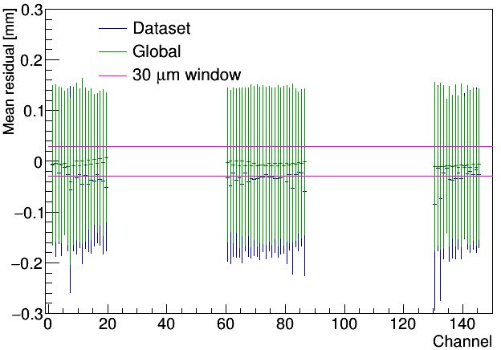
Channel RESIDUAL comparison
Mean residual, tracks above the wire
Mean residual, tracks below the wire
Proton beam 0.55 GeV/c
Residual shift stay mostly within a window of 30 µm

Slide 15
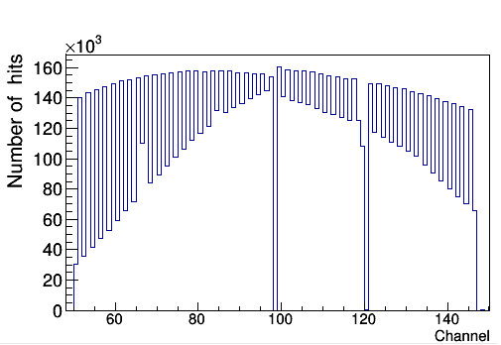
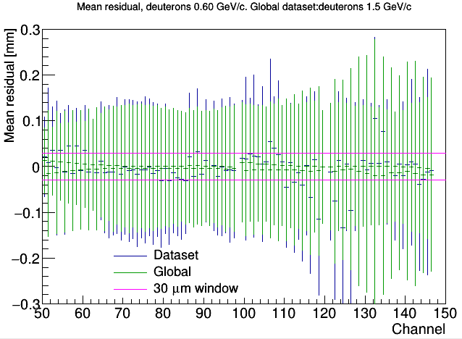
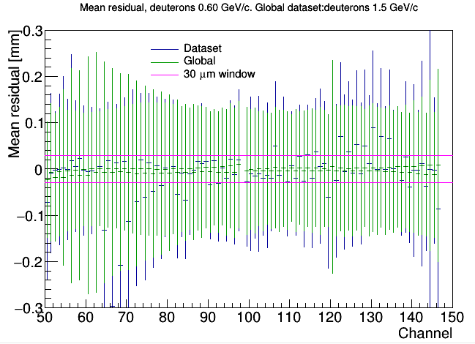
Channel RESIDUAL comparison
Mean residual, tracks below wire
Hits per channel, Deuterons 1.5 GeV/c (Global sample)
Mean residual, tracks above wire
Deuteron beam 0.60 GeV/c

