Slide 1
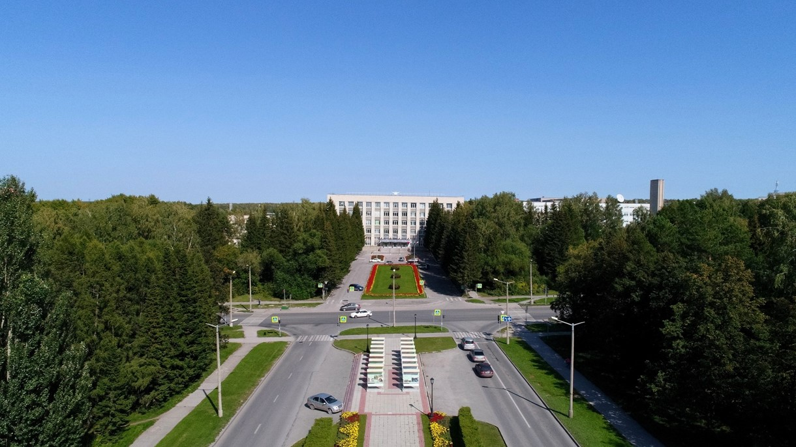
Status of the PANDA Solenoid Magnet Production in BINP
S.Pivovarov, E.Pyata, BINP, Novosibirsk

Slide 2
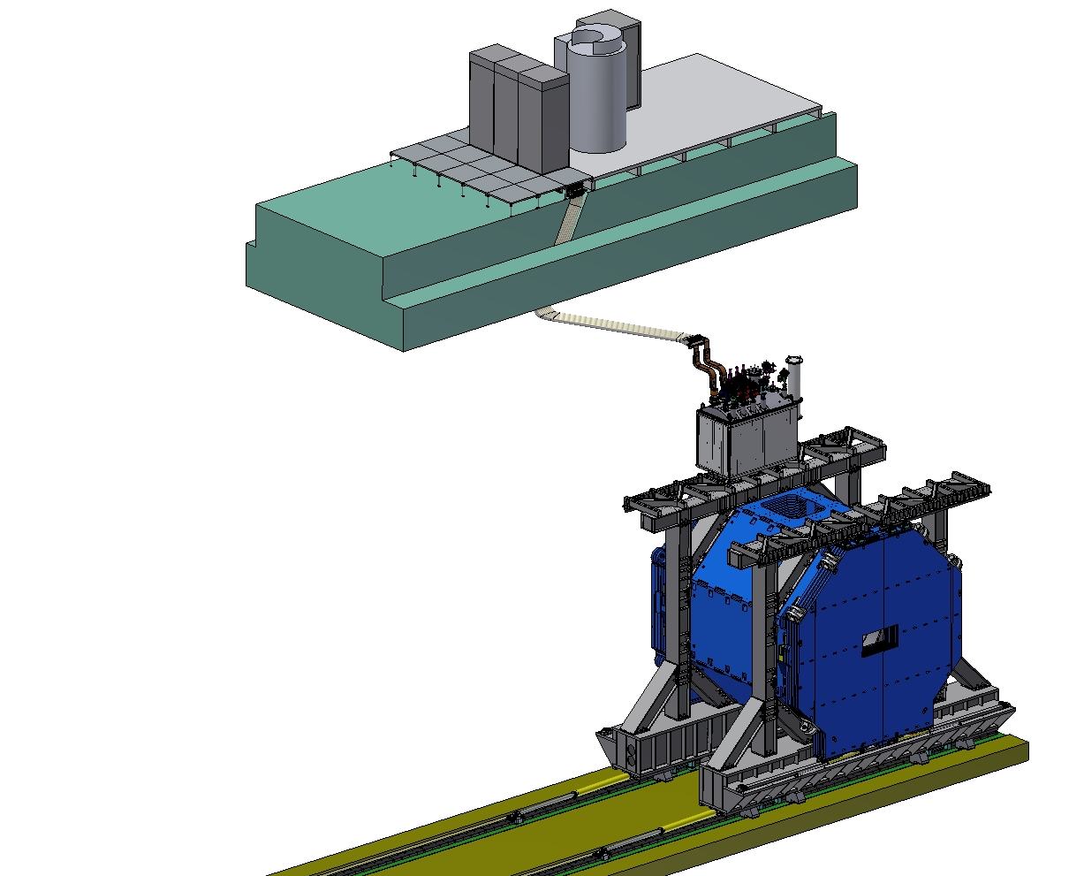
PANDA solenoid magnet, BINP responsibility
Power supply and energy extraction system
Control Dewar box
Cable channel
Solenoid and yoke
Frame of Yoke
Figure 1. Arrangement of the components of the PANDA solenoid.

Slide 3
Development of the PANDA solenoid magnet
Name of item | Status of work
Yoke and frame | Design is ready, production
Cryostat of solenoid | Design is ready, technological development, Call for tender
Cold mass | Design is ready, technological development, Call for tender
Conductor purchasing | Development work, preparation Call for tender
Control Dewar box | Preliminary design December 2019
PANDA solenoid power cabling | Design is ready, production
Power supply and energy extraction system | Detail design is ready, production
Magnet safety system | in process
Table 2. Status of work of the PANDA solenoid production.

Slide 4
The main milestones of the yoke production
Name of milestone | Date 2017/10
FDR of the yoke | 20-25/11/2017
Contract with SibMash (SET), signed | 2/11/2017
Purchasing raw materials (1st batch, 60 t) | 26/12/2017
Start of production of the 1st octant | 01/2018
Status production
First octant production, W3 | 11/2018
Welding of 8 octants | ready
Machining of 6 octants | ready
Final machining of the vertical octant | 11/2019
Final machining of the upper octant | 11/2019
Production of the Upstream door | 11/2019
Production of the Downstream door | 11/2019
Production of a tooling for the yoke assembly | 11/2019
Table 3. The main milestones of the yoke production.

Slide 5
The main milestones of the yoke production
Name of milestone | Date 2017/10
Production of the all barrel octants | 11/2019
Production of the frame and beams | 11/2019
Production of the doors | 12/2019
Control assembling at SET | 12/2019
Finalization of the parts | 12/2019-01/2020
Assembling of the Yoke at BINP | ? Q2-2020
Table3. The main milestones of the yoke production.

Slide 6
The main milestones of the Cryostat production
Name of milestone |  | Date 2017/10
FDR of the Cryostat |  | 08/02/2019
FDR of the Cold Mass |  | 17/04/2019
Status production
Cryostat | Design is ready, technological development, Call for tender
Cold Mass | Design is ready, technological development, Call for tender
First Prototype of the Coil | 11/2019
Tooling for winding Coil (and Prototype) | 11/2019
Tooling for impregnation of Coil (and Prototype) | 11/2019
2nd and 3rd Prototype production | 12/2019 – 02/2020
Tooling for assembling of the Magnet | Design is ready, technological development, Call for tender
Tooling for installation of the Magnet into the Yoke | Design is ready, technological development, Call for tender
Table 3. The main milestones of the Cryostat production.

Slide 7
Status of the PANDA conductor development/ procurement

Slide 8
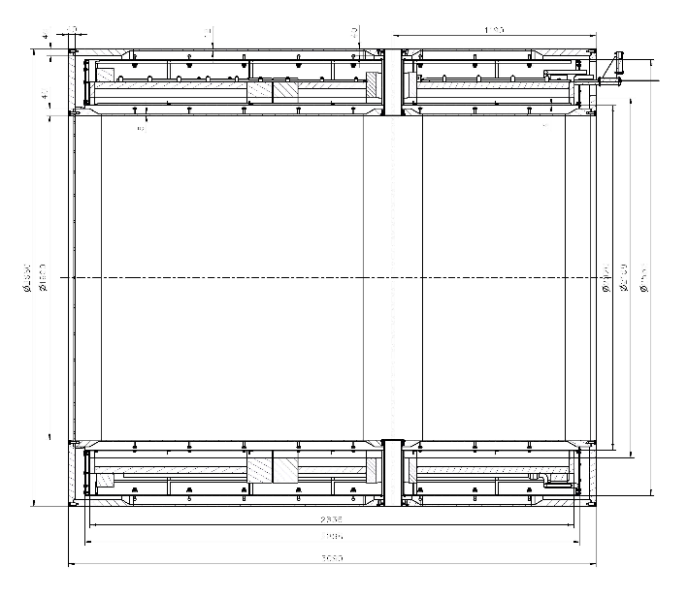
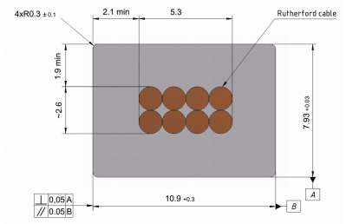
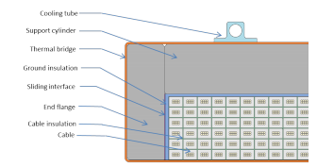
Main risks
Purchasing super conductive conductor - lack of a manufacturers
Rutherford cable, 8 strands, extruded in Al matrix
Thickness (after cold work) at 300 K | mm | 7.93 | ± 0.03
Width (after cold work) at 300 K | mm | 10.95 | ± 0.03
Critical current (at 4.2 K, 5 T) | A | > 14690
Critical current (at 4.5 K, 3 T) | A | > 16750
Overall Al/Cu/sc ratio |  | 10.5/1.0/1.0
Aluminum RRR (at 4.2 K, 0 T) |  | > 1000
Al 0.2% yield strength at 300 K | MPa | > 30
Figure 6. Longitudinal section of the cryostat with cold mass.
Table 7. Conductor mechanical and electrical parameters.
Figure 5. Cold mass cross-section.
Figure 9. Drawing of the conductor.

Slide 9
Status of the PANDA conductor development/ procurement
Rutherford cable co-extrusion/ conklad in a pure Al
Plan
Production of new dies - July 2019 - ready.
Tests of the Conklad - July 2019. - ready
Cryogenic tests in CERN/ VNIIKP - December 2019/ February 2020
Request 1000m Cu Rutherford cable for tests in SARKO - preparation of the contract
Preparation contracts for PANDA NbTi strands production, VNIINM - 11-12/ 2019
Preparation contracts for PANDA Rutherford cables production, VNIIKP - 1-2/ 2020
1000m Cu Rutherford cable for tests in SARKO - 02-03/ 2020
Preparation contracts for PANDA conductor production with SARKO - 02-03/ 2020

Slide 10
Status of the PANDA conductor development/ procurement
Rutherford cable co-extrusion/ conklad in a pure Al
Plan
Procurement A995/998 wire 9,5 mm
Preparation of the contract for purchasing 3500 kg A995 aluminum raw material;
Sign of the contract for production A995/998 wire Ø 9,5 mm with NANOELECTRO:
First step – production from A995 aluminum raw material 147 kg;
2nd step – production 2500 kg A995/998 wire 9,5 mm.
Conklad – 02/2020 in SARKO with prototype PANDA cable and A995/998 wire 9,5 mm.
Tests of the prototype PANDA cable and A995/998 matrix after Conklad – 02-03/2020
Co-extrusion/ Conklad – 02/2020 in SARKO with Cu Rutherford cable 1000m and A995/998 wire 9,5 mm.
Cold work to result the overall geometrical conductor dimensions - 03-04/ 2020
Production PANDA NbTi strands - 06-07/ 2020
Production PANDA NbTi conductor with A995 matrix - 07-08/ 2020

Slide 11
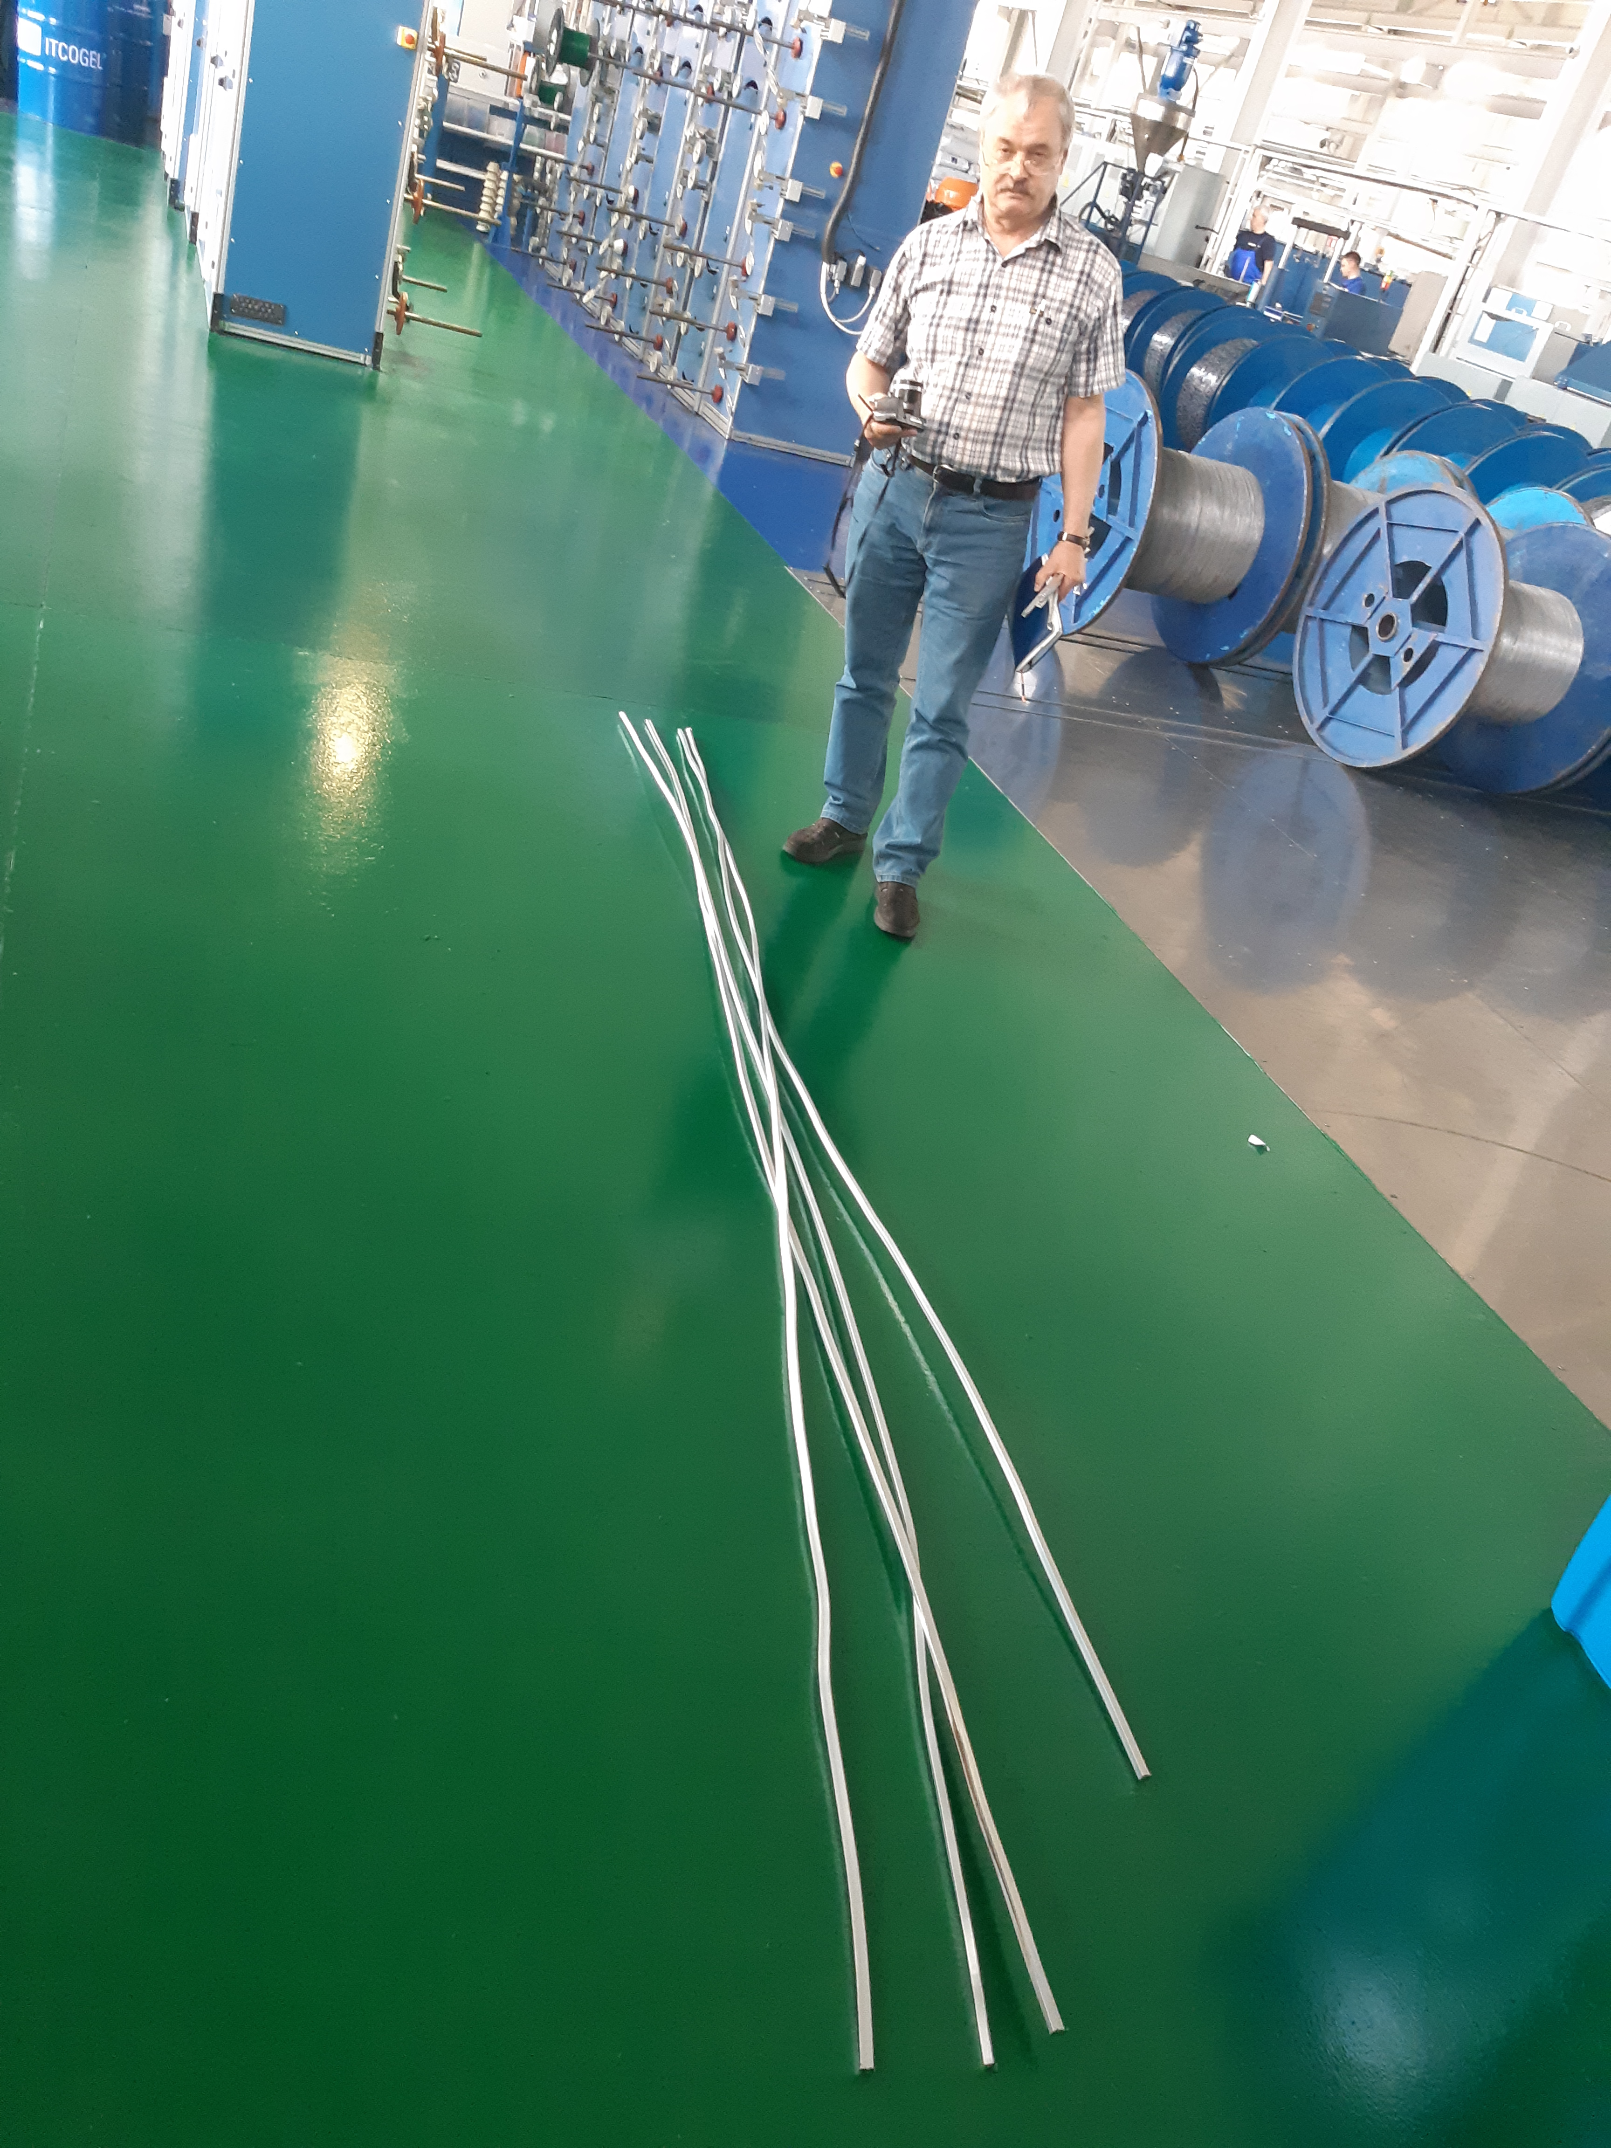
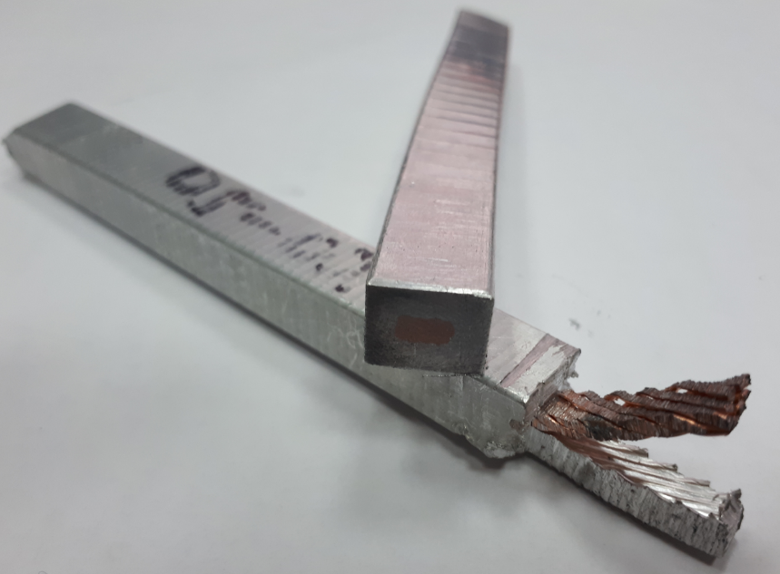
Sarko.
Produced about 20 meters a conductor from A95 and NbTi cable;
4 pieces the conductor 3,5m prepared for following tests;
Mechanical tests should be in BINP;
Cryogenic tests for RRR and critical currents should be carried out in Bochvar institute and CERN.

Slide 12
3D model of the Yoke and Frame.
Frame
Yoke
Control assembling 12/2019

Slide 13
Module production
Module after welding
Finished module

Slide 14
Upstream Door production

Slide 15
Downstream Door production

Slide 16
Beam production

Slide 17
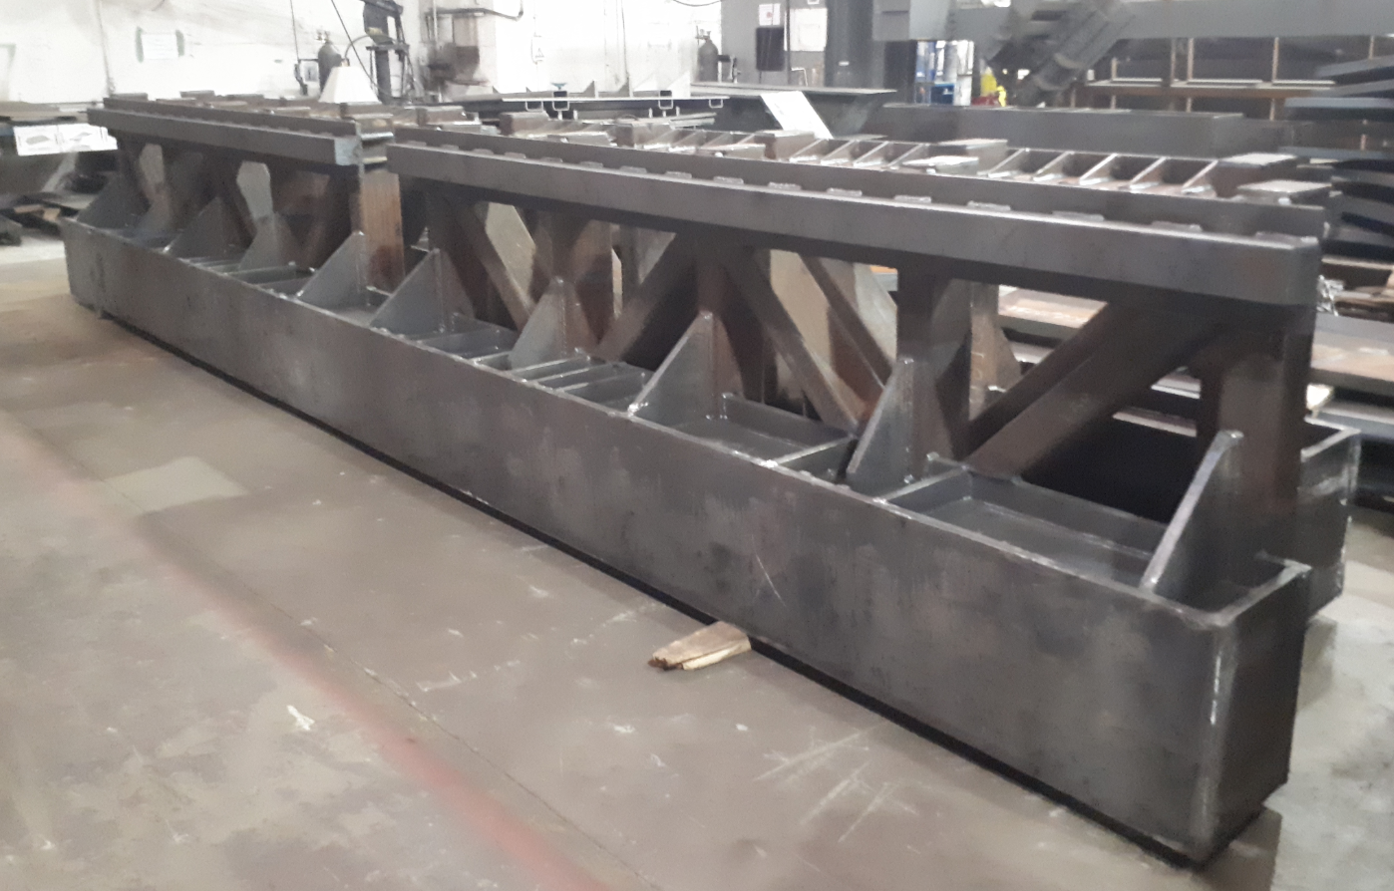
Top Frame production

Slide 18
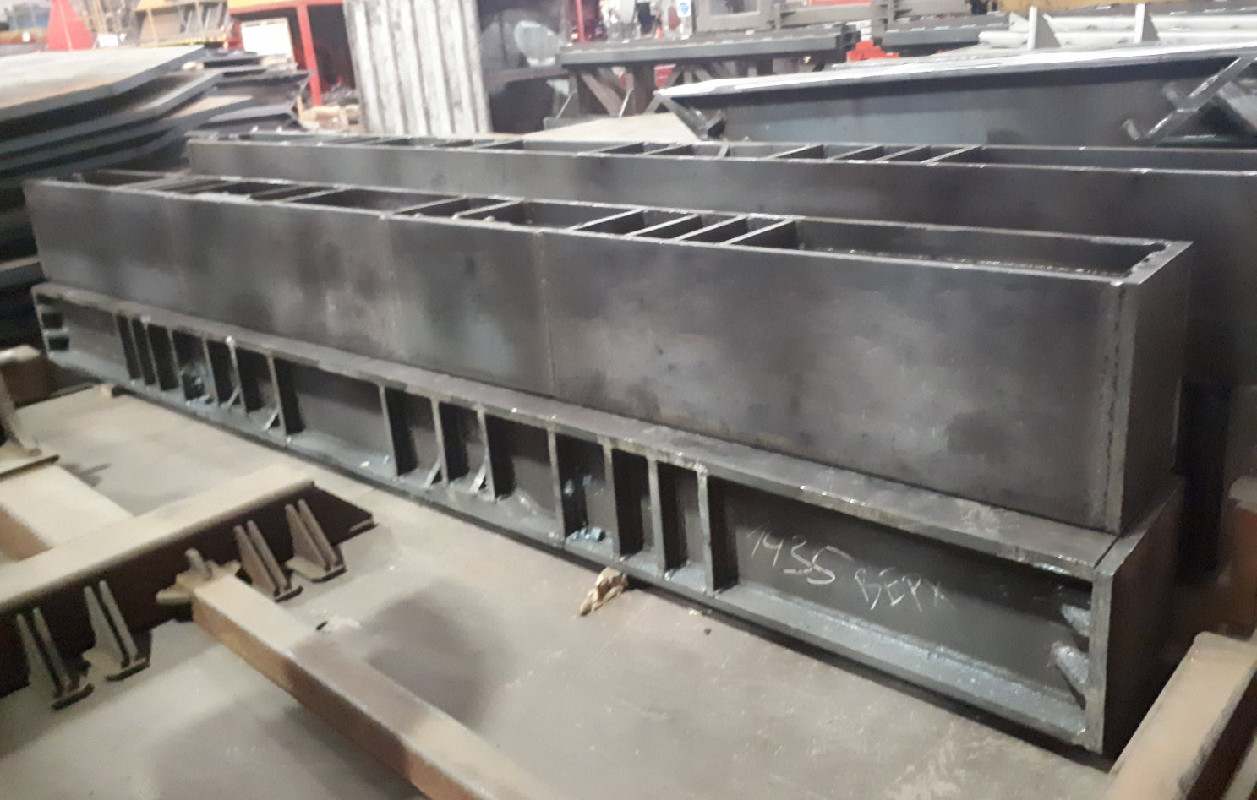
Vertical Beams production

Slide 19
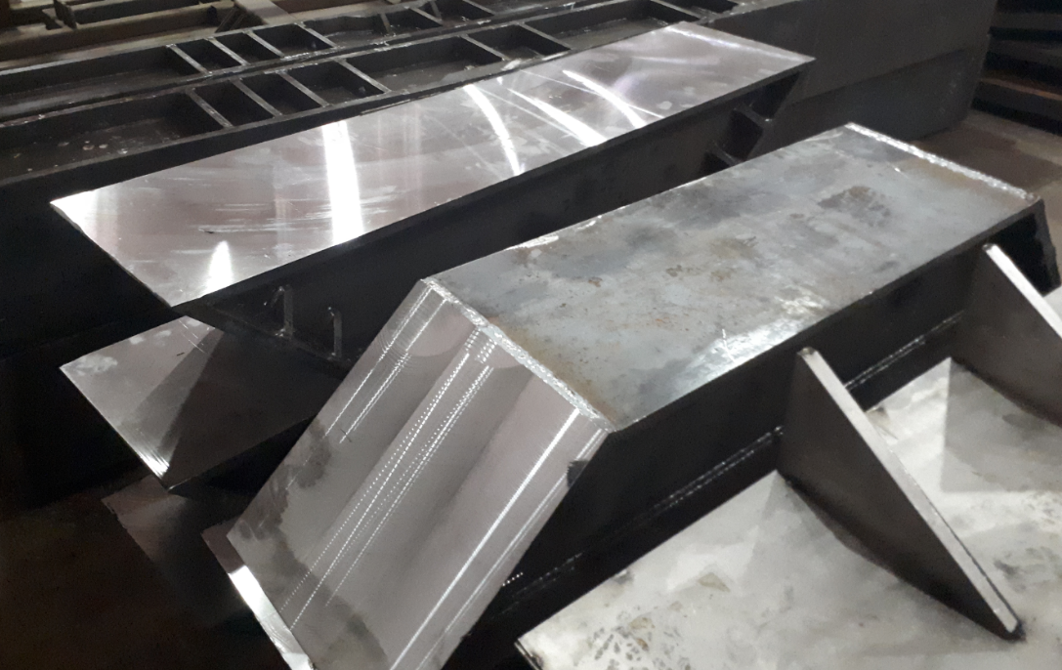
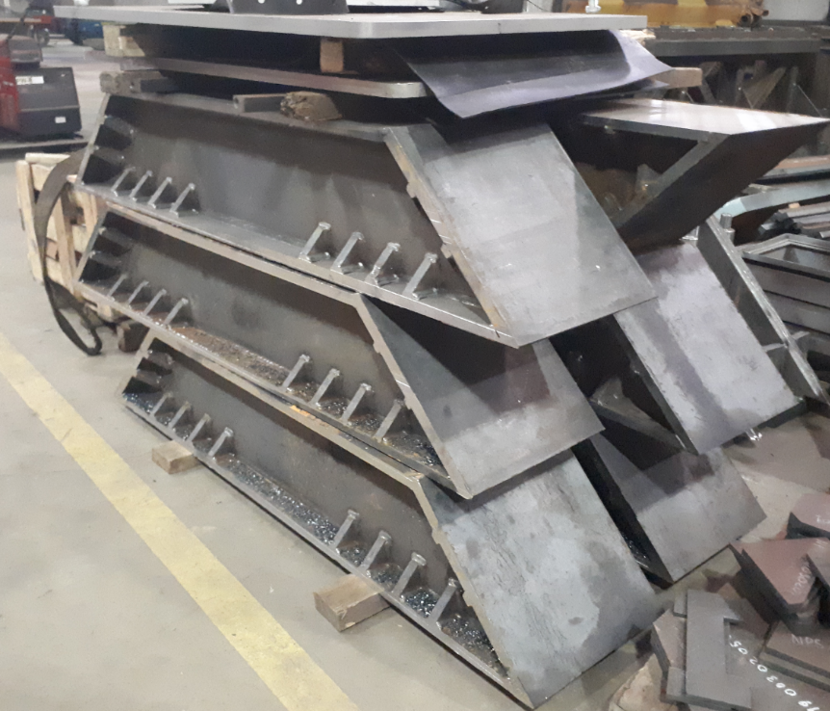
Angle Beams production

Slide 20
3D model of the Magnet and Control Dewar.
Control Dewar box
Preliminary design December 2019
Cryostat and Coil
Design is ready, technological development

Slide 21
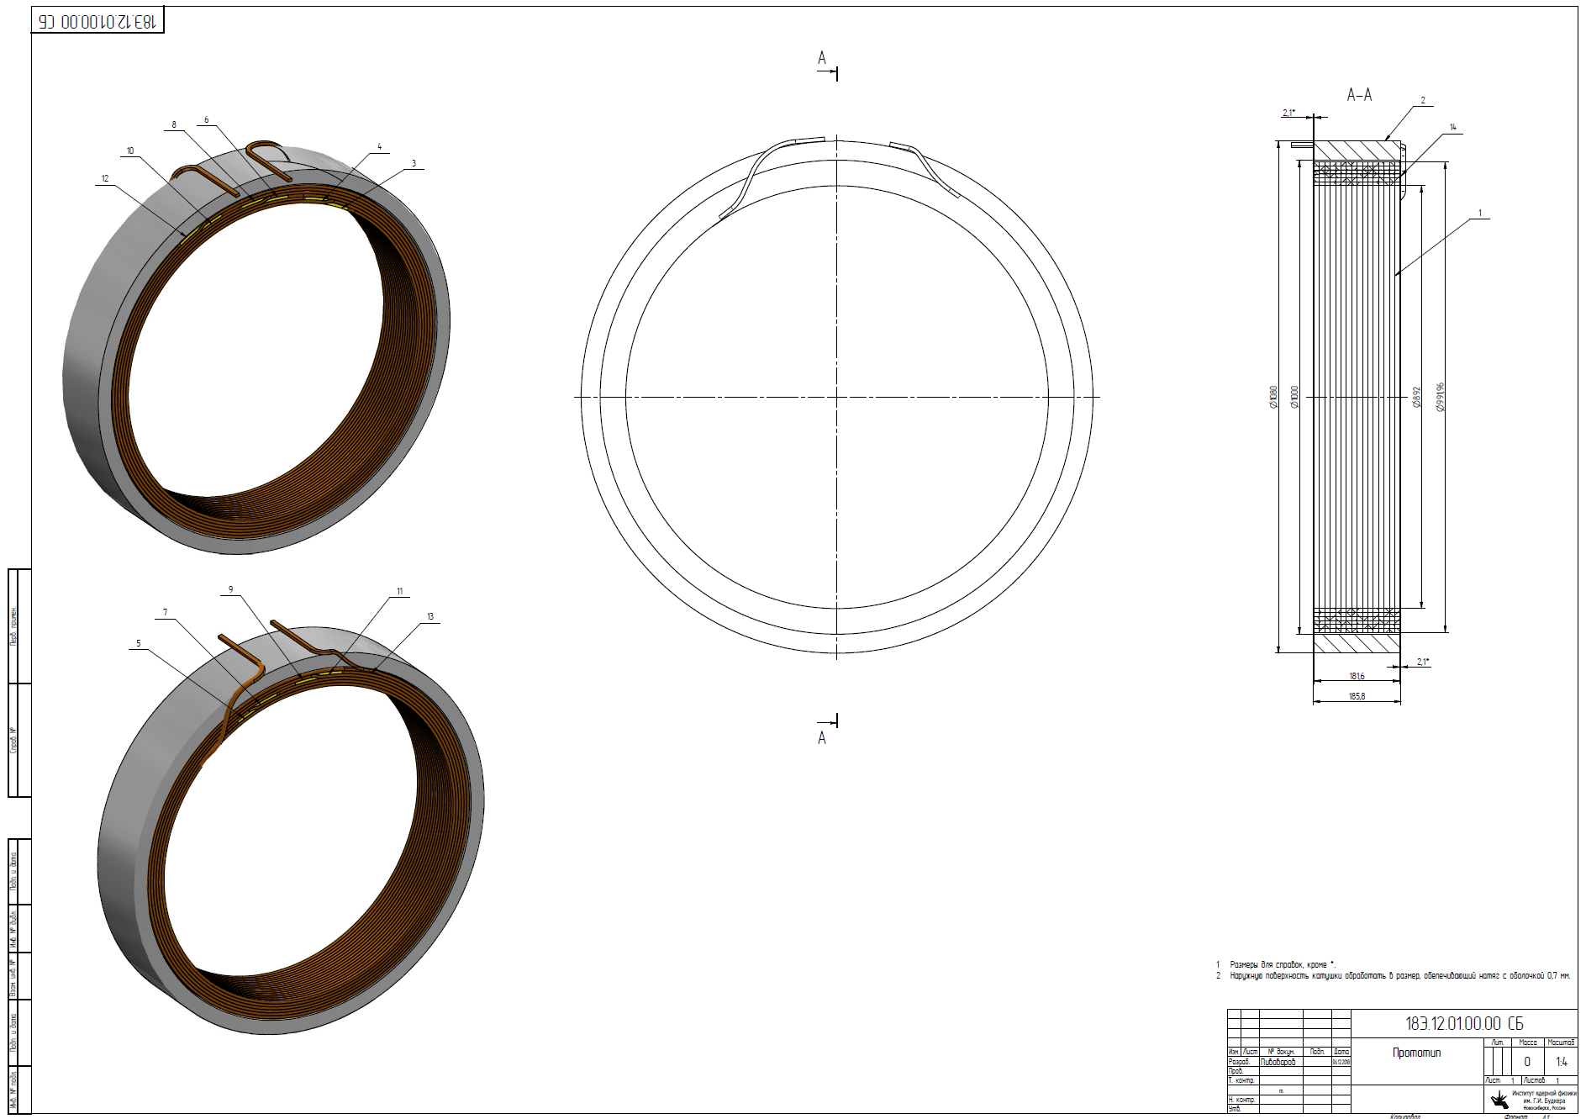
The Prototype of the Coil (3pcs.)
d = 1m, L=180 mm
Conductor:
Al - 10,85 мм x 7.93 мм,
6 layers - 16 turns
Design is ready, production
.

Slide 22
Drawing of the Devices for winding coil (scheme).
Design is ready, production

Slide 23
Drawing of the Device for impregnation coil (scheme).
Design is ready, production

Slide 24
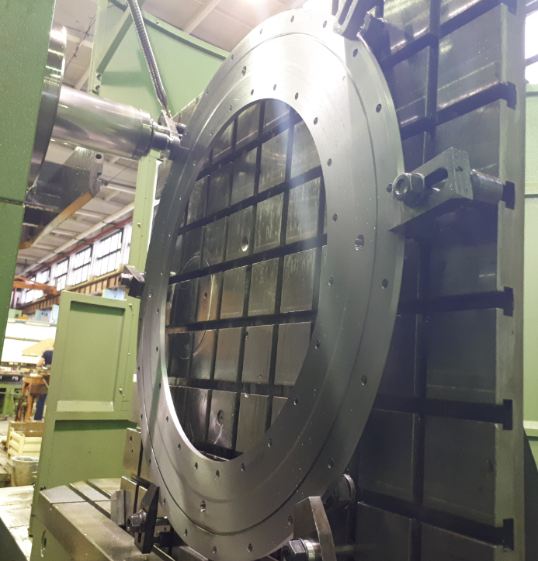
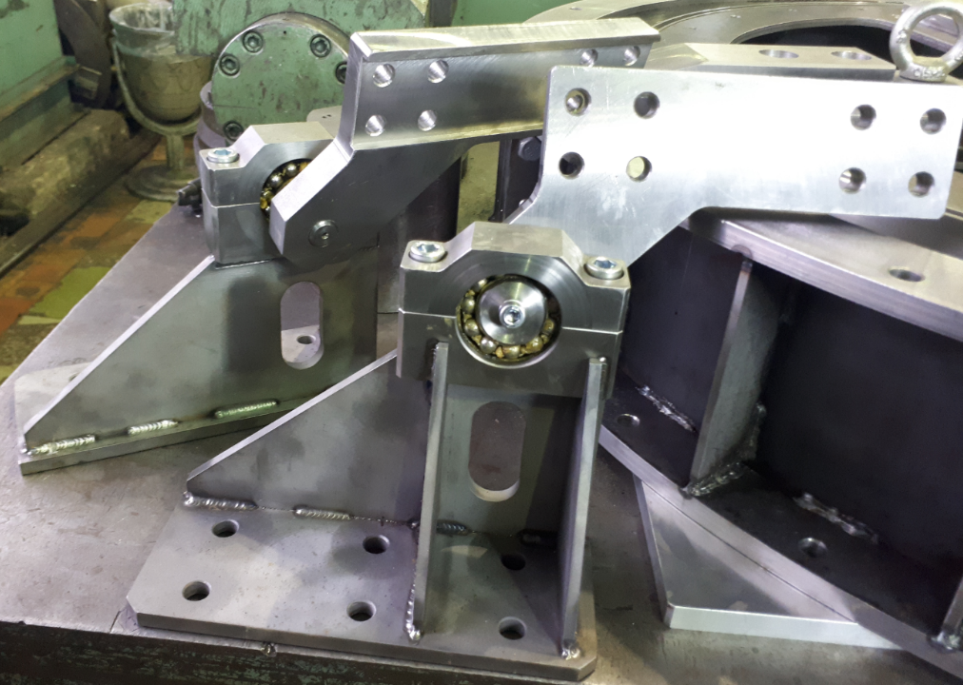
Tooling for winding and impregnation coil of Prototype

Slide 25
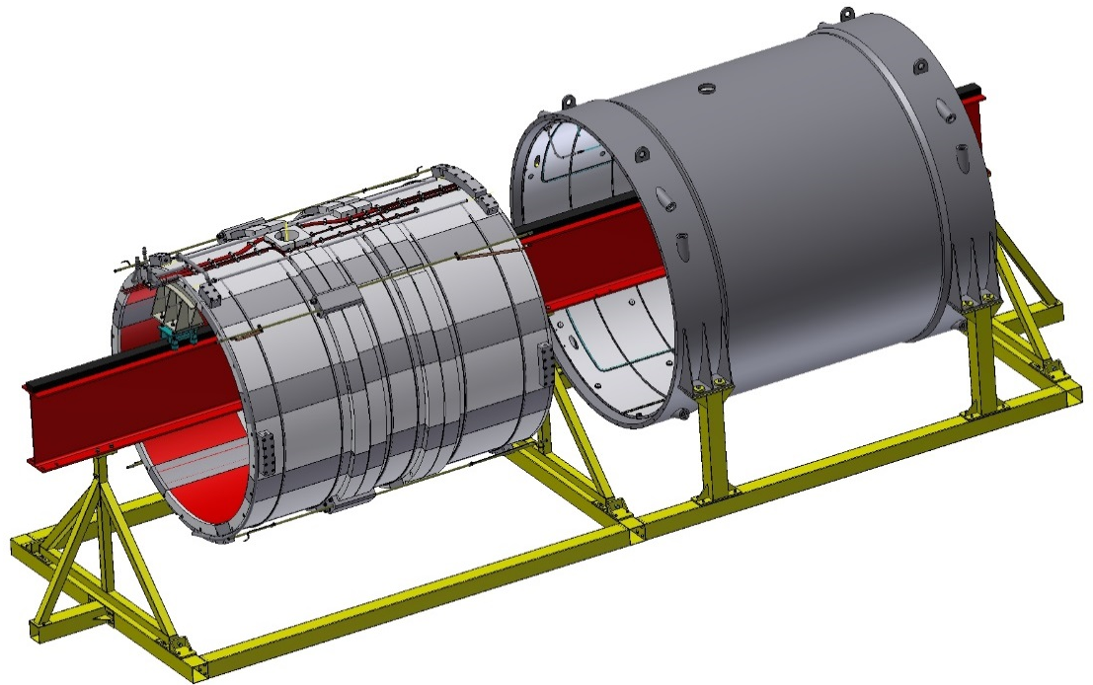
Tooling for assembling of PANDA Magnet
Support of flanges of cryostat
FPDSSM42060000AS_A
Support of inner shell of cryostat FPDSSM42050000AS_A
Support of inner shield
FPDSSM42040000AS_A
Beam
FPDSSM42010000AS_Aуфь
Support of cold mass
FPDSSM42030000AS_A
Support of outer shield
FPDSSM42020000AS_A
Design is ready, technological development

Slide 26
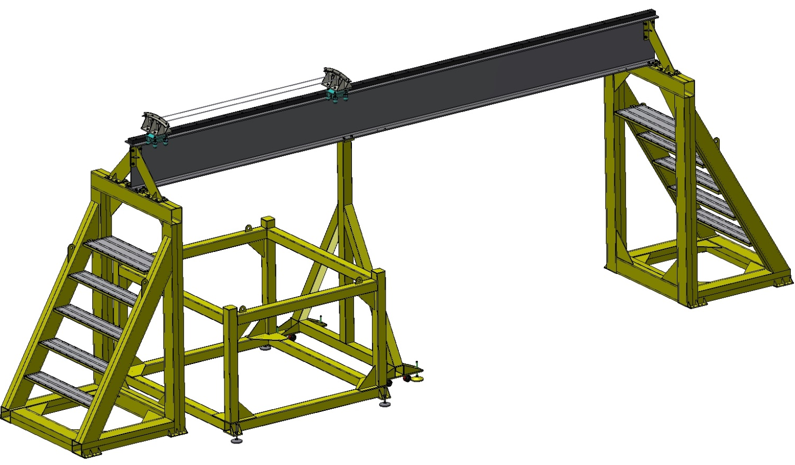
Tooling for installation of the Magnet into the Yoke
Beam (1.6t)
Rollers system
Transport support
of Magnet
Central removable Support
Fixed Support
Support for Magnet
Removable Support
Design is ready, technological development

Slide 27
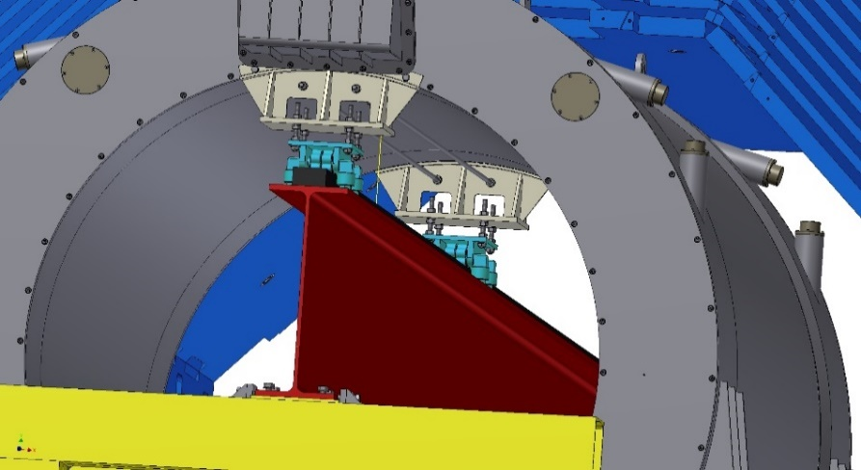
Installation procedure of the Magnet into the Iron Yoke
Rollers system
Insert removable support and install the rollers system for moving magnet.

Slide 28
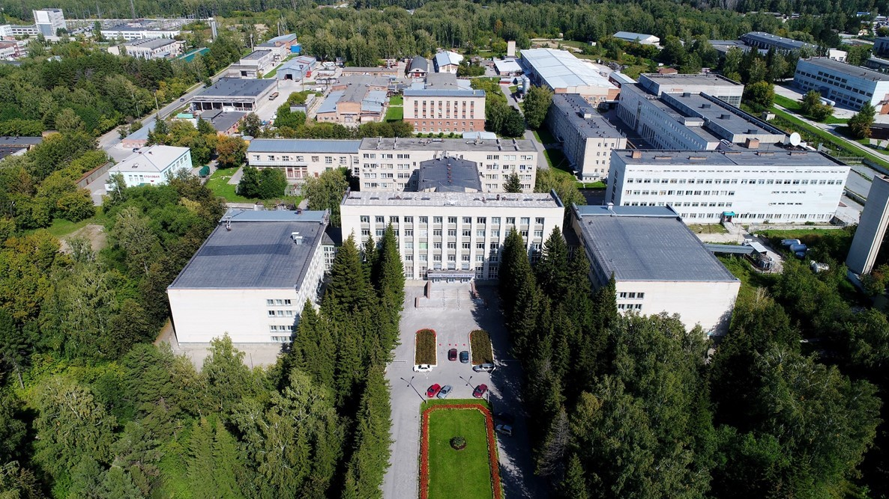
Thank you for your attention

