Slide 1
Photonis 2150, DiRICH and Photonis ES440
Merlin Böhm, A. Lehmann, S. Krauss, D. Miehling,

Slide 2
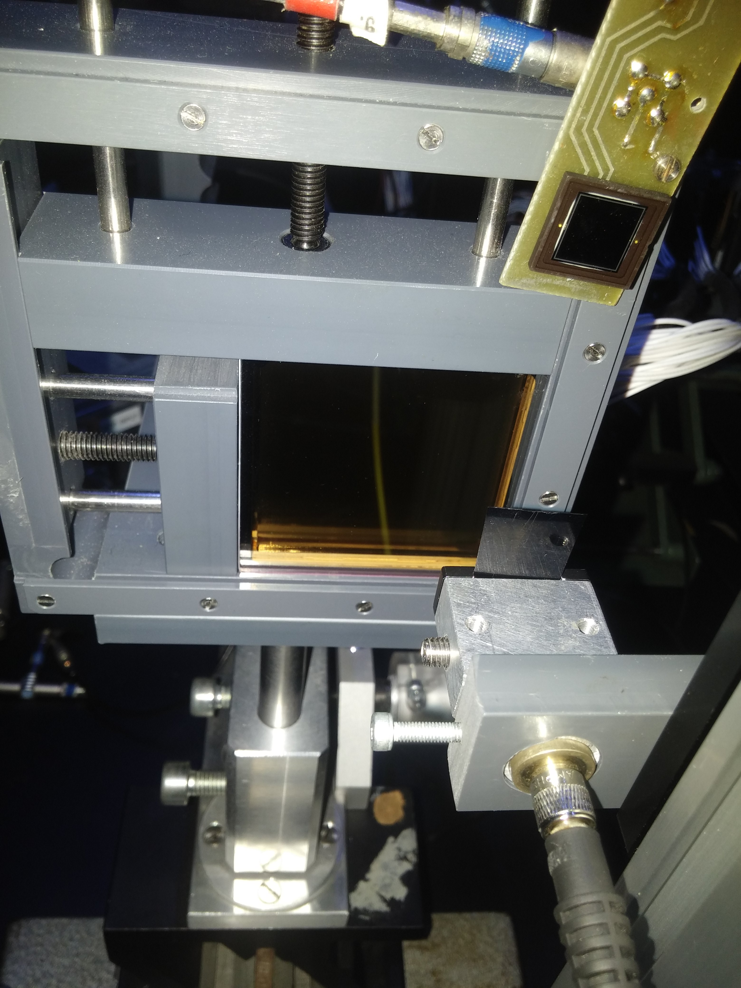
Measurement setups and measured parameters
Surface scans: PILAS Laser with micro focus attached to a 3-axis stepper
FPGA based DAQ: TRB, Padiwa
Padiwa FEE for discrimination
TRB for time and TOT measurement
Multihit capability
TRB3 and Padiwa3:
Signal height distribution (important for setting the threshold)
Crosstalk, charge cloud width and recoil electron behavior
For each Pixel: time resolution, darkcount rate and afterpulse probability
Photodiode
y
MCP-PMT
z
x
y
Laser with ND-filter
or diffusor
x

Slide 3
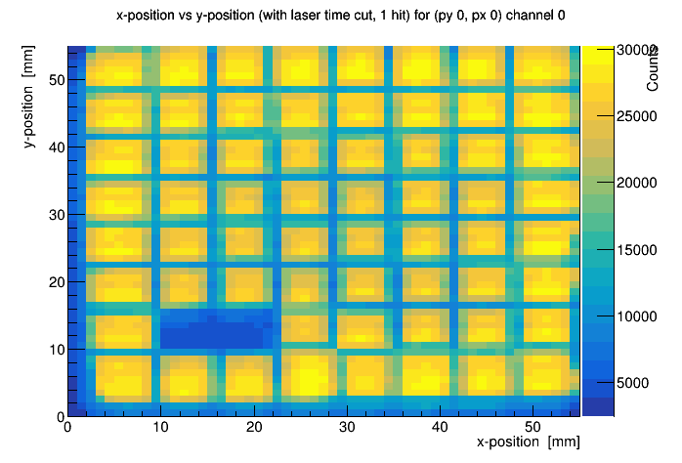
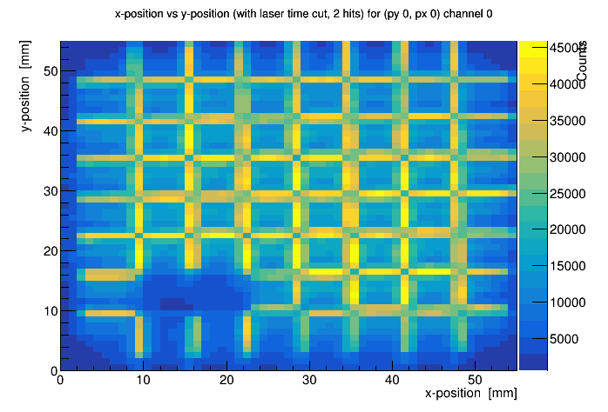
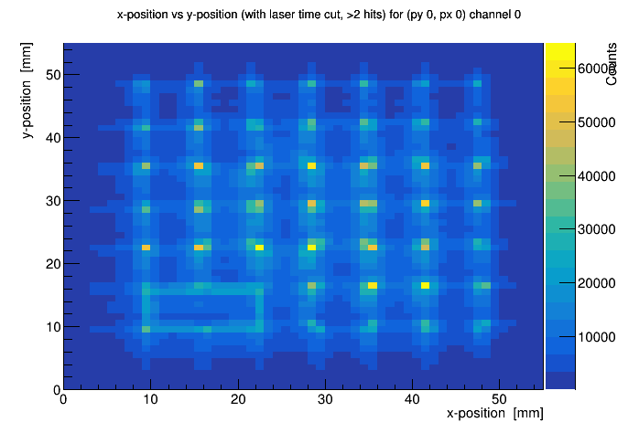
Photonis 9002150 - TRB measurements
1 Hit
2 Hits
3 Hits
Narrow time window of 1.5 ns, at 2200V (0.7e6 gain)
2 Pixels simultaneously hit reveals charge cloud width
Charge cloud width ~1.6 mm FWHM
3 Pixels simultaneously hit reveals edge of pixels

Slide 4
Photonis 9002150 - TRB measurements
1 Hit
2 Hits
3 Hits
Two channels disabled
Shorted
Narrow time window of 1.5 ns, at 2200V (0.7e6 gain)
2 Pixels simultaneously hit reveals charge cloud width
Charge cloud width ~1.6 mm FWHM
3 Pixels simultaneously hit reveals edge of pixels

Slide 5
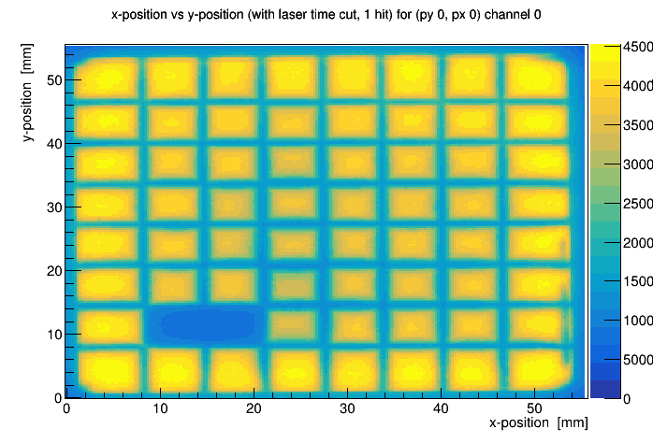
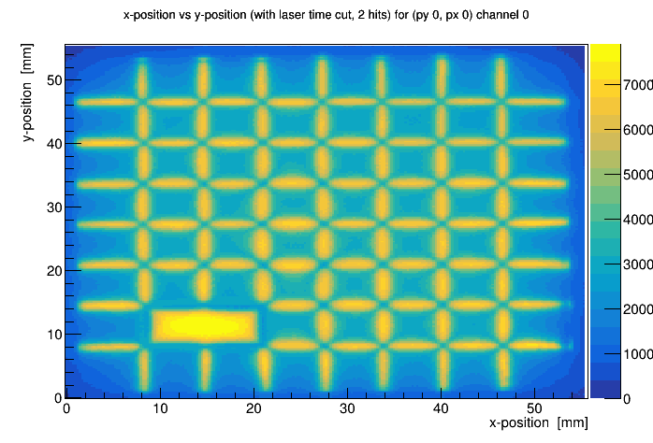
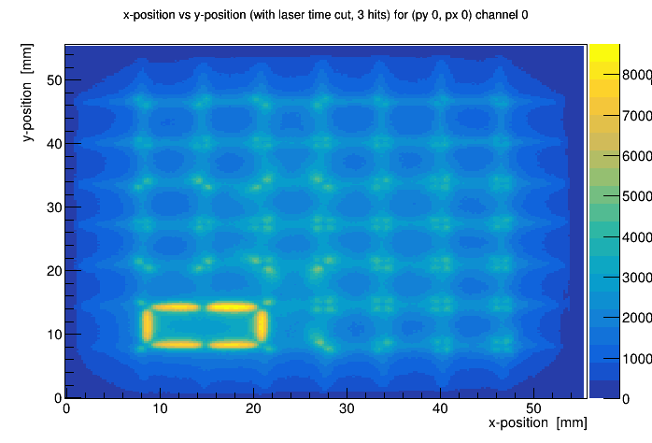
Photonis 9002150 - TRB measurements
1 Hit
2 Hits
3 Hits
Shorted pixels are visible in 2 hit plots
Pixels are shorted inside the MCP-PMT

Slide 6
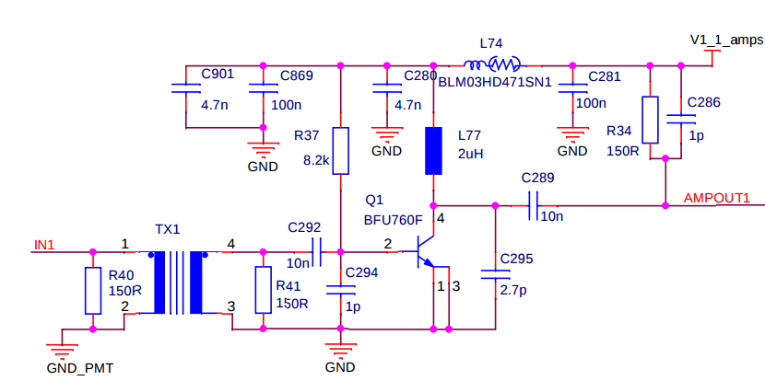
TRB vs DiRICH
Irradiating one pixel and alter the threshold
Compare 1pF and 10pF at DiRICH3 frontend lowpass filter and Padiwa3

Slide 7
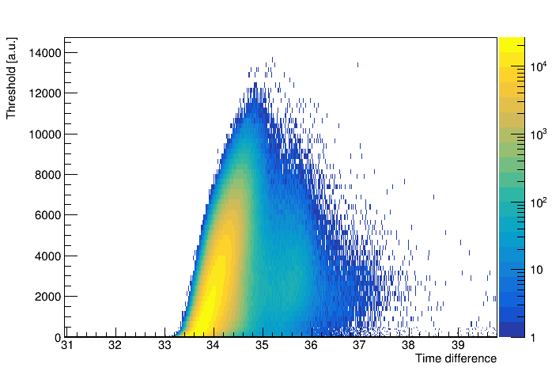
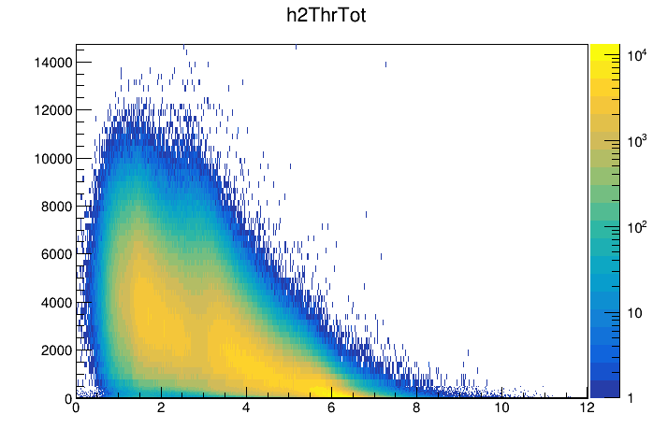
TRB vs DiRICH
Idea: use same threshold for comparison
Create plots with Laser/Pixel time difference vs threshold
Padiwa3 (with modified capacitor and resistor):

Slide 8
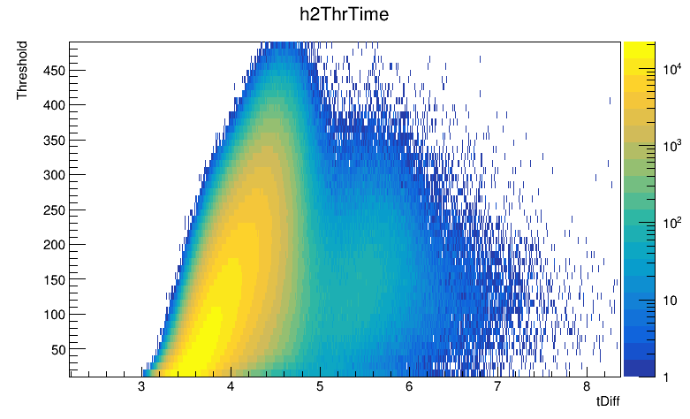
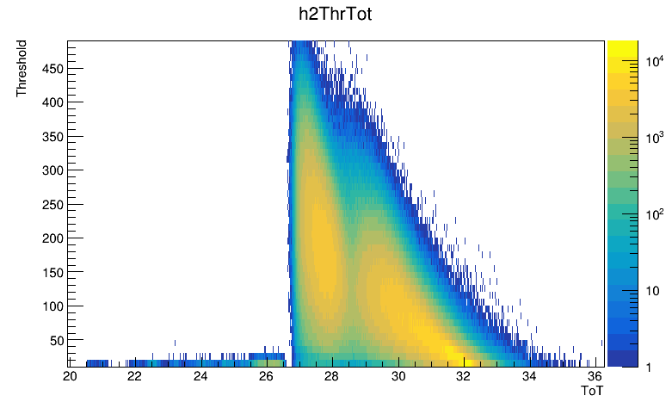
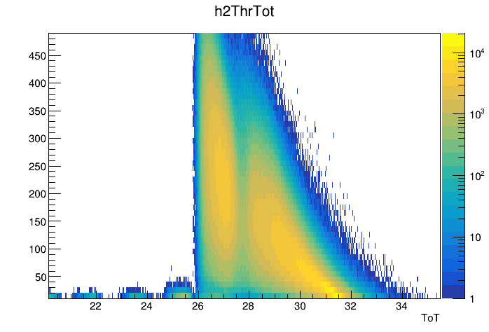
Time difference
DiRICH 1 pF:
Time over threshold
DiRICH 10 pF:

Slide 9
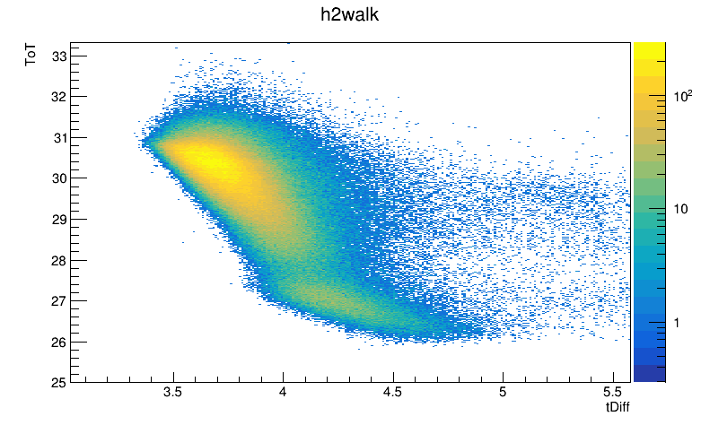
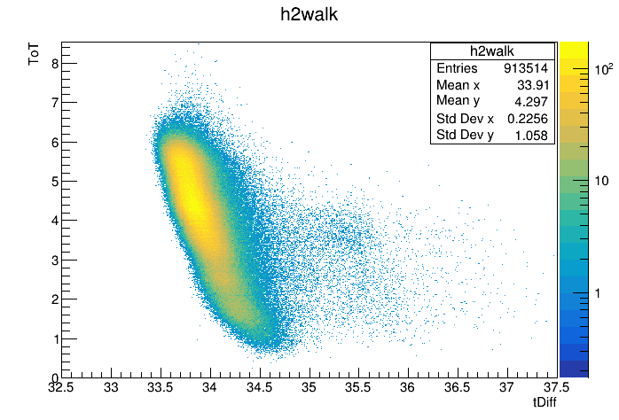
TRB vs DiRICH
About 10-20% improvement in time resolution between 10 pF (~125 ps RMS) compared to 1 pF (~140 ps RMS) and Padiwa 3
Need to check higher capacitor values
DiRICH 10 pF
Padiwa3

Slide 10
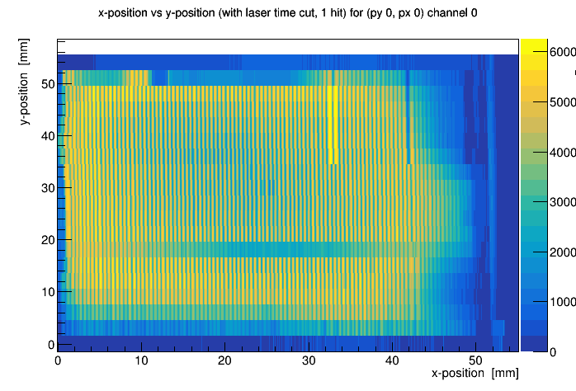
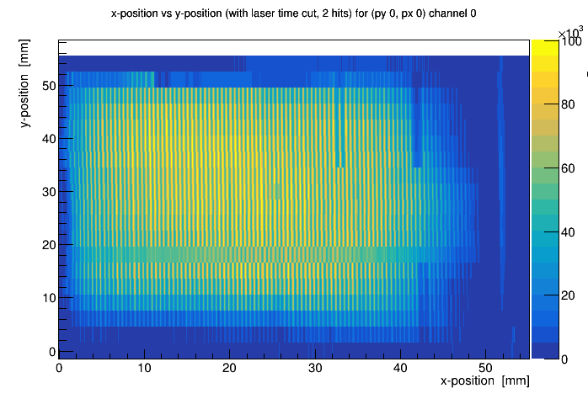
Photonis ES440
QE:
3x100 Pixel MCP-PMT
Narrow time window of 1.5 ns at 1e6 gain
1 Hit:
2 Hits:

Slide 11
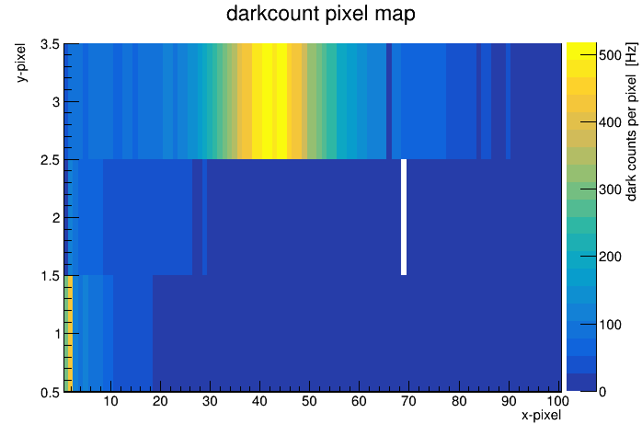
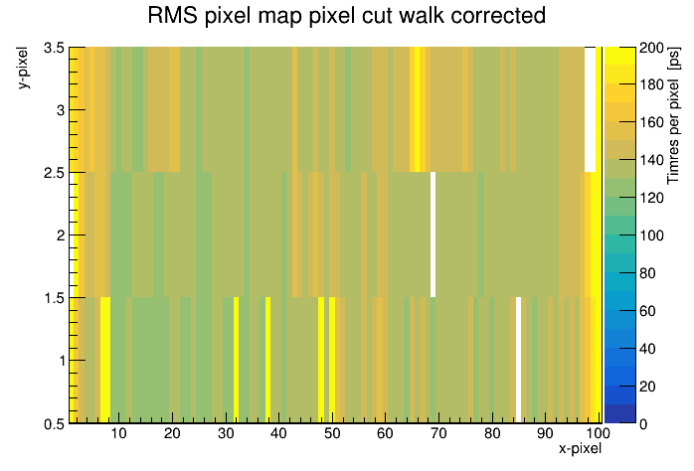
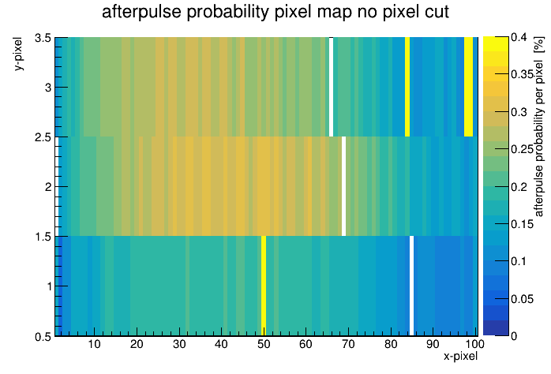
Photonis ES440
Time resolution (5 ns window): ~140 ps
Sensor darkcount rate: ~20 kHz
Average afterpulse probability: ~0.25 %

Slide 12
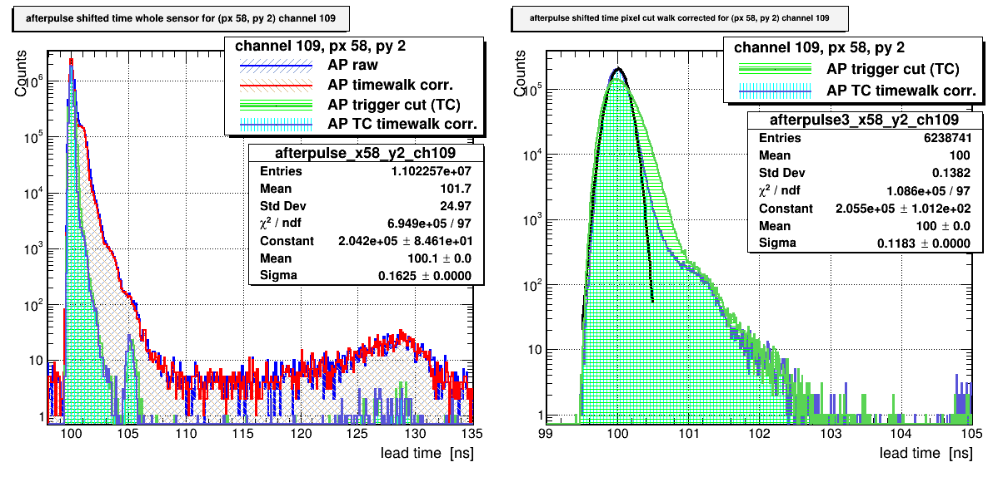
Photonis ES440
Trigger cut (TC): only events when the laser is on the pixel
Further investigating the time distribution

Slide 13
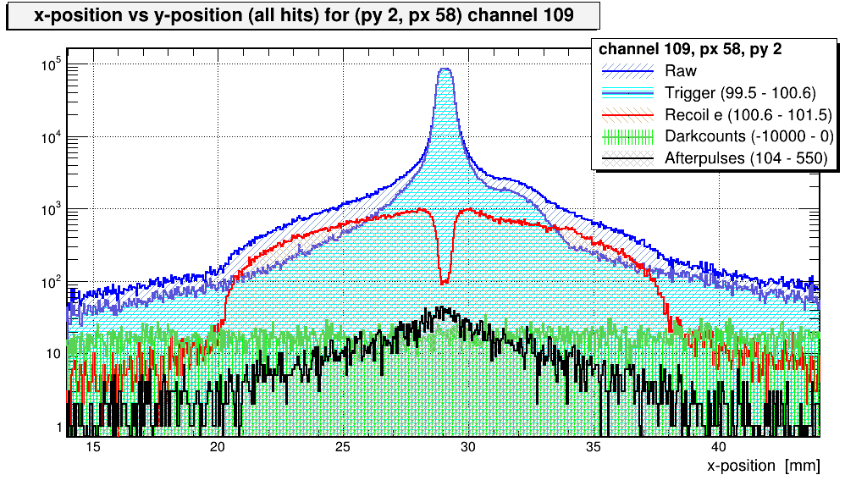
Photonis ES440 – time distributions
gh

Slide 14
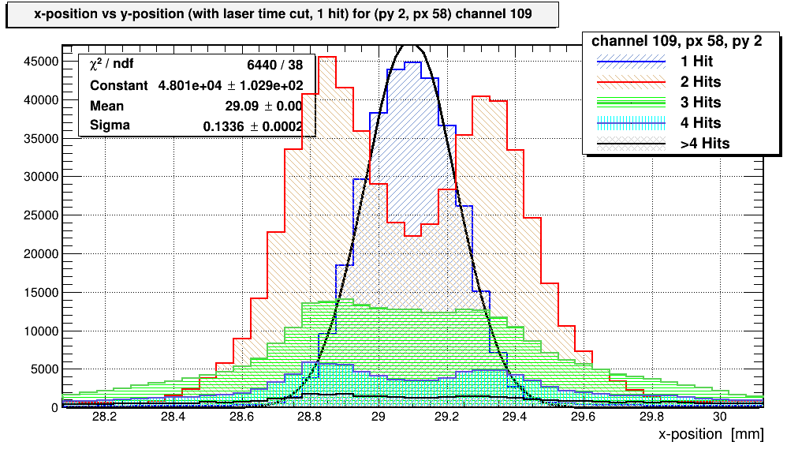
Photonis ES440 – Hit distributions
f

Slide 15
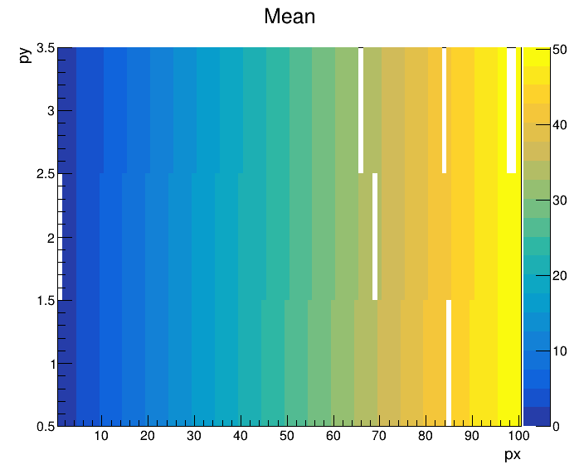
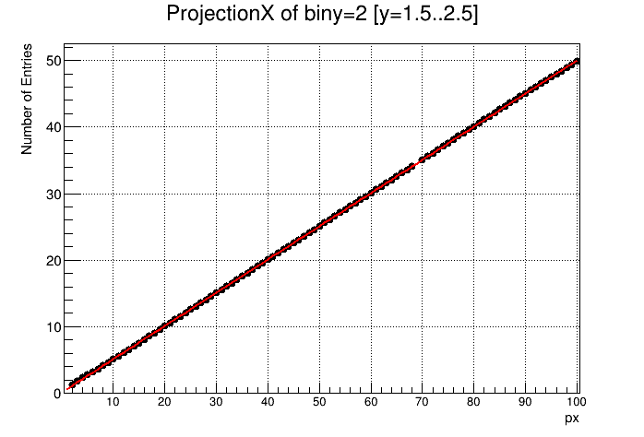
Plot mean of the fits of the individual pixels
Pixel position is linear (fit)

Slide 16
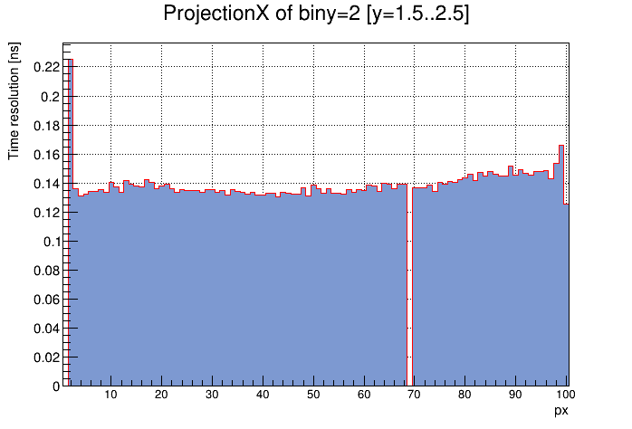
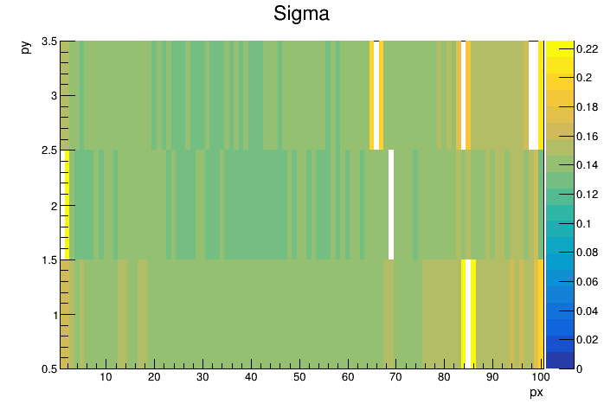
Plot width (sigma) of the fits of the individual pixels
Pixel width mostly constant

Slide 17
Summary
Photonis 9002150 has two shorted pixels
Higher low pass capacitance at DiRICH frontend leads to lower signal heights but better time resolutions
Photonis ES440: first measurements look promising, good time resolution, low afterpulse probability and good position accuracy

