Slide 1
Update on lifetime measurements
of MCP-PMTs and status of afterglow and saturation measurements
D. Miehling, M. Böhm, S. Krauss,
A. Lehmann
PANDA-Meeting 19/3 GSI,November 5, 2019

Slide 2
The $\overline{P}$ANDA detector at FAIR/GSI
High $\overline{p}p$ annihilation rate
(average 20 MHz)
Barrel DIRC
Disc DIRC
Focal planes of both
DIRC detectors are inside magnetic field
Notes:
Wegen das Magnetfeldes von bis zu 2 Tesla MCP-PMT nötig

Slide 3
The PANDA DIRC detector
Sensor requirements:
Immunity to magnetic fields > 1 Tesla
High rate stability (> 1 MHz/cm²)
Fast time response (< 50 ps)
Low dark counts (< 10 kHz/cm²)
High position resolution:
Compact design
Microchannel-plate Photomultipliers (MCP-PMTs) needed
Problem until few years ago: low lifetime
Lifetime indicator: Quantum efficiency as function of integrated anode charge (IAC) ($∝$detected number of photons)
Barrel DIRC: 5x5mm²
Disc DIRC: 0.5x16mm²
Barrel DIRC IAC ~ 5 C/cm²
Disc DIRC IAC > 5 C/cm²

Slide 4
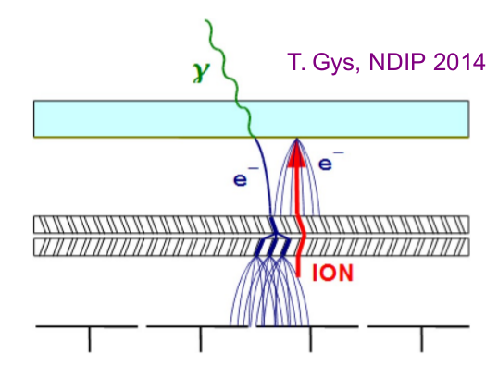
Aging of photocathode
Photocathode of MCP-PMT gets damaged from impact of (heavy) feedback ions produced in the residual gas
Damaging effects at the photocathode
Chemical reactions and adsorption
Surface defects
Possible countermeasures against aging
More robust photocathode
Better vacuum
Reducing flux of (heavy) ions

Slide 5
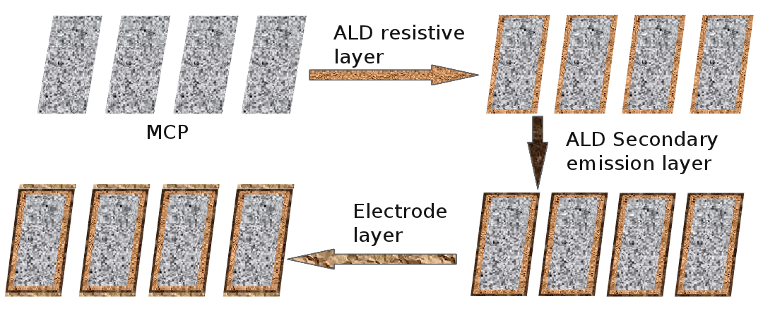
Approaches to increase Lifetime
New cathode material
Baking in Cs/Sb –vapor
Disadvantage: higher dark count rate
Protection layer (film ${Al}_{2}O_{3})$
In front of first MCP layer
Disadvantage: reduction of collection efficiency
Between MCP layers
Best results and focus of this talk:
Treatment of MCP surfaces
Electron scrubbing
Atomic layer deposition (ALD)
Company Arradiance & LAPPD
First prototypes from Photonis
Later prototypes from Hamamatsu, too

Slide 6
Parameters of lifetime measurements
Goal: Simultaneous measurement of different MCP-PMTs under similar conditions as in the PANDA-DIRCs
Constant illumination with 1 MHz single photons
All MCP-PMTs in same light spot
Permanent monitoring of integrated anode charge
QE measurement:
Every few weeks:
Wavelength spectrum with Xenon arc lamp (75 W) and a monochromator (Δλ = 2 nm, 250 nm - 800 nm)
Also measuring gain and dark counts
Every several months:
Surface scans with picosecond laser (372 nm, spot size: ø~0.5-1 mm)

Slide 7
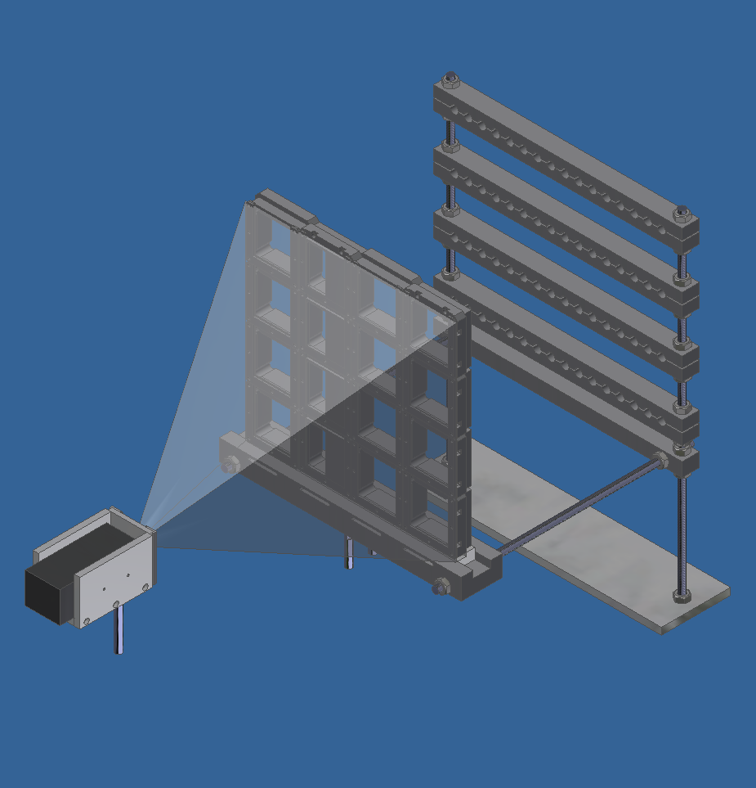
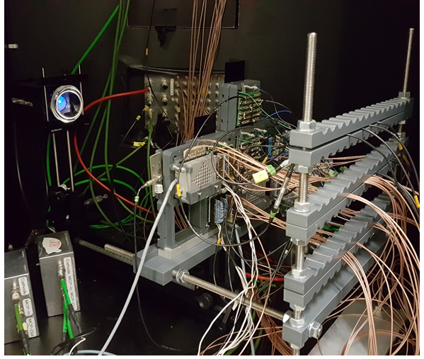
Lifetime setup
LED box with diffuser
Sensors
Cable holder
Pulsed LED inside aluminum Box
Thorlabs engineered diffuser
In front of LED to get homogeneous light spot on sensors
Holding construction for up to 16 sensors all illuminated by same LED
Cable management behind sensors
Lens
Voltage dividers

Slide 8
Illumination Overview QE (all sensors with ALD)
Data from February 21, 2018
Film between MCP
Two ALD layers
Film in front of first MCP
Manufacturer
Senor ID
IAC
[mC/cm²]
QE latest [%]
QE latest/QE start [%]
QE start [%]
Photonis
XP85112
Hamamatsu R10754X
Hamamatsu R13266-07-M768 / M64
9001223
9001332
9001393
22.1
5.3
24
15909
23.0
8.2
36
19.1
19.3
101
KT0001 (M16M)
19534
21.7
5.6
26
KT0002 (M16M)
18175
21.1
6.2
JS0022 (64 pix.)
608
17.4
4.9
28
9234
97
18
JS0035 (64 pix.)
5294
25.5
24.8
JS0018 (768 pix.)
1133
18.0
JS0027 (768 pix.)
2261
24.3
22.2
91
3.22
17942
29
2 Inch
1 Inch
2 Inch

Slide 9
Illumination Overview QE (all sensors with ALD)
Data from October 11, 2019
Two ALD layers
Film in front of first MCP
Manufacturer
Senor ID
IAC
[mC/cm²]
QE latest [%]
QE latest/QE start [%]
QE start [%]
Photonis
XP85112
Hamamatsu R13266-07-M768 / M64
9001393
9002108
25101
19.1
19.8
104
21.7
4.9
23
98
95
JS0035 (64 pix.)
10650
25.5
25.1
JS0027 (768 pix.)
4828
24.3
YH0250 (64 pix.)
8819
25.4
24.5
96
23.0
1678
2 Inch
2 Inch
9002108 removed on October 11 2019

Slide 10
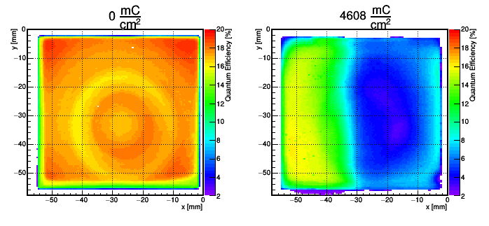
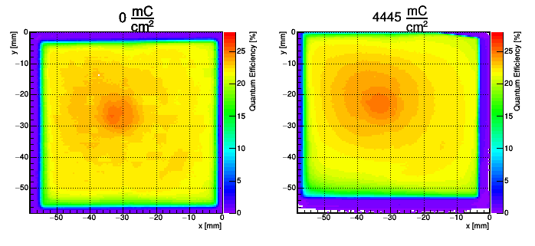
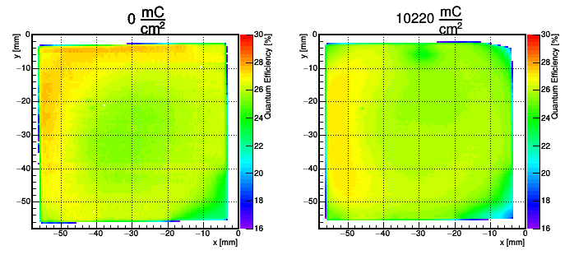
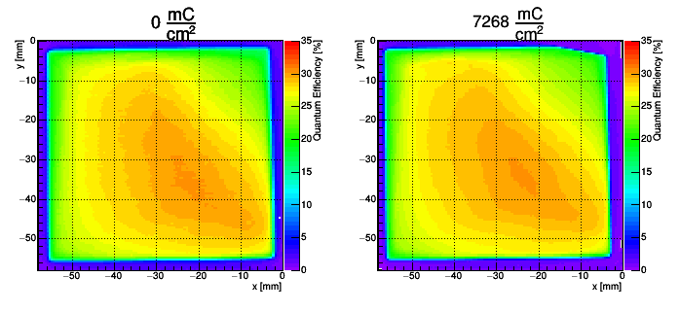
QE scans of new Hamamatsu 2 inch ALD devices
JS0022 (8x8 pix., film)
JS0027 (6x128 pix., film)
JS0035 (8x8 pix., film)
YH0250 (8x8 pix., no film)
later prototypes tend to show better performance
measurement still ongoing
Covered

Slide 11
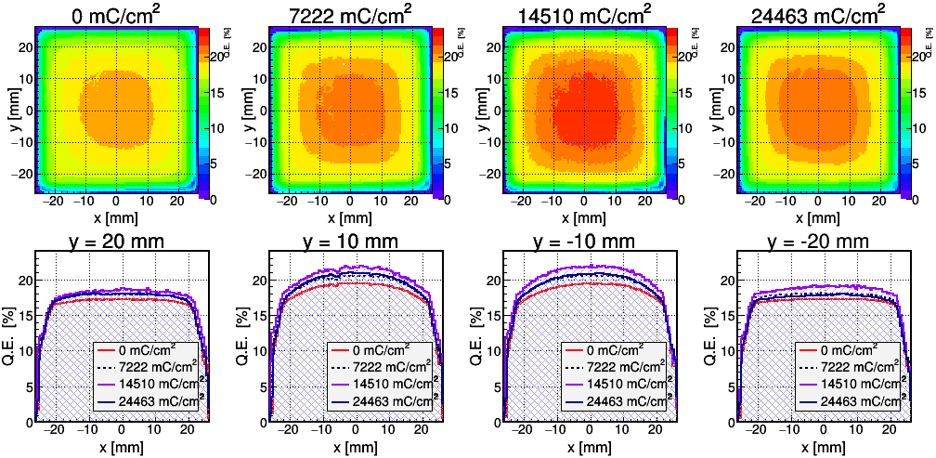
QE scans of Photonis 9001393-URD (2 ALD layers)
Not covered
2 ALD layers
No damage visible @25 C/cm² (~50 years of PANDA)

Slide 12
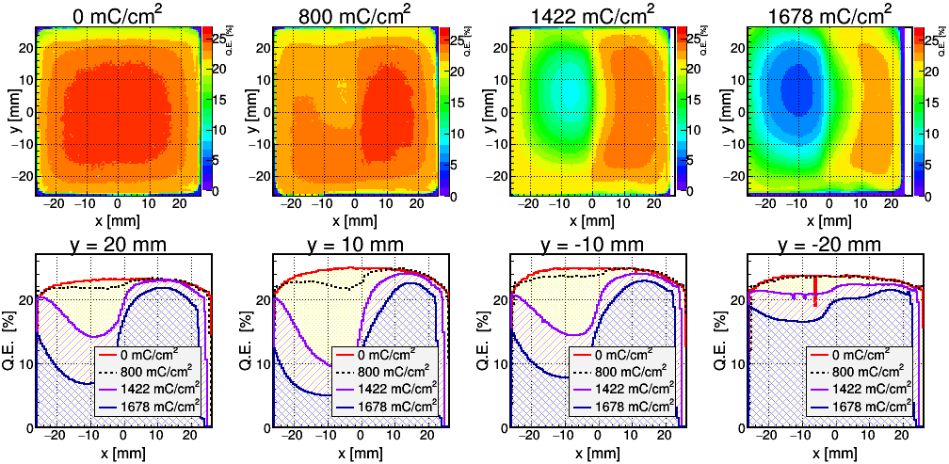
QE scans of Photonis 9002108 (ALD)
Covered (not illuminated)
Clear sign of Cathode damage
Aging starting from the center
Not illuminated side less and later damaged
Probably caused by feedback ions
ALD-coating by Photonis (and not Arradiance)
removed on October 11 2019

Slide 13
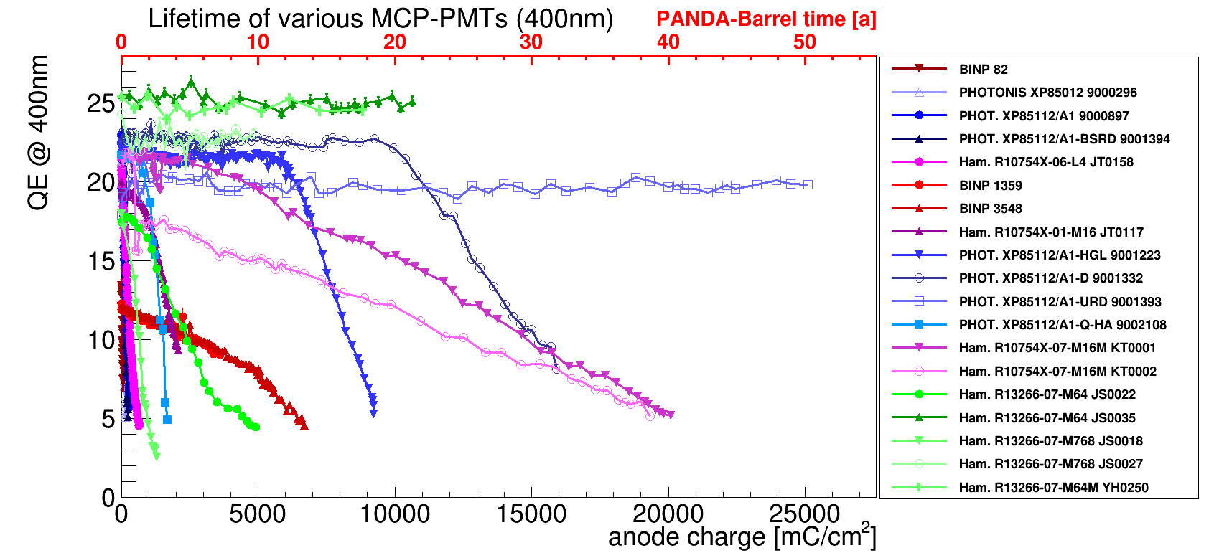
Lifetime data of all sensors (October 11, 2019)
No countermeasures
Most sensors with ALD coated MCPs have lifetime > 5 C/cm²
devices with no countermeasures have a lifetime of < 200mC/cm²
New cathode material
Film
ALD

Slide 14
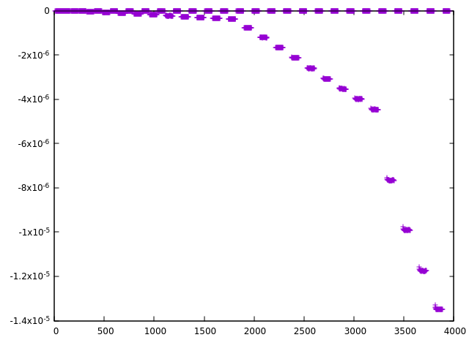
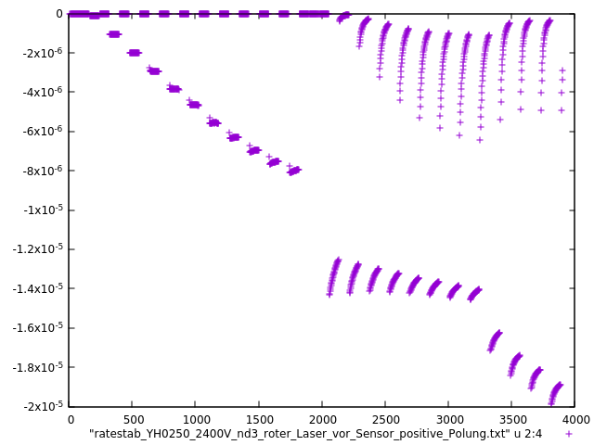
Reminder: Afterglow
After illuminating MCP-PMTs with high intensity light the darkcount rate is significantly increased
The count rate decays within several seconds - minutes
This effect can also be observed during our rate stability measurements:
Red line corresponds to 2MHz photonrate per cm² (EDD)
Afterglow
Laser off
anode current in A
anode current in A
Laser on
time in s
time in s
Photonis 9001393-URD
Hamamatsu YH0250

Slide 15
Afterglow
Afterglow comes from photons from the MCP itself after high illumination
Afterglow depends on duration and intensity of illumination and gain of the MCP-PMT
→ for more information see Merlins talk at DIRC2019
measurements with a lot of sensors were done
divide afterglow current (at ~ EDD rates) by anode current to get a feeling of how much the sensors shows this effect
good news: no problem for MCP-PMTs for the Barrel DIRC rates, only Hamamatsu YH-series for EDD could cause issues
Sensor | JS0035 | YH0250 | JS0027 | KT0002 | 9001332 | 9001341 | 9001393 | 9001394 | 9002108 | 9002150 | 9001165 | 9001340
afterglow | 3e-05 | 4e-03 | - | <6e-06 | <3e-05 | 1e-05 | 4e-05 | 1e-05 | 2e-06 | 1e-05 | 1e-04 | 6e-05

Slide 16
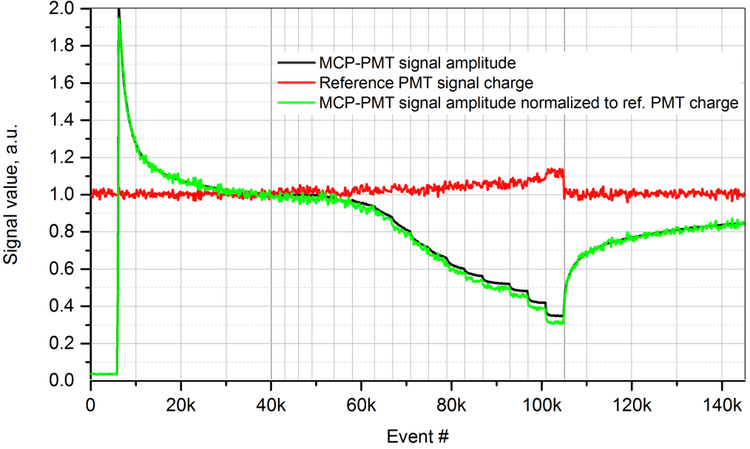
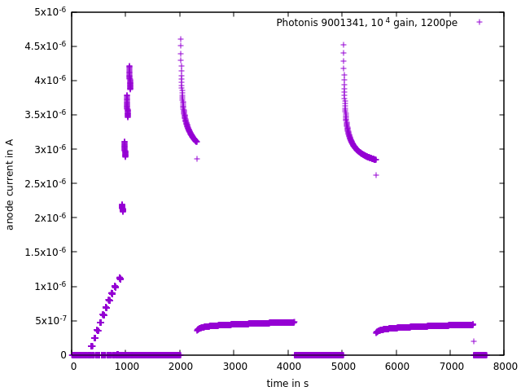
Gain recovery
Antamanova et al. observed (2018 JINST 13 T09001)
After high illumination the gain is lower than before
Only in ALD tubes, but not in non-ALD tubes
We can reproduce this effect for many tubes, but not for all
High
illumination,
Gain can drop
Low
Illumination,
Gain recovers
Normal Gain
Rate stability
measurement

Slide 17
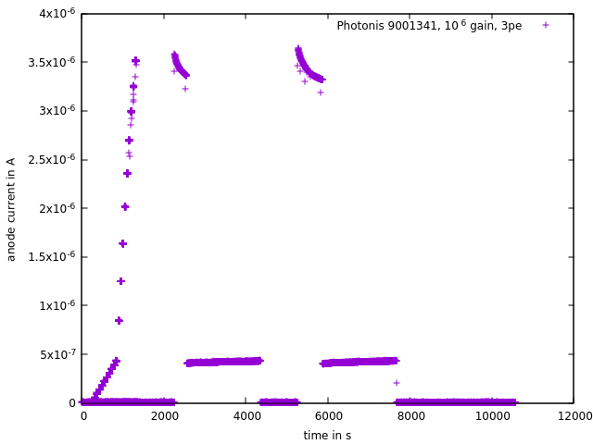
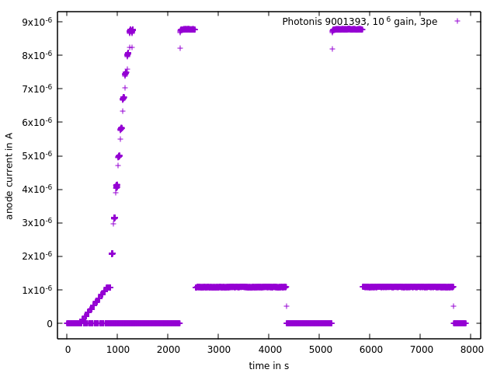
Gain saturation and recovery time
effects seem to be correlated with ratestability, higher ratestability reduces these effects
the effects are in the order of a few % (for example the 9001341 loses 5% gain in 5 minutes @700 kHz Photons/cm²)
more investigations needed to determine the equilibrium
good news again: no problem for sensors at Barrel DIRC rates, for EDD one should keep this in mind
„bad“ example, 9001341
„good“ example, 9001393

Slide 18
Dependence on number of photoelectrons
afterglow, ratestability, saturation and recovery time depend on the number of photoelectrons per laser pulse
both plots with Photonis 9001341 and up to ~4µA anode current, but left with 10e4 gain and 1200 pe, right with 10e6 gain and 3pe and higher laser frequencies
left the number of photons per time intervall is very high for a short time

Slide 19
Gain saturation and recovery time
„bad“ sensors: YH0250, JS0027, 9001341, 9002108,
„good“ sensors: JS0035, KT0002, 9002150, 9001165, 9001340
„very good“ sensors: 9001332, 9001393, 9001394
„bad“ means one can see a effect at ~5pe per pulse and at ~1000pe per pulse
„good“ means one can see a effect only at ~1000pe per pulse
„very good“ means no effect even at ~1000pe per pulse
good news: no problem for MCP-PMTs for the Barrel DIRC rates, only Hamamatsu YH-series for EDD could cause issues

Slide 20
Summary
Requirements: > 5 C/cm² at ${10}^{6}$ gain (50% duty cycle, 10 years)
Photonis
Best sensor at 25 C/cm² without any sign of cathode damage
New sensor already damaged at 1.2 C/cm², now at 1.6 C/cm² only ~3% QE left in the hole
Hamamatsu:
Later produced (higher serial number) 2 inch tubes tend to have better performance
JS0035 reached 5 C/cm² as first 2 inch tube (now at almost 11C/cm²)
JS0027 (almost) reached 5 C/cm² as well
afterglow, saturation and recovery time should be no problems for Barrel DIRC, but should be further investigated for EDD

Slide 21
Thank you for your attention!

Slide 22
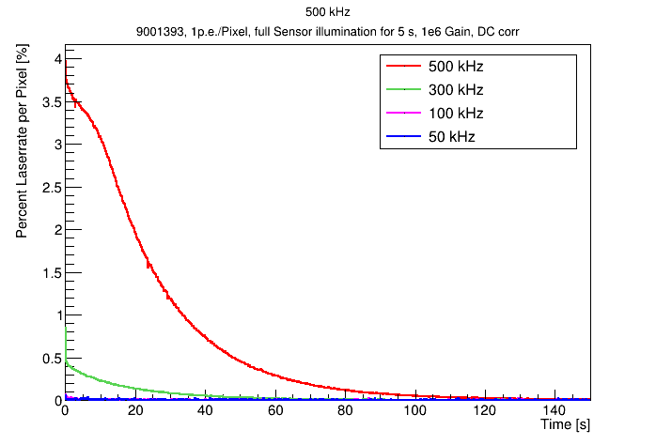
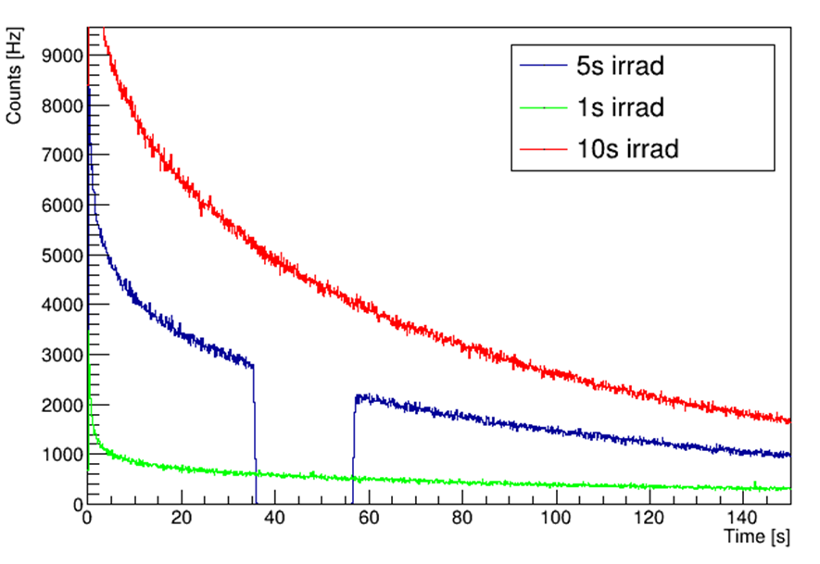
Afterglowing – further investigations with 9001393 with TRB
Illuminating the full MCP-PMT PC several seconds with ~1 p.e./Pixel, then turn off the laser and measure the count rate for 300 s
Higher illumination intensity (laser frequency) results in more afterglow
Observed up to 10% afterglow events compared to the laser rate
Longer illumination intensity results in more afterglow
Turning off the HV during the decay has no effect on the number of afterglow events
Amount of afterglow events depends on the voltage applied (gain) during the illumination
HV off

Slide 23
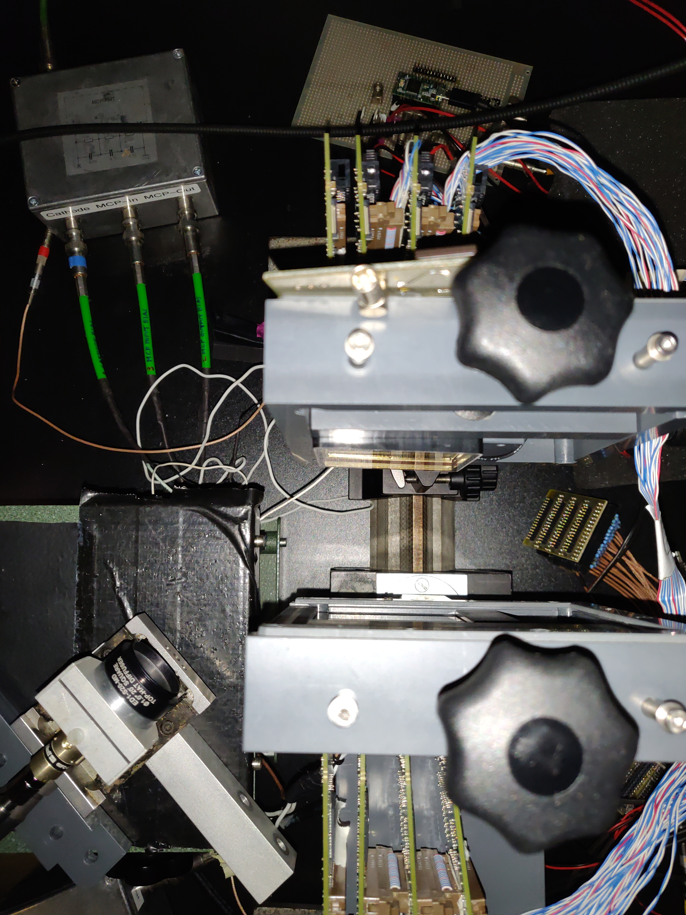
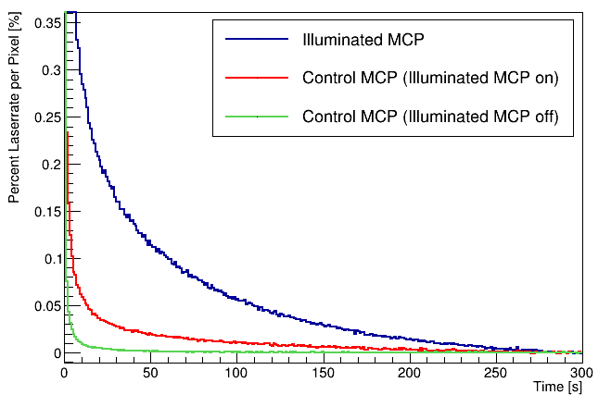
Afterglowing - photons or electrons?
Illuminated MCP
(1394)
Measured two facing MCP-PMTs, once with the illuminated MCP-PMT turned on and once turned off
Observe the count rates of the control MCP-PMT
Count rates of the control MCP-PMT are higher when the illuminated MCP-PMT has been turned on
->Afterglow effect must be based on Photons
Control MCP
(1341)
Laser

