Slide 1
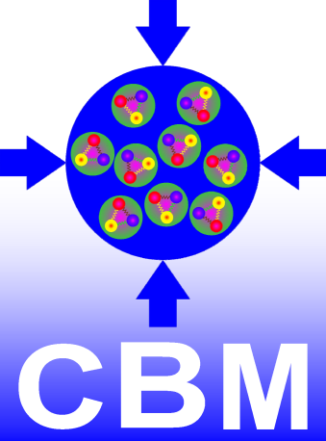
Hadron identification with the muon setup of CBM
Anna Senger
for the CBM collaboration
8th International Conference on New Frontiers in Physics (ICNFP 2019)

Slide 2
Outline
Motivation
CBM detector configurations
Simulations and reconstruction package
Muon setup:
di-muons
hadron reconstruction without PID
hadron PID behind muon system
preliminary results of hyperon reconstruction using PID
Conclusions
Next steps
PID ≡ particle identification

Slide 3
Motivation
A substantial part of the future CBM beam time will be devoted to muon measurements, which can be performed with higher reaction rates than with the detector configuration for electron measurements.
The overall statistics for multi-strange hyperons would be strongly enhanced, if they could be measured also with the muon setup.
The simultaneous measurement of hadrons and dileptons, both for the electron and the muon setup, allows for consistency checks of the dilepton results.

Slide 4
CBM detectors for SIS100
Micro-Vertex Detector (MVD)
Silicon Tracking System (STS)
Muon Chamber System (MUCH)
Ring Imaging Cherenkov detector (RICH)
Transition Radiation Detector (TRD)
Time of Flight Detector (TOF)
Projectile Spectator Detector (PSD)
primary and secondary vertex reconstruction with high precision
track, vertex and momentum reconstruction
muon identification
electron identification
global tracking, electron identification
electron and neutral particle identification
reaction plane and centrality determination
TRD
MVD
STS
RICH
PSD
TOF
MUCH

Slide 5
CBM setups
Hadron setup: STS+TOF Observables:
hadrons
hypernuclei
Electron setup: (MVD)+STS+RICH+TRD+TOF+PSD Observables:
dielectrons
hadrons
hypernuclei
Muon setup: STS+MUCH+TRD+TOF+(PSD) Observables:
dimuons
hadrons ?

Slide 6
Simulations and software
CBMROOT software package for simulation, reconstruction, and analysis based on the ROOT software toolkit
UrQMD, PHSD and PLUTO as primary particle generators
GEANT3/4 simulation software for transport of particles through materials
Kalman Filter Particle Package (KFPP) for particle reconstruction

Slide 7
Detector implementation
Geometry of detectors and support structures from technical drawings
Digitization scheme from detector and electronics tests
Hit reconstruction from mathematical models

Slide 8
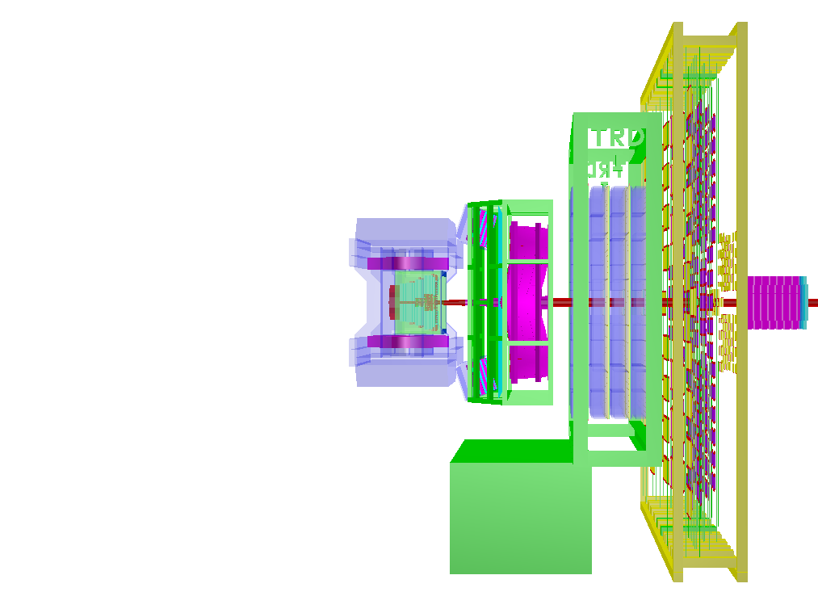
Electron setup
TOF
TRD
MVD+STS
in magnet
RICH
PSD

Slide 9
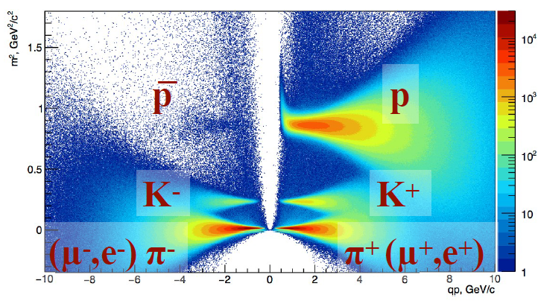
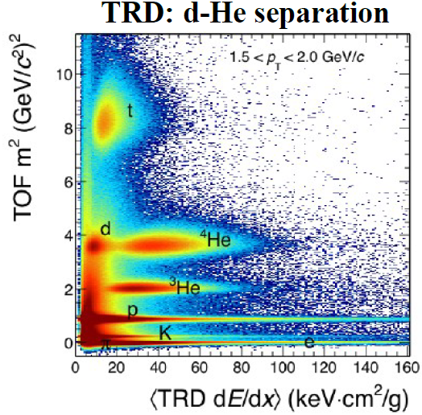
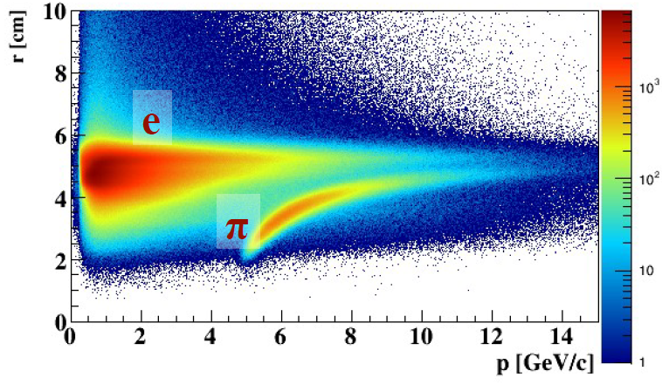
Hadron identification in electron setup
1
2
3
TOF hadron identification
TRD-TOF d-He separation
RICH electron identification
Pictures: Iouri VASSILIEV

Slide 10
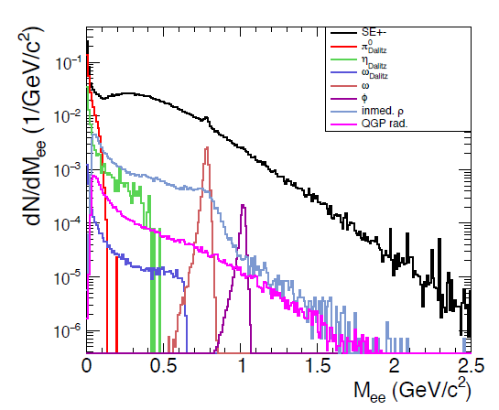
Low-mass vector mesons
central UrQMD
Au+Au events
at 8 A GeV/c
Electron PID:
MVD – hit topology: rejection of closed tracks (γ→e⁺e⁻), vertex reconstruction
STS – track and momentum reconstruction
RICH – electron-pion separation via ring radius
TRD - electron-pion separation via energy loss
TOF – electron identification via mass distribution
from di-electron analysis task

Slide 11
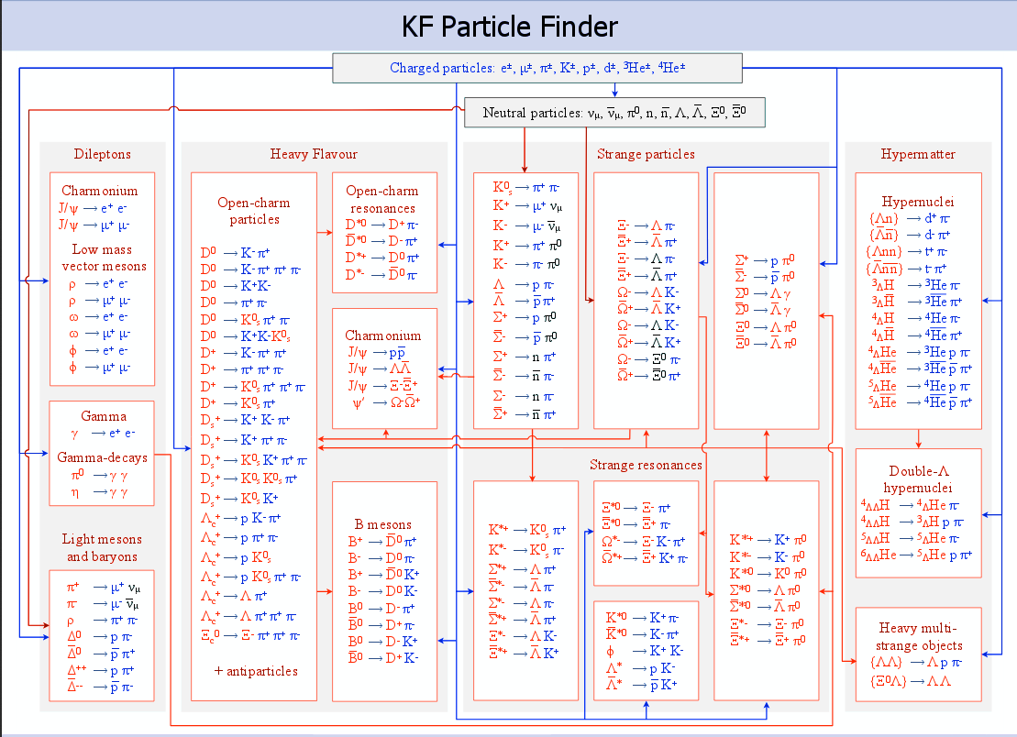
KF Particle Package (KFPP)
Picture: Maxim ZYZAK

Slide 12
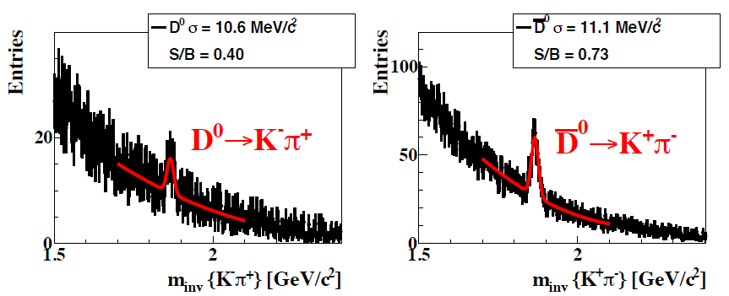
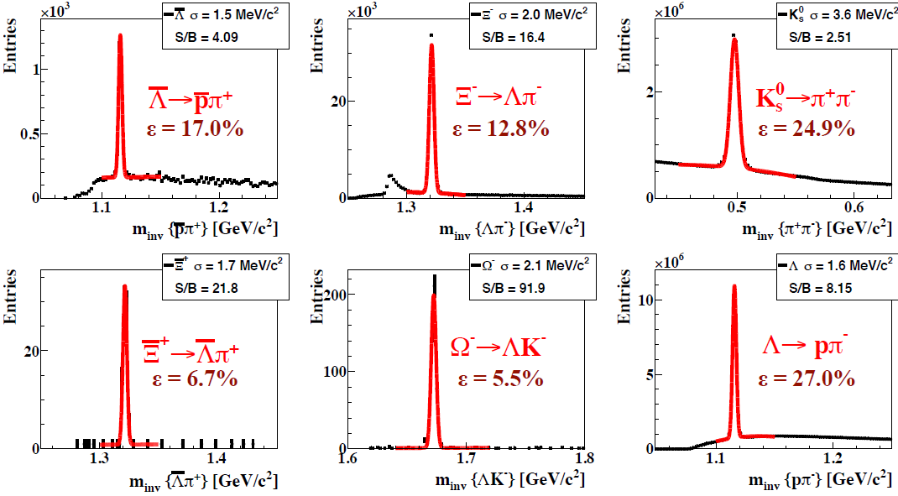
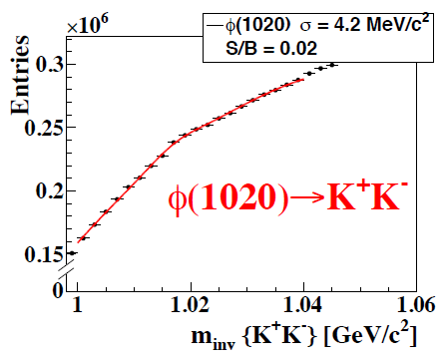
Results of KFPP
5×10⁶ central UrQMD Au+Au events at 10 A GeV/c
10¹¹ central UrQMD Ni+Ni events at 15 A GeV/c
Pictures: Maxim ZYZAK

Slide 13
Muon setup
TOF
TRD
STS
in magnet
MUCH

Slide 14
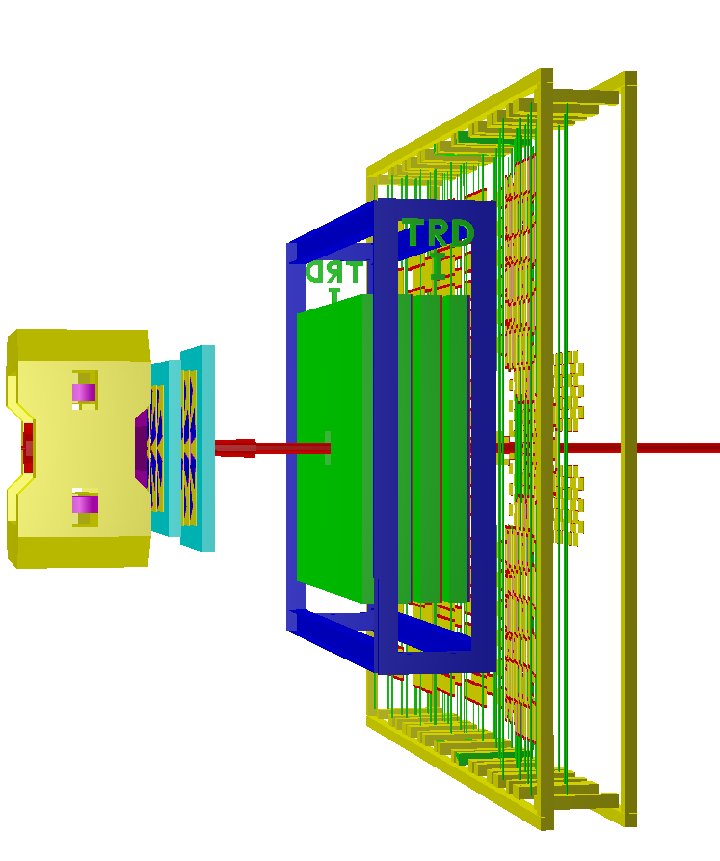
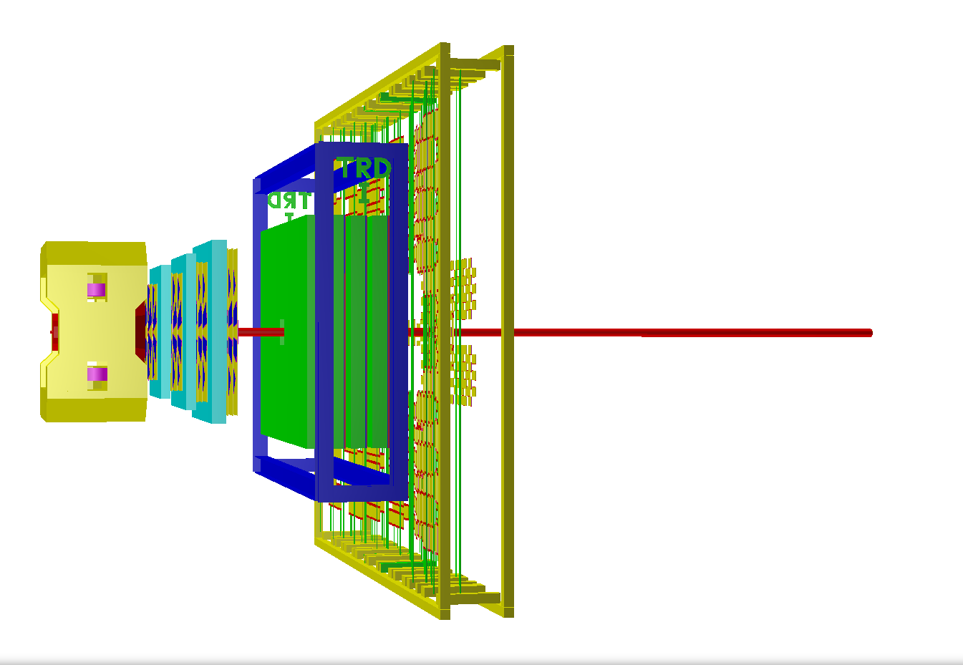
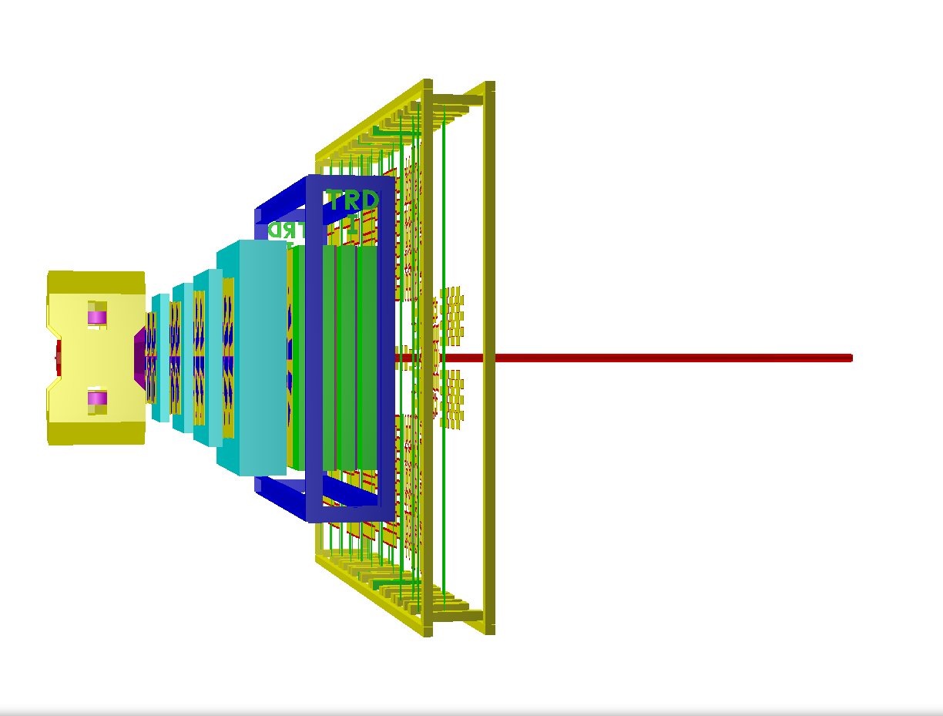
Configurations
for beam energies
up to 4 AGeV
for beam energies
above 4 AGeV
for charmonium measurements
TOF
TOF
TOF
magnet
with
STS
TRD
magnet
with
STS
TRD
magnet
with
STS
TRD
MUCH
MUCH
MUCH
MUCH:
2 GEM stations
absorbers:
60 cm C
(20+20) cm Fe
MUCH:
4 GEM stations
absorbers:
60 cm C
(20+20+30) cm Fe
MUCH:
4 GEM stations
absorbers:
60 cm C
(20+20+30+100) cm Fe

Slide 15
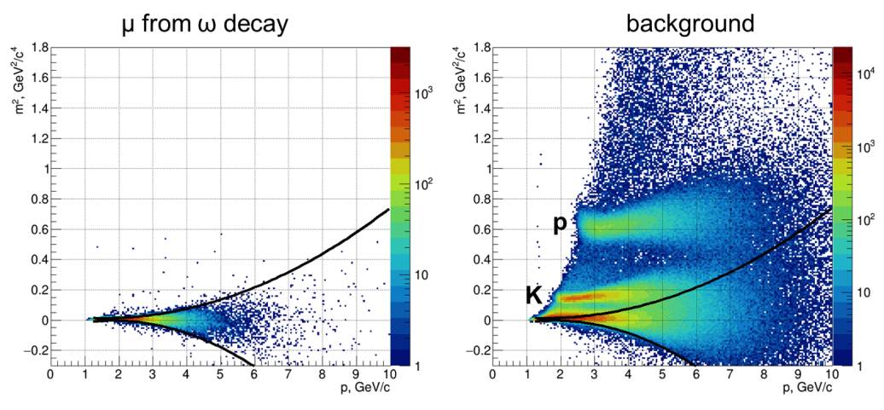
Muon reconstruction
Muon PID
STS – track, vertex and momentum reconstruction
MUCH-TRD – track extrapolation
TOF – muon identification

Slide 16
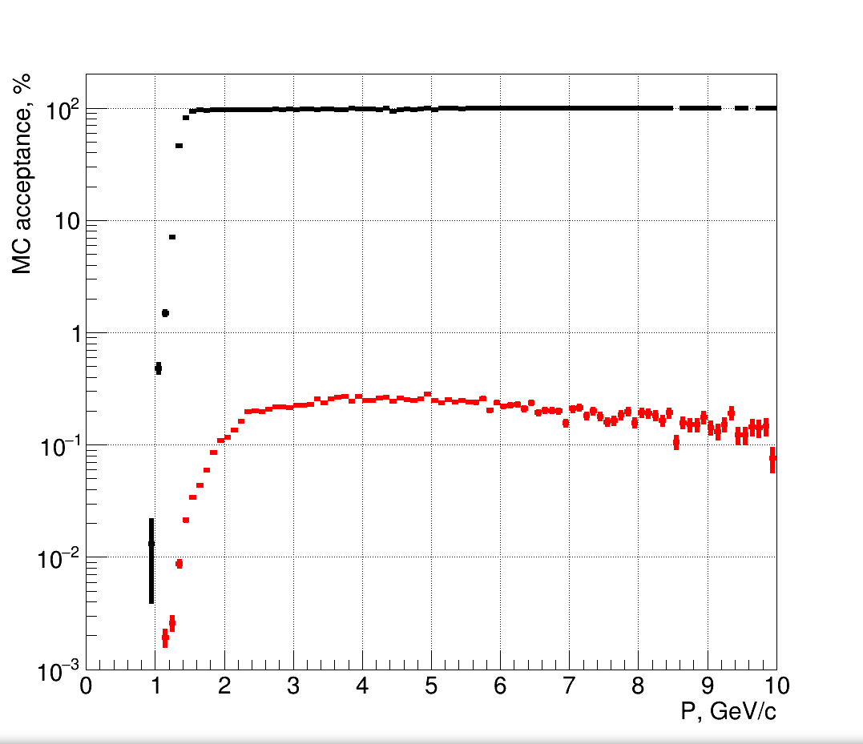
MC acceptance STS+TOF
central UrQMD
Au+Au events
at 12 A GeV/c
Condition: MC track in STS has MC point in TOF
muons
background

Slide 17
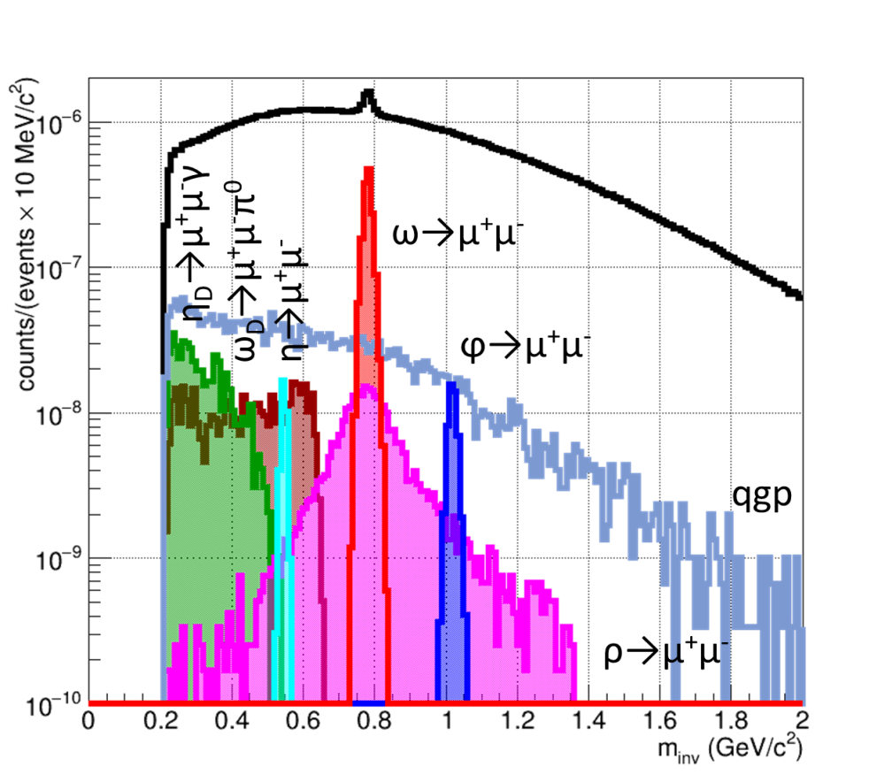
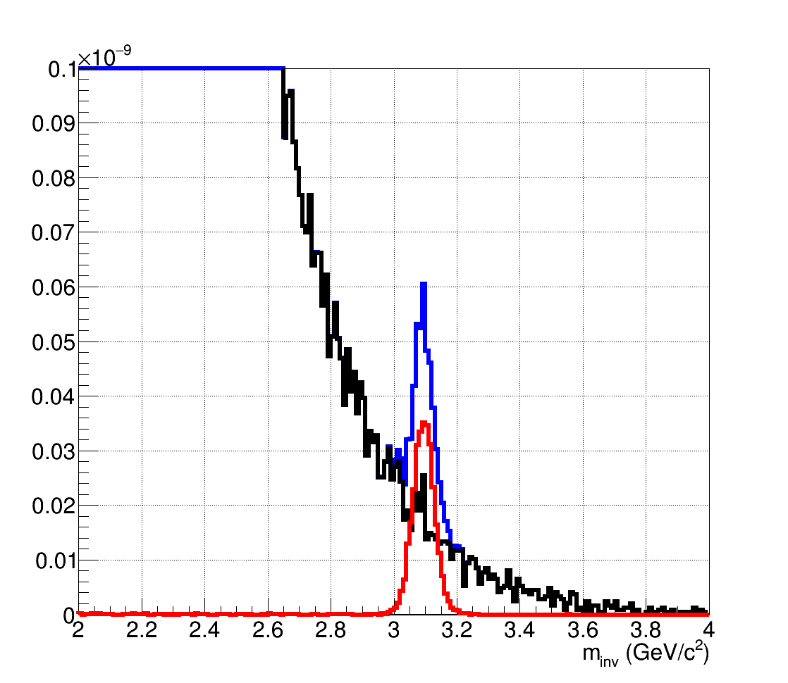
Invariant mass spectra
central UrQMD
Au+Au events
MUCH:
4 GEM stations
absorbers:
60 cm C + (20+20+30+100) cm Fe
8 A GeV/c
10 A GeV/c
J/ψ→μ⁺μ⁻
from di-muon analysis task

Slide 18
Hadron reconstruction in STS without TOF PID

Slide 19
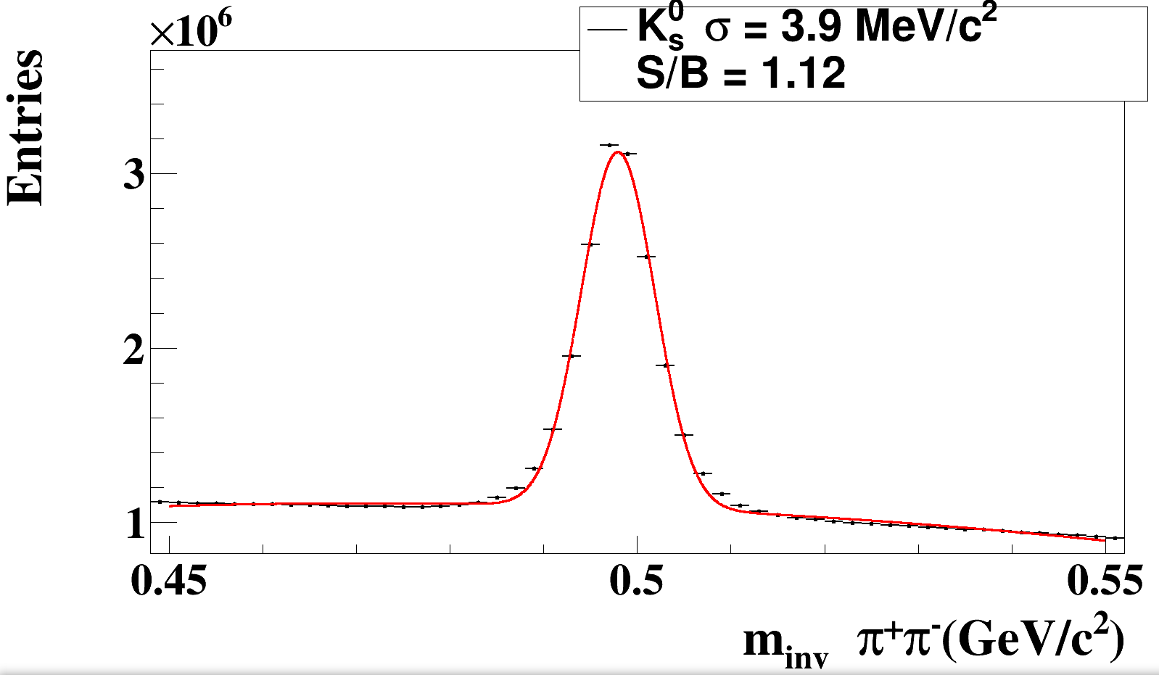
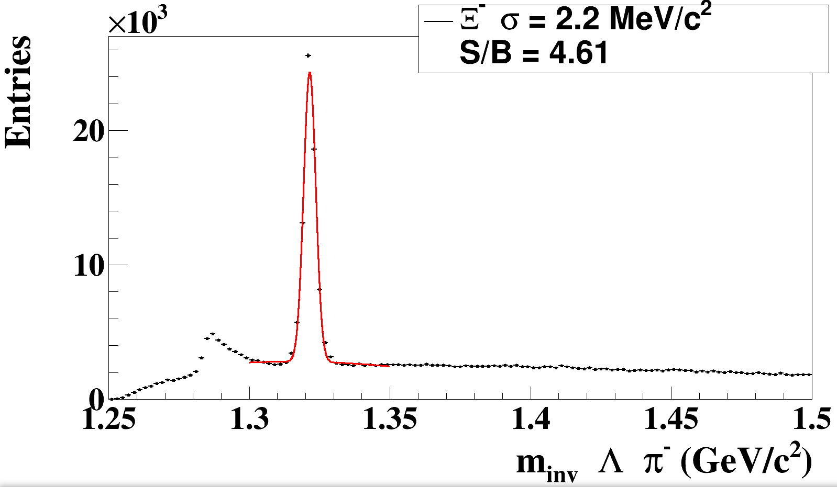
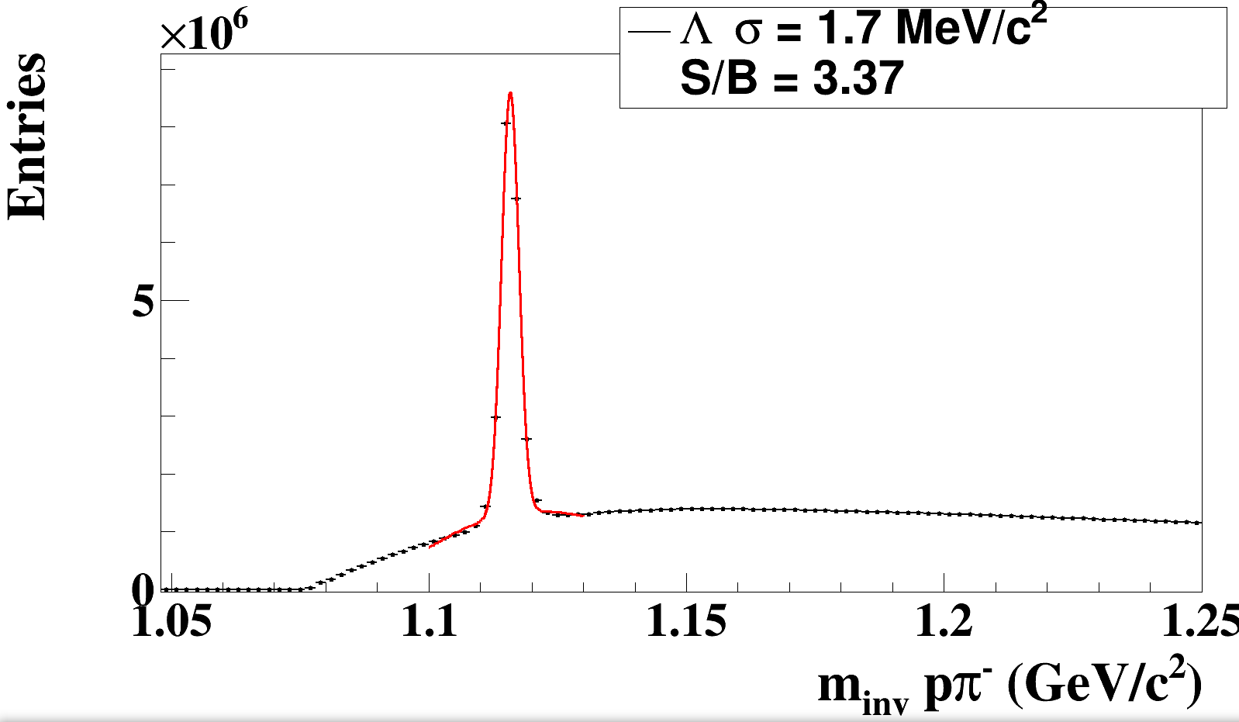
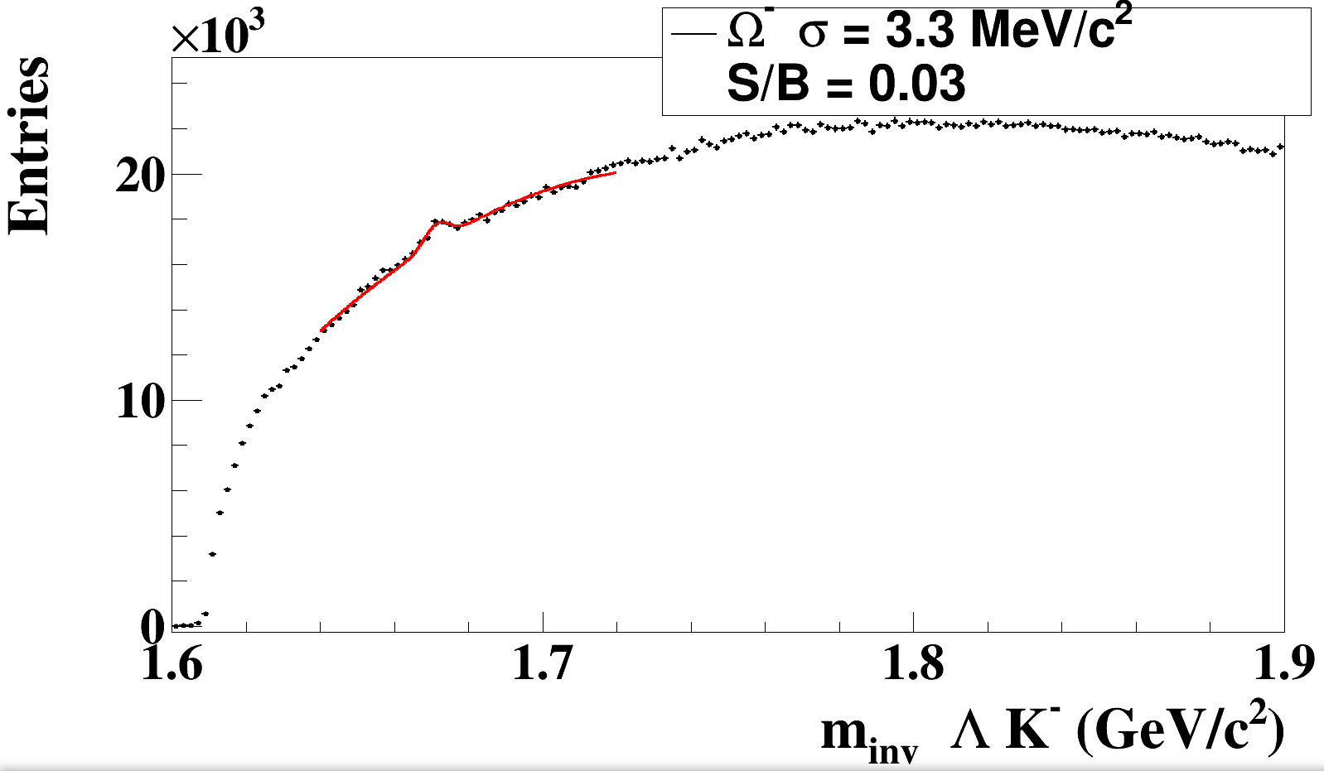
Hyperon reconstruction in STS without TOF
5×10⁶
central UrQMD
Au+Au events
at 12 A GeV/c
K⁰_{S}
ε_{4π} = 22%
Ξ⁻
ε_{4π} = 9%
Λ
Ω⁻
ε_{4π} = 23%
ε_{4π} = 12%
PID is needed for background suppression

Slide 20
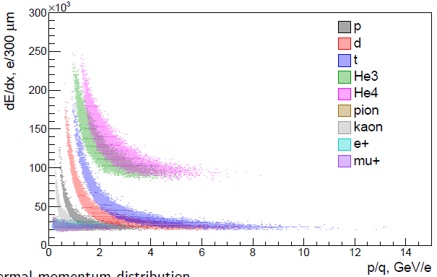
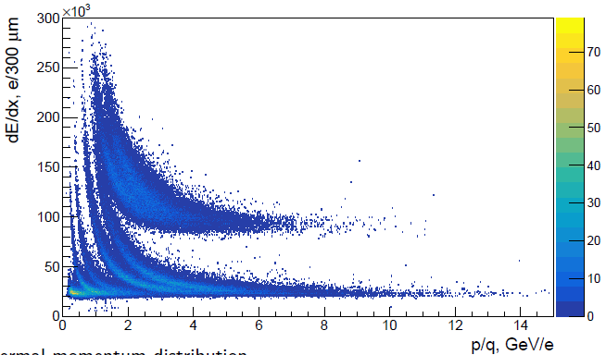
_{Λ}³H→ ³He + π⁻ PID in STS
central UrQMD
Au+Au events
at 2 A GeV/c
+ light fragments
PID in STS:
all negative particles are π⁻
positive particles with selected dE/dx are ³He (see picture)
³He
Picture: Maxim TEKLISHYN

Slide 21
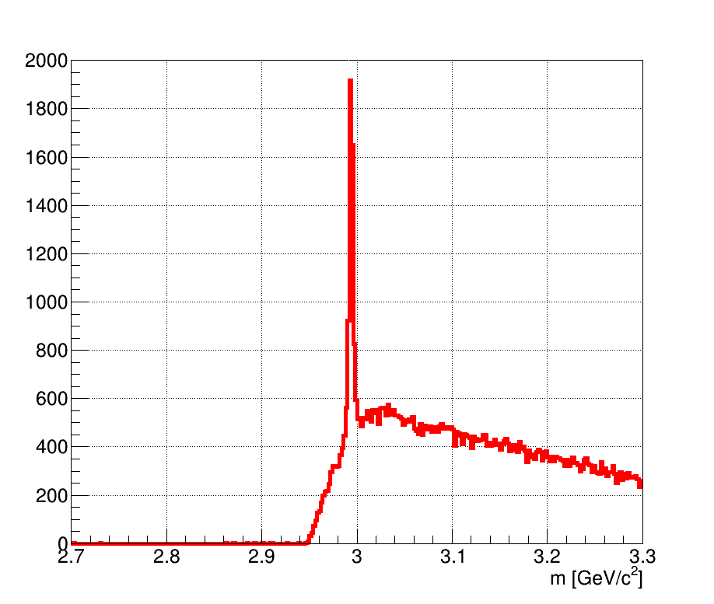
_{Λ}³H→ ³He + π⁻ reconstruction in STS
5×10⁶
central UrQMD
Au+Au events
at 12 A GeV/c
+ _{Λ}³H from thermal generator
reconstruction efficiency
9.5%
branching ratio: H. Kamada et al., Phys. Rev., Ser. C 57, 1595 (1998)
multiplicity : J. Steinheimer et. all, Phys. Lett. B714, 85, (2012)

Slide 22
_{Λ}⁴He→ ³He + π⁻ + p
central UrQMD
Au+Au events
at 2 A GeV/c
+ light fragments
PID in STS:
all negative particles are π⁻
positive particles ³He or p (see picture)
³He
p
Picture: Maxim TEKLISHYN

Slide 23
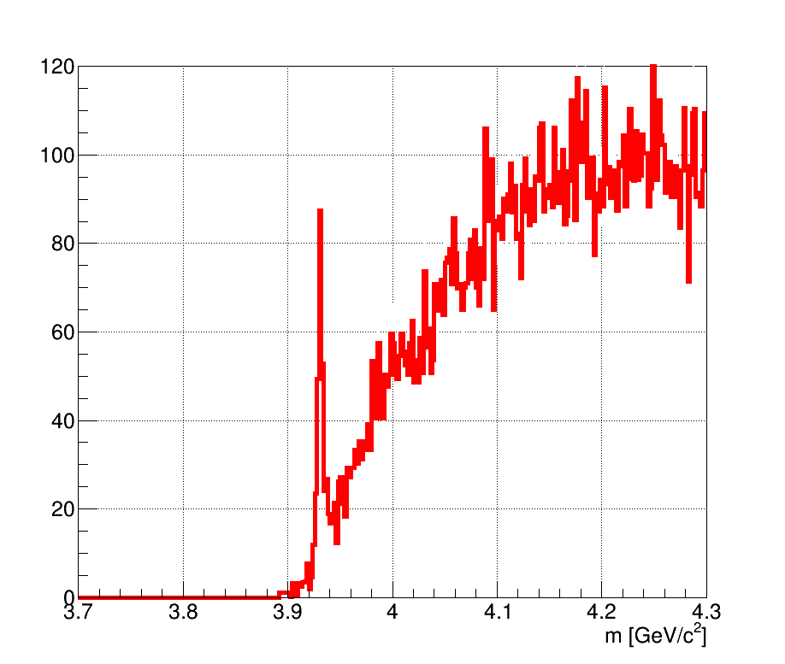
_{Λ}⁴He→ ³He + π⁻ + p reconstruction in STS
5×10⁶
central UrQMD
Au+Au events
at 12 A GeV/c
+ _{Λ}⁴He from thermal generator
reconstruction efficiency
5.7%
branching ratio: H. Kamada et al., Phys. Rev., Ser. C 57, 1595 (1998)
multiplicity : J. Steinheimer et. all, Phys. Lett. B714, 85, (2012)

Slide 24
Hadron identification with TOF behind MUCH
TOF
TRD
STS
MUCH

Slide 25
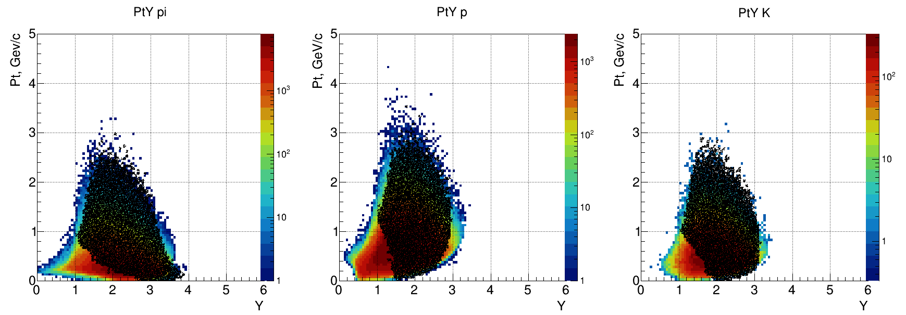
MC acceptance
central UrQMD
Au+Au events
at 12 A GeV/c
pions
protons
kaons
color plot – in STS
black points – in TOF

Slide 26
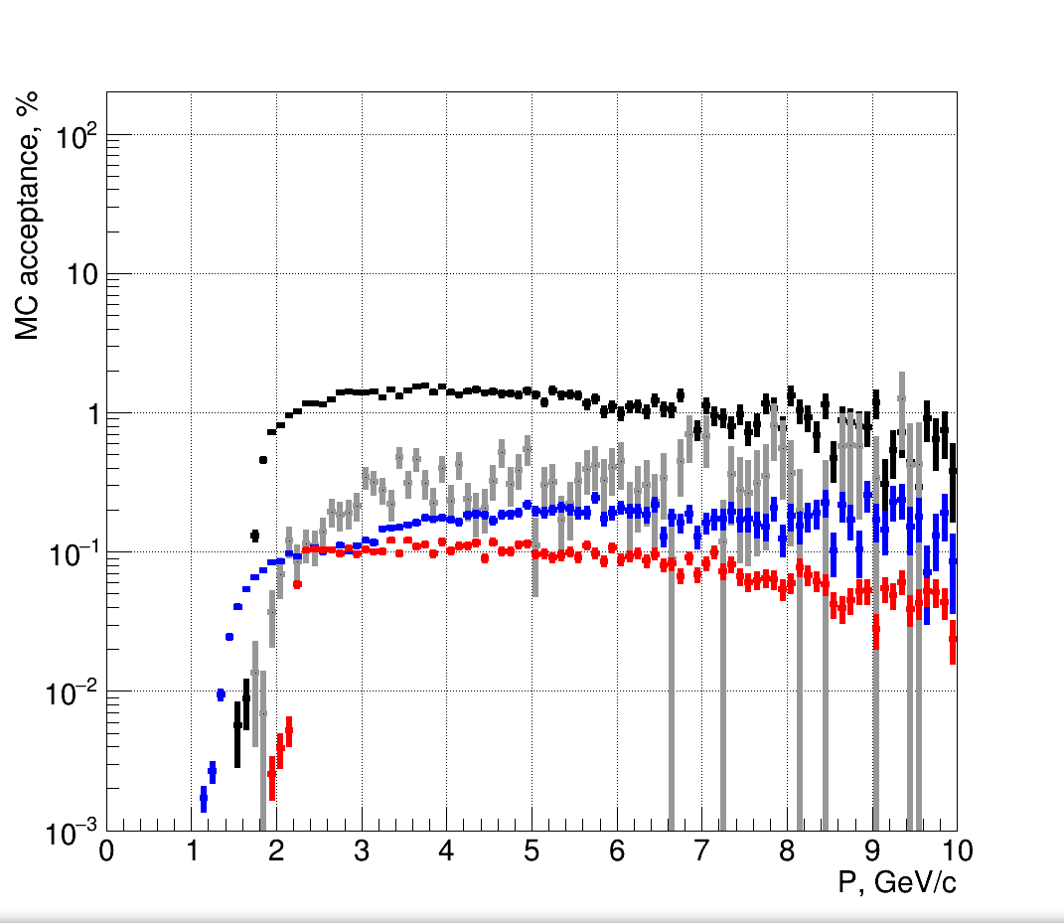
4π MC acceptance
central UrQMD
Au+Au events
at 12 A GeV/c
Condition: primary track has MC points in all detectors
K+
K-
π
p

Slide 27
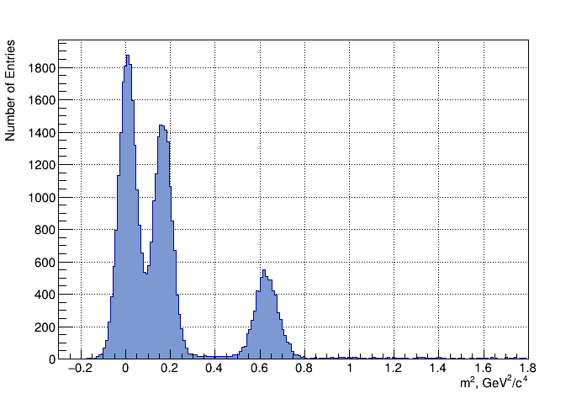
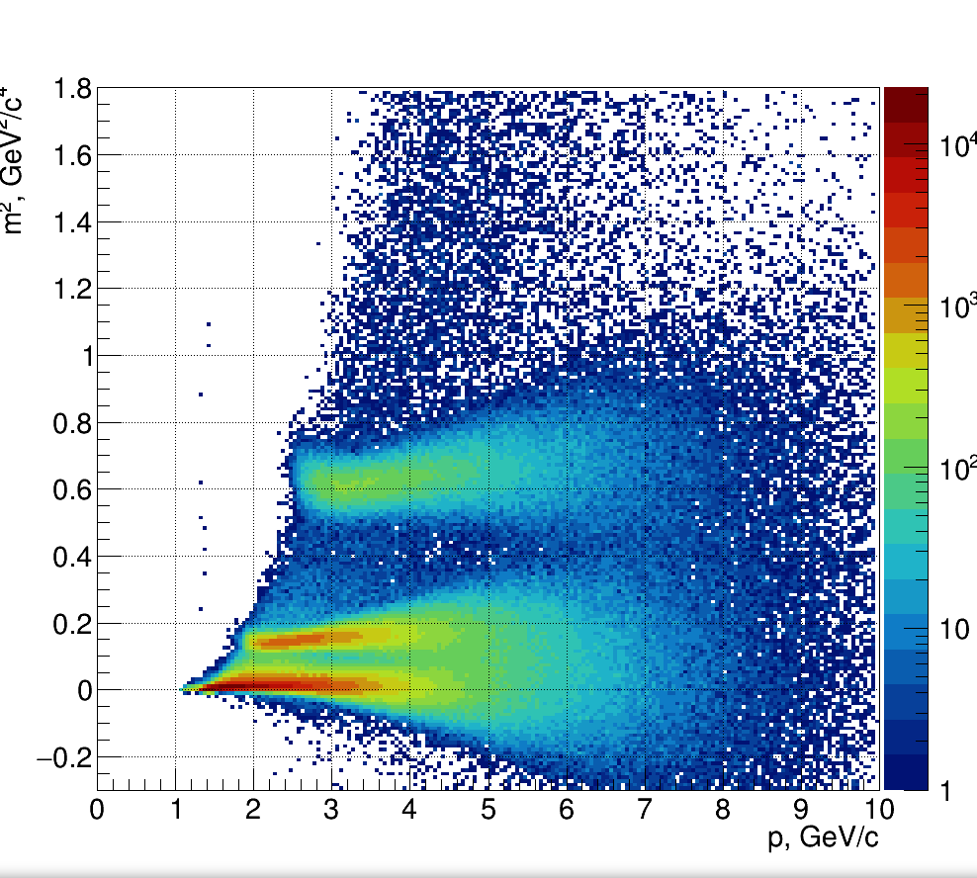
Hadron PID in TOF
5×10⁶
central UrQMD
Au+Au events
at 12 A GeV/c
projection
p
K
π

Slide 28
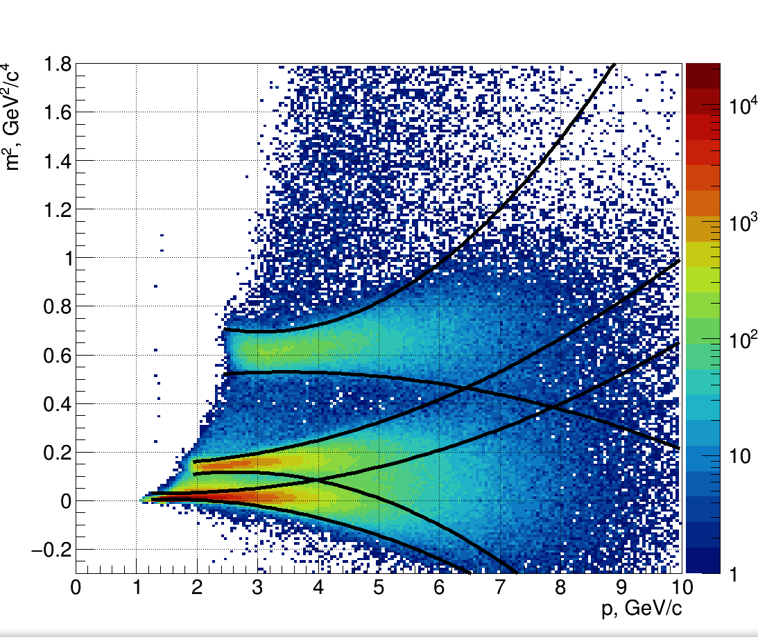
Hadron PID in TOF
5×10⁶
central UrQMD
Au+Au events
at 12 A GeV/c
2σ limits from Gaus fit
p
K
π

Slide 29
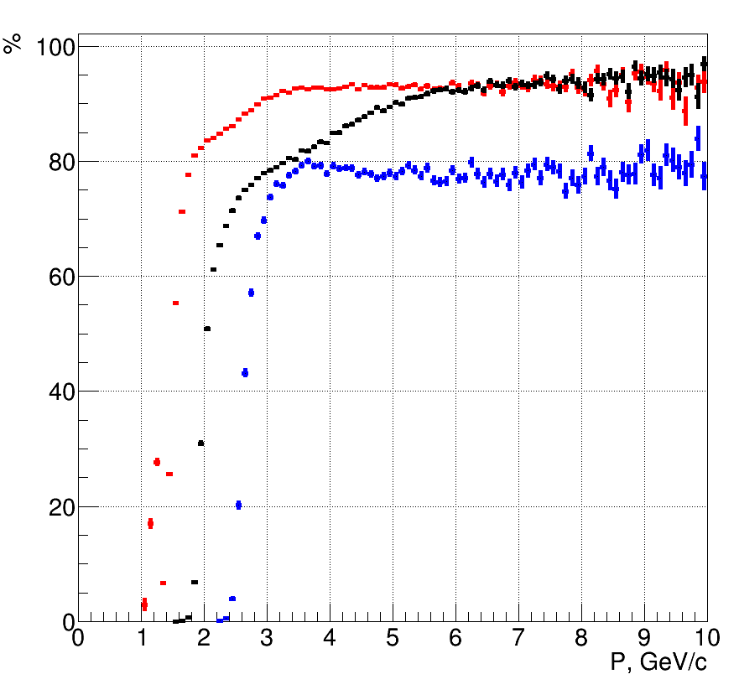
TOF PID efficiency for particles passing MUCH
5×10⁶
central UrQMD
Au+Au events
at 12 A GeV/c
inclusive the tracking and matching efficiency
π
K
p
p
K
low proton PID efficiency has to be understood !
π

Slide 30
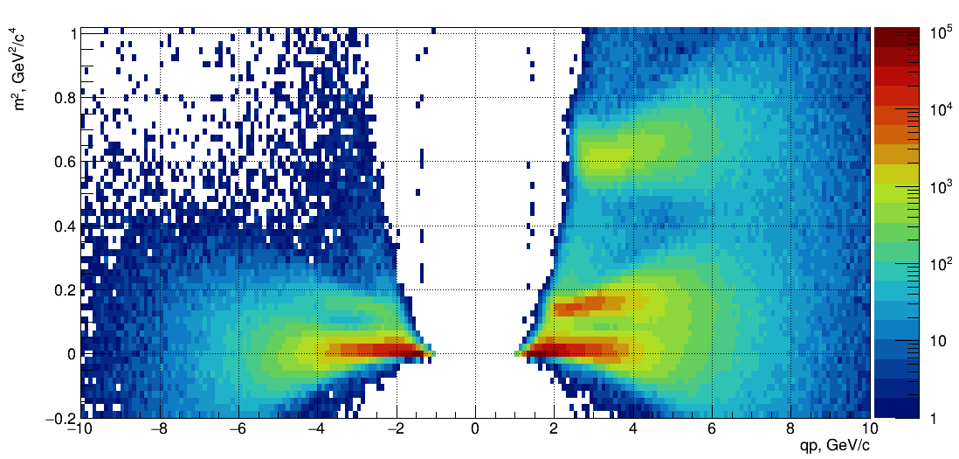
Ω-background suppression strategy
5×10⁶
central UrQMD
Au+Au events
at 12 A GeV/c
tracks in STS without TOF hit – without PID
tracks with TOF hit
p
Backround
will be removed
K⁻
π⁻

Slide 31
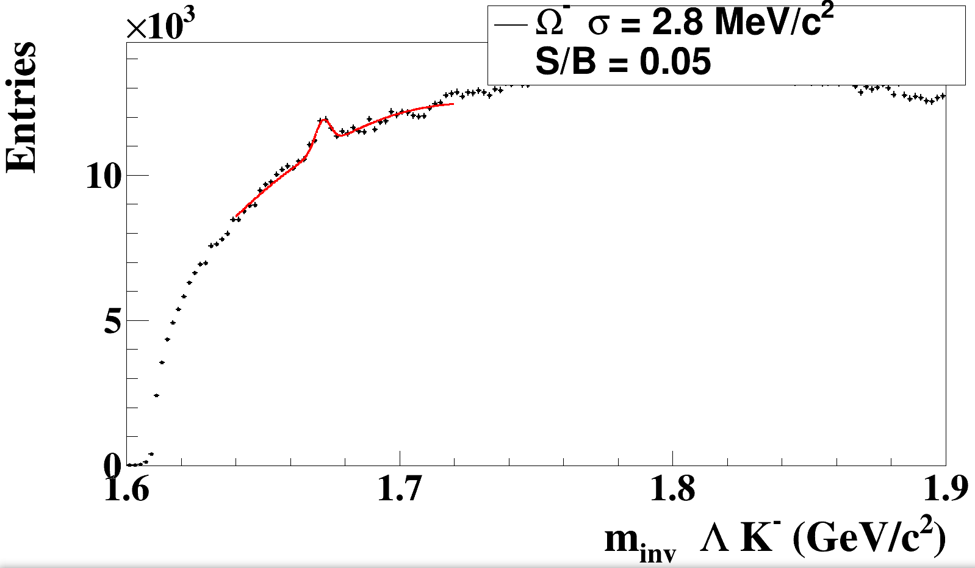
Ω-background suppression with PID
5×10⁶
central UrQMD
Au+Au events
at 12 A GeV/c
ε_{4π} = 12%
Preliminary !

Slide 32
p PID in STS (?)
central UrQMD
Au+Au events
at 2 A GeV/c
+ light fragments
p
Picture: Maxim TEKLISHYN

Slide 33
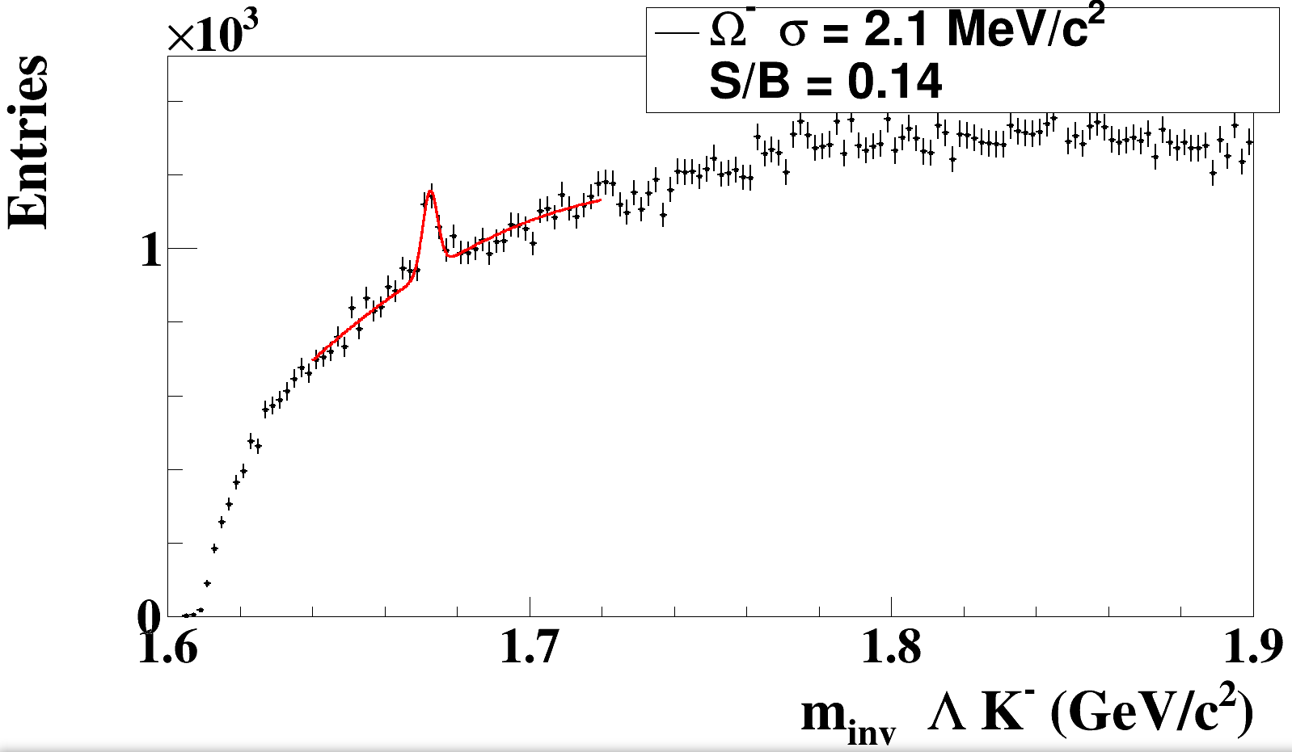
Ω-background suppression with PID in STS and TOF
5×10⁶
central UrQMD
Au+Au events
at 12 A GeV/c
ε_{4π} = 12%
Preliminary !

Slide 34
Conclusions
Hypernuclei can be reconstructed without TOF identification using dE/dx information from STS
Hyperons can be identified by the STS without TOF during muon measurements with reduced S/B. Their yield can be used for the physics analysis, and also as consistency check between muon and electron measurements
The TOF PID for particles passing MUCH helps to suppress background

Slide 35
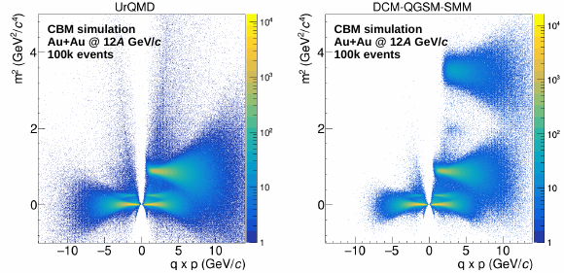
Next steps
Electron setup
Hyponuclei reconstruction with muon setup: simulations with DCM-QGSM-SMM as input and GEANT4 for transport
Implementation of TOF PID for muon setup in standard KFPP
Use TRD dE/dx separation for light fragments and background suppression
Picture: Oleg GOLOSOV

Slide 36
Backup

Slide 37
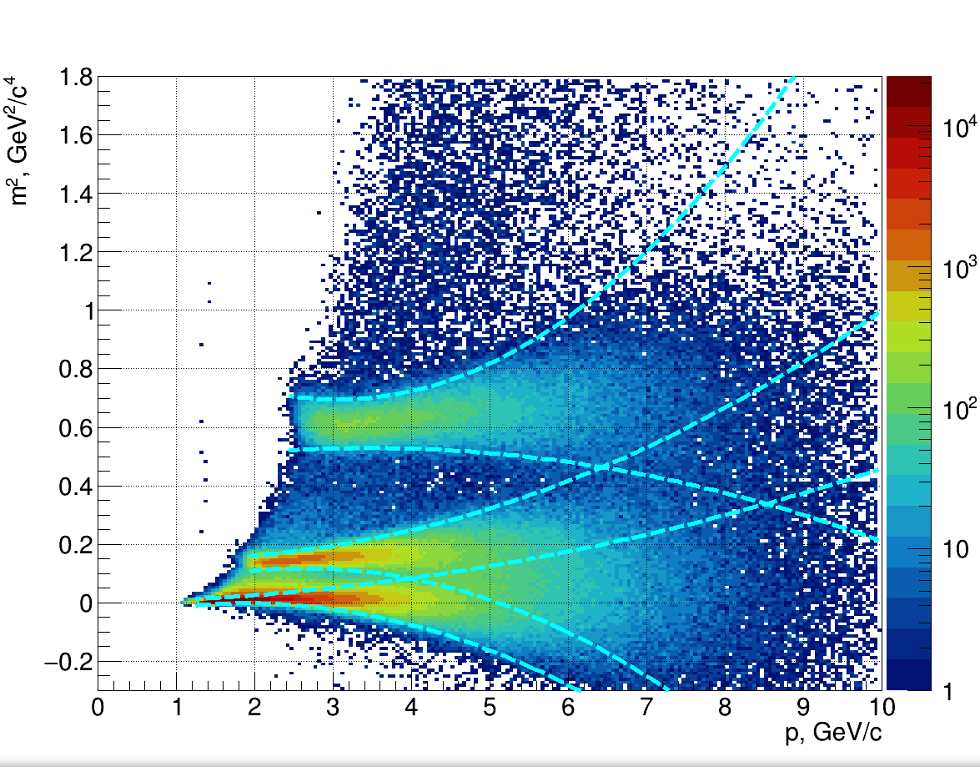
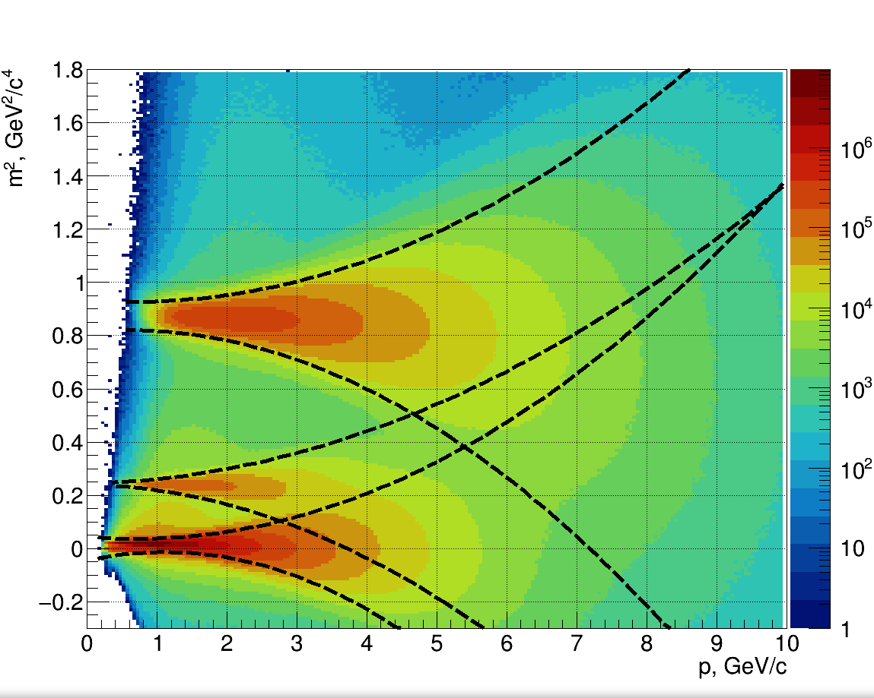
Particle identification in TOF in muon and electron setups
5×10⁶
central UrQMD
Au+Au events
at 12 A GeV/c
muon setup
electron setup
2σ fit
2σ fit

Slide 38
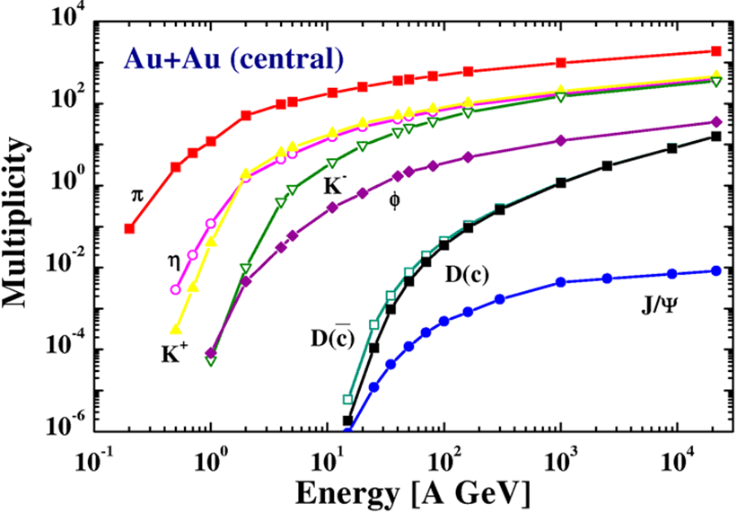
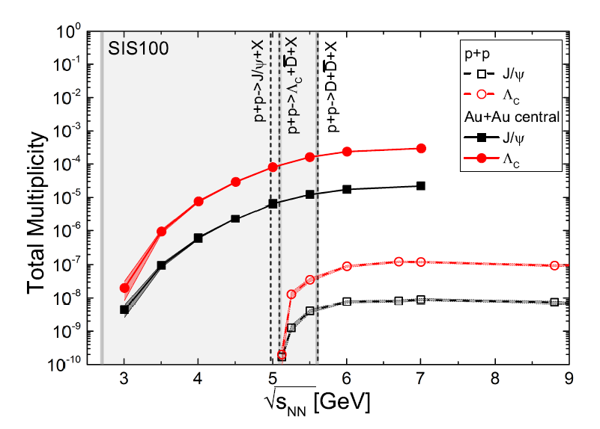
Predictions for J/ψ (SIS100)
W. Cassing, E. Bratkovskaya, A. Sibirtsev
Nucl. Phys. A 691 (2001) 753
J. Steinheimer, A. Botvina, M. Bleicher arXiv:1605.03439v1
HSD calculation
Central Au+Au collisions 10 A GeV : M_{J/ψ} = 1.7⋅10⁻⁷
UrQMD calculation including subthreshold charm production via
N* → Λ_{c} + D and N* → N +J/ψ
Central Au+Au collisions 10 A GeV: M_{J/ψ} = 5⋅10⁻⁶
http://fias.uni-frankfurt.de/~phsd-project/HSD

Slide 39
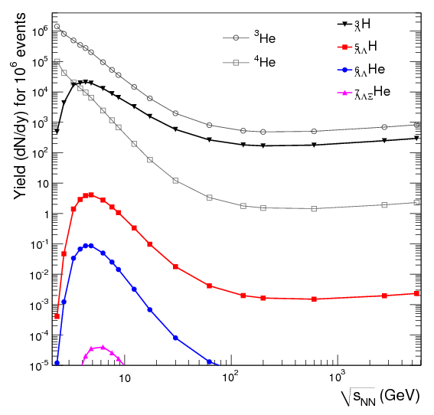
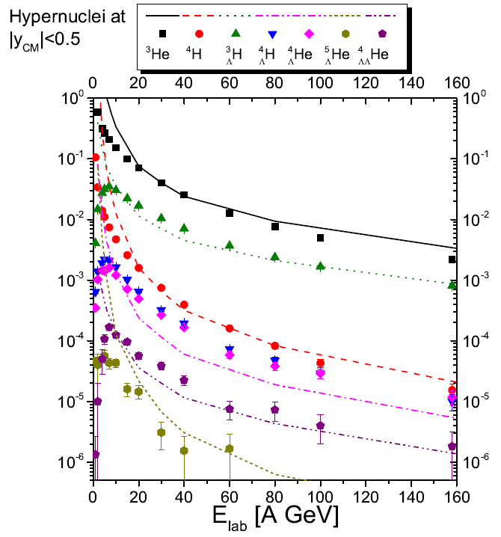
Hypernuclei production in A+A collisions
central UrQMD Au+Au events
at 12 A GeV/c
_{Λ}³H → ³He + π⁻
_{Λ}³H → ³He + π⁻
_{Λ}⁴He → ³He + π⁻ + p
A. Andronic et al., Phys. Lett. B697 (2011) 203
J. Steinheimer et al., arXiv:1203.2547 (2012)

