Slide 1

Mike Lamont
Joerg Jaeckel, Claude Vallée
PBC working groups

Slide 2
The brief
Maximize physics reach of CERN’s existing complex
Within the limits posed by an already vibrant and diverse physics program!
Evaluate the options’ motivation and competitiveness in the worldwide landscape

Slide 3
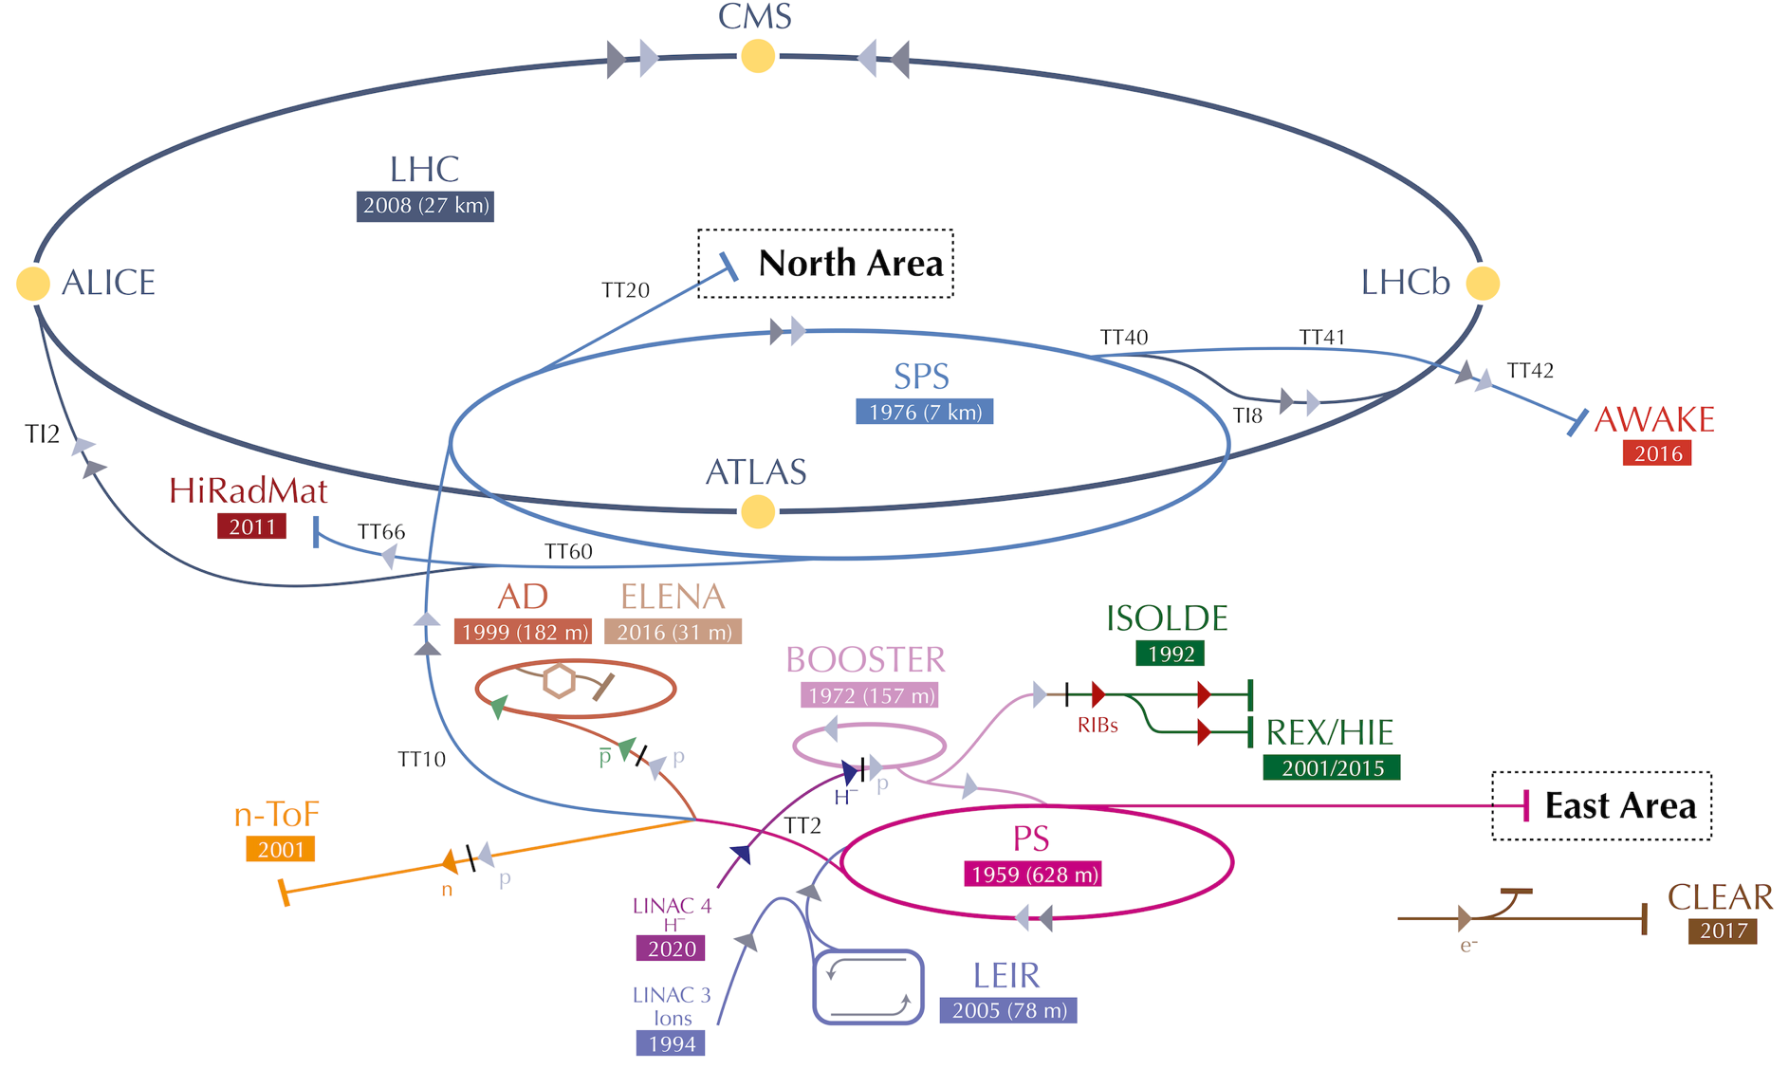
Notes:
Lot of history, a lot of experience

Slide 4
Higgs discovered with mass ~125 GeV.
No new particles found.
“Remarkably, the SM properties are just right to keep all its coupling constants under control, up to meaningful high energies.”

Slide 5
The need for physics
Beyond the Standard Model (BSM)
Dark Matter
Dark Energy
Neutrino masses and oscillations
Matter-antimatter asymmetry
Naturalness
Strong CP problem
Cosmological constant problem
Hierarchy problem
Stability of the Higgs mass against radiative corrections.

Slide 8
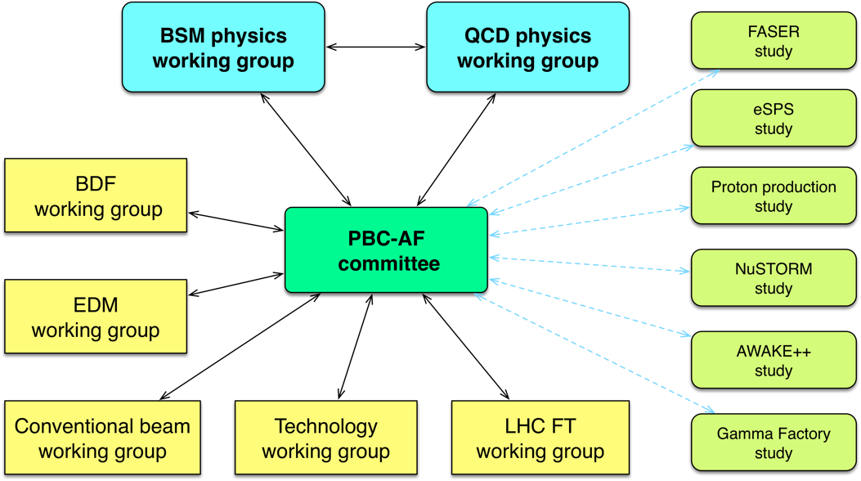
PBC structure
Evaluate proposed options in the worldwide landscape

Slide 9
Schematic overview of the BSM landscape
Beam dumps, Long Lived Particles
MeV – GeV (HNL, ALPS, Light Dark Matter)
Precision experiments
>>TeV (search for new physics in clean and very rare flavour processes or in EDMs)
Non-accelerator projects
Sub-eV (axions, ALPs)
Heavy Neutral Leptons (HNL), Axion-like particles (ALPS)

Slide 10
Stefania Gori
Stefania Gori

Slide 12
In the dark

Slide 13
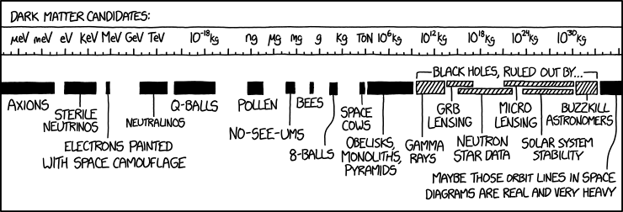

Slide 15
Direct detection – WIMP searches

Slide 16
Hidden Sector

Slide 18
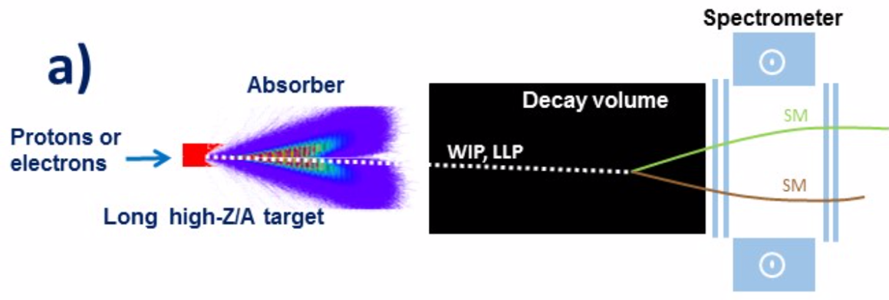
Beam Dump Facilities
BDFs ideal for exploring light feebly interacting particles and Light Dark Matter
  Luminosity (yield of π, K, D, B decay and photons):
    HL-LHC: ~10³⁵ cm⁻²s⁻¹ x 10⁷ s = 10⁴² cm⁻²
    SPS (1 m long high A/Z target): 4*10¹³ x 6*10²⁴ cm⁻³ x 10² cm x 10⁶ ~ 2*10⁴⁶ cm⁻²
    Superior luminosity compensates for lower energy (e.g. yield of charm hadrons ~10¹⁶@HL-LHC vs ~10¹⁸@SPS)
  Geometrical acceptance
  Long lifetimes
  Background suppression
Notes:
Lumi is 4 orders of magnitude higher while cross-section is only ~2 orders of magnitude less at E_CMS=27 GeV than at 13 TeV
Geometrical acceptance: large boost ensures good acceptance at BDF
Long lifetimes: BDF ideal for lower masses and weak couplings -- lifetime of HNLs goes as inverse of the 5th power of mass for instance
Background suppression: BDF configuration allow efficient filtering of background with shields

Slide 19
Theorist’s picture

Slide 20
Active beam dumps

Slide 21
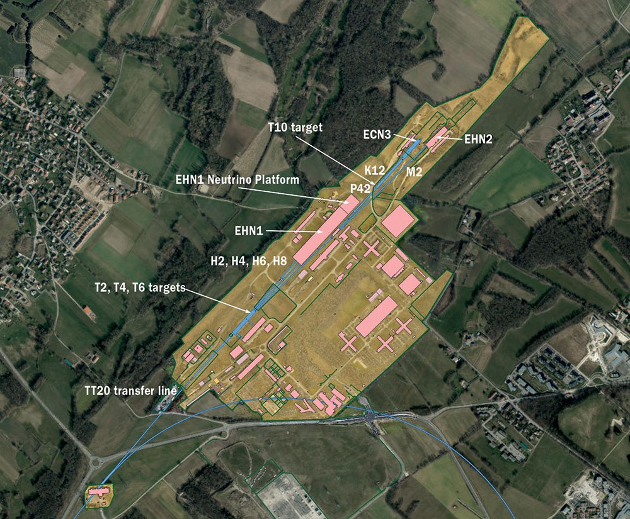
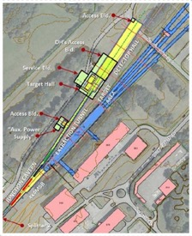
North Area
NA64++ (muons)
M2: 100 – 160 GeV
up to 1e13 mot/year
NA64++ (electrons)
H4: 100 GeV
up to 5e12 eot/year
NA62-dump mode K12: 400 GeV protons
up to 1e19 pot/year
KLEVER
K12: 400 GeV protons
up to 1e19 pot/year
BDF -> SHiP, TauFV
400 GeV protons
4e19 pot/year
Attempting to rebrand as the HSC (Hidden Sector Campus)

Slide 22
NA64++

Slide 23
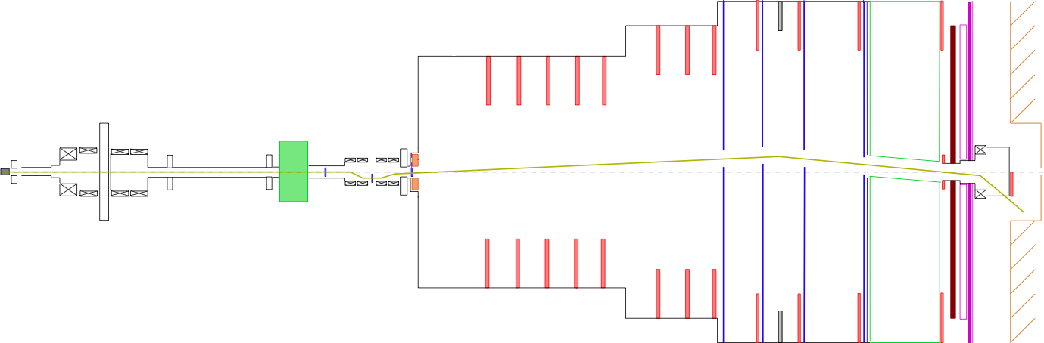
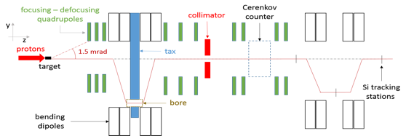
NA62++: dump mode
Instead of putting the protons on target for kaon production,
dump them on absorbers which act as a beam dump
TAXes
Be target
HNL
A’
Dark Scalars
beam
ALPs
20 m
80 m
HNL, dark photons dark scalars and ALPS can originate from the charm, beauty and photons produced in the dump

Slide 24
SPS Beam Dump Facility (BDF)
Slow extraction from SPS into existing TT20 transfer line
Switch to new transfer line at existing North Area splitters
Heavy target plus magnetized hadron absorber
Target complex with sophisticated handling capabilities
Underground Experimental Hall
Momentum | 400 GeV/c
Protons on target per cycle | 4.0e13
Cycle length | 7.2 s
Spill duration | 1 s
Avg. power on target | 355 kW
Avg. power on target during spill | 2560 kW
Protons on target (PoT) per year | 4e19
PoT in 5 years’ data taking | 2.0e20

Slide 25
BDF
2016-2018: 3 year feasibility study
  extraction, beamlines, target, target complex, experimental hall, integration, civil engineering, safety, and radiation protection
BDF Comprehensive Design Study on arXiv

Slide 26
SHiP
A discovery machine for weakly coupled LLPs with a complementary detector for neutrino physics and LDM scattering signatures
Large geometrical acceptance: long volume close to dump
“Zero” background

Slide 27
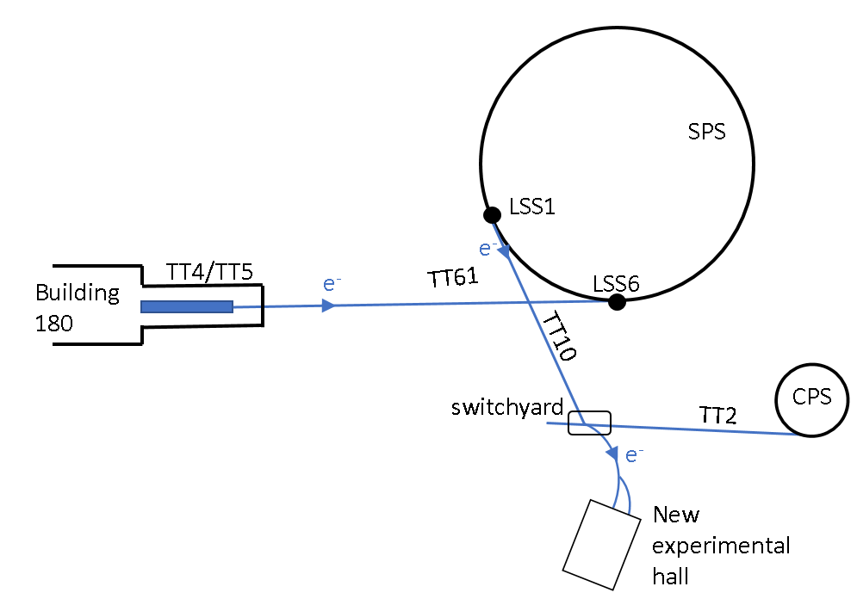
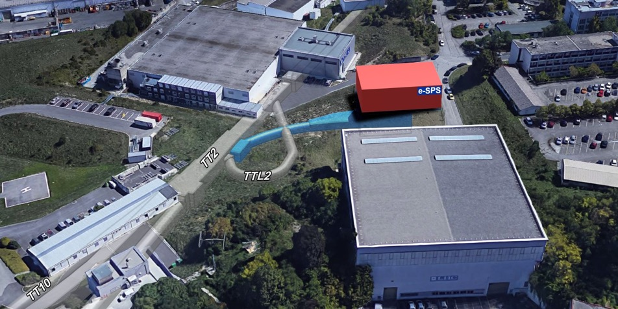
eSPS
~70 m long X-band based linac (CLIC technology): e- to 3.5 GeV
Acceleration to 16 GeV in the SPS
Slow resonant extraction in ~10 s
Beam delivered via the existing transfer line to the Meyrin site
A new, short beamline would branch to an experimental hall
  foreseen client is LDMX – a missing momentum active beam dump experiment
R&D facility

Slide 28
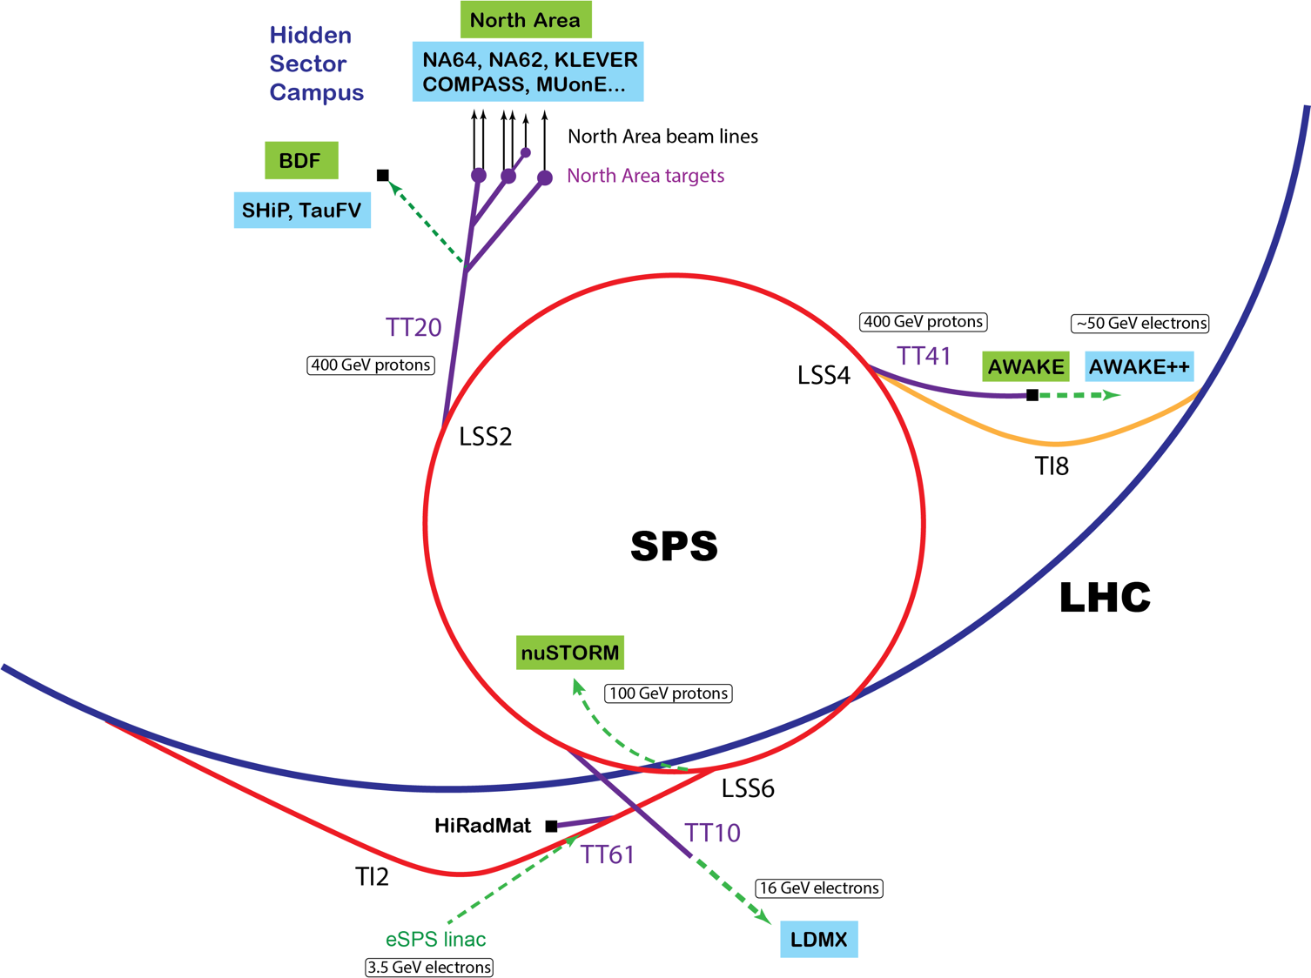

Slide 29
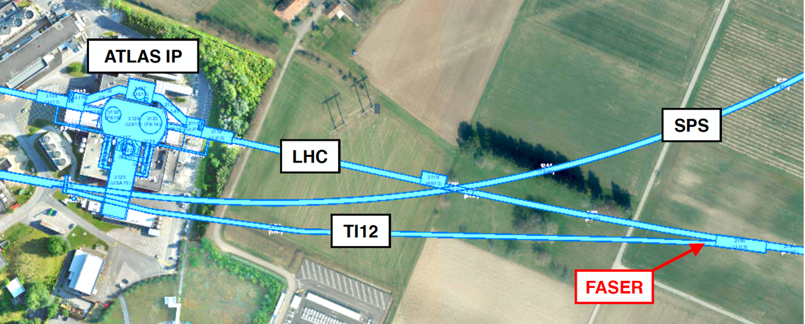
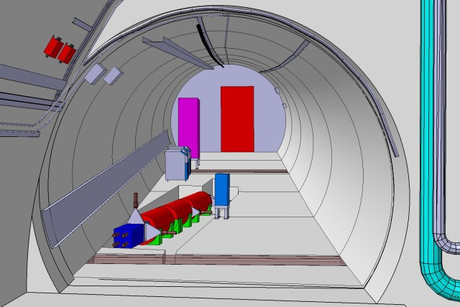
Long Lived Particles at the LHC
FASER: Preparation for installation in 2020 ongoing
FASER: sensitive to decays in a cylindrical region of radius R = 10 cm and length L = 1.5 m
FASER2: R = 1 m and L = 5 m for construction in Long Shutdown 3

Slide 30

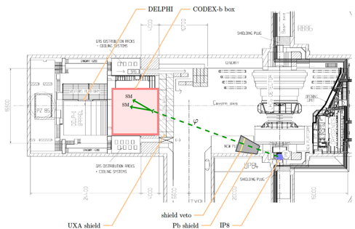
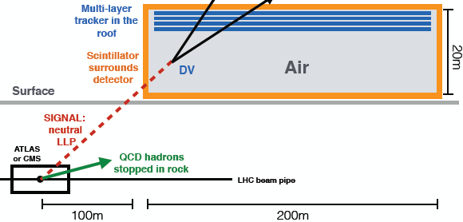
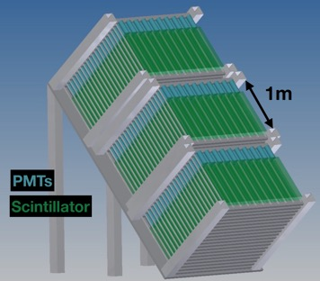
Long Lived Particles at the LHC
FASER
CODEX-b
~1 m³ ~ 5 μIKEAs
Feng, Galon, Kling, Trojanowski (2017)
~1000 m³ ~ 20 mIKEA
Gligorov, Knapen, Papucci, Robinson (2017)
milliQan
MATHUSLA
~800,000 m³ ~ 4 IKEA
Chou, Curtin, Lubatti (2016)
~9 m³ ~ 35 μIKEAs

Slide 31
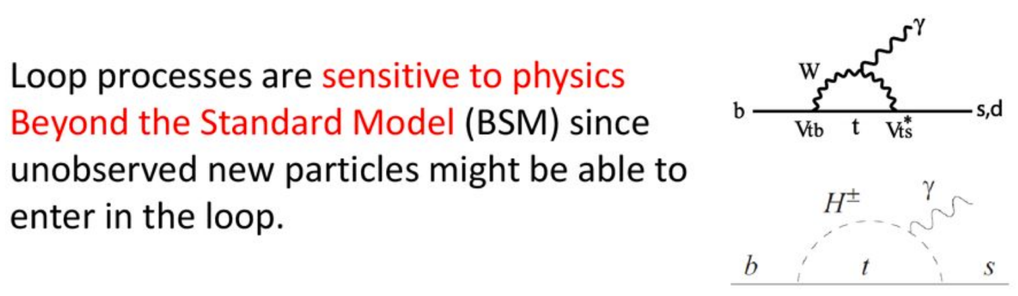
Precision

Slide 32
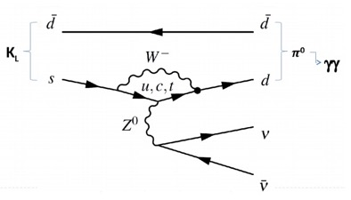
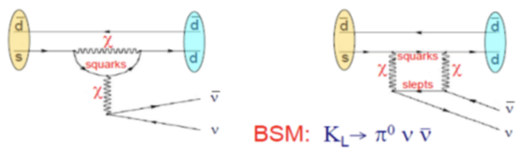
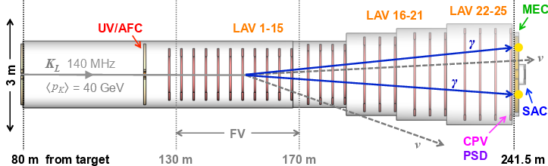
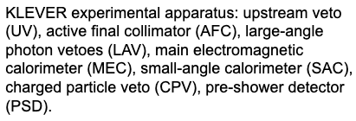
BSM particle with loops can increase the rate by x10 with respect to SM
Study phase – start data taking ~2026

Slide 33
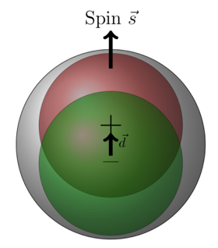
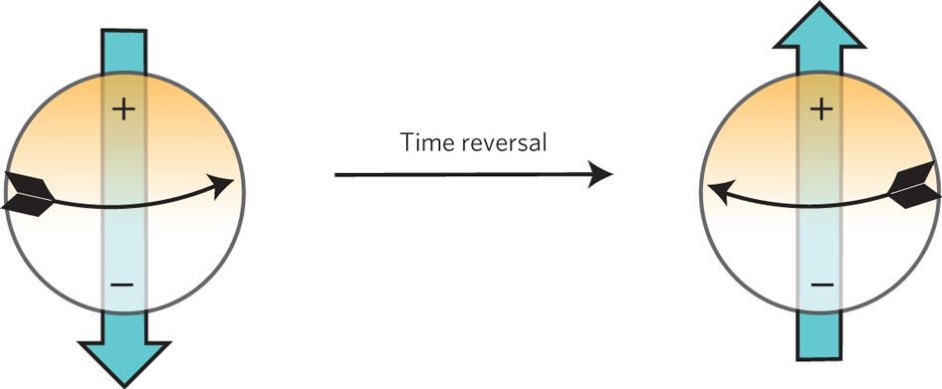
Electric Dipole Moments
Permanent EDM of fundamental spin systems are the most sensitive probes of CPV with no SM background (yet)
Experiments test new physics (way) beyond TeV scale
Explanations of the Baryon Asymmetry of the Universe require additional CP violation; could show up in EDM

Slide 34
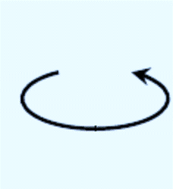
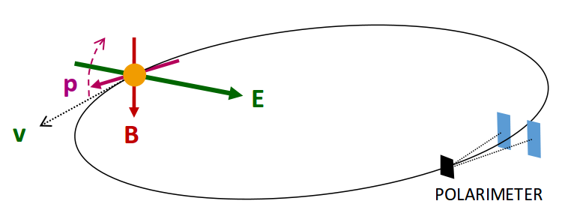

EDM Storage Ring
Stored (proton) beam is spin polarized: begin with spins aligned along the momentum vector.
Beam energy fixes the ratio between the magnetic and electric fields to keep the spin in the longitudinal direction (frozen spin)
  For an all-electric proton ring 𝑬_{𝒌𝒊𝒏}=𝟐𝟑𝟐.𝟖 MeV
An EDM generates a vertical spin component by coupling with radial E field
Difference in the scattering rate between the left and right directions is sensitive to the polarization.
$$P$$

Slide 35
EDM Storage Ring
Interesting potential statistical sensitivity (~10⁻²⁹ e.cm)
Challenging systematics
  in particular parasitic radial magnetic field (~10 aT mimics 10⁻²⁹ e.cm)
Extensive studies by EDM community:
  Polarimetry, deflectors, magnetic shielding, instrumentation
  Optics, lattice, ring design, beam dynamics
  Systematics and proposed mitigation measures, simulations

Slide 36
Addressing systematics
Typical residual magnetic fields inside state-of-the-art multilayer shielding with degaussing procedures are around 1 nT
Radial B-field expected to be the main limitation to achievable sensitivity even with
orbit separation measurement to estimate (and correct) average horizontal magnetic field.

Slide 37
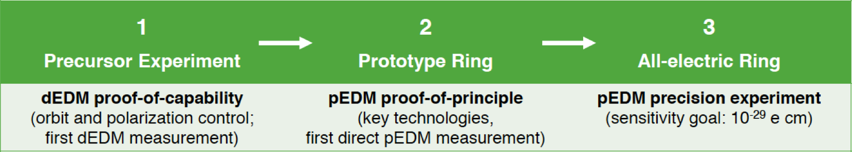
EDM Roadmap
Impressive “precursor” results at COSY with polarized deuterons in a magnetic storage ring
Prototype seen as essential next step:
Small ring (100 m circum.) all-electric at 30 MeV; and combined electric and magnetic fields to allow frozen spin operation at 45 MeV
If the prototype is at COSY, takes advantage of the existing facility for the production of polarized proton (and deuteron) beams, beam bunching, and spin manipulation.
Feasibility study at https://arxiv.org/abs/1912.07881

Slide 38
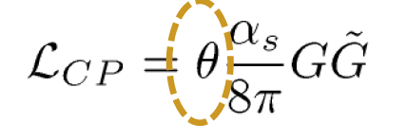
Axions
Strong-CP problem
  Lack of CP violation in strong interactions
  nEDM ~ 10⁻²⁶ e.cm => θ_{QCD} ~10⁻¹⁰
Peccei-Quinn theory (1977)
  Appealing solution to the strong CP problem
  A new global symmetry, U(1)_{PQ}, with a scalar field permeating all space
  Spontaneous (explicit) PQ symmetry breaking => new Goldstone boson: axion
  Similar to Higgs mechanism
May solve the DM problem for “free”!

Slide 39
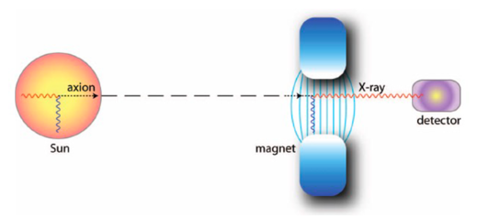
Detection
Light-shining-through-walls (LSW)
Helioscope
Haloscope

Slide 40



Detection of axions
Source | Experiments | Model & Cosmology dependency | Technology
Relic axions | ADMX, HAYSTAC, CASPEr, CULTASK, CAST-CAPP, MADMAX, ORGAN, RADES, QUAX, AXIOMA, ABRA, DM-Radio, … | High | New ideas emerging, Active R&D going on,…
Lab axions | ALPS, JURA, OSQAR, CROWS, ARIADNE,… | Very low | Ready for large scale experiment
Solar axions | SUMICO, CAST, (Baby)IAXO | Low | Ready for large scale experiment
Large complementarity among categories

Slide 41
Initiatives integrated into the Technology WG

Slide 42
IAXO by way of BabyIAXO

Slide 44
Gamma factory
Accelerate and store high energy beams of highly ionized atoms and excite their atomic degrees of freedom by laser photons to produce:
Enjoy relativistic magic twice
Witek Krasny

Slide 45
Gamma Factory

Slide 46
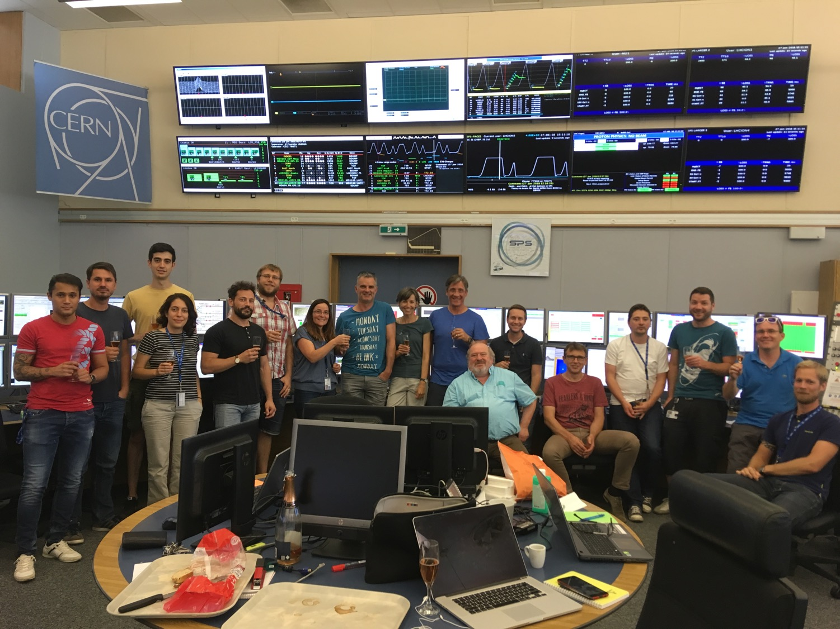
Pb80+
Pb81+
Pb80+
Pb81+

Slide 48
Next step: Proof of principle in SPS
Work very much in progress
Letter of Intent to SPSC submitted

Slide 49
PBC BSM Benchmark Cases
The BSM WG selected a set of theoretically and phenomenologically motivated target areas
used as benchmarks models to explore the physics reach of the received proposals
and put them into the worldwide landscape.

Slide 50
Dark photon – visible mode

Slide 51
Options - summary
Well motivated, competitive, cost-effective options, making good use of CERN’s existing complex, beams, and expertise.
Rare decays and precise measurements
KLEVER (K⁰_{L} → π⁰𝜈𝜈)
TauFV@BDF: 𝜏 → 3μ
REDTOP (𝜂 decays)
MUonE (hadronic vacuum polarization for (g-2_{μ}))
EDM proton storage ring
Long-lived particles from LHC collisions
FASER, MATHUSLA, CODEX-b, milliQAN
QCD measurements
COMPASS++, DIRAC++
NA61++, NA60++
Fixed target (gas, crystals) in ALICE & LHCb
Other facilities:
𝛾-factory from Partially Stripped Ions; nuSTORM
Hidden sector with “beam dumps”
NA64++ (e,μ)
NA62++
Beam Dump Facility at North Area (SHiP)
LDMX@eSPS
AWAKE++
Non-accelerator projects
Exploit CERN’s technology (RF, vacuum, magnets, optics, cryogenics) for
experiments possibly located in other labs.
E.g. axion searches: IAXO (helioscope), JURA (Light Shining through Wall)

Slide 52
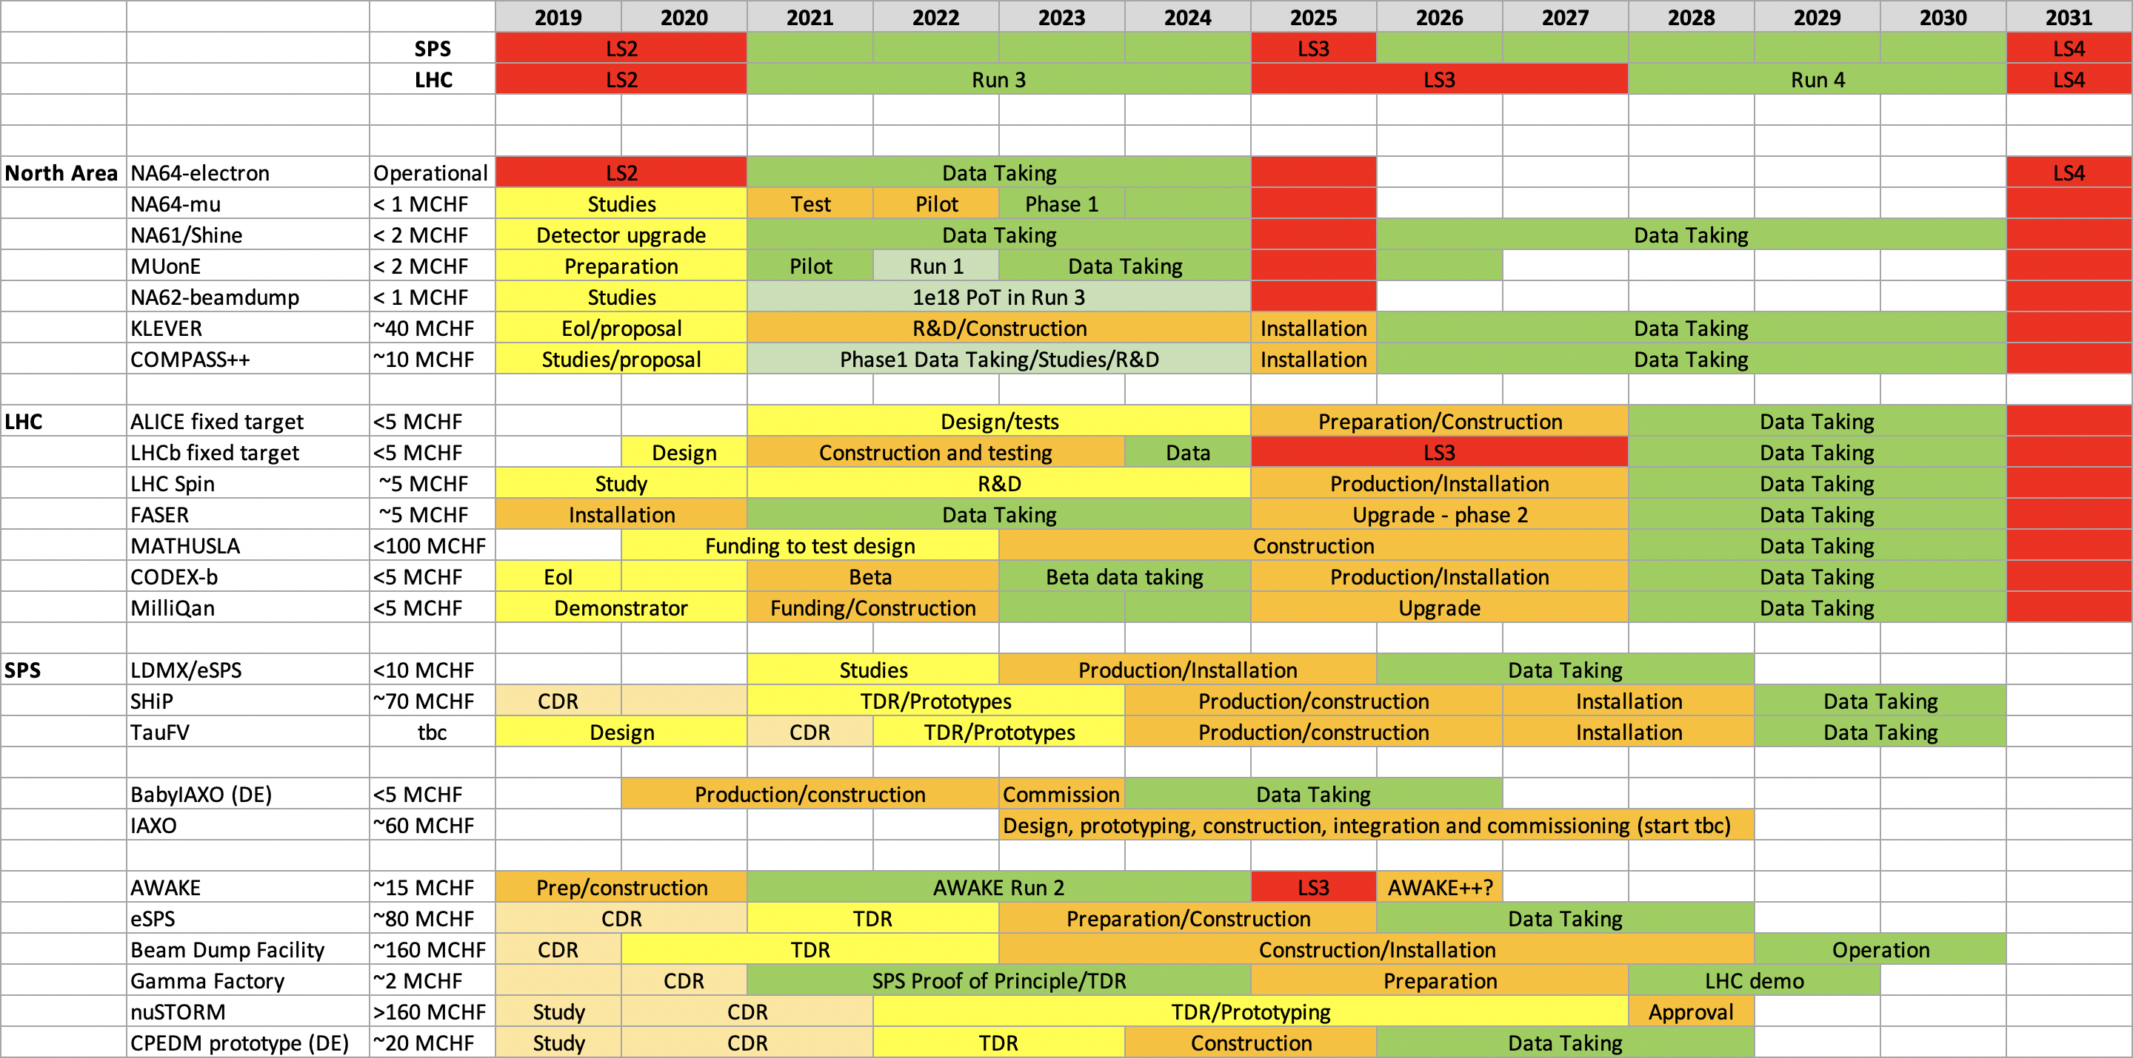

Slide 53
The future is colourful and dark and interesting!
The absence, so far, of unambiguous signals of new physics from
  direct searches at the LHC,
  indirect searches in flavour physics,
  and direct detection Dark Matter experiments,
  along with the absence of a clear guidance from theory about the energy scale, motivates today, more than ever, the broadening of the experimental effort in the quest for new physics

Slide 55
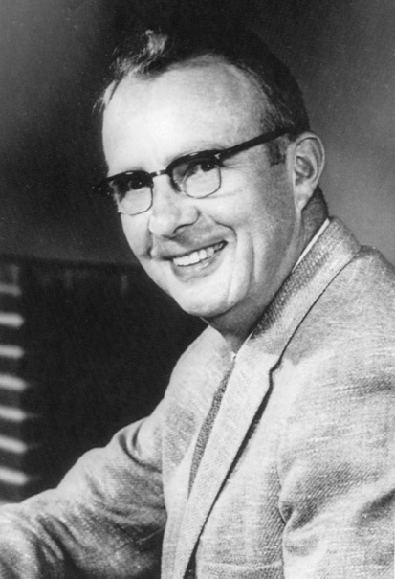
Luis Alvarez, Nobel laureate of physics in 1968, and one of the first experimental physicists to measure the magnetic dipole moment of the neutron
“Before you rush into continuing with a new, improved version of the experiment you’ve just done, sit down and take stock. Think deeply about what the important problems in physics are.
And think particularly deeply about the important opportunities in physics, opportunities that have emerged thanks to new technologies and recent experimental results.
Take a month or two to think about it; study what the most interesting and important problems are. Then decide what you want to do next.”

