Slide 1
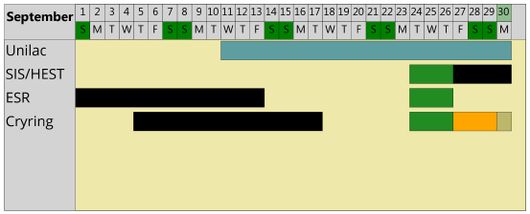
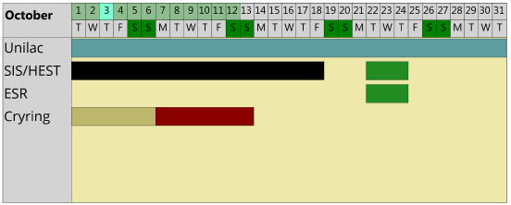
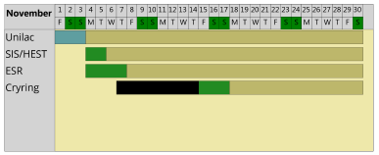
machine status
CRYRING@ESR & HITRAP
CRYRING@ESR
electron cooler – not counting on operation in September, only little hope
one test fill did not start due to a blocked filling pipe, another test starts next week
user experiment beamtime (C+)
shifted to November
three vacuum sections are baking (despite the delay due to the det.)
Control System – prepare dry run
- Safety inspection of movable electrical devices (DGUV-3)
- Start with the most likely ones to fail (power cords) and check them rolling
- date for complete inspection set for mid January
HITRAP - no activity
C⁺
C⁺

