Slide 1

PANDA The preliminary design of the control Dewar for solenoid magnet

Slide 2
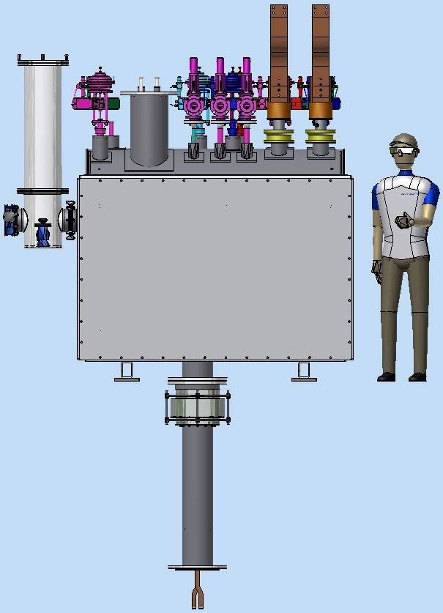
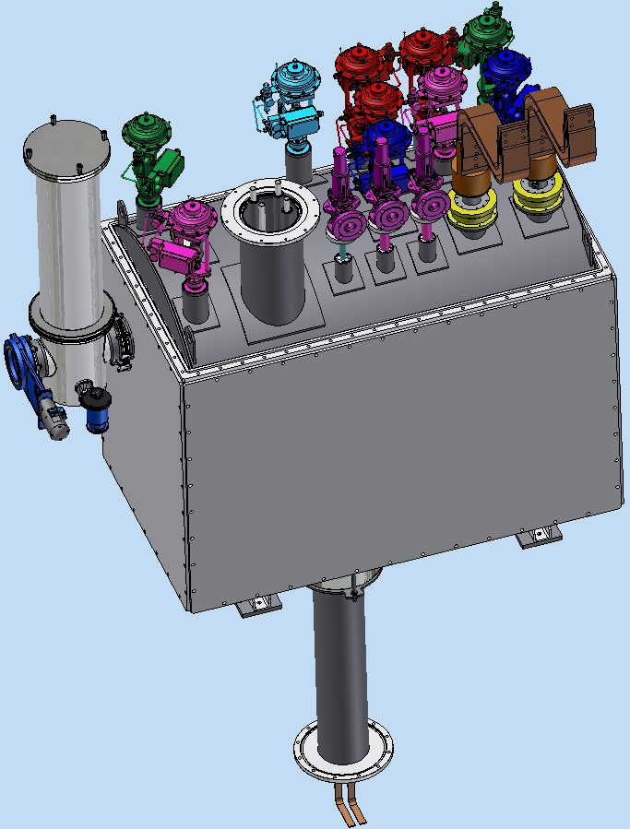
PANDA control Dewar
The PANDA control Dewar is designed to ensure helium delivery to the user in accordance with the flow scheme.
Vacuum barrier
Technologic volume
- transfer lines (TL) connecting refrigerator and the control Dewar through a vacuum barrier
- transfer line (Chimney) connecting the vacuum vessels of cryostat and control Dewar
Chimney
Control Dewar
Figure 1. General view of the control Dewar.

Slide 3
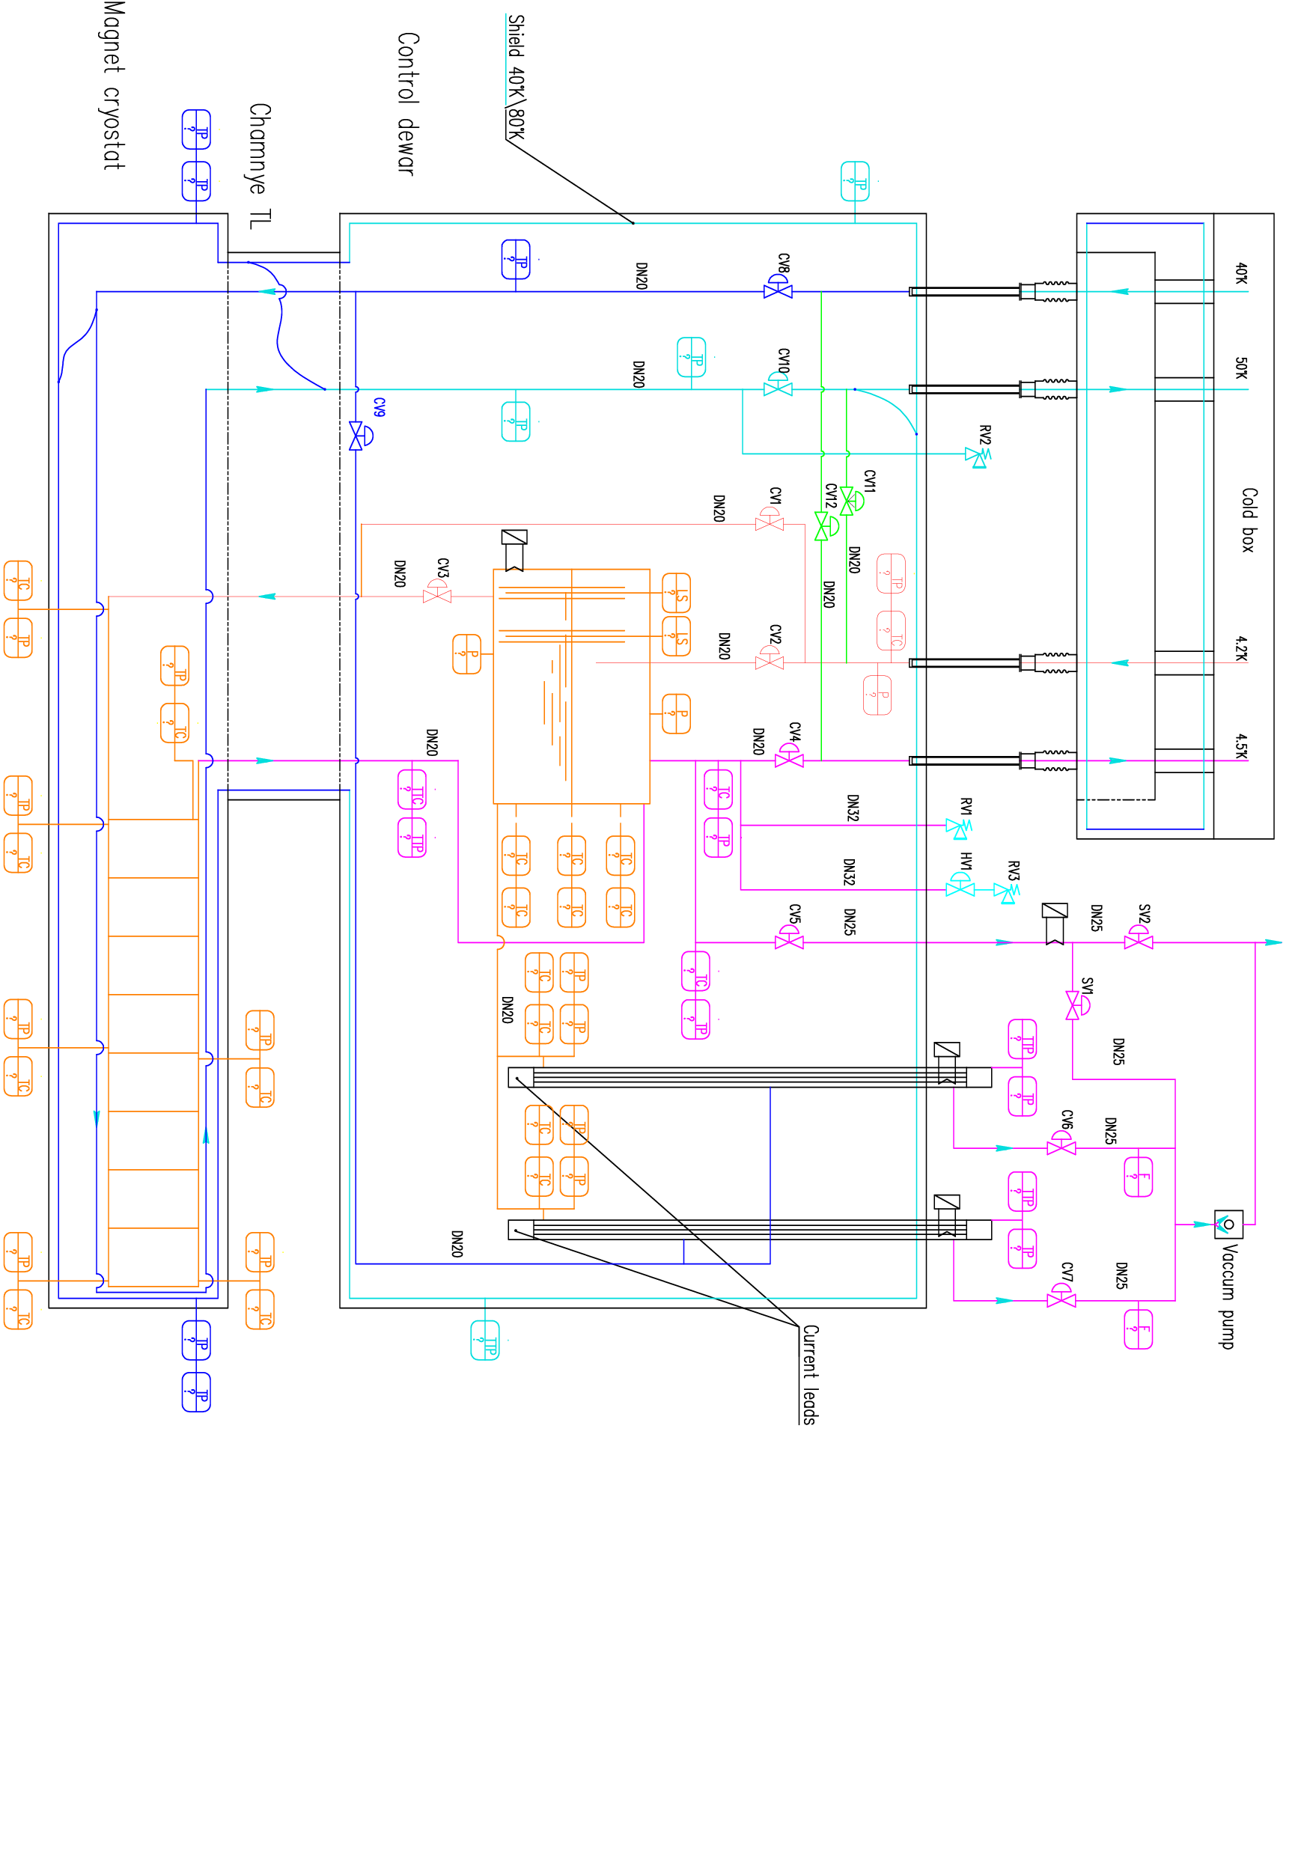
PANDA solenoid, Flowscheme
Figure 2. Process Flow Diagram of the PANDA cryogenic system.

Slide 4
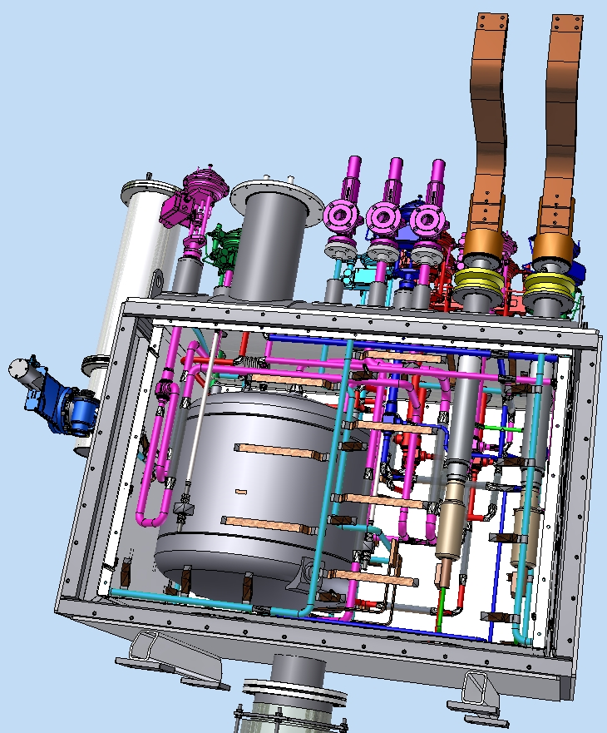
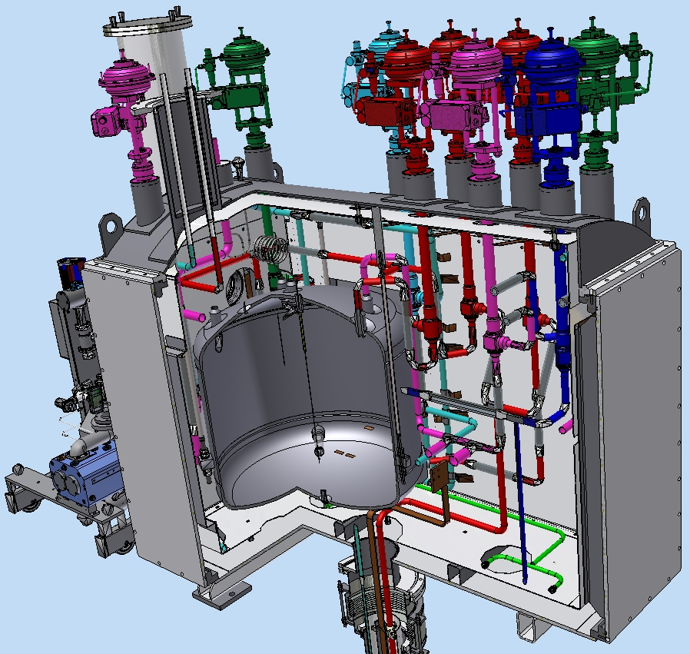
Control Dewar consists of:
a vessel for liquid helium (~480L);
valves, gauges;
current leads;
AL thermal shields cooled by gaseous helium;
vacuum shell.
1
2
3
5
4
Figure 3. The main components of the control Dewar.

Slide 5
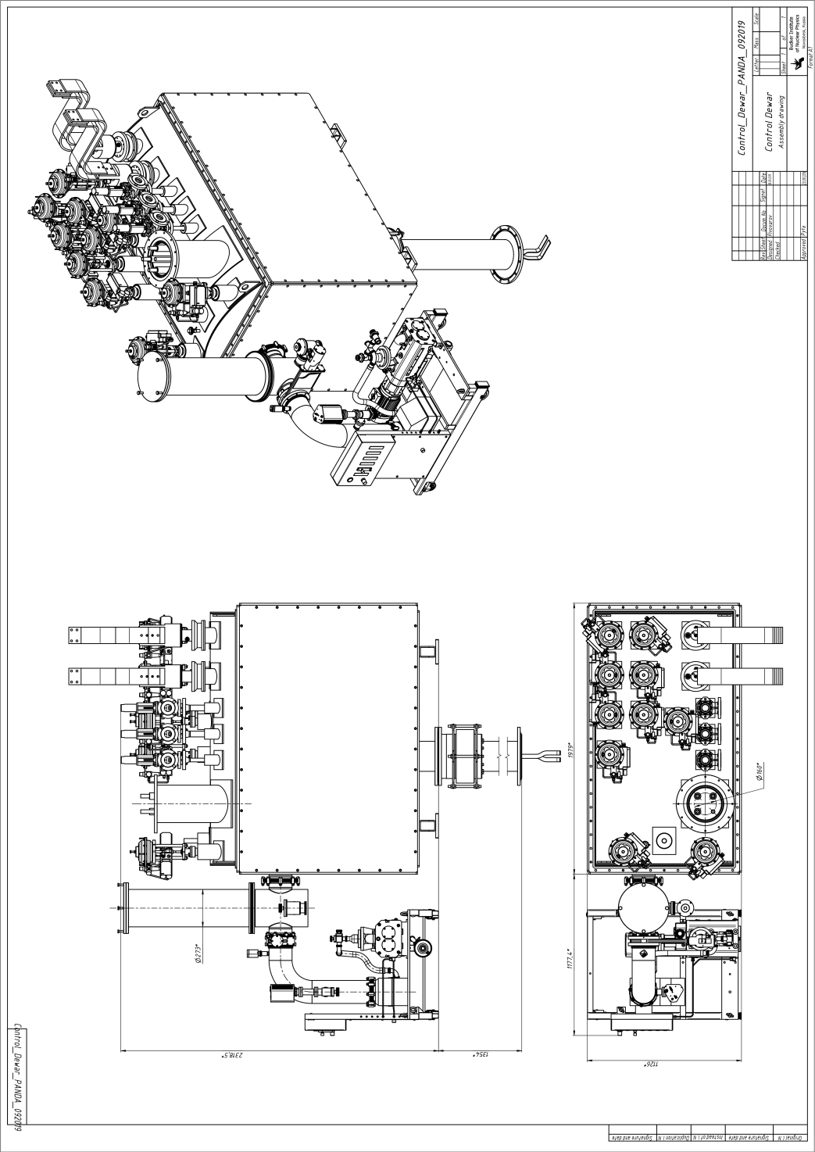
Flexible contact
2318.5mm
The surface of the common platform.
Figure 4. Dimensions and weight of the control Dewar.
Weight control Dewar about 3160 kg. with vacuum post 3350 kg.

Slide 6
PANDA solenoid 2019, Vacuum scheme control Dewar and cryostat
Safety valve Flange DN350
Vacuum stand
The PANDA Control Dewar and the Cryostat are a single vacuum volume
Full range gauge
V1
DN150
Technologic
volume
RGA
V4
Control Dewar
S
V5
DN63
TMP 680 l/sec
Primary pump
3-4 l/sec
V3
Pirani
Leak Detector
Cryostat
Figure 5.Vacuum scheme.

Slide 7
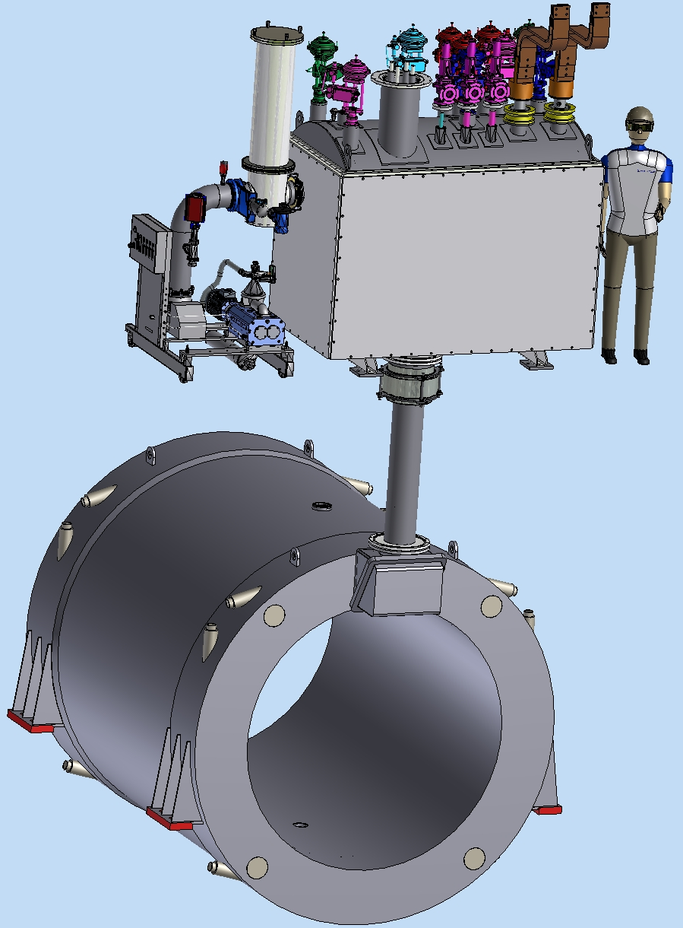
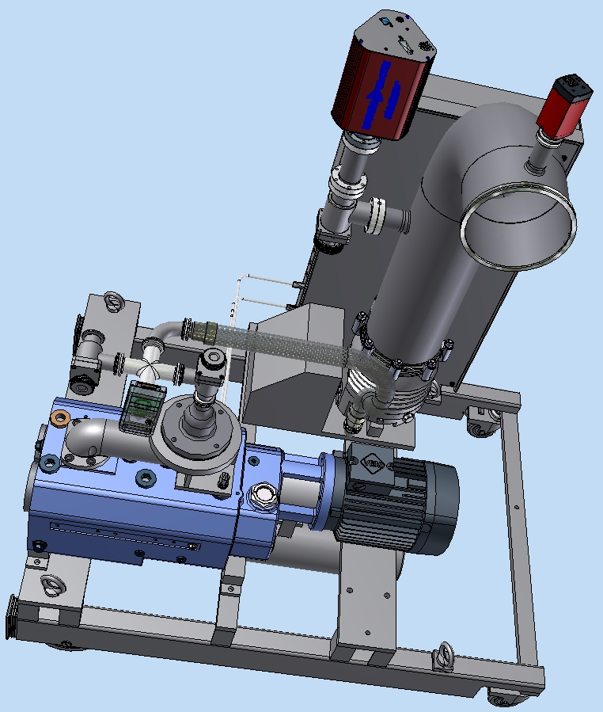
PANDA control Dewars and cryostats vacuum
Pump station
RGA
Flange Kf25 for leak detector
Full range guage
Pump (680 l/s)
Control Dewar
Chimney
Primary pump
Pirani
Cryostat
Figure 6. PANDA control Dewar and cryostats vacuum.

Slide 8
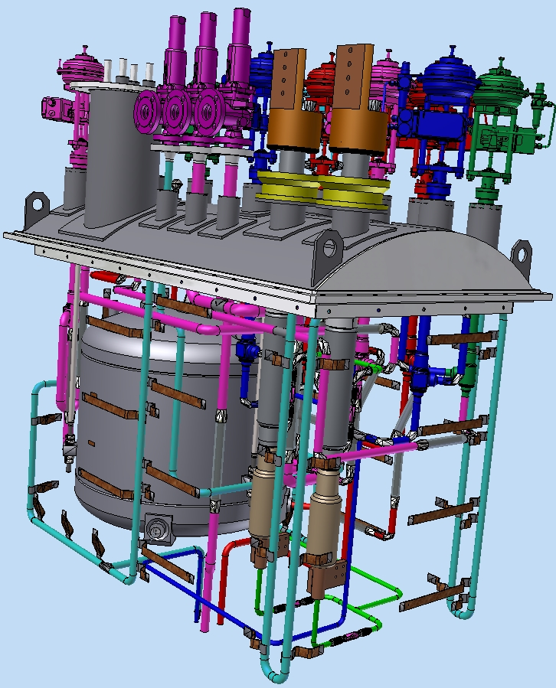
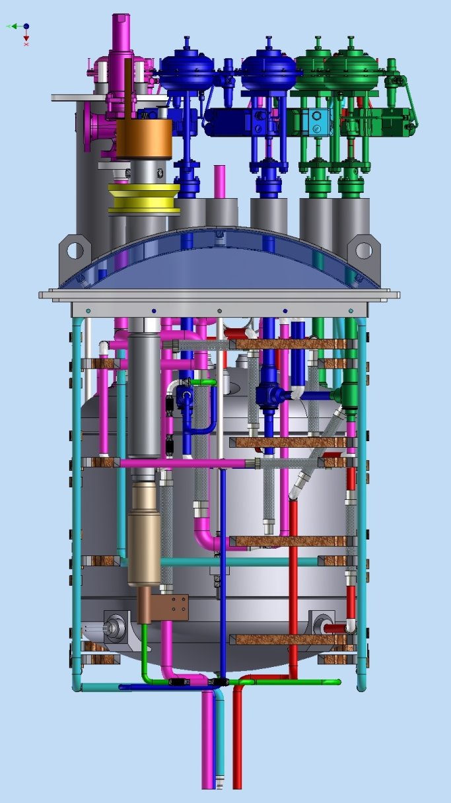
The stages of Assembly of the PANDA control Dewar:
1. Installation of pipelines on the lid of the control Dewar
Valves
Supporting top cover
Thermal shield
Pipelines
He vessel
Current
leads
Figure 7. The stage 1.

Slide 9
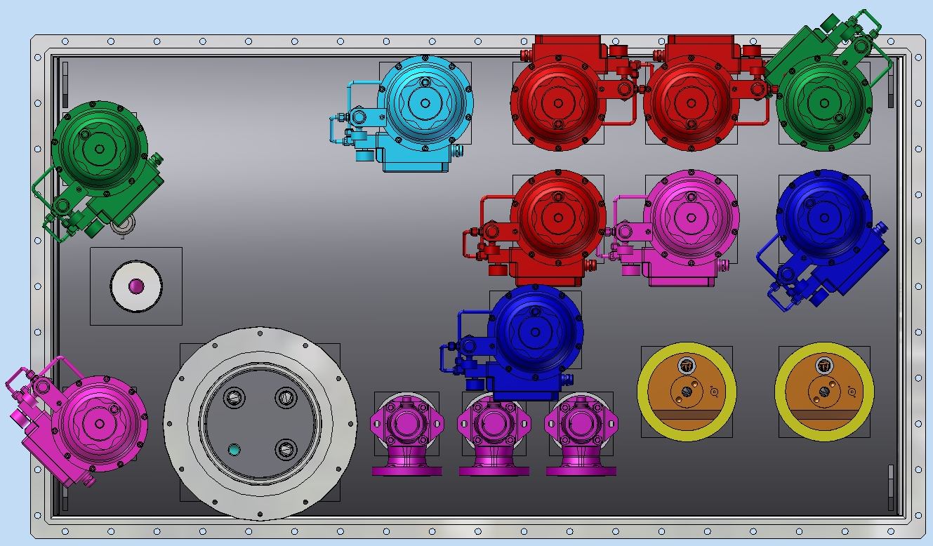
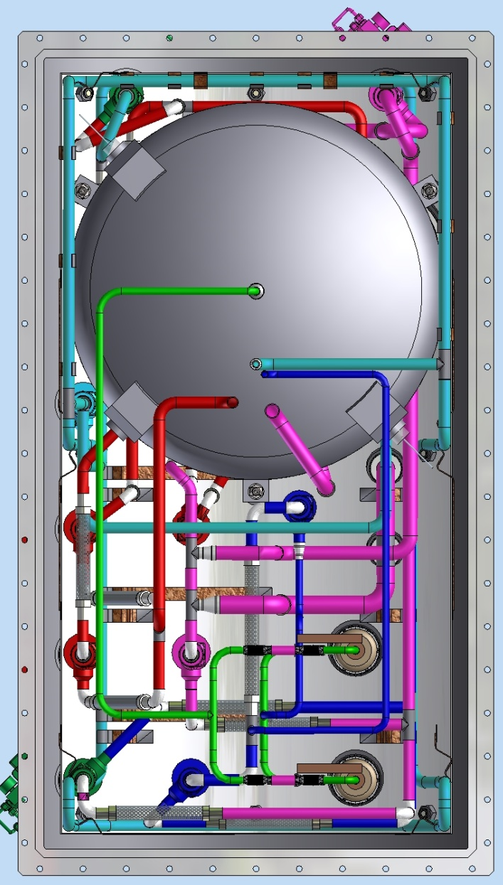
The stages of Assembly of the PANDA control Dewar:
1. Installation of pipelines on the lid of the control Dewar
1100
50K
4,2K
1950
5K
The input of the Vacuum barrier
40K
Figure 8. The stage 1.

Slide 10
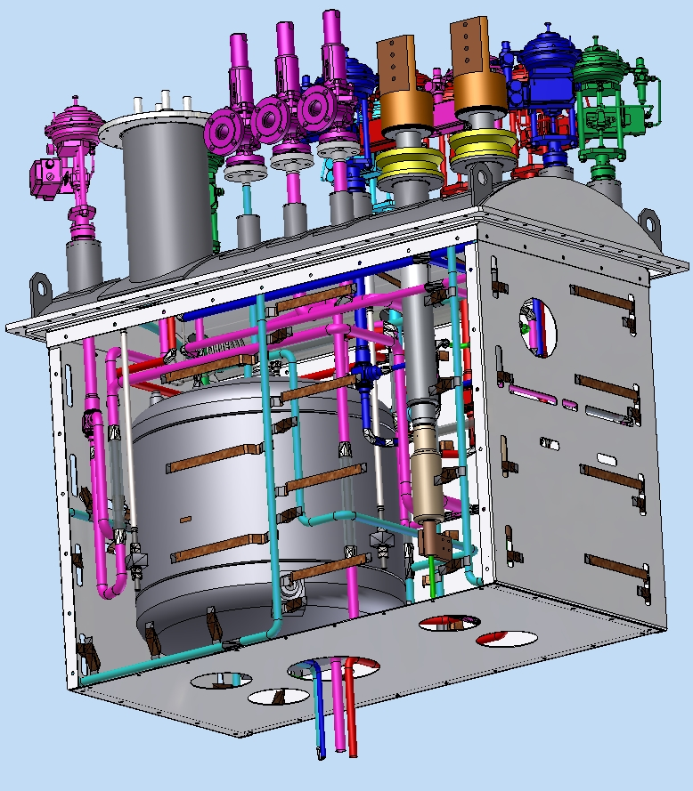
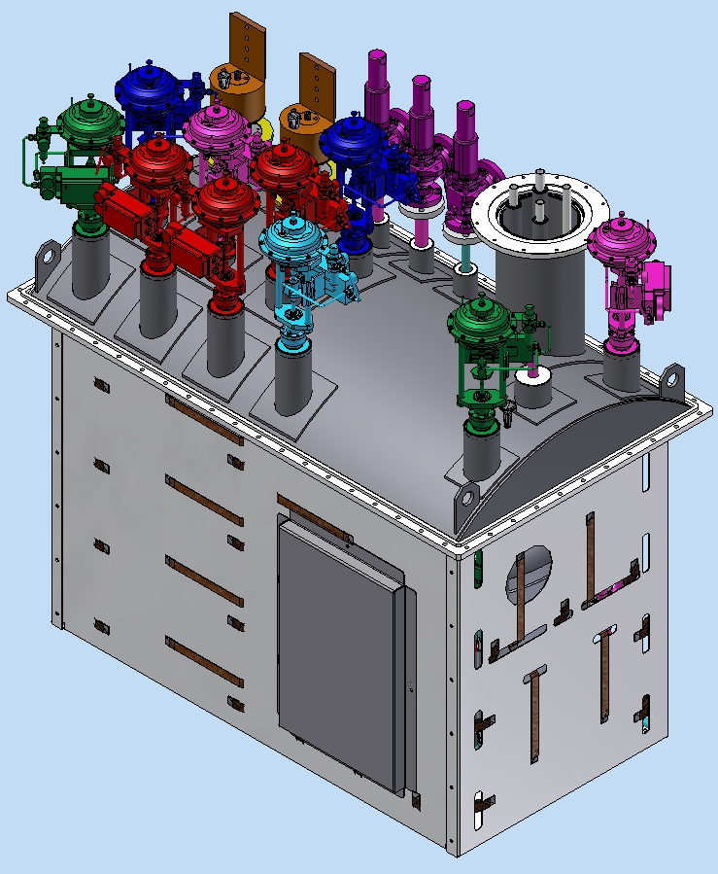
2. Installation of the thermal shields at the Pipelines assembly, and attached the thermal bridges
Thermal bridge
AL Thermal
shield
Pipeline 50K
Figure 9. The stage 2.
m=1490 kg.

Slide 11
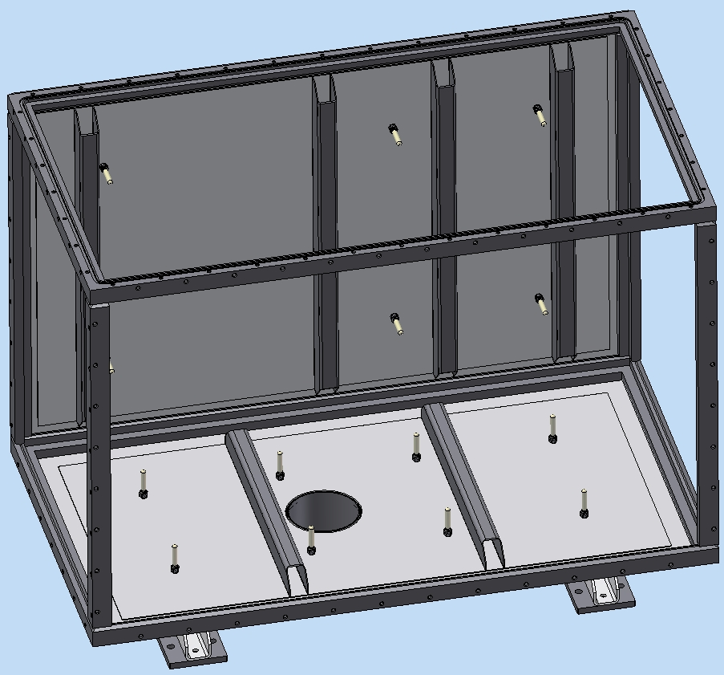
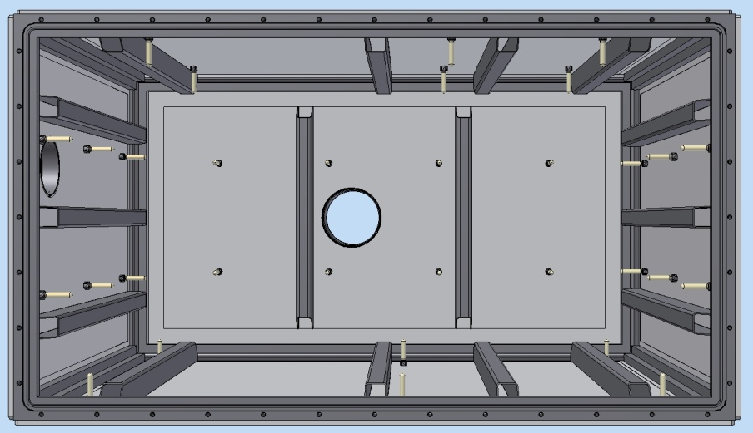
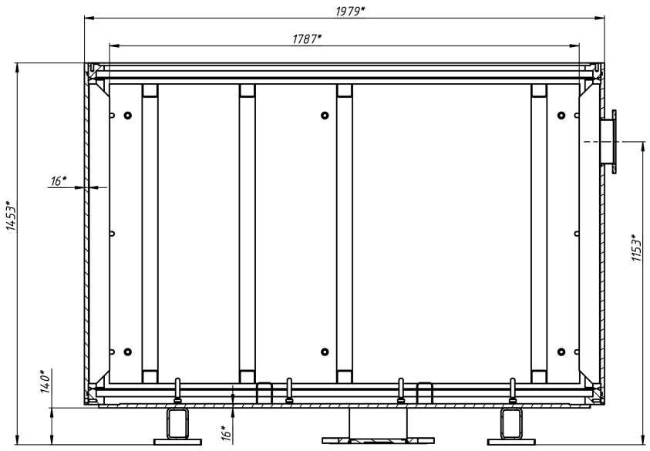
Design of the Vacuum shell
Vacuum shell Assembly, top view.
The Frame
Removable wall
The material of the frame and walls of the Vacuum shell is low alloy steel. m=1670 kg.
G10 supports
Figure 10. Vacuum shell.

Slide 12
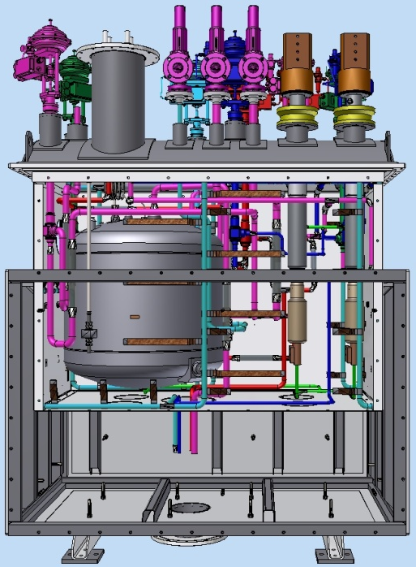
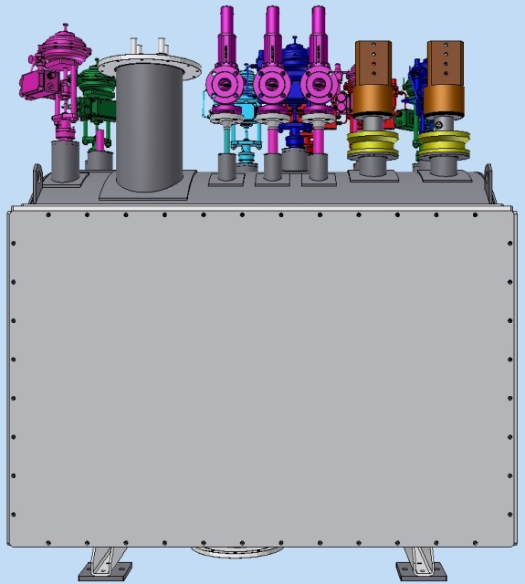
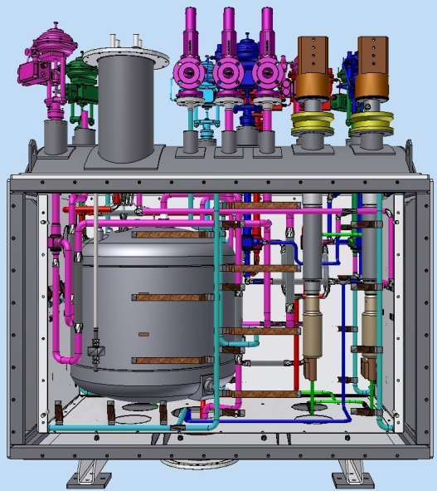
The stages of Assembly of the PANDA control Dewar:
3. Installation pipelines on the lid and thermal shields to the vacuum shell
Figure 11. The stage 3.

Slide 13
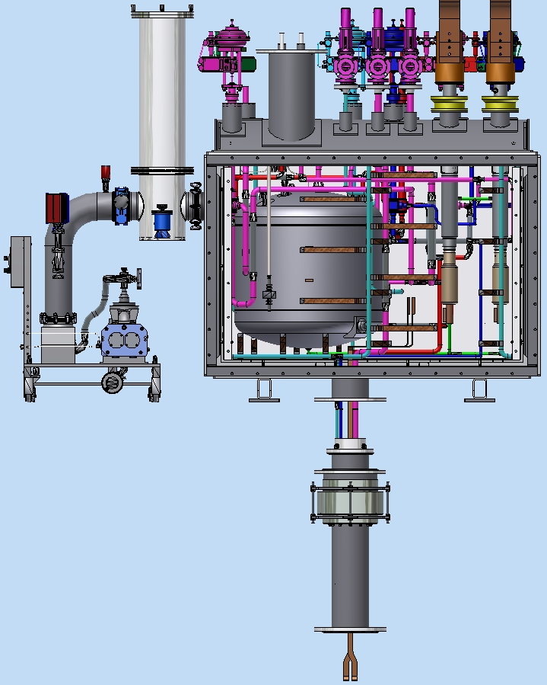
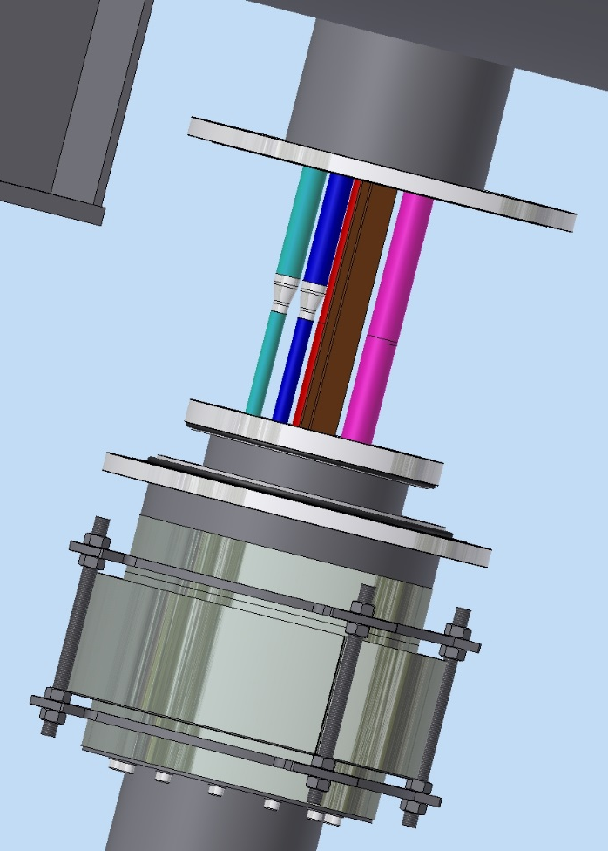
The interface of the PANDA control Dewar:
Control Dewar
Shift the bellows unit
Combine the pipies in
accordance with the
flow scheme
-Carry out the connection of
the superconductor
-Carry out pipes connection
by welding
Install super insulation
Install the bellows unit in place
Install the front wall of the
thermal shield, fix the thermal bridges
Install the front wall of the Vacuum shell
Chimney

Slide 14
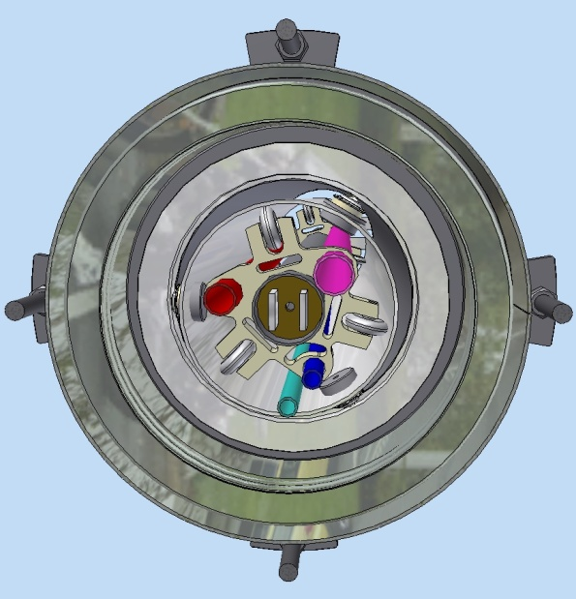
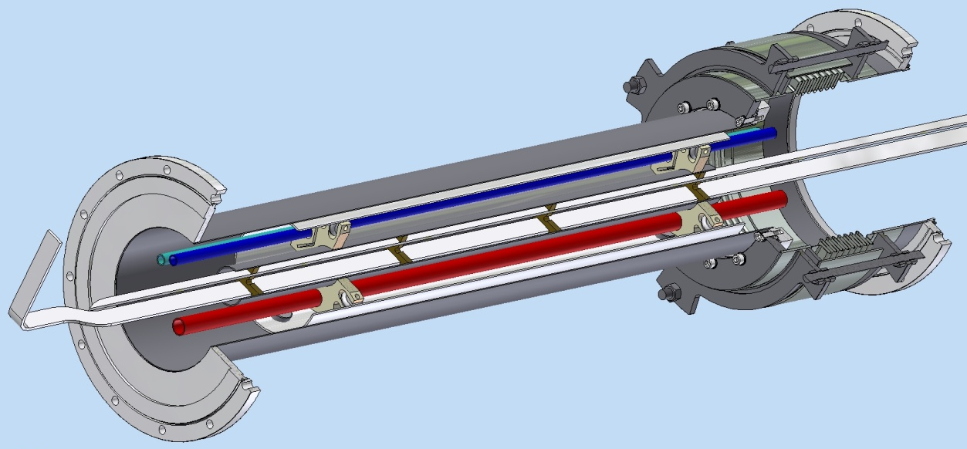
The Chimney design:
Chimney
Bellows unit
Thermal shield
Spacer
Pipelines
Flange ISO320RBR
Superconductor
Flange ISO320RBR
m=90 kg.

Slide 15
Thank you for your attention

