Slide 1

Yoke assembling procedure
18 September 2019

Slide 2
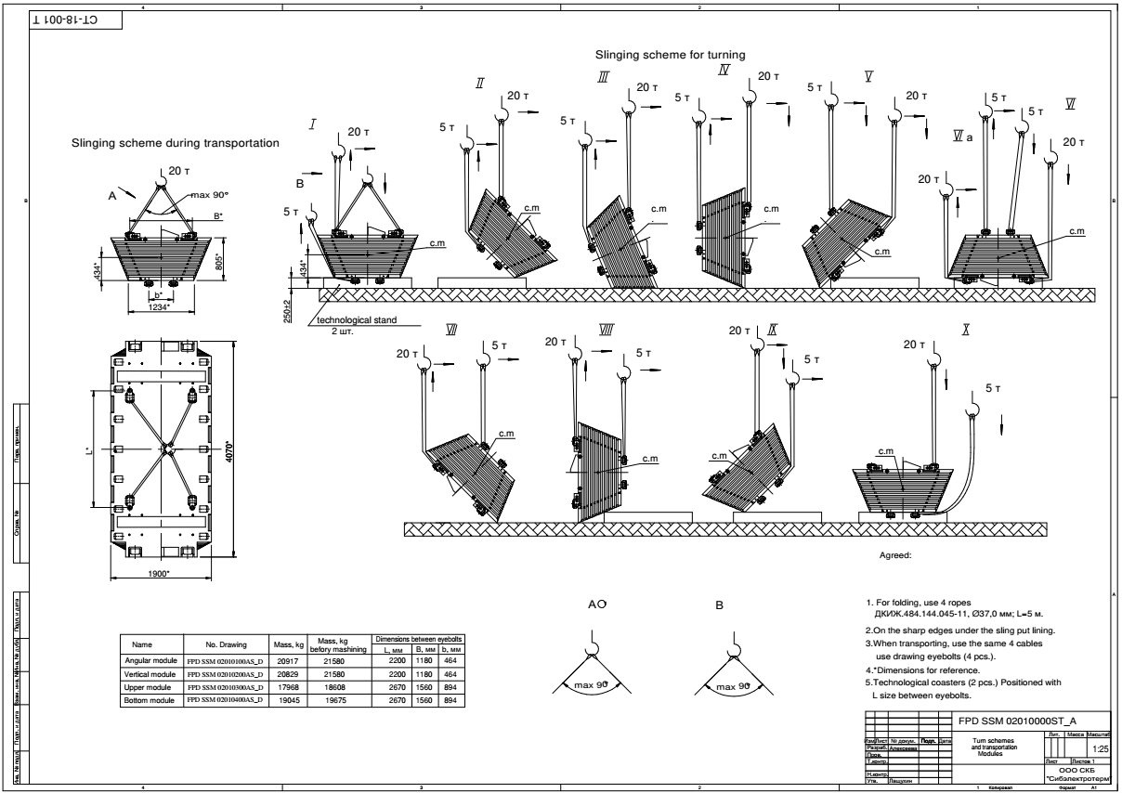
Yoke assembling procedure
Slinging scheme for turning.

Slide 3
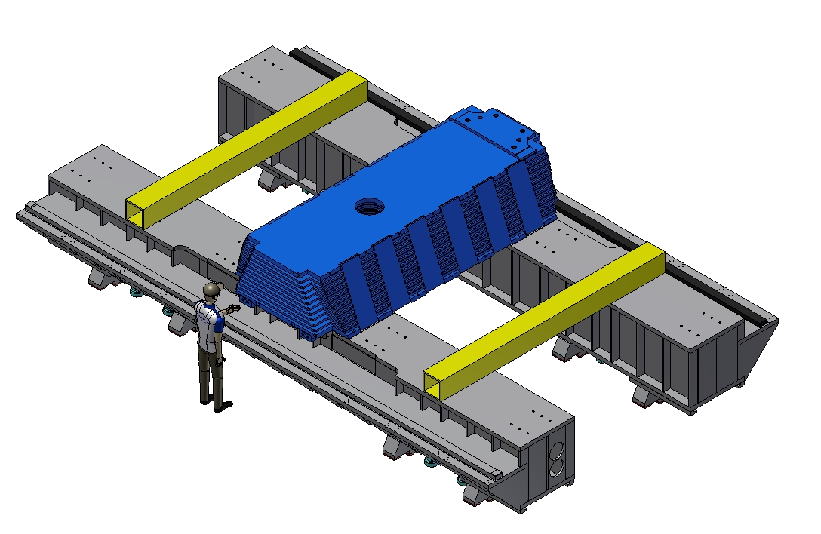
Yoke assembling procedure
Weight octant – 20,4 t
Installation and alignment of the first W1 octant.

Slide 4
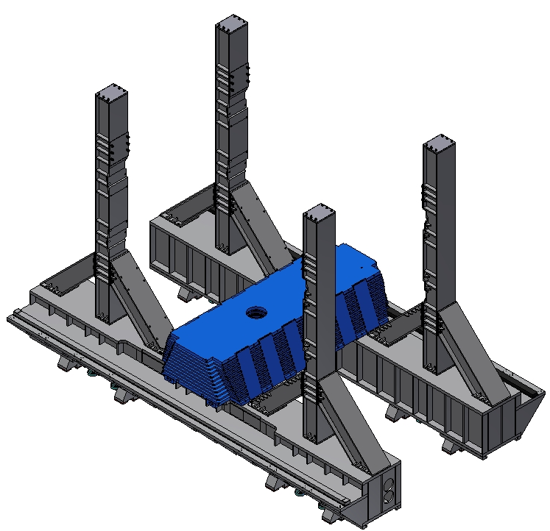
Yoke assembling procedure
6290
Installation of the beams of the frame.

Slide 5
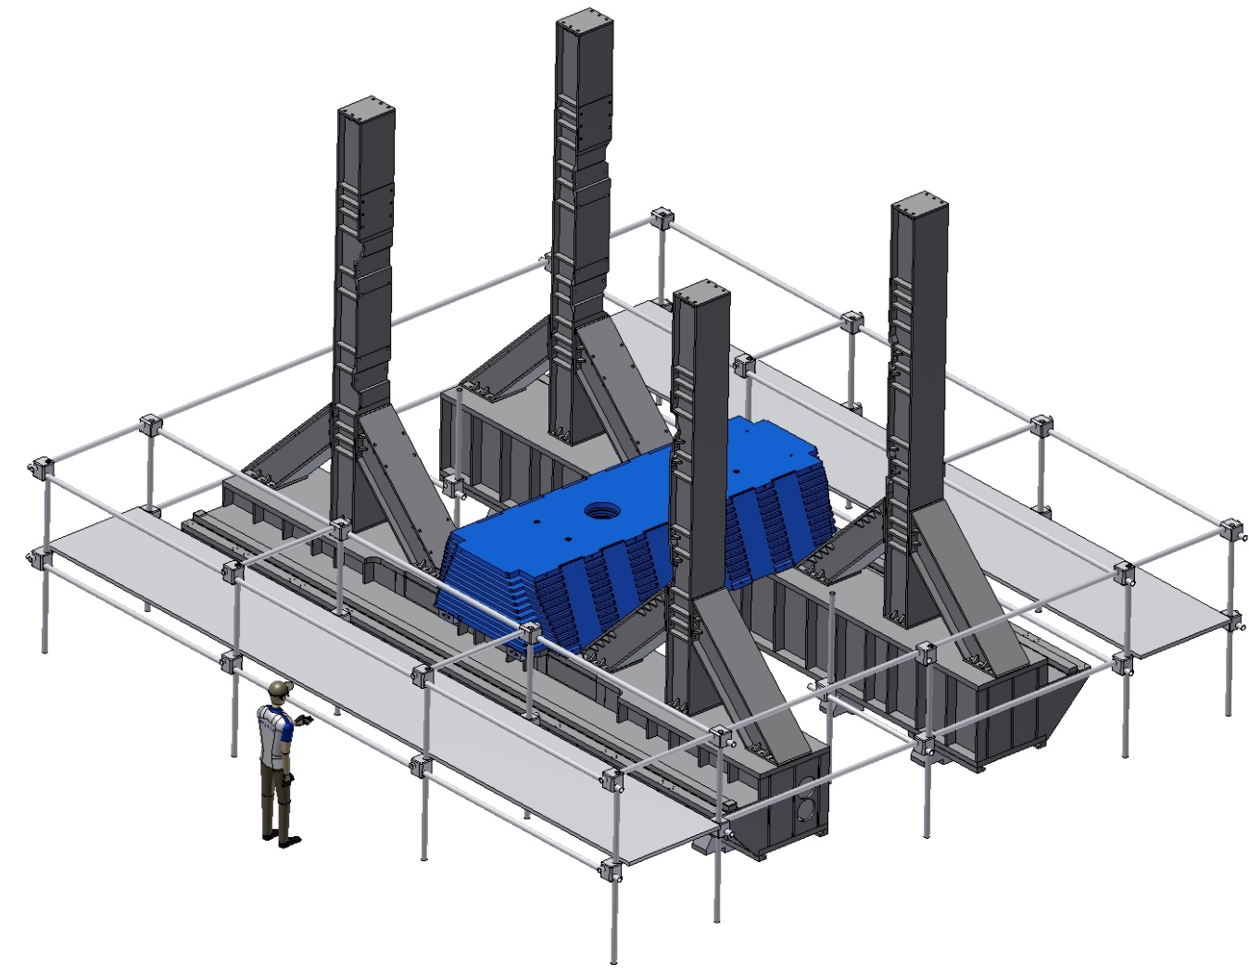
Yoke assembling procedure
Mounting of a scaffold.

Slide 6
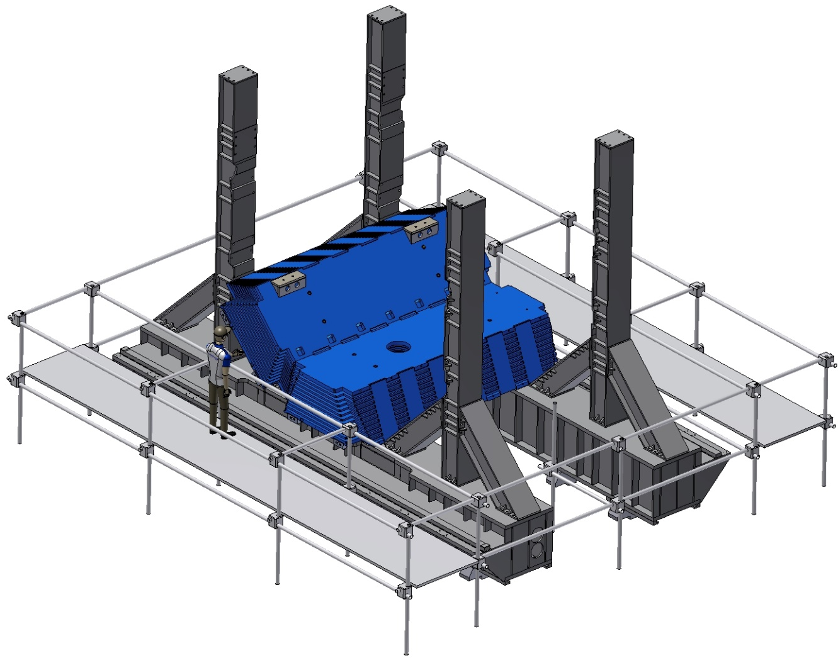
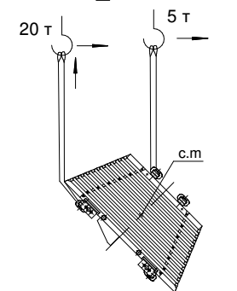
Yoke assembling procedure
Weight octant – 20,8 t
Installation of the W2 angle octant.

Slide 7
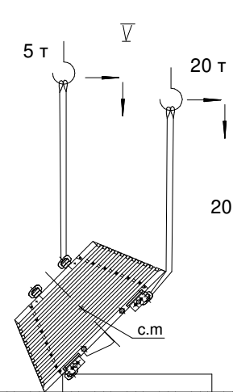
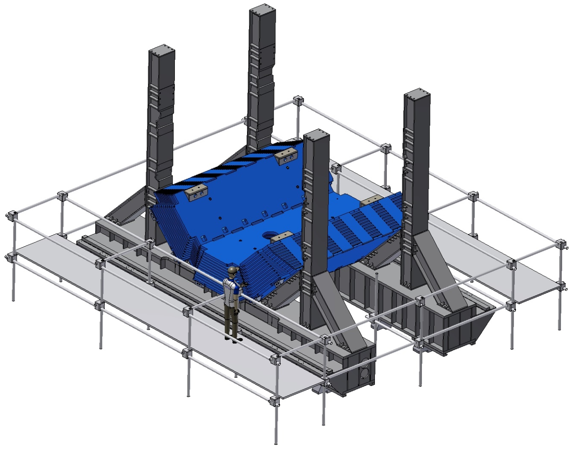
Yoke assembling procedure
Weight octant – 20,8 t
Installation of the W8 angle octant.

Slide 8
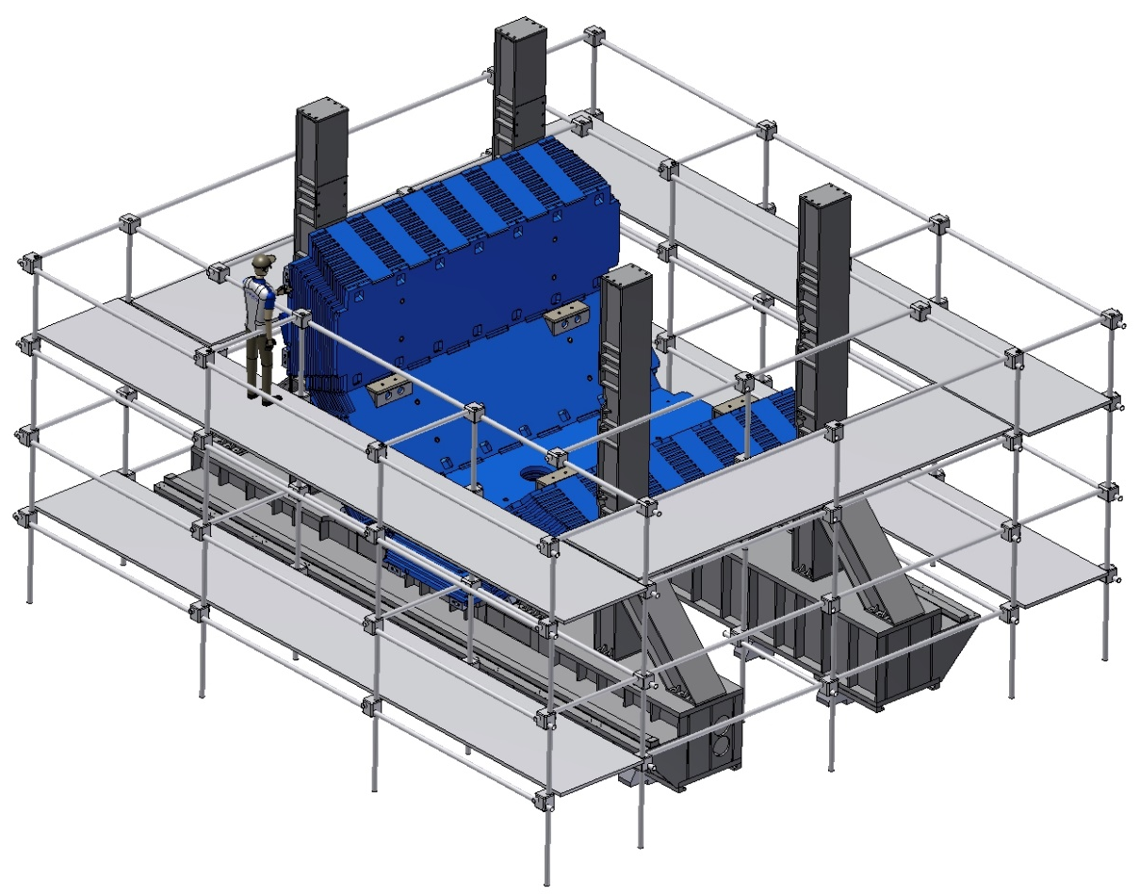
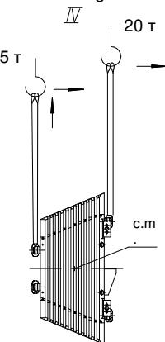
Yoke assembling procedure
Weight octant – 20,8 t
Mounting of a scaffold and installation of the W3 vertical octant.

Slide 9
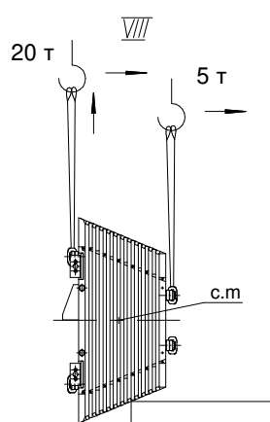
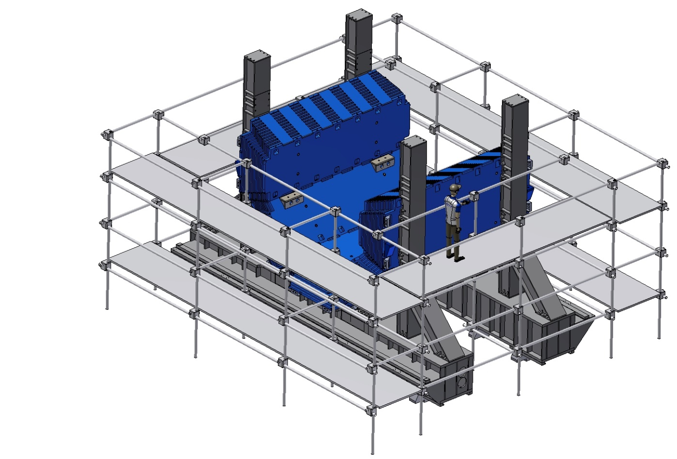
Yoke assembling procedure
Weight octant – 20,8 t
Installation of the W7 vertical octant.

Slide 10
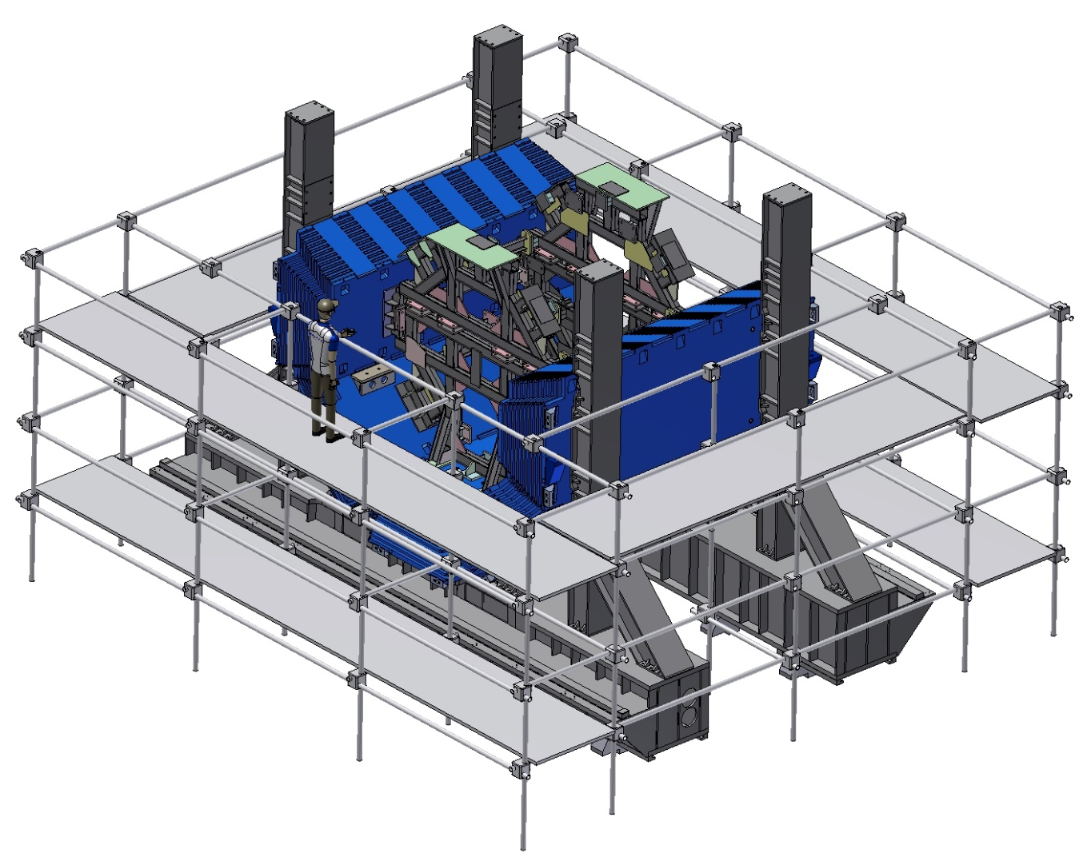
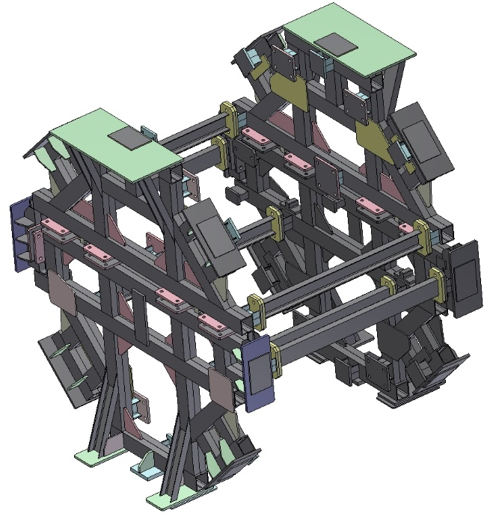
Yoke assembling procedure
Inner Support
Weight ~ 3 t
Installation of inner support.

Slide 11
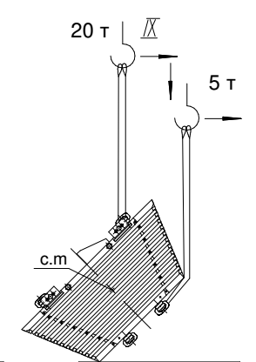
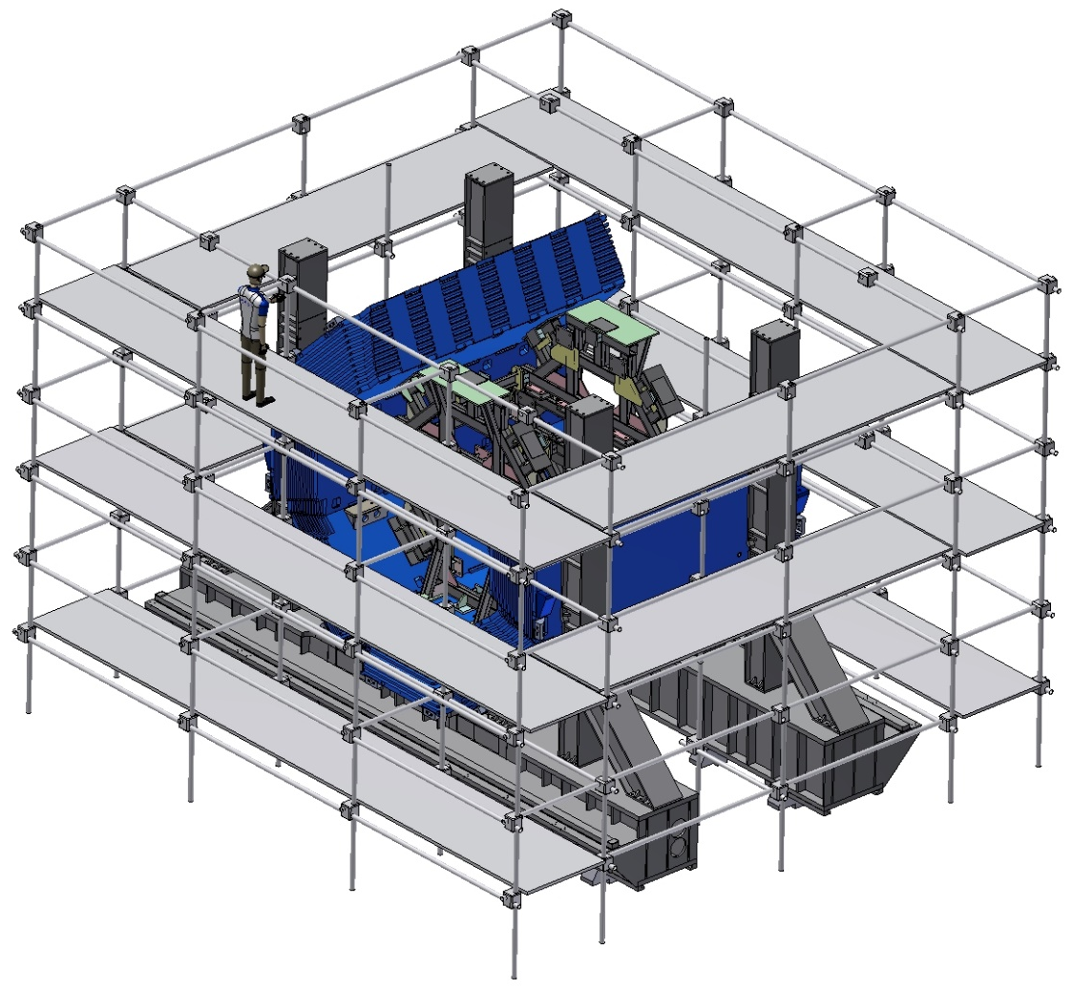
Yoke assembling procedure
Weight octant – 20,8 t
Mounting of a scaffold and installation of the W4 angle octant.

Slide 12
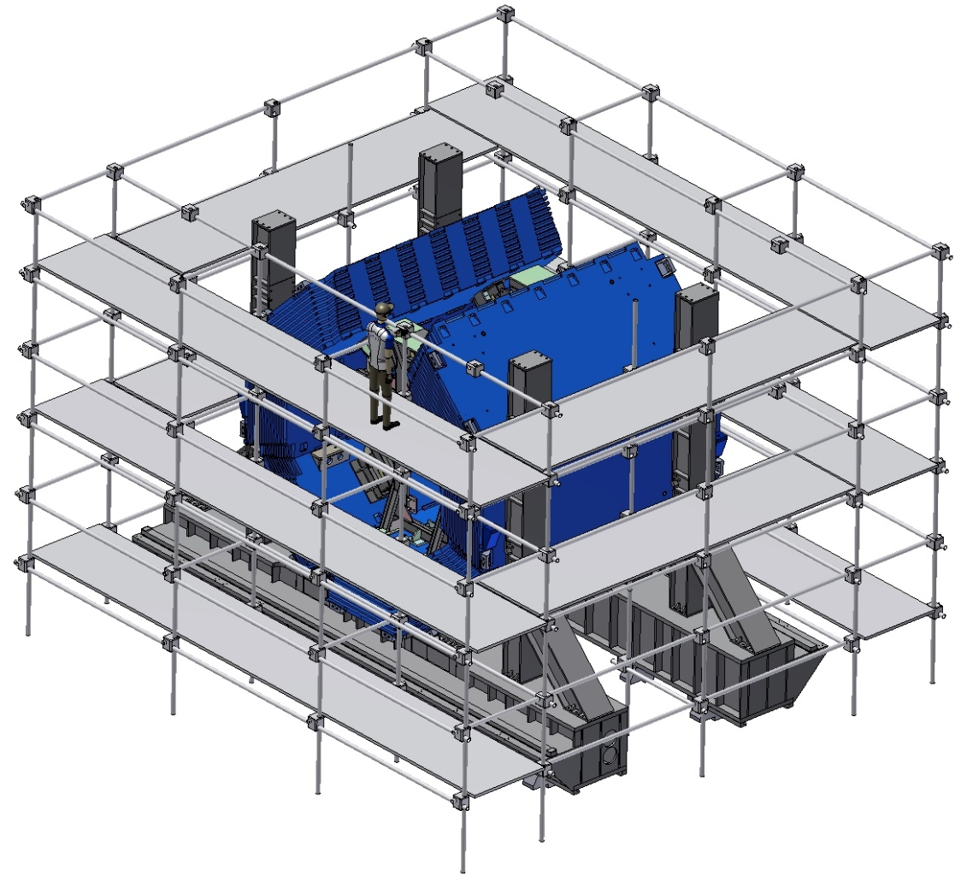
Yoke assembling procedure
Weight octant – 20,8 t
Installation of the W6 angle octant.

Slide 13
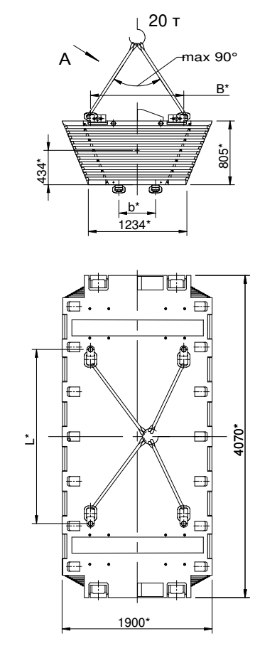
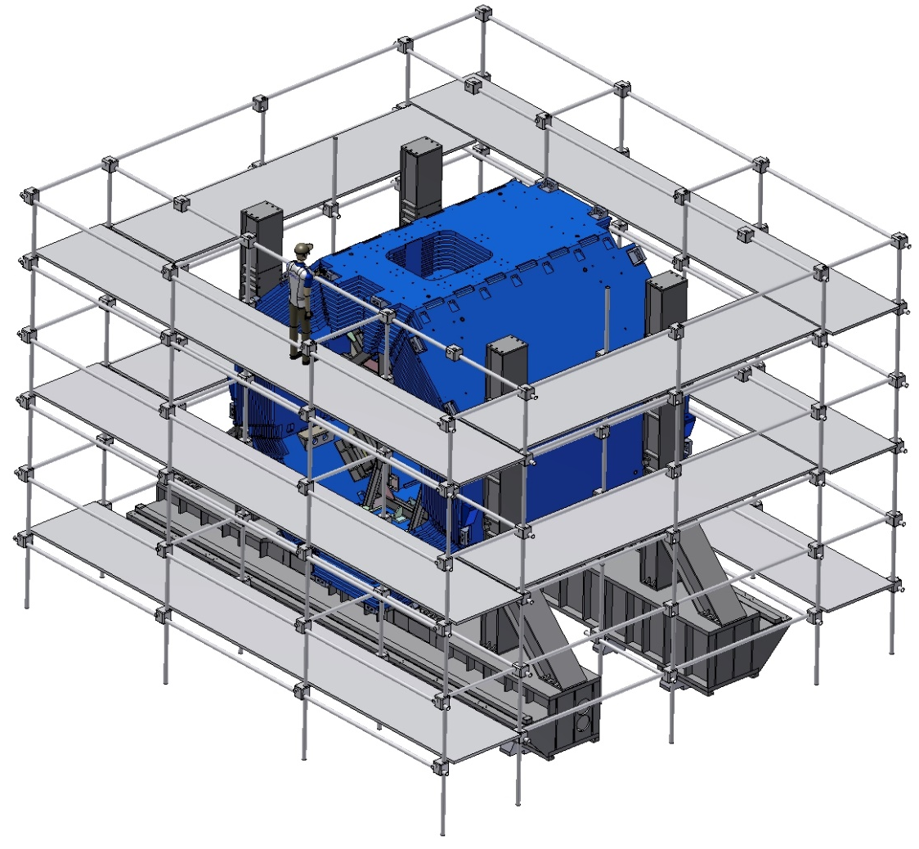
Yoke assembling procedure
Weight octant – 18,9 t
Installation of the W5 upper octant.

Slide 14

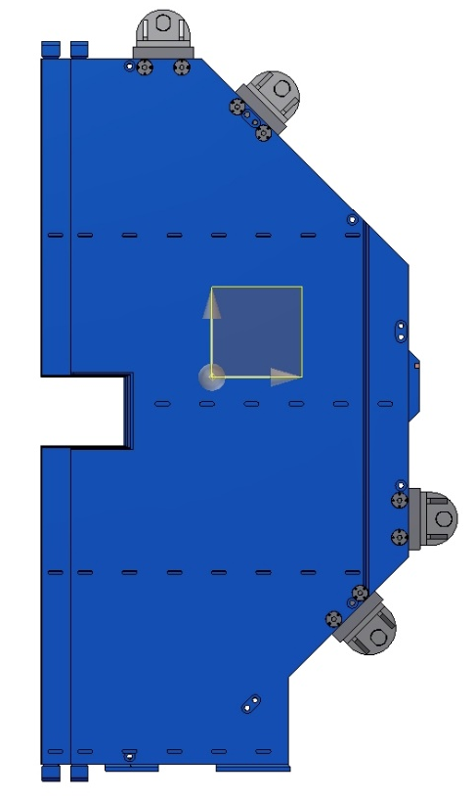
Yoke assembling procedure
Weight door – 23 t
Installation of the left Upstream door.

Slide 15
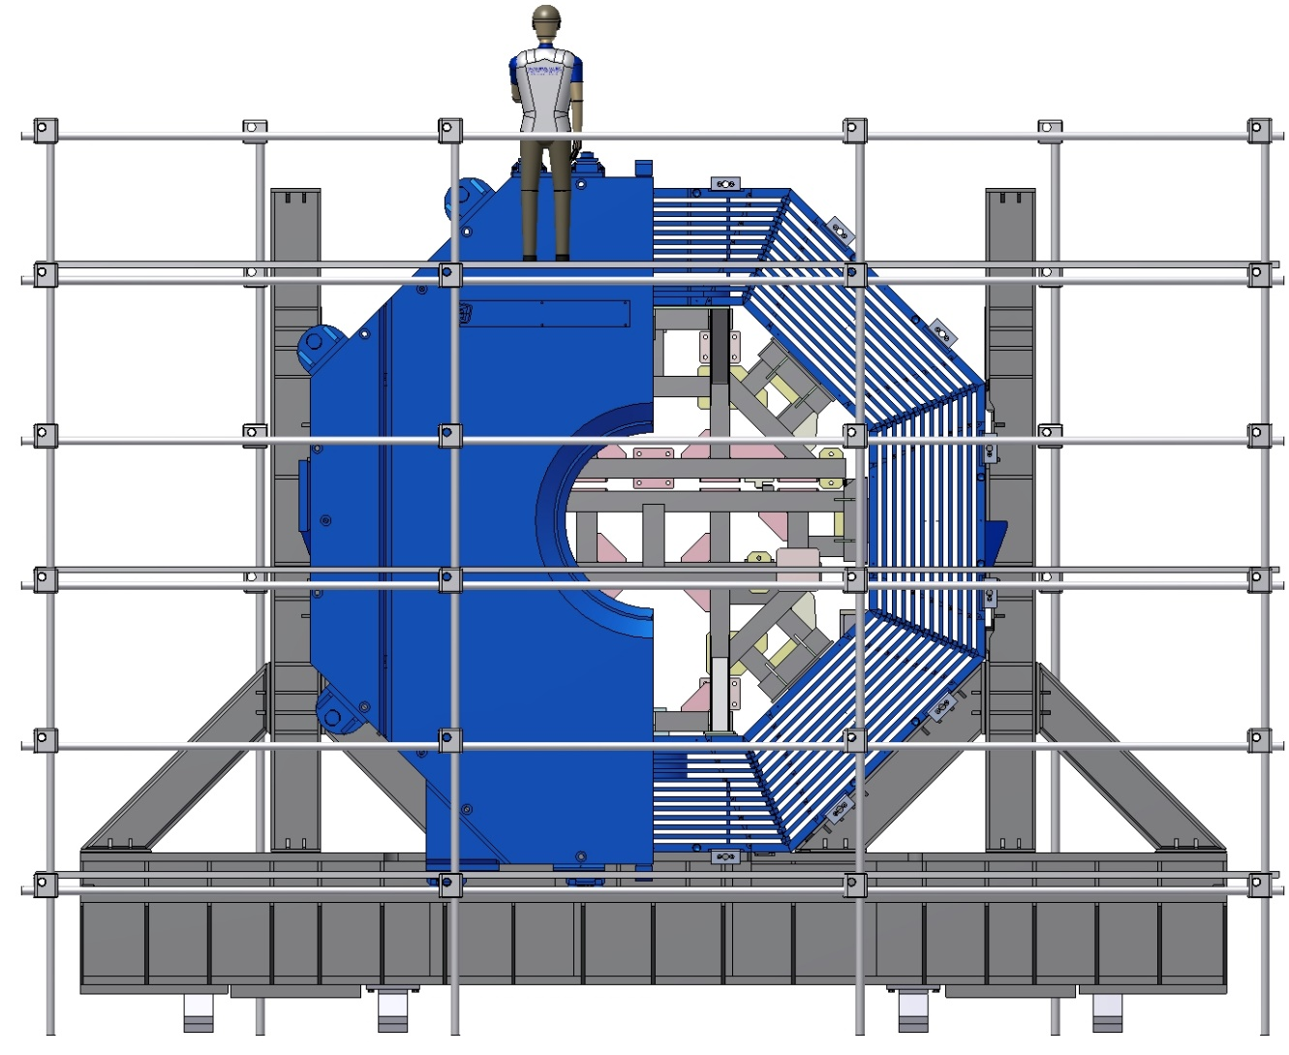
Yoke assembling procedure
Front view.

Slide 16
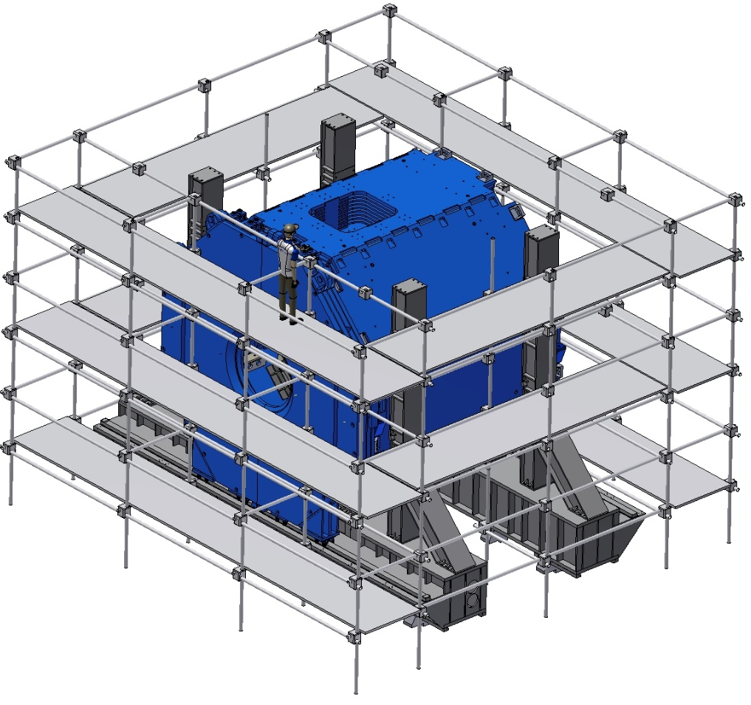
Yoke assembling procedure
Weight door – 23 t
Installation of the right Upstream door.

Slide 17
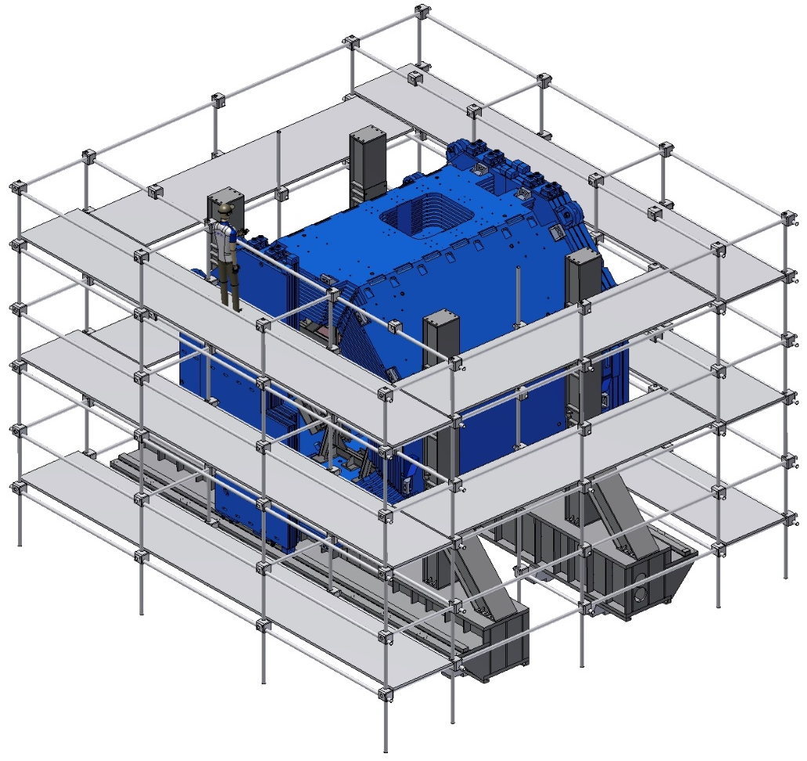
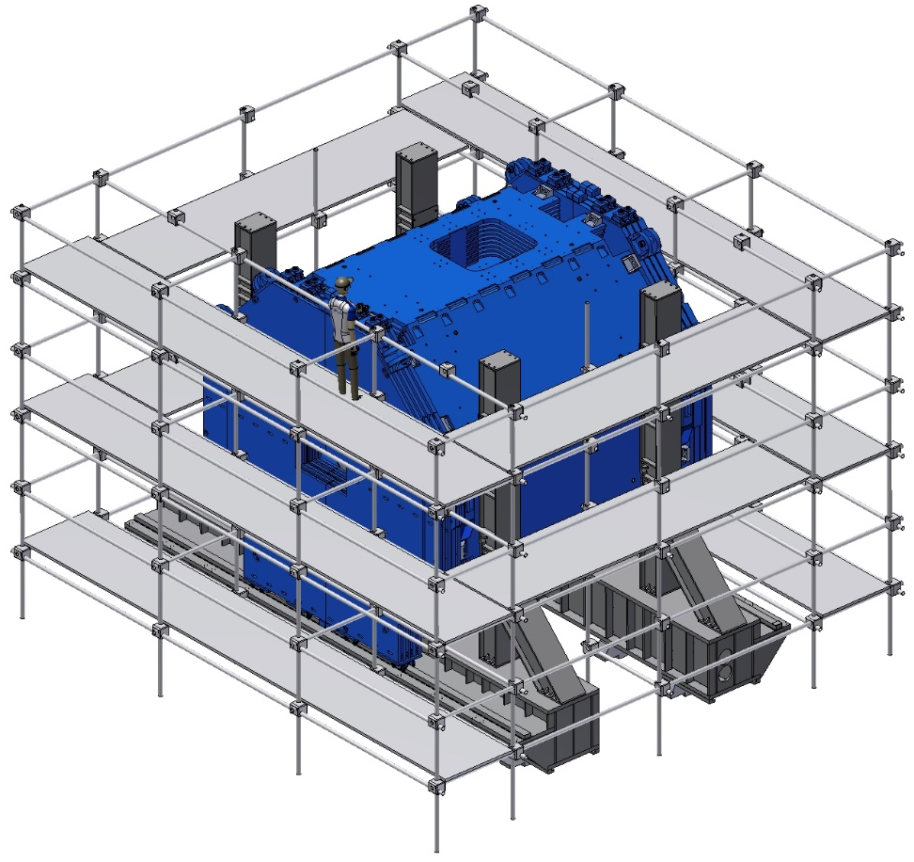
Yoke assembling procedure
Weight door – 21 t
Installation of the Downstream doors.

Slide 18
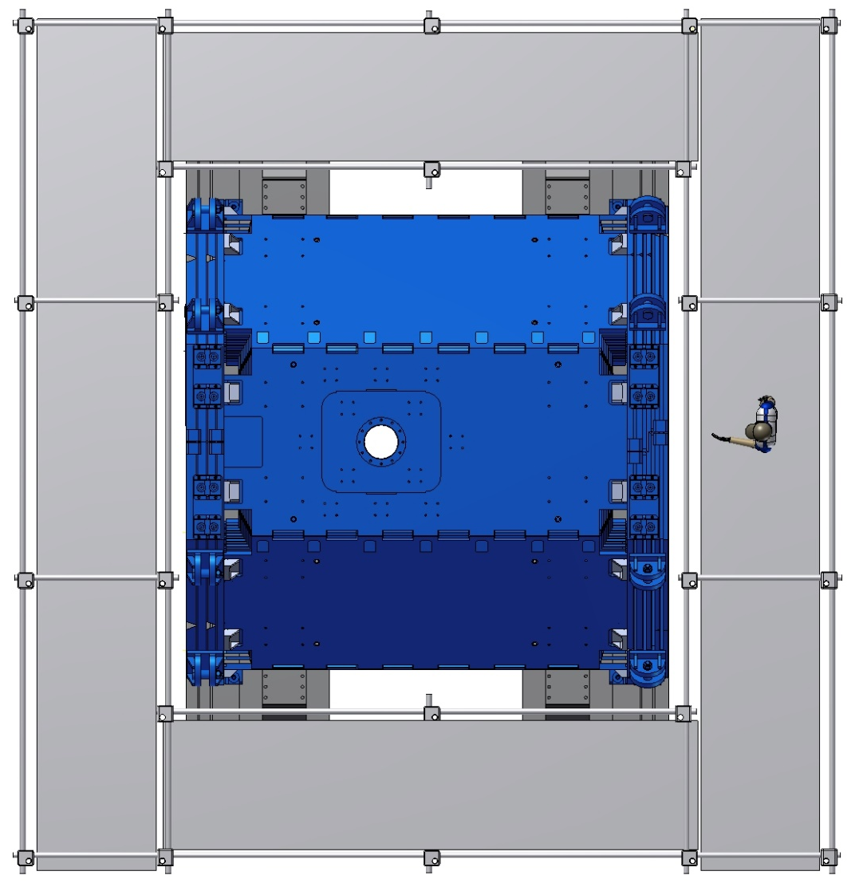
Yoke assembling procedure
Top view.

Slide 19
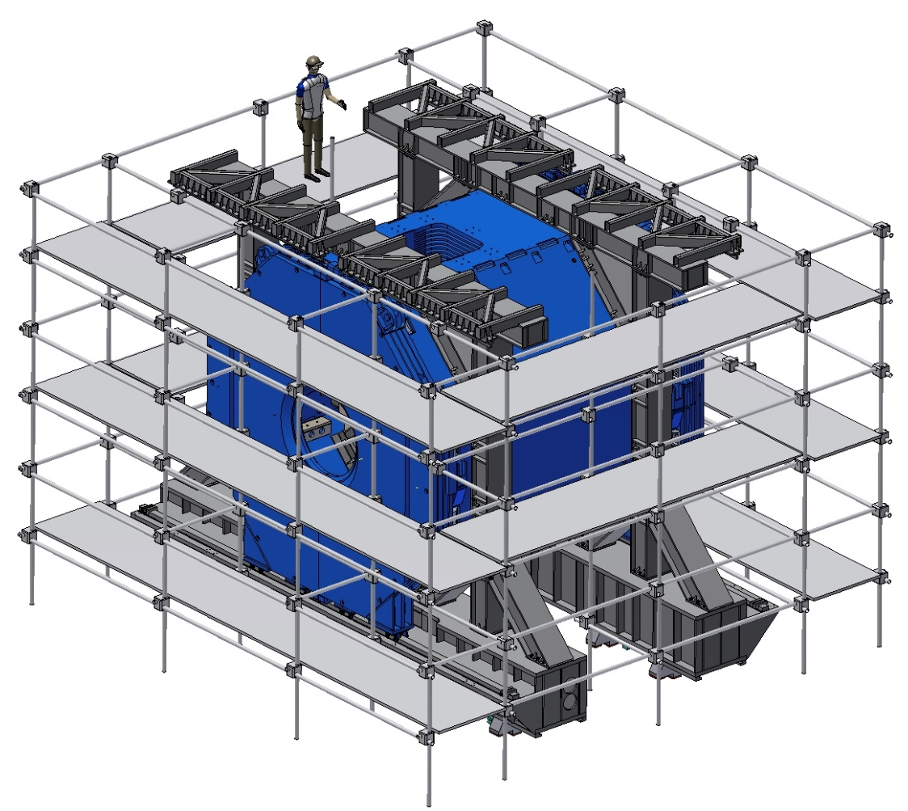
Yoke assembling procedure
Mounting of the Beams of Frame.

Slide 20
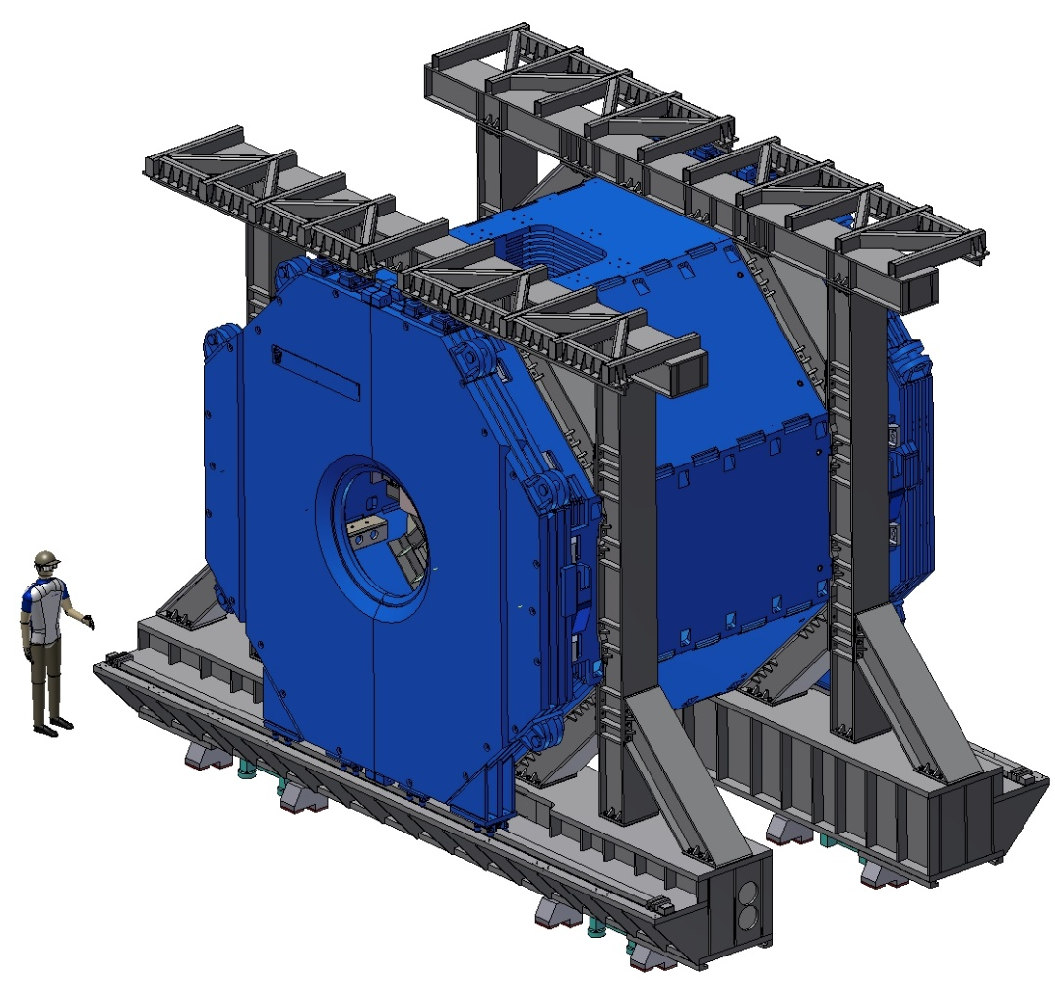
Yoke assembling procedure
Dismount of the scaffold.

Slide 21
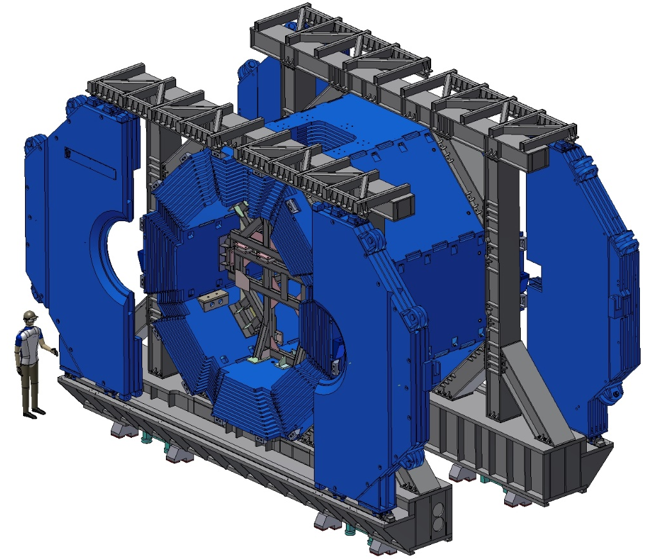
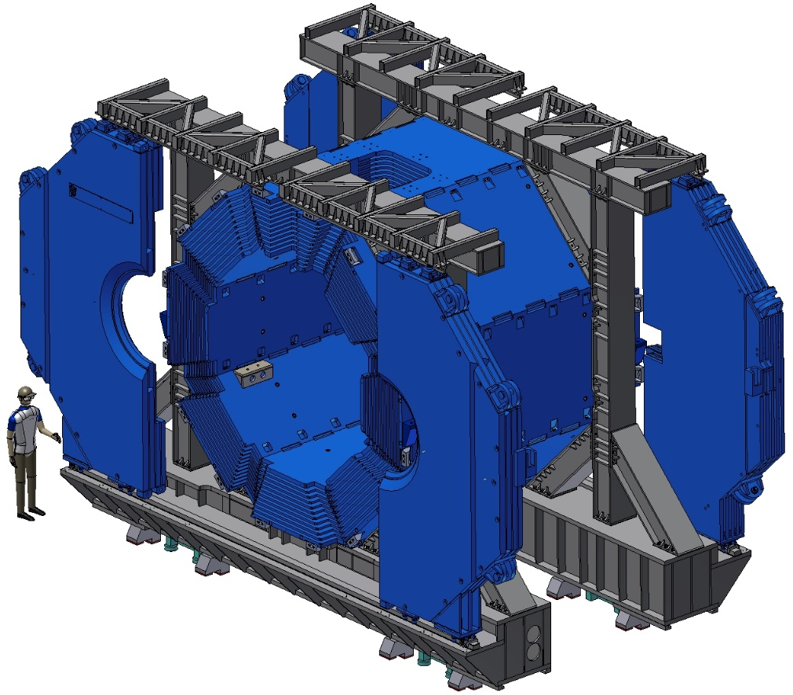
Yoke assembling procedure
Open the wings of the doors and dismount of the inner supports.

Slide 22
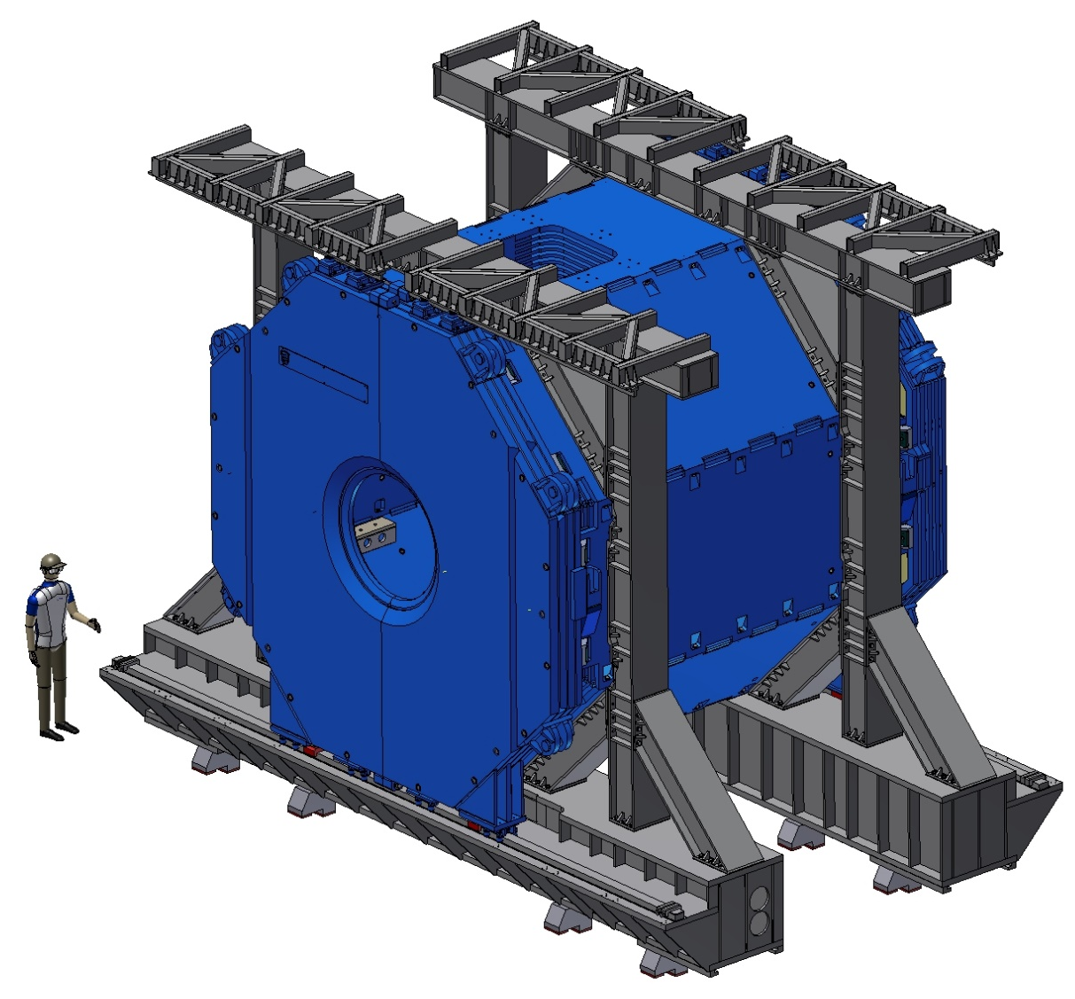
Yoke assembling procedure
The Yoke in assembly.

Slide 23
Thank you for your attention!

