Slide 1

Installation procedure of the Magnet into the Iron Yoke

Slide 2
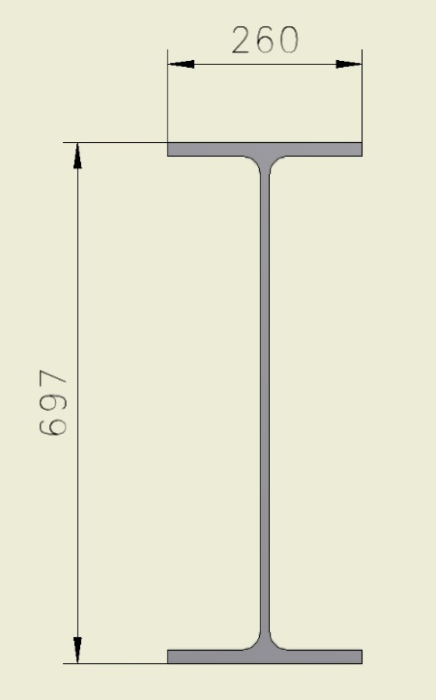
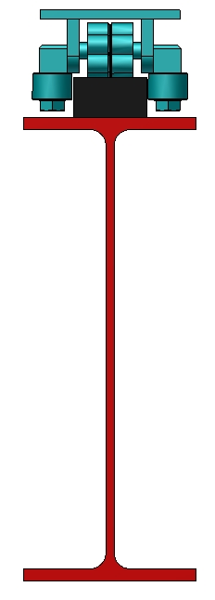
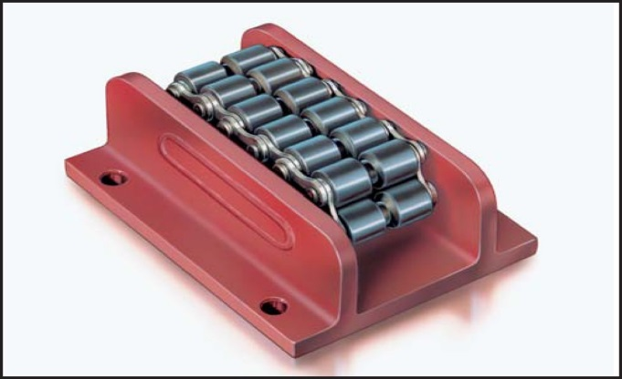
Magnet assembly procedure
For installation of the Magnet into the Yoke it is possible to use an I-beam steel 70B2 (697 x 260 mm) GOST 26020-83. The length of the beam is L = 9 m.
To roll inside, we can use rollers that are used to open doors (Roller skate Boerkey model AM-H)
Rail

Slide 3
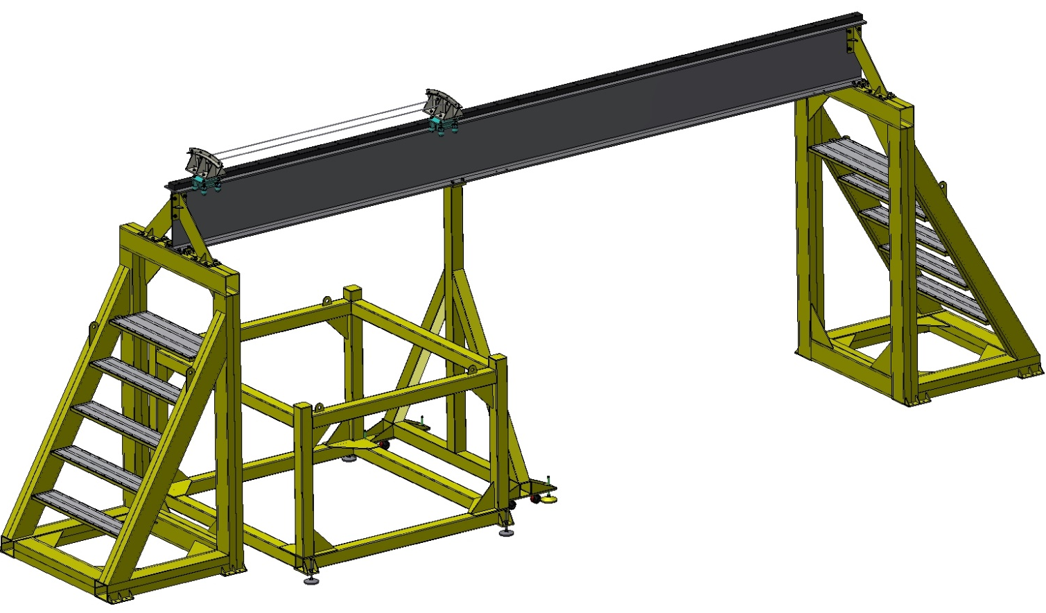
Installation procedure of the Magnet into the Iron Yoke
Beam (1.6t)
Rollers system
Central removable Support
Fixed Support
Support for Magnet
Removable Support
Tooling for installation of the Magnet into the Iron Yoke.

Slide 4
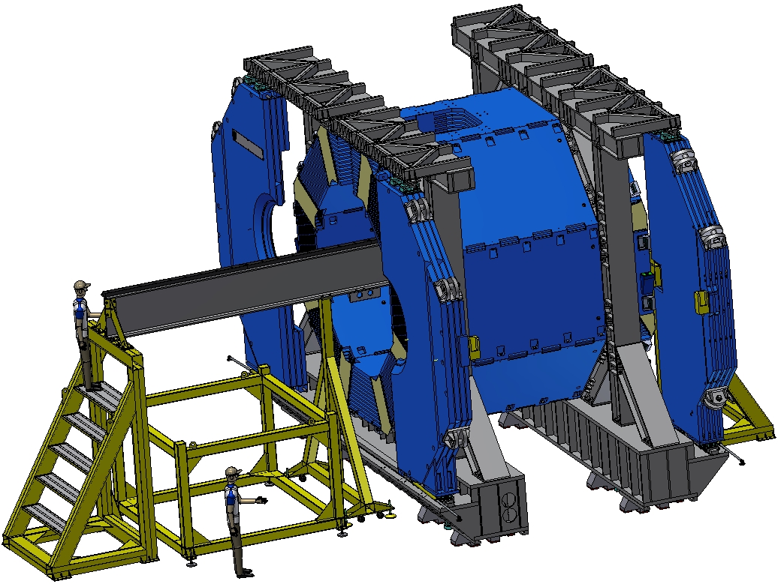
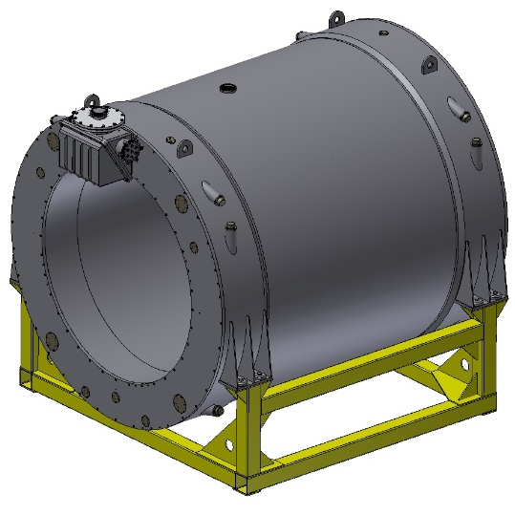
Installation procedure of the Magnet into the Iron Yoke
Yoke
(the doors are opened)
Magnet on the transport frame
RAMAZI RAMAZI
Preparation of the tooling for moving of the magnet: installation of fixed and removable support, support for magnet and beam.

Slide 5
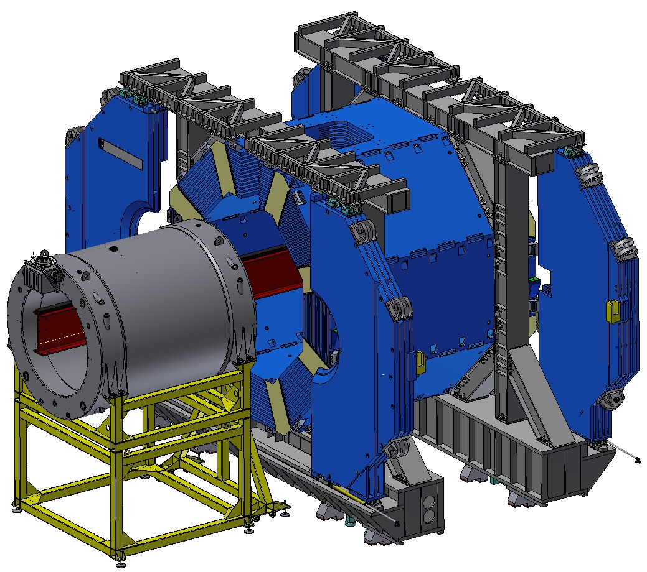
Installation procedure of the Magnet into the Iron Yoke
Magnet on the transport frame
Support for Magnet
Central removable Support
Remove left support and install the magnet with transport frame on the support of magnet.

Slide 6
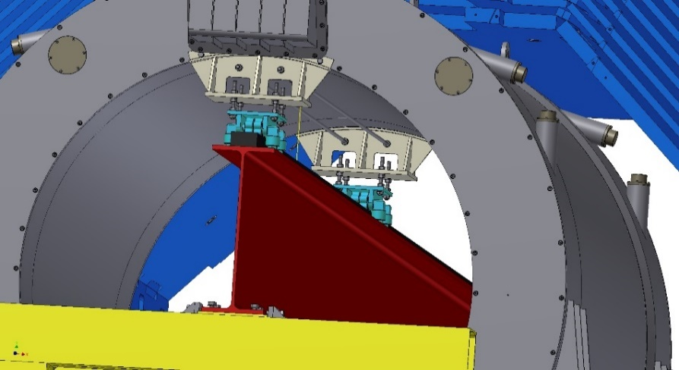
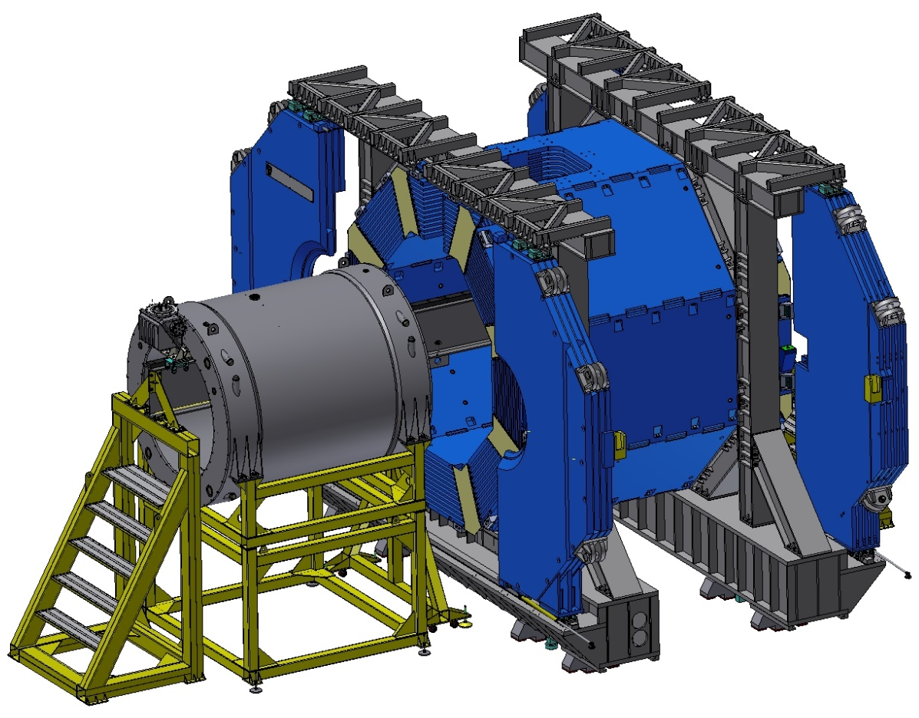
Installation procedure of the Magnet into the Iron Yoke
Rollers system
Removable Support
Insert removable support and install the rollers system for moving magnet.

Slide 7
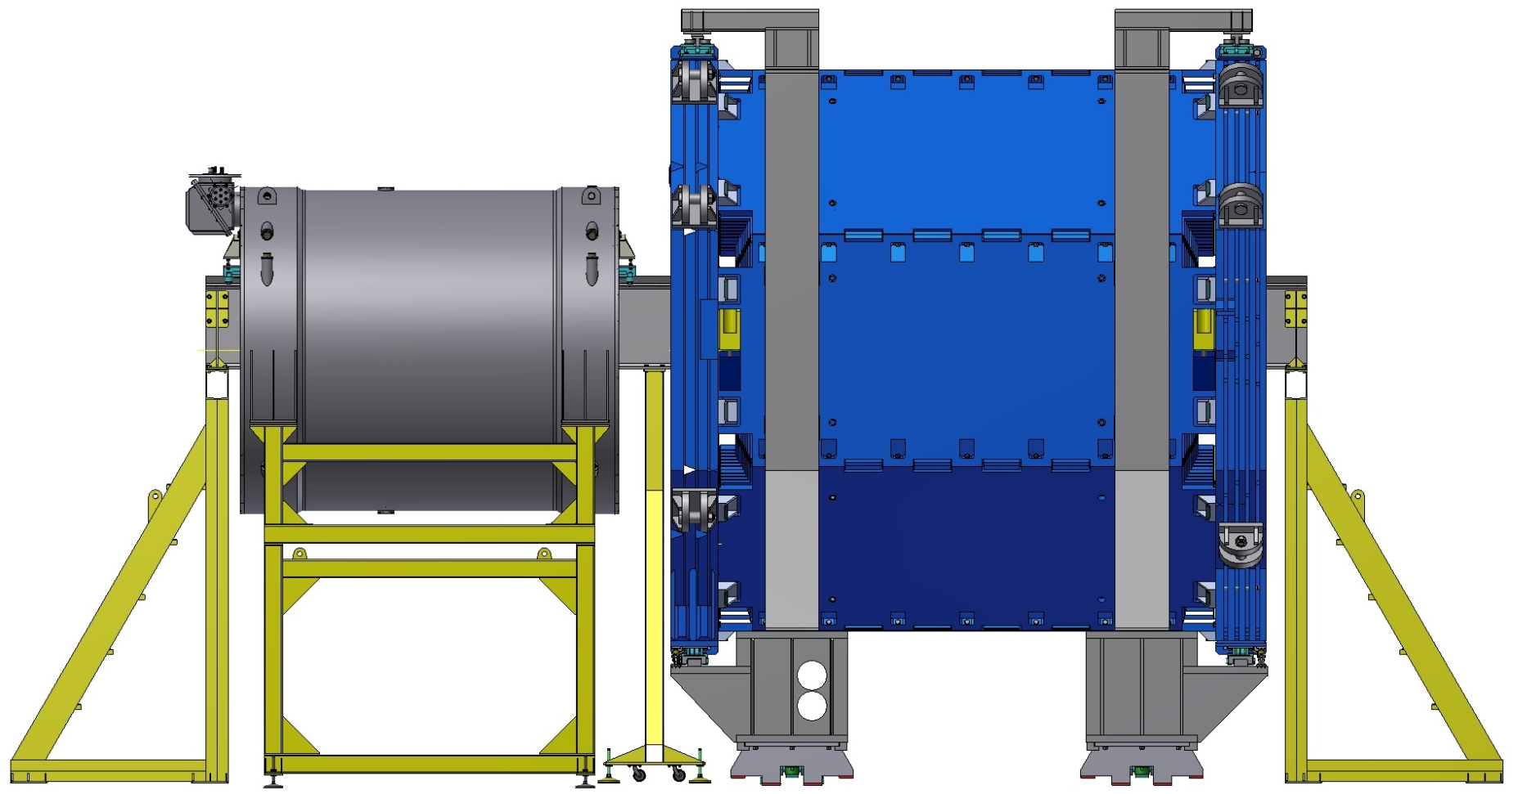
Installation procedure of the Magnet into the Iron Yoke
Support for Magnet
Remove the magnet fixation on the transport frame and move the support of magnet with transport frame down.

Slide 8
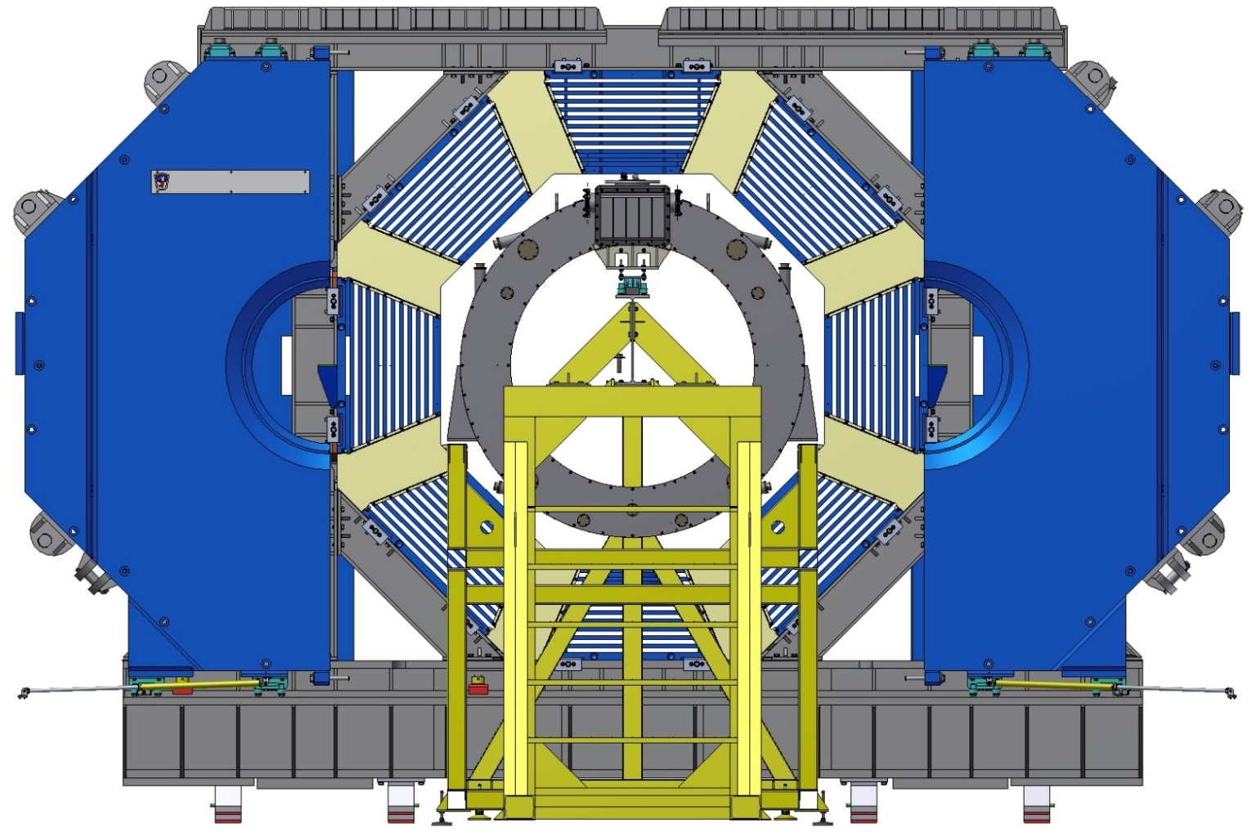
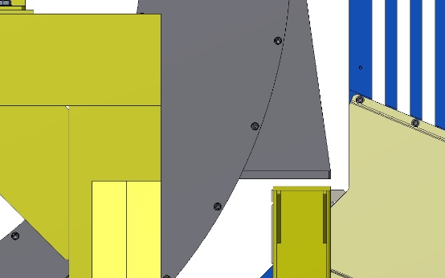
Installation procedure of the Magnet into the Iron Yoke
Gap 15…20 mm
Front view

Slide 9
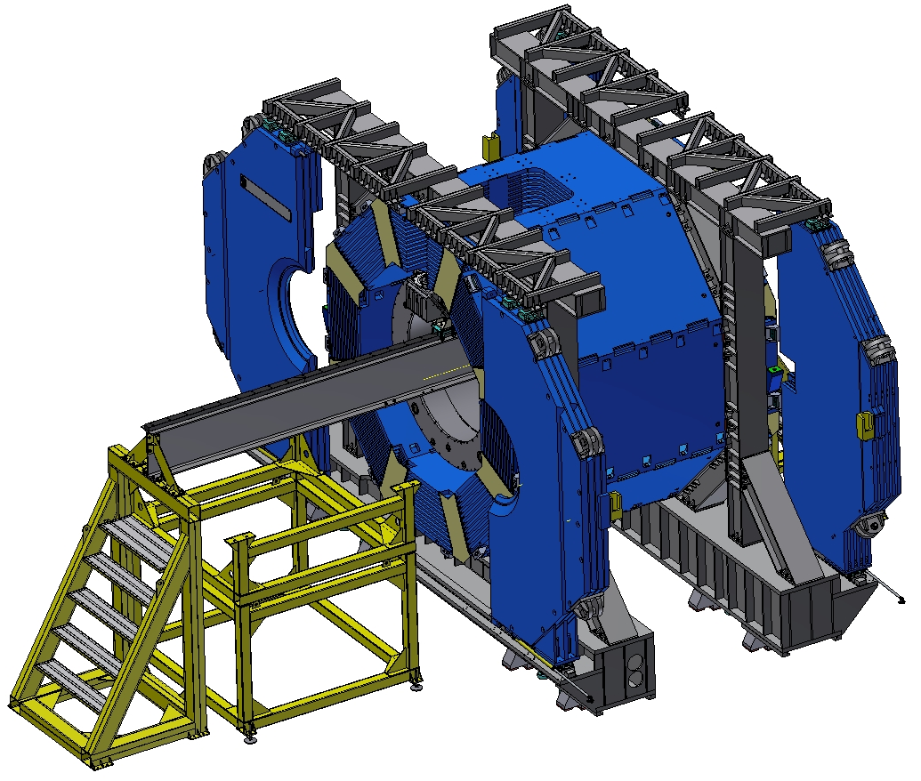
Installation procedure of the Magnet into the Iron Yoke
Remove the central support, install and align of the Magnet into the yoke.

Slide 10
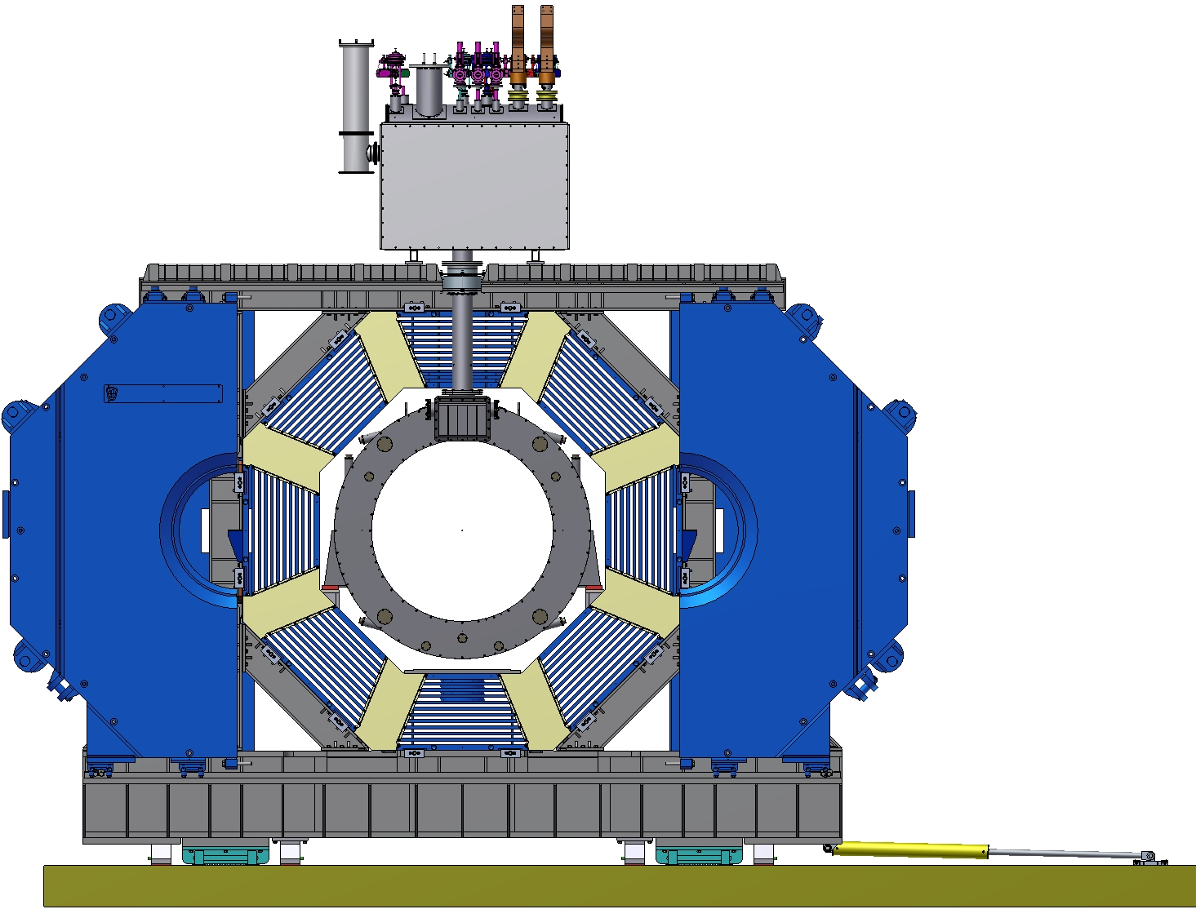
Installation of the Control Dewar.
Install and connect of the Control Dewar with the magnet by a transfer line.

Slide 11
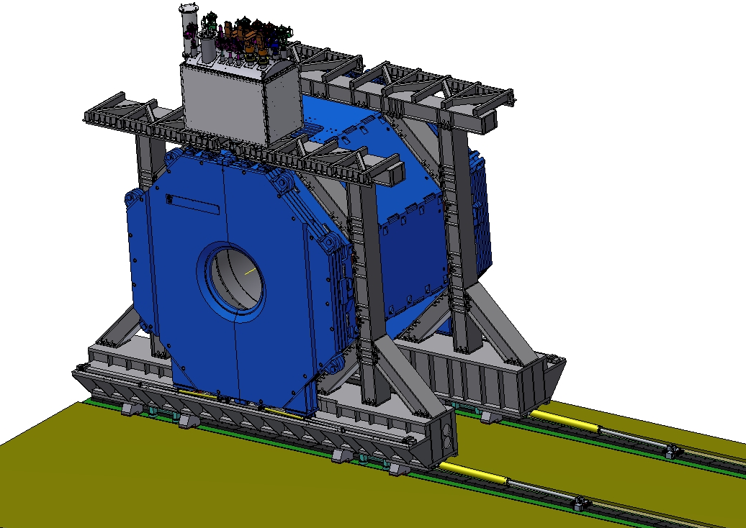
Installation of the Control Dewar.
Magnet with Control Dewar.

Slide 12
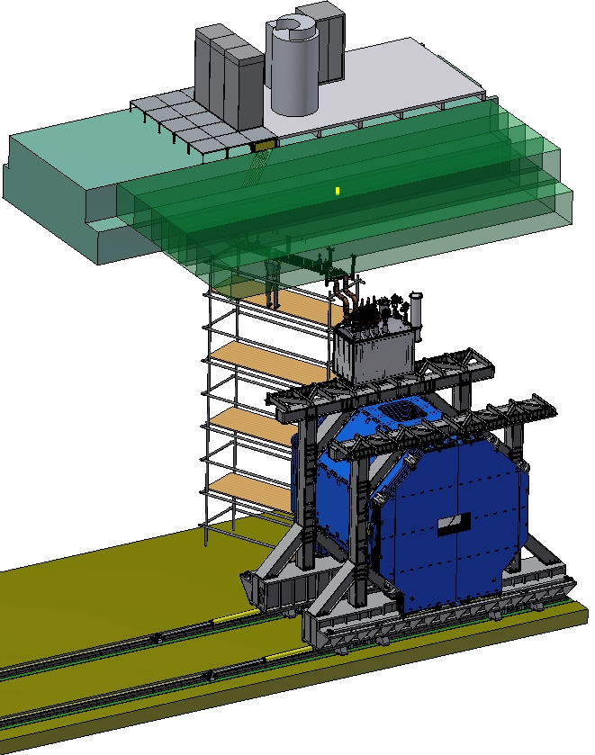
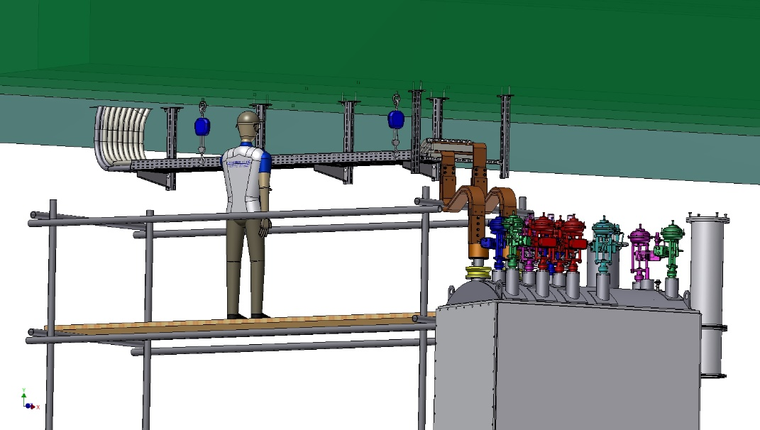
Power supply of PANDA Magnet.
Сonnection of the Control Dewar with the Power supply system.

Slide 13
Thank you for your attention!

