Slide 1
Extended design of the new concept for the Central Space Frame(CSF)

Slide 2
Contents:
1. Requirements
2. Material comparison
3. Overview of the first concept
4. Extended design
5. Conclusion

Slide 3
1. Requirements
Requirements:
CSF has to carry the STT, the MVD and possibly the DCDC and the GBT electronics
Electronic: ~180kg in its center of gravity 1506 mm upstream from the interaction point
STT: ~80kg
MVD: ~30kg
CSF has to fix the target pipe and the target cross
The volume of material has to be preferably low
The material of the frame should have a low density and a low nuclear charge number

Slide 4
2. Material comparision
Regarding to the requirement described, carbon composite seems to be the best choice for the central space frame.
material | Titan | Aluminum | CFRP (carbon composite)
density | 4,5 g/cm³ | 2,7 g/cm³ | ~1,6 g/cm³
nuclear charge number | 22 | 13 | 6*
young‘s modulus | 105 GPa | 80 GPa | ≥ 125 GPa

Slide 5
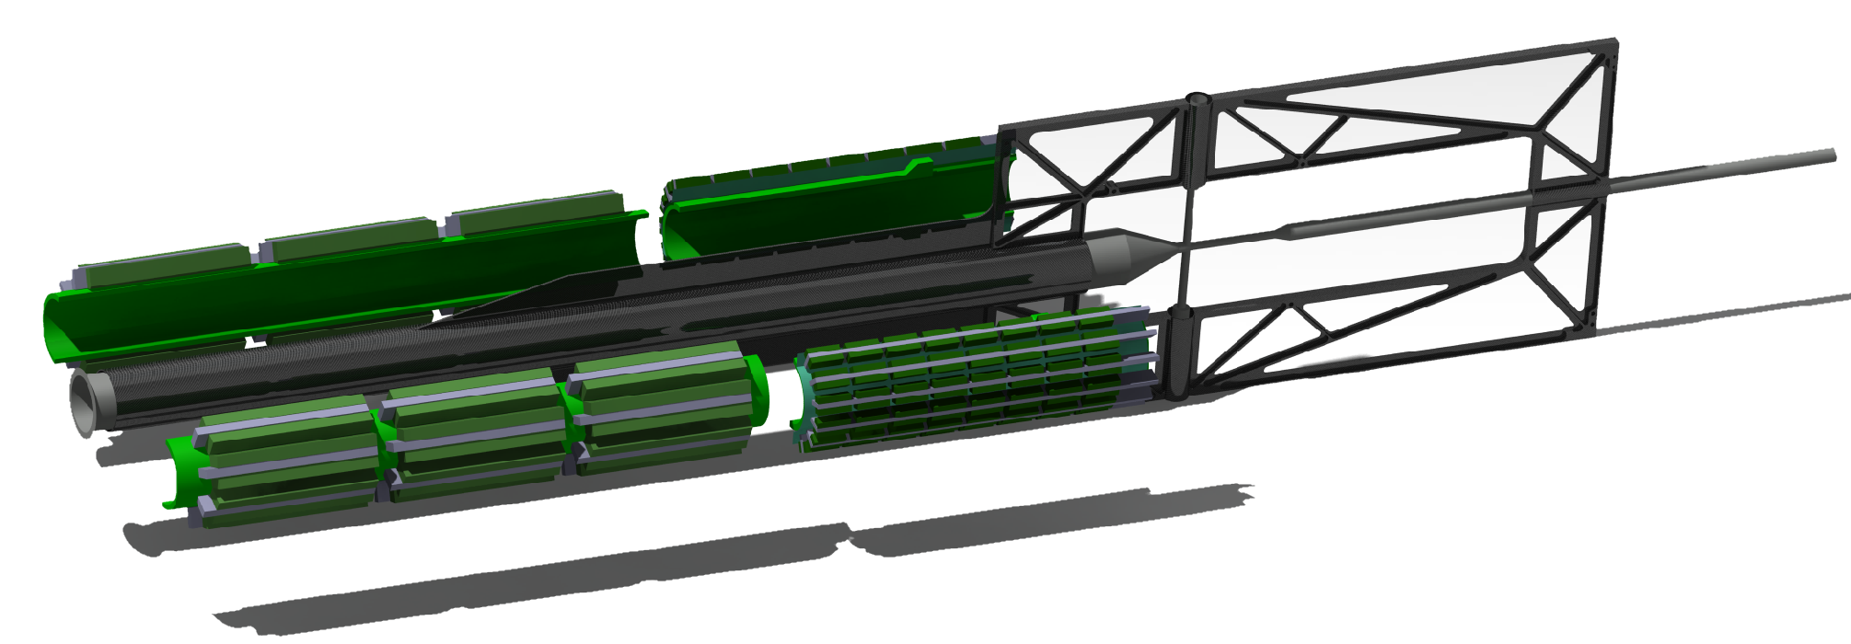
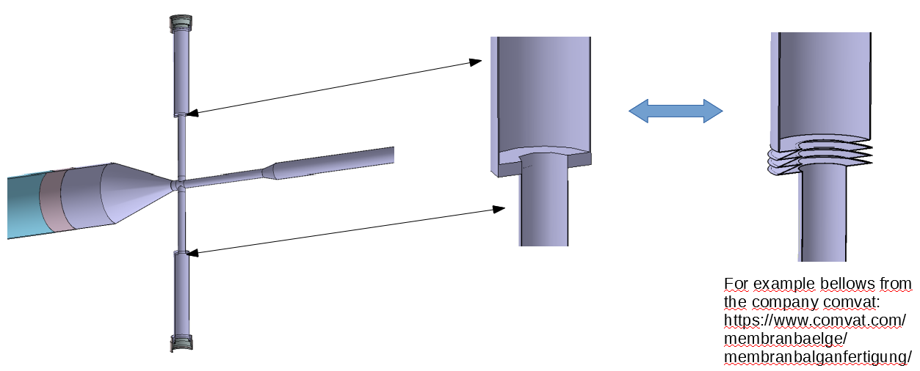
3. Overview of the first concept
Suggestions:
1. An CSF design in combination with an additional support structure for the electronics. It could release the beam pipe of the critical torque without any further needs for suspensions during transport or mounting.
2. With two bellows perpendicular to the target pipe, instead of the current welded flange, critical stresses in the target cross could be avoided.

Slide 6
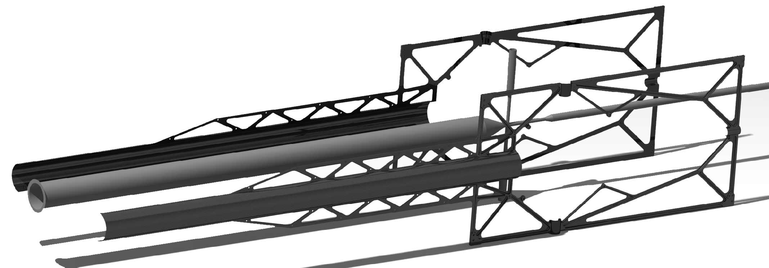
3. Overview of the first concept
In the first design the CSF and the support structure was made of two separate symmetric halves, to be connected in the Y,Z-plane of the target cross. The two halves should be attached together with screws at the roller skates of the rails of the Barrel DIRC.
CSF left
target pipe
CSF right

Slide 7
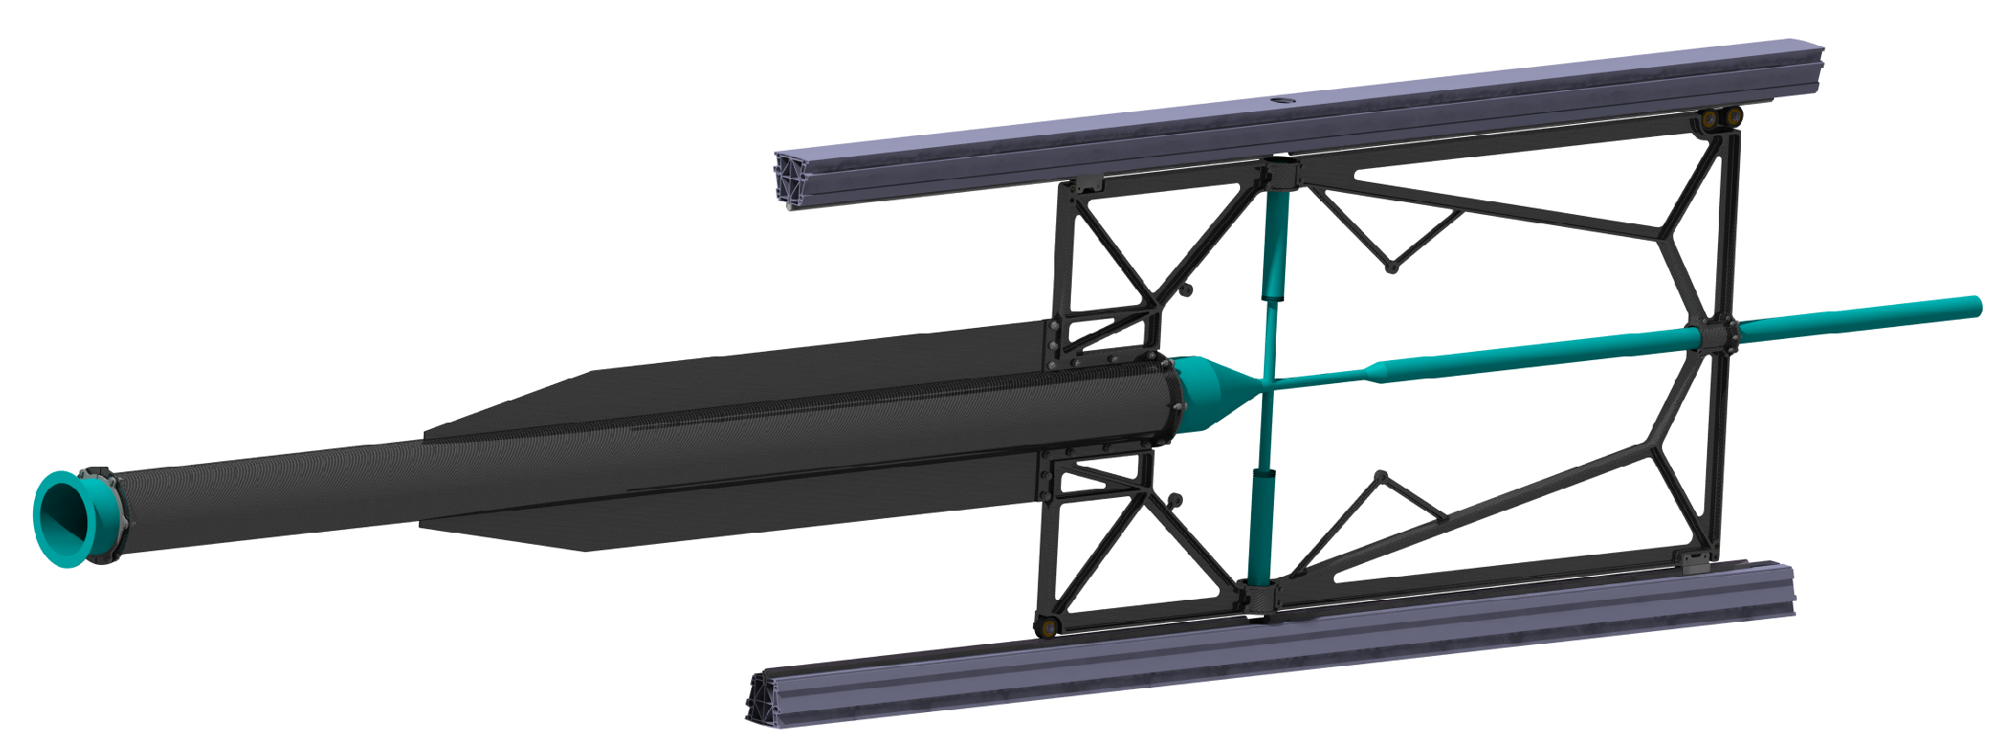
4. Extended design
The picture below shows the extended design of the CSF with the CT beams of the Barrel DIRC.
The CT beams carries the guiding system for the CSF and the inner detectors.
The following slides shows a short overview of the seperatet components of the assembly.
CT beam
target pipe
CSF
CT beam

Slide 8
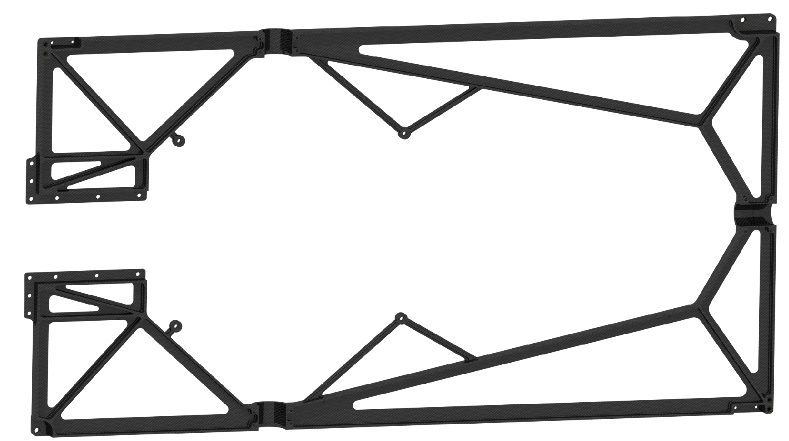
4. Extended design
The first component of the CSF is the mainframe. It is splitted no longer in two parts, which makes production and mounting more easily.
Integrated in the mainframe are several inserts for anchor points of the detectors and the roller and guiding system.

Slide 9
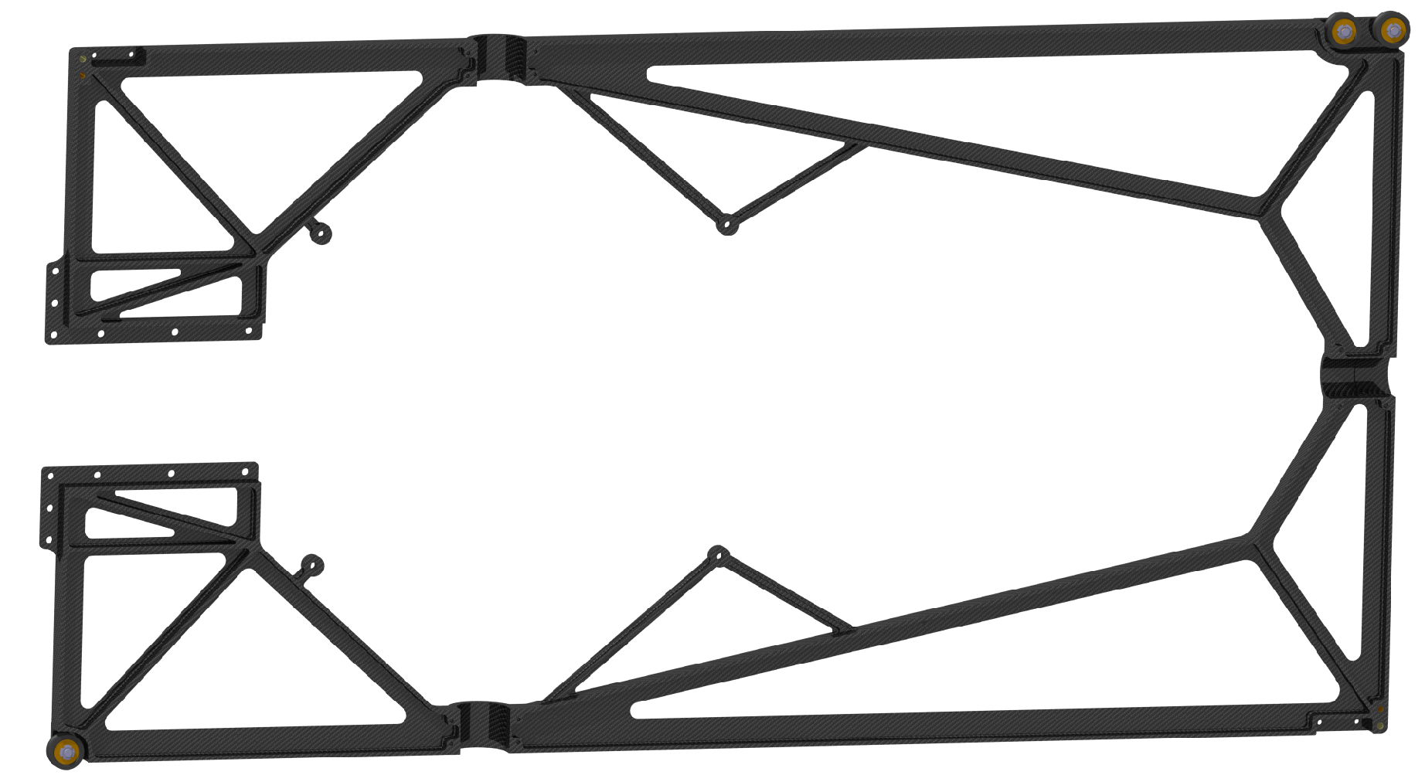
4. Extended design
For the movement rollers with ball-bearings are in charge. Because of the magnetic field and the radiation the rollers and the bearings are made out of technical ceramic.
downstream
rollers
mainframe
upstream roller

Slide 10
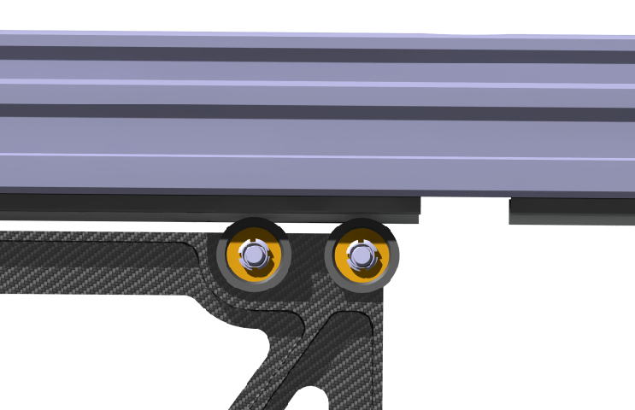
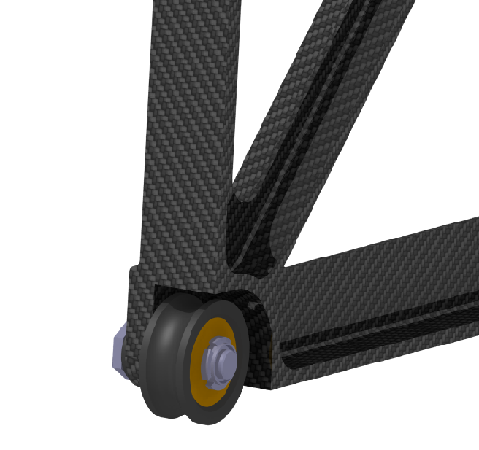
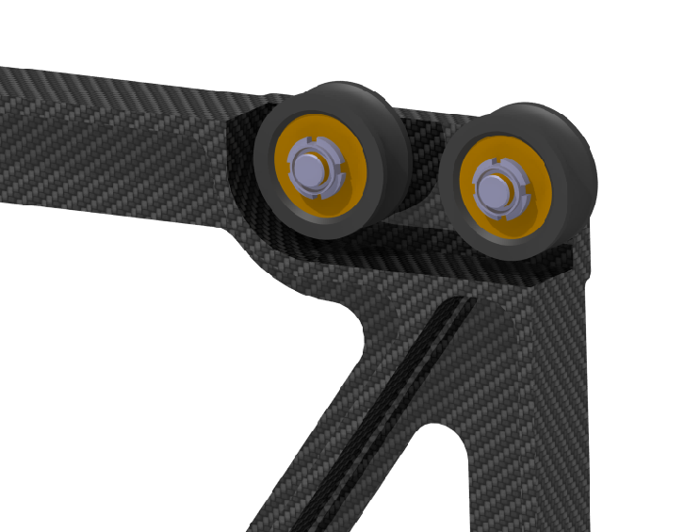
4. Extended design
Because of the hole for the target pipe the CSF has to cross, two rollers are needed on the downstream side.
~50
upstream roller
downstream rollers

Slide 11
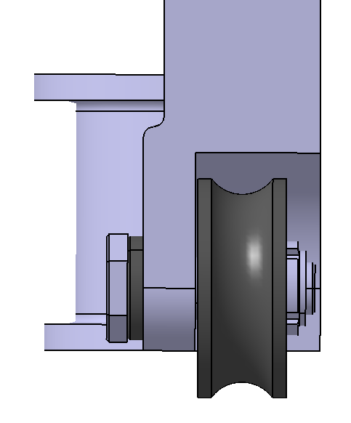
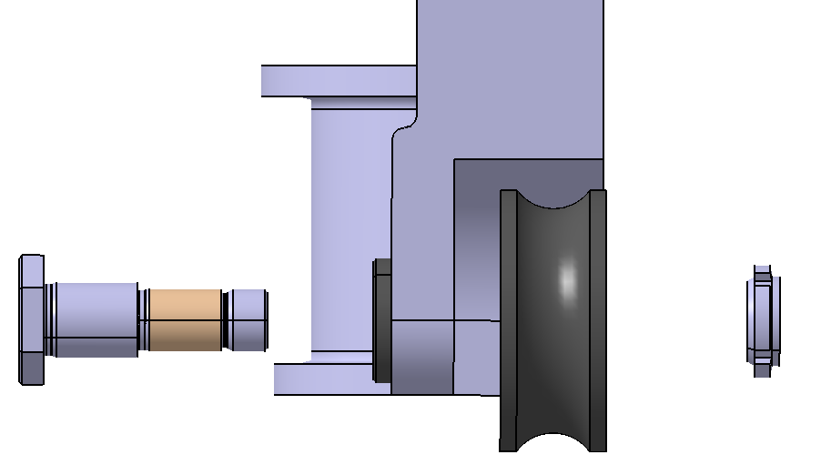
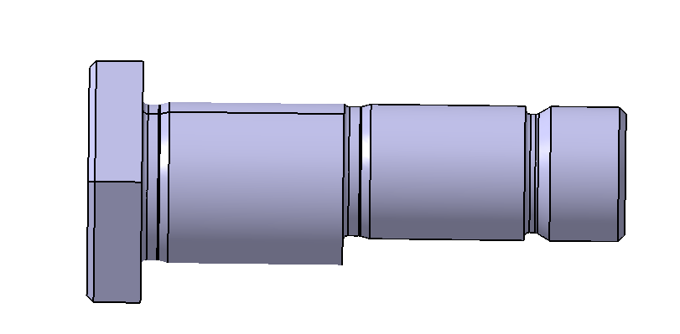
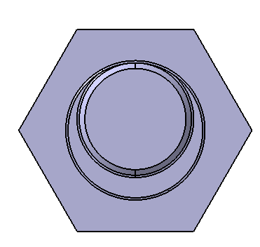
4. Extended design
The single roller on the upstream side has an eccentric bolt for adjusting the CSF in vertical axis.
By loosen the lock nut and turning the Bolt, the roller move the CSF up or down.
locknut
Excentric bolt
roller
e

Slide 12
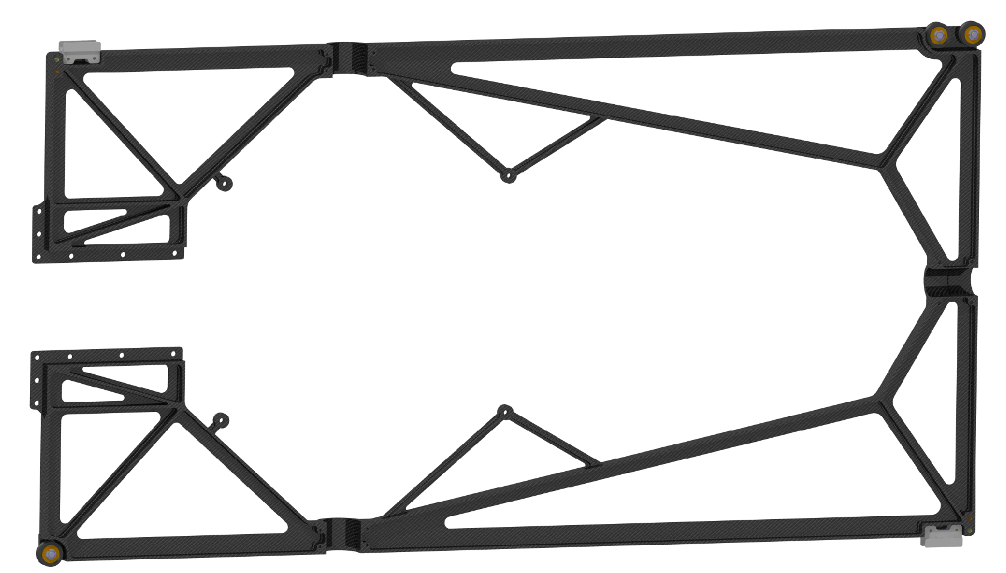
4. Extended design
For an additional guiding only perpendicular of the beam, two components made of PEEK are foreseen.
horizontal guide
downstream
rollers
mainframe
horizontal guide
upstream roller

Slide 13
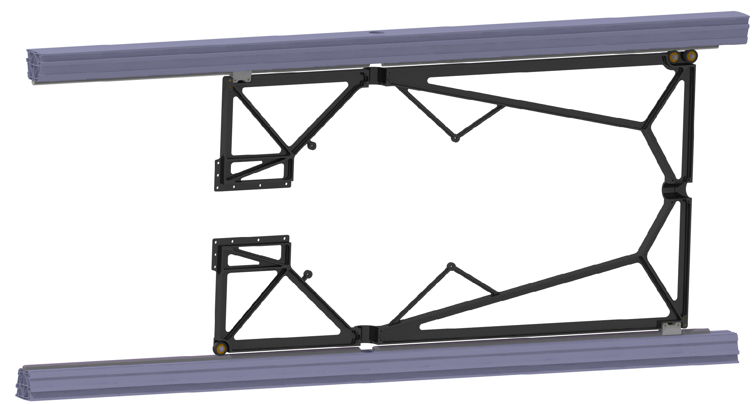
4. Extended design
With the rollers and the guides, the main frame can be attached to a mounting beam.
The following pictures shows the CT beams of the Barell Dirc instead of a possible mounting beam.
CT beam
downstream rollers
horizontal guide
mainframe
upstream roller
horizontal guide
CT beam

Slide 14
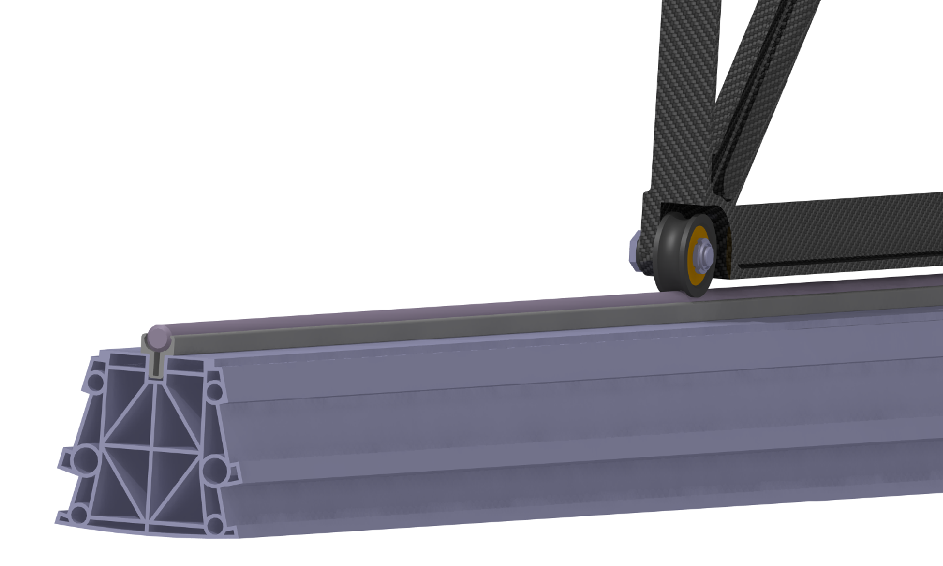
4. Extended design
Attached to the CT beam is a guide shaft made of hard anodized aluminum.
The guide shaft is clicked into a aluminum profile from the company ITEM.
This Profile is pressed into a groove of the CT beam.
upstream roller
guide shaft
click profile
CT beam

Slide 15
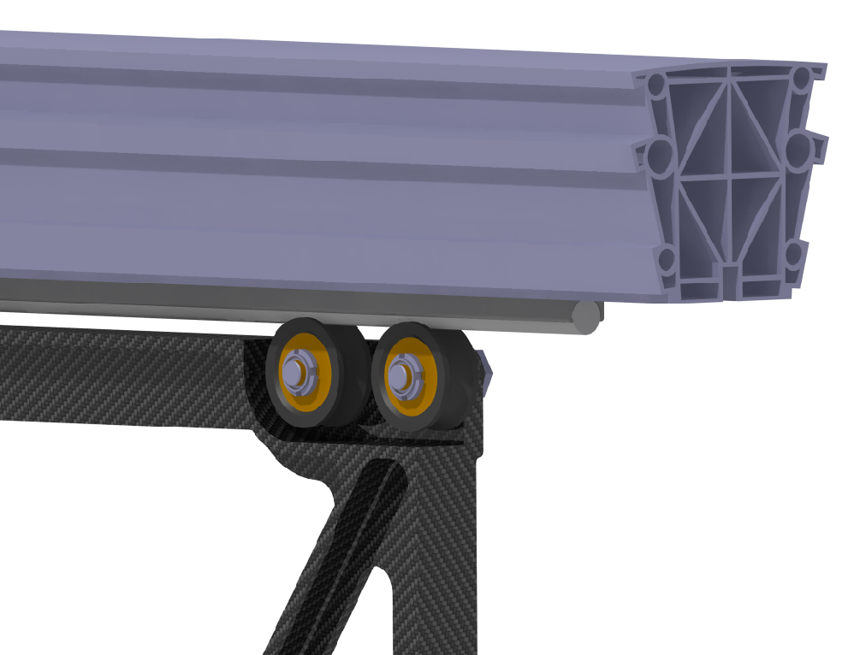
4. Extended design
Attached to the CT beam is a guide shaft made of hard anodized aluminum.
The guide shaft is clicked into a aluminum profile from the company ITEM.
This Profile is pressed into a groove of the CT beam.
CT beam
click profile
guide shaft
downstream roller

Slide 16
4. Extended design
The second component of the CSF is the support structure for the electronic.
The support structure is splitted in two identical parts on the west and the east side.
.
support structure
GBT‘s
DCDC changer

Slide 17
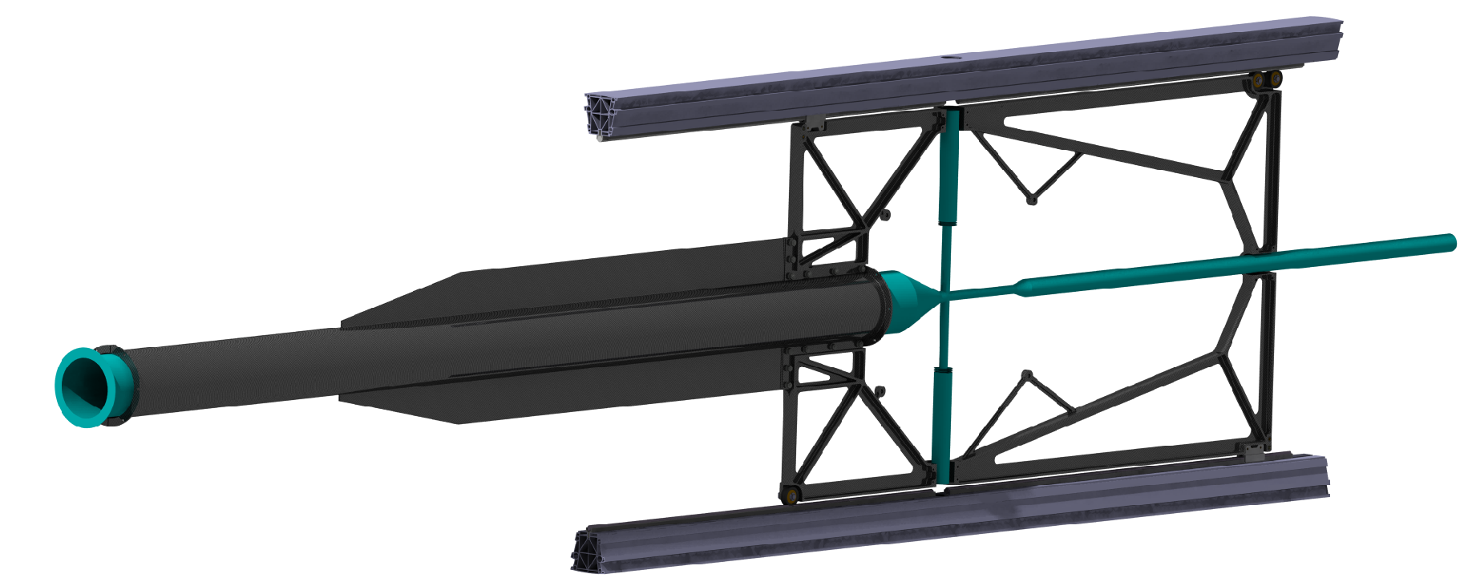
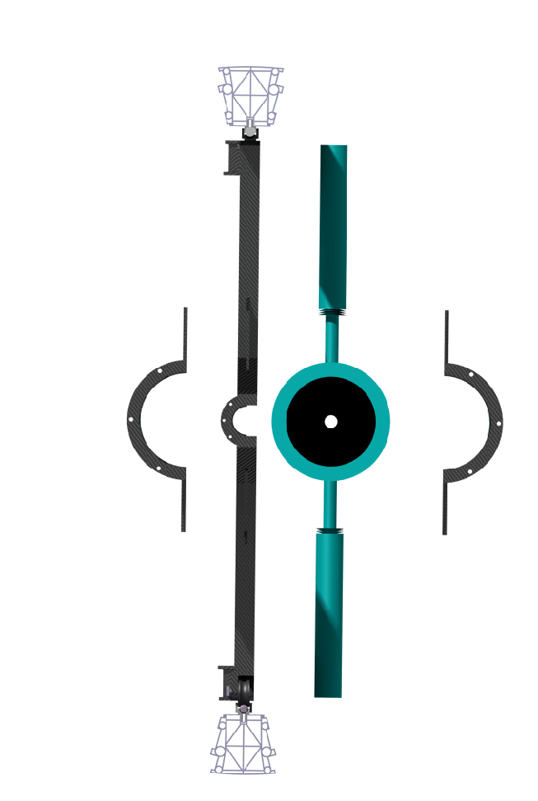
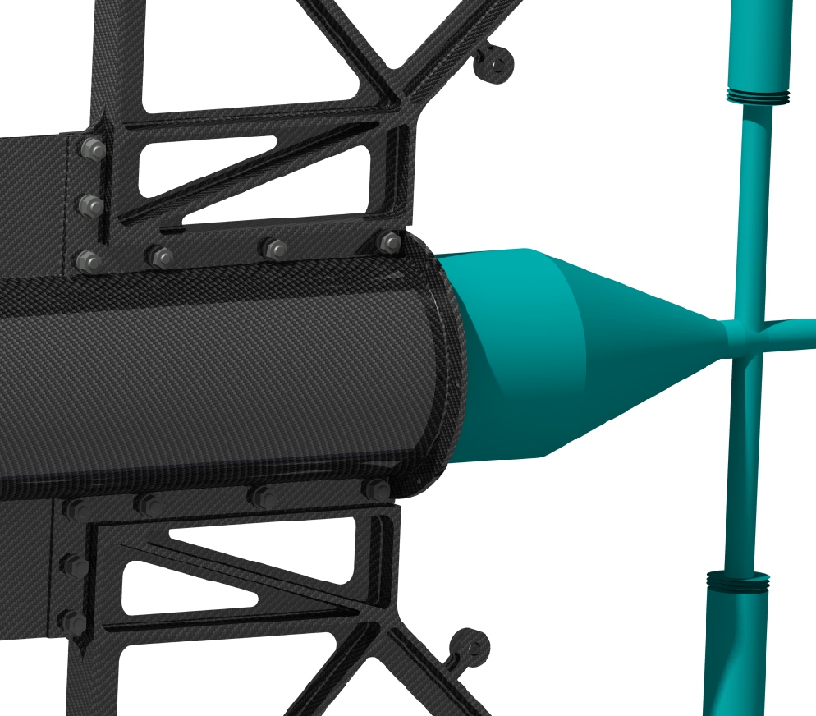
4. Extended design
Together with the target pipe, both support structures will be connected to the mainframe via screws.
With the mainframe, the four components build a very stiff assembly.
.
front view
CT beam
mainframe
target pipe
support structure
support structure
screws and
nuts
target pipe
CT beam

Slide 18
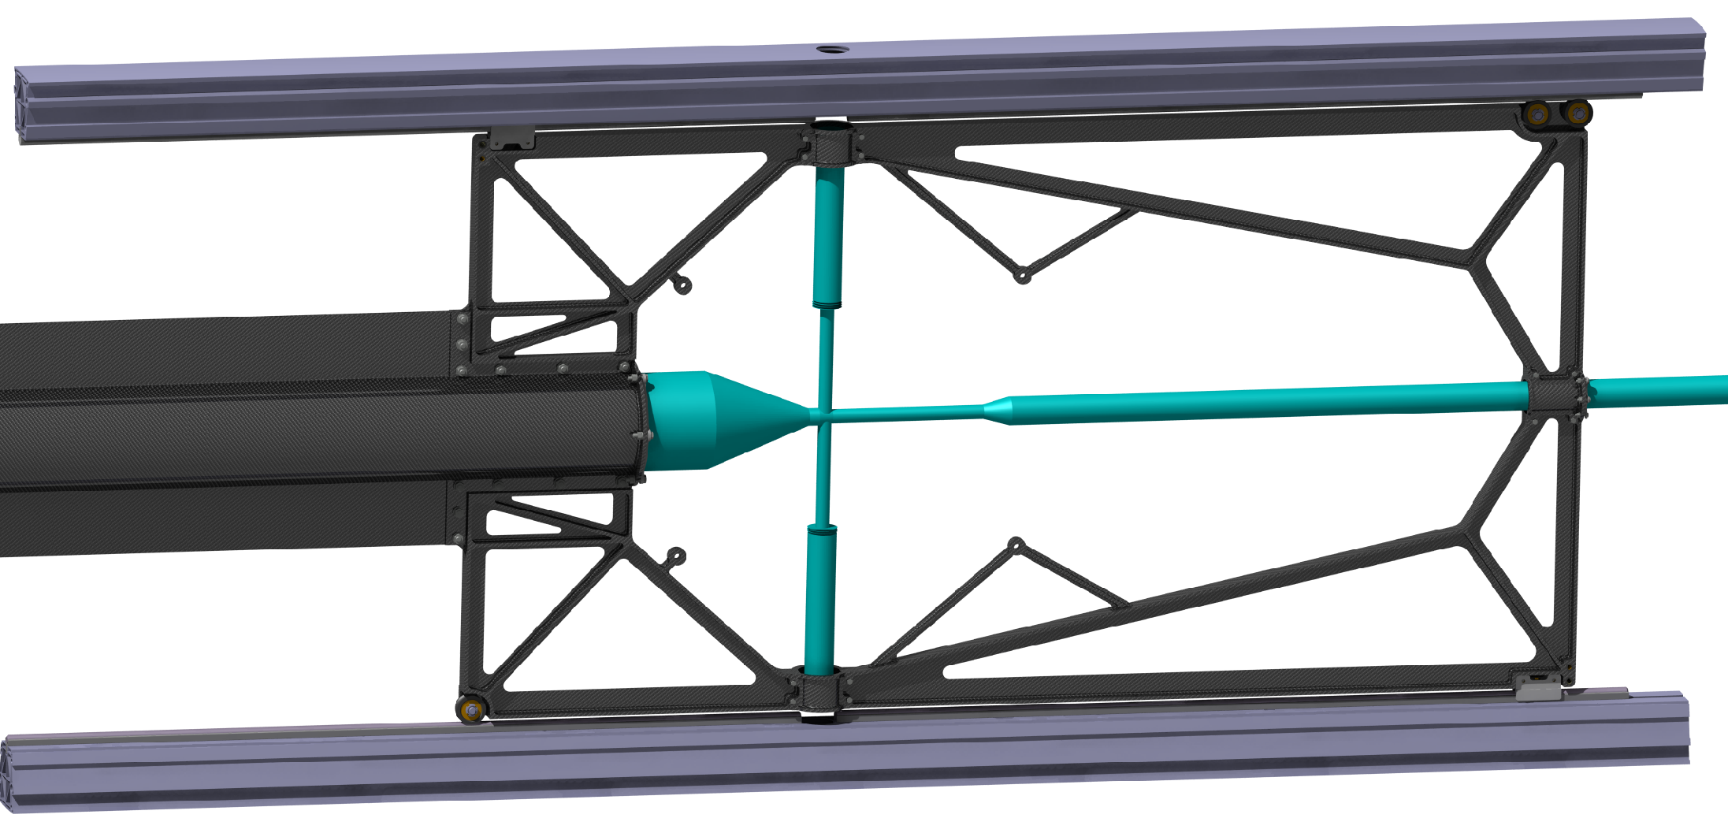
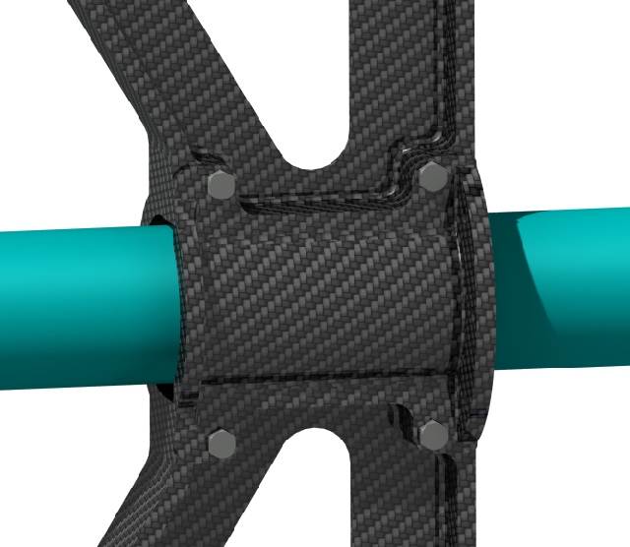
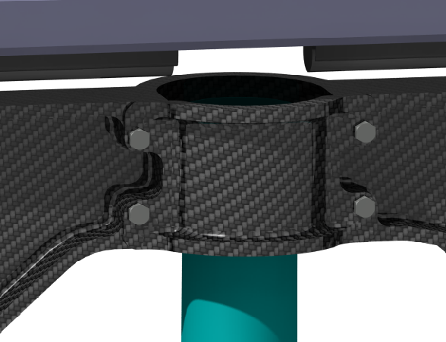
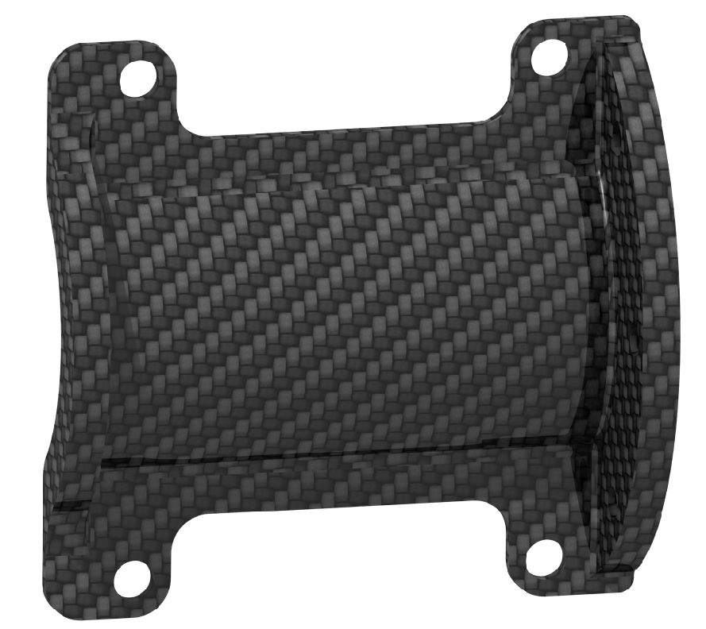
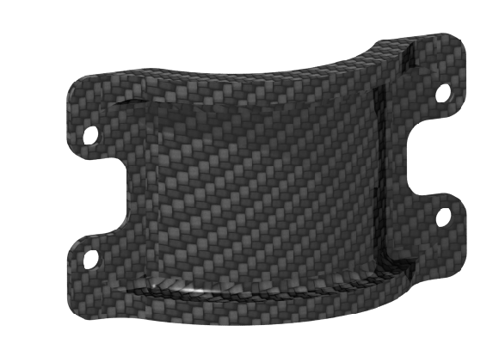
4. Extended design
The next two components are the two adapter for the bayonet lock at the cross and the adapter for the target pipe at the downstream side.
.

Slide 19
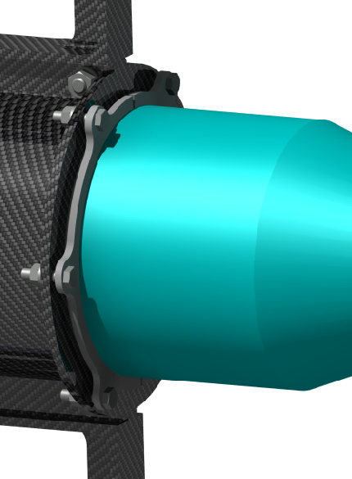
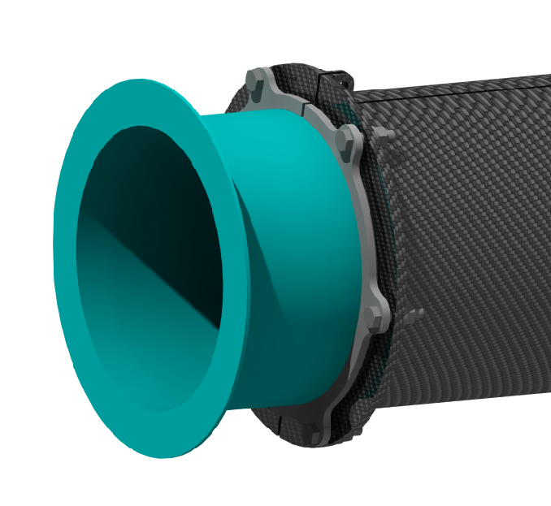
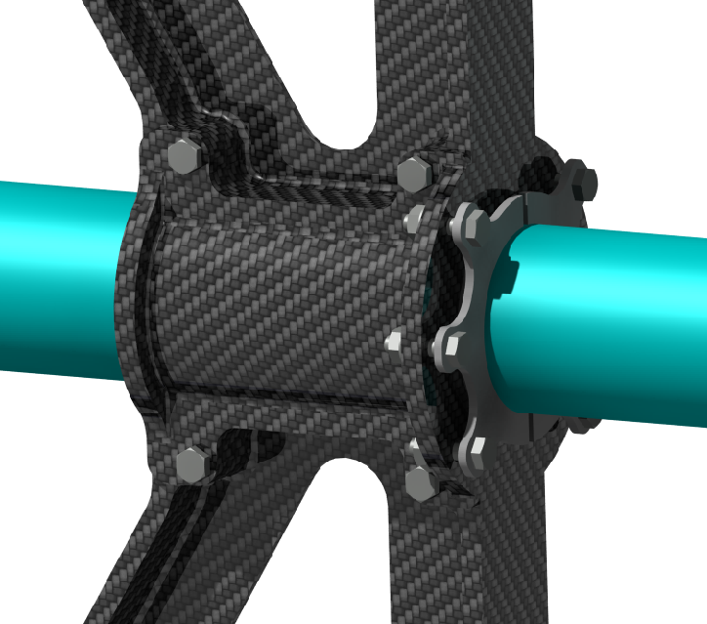
4. Extended design
The connection between the target pipe and the CSF is made via wedge shaped half shells.
This half shells are made out of PEEK and are located at three points of the CSF.
.
target pipe
target pipe
target pipe
half shells
half shells
half shells

Slide 20
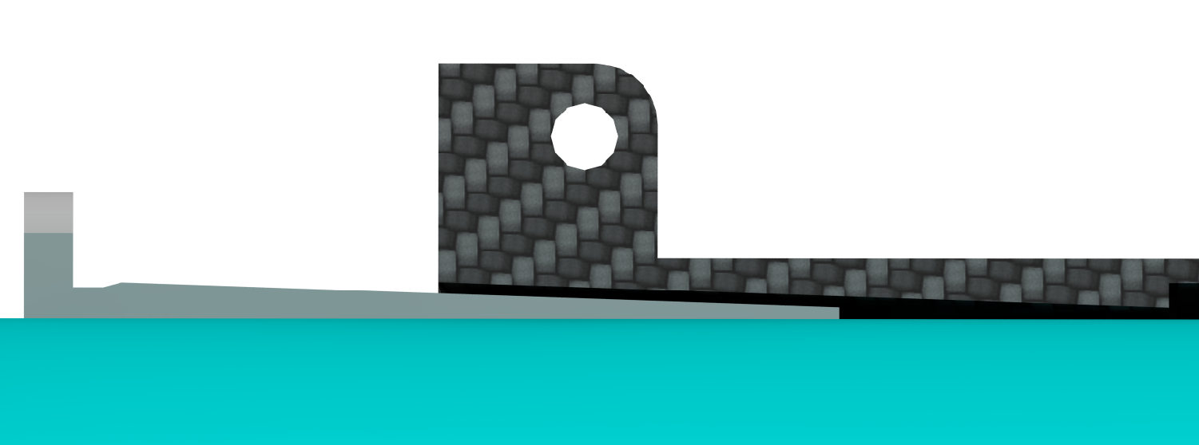
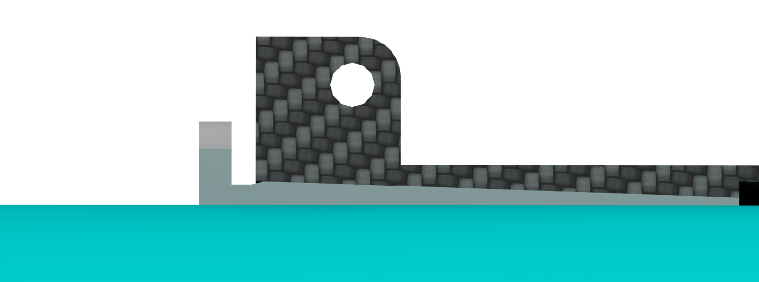
4. Extended design
The principal working of the half shells based on clamping the target pipe against the CSF via a wedge geometry.
For realizing that, wedge shaped geometries are integrated in the CSF as well.
half shell
wedge shaped geometry in the CSF
(here by way for example at he upstream side)
CSF
target pipe
CSF
half shell
target pipe

Slide 21
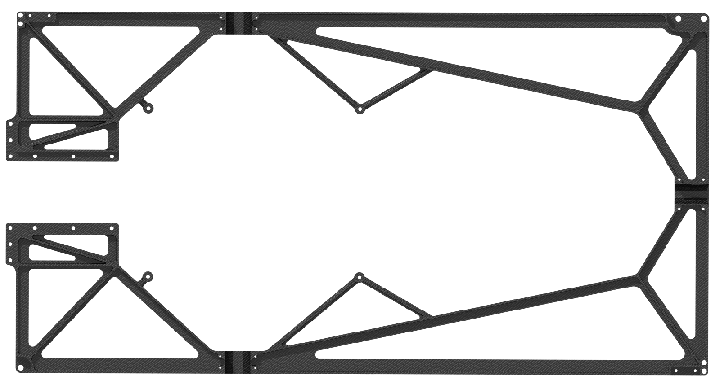
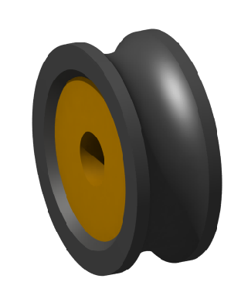
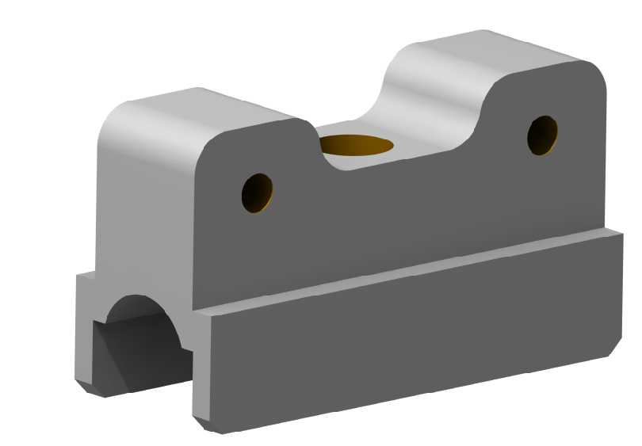
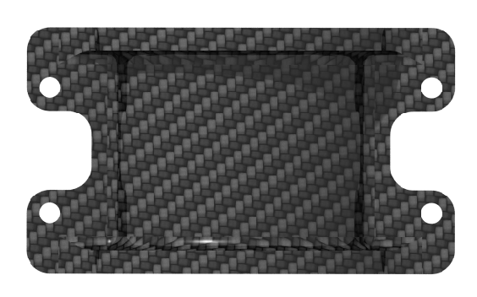
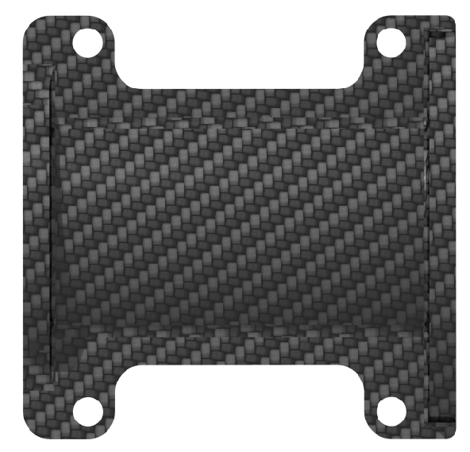
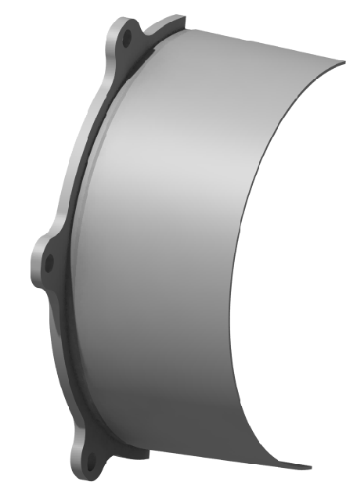
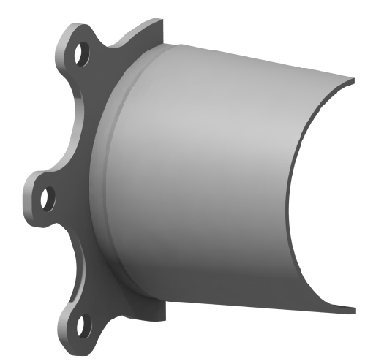
4. Extended design
Here again the summary of the individual components of the CSF.
1x mainframe
3x roller
2x horizontal guides
2x support structure
2x adapter for bayonet
1x adapter downstream
4x half shell upstream
2x half shell downstream

Slide 22
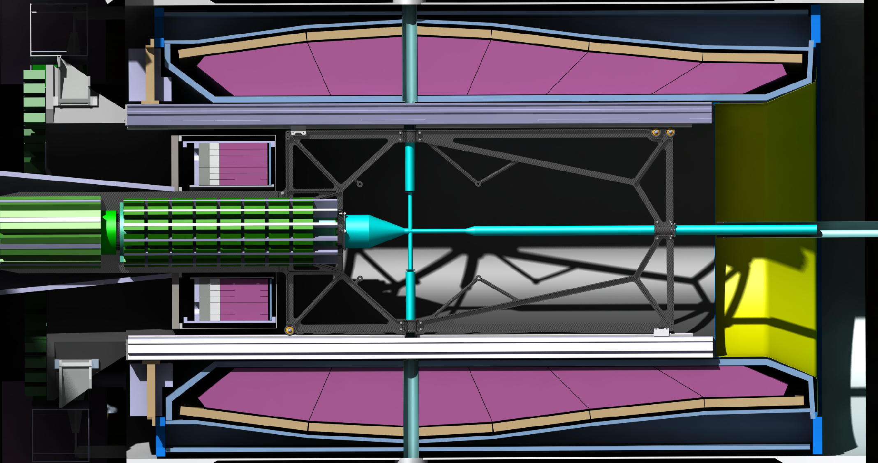
4. Extended design
The last two slides shows the CSF at its later position in the target spectrometer with and without the electronic, which will be attached to the support structure.

Slide 23
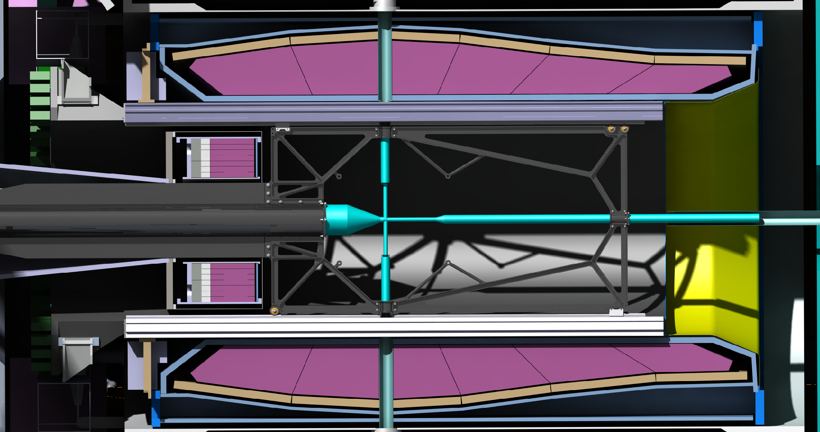
4. Extended design
The last two slides shows the CSF at its later position in the target spectrometer with and without the electronic, which will be attached to the support structure.

Slide 24
5. Conclusion
pros | cons
Target pipe will not be loaded by the electronic | The diameter of the target pipe has to be reduced from 150 mm to 140 mm(in the area of the support structure )
There is no need for suspensions during the mounting of the detectors | The CSF would be more complex regarding to the additional structure
No temporary suspension rods are necessary while installation the BW EMC in the spectrometer
There is a lower risk to cause damage to the target pipe, while exchange the suspensions for example
We need no welded anchor points on the target pipe for suspensions for the electronics
By the seperated support structures, assembly of the electronic should be more flexible
The mounting of the hole assembly can be done on the final rails system

