Slide 1
3rd BINP Workshop Novosibirsk 25. – 29.11.2019 Site Management – Documentation
H Reich-Sprenger & H Hagelskamp

Slide 2
Documentation
Specification, Design:
technical design drawings component
technical properties
tolerences
materials
CDR, TDR, Production, FAT:
technical drawings component
production plan
QC plan
QC protocols
Transport:
transport instructions
pack & unpack instructions
FAIR | BINP
x
x
x
x
 | x
 | x
 | x
 | x
 | x
 | x

Slide 3
Site Management – Pre-Assembly & Installation
Pre-Assembly:
technical drawings assembly unit
parts list
work instructions
QC protocols
documentation as built
release protocol → „ready for installation“
Installation:
technical drawings assembly unit & accelerator section
parts list
work instructions
risk assesment (safety at work)
QC protocols
documentation as built
FAIR | BINP

Slide 4
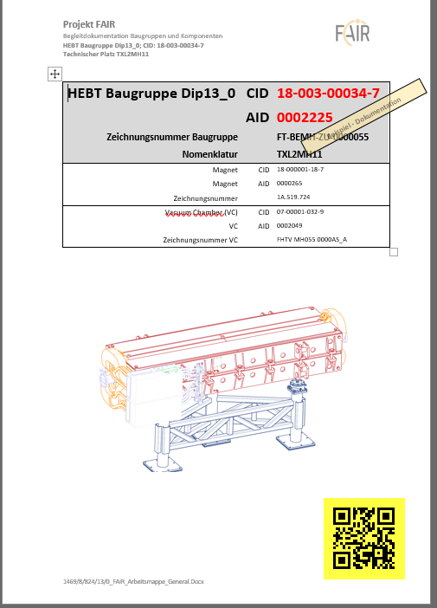
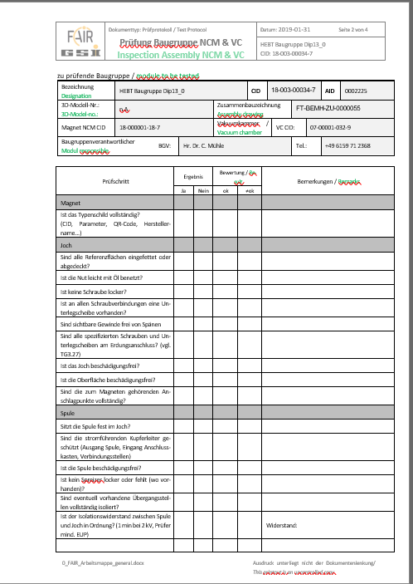
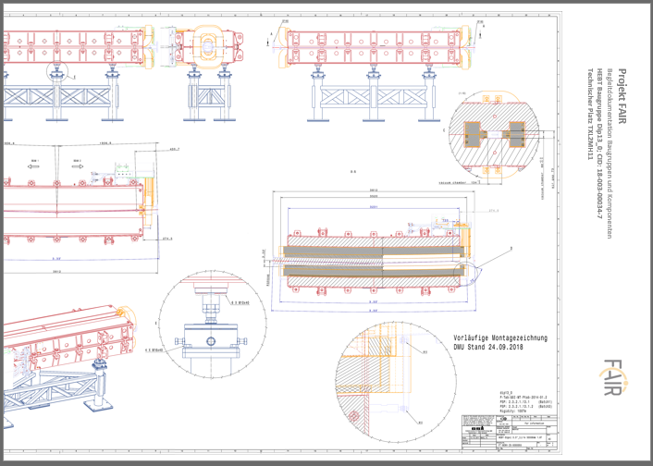
Site Management – Pre-Assembly & Installation
HEBT contracts
CR contracts
Pre-Assembly:
technical drawings assembly unit
parts list
work instructions
QC protocols
documentation as built
release protocol → „ready for installation“
At GSI/FAIR:
standard workflow for Pre-Assembly of HEBT magnet units established
in preparation:
SIS magnet modules, RF units, beam diagnostic units,…
SFRS magnet modules,
CR
Objektive 1 :
to agree scope and content of the required documentation.
to confirm contractual obligations and partner‘s responsibilities.

Slide 5
Site Management – Pre-Assembly & Installation
CR contracts
documents essential for pre-assembly, contracted (?) FAIR /BINP:
component technical drawing
component QC protocols
component handling instructions
….documents for vacuum chamber integration ?
….
Not included in contracts between BINP and FAIR:
….
…..
…
Objektive :
to confirm contractual obligations and partner‘s responsibilities.

Slide 6
Site Management – Pre-Assembly & Installation
HEBT contracts
documents essential for pre-assembly, contracted (?) FAIR /BINP:
component technical drawing
component QC protocols
component handling instructions
….documents for vacuum chamber integration ?
….
Not included in contracts between BINP and FAIR:
….
…..
…
Objektive :
to confirm contractual obligations and partner‘s responsibilities.

Slide 7
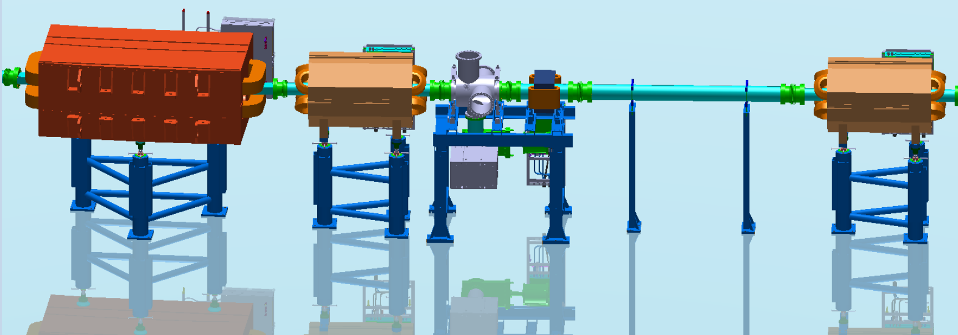
Machine Installation – Definition of Assembly Units
nc dipole unit
nc 4-pole unit
BI & nc steerer unit
straight vacuum unit
nc 4-pole unit
Magnet (CID)
yoke
upper
lower
coil
upper
lower
Hall-sensor
connection box
base frame
alignment supports
no 1
no 2
no 3
Vacuum Chamber (CID)
Magnet (CID)
yoke
no1
no2
no3
no4
coil
no1
no2
no3
no4
connection box
base frame
alignment supports
no 1
no 2
no 3
Vacuum Chamber (CID)
BI Vac chamber (CID)
Detector 1 (CID)
part no1
flange
part no2
Detector 2 (CID)
part no1
flange
part no2
Vac pump (CID)
Vac diagnostics (CID)
connection box
base frame
alignment supports
no 1
no 2
no 3
Vac chamber (CID)
support frame no1
support frame no2
Magnet (CID)
yoke
coil
connection box
base frame
alignment supports
Vacuum Chamber (CID)
Each defined Assembly Unit:
Documentation in PLM including:
Sub-components
Status
Location
executed works and tests

Slide 8
Site Management – Pre-Assembly & Installation
HEBT contracts
Installation:
technical drawings assembly unit & accelerator section
parts list
work instructions
risk assesment (safety at work)
QC protocols
documentation as built
Objektive 2 (Installation manual):
to agree scope and content of the required documentation.
to confirm contractual obligations and partner‘s responsibilities.
CR contracts

Slide 9
Site Management – Pre-Assembly & Installation
HEBT contracts
documents essential for Installation, contracted (?) FAIR /BINP:
sector technical drawings
sector QC protocols
handling instructions
risk assesment
….documents for final sector testing ? ?
….
Not included in contracts between BINP and FAIR:
….
…..
…
Objektive :
to confirm contractual obligations and partner‘s responsibilities.

Slide 10
Site Management – Pre-Assembly & Installation
CR contracts
documents essential for Installation, contracted (?) FAIR /BINP:
sector technical drawings
sector QC protocols
handling instructions
risk assesment
….documents for final sector testing ? ?
….
Not included in contracts between BINP and FAIR:
….
…..
…
Objektive :
to confirm contractual obligations and partner‘s responsibilities.

Slide 11
Mechanical Completion (Definition)
After all mechanical works including pre-commissioning (PC) activities are completed:
Each component installed conforms to or is fabricated and tested
According project specifications (Performance & Safety) ✓
After release of the Mechanical Completion Certificate (Milestone) by the client:
Handover to operation for commissioning
Commissioning
Procurement
Operation
Pre Assembly
Mechanical Completion
Installation on site
Pre-Commissioning

Slide 12
Site Management – Pre-Assembly & Installation
FAT
Transport
SAT
Installation
FAT
Transport
SAT
Pre-Assembly
Installation
who ensures the completeness of documents essential for:
mechanical completion
release for commissioning

Slide 13
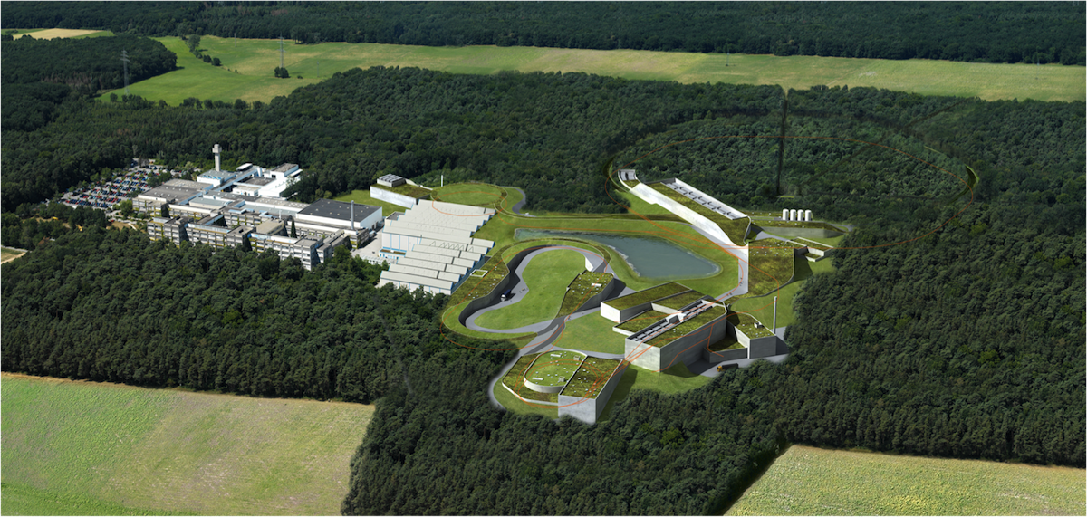
Thank you very much !

