Slide 1
3rd BINP Workshop
Novosibirsk 25. – 29.11.2019
Site Management – Documentation
H Reich-Sprenger & H Hagelskamp

Slide 2
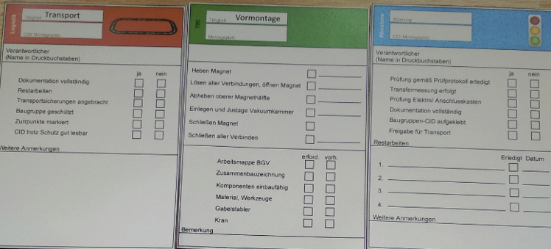
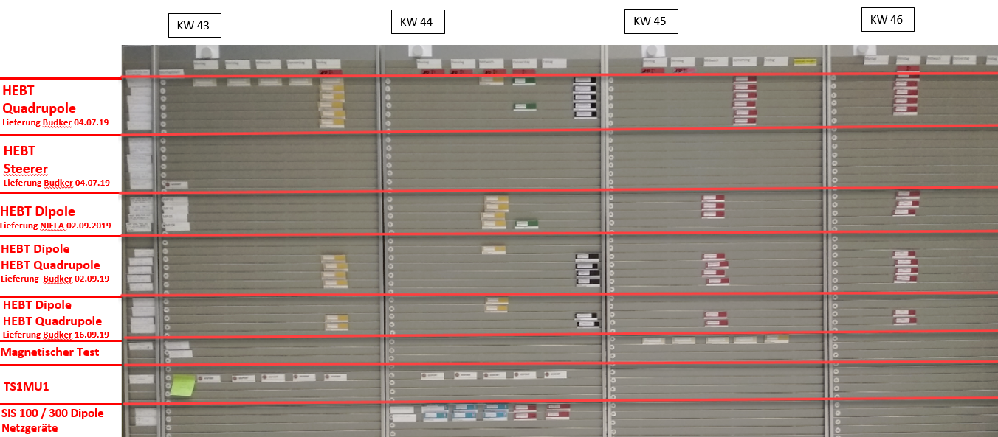
Installation – Pre-Assembly and Testing
  LCM Planning of Pre-assembly
  According to FAIR construction site standards, Lean Construction Management process for planning of Pre-Assembly and Testing activities was established.
      Definition of work steps and executive department
      Weekly coordination meetings of all involved parties in the TES
      Planning of pre-assembly activities for the next 4 weeks ( LCM board )
      Tracking of executed activities
      ‘lessons learned’ sessions
Transportation
Assembly
Check / Release
2

Slide 3
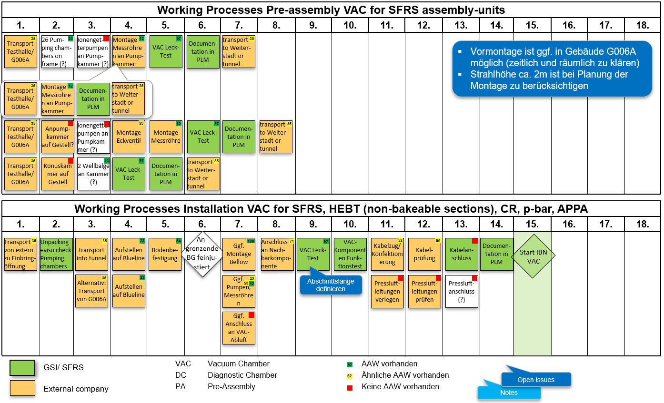
Pre-Assembly & Installation: Preparation
Work Instructions & work sequence Excerpt LCM Workshop VAC/ SFRS
3

Slide 4
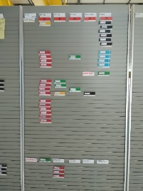
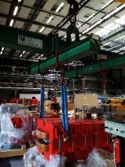
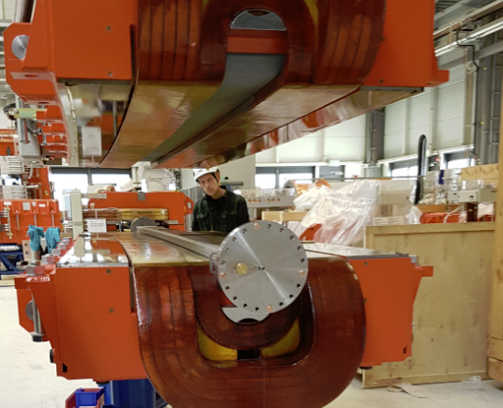
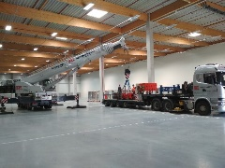
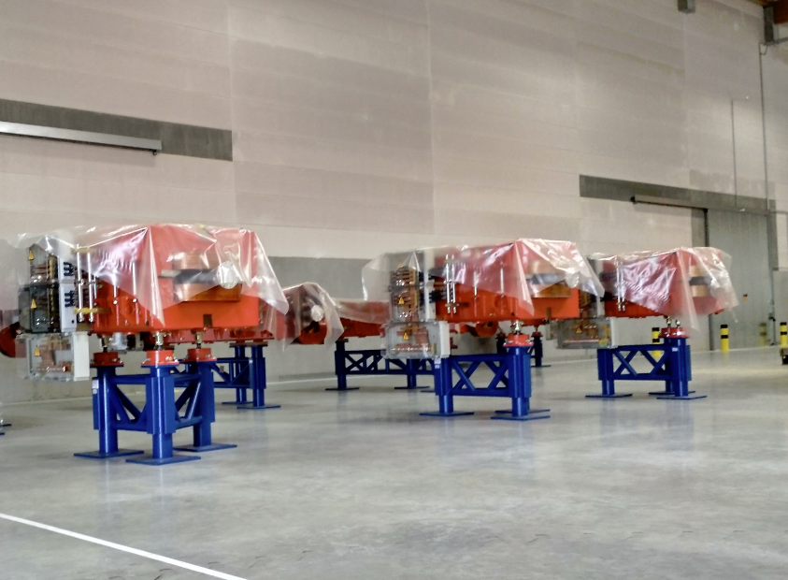
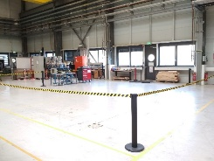
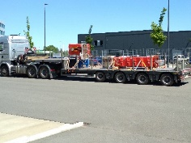
Pre-Assembly, Testing → Storage “Ready for Installation”
  Pre-Assembly of HEBT-Magnets: typical workflow
LCM Planning
of activities
Delivery of
parts to GSI
Execution of
Pre-Assembly
Transportation to intermediate storage
Unloading in storage building
Storage & Protection
Preparation of area for
new delivery
4

Slide 5
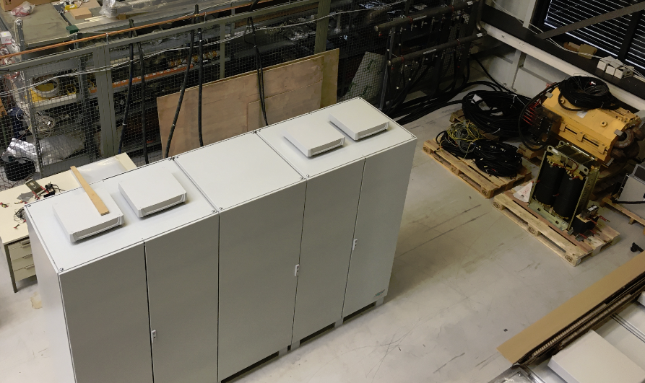
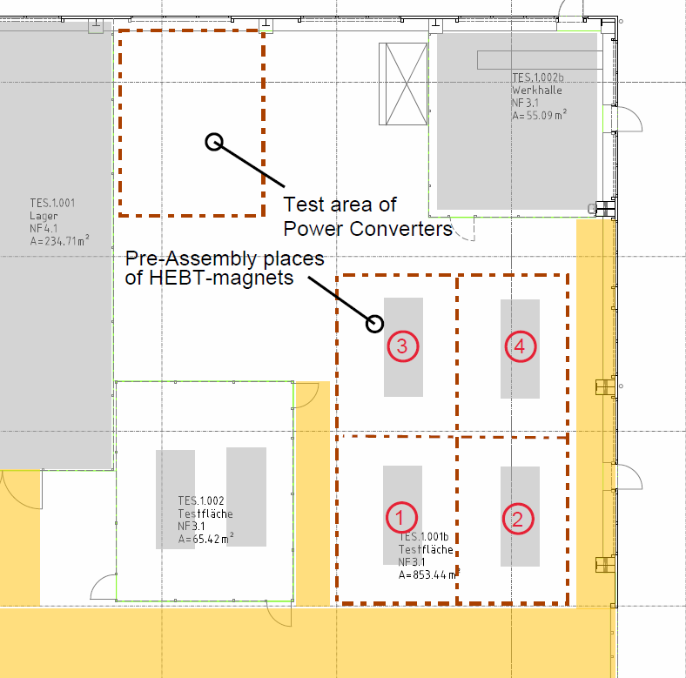
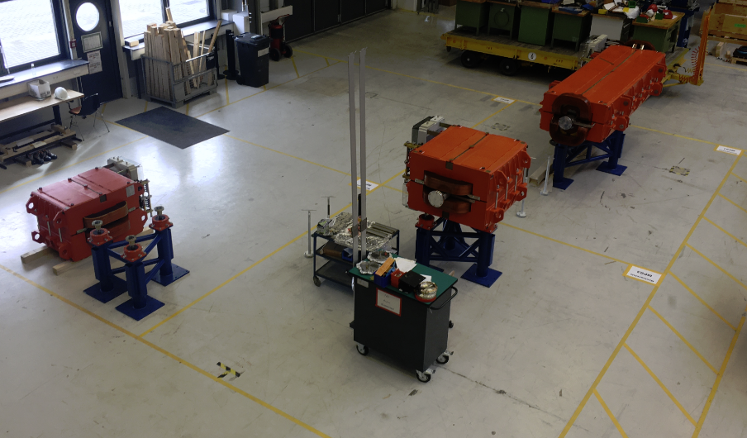
Pre-Assembly and Testing
  Definition of Pre-Assembly and testing areas in the Testing Halle (TES)
Power converters
Statistiken und Daten
HEBT Magnets
5

Slide 6
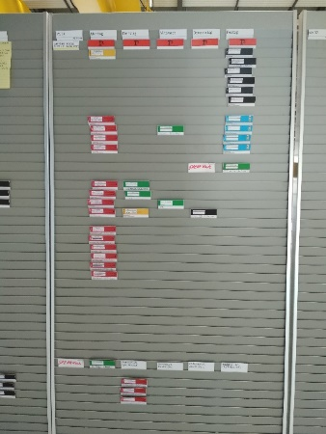
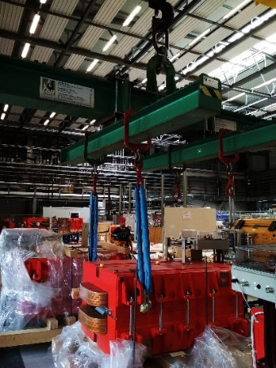
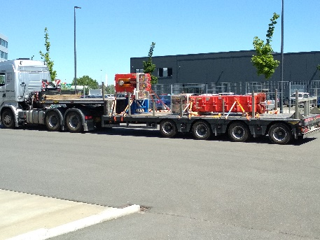
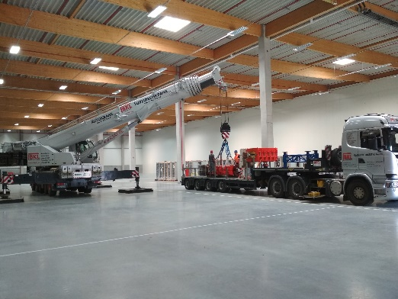
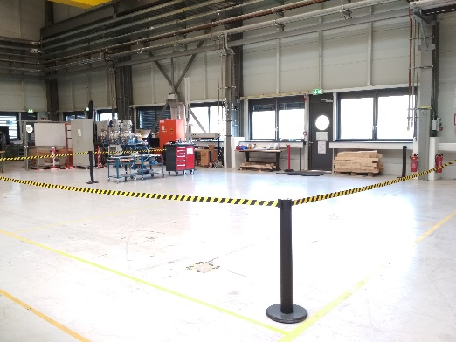
Installation – Pre-Assembly and Testing
  Pre-Assembly of HEBT-Magnets: Typical Workflow
LCM Planning of
activities
Delivery of single
parts to GSI
Execution of Pre-Assembly
Transport of assembled magnets
to intermediate storage
Unloading in storage building managed by external logistic partner
Storage & Protection
Preparation of Pre-Assembly area for
new delivery
6

Slide 7
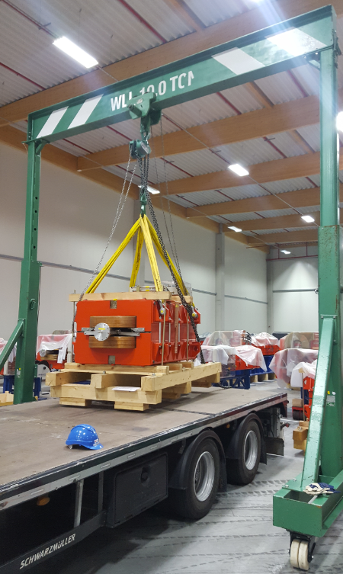
Transport - & Storage Logistics
  Storage of FAIR components in Weiterstadt
      Logistic management by DB Schenker in close collaboration with GSI logistic department
      Regular data exchange between SAP PLM and Schenker logistic software
      successful test run of mobile bridge crane in order to reduce efforts for truck-mounted crane. Procurement started.
      Installation of shelves to effectively store pallets and smaller components
      Removal of building’s partition wall to improve arrangement and handling of stored components
7

Slide 8
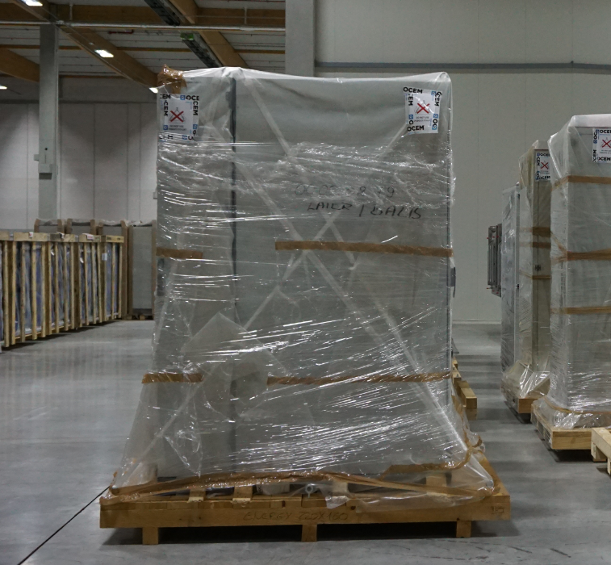
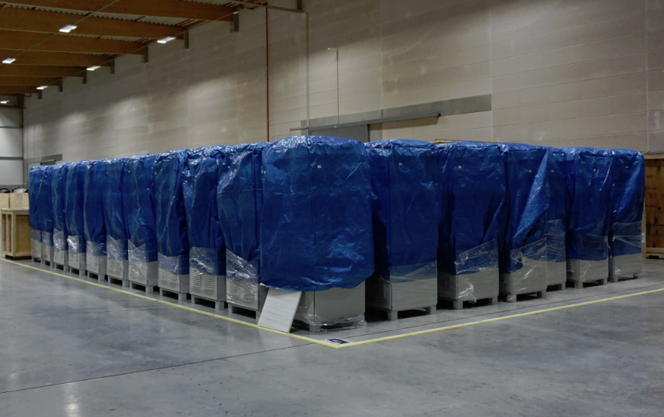
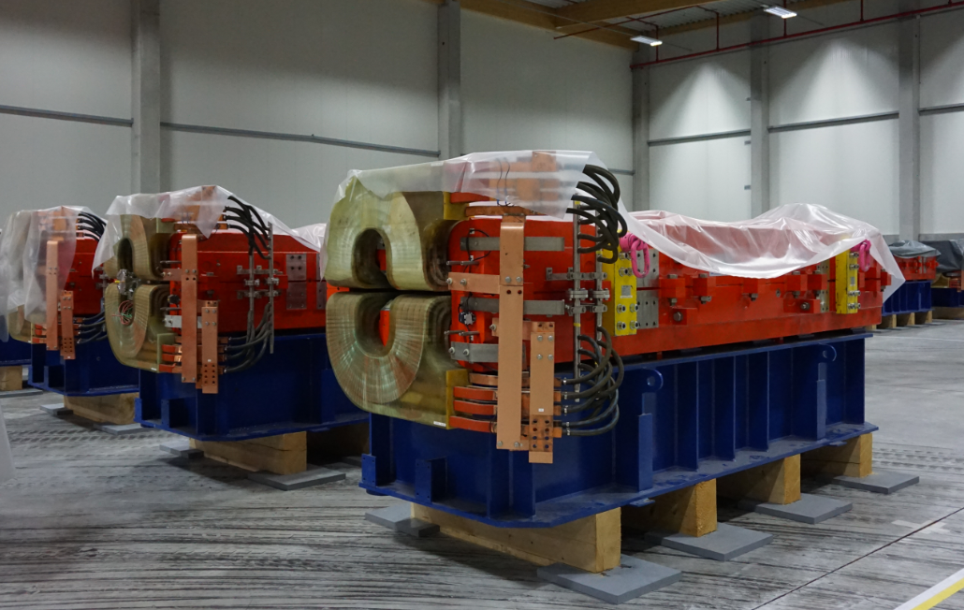
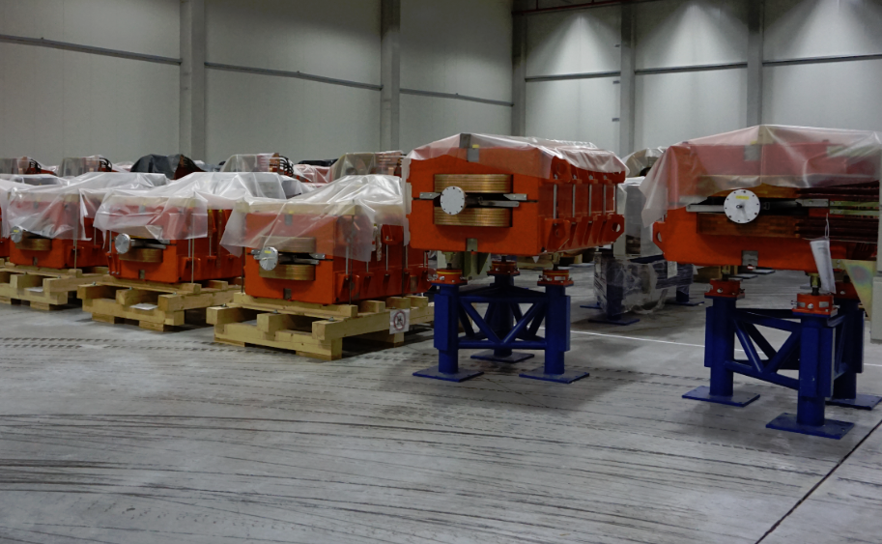
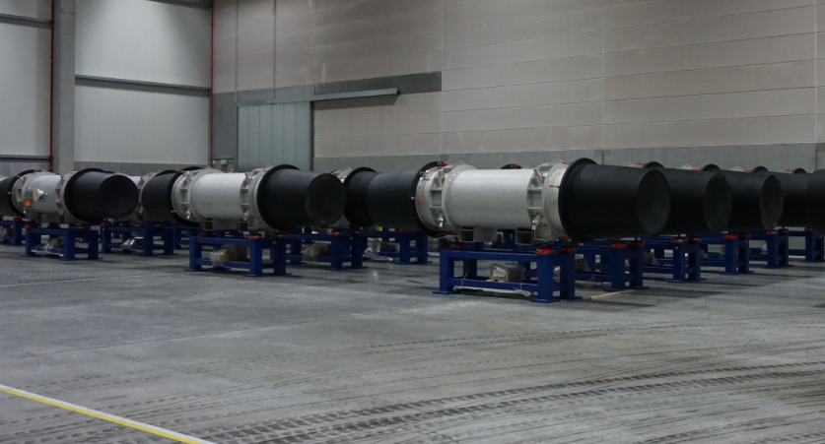
Storage Logistics
(external storage, managed by external company (DB Schenker)
  Main Components currently stored in Weiterstadt
      300 Racks
      70 Power Converters
      40 HESR-Dipoles
      25 HEBT-Dipoles
      30 SIS100 Dipoles
8

Slide 9
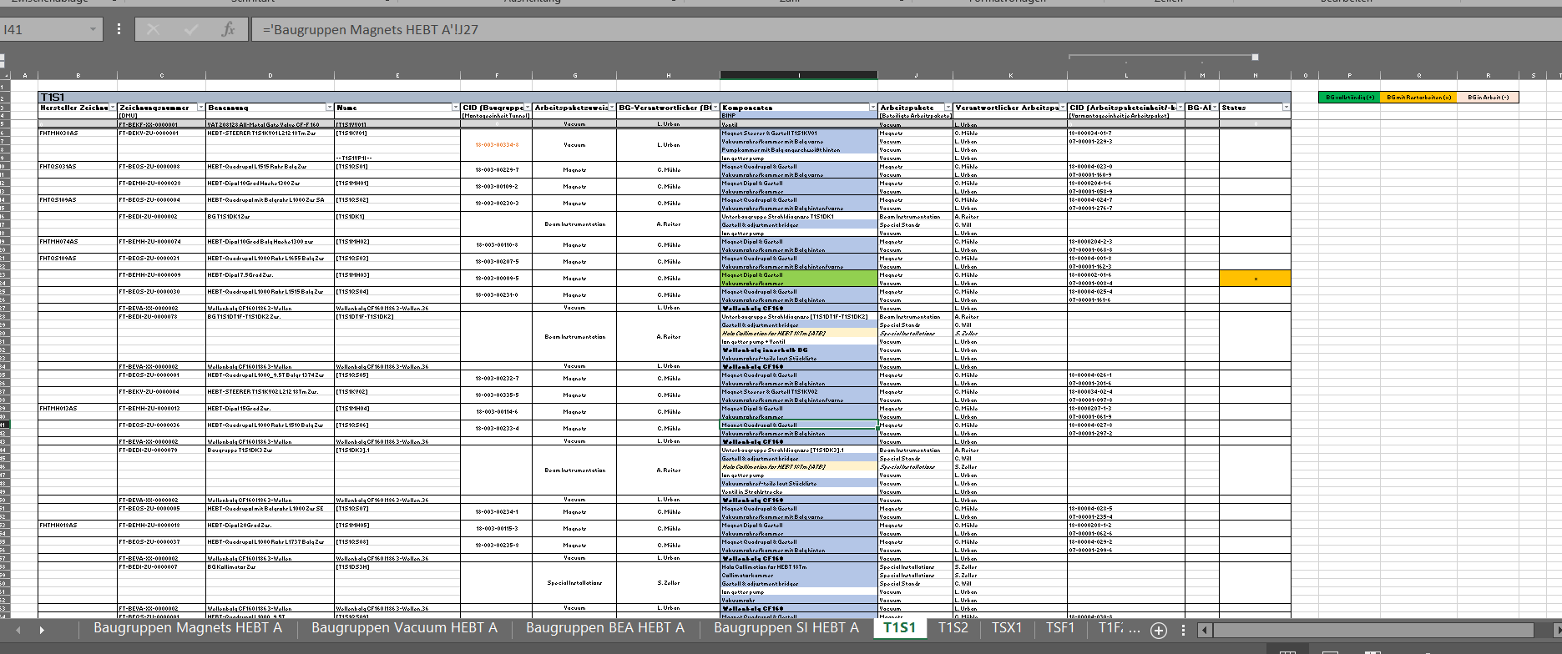
Pre-Assembly GSI/FAIR
Tracking of Components and Assembly Units (example HEBT)
Status of
all components „along the beamline“
all Pre-Assembly Units
tracking items by
delivery packages
beamlines
workpackages
responsibilities
Delivered
Assembled
BINP inkind

Slide 10
Pre-Assembly CR and SFRS Target Hall (proposal)
 | Task Name | end of SAT | arrival at FAIR (ready for pre-assembly | Q2/2020 | Q3/2020 | Q4/2020 | Q1/2021 | Q2/2021 | Q3/2021 | Q4/2021 | Q1/2022 | Q2/2022 | Q3/2022 | Q4/2022 | Q1/2023 | Q2/2023 | Q3/2023 | Q4/2023 | Q1/2024 | Q2/2024
Building ready for installation |  |  |  |  |  |  |  |  |  | G006 (SFRS) Ready | G018 (SFRS) Ready |  | G007 (CR) ready
SFRS | SM_02 FoS | 07.04.2020 | 14.04.2020
 | LM_11 FoS cool down to 4 K and test | 15.09.2020 | 22.09.2020
 | SM_4 | 29.09.2020 | 06.10.2020
 | SM_8 (spare) | 27.10.2020 | 03.11.2020
 | SM_3 | 10.11.2020 | 17.11.2020
 | SM_5 | 08.12.2020 | 15.12.2020
 | SM_6 | 19.01.2021 | 26.01.2021
 | SM_1 | 16.02.2021 | 23.02.2021
 | SM_7 | 16.03.2021 | 23.03.2021
 | LM_1 | 20.04.2021 | 27.04.2021
 | SCD_01 cool down to 4 K and test | 04.05.2021 | 11.05.2021
 | LM_2 | 04.05.2021 | 11.05.2021
 | LM_3 | 01.06.2021 | 08.06.2021
 | SCD_04 | 15.06.2021 | 22.06.2021
 | LM_4 | 13.07.2021 | 20.07.2021
 | SCD_05 | 27.07.2021 | 03.08.2021
 | SCD_03 | 24.08.2021 | 31.08.2021
 | SCD_02 | 07.09.2021 | 14.09.2021
 | SCD_06 | 07.09.2021 | 14.09.2021
 | LM_5 | 05.10.2021 | 12.10.2021
 | SCD_07 | 19.10.2021 | 26.10.2021
 | LM_6 | 16.11.2021 | 23.11.2021
 | SCD_08 | 30.11.2021 | 07.12.2021
 | SCD_09 | 25.01.2022 | 01.02.2022
 | LM_8 | 08.02.2022 | 15.02.2022
 | SCD_10 | 22.03.2022 | 29.03.2022
 | SCD_12 | 05.04.2022 | 12.04.2022
 | SCD_11 (branch) | 26.04.2022 | 03.05.2022
 | SCD_13 | 10.05.2022 | 17.05.2022
 | SCD_15 | 24.05.2022 | 31.05.2022
 | LM_7 | 07.06.2022 | 14.06.2022
 | SCD_16 | 21.06.2022 | 28.06.2022
 | SCD_17 | 05.07.2022 | 12.07.2022
 | LM_9 | 19.07.2022 | 26.07.2022
 | LM_13 | 02.08.2022 | 09.08.2022
 | SCD_18 | 16.08.2022 | 23.08.2022
 | LM_10 | 30.08.2022 | 06.09.2022
 | LM_14 | 13.09.2022 | 20.09.2022
 | LM_15 | 27.09.2022 | 04.10.2022
 | LM_12 | 11.10.2022 | 18.10.2022
 | LM_16 | 25.10.2022 | 01.11.2022
 | SCD_20 | 08.11.2022 | 15.11.2022
 | SCD_14 (branch) | 17.01.2023 | 24.01.2023
 | LM_17 | 17.01.2023 | 24.01.2023
 | LM_19 | 13.02.2023 | 20.02.2023
 | SCD_19 | 14.03.2023 | 21.03.2023
 | SCD_22 | 14.03.2023 | 21.03.2023
 | LM_20 | 17.04.2023 | 24.04.2023
 | SCD_21 | 02.05.2023 | 09.05.2023
 | LM_21 | 05.05.2023 | 12.05.2023
 | SCD_24 | 29.05.2023 | 05.06.2023
 | LM_18 | 13.06.2023 | 20.06.2023
 | LM_22 | 10.07.2023 | 17.07.2023
 | LM_24 (spare) | 18.08.2023 | 25.08.2023
 | SCD_23 (branch) | 22.08.2023 | 29.08.2023
 | EB_LM_02 | 29.09.2023 | 06.10.2023
 | LM_23 | 03.10.2023 | 10.10.2023
 | EB_LM_04 | 10.11.2023 | 17.11.2023
 | EB_LM_01 | 14.11.2023 | 21.11.2023
 | EB_LM_05 | 19.01.2024 | 26.01.2024
 | EB_LM_03 | 23.01.2024 | 30.01.2024
 | EBD_01 FoS | 05.02.2024 | 12.02.2024
 | EBD_02 | 08.04.2024 | 15.04.2024
 | EBD_03 | 20.05.2024 | 27.05.2024
CR | FOS Dipole
 | FOS Quad
 | Dipol series (25)
 | Quad series (45)
SFRS
5 long multiplets/dipole delivered before access to building (59t / 52t)
14 short multiplets delivered before access to building (24t / 18t)
SFRS Storage area requested : ~ 350 m2
CR Storage area requested : ~ 250 m2
7 dipoles delivered before access to building (60 t)
CR
15 quads-groups delivered before access to building (22 t)
10

Slide 11
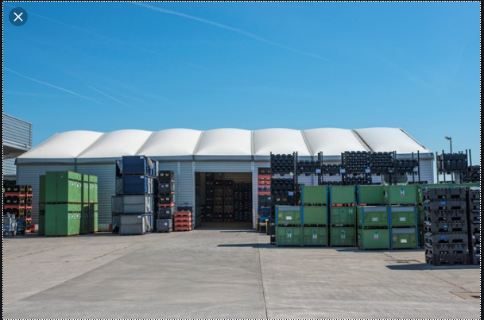
Pre-Assembly CR and SFRS Target Hall (proposal)
Pre-Assmenly area
Handling /Transport area
Storage area
(max 1500m2)
Unloading by TH crane (30t) or mobile crane (70t)
floor transport by air cushion system
11

Slide 12
Pre-Assembly GSI/FAIR

Slide 13
Site Management – Pre-Assembly & Installation
Pre-Assembly:
  technical drawings assembly unit
  parts list
  work instructions
  QC protocols
  documentation as built
  release protocol → „ready for installation“
Installation:
  technical drawings assembly unit & accelerator section
  parts list
  work instructions
  risk assesment (safety at work)
  QC protocols
  documentation as built
FAIR | BINP | To be discussed

Slide 14
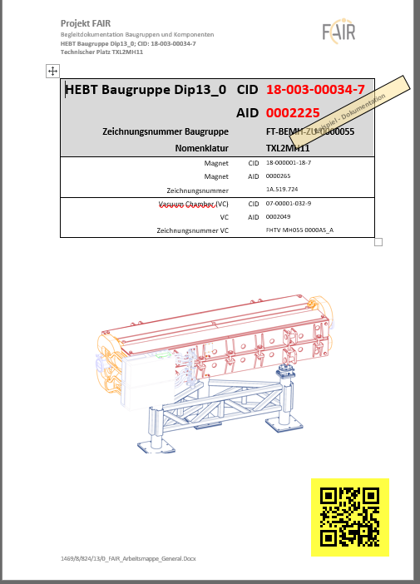
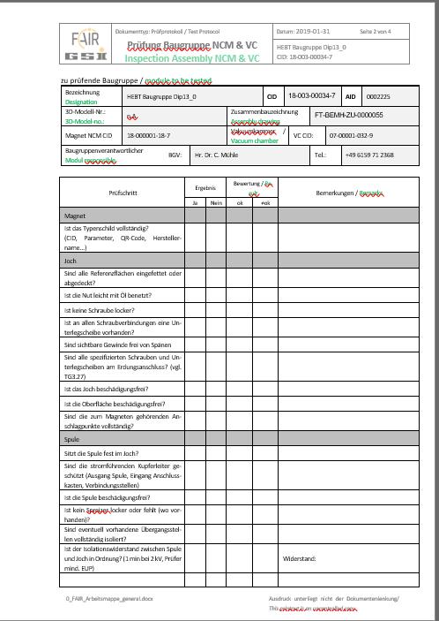
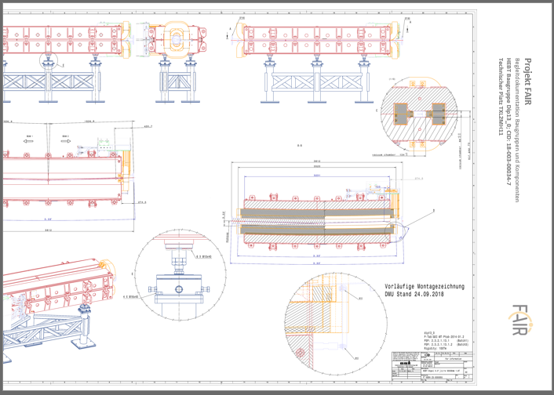
Site Management – Pre-Assembly & Installation
HEBT contracts
CR contracts
Pre-Assembly:
  technical drawings assembly unit
  parts list
  work instructions
  QC protocols
  documentation as built
  release protocol → „ready for installation“
At GSI/FAIR:
standard workflow for Pre-Assembly of HEBT magnet units established
in preparation:
  SIS magnet modules, RF units, beam diagnostic units,…
  SFRS magnet modules,
  CR
Objektive 1 :
to agree scope and content of the required documentation.
to confirm contractual obligations and partner‘s responsibilities.

Slide 15
Site Management – Pre-Assembly & Installation
CR contracts
documents essential for pre-assembly, contracted (?) FAIR /BINP:
component technical drawing
component QC protocols
component handling instructions
….documents for vacuum chamber integration ?
….
Not included in contracts between BINP and FAIR:
….
…..
…
Objektive :
to confirm contractual obligations and partner‘s responsibilities.

Slide 16
Site Management – Pre-Assembly & Installation
HEBT contracts
documents essential for pre-assembly, contracted (?) FAIR /BINP:
component technical drawing
component QC protocols
component handling instructions
….documents for vacuum chamber integration ?
….
Not included in contracts between BINP and FAIR:
….
…..
…
Objektive :
to confirm contractual obligations and partner‘s responsibilities.

Slide 17
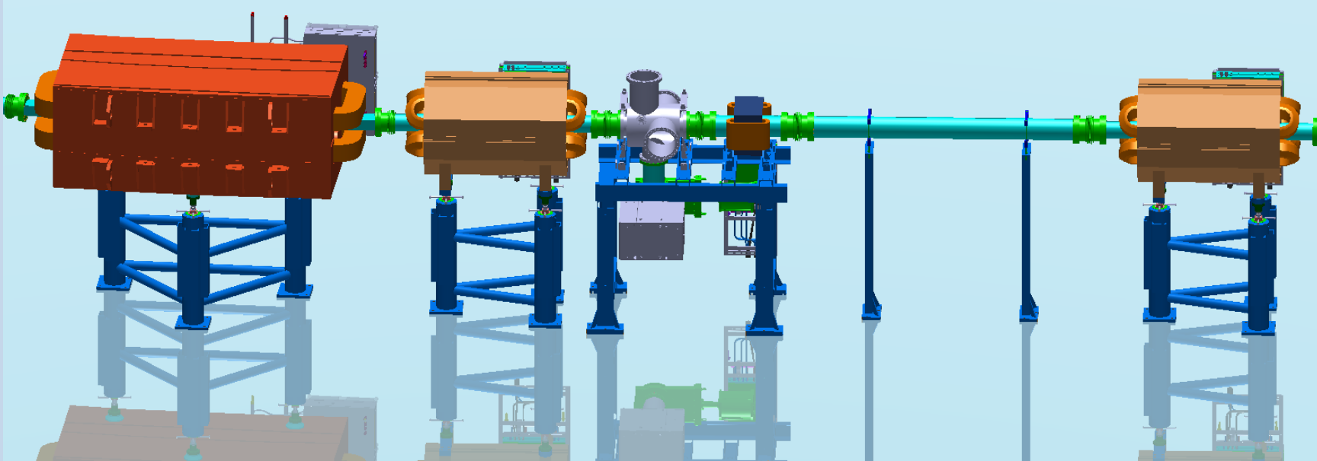
Machine Installation – Definition of Assembly Units
nc dipole unit
nc 4-pole unit
BI & nc steerer unit
straight vacuum unit
nc 4-pole unit
Magnet (CID)
  yoke
    upper
    lower
  coil
    upper
    lower
  Hall-sensor
  connection box
  base frame
  alignment supports
    no 1
    no 2
    no 3
Vacuum Chamber (CID)
Magnet (CID)
  yoke
    no1
    no2
    no3
    no4
  coil
    no1
    no2
    no3
    no4
  connection box
  base frame
  alignment supports
    no 1
    no 2
    no 3
Vacuum Chamber (CID)
BI Vac chamber (CID)
  Detector 1 (CID)
    part no1
    flange
    part no2
  Detector 2 (CID)
    part no1
    flange
    part no2
  Vac pump (CID)
  Vac diagnostics (CID)
  connection box
  base frame
  alignment supports
    no 1
    no 2
    no 3
Vac chamber (CID)
support frame no1
support frame no2
Magnet (CID)
  yoke
  coil
  connection box
  base frame
  alignment supports
Vacuum Chamber (CID)
Each defined Assembly Unit:
Documentation in PLM including:
  Sub-components
  Status
  Location
  executed works and tests

Slide 18
Site Management – Pre-Assembly & Installation
HEBT contracts
Installation:
  technical drawings assembly unit & accelerator section
  parts list
  work instructions
  risk assesment (safety at work)
  QC protocols
  documentation as built
Objektive 2 (Installation manual):
to agree scope and content of the required documentation.
to confirm contractual obligations and partner‘s responsibilities.
CR contracts

Slide 19
Site Management – Pre-Assembly & Installation
HEBT contracts
documents essential for Installation, contracted (?) FAIR /BINP:
sector technical drawings
sector QC protocols
handling instructions
risk assesment
….documents for final sector testing ? ?
….
Not included in contracts between BINP and FAIR:
….
…..
…
Objektive :
to confirm contractual obligations and partner‘s responsibilities.

Slide 20
Site Management – Pre-Assembly & Installation
CR contracts
documents essential for Installation, contracted (?) FAIR /BINP:
sector technical drawings
sector QC protocols
handling instructions
risk assesment
….documents for final sector testing ? ?
….
Not included in contracts between BINP and FAIR:
….
…..
…
Objektive :
to confirm contractual obligations and partner‘s responsibilities.

Slide 21
Mechanical Completion (Definition)
After all mechanical works including pre-commissioning (PC) activities are completed:
  Each component installed conforms to or is fabricated and tested
  According project specifications (Performance & Safety) ✓
After release of the Mechanical Completion Certificate (Milestone) by the client:
  Handover to operation for commissioning
Commissioning
Procurement
Operation
Pre Assembly
Mechanical Completion
Installation on site
Pre-Commissioning

Slide 22
Site Management – Pre-Assembly & Installation
FAT
Transport
SAT
Installation
FAT
Transport
SAT
Pre-Assembly
Installation
who ensures the completeness of documents essential for:
mechanical completion
release for commissioning

Slide 23
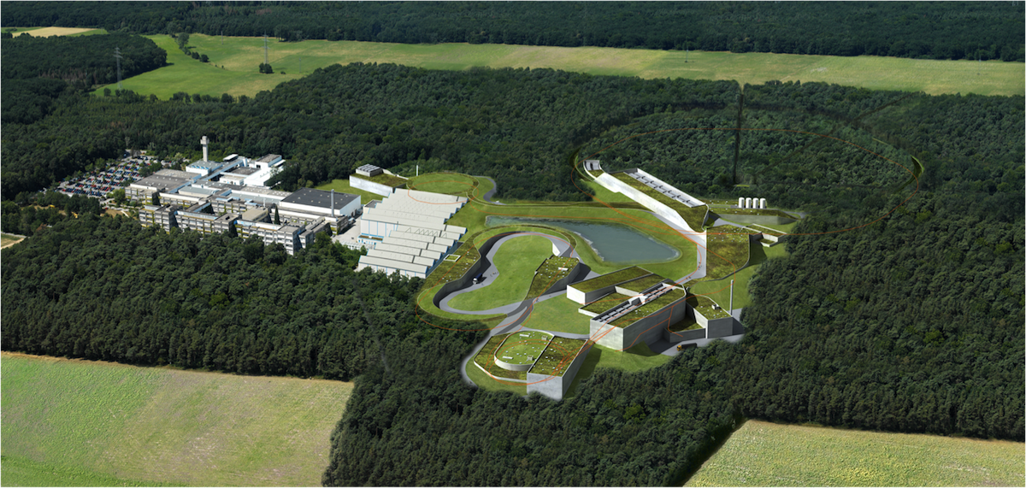


Thank you very much !

