Slide 1
3rd BINP Workshop Novosibirsk 25. – 29.11.2019 CR detailed Installation Schedule
H Reich-Sprenger & H Hagelskamp

Slide 2
Site Management - Objectives
Detailed Installation Plan:
align LCM results with MS Projects plan
agree on detail installation sequences at the interface with HEBT Transport and P-Bar Antiproton Target.
injection and extraction lines.
Take HESR as example and guideline.
Objective 4:
finalize installation schedule
finalize resource requirements
agree on resource support and interaction between GSI and BINP.

Slide 3
Machine Installation – Project Planning CR
Installation window 09-2022 to 09-2023

Slide 4
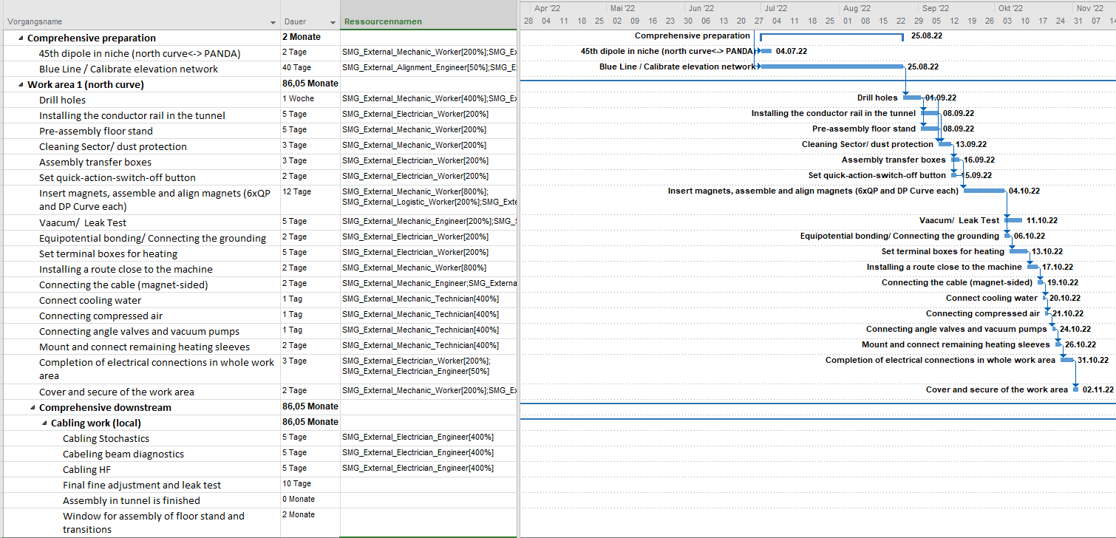
Machine Installation – Project Planning CR
MS Project current status – does not completely reflect BINP concept
Required MS Project structure:
showing processes and activities; ie. mechanical, water, electrical
showing test activities; ie vacuum testing, first functional tests

Slide 5
Machine Installation – Project Planning CR
Proposal from Installation Team.
PMO generate a standard template for CR installation schedule.
standard sequence of activities
standard logic links.
similar to HESR and HEBT.
BINP provide inputs:
to confirm CR installation sections (arcs and straights)
to confirm installation sequence of beam line.
to confirm installation sequence of supply units.
process of cooling water installation.
process of electrical connections (both ends).
concept and sequence of testing activities.

Slide 6
Site Management - Objectives
Manpower Resources
for installation and preassembly
Manpower estimate by BINP
for HEBT
for CR
mixed teams
300 magnets => 300 days for three people
crane and transport equipment by FAIR
Objectives 5:
define and agree manpower requirements
Qualification and Capacities
Define time schedules for deployment
Pre-Assembly
Installation
BINP – FAIR workshop 2018 , H. Hagelskamp, H. Reich-Sprenger

Slide 7
Machine Installation – Project Planning CR
MS Project – generic resource planning
Current Resource Plan: indicates 25 FTE from BINP on average and 45 at peak time.
Proposed Resource Plan (estimated from HEBT&HESR):
Min. 3 crews consisting of 1 engineer / 1 technician / 4 mechanical workers / 2 electrical workers = 24 FTE from BINP
plus 2 FTE - external logistics.
plus 2 FTE - external alignment.

Slide 8
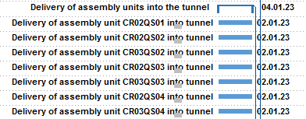
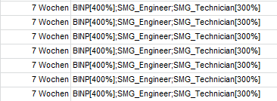
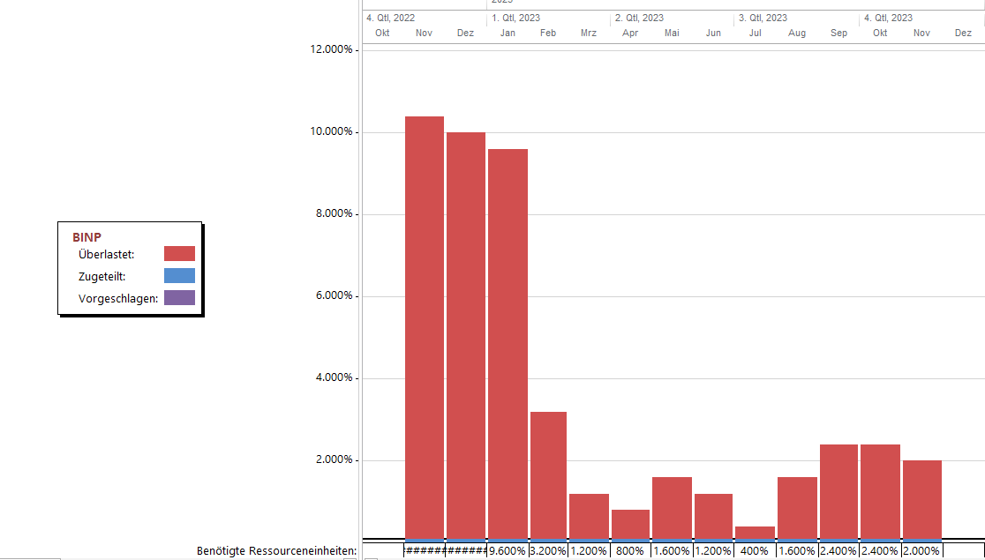
Machine Installation – Project Planning CR
MS Project current status – resource planning
current delivery capacity plan: 7 weeks x 8 people = 56 man weeks per assembly unit
total result: delivery of assembly units = >100 FTE in Nov 2022
general overhaul needed for MS Project
inaccuracy leads to controversial reporting

Slide 9
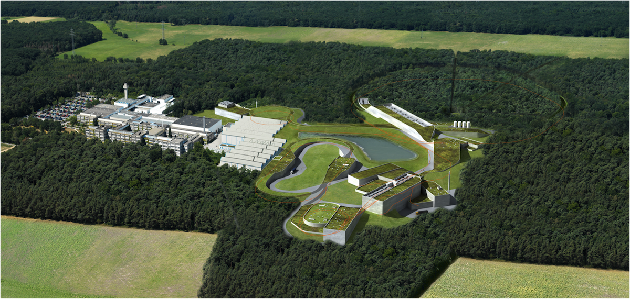
Thank you very much !

