Slide 1
Cr ScRAPERs
FAIR Contract No. CC 2.5.2.2.1
Work Packages: PSP 2.5.6.6.1
Yury Rogovsky on behalf of CR team
Budker Institute of Nuclear Physics
November 28, 2019
3rd FAIR-BINP Workshop,Novosibirsk, Russia

Slide 2
Contents
CDR documentation
Project management structure
Screpers in the CR
  General overview
  Construction. General view. Type 1, type 2.
  Functional description
  Location
  Features of using
Production and realization – manufacturing process chart
Monitoring and measurements
Control documents & data records
Risk analysis
Production plan

Slide 3
FDR documentation for Beam Scraper
The Detailed Specification is outlined in EDMS => https://edms.cern.ch/document/1577945/1.8
The set of documents for the CR_Beam Scraper is given in EDMS
CR_Beam Scraper Type-1 AID:0002492
Mechanics - 3D model [AID:0002492] => https://edms.cern.ch/document/2150209/1
Mechanics - 2D drawings and BoM [AID:0002492] => https://edms.cern.ch/document/2150210/1
Test plan [AID:0002492] => https://edms.cern.ch/document/2150205/1
Risk analysis and hazard analysis [AID:0002492] => https://edms.cern.ch/document/2150201/1
Operating manual / user manual [AID:0002492] => https://edms.cern.ch/document/2150203/1
CR_Beam Scraper Type-2 AID:0002496
Mechanics - 3D model [AID:0002496] => https://edms.cern.ch/document/2150243/1
Mechanics - 2D drawings and BoM [AID:0002496] => https://edms.cern.ch/document/2150244/1
Test plan [AID:0002496] => https://edms.cern.ch/document/2150239/1
Risk analysis and hazard analysis [AID:0002496] => https://edms.cern.ch/document/2150235/1
Operating manual / user manual [AID:0002496] => https://edms.cern.ch/document/2150237/1

Slide 4
FDR documentation for Beam Scraper
The Detailed Specification is outlined in EDMS => https://edms.cern.ch/document/1577945/1.8
The set of documents for the CR_Beam Scraper is given in EDMS
Also the corresponding sets of documents have been uploaded for the following assigned AIDs
CR_Beam Scraper Type-2 (AID:0002496);
CR_Vacuum Chamber, Mechanics others for CR_Beam Scraper Type-1 (AID:0002493);
CR_Stepping-motor Drive for CR_Beam Scraper Type-1 (AID:0002494);
CR_Stepping-motor Control for CR_Beam Scraper Type-1 (AID:0002495);
CR_Vacuum Chamber, Mechanics others for CR_Beam Scraper Type-2 (AID:0002497);
CR_Stepping-motor Drive for CR_Beam Scraper Type-2 (AID:0002498);
CR_Stepping-motor Control for CR_Beam Scraper Type-2 (AID:0002499)

Slide 5

Project Management Structure
Work Package Leader (WPL): Yury Rogovsky, Research Scientist)
The Project Manager is responsible for:
  Development of the technical documentation and manufacturing drawings for the deliverables;
  Ensuring that the production of the BPM system is according to the technical specifications and time schedule;
  Follow-up of production activities;
  Transportation, delivery of the equipment to the FAIR site;
  Regular and timely reporting on progress and problems;
  Timely conduction/participation of reviews and provisions of feedback;
  Factory Acceptance Test (FAT) and Site Acceptance Test (SAT) to verify the given specifications of the components;
Deputy : Oleg Meshkov, Head of Laboratory
The Deputy is responsible for:
  Follow-up of production activities;
  Validation of the achievements at the defined milestones;
  Control of the documents to be delivered to FAIR;
  Regular and timely reporting on progress and problems;
  Timely conduction/participation of reviews and provisions of feedback;
  Factory Acceptance Test (FAT) to verify the given specifications of the components;
  SAT (Site Acceptance Test)
Scientific Design Department
Name: Vladimir Cheskidov, Principal Design Engineer)
The Principal Design Engineer is responsible for:
  Beam stopper design (3D-models, production drawings);

Slide 6
BScr: General overview
Beam scrappers are intercepting devices to restrict a 2-dimensional intensity distribution of the antiproton or ion beam in the transversal plane. Each scrapper contains the opposite blades both at X, Y directions. It enables us to restrict both dimension of vacuum chamber at the scrapper position.
The SCR consists of:
Blades of beam scrapper on holder
Mechanical drive to move the blades in and out of the vacuum chamber
Vacuum chamber to house and mount all the required components
Electronics and DAQ
The mechanical drive consist from stepper motor, reduction gear and ball spline. All of them are purchased items

Slide 7
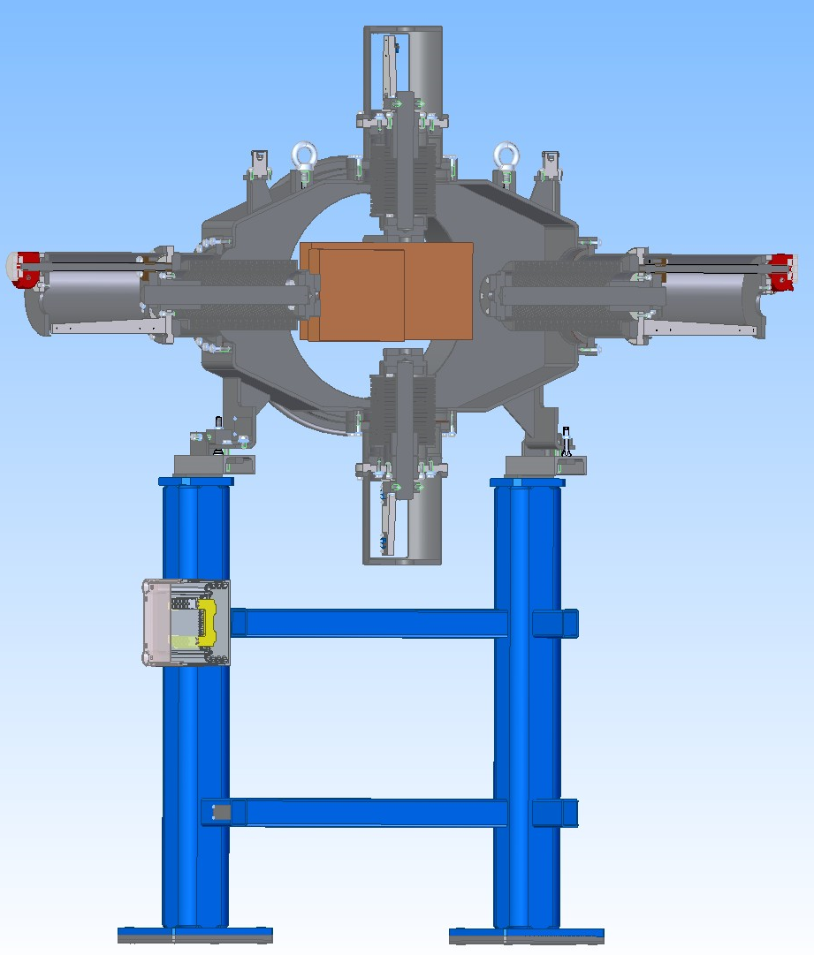
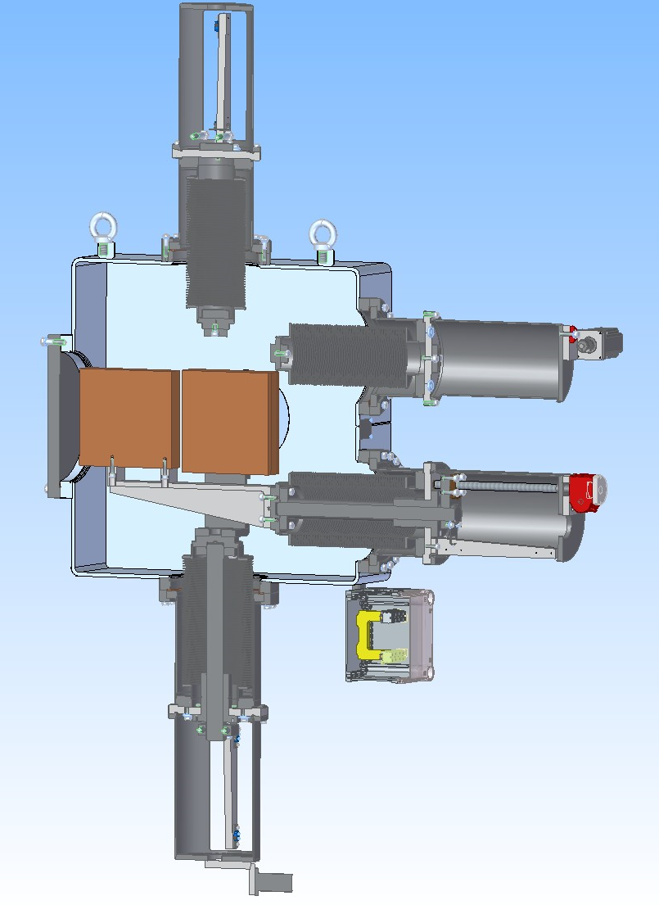
Construction. General view. Type 1, type 2.
Blade thickness is 50 mm
The weight of one blade is about 20 kG
Speed of the blade movement is 2.5 mm/sec
Each blade has two end switches and potentiometer for measurement of position

Slide 8
Functional description
Charged particles (antiprotons or ions) that impinge on the scrapper body lose their energy in the material according to their specific energy loss, which is a function of the particle type, its energy and charge, material type Main source of the losses is the energy losses for ionization of the matter.
Material \ Energy loss | Antiprotons, 4% | Antiprotons, 10% | Antiprotons, 100% | Ions, 100%
 | Z = 1 | Z = 1 | Z = 1 | Z = 40 / Z = 92
Carbon | 29.0 cm | 72.3 cm | 637.1 cm | 7.0 / 2.5 cm
Aluminum | 26.9 cm | 67.2 cm | 596.4 cm | 6.4 / 2.3 cm
Iron | 10.6 cm | 26.5 cm | 237.1 cm | 2.5 / 0.9 cm
Copper | 9.4 cm | 23.4 cm | 209.7 cm | 2.2 / 0.8 cm
Tungsten | 5.4 cm | 13.5 cm | 122.5 cm | 1.2 / 0.5 cm
Lead | 9.5 cm | 23.6 cm | 214.6 cm | 2.2 / 0.8 cm

Slide 9
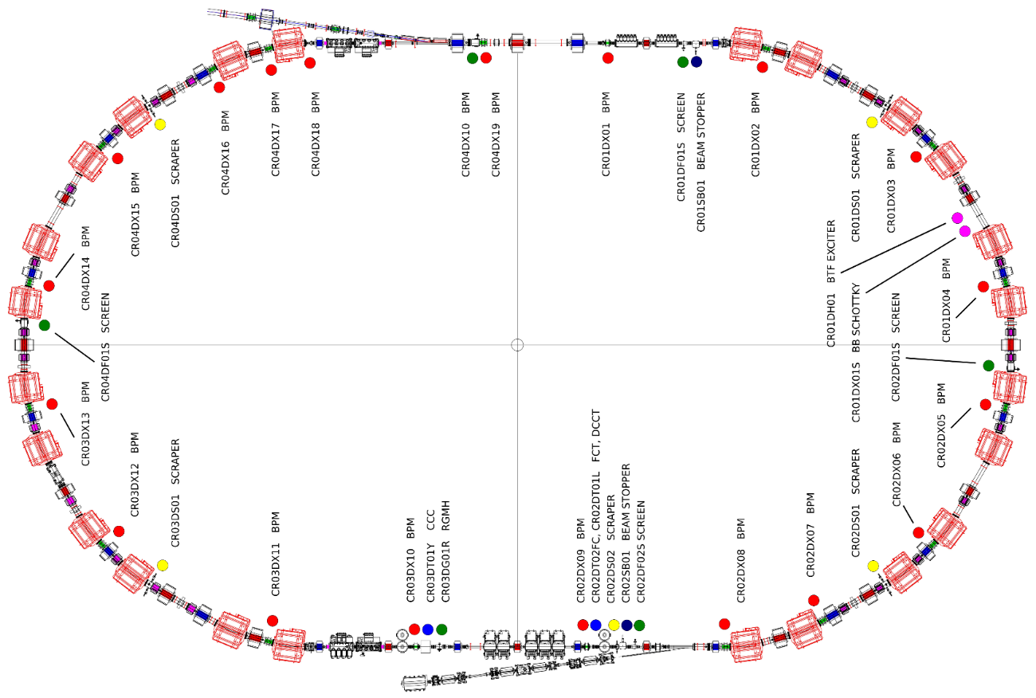
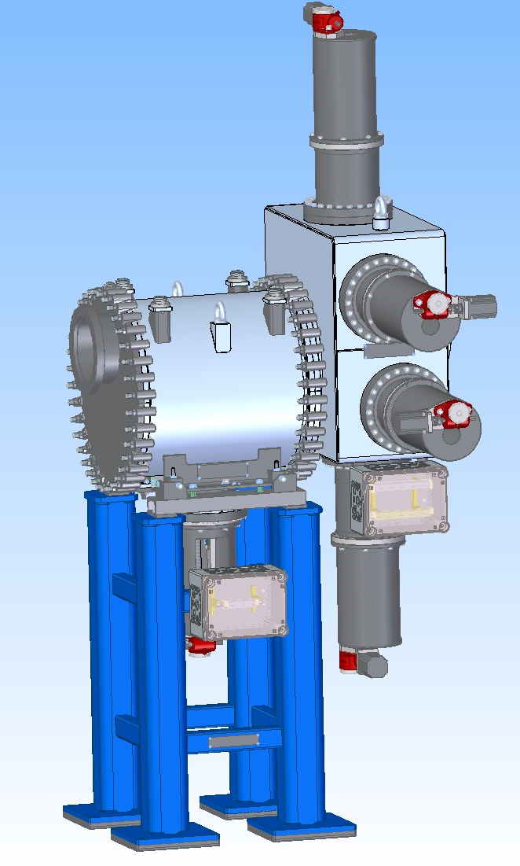
BScr: location
The beam scrappers are marked in the CR drawings as CR01DS1, CR02DS1, CR02DS2, CR03DS1, CR04DS1.
The SCR will be installed into quarters of the CR (near the center of each quarter) between bending magnets and sextupole.
The SCR installed in the injection straight section is able to operate as a collimator slit.

Slide 10
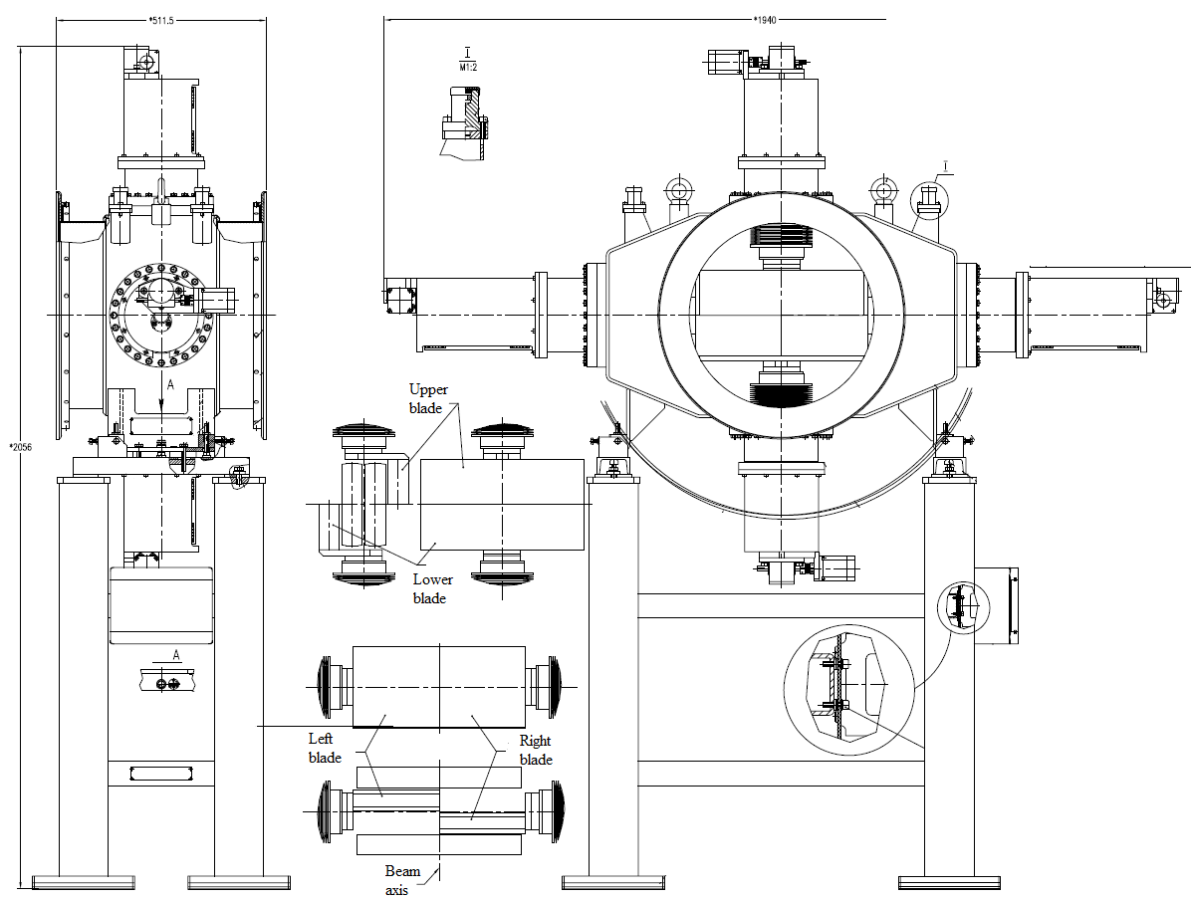
SCR: features of using – two options
The blades of beam scrappers can cut off the beam halo;
With the knowledge of the actual blades position, the estimated beam sizes in principle can be calculated in case then blades are approaching to the beam edge. This position can be determined from the beam lifetime.
Figure 4. Preliminary 2D model of the CR beam scrapper of “Type 1” with vacuum chamber.

Slide 11
BScr : basic parameters
Type | “Type 1” | “Type 2”
Number of elements | 4 | 1
Overall length, flange to flange | 511.5 mm | 458 mm
Horizontal aperture | 390 mm | 160 mm
Vertical aperture | 160 mm | 160 mm
Mechanical drive
Type | Stepper motor PKP569FN24A2
Maximum Holding Torque | 2.1 N*m
Rated Current | 2.4 A/Phase
Basic Step Angle | 0.72
Endpoints | 2
Endpoints switchers | Yes (CHERRY DC1C-L1AA)
Blade material | Cu | Cu
Blade thickness, mm | 50 | 50
Number of blades | 4 | 4

Slide 12
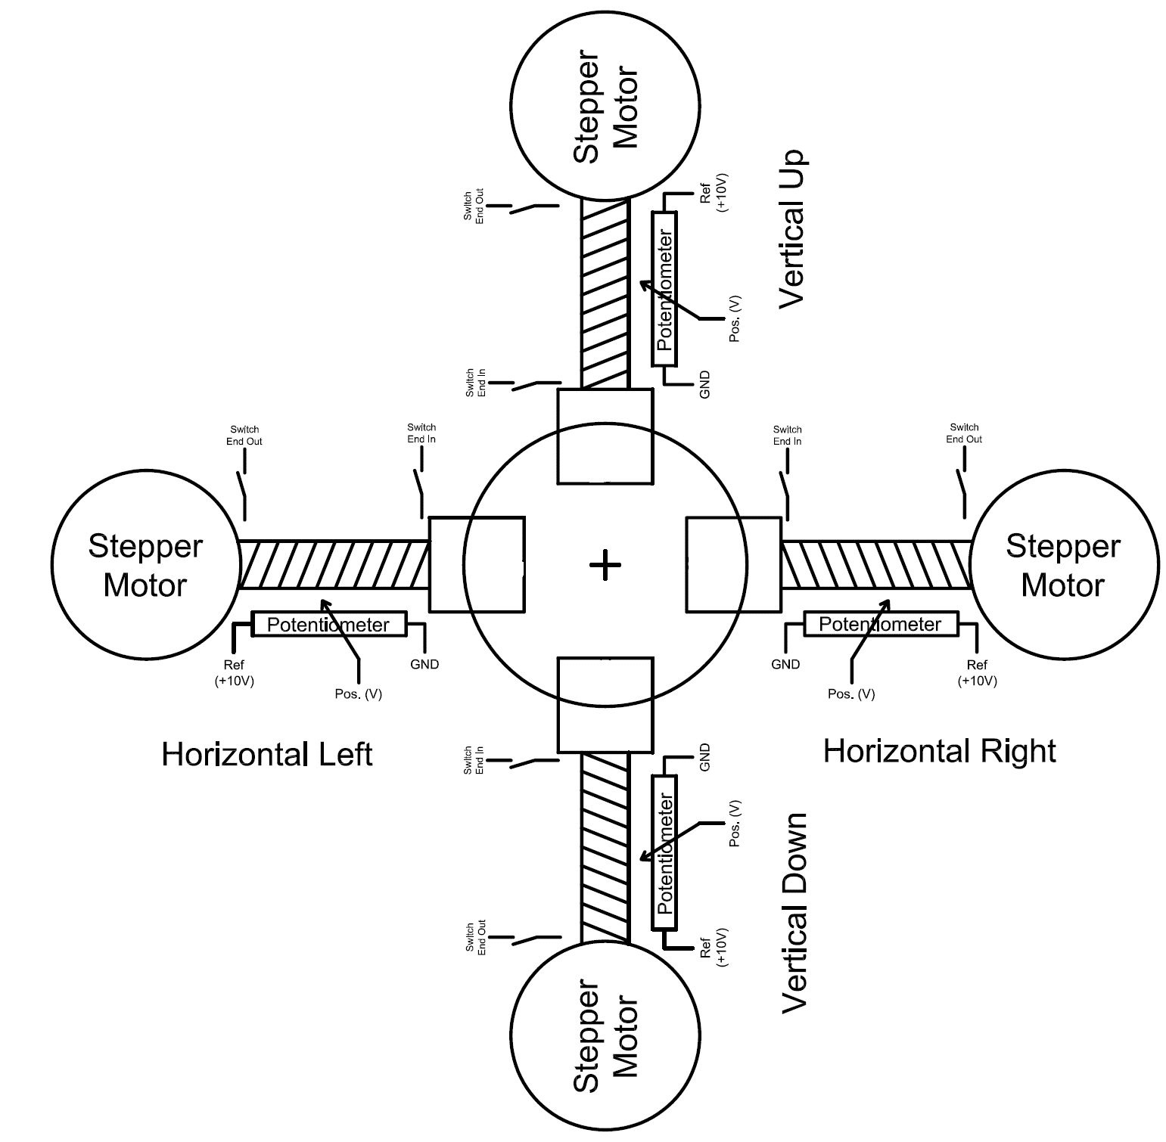
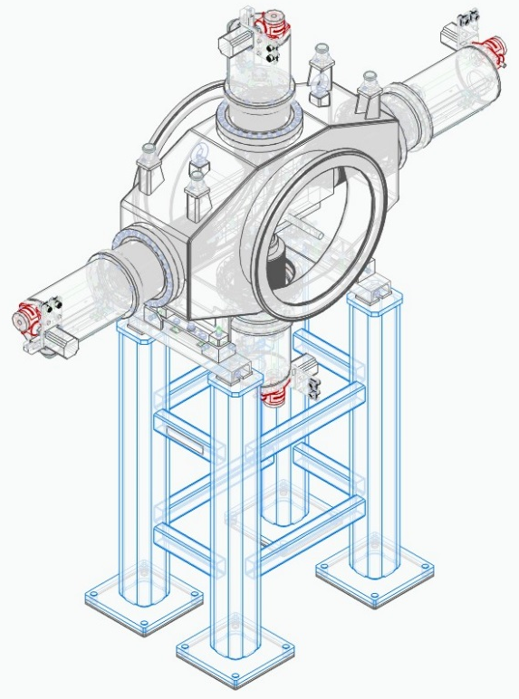
The additions to the Scrapers design introduced after CDR review
1. The design and electric scheme of the end switches meets to the standards of GSI;
2. The CLF-300 potentiometers are introduced for measurement of position of each blade .
The layout of the beam scraper mechanics and control of the blades position

Slide 13
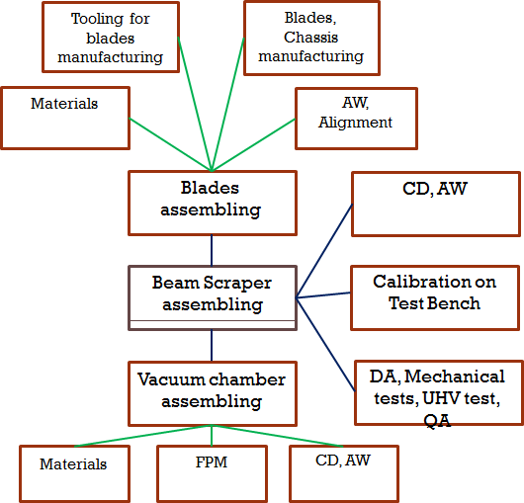
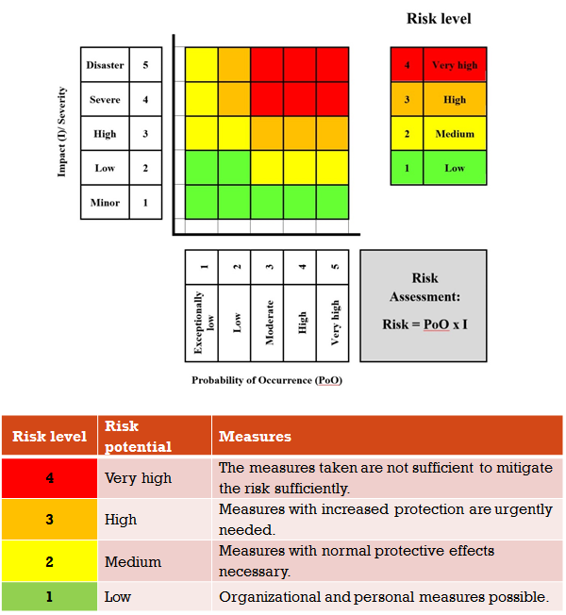
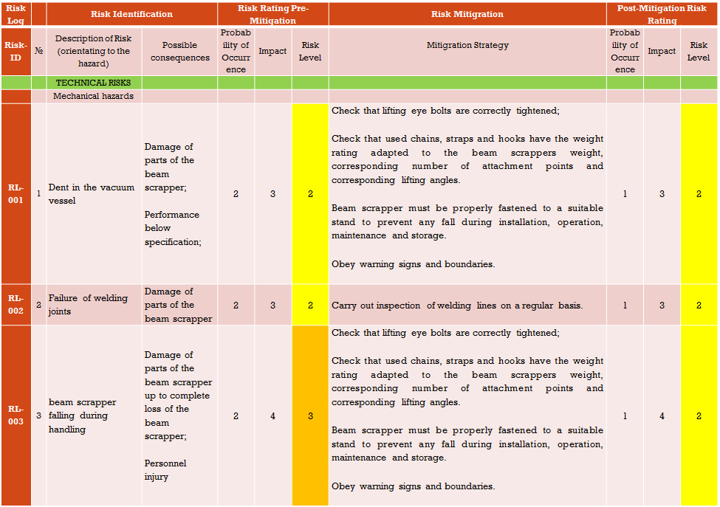
Manufacturing Process Chart,
Risk analysis,
Control documents & data records were discussed and approved during CDR review.
The test and inspection plans are described in details and uploaded to EDMS.

Slide 14
Milestones
June 2019 –October 2019: preparation and passing milestone M6 (CDR)
November 2019 – January 2020: detail designing, preparation of drawings. Passing milestone M7 (FDR). Purchasing required accessories, materials, components
February 2020 – October 2020: tooling production, production, manufacturing at experimental workshop
November 2020 – January 2021: testing, QA, calibration, FoS revision. Passing milestone M8 [ March 2021]
December 2023 – January 2023: final installation in CR tunnel

Slide 15
Thank you for your attention!
Questions ?
15

Slide 16
Back up

Slide 17
Manufacturing Process Chart
Tooling for blades manufacturing
Blades,
Chassis manufacturing
Materials
AW, Alignment
FPM UHV CD VC BSCR AW DA | Flanges & pipes manufacturing Ultra High Vacuum Checking Dimensions Main Vacuum Chamber Beam Scraper Assembling and welding Degassing annealing .
Blades assembling
CD, AW
Beam Scraper assembling
Calibration on Test Bench
Vacuum chamber assembling
DA, Mechanical tests, UHV test, QA
Materials
FPM
CD, AW

Slide 18
Monitoring and measurements
Input tests
  The input tests of the procured products are performed to certify the compliance of procured raw material, components, facilities, measurement and test equipment to quality requirements of the procurement contract.
Factory Acceptance Test (FAT)
  The tests performed by the BINP’s facility shall follow the quality assurance procedures and requirements described in Section 5 of F-CS-BD-01e “Common Specification Beam Diagnostics for FAIR”.
Site Acceptance Test (SAT)
  SAT will be performed by the Contractor at the final location of the equipment according to Section 5 of “Common Specification Beam Diagnostics for FAIR” F-CS-BD-01e “Common Specification Beam Diagnostics for FAIR” including installation at the CR tunnel and commissioning of all components without beam.
  The tests will at least include:
    Verification of mechanical damages
    Mechanical tests
    Principal function tests
    Long time test stability
    Thermal stability test
Final Acceptance
  The Final Acceptance shall take place after the equipment delivery to the FAIR site and the Site Acceptance Test has been passed. The Final Acceptance will be formally documented by a Final Acceptance Protocol. The Final Acceptance Protocol will be issued by BINP within five (5) working days and will be signed by both sides within thirty (30) days after the acceptance completion.

Slide 19
Control documents & data records
List of documents and records to be uploaded to EDMS
Manuals/Instructions
  Production plan;
  Quality plan (including measurements plan, control of measurement tools);
  Risk analysis;
  Installation and Operation manual (including installation, operation, troubleshooting, maintenance, storage, recycling and safety instructions);
Drawings, Models
  Digital 3D-models of the BSCR;
  Complete and approved set of production drawings of the BSCR;
  Complete and approved set of drawings of the components;
  Complete and approved set of drawings of tools and units;
  All released drawings, which are relevant to BINP contribution;
Certificates
  Certificate for all components inside UHV (for high vacuum acceptance);
  Certificates of all materials being used for loading (crane eyes, setting areas, etc.);
  Welding certificates and welding instructions (including Strength analysis for welded joints; Acceptance certificate for welded products; calculation of all security-relevant welding joints (crane eyes, etc.) in a traceable form);
  Certificates for all 3rd party / commercial products or components (CMOS camera, pneumatic cylinder, etc.).

Slide 20
Control documents & data records
List of documents and records to be uploaded to EDMS
Test protocols
  Protocol set of the Factory Acceptance Tests (FAT);
  Protocol set of the Site Acceptance Tests (SAT);
  Set of Final Acceptance Protocols;
  Set of Quality Control Protocols;
  Storage/Transportation documentation for beam scrapper system;
Additional documents
  List of personal information and project management structure;
  Time schedules;
  Minutes of meetings, reviews, evaluations, etc.;
  Relevant information exchange between BINP and FAIR.

Slide 21
Risk analysis
The Risk analysis is oriented to the hazards during the life cycle of Beam Scraper System for the FAIR Collector Ring (CR) System.
Comprises items related to the Work Packages: PSP 2.5.6.6.1.
The specifications of beam scraper system for the Collector Ring (CR) is described in the Detailed Specification, F-DS-CR-2.5.6-Scrapper_v1.8_2016_12_21. .
The Risk analysis is applied to production and testing; shipment, transportation and storage; installation and commissioning; operation; adjustment; testing; maintenance and repair; decommissioning and dismantling of beam scrapper system.

Slide 22
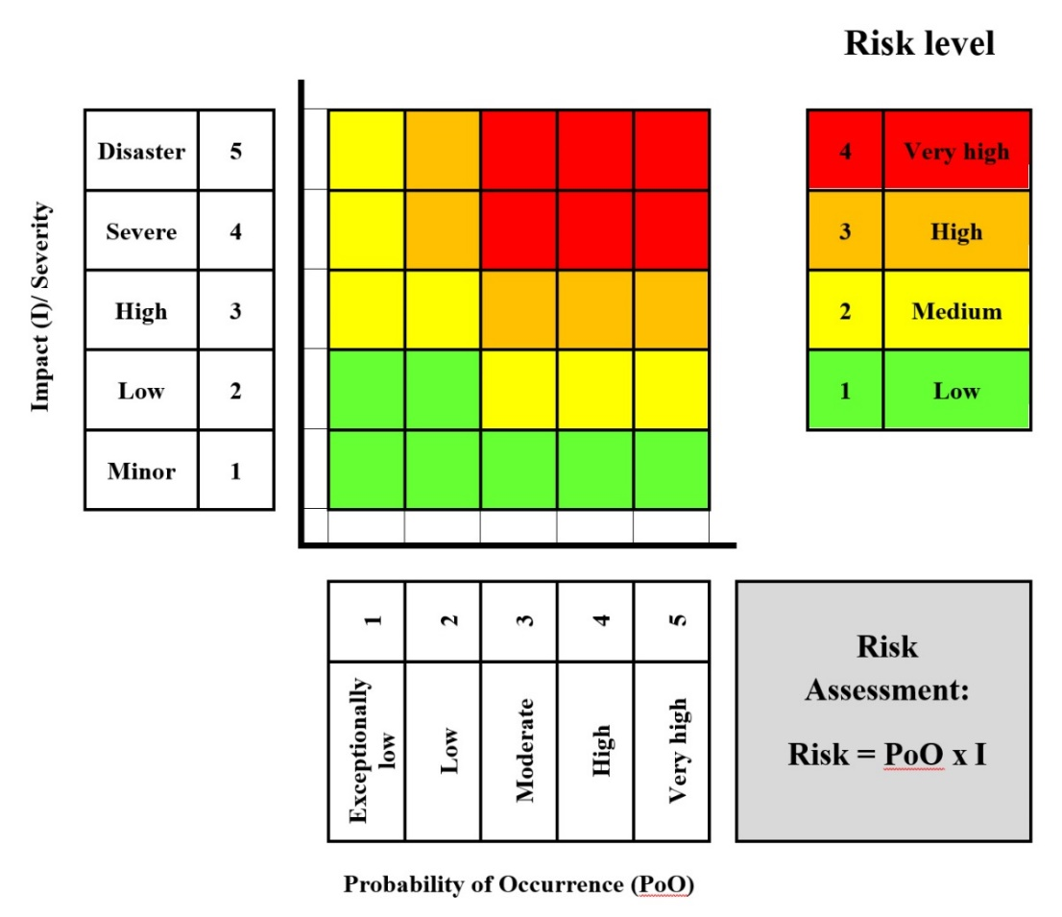
Risk Rating
Risk level | Risk potential | Measures
4 | Very high | The measures taken are not sufficient to mitigate the risk sufficiently.
3 | High | Measures with increased protection are urgently needed.
2 | Medium | Measures with normal protective effects necessary.
1 | Low | Organizational and personal measures possible.

Slide 23
Risk Log |  | Risk Identification |  | Risk Rating Pre-Mitigation |  |  | Risk Mitigration | Post-Mitigation Risk Rating
Risk- ID | № | Description of Risk (orientating to the hazard) | Possible consequences | Probability of Occurrence | Impact | Risk Level | Mitigration Strategy | Probability of Occurrence | Impact | Risk Level
 |  | TECHNICAL RISKS
 |  | Mechanical hazards
RL-001 | 1 | Dent in the vacuum vessel | Damage of parts of the beam scrapper; Performance below specification; | 2 | 3 | 2 | Check that lifting eye bolts are correctly tightened; Check that used chains, straps and hooks have the weight rating adapted to the beam scrappers weight, corresponding number of attachment points and corresponding lifting angles. Beam scrapper must be properly fastened to a suitable stand to prevent any fall during installation, operation, maintenance and storage. Obey warning signs and boundaries. | 1 | 3 | 2
RL-002 | 2 | Failure of welding joints | Damage of parts of the beam scrapper | 2 | 3 | 2 | Carry out inspection of welding lines on a regular basis. | 1 | 3 | 2
RL-003 | 3 | beam scrapper falling during handling | Damage of parts of the beam scrapper up to complete loss of the beam scrapper; Personnel injury | 2 | 4 | 3 | Check that lifting eye bolts are correctly tightened; Check that used chains, straps and hooks have the weight rating adapted to the beam scrappers weight, corresponding number of attachment points and corresponding lifting angles. Beam scrapper must be properly fastened to a suitable stand to prevent any fall during installation, operation, maintenance and storage. Obey warning signs and boundaries. | 1 | 4 | 2

Slide 24
 |  | Electrical hazards
RL-004 | 4 | Cable breaks (power, diagnostic, etc.) including cracks or breaks in the insulation, failure of cable connections | Loss of equipment functionality; Electrical shock; Fire; Personnel injury | 2 | 2 | 1 | Cables must be labelled. Cables must be traceable, viewable and accessible. Cables must be protected from mechanical damage. Avoid creating stumbling hazards with cables. Regular inspection of insulation and connections. Braked cables must be marked, apply a do-not-use tag. Braked cables must be replaced. | 1 | 2 | 1
RL-005 | 5 | Power/ power supply failure (supply interrupted due to external reason) | Loss of equipment functionality | 2 | 1 | 1 | Does not require any action (supply interrupted due to external reason). | 2 | 1 | 1
 |  | Humidity hazards
RL-006 | 6 | High air humidity in the environment around the beam scrapper | Corrosion | 3 | 1 | 1 | beam scrapper system will be packed for transportation under the conditions to avoid contact of product with rain water, spatter or condensates. Use climate-control system in the tunnel. Carry out preventive diagnostic measures in the tunnel on a regular basis. | 2 | 1 | 1

Slide 25
 |  | Pneumatic hazards
RL-007 | 7 | Leakage of connections and fittings | Pneumatic driver failure | 2 | 2 | 1 | Check the integrity of connections and fitting 1 or 2 times in a year. Replace connectors and fittings if it is necessary. | 1 | 1 | 1
 |  | Radiation hazards
RL-008 | 8 | Beam scrapper materials may become radioactive during operation | Tunnel environment radioactive contamination; Workers exposure to radiation; Difficulties to repair and maintenance of equipment | 2 | 4 | 3 | Use radioactivity supervision system in the tunnel. Carry out preventive diagnostic measures in the tunnel on a regular basis. Follow the GSI Safety Regulations. Complete the required GSI Safety Trainings. | 1 | 4 | 2
 |  | Ergonomic hazards
RL-009 | 9 | Accidents of the vacuum vessel sharp edges | Personnel injury | 3 | 1 | 1 | Use the rubber corner bumpers. Use the basic Personal Protective Equipment (hard hats, safety glasses, steel tip shoes). | 2 | 1 | 1
 |  | Combination of hazards
RL-010 | 10 | Design alteration and/or performance below specification | Delays to the schedule; Failed to reach the required field quality | 3 | 3 | 3 | The Parties shall monitor the scientific and technical progress of the Collaboration Contract activities. The Parties shall clarify the Technical Specifications during the project development. (Risk originated mainly from unpredictable deviation of the beam scrappers susceptibility of the stainless steel material of dipoles vacuum chambers from the specified low value. Proposed the following mitigation measures: special multi-pole correctors, which will compensate the negative influence of all field distortions produced in dipoles by slightly beam scrappers material of their vacuum chambers.) | 2 | 3 | 2
RL-011 | 11 | Lack of knowledge about GSI site, GSI safety regulations and procedures | Damage to the personnel health due to hazards created by others | 2 | 1 | 1 | The Parties shall coordinate efforts to create and maintain a clean and organized work environment. Follow the GSI Safety Regulations. Complete the required GSI Safety Trainings. | 1 | 1 | 1

Slide 26
Parameters inspection of scraper elements
Length of the scraper;
Limits of blades movement;
Fidelity of operation of endpoint switches and potentiometer;
Examination of slits between opposite blades in final position;.
The correspondence between measured and real position of the; blades;
The complete time of the insertion of the blades.

