Slide 1
CR status and time line
Ivan Koop, Dmitry Shwartz, Oleksyy Dolinskyy
3rd BINP-FAIR Collaboration Coordination Workshop
Tuesday 26 November 2019

Slide 2
Outline
WP 2.5.2 - Magnets
WP 2.5.3 - Power Converters
WP 2.5.5 - Septums, Kickers
WP 2.5.6 - Beam Diagnostics
WP 2.5.7 – Vacuum Chambers
WP 2.5.23 - Civil Construction Interface
GSI Work Packages
Nearest Actions

Slide 3
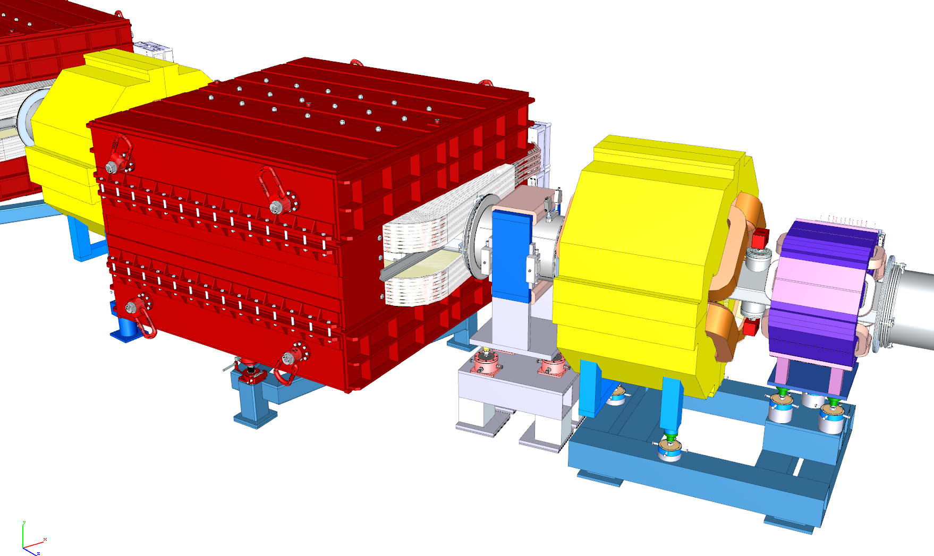
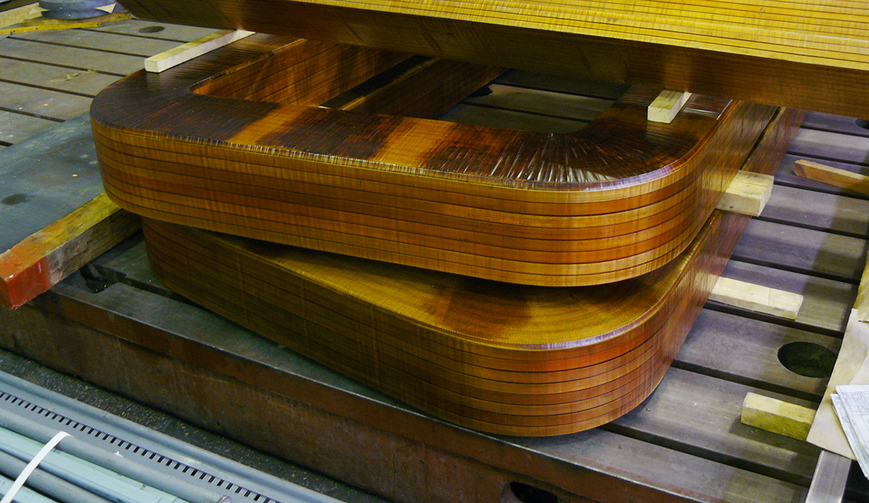
WP 2.5.2: Magnets – Alexander Starostenko
Dipoles (26 units): CDR, FDR done, production is ongoing.
Coils for FoS dipole will be finished in December 2019.
Large size laminations for 2 dipoles are ordered in a firm and will be delivered in November 2019.
Stamping of the pole iron sheets shall start in January 2020 – delay caused by interference with HEBT magnets.
FoS dipole will be ready to test in March 2020.
Series production will start in June 2020.
Last dipole will be delivered, tested and installed in August 2023.
First two impregnated dipole coils

Slide 4
WP 2.5.2: Magnets – Denis Gurov, Anatoly Utkin, Alexander Tsyganov
Quads, Sextupoles, Correctors: Design nearly finished, CDR for the largest WQ-family passed.
Production drawings for WQ will be ready in November 2019. FDR for WQ expected in December 2019 – February 2020.
Other families, SWQ, EWQ, NQ and sextupoles, are pre-designed. CDR, FDR, production will start in first half 2020.
Cooperation with the external partners to accelerate the production: stamping of iron sheets. Negotiations in progress.
FoS WQ: October 2020. Series production: autumn 2020 - August 2023.
Most complicated design of SWQ-type quad with the octupole corrector coils embedded:

Slide 5
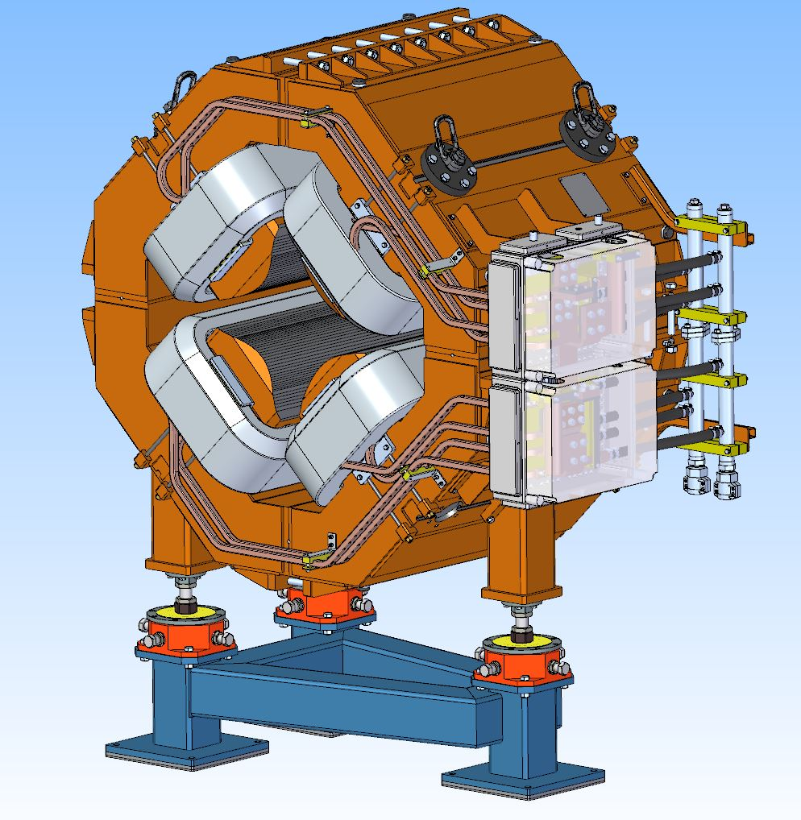
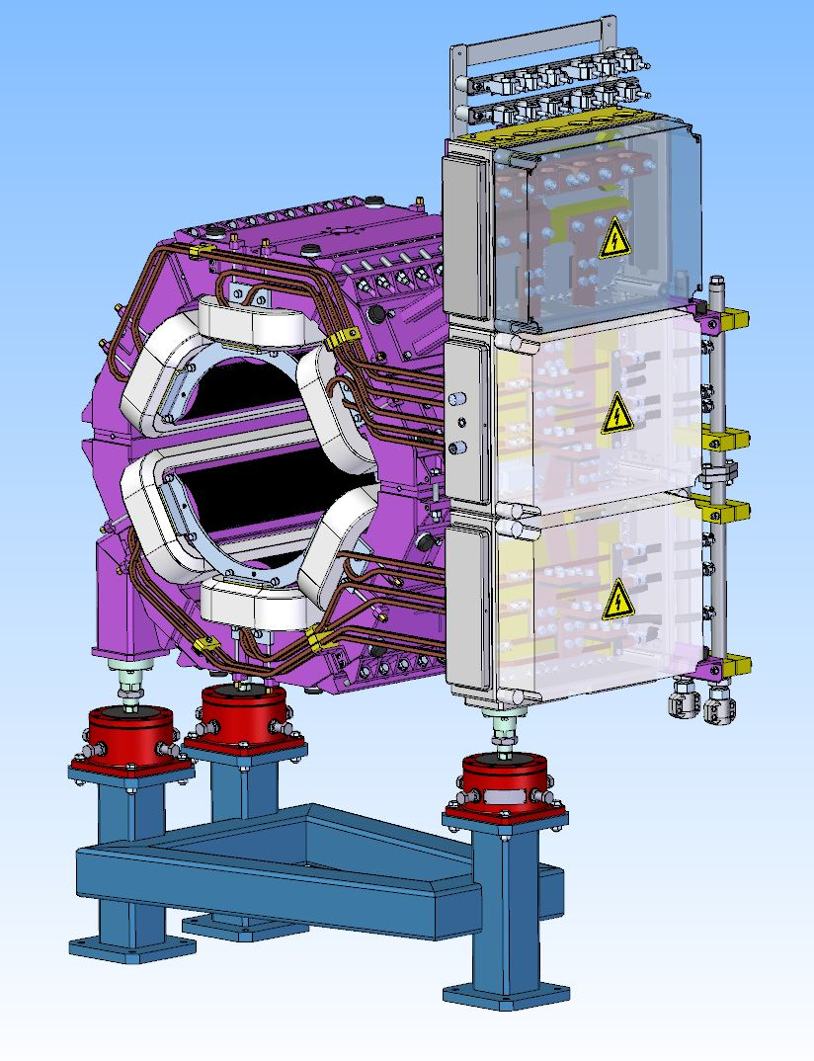
WP 2.5.2: Magnets – 3d models
WQ-Quad
CR H/V-corrector
CR-Sextupole

Slide 6
2.5.2 Timeline for Magnets
Years | 2020 |  |  |  |  |  |  |  |  |  |  |  | 2021 |  |  |  |  |  |  |  |  |  |  |  | 2022 |  |  |  |  |  |  |  |  |  |  |  | 2023 |  |  |  |  |  |  |  |  |  |  |  | 2024
Months | 1 | 2 | 3 | 4 | 5 | 6 | 7 | 8 | 9 | 10 | 11 | 12 | 1 | 2 | 3 | 4 | 5 | 6 | 7 | 8 | 9 | 10 | 11 | 12 | 1 | 2 | 3 | 4 | 5 | 6 | 7 | 8 | 9 | 10 | 11 | 12 | 1 | 2 | 3 | 4 | 5 | 6 | 7 | 8 | 9 | 10 | 11 | 12 | 1 | 2 | 3 | 4 | 5 | 6 | 7 | 8 | 9 | 10 | 11 | 12
Production
Delivery
Pre- Assemb
Installation
Commissio.

Slide 7
WP 2.5.3: Power Converters – Dmitry Senkov
Dipole power converter(I=1.5 kA, U=2.5 kV) :
CDR and FDR expected in November 2019.
Commercial offer to produce the full system done.
FAT and delivery planned for the first half of 2023.
Quad power converters (1.5 kA) and Sextupole power converters (500A):
Predesign done. Test-unit is in operation during one year at the magnet test stand.
CDR and FDR expected in November 2019.
FoS : October 2020.
Series production: autumn 2020 - August 2023.
Power converters for correctors (20 A):
CDR planned for November 2019. FDR and production start in first half 2020.
Pulse power converters for septa magnets (5 kA):
CDR planned for November 2019. FDR and production start in first half 2020.

Slide 8
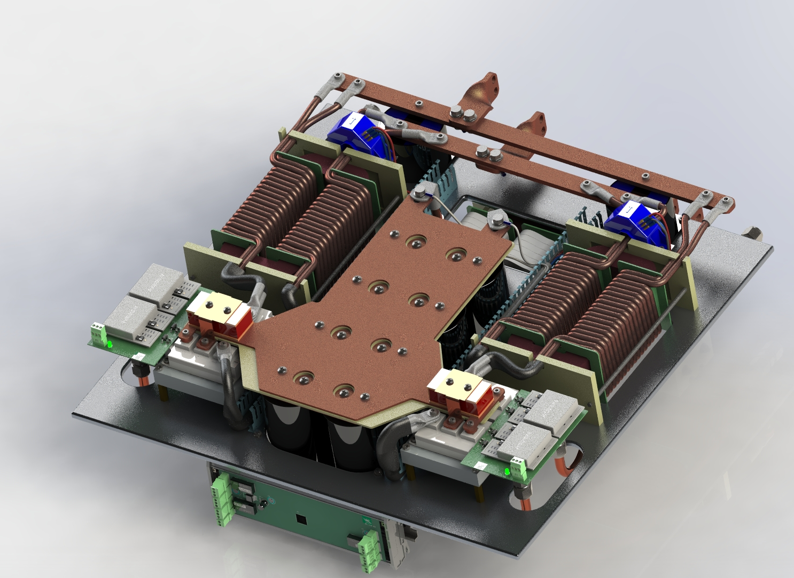
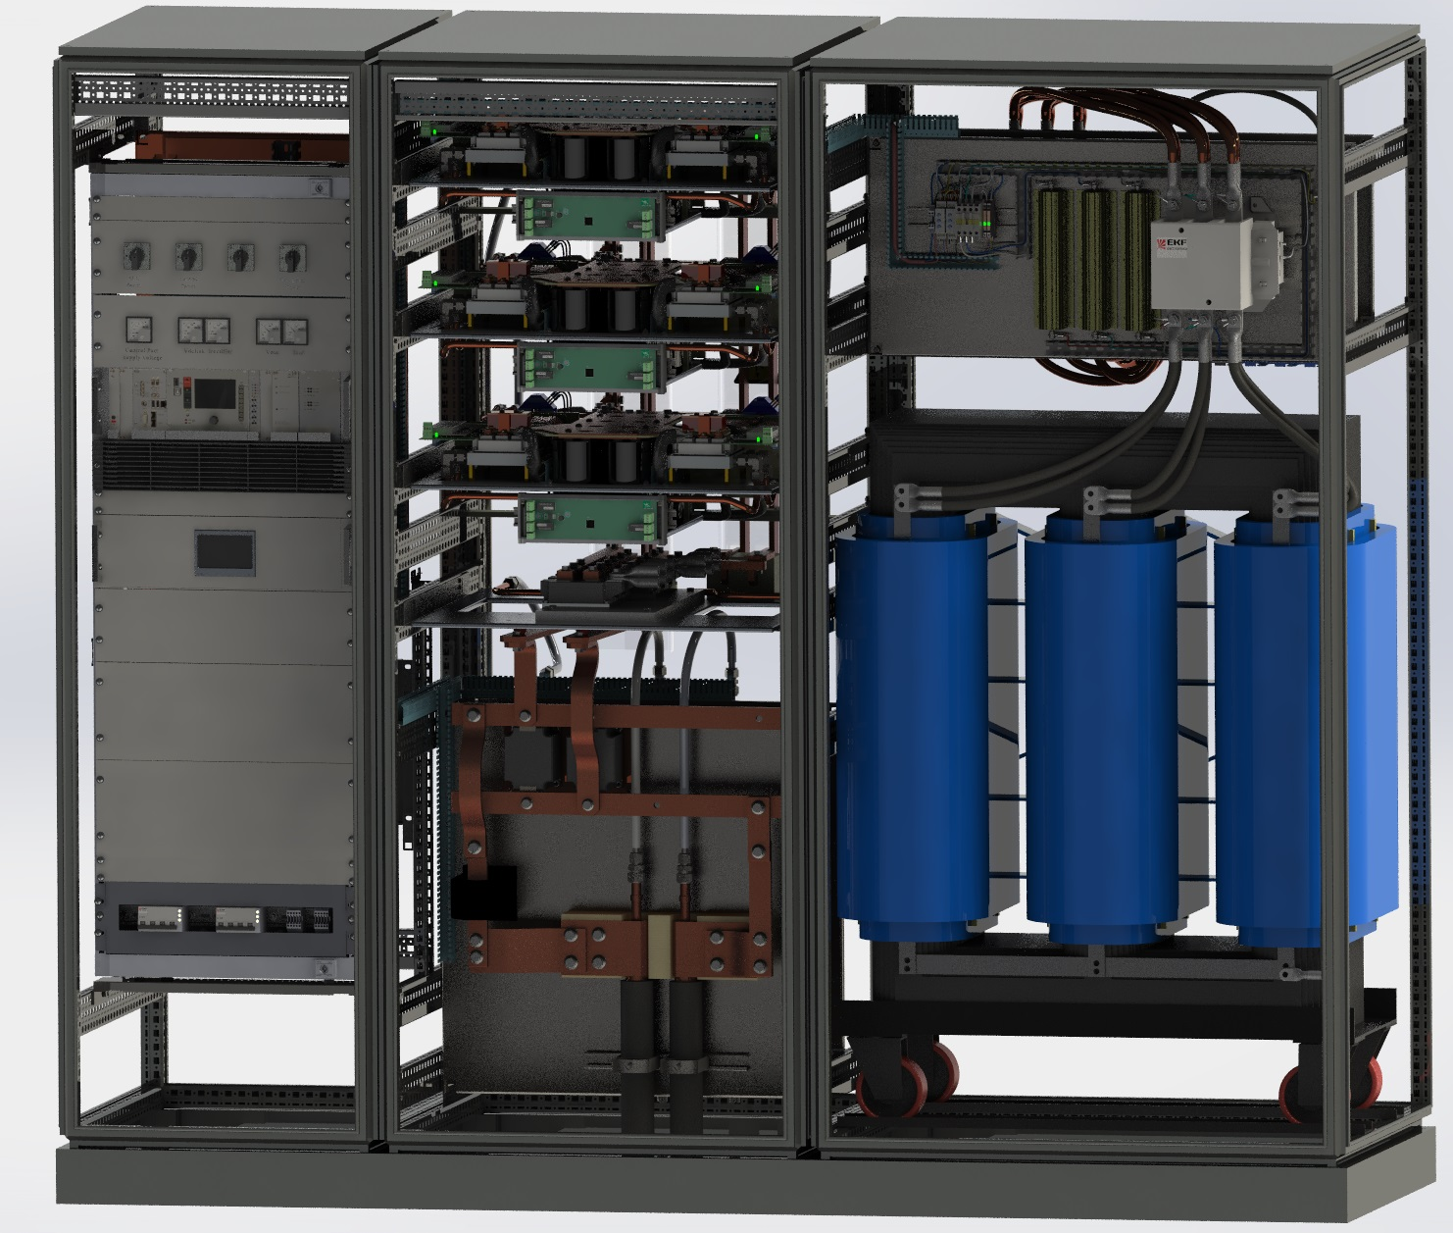
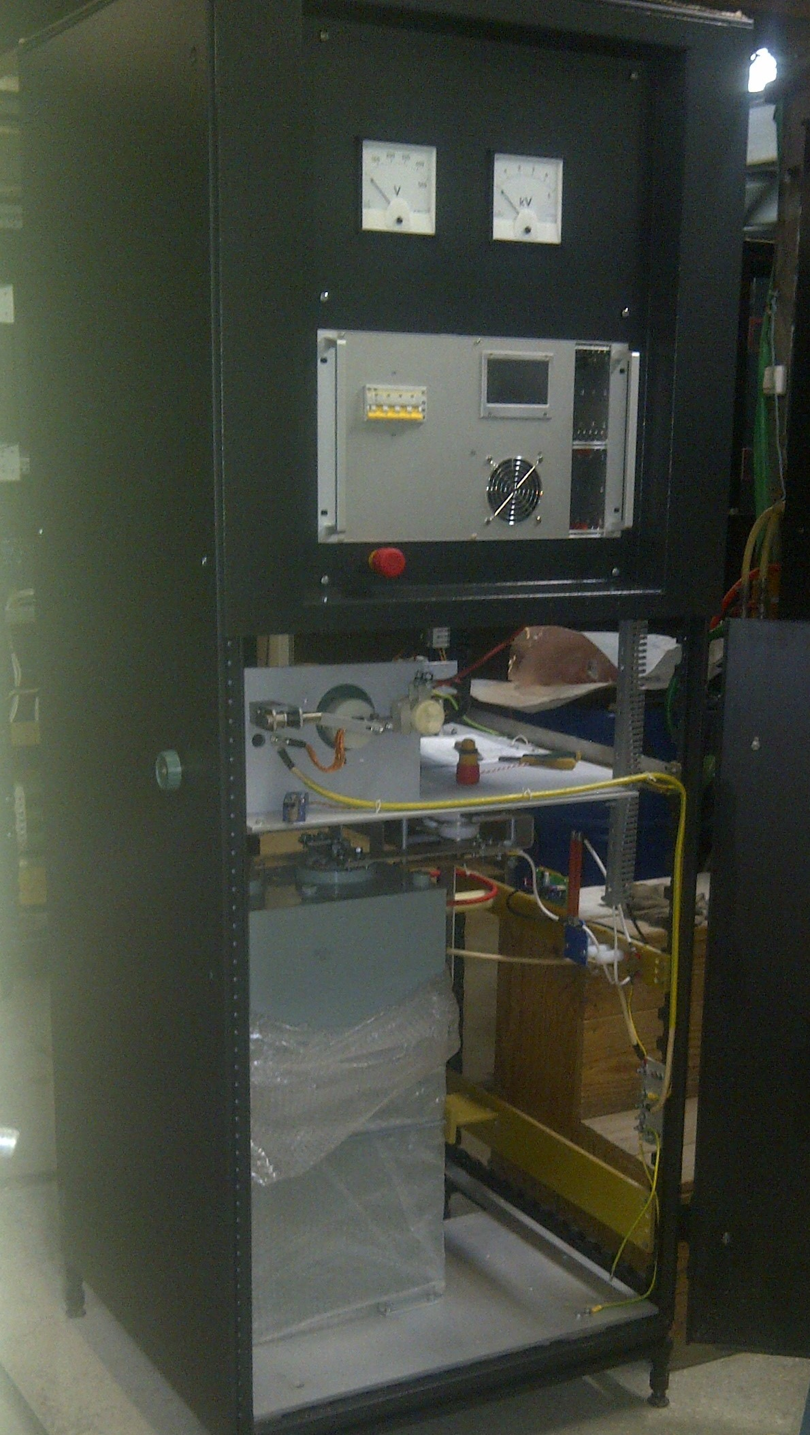
WP 2.5.3: Power Converters parts
500A Power section for
Quad Power Converter
Prototype pulsed Power Converter for Septum
Preliminary design for
1500A Quad power converter

Slide 9
2.5.3 Timeline for Power Converters
Years | 2020 |  |  |  |  |  |  |  |  |  |  |  | 2021 |  |  |  |  |  |  |  |  |  |  |  | 2022 |  |  |  |  |  |  |  |  |  |  |  | 2023 |  |  |  |  |  |  |  |  |  |  |  | 2024
Months | 1 | 2 | 3 | 4 | 5 | 6 | 7 | 8 | 9 | 10 | 11 | 12 | 1 | 2 | 3 | 4 | 5 | 6 | 7 | 8 | 9 | 10 | 11 | 12 | 1 | 2 | 3 | 4 | 5 | 6 | 7 | 8 | 9 | 10 | 11 | 12 | 1 | 2 | 3 | 4 | 5 | 6 | 7 | 8 | 9 | 10 | 11 | 12 | 1 | 2 | 3 | 4 | 5 | 6 | 7 | 8 | 9 | 10 | 11 | 12
Production
Delivery
Pre- Assemb
Installation
Commissio.

Slide 10
WP 2.5.5: Septums, Kickers– Peter Shatunov, Alexey Kasaev
Injection septum magnet:
Specs are published.
CDR expected in November 2019.
FDR expected in the beginning of 2020.
FAT and delivery planned for the beginning of 2023.
Extraction septum magnet:
Specs are published.
CDR expected in the end of 2019.
FDR expected in the first half of 2020.
FAT and delivery are planned for the beginning of 2023.
Injection-Extraction kickers:
Specs are published.
CDR expected in November 2019 - beginning of 2020.
FDR expected in the first half of 2020.
FAT and delivery are planned for the second half of 2023.

Slide 11
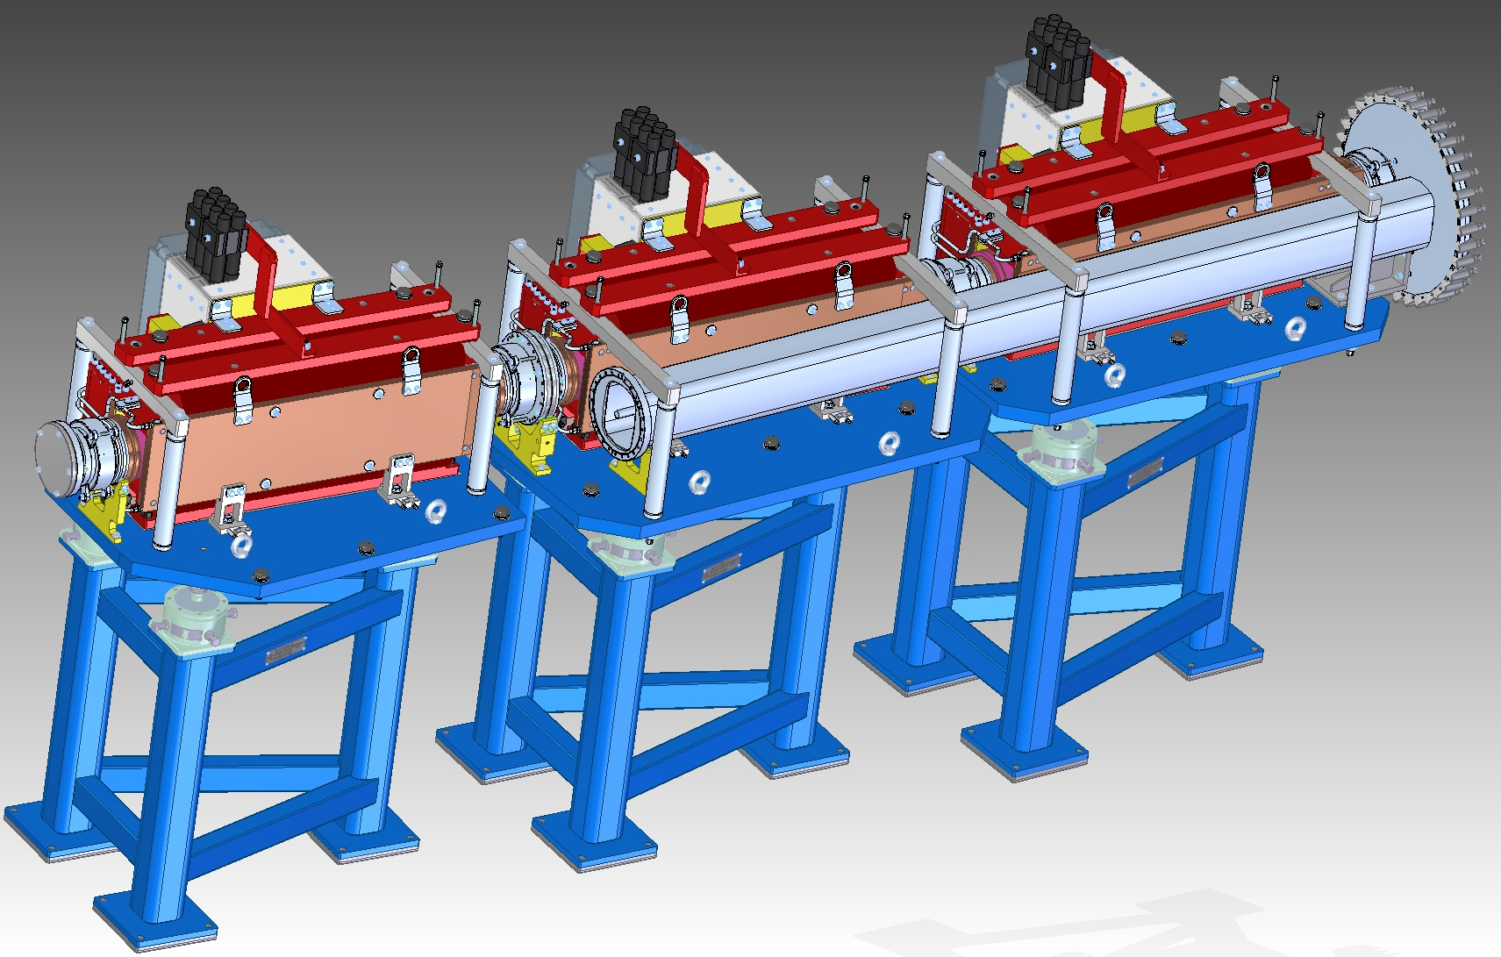
WP 2.5.5: Septums, Kickers
3 Septum-Magnets Assembly
CR-Kicker composed of 3 Sections

Slide 12
2.5.5 Timeline for Septum Magnets
Years | 2020 |  |  |  |  |  |  |  |  |  |  |  | 2021 |  |  |  |  |  |  |  |  |  |  |  | 2022 |  |  |  |  |  |  |  |  |  |  |  | 2023 |  |  |  |  |  |  |  |  |  |  |  | 2024
Months | 1 | 2 | 3 | 4 | 5 | 6 | 7 | 8 | 9 | 10 | 11 | 12 | 1 | 2 | 3 | 4 | 5 | 6 | 7 | 8 | 9 | 10 | 11 | 12 | 1 | 2 | 3 | 4 | 5 | 6 | 7 | 8 | 9 | 10 | 11 | 12 | 1 | 2 | 3 | 4 | 5 | 6 | 7 | 8 | 9 | 10 | 11 | 12 | 1 | 2 | 3 | 4 | 5 | 6 | 7 | 8 | 9 | 10 | 11 | 12
Production
Delivery
Pre- Assemb
Installation
Commissio.
2.5.5 Timeline for the Kickers (2 pcs.)
Years | 2020 |  |  |  |  |  |  |  |  |  |  |  | 2021 |  |  |  |  |  |  |  |  |  |  |  | 2022 |  |  |  |  |  |  |  |  |  |  |  | 2023 |  |  |  |  |  |  |  |  |  |  |  | 2024
Months | 1 | 2 | 3 | 4 | 5 | 6 | 7 | 8 | 9 | 10 | 11 | 12 | 1 | 2 | 3 | 4 | 5 | 6 | 7 | 8 | 9 | 10 | 11 | 12 | 1 | 2 | 3 | 4 | 5 | 6 | 7 | 8 | 9 | 10 | 11 | 12 | 1 | 2 | 3 | 4 | 5 | 6 | 7 | 8 | 9 | 10 | 11 | 12 | 1 | 2 | 3 | 4 | 5 | 6 | 7 | 8 | 9 | 10 | 11 | 12
Production
Delivery
Pre- Assemb
Installation
Commissio.

Slide 13
WP 2.5.6, 2.5.9: CR / TCR1 Beam Diagnostics - Yury Rogovsky, Oleksandr Chorniy
Beam Position Monitor (CR – 19, TCR1 – 6):
CDR (mechanical part) – approved in May 2019.
CDR (analog preamplifier) – expected in the end of October 2019.
FoS – ongoing.
FDR – expected in Q1 2020.
FAT and delivery planned up to the end of 2022 (last pcs).
Residual Gas Monitor (CR – 2):
CDR expected in November 2019.
FDR – expected in Q2 2020.
FAT and delivery planned in Q4 2021.
DCCT, FCT (CR – 1 ):
CDR / FDR approved in May 2019.
FAT and delivery after procurement (BERGOZ), planned for 2020.
Beam Stopper (CR – 2):
CDR approved in May 2019. FDR is planned for the Q1 2020.
FAT and delivery planned in Q1 2022.
Ivan Koop, BINP
13

Slide 14
WP 2.5.6, 2.5.9: Other CR/TCR1 Beam Diagnostics
Beam Scraper (CR – 5):
CDR was approved in May 2019.
FDR is planned in November 2019.
FAT and delivery planned in Q2 2022.
Scintillating Screen (CR – 5, TCR1 - 3):
CDR was approved in May 2019.
FDR is planned for Q1 2020.
FAT and delivery planned in Q3 2022.
BTF, Schottky BPM (CR – 1, 1):
Contract between ITEP and FAIR is signed.
Kick-Off meeting in October 2019.
Cryogenic Current Comparator (CR – 1):
The concept is ongoing in GSI.
Ivan Koop, BINP
14

Slide 15
WP 2.5.6, 2.5.9: Few Beam Diagnostics Components 3d-Models
Scraper
Beam Stopper
BPM and V-corrector
Narrow BPM and H/V corrector
Ivan Koop, BINP
15

Slide 16
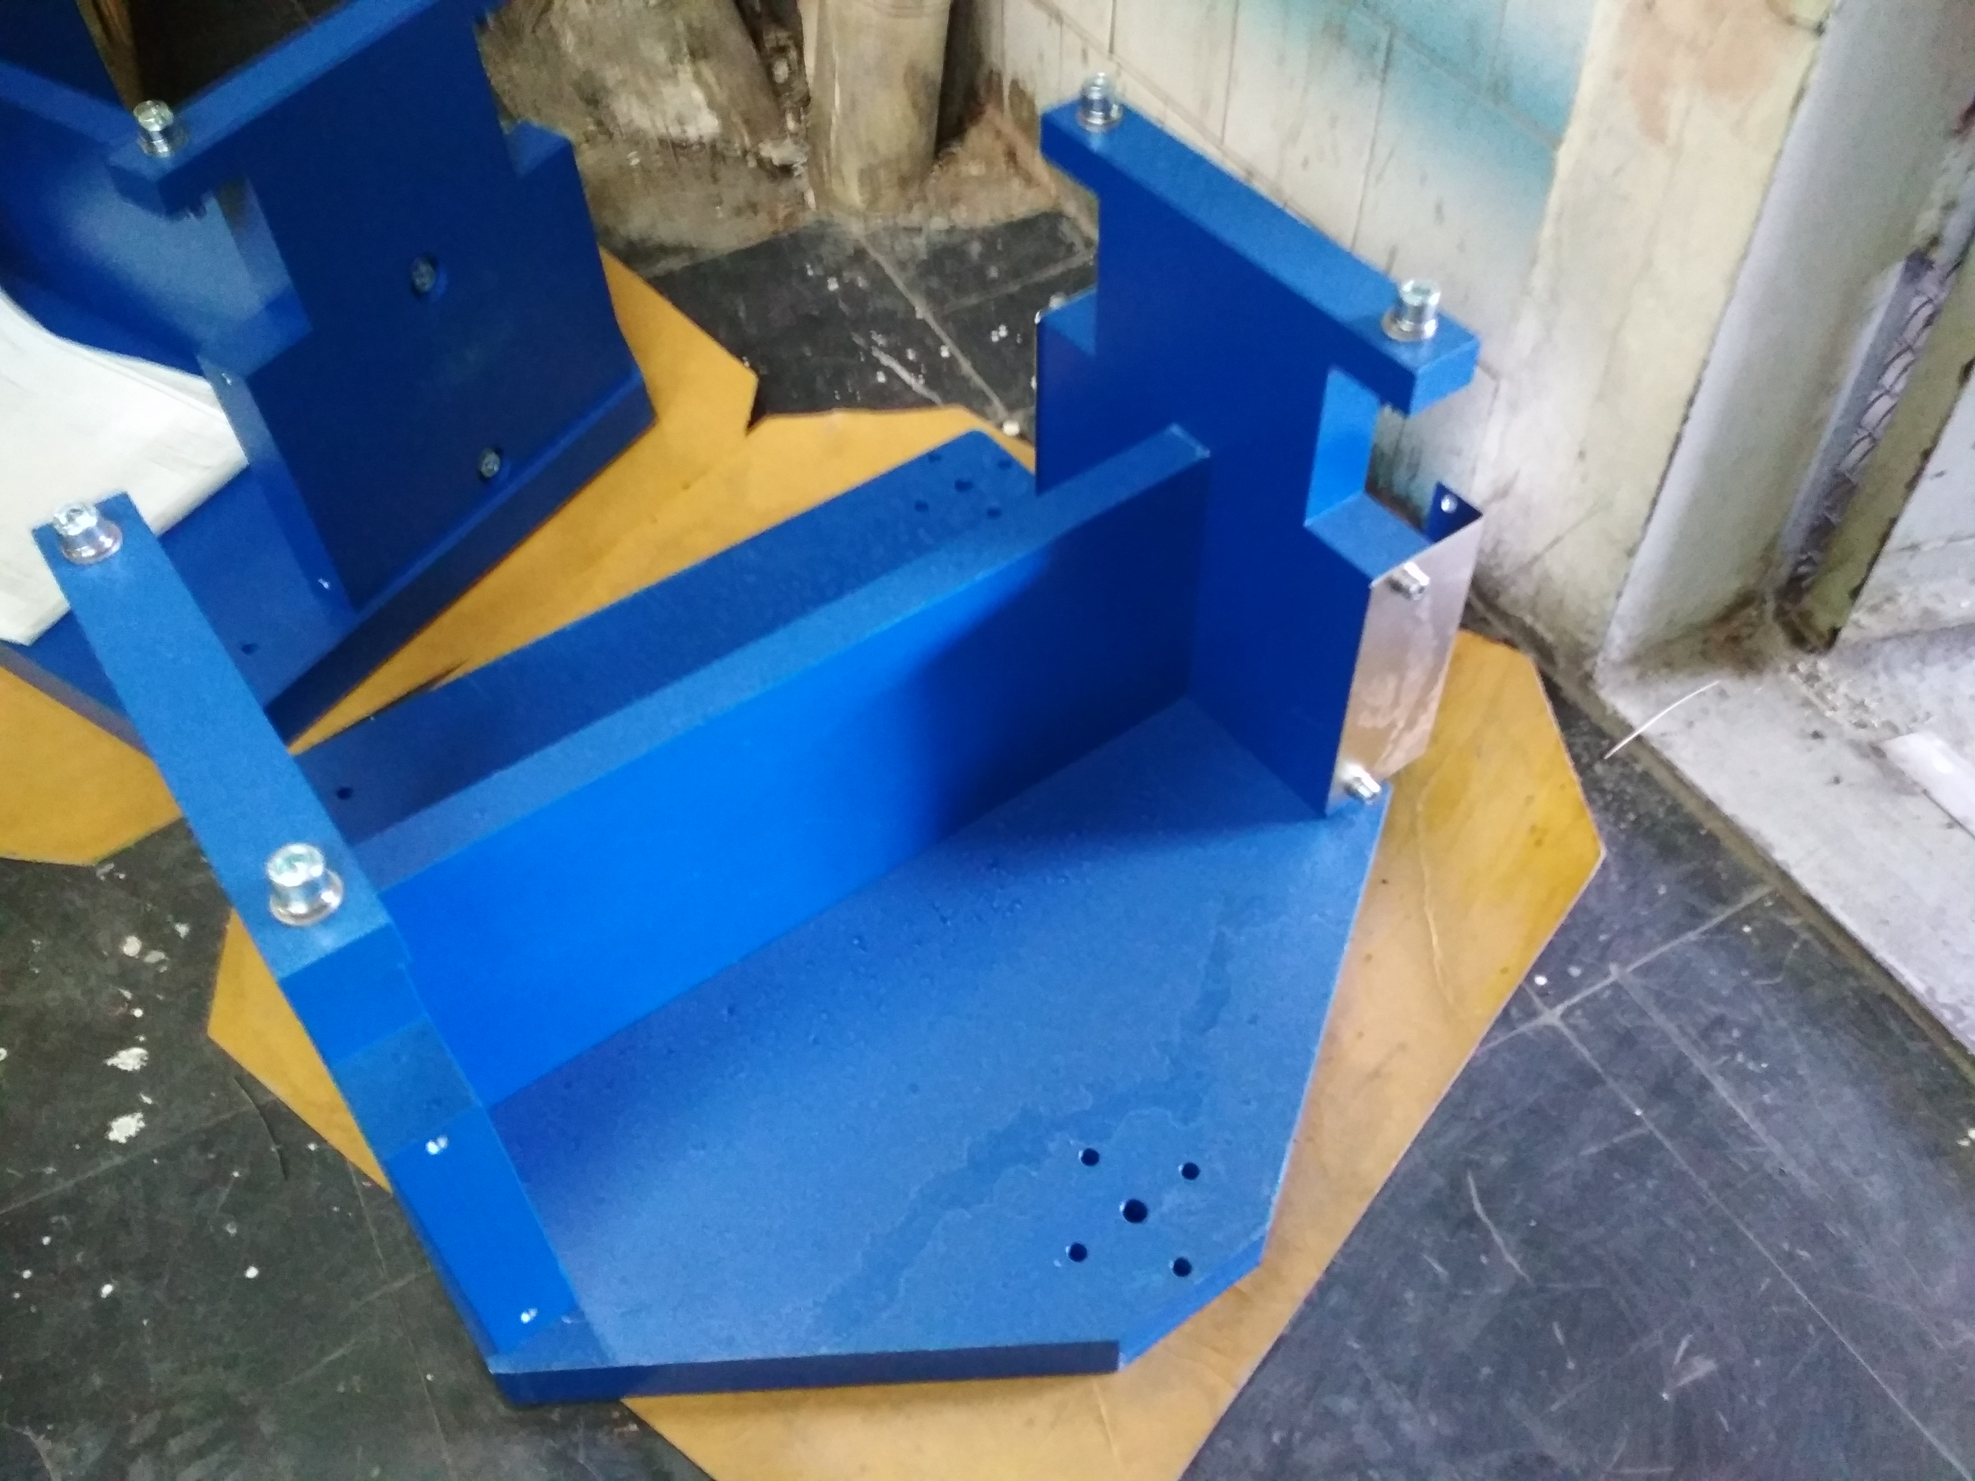
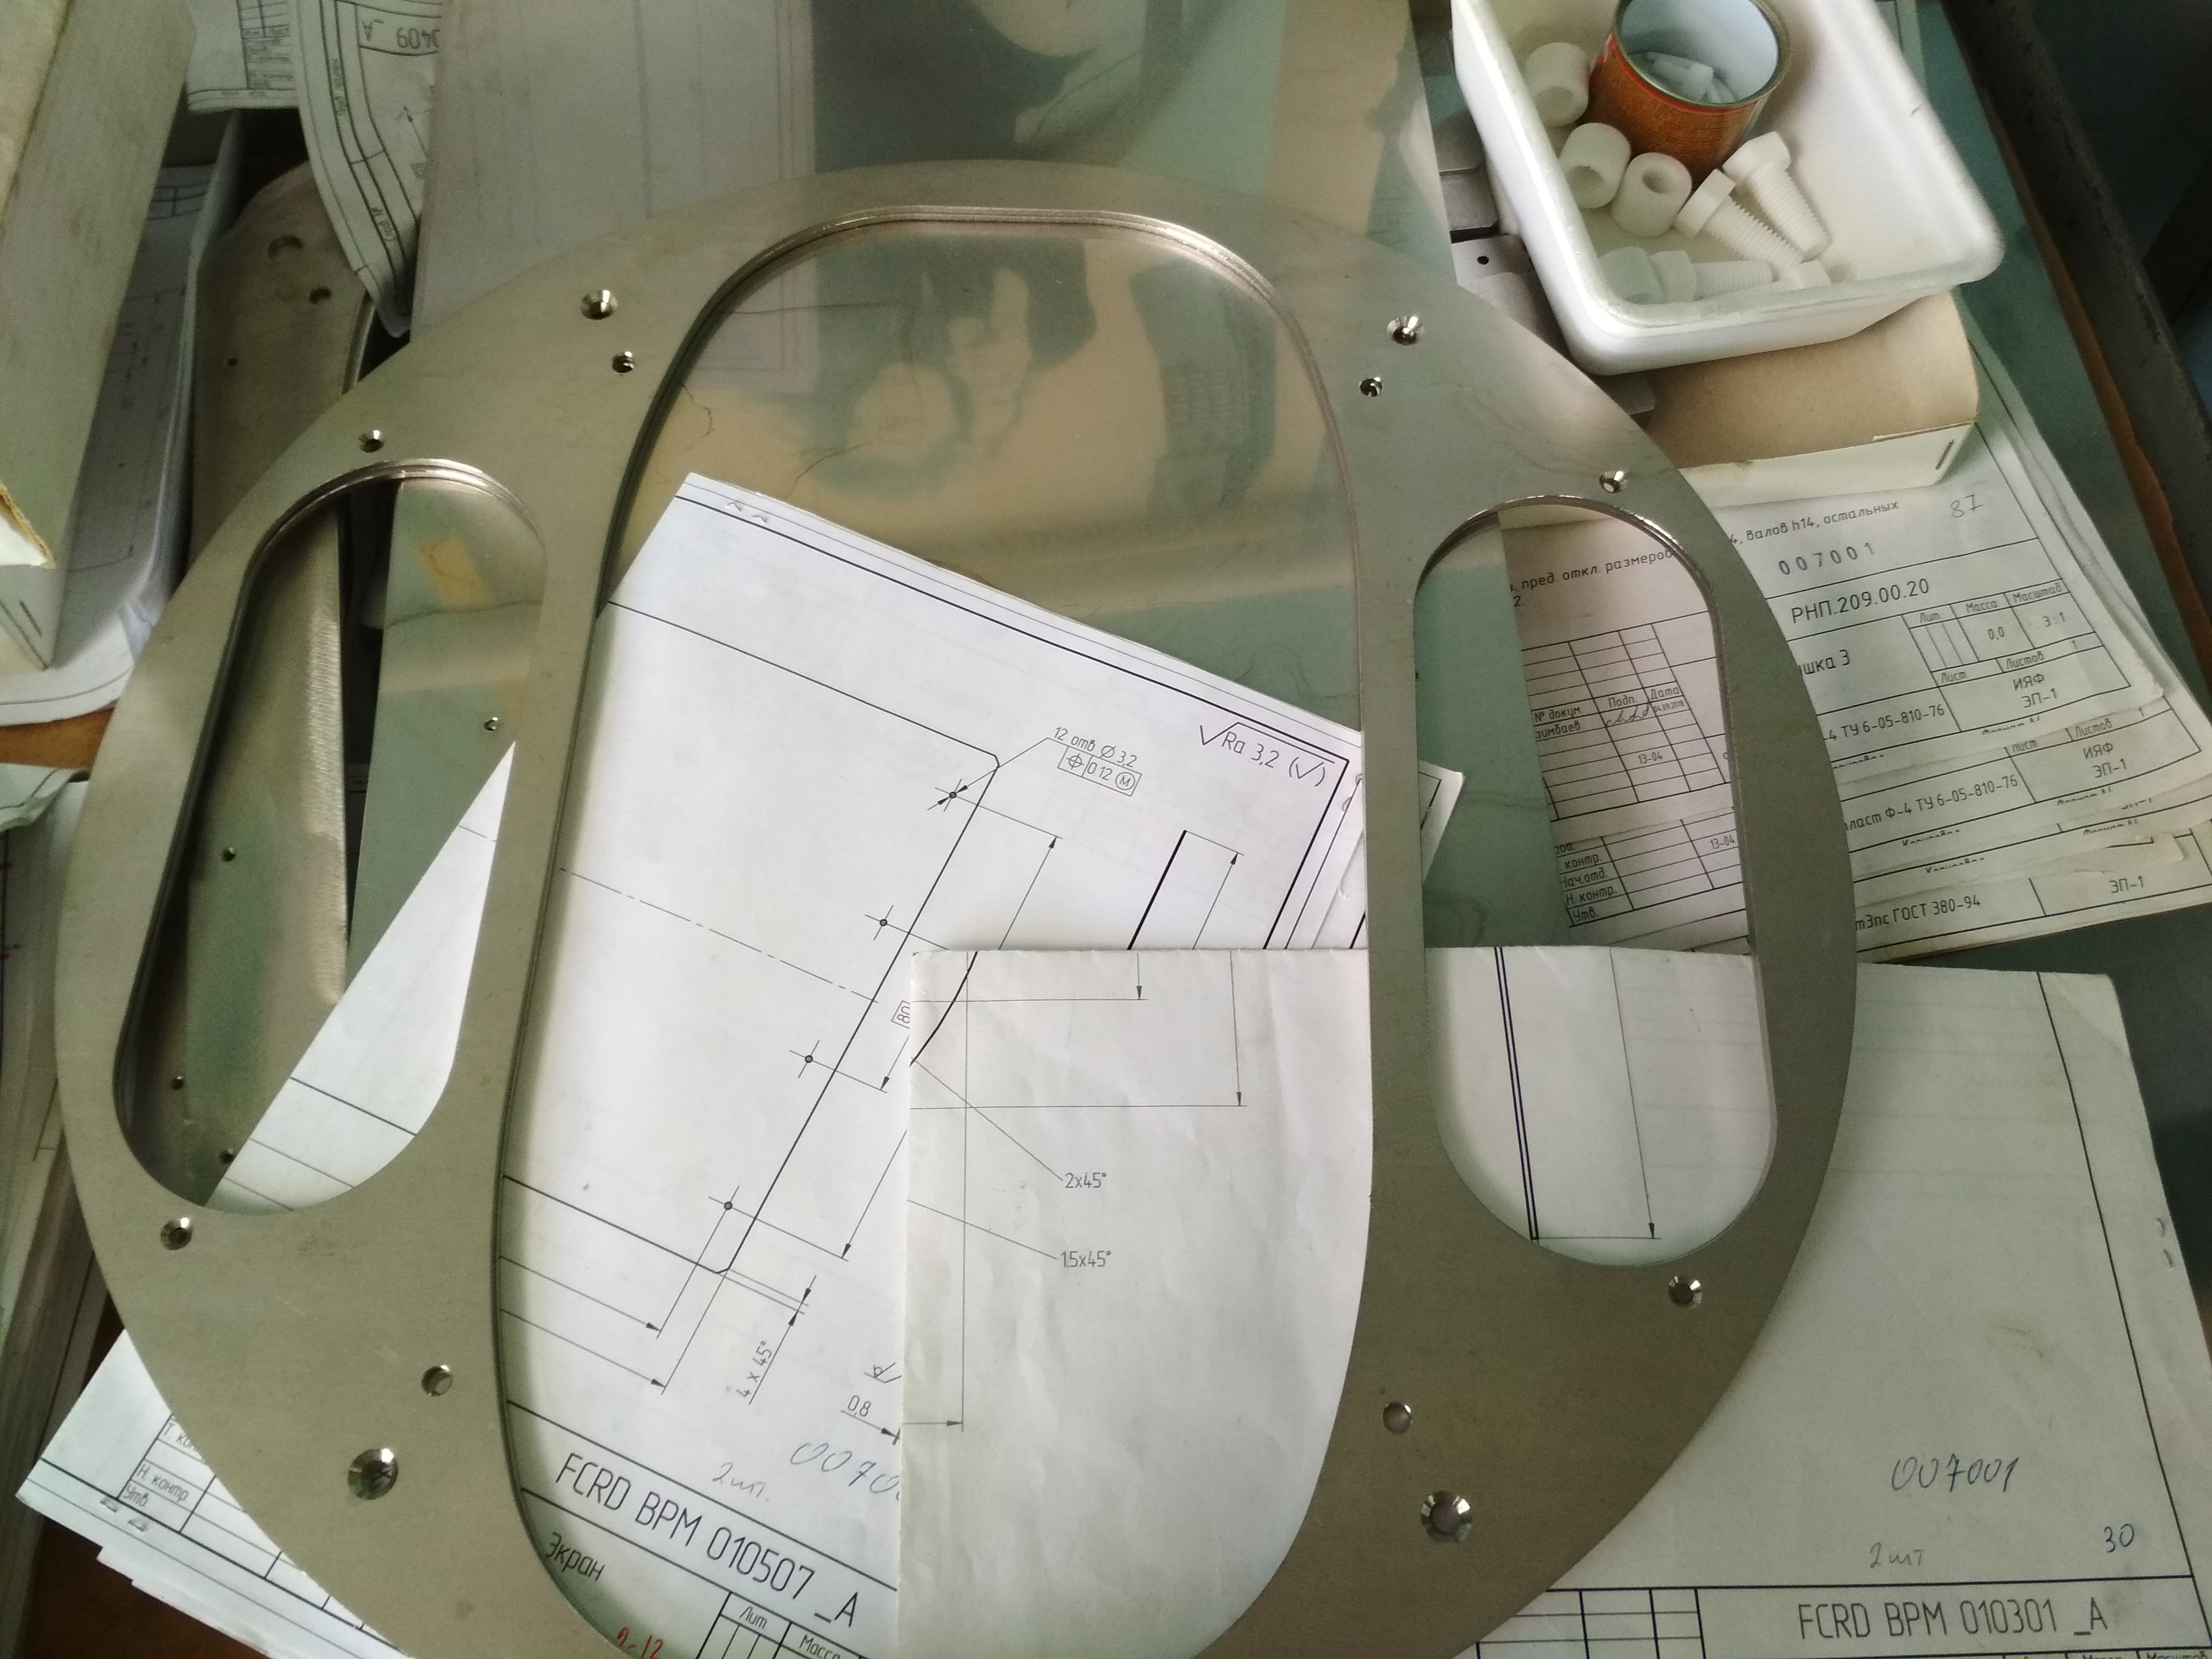
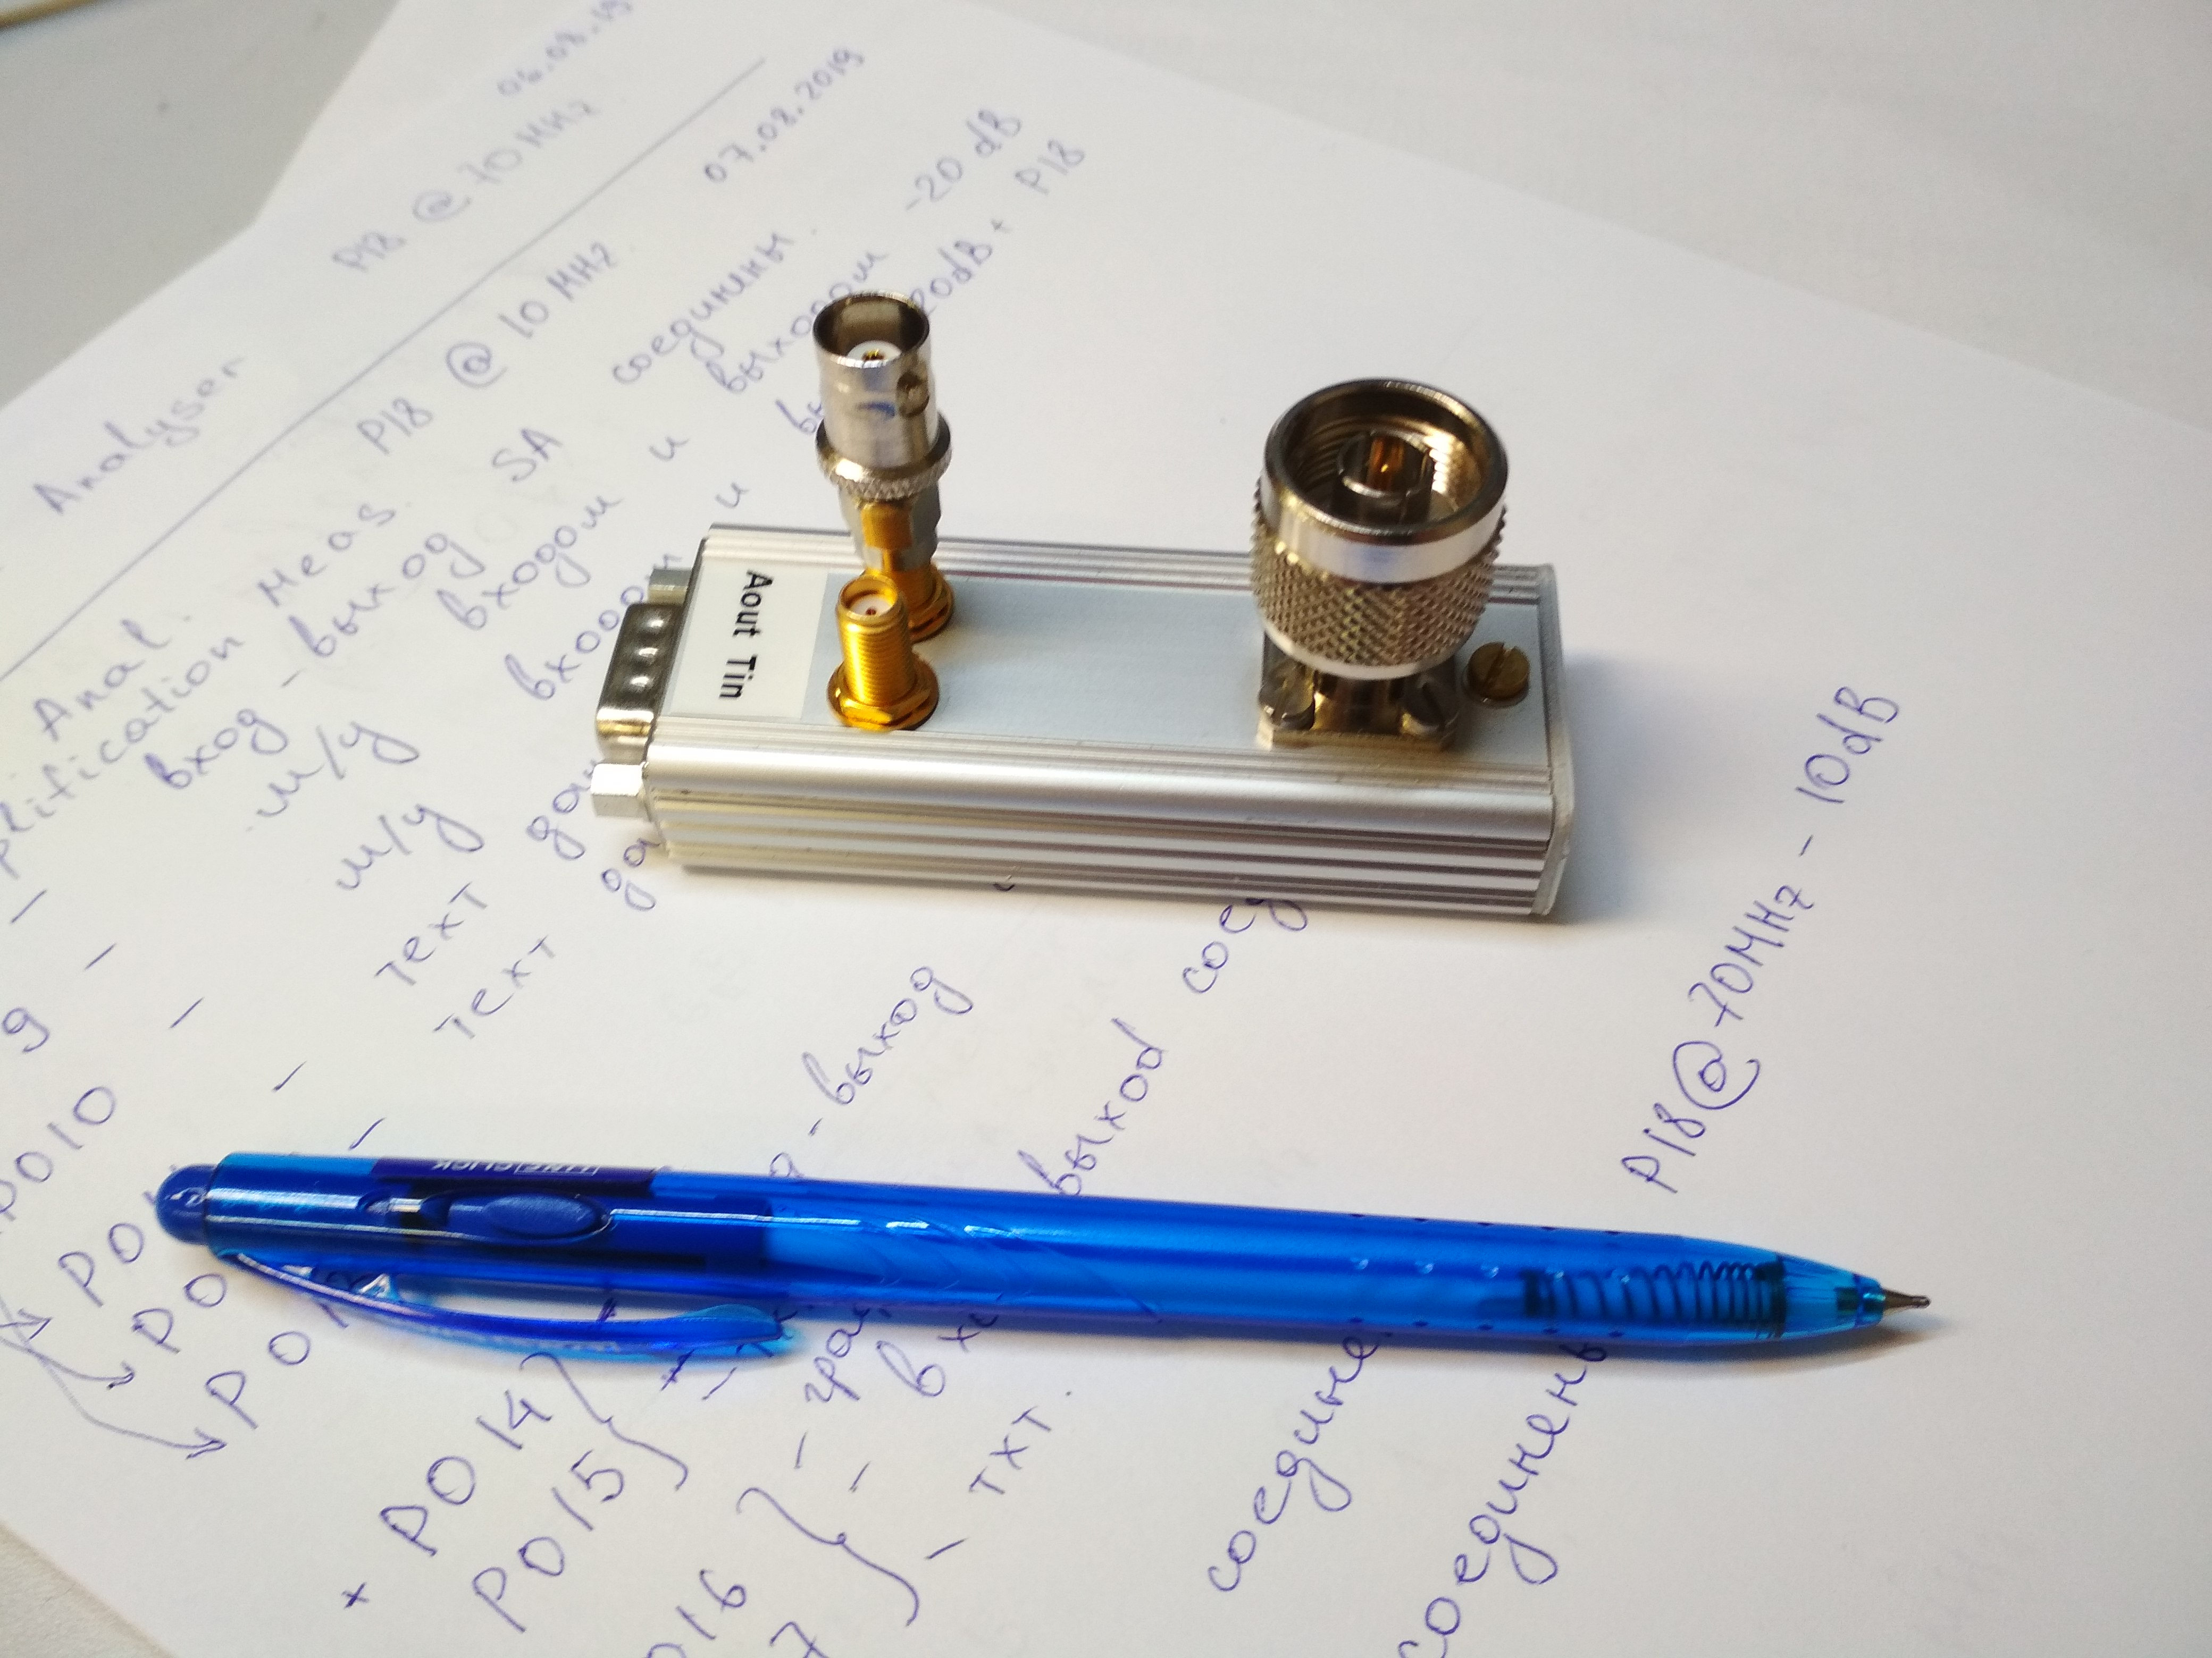
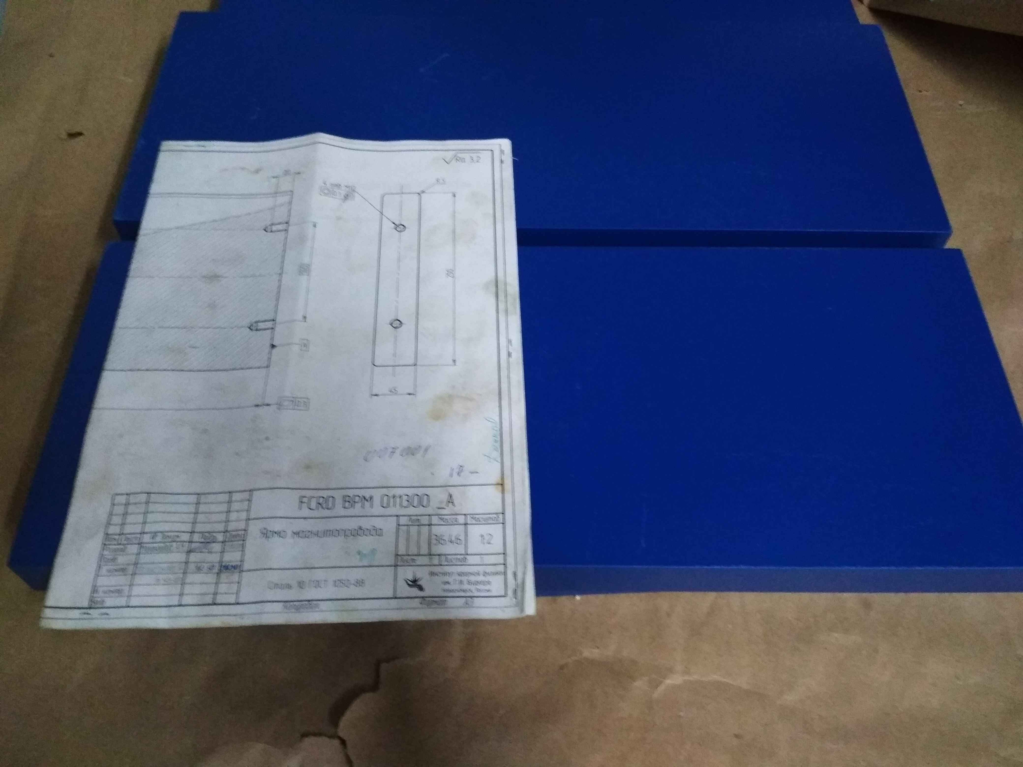
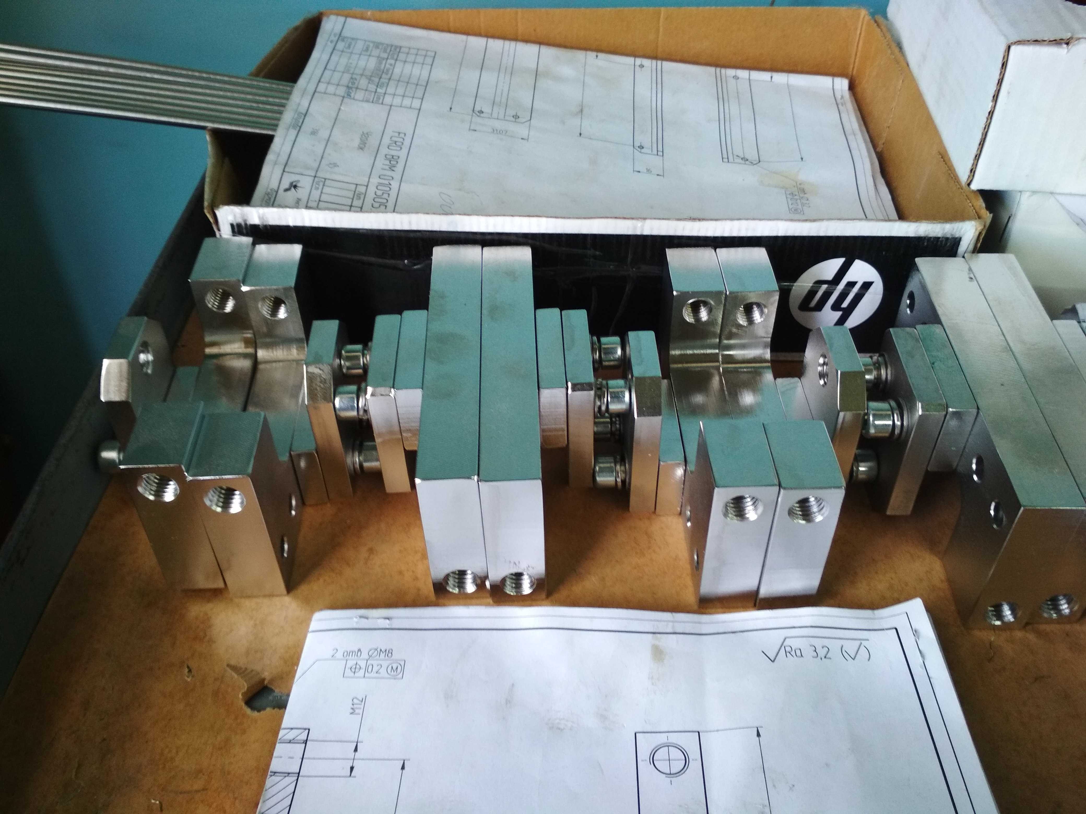
WP 2.5.6, 2.5.9: Beam Diagnostics: Production of BPM components ongoing.
V. Cor. Stand and Yoke
BPM VC parts
Preamp. Prototype, with
Cooperation IKP4 FZJ
Ivan Koop, BINP
16

Slide 17
2.5.6 Timeline for BPMs
Years | 2020 |  |  |  |  |  |  |  |  |  |  |  | 2021 |  |  |  |  |  |  |  |  |  |  |  | 2022 |  |  |  |  |  |  |  |  |  |  |  | 2023 |  |  |  |  |  |  |  |  |  |  |  | 2024
Months | 1 | 2 | 3 | 4 | 5 | 6 | 7 | 8 | 9 | 10 | 11 | 12 | 1 | 2 | 3 | 4 | 5 | 6 | 7 | 8 | 9 | 10 | 11 | 12 | 1 | 2 | 3 | 4 | 5 | 6 | 7 | 8 | 9 | 10 | 11 | 12 | 1 | 2 | 3 | 4 | 5 | 6 | 7 | 8 | 9 | 10 | 11 | 12 | 1 | 2 | 3 | 4 | 5 | 6 | 7 | 8 | 9 | 10 | 11 | 12
Production
Delivery
Pre- Assemb
Installation
Commission
2.5.6 Timeline for other BD-components
Years | 2020 |  |  |  |  |  |  |  |  |  |  |  | 2021 |  |  |  |  |  |  |  |  |  |  |  | 2022 |  |  |  |  |  |  |  |  |  |  |  | 2023 |  |  |  |  |  |  |  |  |  |  |  | 2024
Months | 1 | 2 | 3 | 4 | 5 | 6 | 7 | 8 | 9 | 10 | 11 | 12 | 1 | 2 | 3 | 4 | 5 | 6 | 7 | 8 | 9 | 10 | 11 | 12 | 1 | 2 | 3 | 4 | 5 | 6 | 7 | 8 | 9 | 10 | 11 | 12 | 1 | 2 | 3 | 4 | 5 | 6 | 7 | 8 | 9 | 10 | 11 | 12 | 1 | 2 | 3 | 4 | 5 | 6 | 7 | 8 | 9 | 10 | 11 | 12
Production
Delivery
Pre- Assemb
Installation
Commission

Slide 18
WP 2.5.7: Vacuum – Alexander Krasnov
Dipole vacuum chamber:
CDR of the dipole vacuum chamber done.
Decision made for transition from welding to CR-K flanges.
FoS expected soon. Series production until Q2 2023.
Quad/Sextupole common vacuum chamber:
CDR done.
FoS expected soon. Series production until Q2 2023.
Other chambers in progress.

Slide 19
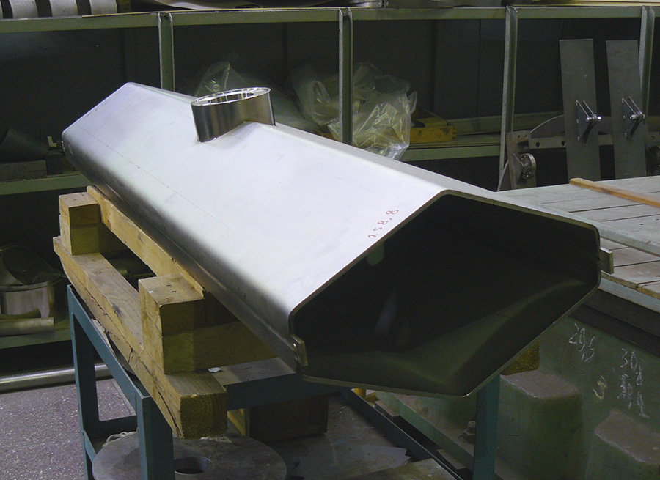
WP 2.5.7: Vacuum – Quadrupole chamber
Vacuum chamber in preparations for welding of a pump port.
Tuning of e-welding regimes for hexagonal chamber:

Slide 20
Springy metal seals for ISO-K,
Preliminary BINP experience
Type | CE-052800-6.35H-2/0-4-SN50 | CSE-052800-6.35H-2/2-1-S50
Seal Diameter, mm | 528 | 528
Axial Section, mm | 6,35 | 6,35
Material of C-ring | Alloy 718 | Alloy 718
Spring material | - | Alloy 718
Plating | SnBi | Ag
Plating thickness, μ | 30÷50 | 30÷50
Load, N/mm | 160 | 770
Treatment | solution annealing + precipitation hardened | work hardened
Number of clamps | 24 | 48
Torque, N*m | 45* | 45**
Nominal deformation | Reached (5,2 mm) | Did not reach
Max. deformation load, kN*m | 10*** | 10***
Number of sealing cycles | 5 (at least) | 2 (at least)
Number of tested seals | 3 | 2
Leak tightness liter*mbar/s | < 1E-10 | < 1E-10
Number of unsuccessful sealing | 0 | 0
Experimental installation
Flange type: flat symmetrical ISO-K with external spacer
Advantages: - weight: 32 kg (COF type – 80 kg)
symmetry: does not need angular orientation
(COF needs oval holes on one of connected flanges to compensate angular inaccuracy)
- space: 80 mm along the beam (COF needs 155 mm)
* Sealing reached at 15 N*m
** Sealing reached at 30 N*m
*** Experiment with DN 250 CF shown leak appearance at 8 kN*m
BINP successfully tested seals with spring and different coatings. After that decision made: use ISO-K for all large diameter vacuum chambers.
a.a.krasnov@inp.nsk.su

Slide 21
2.5.7 Timeline for Dipole Vacuum Chambers
Years | 2020 |  |  |  |  |  |  |  |  |  |  |  | 2021 |  |  |  |  |  |  |  |  |  |  |  | 2022 |  |  |  |  |  |  |  |  |  |  |  | 2023 |  |  |  |  |  |  |  |  |  |  |  | 2024
Months | 1 | 2 | 3 | 4 | 5 | 6 | 7 | 8 | 9 | 10 | 11 | 12 | 1 | 2 | 3 | 4 | 5 | 6 | 7 | 8 | 9 | 10 | 11 | 12 | 1 | 2 | 3 | 4 | 5 | 6 | 7 | 8 | 9 | 10 | 11 | 12 | 1 | 2 | 3 | 4 | 5 | 6 | 7 | 8 | 9 | 10 | 11 | 12 | 1 | 2 | 3 | 4 | 5 | 6 | 7 | 8 | 9 | 10 | 11 | 12
Production
Delivery
Pre- Assemb
Installation
Commissio.
2.5.7 Timeline for other Vacuum Chambers
Years | 2020 |  |  |  |  |  |  |  |  |  |  |  | 2021 |  |  |  |  |  |  |  |  |  |  |  | 2022 |  |  |  |  |  |  |  |  |  |  |  | 2023 |  |  |  |  |  |  |  |  |  |  |  | 2024
Months | 1 | 2 | 3 | 4 | 5 | 6 | 7 | 8 | 9 | 10 | 11 | 12 | 1 | 2 | 3 | 4 | 5 | 6 | 7 | 8 | 9 | 10 | 11 | 12 | 1 | 2 | 3 | 4 | 5 | 6 | 7 | 8 | 9 | 10 | 11 | 12 | 1 | 2 | 3 | 4 | 5 | 6 | 7 | 8 | 9 | 10 | 11 | 12 | 1 | 2 | 3 | 4 | 5 | 6 | 7 | 8 | 9 | 10 | 11 | 12
Production
Delivery
Pre- Assemb
Installation
Commissio.

Slide 22
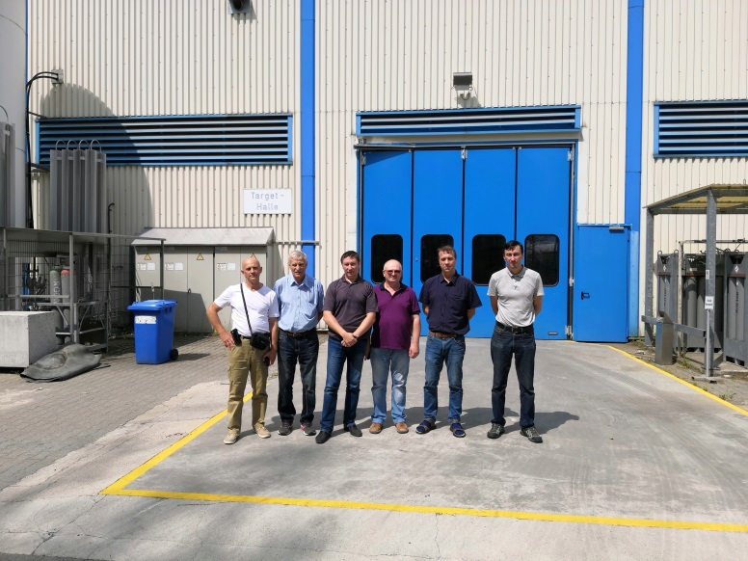
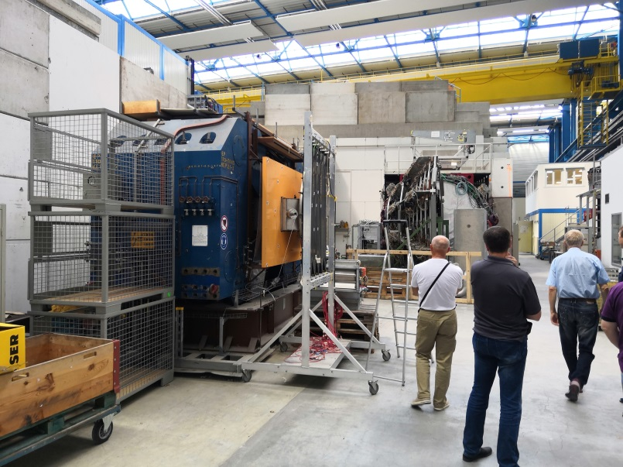
WP 2.5.23: Infrastructure – Albert Rakhimov, Vasily Prosvetov
Cable Data Base prepared.
Still a change request expected to improve the air cooling in the CR’s building, 2-nd floor area.
Preassembling, storage and test place under discussion.
General requirements are formulated.
Installation plan under developing.
Possible place for preassembling of dipole magnets at GSI’s target hall.
Two old magnets will be removed there from.

Slide 23
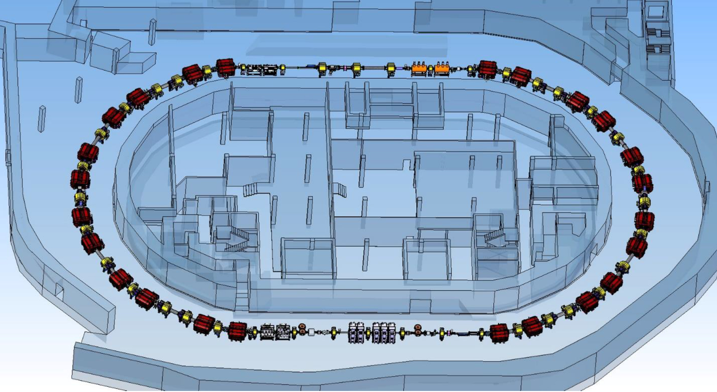
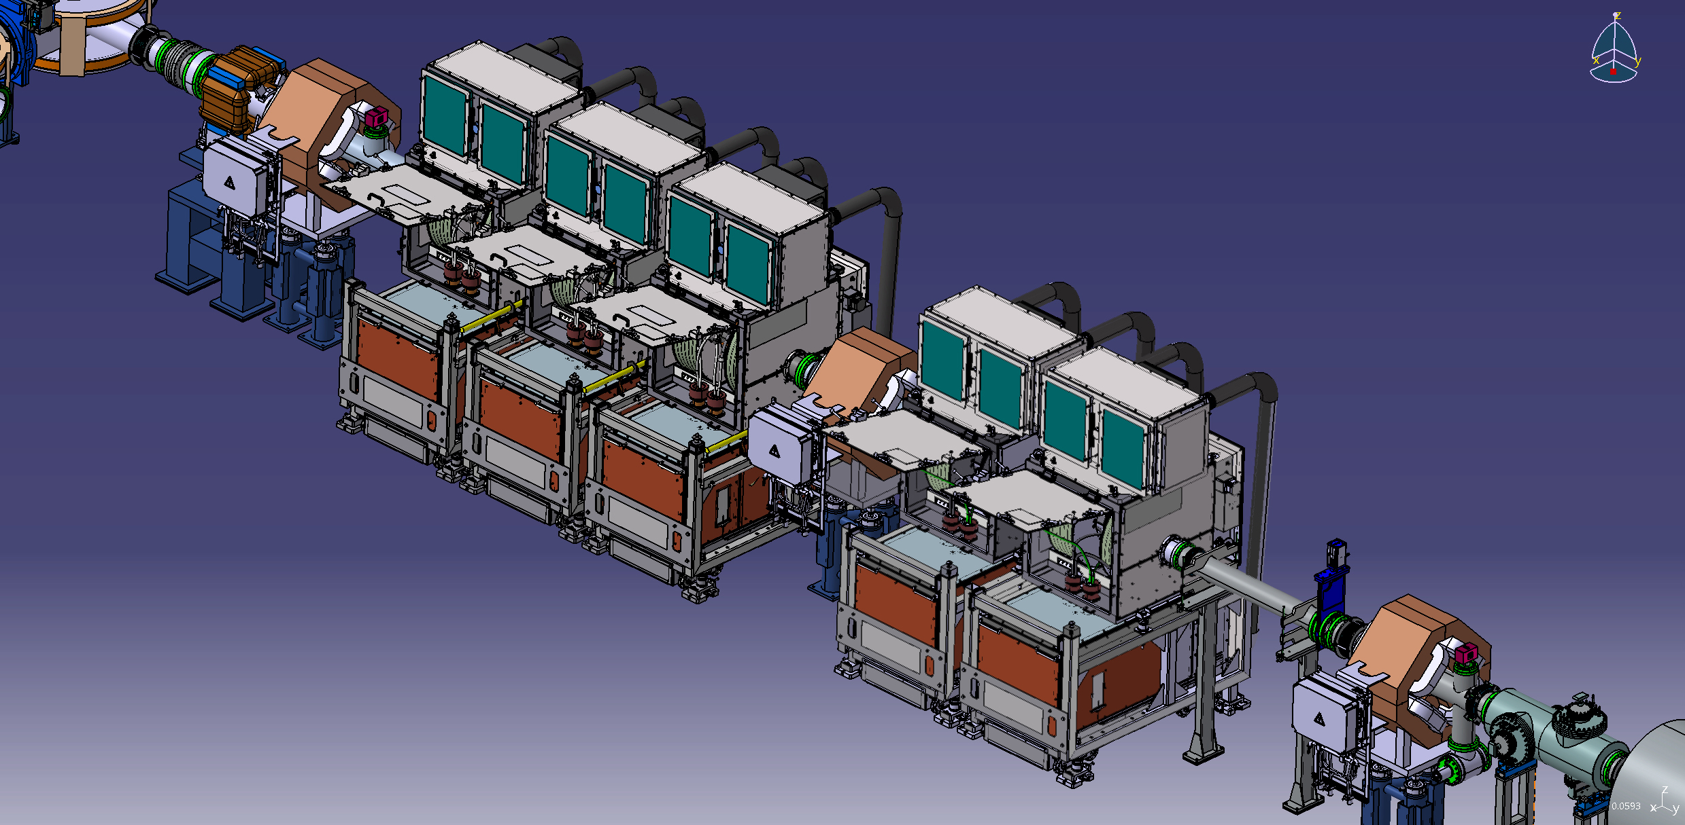
RF system (debuncher)
5 RF debunchers

Slide 24
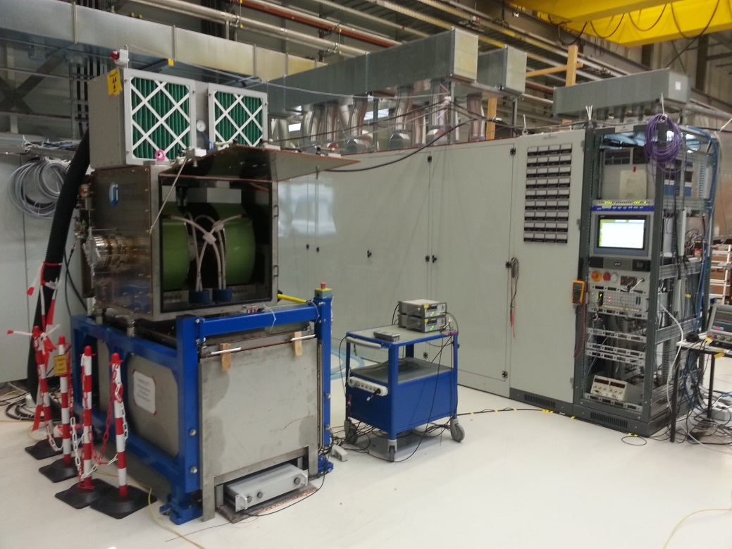
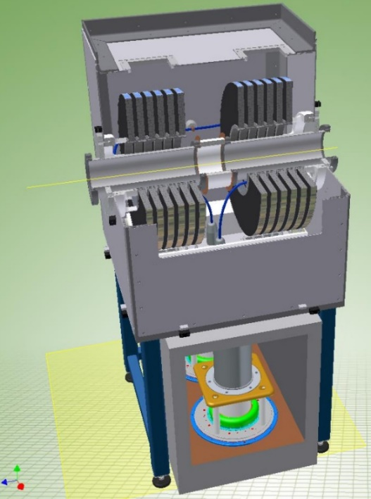
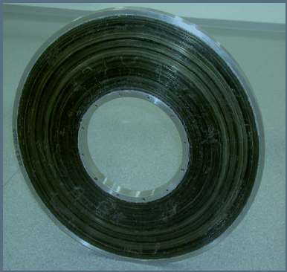
RF system
Number of units 5
Max. voltage 40 kV/unit
Frequency range 1.1 – 1.5 MHz
Inner pipe diameter 150 mm
CR debuncher during commissioning at GSI.
Two inductively loaded coaxial quarter wavelength resonators working on a common ceramic gap
Ring core of cobalt-based magnetic alloy

Slide 25
RF system: Status
All five series cavities available
All five series power amplifiers available
All four driver series amplifiers available
All five series power supplies available
Interface racks and water distribution available
LLRF components partly available
Integration of second RF station in test environment is completed
Commissioning and testing of second RF station is ongoing.

Slide 26
RF system: Open points to be improved
General improvements of reliability required (false shutdowns of power supply, tetrodes?)
Significant EMI disturbances at 1.5MHz originating from the power supply
Improvements of EMC hardness required (e.g. shutdowns of CR Debuncher when another RF system switches on in test area)
Rise time in CW at low voltages too slow
Short disturbance at the gap during transition from CW to pulsed operation

Slide 27
RF system: Next steps
SAT of 2nd RF station
Endurance test of 2nd RF station (5*24h)
Set-up 3rd RF station
Commission and test 3rd RF station
Decision on how to proceed with the testing of RF stations 4 and 5
Study together with the power supply manufacturer to improve EMI characteristics
Continuing operation of CR Debuncher to evaluate reliability situation and in case of problems trying to fix them

Slide 28
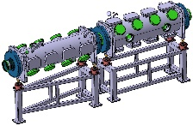
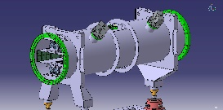
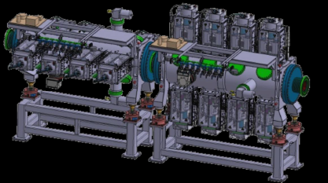
Stochastic cooling system
Kickers
Palmer Pick-Up
3D cooling by Filter, Palmer or TOF method
System bandwidth 1-2 GHz
Slot-line pick-ups with movable (plunging) electrode modules at cryogenic temperature (20-30 K) to improve signal-to-noise ratio for antiprotons
Palmer pick-up for pre-cooling of hot radioactive ion beams
Slot-line double Pick-Up

Slide 29
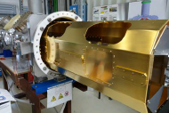
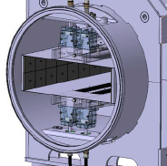
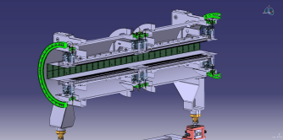
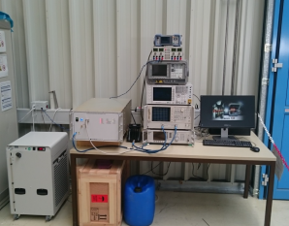
Stochastic cooling system: Status
Cryogenic Plunging Pick-Up:
- The prototype tank with full cryo-plunging concept has been tested in this year. Some improvements must be done.
- Endurance tests of the plunging foils successful, done.
- RF Electrode module under re-design.
The time line is critical but reachable.
Palmer Pick-up
The vacuum tank and inner electrodes under production at external companies.
The assembling and test with beam will take place at FZJ center in 2020.
Time line is not critical.
Power Amplifiers
Series production ongoing. First batch (8 units from 34) has been delivered to GSI. SAT ongoing
Time line is not critical
Prototype of Pick-Up tank
Palmer Pick-up design
Power Amplifier under
test at GSI

Slide 30
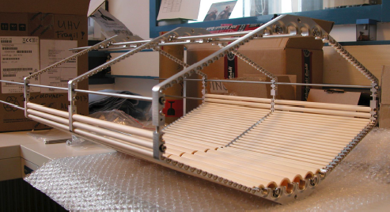
Stochastic cooling system: Status
Microwave Damping- Coated Ceramic Absorbers
- Draft engineering concept ready.
First batch of Al2O3 tubes for prototyping coated (by NiCr-sputtering at ISE Freiburg).
- UHV test done (outgassing rate acceptable).
2019-2020: Procure and store series of tubes.
Q1/2020 :assembly and full damping tube concept test after delivery of prototype chamber by BINP.
Time line is not critical
Kicker
The concept of the RF electrodes for Kicker is still under study.
No engineering design for electrodes and tanks.
The time line is very critical. Q4/2023 ?
Resistively coated ceramic tube modules inside all hexagonal quadrupole/sextupole vacuum chambers

Slide 31
Summary
It is important to have some convenient place for preassembling and testing of the magnets.
Delay with the design and production of CR magnets is not critical relative to current plan (start commissioning in Q4 2023).
Still we should find a way to accelerate the manufacturing of few critical components.
Cooperation with industry is one of such steps.
Integrated over all CR Work Packages time line plan:
Years | 2020 | 2021 | 2022 | 2023 | 2024
Months | 1 | 2 | 3 | 4 | 5 | 6 | 7 | 8 | 9 | 10 | 11 | 12 | 1 | 2 | 3 | 4 | 5 | 6 | 7 | 8 | 9 | 10 | 11 | 12 | 1 | 2 | 3 | 4 | 5 | 6 | 7 | 8 | 9 | 10 | 11 | 12 | 1 | 2 | 3 | 4 | 5 | 6 | 7 | 8 | 9 | 10 | 11 | 12 | 1 | 2 | 3 | 4 | 5 | 6 | 7 | 8 | 9 | 10 | 11 | 12
CR Building
Production
Delivery
Pre- Assemb
Installation
Commission

