Slide 1
Radiation resistant SFRS magnets.
D. Gurov, A.Utkin for CR team
BINP, Novosibirsk
28.11.2019
3rd FAIR-BINP Workshop, Novosibirsk, RUSSIA

Slide 2
Contents
Dipole 3D view
Dipole transversal view
Dipole commutation
Mechanical adjustman box
Production plan
Parameters of multipoles
Wire for coils
Construction of Quadrupole 1-b
Field in yoke
Yoke saturation and longitudinal field distribution
Field quality
Construction of Quadrupole2
Field in yoke
Yoke saturation and longitudinal field distribution
Field quality
Construction of sextupole
Field in yoke
Yoke saturation and longitudinal field distribution
Field quality

Slide 3
Radiation resistant dipole magnet

Slide 4
Dipole transversal view

Slide 5
Water and current commutation box

Slide 6
Mechanical adjustment box

Slide 7
Production plan
Month | Date | Yoke | Stand | Coil | Magnet
0 | 01.04.2019
1 | 01.05.2019
2 | 01.06.2019
3 | 01.07.2019
4 | 01.08.2019 | Design (yoke 3D)
5 | 01.09.2019
6 | 01.10.2019
7 | 01.11.2019
8 | 01.12.2019 | Conseptional design (water,current)
9 | 01.01.2020
10 | 01.02.2020
11 | 01.03.2020 | Steel Procurement
12 | 01.04.2020 |  | Adopting drawings (translation e.t.c)
13 | 01.05.2020 | Yoke production |  | Passing drawings for production
14 | 01.06.2020 |  | Passing drawings for production | Technological design
15 | 01.07.2020 |  | Technological design
16 | 01.08.2020 |  |  | Cable delivering
17 | 01.09.2020 |  |  | Materials procurement
18 | 01.10.2020 |  | Materials procurement | (alloy,cupper,tubes,ceramics,st.steel)
19 | 01.11.2020 |  | (steel, reductors e.t.c) | Tooling production
20 | 01.12.2020
21 | 01.01.2021 |  | Stand productin
22 | 01.02.2021
23 | 01.03.2021
24 | 01.04.2021
25 | 01.05.2021 |  |  | Coils production
26 | 01.06.2021 |  |  | (winding, impregnation)
27 | 01.07.2021 |  |  | (production of segments)
28 | 01.08.2021 |  |  | (uniting segments into coils)
29 | 01.09.2021
30 | 01.10.2021
31 | 01.11.2021 |  |  | Test of coils
32 | 01.12.2021 |  |  |  | Assembling of magnets
33 | 01.01.2022
34 | 01.02.2022
35 | 01.03.2022 |  |  |  | Measurement and optimisation
36 | 01.04.2022
37 | 01.05.2022 |  |  |  | Disassembling and packing
38 | 01.06.2022
39 | 01.07.2022
40 | 01.08.2022
41 | 01.09.2022
42 | 01.10.2022

Slide 8
Hangling instruction

Slide 9
Hangling instruction

Slide 10
Parameters of multipoles
2.4.2.2.1 | Quadrupole 1a | 1 | 1.6 T/m | 15.4 T/m | 0.933 | Ø 130 | ±1∙10⁻³
2.4.2.2.1 | Quadrupole 1b | 1 | 1.2 T/m | 11.8 T/m | 1.244 | Ø 180 | ±1∙10⁻³
2.4.2.2.2 | Quadrupole 2 | 1 | 0.6 T/m | 6.1 T/m | 1.200 | 380 × 240 | ±1∙10⁻³
2.4.2.3.1 | Sextupole 1 | 2 | 3.5 T/m² | 34 T/m² | 0.600 | Ø 380 | ±5∙10⁻³

Slide 11
Wire for coils
Wire 2000A-H
Minimal bending radius 120-130 mm.
Maximal length of wire – 60 m.
Maximal current 2000 Amper.

Slide 12
Construction of Quadrupole-1b
Coil contain 4 separate segments 9 turns each (36 turns)
Maximal current – 50 kA ( 1390 A per turn)
Quarter of yoke with coils (dimensions are in cm)

Slide 13
Construction of Quadrupole-1b coil
Longitudinal dimensions of all segments of coil are equal on area 55 mm.
The ends of wire in segments are directed upwards (along the neck of the yoke)
We propose to make not a monolithic, but a composite coil and place the segments in the frame and rigidly fix them in places of their equal longitudinal size

Slide 14
3D magnetic calculations for quadrupole-1b
Calculations was made at “Mermaid” software for magneto-static calculatins
Calculated 1/8 of quadrupole magnet
Steel type, used in calculations – Armco
Calculations was made for total currents 4, 14, 24, 34, 44, 50 kA
Yoke length 1180 mm.
Inscribed radius 95 mm.

Slide 15
Field in yoke
Field in yoke (kGs) at maximal gradient value
Permeability in yoke at maximal gradient value

Slide 16
Yoke saturation and longitudinal field distribution

Slide 17
Field quality
Field quality at 90 mm radius

Slide 18
Construction of Quadrupole2
Coil contain 4 separate segments 11 turns each (length of wire in segments varies from 42 to 50 meters)
Maximal current – 76 kA ( 1730 A per turn)
Quarter of yoke with coils (dimensions are in cm)

Slide 19
Construction of Quadrupole2 coil
Longitudinal dimensions of all segments of coil are equal on area 96 mm.
The ends of wire in segments are directed upwards (along the neck of the yoke)
We propose to make not a monolithic, but a composite coil and place the segments in the frame and rigidly fix them in places of their equal longitudinal size

Slide 20
3D magnetic calculations for quadrupole2
Calculations was made at “Mermaid” software for magneto-static calculatins
Calculated 1/8 of quadrupole magnet
Steel type, used in calculations – Armco
Calculations was made for total currents 10, 20, 40, 60, 75.4 kA
Yoke length 1060 mm.
Inscribed radius 163 mm.

Slide 21
Field in yoke
Field in yoke (kGs) at maximal gradient value
Permeability in yoke at maximal gradient value

Slide 22
Yoke saturation and longitudinal field distribution

Slide 23
Field quality
Field quality at 140 mm radius

Slide 24
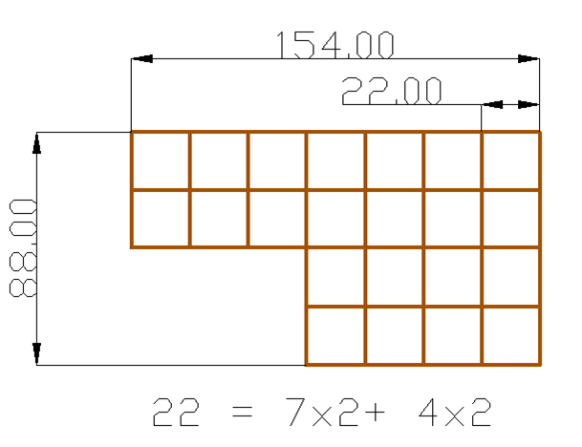
Construction of sextupole
Calculations was made at “Mermaid” software for magneto-static calculatins
Calculated 1/8 of sextupole magnet
Steel type, used in calculations – Armco
Calculations was made for total currents 3.6, 18, 27, 36 kA
Yoke length 600 mm, inscribed radius 200 mm.
Length of wire, required for coil is about 55 meters.
Imax= 1720A

Slide 25
3D magnetic calculations for sextupole

Slide 26
Field in yoke
Field in yoke (kGs) at maximal gradient value
Permeability in yoke at maximal gradient value

Slide 27
Yoke saturation and longitudinal field distribution

Slide 28
Field quality
Field quality at 190 mm radius

