Slide 1
Supplier Report & Dashboard
3rd BINP-FAIR Collaboration Coordination Workshop
Nico Oepen
26.11.2019

Slide 2
Supplier Report & Dashboard
Project steering & tracking process overview
Components status tracking

Slide 3
Project steering & tracking process overview
planning phase
S002
manufacturing phase
S004 & S005
installation & commissioning without beam
S007
commissioning with beam
S008
shipment & SATA
S006
procurement tracking
& expediting
components
status tracking
M8-M10
pre - & installation
status
tbd
reporting data bank for planning = MS Project
Input for reporting:
progress reporting
critical path analysis
project prognosis
resource planning
cost planning
Input for logistics and installation:
coordination of the delivery/storage
coordination of installation

Slide 4
Components status tracking M8-M10
components status tracking
M8-M10
manufacturing phase
S004 & S005
shipment & SATA
S006
monthly
supplier status report
supplier tracking & expediting (components status)
reason & aim
A realistic status & planning is very important to steer and update:
Planning of logistics
Integration & pre-assembly
Installation
Payment & outflow planning
FAIR receives monthly status reports from every supplier

Slide 5
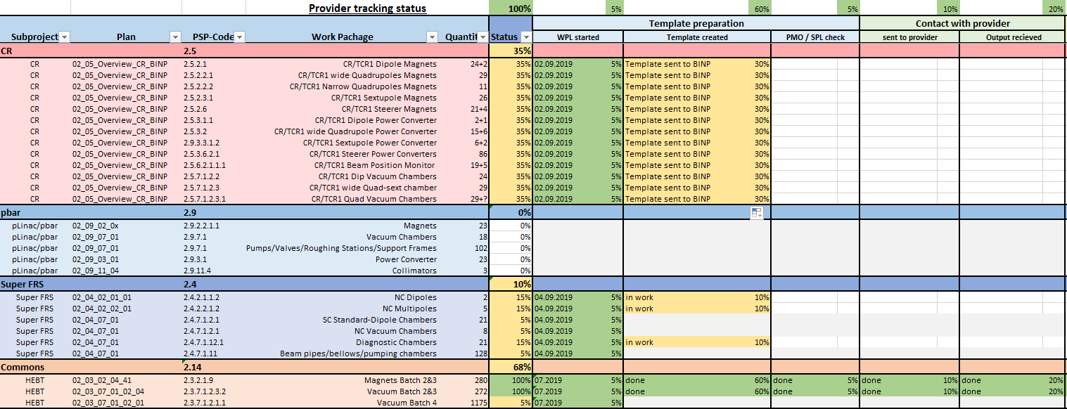
Status of the implementation
At HEBT Magnets/Vacuum the template is already in use. The rest will follow successively (after contract signature).

Slide 6
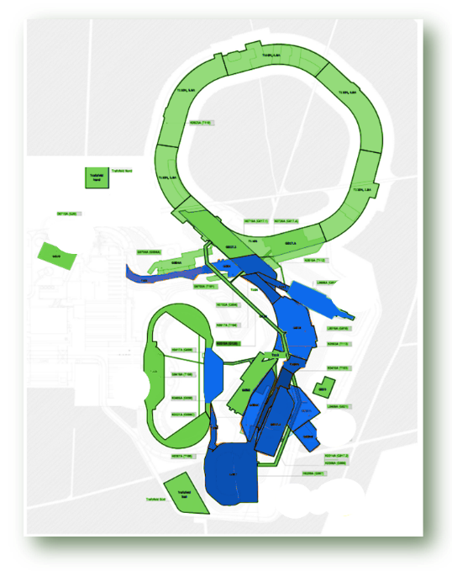
BINP components at FAIR
BINP is involved in:
CR
Super-FRS
pbar
HEBT
CBM
PANDA
Almost the entire southern part of the facility.

Slide 7
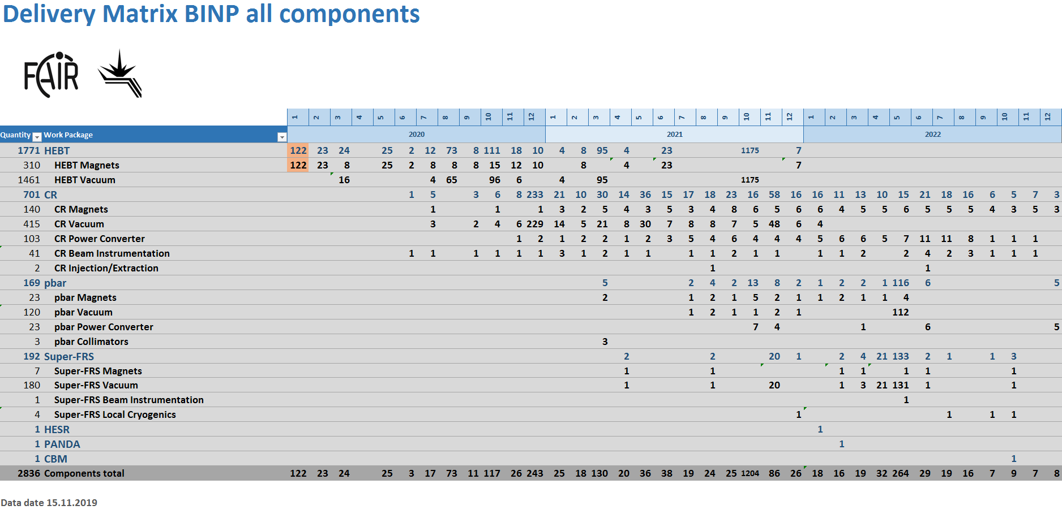
Components for detailed supplier tracking
2836 Components in total (thereof 1759 are vacuum small parts and standard components)
Large numer of components is built at BINP – tracking is mandatory (logistics, installation, …)

Slide 8
Components status tracking
Monthly supplier status report (provided by FAIR)

Slide 9
Supplier Satus Report
example HEBT Vacuum
First sheet for your information

Slide 10
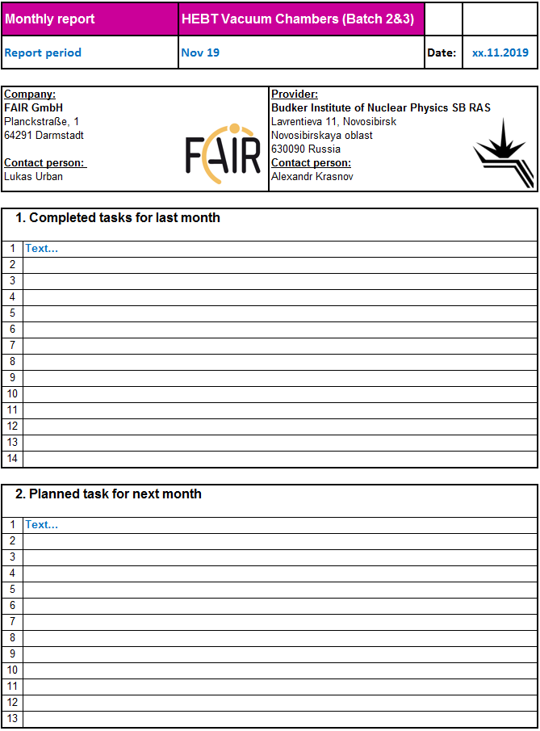
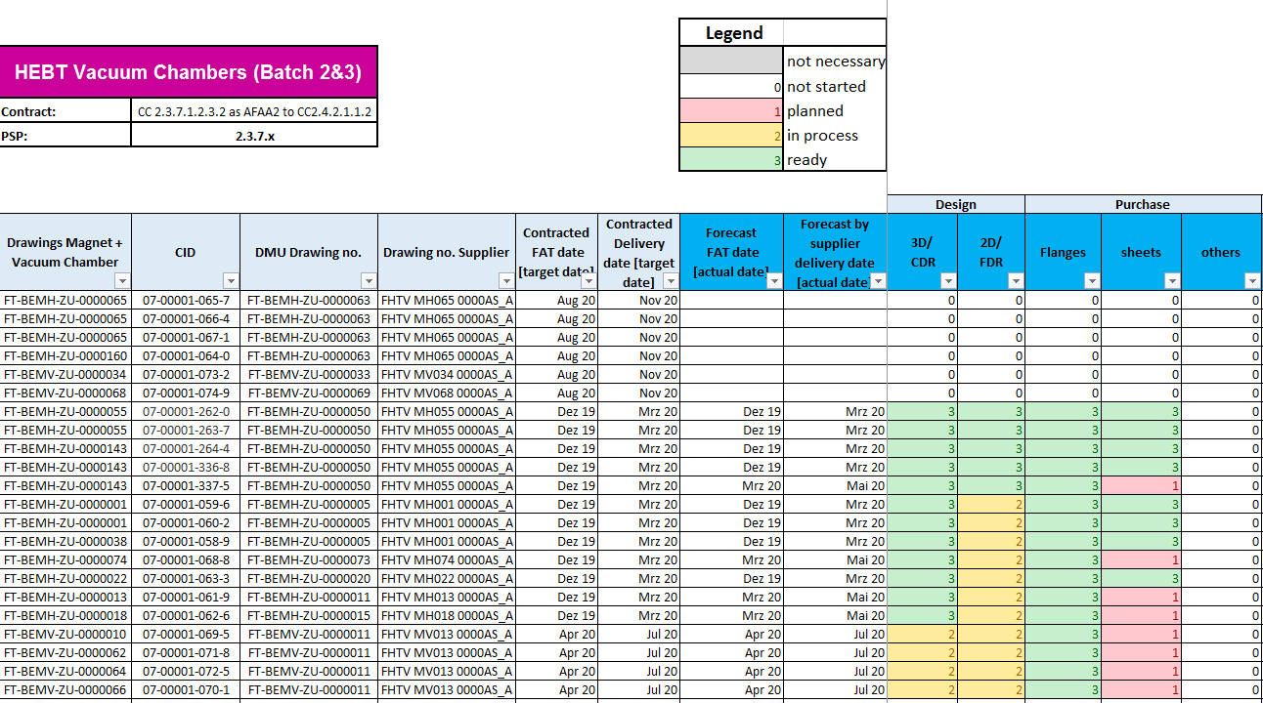
Supplier Satus Report: HEBT Vacuum
1
3
4
2
The whole Excel-template at a glance

Slide 11
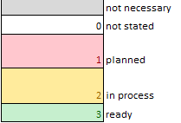
Supplier Satus Report Structure
example HEBT Magnets
1
Static part, will be filled by FAIR team.
PSP number, quantity, DMU drawing number und CID number … number …
2
FAT, Delivery date [target]
Forecast FAT, delivery date [actual prognosis]
please update monthly
3
Components status individual “body”
please update monthly

Slide 12
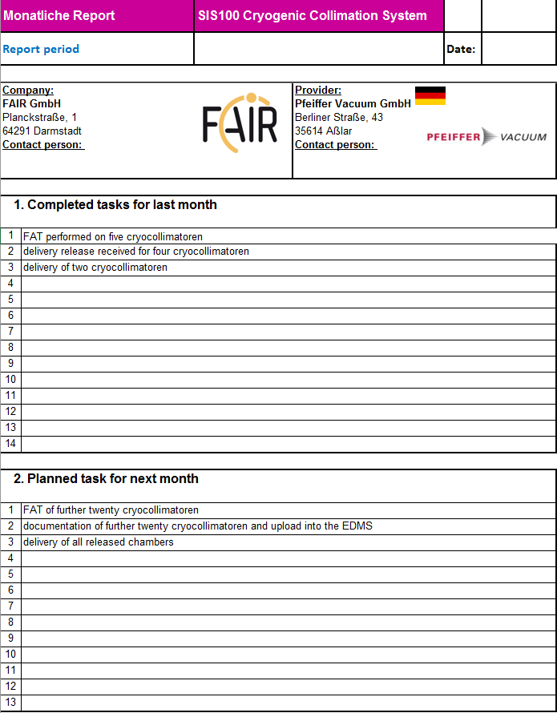
Supplier Satus Report Structure
example HEBT Vacuum
Summary: completed tasks
for last month &
tasks planned for next month
4
please update monthly
example from SIS100

Slide 13
Summary
Why is all this important?
High quantity of components will be delivered by BINP to FAIR
In the coming months the delivery volume will increase continuously
Logistics at FAIR needs high quality data for coordinated transport/storage
and installation
Critical path definition and update using the status reports
Cashflow planning for the next years
Coordinate and provide resources (personal/work areas/equipment) for installation
Ensure that all components are at FAIR when needed

Slide 14
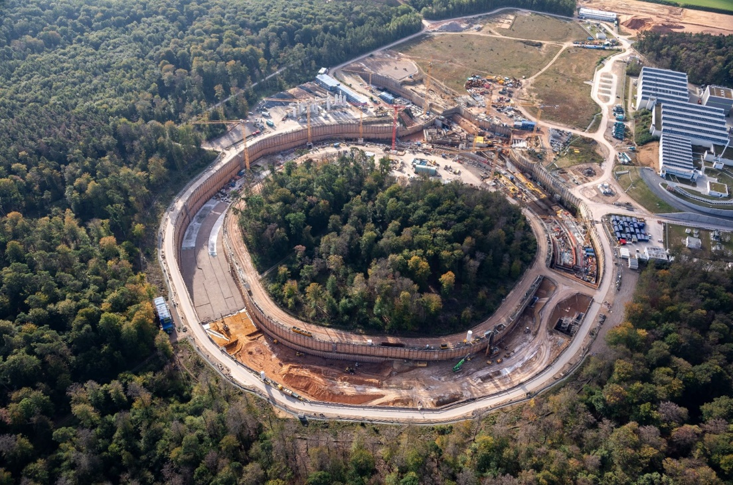
Many thanks & great team work further on

Slide 15
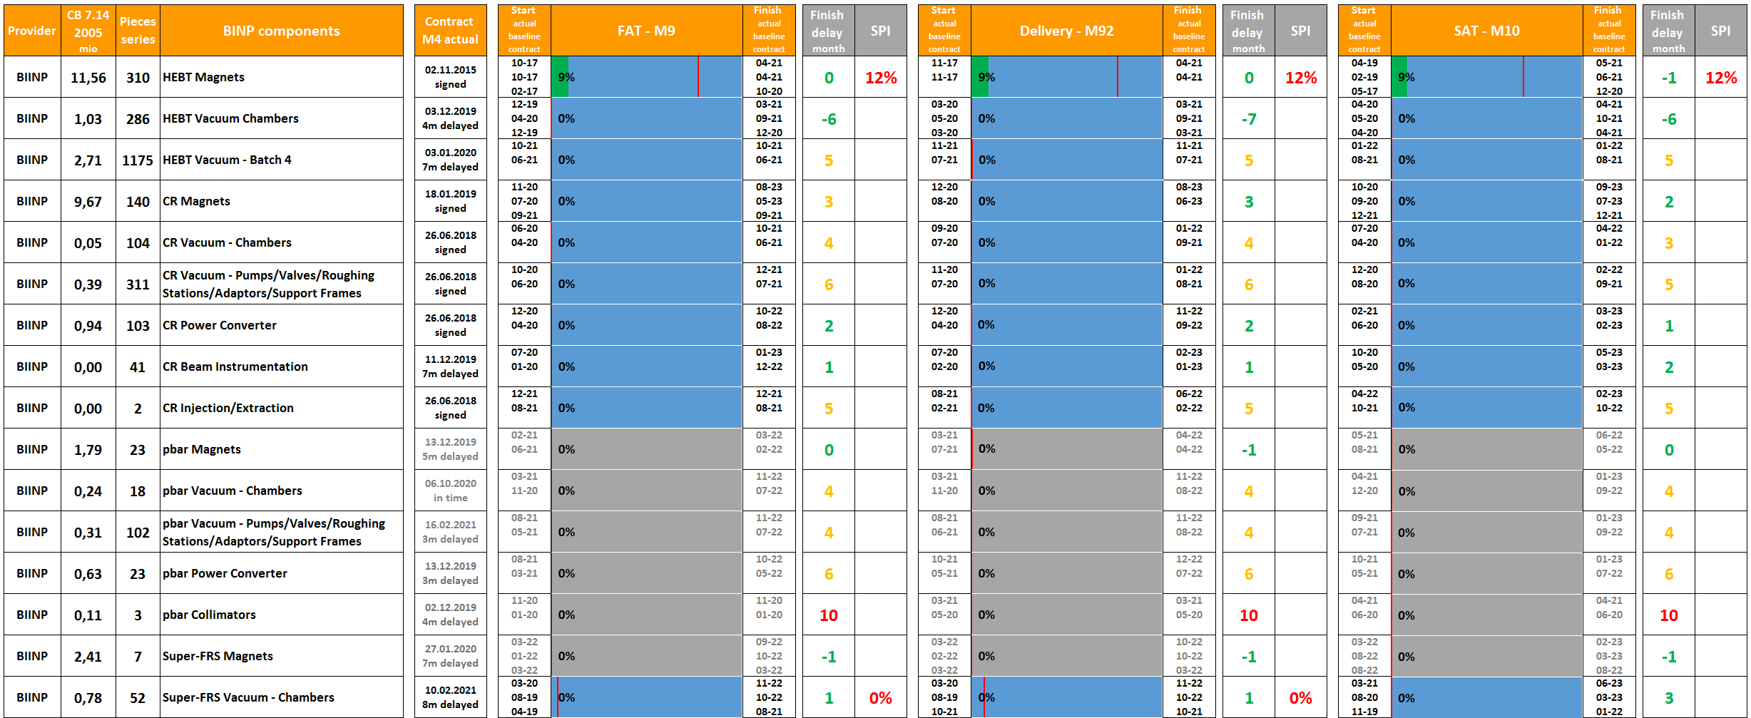
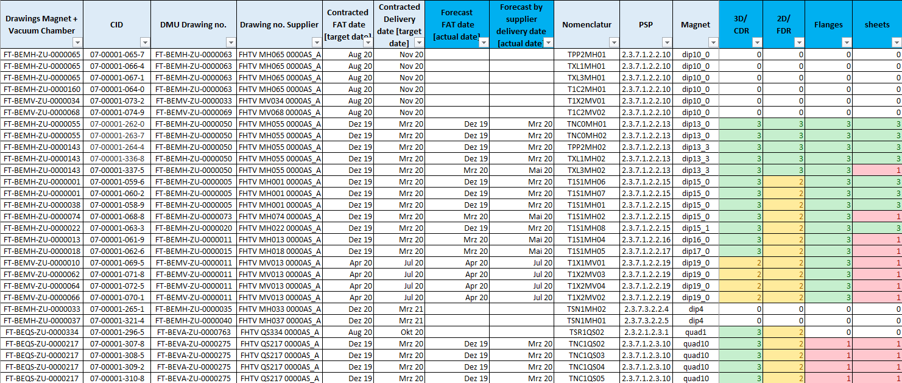
Implementation steps
Define list of components for detailed
supplier tracking & expediting status report
create subproject dashboard overview
Template preparation
Contact BINP
FAIR receives monthly status reports from every supplier

Slide 16
Top level overview dashboard for FAIR management
The components dashboard overview is a summary of all suppliers reports

Slide 17
Supplier Satus Report Structure
example HEBT Vacuum
Step 2:
Third sheet
„Component Dashboards“
To be updated monthly.
Detailed steps in the
production phase.

