Slide 1
Pre assembly SuperFRS for Elytt magnets
Haik Simon
FAIR-BINP Workshop
Novosibirsk, November 25-29, 2019
Haik Simon / FAIR-BINP Workshop, Novosibirsk, November 25-29, 2019

Slide 2
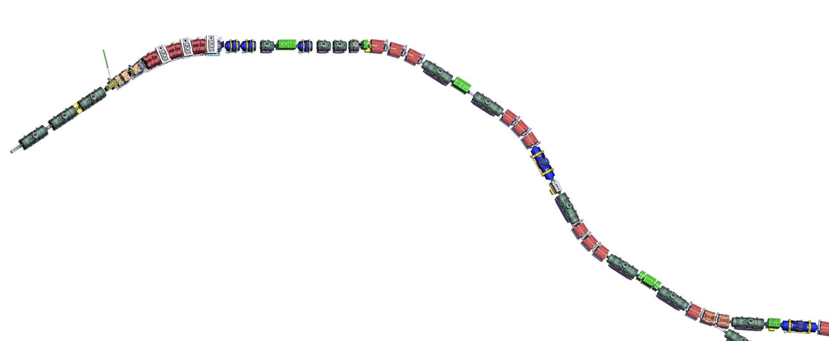
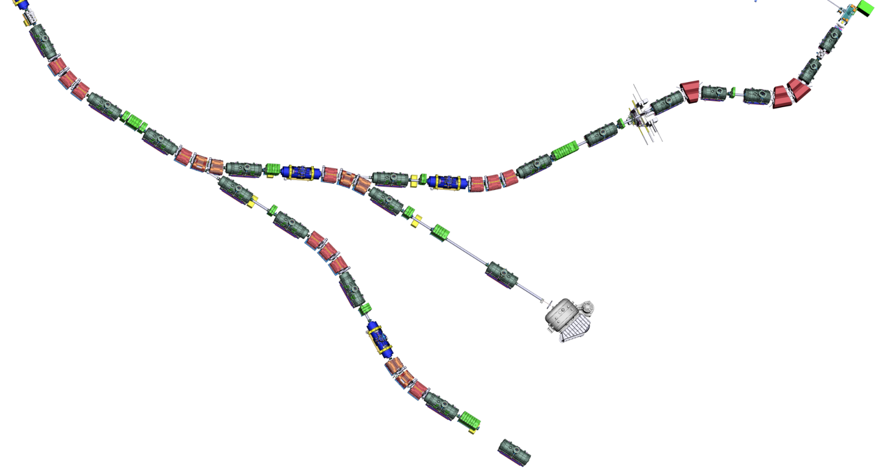

Super-FRS layout
BC3-NCS
Assembly Units
along the beamline
NC_D3
SM_02
SM_01
SM_03
SM_04
SM_07
SCD_01
SM_05
NC_D2
DC_02
SM_06
DC_03
SCD_02
BC1
BC2
SCD_03
NC_D1
NC_QS
LM_04
NC_QQ
DC_04
TA
FPF1
FPF2
FPF3
LM_03
LM_05
VAC_02
SCD_04
LM_02
FPF0
FPF4
DC_01
SCD_05
LM_01
SCD_06
VAC_01
FTF1
LM_06
DC_05
FLF6
FMF1
LM_07
FLF5
DC_17
SCD_07
FLF3
SCD_08
FLF4
EBM_05
SCD_09
VAC_06
DC_16
LM_08
DC_14 (maybe)
EBM_04
DC_06
FMF3
FLF2
DC_07
DC_08
LM_17
EBD_03
SCD_11 (branch)
VAC_05
NC_QQ nc quadrupole 1a + quadrupole 1b
NC_QS nc quadrupole 2 + sextupole
NC_D nc dipole
BC beam catcher
BC3-NCS beam catcher 3 + nc sextupole
TA target chamber
DC diagnostic chamber
SM sc short multiplet
LM sc long multiplet
SCD sc dipole
VAC vacuum part
EBD EB dipole
EBM EB multiplet
BDN Beam dump NUSTAR
LM_09
DC_15
FLF1
EBM_02
SCD_10
DC_13
EBD_01
EBM_03
EBD_02
FMF2
SCD_12
SCD_14 (branch)
LM_16
EBM_01
LM_10
SCD_13
DC_09
LM_11
LM_14
SCD_18
SCD_17
SCD_15
SCD_16
LM_15
DC_12
LM_18
LM_12
VAC_07
DC_18
DC_10
LM_19
VAC_03
FRF1
SCD_19
DC_11
SCD_20
FHF1
VAC_04
SCD_21
LM_13
LM_20
VAC_ NUSTAR
FRF2
DC_19
FHF2
VAC_08
GLAD
LM_21
BDN
SCD_22
FHF3
VAC_09
SCD_23 (branch)
SCD_24
LM_22
DC_20
FRF3
VAC_10
LM_23
VAC_11

Slide 3
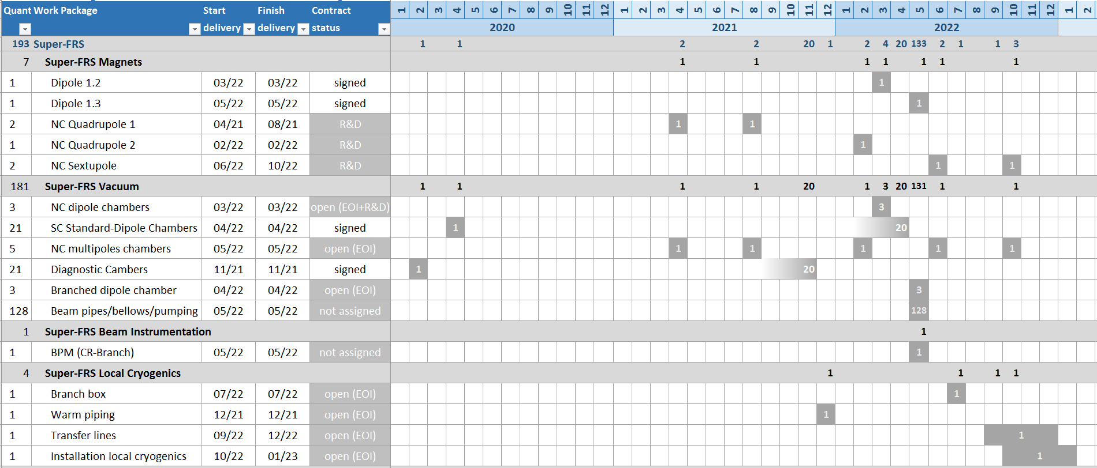
Delivery Matrix
First of Series

Slide 4
Super-FRS Vacuum
SC standard-dipoles chambers
Scope:
21 vacuum chambers for sc standard dipoles including pumping ports
installation services
  Status / Schedule
Detailed specs released
Contract signed on 11/09/2019
CDR FoS: Nov 2019
FDR FoS: Feb 2020
CDR series: Mar 2020
FAT and delivery FoS: Apr 2020
FDR series: May 2020
Manufacturing: May 2020 – Feb 2022
End of FAT series: Feb 2022
End of SAT: Apr 2022
End of installation services: Apr 2022
Final acceptance: Apr 2022
scheduling in line with nc magnets
Reporting …

Slide 5
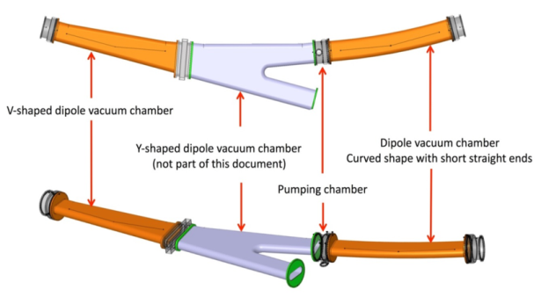
Super-FRS Vacuum
SC branched-dipoles chambers
Scope:
3 sc branched-dipoles chambers
  Status / Schedule
EoI received long time ago
chamber's specs released (included in magnets’ specs)
Design of magnet CDR CEA: Q1/2019
Magnet production scheme allows for
integration of BINP chamber in the
assembly scheme
Manufacturing expected together with
branched dipoles (currently 2021)
Technical discussion in the workshop

Slide 6
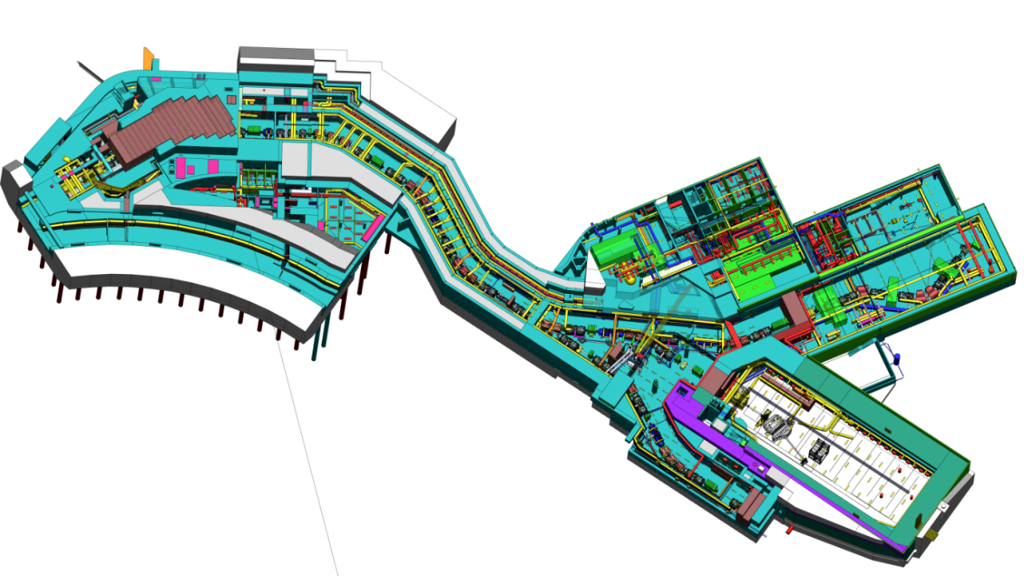
Hall space (~60 x 20 = 1200 m²)
Truck
onloading
Deliver directly to site:
# Magnet + chamber without end flanges
+Single crane operation
+Transport to installation place via air cushion
+No additional storage space needed.
crane missing ➔ lifting tool 25t required
Floor at -3m ➔ fork lift, tools require transport

Slide 7
Super-FRS
D3y – branched SC dipoles
Summary of 15/06/2018 presentation
A. Madur on behalf of
Patrick GRAFFIN, Michaël MASSINGER, Hugo REYMOND
Notes:
I’ll present you the mecanical part of the special magnet 9,75°

Slide 8
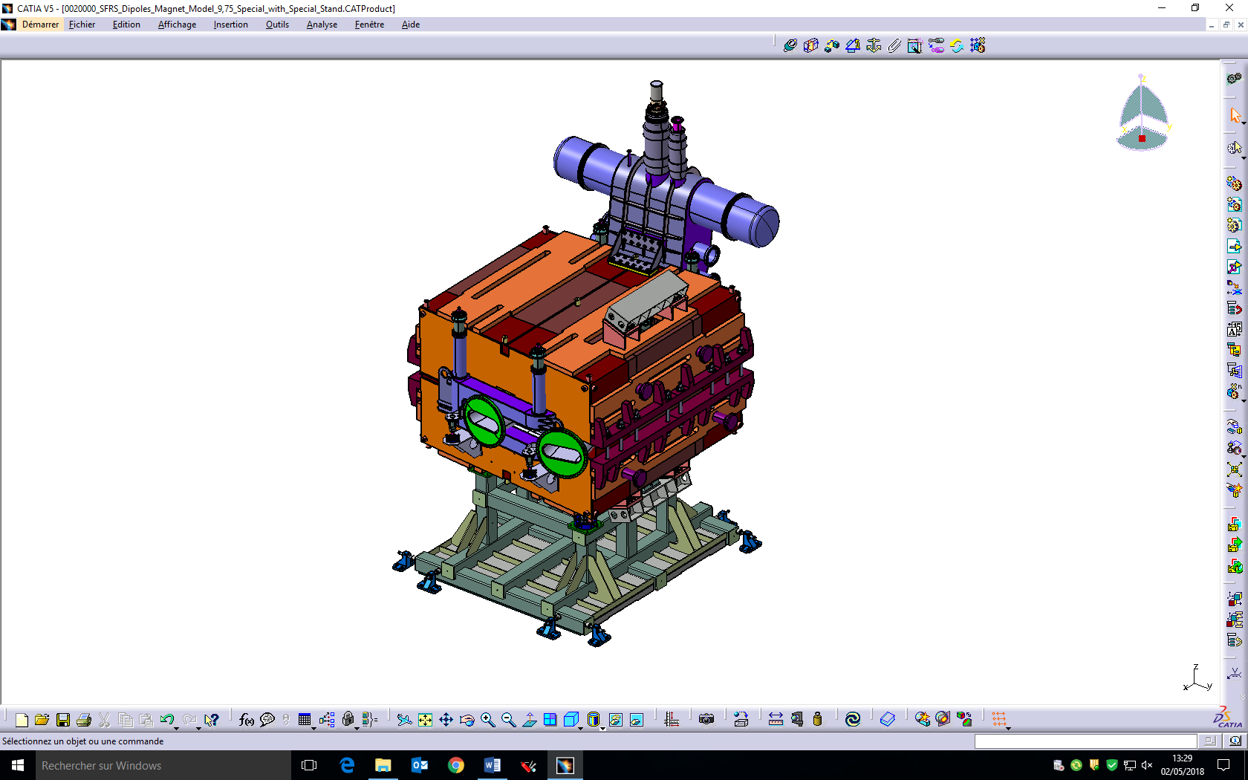
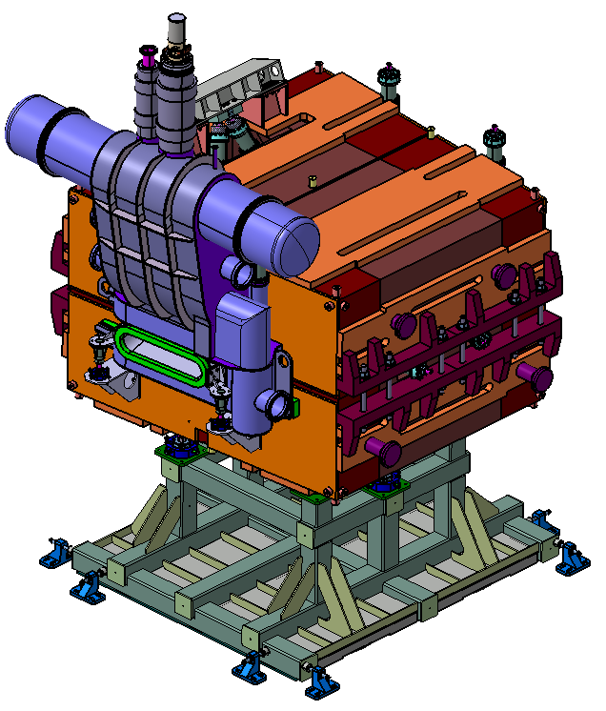
Super-FRS D3y

Slide 9
It‘s movie time

Slide 10
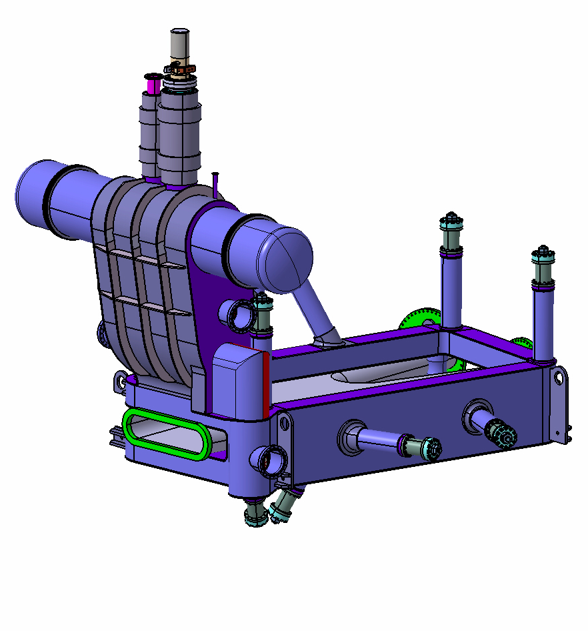
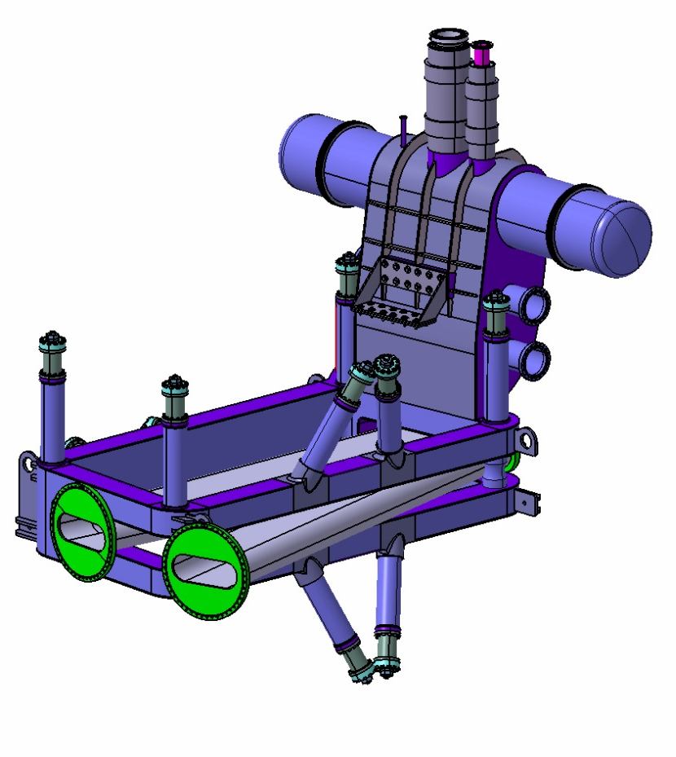
Overview D3Y 9.75° or branched dipole

Slide 11
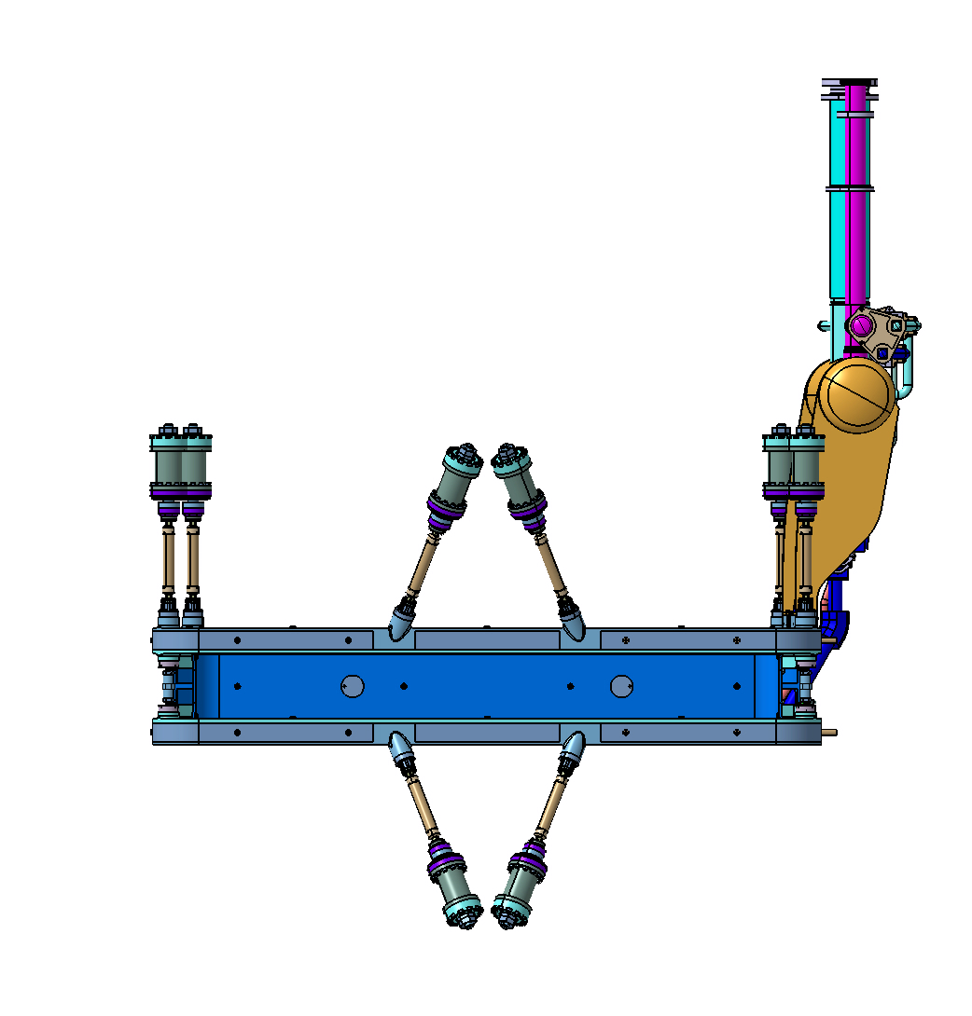
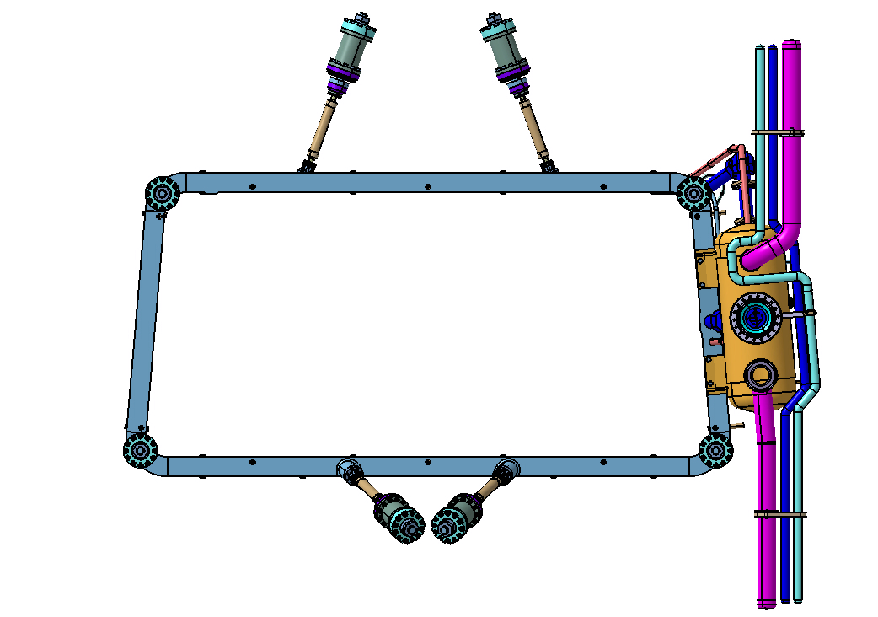
Geometry
Cold mass
The 4 vertical cold to warm supports :
allow the vertical adjustment of the cold mass
The 2 horizontal cold to warm supports :
allow lateral adjustment of the cold mass
20°
20°
2400
2257
655
950
420
1213
620
The 4 tilted cold to warm supports :
reduce the movement of the cold mass during energizing phase
2407

Slide 12
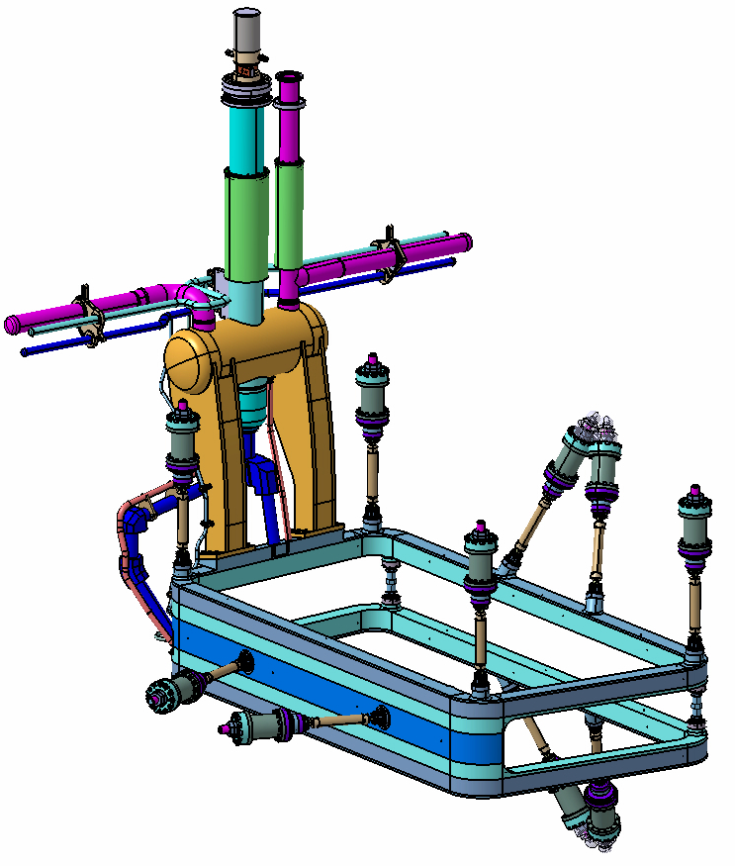
Geometry
Cold mass
Cold to warm supports (x10)
70°
Adjustable pillars M24 (± 7 mm)
Notes:
CTWS : +- 5mm
Pillar :

Slide 13
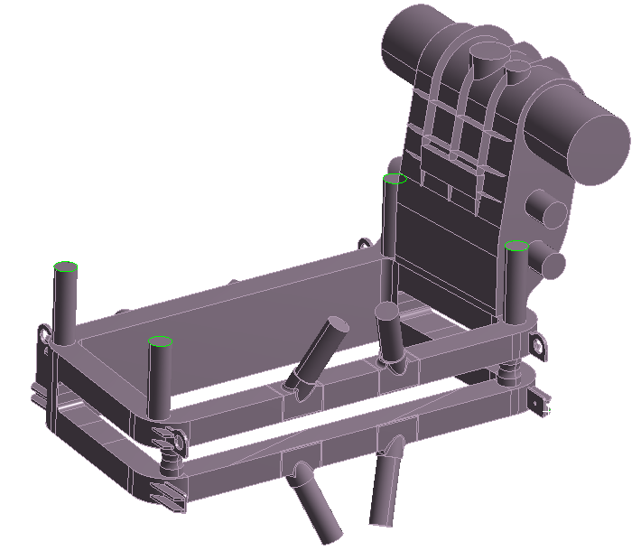
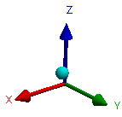
Cryostat

Slide 14
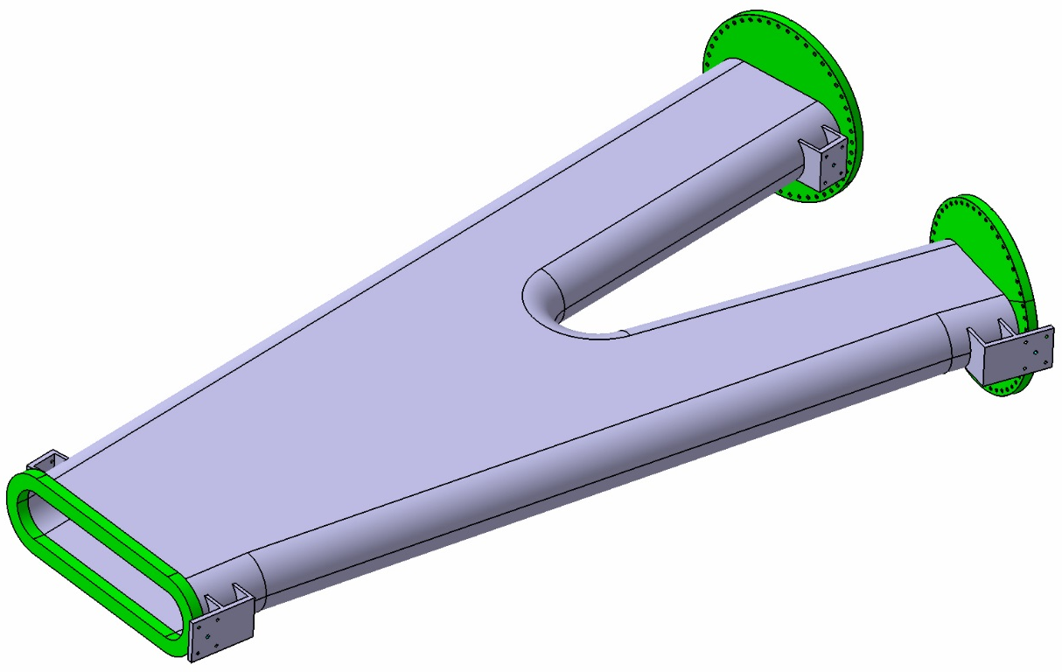
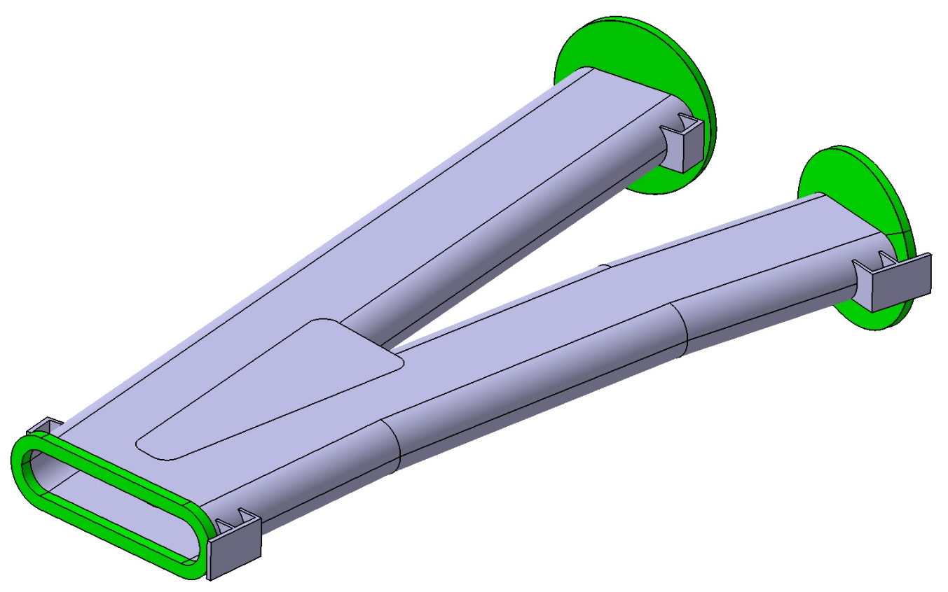
Beam Chamber
Old
New

Slide 15
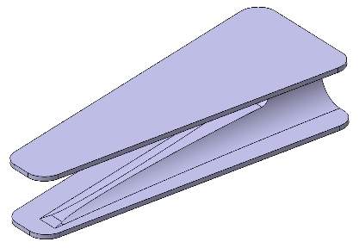
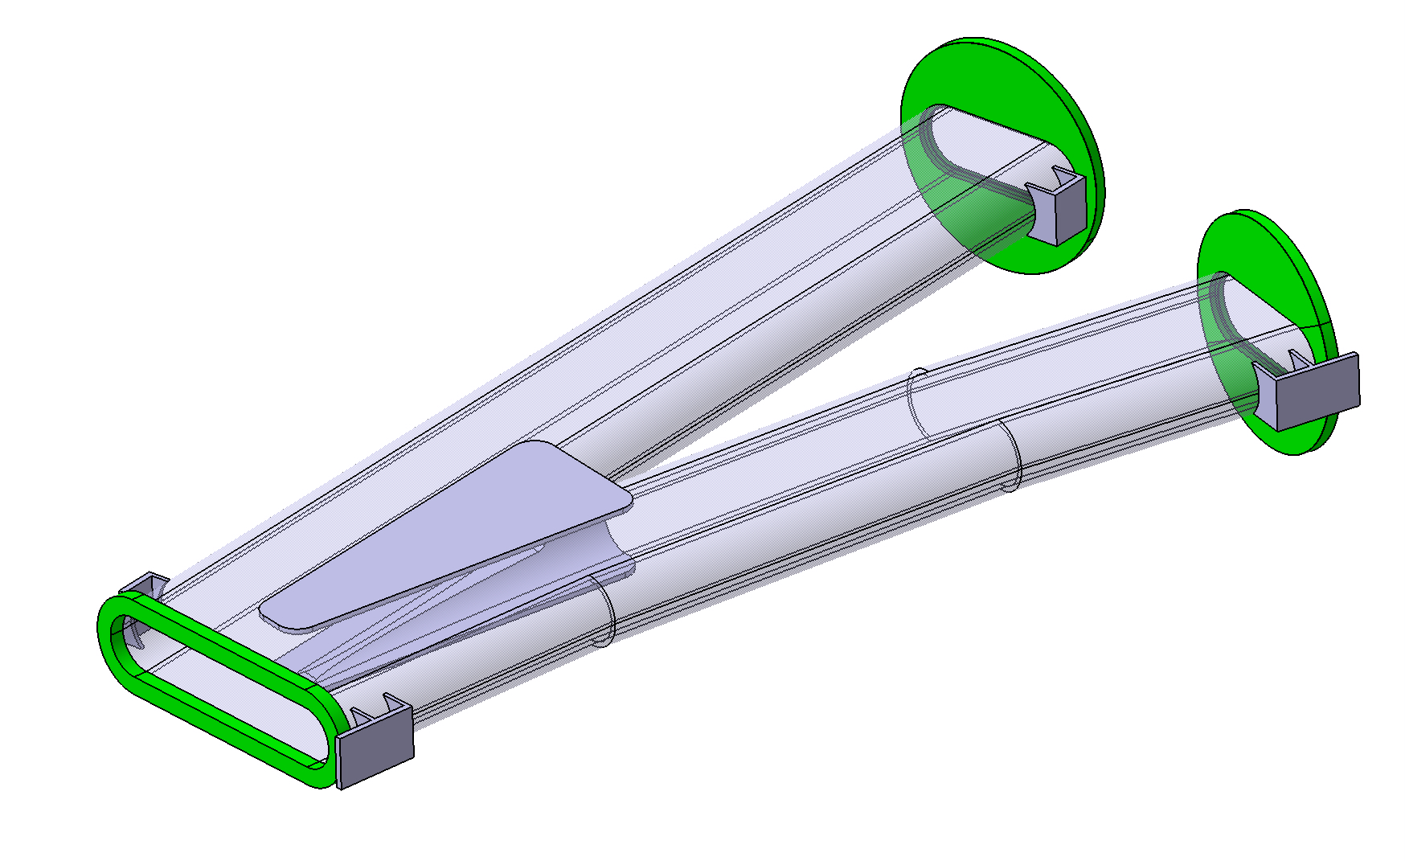
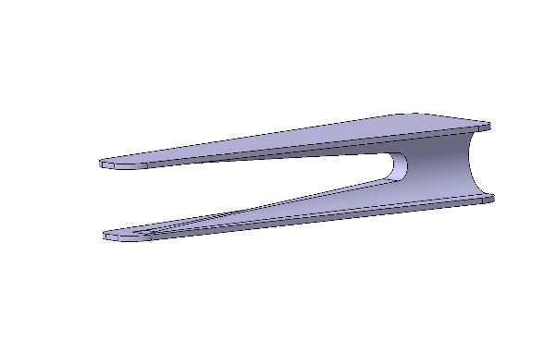
Beam Chamber
Machining Part
Flange
Thickness : 28 mm
Fixing Part
Thickness :
Plate : 10 mm
Base Plate : 15 mm
Flange
Thickness : 28 mm
Fixing Part
Thickness :
Plate : 10 mm
Base Plate : 15 mm
Fixing Part
Thickness :
Plate : 10 mm
Base Plate : 15 mm
Chamber
Thickness : 12 mm
Fixing Part
Thickness :
Plate : 10 mm
Base Plate : 15 mm
Flange
Thickness : 34 mm

Slide 16

Beam Chamber
UX=UY=UZ=0
UX=UY=UZ=0
UX=UY=UZ=0
Vacuum in the beam chamber (External Pressure : 0,1 Mpa)
UX=UY=UZ=0
UX=UY=UZ=0
Z
X
Y
UX=UY=0
UX=UY=UZ=0

Slide 17
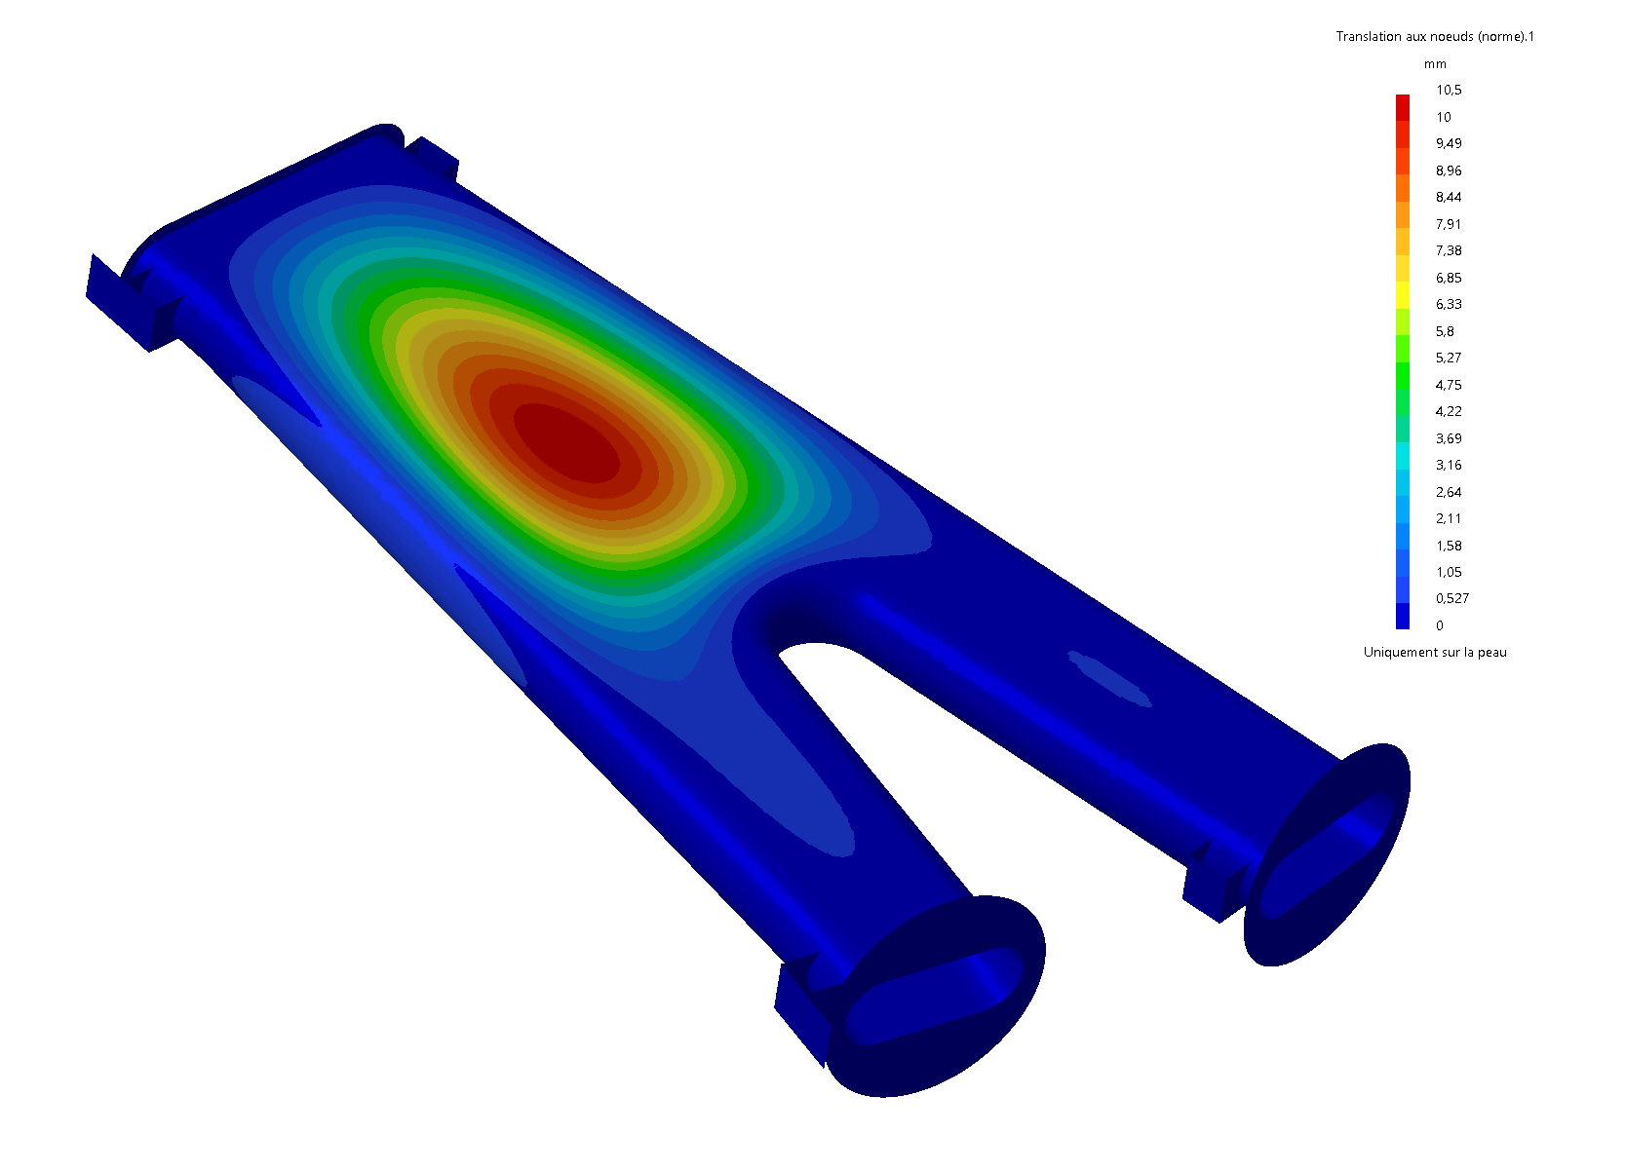
Beam Chamber
Vacuum
Displacement
Old
Uz =10.5 mm

Slide 18
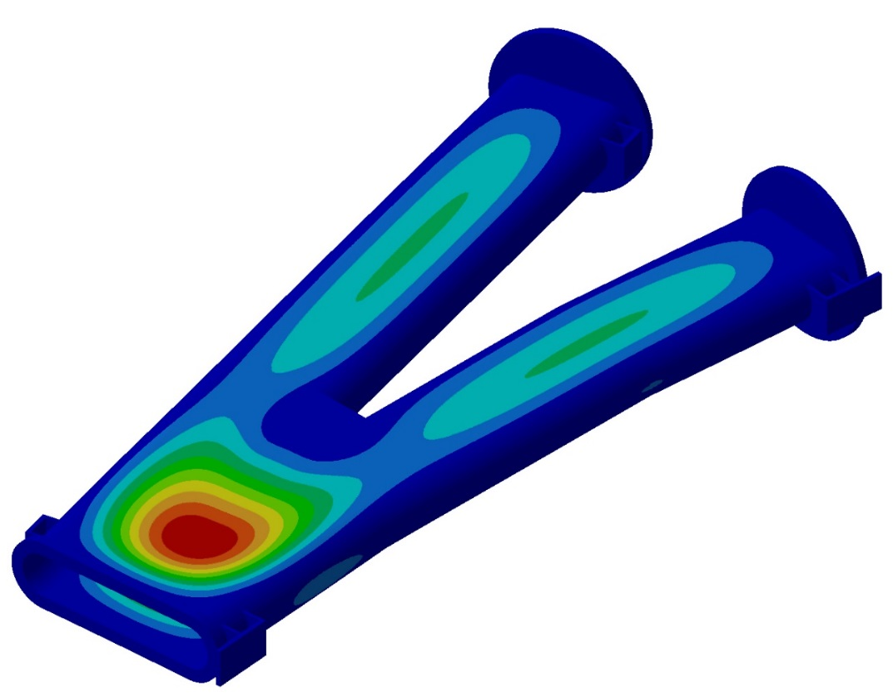

Beam Chamber
Vacuum
Displacement
Uz = 1.09 mm
New

Slide 19
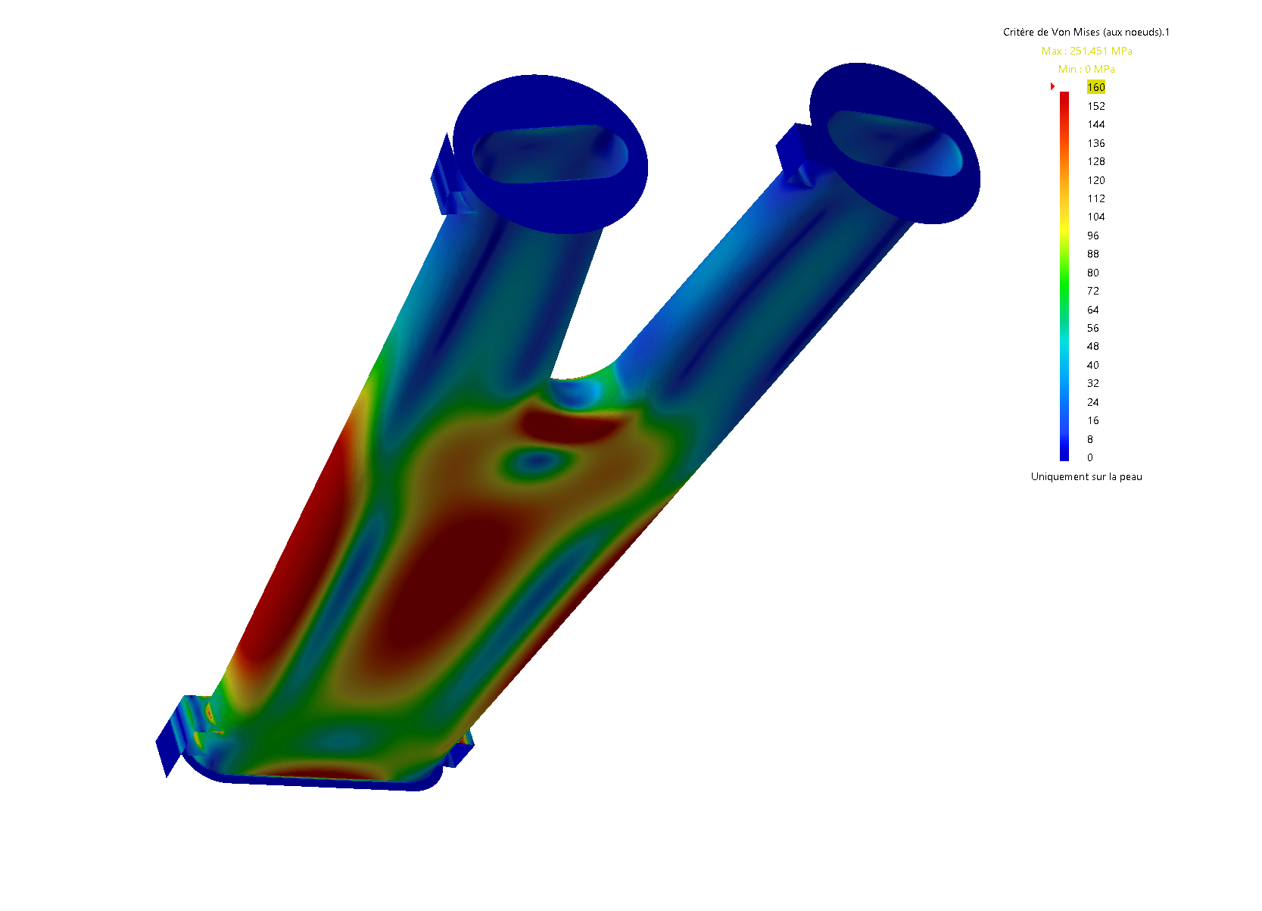
Beam Chamber
Vacuum
Von-Mises
Old

Slide 20
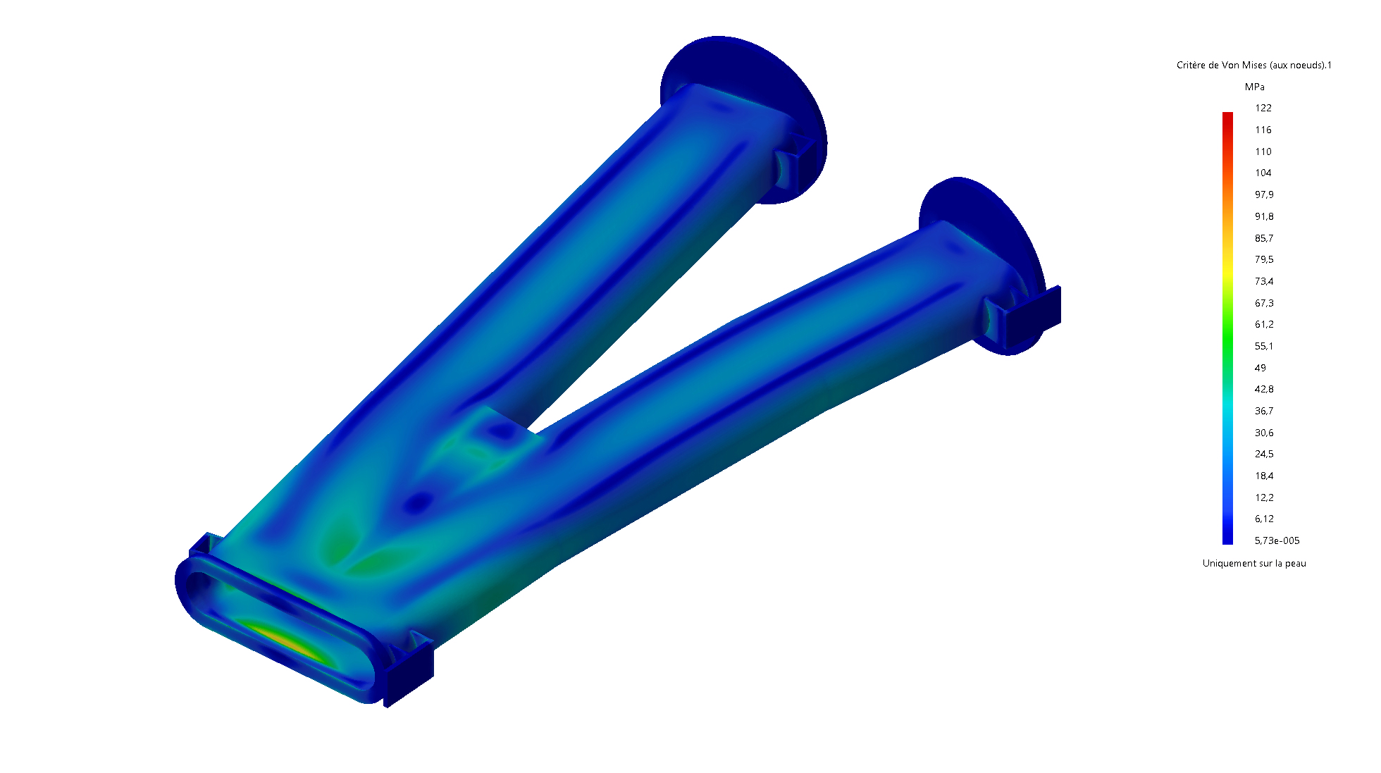
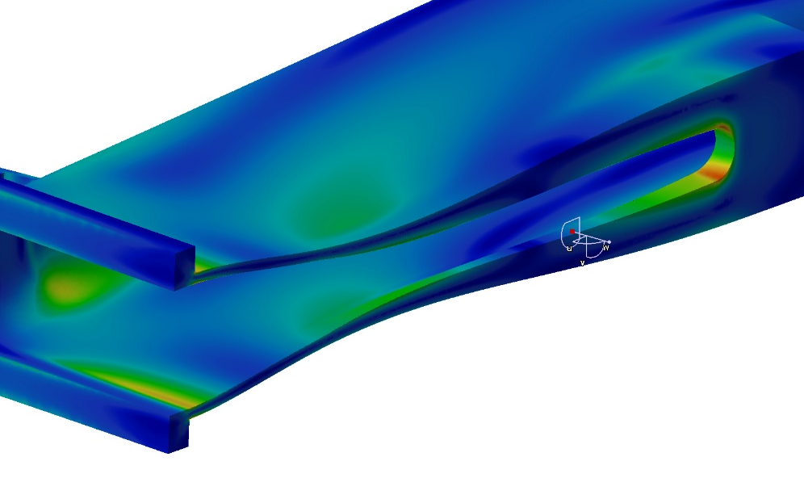
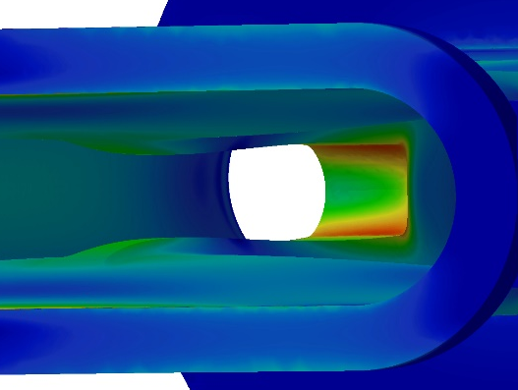
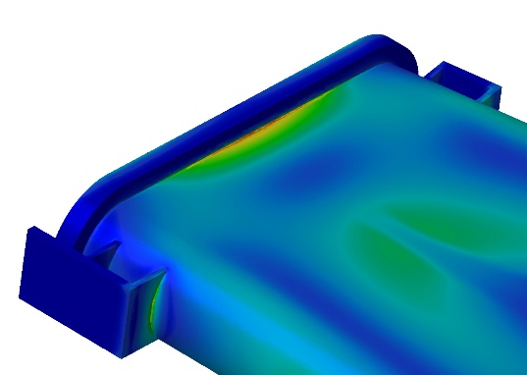
Beam Chamber
Vacuum
Von-Mises
A
Max 108 MPa
A
(122 MPa)
A
New
A

Slide 21
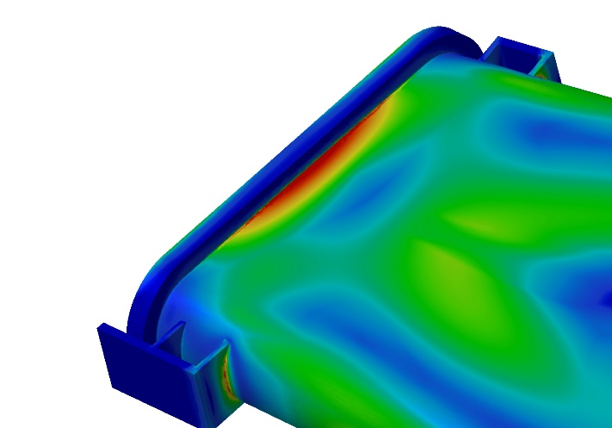
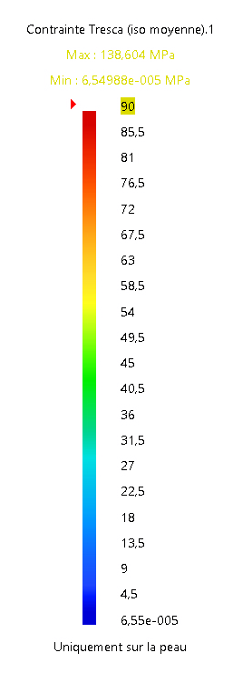
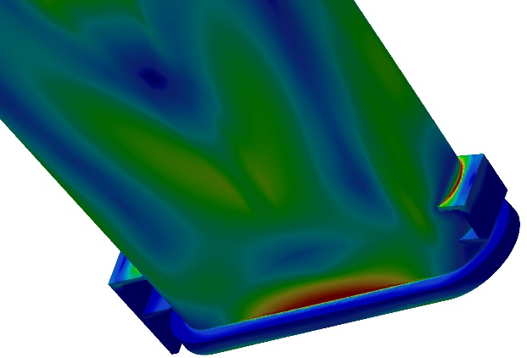

Beam Chamber
Vacuum
Tresca
Max 122 MPa
Max 138 MPa

Slide 22
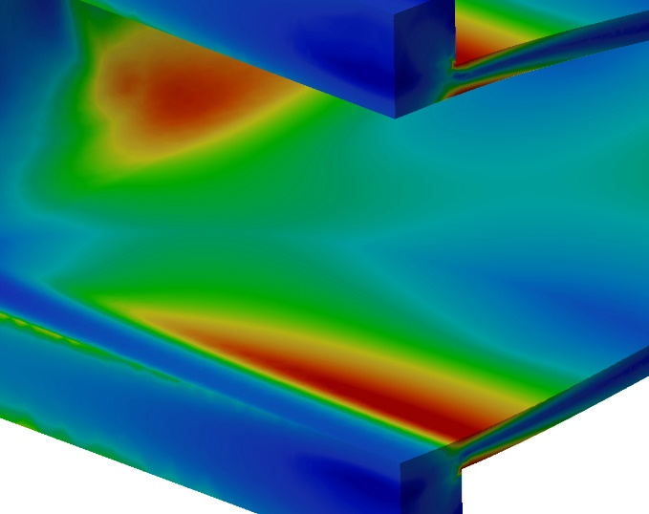
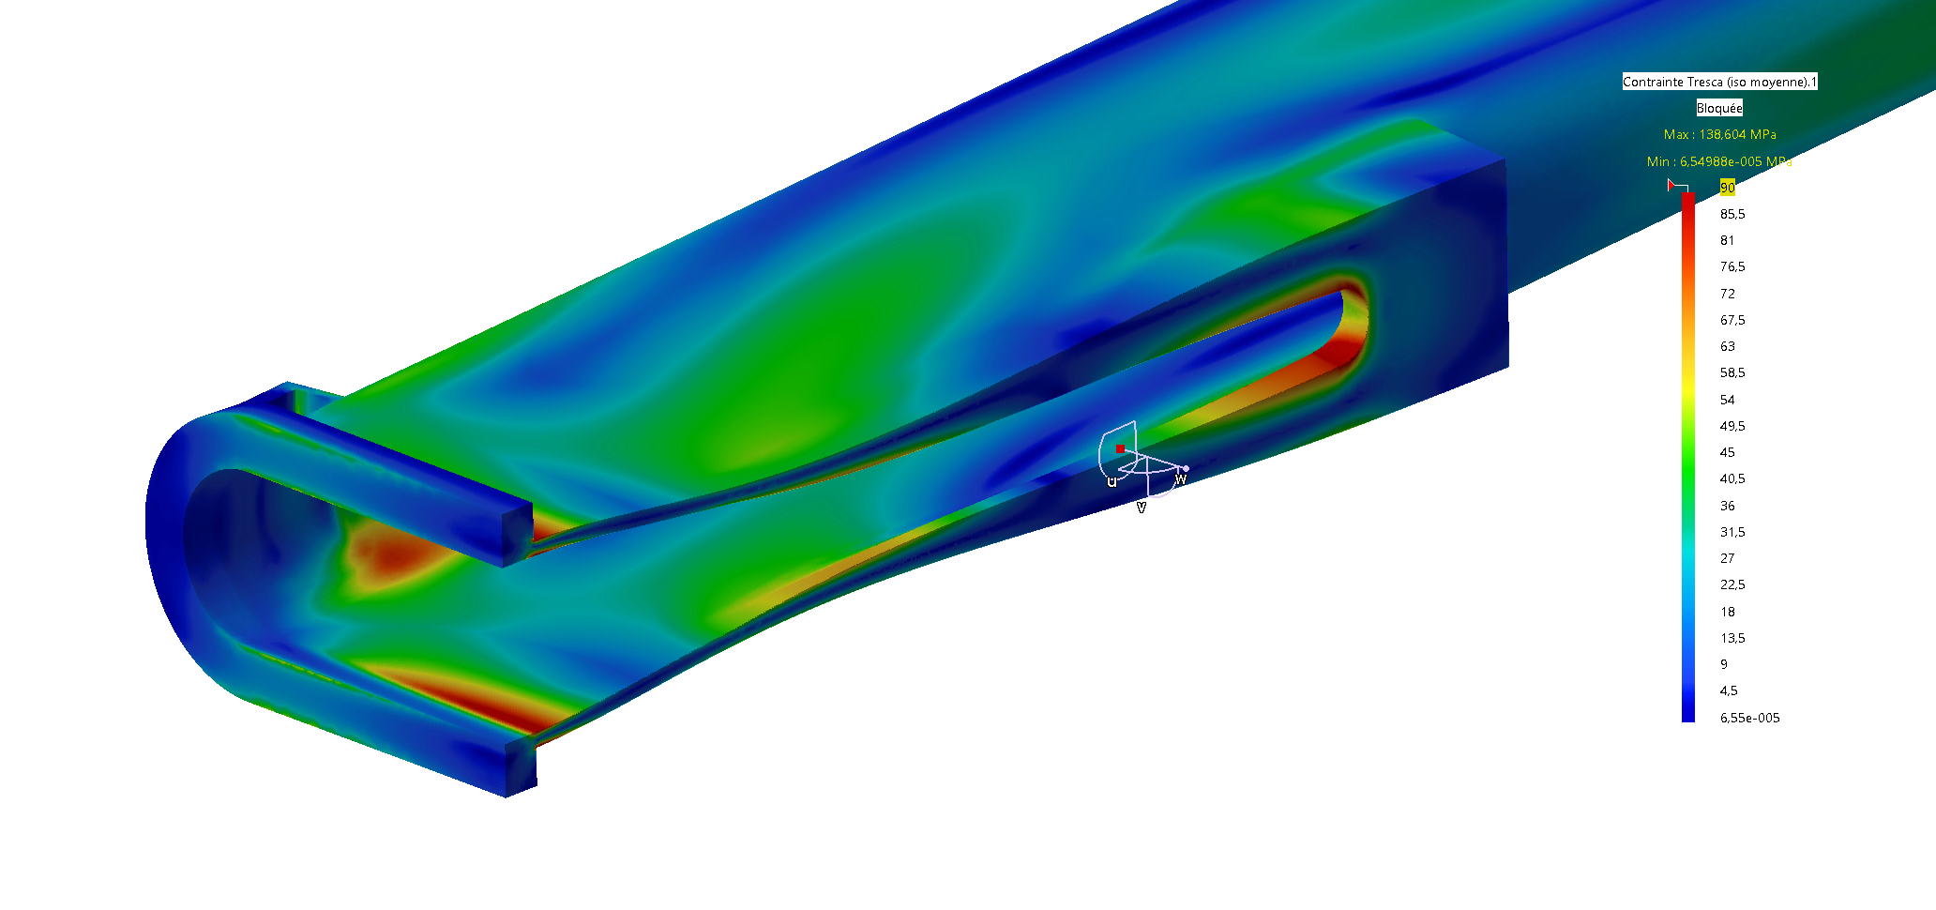
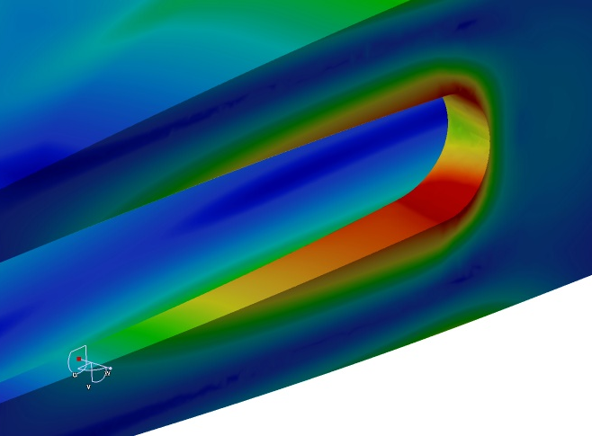
Beam Chamber
Vacuum
Max 93 MPa
Max 138 MPa
Max 116 MPa

Slide 23
Beam Chamber
Vacuum
Max 93 MPa
Max 138 MPa
Max 116 MPa

Slide 24
Beam Chamber
Vacuum
Max 93 MPa
Max 138 MPa
Max 116 MPa

Slide 25
Beam Chamber
Vacuum
Max 93 MPa
Max 138 MPa
Max 116 MPa

Slide 26
Beam Chamber
Vacuum
Max 93 MPa
Max 138 MPa
Max 116 MPa

Slide 27
Beam Chamber
Vacuum
Max 93 MPa
Max 138 MPa
Max 116 MPa

