Slide 1
Beam Position Monitor for CR.
FDR Review Meeting.
Yu. Rogovsky for CR team
BINP, Novosibirsk
November 28, 2019
3rd BINP-FAIR Workshop, Novosibirsk, Russia
Notes:
1

Slide 2
Outline
FDR documentation
Beam Position Monitors overview in CR
Base principles and Mechanical Concept
Calculations and simulations Risk analysis
Production and realization – manufacturing process chart
Production plan

Slide 3
FDR Contents
Today we will discuss only Beam Position Monitor itself, containing:
Electrodes with chassis
Vacuum chamber
Stand support
No analog electronics (will be reviewed later, CDR passed and approved, see EDMS container => https://edms.cern.ch/document/2254799/1, released 2019-10-22)
QA questions: Risk Analisys, Manufacturing
Documentation
3D models and 2D drawings
Further communications

Slide 4
Documentations
The Detailed Specification is outlined in EDMS
https://edms.cern.ch/document/1562811/2.3.1
CR_Pickup Type-1, AID:0002479
Mechanics - 3D model [AID:0002479] => https://edms.cern.ch/document/2117330/1
Mechanics - 2D drawings and BoM [AID:0002479] => https://edms.cern.ch/document/2117331/1
CR_Pickup Type-2, AID:0002481
Mechanics - 3D model [AID:0002481] => https://edms.cern.ch/document/2117398/1
Mechanics - 2D drawings and BoM [AID:0002481] => https://edms.cern.ch/document/2117399/1
CR_Pickup Type-3, AID:0002483
Mechanics - 3D model [AID:0002483] => https://edms.cern.ch/document/2117466/1
Mechanics - 2D drawings and BoM [AID:0002483] => https://edms.cern.ch/document/2117467/1
Conceptual description => https://edms.cern.ch/document/2117315/1
Quality plan => https://edms.cern.ch/document/2117326/1
Risk analysis and hazard analysis => https://edms.cern.ch/document/2117322/1
Installation and operation manual => https://edms.cern.ch/document/2117324/1
Also the corresponding sets of documents have been uploaded for the following assigned AIDs
CR_Pickup Type-2 (AID:0002481);
CR_Pickup Type-3 (AID:0002483);
CR_Pickup, Vacuum Chamber, Mechanics_for CR_Pickup Type-1 (AID:0002480);
CR_Pickup, Vacuum Chamber, Mechanics_for CR_Pickup Type-2 (AID:0002482);
CR_Pickup, Vacuum Chamber, Mechanics_for CR_Pickup Type-3 (AID:0002484);
CR_Pre-amp (AID:0002485)

Slide 5
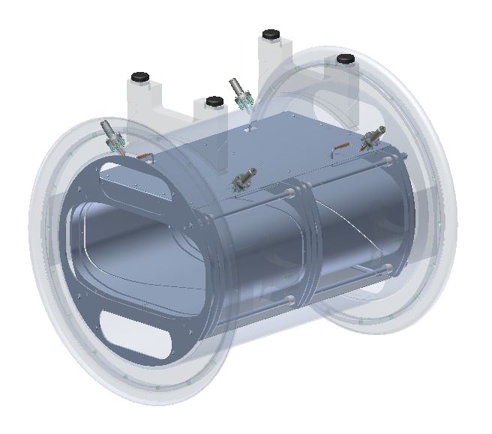
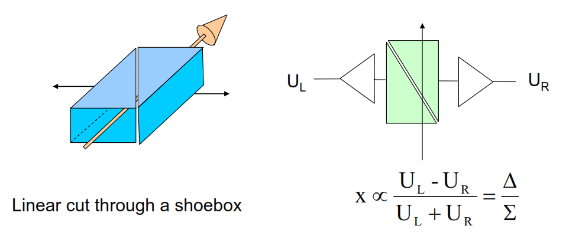
Purpose and Basic Principles
• the single pass trajectory (beam positions versus machine azimuths),
• the beam oscillation sampled at one or several azimuths (beam positions versus time),
• the closed orbit (average beam positions versus machine azimuths).
A by-product is the beam current intensity measured at each monitor from the sum signal of the pick-up electrodes. In addition, position data will be used for base-band tune determination, by applying a Fourier transformation to digitized position data.

Slide 6
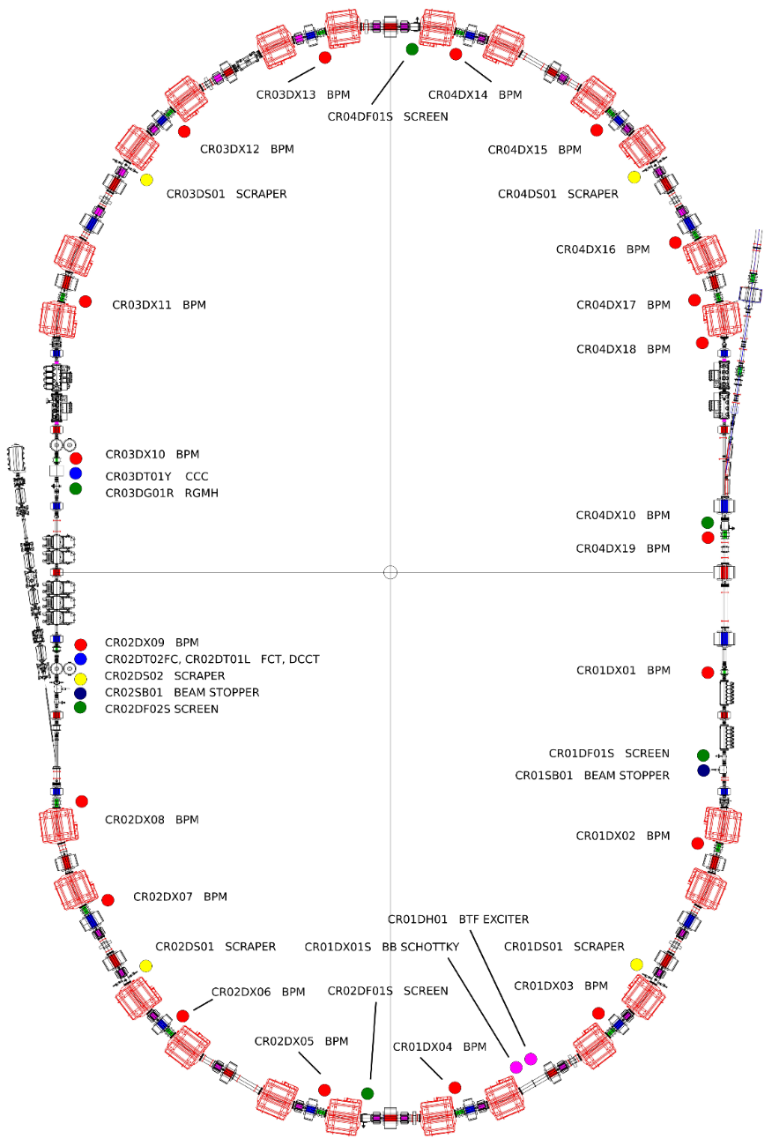
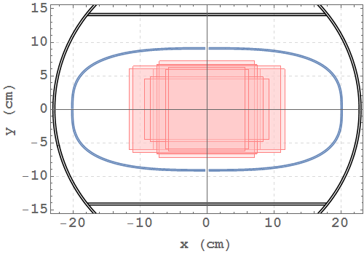
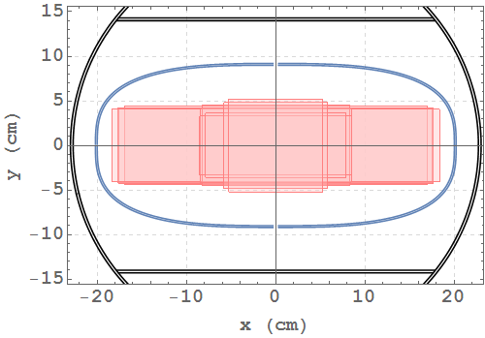
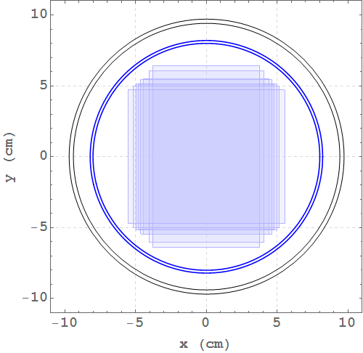
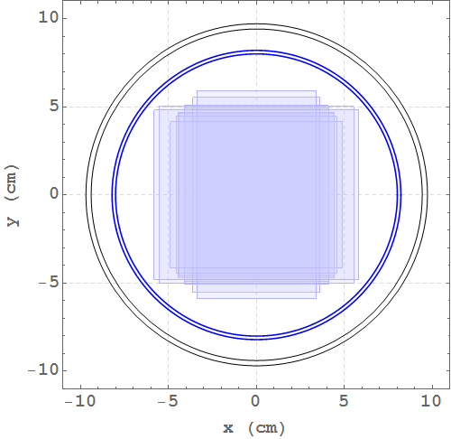
Locations along CR
19 BPMs (red points): 14 in arcs, 5 in straights
Maximum beam size at different points along the CR arcs: pbar – left, ions – right.
Maximum beam size at different points along the CR straights pbar – left, ions – right.

Slide 7
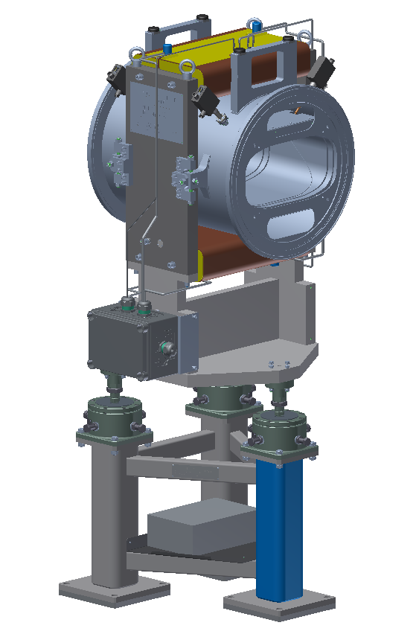
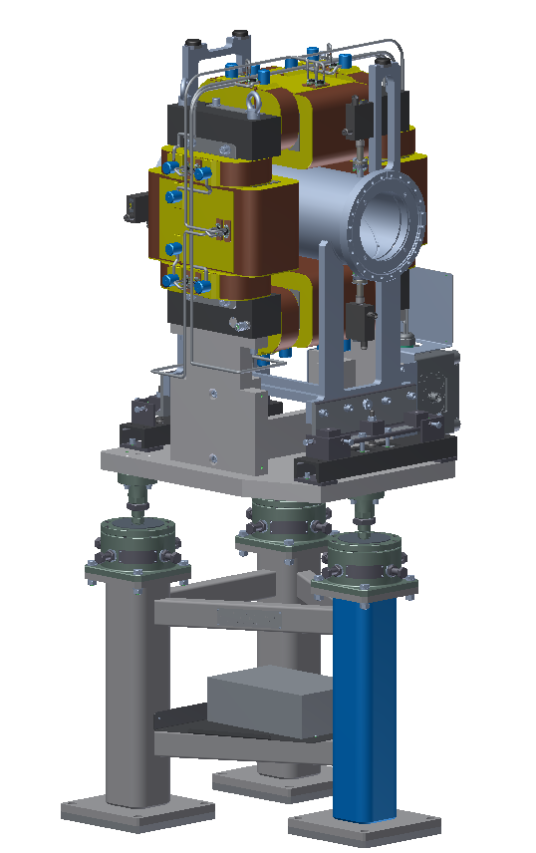
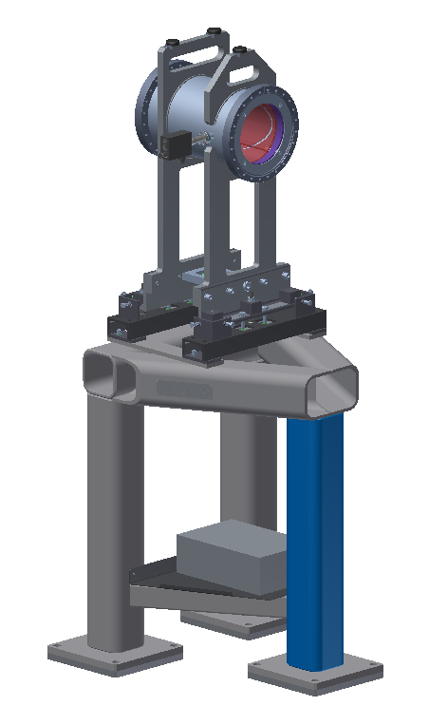
Beam Position Monitor (Mech.)
Type1
Type2
Type3
BPM Type1 – 400 x 200 mm aperture – 3D model and drawings is ready (already @ Experimental Workshop)
BPM Type2 – 200 x 200 mm aperture – 3D model and drawings is ready (already @ Experimental Workshop)
BPM Type3 – 200 x 200 mm aperture – 3D model and drawings is ready (half of BPM Type2)

Slide 8
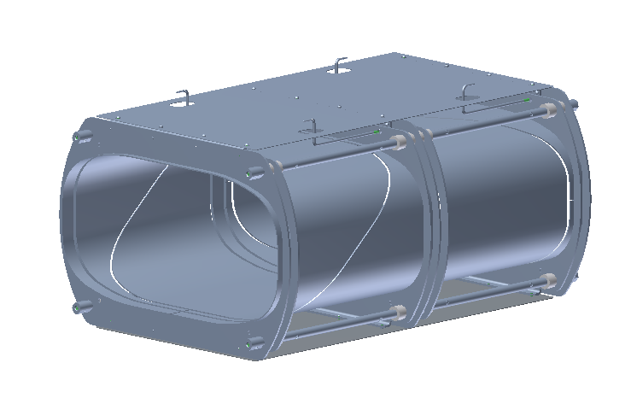
Beam Position Monitor (Detector)
Electrodes Assembly
BPM Type1 detector
Super elliptical electrodes shape for Type1 detector and round for Type2 and Type3 detector (not show here, but satisfied). Design for detectors are almost the same.

Slide 9
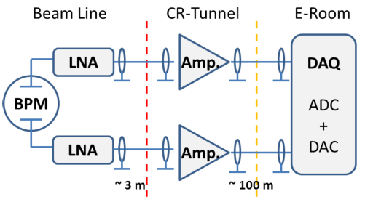
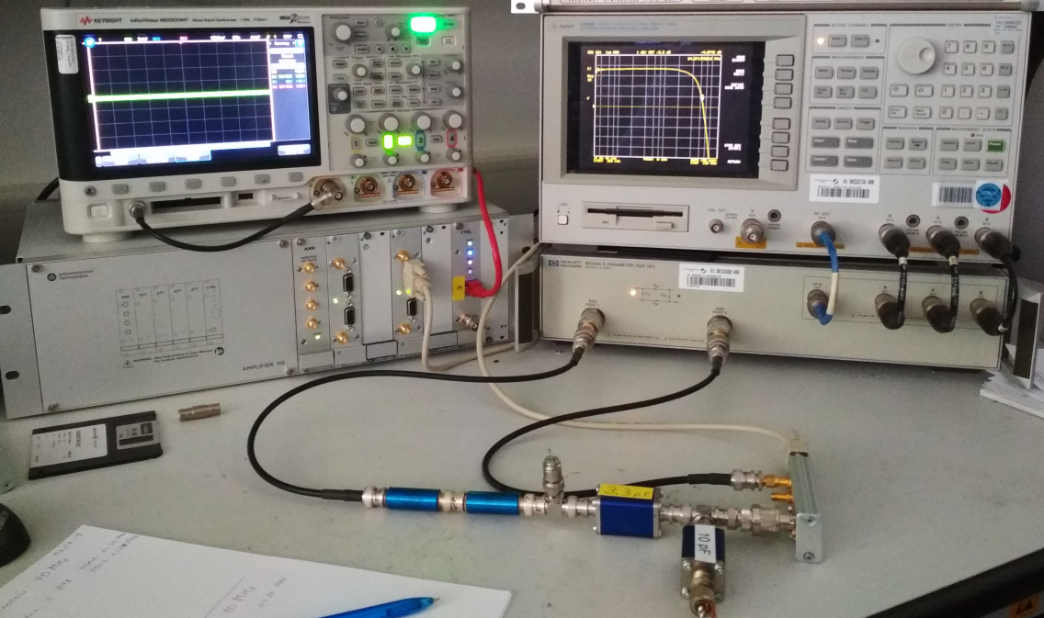
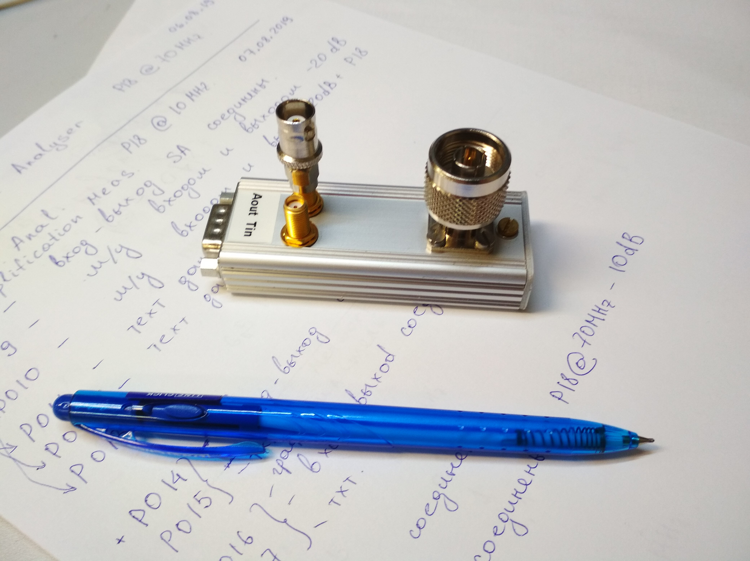
BPM System Layout
Beam Area / Radiation Area:
Vacuum chamber with flanges
Detector (signal electrodes on chassis)
LNA Preamplifier (with short cables)
Radiation Reduced Area:
VGA Preamplifier (with long cables)
Power supplies (external)
Interconnection / Communication panels
ELR / Safe Area:
Digital DAQ
Timings and Controls
Schematic circuit diagram of the signal chain of BPM system.
See EDMS container => https://edms.cern.ch/document/2254799/1 for more details. Released @ 2019-10-22

Slide 10
Beam Position Monitor (Req.Param.)
Parameter | Value
Physical requirements
Type | “Type 1” | “Type 2” | “Type 3”
Number of elements | 14 | 4 | 1
Overall length, flange to flange | 630 mm | 625 mm | 340 mm
Horizontal aperture | 400 mm | 160 mm | 160 mm
Vertical aperture | 200 mm | 160 mm | 160 mm
Absolute accuracy (single) | 5 mm
Absolute accuracy*⁾ | 1 mm
Absolute accuracy (K-mod)**⁾ | 0.4 – 0.5 mm
Resolution *⁾ | 0.1 mm @ 0.1 kHz
Detector
Number of Pick-up Electrodes | 4 | 4 | 2
Pick-up material | Stainless steel | Stainless steel | Stainless steel
Pick-up length | ≥ 250 mm | ≥ 250 mm | ≥ 250 mm
Pick-up bandwidth | 0.1 – 100 MHz
Pick-up capacity (typical) | 140-160 pF | 100-120 pF |  | 100-120 pF
Pick-up cross-talk | ≤ 40 – 50 dB
Output connector | N-type (suitable for UHV)
Parameter | Value
Input resistance | 0.1 – 1 MΩ
Input capacity | ≤ 40pF
Input signal range | 10 μV – 1 V
Bandwidth | 0.1 – 30 MHz
Gain range | 0 – 60 dB
Gain step | 10 dB
Gain switching time | ≤ 1 ms
Input voltage noise | ≤ 3 nV/ Hz^{0.5}
Input current noise | ≤ 2 fA/ Hz^{0.5}
Output impedance | 50 Ω
1 dB compression point (P1dB) | ≥ 15 dBm
Inequality of calibration signals | ≤ 1%
Instability of ΔU / ΣU | ≤ 0.5×10⁻³ @ 10 – 40°C
Calibration signal type | sine-wave
Calibration signal frequency | 1 – 2 MHz
Calibration signal amplitude | ~ 0.5 – 1 V
Calibration signal attenuation | ≥ 70 dB
Control interface | RS-485
Power voltage | 5 – 12 V DC
Input / Output connectors | SMA
Detector itself
Analog Electronics
Details available in EDMS: https://edms.cern.ch/document/1562811/2.3.1

Slide 11
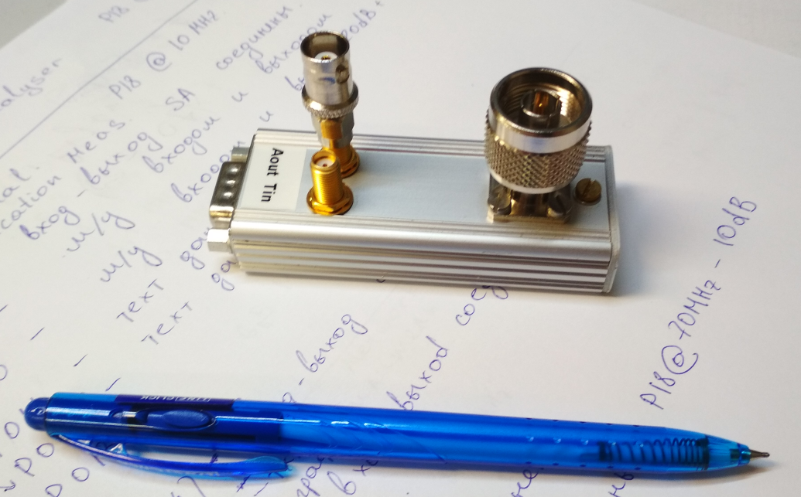
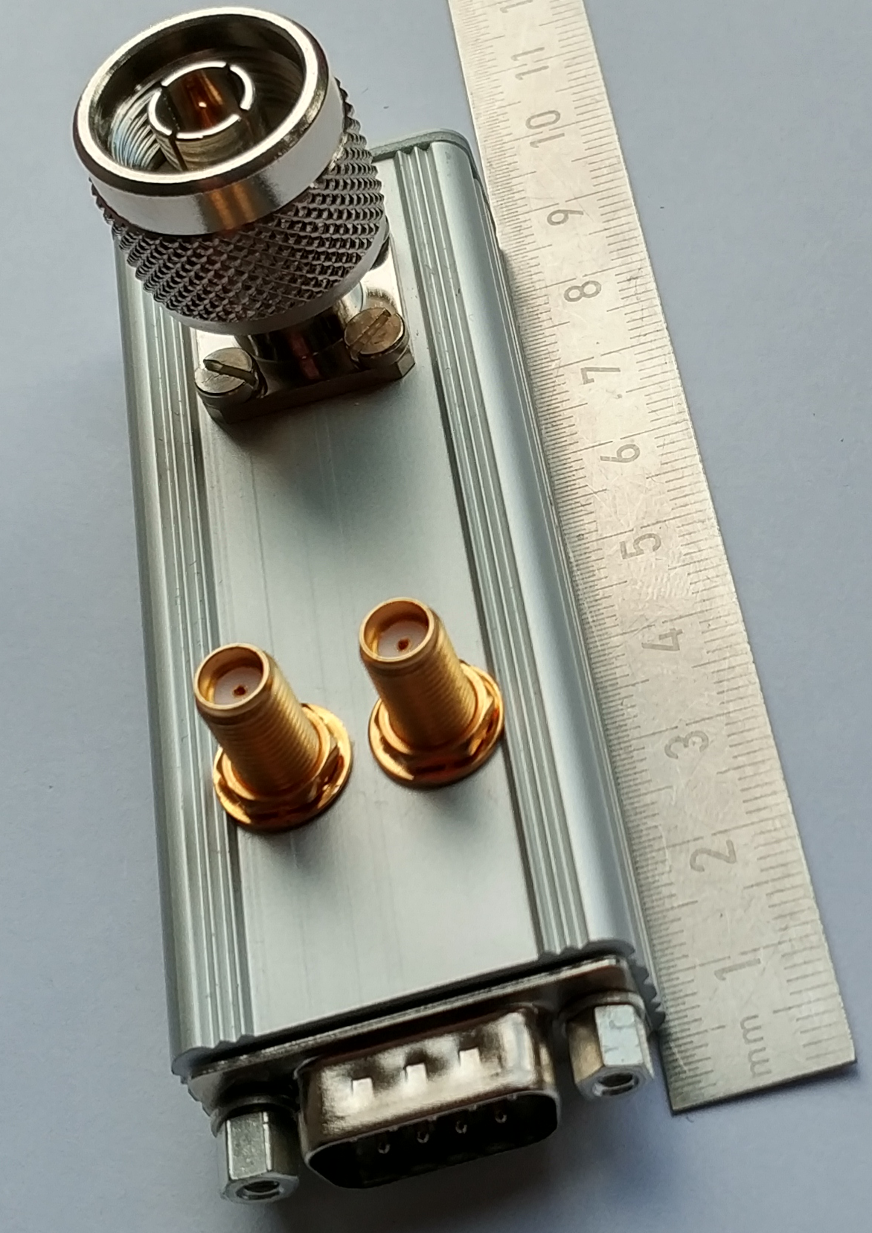
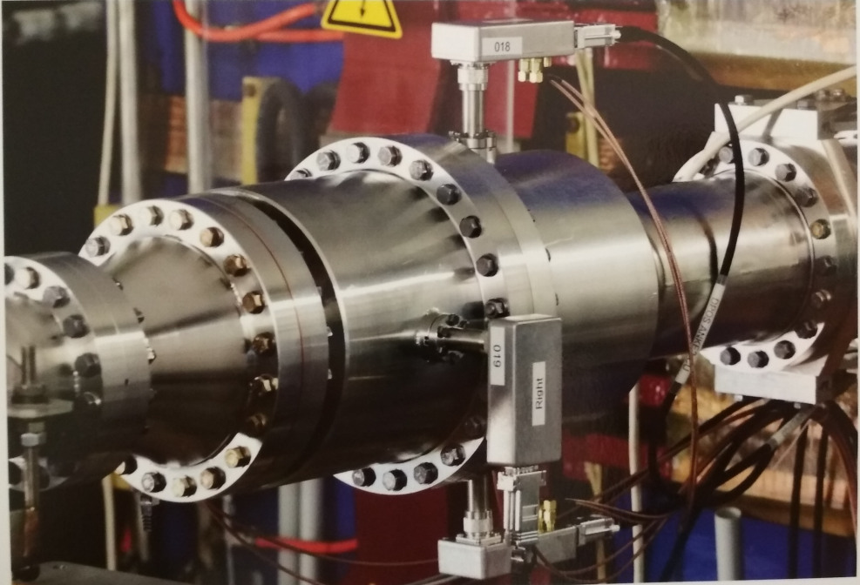
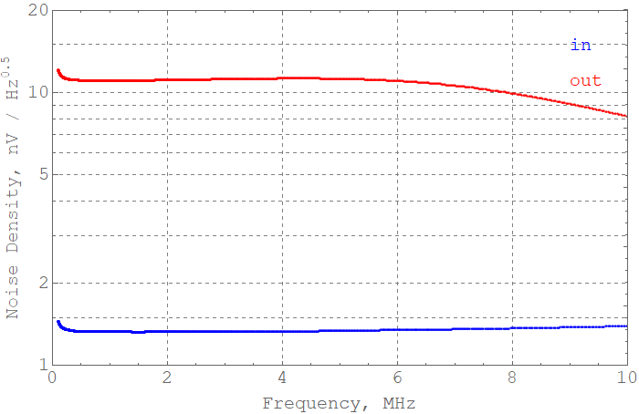
Low Noise Amplifier (LNA)
Parameter | Value
Amplification | 20 dB
Noise | 6 µV at 50 pF input capacitance
Bandwidth | 10 MHz default, or up to 70 MHz
Input Impedance | 500 kΩ
Power supply | +8V and -8V
Output range | ±1.5V at 50 Ω
Connector in. | N-type
Connector out. / cal. | SMA
Prototype developed at FZJ, IKP-4 by Sergey Merzliakov, Vsevolod Kamerdzhiev for COSY synchrotron. Proposed for HESR @ FAIR. With modifications to CR @ FAIR.
“Status overview of the HESR beam instrumentation”, in proc. IBIC-2018, mopa01

Slide 12
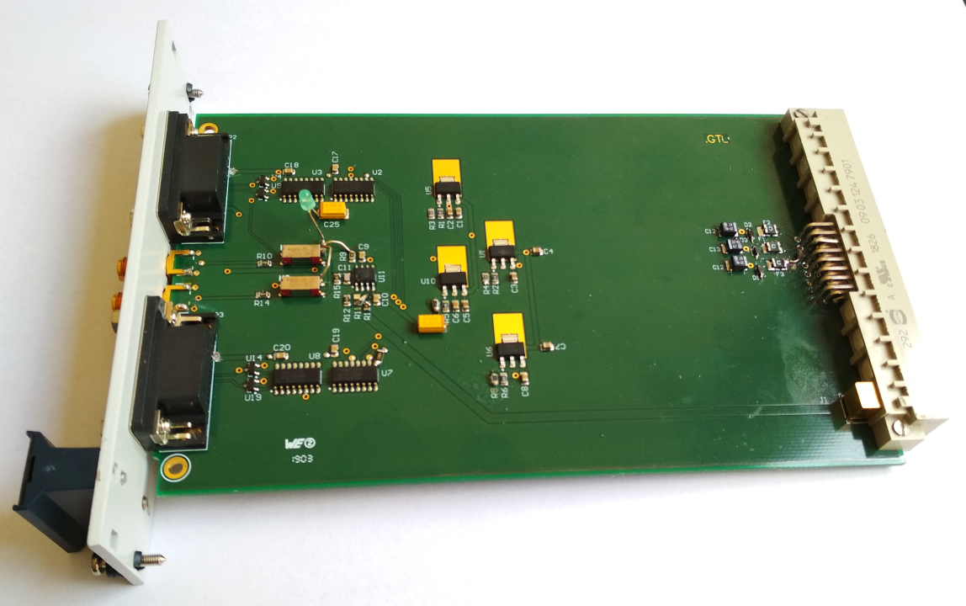
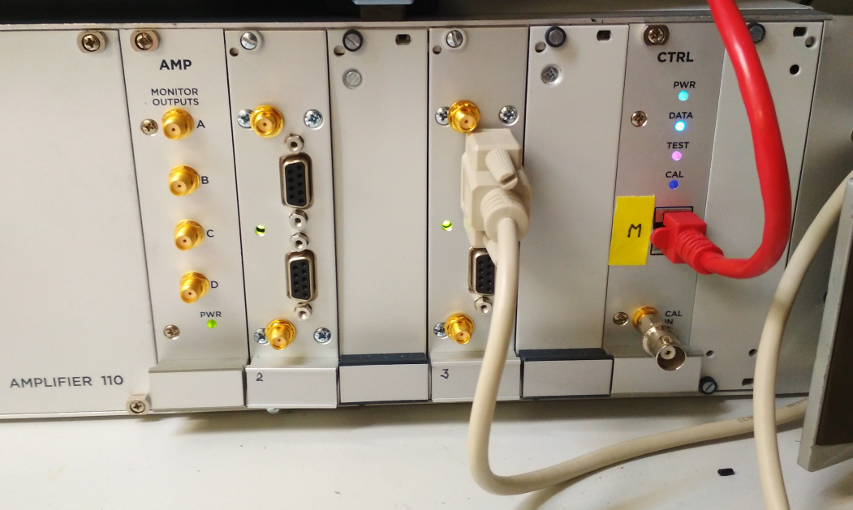
VGA Modifications (I)
Due to modular structure of A110 Amplifier we can safely remove different modules without any damage to existing one or chassis.
Produce special module (LNACTRN) for powering (+ control, synchronization, calibration) of LNA with proper interaction interface with control bus.
Remove Attenuation modules from A110 chassis.
Insert LNACTRN module intro A110 chassis.
Use “standard” FESA classes for operations.

Slide 13
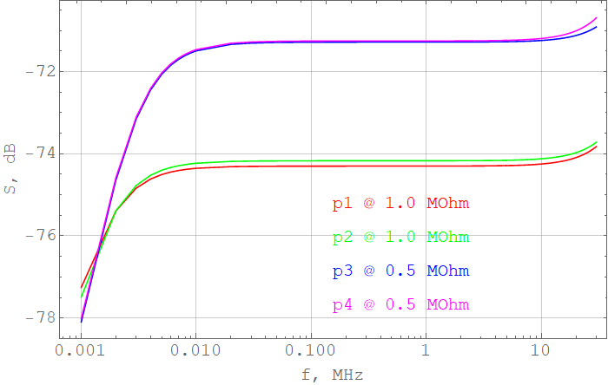
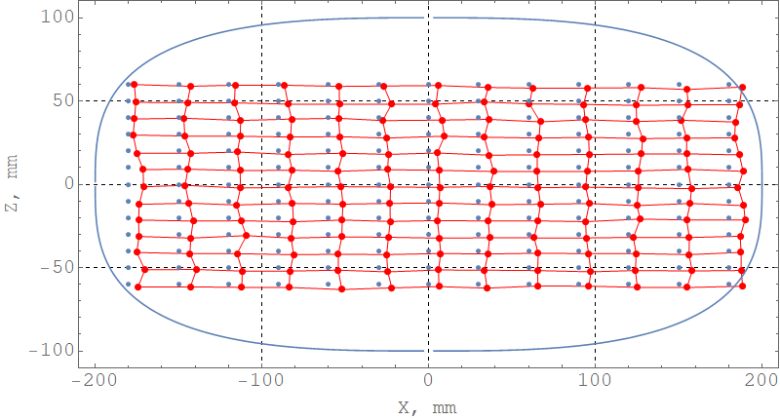
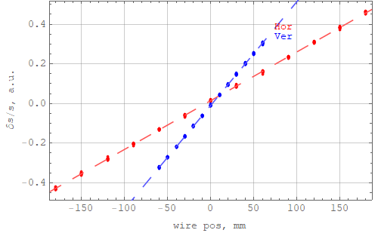
Beam Position Monitor (Optim. I)
C ≈ 160 pF
Dimentions: a=200, b=100
CrossTalk ≈ -50-60 dB (10-20 dB damped) @ 50 MHz
Kx = 406 mm
Dx = -6 mm
Res. Err ≈ 1%
Ky = 191 mm
Dy = -1.5 mm
Res. Err ≈ 1%

Slide 14
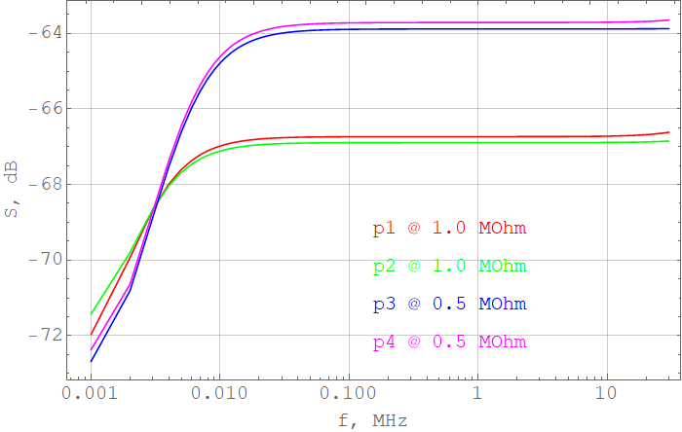
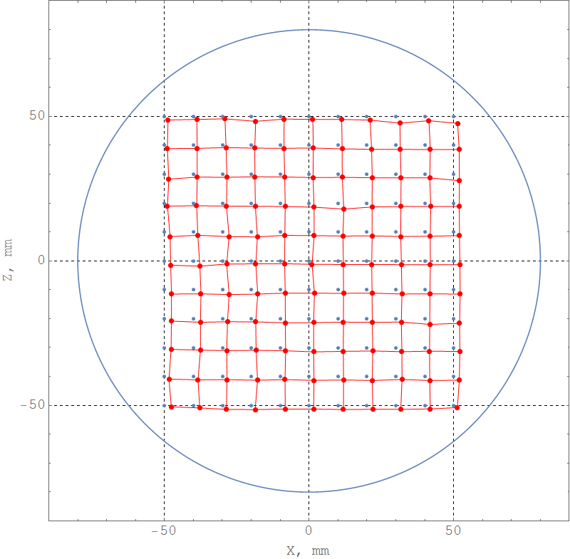
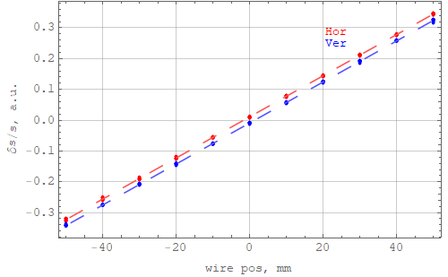
Beam Position Monitor (Optim. II)
C ≈ 120 pF
Dimentions: a=80, b=80
CrossTalk ≈ -50-70 dB (15-20 dB damped) @ 50 MHz
Kx = 149 mm
Dx = -1.7 mm
Res. Err ≈ 1%
Ky = 150 mm
Dy = -1.2 mm
Res. Err ≈ 1%

Slide 15
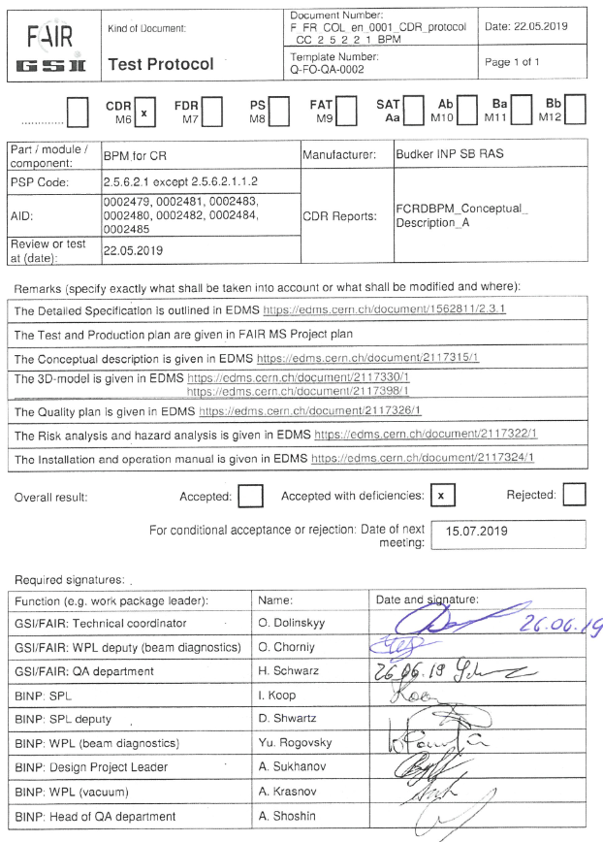
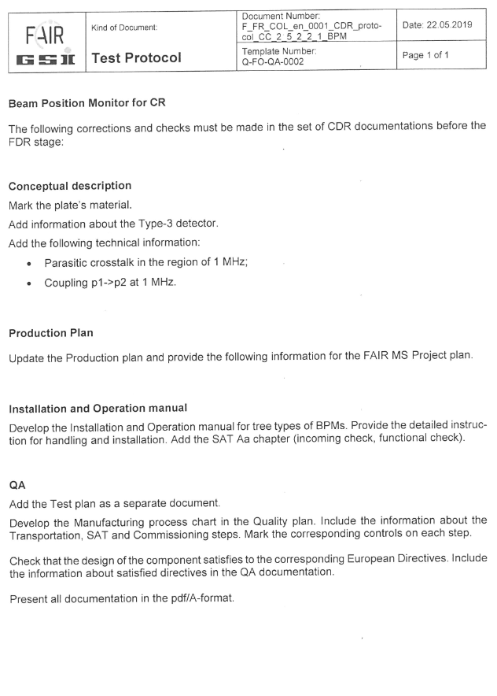
CDR Review accepted / passed
More Details in EDMS: https://edms.cern.ch/document/2117316/1

Slide 16
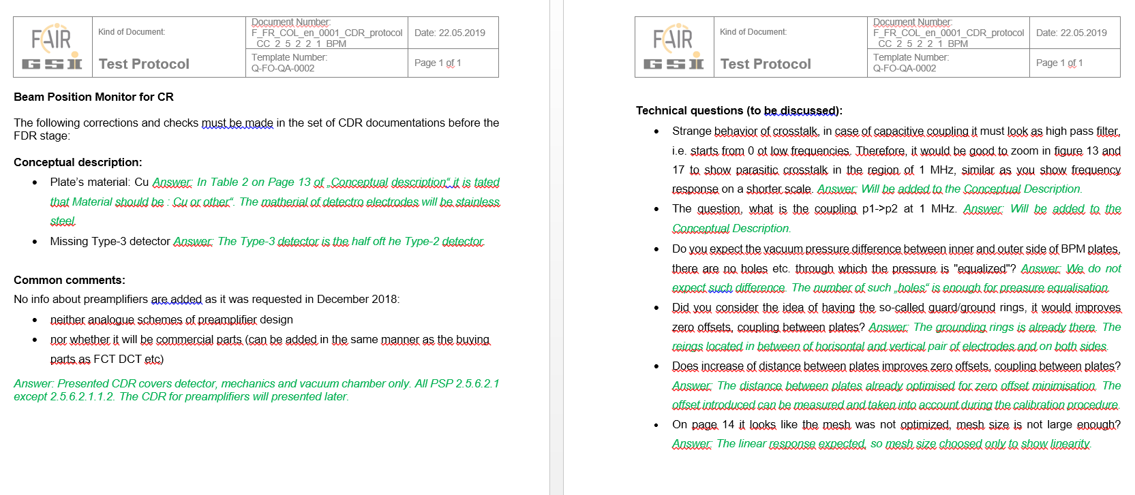
CDR Review accepted / passed
Most of the questions appeared during CDR review was discussed during the meeting. The net questions was discussed via e-mail. The example above shows one of e-mail discussion with O. Chorniy @ Date: Mon, Jun 24, 2019 at 5:08 PM
All technical questions was discussed and clarified.

Slide 17
Risk Assessment Table (I)
Risk Log |  | Risk Identification |  |  | Risk Rating Pre-Mitigation |  |  | Risk Mitigration | Post-Mitigation Risk Rating
Risk- ID | № | Description of Risk (orientating to the hazard) | Life cycle | Possible consequences | Probability of Occurrence | Impact | Risk Level | Mitigration Strategy | Probability of Occurrence | Impact | Risk Level
 |  | TECHNICAL RISKS
 |  | Mechanical hazards
RL-001 | 1 | Dent in the vacuum vessel | BCI | Damage of parts of the beam position monitor; Performance below specification; | 2 | 3 | 2 | Check that lifting eye bolts are correctly tightened; Check that used chains, straps and hooks have the weight rating adapted to the beam position monitor weight, corresponding number of attachment points and corresponding lifting angles. Beam position monitor must be properly fastened to a suitable stand to prevent any fall during installation, operation, maintenance and storage. Obey warning signs and boundaries. Follow handling and installation instructions according to the BINP Installation and Operation Manual, FCRDBPM_Installation_Operation_manual_A. | 1 | 3 | 2
RL-002 | 2 | Failure of welding joints | ABCI | Damage of parts of the beam position monitor | 2 | 3 | 2 | Carry out inspection of welding lines on a regular basis. Follow handling and installation instructions according to the BINP Installation and Operation Manual, FCRDBPM_Installation_Operation_manual_A. | 1 | 3 | 2
RL-003 | 3 | Beam position monitor falling during handling | BСJ | Damage of parts of the beam position monitor up to complete loss of the beam position monitor; Personnel injury | 2 | 4 | 3 | Check that lifting eye bolts are correctly tightened; Check that used chains, straps and hooks have the weight rating adapted to the beam position monitor weight, corresponding number of attachment points and corresponding lifting angles. Beam position monitor must be properly fastened to a suitable stand to prevent any fall during installation, operation, maintenance and storage. Obey warning signs and boundaries. Follow handling and installation instructions according to the BINP Installation and Operation Manual, FCRDBPM_Installation_Operation_manual_A. | 1 | 4 | 2
 |  | Electrical hazards
RL-004 | 4 | Cable breaks (power, diagnostic, etc.) including cracks or breaks in the insulation, failure of cable connections | CI | Loss of equipment functionality; Electrical shock; Fire; Personnel injury | 2 | 2 | 1 | Cables must be labelled. Cables must be traceable, viewable and accessible. Cables must be protected from mechanical damage. Avoid creating stumbling hazards with cables. Regular inspection of insulation and connections. Braked cables must be marked, apply a do-not-use tag. Braked cables must be replaced. | 1 | 2 | 1
RL-005 | 5 | Power / power supply failure (supply interrupted due to external reason) | D | Loss of equipment functionality | 2 | 1 | 1 | Does not require any action (supply interrupted due to external reason). | 2 | 1 | 1
 |  | Humidity hazards
RL-006 | 6 | High air humidity in the environment around the beam position monitor | BD | Corrosion | 3 | 1 | 1 | Beam position monitor system will be packed for transportation under the conditions to avoid contact of product with rain water, spatter or condensates. Use climate-control system in the tunnel. Carry out preventive diagnostic measures in the tunnel on a regular basis. | 2 | 1 | 1

Slide 18
Risk Assessment Table (II)
 |  | Radiation hazards
RL-007 | 7 | Beam position monitor materials may become radioactive during operation | D | Tunnel environment radioactive contamination; Workers exposure to radiation; Difficulties to repair and maintenance of equipment | 2 | 4 | 3 | Use radioactivity supervision system in the tunnel. Carry out preventive diagnostic measures in the tunnel on a regular basis. Follow the GSI Safety Regulations. Complete the required GSI Safety Trainings. | 1 | 4 | 2
 |  | Ergonomic hazards
RL-008 | 8 | Accidents of the vacuum vessel sharp edges | ALL | Personnel injury | 3 | 1 | 1 | Use the rubber corner bumpers. Use the basic Personal Protective Equipment (hard hats, safety glasses, steel tip shoes). | 2 | 1 | 1
 |  | Combination of hazards
RL-009 | 9 | Design alteration and/or performance below specification | A | Delays to the schedule; Failed to reach the required field quality | 3 | 3 | 3 | The Parties shall monitor the scientific and technical progress of the Collaboration Contract activities. The Parties shall clarify the Technical Specifications during the project development. (Risk originated mainly from unpredictable deviation of the beam position monitor susceptibility of the stainless steel material of dipoles vacuum chambers from the specified low value. Proposed the following mitigation measures: special multi-pole correctors, which will compensate the negative influence of all field distortions produced in dipoles by slightly beam position monitor material of their vacuum chambers.) | 2 | 3 | 2
RL-010 | 10 | Lack of knowledge about GSI site, GSI safety regulations and procedures | ALL excluding AB | Damage to the personnel health due to hazards created by others | 2 | 1 | 1 | The Parties shall coordinate efforts to create and maintain a clean and organized work environment. Follow the GSI Safety Regulations. Complete the required GSI Safety Trainings. | 1 | 1 | 1
Based on Arrangement of Risks
Includes: Mechanical, Electrical, Radiation, Ergonomic and Combined hazards
Rages risk hazards on its impacts and propose Mitigation Actions

Slide 19
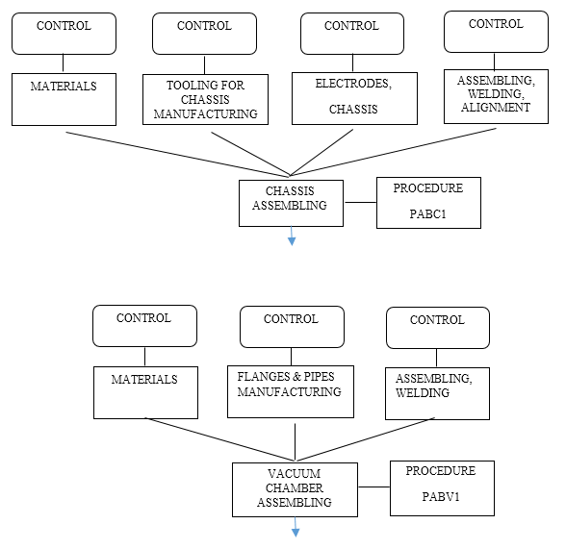
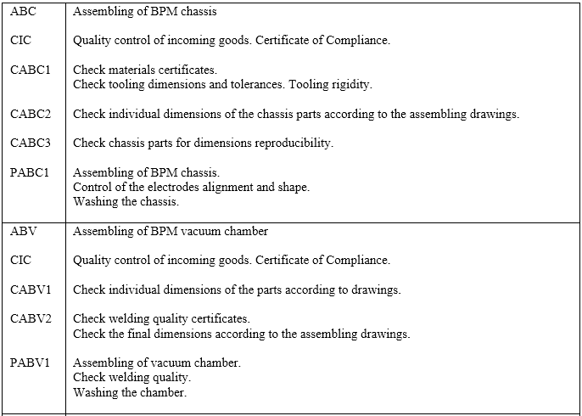
Manufacturing Process Chart (I)
See “FCRDBPM_Quality_plan_B” for details

Slide 20
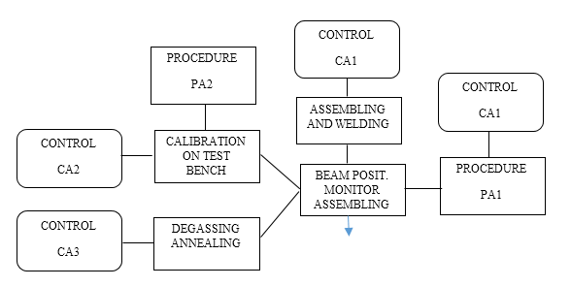
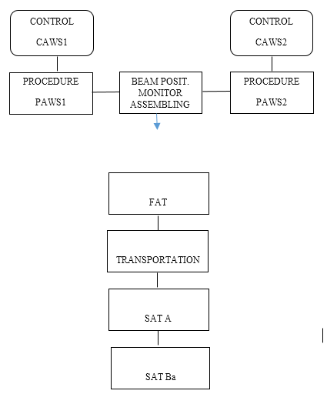
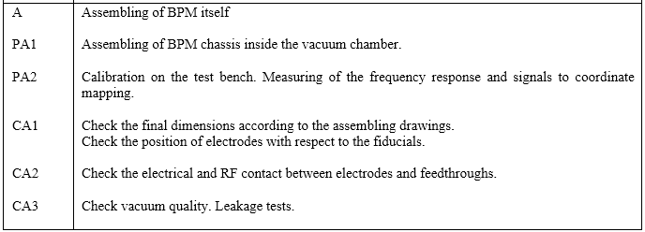
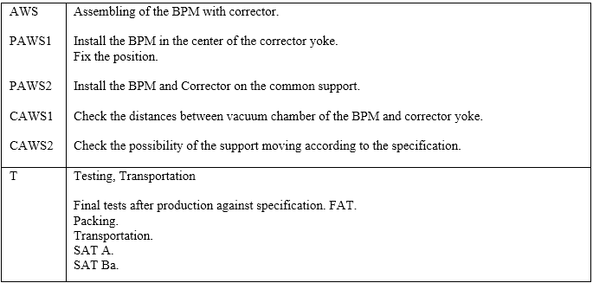
Manufacturing Process Chart (II)
See “FCRDBPM_Quality_plan_B” for details

Slide 21
Applicable Documents
All beam position monitors for the FAIR Collector Ring (CR) System will be designed and manufactured in compliance with the FAIR Specifications (Annex), according to the best BINP engineering practice and applying the following laws and regulations:
Federal Law 184-FZ On Technical Regulation, dated 27.12.2002
GOST R ISO 31000-2010 Risk management. Principles and guidelines.
GOST R ISO/IEC 31010:2011 Risk management. Risk assessment techniques.
GOST R 51901.1-2002 Risk management. Risk analysis of technological systems.
GOST R 51901.11-2005/ IEC 61882:2001 Hazard and operability studies (HAZOP studies) – Application guide.
GOST 27.301-95 Dependability in technics. Dependability prediction. Basic principles.
GOST 27.310-95 Dependability in technics. Failure mode, effects and criticality analysis. Basic principles.
Applicable EU Directives
Directive | Description | True |  | Justification for the decision, measures
 |  | Yes | No
2006/42/EG | Machine Directive | + |  | Transportation and installation process
2006/95/EG | Low Voltage Directive | + |  | The BPM equipped with an electrical equipment designed to operate at a nominal voltage of 220 V for alternating current.

Slide 22
Milestones
December 2018 – May 2019: preparation and passing milestone M6 (CDR)
June 2019 – December 2019: detail designing, preparation of drawings. Passing milestone M7 (FDR). Purchasing required accessories, materials, components
March 2019 – March 2020: tooling production, test bench development and production, manufacturing @ to experimental workshop-1 (EW-1)
August 2020 – December 2020: prototype testing, QA, calibration, FoS revision. Passing milestone M8 [January 2020]
November 2020 – November 2022: manufacturing and testing the other BPM, FAT, delivering to FAIR facility, SAT, pre-installation assembling. Approximately 3 BPMs every 3 month.
December 2022 – February 2023: final installation in CR tunnel [All series M10 – January 2023]

Slide 23
Summary
Quality plan is prepared and uploaded to EDMS – Q4-2019
Risk Analysis is prepared and uploaded to EDMS – Q4-2019
3D models is ready and uploaded to EDMS (2D drawings in EW) – Q4-2019
Conceptual description is uploaded to EDMS – Q4-2019
Production chart and main milestones corrected and presented – Q4-2019
Prototype production is started (material procurement as well) – Q4-2018
CDR review for BPM passed (approved with deficiencies) – Q2-2019
CDR review for Analog amplifiers passed (approved) – Q3-2019
FDR review procedure started for BPM – Q4-2019

Slide 24
Questions
24

