Slide 1

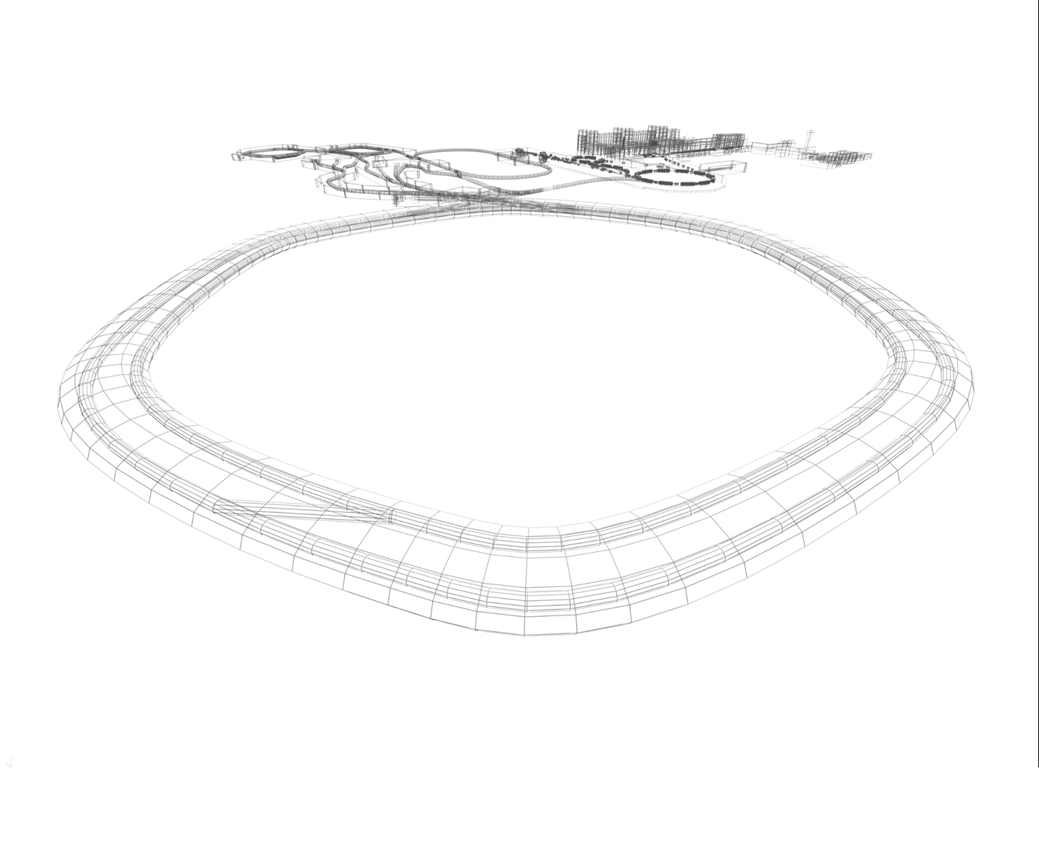
CR Power Converters
3nd Joint BINP-FAIR CC Workshop
25.11 - 28.11.2019
Status

Slide 2
CR magnet system
3nd Joint BINP-FAIR CC Workshop
25.11 - 28.11.2019
24
DIPOLES
1 POWER
CONV
DC magnets/ correctors
40 QUADRUPOLES
15 POWER
CONV
24 SEXTUPOLES
6 POWER
CONV
CR Magnet System
48+12
CORR+OCT
48+12 CORR
PS
Injection/ Extraction
magnets
KICKER
MAGNETS
KICKER
PSs
INJECTION
SEPTUM
INJ SEPTUM PS
EXTRACTION
SEPTUM
EXT SEPTUM PS

Slide 3
TCR1 magnet system
3nd Joint BINP-FAIR CC Workshop
25.11 - 28.11.2019
2
DIPOLES
2 POWER
CONV
TCR1 Magnet System
DC magnets/ correctors
6 QUADRUPOLES
6 POWER
CONV
2
SEXTUPOLES
2 POWER
CONV
5
CORRECTORS
5 CORR
PS

Slide 4
CR+TCR1 Power Converters
3nd Joint BINP-FAIR CC Workshop
25.11 - 28.11.2019
CR DPC type
CR QPC Type
CR SPC Type
CR OPC Type
CR CPC Type
1 CR Dipole magnets Power
Converter
15 CR Quad magnets Power
Converters
6 CR Sext magnets Power
Converters
12 CR Octupol magnets Power
Converters
48 CR Steer. magnets Power
Converters
2 TCR1 Dipole magnets Power
Converters
2 TCR1 Sext magnets Power
Converters
7 TCR1 Steer. magnets Power
Converters
6 TCR1 Quad magnets Power
Converters
1 PC
23 PCs
8 PCs
12 PCs
55 PCs

Slide 5
CR magnets types
3nd Joint BINP-FAIR CC Workshop
25.11 - 28.11.2019
TYPE | SUB | Qty | Imax A | Lm mHn | Rm mOm | Vm V | Deviat
DIPOLES | - | 24 | 1450 | 377 | 62.45 | 91 | 10ppm
QUADRUPOLES | EWQ | 3 | 1500 | 49.8 | 26.31 | 38 | 100ppm
 | WQ | 14 | 1500 | 59 | 26.31 | 38 | 100ppm
 | SWQ | 12 | 1500 | 44 | 21.67 | 31 | 100ppm
 | NQ | 11 | 1450 | 11 | 10.1 | 15 | 100ppm
SEXTUPOLES | - | 24 | 500 | 6 | 35 | 18 | 0.1%
OCTUPOLES | - | 12 | 30 | 86 | 2450 | 74 | 1%
CORRECTORS | H | 24 | 6 | 182 | 9560 | 58 | 1%
 | V | 16 | 14 | 158 | 4200 | 59 | 1%
 | H/V | 8 | 20 | 90 | 760 | 16 | 1%

Slide 6
3nd Joint BINP-FAIR CC Workshop
25.11 - 28.11.2019
CR Quadrupole Magnets Power Converters Types
QUAD TYPE | Magnets in series | G kGs/cm | Inom kA | Vm tot V | Vcable V | Vtotal V | Ptotal kW
EWQ | 1 | 0.3 | 1.18 | 33 | 11 | 44 | 52
EWQ | 2 | 0.3 | 1.18 | 66 | 11 | 77 | 91
WQ | 4 | 0.32 | 1.00 | 114 | 10 | 124 | 124
WQ | 4 | 0.32 | 1.00 | 114 | 10 | 124 | 124
WQ | 4 | 0.41 | 1.28 | 144 | 13 | 157 | 201
WQ | 2 | 0.35 | 1.10 | 62 | 11 | 73 | 80
SWQ | 4 | 0.36 | 1.13 | 106 | 11 | 117 | 132
SWQ | 4 | 0.33 | 1.04 | 98 | 10 | 108 | 112
SWQ | 4 | 0.38 | 1.20 | 112 | 12 | 124 | 149
NQ | 2 | 0.43 | 0.83 | 24 | 8 | 32 | 27
NQ | 2 | 0.52 | 1.00 | 28 | 10 | 38 | 38
NQ | 2 | 0.52 | 1.00 | 28 | 10 | 38 | 38
NQ | 2 | 0.43 | 0.83 | 24 | 8 | 32 | 27
NQ | 2 | 0.58 | 1.12 | 32 | 11 | 43 | 48
NQ | 1 | 0.57 | 1.10 | 16 | 11 | 27 | 30

Slide 7
3nd Joint BINP-FAIR CC Workshop
25.11 - 28.11.2019
TCR1 Quad_CR_Type Power Converters
QUAD TYPE | Magnets in series | G kGs/cm | Inom kA | Vm tot V | Vcable V | Vtotal V | Ptotal kW
Dip | 1 | 0.43 | 1.42 | 98 | 12 | 110 | 156
WQ | 1 | 0.52 | 1.48 | 38 | 12 | 50 | 75
SQ | 1 | 0.48 | 1.45 | 15 | 12 | 27 | 39

Slide 8
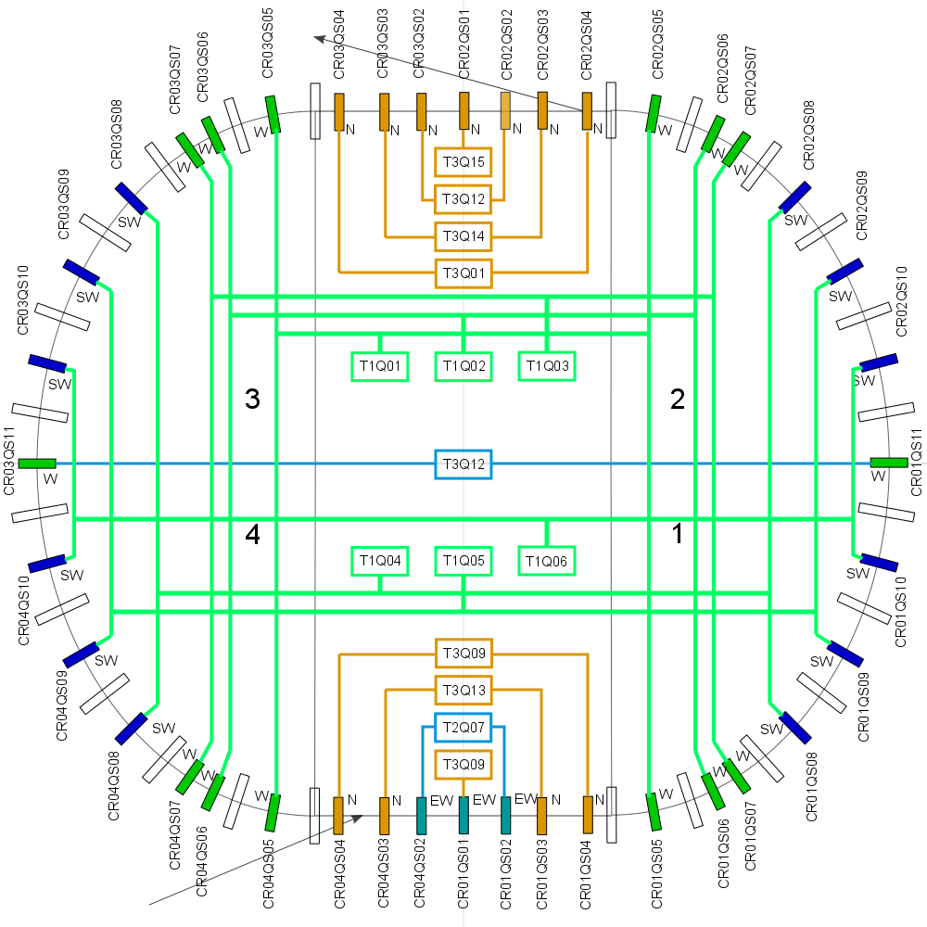
3nd Joint BINP-FAIR CC Workshop
25.11 - 28.11.2019

Slide 9
3nd Joint BINP-FAIR CC Workshop
25.11 - 28.11.2019
CR MAGNETS POWER CONVERTERS PARAMETERS
PARAMETER | DPC | QPCTYPE1 | QPCTYPE2 | QPCTYPE3 | SPC | OPC | CPC
MAINS | AC 20kV 50Hz T | AC 400 V 50Hz TN-S
IOUT MAX | 1450 A | 1500 A |  |  | 500 A | 30A | 6/14/20 A
VOUTMAX | 2750 | 200 V | 100 V | 50 V | 100 V | 90V | 75/75/40 V
ΔIOUT/IOUT | 10ppm | 100ppm |  |  | 0.1% | 1% | 1%
LONG TERM STABILITY | 10ppm | 100ppm |  |  | 0.1% | 1% | 1%
CONTROL | GSI CONTROL UNIT
DCCT | GSI CONTROL UNIT |  |  |  | Built In | Built In
MAX POWER | 4MW | 300kW | 150kW | 75kW | 50kW | 2.7kW | < 1kW

Slide 10
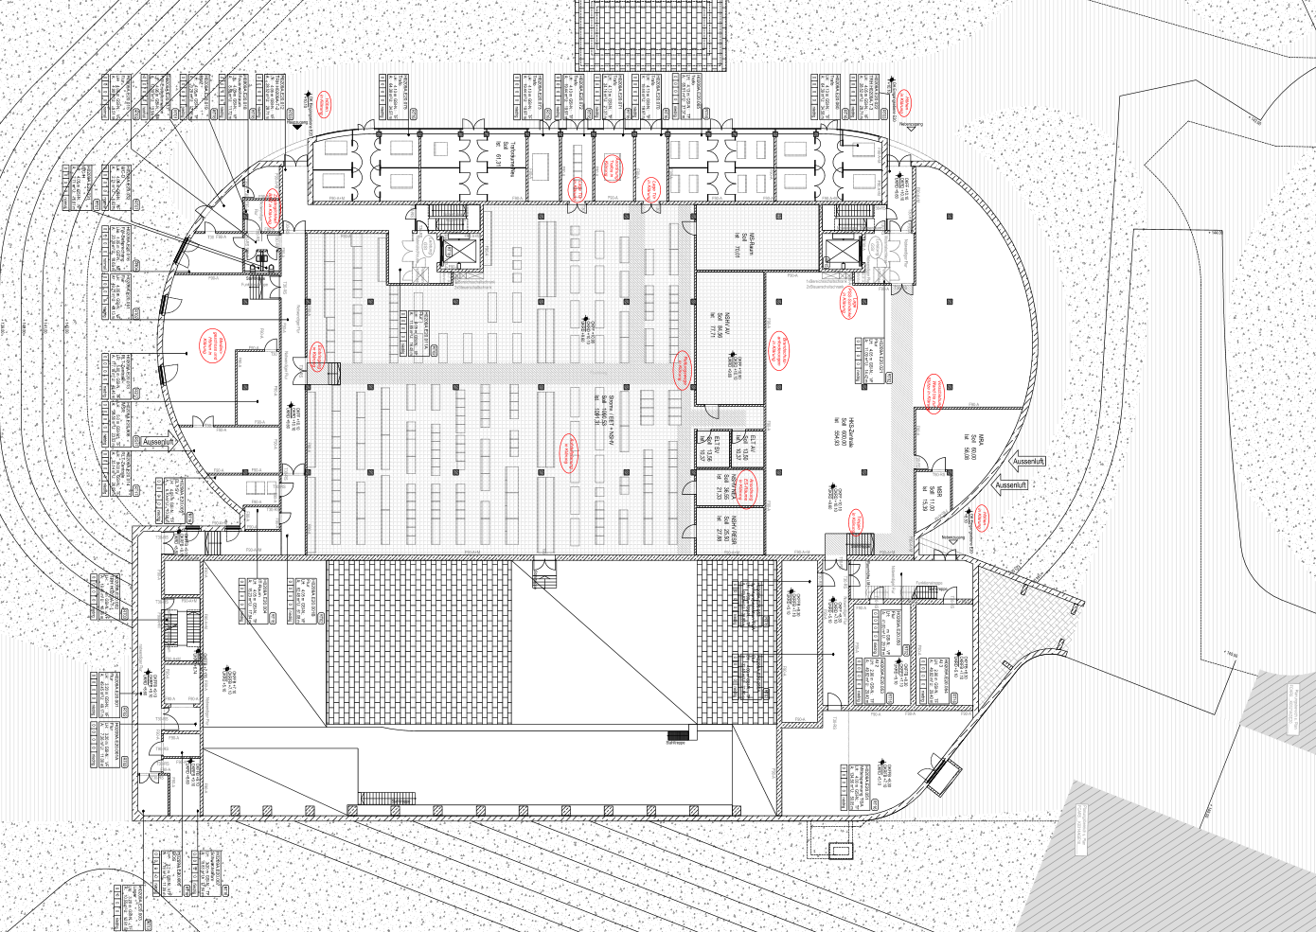
3nd Joint BINP-FAIR CC Workshop
25.11 - 28.11.2019
POWER CONVERTERS LOCATION

Slide 11
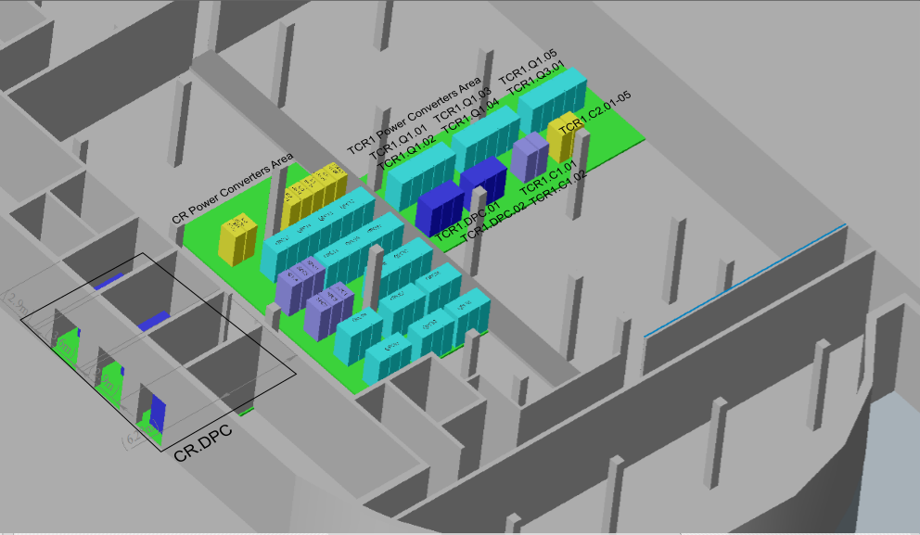
3nd Joint BINP-FAIR CC Workshop
25.11 - 28.11.2019
POWER CONVERTERS LOCATION
Blue – QPC, Indigo – SPC, Yellow – OPC&CPC

Slide 12
3nd Joint BINP-FAIR CC Workshop
25.11 - 28.11.2019
POWER CONVERTERS SETUP
High Power part. It is supplied by a 20kV, 3-phase Common supply system C2
Control part. It is supplied by a 400V, 3-phase Common supply system C2

Slide 13
3nd Joint BINP-FAIR CC Workshop
25.11 - 28.11.2019
POWER CONVERTERS SETUP
High Power part. It is supplied by a 400V, 3-phase Common supply system C2
Control part. It is supplied by a 400V, 3-phase Common supply system C2

Slide 14
DIP MAGNETS POWER CONVERTER DIAGRAM
3nd Joint BINP-FAIR CC Workshop
25.11 - 28.11.2019
1.5kA 2750V
20kVAC
MAINS
5.2 MVA
Step-Down
TRANSFORMER
+ POLARITY
12 pulse SCR RECTIFIER
POLARITY
12 pulse SCR
RECTIFIER
OUTPUT
FILTER
DCCT
DIP
MAGNETS
1.5kA

Slide 15
QUAD MAGNETS POWER CONVERTER DIAGRAM
3nd Joint BINP-FAIR CC Workshop
25.11 - 28.11.2019
TYPE1
TYPE2
TYPE3
1.5kA 200V
1.5kA 100V
1.5kA 50V
IGBT
H-BRIDGE
1.5kA 600V
20kHz
OUTPUT
FILTER
400VAC
MAINS
Step-Down
TRANSFORMER
RECTIFIER
IGBT
H-BRIDGE
1.5kA 600V
20kHz
OUTPUT
FILTER
IGBT
H-BRIDGE
6x250A 600V
20kHz
OUTPUT
FILTER
DCCT
QUAD
MAGNETS
1.5kA

Slide 16
SEXTUPOLE MAGNETS POWER CONVERTER DIAGRAM
3nd Joint BINP-FAIR CC Workshop
25.11 - 28.11.2019
500A 100V
400VAC
MAINS
Step-Down
TRANSFORMER
RECTIFIER
IGBT
H-BRIDGE
1.5kA 600V
20kHz
OUTPUT
FILTER
IGBT
H-BRIDGE
2x250A 600V
20kHz
OUTPUT
FILTER
DCCT
SEXT
MAGNETS
500A

Slide 17
OCTUPOLE MAGNETS POWER CONVERTER DIAGRAMM
3nd Joint BINP-FAIR CC Workshop
25.11 - 28.11.2019
30A 90V
400VAC
MAINS
3kW
100 V OUT
AC/DC
IGBT
H-BRIDGE
20kHz
OUTPUT
FILTER
DCCT
OCT
MAGNET
30A

Slide 18
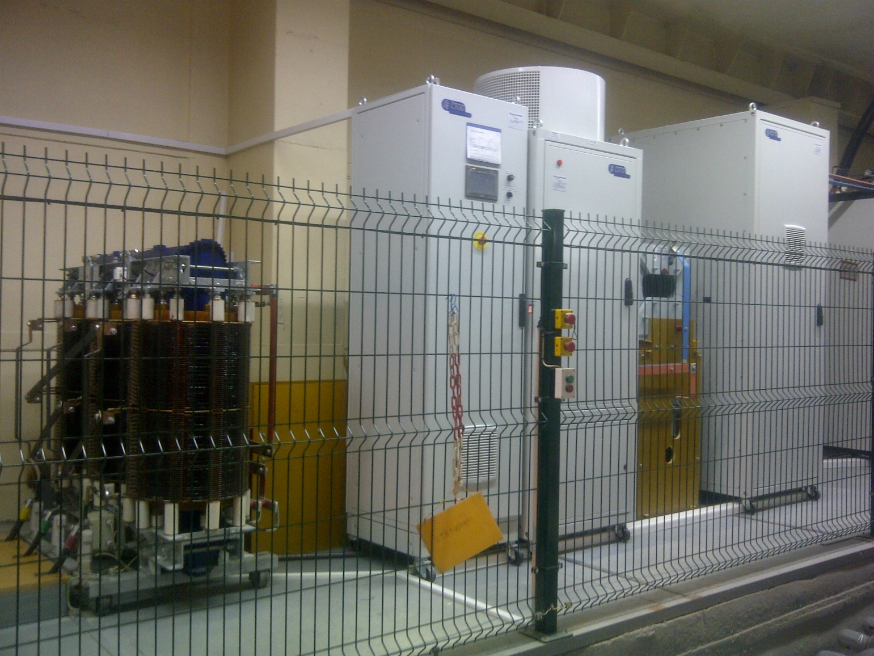
3MVA (1kA 3kV) ČKD DC SOURCE
3nd Joint BINP-FAIR CC Workshop
25.11 - 28.11.2019

Slide 19
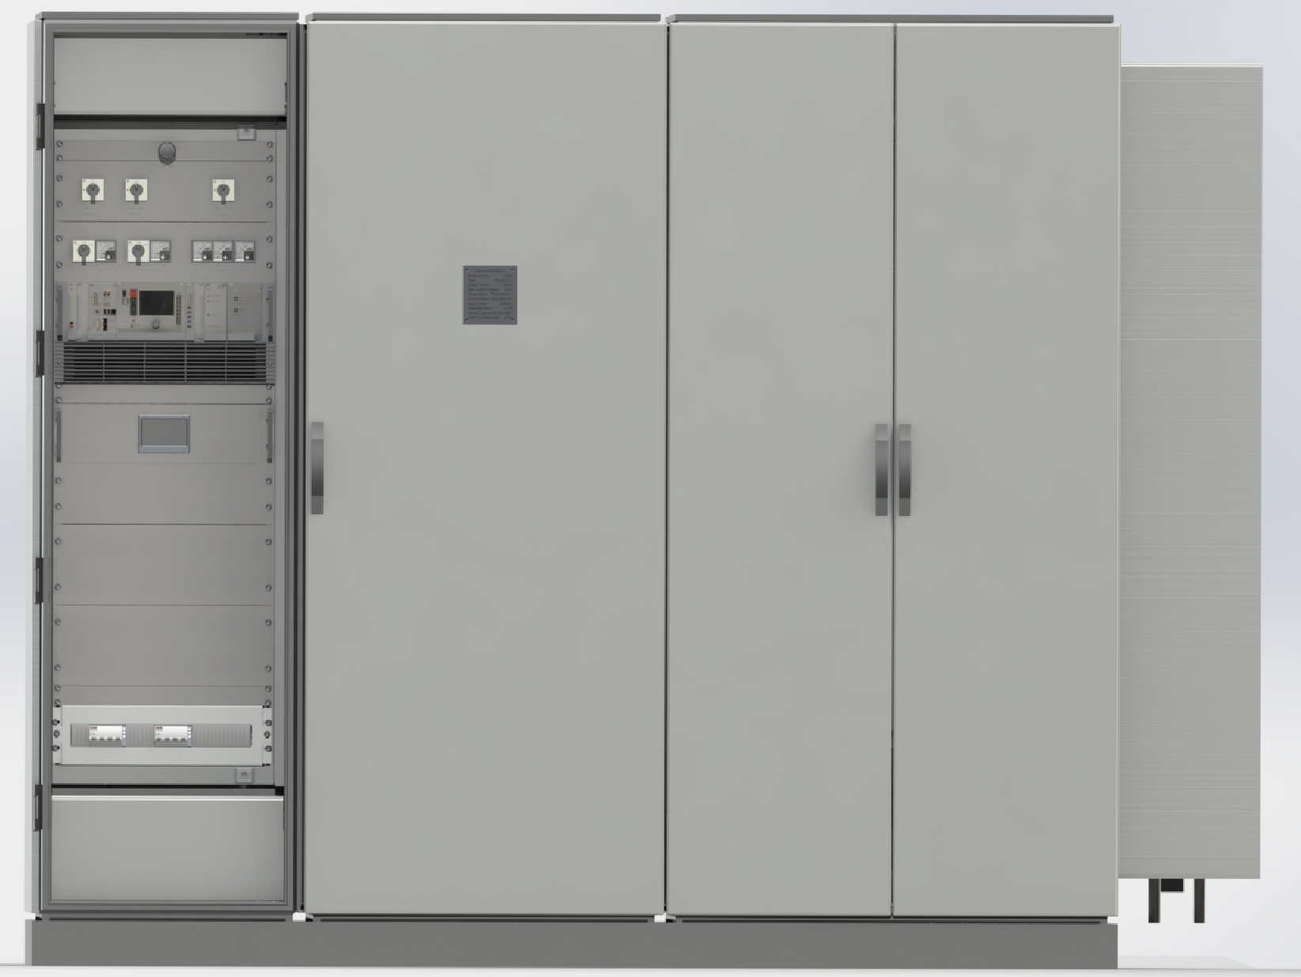
QUAD POWER APPEARANCE
3nd Joint BINP-FAIR CC Workshop
25.11 - 28.11.2019

Slide 20
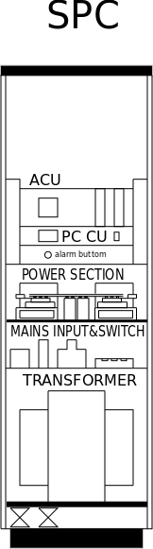
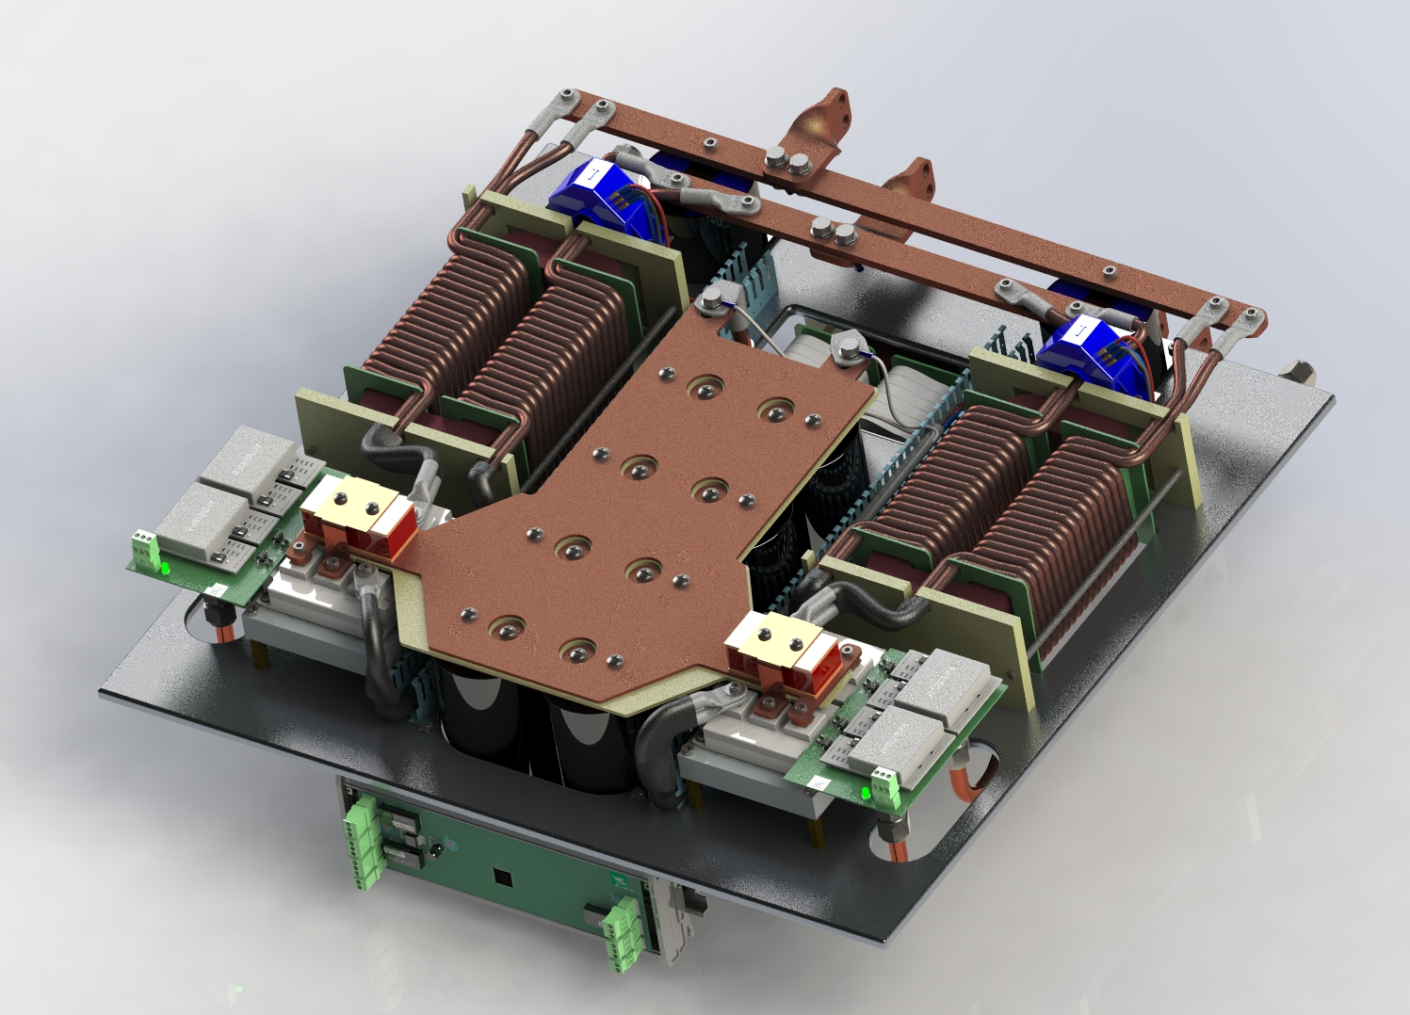
SEXTUPOLES POWER CONVERTER RACK LAYOUT
3nd Joint BINP-FAIR CC Workshop
25.11 - 28.11.2019
500A
Power Section

Slide 21
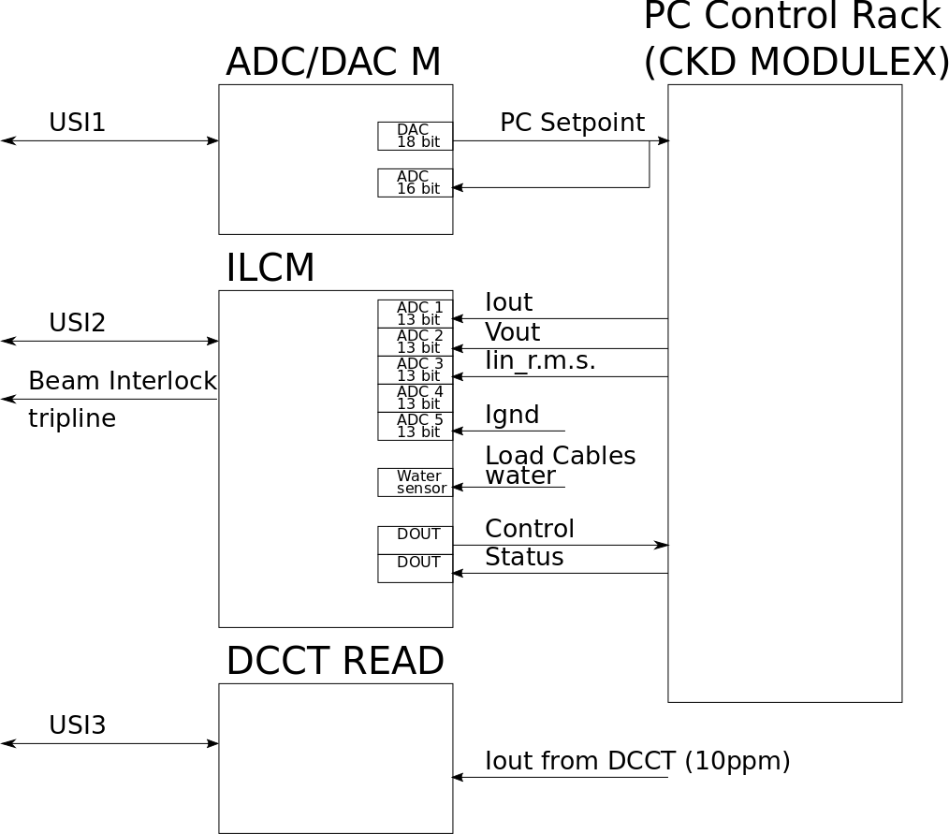
DIPOLE POWER CONVERTER CONTROL DIAGRAMM
3nd Joint BINP-FAIR CC Workshop
25.11 - 28.11.2019

Slide 22
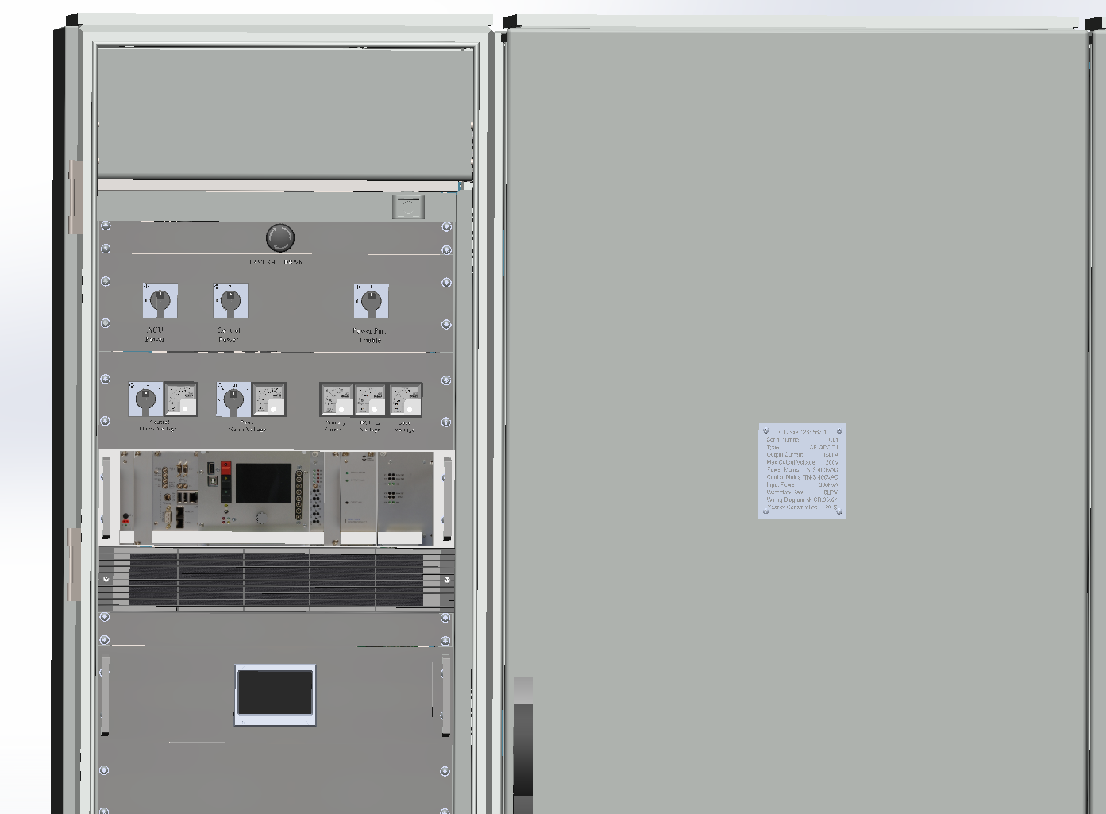
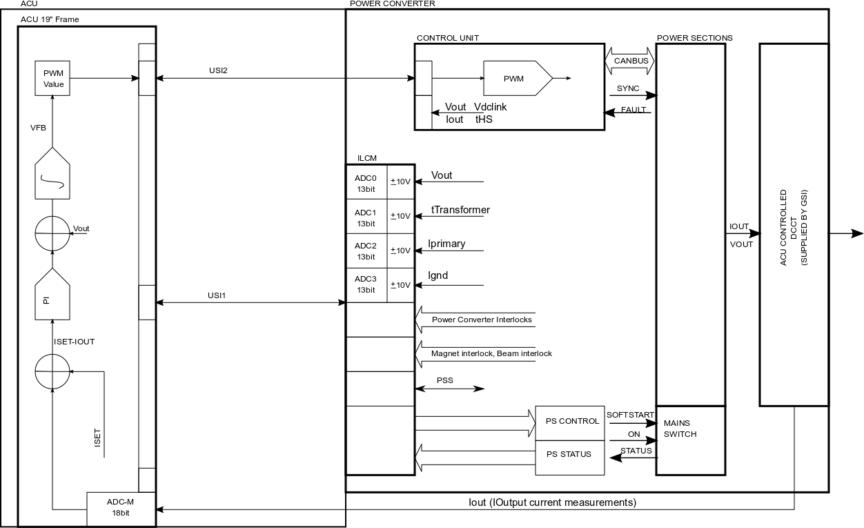
QUAD POWER CONVERTER CONTROL
3nd Joint BINP-FAIR CC Workshop
25.11 - 28.11.2019

Slide 23
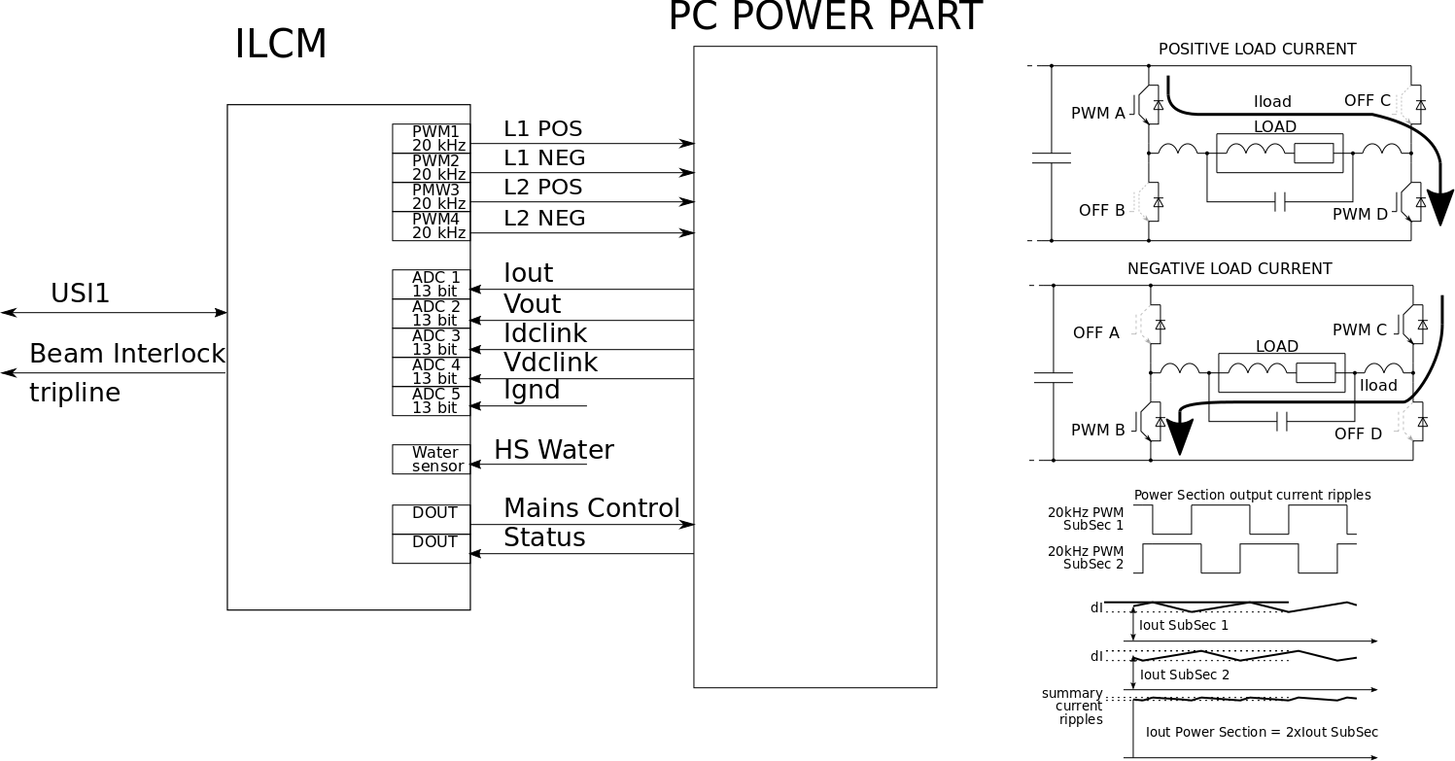
SEXTUPOLE POWER CONVERTER CONTROL
3nd Joint BINP-FAIR CC Workshop
25.11 - 28.11.2019

Slide 24
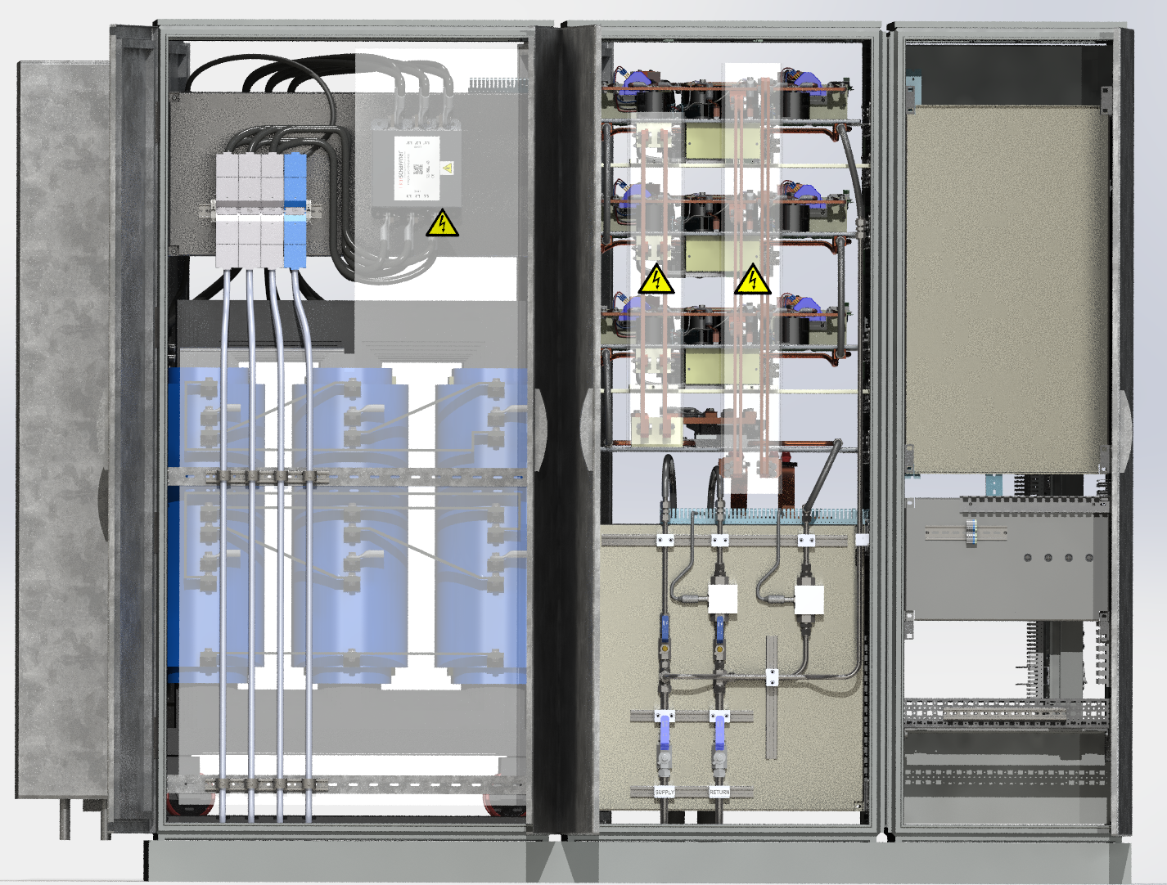
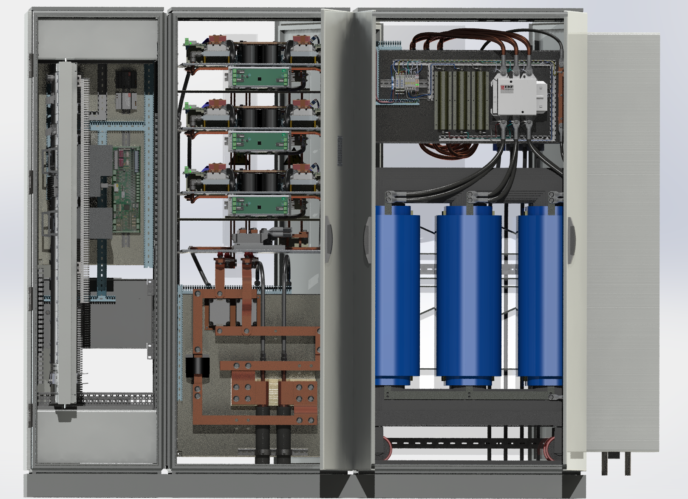
3nd Joint BINP-FAIR CC Workshop
25.11 - 28.11.2019
POWER CONVERTERS CONNECTIONS
Connection to electrical power : TN-S
Connection to load:

Slide 25
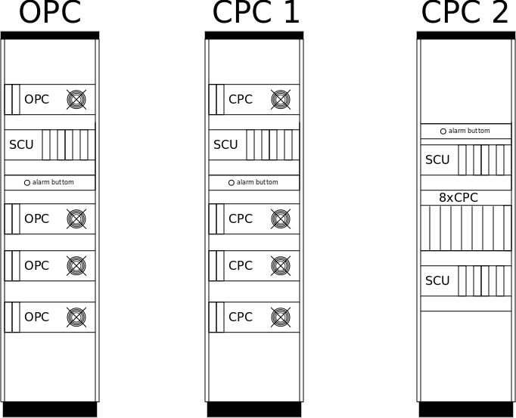
OCTUPOLE & STEERER POWER CONVERTERS
RACK LAYOUT
3nd Joint BINP-FAIR CC Workshop
25.11 - 28.11.2019

Slide 26
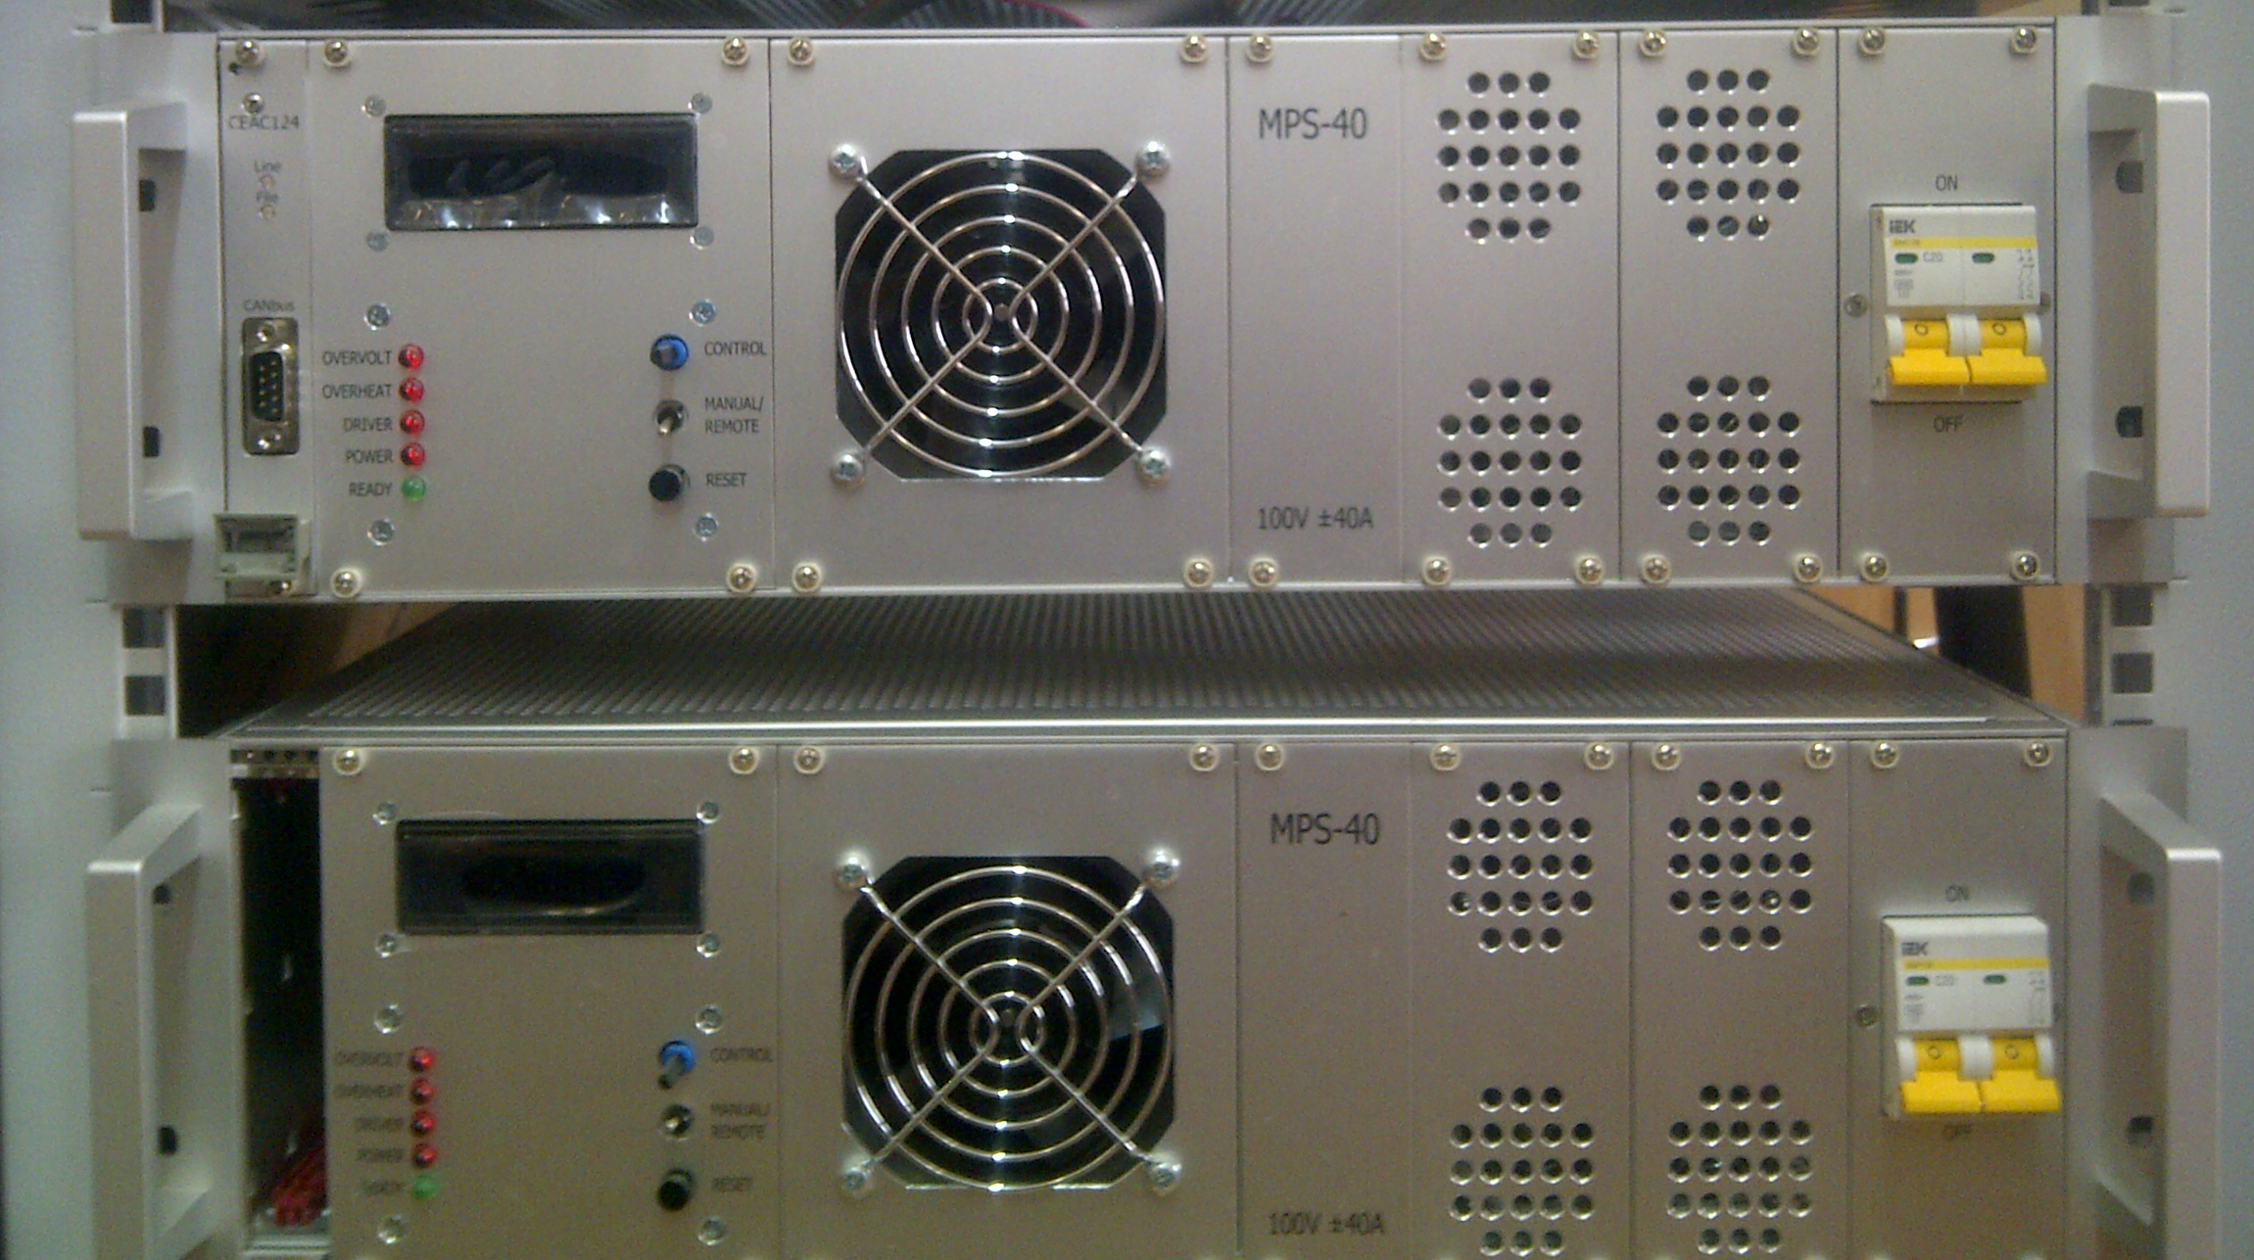
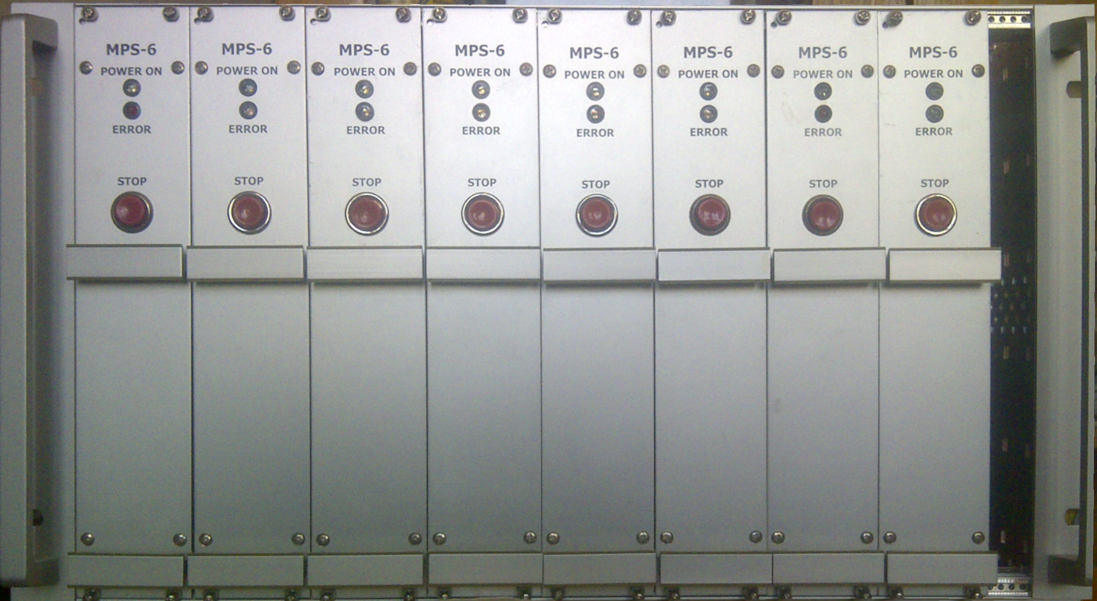
OCT. & CORR. POWER BLOCKS
3nd Joint BINP-FAIR CC Workshop
25.11 - 28.11.2019

Slide 27
Current status
3nd Joint BINP-FAIR CC Workshop
25.11 - 28.11.2019
Concept
Discussed and agreed
Specifications
Ready
Design
Prototyped
CDR
Under release

Slide 28
PSS SYSTEM
3nd Joint BINP-FAIR CC Workshop
25.11 - 28.11.2019
QuadType PC with integrated PSS System
TCR1 DPC
CR QPC Type3
Need to understand
Is it enough?
How many QPC needs PSS

Slide 29
Thank you for attention
3nd Joint BINP-FAIR CC Workshop
25.11 - 28.11.2019

