Slide 1
Vertical steering magnets for CR.
FDR Review.
A. Tsyganov for CR team
BINP, Novosibirsk
November 25, 2019
3st FAIR Workshop, Novosibirsk , Russia
Notes:
1

Slide 2
Outline
FDR documentation
Project management structure
Purpose and Basic Principles
Quantity in CR
Magnetic simulations
Production and realization – manufacturing process chart
Production plan

Slide 3
FDR Documentations
The Detailed Specification is outlined in EDMS
https://edms.cern.ch/ui/#!master/navigator/document?P:1987795909:1615665351:subDocs
The set of documents for the CR_Vertical Steering Magnets, TCR1_Vertical Steering Magnets (AID:0002502) is given in EDMS
3D model [AID:0002502]
https://edms.cern.ch/document/2137875/1
2D drawings and BoM [AID:0002502]
https://edms.cern.ch/document/2137876/1
Quality plan, Magnetic measurements plan [AID:0002502]
https://edms.cern.ch/document/2137871/1
Test [AID:0002502]
https://edms.cern.ch/document/2137867/1
Installation and operation manual https://edms.cern.ch/ui/#!master/navigator/document?D:100352978:100352978:subDocs

Slide 4
Project Management Structure
Work Package Leader (WPL)
Name: Alexander Starostenko (A.A.Starostenko@inp.nsk.su, Head of BINP Division № 5-11)
The Project Manager is responsible for:
  Follow-up of production activities;
  Regular and timely reporting on progress and problems;
  Timely conduction/participation of reviews and provisions of feedback;
Deputies
Name: Alexander Tsyganov (A.S.Tsygunov@inp.nsk.su, Research Scientist)
The Deputy is responsible for:
  Development of the technical documentation and manufacturing drawings for the deliverables;
  Ensuring that the production of the magnets is according to the technical specifications and time schedule;
  Preliminary magnet design, final magnet design (development, simulation);
  Follow-up of production activities;
  Magnetic measurements to ensure the required field and field quality;
  Transportation, delivery of the equipment to the FAIR site;
  Factory Acceptance Test (FAT) to verify the given specifications of the components;
Name: Tatyana Rybitskaya (T.V.Rybitskaya@inp.nsk.su, Research Scientist)
The Deputy is responsible for:
  Magnetic field calculation;
Scientific Design Department
Name: Andrey Molokoedov (A.M.Molokoedov@inp.nsk.su, Principal Design Engineer)
The Principal Design Engineer is responsible for:
  Vertical steering design (3D-models, production drawings);
Details in “Quality Plan”

Slide 5
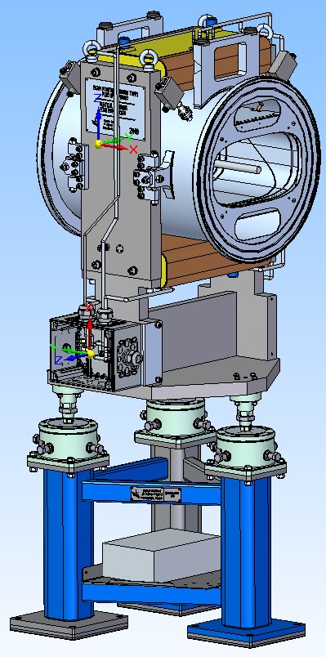
Purpose and Basic Principles
Vertical steering magnets are used to create a magnetic field of high quality for small-angle correction the of charged particle beam trajectories in the CR of FAIR.
These steerings are O-Shape magnets.
These coils of steerer are made of copper bar, which is cooled in the air.
This corrector is combined with the BPM (Type1)

Slide 6
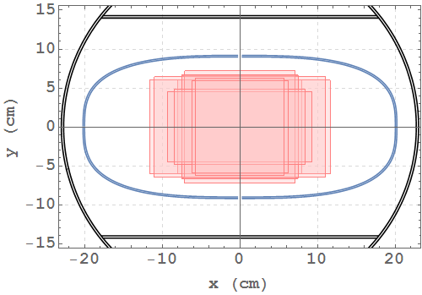
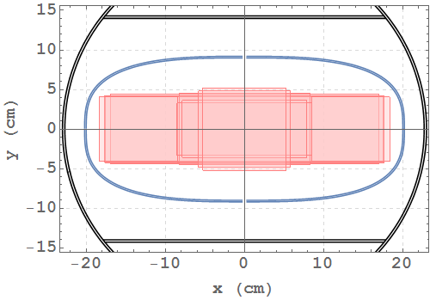
Quantity in CR
18 vertical steering magnets : 14 in arcs, 3 in TCR1.
Approximately 400 x 200 mm of useful aperture and maximum beam size at different points along the CR arcs: pbar – left, ions – right (Figs from CDR of BPM - TYPE 1)
The 3D model of vertical steering magnet and drawings are ready..

Slide 7
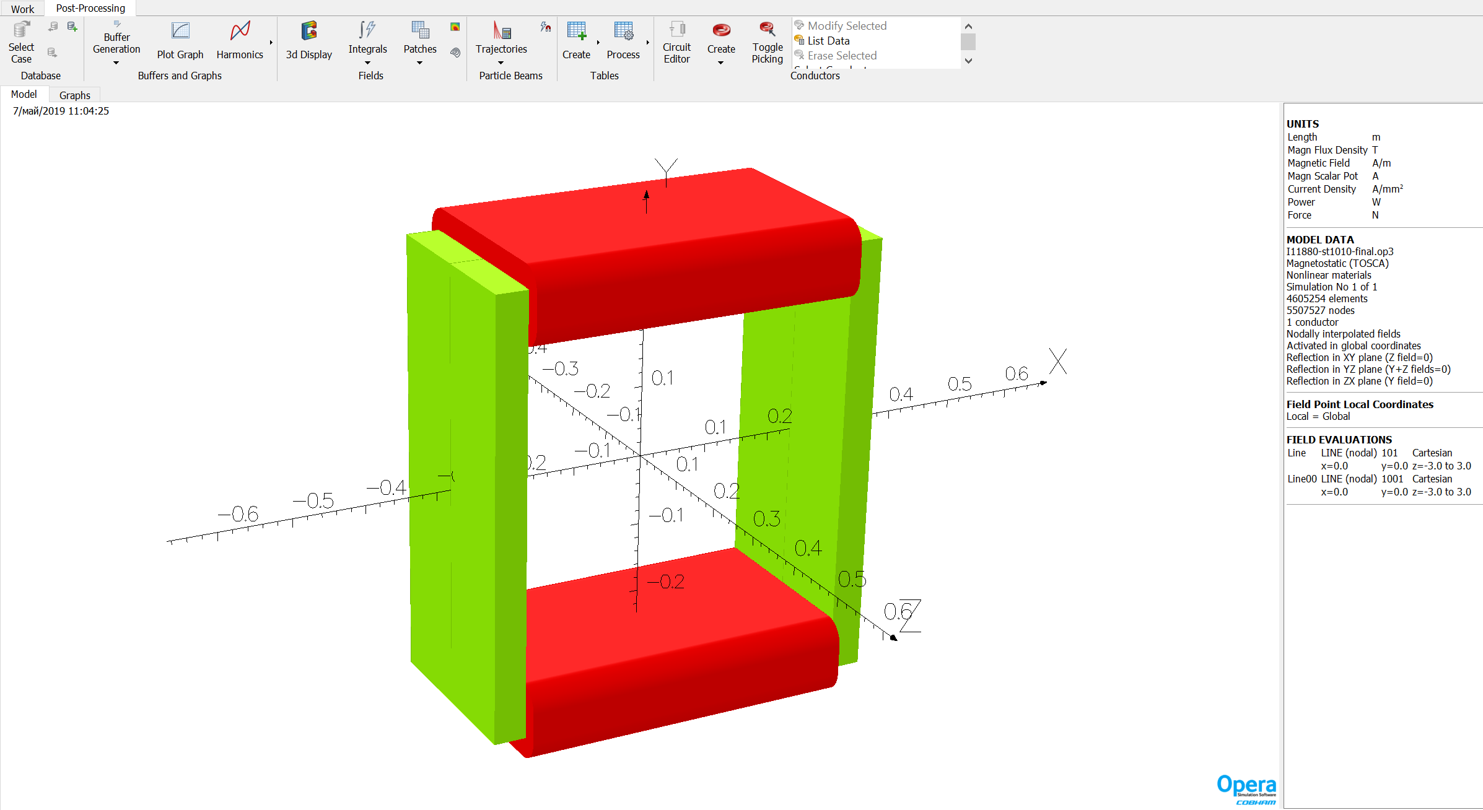
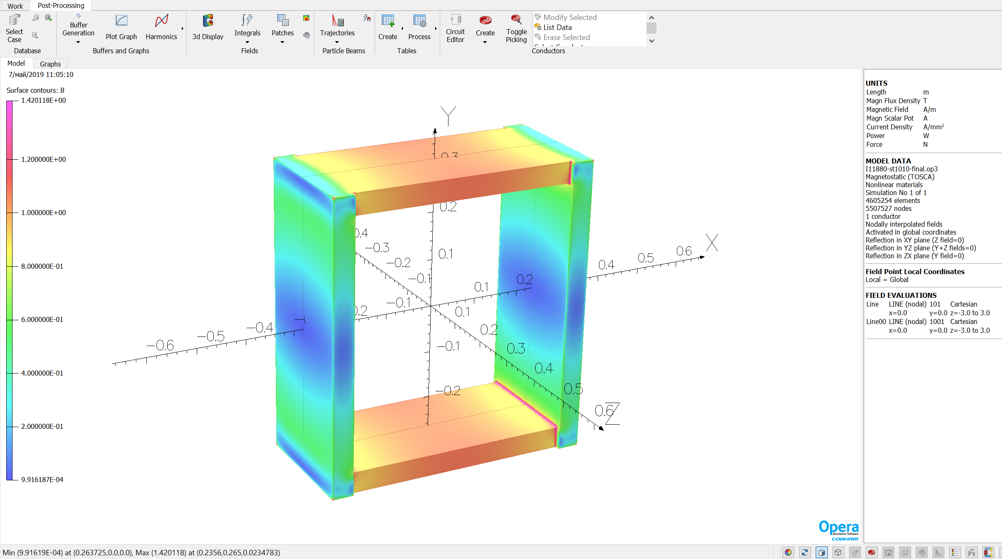
Magnetic simulation
The simulation model of vertical steering magnet.
The magnetic saturation in the yoke. Units of measure [T].

Slide 8
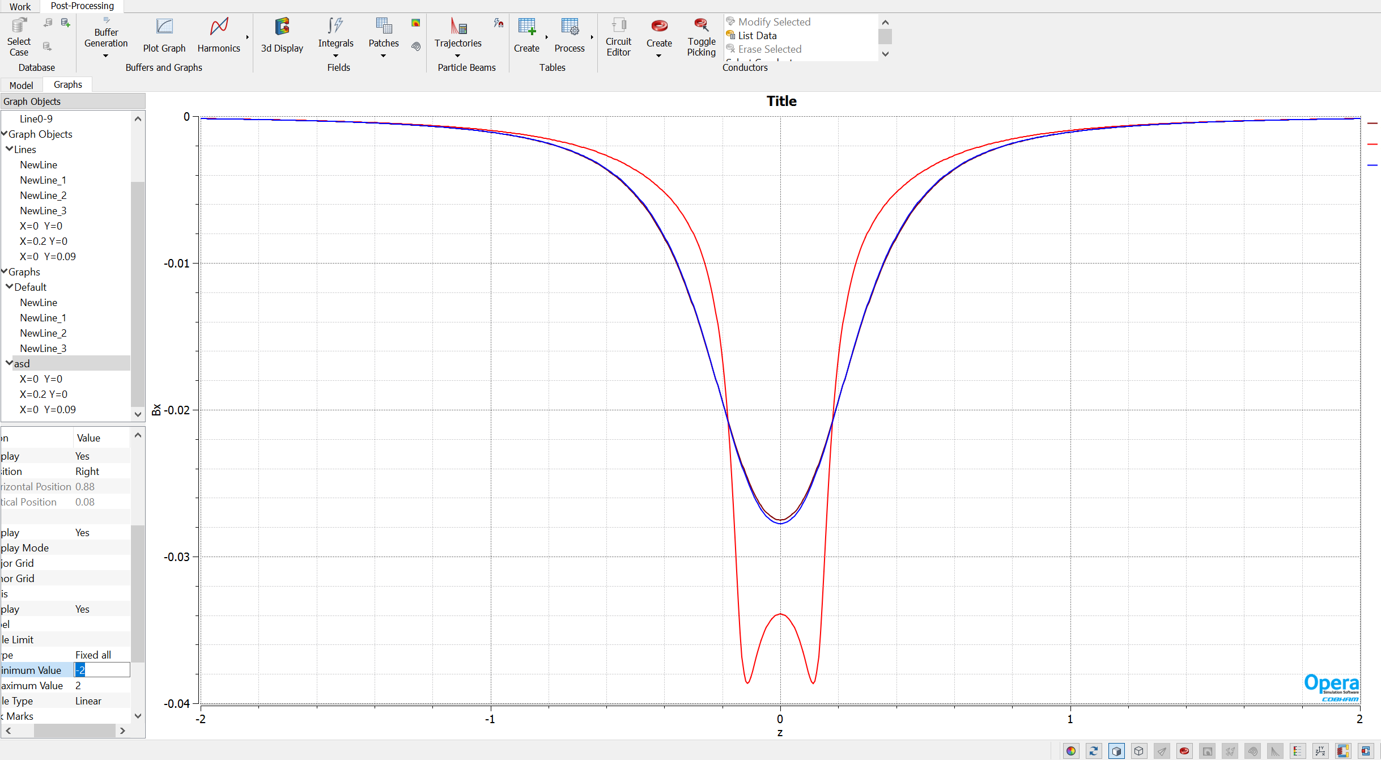
Magnetic simulation
The simulation of magnetic fields Bx [T] along Z [m] for different X and Y
The values of the integral ∫Bxdz for different X and Y
Between the maximum and minimum values of the integral ∫Bxdz difference +/- 0.65%
X[m] | Y[m] | ∫ Bx dz [T·m]
0 | 0 | -0.02014
0.2 | 0 | -0.02038
0 | 0.09 | -0.02012

Slide 9
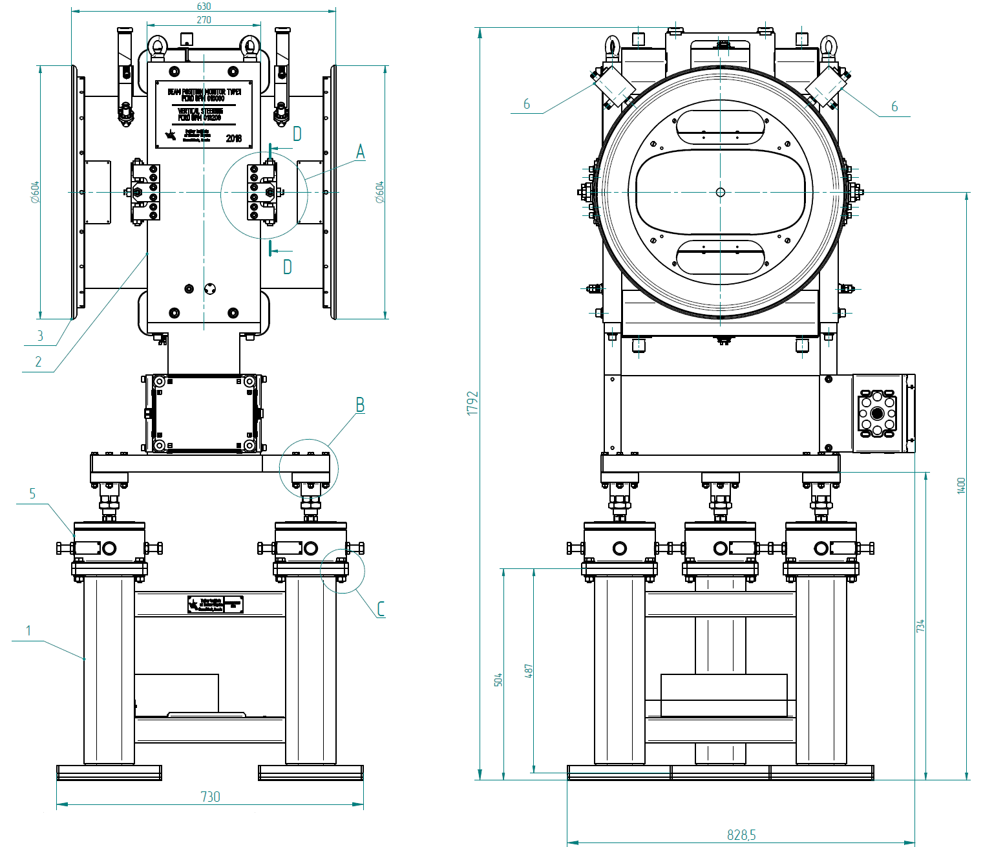
Main parameters for vertical steering magnets
Parameter | Value | Units
Maximum field integral | 0.02 | T·m
Field quality, ∫ΔBx/∫Bx | ±1.5 | %
Overall weight without stand | 560 | kg
External radius of the vacuum chamber in the steering magnet | 230 | mm
Usable aperture | Super ellipse x=±200, у=±90 | mm
Effective length | 740 | mm
Packing factor | solid
BH-curve | M1200-100A or AISI 1010
Yoke length | 270 | mm
Iron weight without stand | 390 | kg
Current density in conductor | 1.1 | A/ mm²
Total number of turns per magnet | 2376
Conductor cross section | 2.24x4 | mm²
Copper weight per magnet | 166 | kg
Current at max field | 10 | A
Power consumption | 320 | W
Resistance per magnet | 3.2 | Ohm
Details available in EDMS: https://edms.cern.ch/ui/#!master/navigator/document?P:1987795909:1615665351:subDocs

Slide 10
What rate a change of the magnetic field when the power current is turned on?
t, sec |  | dB/Bnom, %
0 |  | 100
0,1 |  | 43,80571
0,2 |  | 17,24253
0,3 |  | 9,998331
0,4 |  | 6,719412
0,5 |  | 4,857286
0,6 |  | 3,655483
0,7 |  | 2,820898
0,8 |  | 2,219997
0,9 |  | 1,779336
1 |  | 1,452178
1,5 |  | 0,58421
98,5 % of nominal magnetic field is achived of 1 s

Slide 11
Manufacturing Process Chart
Acronyms and Abbreviations:
P PM1 PC1 PC2 PK1 | The yoke parts production Milling the yoke parts procedure. Checking the dimensions and the holes' positions of the yoke parts during production. Checking the number and types of yoke parts. Marking parts of the yoke procedure.
Y YC1 YA1 YC2 YM1 YC3 YC4 | Yoke production Check completeness (availability of all parts and fasteners). Assembling of yoke parts procedure. Check the assembling. Processing of the assembled yoke procedure. Check the dimensions of the machining. Visual check the paintwork.
C CW1 CC1 CP2 CC2 CP3 CP4 | Coil production Coil winding procedure. Check dimensions and interturn insulation of the coils before impregnation. Coil impregnation procedure. Check dimensions of the coils after the impregnation. Brazing procedure for external brazing. Electrical tests of the coils.
A AP1 AC1 AP2 AP3 AP4 | Magnet assembly Magnets assembly procedure. Check the magnet dimensions. Electromechanical tests procedure. Magnetic measurements procedure. Final tuning procedure if necessary. Final tests after production against specification. FAT. Packing. Transportation. SAT A. SAT Ba.

Slide 12
Comments to 3D model
Interfaces with neighboring vacuum chambers could not be checked because they are not included in the DMU model up to now.
Overlap of wires
Only 6 holes for drilling bore holes into the floor are reachable.
Unusual characters for the model of the small BPM connection box.
The comments are minor.
The designer corrects the comments.
The corrected 3d model will be loaded soon

Slide 13
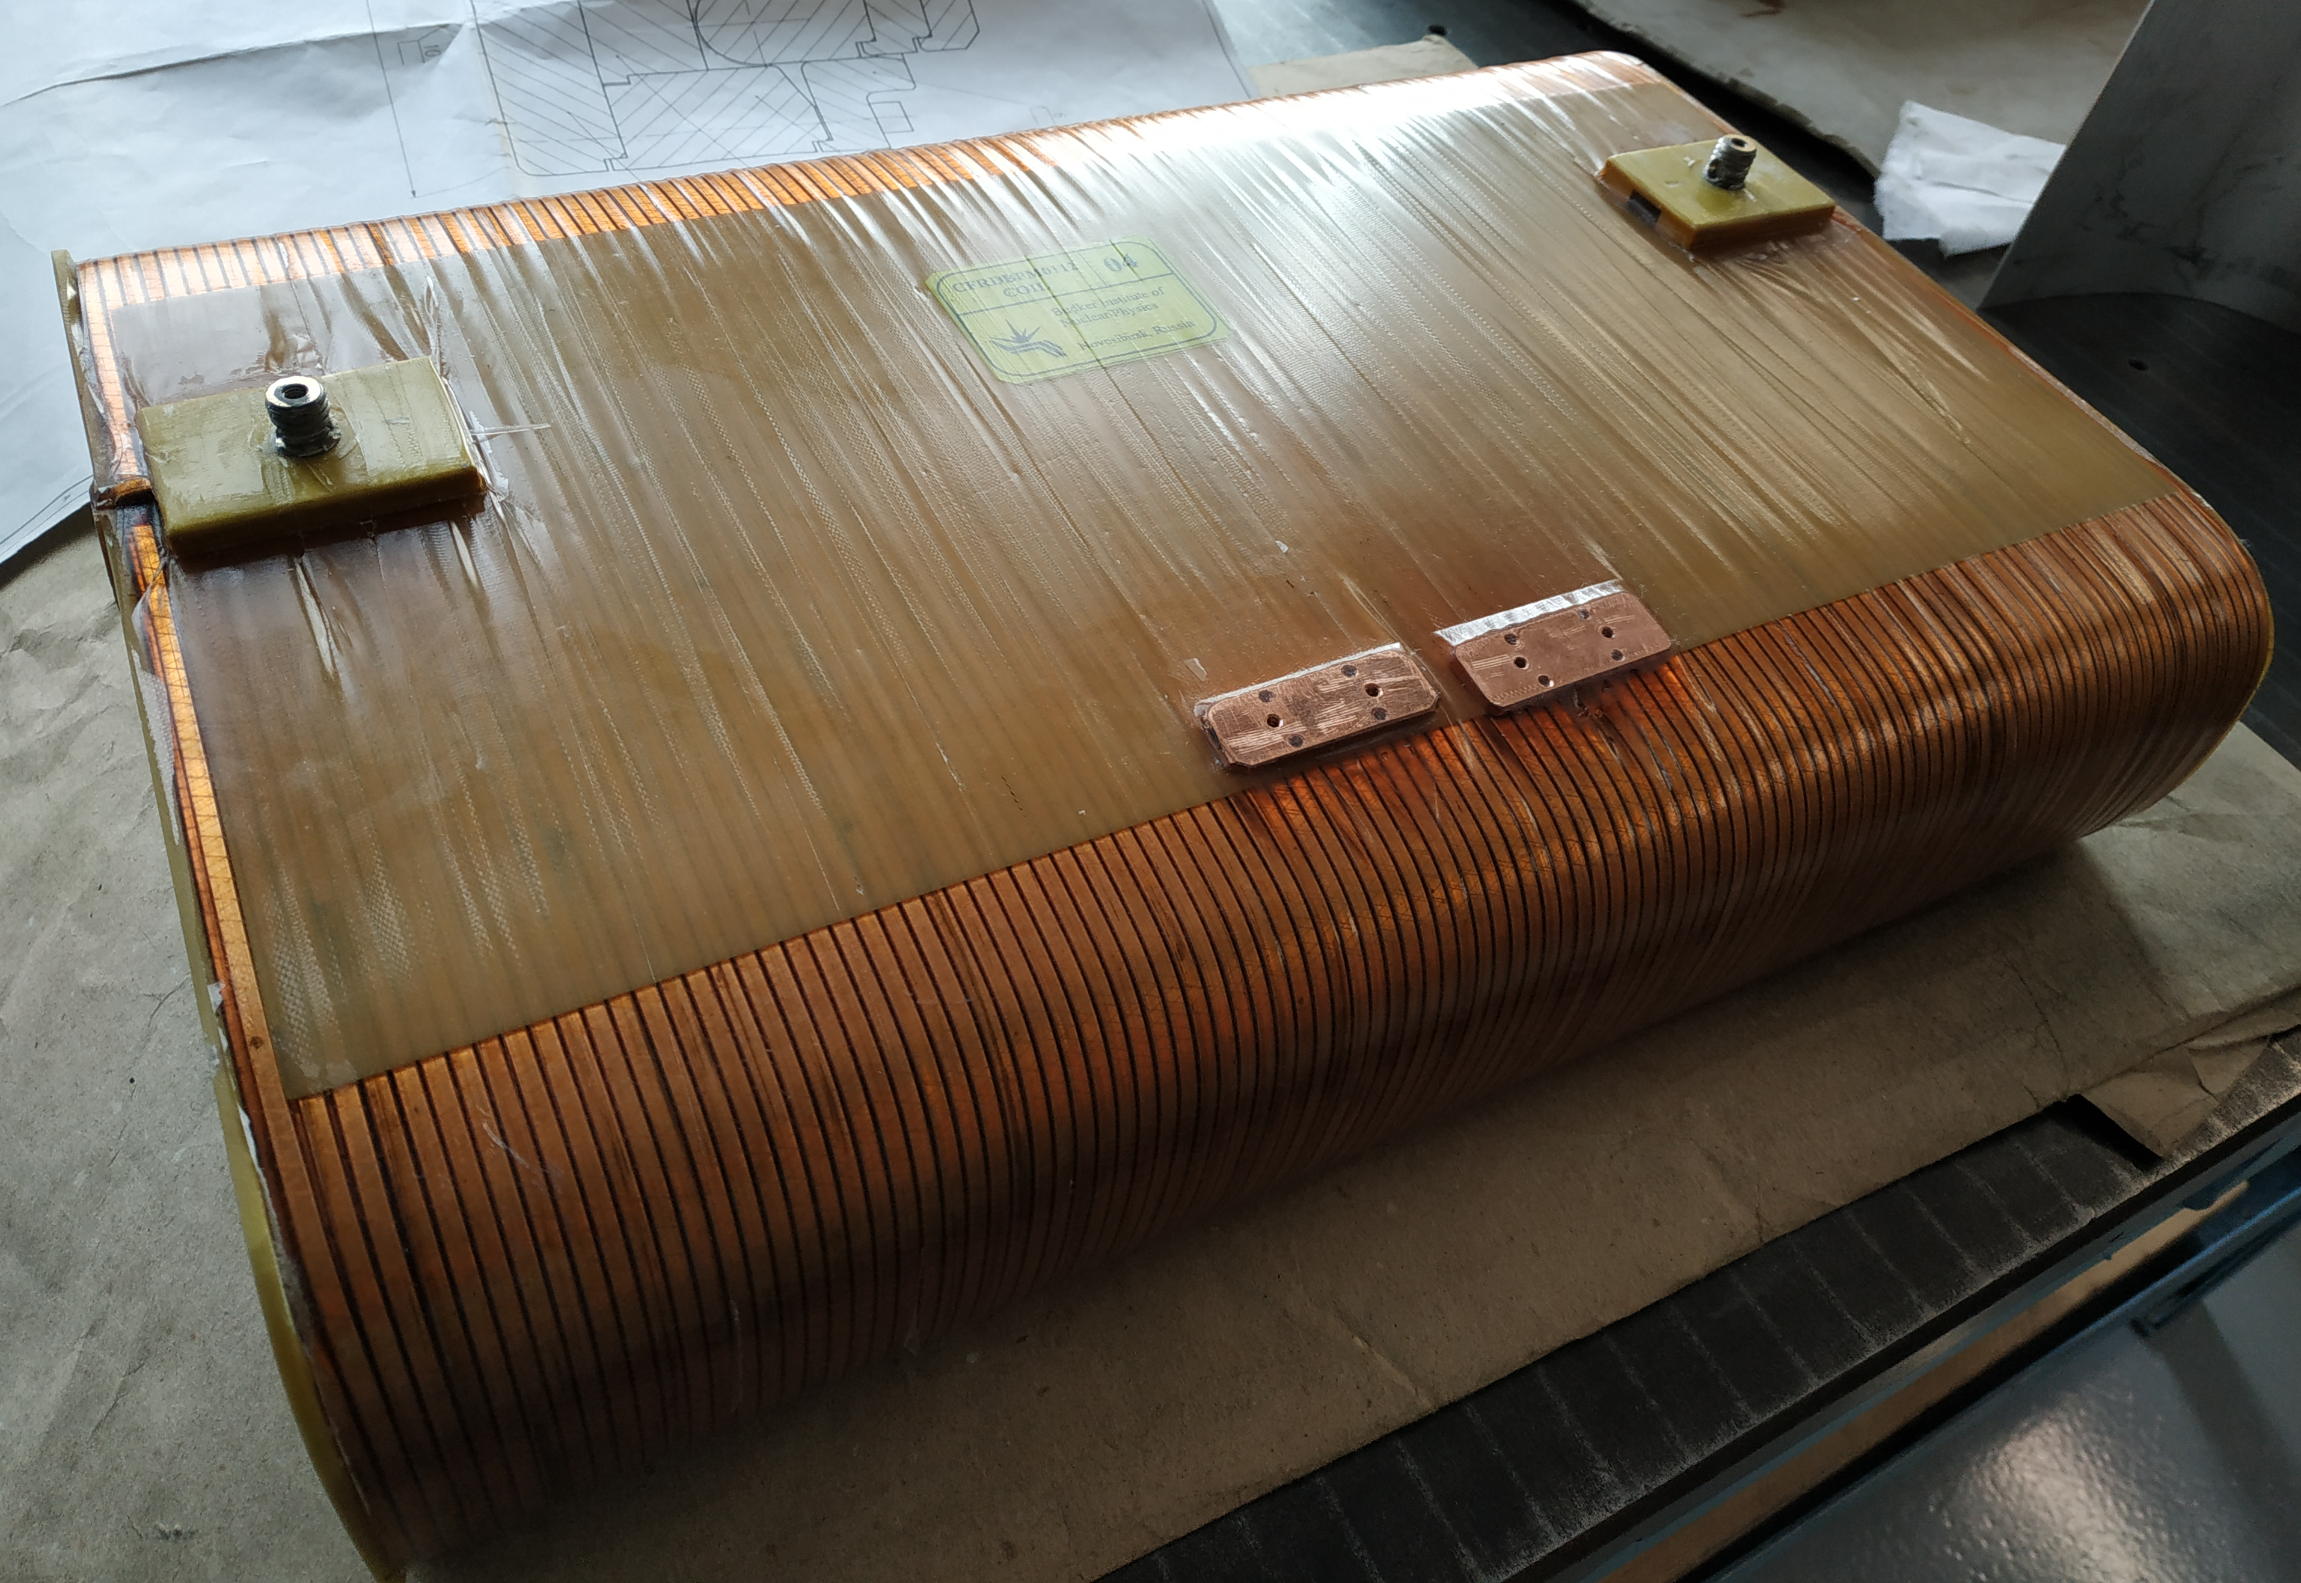
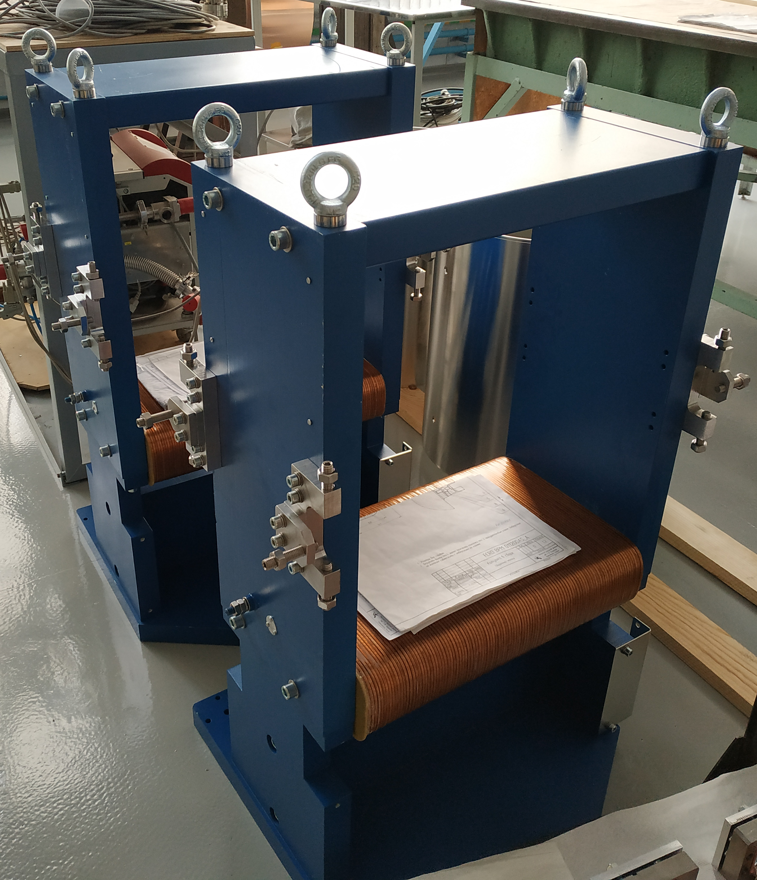
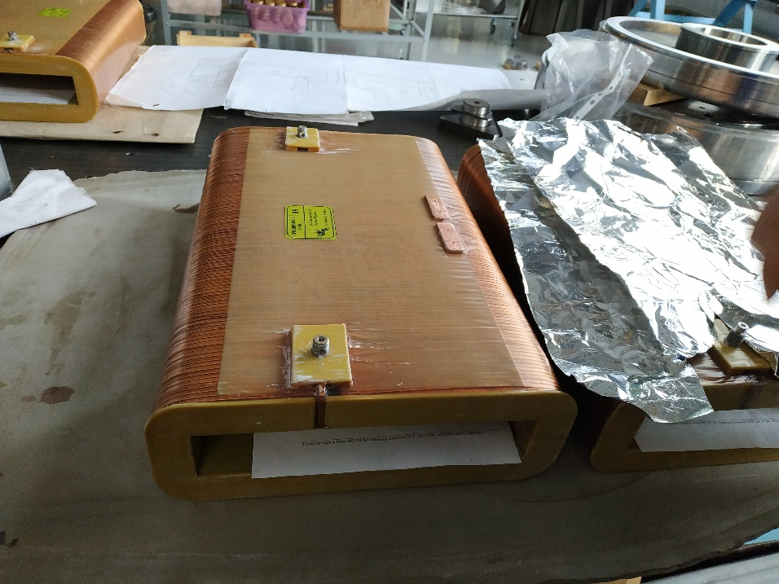
Firsts steerers CR in production

Slide 14
Milestones
April 2019 – May 2019: preparation and passing milestone M6 (CDR)
June 2019 – November 2019: detail designing, preparation of drawings. Passing milestone M7 (FDR). Purchasing required accessories, materials, components
August 2019 – October 2019: tooling production, test bench development and production, manufacturing and to experimental workshop-1 (EW-1)
November 2019 – December 2019: FoS testing, QA, magnetic measure, FoS revision. Passing milestone M8
November 2019 – November 2022: manufacturing and testing the other vertical steering magnets, FAT, delivering to FAIR facility, SAT, pre-installation assembling. Approximately 2 vertical steering magnets every 4 month.
December 2022 – February 2023: final installation in CR tunnel [All series M10 – January 2023]

Slide 15
Summary
Quality plan is prepared and uploaded to EDMS – Q4-2019(Q2-2019)
Risk Analysis is prepared and uploaded to EDMS – Q4-2019(Q2-2019)
3D models and 2D drawings is uploaded to EDMS – Q4-2019(Q2-2019)
Production chart and main milestones defined and presented – Q2-2019
Fos production is started (material procurement as well) – Q4-2019
Ready for FDR approval (protocol signature) for vertical steering magnet – Q4-2019

Slide 16
Questions
16

