Slide 1
Combined steering magnets for CR.
FDR Review.
A. Tsyganov for CR team
BINP, Novosibirsk
November 25, 2019
3st FAIR Workshop, Novosibirsk , Russia
Notes:
1

Slide 2
Outline
FDR documentation
Project management structure
Purpose and Basic Principles
Quantity in CR
Magnetic simulations
Production and realization – manufacturing process chart
Production plan

Slide 3
FDR Documentations
The Detailed Specification is outlined in EDMS
https://edms.cern.ch/ui/#!master/navigator/document?P:1987795909:1633987445:subDocs
3D-model [AID:0002520]
https://edms.cern.ch/document/2147179/1
2D drawings and BoM [AID:0002520]
https://edms.cern.ch/document/2147180/1
Risk analysis and hazard analysis [AID:0002520]
https://edms.cern.ch/document/2147171/1
Test [AID:0002520]
https://edms.cern.ch/document/2147175/1
Installation and operation manual https://edms.cern.ch/ui/#!master/navigator/document?D:100364192:100364192:subDocs

Slide 4
Project Management Structure
Work Package Leader (WPL)
Name: Alexander Starostenko (A.A.Starostenko@inp.nsk.su, Head of BINP Division № 5-11)
The Project Manager is responsible for:
  Follow-up of production activities;
  Regular and timely reporting on progress and problems;
  Timely conduction/participation of reviews and provisions of feedback;
Deputies
Name: Aleksander Tsyganov (A.S.Tsygunov@inp.nsk.su, Research Scientist)
The Deputy is responsible for:
  Development of the technical documentation and manufacturing drawings for the deliverables;
  Ensuring that the production of the magnets is according to the technical specifications and time schedule;
  Preliminary magnet design, final magnet design (development, simulation);
  Follow-up of production activities;
  Magnetic measurements to ensure the required field and field quality;
  Transportation, delivery of the equipment to the FAIR site;
  Factory Acceptance Test (FAT) to verify the given specifications of the components;
Name: Tatyana Rybitskaya (T.V.Rybitskaya@inp.nsk.su, Research Scientist)
The Deputy is responsible for:
  Magnetic field calculation;
Scientific Design Department
Name: Andrey Molokoedov (A.M.Molokoedov@inp.nsk.su, Principal Design Engineer)
The Principal Design Engineer is responsible for:
  Combined steering magnet design (3D-models, production drawings);
Details in “Quality Plan”

Slide 5
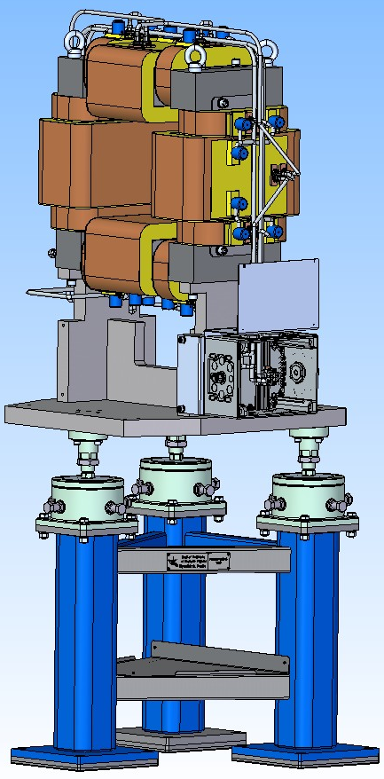
Purpose and Basic Principles
Combined steering magnets are used to create a magnetic field of high quality for small-angle two-axis correction the of charged particle beam trajectories in the CR of FAIR.
These steerings are O-Shape magnets.
These coils of steerer are made of copper bar, which is cooled in the air.
This corrector is combined with the BPM (Type2)

Slide 6
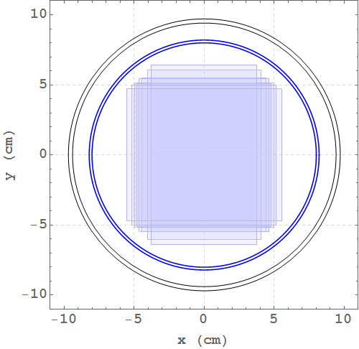
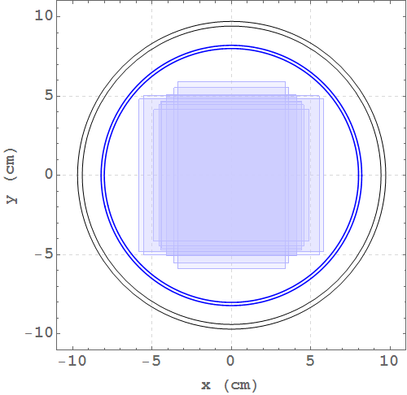
Quantity in CR
5 combined steering magnets.
Maximum beam size at different points along the CR straights pbar – left, ions – right.
Approximately R=100mm of useful aperture and maximum beam size at different points along the CR arcs: pbar – left, ions – right (Figs from CDR of BPM - TYPE 2)
The 3D model of combined steering magnet is ready.

Slide 7
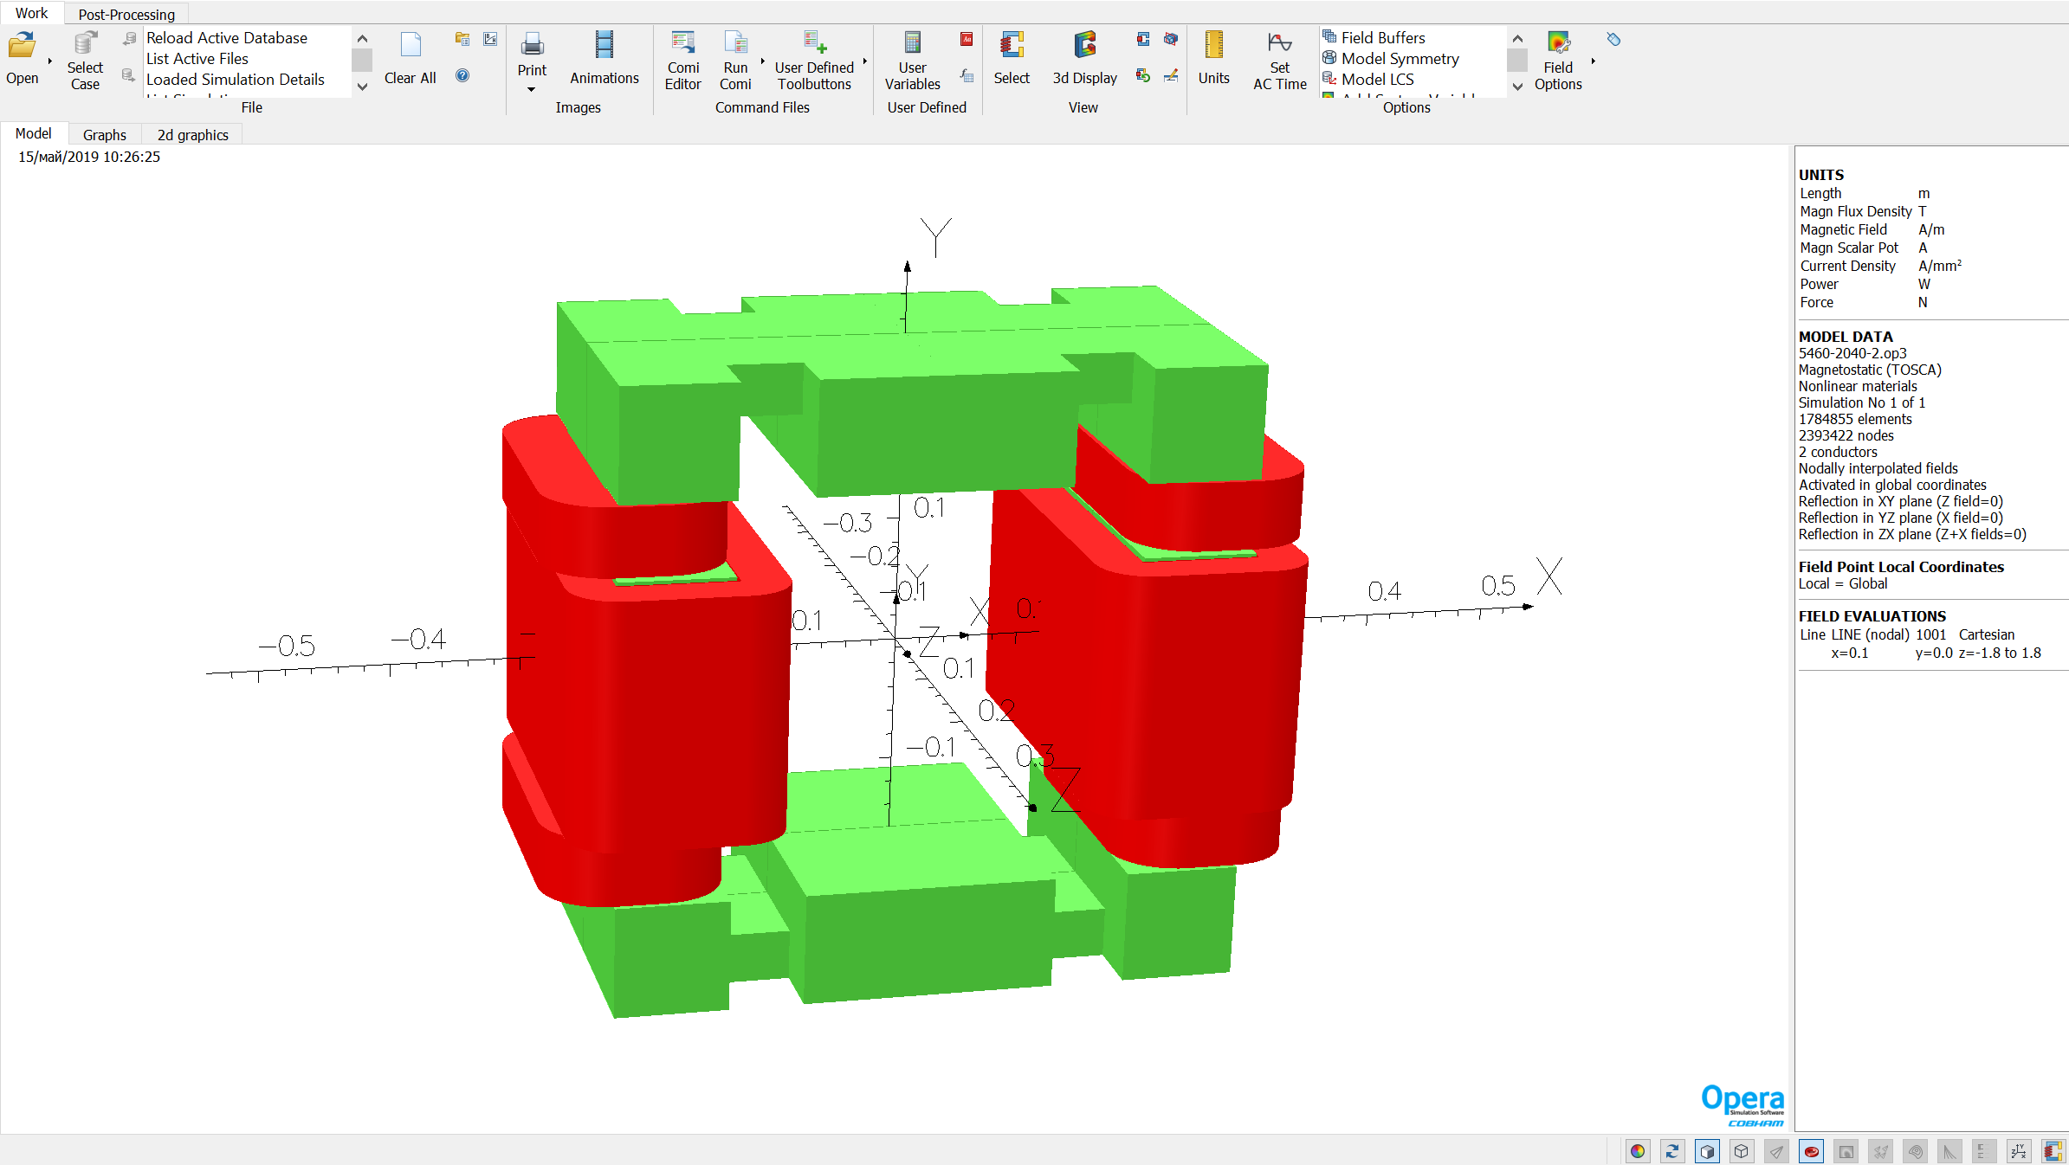
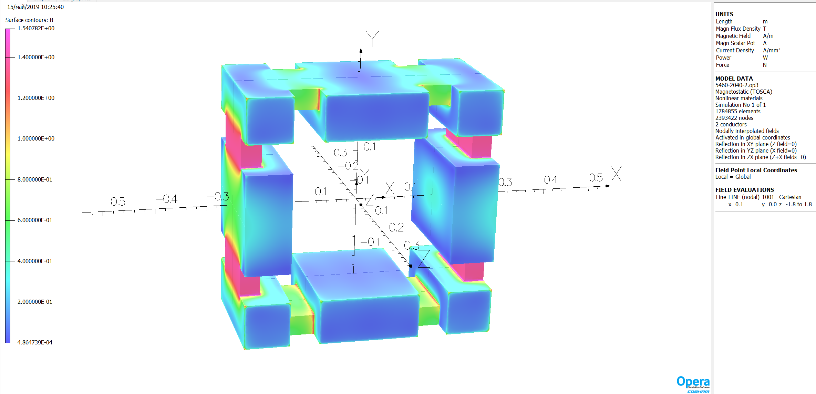
Magnetic simulation
The simulation model of combined steering magnet with coils only to the horizontal correction of beam trajectories..
The magnetic saturation in the yoke. Units of measure [T].

Slide 8
Magnetic simulation
The simulation values of integral in the magnetic field By [T] for different points for the half circle with radius 100mm.
Between the maximum and minimum values of the integral ∫Bydz difference ± 0,72 %

Slide 9
Main parameters for combined steering magnets
Parameter | Value | Units
Maximum flux density | 0.0335 | T
Field quality, ΔB/B | ±1.5 | %
Maximum field integral | 0.02 | T·m
Correction angle | ±1.5 | mrad
Overall weight without stand | 670 | kg
Time for polarity change less | 1 | s
External radius of the vacuum chamber in the steering magnet | 100 | mm
Packing factor | solid
BH-curve | M1200-100A or AISI 1010
Yoke length | 270 | mm
Iron weight without stand | 358 | kg
Data of coils
Corrector length with coils | 350 | mm
Corrector height without stand | 597 | mm
Corrector width | 597 | mm
Current density in conductor | 1 | A/ mm²
Number of turns | 1272x2
Conductor cross section | 2.5х6.3 | mm²
Copper weight per magnet | 312 | kg
Current at max field | 15 | A
Voltage | 16.5 | V
Power consumption per magnet | 250+250 | W
Resistance per magnet | 1.1+1.1 | Ohm
Inductance per magnet | 320 | mH
Details available in EDMS: https://edms.cern.ch/ui/#!master/navigator/document?P:1987795909:1633987445:subDocs

Slide 10
Manufacturing Process Chart
Acronyms and Abbreviations:
P PM1 PC1 PC2 PK1 | The yoke parts production Milling the yoke parts procedure. Checking the dimensions and the holes' positions of the yoke parts during production. Checking the number and types of yoke parts. Marking parts of the yoke procedure.
Y YC1 YA1 YC2 YM1 YC3 YC4 | Yoke production Check completeness (availability of all parts and fasteners). Assembling of yoke parts procedure. Check the assembling. Processing of the assembled yoke procedure. Check the dimensions of the machining. Visual check the paintwork.
C CW1 CC1 CP2 CC2 CP3 CP4 | Coil production Coil winding procedure. Check dimensions and interturn insulation of the coils before impregnation. Coil impregnation procedure. Check dimensions of the coils after the impregnation. Brazing procedure for external brazing. Electrical tests of the coils.
A AP1 AC1 AP2 AP3 AP4 | Magnet assembly Magnets assembly procedure. Check the magnet dimensions. Electromechanical tests procedure. Magnetic measurements procedure. Final tuning procedure if necessary. Final tests after production against specification. FAT. Packing. Transportation. SAT A. SAT Ba.

Slide 11
Comments to 3D model
Wiring does not fit with the model of the connection box
Overlap of wires
Thermoswitches should be covered
Unusual characters for the model of the small BPM connection box.
The comments are minor.
The designer corrects the comments.
The corrected 3D model will be loaded soon

Slide 12
Milestones
April 2019 – May 2019 : preparation and passing milestone M6 (CDR)
June 2019 – November 2019: detail designing, preparation of drawings. Passing milestone M7 (FDR). Purchasing required accessories, materials, components
November 2019 – May 2020: tooling production, test bench development and production, tooling manufacturing in experimental workshop-1 (EW-1)
June 2020 – October 2020: FoS testing, QA, magnetic measure, FoS revision. Passing milestone M8
March 2021 – November 2022: manufacturing and testing the other combined steering magnets, FAT, delivering to FAIR facility, SAT, pre-installation assembling. Approximately 1 combined steering magnets every 5 month.
December 2022 – February 2023: final installation in CR tunnel [All series M10 – January 2023]

Slide 13
Summary
Quality plan is prepared and uploaded to EDMS – Q4-2019 (Q2-2019)
Risk Analysis is prepared and uploaded to EDMS – Q4-2019 (Q2-2019)
3D models, 2D drawings is ready and uploaded to EDMS – Q4-2019
(Q2-2019)
Production chart and main milestones defined and presented – Q4-2019 (Q2-2019)
FoS production is started (material procurement as well) – Q4-2020
Ready for FDR approval (protocol signature) for combined steering magnet – Q4-2019

Slide 14
Questions
14

