Slide 1
CR diagnostics. Current status.
Yu. Rogovsky for CR team
BINP, Novosibirsk
November 28, 2019
3rd BINP-FAIR Workshop, Novosibirsk, Russia
Notes:
1

Slide 2
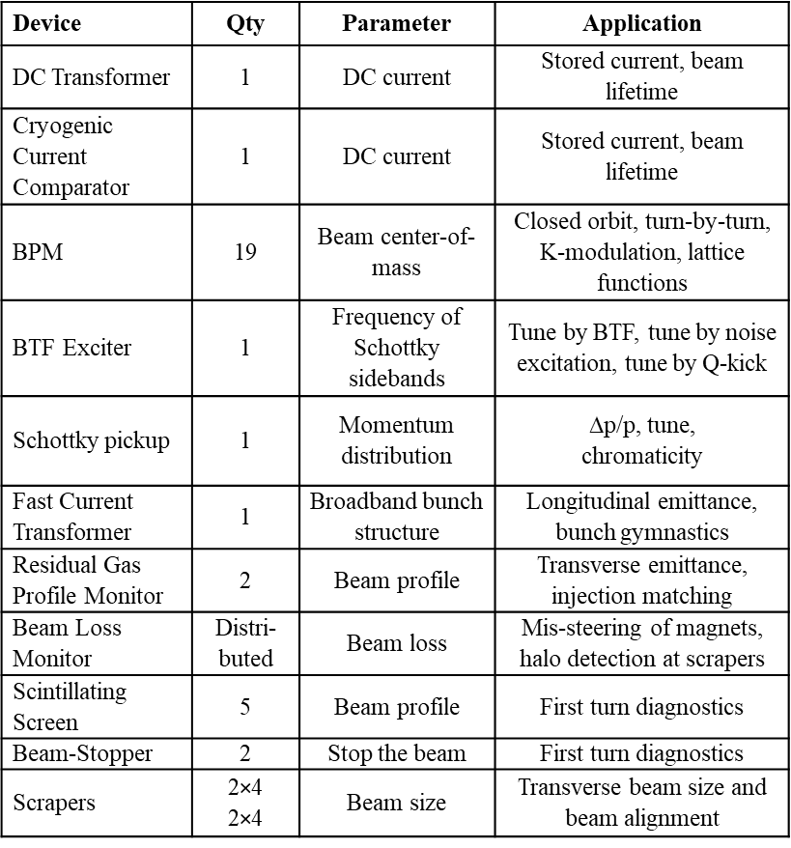
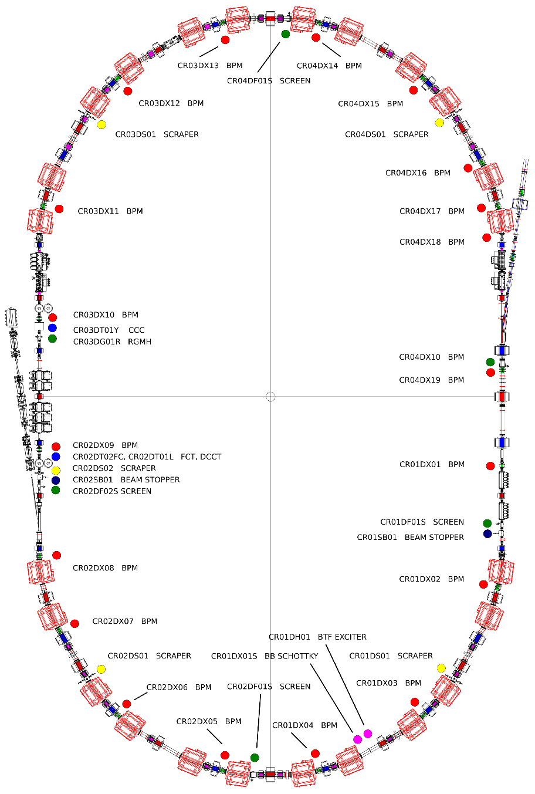
CR Beam Diagnostics
…

Slide 3
WP 2.5.6, 2.9.6: Yu.Rogovsky, O.Chorniy
Beam Position Monitor (CR – 19, TCR1 – 6):
CDR (mechanical part) – approved in May 2019.
CDR (analog preamplifier) – expected in the end of October 2019.
FoS – ongoing.
FDR – expected in Q1 2020.
FAT and delivery planned up to the end of 2022 (last pcs).
Residual Gas Monitor (CR – 2):
CDR expected in the end of November 2019.
FDR – expected in Q2 2020.
FAT and delivery planned in Q4 2021.
DCCT, FCT (CR – 1 ):
CDR / FDR approved in May 2019.
FAT and delivery after procurement (BERGOZ), planned for 2020.
Beam Stopper (CR – 2):
CDR approved in May 2019. FDR is planned for the Q1 2020.
FAT and delivery planned in Q1 2022.

Slide 4
WP 2.5.6, 2.9.6: Yu.Rogovsky, O.Chorniy
Beam Scrapper (CR – 5):
CDR approved in May 2019.
FDR is planned in the end of November 2019.
FAT and delivery planned in Q2 2022.
Scintillating Screen (CR – 5, TCR1 - 3):
CDR approved in May 2019. FDR is planned for the Q1 2020.
FAT and delivery planned in Q3 2022.
BFT, Schottky BPM (CR – 1, 1):
Contract between ITEP and FAIR.
First Kick-Off meeting in October 2020.
Cryogenic Current Comparator (CR – 1):
The concept is ongoing in GSI.
Beam Loss Monitor (CR – 8, distributed around the ring):
The concept is ongoing in GSI.

Slide 5
Status WP report (October 2019)
Qualitative rating:
done
as planned
critical, but reachable
very critical, unreachable
not applicable
PSP | 2.5.6
WP | CR Diagnostics
WP-Leader | Rogovsky Yury
Report period | October 2019
X
Status for WP
Deadlines
Costs
Resources
PSP | Subproject | Responsibility | S | CDR | FDR | PR FoS | FAT FoS | SAT FoS | SP | FAT SP | DL | SAT SP | IN | CO | Activities in reporting period / Risks
2.5.6.1.1 | DCCT | Yu. Rogovsky | x | x | x |  |  |  |  |  |  |  |  |  | None. Added to FAIR procurement list.
2.5.6.2.1 | BPM | Yu. Rogovsky E. Bekhtenev | x | x |  |  |  |  |  |  |  |  |  |  | Preamplifier CDR review done. CDR Approved.
2.5.6.3.4 | FCT | Yu. Rogovsky | x | x | x |  |  |  |  |  |  |  |  |  | None. Added to FAIR procurement list.
2.5.6.4.1 | RGM | M. Bryzgunov | x |  |  |  |  |  |  |  |  |  |  |  | Conceptual design is going. 3D design is going.
2.5.6.6.1 | Scintillating Screen | V. Balakin | x | x |  |  |  |  |  |  |  |  |  |  | Illumination of screen concept (minor changes) finished. FDR preparation.
2.5.6.6.3 | Beam Stopper | V. Borin | x | x |  |  |  |  |  |  |  |  |  |  | FDR preparation.
2.5.6.7.1 2.5.6.7.2 | Beam Scrapper | O. Meshkov | x | x |  |  |  |  |  |  |  |  |  |  | FDR preparation.
WP subprojects (4th level):
Legend:
S - Specification; CDR Conceptual Design Review; FDR Final Design Review; PR- Production FoS; FAT FoS Factory acceptance test) FoS; SAT FoS - Site Acceptance Test of FoS; SP – Series Production; FAT SP – Factory acceptance test of Series Production; DL –Delivery; SAT SP – Site Acceptance Test of Series Production; IN – Installation; CO – commissioning without beam

Slide 6
Status WP report (October 2019)
PSP | 2.5.6
WP | CR Diagnostics
WP-Leader | Rogovsky Yury
Report period | October 2019
Qualitative rating:
done
as planned
critical, but reachable
very critical, unreachable
not applicable
Status for WP
Deadlines
Costs
Resources
X
PSPSp | Subproject | Responsibility | S | CDR | FDR | PR FoS | FAT FoS | SAT FoS | SP | FAT SP | DL | SAT SP | IN | CO | Activities in reporting period / Risks
2.5.6.3.1 | BTF | M. Shwickert O. Chorniy | x |  |  |  |  |  |  |  |  |  |  |  | GSI / ITEP side responsibility. Kick-off was in October 2019.
2.5.6.3.2 | Schottky Pickup | M. Shwickert O. Chorniy | x |  |  |  |  |  |  |  |  |  |  |  | GSI / ITEP side responsibility. Kick-off was in October 2019.
2.5.6.1.3 | CCC | M. Shwickert O. Chorniy |  |  |  |  |  |  |  |  |  |  |  |  | The specification should be ready until the middle of 2019 (according to plans).
2.5.6.5.1 | BLM | M. Shwickert O. Chorniy | x |  |  |  |  |  |  |  |  |  |  |  | Specification prepared by GSI side. No further information.
WP subprojects (4th level):
Legend:
S - Specification; CDR Conceptual Design Review; FDR Final Design Review; PR- Production FoS; FAT FoS Factory acceptance test) FoS; SAT FoS - Site Acceptance Test of FoS; SP – Series Production; FAT SP – Factory acceptance test of Series Production; DL –Delivery; SAT SP – Site Acceptance Test of Series Production; IN – Installation; CO – commissioning without beam

Slide 7
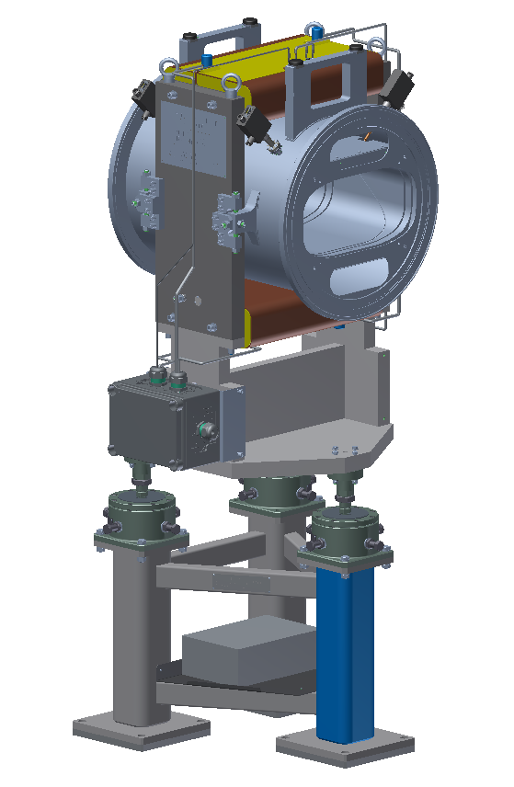
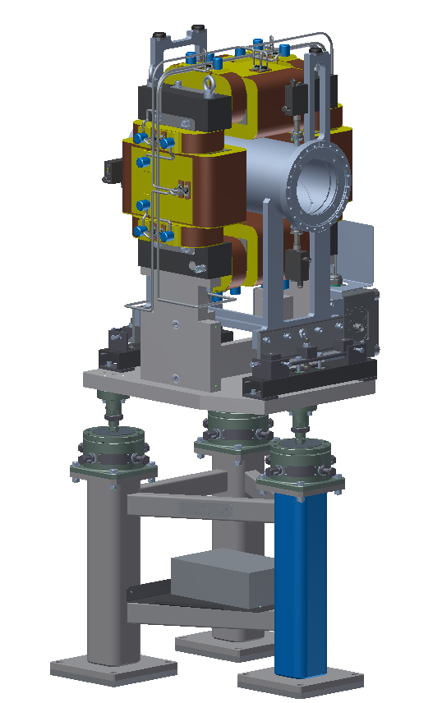
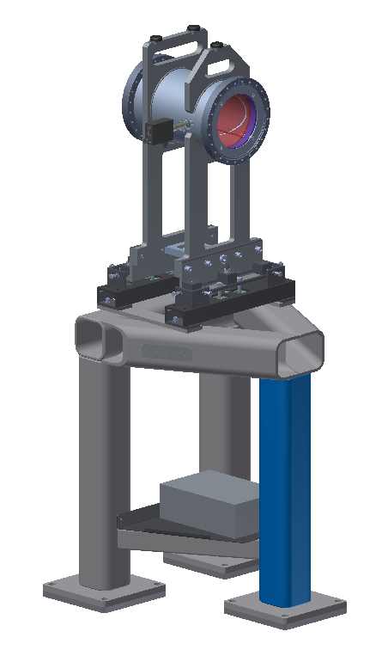
Beam Position Monitor (Mech.)
Type1
Type2
Type3
BPM Type1 – 400 x 200 mm aperture – 3D model and drawings is ready (already @ Experimental Workshop)
BPM Type2 – 200 x 200 mm aperture – 3D model and drawings is ready (already @ Experimental Workshop)
BPM Type3 – 200 x 200 mm aperture – 3D model and drawings is ready (half of BPM Type2)

Slide 8
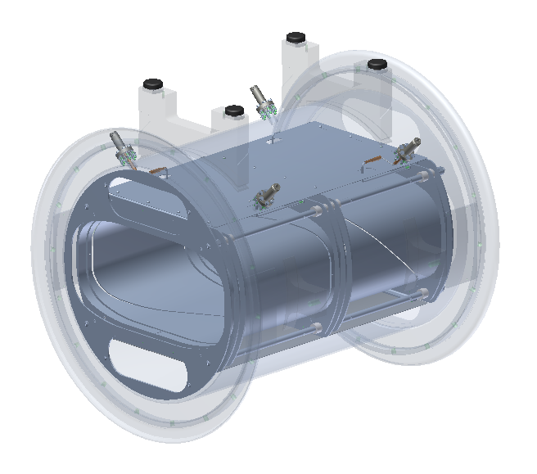
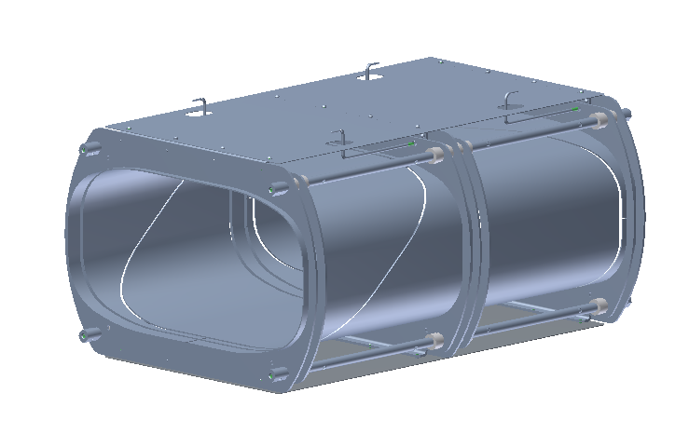
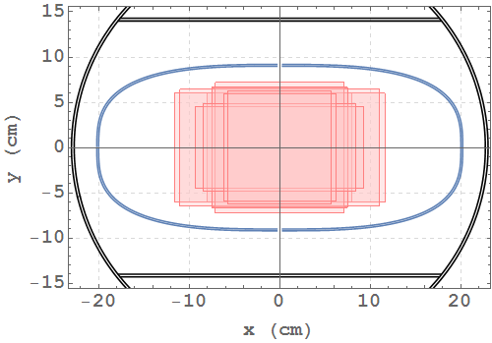
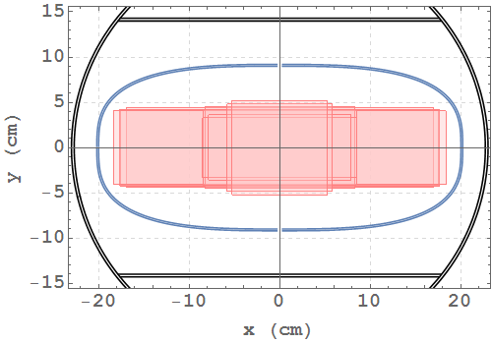
Beam Position Monitor (Detector)
Electrodes Assembly
BPM Type1 detector
Maximum beam size at different points along the CR arcs: pbar – left, ions – right.
Super elliptical electrodes shape for Type1 detector and round for Type2 and Type3 detector (not show here, but satisfied). Design for detectors are almost the same.

Slide 9
Beam Position Monitor (Req.Param.)
Parameter | Value
Physical requirements
Type | “Type 1” | “Type 2” | “Type 3”
Number of elements | 14 | 4 | 1
Overall length, flange to flange | 630 mm | 625 mm | 340 mm
Horizontal aperture | 400 mm | 160 mm | 160 mm
Vertical aperture | 200 mm | 160 mm | 160 mm
Absolute accuracy (single) | 5 mm
Absolute accuracy*⁾ | 1 mm
Absolute accuracy (K-mod)**⁾ | 0.4 – 0.5 mm
Resolution *⁾ | 0.1 mm @ 0.1 kHz
Detector
Number of Pick-up Electrodes | 4 | 4 | 2
Pick-up material | Stainless steel | Stainless steel | Stainless steel
Pick-up length | ≥ 250 mm | ≥ 250 mm | ≥ 250 mm
Pick-up bandwidth | 0.1 – 100 MHz
Pick-up capacity (typical) | 140-160 pF | 100-120 pF |  | 100-120 pF
Pick-up cross-talk | ≤ 40 – 50 dB
Output connector | N-type (suitable for UHV)
Parameter | Value
Input resistance | 0.1 – 1 MΩ
Input capacity | ≤ 40pF
Input signal range | 10 μV – 1 V
Bandwidth | 0.1 – 30 MHz
Gain range | 0 – 60 dB
Gain step | 10 dB
Gain switching time | ≤ 1 ms
Input voltage noise | ≤ 3 nV/ Hz^{0.5}
Input current noise | ≤ 2 fA/ Hz^{0.5}
Output impedance | 50 Ω
1 dB compression point (P1dB) | ≥ 15 dBm
Inequality of calibration signals | ≤ 1%
Instability of ΔU / ΣU | ≤ 0.5×10⁻³ @ 10 – 40°C
Calibration signal type | sine-wave
Calibration signal frequency | 1 – 2 MHz
Calibration signal amplitude | ~ 0.5 – 1 V
Calibration signal attenuation | ≥ 70 dB
Control interface | RS-485
Power voltage | 5 – 12 V DC
Input / Output connectors | SMA
Detector itself
Analog Electronics
Details available in EDMS: https://edms.cern.ch/document/1562811/2.3.1

Slide 10
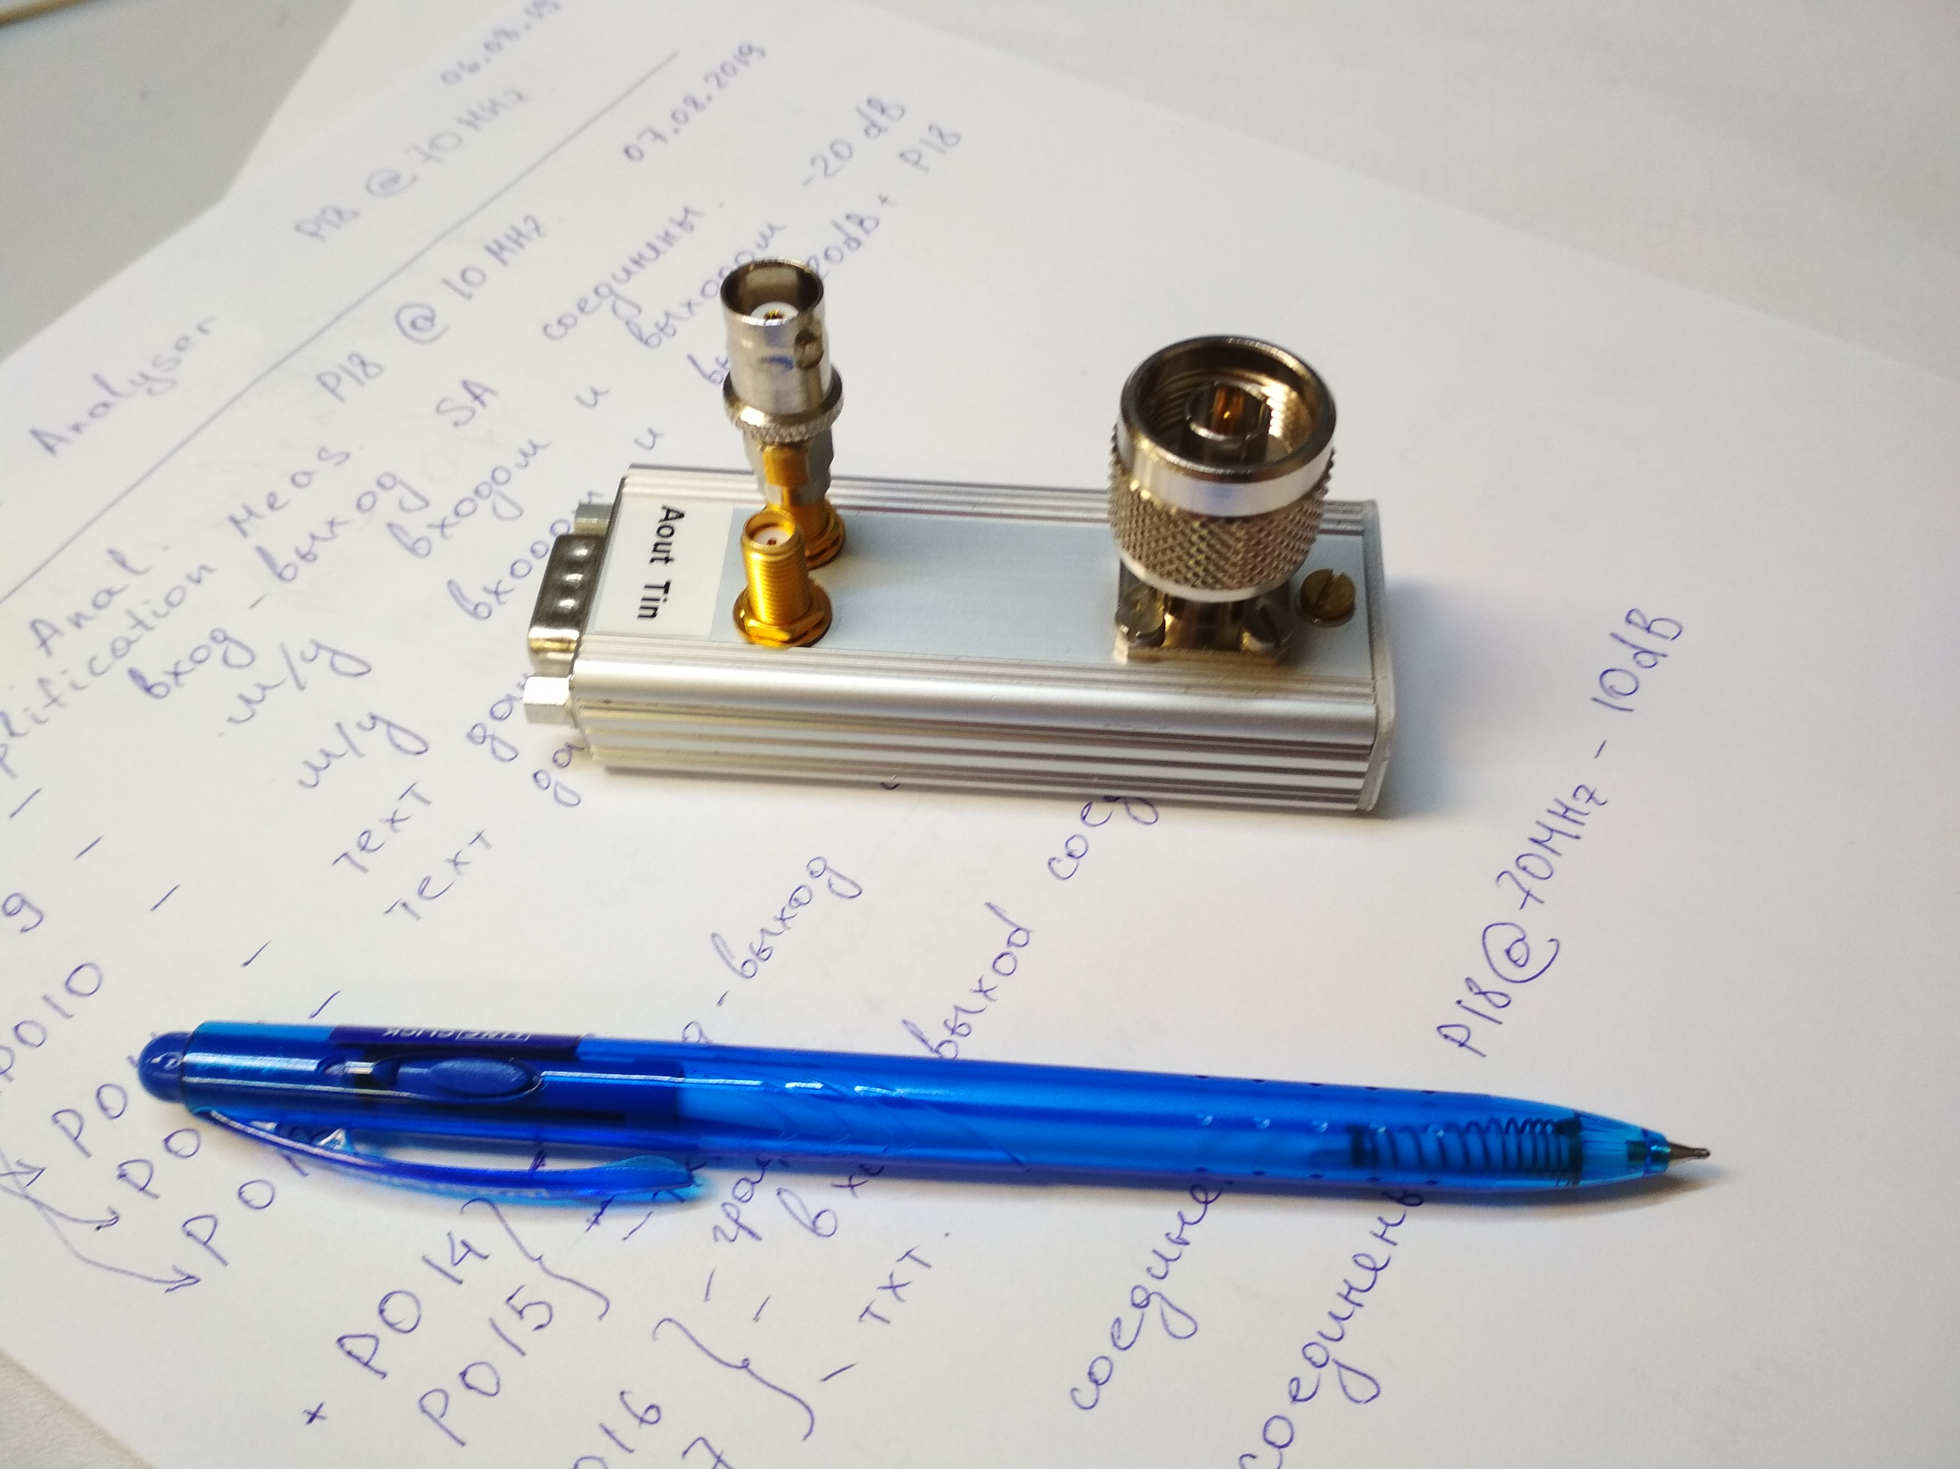
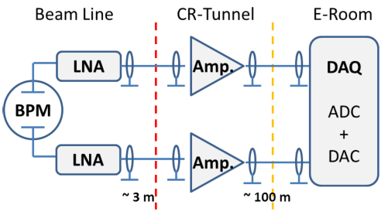
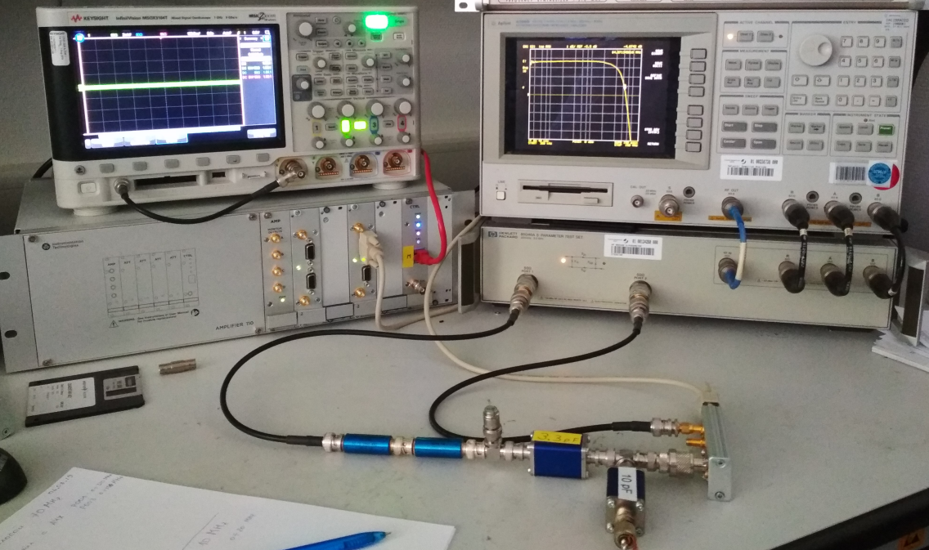
Beam Position Monitor (Electronic)
Schematic circuit diagram of the signal chain of BPM system.
LNA as an impedance matching transformer
BINP + Juelich
Libera, Slovenia in-kind
Final design of LNA (low noise) and VGA (variable gain) simplifier will be finished in Q2-2020
Interface Analog-Digital defined, and should be consistent.
Digital electronics needed for test bench construction and BPM calibrations
Schematic structure of amplifiers chain.
See EDMS container => https://edms.cern.ch/document/2254799/1 for more details. Released @ 2019-10-22

Slide 11
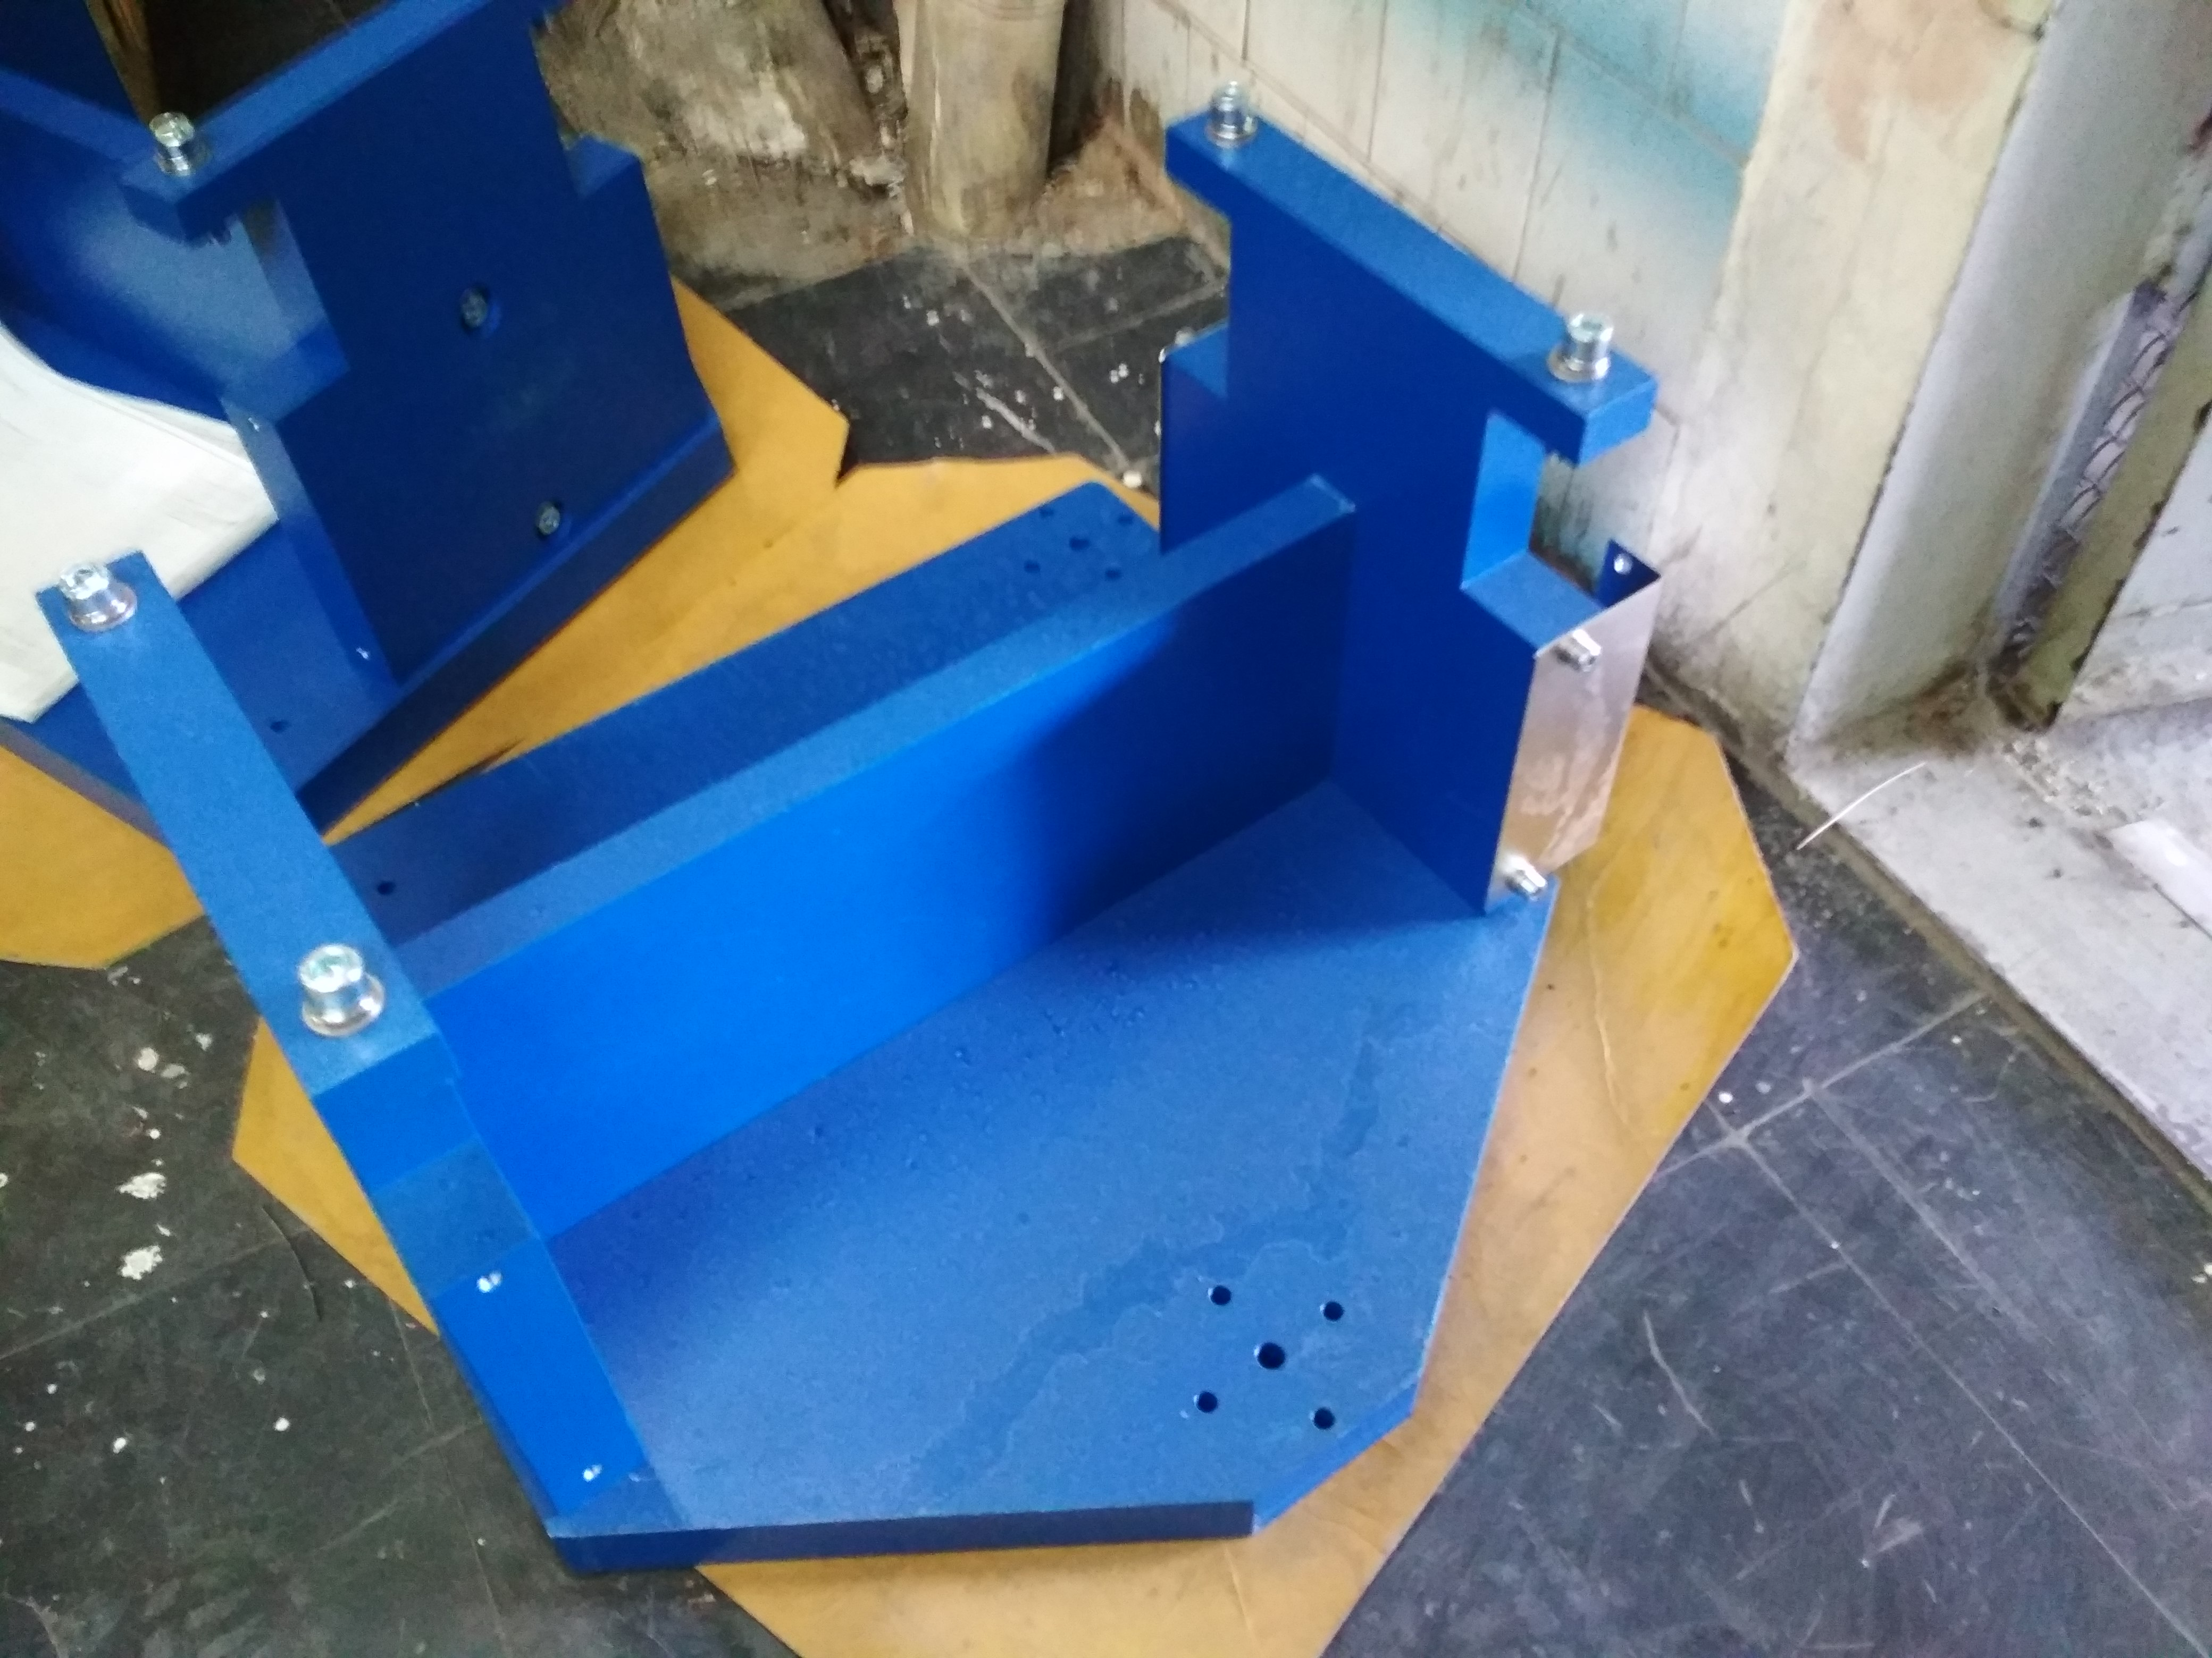
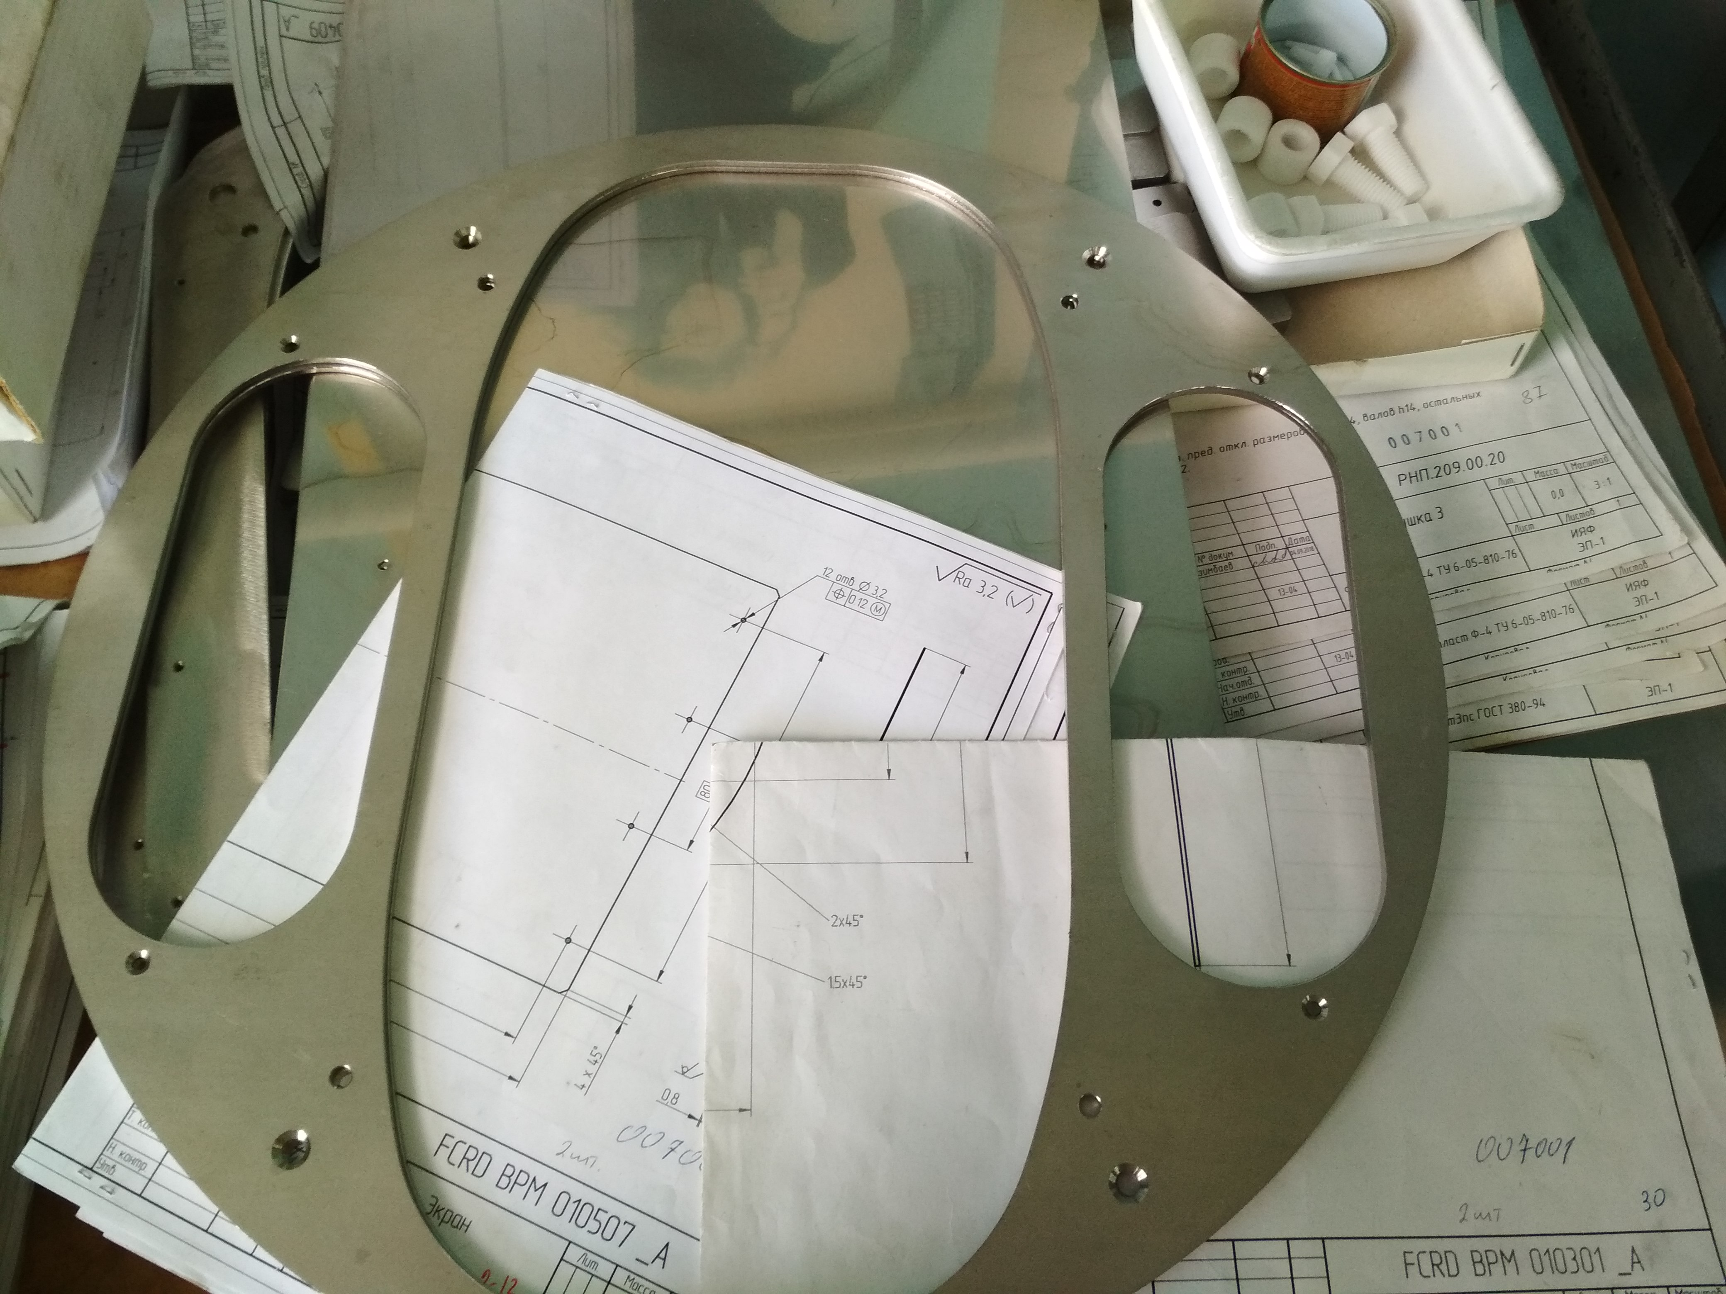
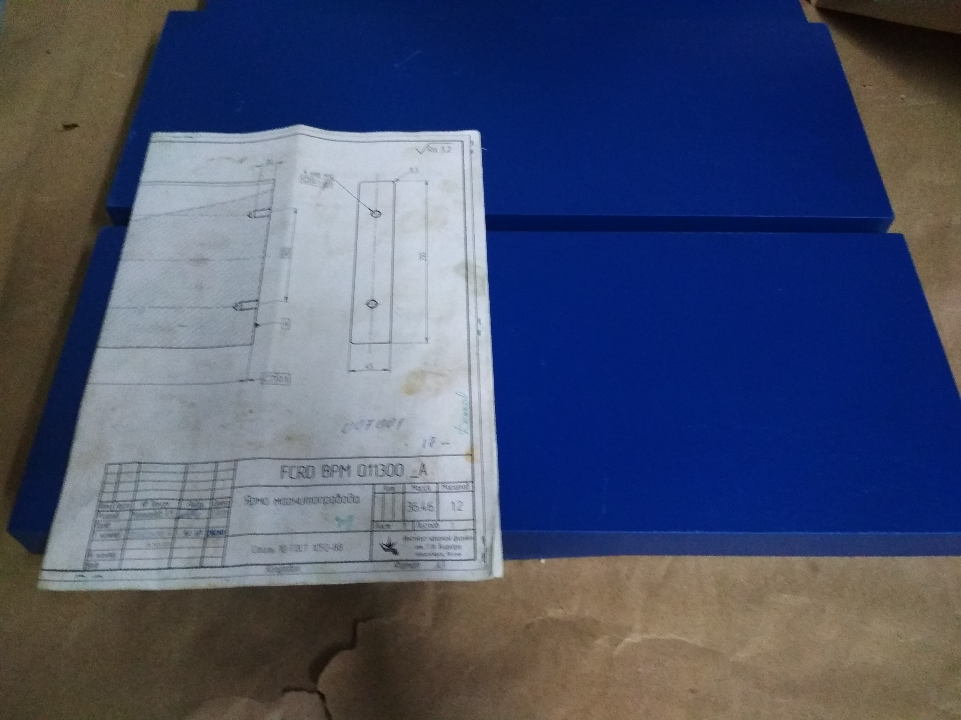
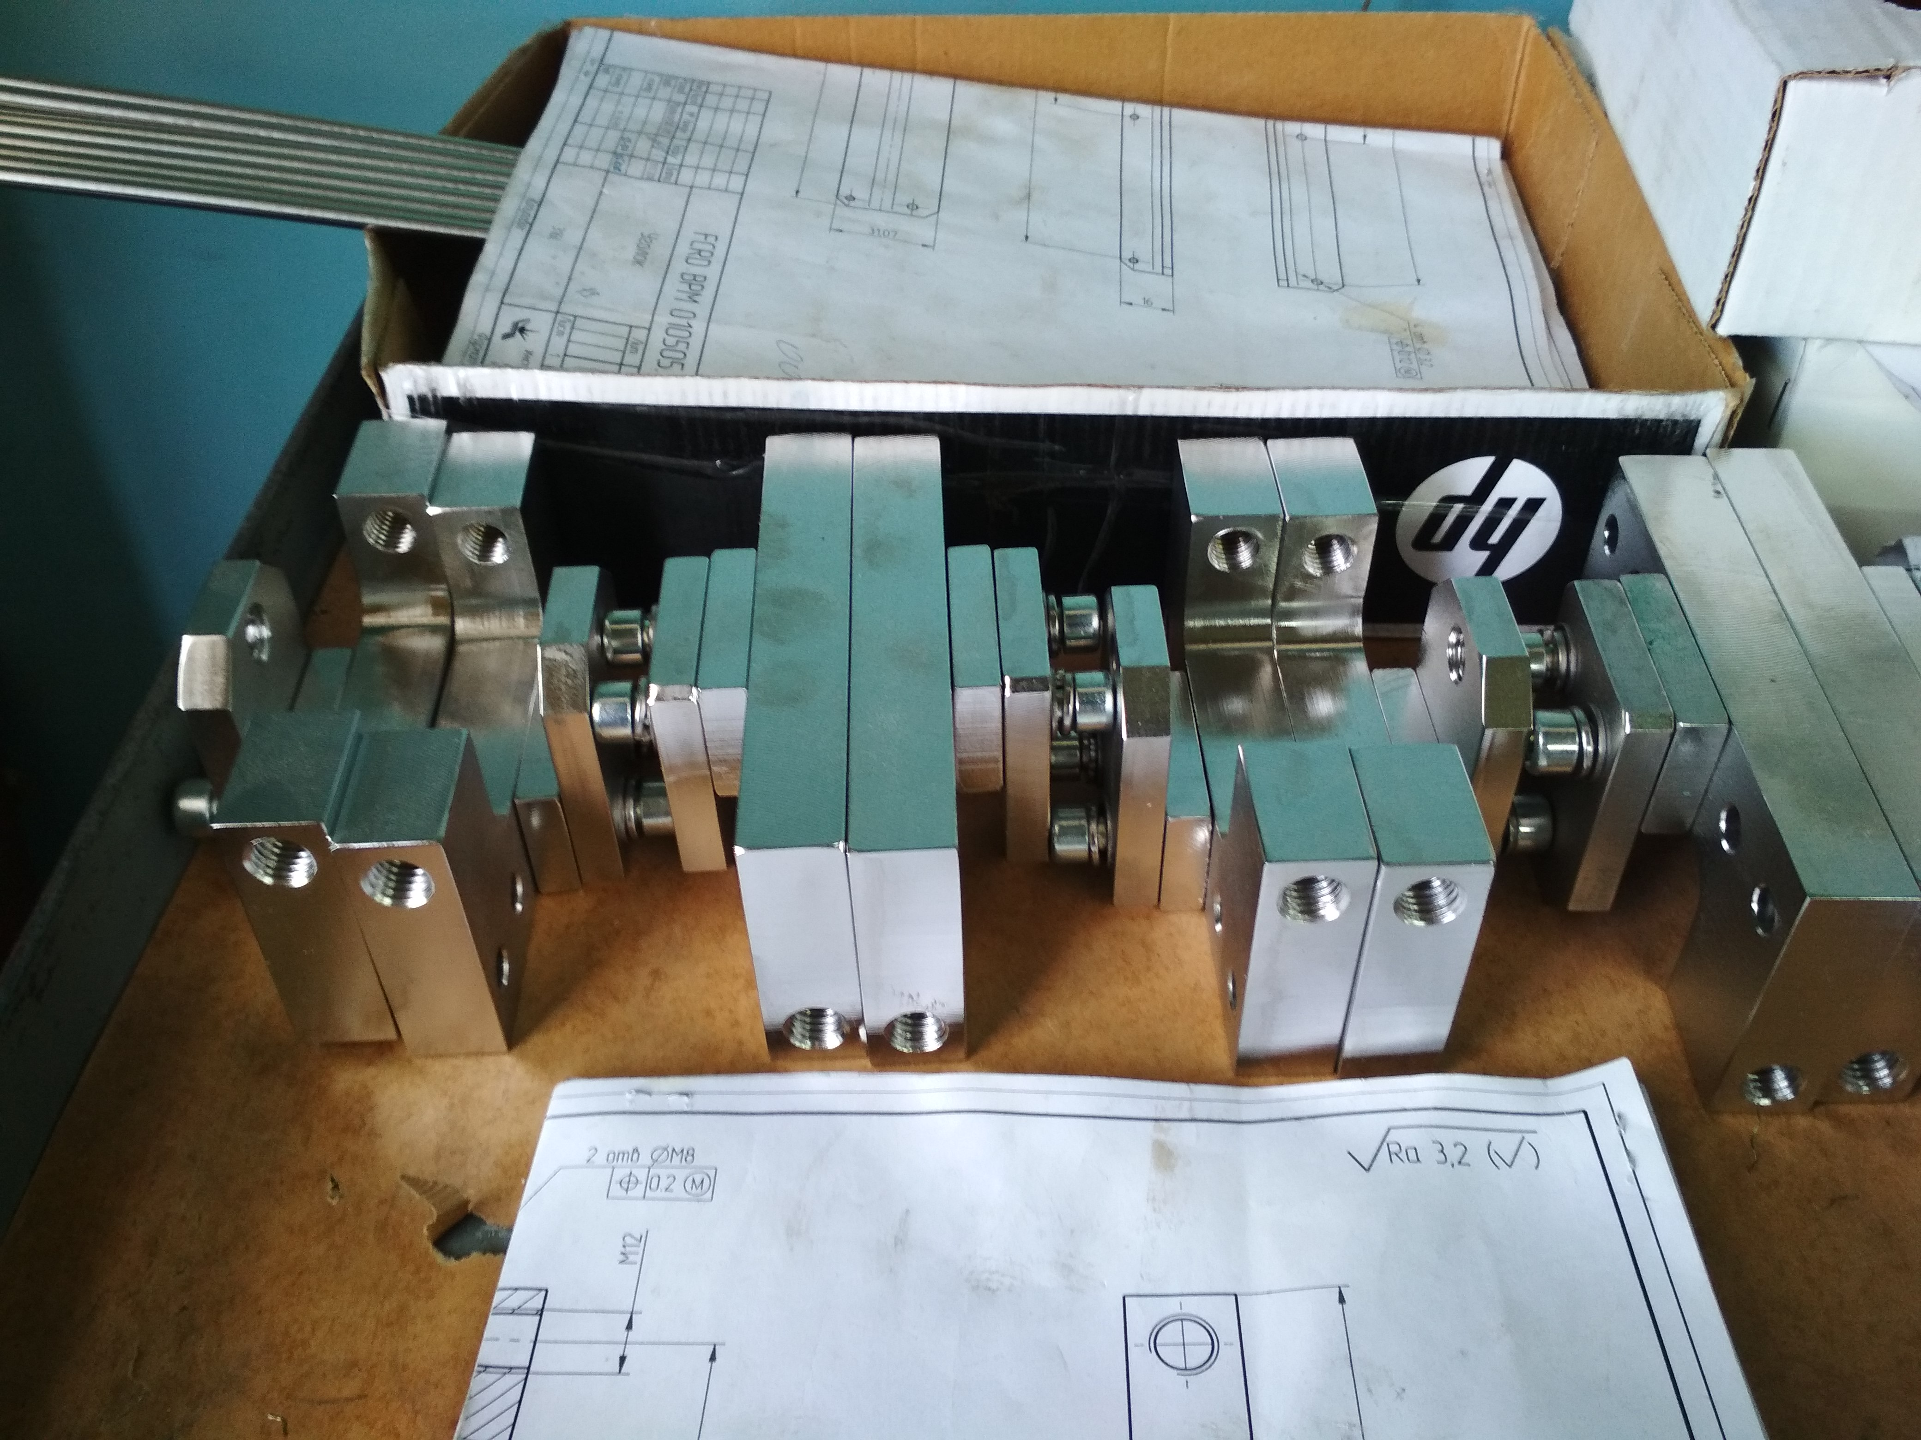
Few BD components production
V. Cor. Stand and Yoke
BPM VC parts
Preamp. Prototype, with
Cooperation IKP4 FZJ

Slide 12
Residual Gas Monitor: Principle
Principle of RGM work is based on registration of secondary ions appeared during ionization of rest gas by the beam.
For measuring both transverse profiles two identical monitors (rotated 90°) are needed.
Secondary particle detector is based on two MCP (chevron or V-stack) and phosphor screen. To obtain picture from the MCP a CCD camera, installed outside the vacuum chamber will be used.
Deuterium UV lamp, installed outside the vacuum chamber, will be used for MCP calibration.
Parameter | Value
RGM length (both directions) | 110 mm
Horizontal aperture | 160 mm
Vertical aperture | 160 mm
Transverse detector size | ≈ 100 mm

Slide 13
Residual Gas Monitor: Principle
Due to thermal motion of the rest gas atom the resolution of the RGM is about 1 mm.
For L = 15 cm and U = 10 kV FWHM = 2.36 σ = 0.8 mm. Assuming better resolution 0.5 mm, the needed electric field uniformity is 0.3%.

Slide 14
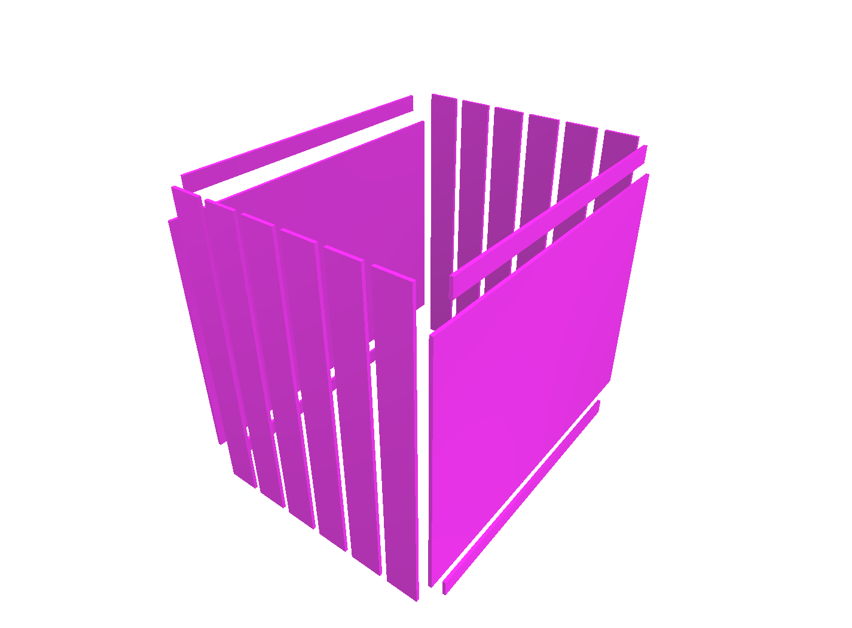
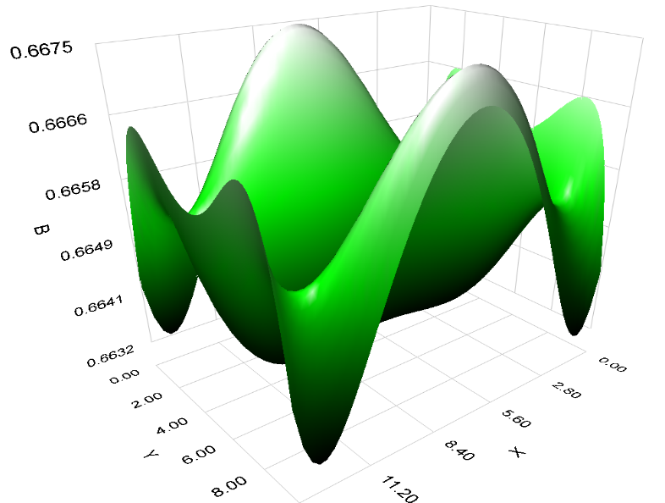
Residual Gas Monitor: Calculations
Uniformity of transverse field is better then 1%. In area 5x10 cm uniformity better then 10⁻³ is possible.
Y
Z
X
Sketch of the box from Mermaid 2010
100 mm (MCP)
E_{Y}
Z
X
Distribution of transverse field in
center of the box
Distribution of transverse field in
median plane of the box

Slide 15
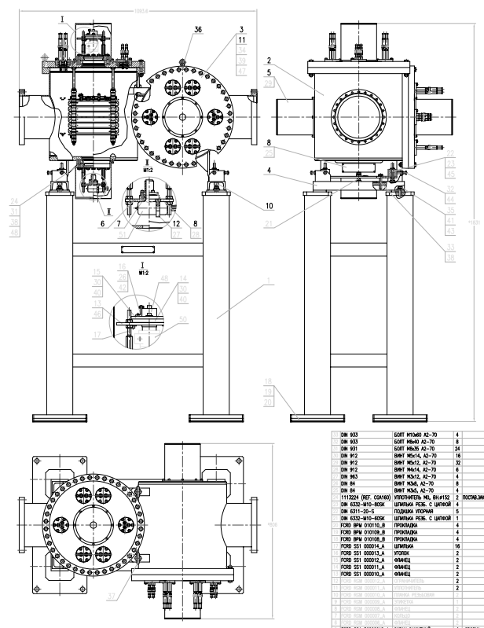
Residual Gas Monitor: Design
Design of the RGM:
2D – finished @ November 2019
3D – started. Finish @ Q1-2020

Slide 16


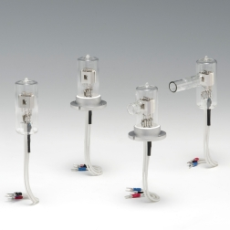
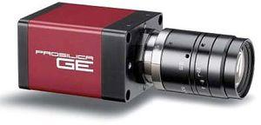
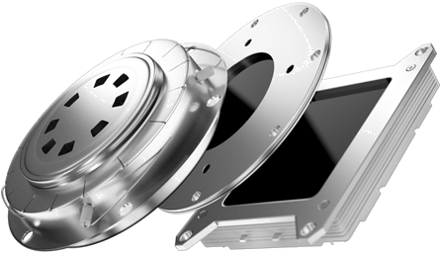

Residual Gas Monitor: Components
Prosilica GE680
Deuterium lamp (L2D2 lamp)
MCP detector

Slide 17
Residual Gas Monitor: Milestones
March 2019 – December 2019: preparation and passing milestone M6 (CDR)
January 2020 – July 2020: detail designing, preparation of drawings. Passing milestone M7 (FDR). Purchasing required accessories, materials, components
May 2020 – January 2021: tooling production, development and production, manufacturing @ experimental workshop-1 (EW-1)
February 2021 – July 2021: testing, QA, calibration, FoS revision. Passing milestone M8
August 2021 – September 2022: delivering to FAIR facility, SAT, pre-installation assembling
October 2022 – January 2023: final installation in CR tunnel

Slide 18
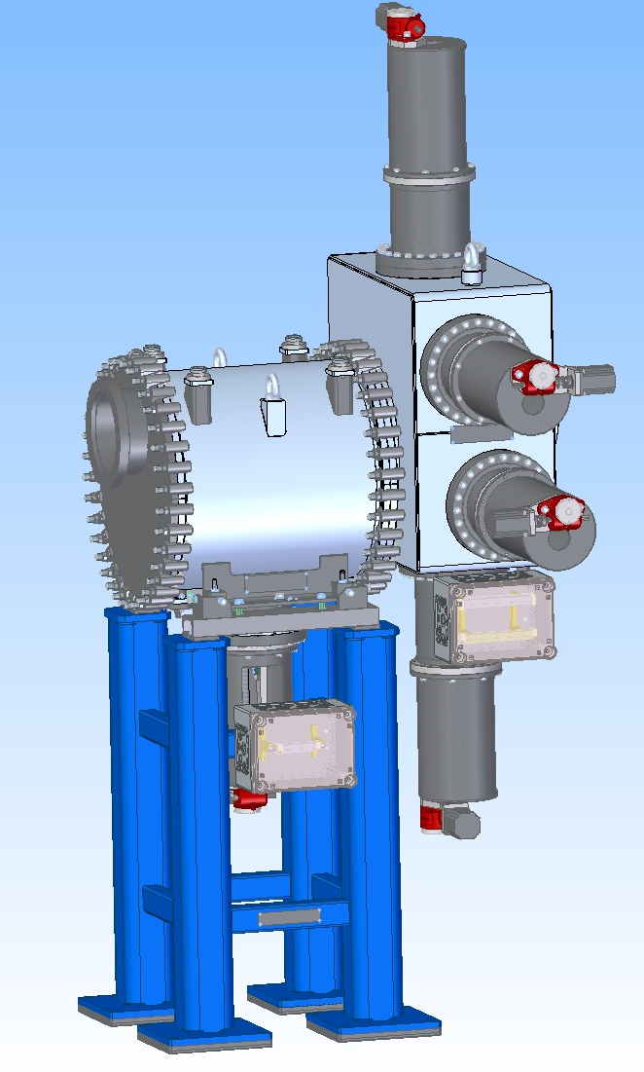
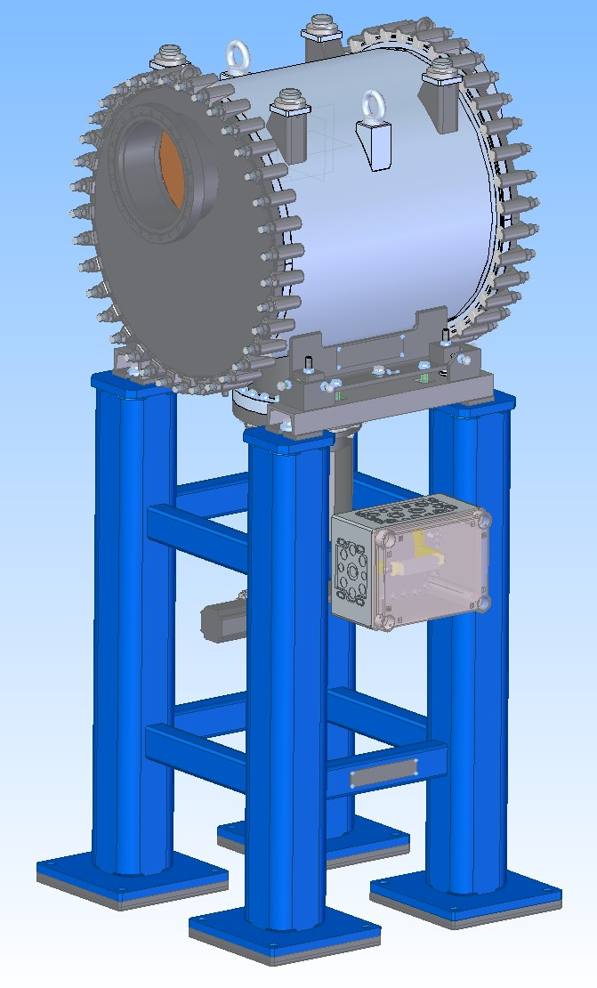
Beam Stopper: 3D view, Typ-1,2
Type1
Type2
Design of the Beam Stopper:
2D, 3D – finished @ July 2019
CDR under preparation

Slide 19
Beam Stopper: Milestones
December 2018 – May 2019: preparation and passing milestone M6 (CDR)
September 2019 – April 2020: detail designing, preparation of drawings. Passing milestone M7 (FDR). Purchasing required accessories, materials, components
May 2020 – January 2021: tooling production, test bench development and production, manufacturing @ experimental workshop-1 (EW-1)
February 2021 – July 2021: testing, QA, calibration, FoS revision. Passing milestone M8 [June 2021]
August 2021 – July 2022: delivering to FAIR facility, SAT, pre-installation assembling
August 2022 – January 2023: final installation in CR tunnel

Slide 20
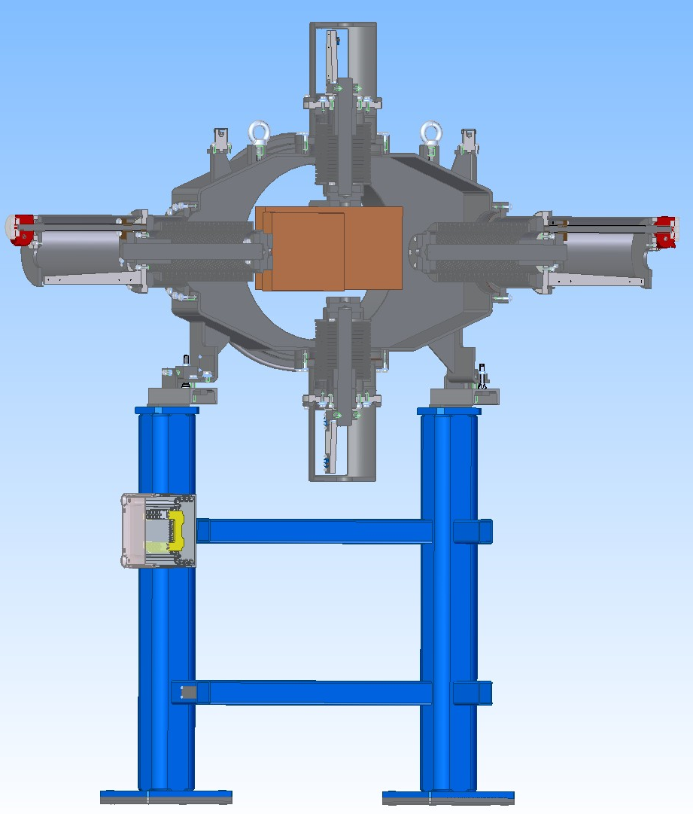
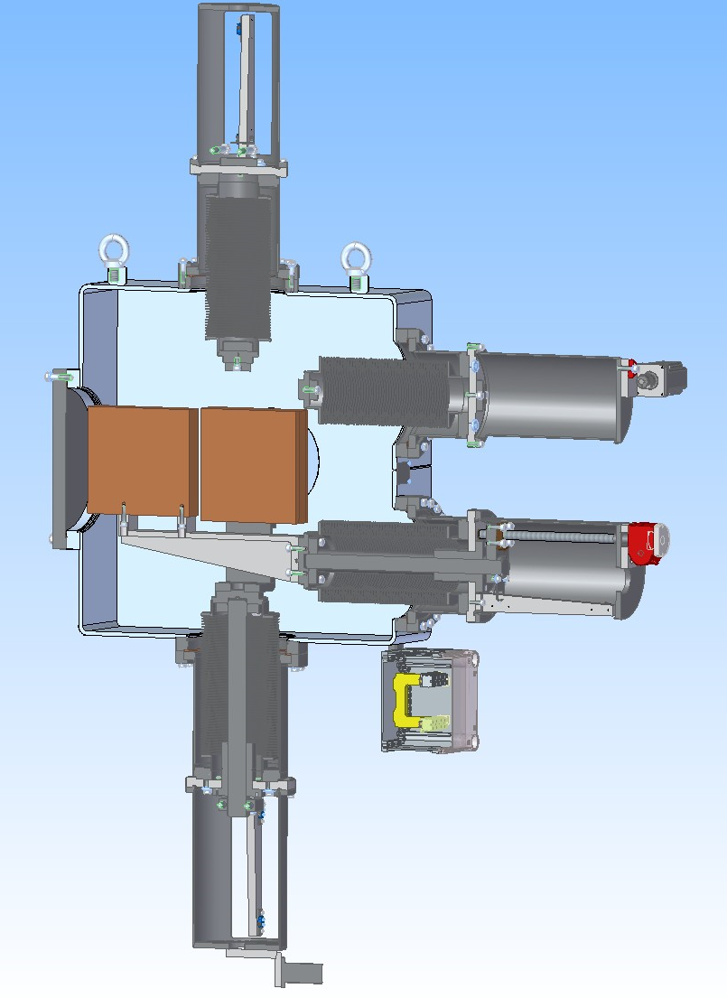
Beam Scraper: 3D view, Type-1,2
Blade thickness is 50 mm
The weight of one blade is about 20 kG
Speed of the blade movement is 2.5 mm/sec
Each blade has two end switches and potentiometer for measurement of position

Slide 21

Beam Scraper: Locations
The beam scrappers are marked in the CR drawings as CR01DS1, CR02DS1, CR02DS2, CR03DS1, CR04DS1.
The SCR will be installed into quarters of the CR (near the center of each quarter) between bending magnets and sextupole.
The SCR installed in the injection straight section is able to operate as a collimator slit.

Slide 22
Beam Scraper: Milestones
June 2019 –October 2019: preparation and passing milestone M6 (CDR)
November 2019 – January 2020: detail designing, preparation of drawings. Passing milestone M7 (FDR). Purchasing required accessories, materials, components
February 2020 – October 2020: tooling production, production, manufacturing at experimental workshop
November 2020 – January 2021: testing, QA, calibration, FoS revision. Passing milestone M8 [ March 2021]
December 2023 – January 2023: final installation in CR tunnel

Slide 23
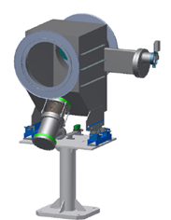
Scintillating Screen: Milestones
Documents preparation for passing milestone M6 (CDR) was finished
CDR passed during December 2019
The next step is milestone M7 (FDR) preparation
CR Scint. Scr. Type1
Next year plans:
  Purchasing required accessories (CMOS camera, pneumatic actuator, etc.) – Done
  Making detail design for manufacturing – Done
  Passing M7 (FDR) milestone (Q3 2019) – Under preparation. Will be Done in Q1-2020

Slide 24
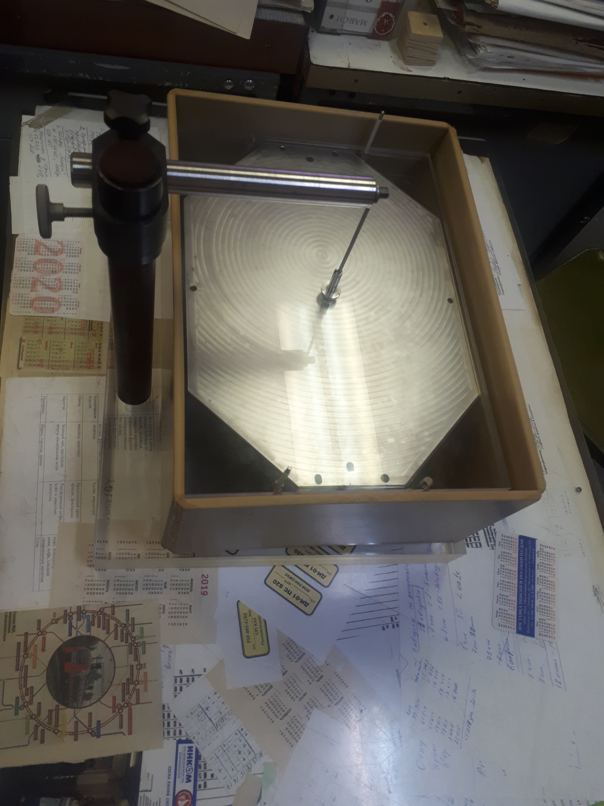
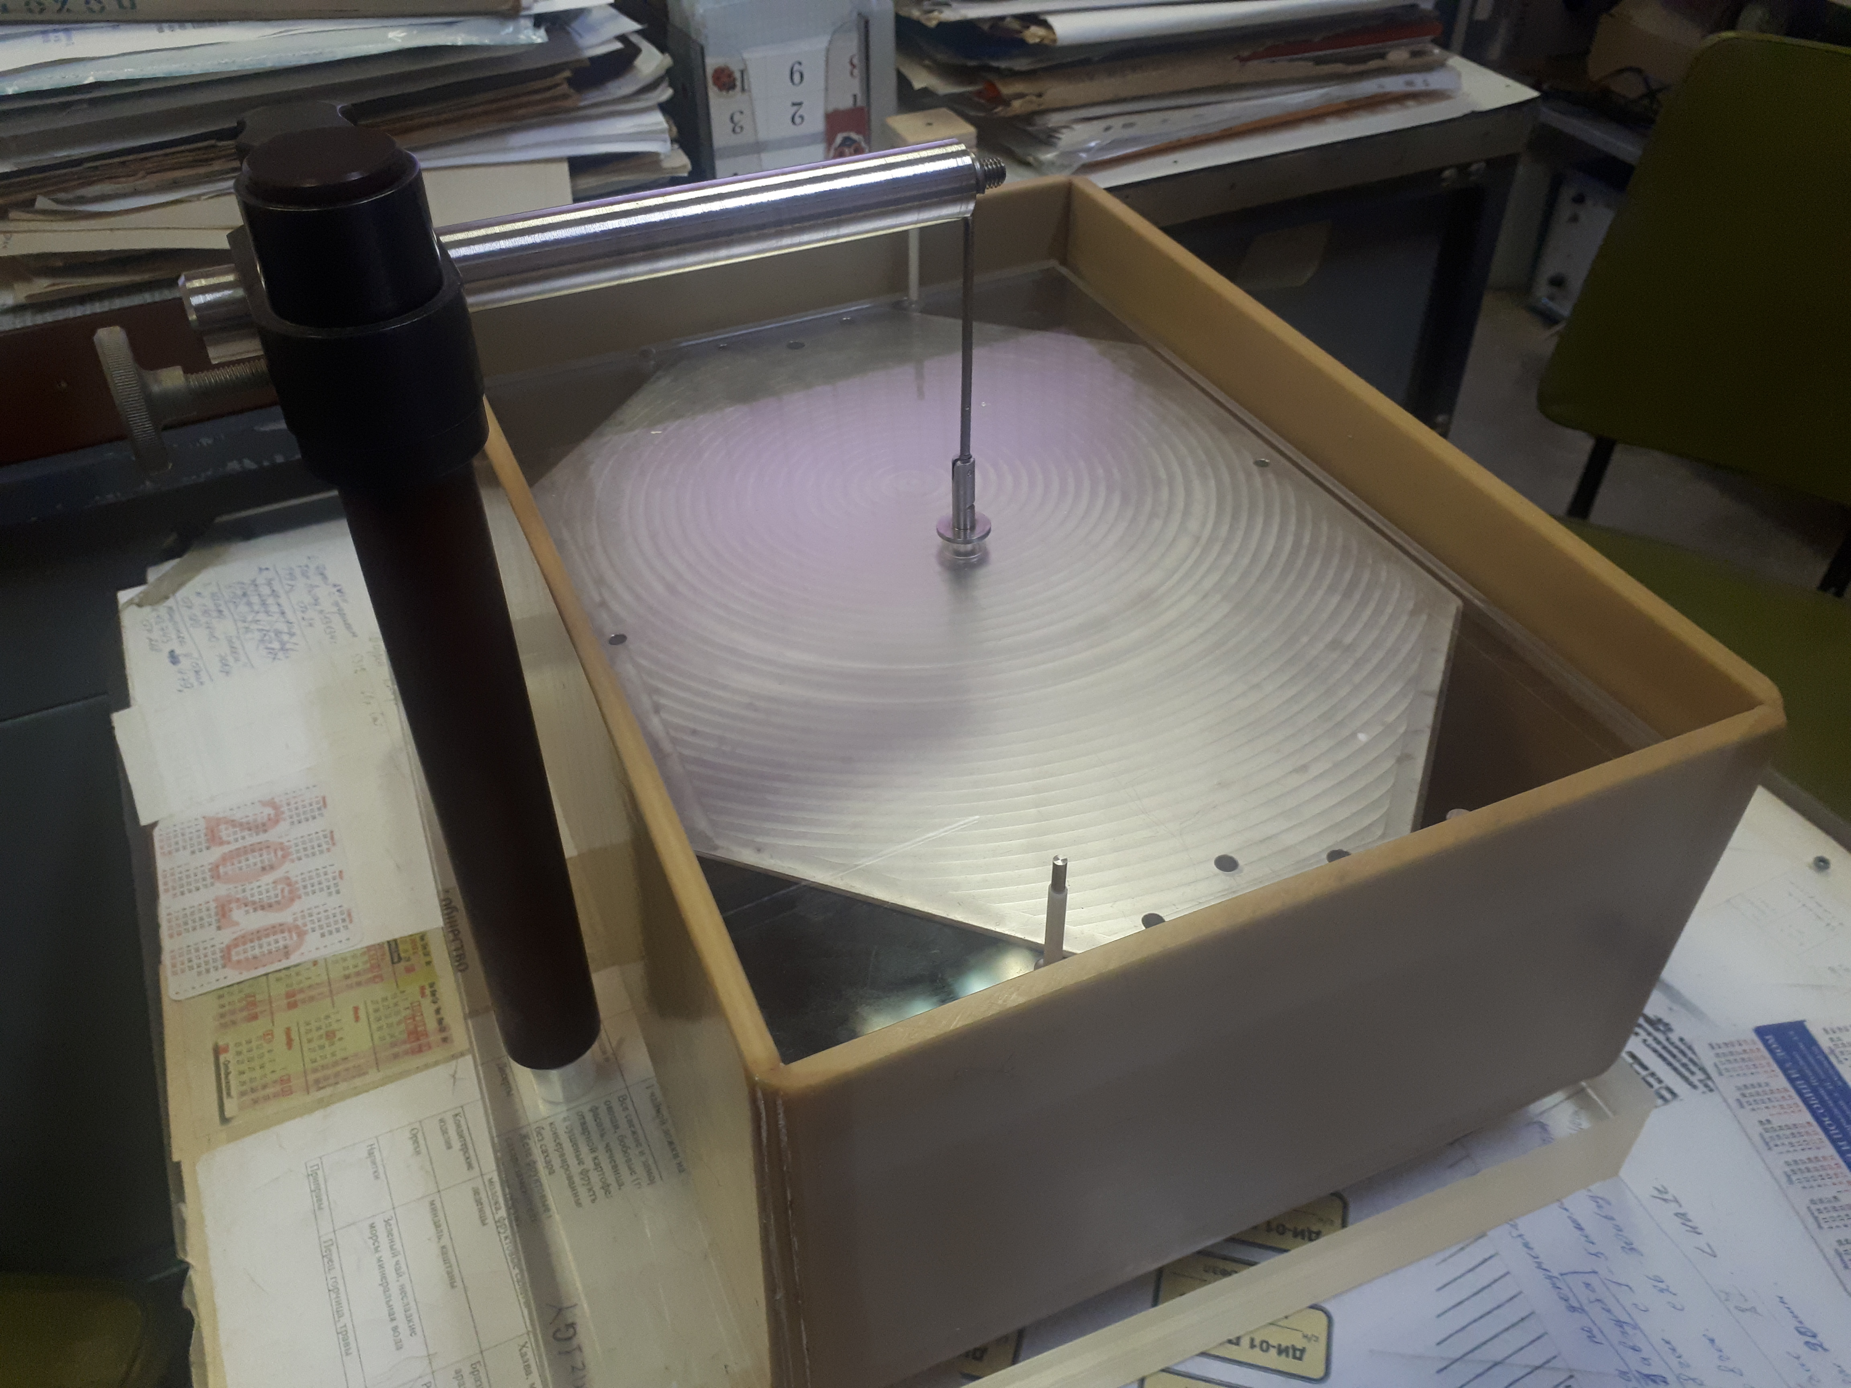
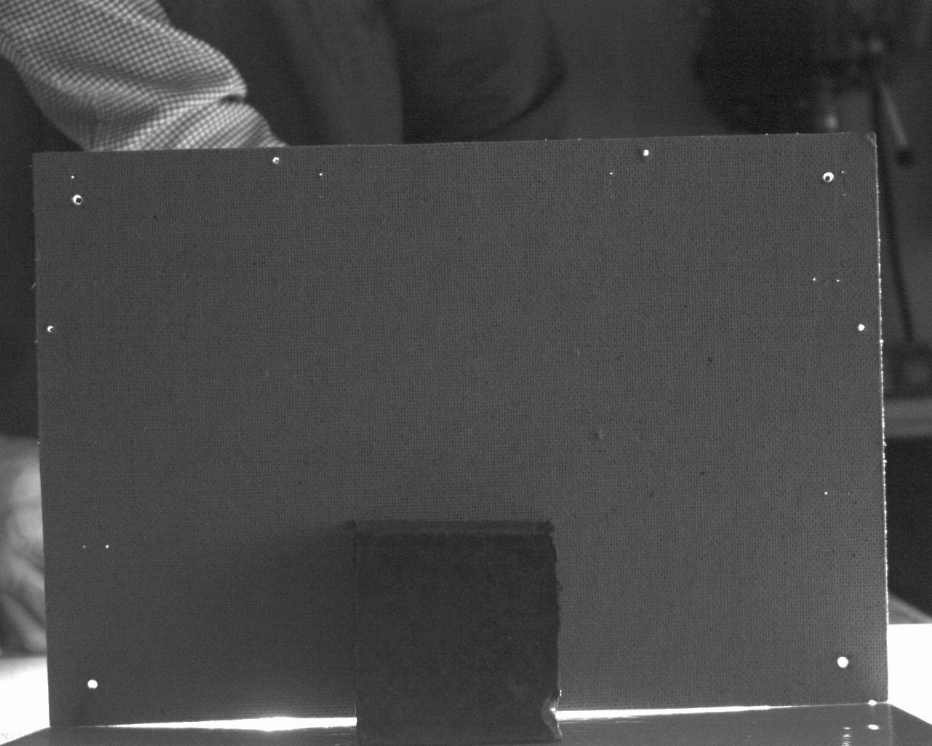
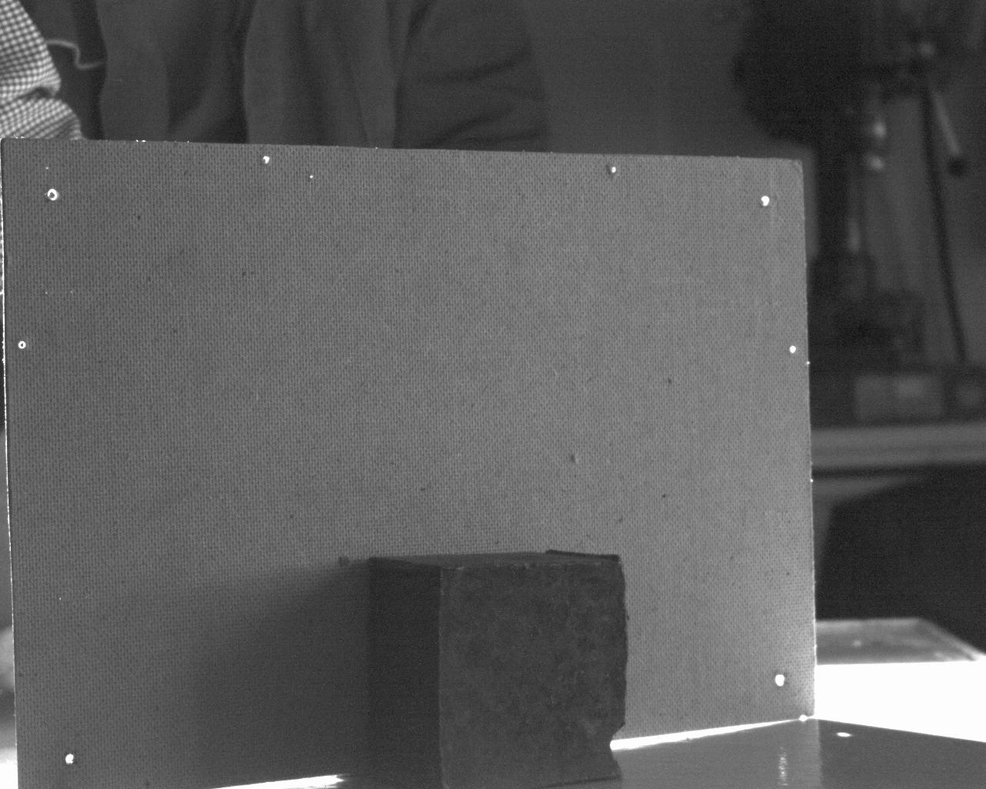

Scintillating Screen: Detector
Procured and Delivered:
CCD Camera
CCD Objective
Tooling for detector covering by P43 scint.
Assembled and Tested:
CCD with Objective and backlight diode
Tooling for detector covering @ Moskow, Prokhorov general Physics Institute

Slide 25
Scintillating Screen: Milestones
1. September 2018 – December 2018: preparation and passing milestone M6 (CDR) [Q4 2018]
2. January 2019 – September 2019: detail designing, preparation of drawings. Passing milestone M7 (FDR) [Q1 2020]. Purchasing required accessories and materials (CMOS camera, pneumatic actuator, etc.)
3. September 2019 – January 2020: delivery prepared drawings to experimental workshop-1 (EW-1), changing drawings if necessary, starting of manufacture
4. January 2020 – September 2020: scintillating screens (SS) manufacture in the EW-1, prototypes testing, revision – FoS [M8 – Q3 2020]
5. October 2020 – December 2022: manufacturing and testing the other SS, SAT, delivering to FAIR facility, FAT, pre-installation assembling [All series M10 – Q3 2022]
6. Q4-2022 – Q1 2023: final installation in collector ring tunnel

Slide 26
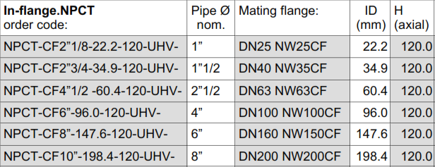
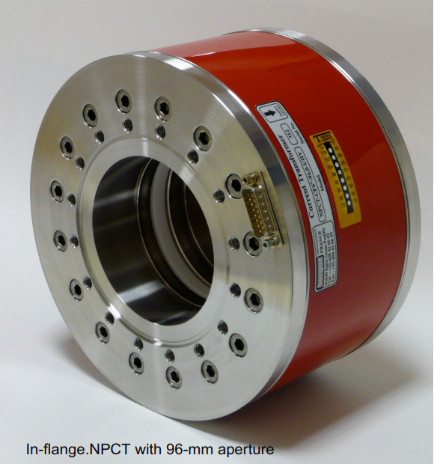
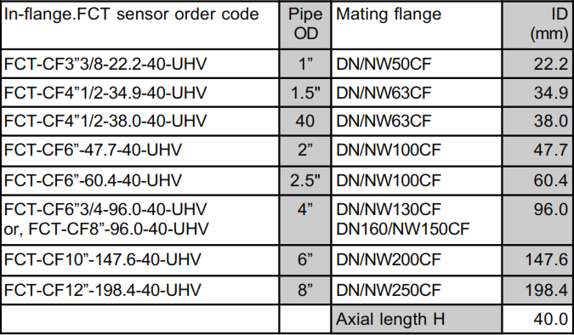
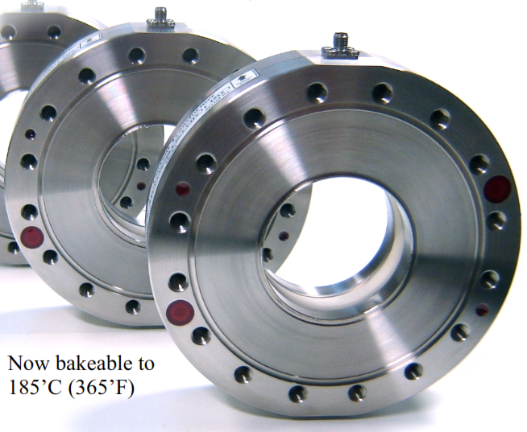

DCCT and FCT (commercial)
~120 k€
~40 k€
Commercially available devices From BERGOZ company.
Delivered ready for installation. Flange adaptors required from BINP. DCCT delivered with electronics. CDR passed
@ Q2-2019

Slide 27
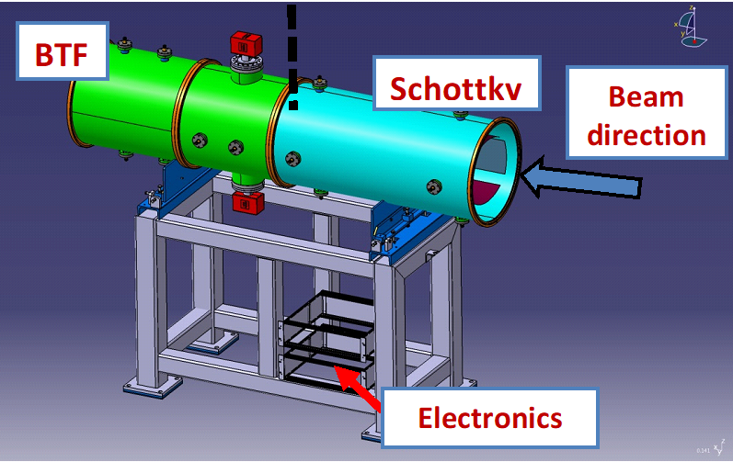
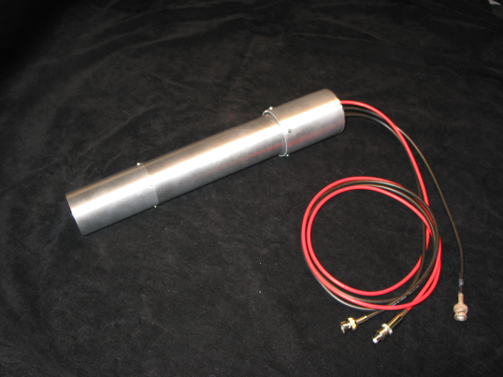
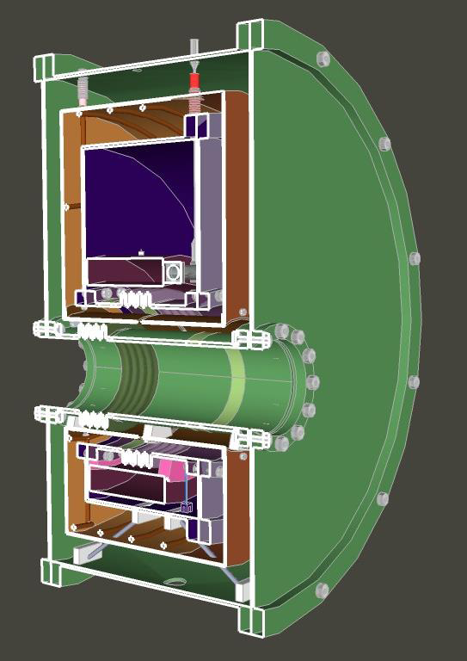
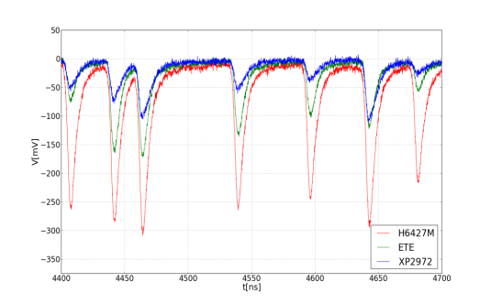
BTF, Schtotky, CCC, BLM
BTF Exciter and Schottky BPM: both shares the same vacuum vessel
Specification approved, Preliminary 3D model is ready, Dimensions fixed
ITEP, Russia in-kind, Contract signed (ITEP-FAIR)
Kick-Off meeting was in October 2019
CDR is ongoing (preliminary version discussed)
CCC will be build by GSI
Specification under preparation, Dimension fixed
O. Chorniy talk @ 16:30 November 6, for details
BLM: distributed system around the CR
Specification prepared by GSI and approved
Devices will be purchased @ GSI. Details should be discussed
Example of CCC design

Slide 28
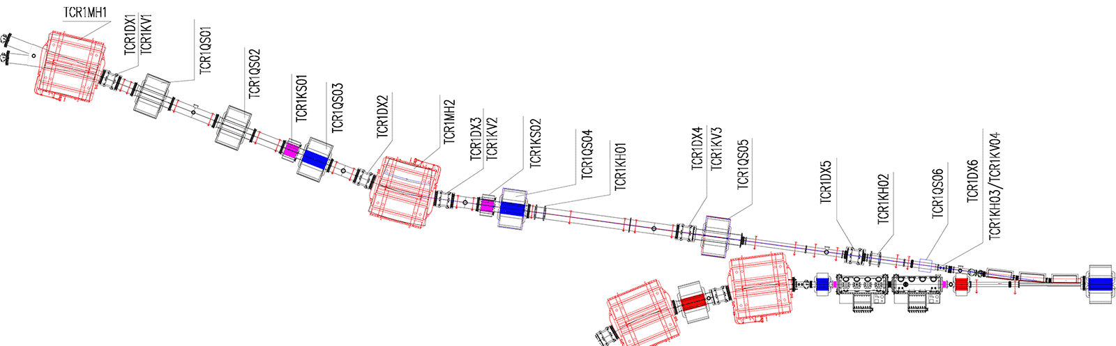
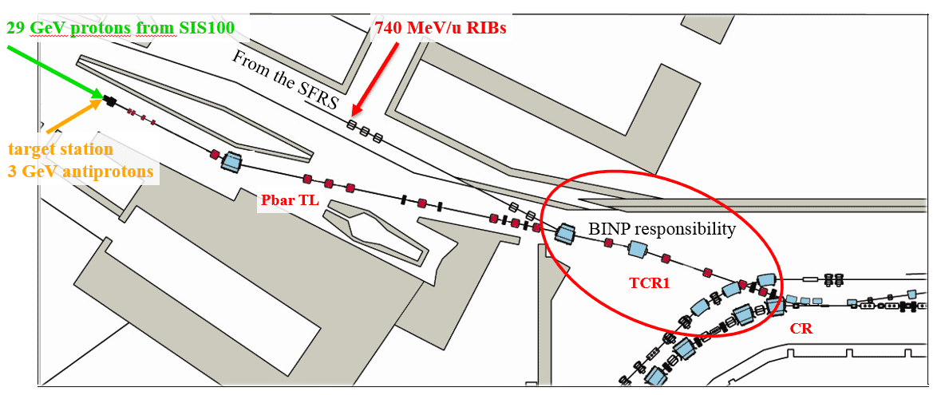
TCR1 line diagnostics
TCR1 beam transfer line (common part for Pbar and SFRS beam lines)
6 BPM: 5 – CR Type1, 1 – Increased CR Type2
1 FCT: 1 – CR Type from BERGOZ
3 Scint: 3 – CR Type 1

Slide 29
CR Diagnostics Milestones
Name | M6 - CDR | M7 – FDR | M8 - FoS | M10 - Series
BPM | Q2-2019 | Q4-2019 | Q1-2020 | Q1-2023
Scint. Screen | Q2-2019 | Q1-2020 | Q3-2020 | Q4-2022
Beam Scrap | Q2-2019 | Q4-2019 | Q3-2021 | Q4-2022
Beam Stopper | Q2-2019 | Q1-2020 | Q3-2021 | Q4-2022
RGM | Q4-2019 | Q3-2020 | Q3-2021 | Q4-2022
FCT | Q2-2019 | Q3-2020 | Q3-2021 | Q1-2022
DCCT | Q2-2019 | Q3-2020 | Q3-2021 | Q1-2022

Slide 30
Conclusion / Progress 2019
Most of all design work for all DB components was finished (or 90% ready)
CDR for the BPM detector and mechanics, BPM amplifiers, FCT, DCCT, Scintillating Screen, Beam Scraper, Beam Stopper passed
CDR for the RGM will be presented
FDR for the BPM detector and mechanics, Beam scrapper ready
FDR for other BD components will be presented soon
Timelines for all BD components defined / corrected
BTF, Schottky BPM (ITEP in-kind) in a good shape. Kick-Off @ October 2019
TCR1 diagnostics subsystems are now under design and we expect good progress in coming 2020 year.
We should keep close contact with FAIR-GSI colleagues (and subcontractors).

Slide 31
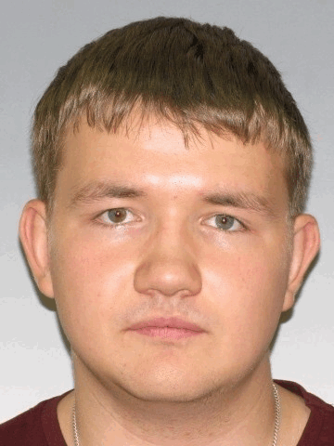
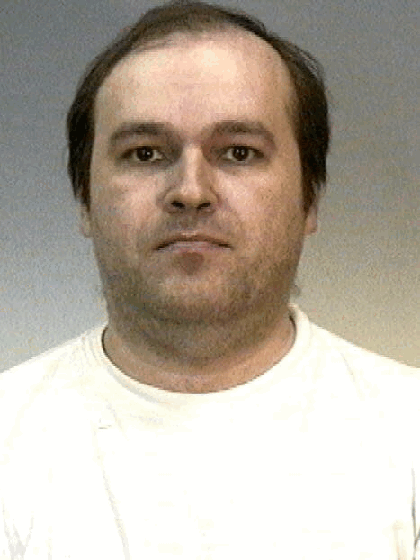
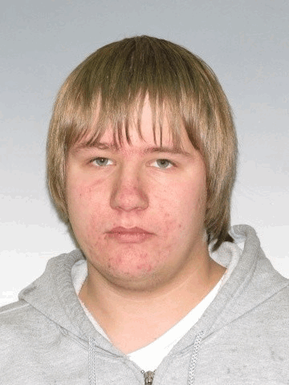
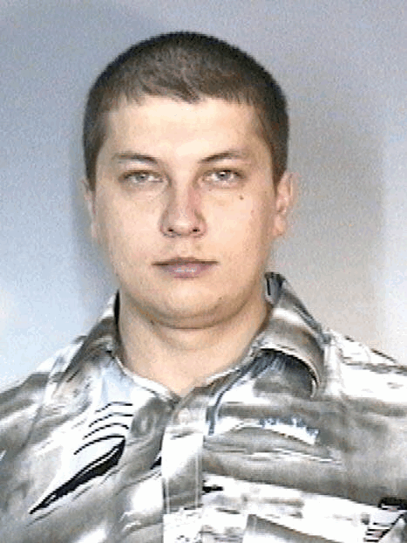
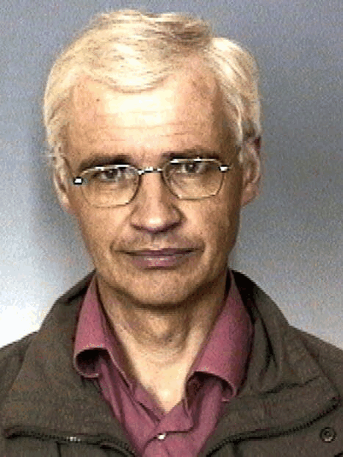
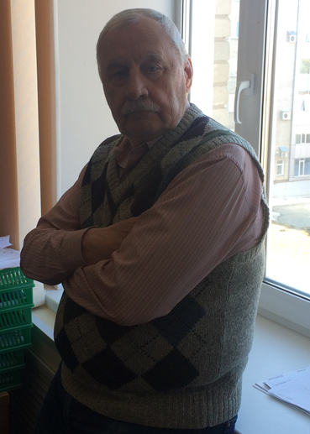
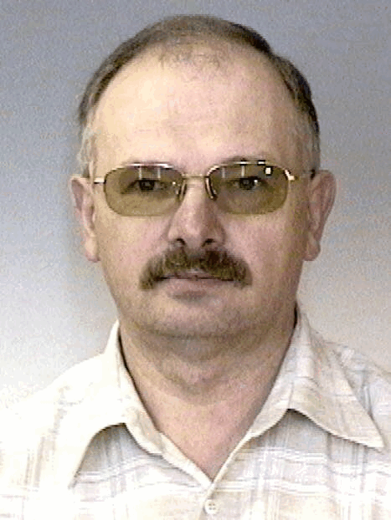
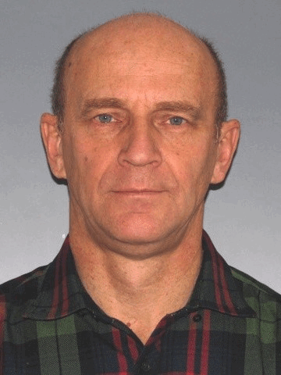
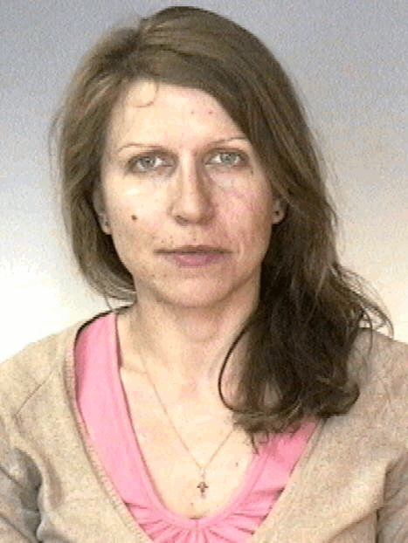
Thanks
Vitaliy Balakin
Eugeny Bekhtenev
Vladislav Borin
Maksim Bryzgunov
Oleg Meshkov
Vladimir Cheskidov
Andrey Sukhanov
Andrey Molokoedov
Ekaterina Petrova
All BINP stuff involved
Oleksandr Chorniy
GSI Colleagues

Slide 32
3st FAIR Workshop: TODO
During the Workshop we plan to present 2 FDR presentations for BPM and Beam Scrapper:
  BPM: Yu. Rogovsky talk @ 14:30, November 28
  Scraper: Yu.Rogovsky talk @ 15:00, November 28
Other questions for clarifications

Slide 33

Questions
33

