Slide 1
CR
Main Magnetic Elements
STATUS
Alexandr Starostenko

Slide 2
Common Status report
Qualitative rating:
done
as planned
critical, but reachable
very critical, unreachable
not applicable
PSP | 2.5.2
WP | CR Magnets
WP-Leader | Alexandr Starostenko
Report period | November 2019
X
PSP` | Subproject | Responsibility | S | CDR | FDR | PR FoS | FAT FoS | SAT FoS | SP | FAT SP | DL | SAT SP | IN | CO | Activities in reporting period / Risks
2.5.2.1 | Dipole Magnets | A. Starostenko | x | x | x |  |  |  |  |  |  |  |  |  | Production line is in preparation. Tooling is in work. First batch of outer yoke iron was received. First two coils was manufactured.
2.5.2.2 | Quadrupole Magnets | A. Utkin D. Gurov | x |  |  |  |  |  |  |  |  |  |  |  | CDR – SWQ, EWQ, NQ, NQM, NFQ documents is in preparation FDR WQ is in preparation
2.5.2.3 | Sextupole Magnets | A. Tsyganov | x | x |  |  |  |  |  |  |  |  |  |  | FDR is in preparation
2.5.2.4 | Octupole Correction Magnets | D. Gurov | x |  |  |  |  |  |  |  |  |  |  |  | CDR is in preparation
2.5.2.6 | Orbit Correction Magnets | A. Tsyganov | x | x |  |  |  |  |  |  |  |  |  |  | FoS is practically ready FDR is in preparation
WP subprojects (4th level):
Legend:
S - Specification; CDR Conceptual Design Review; FDR Final Design Review; PR- Production FoS; FAT FoS Factory acceptance test) FoS; SAT FoS - Site Acceptance Test of FoS; SP – Series Production; FAT SP – Factory acceptance test of Series Production; DL –Delivery; SAT SP – Site Acceptance Test of Series Production; IN – Installation; CO – commissioning without beam

Slide 3
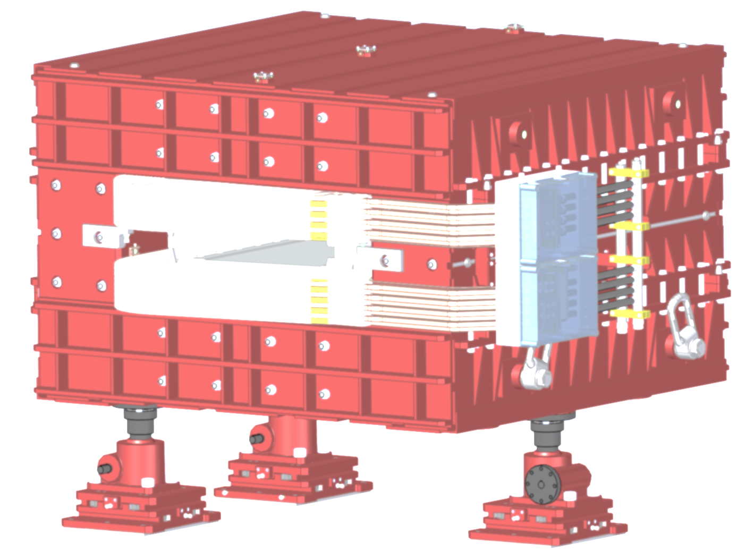
CR dipole

Slide 4
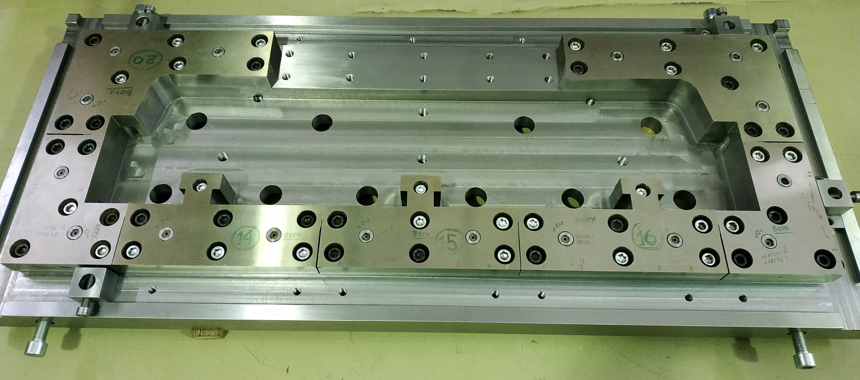
Stamping tool for Poles. Matrix

Slide 5
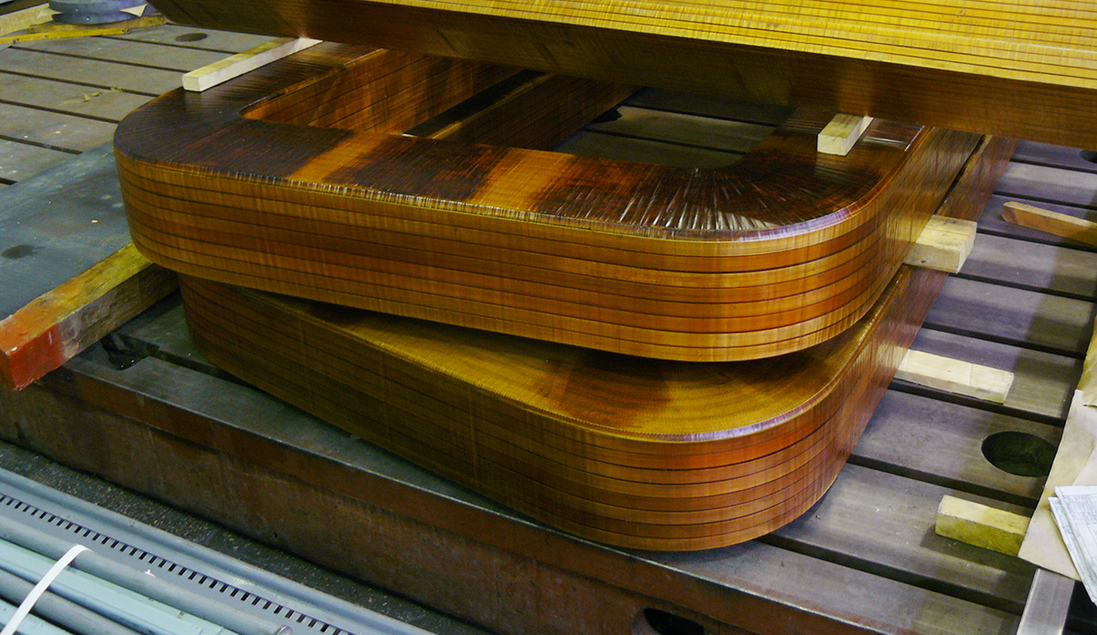
Coils. First set of coils is ready

Slide 6
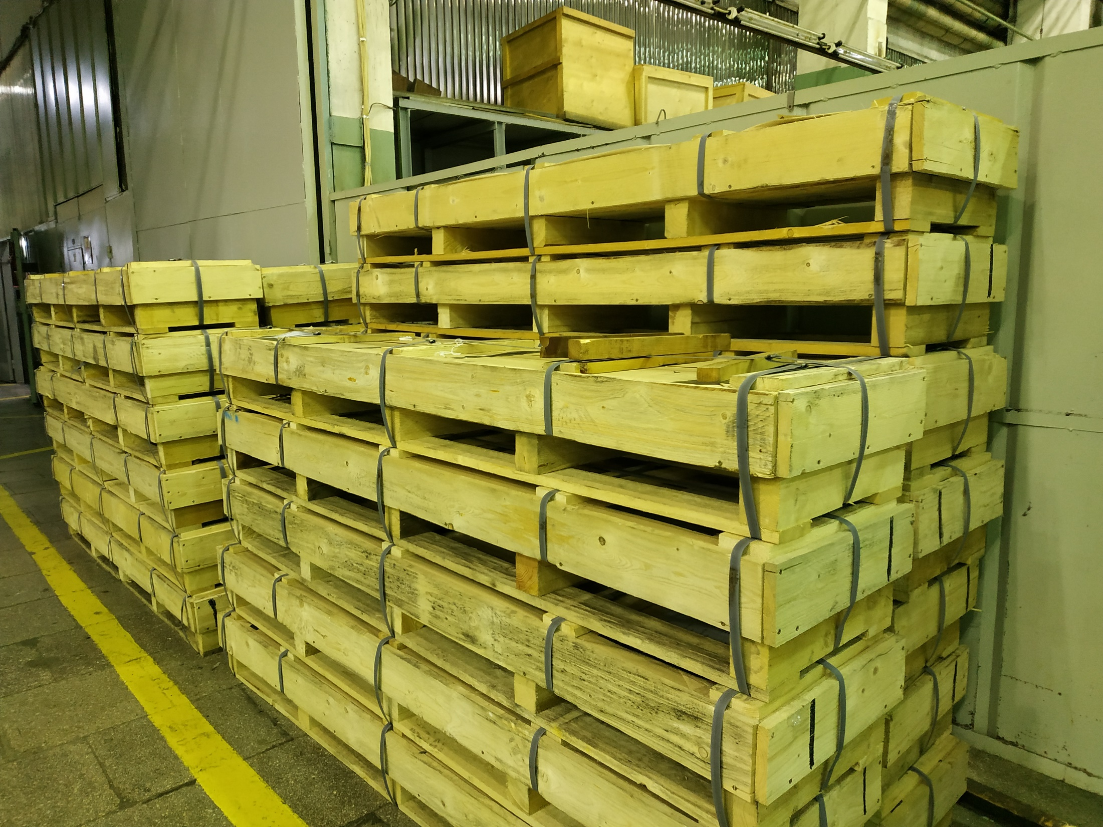
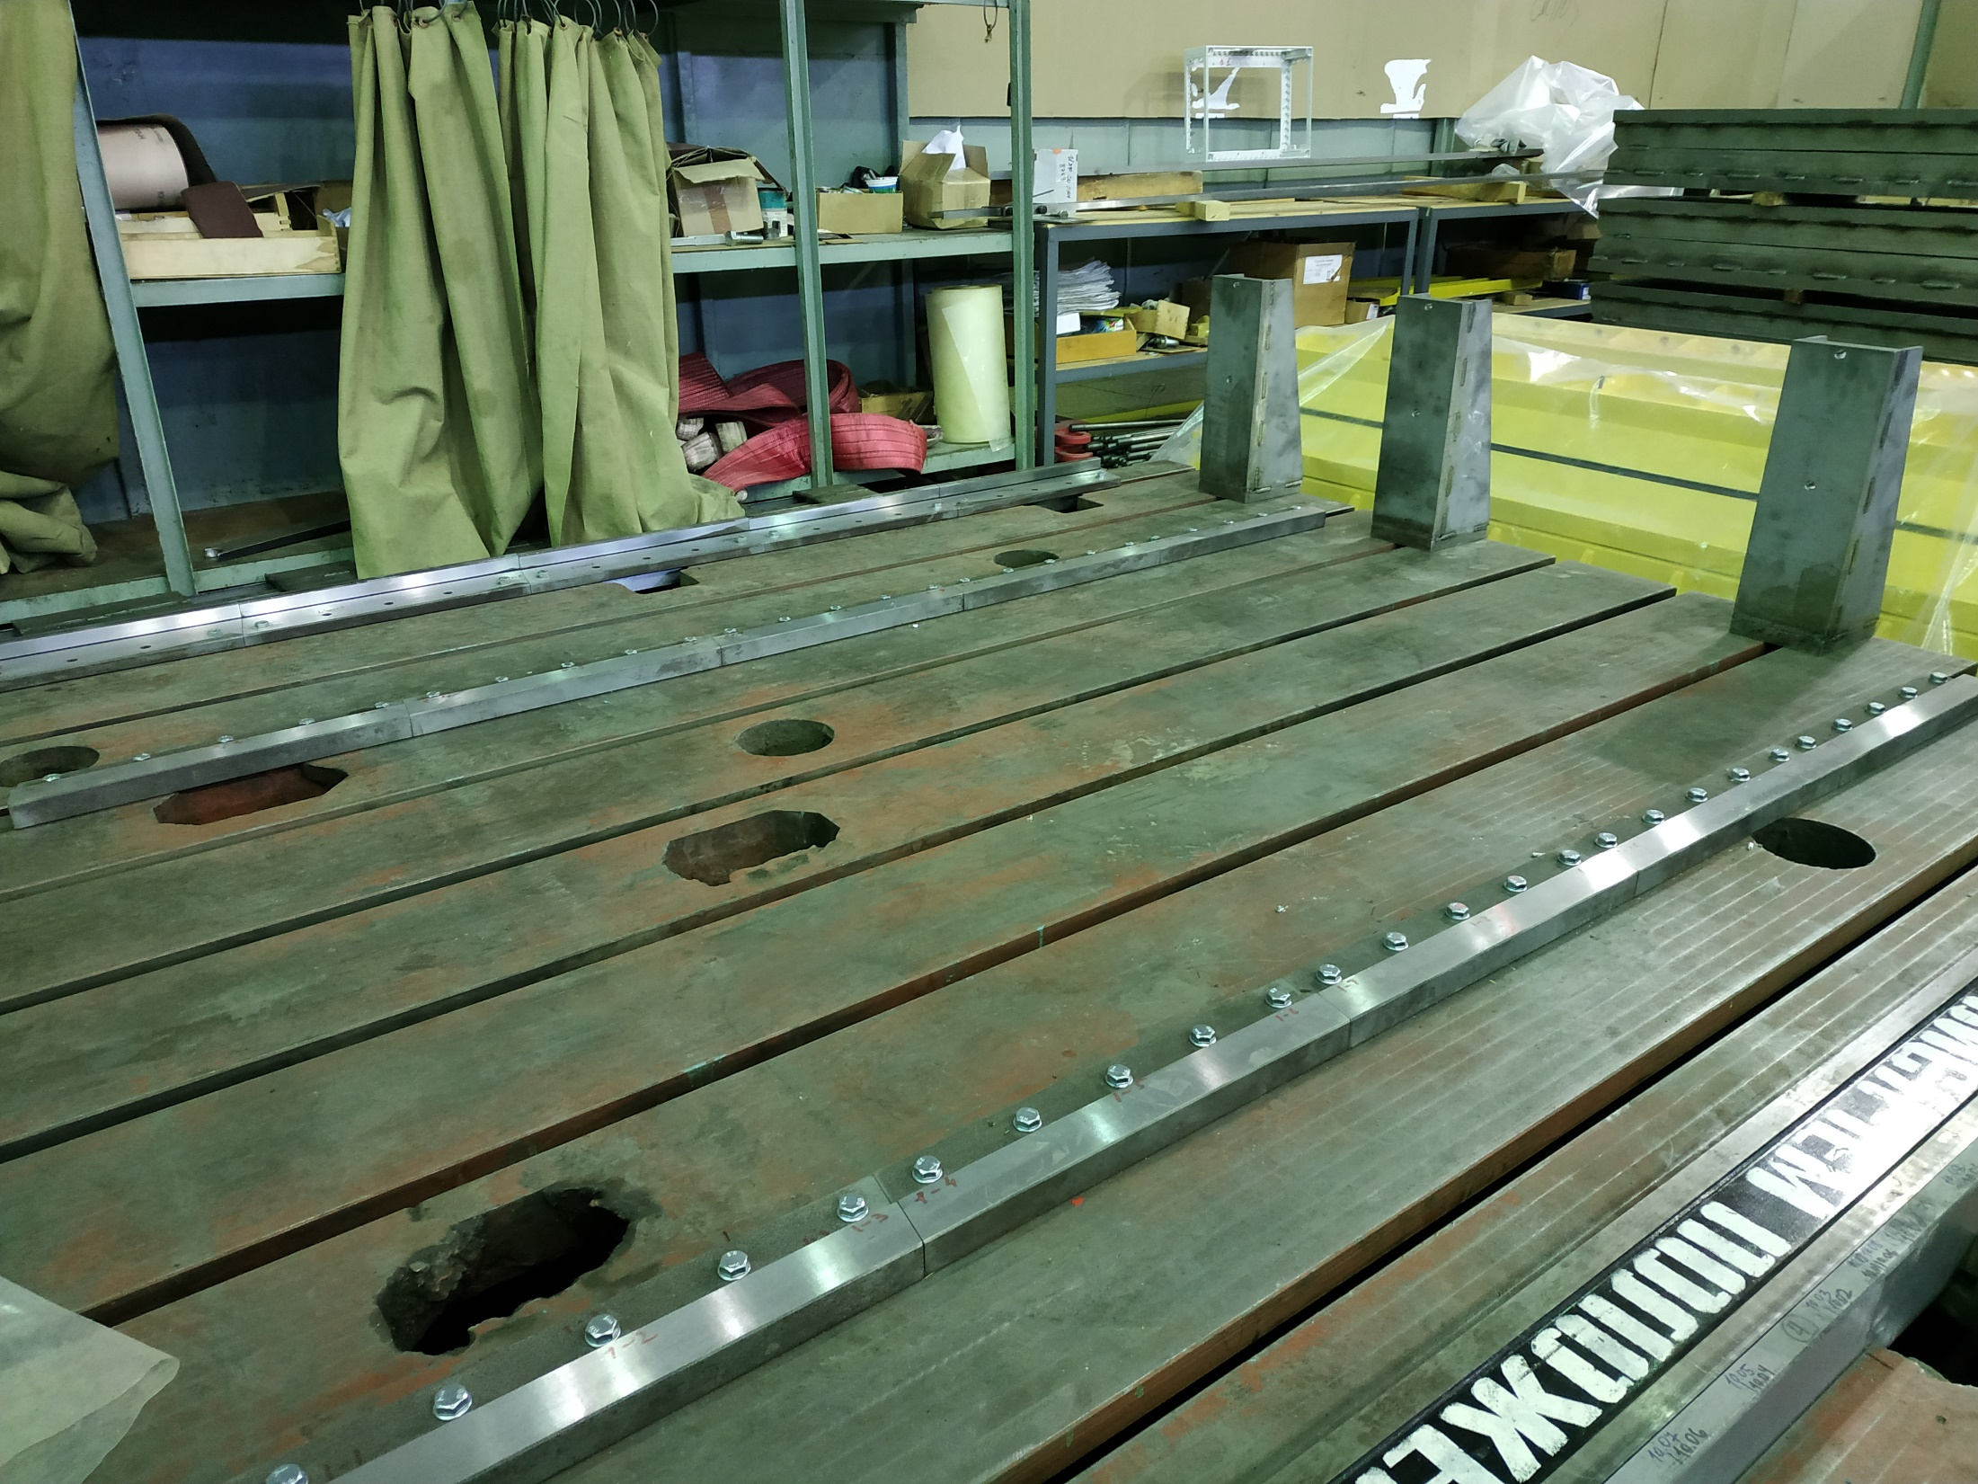
Outer yoke. Laminas for upper plate is ready. Staking fixture under assembly

Slide 7
CR
steerers

Slide 8
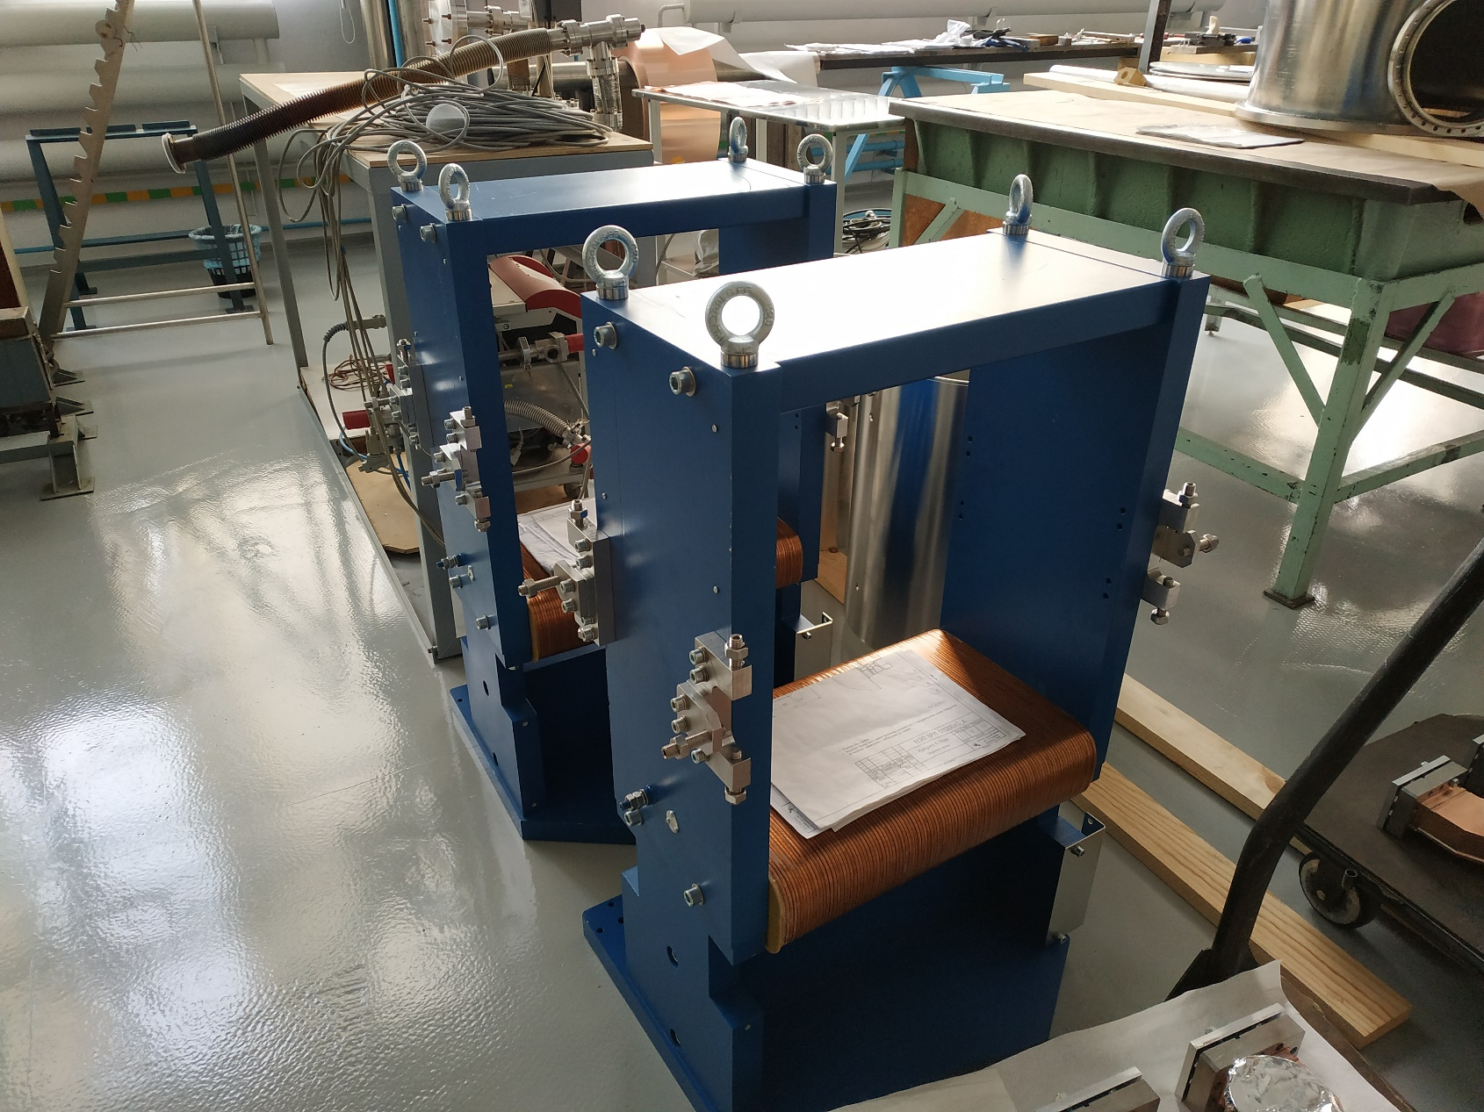
CR steerers.
Vertical corrector under assembly

Slide 9
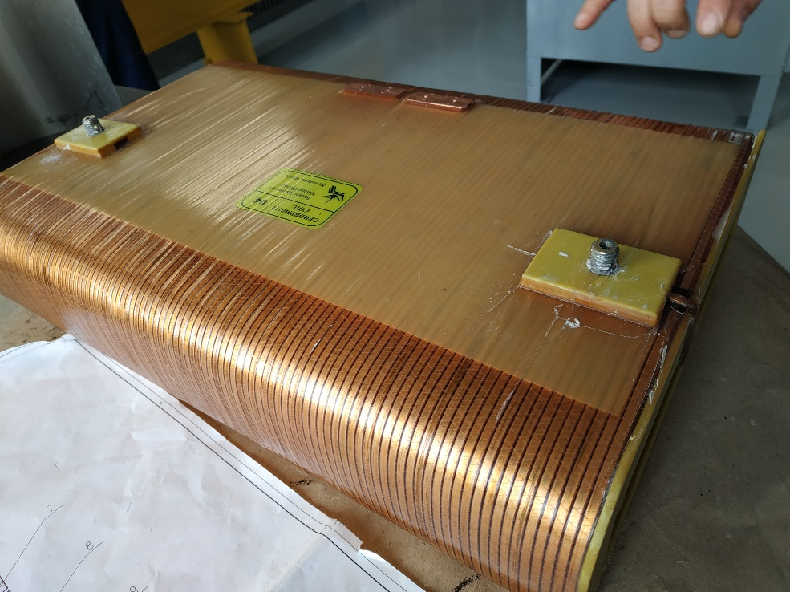
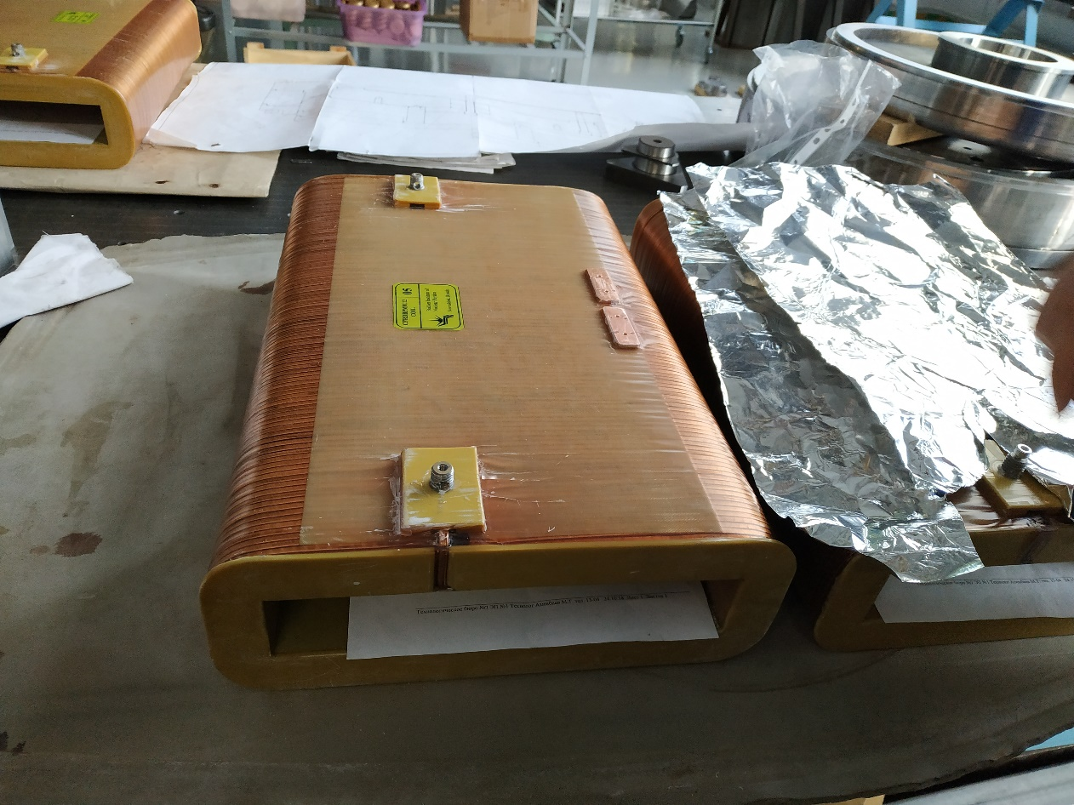
CR steerers.
Ready coils

Slide 10
Thanks!

