Slide 1

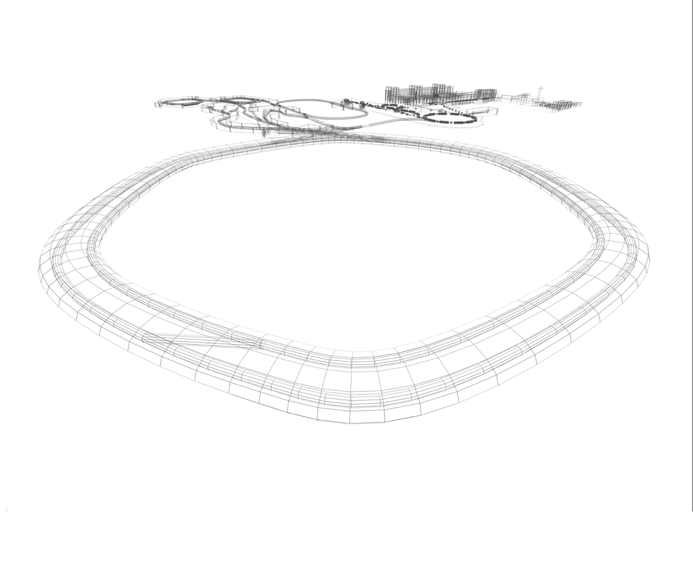
Work Package:
PSP 2.5.3.2.1.1.
CR Quadrupole magnet Power Converter Type 1
3nd Joint BINP-FAIR CC Workshop
25.11 - 28.11.2019
Conceptual Design

Slide 2
3nd Joint BINP-FAIR CC Workshop
25.11 - 28.11.2019
CR Quadrupole Magnets Power Converters Types
QUAD TYPE | Magnets in series | G kGs/cm | Inom kA | Vm tot V | Vcable V | Vtotal V | Ptotal kW
EWQ | 1 | 0.3 | 1.18 | 33 | 11 | 44 | 52
EWQ | 2 | 0.3 | 1.18 | 66 | 11 | 77 | 91
WQ | 4 | 0.32 | 1.00 | 114 | 10 | 124 | 124
WQ | 4 | 0.32 | 1.00 | 114 | 10 | 124 | 124
WQ | 4 | 0.41 | 1.28 | 144 | 13 | 157 | 201
WQ | 2 | 0.35 | 1.10 | 62 | 11 | 73 | 80
SWQ | 4 | 0.36 | 1.13 | 106 | 11 | 117 | 132
SWQ | 4 | 0.33 | 1.04 | 98 | 10 | 108 | 112
SWQ | 4 | 0.38 | 1.20 | 112 | 12 | 124 | 149
NQ | 2 | 0.43 | 0.83 | 24 | 8 | 32 | 27
NQ | 2 | 0.52 | 1.00 | 28 | 10 | 38 | 38
NQ | 2 | 0.52 | 1.00 | 28 | 10 | 38 | 38
NQ | 2 | 0.43 | 0.83 | 24 | 8 | 32 | 27
NQ | 2 | 0.58 | 1.12 | 32 | 11 | 43 | 48
NQ | 1 | 0.57 | 1.10 | 16 | 11 | 27 | 30

Slide 3
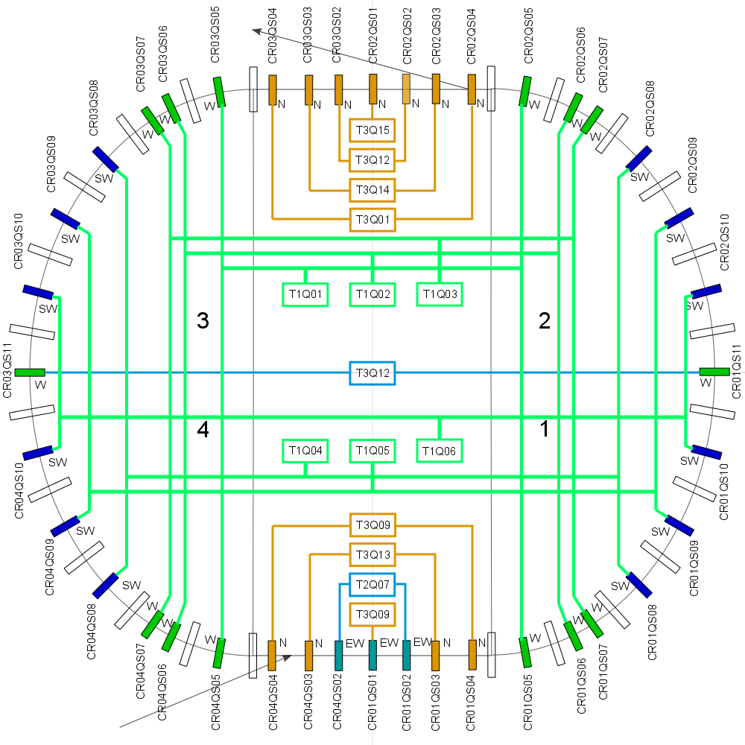
3nd Joint BINP-FAIR CC Workshop
25.11 - 28.11.2019

Slide 4
3nd Joint BINP-FAIR CC Workshop
25.11 - 28.11.2019
Power converter type 1 for CR quadrupole magnets technical requirements
Power converter type | CR Quadrupole magnets Power Converter QPC Type 1
Maximum current, I_{max} | 1500A
Nominal current, I_{N} | 1480A
Range of load current, I_{min}…I_{max} | -1500A…1500A
Rise time from 0 to I_{max} | 5sec
Fall time from I_{max} to 0 | 5sec
Maximum output voltage V_{max} | 200V
ΔIout/ I_{N} | ±50 ppm p-p
Long Term Current Stability | 100 ppm r.m.s.
Operating mode | DC operation, Ramping operation
Control | ACU
DCCT | ACU controlled DCCT
Mains | AC 400V 50Hz TN-S
Maximum Output Power | 300kW
Minimal Power Factor | 0.95
Cooling | Distill Water
Cooling water maximal flow | 16L/min
Cooling water max pressure | 15 bar
Cooling water input temperature | 25°C ± 2°C
Max allowed outlet temperature | 55°C
Load connection cable cross-section | 750mm²
Maximum length of load cable | 200m
Number of cabinets per converter | 3
Power converter dimensions WxDxH, m | 2.75x0.8x2.1

Slide 5
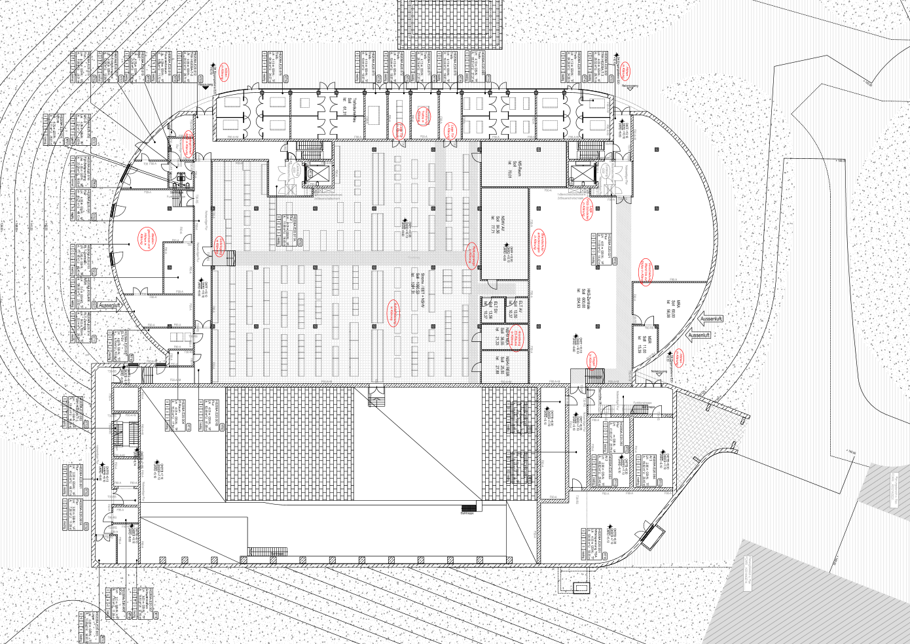
3nd Joint BINP-FAIR CC Workshop
25.11 - 28.11.2019
POWER CONVERTERS LOCATION

Slide 6
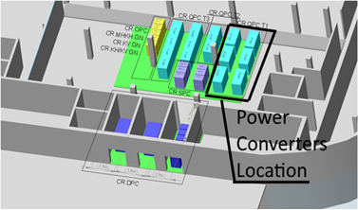
3nd Joint BINP-FAIR CC Workshop
25.11 - 28.11.2019
QPC T1 POWER CONVERTERS LOCATION

Slide 7
3nd Joint BINP-FAIR CC Workshop
25.11 - 28.11.2019
POWER CONVERTERS SETUP
High Power part. It is supplied by a 400V, 3-phase Common supply system C2
Control part. It is supplied by a 400V, 3-phase Common supply system C2

Slide 8
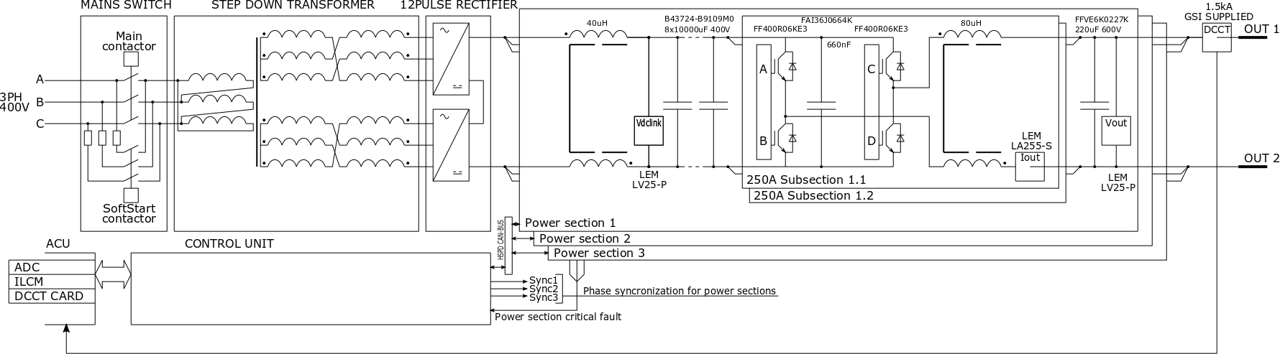
QPC T1 power converter block diagram
3nd Joint BINP-FAIR CC Workshop
25.11 - 28.11.2019

Slide 9
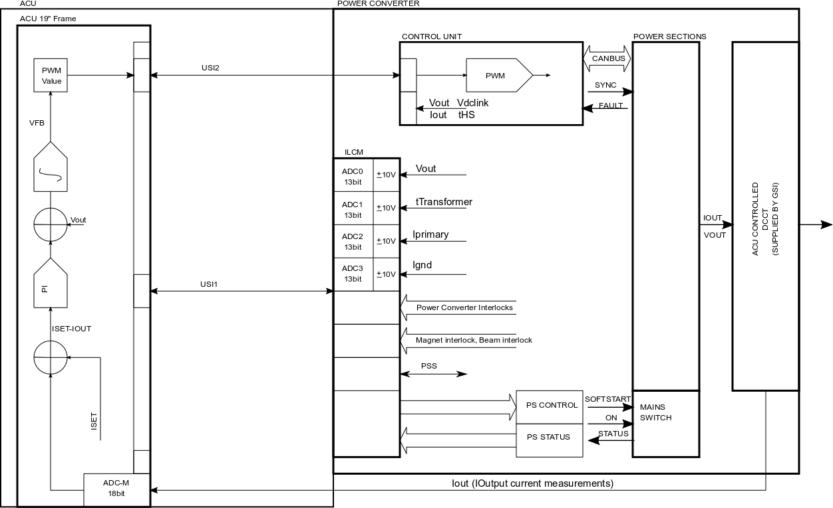
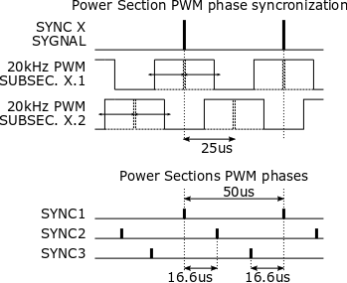
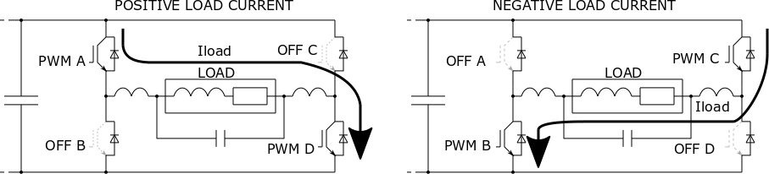
QPC T1 power converter control
3nd Joint BINP-FAIR CC Workshop
25.11 - 28.11.2019

Slide 10
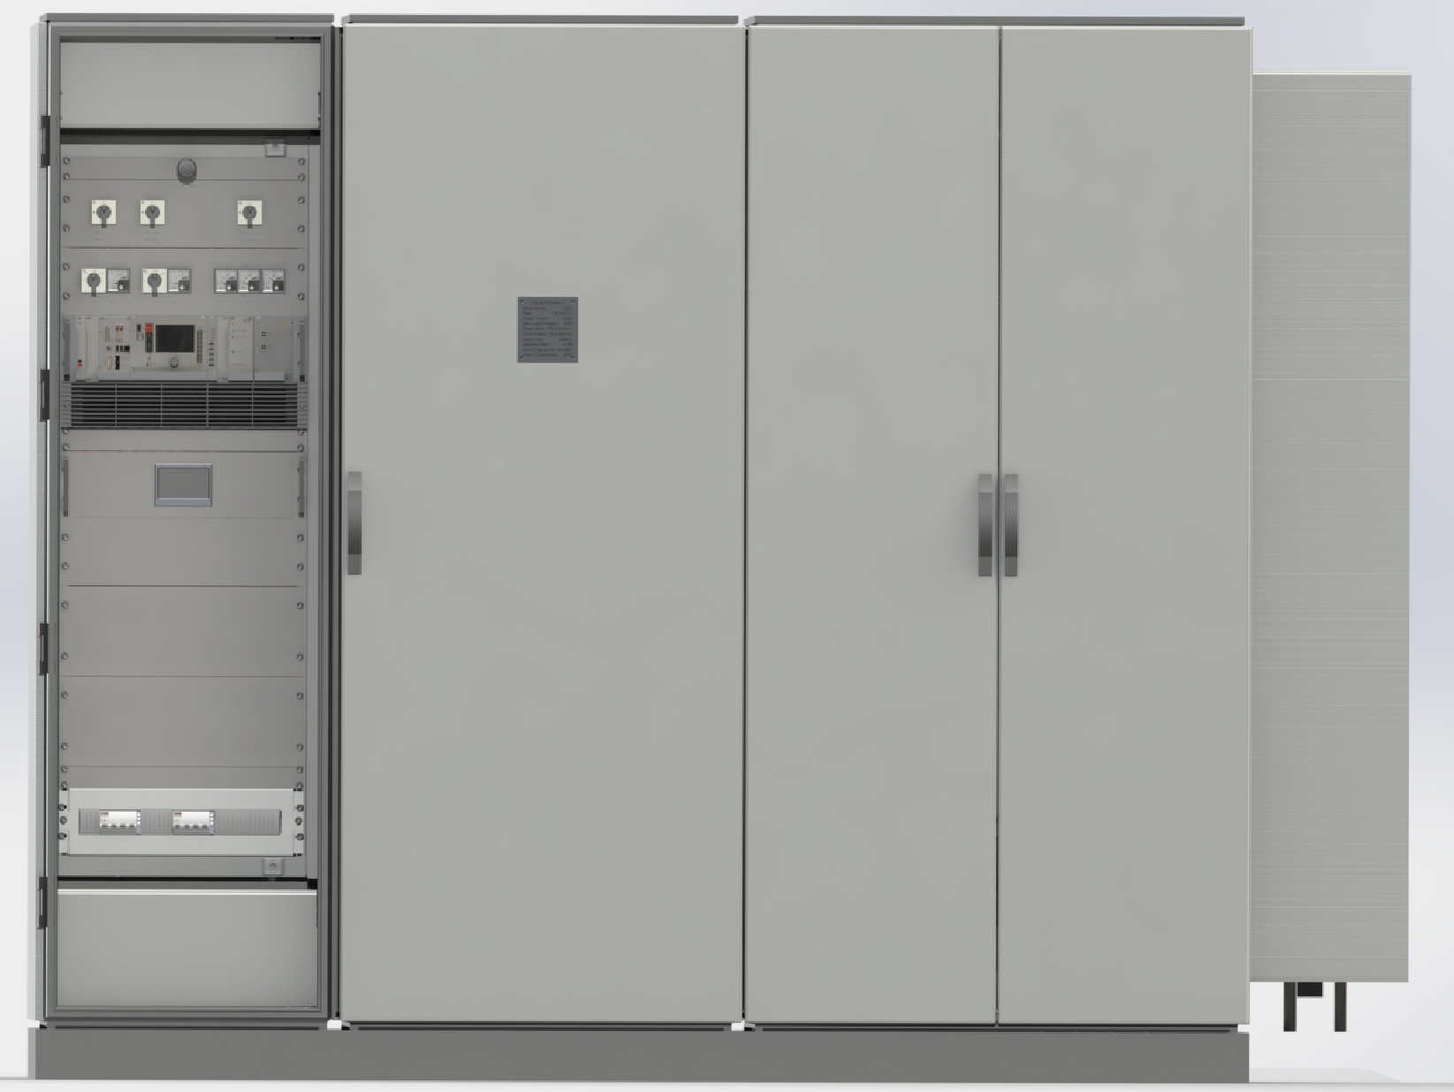
The appearance of QPC T1.
3nd Joint BINP-FAIR CC Workshop
25.11 - 28.11.2019

Slide 11
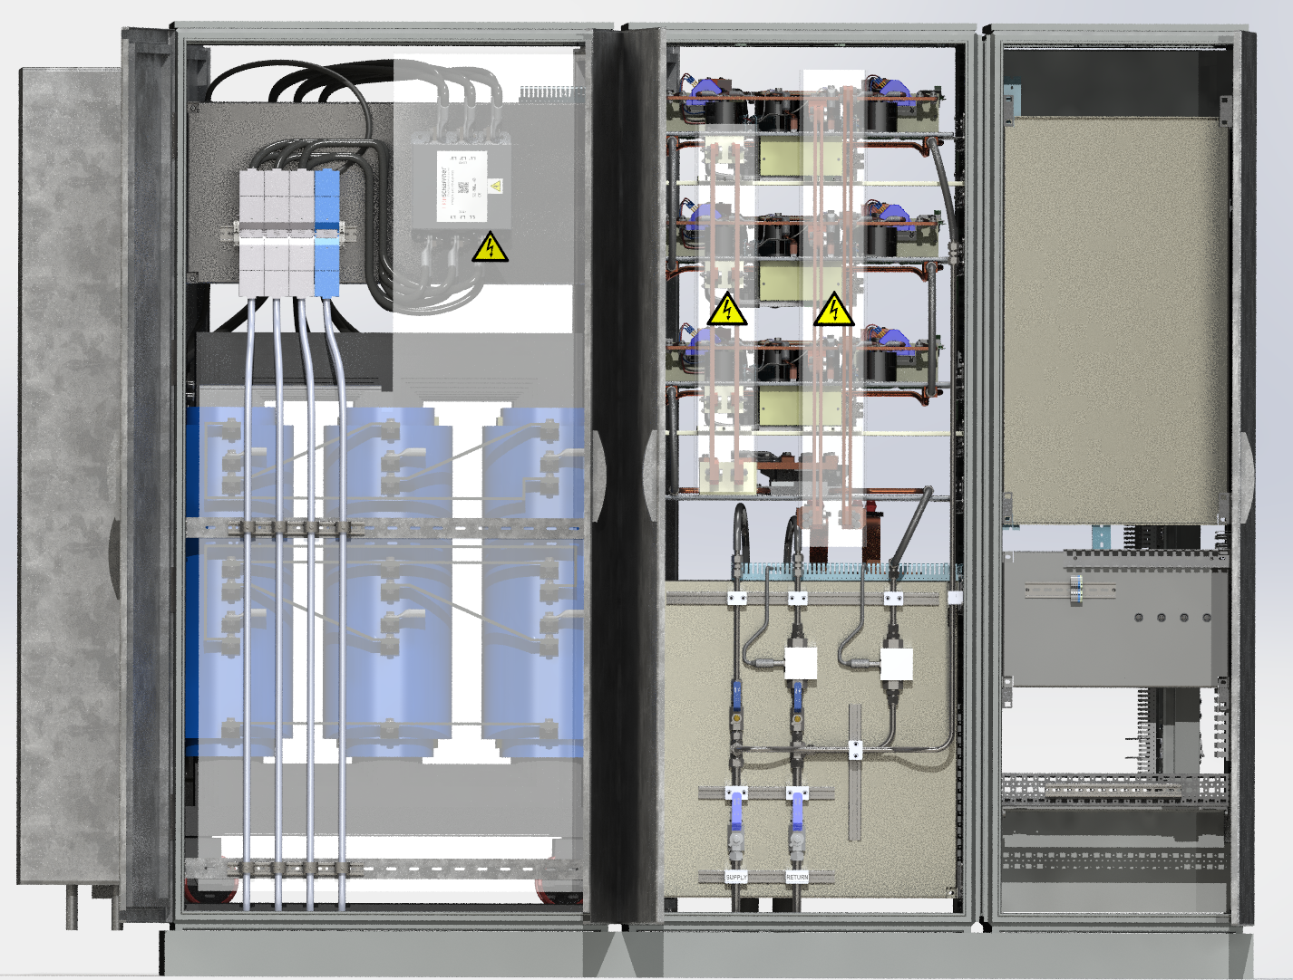
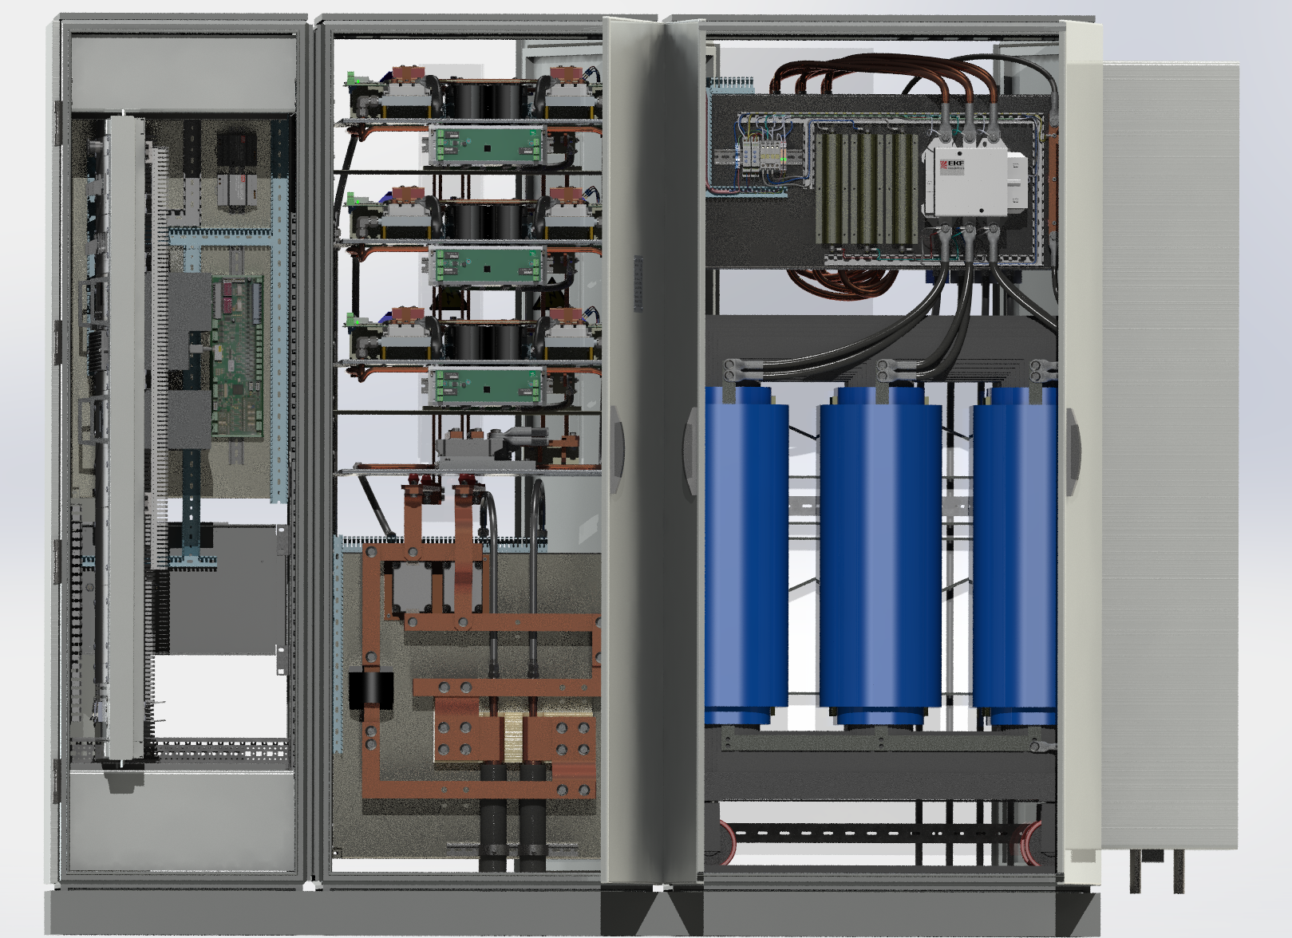
3nd Joint BINP-FAIR CC Workshop
25.11 - 28.11.2019
QPC T1 Grid, water, and load connections
Connection to electrical power : TN-S
Connection to load:

Slide 12
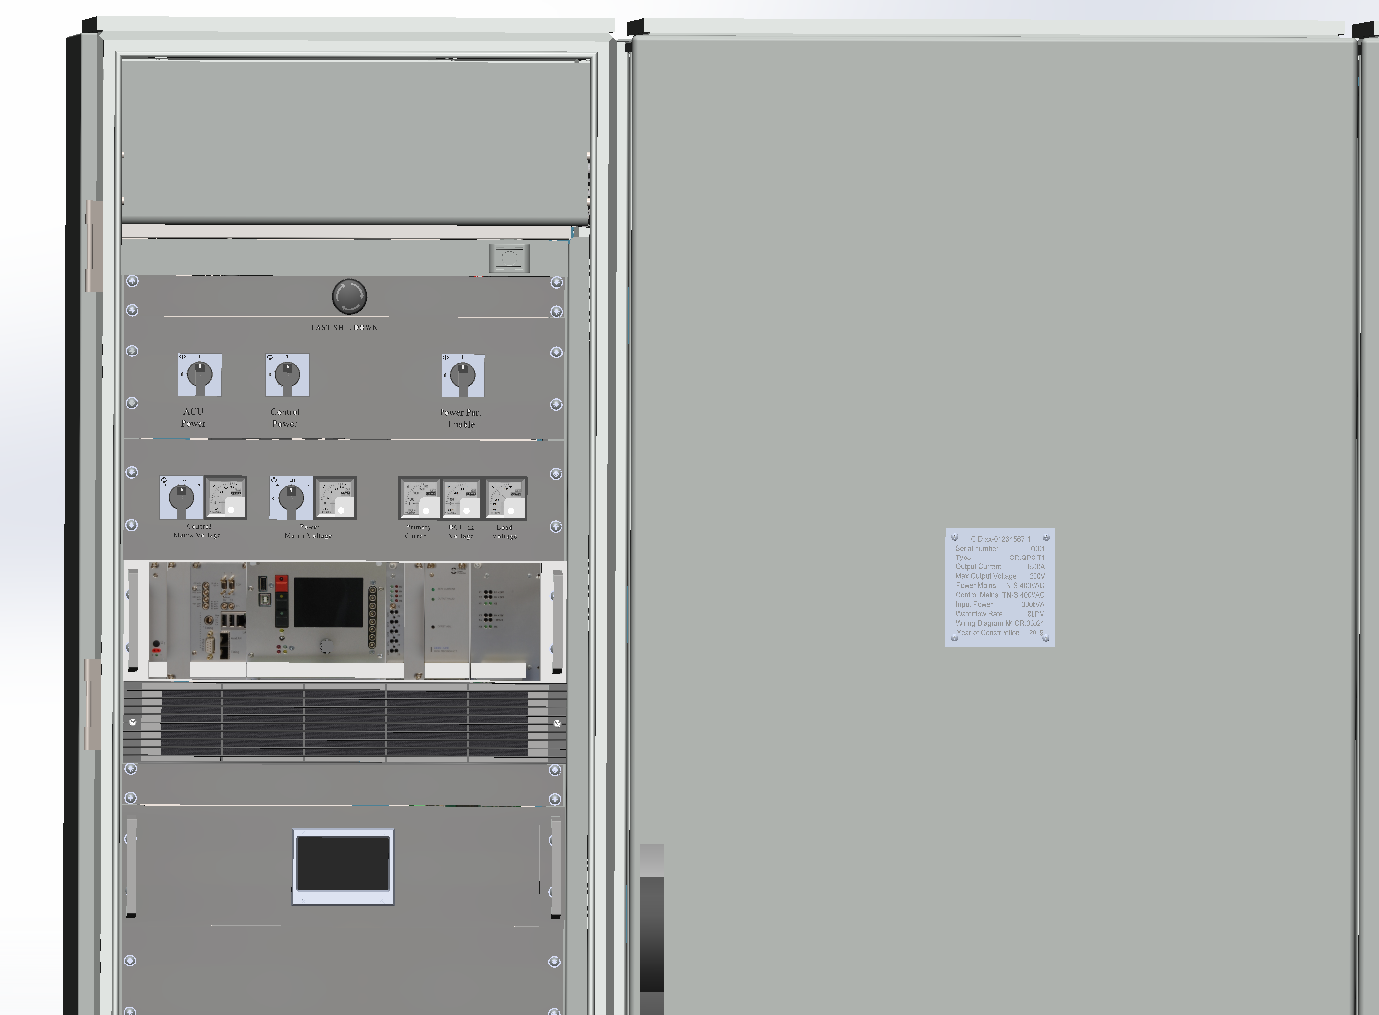
QPC T1 power control cabinet
3nd Joint BINP-FAIR CC Workshop
25.11 - 28.11.2019

Slide 13
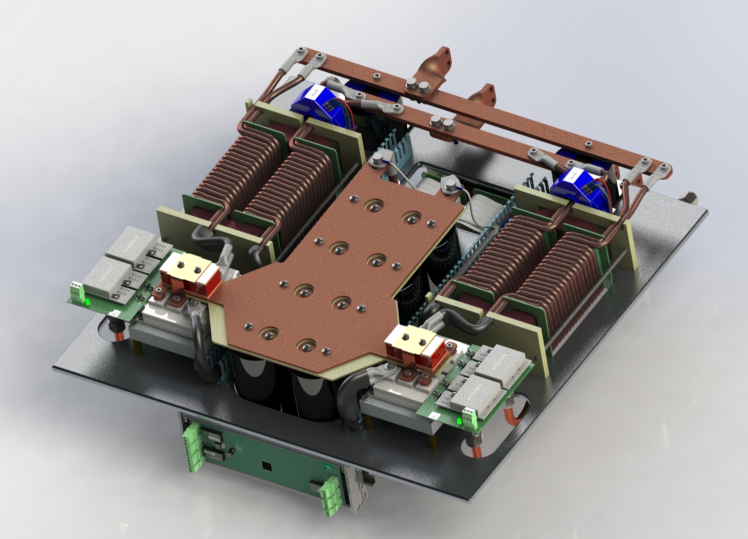
QPC T1 500A power section
3nd Joint BINP-FAIR CC Workshop
25.11 - 28.11.2019

Slide 14
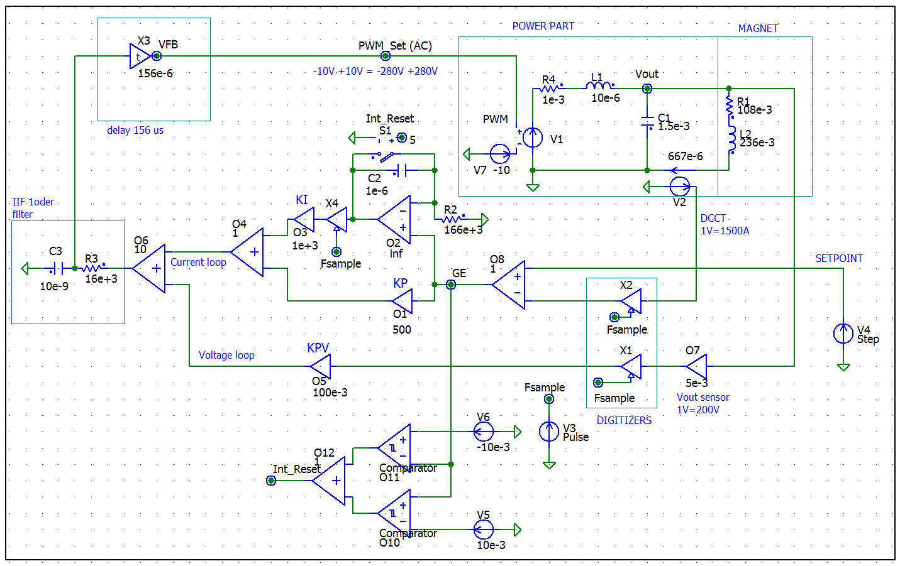
Closed loop simulation
3nd Joint BINP-FAIR CC Workshop
25.11 - 28.11.2019

Slide 15
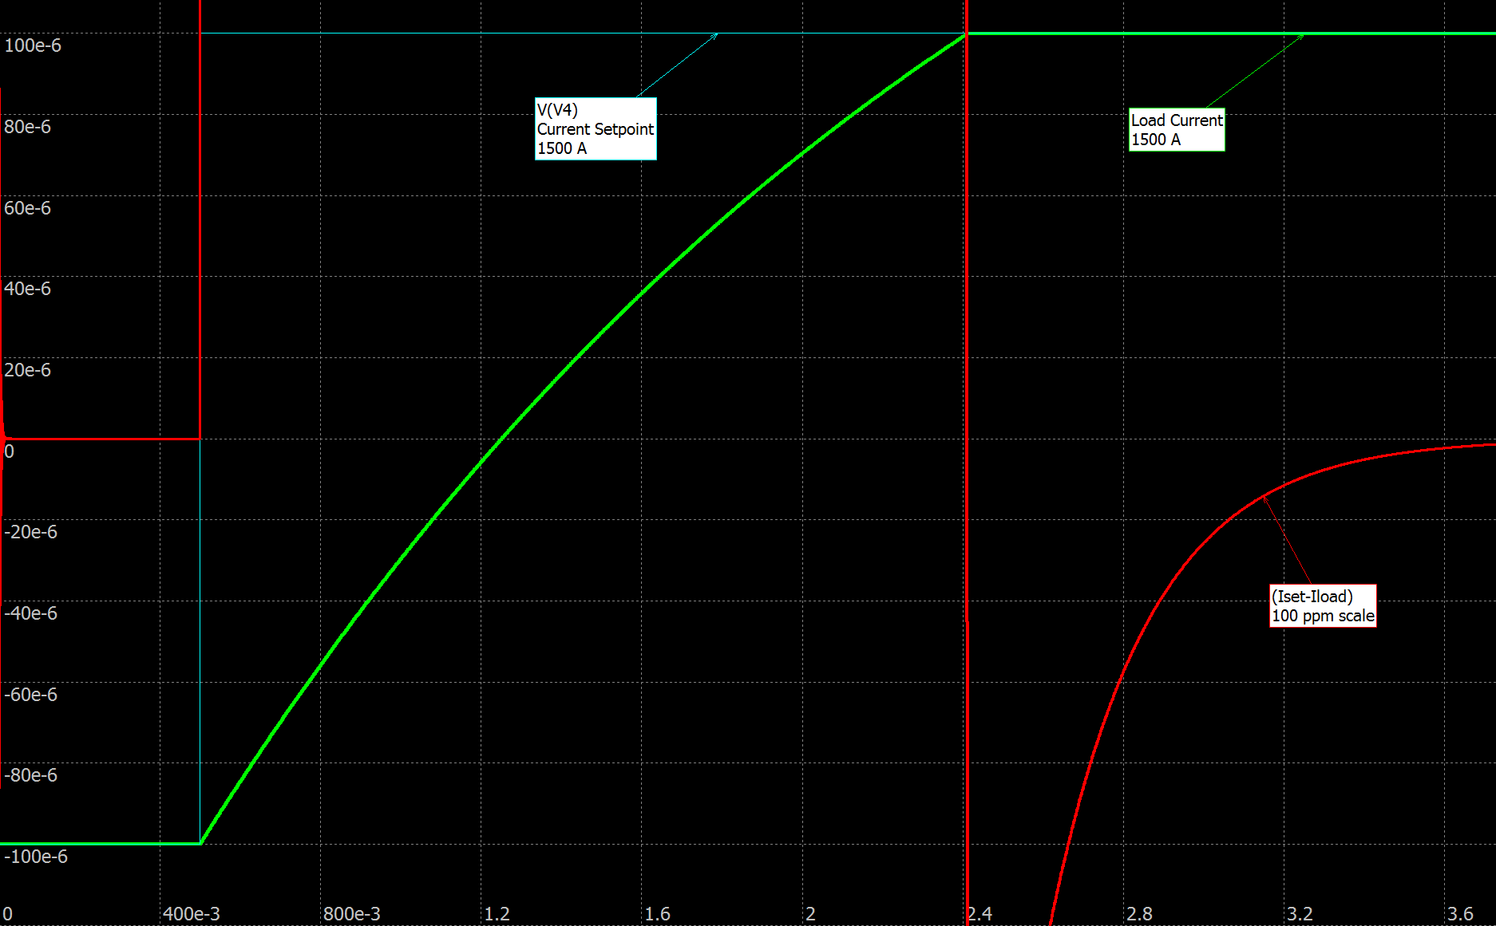
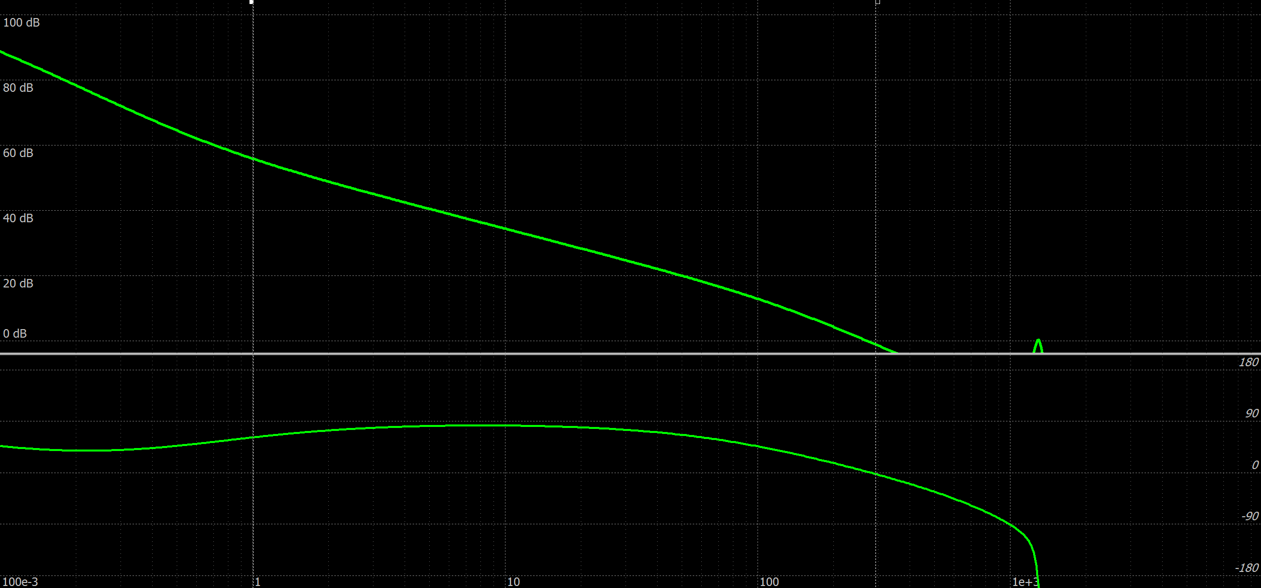
Closed loop simulation
3nd Joint BINP-FAIR CC Workshop
25.11 - 28.11.2019
Step response
Frequency response

Slide 16
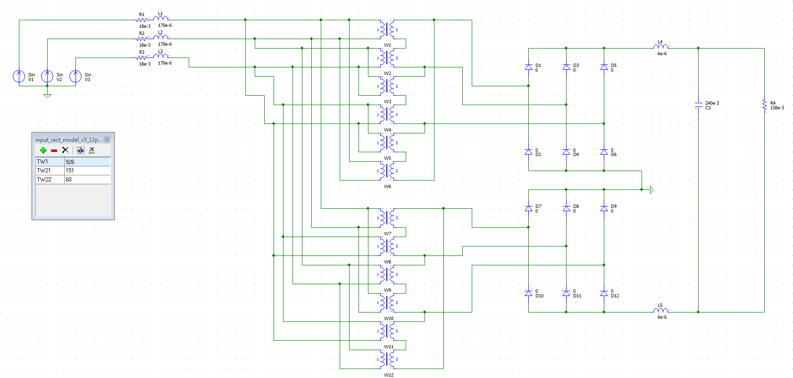
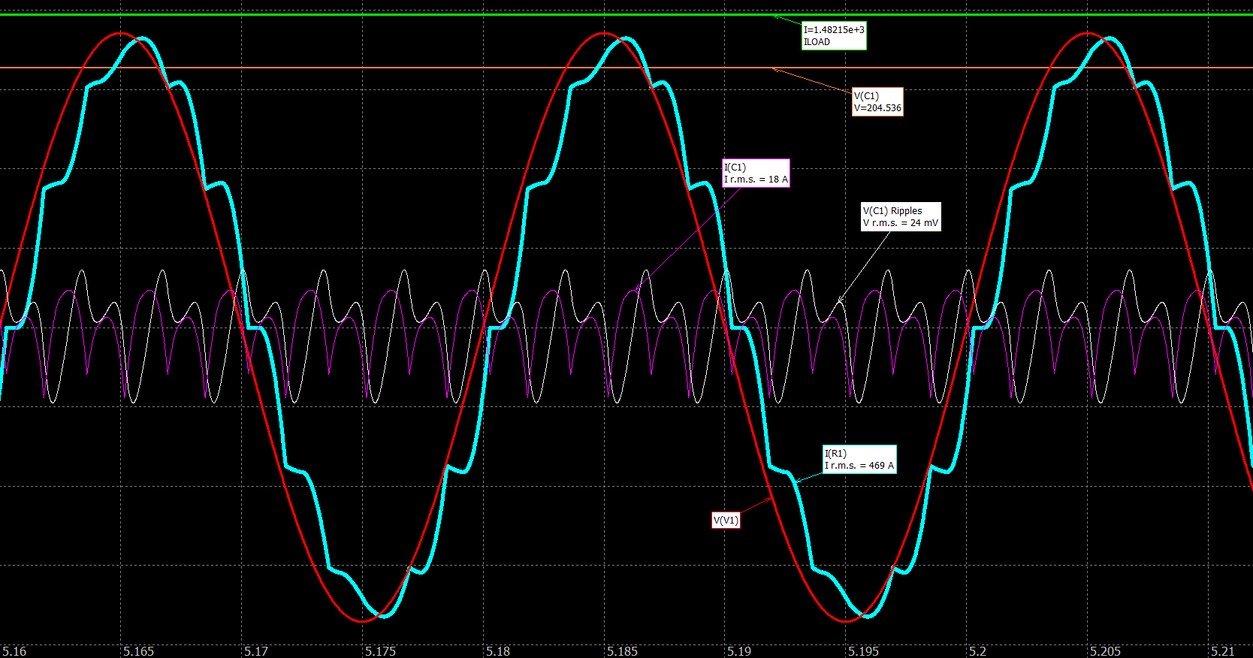
Rectifier simulation
3nd Joint BINP-FAIR CC Workshop
25.11 - 28.11.2019
Power factor
Is better than 0.97

Slide 17
Rectifier simulation
3nd Joint BINP-FAIR CC Workshop
25.11 - 28.11.2019

Slide 18
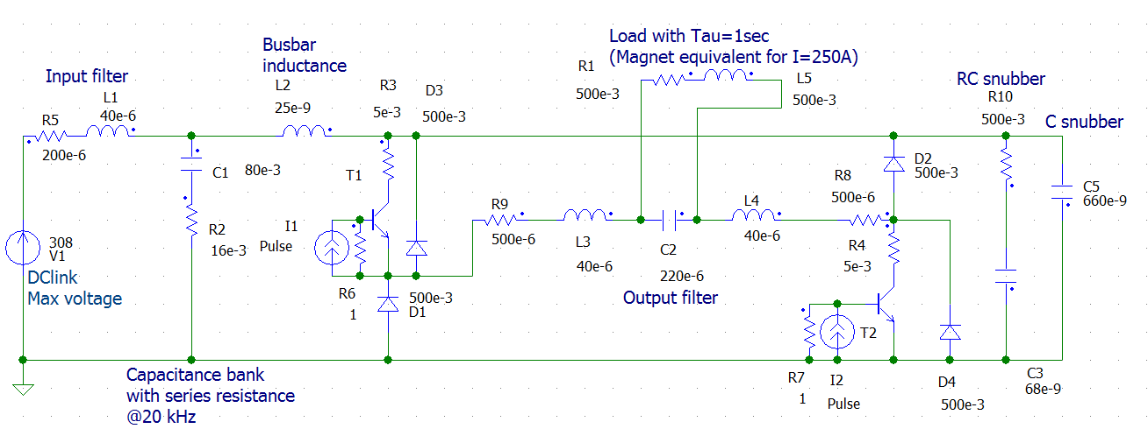
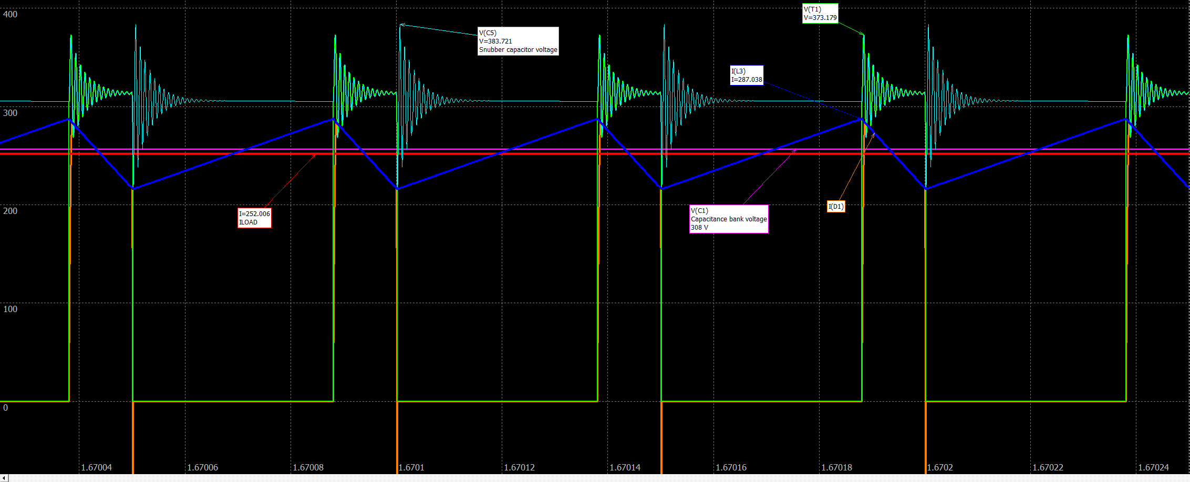
QPC T1 Power section simulation
3nd Joint BINP-FAIR CC Workshop
25.11 - 28.11.2019

Slide 19
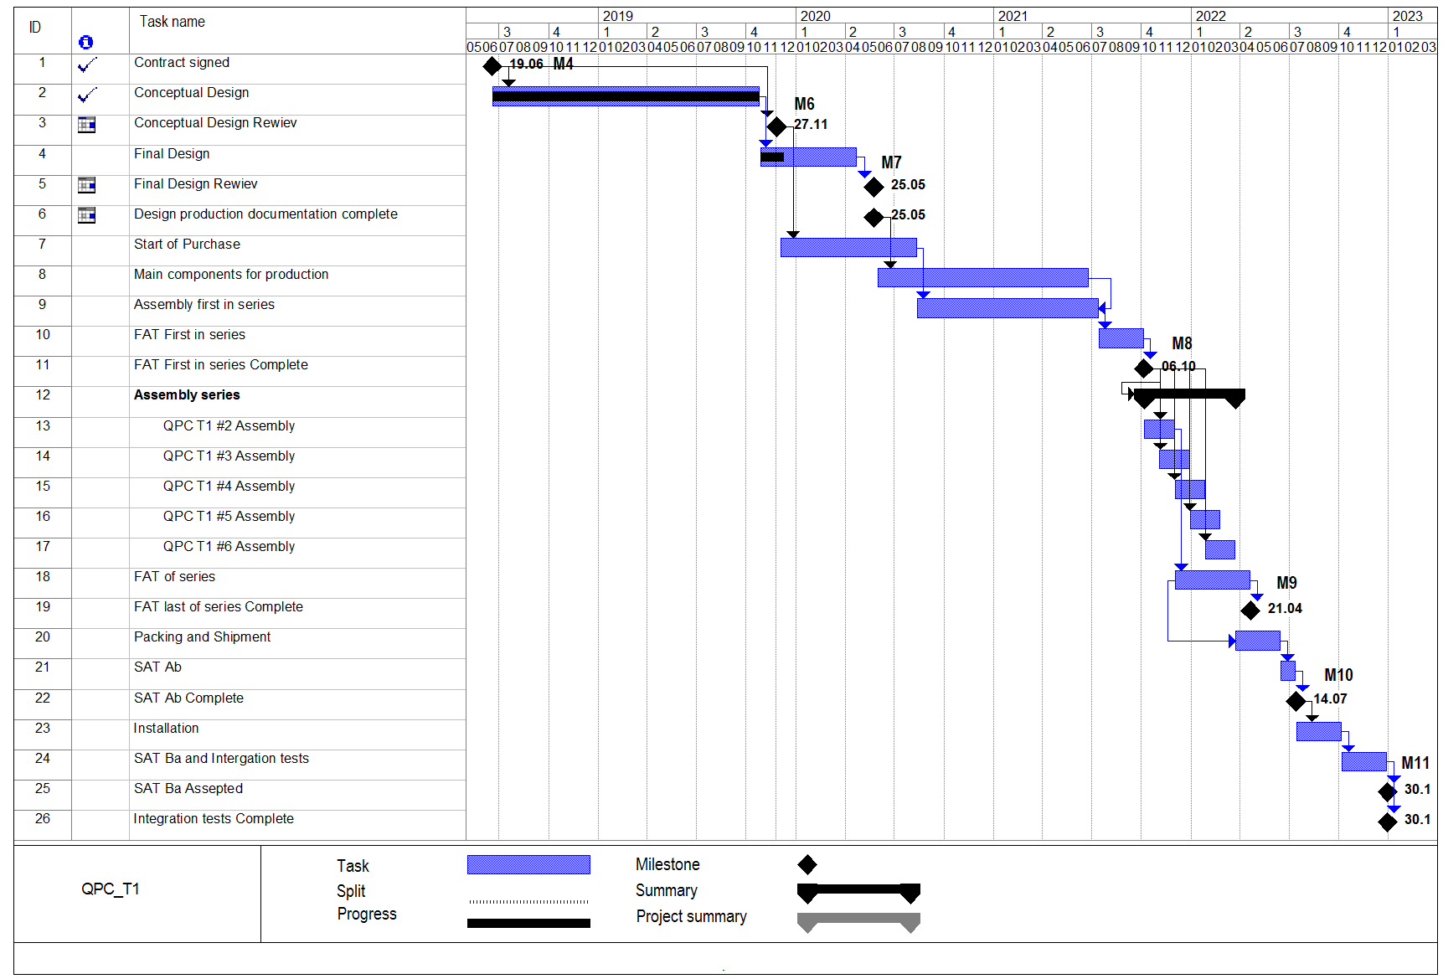
QPC T1 Production plan
3nd Joint BINP-FAIR CC Workshop
25.11 - 28.11.2019

Slide 20
Thank you for attention
3nd Joint BINP-FAIR CC Workshop
25.11 - 28.11.2019

