Slide 1
NSQ Magnet for CR.
CDR Review.
D. Gurov, A.Utkin for CR team
BINP, Novosibirsk
November 27, 2019
3rd FAIR-BINP Workshop, Novosibirsk, Russia

Slide 2
Contents
CDR documentation
Project management structure
Base principles and Concept
NSQ quadrupoles in CR
Calculations and simulations
Assembling
Production plan

Slide 3
CDR Documentations
Test plan
https://edms.cern.ch/document/2245947/1
Mechanics - 3D model
https://edms.cern.ch/document/2245951/1
Operating manual / user manual https://edms.cern.ch/document/2245945/1
Risk analysis and hazard analysis [AID:0002663]
https://edms.cern.ch/document/2245943/1

Slide 4
Project management
Name: Denis Gurov
Position: Research Scientist Email: D.S.Gurov@inp.nsk.su
Tel.: +7383329-4684
The Deputy is responsible for:
Follow-up of production activities;
Magnetic measurements to ensure the required field and field quality;
Factory Acceptance Test (FAT) to verify the given specifications of the components;
Name: Anatoly Utkin
Position: Research Scientist Email: A.V.Utkin@inp.nsk.su
Tel.: +7383329-4684
The Deputy is responsible for:
Preliminary magnet design, final magnet design (development, simulation);
Magnetic field calculation;
More Details in “Quality Plan”
The Project Manager
Name: Alexandr Starostenko
Position: Head of BINP Division № 5-11 Email: A.A.Starostenko@inp.nsk.su
Tel.: +7383329-4940
The Project Manager is responsible for:
Development of the technical documentation and manufacturing drawings for the deliverables;
Ensuring that the production of the magnets is according to the technical specifications and time schedule;
Follow-up of production activities;
Transportation, delivery of the equipment to the FAIR site;
Regular and timely reporting on progress and problems;
Timely conduction/participation of reviews and provisions of feedback;
Scientific Design Department
Name: Vladimir Korchagin
Position: Principal Design Engineer Email: V.Ya.Korchagin@inp.nsk.su
Tel.: + 7383329-4953
The Principal Design Engineer is responsible for:
Magnet design (3D-models, production drawings);

Slide 5
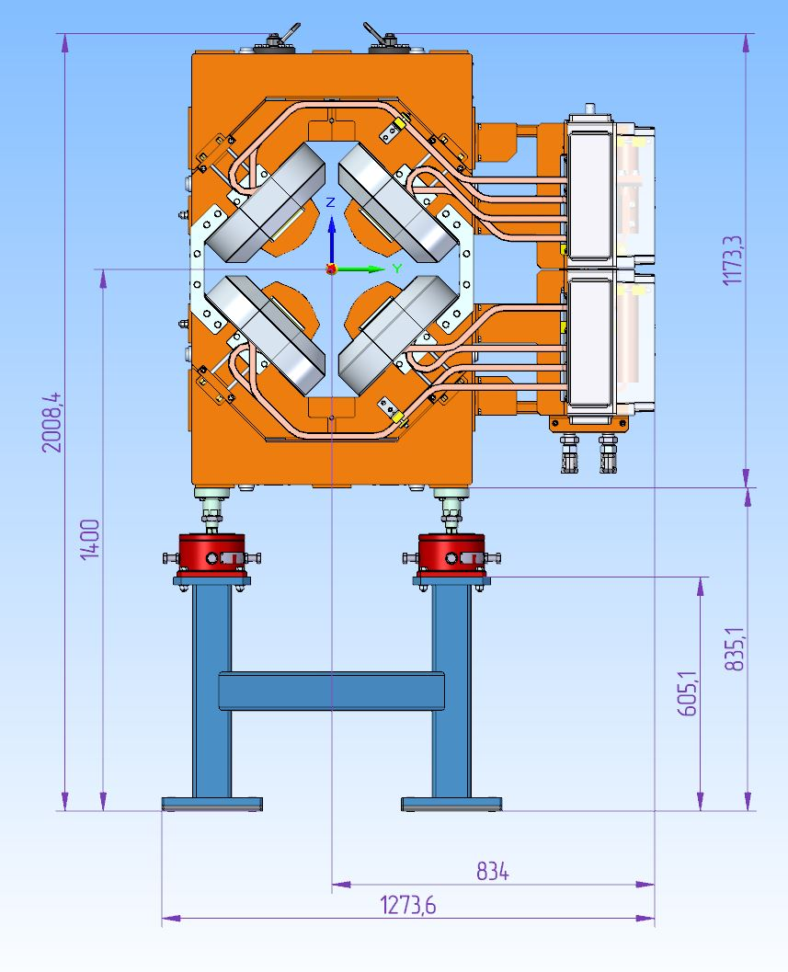
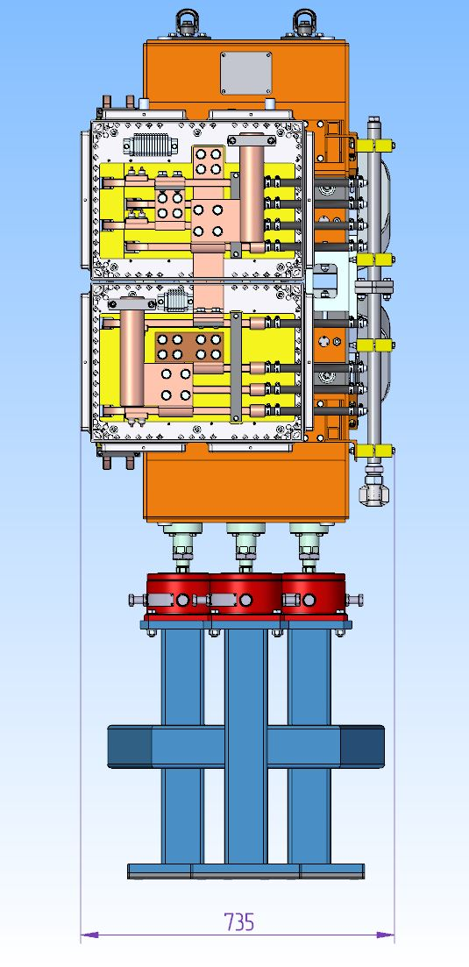
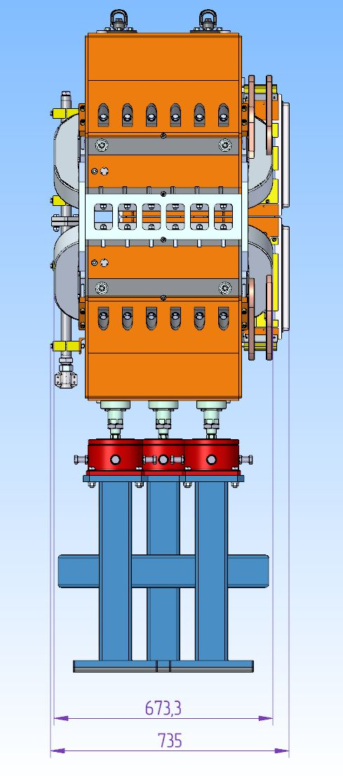
Construction of NSQ magnet

Slide 6
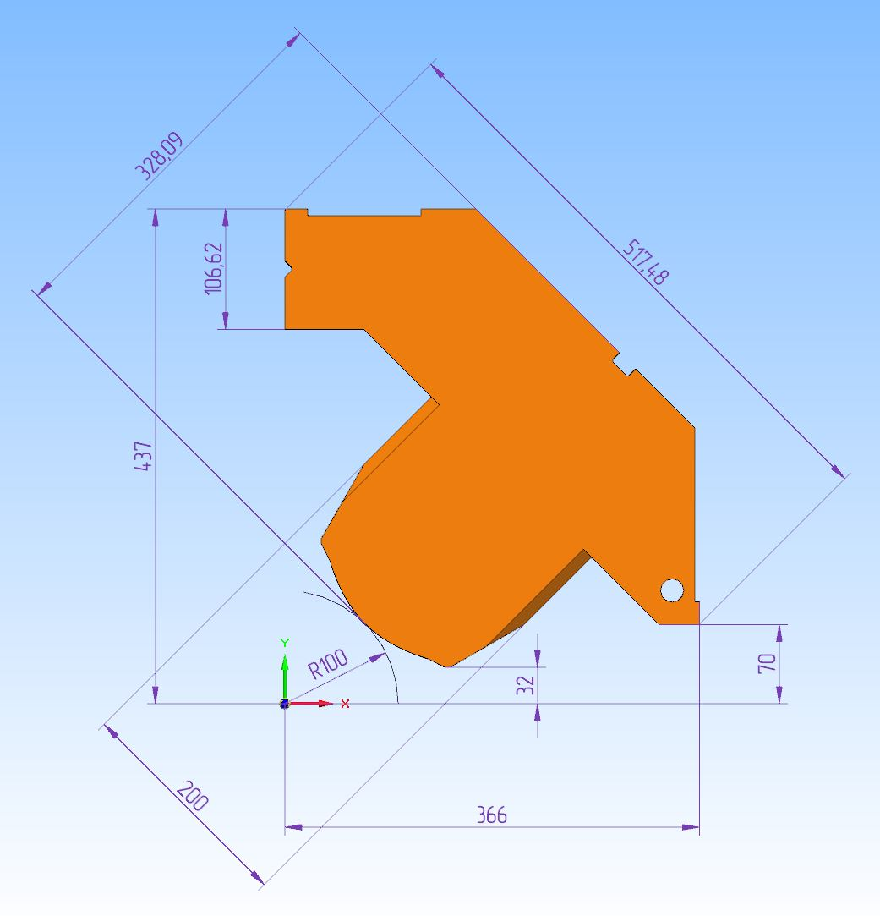
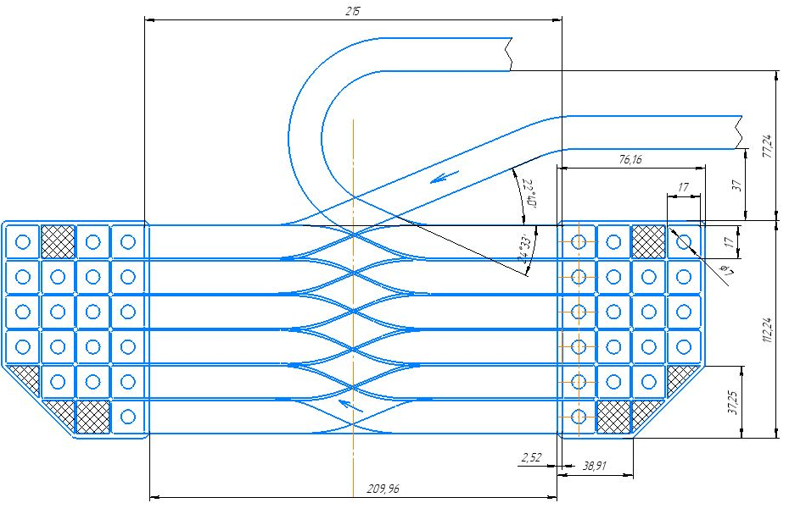
Construction of NSQ magnet
19 turns coil 17x17 mm. wire
7 mm. hole
Quarter of yoke

Slide 7
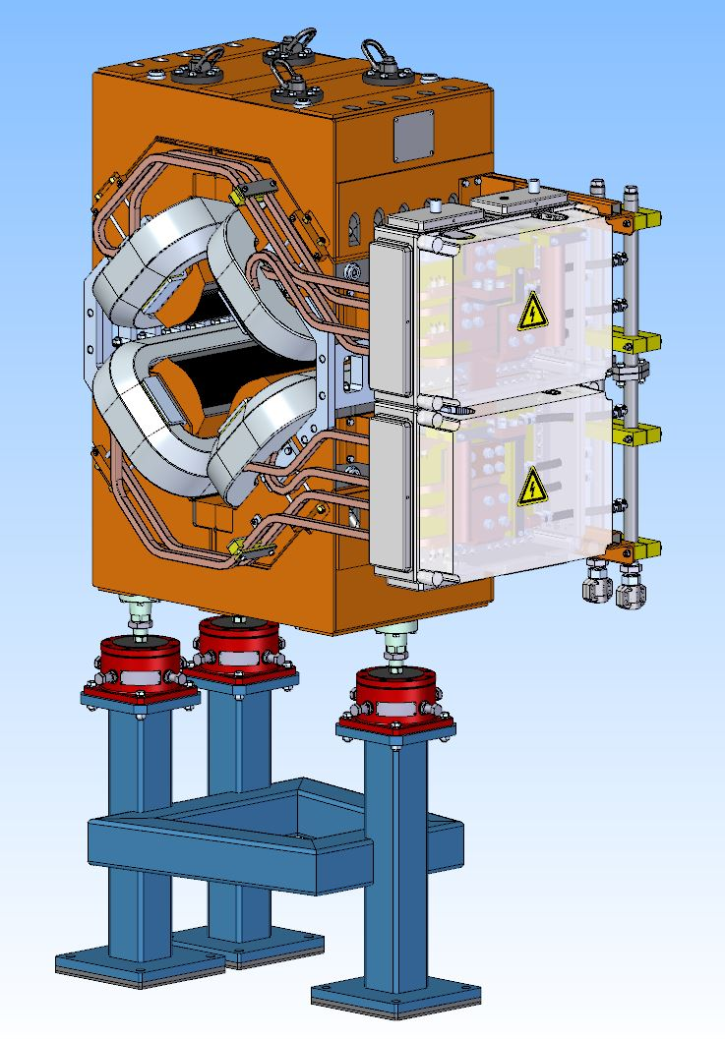
NQ Quadrupole and stand for quadrupole
Parameter | Value
Lamination thickness | 1 mm
Dimensions of wire for coils | 17x17 mm
Number of NSQ magnets | 1
Overall weight | 2.0 t
Coil current | 1210 A
Number of coil turns | 19
Coil resistance | 10.1 mΩ
Coil inductance | 9 mH
Maximum DC power loss | 14.8 kW

Slide 8
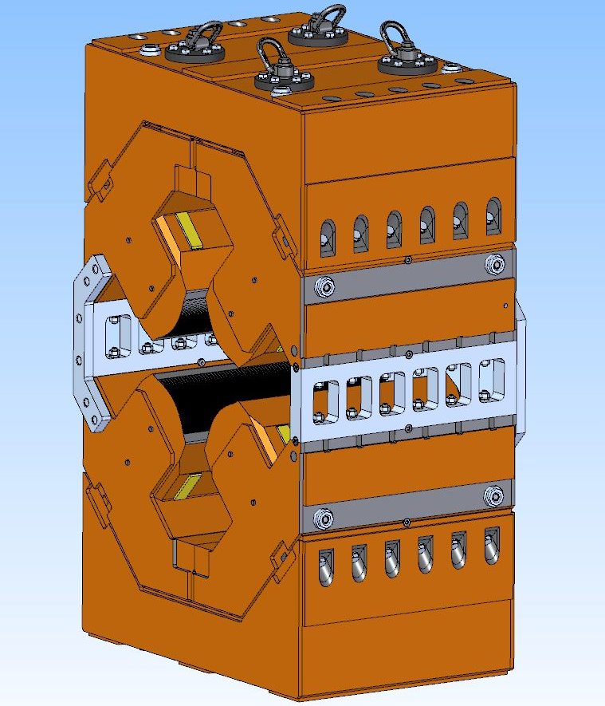
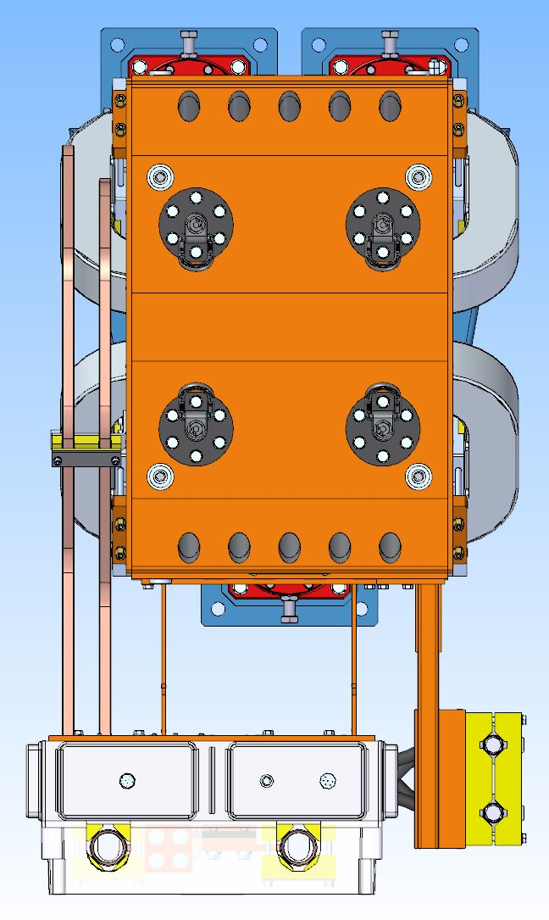
NSQ Quadrupole top wiew and yoke

Slide 9
NQ magnet calculations
3D Magneto-static calculations in “Mermaid” code
Pole profile
Pole profile coordinates (mm)
Y (mm) | X (mm)
287.16 | 145.74
211.28 | 69.86
145.6 | 32
141.6 | 32
127 | 39.37
Hyperbola: | X*Y=5000
39.37 | 127
32 | 141.6
32 | 145.6
69.86 | 211.28
145.74 | 287.16
Chamfer 12 mm depth 12 mm height, side cut outs 15 mm depth 10 mm width

Slide 10
Field in yoke
Field in yoke (kGs) at maximal gradient value
Flux lines in yoke at maximal gradient value

Slide 11
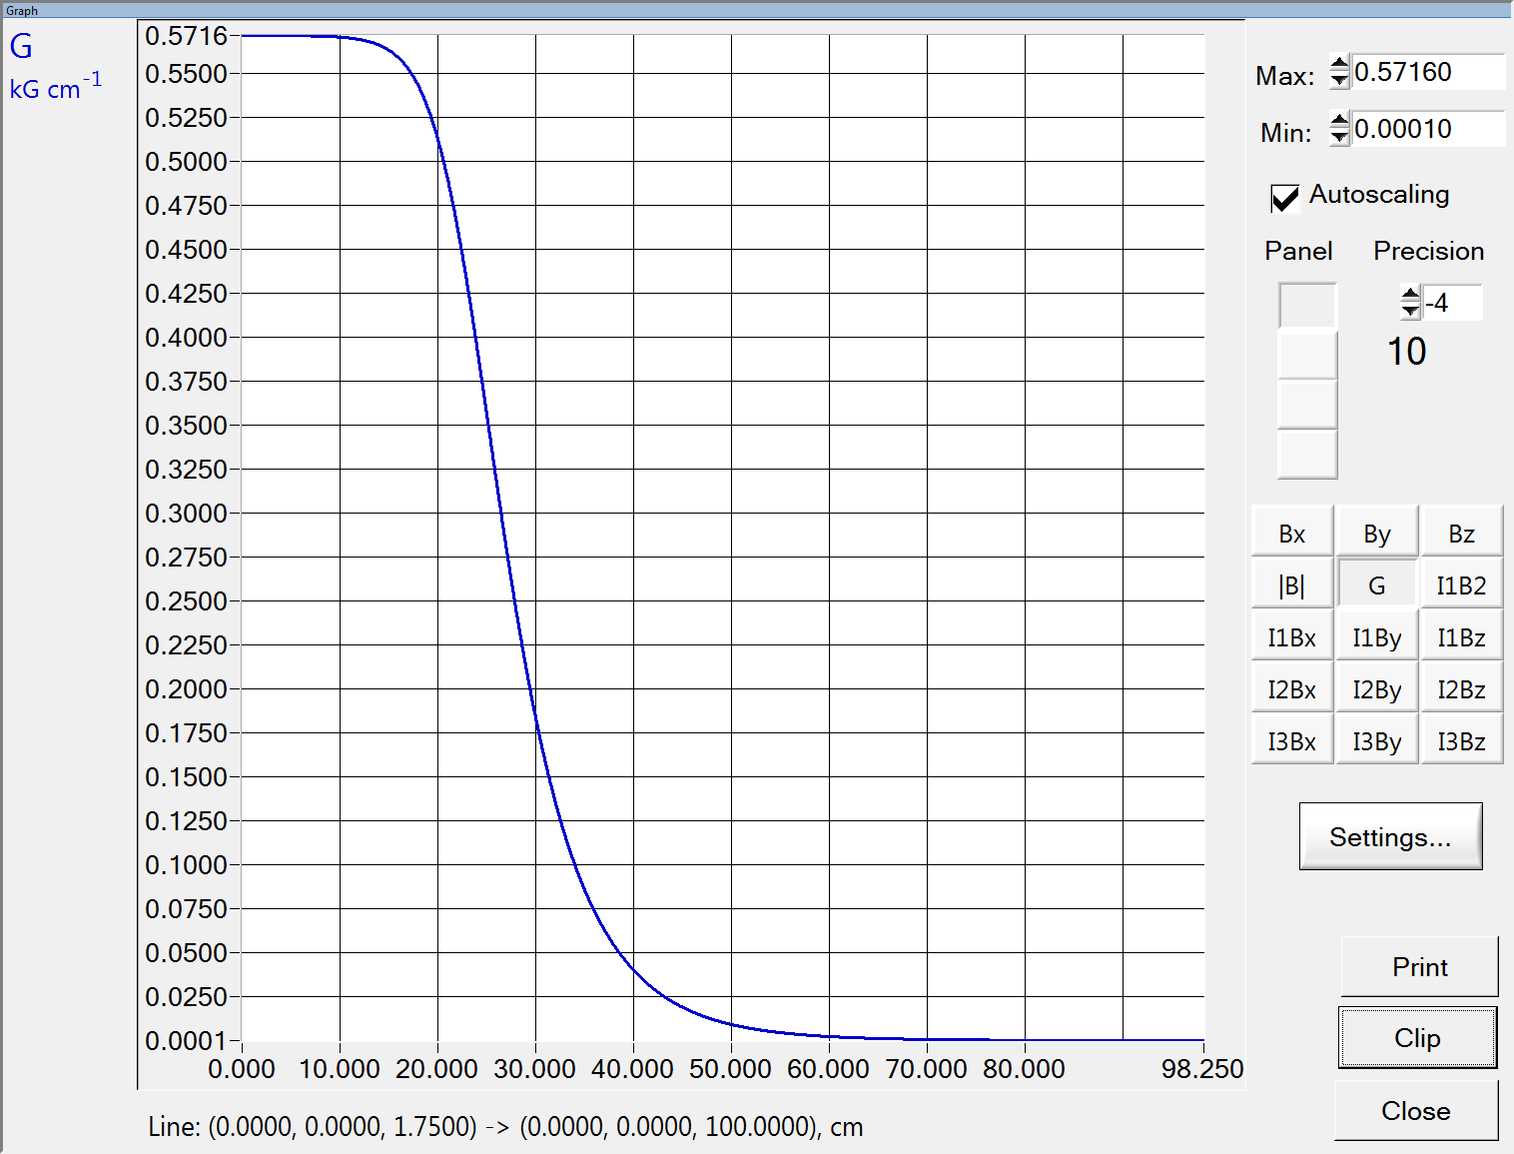
Field quality
Longitudinal gradient distribution at maximal gradient value.
Integral contributions of 6th and 10th multipoles at 136 mm radius.
kGs/cm
cm

Slide 12
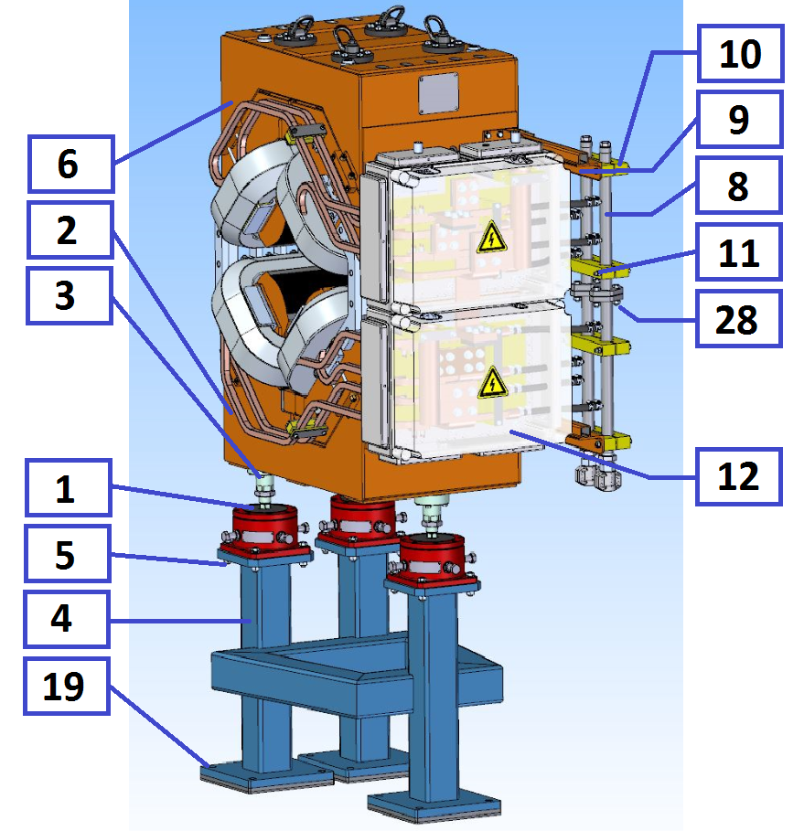
Assembling of the magnet
1. Fasten the alignment feet 1 (3 pcs.) to the lower half of the yoke 2 (1 pcs.), using bolts 3 (18 pcs.);
2. Fasten stainless steel spacers 29 (2 pcs.) to the lower half of the yoke 2 using bolts 7 (12 pcs.);
3. Install the lower half of the yoke of the NSQ quadrupole on the stand 4 (1 pcs.) (alignment feet must be properly fastened to a stand using bolts 5 (12 pcs.) to prevent any fall);
4. Install the vacuum chamber on the lower half of the NSQ quadrupole;
5. Install the upper half of the yoke of the NSQ quadrupole 6 (1 pcs.) on the lower half of the NSQ quadrupole and fasten to each other using bolts 7 (12 pcs.);
6. Fasten stainless steel brackets 30 (4 pcs.) using bolts 31 (24 pcs.) to increase mechanical rigidity;
7. Install the manifolds 8 (2 pcs.) on the side of the magnet on the brackets 9 (2 pcs.) using the mounting blocks 10 (4 pcs.) with the bolts 11 (8 pcs.);
8. Connect the lower and upper half of the manifolds using bolts 28 (4 pcs.);
9. Install the connection boxes 12 (2 pcs.);

Slide 13
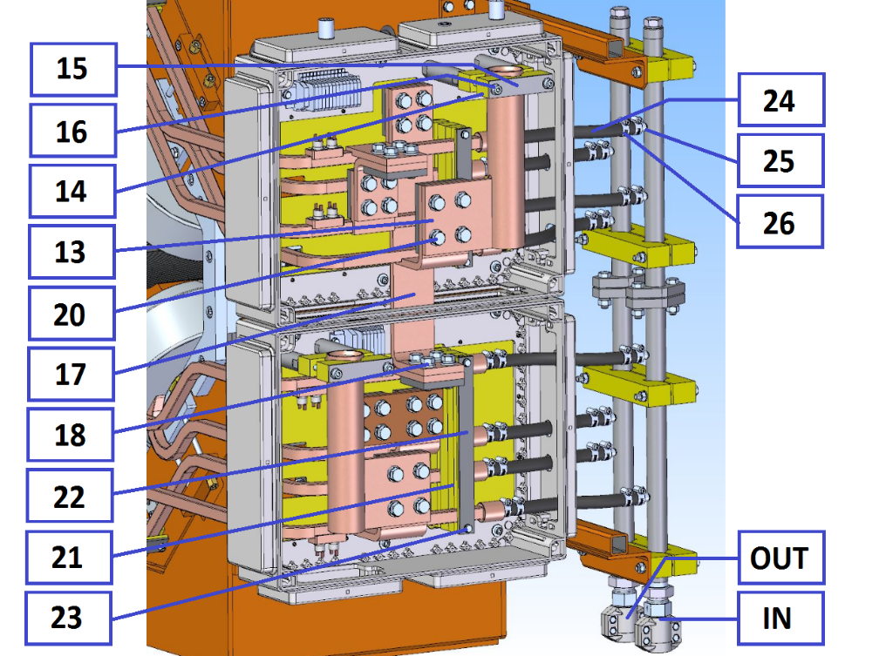
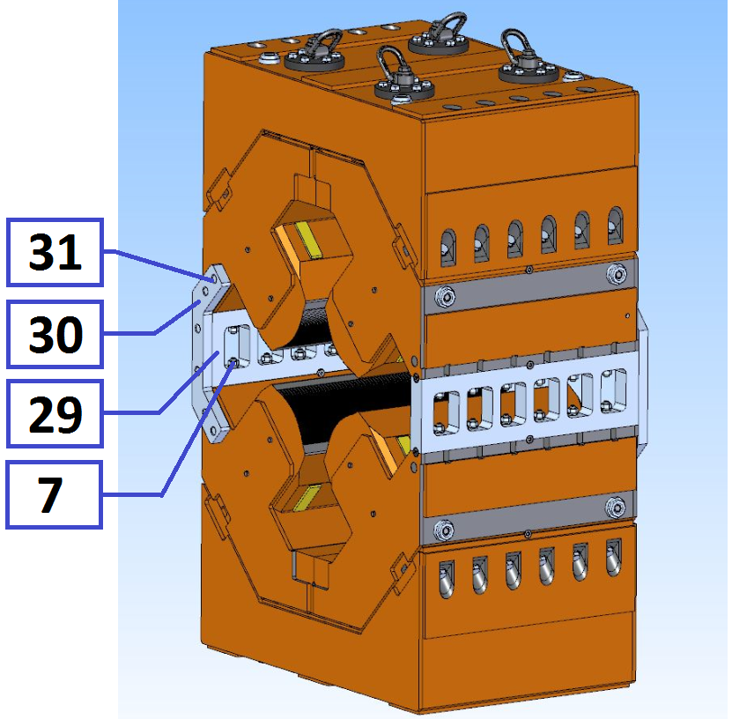
Assembling of the magnet
10. Assemble the connection boxes 12:
10.1. Install the cable connection plates 13 (2 pcs.) using the mounting blocks 14 using the fastening plates 15 with the bolts 16 (4 pcs.);
10.2. Connect the upper and lower windings using the midpoint connection plate 17 (1 pcs.) with the bolts 18 (8 pcs.);
10.3. Connect the cable connection plates 13 (2 pcs.) with the beginning and end of the upper and lower windings with the bolts 20 (8 pcs.);
10.4. Fix the outlets of the sections of the windings using the mounting blocks 21 using the fastening plates 22 with the bolts 23 (4 pcs.);
11. Connect the water hoses 24 (8 pcs.) to the fittings 25, fix with the clamps 26 (16 pcs.).

Slide 14
Production Plan
Month | Activity | Begin | End
0 | Contract is signed | 26.06.2018 | 26.06.2018
8 | Tecnological design, Equipment design | 25.02.2019 | 29.11.2019
14 | Conceptual Design Review | 16.08.2019 | 16.08.2019
15 | Design in detail | 19.09.2019 | 21.09.2019
16 | Final Design Review | 07.11.2019 | 07.11.2019
17 | Material procurement | 20.11.2019 | 30.01.2020
24 | Tooling manufacturing | 17.06.2020 | 25.10.2020
28 | Manufacturing of pre-series | 28.10.2020 | 28.12.2020
30 | FAT of pre-series | 28.12.2020 | 25.02.2021
32 | Shipment of pre-series to FAIR | 02.03.2021 | 24.03.2021
33 | SAT A of pre-series | 07.04.2021 | 19.05.2021
33 | Manufacturing of series | none | none
33 | Prepare series production | none | none
33 | Series production started | none | none
33 | FAT accepted | none | none
41 | Site Assembling series | 20.11.2021 | 03.04.2022
42 | SAT Series | 21.12.2021 | 30.05.2022
43 | SAT accepted | 20.01.2022 | 08.08.2022
NSQ production plan

