Slide 1
Octupole Corrector for CR.
CDR Review.
D. Gurov, A.Utkin for CR team
BINP, Novosibirsk
November 27, 2019
3rd FAIR-BINP Workshop, Novosibirsk, Russia

Slide 2
Contents
CDR documentation
Project management structure
Base principles and Concept
OC octupoles in CR
Calculations and simulations
Assembling
Production plan

Slide 3
CDR Documentations
Risk analysis and hazard analysis https://edms.cern.ch/document/2245853/1
Operating manual / user manual https://edms.cern.ch/document/2245855/1
Test plan
https://edms.cern.ch/document/2245857/1
Mechanics - 3D model
https://edms.cern.ch/document/2245861/1

Slide 4
Project management
Name: Denis Gurov
Position: Research Scientist Email: D.S.Gurov@inp.nsk.su
Tel.: +7383329-4684
The Deputy is responsible for:
Follow-up of production activities;
Magnetic measurements to ensure the required field and field quality;
Factory Acceptance Test (FAT) to verify the given specifications of the components;
Name: Anatoly Utkin
Position: Research Scientist Email: A.V.Utkin@inp.nsk.su
Tel.: +7383329-4684
The Deputy is responsible for:
Preliminary magnet design, final magnet design (development, simulation);
Magnetic field calculation;
More Details in “Quality Plan”
The Project Manager
Name: Alexandr Starostenko
Position: Head of BINP Division № 5-11 Email: A.A.Starostenko@inp.nsk.su
Tel.: +7383329-4940
The Project Manager is responsible for:
Development of the technical documentation and manufacturing drawings for the deliverables;
Ensuring that the production of the magnets is according to the technical specifications and time schedule;
Follow-up of production activities;
Transportation, delivery of the equipment to the FAIR site;
Regular and timely reporting on progress and problems;
Timely conduction/participation of reviews and provisions of feedback;
Scientific Design Department
Name: Vladimir Korchagin
Position: Principal Design Engineer Email: V.Ya.Korchagin@inp.nsk.su
Tel.: + 7383329-4953
The Principal Design Engineer is responsible for:
Magnet design (3D-models, production drawings);

Slide 5
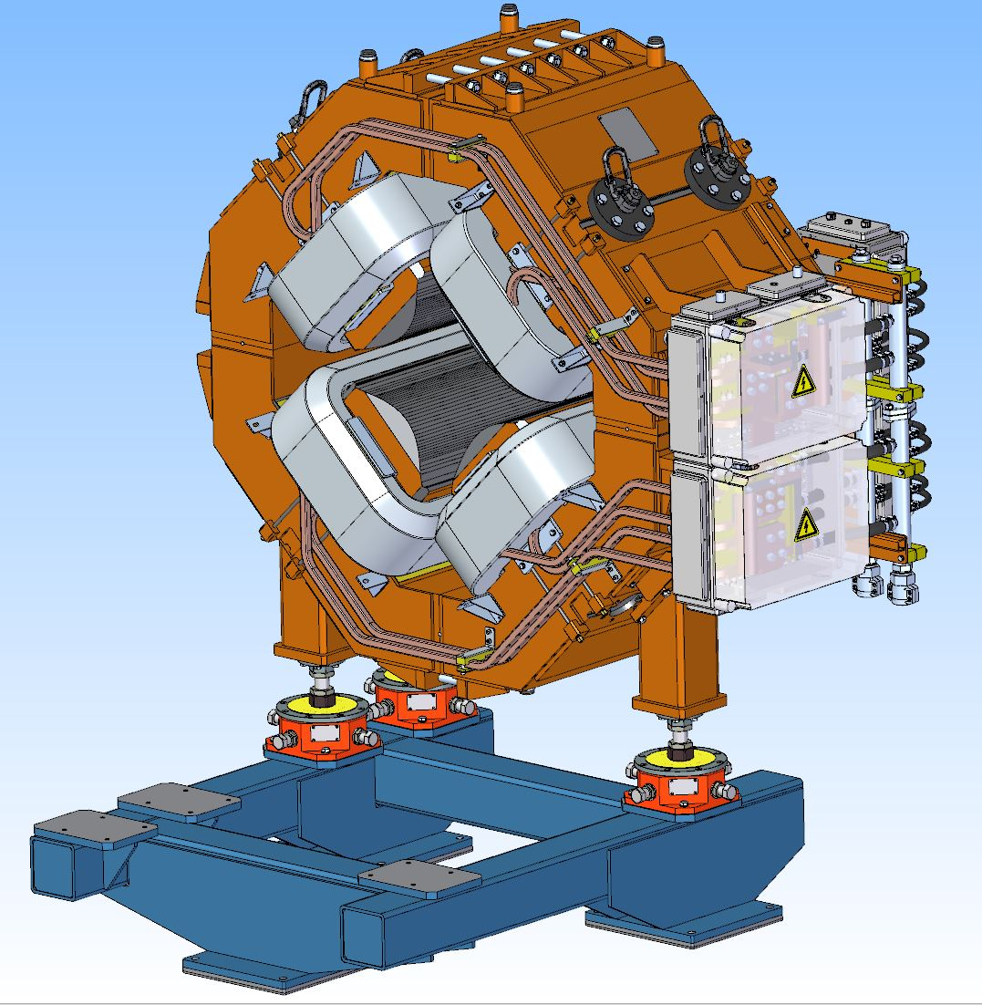
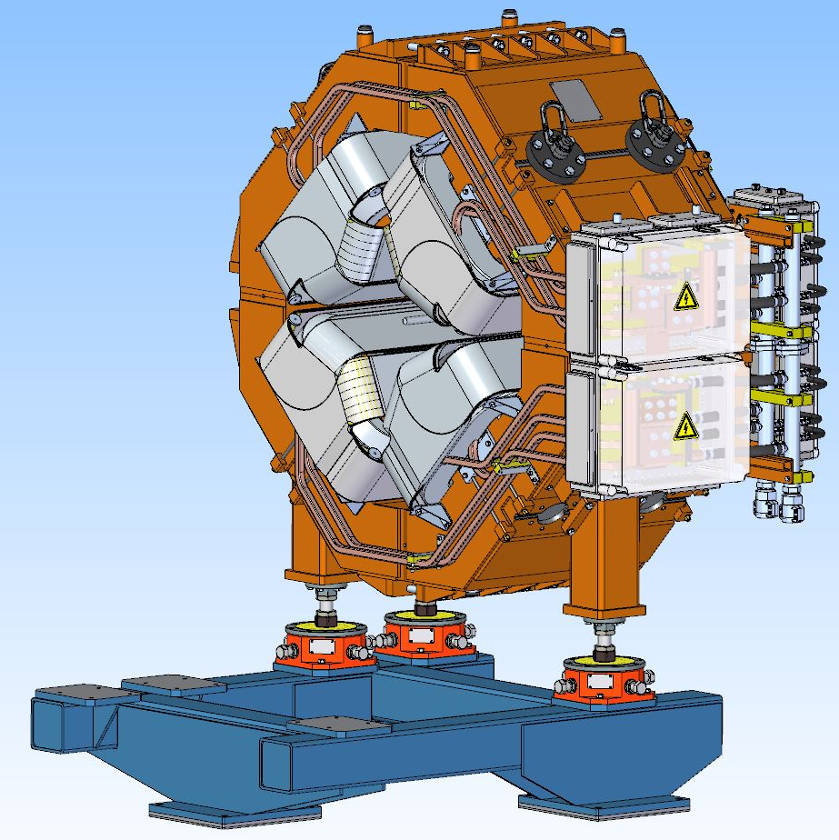
Construction of OC magnet

Slide 6
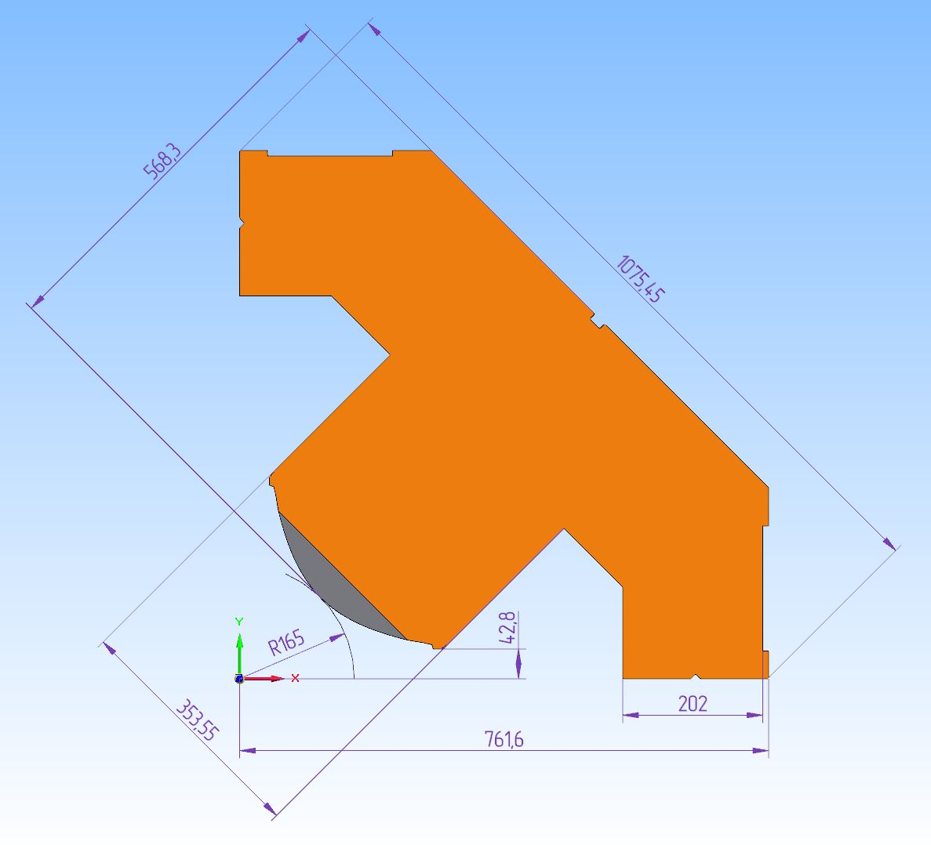
Construction of OC magnet
Quarter of SWQ yoke
Quarter of SWQ yoke with quadrupole and octupole coils

Slide 7
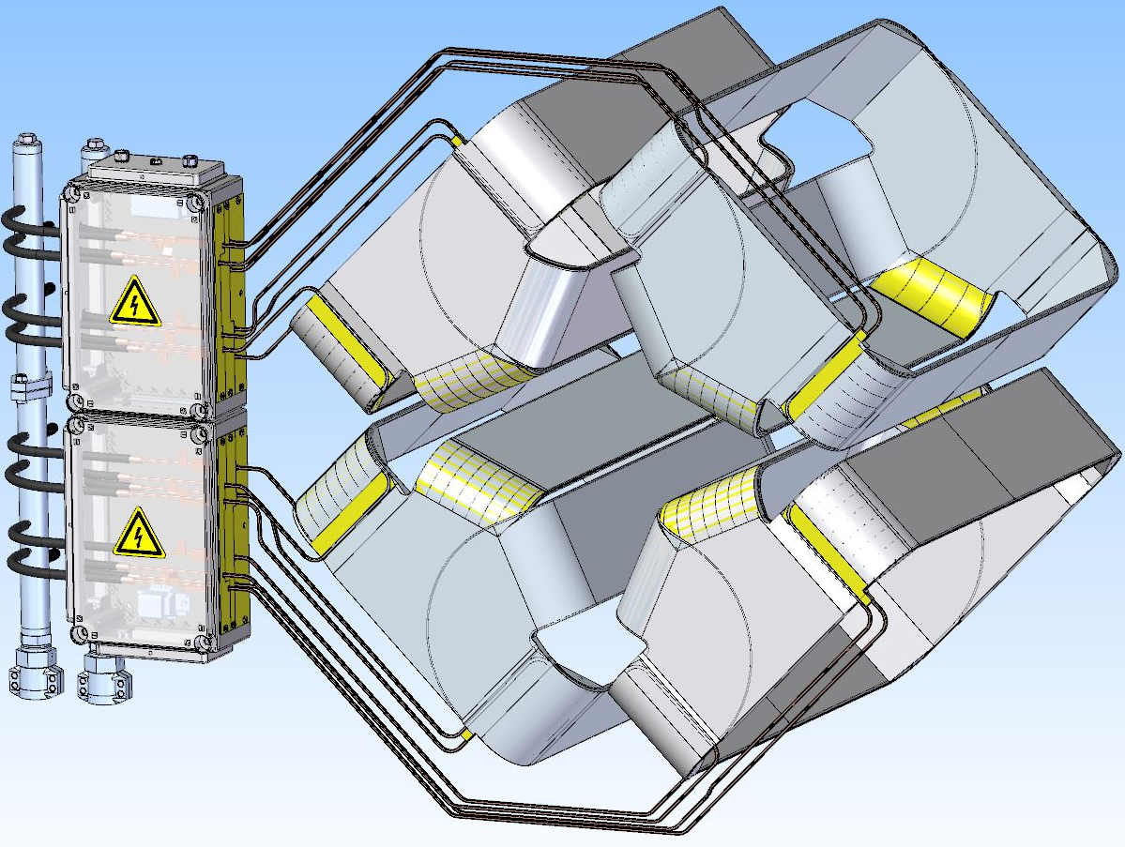
OC Octupole parameters
Parameter | Value
Water consumption | 2.7 l/min
Dimensions of wire for coils | 4.5x4.5 mm
Number of OC magnets | 12
Overall weight | 124 kg
Coil current | 42 A
Number of coil turns | 33
Coil resistance | 930 mΩ
Coil inductance | 68 mH
Maximum DC power loss | 1.65 kW

Slide 8
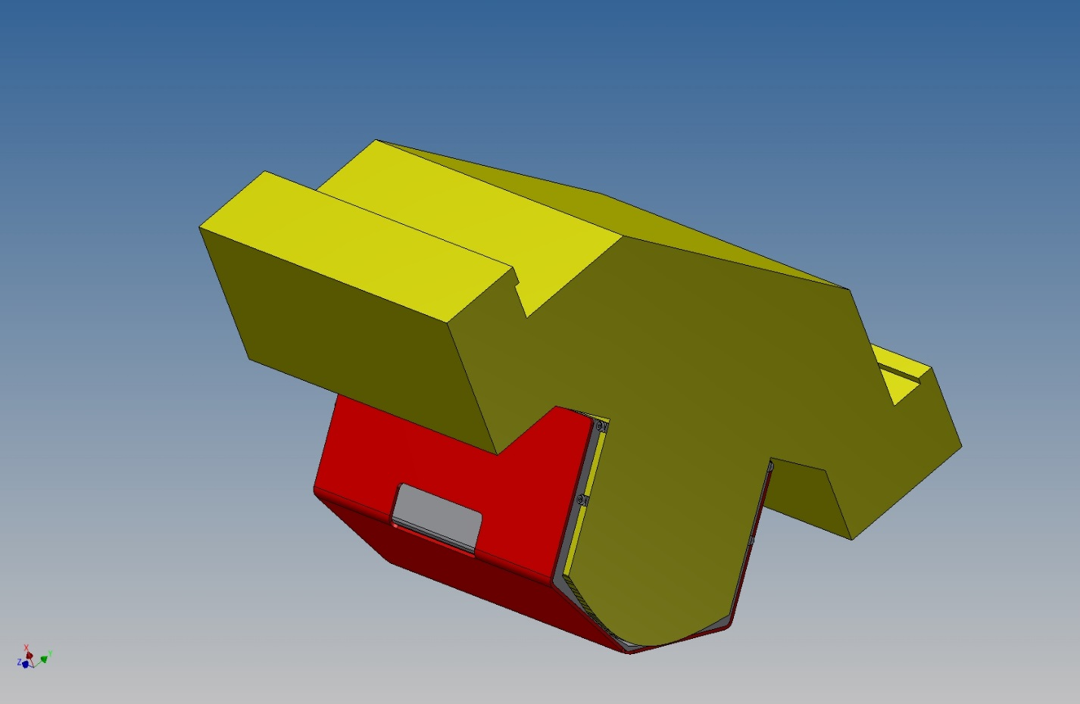
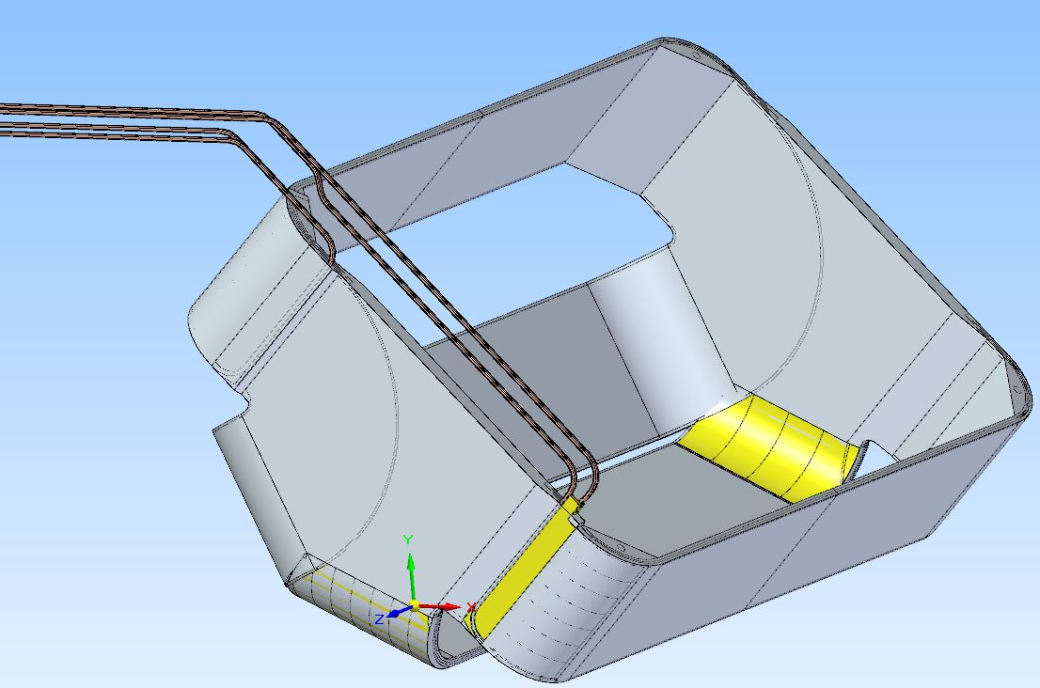
Various constructions of octupole coils
1
3

Slide 9
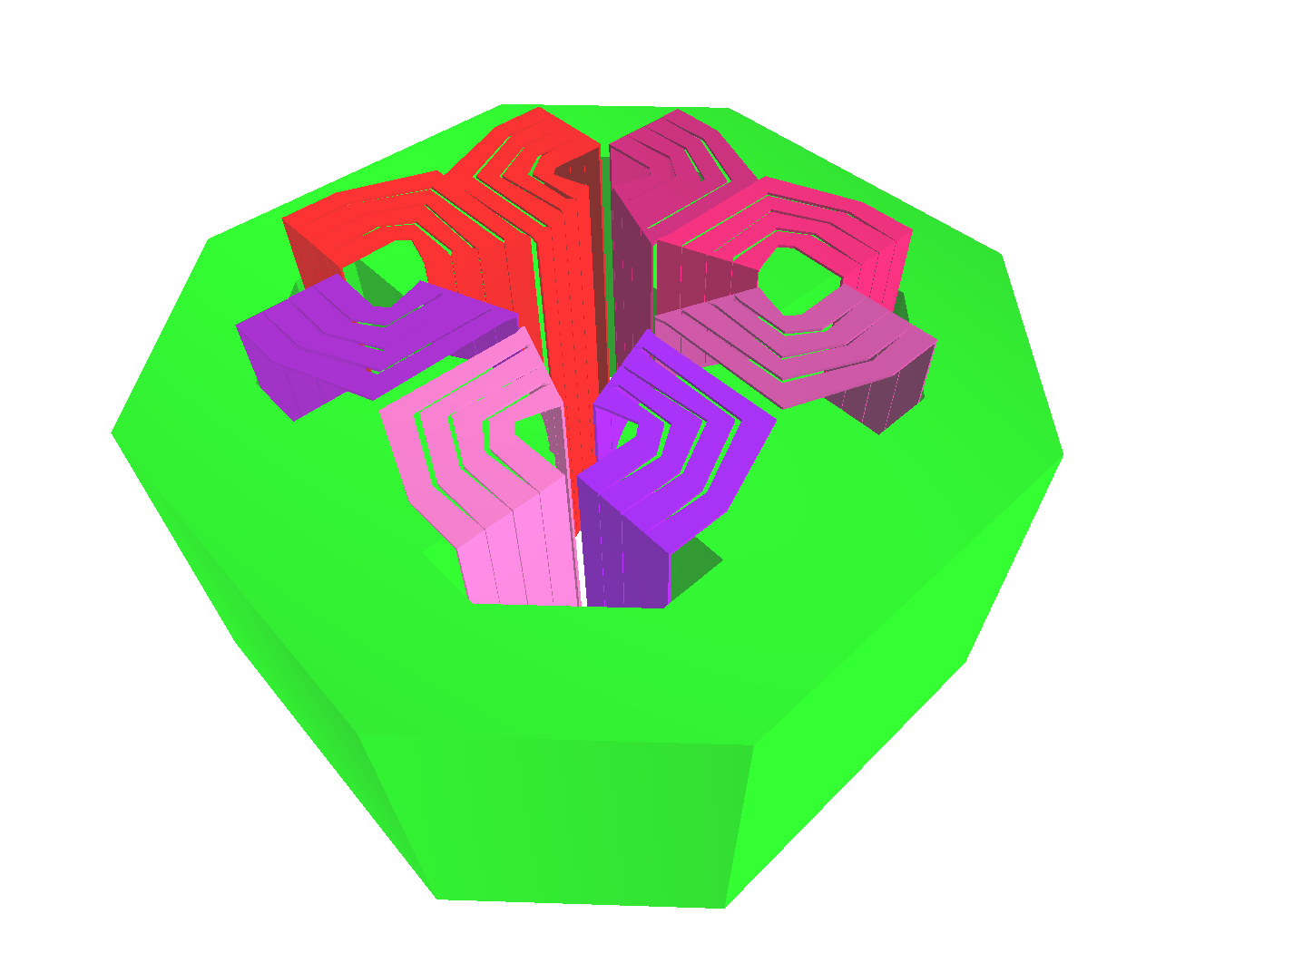
OC magnet calculations
Longitudinal distribution of magnetic field (Gs) in octupole corrector at total current 1 kA per coil at 10 cm. radius (green and red lines are showing the edge of yoke and octupole coils correspondently).
3D Magneto-static calculations in “Mermaid” code
Coil coordinates (mm)
X (mm) | Y (mm)
107.4 | 96.9
109.3 | 101.1
274.7 | 21.4
276.5 | 25.5
412.8 | 8.1
409.7 | 11.4
539.4 | 141.4
542.6 | 138.1
96.9 | 107.4
101.1 | 109.3
21.4 | 274.7
25.5 | 276.5
8.1 | 412.8
11.4 | 409.7
138.1 | 542.6
141.4 | 539.4

Slide 10
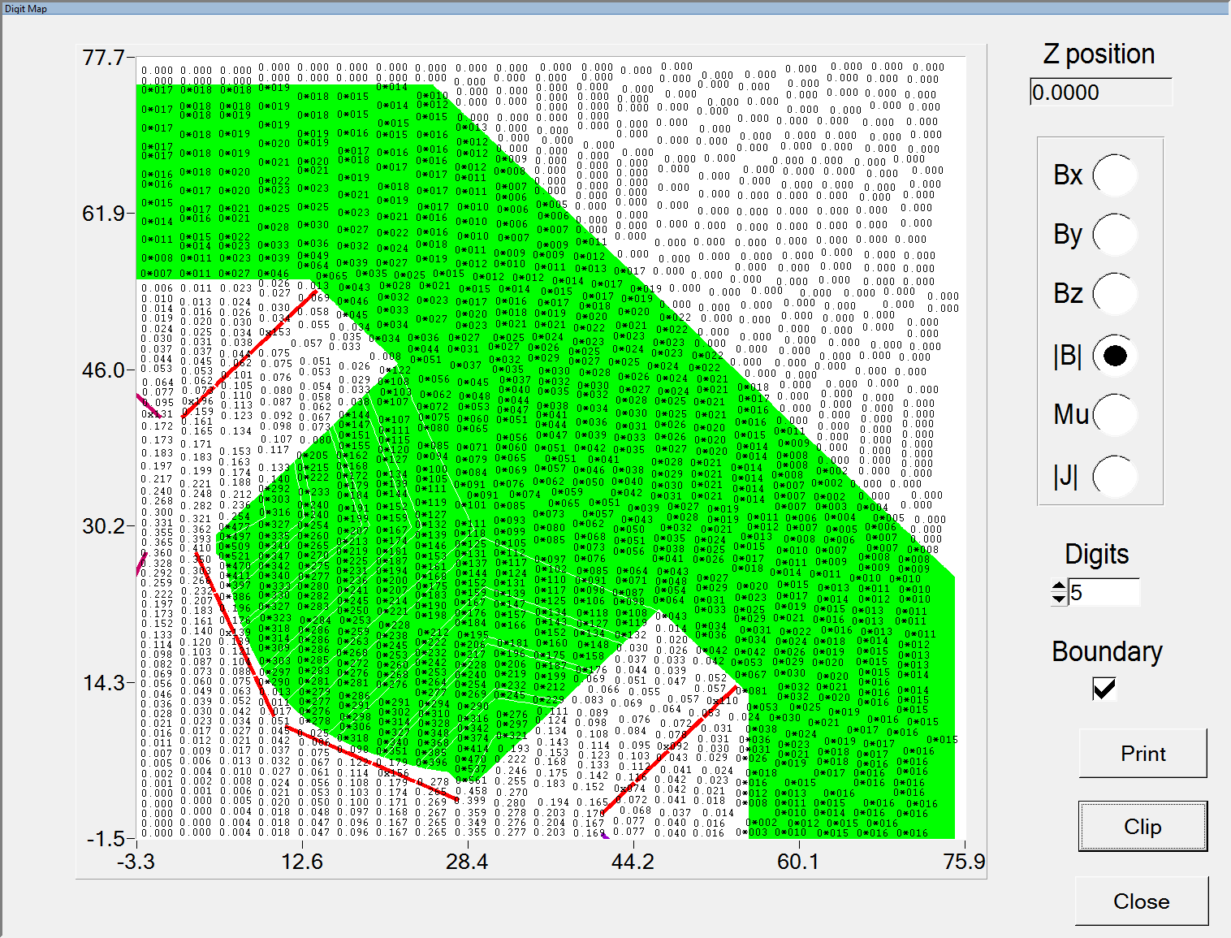
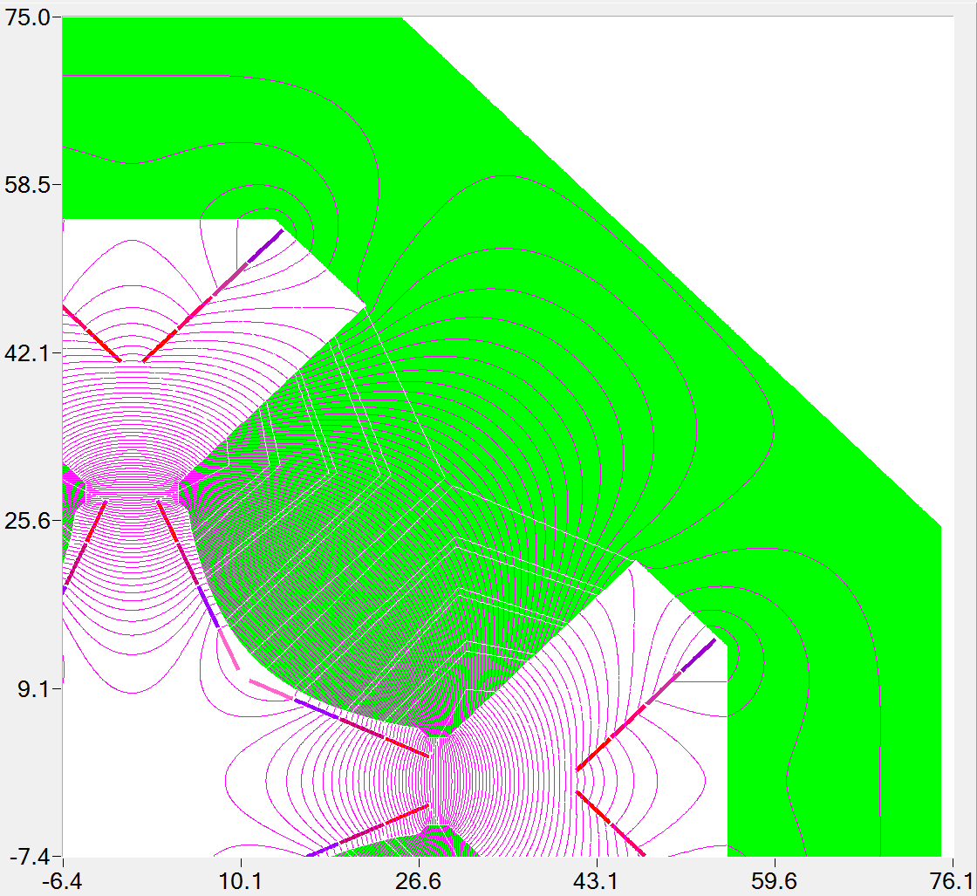
Field in yoke
Field in yoke (kGs) at maximal octupole gradient value
Flux lines

Slide 11
Field quality
The integral harmonic contribution of the field at the 120 mm radius.
Integral contributions of 8th 12th and 16th multipoles at 120 mm radius.
n | An (T/m**2) | Bn (T/m**2)
1 | 2.31E-05 | 0
2 | -1.16E-05 | 0
3 | 8.10E-05 | 0
4 | 1.53 | 0
5 | 1.85E-04 | 0
6 | 0.00 | 0
7 | -2.55E-04 | 0
8 | -8.16E-03 | 0
9 | -2.43E-04 | 0
10 | 0.00 | 0
11 | 1.97E-04 | 0
12 | -1.01E-02 | 0
13 | 1.62E-04 | 0
14 | -1.16E-05 | 0
15 | -1.27E-04 | 0
16 | 6.60E-03 | 0
17 | -1.04E-04 | 0
18 | 0.00 | 0

Slide 12
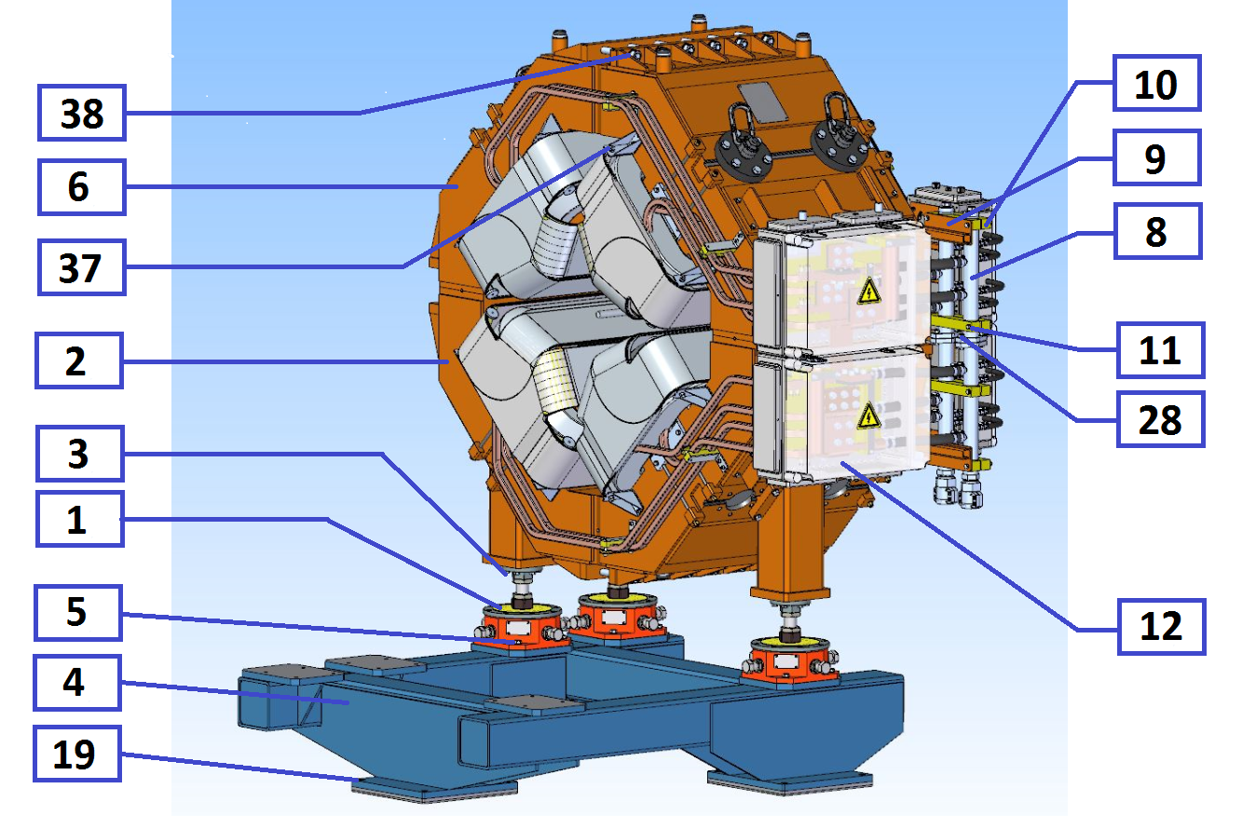
Assembling of the magnet
1. Fasten the Octupole Corrector coils to the quarters of SWQ yoke using bolts 37 (16 pcs.);
2. Fasten the quarters of SWQ yoke to each other to create upper and lower half of SWQ yoke, using bolts 38 (12 pcs.);
3. Fasten the alignment feet 1 (3 pcs.) to the lower half of the yoke 2 (1 pcs.), using bolts 3 (18 pcs.);
4. Install the lower half of the yoke of the SWQ quadrupole on the stand 4 (1 pcs.) (alignment feet must be properly fastened to a stand using bolts 5 (12 pcs.) to prevent any fall);
5. Install the lower half of the sextupole yoke on the stand (sextupole alignment feet must be properly fastened to a stand to prevent any fall);
6. Install the vacuum chamber on the lower half of the SWQ quadrupole and sextupole;
7. Install the upper half of the yoke of the SWQ quadrupole 6 (1 pcs.) on the lower half of the SWQ quadrupole and fasten to each other using bolts 7 (12 pcs.);
8. Install the upper half of the sextupole yoke on the lower half of the sextupole and fasten to each other using bolts;
9. Install the manifolds 8 (2 pcs.) on the side of the magnet on the brackets 9 (2 pcs.) using the mounting blocks 10 (4 pcs.) with the bolts 11 (8 pcs.);
10. Connect the lower and upper half of the manifolds using bolts 28 (4 pcs.);
11. Install the connection boxes for quadrupole coils 12 (2 pcs.) and octupole coils 27 (2 pcs.);

Slide 13
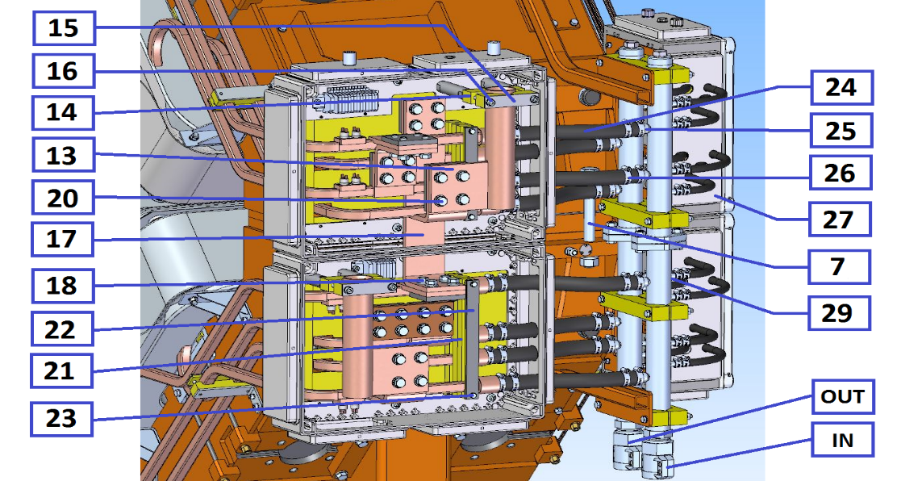
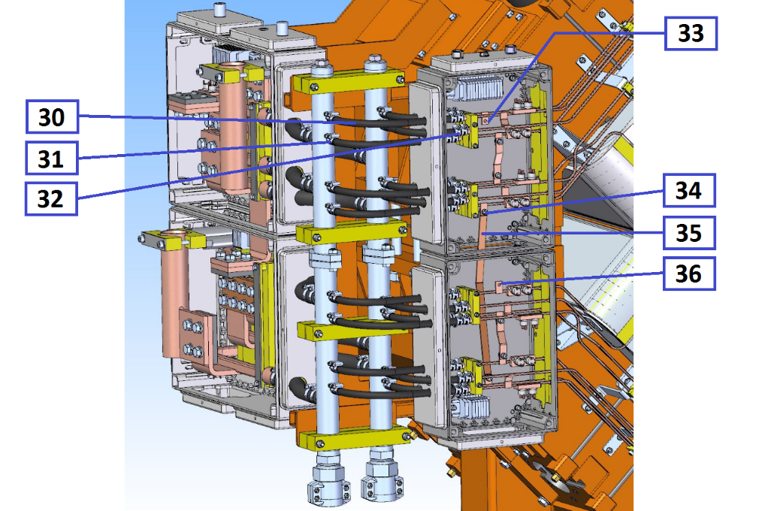
Assembling of the magnet
12. Assemble the quadrupole coils connection boxes 12:
12.1. Install the cable connection plates 13 (2 pcs.) using the mounting blocks 14 using the fastening plates 15 with the bolts 16 (4 pcs.);
12.2. Connect the upper and lower windings using the midpoint connection plate 17 (1 pcs.) with the bolts 18 (8 pcs.);
12.3. Connect the cable connection plates 13 (2 pcs.) with the beginning and end of the upper and lower windings with the bolts 20 (8 pcs.);
12.4. Fix the outlets of the sections of the windings using the mounting blocks 21 using the fastening plates 22 with the bolts 23 (4 pcs.);
13. Connect the water hoses 24 (8 pcs.) to the fittings 25, fix with the clamps 26 (16 pcs.) ;
14. Assemble the octupole coils connection boxes 27:
14.1. Connect the water hoses 30 (16 pcs.) to the fittings 29, fix with the clamps 31,32 (32 pcs.);
14.2. Connect the upper and lower windings using the midpoint connection plate 35 (1 pcs.) with the bolts 34 (2 pcs.);
14.3. Connect power supply to the current outlets 33,36 .

Slide 14
Production Plan
Month | Activity | Begin | End
0 | Contract is signed | 26.06.2018 | 26.06.2018
7 | Tecnological design, Equipment design | 05.02.2019 | 09.11.2019
12 | Conceptual Design Review | 02.07.2019 | 02.07.2019
13 | Design in detail | 05.08.2019 | 26.09.2019
16 | Final Design Review | 07.11.2019 | 07.11.2019
17 | Material procurement | 20.11.2019 | 30.01.2020
19 | Tooling manufacturing | 19.01.2020 | 17.06.2020
25 | Manufacturing of pre-series | 20.07.2020 | 19.09.2020
27 | FAT of pre-series | 19.09.2020 | 17.11.2020
29 | Shipment of pre-series to FAIR | 22.11.2020 | 14.12.2020
30 | SAT A of pre-series | 28.12.2020 | 08.02.2021
36 | Manufacturing of series | 09.07.2021 | 23.05.2023
32 | Prepare series production | 11.03.2021 | 12.07.2021
36 | Series production started | 12.07.2021 | 12.07.2021
38 | FAT accepted | 09.09.2021 | 23.05.2023
39 | Site Assembling series | 21.09.2021 | 27.06.2023
40 | SAT Series | 22.10.2021 | 04.07.2023
40 | SAT accepted | 22.10.2021 | 04.07.2023
OC production plan

