Slide 1
EWQ Magnet for CR.
CDR Review.
D. Gurov, A.Utkin for CR team
BINP, Novosibirsk
November 27, 2019
3rd FAIR-BINP Workshop, Novosibirsk, Russia

Slide 2
Contents
CDR documentation
Project management structure
Base principles and Concept
EWQ quadrupoles in CR
Calculations and simulations
Assembling
Production plan

Slide 3
CDR Documentations
The 3D-models (in EDMS): https://edms.cern.ch/document/2147043/1
Installation operation plan (in EDMS): https://edms.cern.ch/document/2147037/1

Slide 4
Project management
Name: Anatoly Utkin
Position: Research Scientist Email: A.V.Utkin@inp.nsk.su
Tel.: +7383329-4684
The Deputy is responsible for:
Follow-up of production activities;
Magnetic measurements to ensure the required field and field quality;
Factory Acceptance Test (FAT) to verify the given specifications of the components;
Name: Denis Gurov
Position: Research Scientist Email: D.S.Gurov@inp.nsk.su
Tel.: +7383329-4684
The Deputy is responsible for:
Preliminary magnet design, final magnet design (development, simulation);
Magnetic field calculation;
More Details in “Quality Plan”
The Project Manager
Name: Alexandr Starostenko
Position: Head of BINP Division № 5-11 Email: A.A.Starostenko@inp.nsk.su
Tel.: +7383329-4940
The Project Manager is responsible for:
Development of the technical documentation and manufacturing drawings for the deliverables;
Ensuring that the production of the magnets is according to the technical specifications and time schedule;
Follow-up of production activities;
Transportation, delivery of the equipment to the FAIR site;
Regular and timely reporting on progress and problems;
Timely conduction/participation of reviews and provisions of feedback;
Scientific Design Department
Name: Vladimir Korchagin
Position: Principal Design Engineer Email: V.Ya.Korchagin@inp.nsk.su
Tel.: + 7383329-4953
The Principal Design Engineer is responsible for:
Magnet design (3D-models, production drawings);

Slide 5
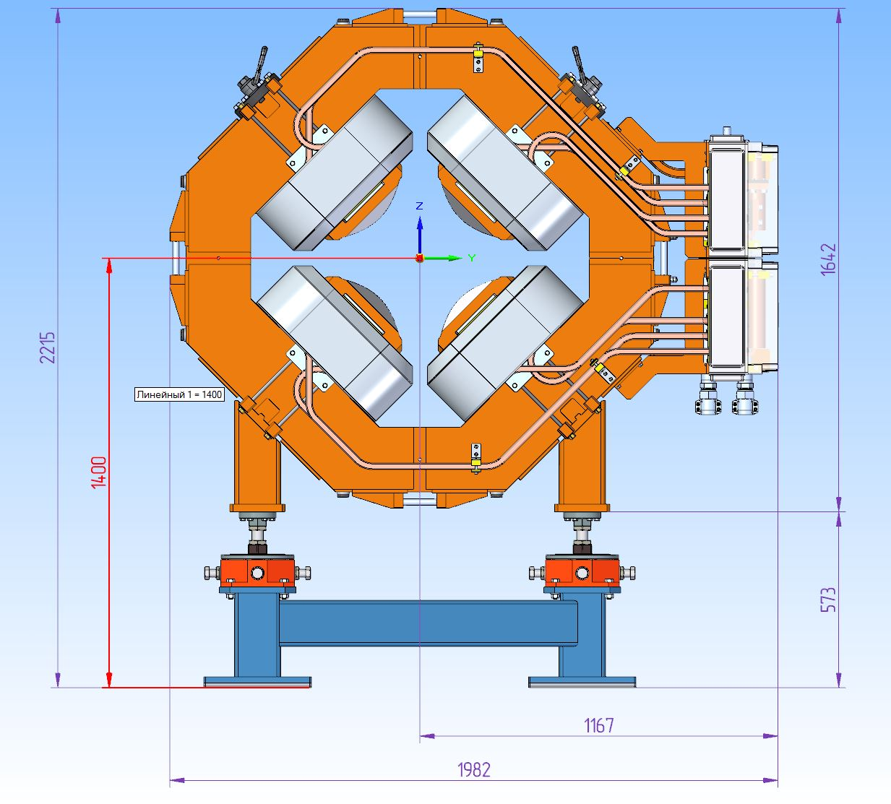
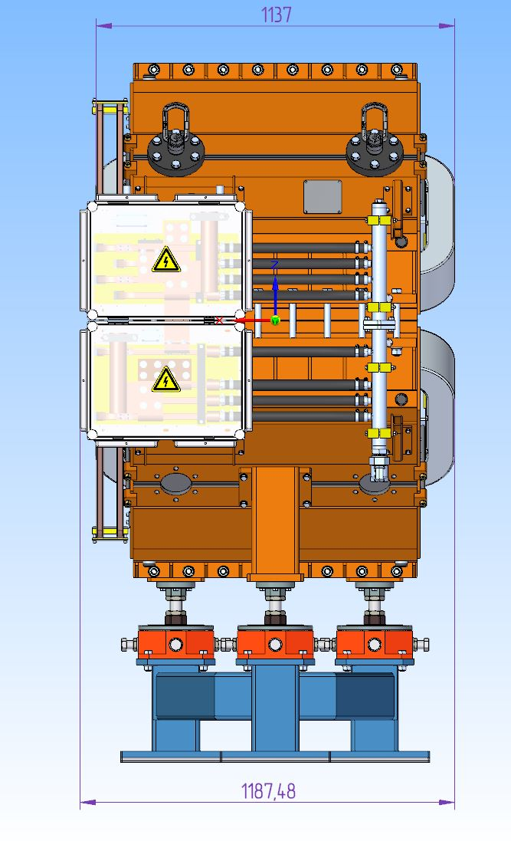
Construction of EWQ magnet

Slide 6
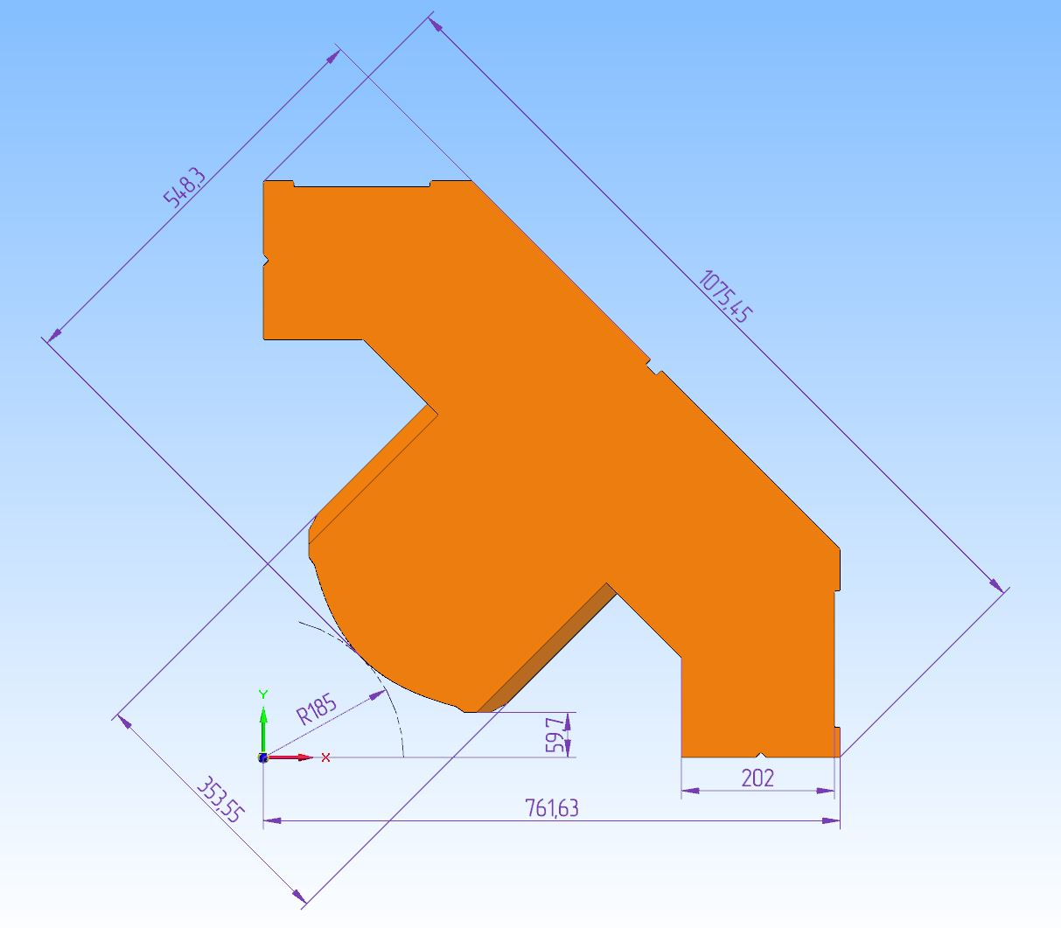
Construction of EWQ magnet
Quarter of yoke
35 turns coil 20.1x20.1 mm wire 11 mm hole

Slide 7
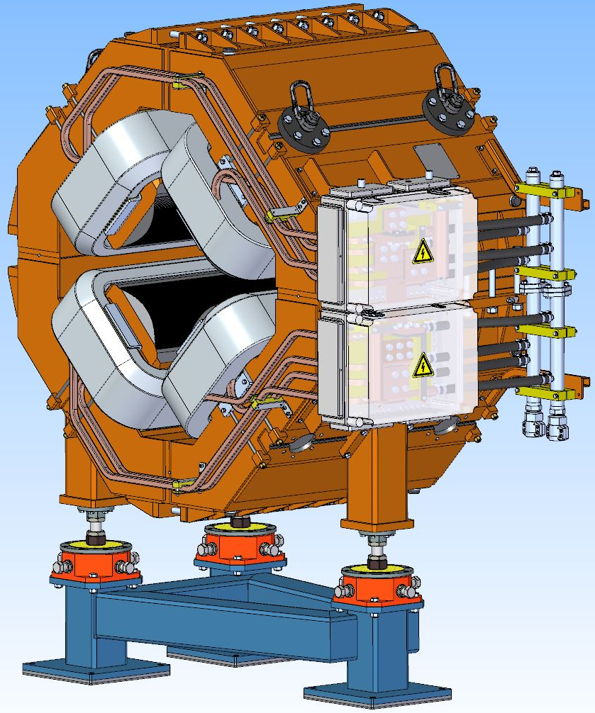
EWQ Quadrupole and stand for the quadrupole
Parameter | Value
Lamination thickness | 1 mm
Dimensions of wire for coils | 20.1x20.1 mm
Number of WQ magnets | 3
Overall weight | 10.5 t
Coil current | 1470 A
Number of coil turns | 35
Coil resistance | 25.6 mΩ
Coil inductance | 62 mH
Maximum DC powerloss | 55.3 kW

Slide 8
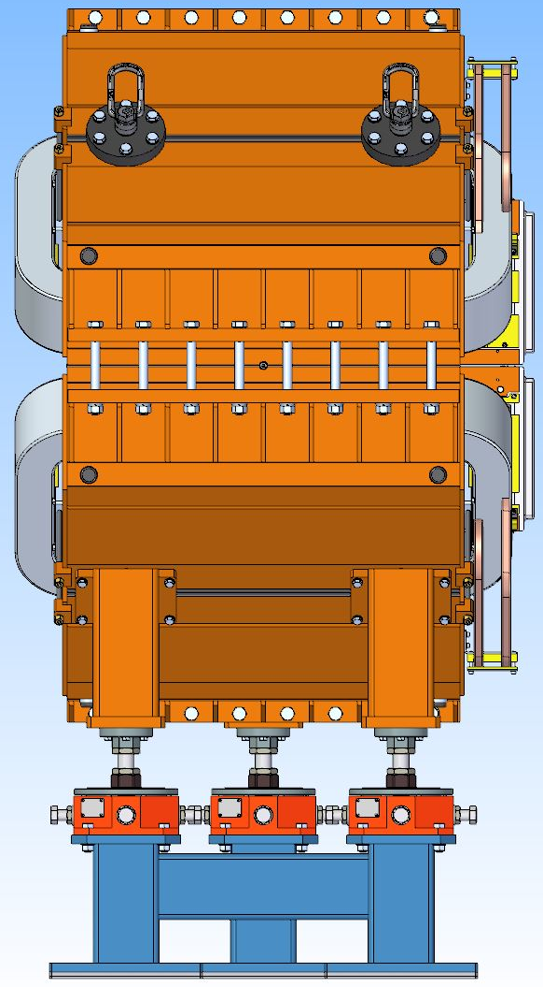
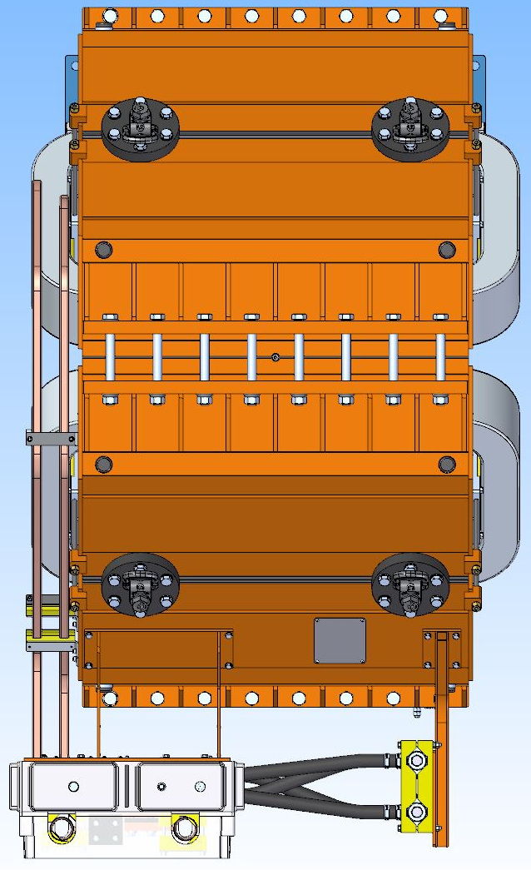
EWQ Quadrupole side view and top view

Slide 9
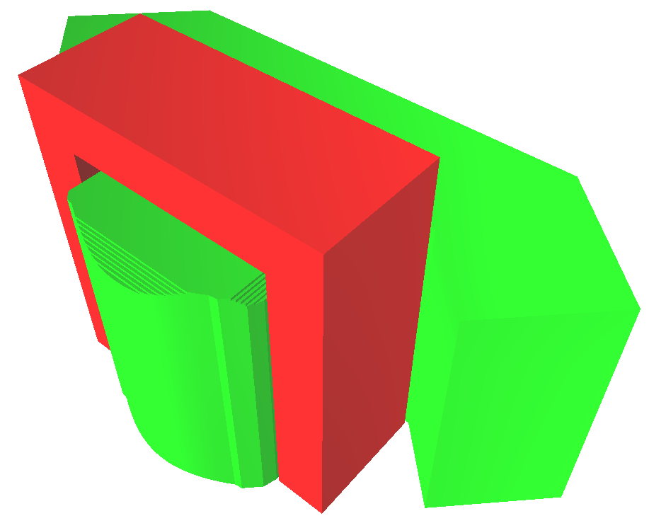
EWQ calculations
3D Magneto-static calculations in “Mermaid” code
Pole profile
Pole profile coordinates (mm)
Y (mm) | X (mm)
71.7 | 321.5
59.7 | 300
59.7 | 265
67.37 | 254
Hyperbola: | X*Y=17112.5
254 | 59.7
300 | 59.7
321.5 | 71.7
Chamfer 29 mm depth 29 mm height, side cut outs 20 mm depth 20 mm width

Slide 10
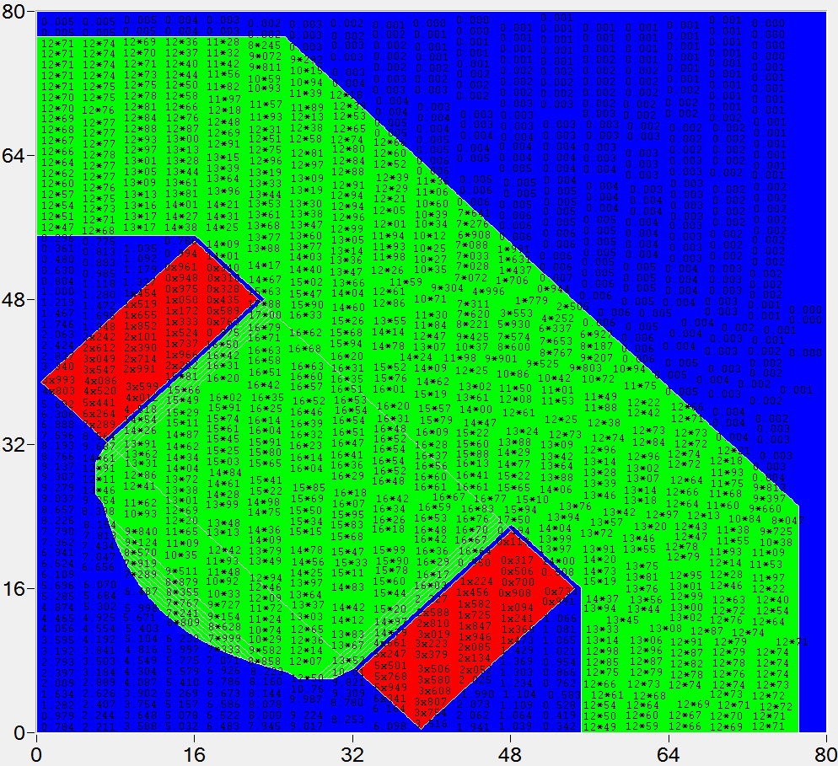
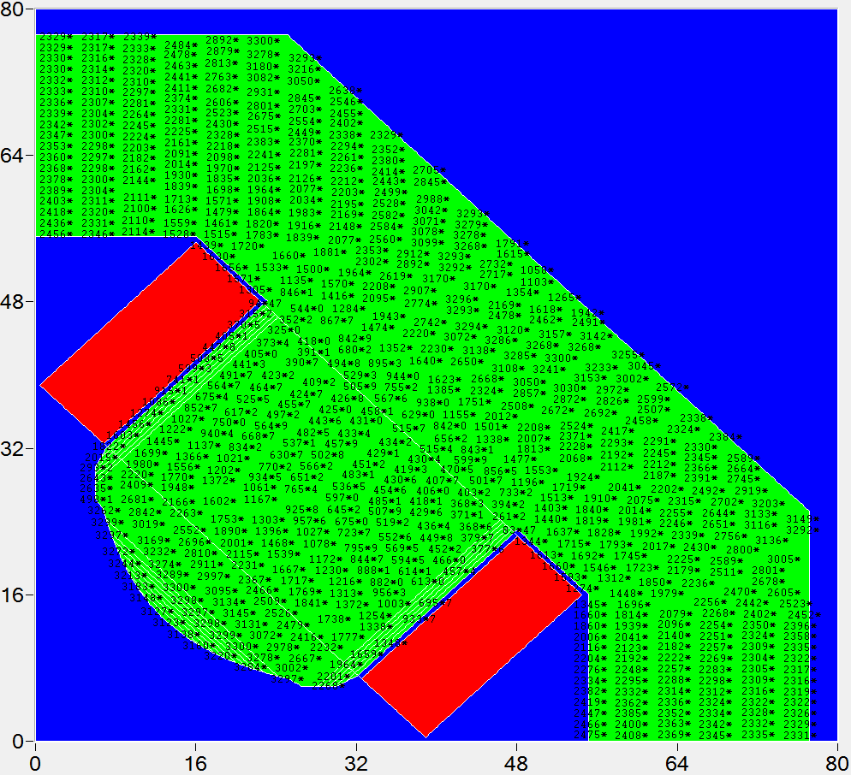
Field in yoke
Field in yoke (kGs) at maximal gradient value
Permeability in yoke at maximal gradient value

Slide 11
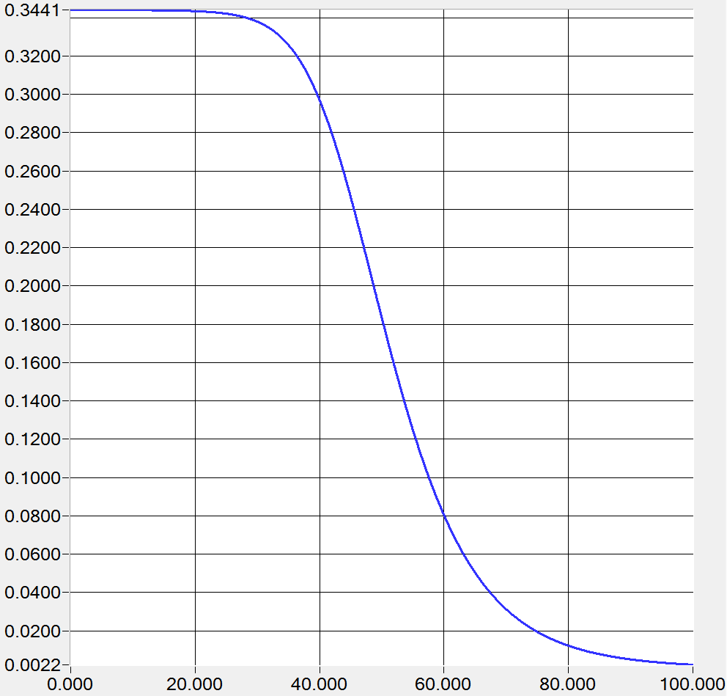
Field quality
Longitudinal gradient distribution at maximal gradient value.
Integral contributions of 6th and 10th multipoles at 136 mm radius.
kGs/cm
cm

Slide 12
Field quality
H - Integral Homogeneity
H= $\left[\int{B\left(x\right)}dl−G∙x∙l\right]/[G∙x∙l]$

Slide 13
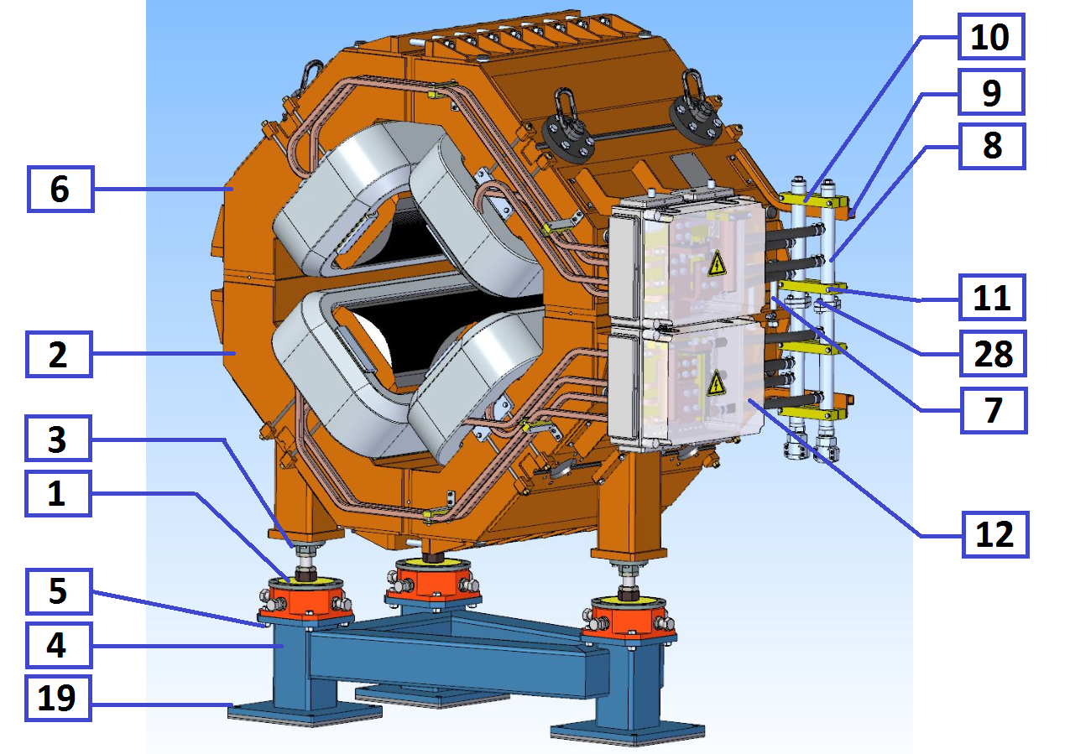
Assembling of the magnet
1. Fasten the alignment feet 1 (3 pcs.) to the lower half of the yoke 2 (1 pcs.), using bolts 3 (18 pcs.);
2. Install the lower half of the yoke of the WQ quadrupole on the stand 4 (1 pcs.) (alignment feet must be properly fastened to a stand using bolts 5 (12 pcs.) to prevent any fall);
3. Install the vacuum chamber on the lower half of the WQ quadrupole;
4. Install the upper half of the yoke of the WQ quadrupole 6 (1 pcs.) on the lower half of the WQ quadrupole and fasten to each other using bolts 7 (16 pcs.);
5. Install the manifolds 8 (2 pcs.) on the side of the magnet on the brackets 9 (2 pcs.) using the mounting blocks 10 (4 pcs.) with the bolts 11 (8 pcs.);
6. Connect the lower and upper half of the manifolds using bolts 28 (4 pcs.);
7. Install the connection boxes 12 (2 pcs.);

Slide 14
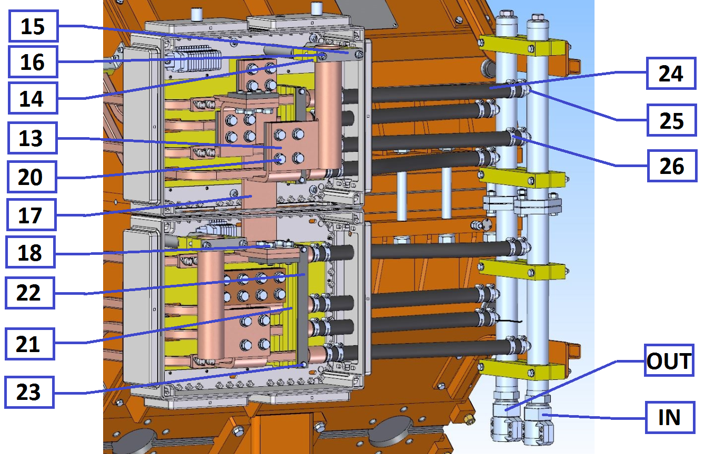
Assembling of the magnet
8. Assemble the connection boxes 12:
8.1. Install the cable connection plates 13 (2 pcs.) using the mounting blocks 14 using the fastening plates 15 with the bolts 16 (4 pcs.);
8.2. Connect the upper and lower windings using the midpoint connection plate 17 (1 pcs.) with the bolts 18 (8 pcs.);
8.3. Connect the cable connection plates 13 (2 pcs.) with the beginning and end of the upper and lower windings with the bolts 20 (8 pcs.);
8.4. Fix the outlets of the sections of the windings using the mounting blocks 21 using the fastening plates 22 with the bolts 23 (4 pcs.);
9. Connect the water hoses 24 (8 pcs.) to the fittings 25, fix with the clamps 26 (16 pcs.).

Slide 15
Production Plan
Month | Activity | Begin | End
0 | Contract is signed | 26.06.2018 | 26.06.2018
6 | Tecnological design, Equipment design | 26.01.2019 | 30.10.2019
11 | Conceptual Design Review | 22.06.2019 | 22.06.2019
12 | Design in detail | 26.07.2019 | 26.09.2019
16 | Final Design Review | 07.11.2019 | 07.11.2019
17 | Material procurement | 20.11.2019 | 30.01.2020
17 | Tooling manufacturing | 19.01.2020 | 28.05.2020
21 | Manufacturing of pre-series | 30.06.2020 | 30.08.2020
23 | FAT of pre-series | 30.08.2020 | 28.10.2020
25 | Shipment of pre-series to FAIR | 02.11.2020 | 24.11.2020
26 | SAT A of pre-series | 08.12.2020 | 19.01.2021
28 | Manufacturing of series | 19.02.2021 | 23.05.2023
28 | Prepare series production | 19.02.2021 | 22.06.2021
32 | Series production started | 22.06.2021 | 22.06.2021
34 | FAT accepted | 20.08.2021 | 23.05.2023
37 | Site Assembling series | 23.07.2021 | 27.06.2023
38 | SAT Series | 23.08.2021 | 04.07.2023
38 | SAT accepted | 23.08.2021 | 04.07.2023

