Slide 1
WQ Magnet for CR.
CDR/FDR Review.
D. Gurov, A.Utkin for CR team
BINP, Novosibirsk
November 28, 2019
3rd FAIR-BINP Workshop, Novosibirsk, Russia

Slide 2
Contents
CDR documentation
Project management structure
Base principles and Concept
WQ quadrupoles in CR
Calculations and simulations
Assembling
Production plan

Slide 3
FDR Documentations
The 3D-models (in EDMS): https://edms.cern.ch/document/2146941/1
Mechanics - 2D drawings anhttps://edms.cern.ch/document/2245832/1

Slide 4
Project management
Name: Anatoly Utkin
Position: Research Scientist Email: A.V.Utkin@inp.nsk.su
Tel.: +7383329-4684
The Deputy is responsible for:
Follow-up of production activities;
Magnetic measurements to ensure the required field and field quality;
Factory Acceptance Test (FAT) to verify the given specifications of the components;
Name: Denis Gurov
Position: Research Scientist Email: D.S.Gurov@inp.nsk.su
Tel.: +7383329-4684
The Deputy is responsible for:
Preliminary magnet design, final magnet design (development, simulation);
Magnetic field calculation;
More Details in “Quality Plan”
The Project Manager
Name: Alexandr Starostenko
Position: Head of BINP Division № 5-11 Email: A.A.Starostenko@inp.nsk.su
Tel.: +7383329-4940
The Project Manager is responsible for:
Development of the technical documentation and manufacturing drawings for the deliverables;
Ensuring that the production of the magnets is according to the technical specifications and time schedule;
Follow-up of production activities;
Transportation, delivery of the equipment to the FAIR site;
Regular and timely reporting on progress and problems;
Timely conduction/participation of reviews and provisions of feedback;
Scientific Design Department
Name: Vladimir Korchagin
Position: Principal Design Engineer Email: V.Ya.Korchagin@inp.nsk.su
Tel.: + 7383329-4953
The Principal Design Engineer is responsible for:
Magnet design (3D-models, production drawings);

Slide 5
Construction of WQ magnet

Slide 6
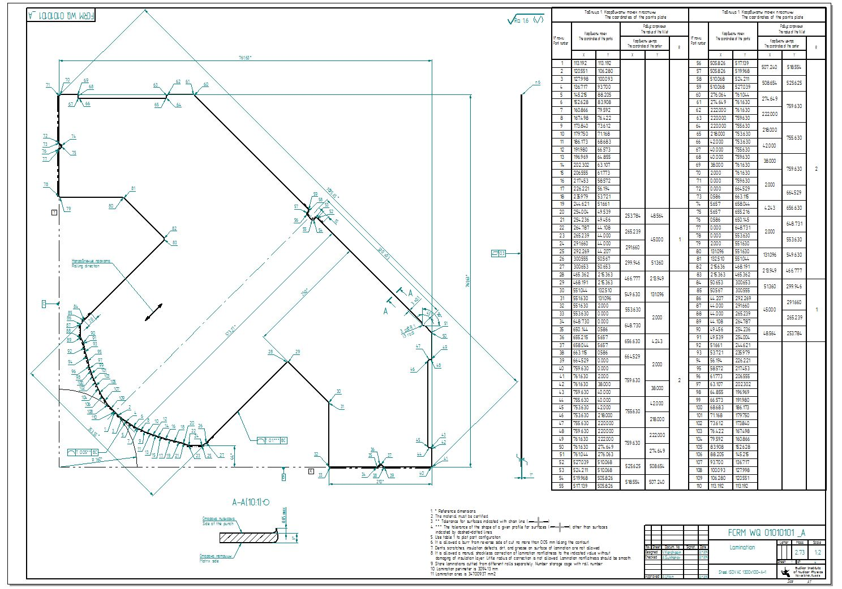
Construction of WQ magnet
Quarter of yoke
Profile for laminas stamping

Slide 7
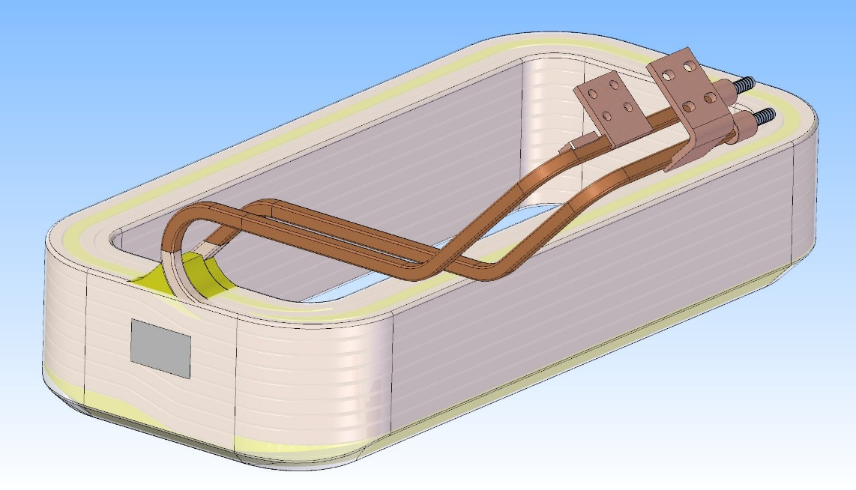
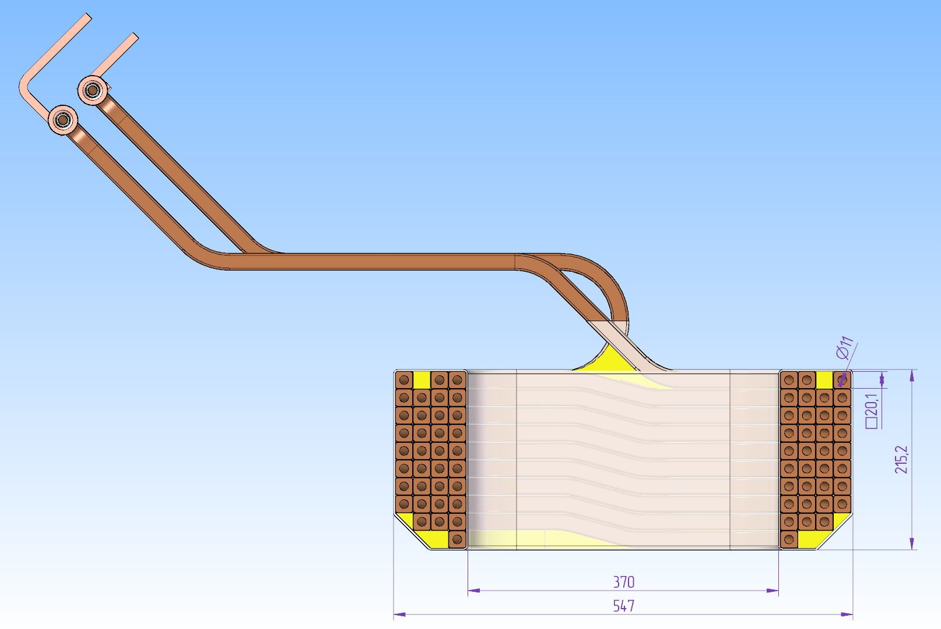
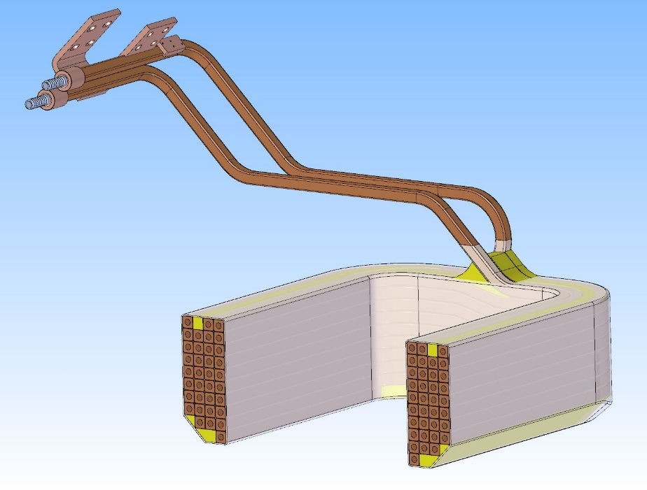
Construction of WQ magnet
35 turns coil
WQ magnet coil construction

Slide 8
WQ Quadrupole and stand for quadrupole only

Slide 9
WQ Quadrupole and stand for one sextupole

Slide 10
WQ Quadrupole and stand for two sextupoles

Slide 11
WQ calculations
3D Magneto-static calculations in “Mermaid” code
Pole profile
Pole profile coordinates (mm)
X (mm) | Y (mm)
113.192 | 113.192
120.551 | 106.28
127.998 | 100.093
136.717 | 93.7
145.215 | 88.205
152.628 | 83.908
160.866 | 79.592
167.498 | 76.422
173.84 | 73.612
179.75 | 71.168
186.173 | 68.683
191.98 | 66.573
196.969 | 64.855
202.302 | 63.107
206.555 | 61.773
217.453 | 58.572
226.221 | 56.194
235.979 | 53.721
244.621 | 51.661
254.125 | 49.512
265 | 44
290 | 44
Chamfer 17.5 mm depth 35 mm height, side cut outs 20 mm depth 20 mm width

Slide 12
Field in yoke
Field in yoke (kGs) at maximal gradient value
Permeability in yoke at maximal gradient value

Slide 13
Field quality
Longitudinal gradient distribution at maximal gradient value.
Integral contributions of 6th and 10th multipoles at 136 mm radius.

Slide 14
Field quality
H - Integral Homogeneity
H= $\left[\int{B\left(x\right)}dl−G∙x∙l\right]/[G∙x∙l]$

Slide 15
Calculation of attraction force
3D model in FEM “Mermaid” of ¼ of construction
I=1490 A
Distance between SWQ yoke and Yoke of the sextupole magnet is 350 mm.

Slide 16
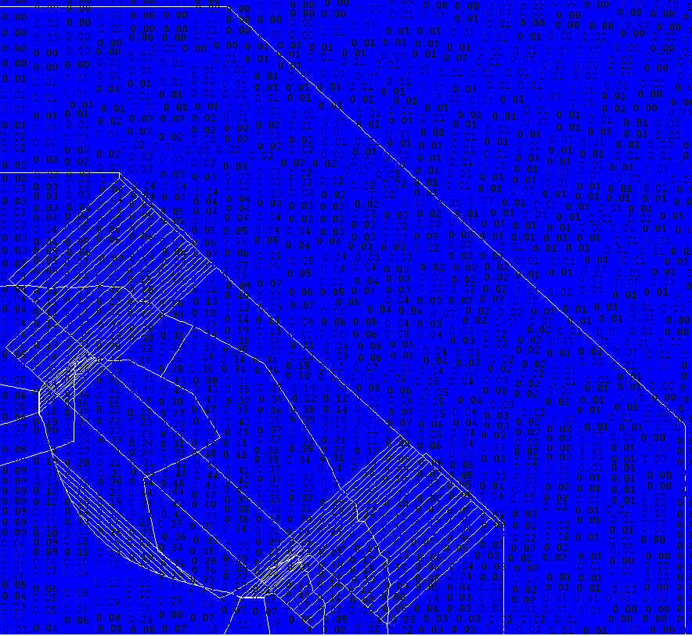
Calculation of attraction force
5
4
3
2
1
Field magnitude (kGs) near surface of sextupole yoke
Longitudinal distribution of magnetic field (kGs) along line from SWQ quadrupole yoke to sextupole yoke

Slide 17
Calculation of attraction force
F(N)= dE/dX =3.26/0.04= 81.4 N
Energy (J)
Distance (mm)
Stored energy (J)

Slide 18
Assembling of the magnet
1. Fasten alignment feet 1 (3 pcs.) to the lower half of the yoke 2 (1 pcs.), using bolts 3 (18 pcs.);
2. Install the lower half of the yoke of WQ quadrupole on stand 4 (1 pcs.) (alignment feet must be properly fastened to a stand using bolts 5 (12 pcs.)to prevent any fall);
3. Install the lower half of the sextupole yoke on stand (when quadrupole shares same stand as sextupole, sextupole alignment feet must be properly fastened to a stand to prevent any fall);
4. Install vacuum chamber on lower half of WQ quadrupole (and sextupole)
5. Install the upper half of the yoke of WQ quadrupole 6 (1 pcs.) on lower half WQ quadrupole and fasten to each other using bolts 7 (16 pcs.)
6. Install the upper half of the sextupole yoke on lower half sextupole (when quadrupole shares same stand as sextupole) and fasten to each other using bolts
7. Install the manifolds 8 (2 pcs.) on the side of the magnet on the brackets 9 (2 pcs.) using the mounting blocks 10 (4 pcs.) with the bolts 11 (8 pcs.);

Slide 19
Assembling of the magnet
8. Connect lower and upper half of manifolds, using bolts 28 (4 pcs.);
9. Install the connection boxes 12 (2 pcs.);
10. Assemble the connection boxes 12:
10.1. Install the cable connection plates 13 (2 pcs.) using the mounting blocks 14 using the fastening plates 15 with the bolts 16 (4 pcs.);
10.2. Connect the upper and lower windings using the midpoint connection plate 17 (1 pcs.) with the bolts 18 (8 pcs.);
10.3. Connect the cable connection plates 13 (2 pcs.) with the beginning and end of the upper and lower windings with the bolts 20 (8 pcs.);
10.4. Fix the outlets of the sections of the windings using the mounting blocks 21 using the fastening plates 22 with the bolts 23 (4 pcs.);
11. Connect the water hoses 24 (8 pcs.) to fittings 25, fix with the clamps 26 (16 pcs.).

Slide 20
Production Plan
Month | Activity | Begin | End
0 | Contract is signed | 26.06.2018 | 26.06.2018
6 | Tecnological design, Equipment design | 27.12.2018 | 30.09.2019
11 | Conceptual Design Review | 23.05.2019 | 23.05.2019
12 | Design in detail | 26.06.2019 | 28.06.2019
16 | Final Design Review | 07.11.2019 | 07.11.2019
17 | Material procurement | 20.11.2019 | 30.01.2020
17 | Tooling manufacturing | 20.11.2019 | 29.03.2020
21 | Manufacturing of pre-series | 01.04.2020 | 01.06.2020
23 | FAT of pre-series | 01.06.2020 | 30.07.2020
25 | Shipment of pre-series to FAIR | 04.08.2020 | 26.08.2020
26 | SAT A of pre-series | 09.09.2020 | 21.10.2020
28 | Manufacturing of series | 22.10.2020 | 23.05.2023
28 | Prepare series production | 22.10.2020 | 22.02.2021
32 | Series production started | 22.02.2021 | 22.02.2021
34 | FAT accepted | 22.04.2021 | 23.05.2023
37 | Site Assembling series | 23.07.2021 | 27.06.2023
38 | SAT Series | 23.08.2021 | 04.07.2023
38 | SAT accepted | 23.08.2021 | 04.07.2023

