Slide 1
SWQ Magnet for CR.
CDR Review.
D. Gurov, A.Utkin for CR team
BINP, Novosibirsk
November 27, 2019
3rd FAIR-BINP Workshop, Novosibirsk, Russia

Slide 2
Contents
CDR documentation
Project management structure
Base principles and Concept
SWQ quadrupoles in CR
Calculations and simulations
Assembling
Production plan

Slide 3
CDR Documentations
Conceptional description (in EDMS): https://edms.cern.ch/document/2146994/1
The 3D-models (in EDMS): https://edms.cern.ch/document/2147009/1

Slide 4
Project management
Name: Anatoly Utkin
Position: Research Scientist Email: A.V.Utkin@inp.nsk.su
Tel.: +7383329-4684
The Deputy is responsible for:
Follow-up of production activities;
Magnetic measurements to ensure the required field and field quality;
Factory Acceptance Test (FAT) to verify the given specifications of the components;
Name: Denis Gurov
Position: Research Scientist Email: D.S.Gurov@inp.nsk.su
Tel.: +7383329-4684
The Deputy is responsible for:
Preliminary magnet design, final magnet design (development, simulation);
Magnetic field calculation;
More Details in “Quality Plan”
The Project Manager
Name: Alexandr Starostenko
Position: Head of BINP Division № 5-11 Email: A.A.Starostenko@inp.nsk.su
Tel.: +7383329-4940
The Project Manager is responsible for:
Development of the technical documentation and manufacturing drawings for the deliverables;
Ensuring that the production of the magnets is according to the technical specifications and time schedule;
Follow-up of production activities;
Transportation, delivery of the equipment to the FAIR site;
Regular and timely reporting on progress and problems;
Timely conduction/participation of reviews and provisions of feedback;
Scientific Design Department
Name: Vladimir Korchagin
Position: Principal Design Engineer Email: V.Ya.Korchagin@inp.nsk.su
Tel.: + 7383329-4953
The Principal Design Engineer is responsible for:
Magnet design (3D-models, production drawings);

Slide 5
Construction of SWQ magnet

Slide 6
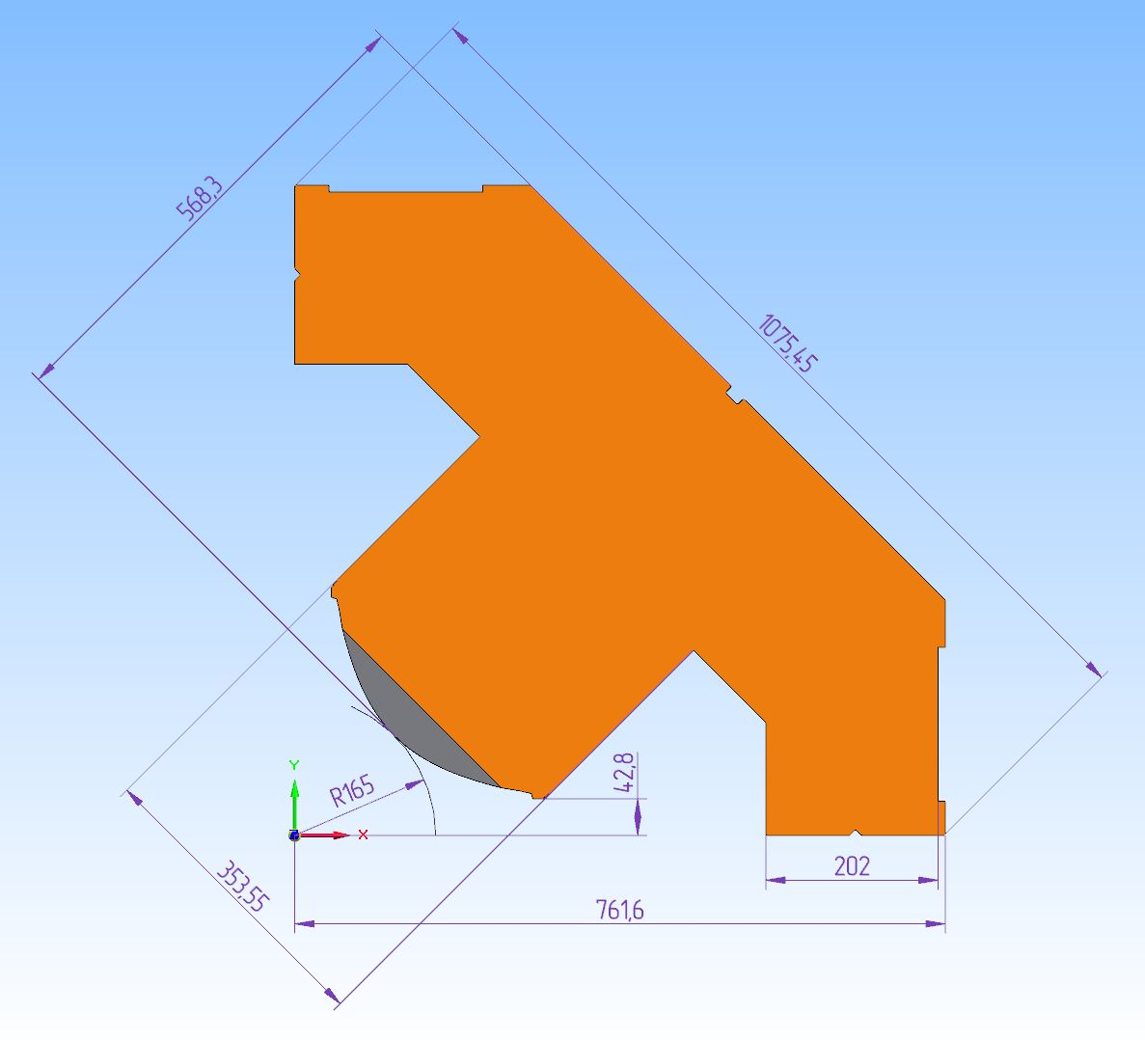
Construction of SWQ magnet
Quarter of yoke
35 turns coil 20.1x20.1 mm wire 11 mm hole

Slide 7
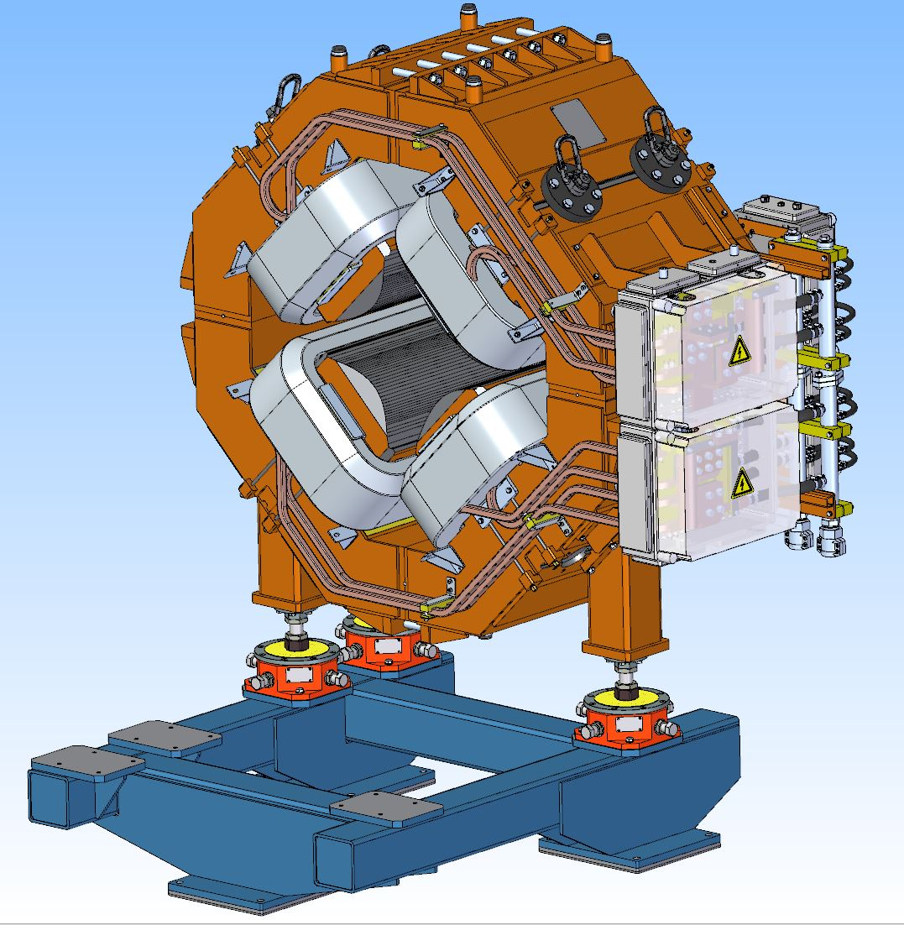
SWQ Quadrupole and stand for quadrupole only
Parameter | Value
Lamination thickness | 1 mm
Dimensions of wire for coils | 20.1x20.1 mm
Number of SWQ magnets | 12
Overall weight | 7.7 t
Coil current | 1486 A
Number of coil turns | 35
Coil resistance | 22.3 mΩ
Coil inductance | 44.6 mH
Maximum DC powerloss | 49.3 kW

Slide 8
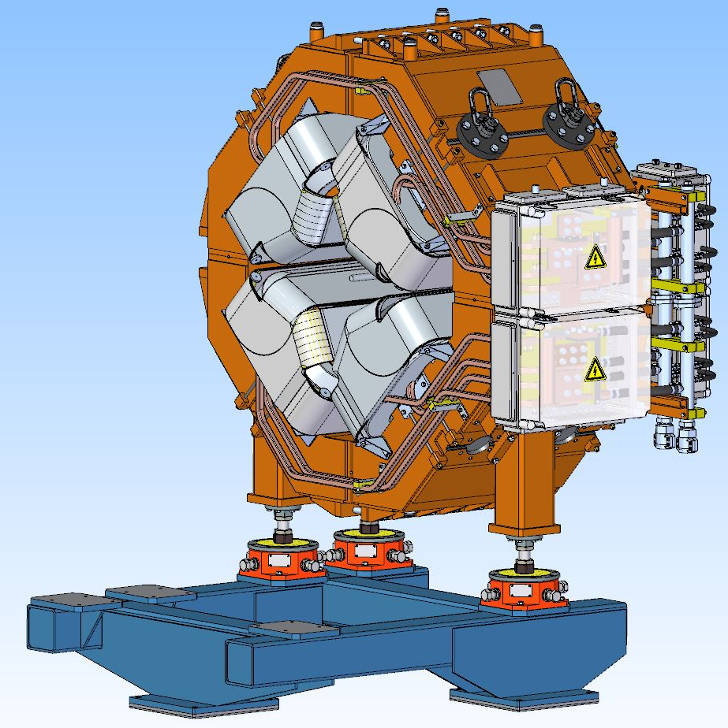
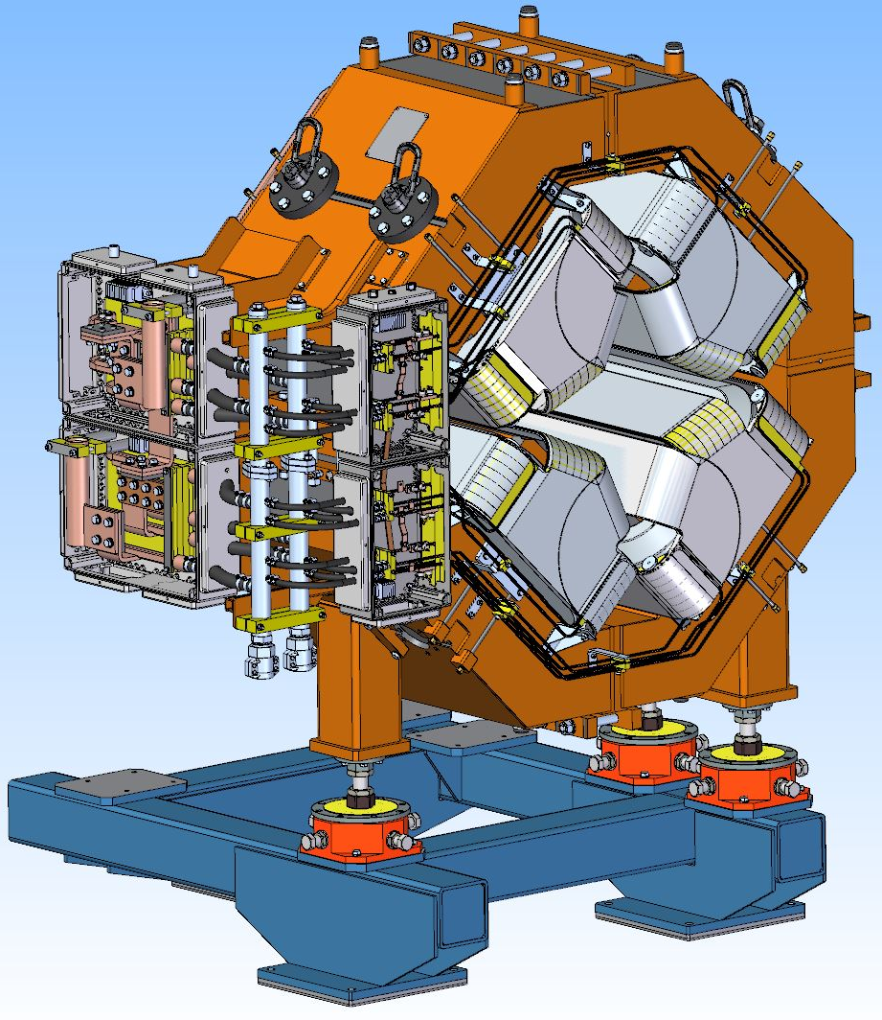
SWQ Quadrupole on stand with octupole corrector

Slide 9
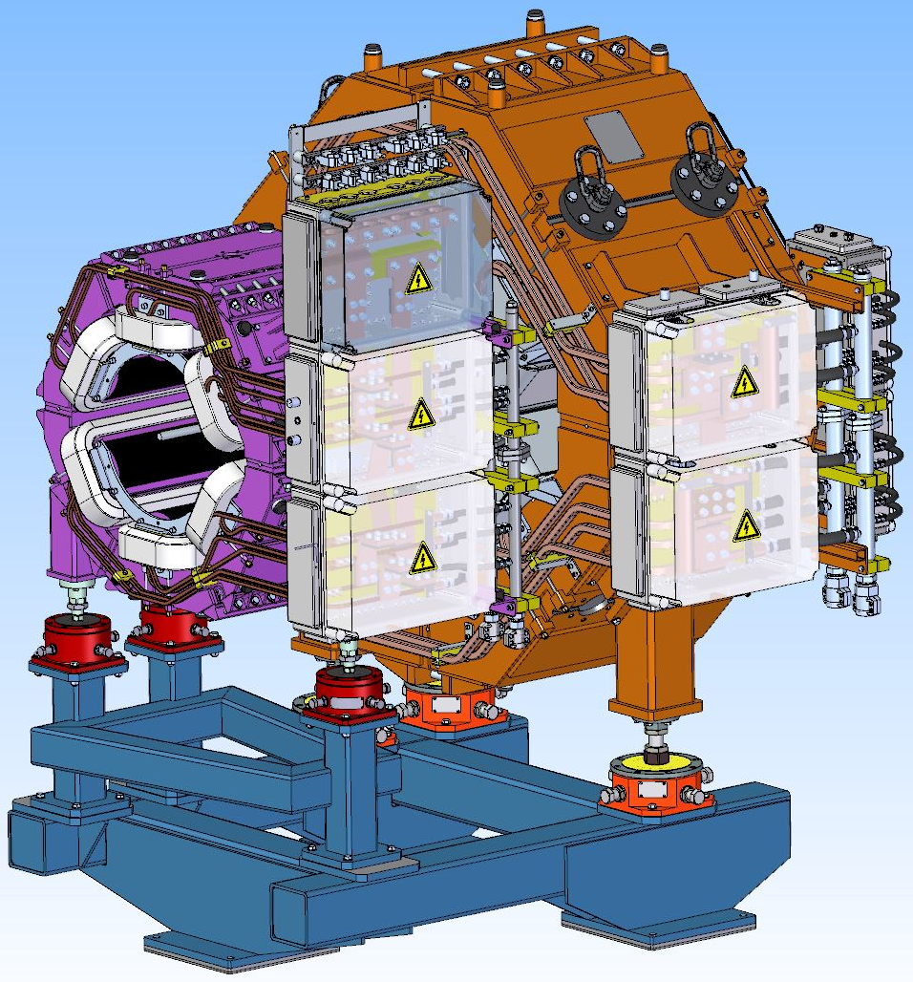
SWQ Quadrupole and stand for sextupole

Slide 10
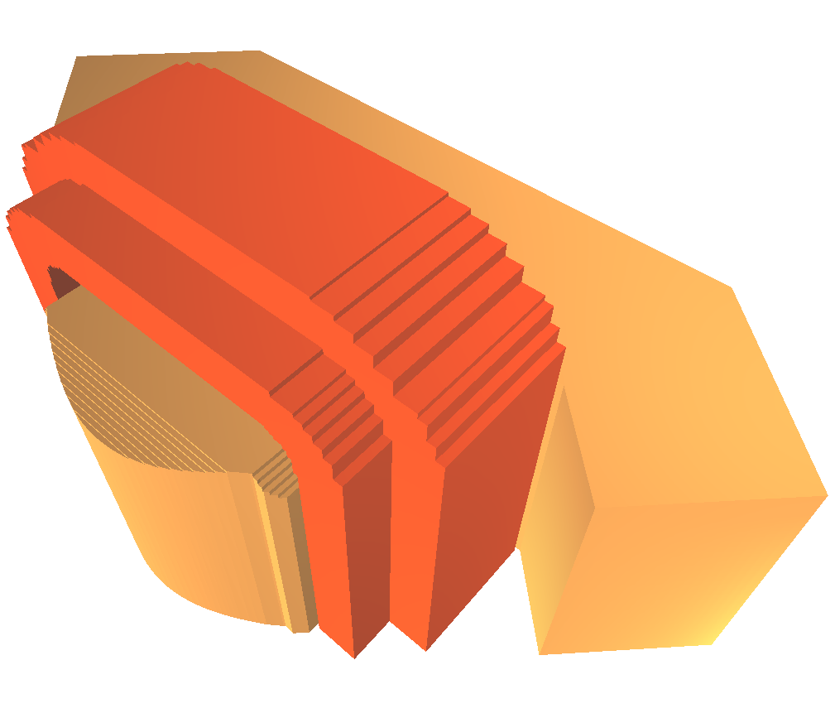
SWQ calculations
3D Magneto-static calculations in “Mermaid” code
Pole profile
Pole profile coordinates (mm)
X (mm) | Y (mm)
116.7291 | 116.729
124.3184 | 109.601
131.9975 | 103.221
140.9899 | 96.628
149.7528 | 90.961
157.3973 | 86.53
165.8926 | 82.079
172.7324 | 78.81
179.2729 | 75.912
185.3673 | 73.392
191.9906 | 70.829
197.9798 | 68.653
203.1242 | 66.882
208.6243 | 65.079
213.01 | 63.703
224.2488 | 60.402
233.2908 | 57.95
243.3536 | 55.4
263.0279 | 52.203
265.5441 | 51.64
269.381 | 47.485
273.7068 | 42.8
292.7019 | 42.8
Chamfer 25 mm depth 45 mm height, side cut outs 30 mm depth 25 mm width

Slide 11
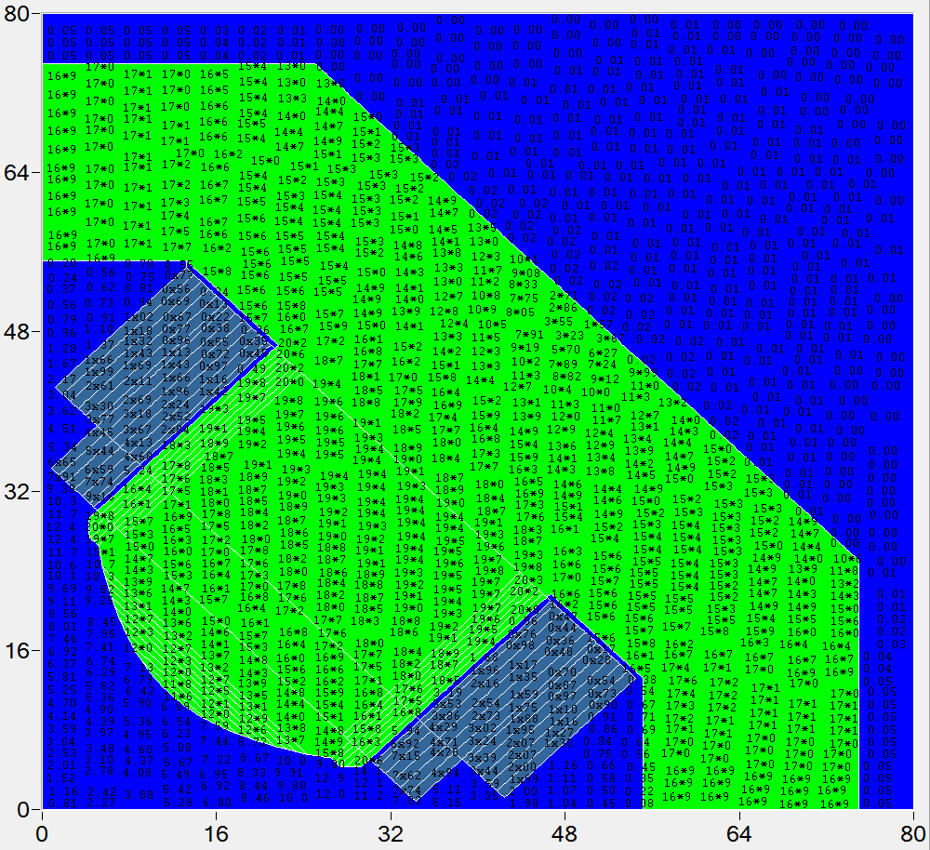
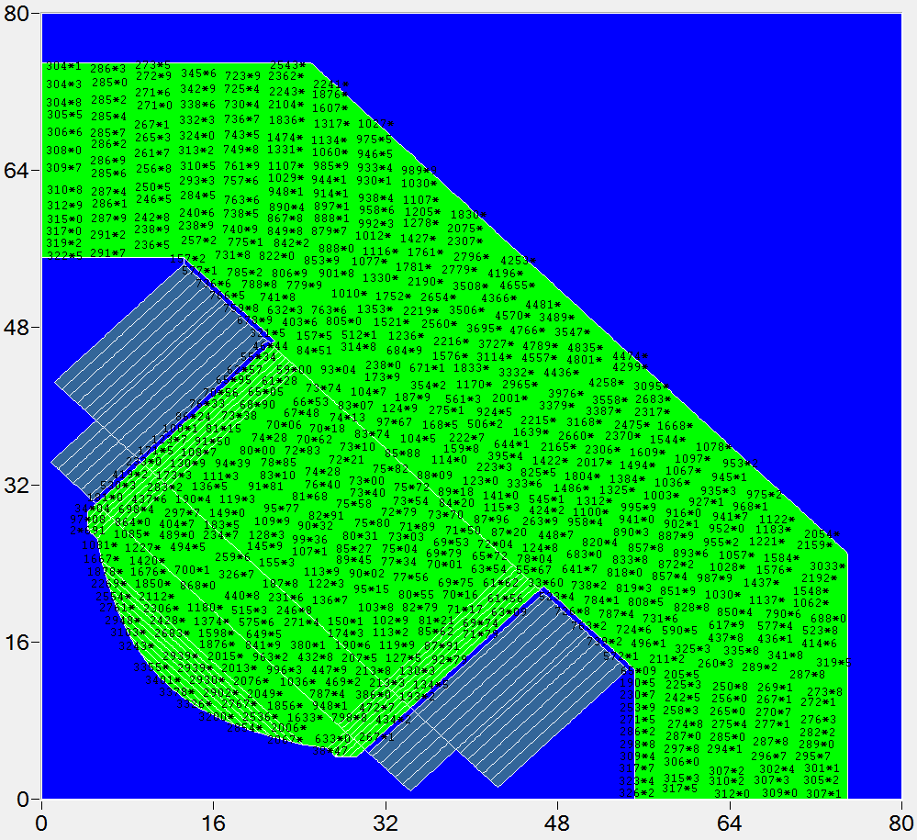
Field in yoke
Field in yoke (kGs) at maximal gradient value
Permeability in yoke at maximal gradient value

Slide 12
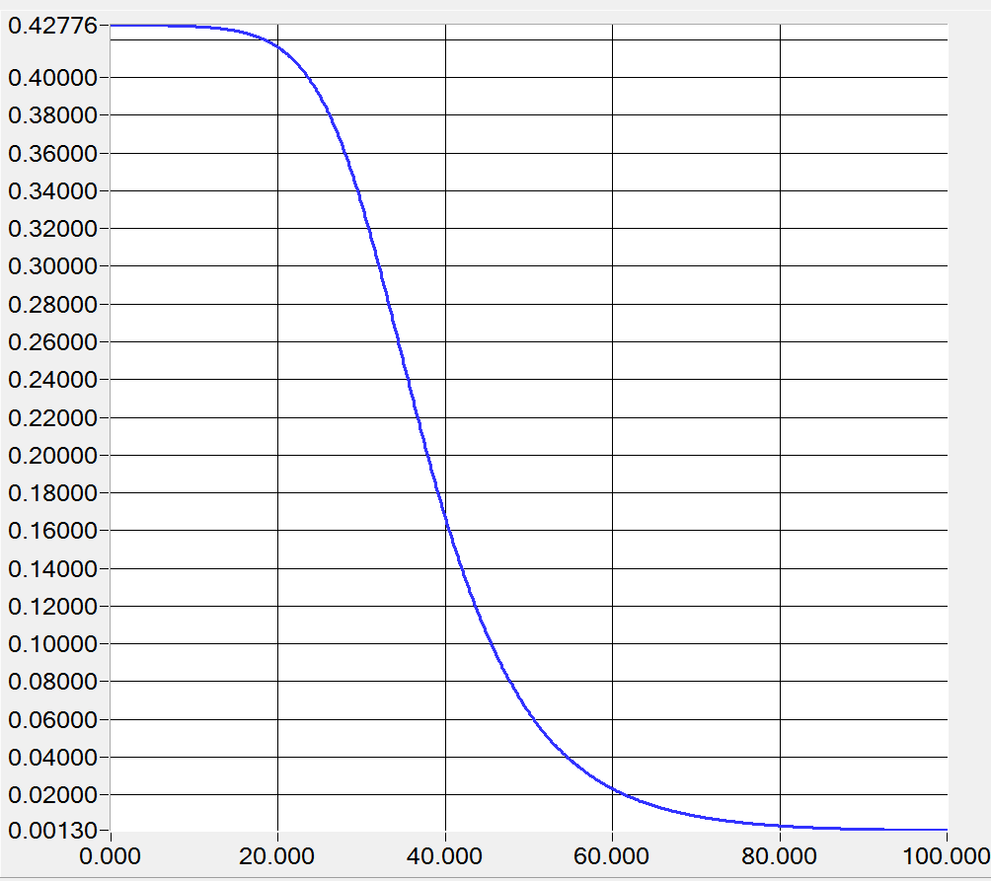
Field quality
Longitudinal gradient distribution at maximal gradient value.
Integral contributions of 6th and 10th multipoles at 136 mm radius.
kGs/cm
cm

Slide 13
Field quality
H - Integral Homogeneity
H= $\left[\int{B\left(x\right)}dl−G∙x∙l\right]/[G∙x∙l]$

Slide 14
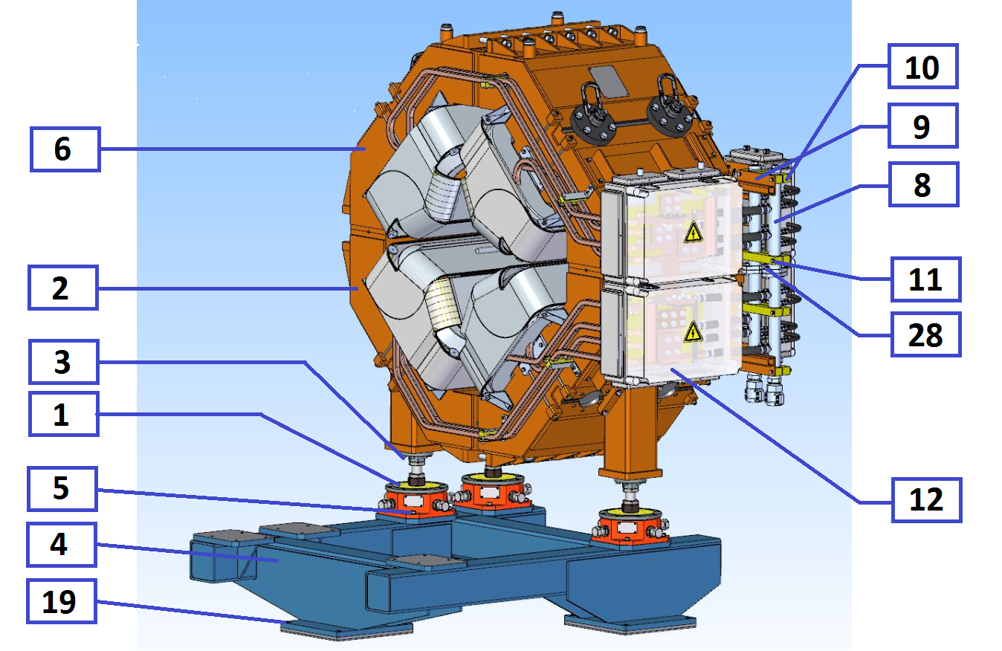
Assembling of the magnet
1. Fasten the alignment feet 1 (3 pcs.) to the lower half of the yoke 2 (1 pcs.), using bolts 3 (18 pcs.);
2. Install the lower half of the yoke of the SWQ quadrupole on the stand 4 (1 pcs.) (alignment feet must be properly fastened to a stand using bolts 5 (12 pcs.) to prevent any fall);
3. Install the lower half of the sextupole yoke on the stand (sextupole alignment feet must be properly fastened to a stand to prevent any fall);to prevent any fall);
4. Install the vacuum chamber on the lower half of the SWQ quadrupole and sextupole;
5. Install the upper half of the yoke of the SWQ quadrupole 6 (1 pcs.) on the lower half of the SWQ quadrupole and fasten to each other using bolts 7 (12 pcs.);
6. Install the upper half of the sextupole yoke on the lower half of the sextupole and fasten to each other using bolts;
7. Install the manifolds 8 (2 pcs.) on the side of the magnet on the brackets 9 (2 pcs.) using the mounting blocks 10 (4 pcs.) with the bolts 11 (8 pcs.);
8. Connect the lower and upper half of the manifolds using bolts 28 (4 pcs.);
9. Install the connection boxes for quadrupole coils 12 (2 pcs.) and octupole coils 27 (2 pcs.);

Slide 15
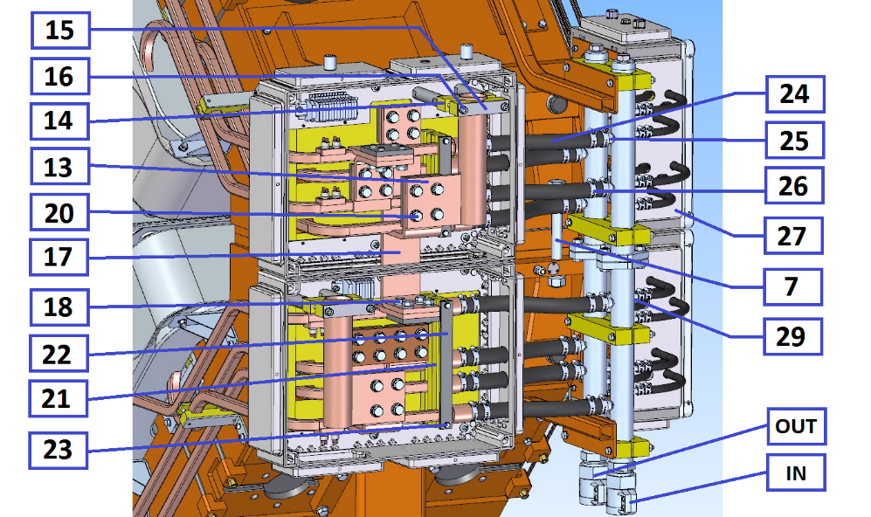
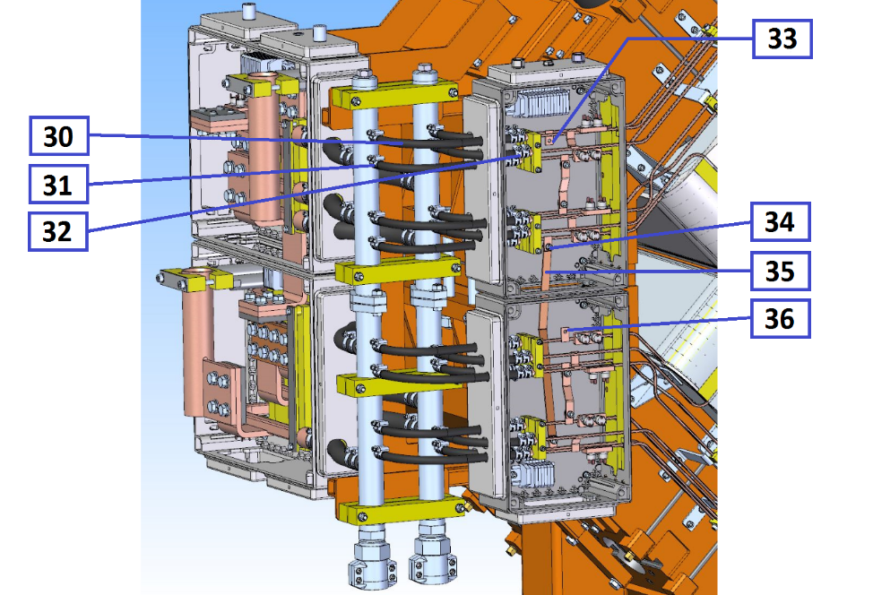
Assembling of the magnet
10. Assemble the quadrupole coils connection boxes 12:
10.1. Install the cable connection plates 13 (2 pcs.) using the mounting blocks 14 using the fastening plates 15 with the bolts 16 (4 pcs.);10.2. Assemble the connection boxes 12:
10.2. Connect the upper and lower windings using the midpoint connection plate 17 (1 pcs.) with the bolts 18 (8 pcs.);
10.3. Connect the cable connection plates 13 (2 pcs.) with the beginning and end of the upper and lower windings with the bolts 20 (8 pcs.);
10.4. Fix the outlets of the sections of the windings using the mounting blocks 21 using the fastening plates 22 with the bolts 23 (4 pcs.);
11. Connect the water hoses 24 (8 pcs.) to the fittings 25, fix with the clamps 26 (16 pcs.).
12. Assemble the octupole coils connection boxes 27:
12.1. Connect the water hoses 30 (16 pcs.) to the fittings 29, fix with the clamps 31,32 (32 pcs.).
12.2. Connect the upper and lower windings using the midpoint connection plate 35 (1 pcs.) with the bolts 34 (2 pcs.);
12.3. Connect power supply to the current outlets 33,36 .

Slide 16
Production Plan
Month | Activity | Begin | End
0 | Contract is signed | 26.06.2018 | 26.06.2018
7 | Tecnological design, Equipment design | 05.02.2019 | 09.11.2019
12 | Conceptual Design Review | 02.07.2019 | 02.07.2019
13 | Design in detail | 05.08.2019 | 26.09.2019
16 | Final Design Review | 07.11.2019 | 07.11.2019
17 | Material procurement | 20.11.2019 | 30.01.2020
19 | Tooling manufacturing | 19.01.2020 | 17.06.2020
25 | Manufacturing of pre-series | 20.07.2020 | 19.09.2020
27 | FAT of pre-series | 19.09.2020 | 17.11.2020
29 | Shipment of pre-series to FAIR | 22.11.2020 | 14.12.2020
30 | SAT A of pre-series | 28.12.2020 | 08.02.2021
36 | Manufacturing of series | 09.07.2021 | 23.05.2023
32 | Prepare series production | 11.03.2021 | 12.07.2021
36 | Series production started | 12.07.2021 | 12.07.2021
38 | FAT accepted | 09.09.2021 | 23.05.2023
39 | Site Assembling series | 21.09.2021 | 27.06.2023
40 | SAT Series | 22.10.2021 | 04.07.2023
40 | SAT accepted | 22.10.2021 | 04.07.2023

