Slide 1
3rd BINP Workshop Novosibirsk 25. – 29.11.2019 Site Management – Workshop Objectives
H Reich-Sprenger & H Hagelskamp

Slide 2
Site Management - Objectives
Objectives:
Documentation
Deliveries
Pre-Assembly
Installation
Manpower resources
Commitments from all partners

Slide 3
Site Management - Objectives
Documentation:
Required documentation for delivery of components.
required documentation for pre-assembly at GSI workshops
assembly drawings (e.g. HEBT)
work instructions
QC protocols
documentation for Installation
work instructions
documentation for CE Declaration
Objektive 1:
to agree scope and content of the required documentation.
to confirm contractual obligations and partner‘s responsibilities.

Slide 4
Site Management - Objectives
Production and Delivery Schedules:
aligning of project delivery requirements and workshop capacity loading.
compare present workshop plan with MS Projects schedules.
for Subprojects
CR – dipoles, quadrupoles, sextupoles, kickers.
HEBT Batches 2&3 magnets and vacuum chambers.
Super FRS – magnets and vacuum chambers.
p-Bar components.
PANDA Dipoles.
other VAC components.
synchronisation of deliveries of Vac-chambers and Magnets to enable a contiuous workflow in the pre-assembly
supplier reporting and dashboard.
Objective 2:
agree and commit to monthly progress reporting and forecasting.
agree harmonized delivery schedules to meet pre-assembly capacities at GSI.

Slide 5
Site Management - Objectives
Pre-Assembly Activities:
Align scope for CR
review and finalise proposals for work steps (in LCM methodology)
first Kicker assembly at GSI (space, media and time requirements)
description and definition of major worksteps and media requirements (LCM)
BINP Manpower - with local support and infrastructure.
workshop in Target Building for dipoles.
worksteps for dipoles, quadrupoles, sextupoles to be difined and written in workinstructions.
identify workshop - Testing Hall for example.
align scope for HEBT
align scope for SFRS
align scope for Panda
HEBT magnet integration:
Assembly drawings
status of delivery of magnets and chamber (with or without flange).
proposal: transfer vac chamber fabrication to GSI.
Objective 3:
agree and finalize pre-assembly scope and infrastructure requirements.
confirm partner responsibilities and contractual obligations.

Slide 6
Site Management - Objectives
Detailed Installation Plan:
align LCM results with MS Projects plan
agree on detail installation sequences at the interface with HEBT Transport and P-Bar Antiproton Target.
injection and extraction lines.
Take HESR as example and guideline.
Objective 4:
finalize installation schedule
finalize resource requirements
agree on resource support and interaction between GSI and BINP.

Slide 7
Site Management - Objectives
Manpower Resources
for installation and preassembly
Presentation of contractual obligations (F Hagenbuck)
Manpower estimate for discussion (F Hagenbuck)
mixed teams
300 magnets => 300 days for three people
crane and transport equipment by FAIR
Refuse removal
Objectives 5:
define and agree manpower requirements
qualification and capacities
Define time schedules for deployment
Pre-Assembly
installation
BINP – FAIR workshop 2018 , H. Hagelskamp, H. Reich-Sprenger

Slide 8
Site Management - Objectives
Status of Planning of Building G007:
all CRs 179,193,212,181 are in work.
extensive changes are required – return to planning phase 2 (LPH2) – conceptual.
Switch Rooms for builing technology have to be relocted.
Due to that changes and adaptations to user rooms are required.
firrst scetches and cut-views will be available in Nov 2019
changed room allocation available in CW 50.
Basic Planning (LPH5) will be completed in Nov. 2020.

Slide 9
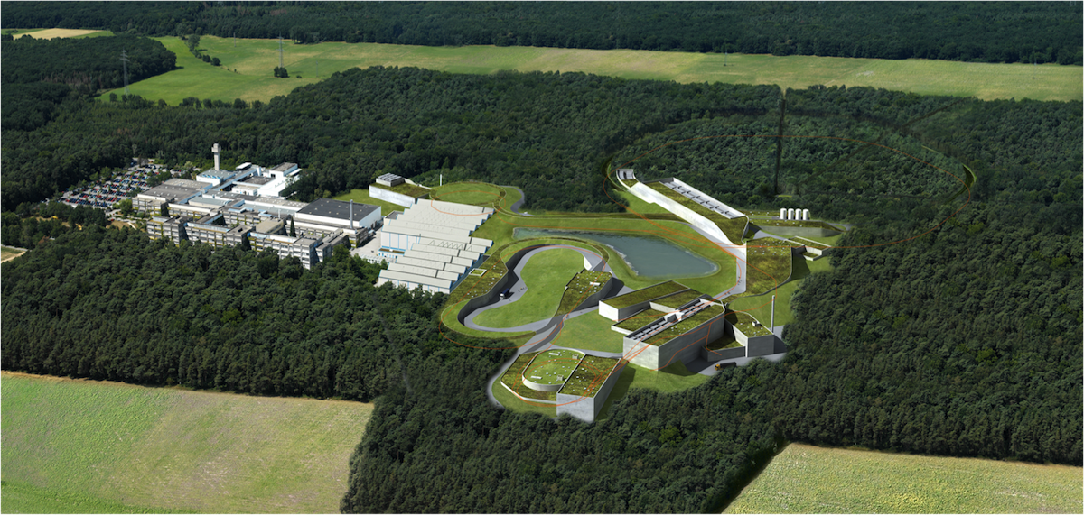
Thank you very much !

