Slide 1
Super-FRS components
Haik Simon
FAIR-BINP Workshop
Novosibirsk, November 25-29, 2019
Haik Simon / FAIR-BINP Workshop, Novosibirsk, November 25-29, 2019

Slide 2
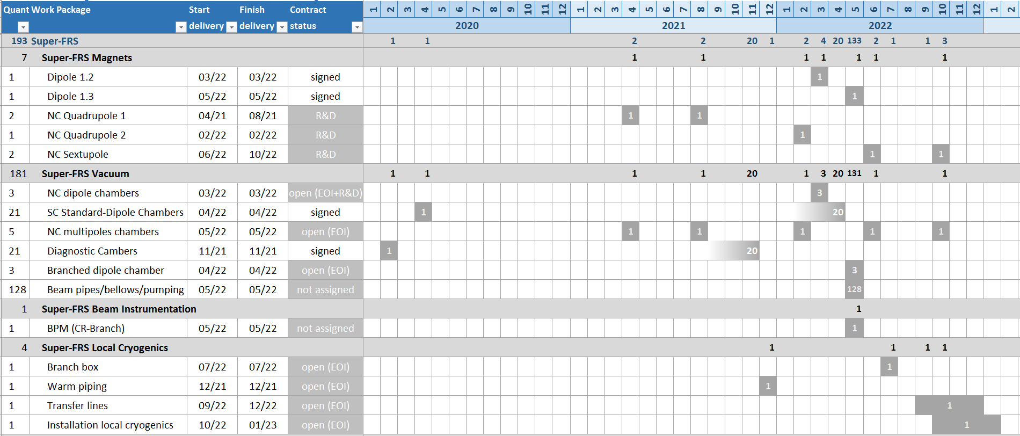
Delivery Matrix
First of Series

Slide 3
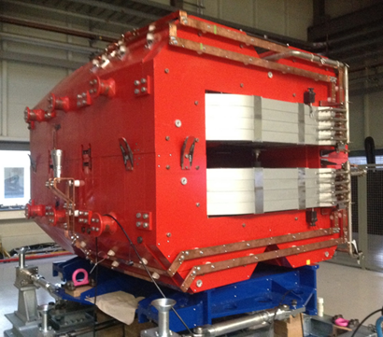
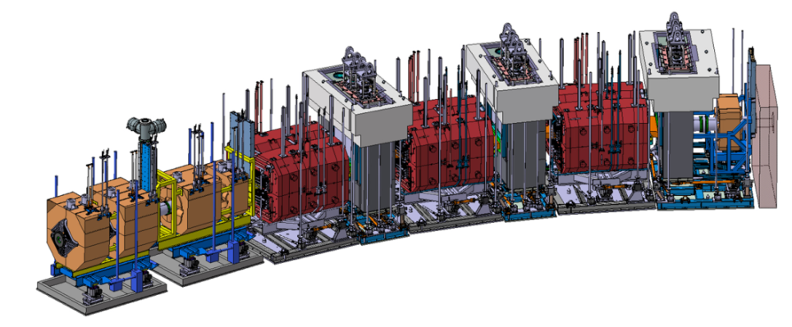
Super-FRS Magnets
Radiation Resistant Dipoles
Scope:
2 nc dipoles using MIC cable
(one prototype dipole built at BINP,
already tested)
Dedicated support structure
Remote connectors and alignment
≈95 ton
interfaces: sextupole, beam catcher, pillow seal
  Status / Schedule
Detailed specs (including support) released
MIC ordered by FAIR
Contract signed on 15/03/2019
Regular reports not received (dash board?)
Production plan review: 08/2019
→ expected this workshop
Conceptual Design Review*: 08/2019
→ expected this workshop
Final Design Review**: 12/2019
→ to be agreed in this workshop
Target Area
** payment to be done (2019?)
** payment shifted to 2020

Slide 4
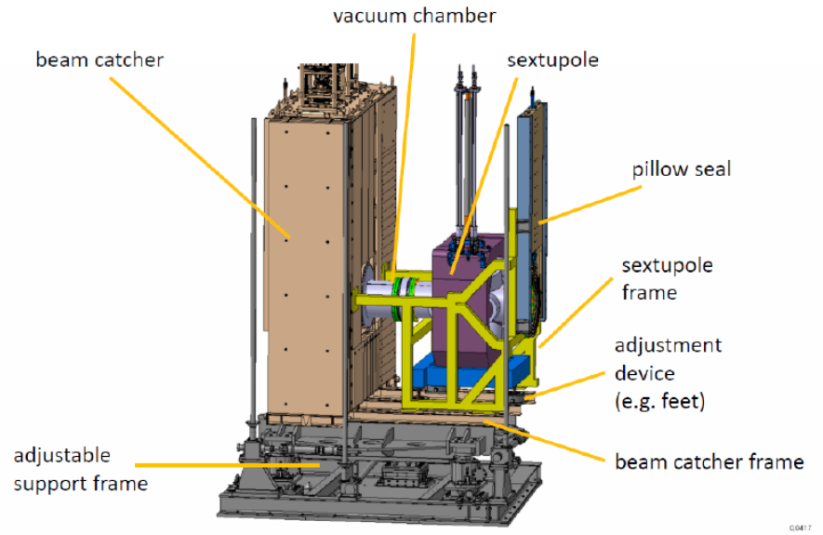
Super-FRS Magnets
Radiation Resistant Multipoles
interfaces: dipole, beam catcher, pillow seal, support structure
Scope:
3 nc quadrupoles and 2 nc sextupoles
Dedicated support structure
Remote connectors and alignment
  Status / Schedule
Detailed specs (including support) released for each magnet, but new insight required
R&D contract signed on 16/09/2019
R&D first results relevant for contract: 11/2019
Critical decision: can we achieve
this within this workshop?
Contract signature: Dec 2019
Conceptual Design Review: Mar 2020
Final Design Review: Sep 2020
Manufacturing: till July 2022
SAT: till January 2023
Installation: from January 2023
≈30 ton
≈30 ton

Slide 5
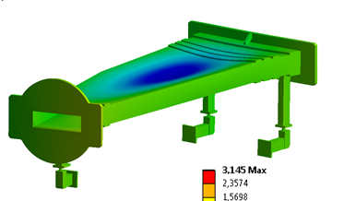
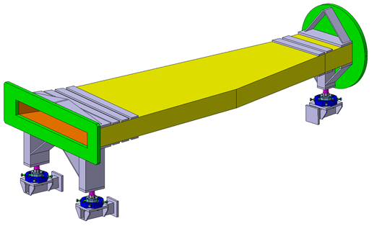

Super-FRS Vacuum
NC dipoles chambers
Scope:
3 nc dipoles chambers withstanding high radiation
Installation on site must be technically feasible
ongoing …
  Status / Schedule
EoI
R&D contract signed on 11/09/2019
Preliminary design review (PDR) with preliminary 3D-Model: Mid-term meeting in May 2020
Fulfilment of research on Super-FRS primary beam absorber for dipole chamber: Nov 2020
Specifications: Nov-Dec 2020
Contract signature: Jan-Feb 2021
Final Design Review: Mar-Apr 2021
Manufacturing: in line with nc dipoles

Slide 6
Super-FRS Vacuum
NC multipoles chambers
Scope:
3 nc quadrupoles chambers
2 nc sextupoles chambers
Installation on site must be technically feasible
  Status / Schedule
EoI
Detailed specs for chamber released 04/2019
(there could be need for minor adjustment
due to ongoing R&D on nc multipoles)
scheduling directly coupled to nc multipole‘s
Contract 12/2019 (?, together with nc multipoles)

Slide 7
Super-FRS Vacuum
SC standard-dipoles chambers
Scope:
21 vacuum chambers for sc standard dipoles including pumping ports
installation services
  Status / Schedule
Detailed specs released
Contract signed on 11/09/2019
CDR FoS: Nov 2019 no document received
FDR FoS: Feb 2020
CDR series: Mar 2020
FAT and delivery FoS: Apr 2020
FDR series: May 2020
Manufacturing: May 2020 – Feb 2022
End of FAT series: Feb 2022
End of SAT: Apr 2022
End of installation services: Apr 2022
Final acceptance: Apr 2022
scheduling in line with nc magnets
Reporting …

Slide 8
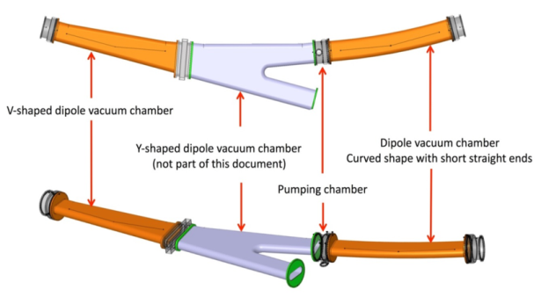
Super-FRS Vacuum
SC branched-dipoles chambers
Scope:
3 sc branched-dipoles chambers
  Status / Schedule
EoI received long time ago
chamber's specs released (included in magnets’ specs)
Design of magnet CDR CEA: Q1/2019
Magnet production scheme allows for
integration of BINP chamber in the
assembly scheme
Manufacturing expected together with
branched dipoles (currently 2021)
Technical discussion in the workshop

Slide 9
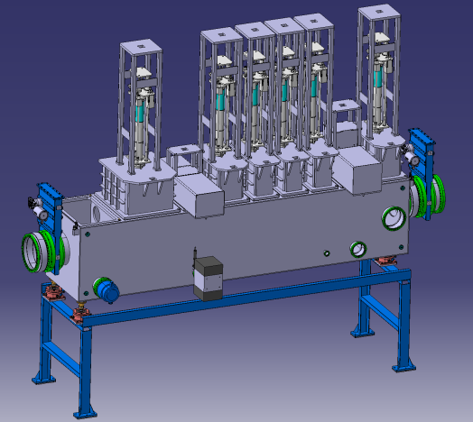
Super-FRS Vacuum
Diagnostic (focal-plan) chambers
Scope:
21 focal-plan chambers
corresponding supports
  Status / Schedule
Detailed specifications released
Contract signed on 15/03/2019
CDR FoS: 06/2019 received 09/2019
FDR FoS*: 09/2019 not received
CDR series*: 12/2019 request to shift to 2020
agree on schedule within this workshop
FAT and delivery FoS: 02/2020
SAT FOS: 05/2020 (problem to assign hall space if dates are not reliable)
FDR series: Mar 2020
Manufacturing: Mar 2020 – Aug 2021 (details on shipment to be decided)
End of FAT: Aug 2021
End of SAT: Nov 2021
Final acceptance: Nov 2021
?
FLF2
* payment shifted to 2020

Slide 10
Super-FRS Vacuum
Beam pipes, bellows, pumping chambers
PSP-Code | Description | Pieces Units | Inst. | Country | Status | Res.-No.
2.4.7.1.11 | Beam pipe (various length) | 13 | BINP | Russia | Council | VI.8.3
2.4.7.1.14 | Pumping chamber | 31 |  |  | NEW
2.4.7.1.15.1 | Beam pipe (various length) part 2 | 28 |  |  | NEW
2.4.7.1.15.2 | Beam pipe/pumping chamber support | 47 |  |  | NEW
2.4.7.4.2 | Bellow (L=150, D=400) | 66 | BINP | Russia | Council | VI.8.3
2.4.7.4.3 | Bellow (L=150, D=400) part 2 | 18 |  |  | NEW
CB8
CB8
Scope:
203 vacuum elements: beam pipes, supports, bellows, pumping chambers
  Status / Schedule
79 elements already assigned to BINP
Manufacturing flexible but installation during 2023
pieces are required in time for pre-assembly
contracts expected within 2020 in batches to be discussed

Slide 11
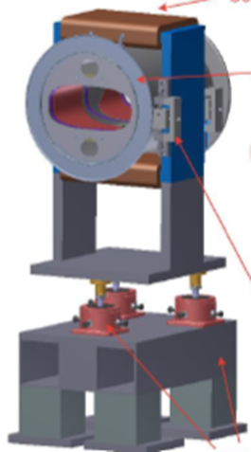
Super-FRS Beam Instrumentation
BPM
Scope:
Beam Position Monitor (Pick-up)
TCR1 BPM
by BINP
  Status / Schedule
topic at BINP workshop (11/2018)
Design of TCR1 BPM by BINP existing
we aiming for CC with BINP adapting BINP`s design
  Detailed specs sent to BINP contact (Yury Rogovsky) on 04/06/2019
  meeting with Y. Rogovsky on 22.10.19
  additional design work requested by BINP a week ago
  design adaption needed due to large y dimension
Consider as amendment to focal plane chamber contract
Design activities could be supported

Slide 12
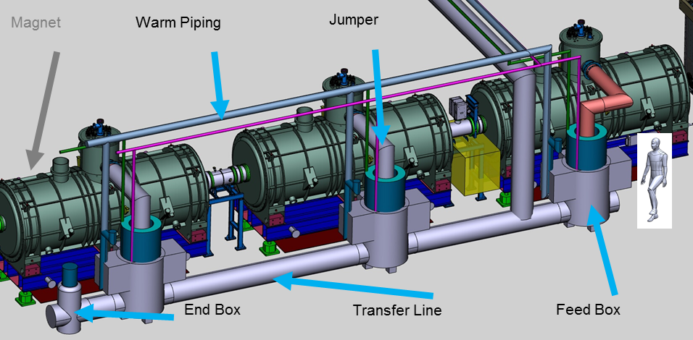
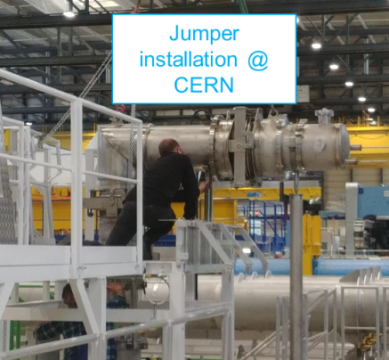
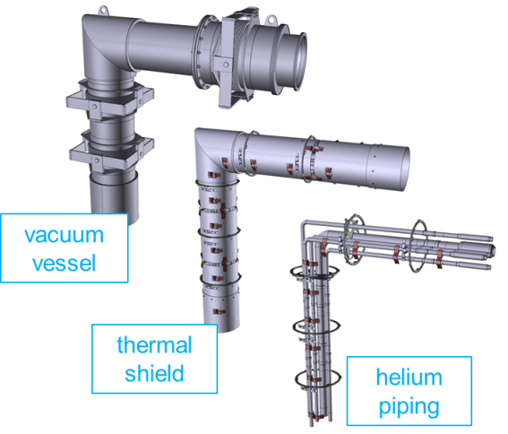
Super-FRS Local cryogenics
Scope:
1 large Branch Box
Feedboxes (≈60)
End Boxes (7)
≈60 Jumper connections (≈250 m)
Transferlines (≈300 m)
1 large Branch Box
≈1.5 km Warm-Gas Piping
~ 120 t of
stainless steel
  Status
  DMU concept ready
  Common/detailed specs released
  (= scope definition)
  ➔technical scope and realization scheme
  quite advanced

Slide 13
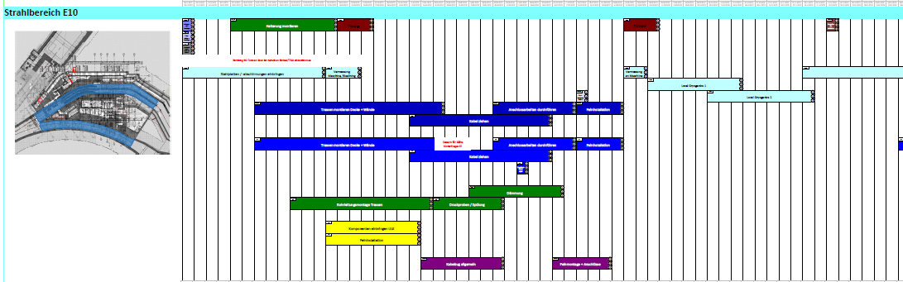
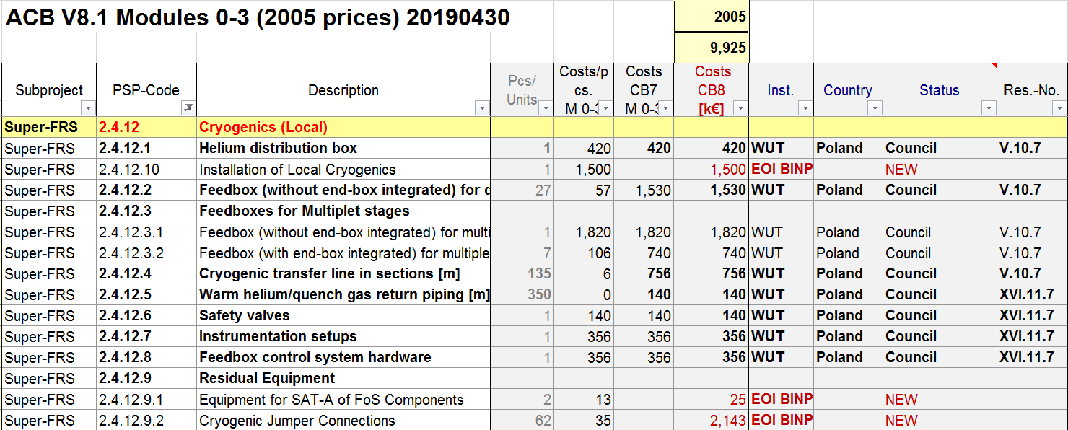


Super-FRS Local cryogenics
Deliverables: Dec 2021 – Oct 2022
Installation others: Oct 2022 – Dec 2022
Installation warm piping: Mar 2022
09/2019
09/2019
Partition of technical scope to be defined

Slide 14
support transparencies

Slide 15
sc standard dipoles (July 2019)
ELYTT Nombre de tarea | Finish FAT
FoS Dipole Type 3 (01) ready to go | 19/03/2020
FoS Dipole Type 2 (02) ready to go | 10/09/2020
Dipole Type 3 AO (03) ready to go | 23/10/2020
Dipole Type 3 AO (04) ready to go | 01/12/2020
Dipole Type 3 AO (05) ready to go | 22/01/2021
Dipole Type 3 AO (06) ready to go | 01/03/2021
Dipole Type 3 AO (07) ready to go | 14/04/2021
Dipole Type 2 (08) ready to go | 20/05/2021
Dipole Type 2 (09) ready to go | 25/06/2021
Dipole Type 3 B0 (10) ready to go | 24/08/2021
Dipole Type 3 B0 (11) ready to go | 29/09/2021
Dipole Type 3 B0 (12) ready to go | 04/11/2021
Dipole Type 3 B0 (13) ready to go | 13/12/2021
Dipole Type 3 B0 (14) ready to go | 28/01/2022
Dipole Type 3 B0 (15) ready to go | 07/03/2022
Dipole Type 3 B0 (16) ready to go | 20/04/2022
Dipole Type 3 B2 (17) ready to go | 26/05/2022
Dipole Type 3 C0 (18) ready to go | 01/07/2022
Dipole Type 3 C1 (19) ready to go | 30/08/2022
Dipole Type 3 D2 (20) ready to go | 05/10/2022
Dipole Type 2 D2 (21) ready to go | 11/11/2022

Slide 16
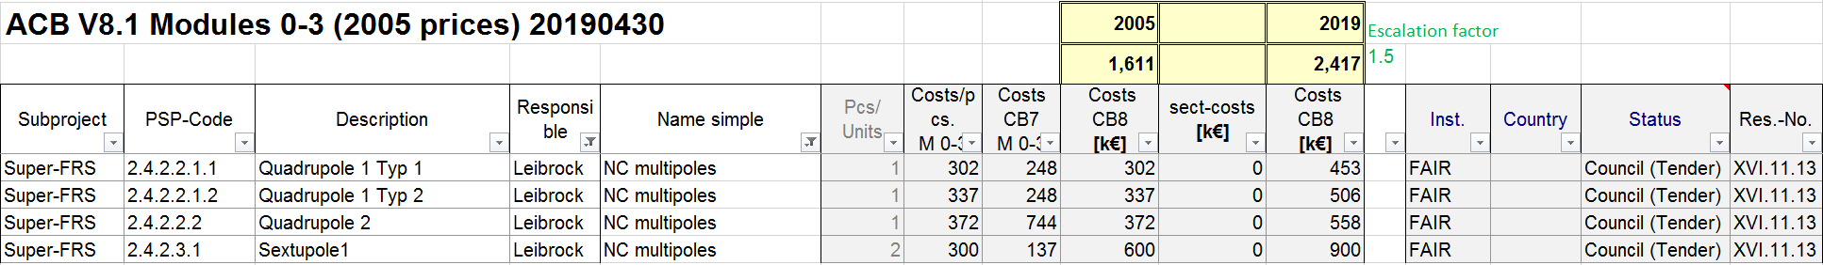
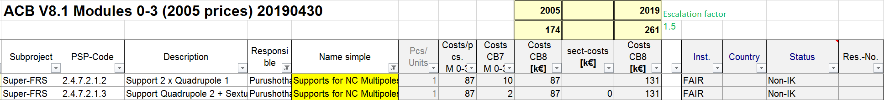
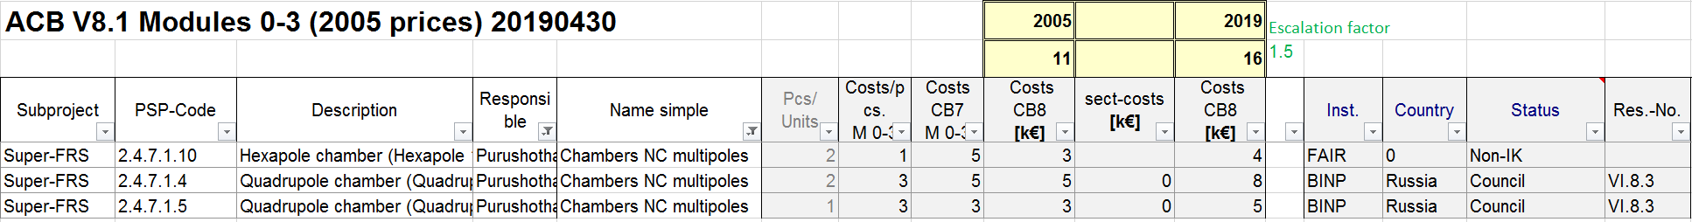
Extract from CB8
last sextupole on the support of beam catcher

Slide 17
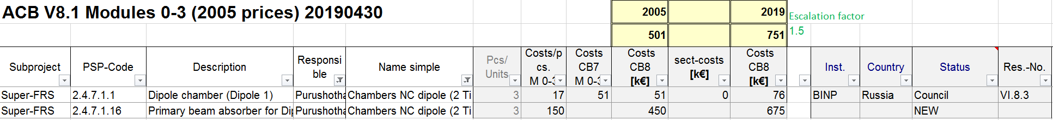
Extract from CB8

Slide 18
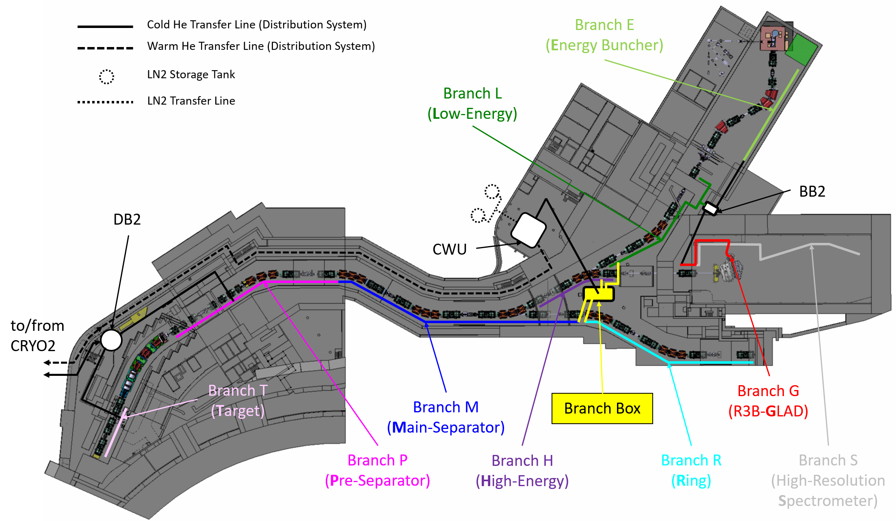
Super-FRS Local cryogenics

Slide 19
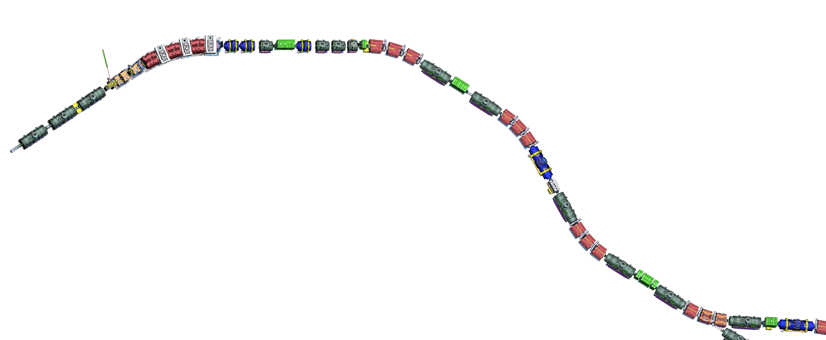
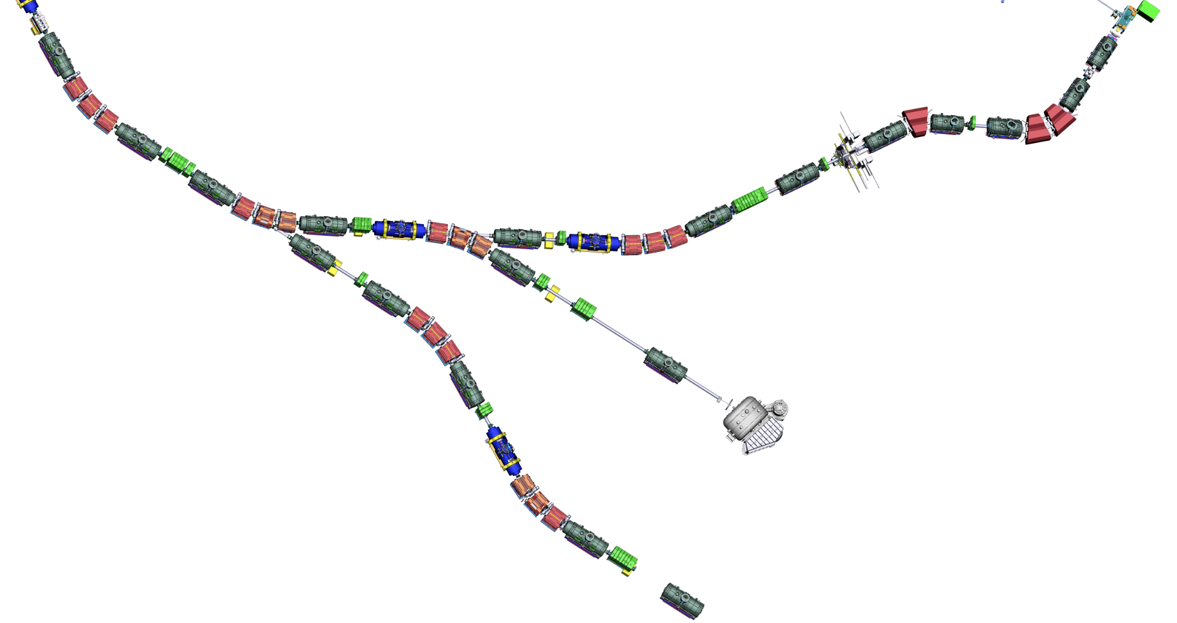
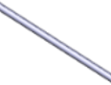
Super-FRS layout
BC3-NCS
Assembly Units
along the beamline
NC_D3
SM_02
SM_01
SM_03
SM_04
SM_07
SCD_01
SM_05
NC_D2
DC_02
SM_06
DC_03
SCD_02
BC1
BC2
SCD_03
NC_D1
NC_QS
LM_04
NC_QQ
DC_04
TA
FPF1
FPF2
FPF3
LM_03
LM_05
VAC_02
SCD_04
LM_02
FPF0
FPF4
DC_01
SCD_05
LM_01
SCD_06
VAC_01
FTF1
LM_06
DC_05
FLF6
FMF1
LM_07
FLF5
DC_17
SCD_07
FLF3
SCD_08
FLF4
EBM_05
SCD_09
VAC_06
DC_16
LM_08
DC_14 (maybe)
EBM_04
DC_06
FMF3
FLF2
DC_07
DC_08
LM_17
EBD_03
SCD_11 (branch)
VAC_05
NC_QQ nc quadrupole 1a + quadrupole 1b
NC_QS nc quadrupole 2 + sextupole
NC_D nc dipole
BC beam catcher
BC3-NCS beam catcher 3 + nc sextupole
TA target chamber
DC diagnostic chamber
SM sc short multiplet
LM sc long multiplet
SCD sc dipole
VAC vacuum part
EBD EB dipole
EBM EB multiplet
BDN Beam dump NUSTAR
LM_09
DC_15
FLF1
EBM_02
SCD_10
DC_13
EBD_01
EBM_03
EBD_02
FMF2
SCD_12
SCD_14 (branch)
LM_16
EBM_01
LM_10
SCD_13
DC_09
LM_11
LM_14
SCD_18
SCD_17
SCD_15
SCD_16
LM_15
DC_12
LM_18
LM_12
VAC_07
DC_18
DC_10
LM_19
VAC_03
FRF1
SCD_19
DC_11
SCD_20
FHF1
VAC_04
SCD_21
LM_13
LM_20
VAC_ NUSTAR
FRF2
DC_19
FHF2
VAC_08
GLAD
LM_21
BDN
SCD_22
FHF3
VAC_09
SCD_23 (branch)
SCD_24
LM_22
DC_20
FRF3
VAC_10
LM_23
VAC_11

