Slide 1
pbar scope
Klaus Knie
BINP-GSI workshop, Nov. 2019, Novosibirsk

Slide 2
Sections of the pbar separator
GSI
BINP
HEBT
PS01 (air)
PS01 (vac.)
TCR1
building 6c (K0321A)
building 7 (H0209A)
Scope (in a nutshell): Now: PS01 all magnets, PS, collimators, quad chambers in 6c
As option: All other vacuum components, PS01 magnets and PS in building 7
Some beam instrumentation identical to TCR1

Slide 3
Magnets
Ion optics: Presentation by S.Udrea on Wednesday
CR type magnets
Special radiation
hard magnets
w/o chambers

Slide 4
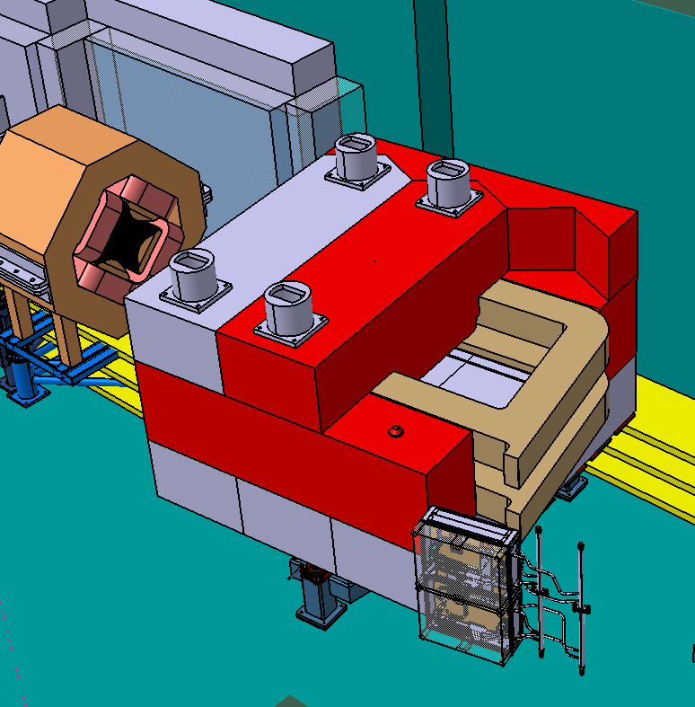
Magnets
PSP 2.9.2.1.1.1 pbar dipole costbook 7: can be spent now!
PSP 2.9.2.1.1.2 rad hard. modification costbook 8: cannot be spent now!
similar for wide quads
Suggestion: Start after target until CB7 money is spent, rest as option until CB8 is approved.
rad. hard dipole

Slide 5
Magnets
2 rad. hard narrow quads + PS
1 rad. hard wide quad + PS
1 rad. hard steerer + PS
1 rad. hard dipole + PS
3 wide quads (CR-type) + PS + vacuum chambers
5 wide quads (CR-type) + PS + vacuum chambers
4 sextupoles (CR-type) + PS + vacuum chambers
6 steering magnets
option
now
Presentations by H. Leibrock, U. Clausen and A. Krämer on Wednesday
now

Slide 6
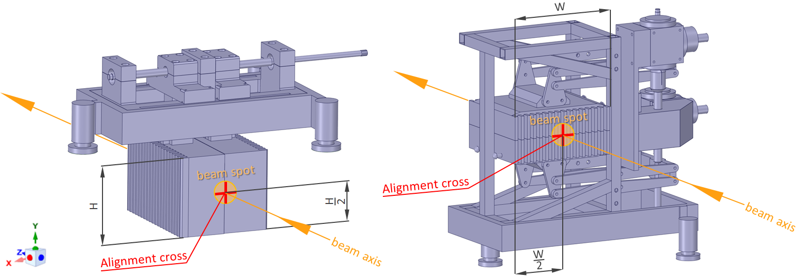
Collimators
2 collimators on air
1 collimator in vacuum
common tables for magnets and collimators
Presentation by P. Katrik on Wednesday

Slide 7
Beam Instrumentation
2 screens and 4 BPMs identical to TCR1 components needed for PS01
Production by BINP?

