Slide 1


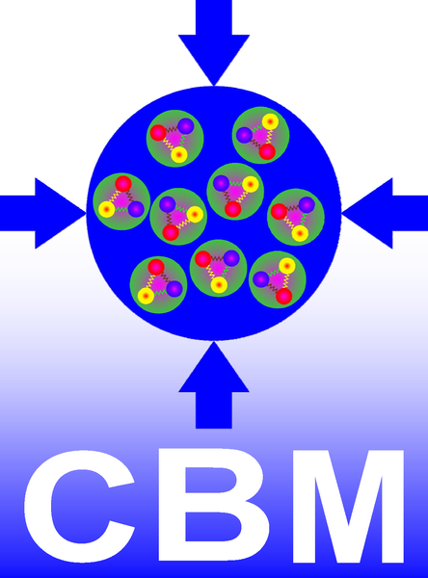

Particle Tracking Challenges:
The CBM Silicon Tracking Station at FAIR
Christian J. Schmidt,
GSI Darmstadt
at Gauhati University, Assam, India

Slide 2
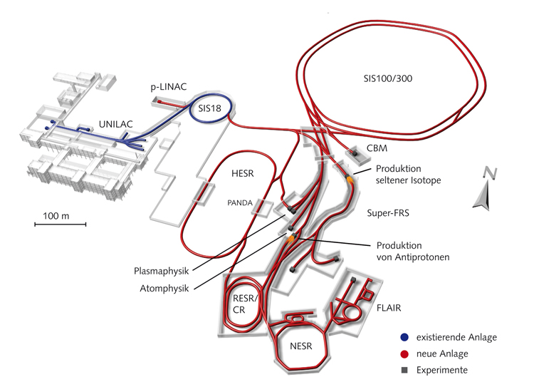

FAIR - Facility for Anti-Proton and Ion Research, Darmstadt
The GSI-future project under construction, operative in 2024
GSI Helmholtz Center for Heavy Ion Research GmbH, Darmstadt, Germany
1 km circumference
CBM
p to U beams,
2 – 45 GeV/nucleon
highest intensities

Slide 3
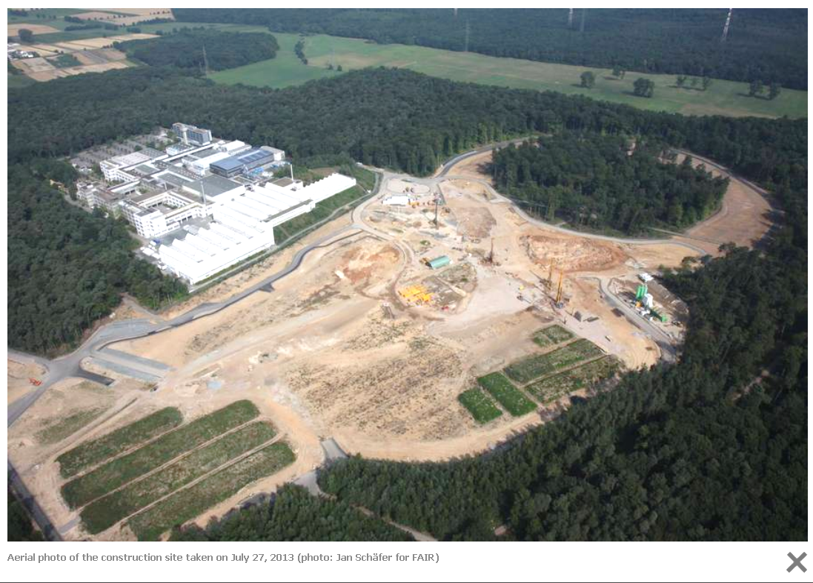

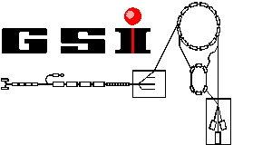
FAIR - Facility for Anti-Proton and Ion Research, Darmstadt
Spring 2017

Slide 4
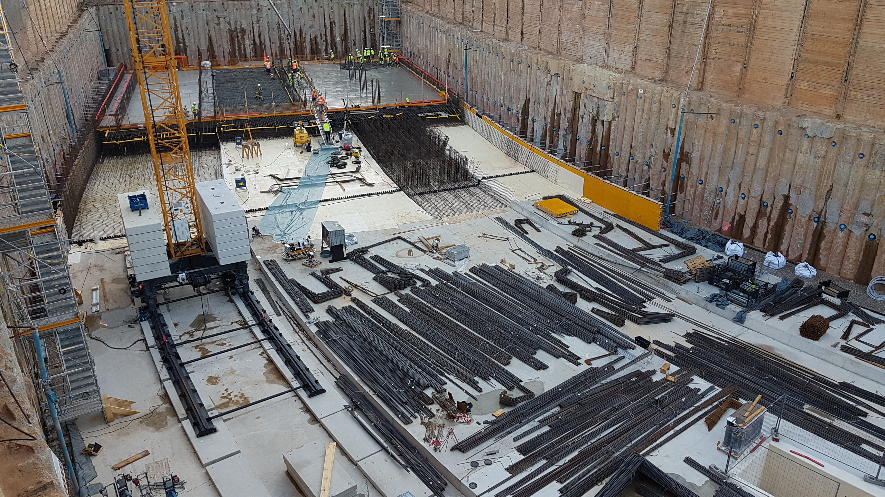
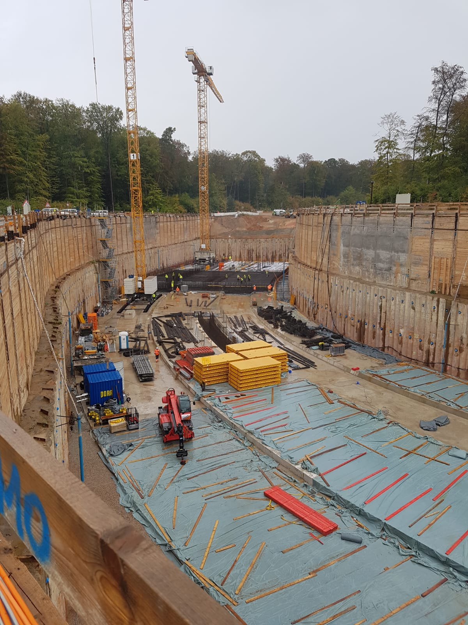
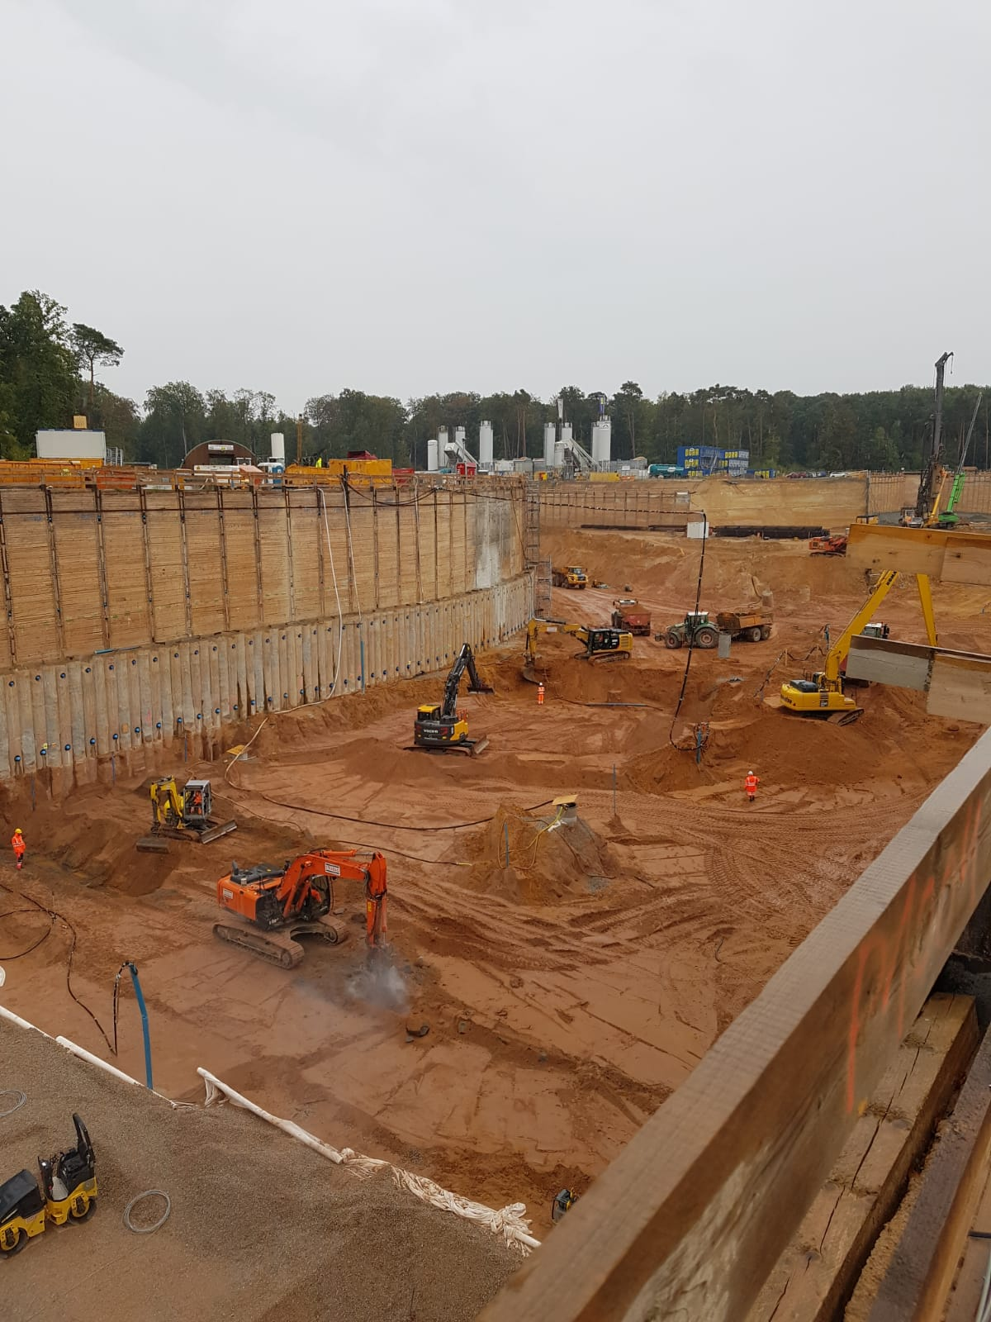
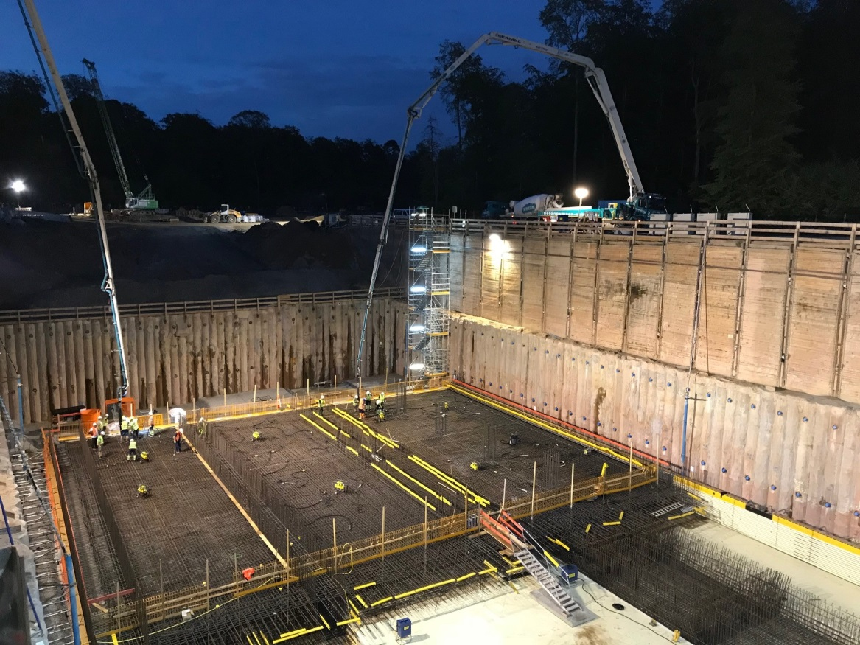
August 2018

Slide 5
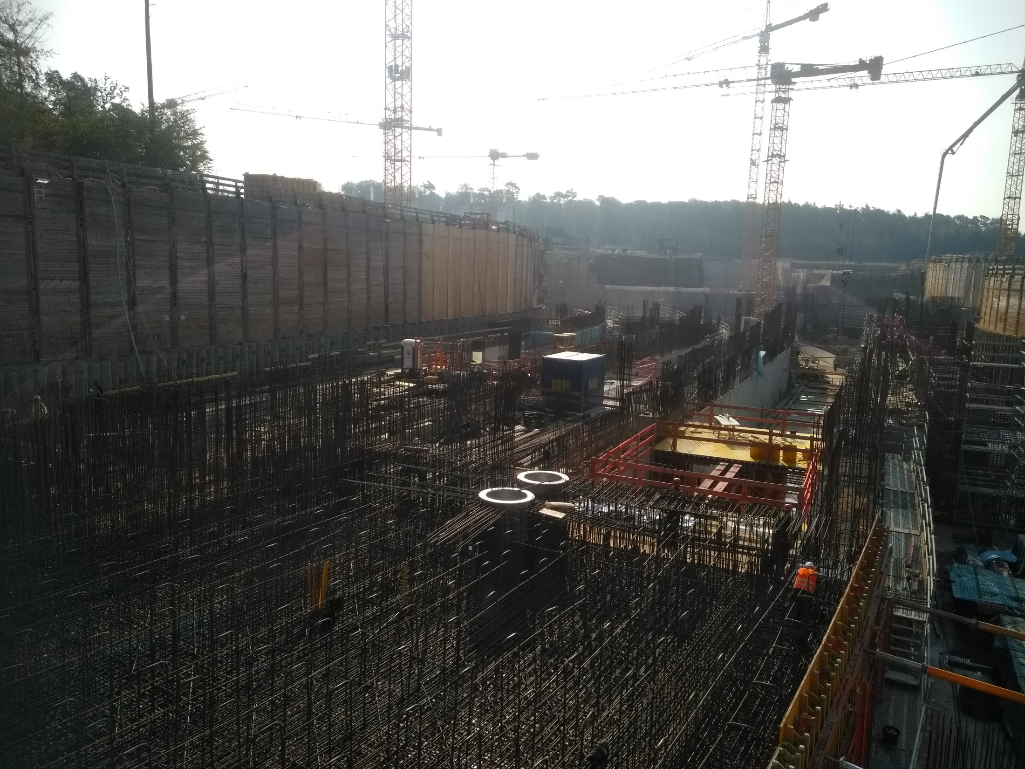

Slide 6
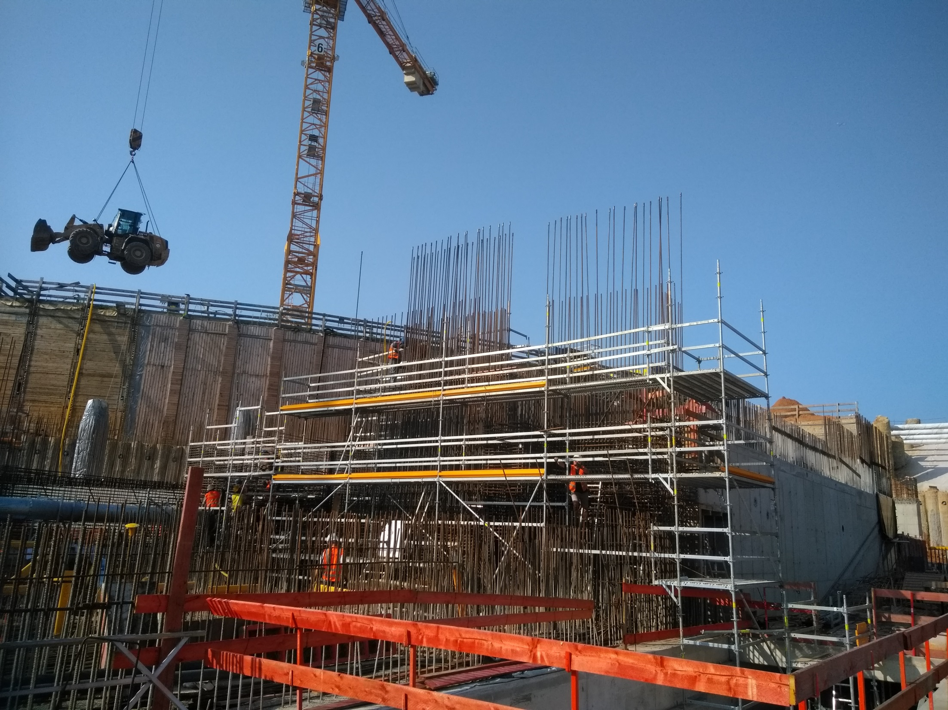

Slide 7
FAIR - Facility for Anti-Proton and Ion Research, Darmstadt
The GSI-future project under construction
GSI Helmholtz Center for Heavy Ion Research GmbH, Darmstadt, Germany
1 km circumference
CBM
p to U beams,
2 – 45 GeV/nucleon
highest intensities

Slide 8
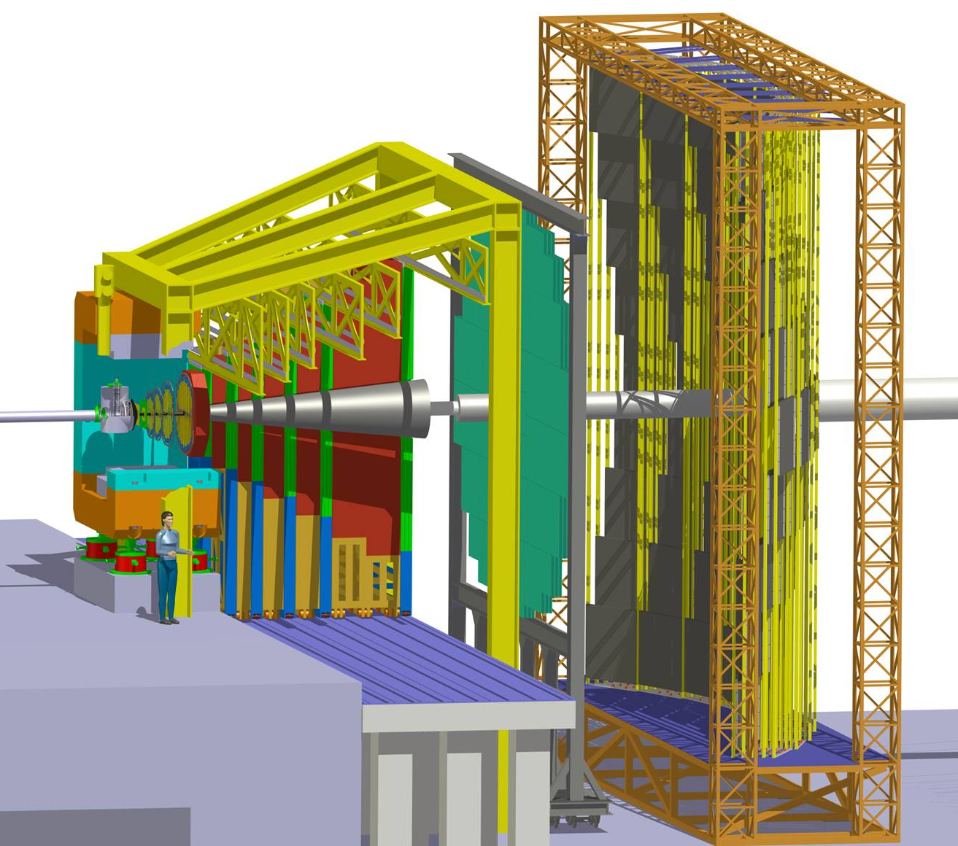
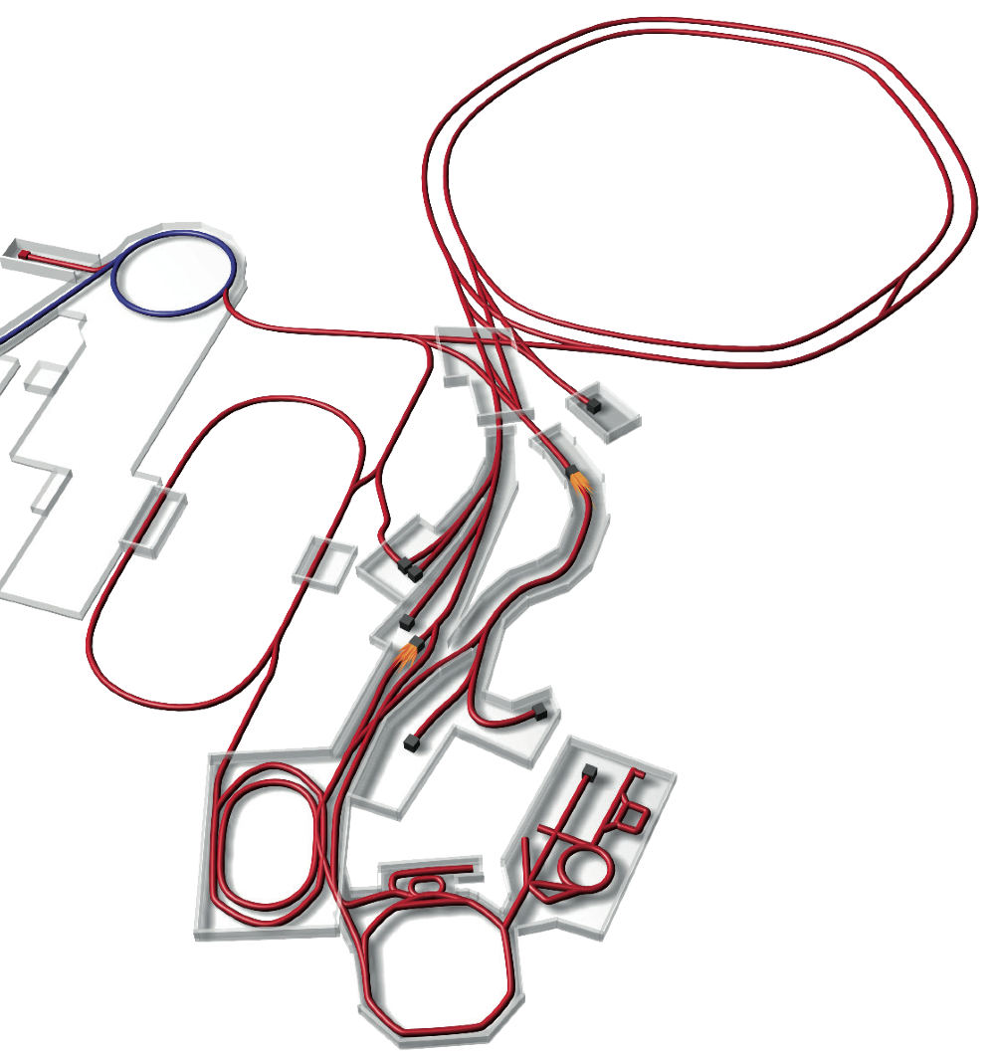
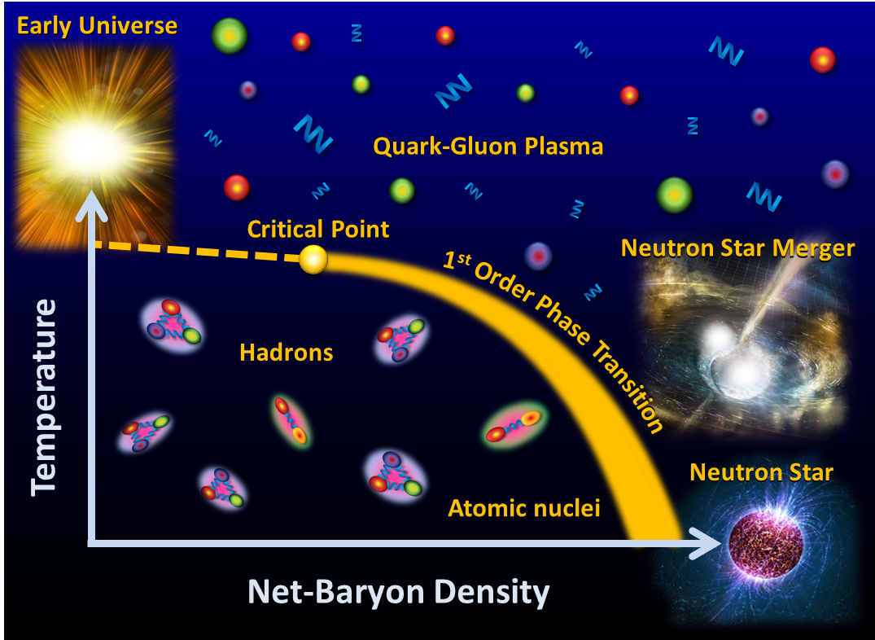
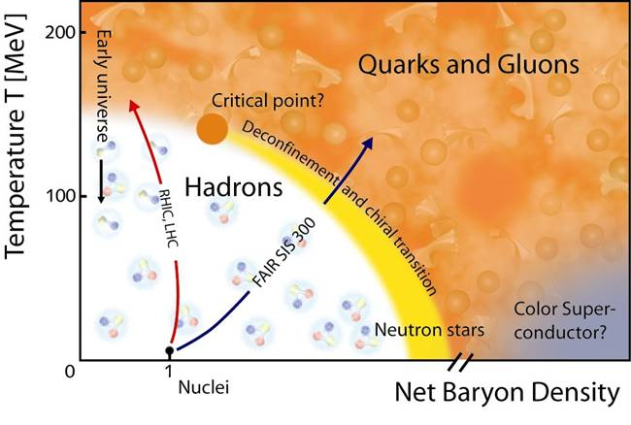
CBM
Compressed Baryonic Matter
  About 500 members
Collide Au heavy ions onto Au nuclei
in a fixed target configuration at ~ 10 GeV/nucleus
CBM

Slide 9
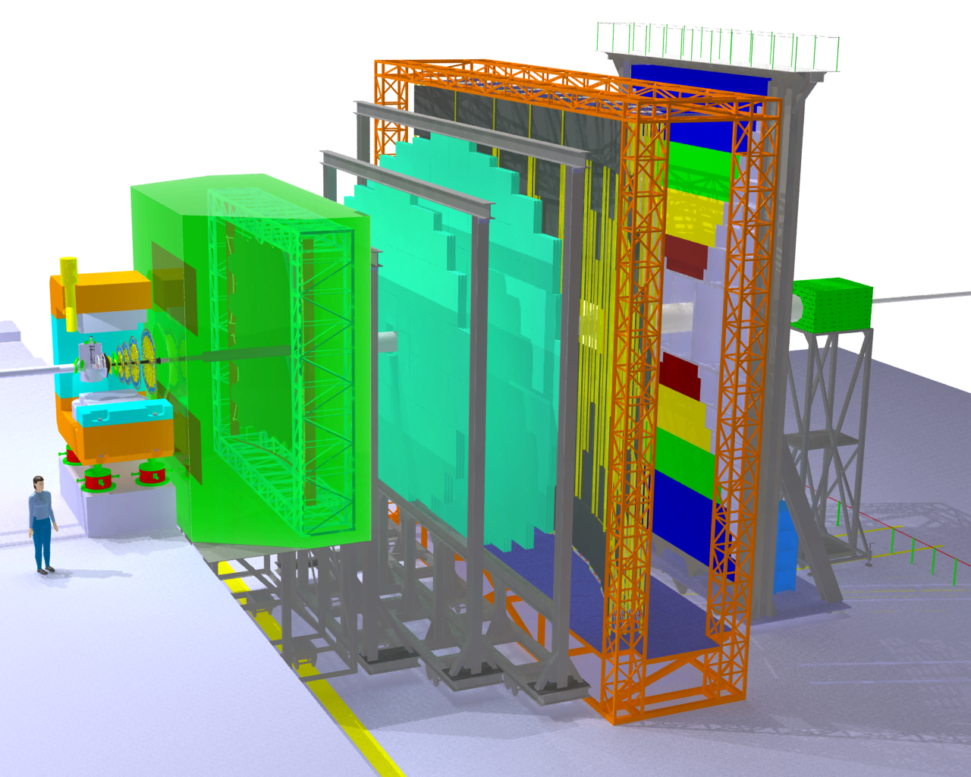
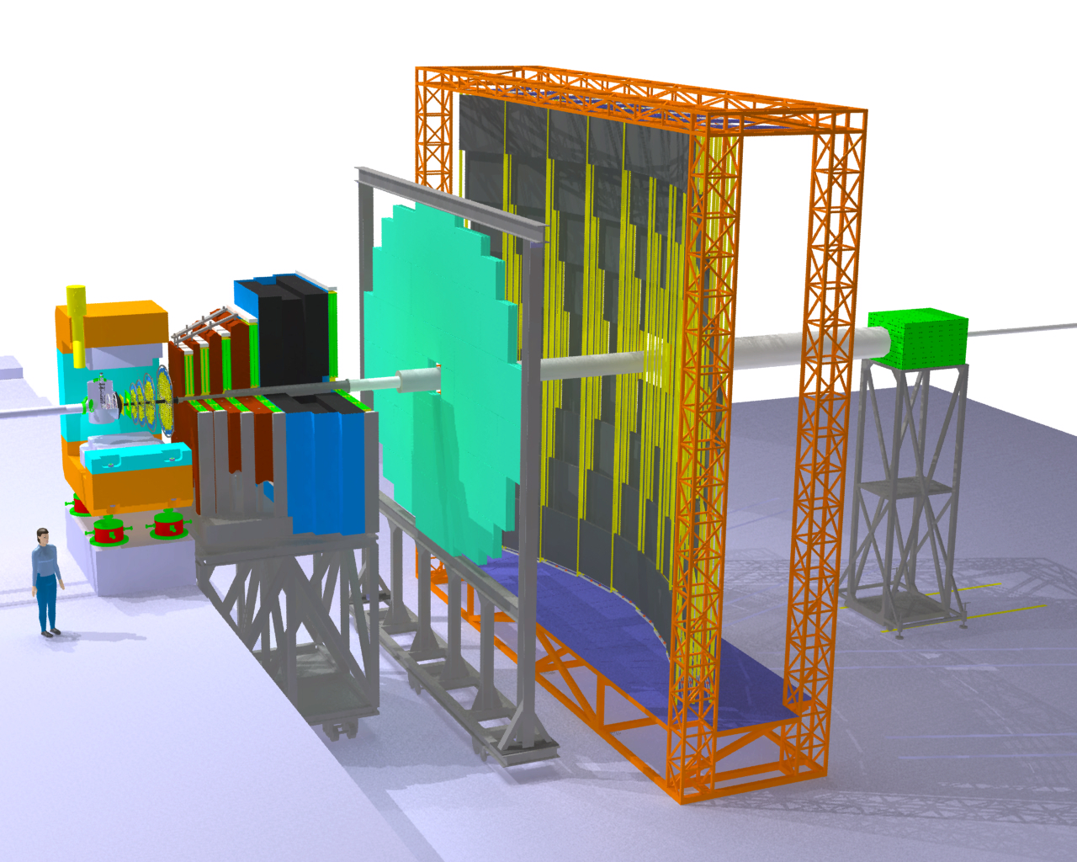
CBM Detector
Transition
Radiation
Detectors
Tracking
Detector
MUCH
Muon
detection
System
Electro-
magnetic
Calorimeter
Ring Imaging
Cherenkov
Detector
Silicon
Tracking
Stations
Vertex
Detector
Projectile
Spectator
Detector
(Calorimeter)
Dipol
magnet
Resistive
Plate
Chambers
(TOF)

Slide 10
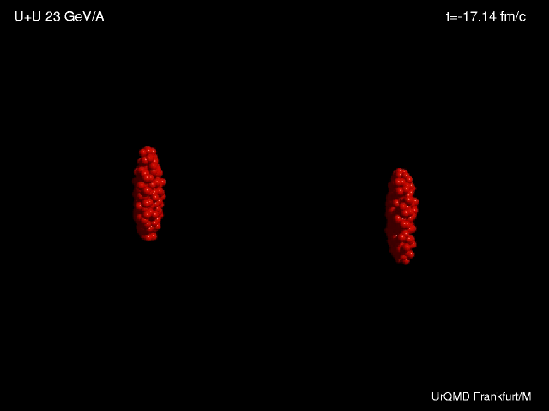

Slide 11
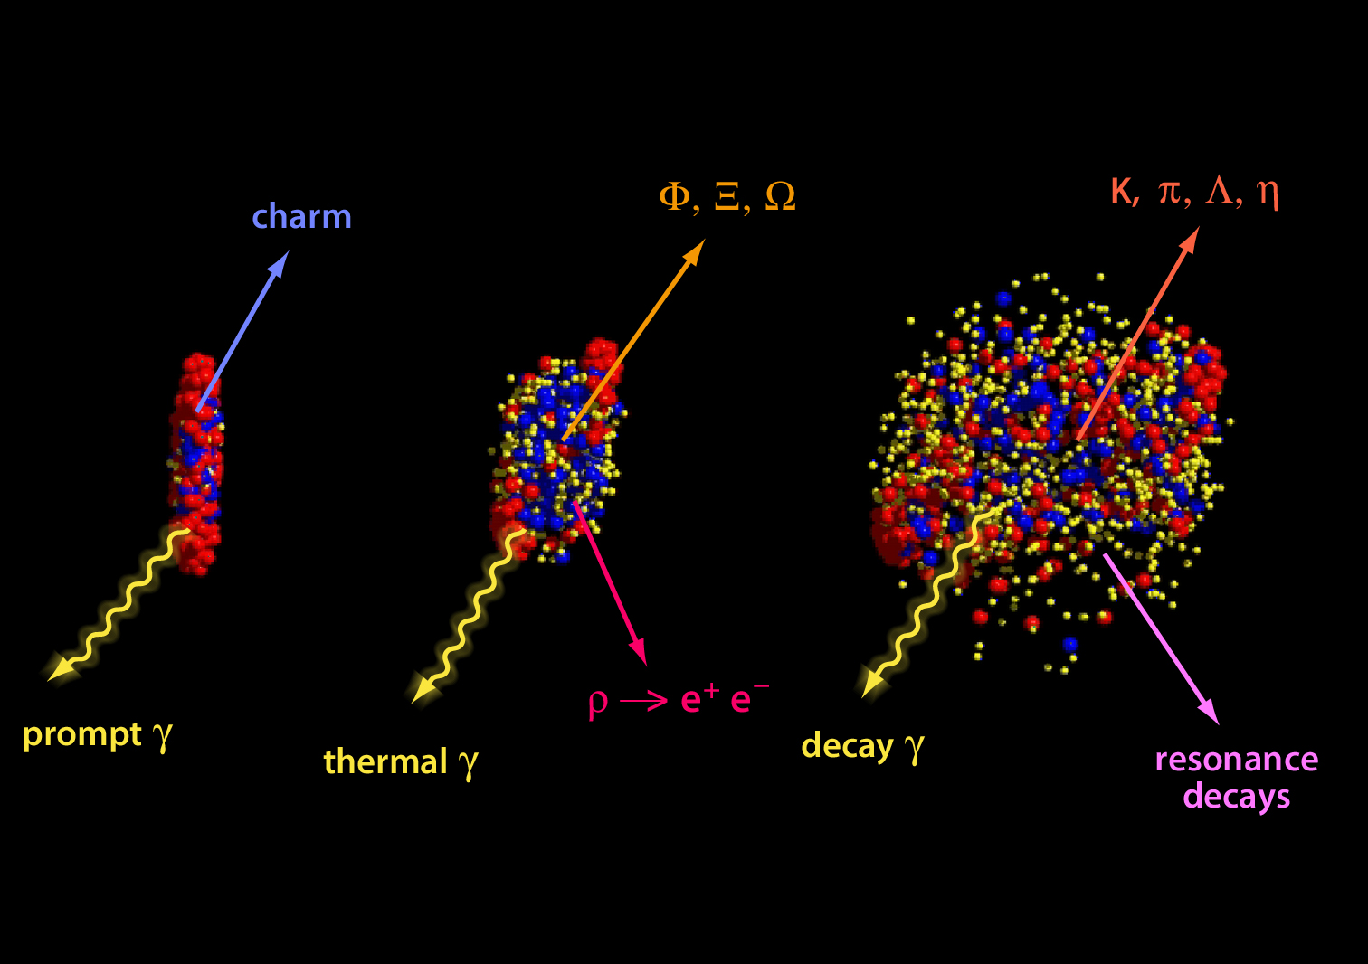
Diagnostic probes

Slide 12
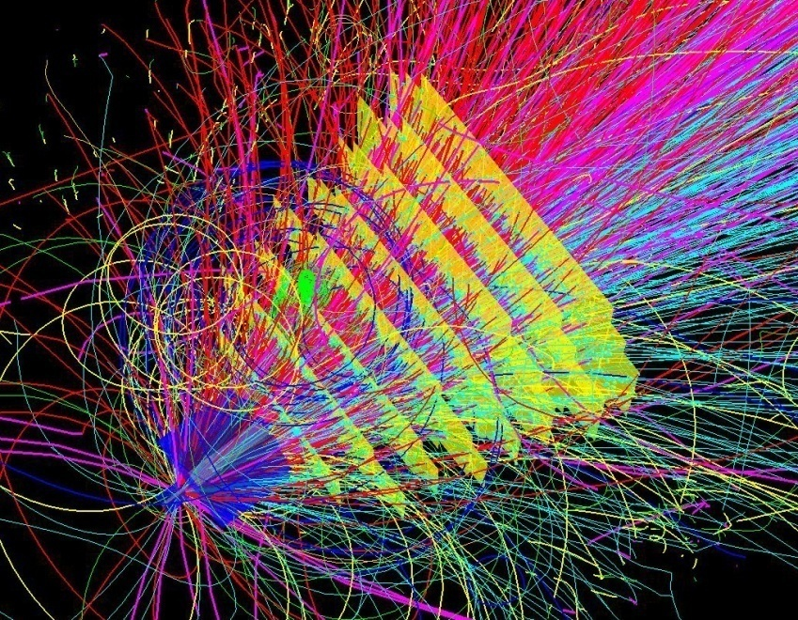
CBM technological challenges
fixed target configuration makes 10MHz Au+Au interaction rate feasible at FAIR
➢ 10 MHz → 6 billion tracks per second
➢ determination of (displaced) vertices (σ ≈ 50 μm)
➢ identification of leptons and hadrons
➢ fast and radiation hard detectors
➢ free-streaming readout electronics
high speed data acquisition and high performance
computer farm for online event selection
➢ 4-D event reconstruction
Notes:
12
12
12

Slide 13
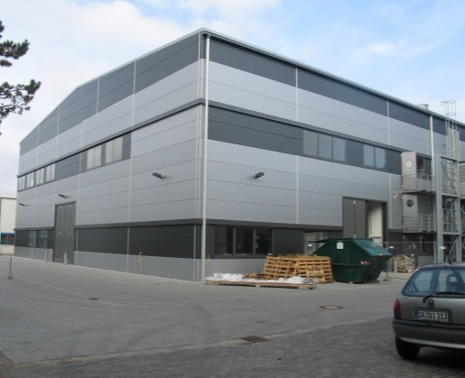
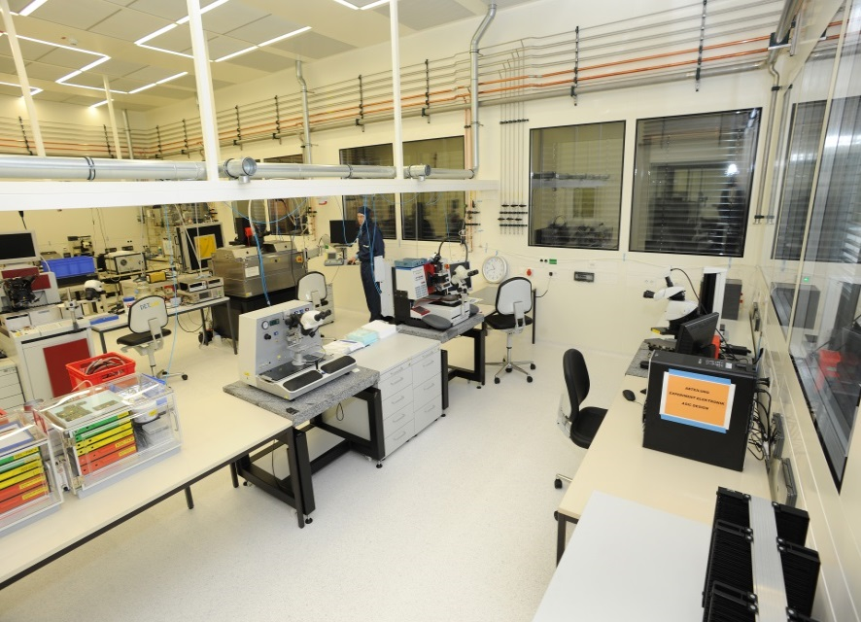
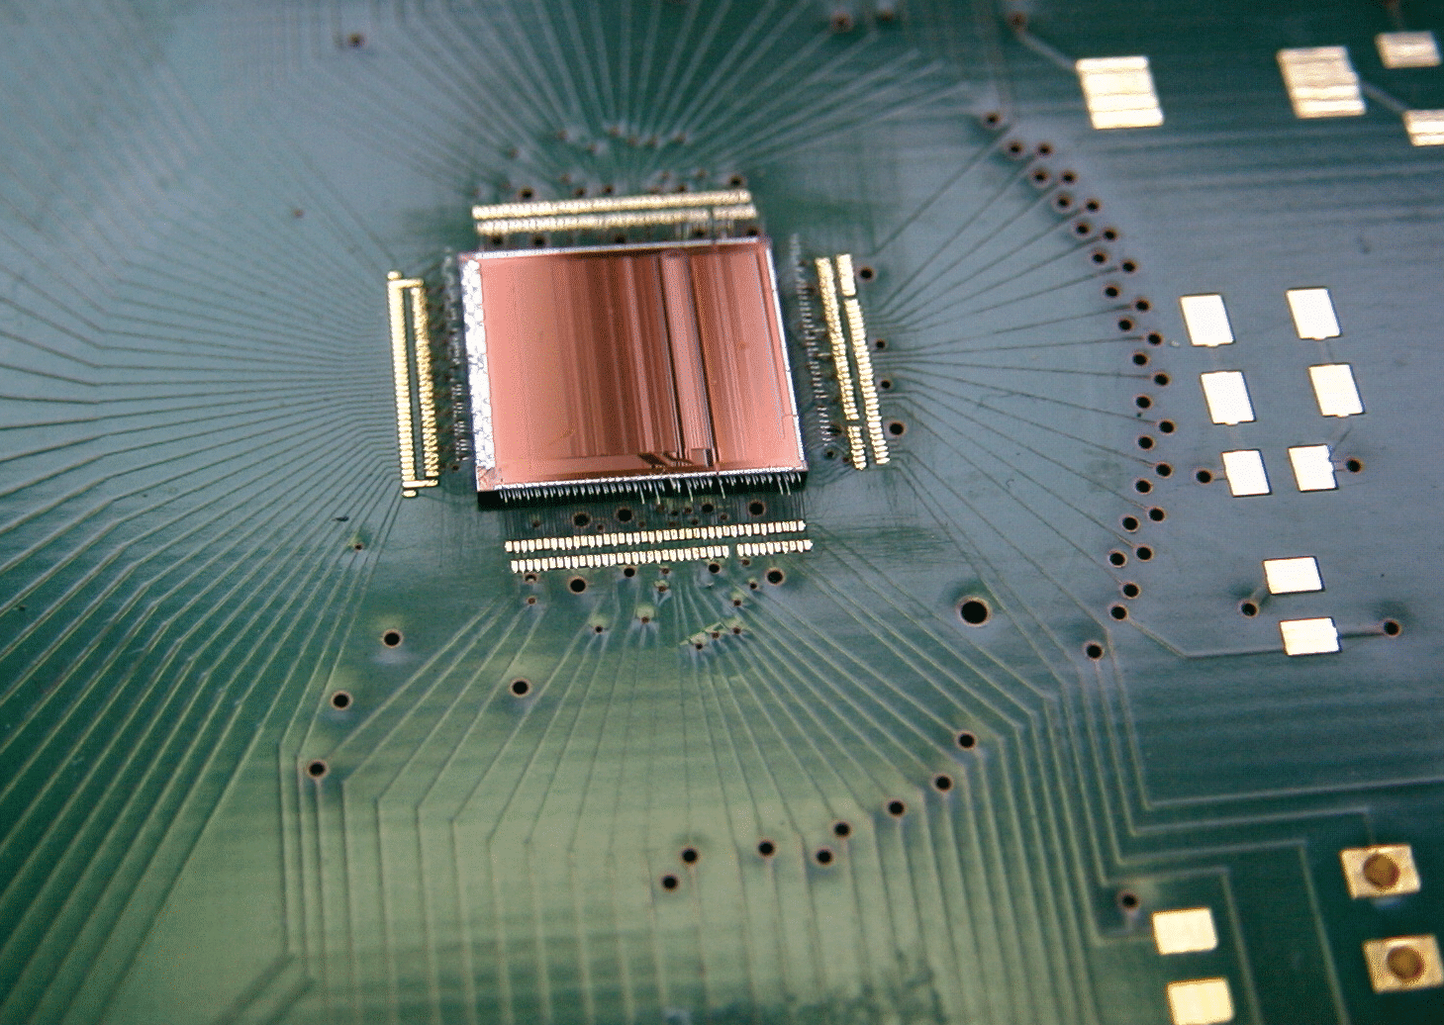
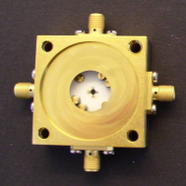
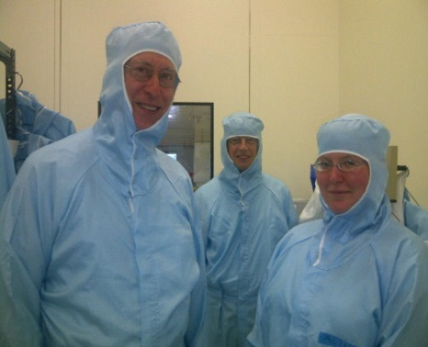
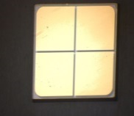
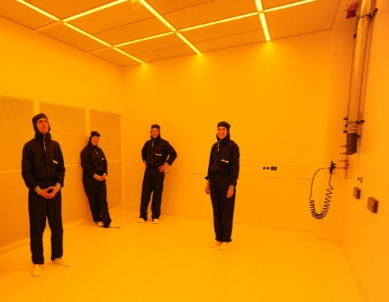
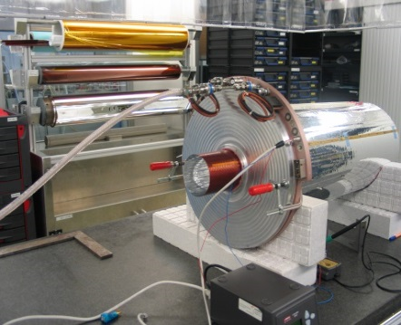
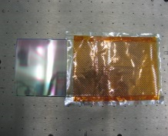

Detector Laboratory at GSI: 600 m² Clean-Room
36 m
22 m
Competences:
Micro Patterned Gaseous Detector Technology
Silicon Strip Detector Integration
ASIC Handling and Integration
Diamond Detectors
PSL APD-characterization lab
Machinery:
Laser Lithography
PVD
Bonding Automates
Probestation and Chip Handling
Automated Wire Winding
Digital Microscope
Thin Foils Handling and Processing
Gaseous Detector Ageing Teststands
Large Prototyping CNC Milling Machine

Slide 14
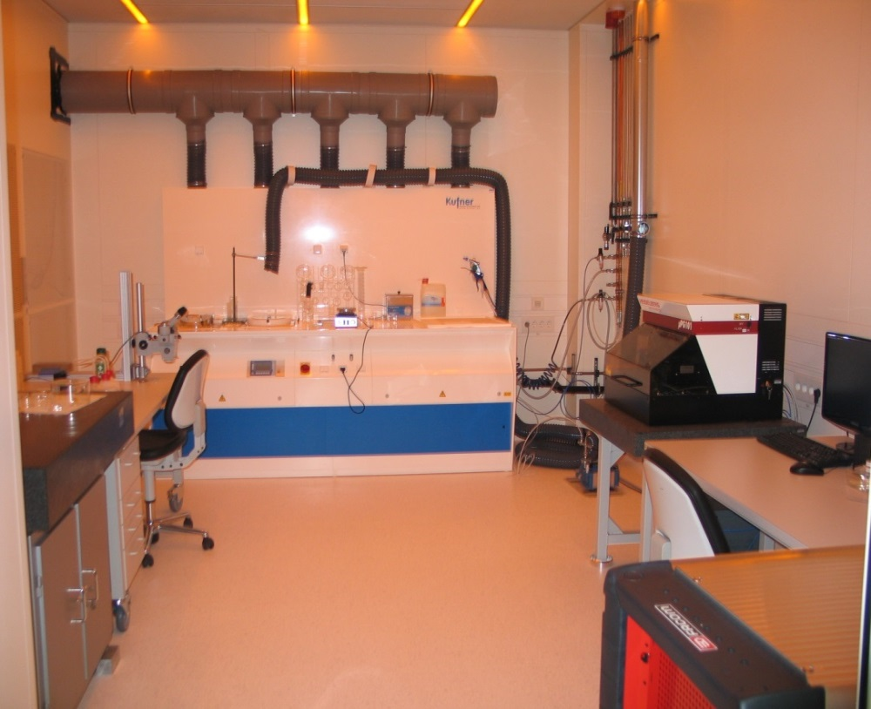
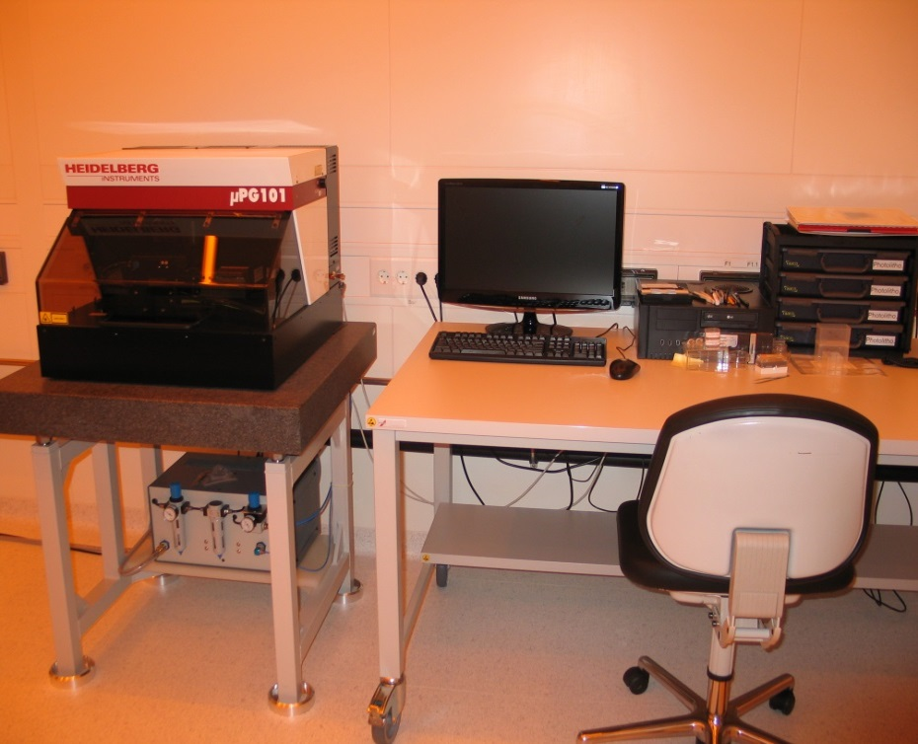
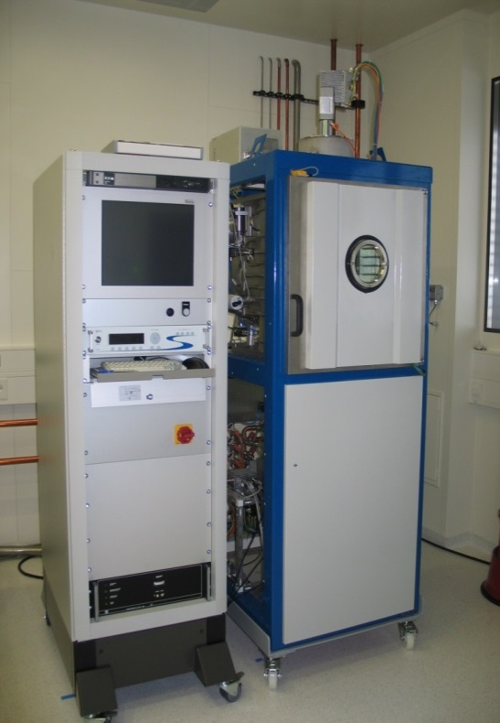
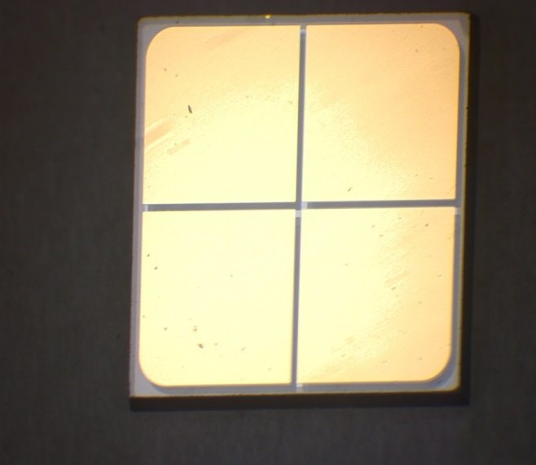
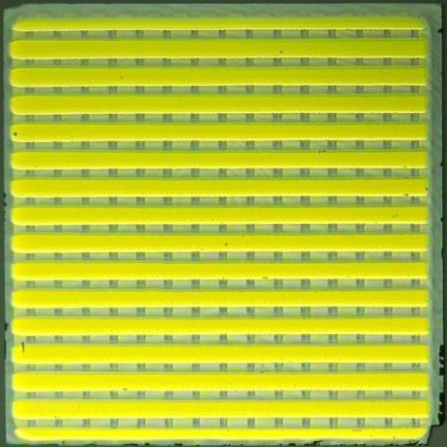
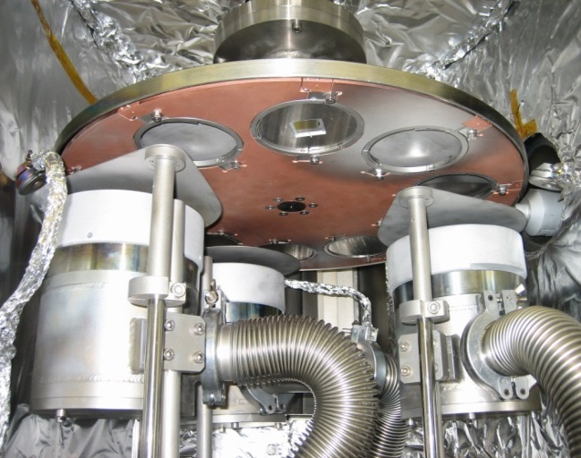

ISO 3 Clean Room for Laser Lithography 1µ
5 x 5 mm² SCDiamond
5 x 5 mm² SCDiamond

Slide 15
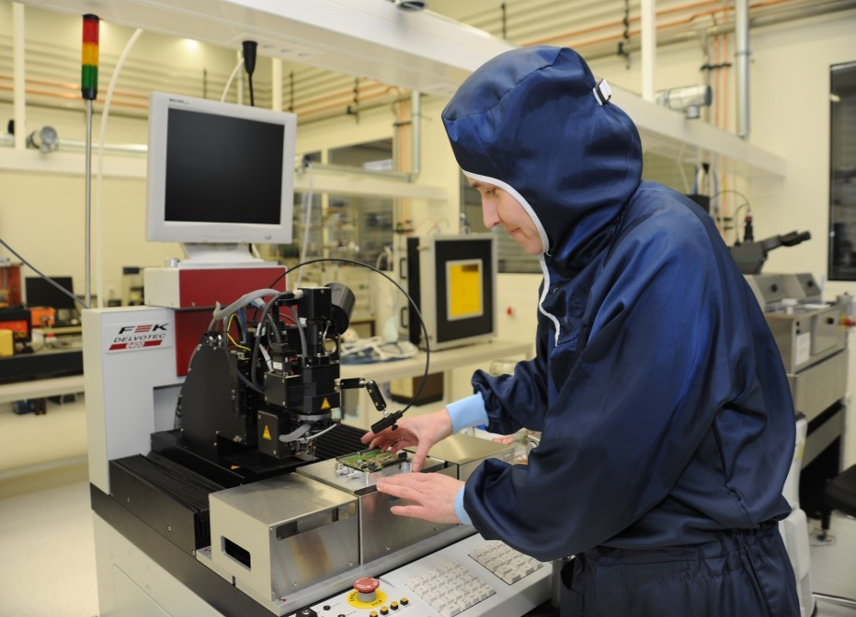

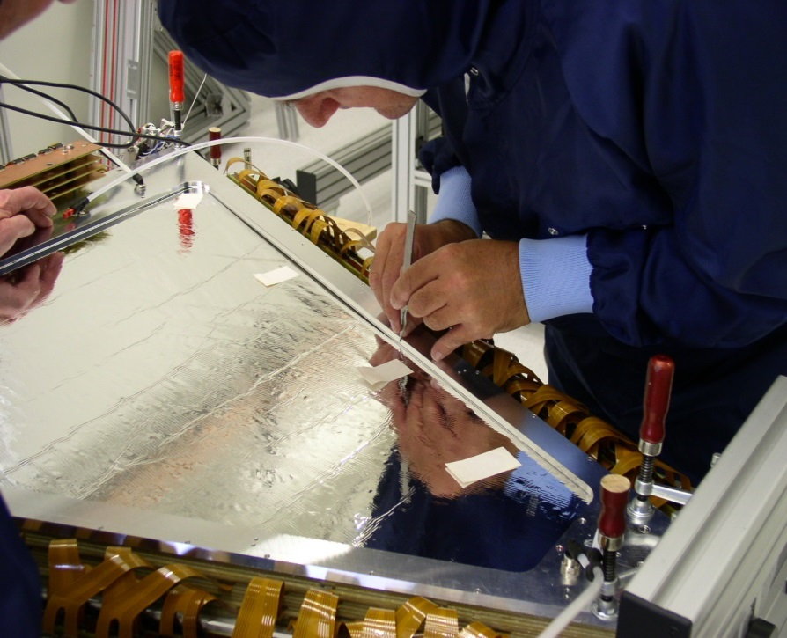
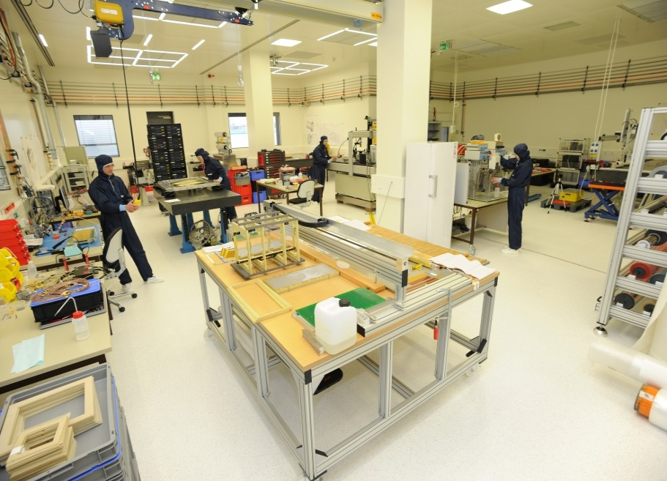
Work at GSI Detectorlab

Slide 16
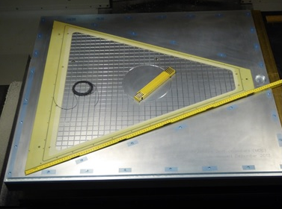
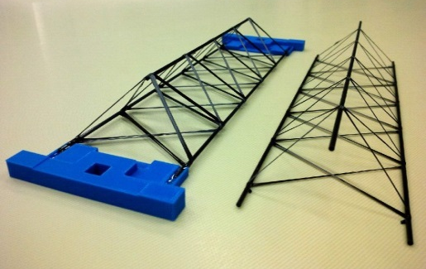
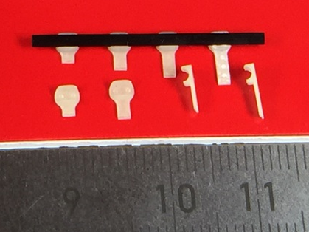
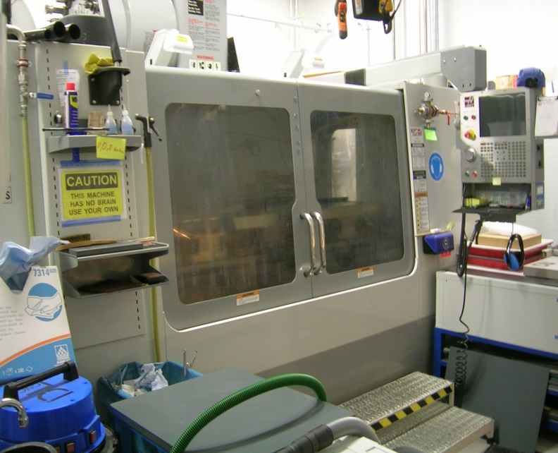
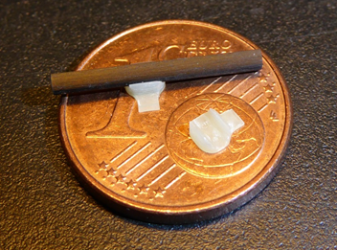
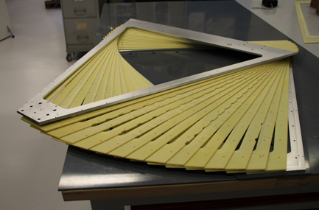
Precision fibre composite milling from very small to very large
CBM-STS sensor clips
100cm x 160cm
fibre composits
= 3D-mold manufacturing
Hades MDC

Slide 17
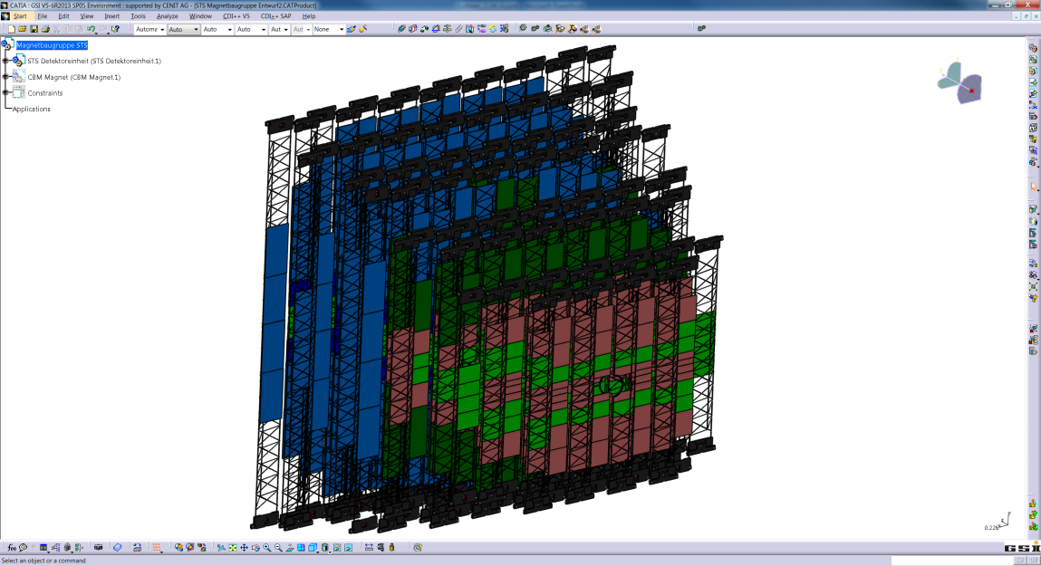
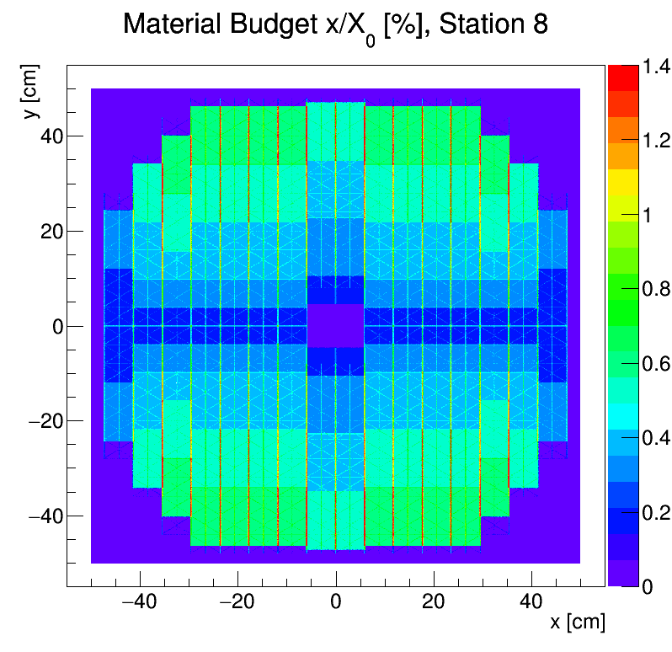
CBM Silicon Tracking System STS
Fixed Target Tracker, Acceptance 2,5°< θ < 25°
Double Sided Silicon Strips in 8 Layers, 58µm
2 Mio. readout channels, ~ 3 m²
Event rate 10 MHz, freely streaming r/o
less than 1% radiation length per layer
to be fit into magnet yoke (1,4m)
x/X₀ [%]
material budget per station
Central Au on Au Collision at 8 AGeV

Slide 18
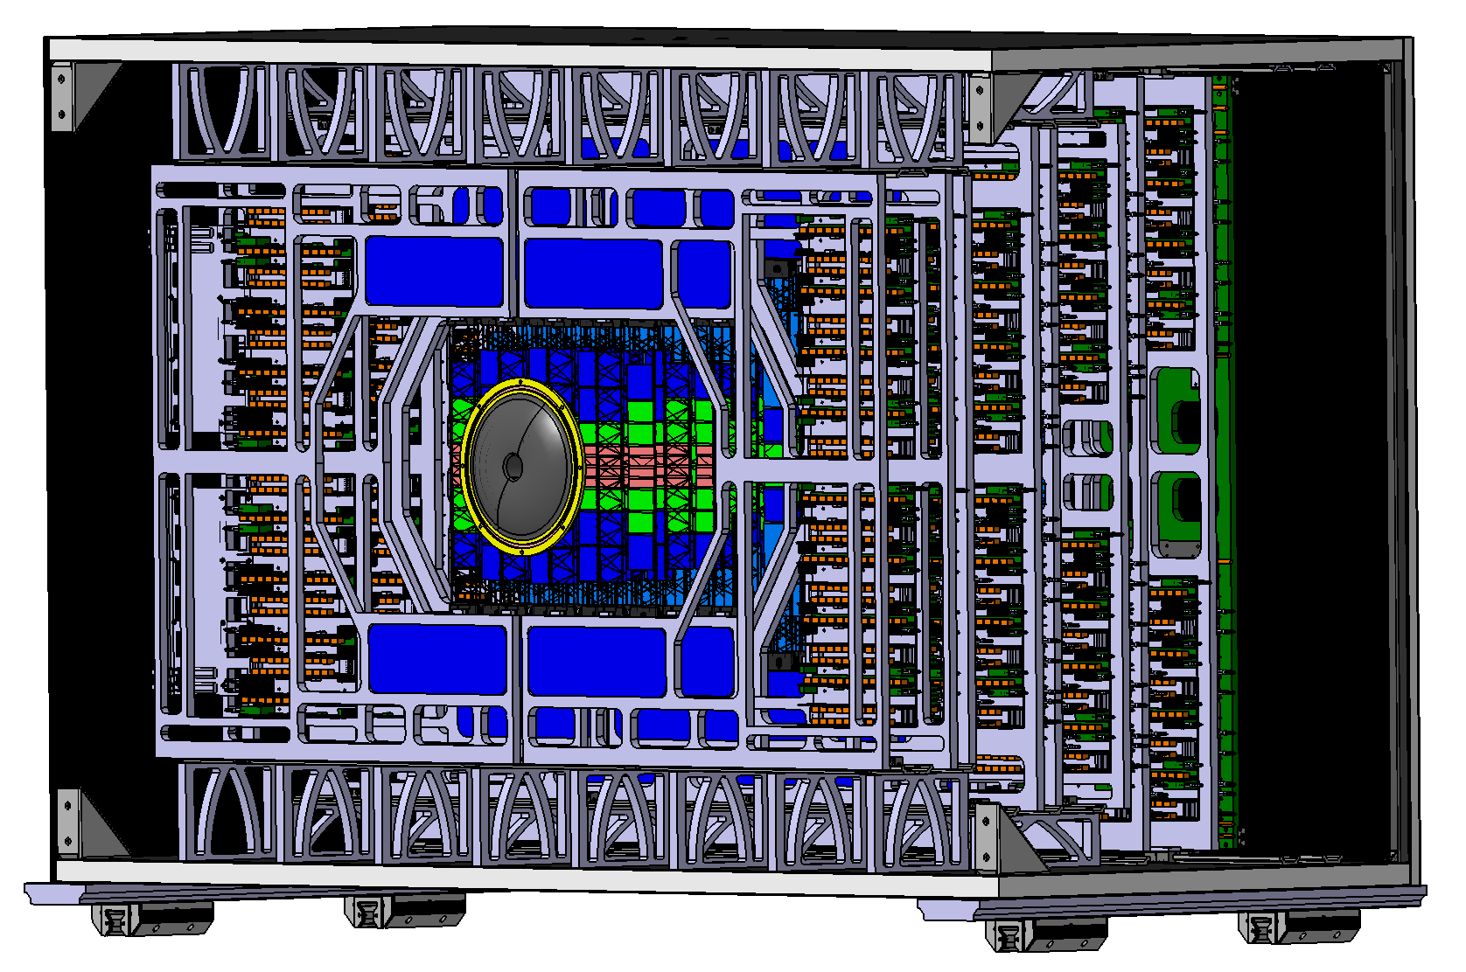
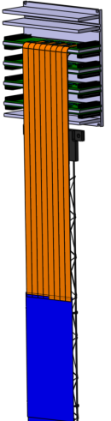
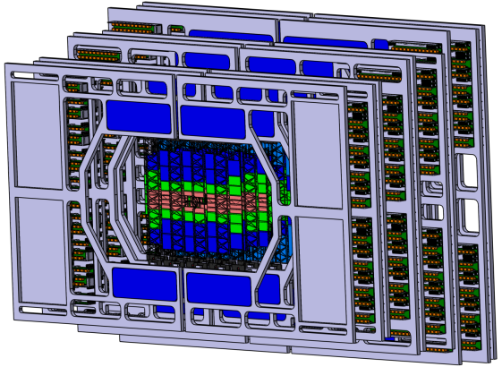
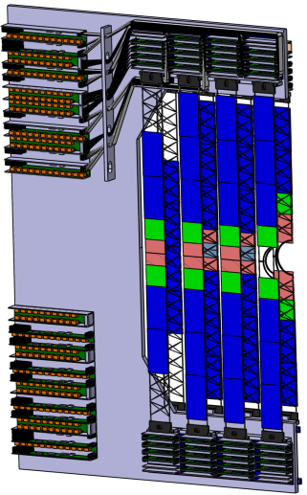
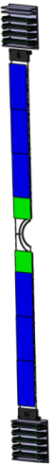
Mechanical Integration in Fixed Target Configuration
Thermal enclosure, operation at -5°C
Minimize mat. budget in acceptance
Electronics outside acceptance, 40kW
140cm
Module
Half-Station
Ladder
of 10 modules

Slide 19




Silicon-Doublesided-Microstrip-Sensors
Sizes
300 µm thick, n-type silicon
double-sided segmentation
2nd metal routing lines
1024 strips of 58 µm pitch
rad. tol. up to 10¹⁴ n_{eq}/cm²
6 x 2 cm²
6 x 4 cm²
6 x 6 cm²
6 x 12 cm²

Slide 20





CBM-STS-module-assembly
Numbers:
1000 Modules
32 cables per module
2048 ch per module
Tab bonding
Micro cables: 10µ Polyimide 14µ Al traces

Slide 21



Micro Cable Technology with TAB-Bonding
double cable layer bonded onto chip

Slide 22




32.000 read-out cables cooperation with LTU, Ukraine
cable stack: thickness 0.230 % X₀
spacer layer
signal layer: 64 Al lines of 116 µm pitch, 14 µm thick on 10 µm polyimide, lengths up to 55 cm

Slide 23



Assembly Jigs
jig for TAB-bonding 1st microcable layer to ASIC
jig for TAB-bonding 1st and 2nd micro-cable layer to ASIC
jig for TAB-bonding micro-cables to sensor with micro-positioners for
x-, y- and rotation

Slide 24



Tab-Bonding Chip-Cables to Silicon Sensor
fixing of the microcables with vacuum and alignment
TAB-bonding of 16 microcables to the sensor (two rows at 8 microcables)
protection of the TAB-bonds with Globtop after QA-measurements
wire-bonding of the STS-YTER-ASIC´s
Wire Bonding Chip-Cables
to Readout Board
... and then the other side...

Slide 25



1024 ch Front End Board (FEB)
Operation: floating at bias potential
256 Mhit/s ~ 10 Gbit/s bandwidth
30,6 mm
STS-XYTER: Dedicated AGH-ASIC Development for CBM
128 ch, self-triggered, dynamics 15 or 75 fC, ~ 1000ENC
power < 10mW/ch, GBTx-compatible output

Slide 26


ZIF 500V-AC-Coupling Connector Part
Mounted device sensitive to shear forces: need to add glue for robustness.
40-pin 0.5mm pitch ZIF
Compatible to 40-line commercial shielded flat cable
Height to be optimized
good for up to 18 up-links

Slide 27


Digital Interfacing: Bridging Signals to Gnd – 3D arrangement
first tombstone tests
...after optimization

Slide 28



128ch Readout ASIC serves as STS-XYTER and Much-XYTER r/o
Moderate Time (~5ns) and Energy res. (5bit)
1000 electrons noise
Switchable Gain, Identical Readout Logic
GBTx-based DAQ, 32 Mhit/s each chip
Power optimized, radiation tolerant
Microchip ASIC developed at AGH Krakow,
Design internationally reviewed,
Detector Integration by international groups
1024 ch CBM-STS readout board

Slide 29

STS-XYTER Readout Microchip Analog Front End
Krzysztof Kasinski and Robert Szczygiel of AGH
Krakow, Poland
Switchable gain
(5x smaller for MUCH)
+ trimming 2 bit
Switchable
(90ns – 280ns)
in 4 steps

Slide 30

Skimming LDOs: Development at SCL Chandigarh
Output noise (100kHz to 100MHz) < 70µV RMS
1/3 of STS-XYTER power-pin related signal noise (210 µV RMS),
1/10 noise power contribution
Final size: 5.7mm x 6.2mm
Two versions: 1.8V/1.6A and 1.2V/1.6A
Ripple rejection up to 100kHz
Junction temp up to 100°C
No self-restart upon overcurrent
Output enable
5 external parts (R, 4 Caps)
pre prototype
5.7mm
6.2mm

Slide 31



Power distribution in harsh environments
Towards Rad Hard LDOs
Cooperation with SCL Chandigarh
Three LDO chips survived 4x10¹³/cm²
2 GeV protons, no SEU observed
P. Koczon, S. Loechner, P. Wieczorek
V2/Hz
STS-XYTER needs on power quality

Slide 32

Final STS-Module:

Slide 33



Concept inherited from ALICE ITS: Carbon fiber ladders
11g for 1m long ladder
mount 10 silicon modules onto one ladder

Slide 34





Assembly Tests : Modules onto Prototype Ladder
Dummy module - I
Dummy module - II
Dummy module - III
Dummy module - IV
Dummy module - V
S.Mehta , University of Tübingen and GSI, Darmstadt
6

Slide 35




Ladder assembly imposes mechanical challenges during assembly of modules onto ladder
Cable stack is thick and stiff
Need precise lengths of cables so they won´t fold up
While mounting on frame, handling difficulty.

Slide 36




Mini-CBM @ FAIR Phase 0: fully assemble and operate small functional CBM subset
Currently: pre-series modules employed in the miniSTS of mCBM@SIS18
13 modules, arranged on 5 ladders, forming 2 tracking stations
mCBM run 02/2019: mCBM run scheduled May 2020:
4 modules on 2 ladders further 9 modules on 3 ladders

Slide 37
The CBM Collaboration
First physics beam targeted in 2024

Slide 38


Slide 39


Time Projection Chamber, the Queen of Trackers
100 m³ gas
Currently engagement in mayor fraction of GEM based ALICE TPC upgrade
None-triggered continuous TPC readout

Slide 40



HADES- The GSI Dilepton Spectrometer
Detector lab engagement in HADES Drift
Chamber design and production

